Slide 1
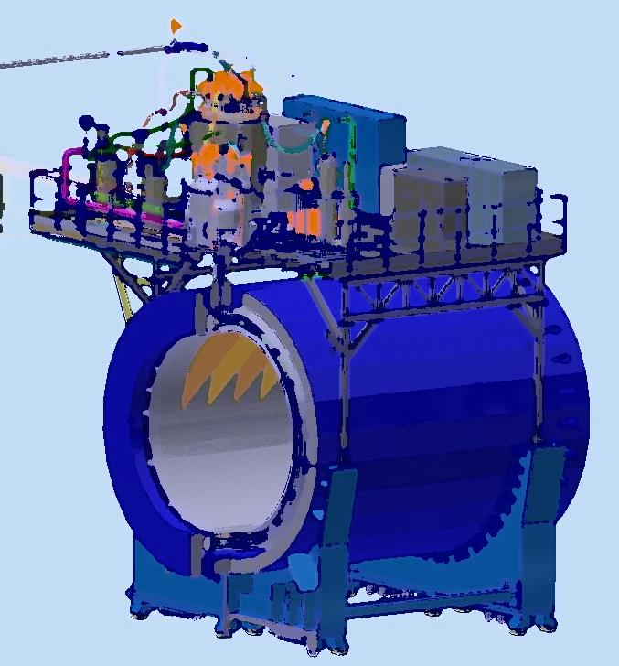
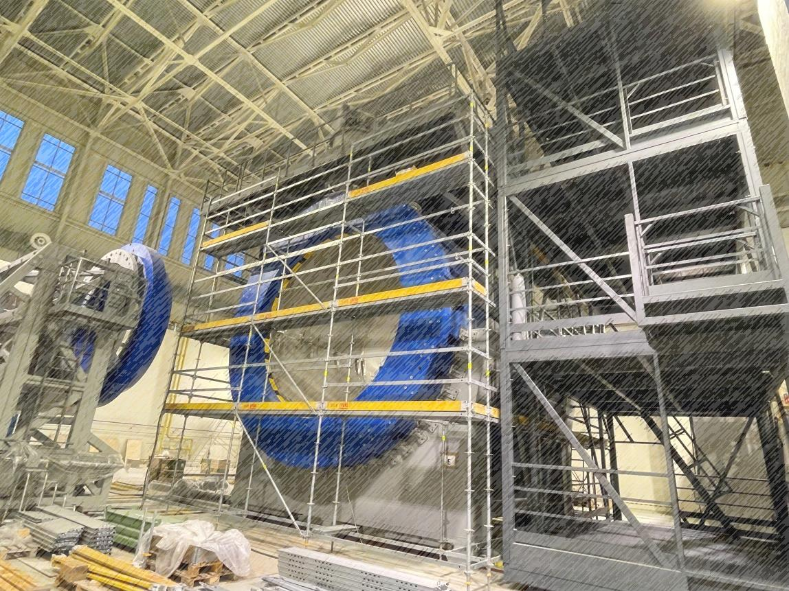
Progress of the Solenoid preparation for cooling
XI Collaboration Meeting of the MPD Experiment at the NICA Facility
18-20/04/2023
Speaker: K. Mukhin
From drawing
To assembled magnet
Dubna 2023

Slide 2
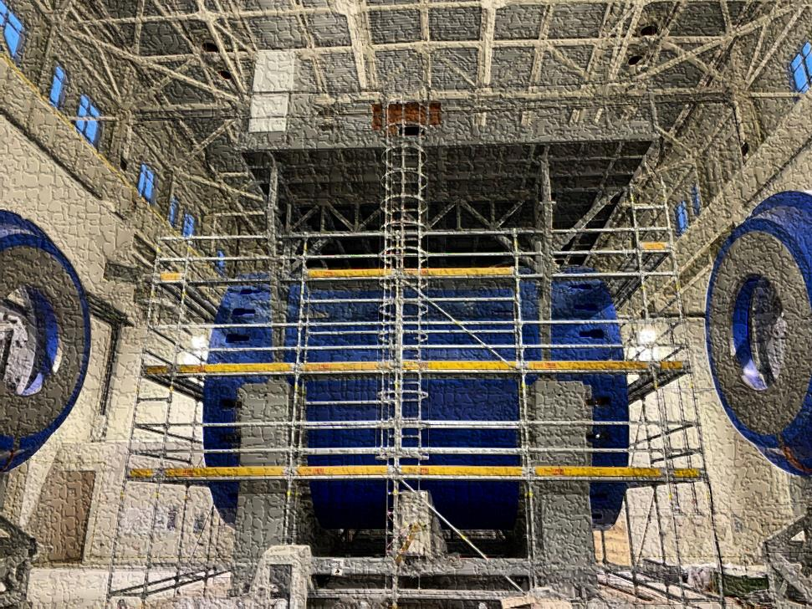
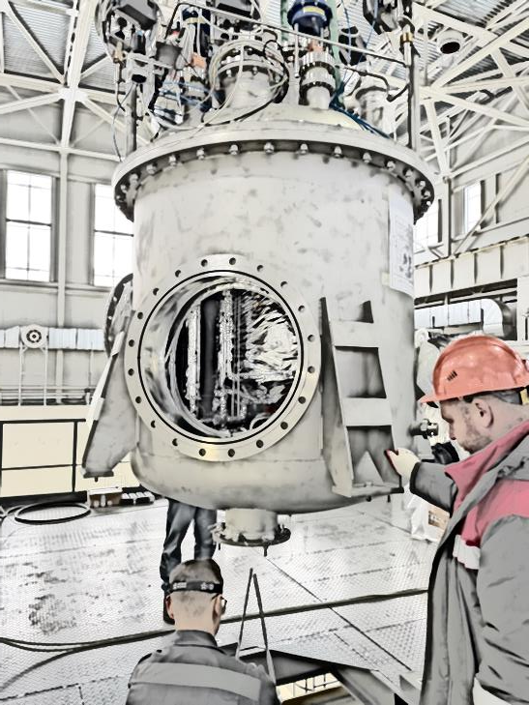
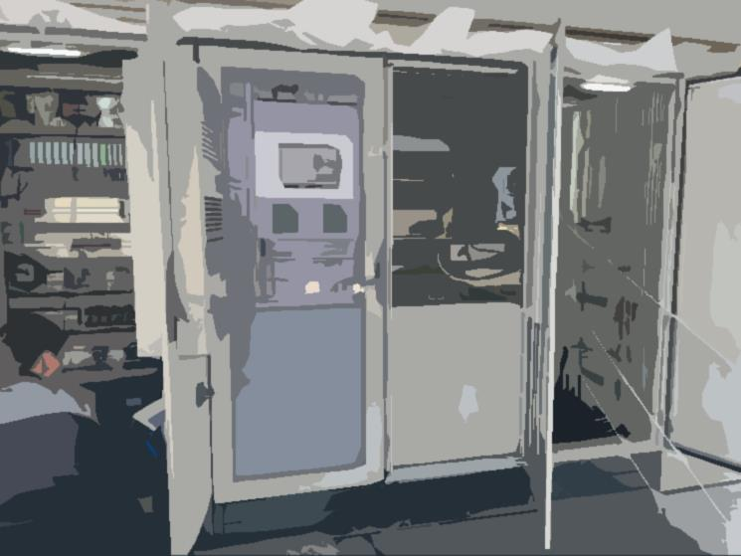
Plan of talk
Activities of magnet assembly
- Chimney area and gauges connection
- CS cables connection to current leads
Cryogenic infrastructure. Prepare for cooling.
- Temporary scheme of cooling at 80 K
- Refrigerator assembling
- Equipment distribution and present situation of delivery breaks
Control and protection system
- Control monitors
- Protection system

Slide 3
Chapter 1 Activities of magnet assembly
- Chimney area and gauges connection
- CS cables connection to current leads

Slide 4
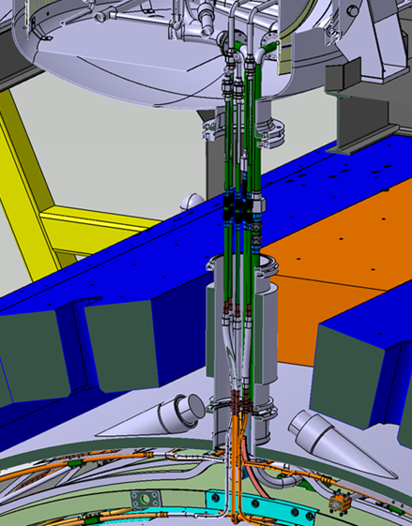
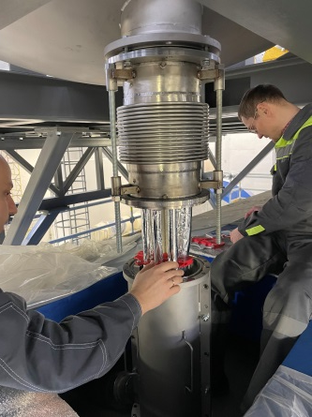
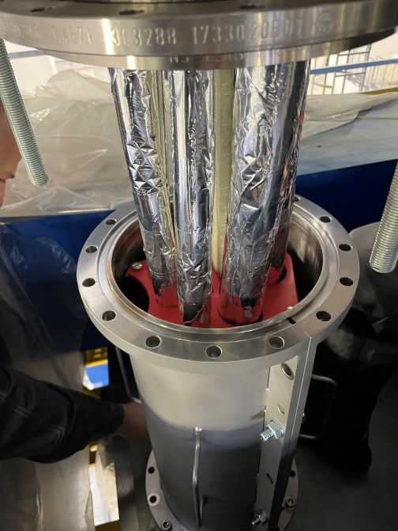
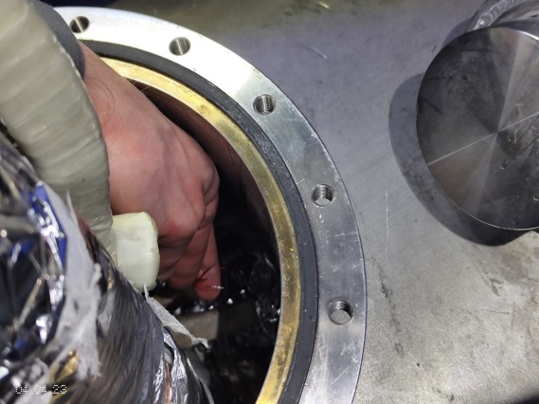
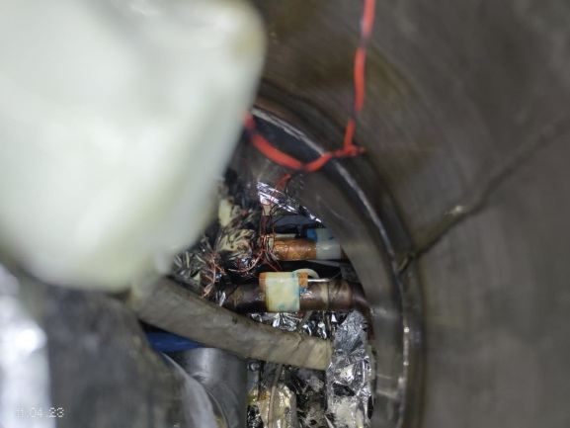
Chimney area assembly
Leak test of LN2 circle successfully done
Leak test of LHe circle successfully done
Some valve have a leak – they reassembling
Cryogenic supports was developed with new configuration
Didn't delivered to
JINR
Good idea to done a chimney vacuum pipe is collapsible
Temperature sensor Pt100 was broken and changed
Position of broken sensor

Slide 5
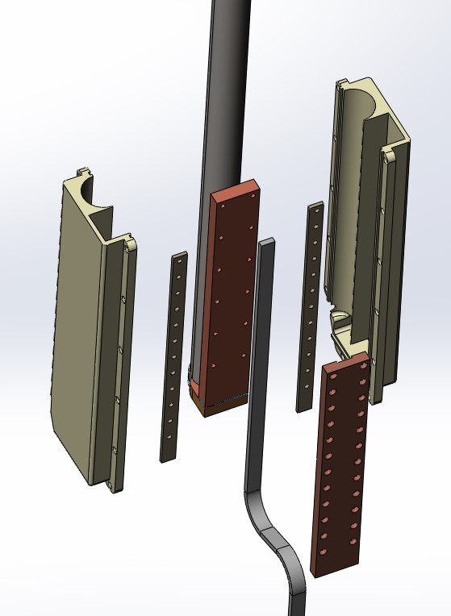
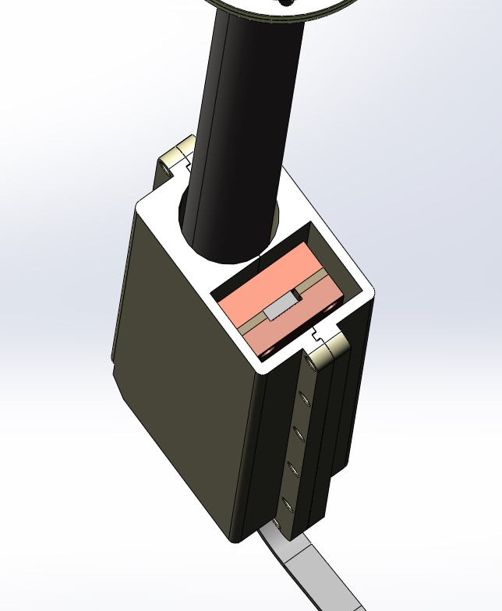
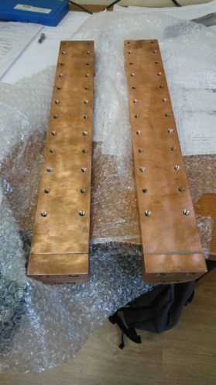
SC cables connect to current leads into control Dewar
LHe pipe
Sky view
Installation box
Copper stationary plate
Copper clamp plate
SC cable
Insulation plate
Missed parts
Installation box (4 pc, - ordered)
Copper clamp plate (2 pc, - ordered and ready)
Fixed insulation plates (4 pc – ordered and ready)
Indium foil (thick 1 mm , 4 pc, - ordered)
Solder (4% Ag/Sn - ordered)
SC cables

Slide 6
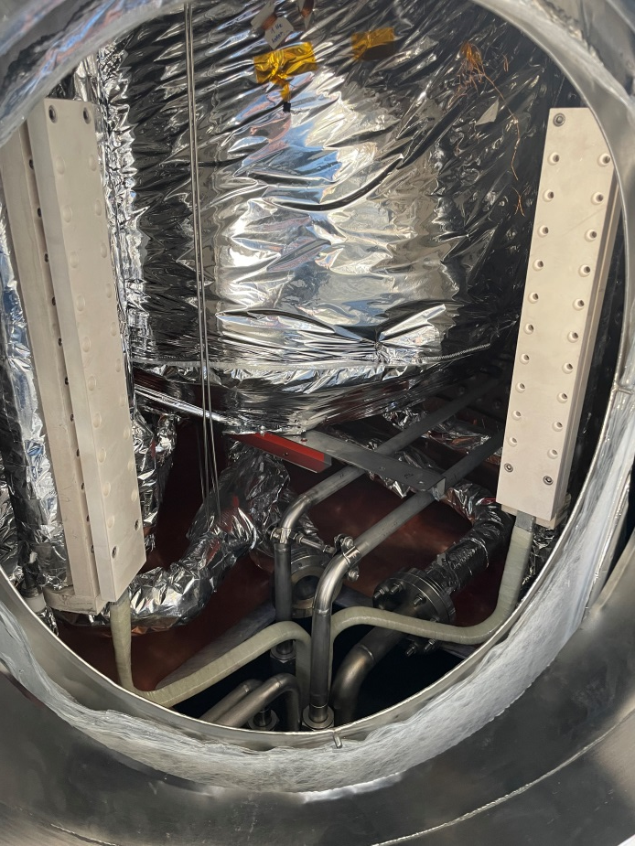
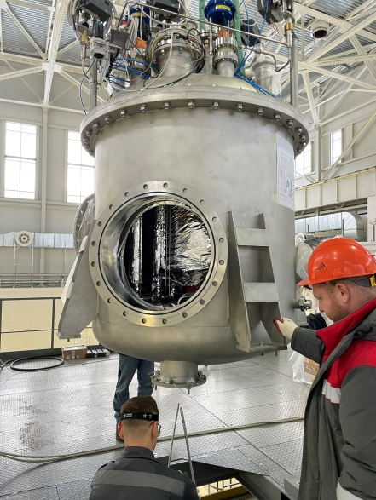
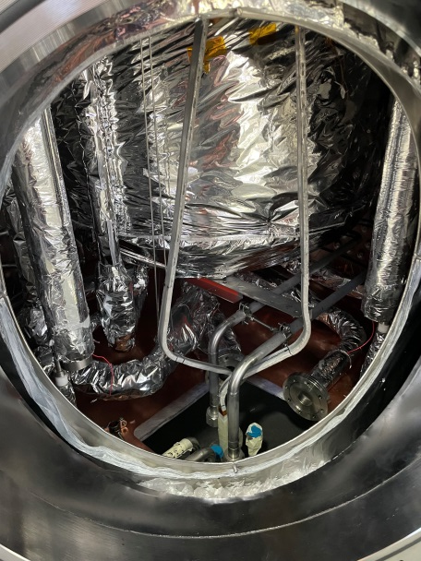
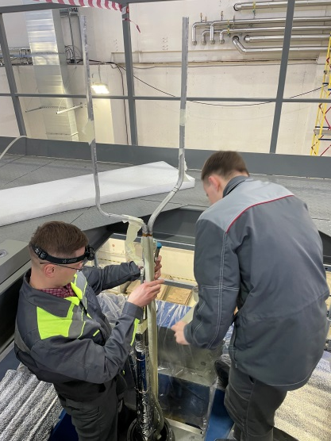
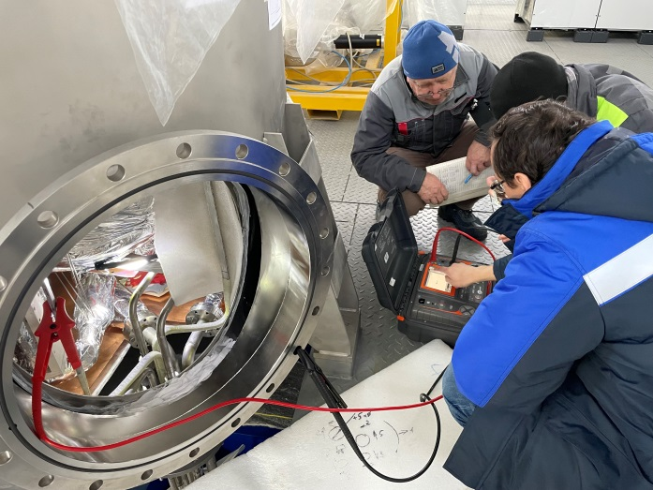
SC cables connect to current leads into control Dewar
Final position
Mounting control Dewar
Insulation and formation CS cable for original form
Local electrical test

Slide 7
Chapter 2 Cryogenic infrastructure. Prepare for cooling.
- Temporary scheme of cooling at 80 K
- Refrigerator assembling
- Equipment distribution and present situation of delivery breaks

Slide 8
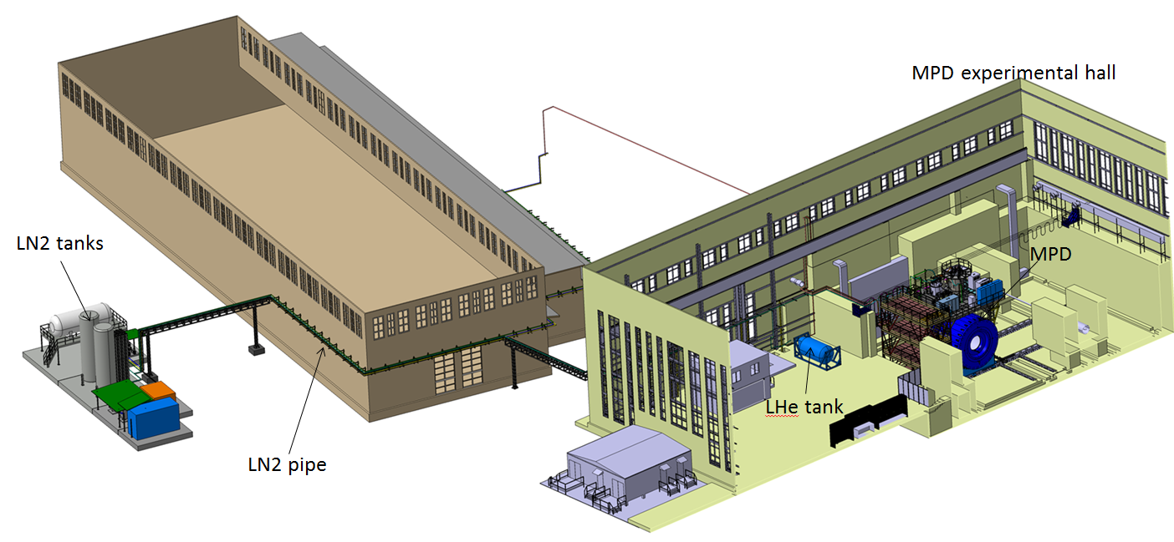
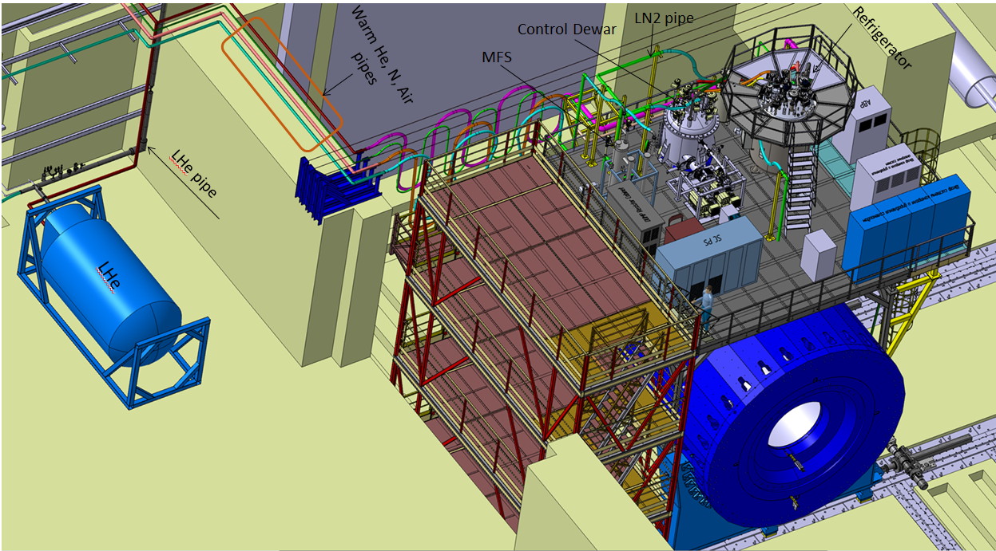
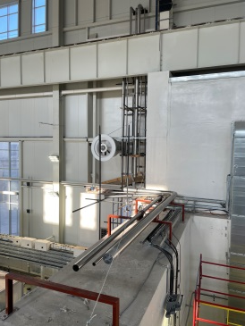
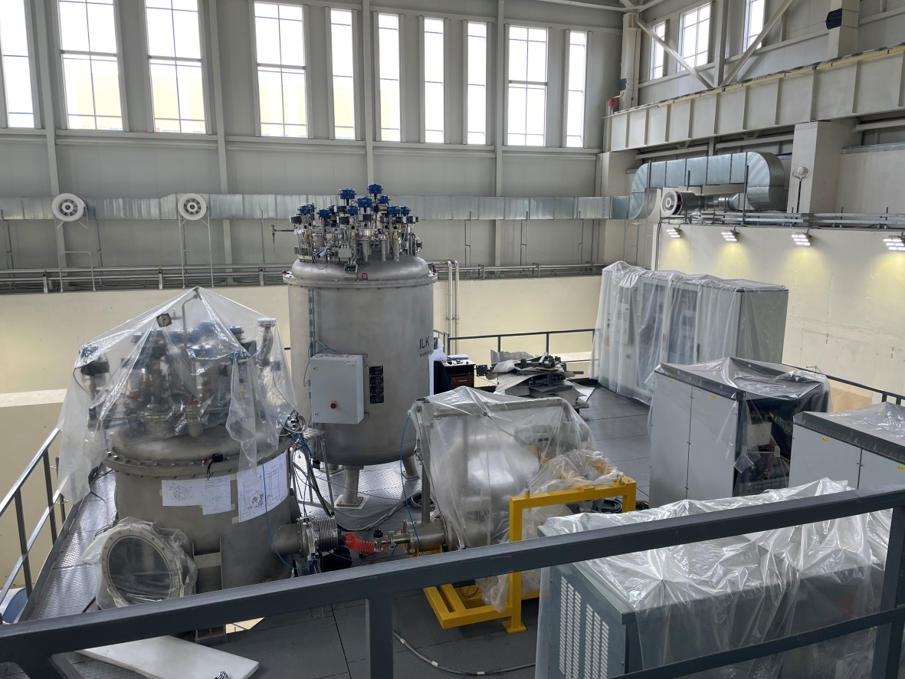
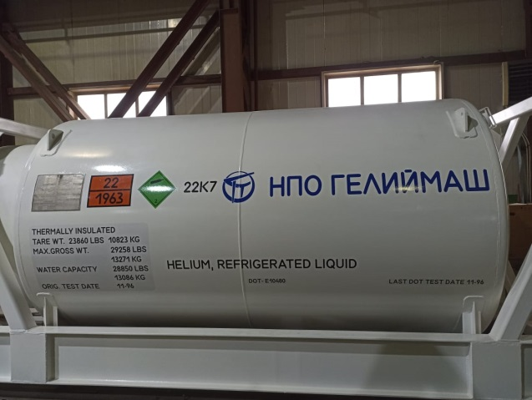
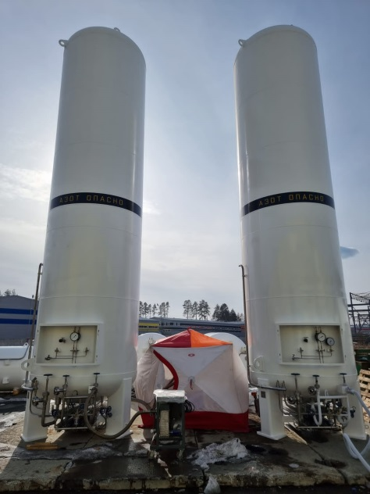
Cryogenic infrastructure at the present time
- Control Dewar
- Refrigerator
- MFS
- LN2 and LHe heaters (was ordered in UK, re-ordered in Russia (May 2023))
- LHe pipe (ordered in UK, drawings was ready, delivery not possible, transfer manufacturing to Russia October 2023 will be installed)
- Cryogenic flexible connection pipes (LHe, LN2 (delivery data May 2023) need to check the bayonets)
- LN2 Tanks (2 pc) – can’t be delivery from CR, ordered in Russia (ready, delivery and mounting in April)
- LHe Tanks (2 pc) – now in Russia ready to installation
- LN2 transfer pipe 120 m with two support frame (October 2023)
- Warm pipes for He, N2 and Instrumentation Air (mounting from 1B to MPD hall about 1500 m long (mounting, end in May 2023 ))
- Flexible warm pipes (ready now in JINR)
- Support system for flexible pipes (developing)

Slide 9
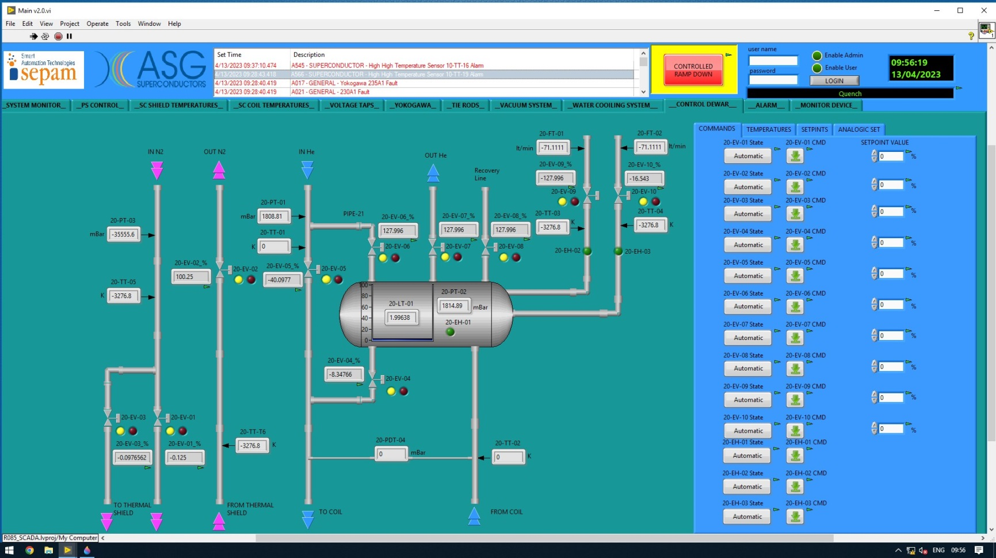
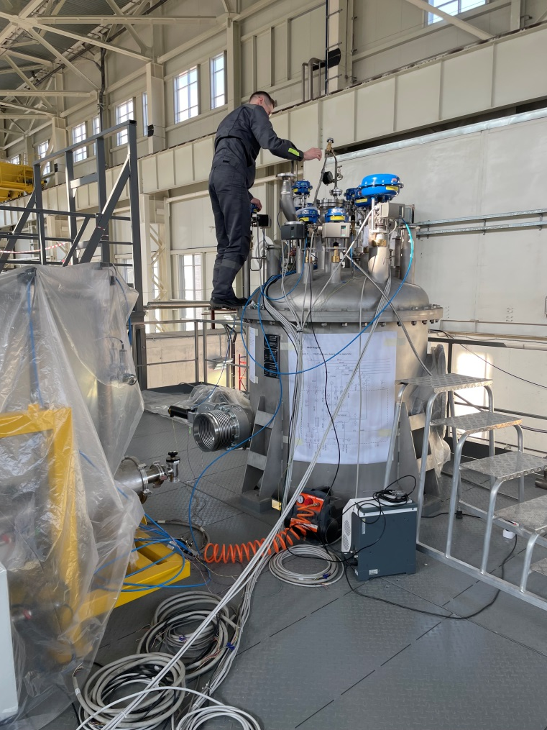
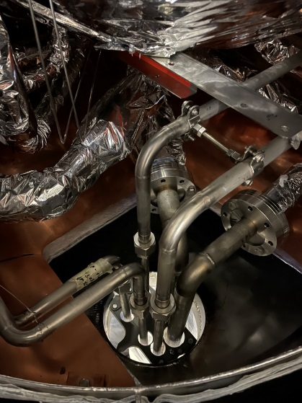
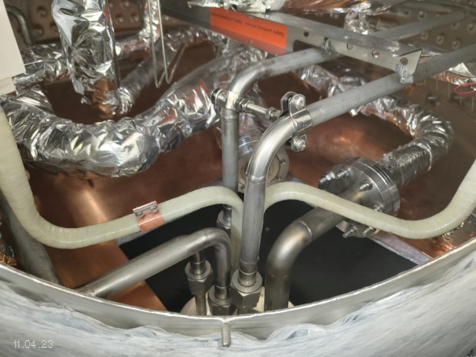
Control Dewar
Control Dewar control window
Control Dewar local connection to control system and testing
- We get all signals from gauges
- We can control and operation of all valves
- No any automatic mode
6 temperature gauges additionally will be install onto CS cables for control
- Leak test of N2 circle and LHe circle was passed.
- Was detected a leak on some valves. Valves was reassembly and the leak has been fixed.

Slide 10
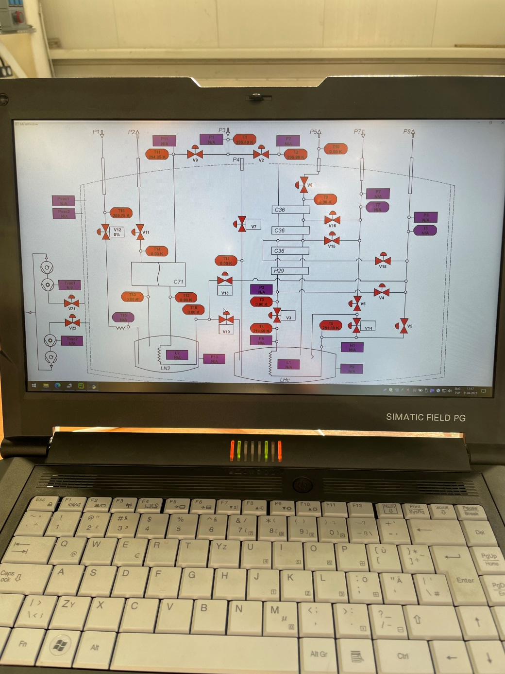
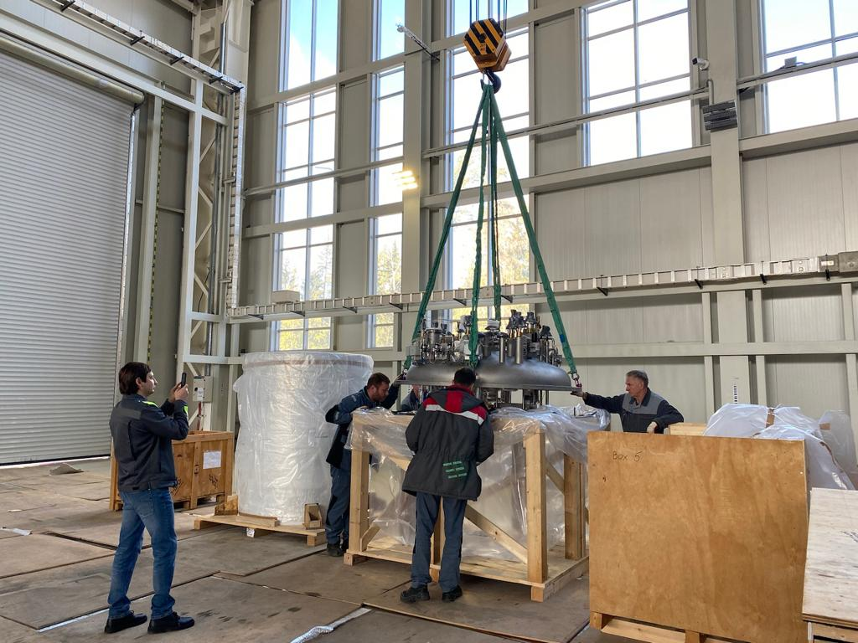
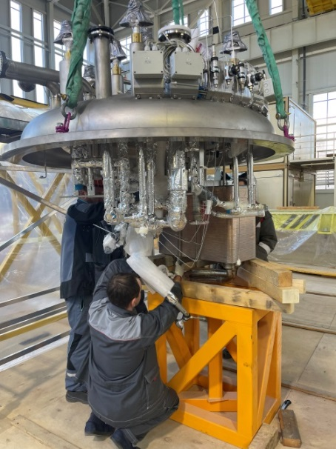
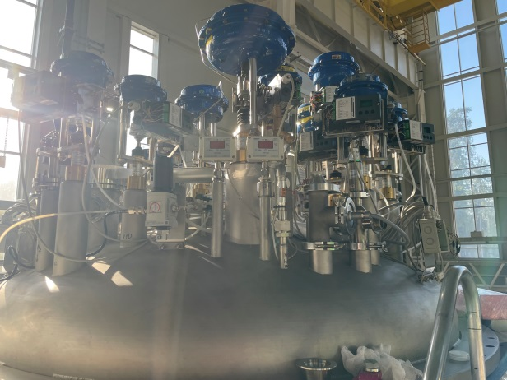
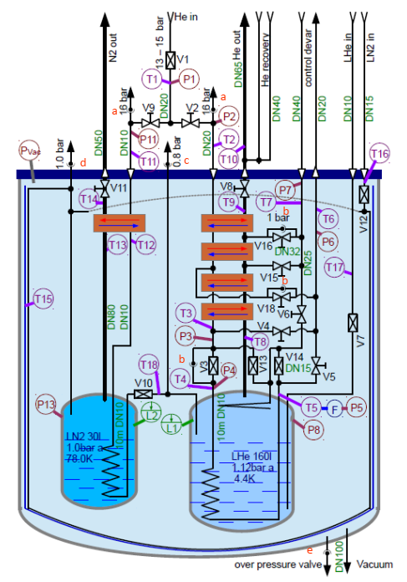
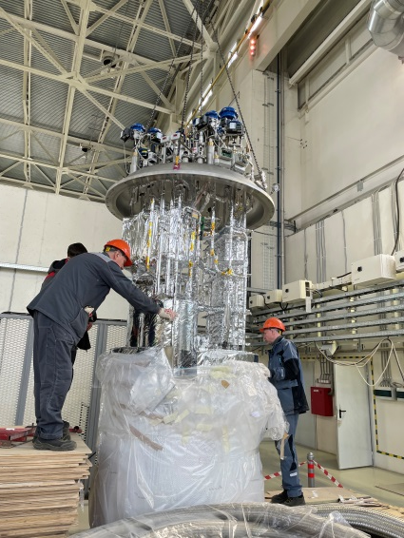
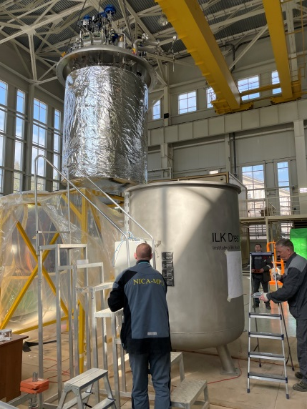
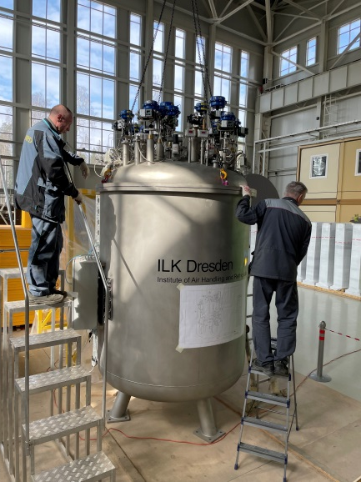
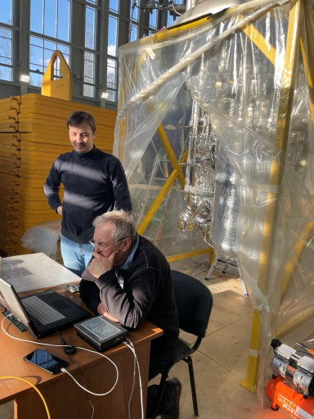
Refrigerator assembly
ILK braked a contract of refrigerator assembling and integration in to solenoid system!
- No drawings and instruction for assembly
- No correct software (not signals from gauges, valves can’t regulation…) for operation
- No electrical scheme
- No calibration data for cernox temperature gauges
JINR cryogenic specialists and slow control specialist successfully:
- Developed program of refrigerator assembling and tests.
- Mechanically assembling refrigerator.
- Provide leak tests.
- Installed new temperature sensors with calibration tables (more than 20).
- Developed software and got signals for gauges and valves

Slide 11
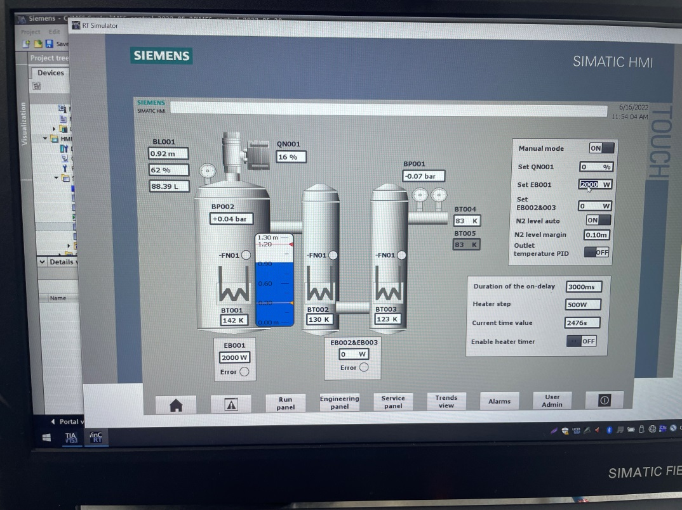
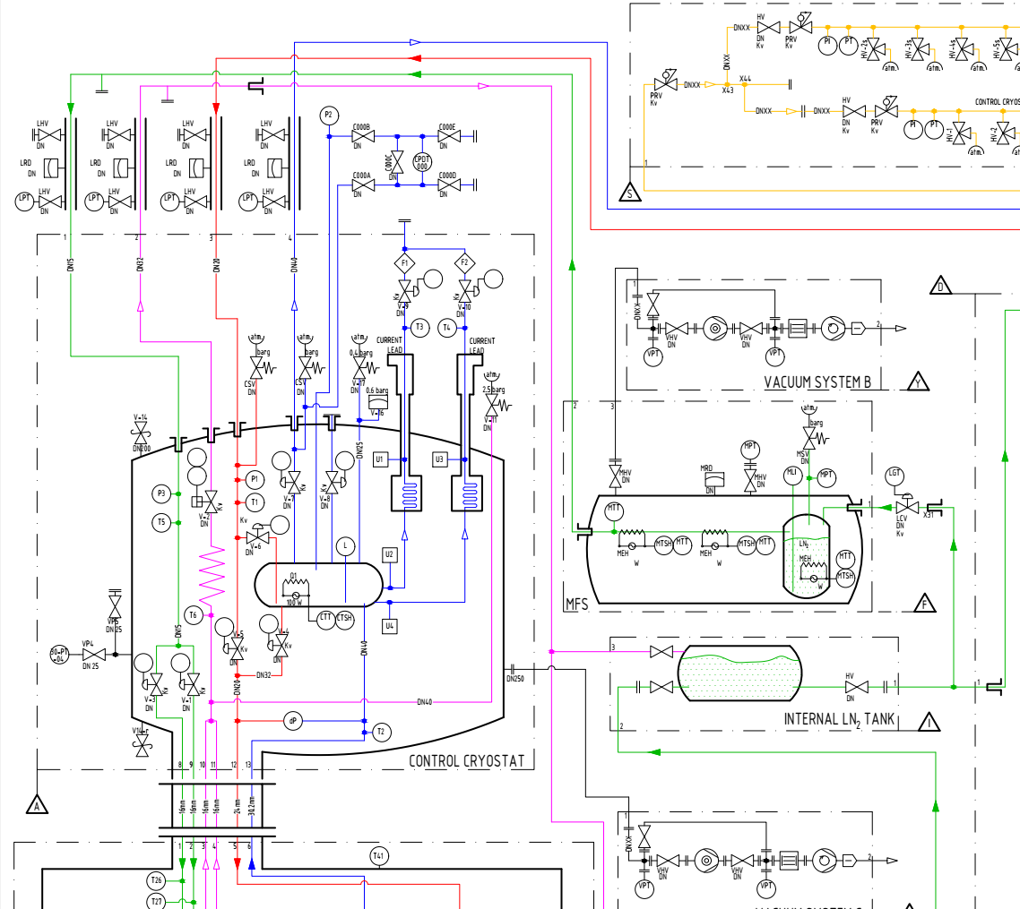
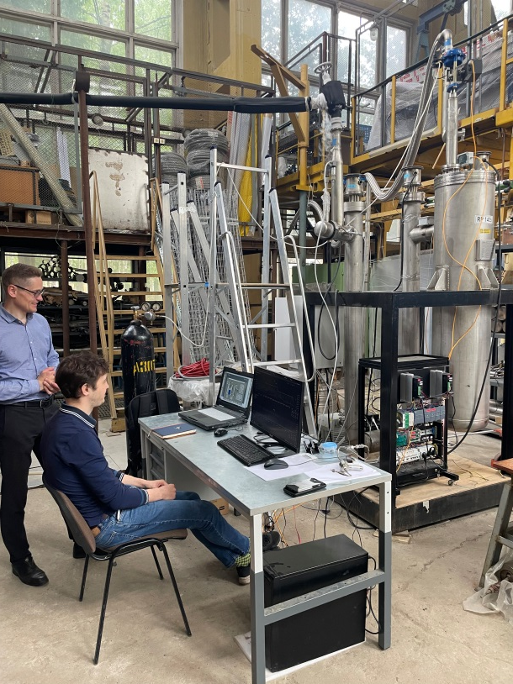
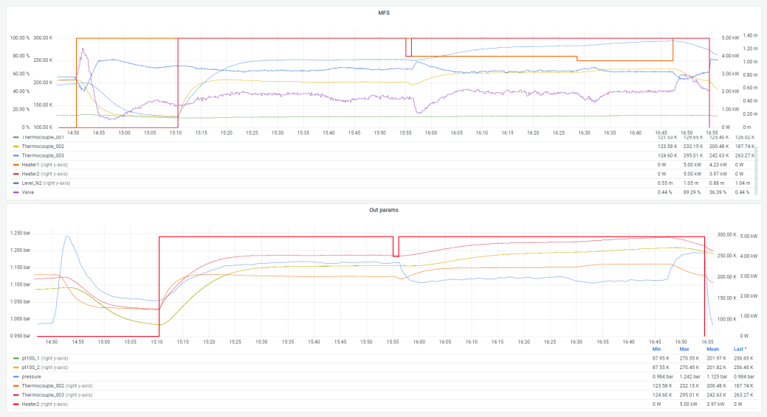
LN2 distribution heat system
General idea is to maintain the set temperature of cooling in automatic mode

Slide 12
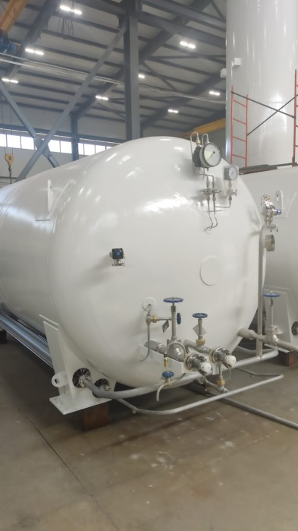
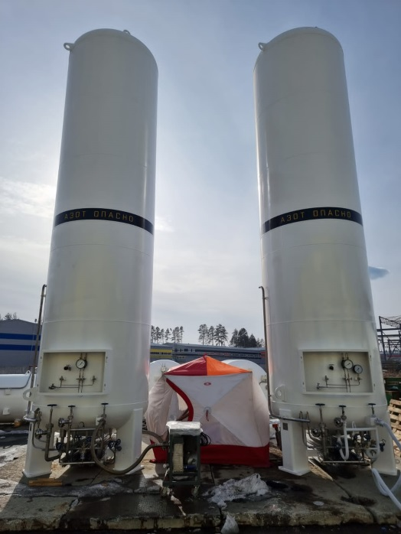
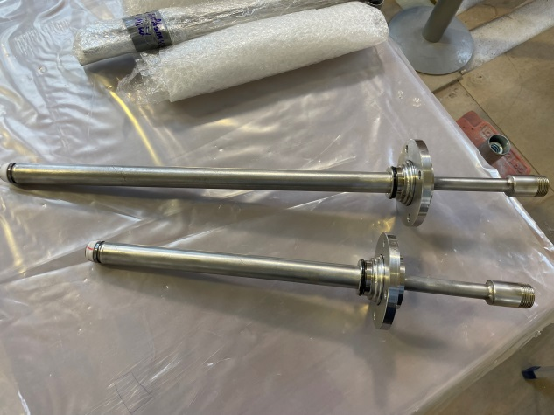
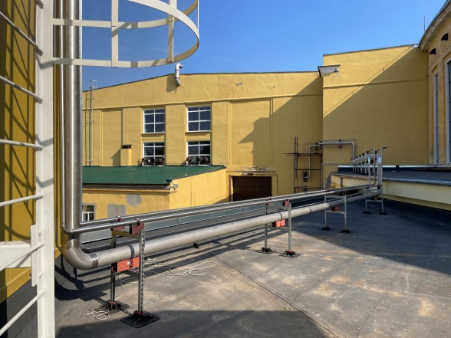
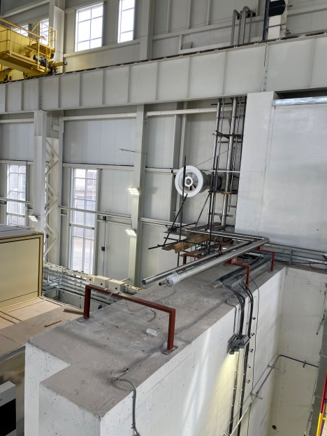
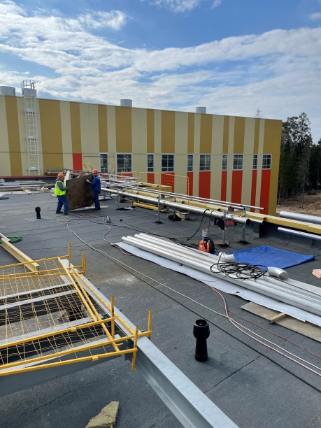
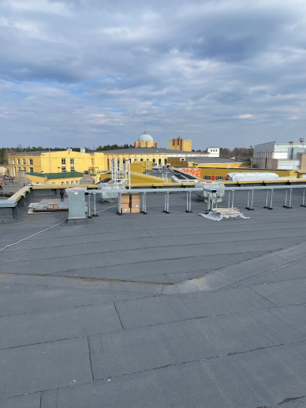
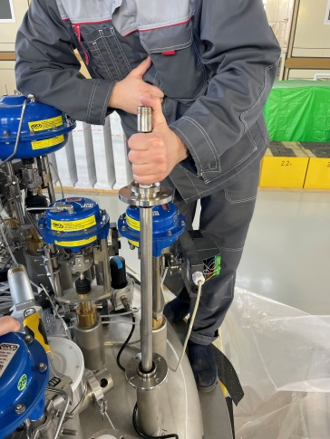
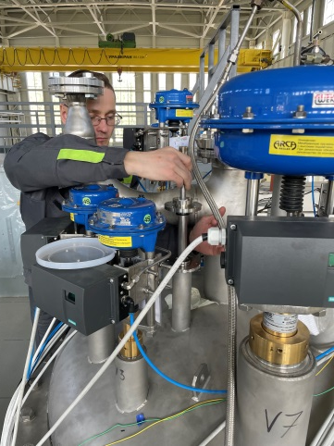
Other technological infrastructure and equipment
Bayonets for cryogenic connection flexible pipes
Warm direct and return pipes (He, N2, Air)
From NICA cryogenic area (1B to MPD hall) totally about 1.5 km.
LN2 tanks 25 m3 and 8 m3
Before welding to the flexible part, the compatibility of the bayonets was tested on the equipment
Flexible warm pipes

Slide 13
Temporary scheme of cooling at 80 K

Slide 14
Cryogenic infrastructure at the present time. Break of delivery and solutions.
Control Dewar (was checked all connections, reassembling valves, cooling pipes, CS cables connected)
Refrigerator (full assembling with leak test, software developing (ILK system not operation))
MFS
LN2 and LHe heaters (was ordered in UK, re-ordered in Russia (May 2023))
LHe pipe (ordered in UK, drawings was ready, delivery not possible, transfer manufacturing to Russia October 2023 will be installed)
Cryogenic flexible connection pipes (LHe, LN2 (delivery data May 2023) need to check the bayonets)
LN2 Tanks (2 pc) – can’t be delivery from CR, ordered in Russia (ready, delivery and mounting in April)
LHe Tanks (2 pc) – now in Russia ready to installation
LN2 transfer pipe 120 m with two support frame (October 2023)
Warm pipes for He, N2 and Instrumentation Air (mounting from 1B to MPD hall about 1500 m long (mounting, end in May 2023 ))
Flexible warm pipes (ready now in JINR)
Support system for flexible pipes (developing)

Slide 15
Chapter 3 Control and protection system.
- Control screens
- Protection system

Slide 16
Control system
All signals from solenoid engineering system connect to control system
Valves position in different operation and alarm modes
Failure list and feedback on CS
Main control parameters
Temperature of CS cables (we add 6 sensors to chimney area and current leads)
Temperature of thermal shield
Volume of LHe in control Dewar vessel
Voltage taps (drop current at CS, current leads)
Pressure inside vacuum vessel
Tie rods (stress sensors, position of cold mass)
Water flow and temperature
Refrigerator failure (by LHe level)

Slide 17
Control monitors
Main screen
Power supply
Vacuum system
Water cooling system

Slide 18
CS cable temperature
Thermal shield temperature
Tie rods sensors
Voltage taps (lose voltage in CS)

Slide 19
Conclusions at present time about control system and power supply system
Positive
We can see every sensors (some of it was repaired)
We found all passwords including admin password
We have access to program and can change a settings
We can see dependents signal from gauge – control…
We developed an electrical scheme of control cabinet system
Vacuum system can be operation from control cabinet
Control Dewar can be operation from control cabinet by manual option
Negative
In the control program and documents no data of warning and alarm parameters:
Temperature CS cables
Voltage taps
Tie rods
Water flow and temperature
No manual of cooling process of solenoid
No manual of power input
No parameters of quench detector
Outer power supplier in present configuration not enough for PS TRIM 1

Slide 20
Timeline of the magnet assembly and ready to cooling and magnetic field measuring
20/04 – 15/05 – refrigerator vacuuming and connected to control Dewar (complete)
15/05 – warm pipes from NICA cryogenic complex to MPD hall complete
15/05 – all equipment for cooling by temporary scheme by 80K in JINR (N2 tank 8 m3, flexible cryogenic pipes, LN2 manifold’s pipe, heaters)
27/04 – start vacuuming solenoid
20/05 – leak test of cryogenic equipment connections by pipes
25/05 – start cooling by temporary scheme on manual option (check sensors, parameters of cooling and etc)
01/06 – 20/06 – assembling cooling water system
15/06 – stop cooling
25/06 – solenoid in warm mode
25/06 – 25/09 – MPD hall close for painting a steel constructions
25/06 – 25/09 – analyses of cooling, optimization parameters, developing manuals for cooling by 4,5K. Prepare manual and developing program of magnet power supply system (current input, safety system, quench protection).
25/09 – 10/11 – power system assembling and tests
30/09 – 15/10 – LHe pipe with N2 shield mounting in MPD hall
15/10 – 30/11 – prepare cryogenic infrastructure to cooling 4,5K
10/01/2024 – 10/03/2024 – magnetic field measuring

Slide 21
Thank you for attention

