Slide 1
Status of the MPD integration
Viacheslav Golovatyuk
(JINR)

Slide 2
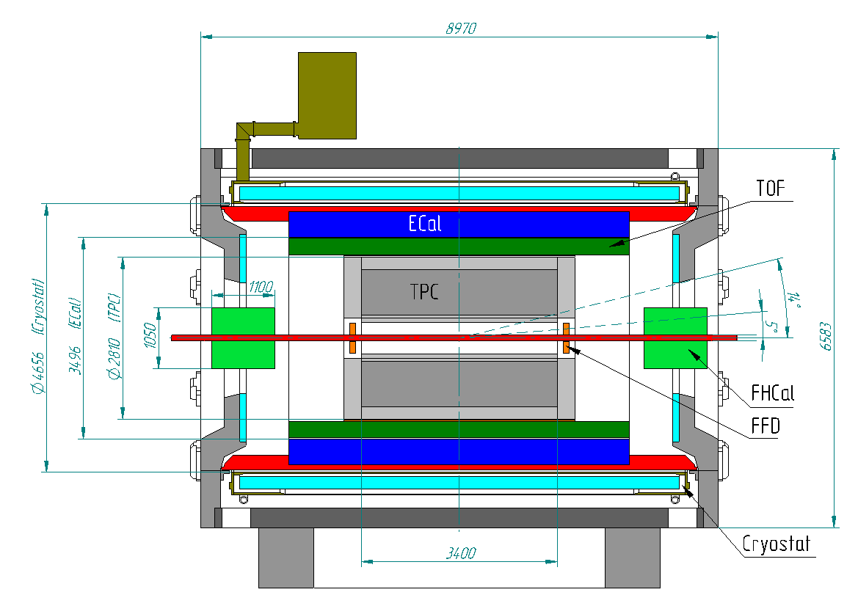
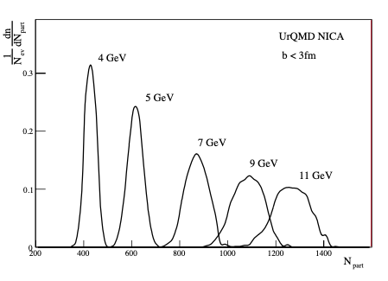
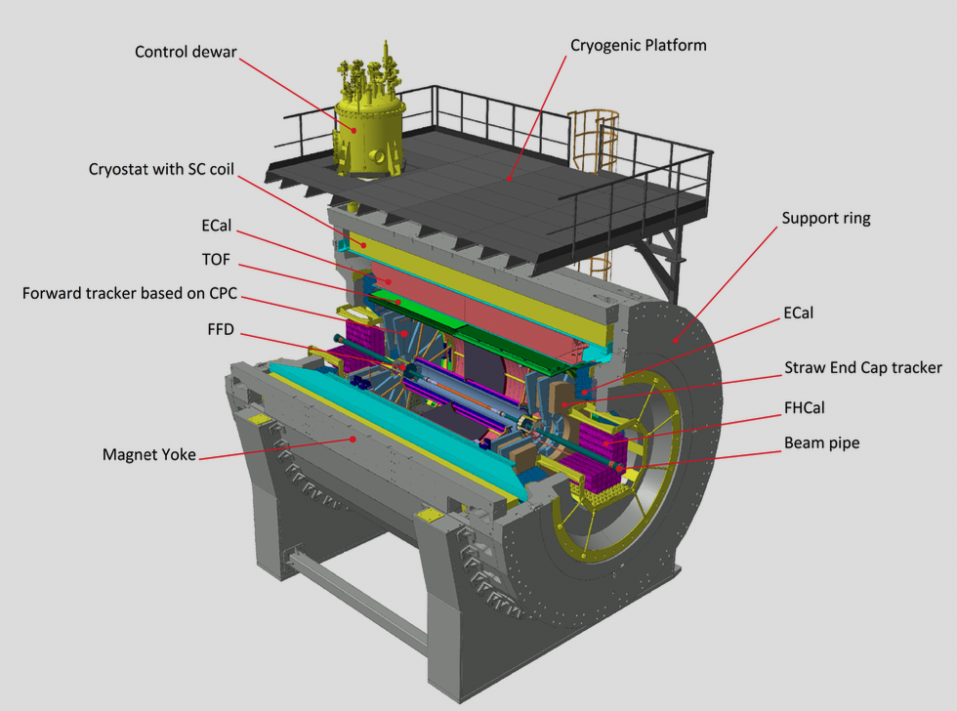
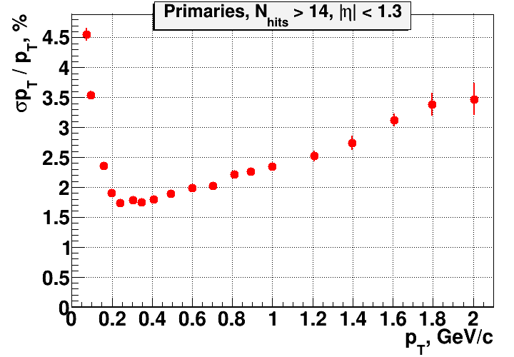
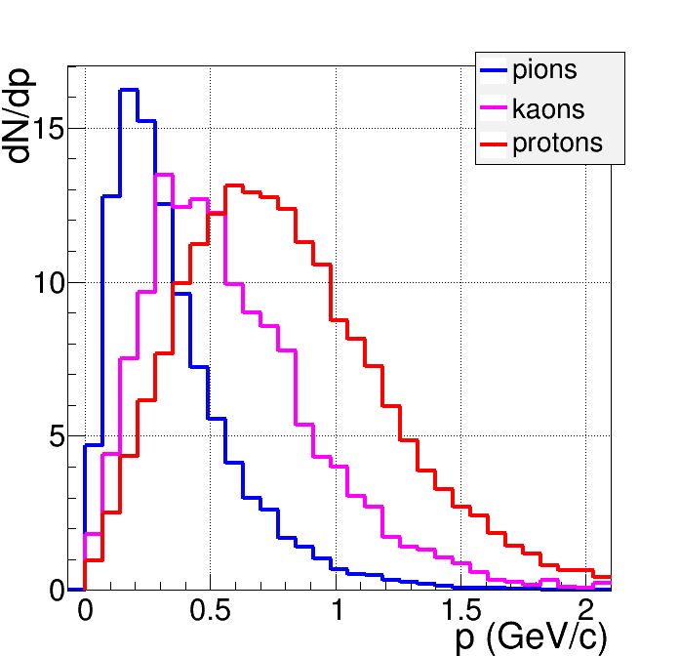
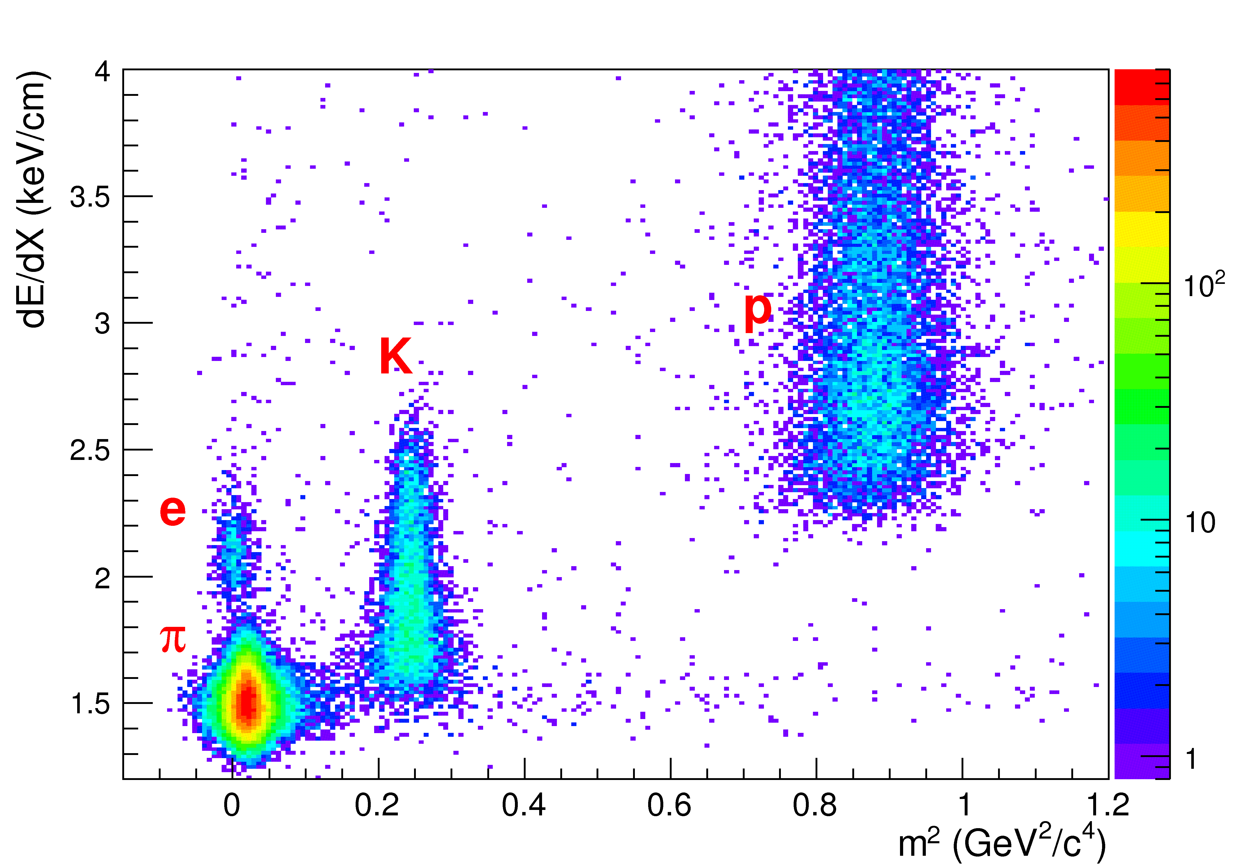
MPD - stage I
MPD - Stage II
Charged multiplicity distributions in central Au + Au collisions (b < 3 fm) calculated by UrQMD.
Momentum resolution with TPC
Momentum distribution of secondary particles

Slide 3
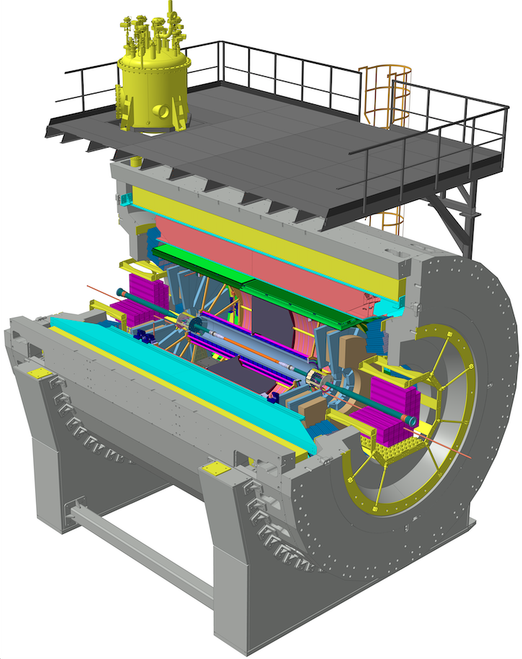
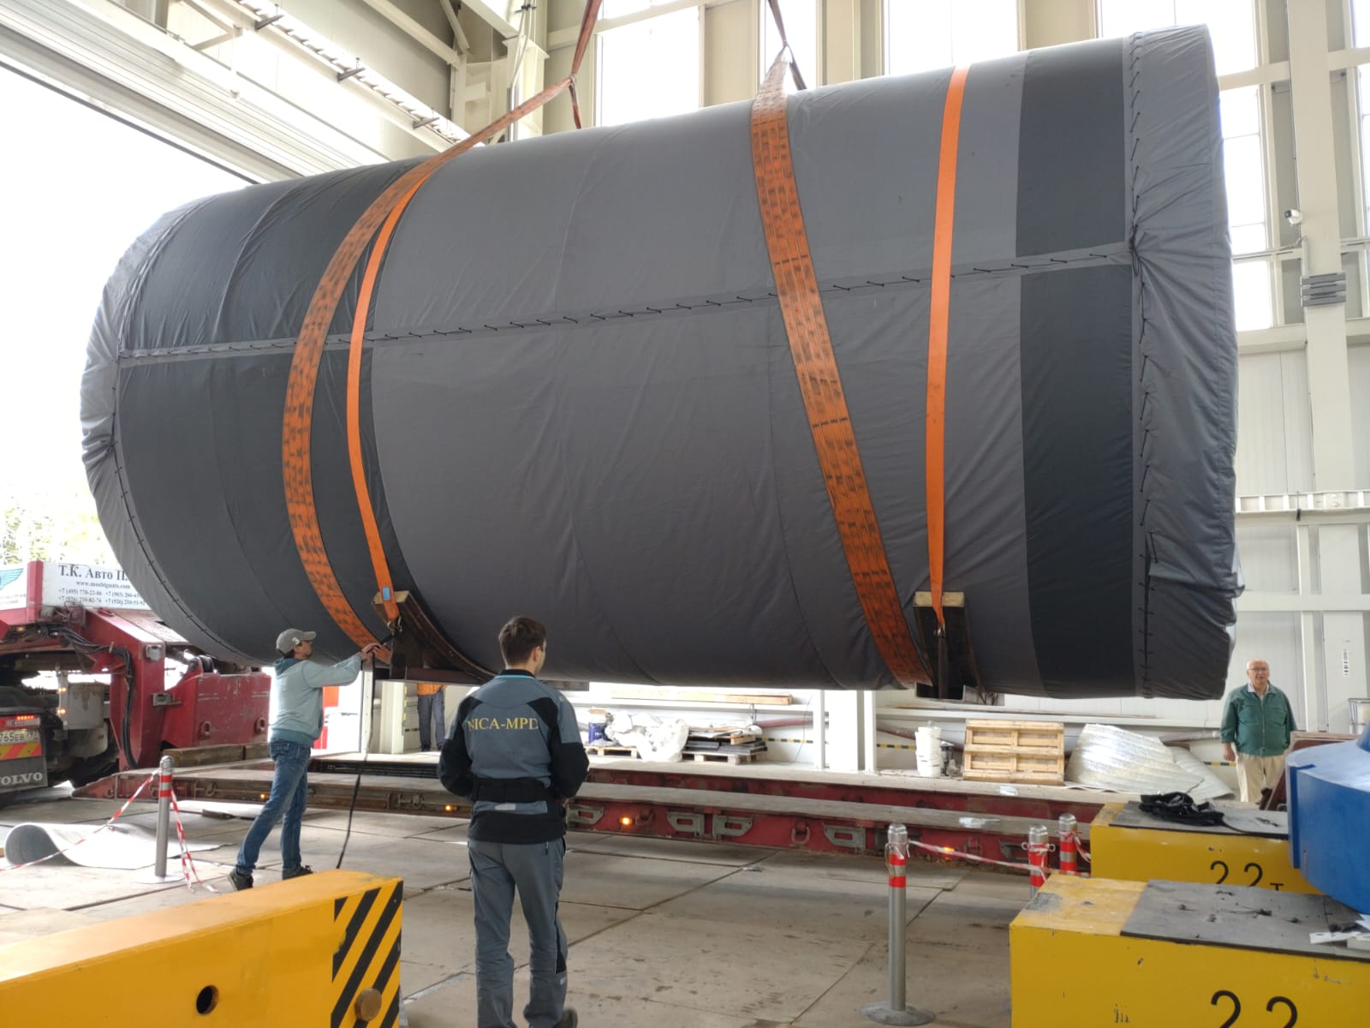
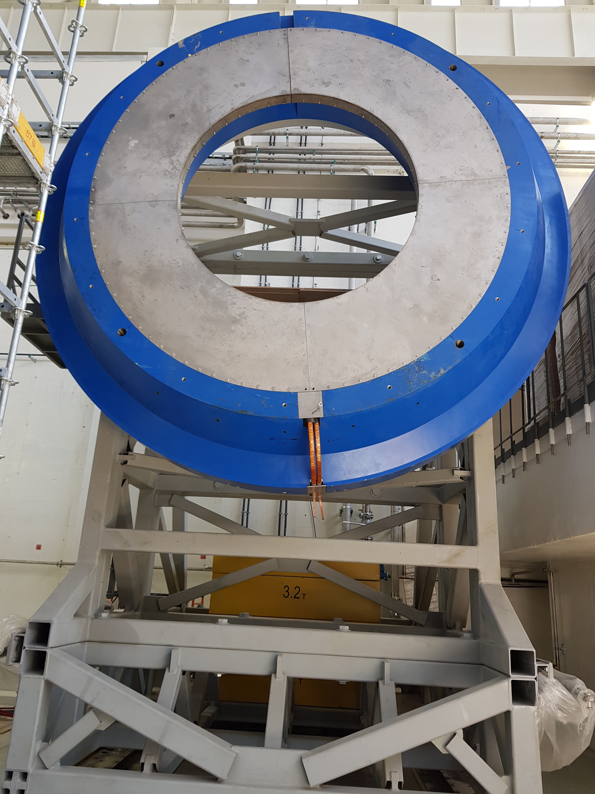
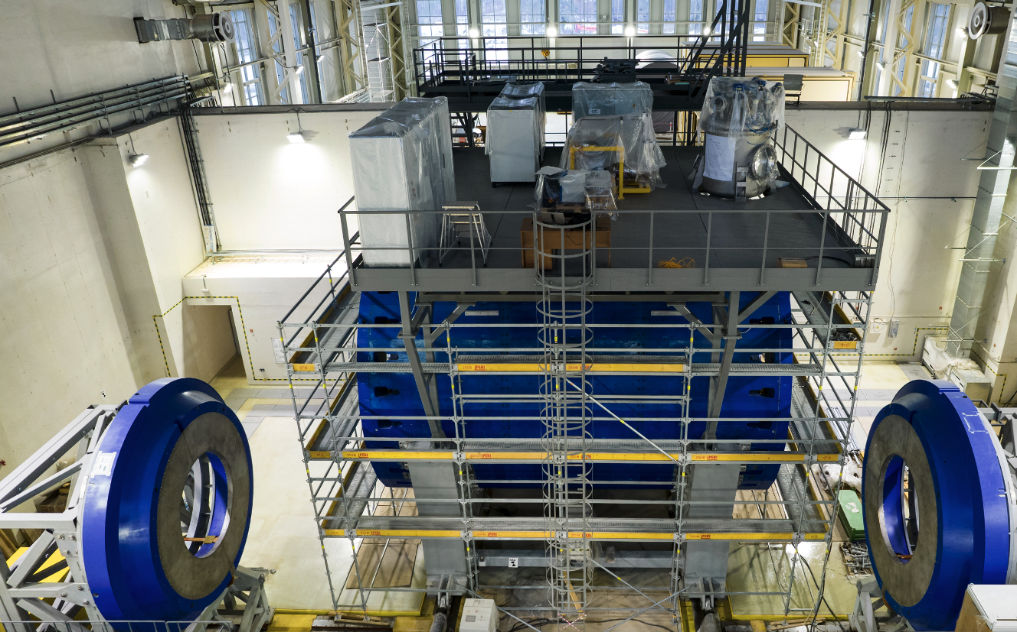
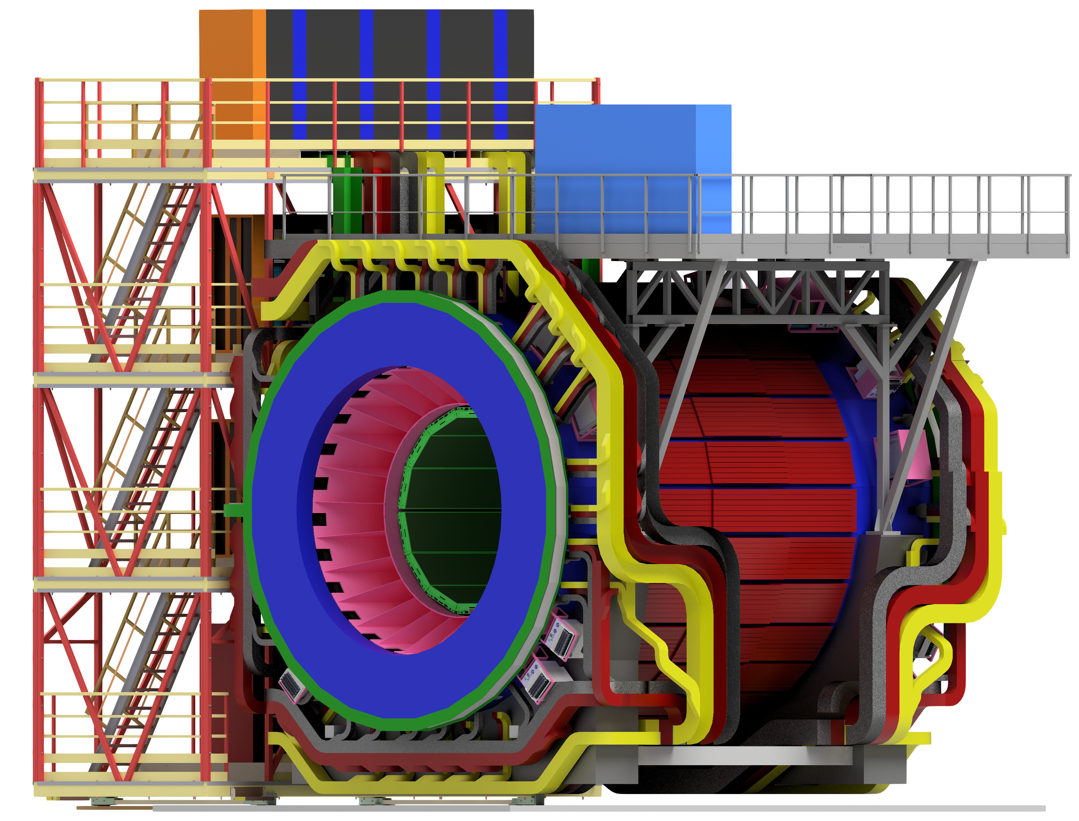
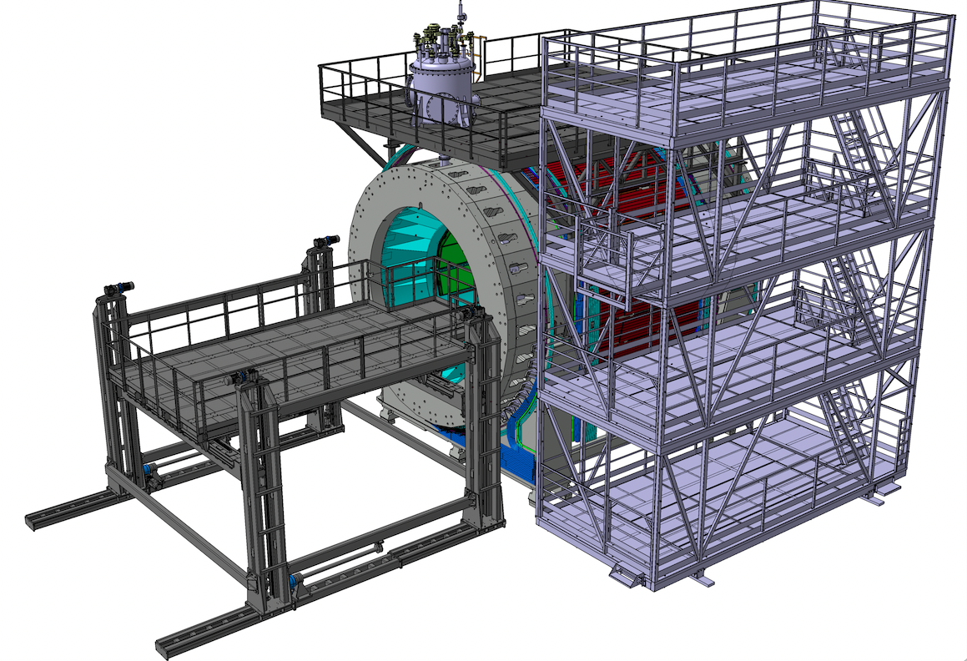
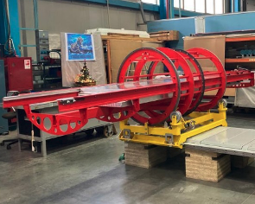
Structure of the MPD Complex
Detectors:
TPC, TOF, Ecal, FFD, FHCal and Luminosity detector,
DAQ and Slow Control
Magnet:
Iron Yoke, Solenoid, Correction Coils,
Cryogenic system, power Supplies,
B field mapper
Engineering systems
Support Frame
Beam pipe
Electronics Platforms with 25 Racks
Detectors Cooling systems
Cable ducts
Integration equipment (Lifting platform, Insertion tools of TPC,TOF,Eal)
MPD Hall
Crane
Ventilation system
Cooling Infrastructure
Control Room,
Server of DAQ
Cryogenic pipes: LHe and LN2, liquid He tank
Radiation shielding

Slide 4

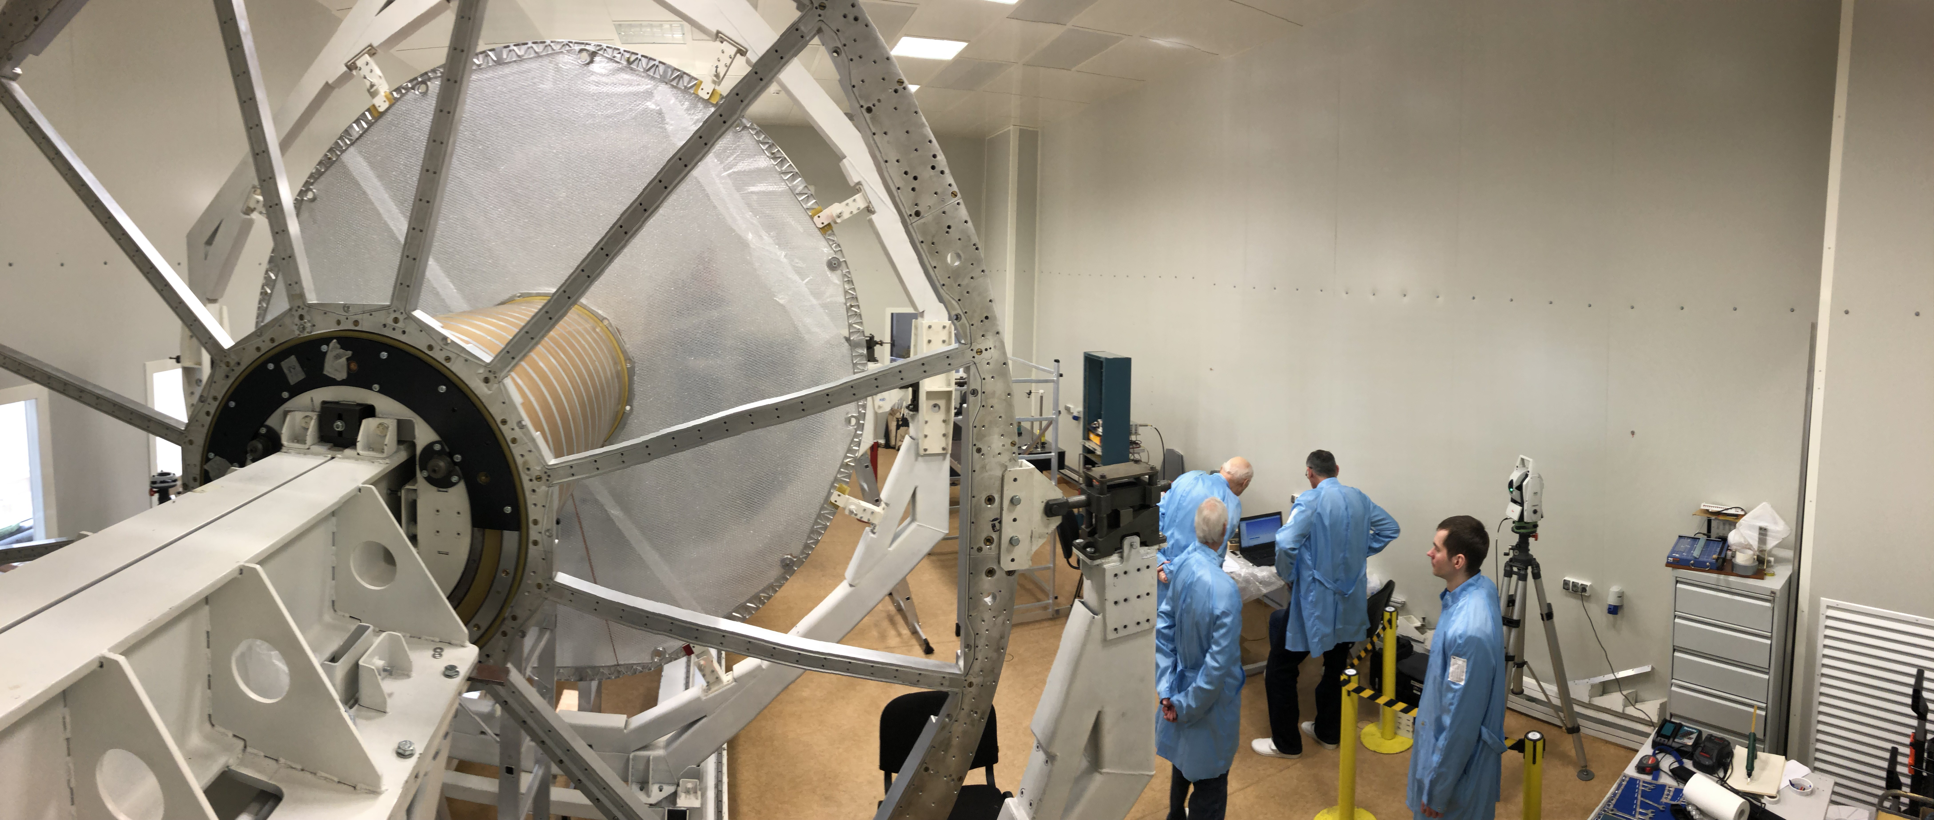
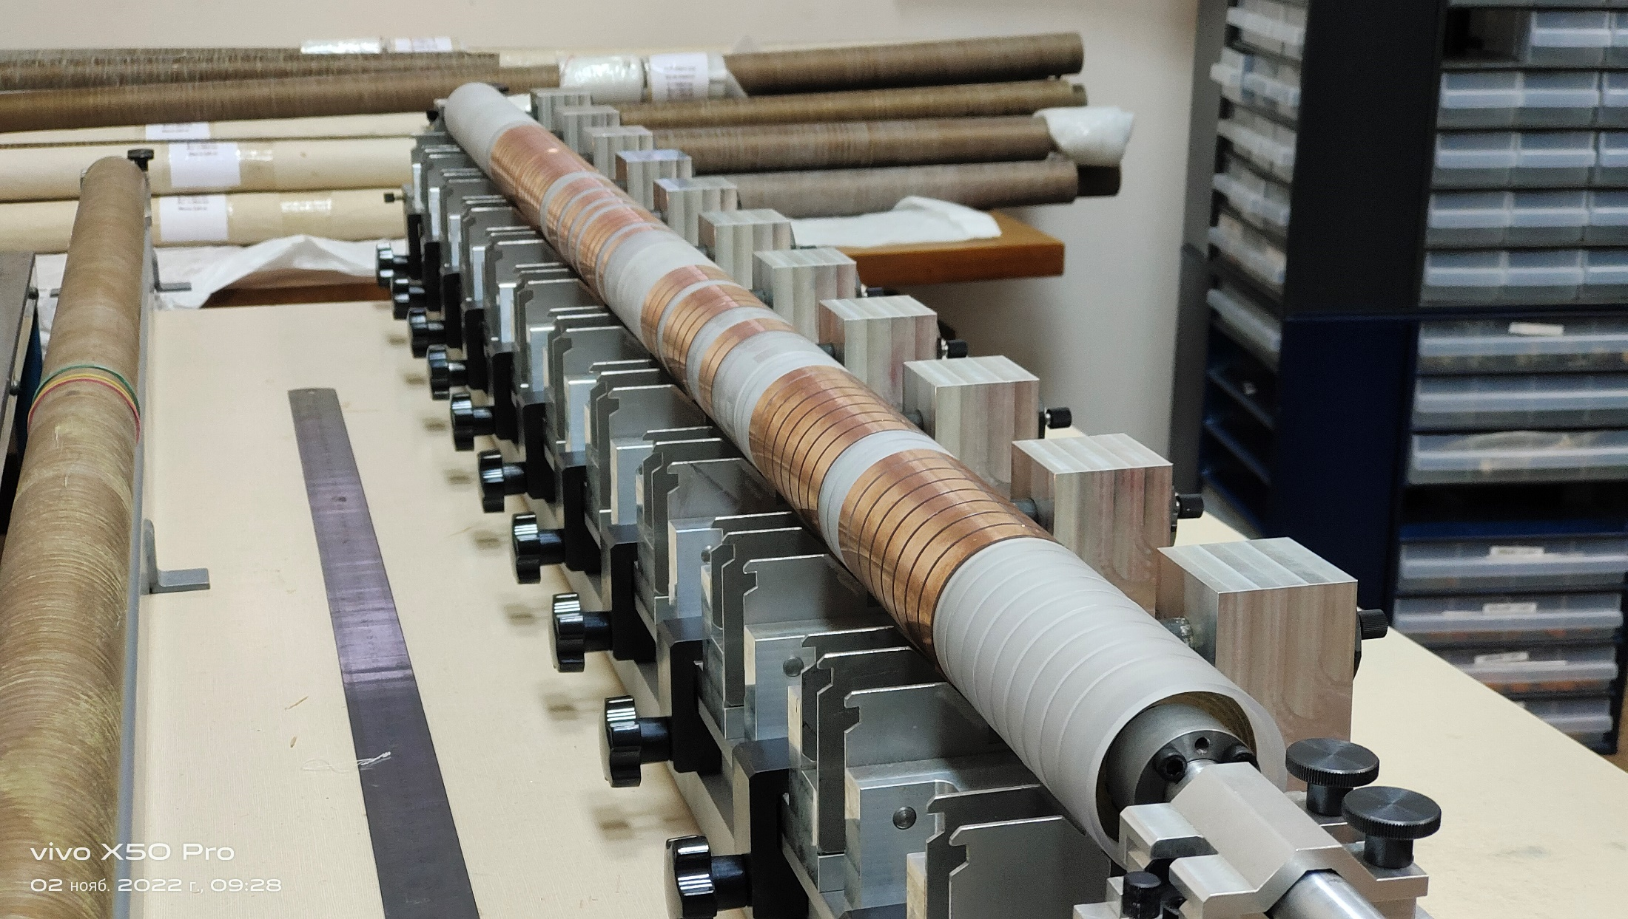
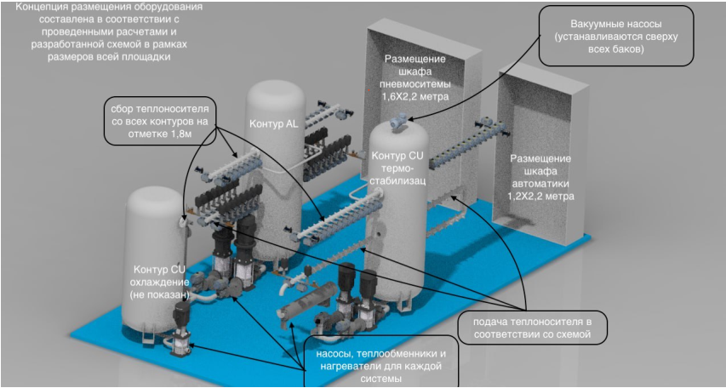
TPC – basic tracker
Rods D=40 mm – reassembled
D=60 mm – assembling in progress
More than 1 year of working with Rods. Plan to finish in June 2023
TPC+ECAL cooling system: calculations and optimization - in progress
Vessel:
C3-C4 assembled
C1-C2 assembled
HV membrane - tested
(C1-C2) + flanges + HV membrane – assembly in progress
Plan is to finish assembling of the TPC and test on the leaks
in October-December 2023
ROC chambers: 24 serial +4 spare =28 pc tested
Electronics: 65% manufactured (967 pc)
No more problem with components – all of them are available
TPC sub-systems in a critical status:
TPC rails manufacture - Feb 2023 –> May 2023—October 2023 - critical item
rails installation into Support Frame, tests - November 2023
- Cooling system: manufacturer is INP BSU, Belarus
- Our request: Cooling of FEE has to be ready in Nov 2023,
The Complete system which also includes external
thermostabilizing panels – September 2024
Notes:
Более 20% модулей время-пролетной системы изготовлены и испытаны. До конца года будет завершено создание всей системы. Основной трекер ТРС собирается в чистой комнате. Собраны два внешних цилиндра. Последовательно идет сборка других частей детектора.

Slide 5
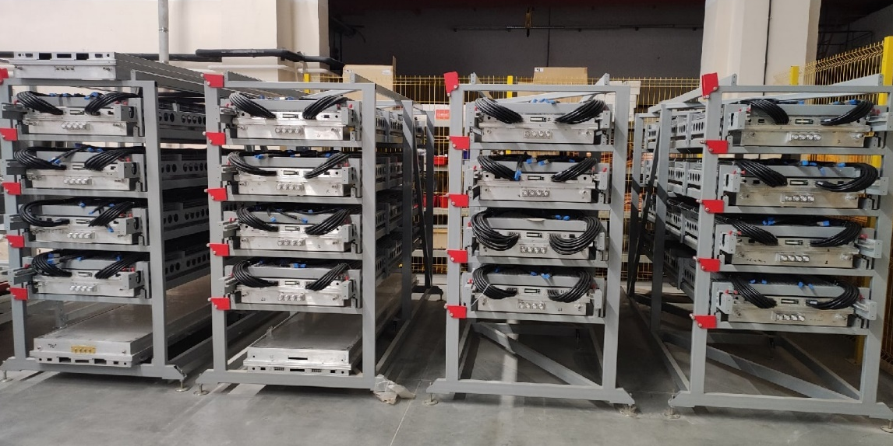
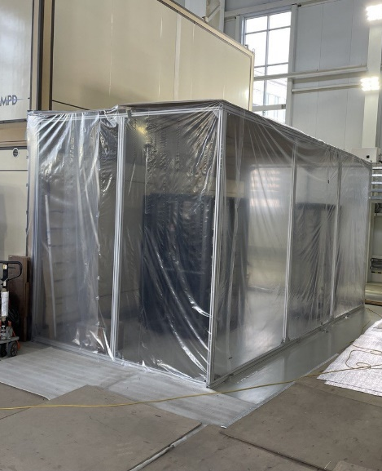
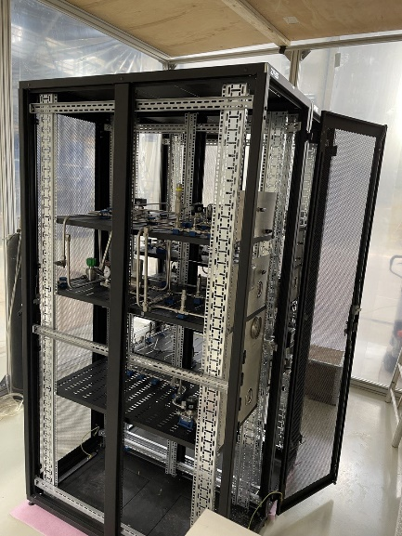
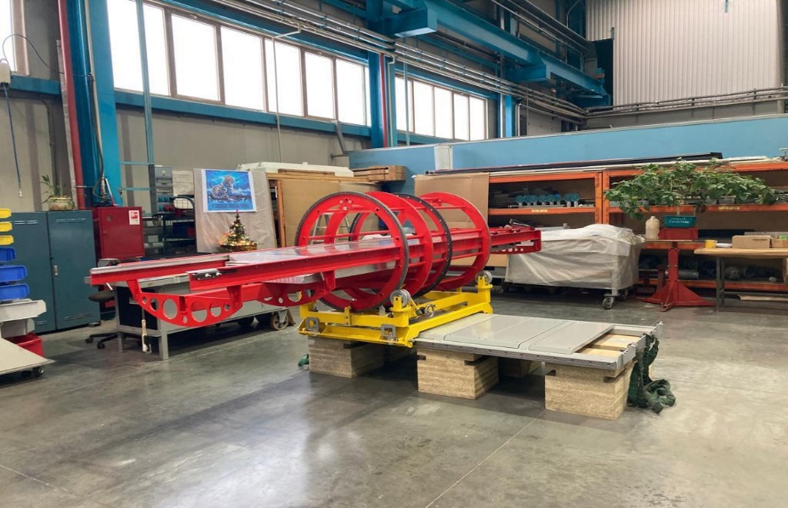
TOF MPD assembling status
The assembly of MRPC detectors for the TOF MPD was finished in September 2022. Totally available 300 (107%) fully tested detectors.
26 of 28 (93%) TOF modules are assembled. The production and testing of the last TOF module of 28 is scheduled for May 2023.
The equipment for installing the modules is ready for use and stored in the laboratory. Rails for TOF will be installed in to the power frame in May 2023.
The assembly of the TOF gas system began in the MPD hall in September 2022. It should be finished in the summer of the 2023.
Due to the fact that there was extra time, it was decided to produce spare TOF modules. Now we are looking for potential manufacturers.
Fact
17/04/2023
26 modules (93%)
Plan
Store of tested TOF modules
Gas system assembling at the MPD hall
The TOF installation bench in LHEP

Slide 6
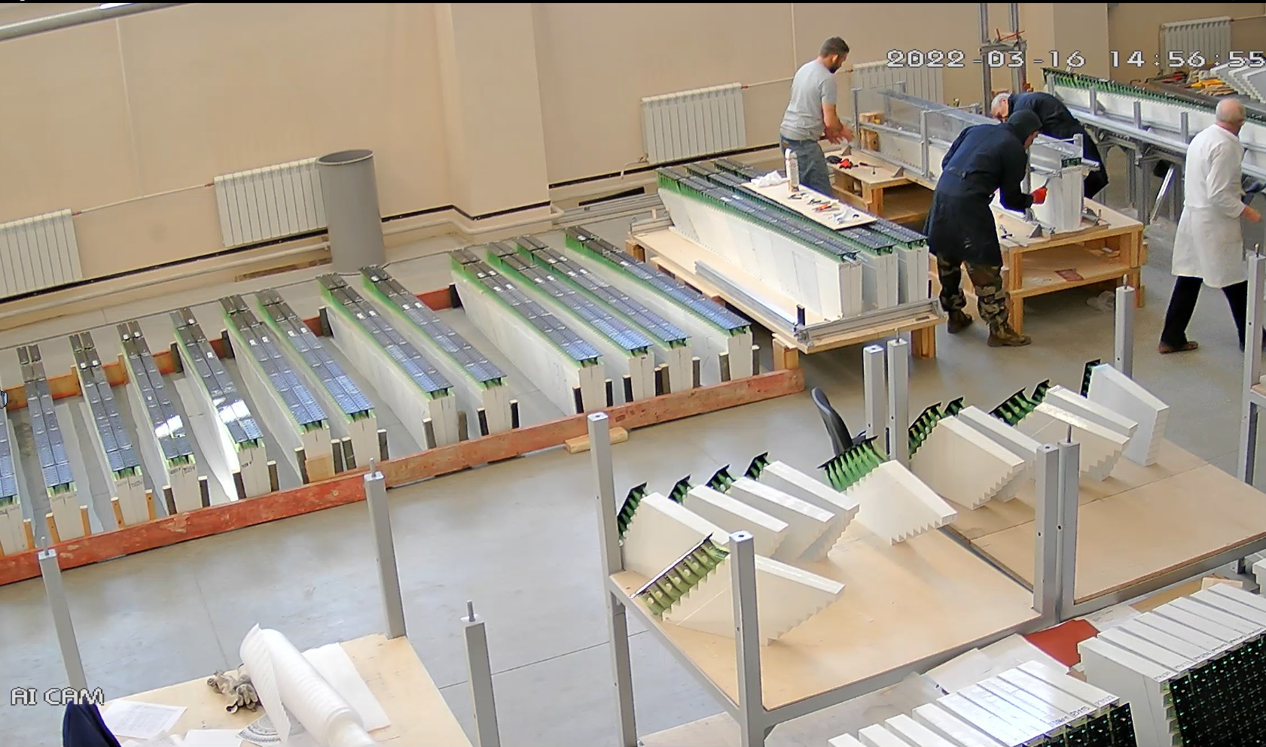
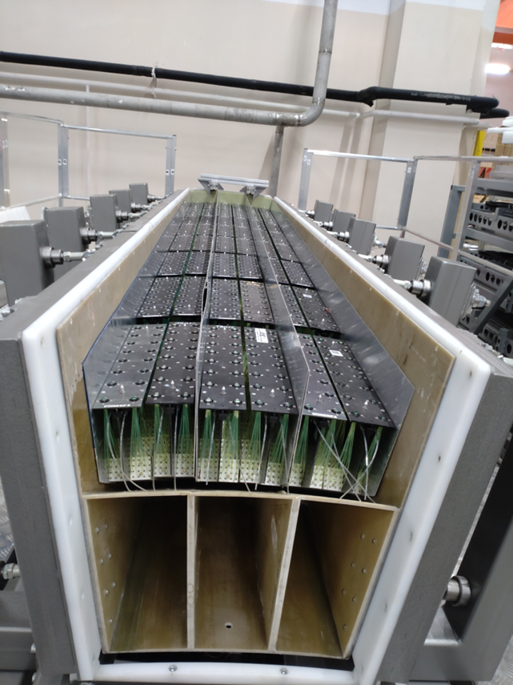
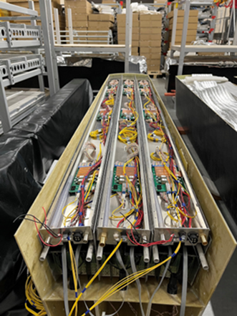
Electromagnetic Calorimeter (ECal)
ECal – Tsinghua University., Yi Wang
Shandong University
Fudan University
South China University
Huzhou University
JINR – production in IHEP (Protvino) and Tenzor (Dubna)
ECal consist of 50 baskets (2400 modules)
Now 1600 modules were produced (66%) by JINR and China (Tsinghua – supervisor)
Production of additional 400 modules in Russia is going on.
For these modules we use Russian made wave shifters which have acceptable characteristics
A mass assembly of half-sector baskets has begun.
About 10 half-sectors per month is a production rate.
A procedure for the mass installation of electronics in half-sectors is under development now.
About 83% of calorimeter should be ready for integration into the MPD frame at the end of 2024
If the Chinese consortium manages to find funds for the production of the remaining 400 modules, it will be on a parity basis with JINR.
We will have a complete set of Ecal sectors (100%).

Slide 7
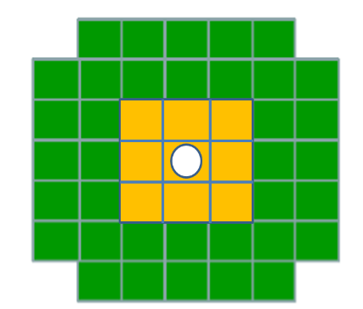
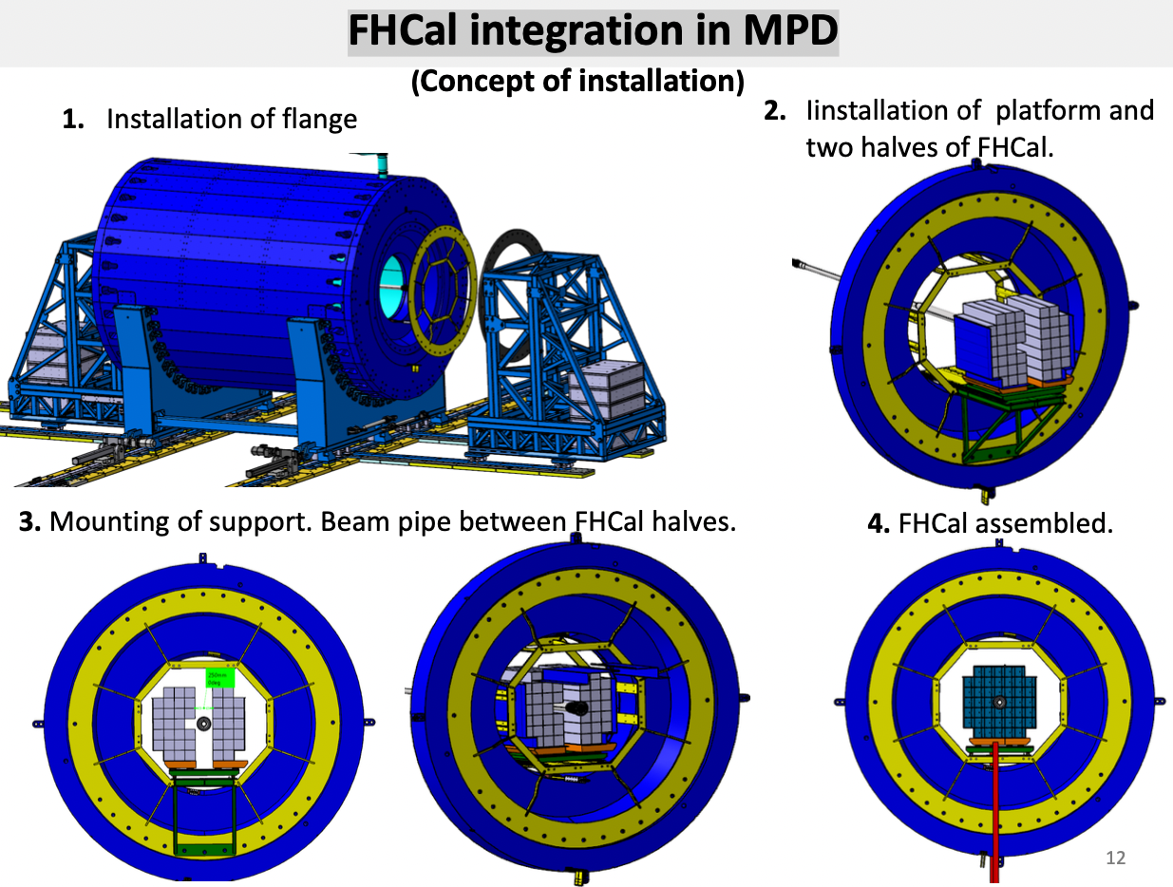
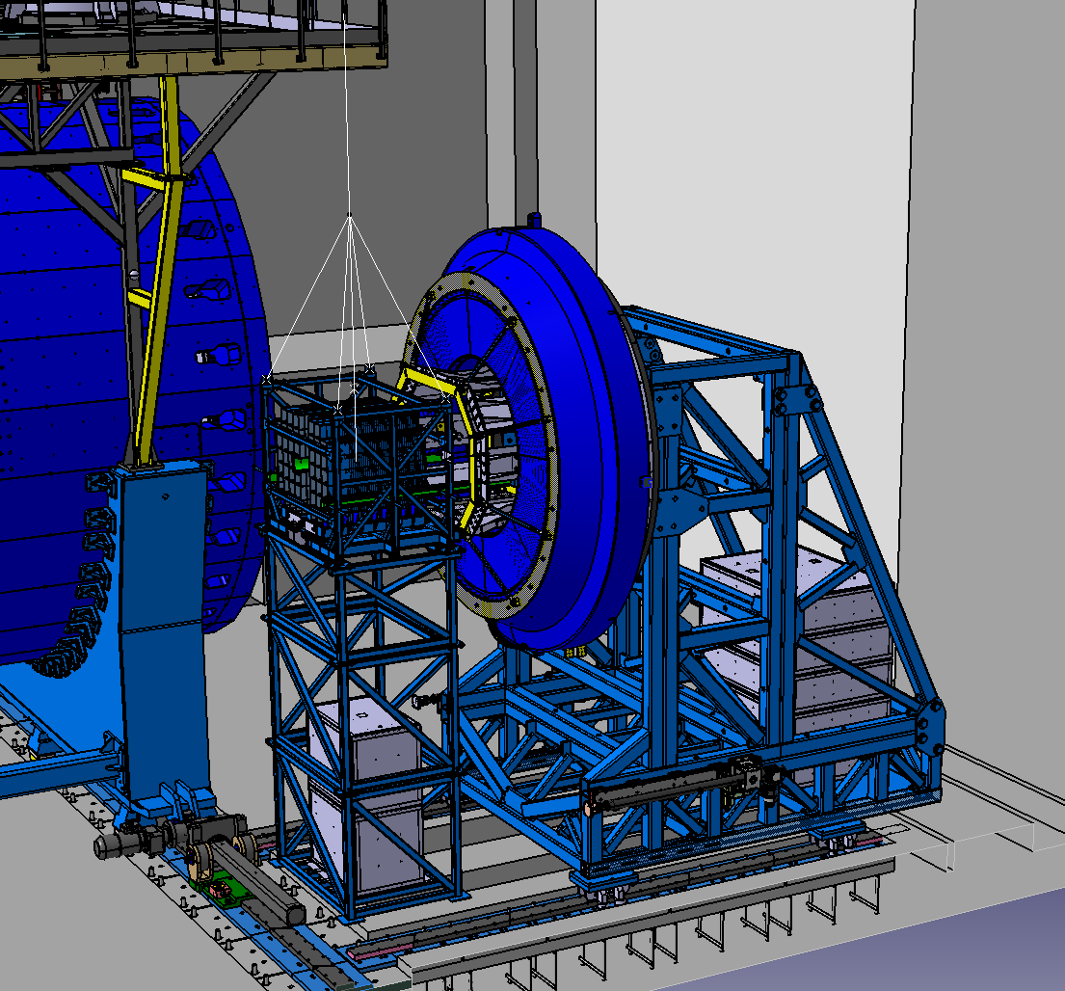
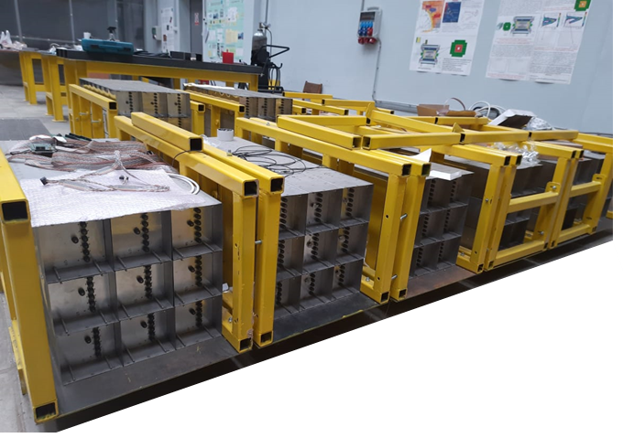
FHCal integration status
90 modules are ready for shipment to JINR.
100 Front-End-Electronics (FEE) boards are tested and ready for the installation in calorimeter.
Mechanical platform is designed. All elements are in production
FHCal assembly will begin in October of 2023.

Slide 8
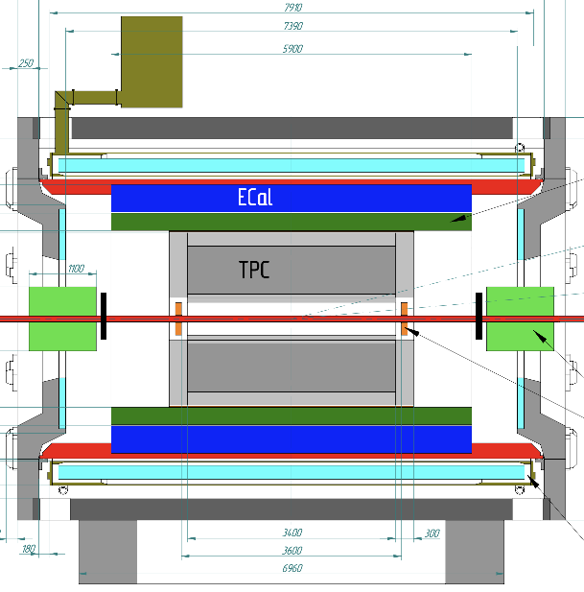
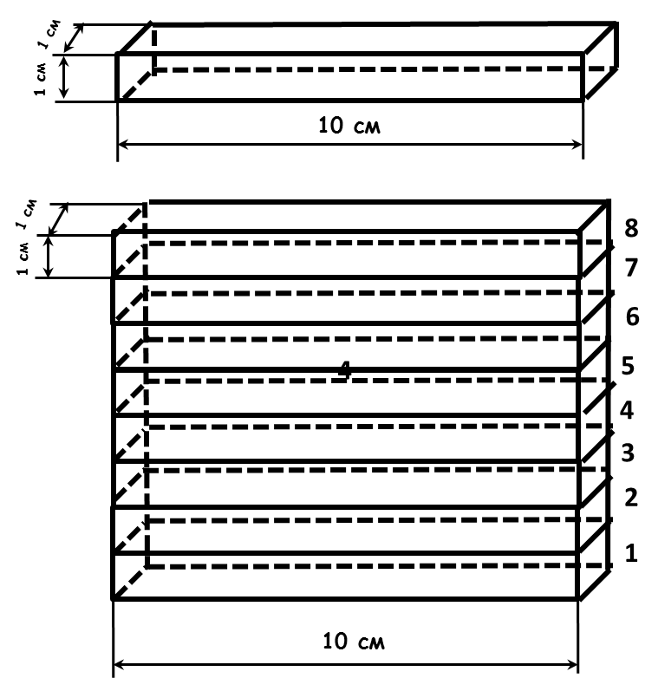
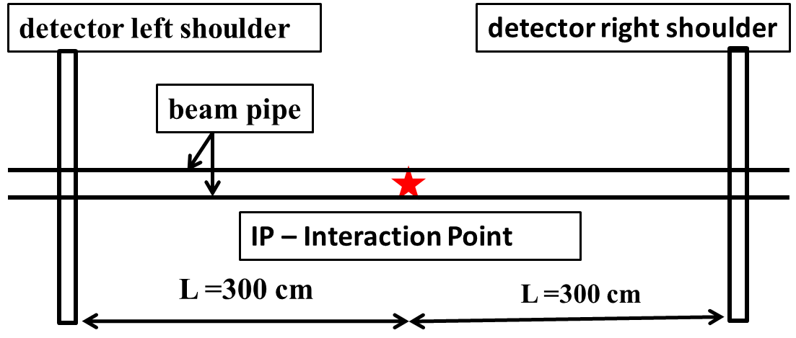
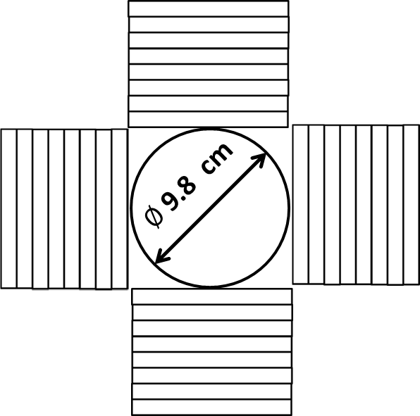
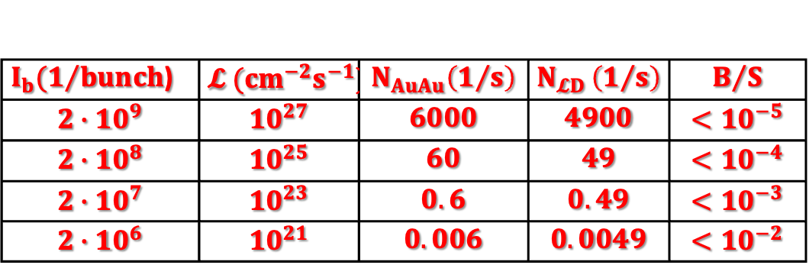
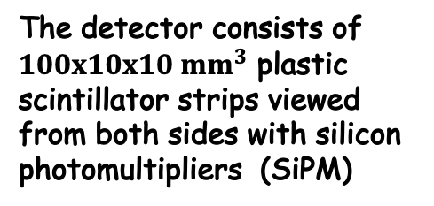
Control of luminosity at the interaction points in the collider NICA
A.Litvinenko ,JINR
and working group
Tasks which have to be solved by the detector
Assistance in controlling the transverse sizes of the bunches
Assistance in setting up transvers convergence of bunches
Assistance in setting up longitudinal convergence of bunches
Control of the distribution of vertices in the longitudinal direction.
SiPM
SiPM
$I_{b}(1/{bunch}$) | $$𝓛 ({cm}^{−2}s^{−1})$$ | $$N_{AuAu}\left(1/s\right)$$ | $$N_{𝓛D }\left(1/s\right)$$ | $$B/S$$
$$2∙{10}^{9}$$ | $${10}^{27}$$ | $$6000$$ | $$4900$$ | $$<{10}^{−5}$$
$$2∙{10}^{8}$$ | $${10}^{25}$$ | $$60$$ | $$49$$ | $$<{10}^{−4}$$
$$2∙{10}^{7}$$ | $${10}^{23}$$ | $$0.6$$ | $$0.49$$ | $$<{10}^{−3}$$
$$2∙{10}^{6}$$ | $${10}^{21}$$ | $$0.006$$ | $$0.0049$$ | $$<{10}^{−2}$$
Detector circuit
one shoulder front view
The detector consists of $100x10x10 {mm}^{3}$ plastic
scintillator strips viewed from both sides with silicon photomultipliers (SiPM)

Slide 9
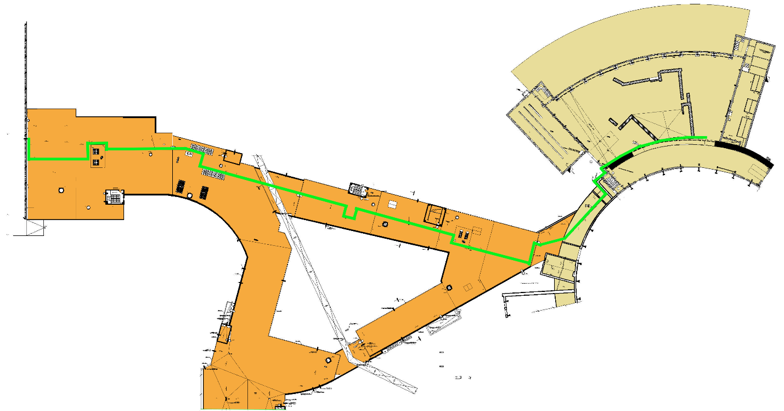
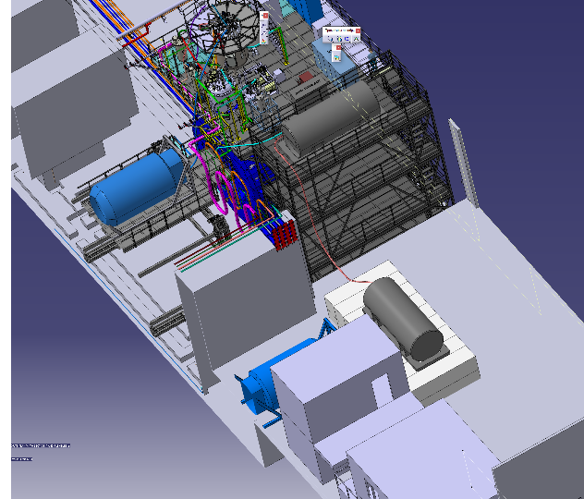
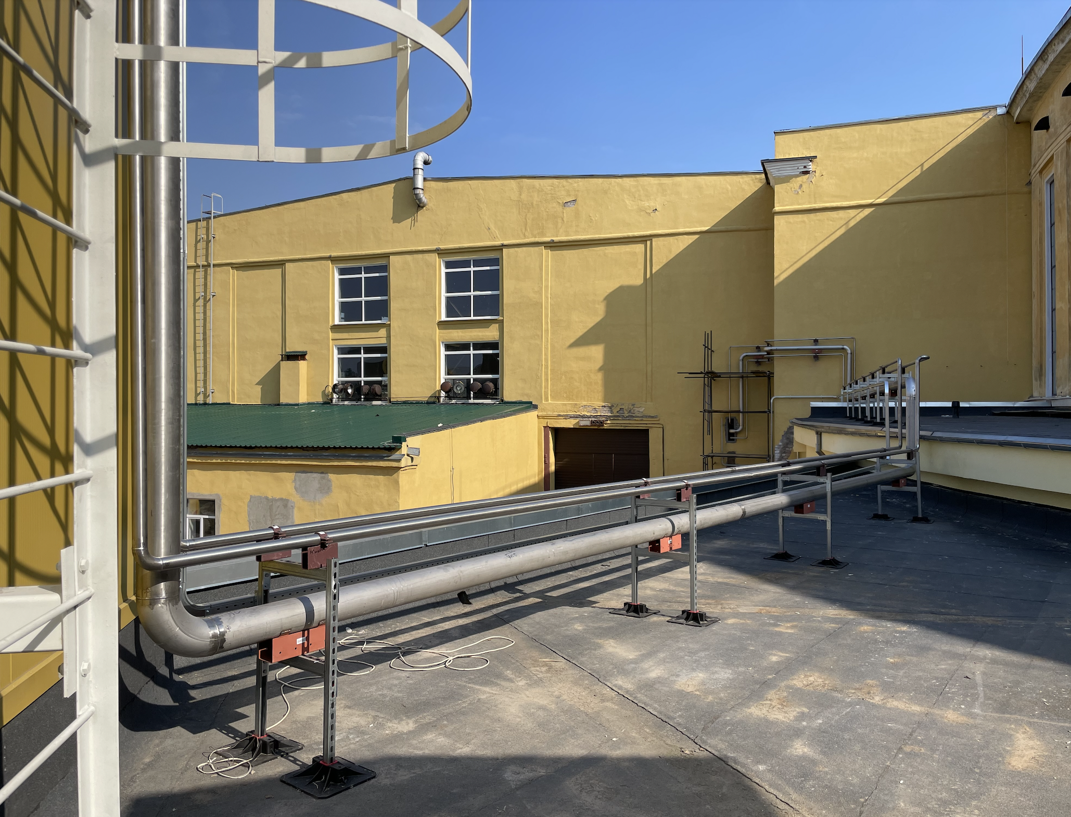
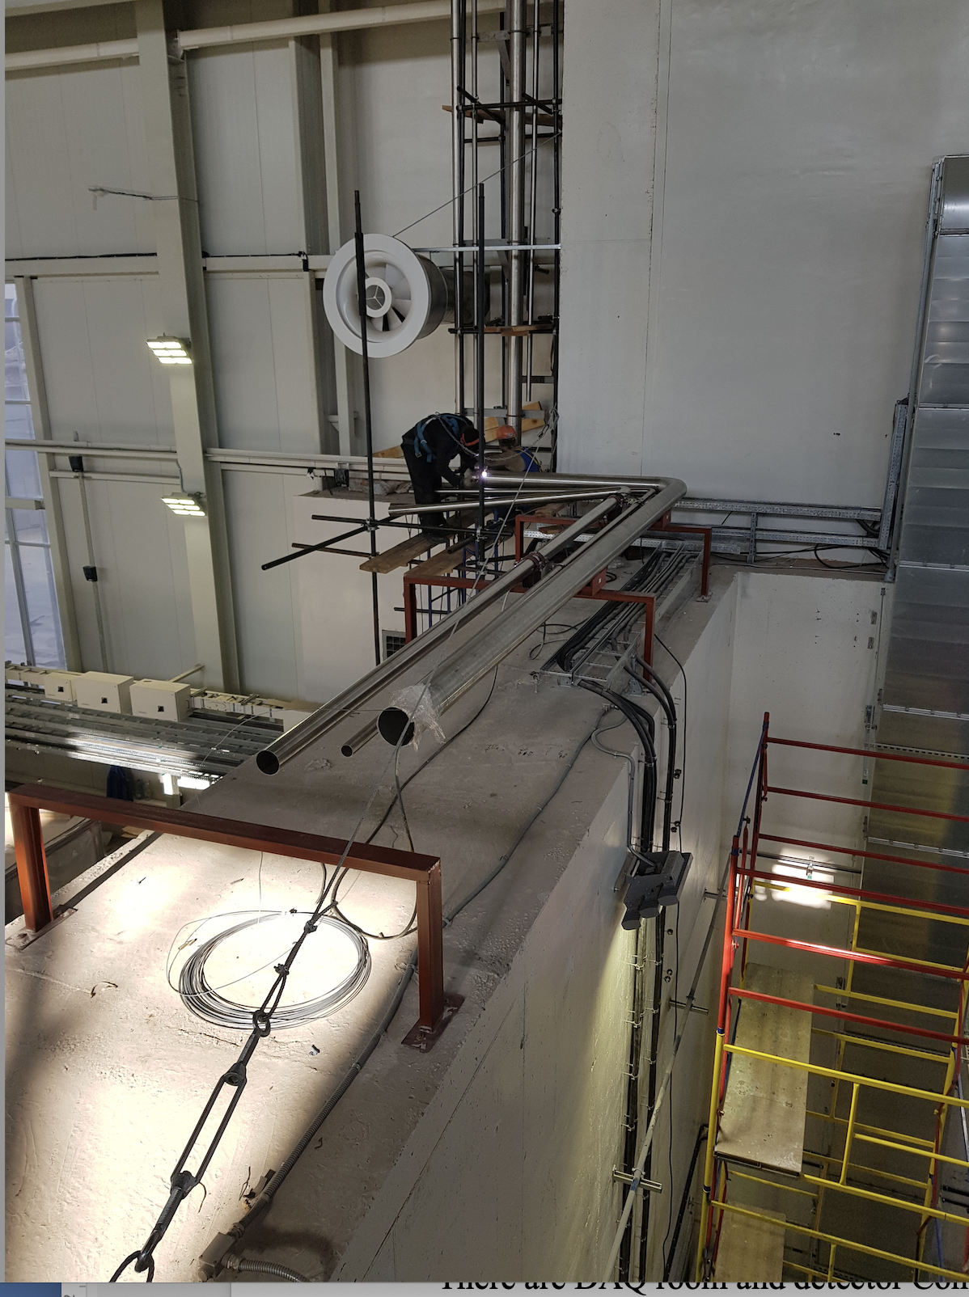
The cryogenic complex of MPD
Total length ~ 400 m
Direct and return gas He lines, GN₂ line and pressured air line are under completion.
The Layout of Solenoid cooling in temporary scheme

Slide 10
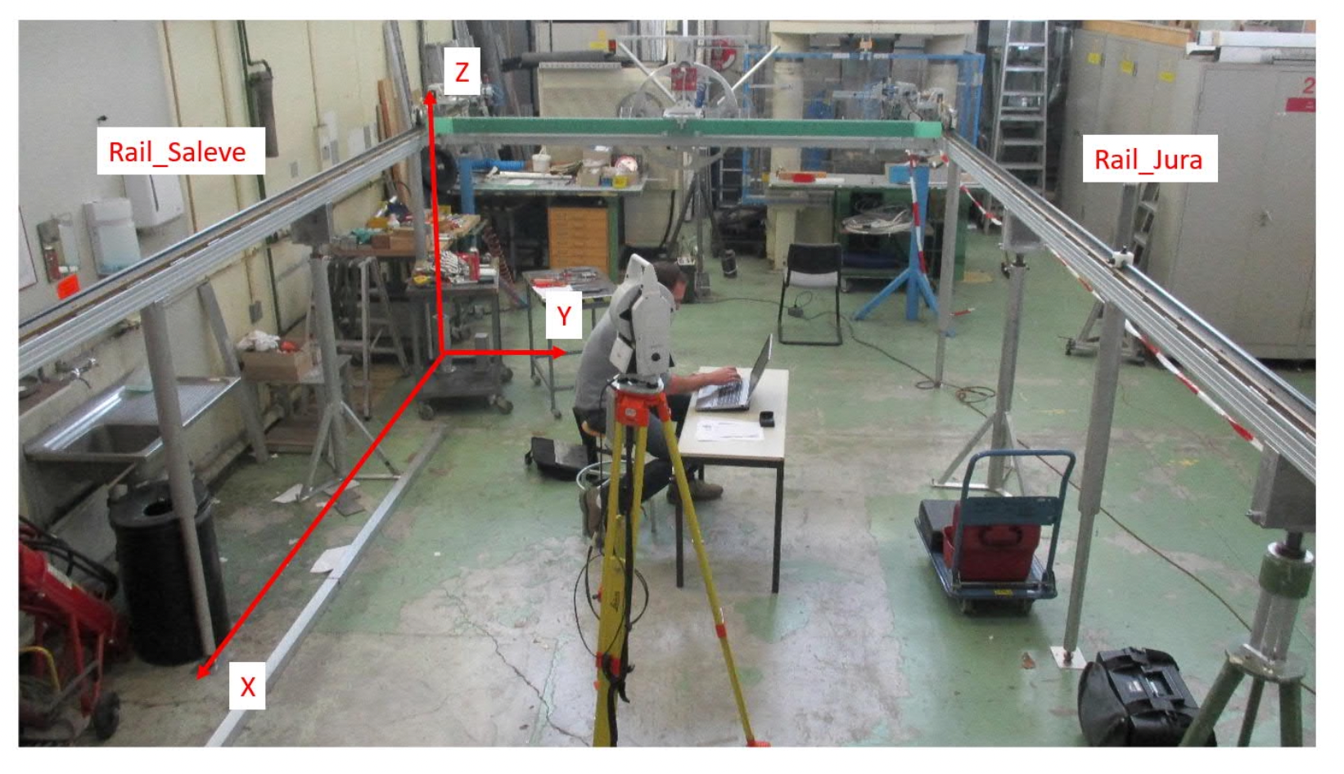
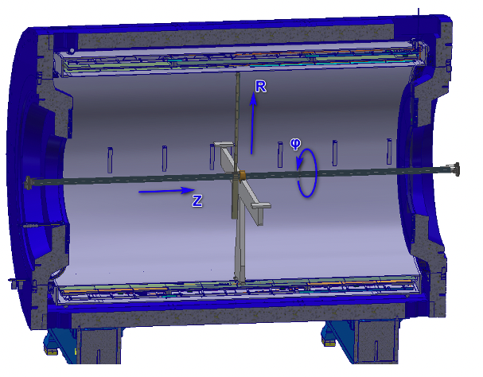
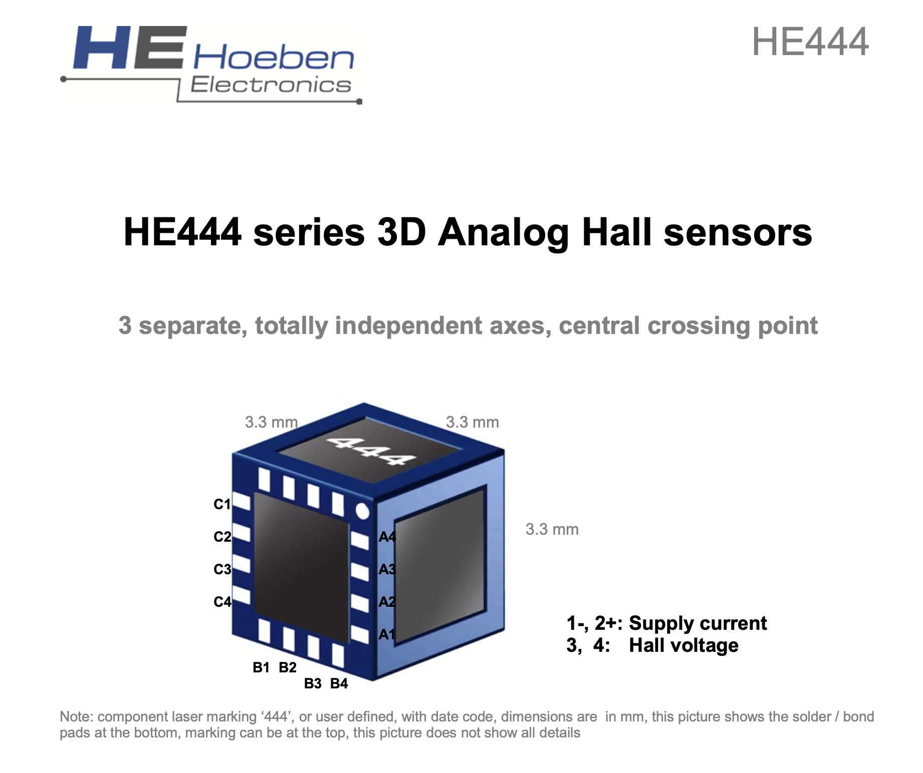
B-field Mapper
CERN design of mapper :
58 Hall probes move in z and ϕ directions
Accuracy – 1.5-2.0 Gs
Range of fields 0.57 -0.5 T
Concept of Novosibirsk INP mapper:
1 Hall 3D probe moves in 3 directions: z , R and ϕ
Accuracy: 0.3 – 0.5 Gs
Range of fields: 0.2-0.57 T
Range of measurement: from R = 0 cm to 2,0 m (It is able to do measurements in the volume of TPC when Ecal and TOF are mounted in the Support structure inside of the Magnet Yoke

Slide 11
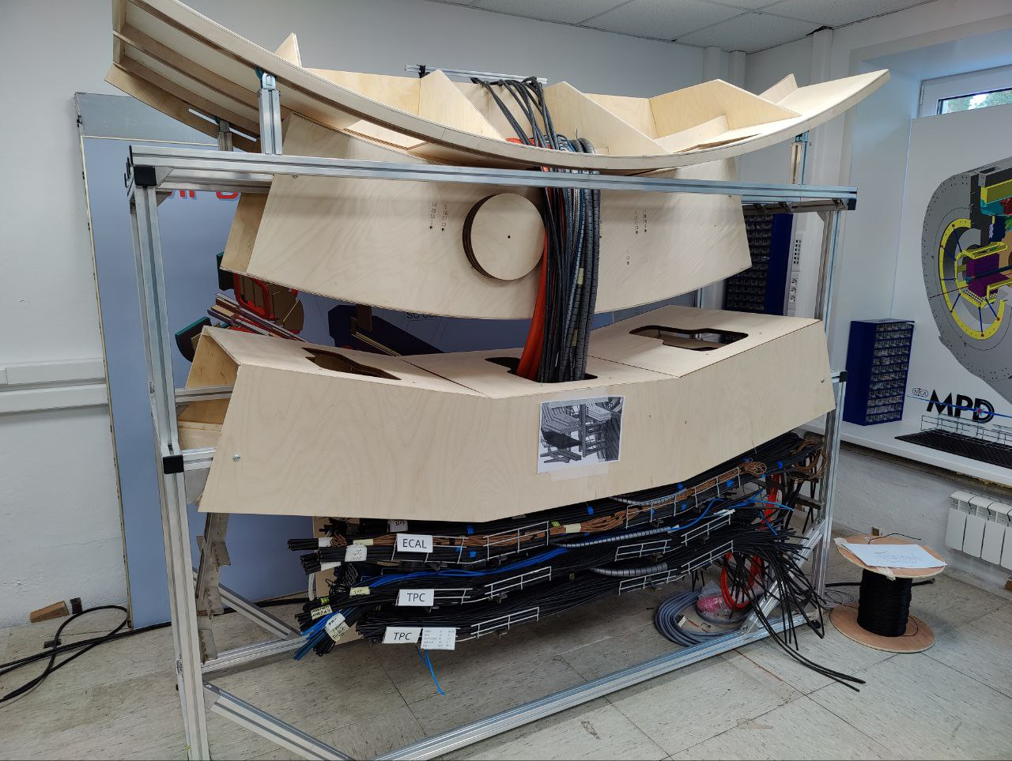
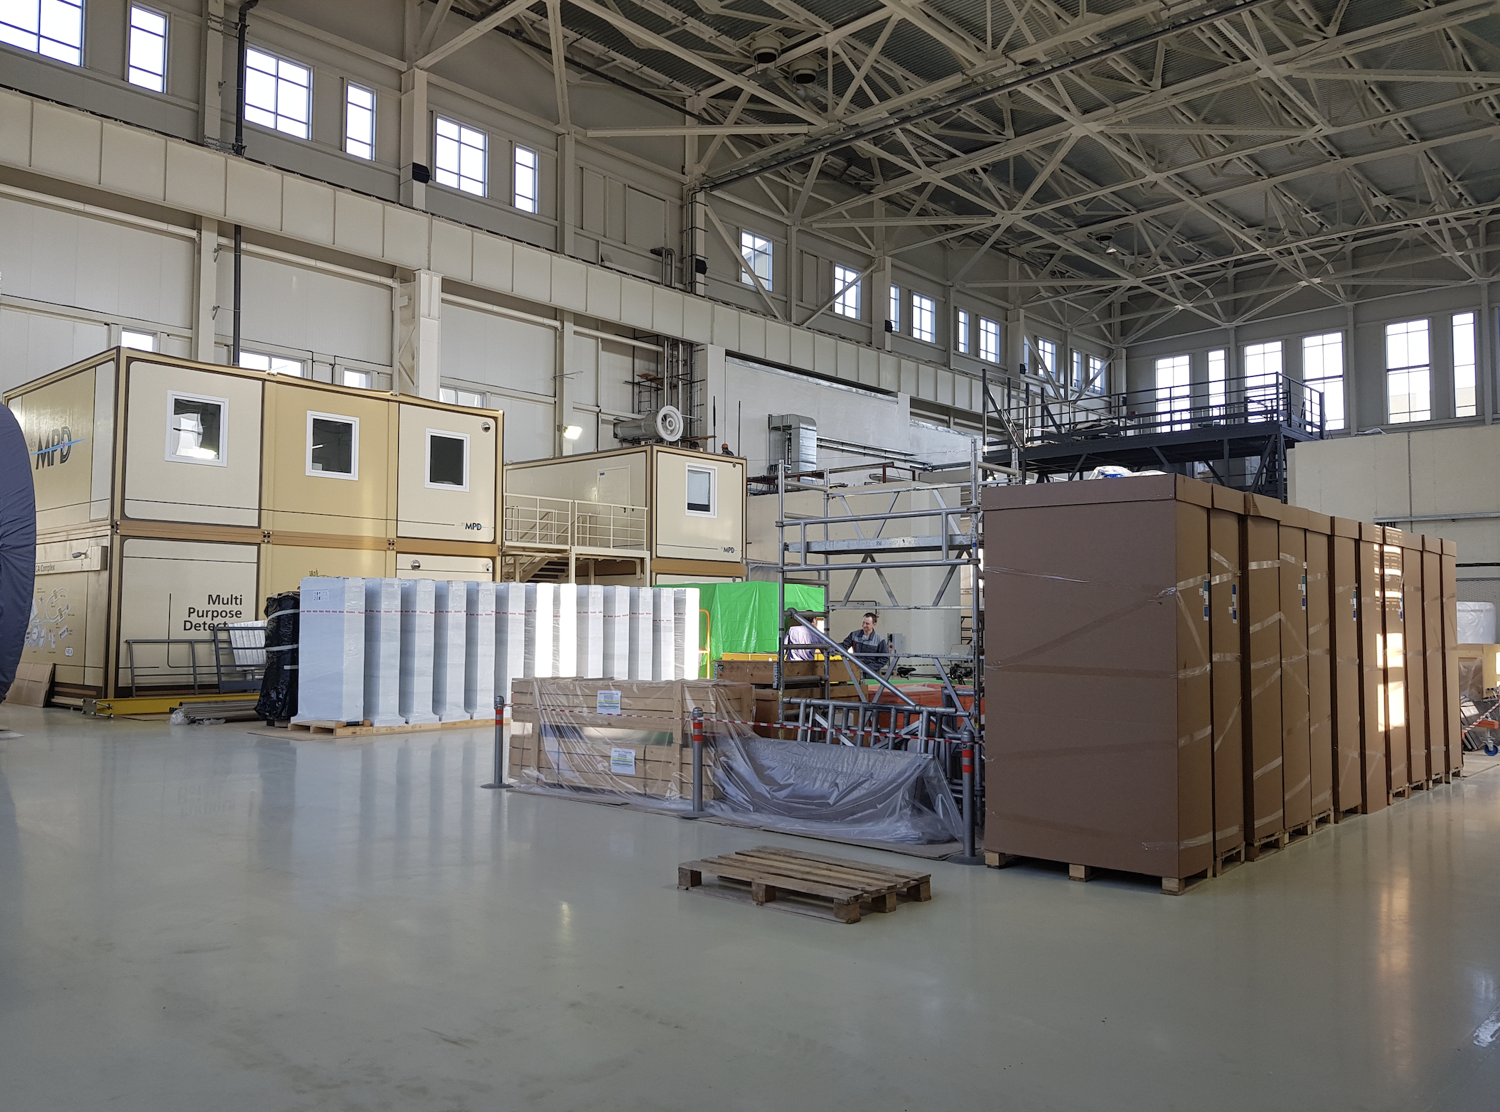
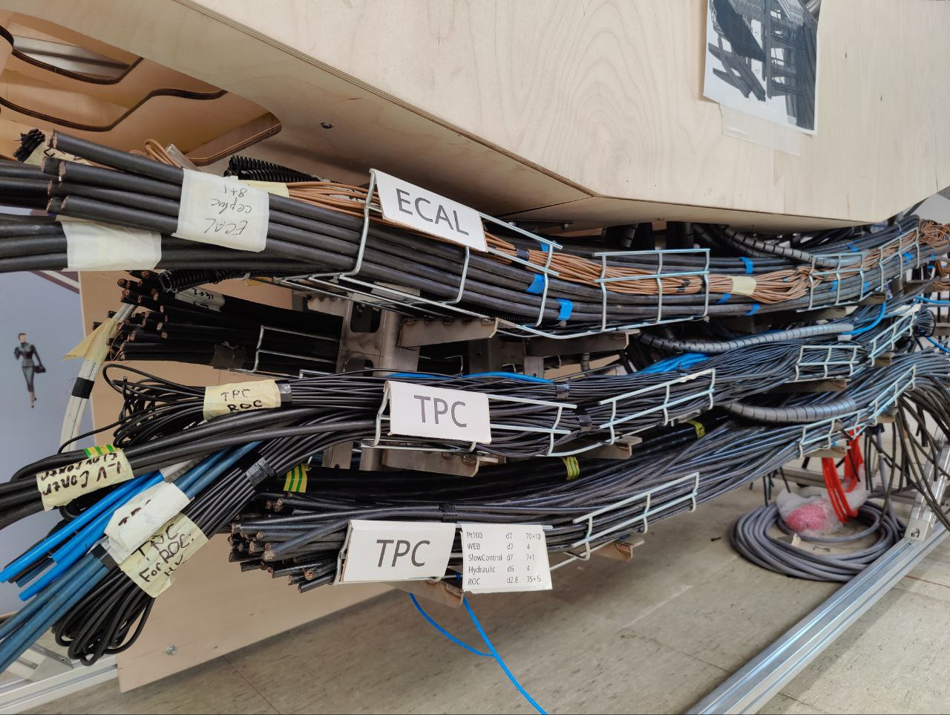
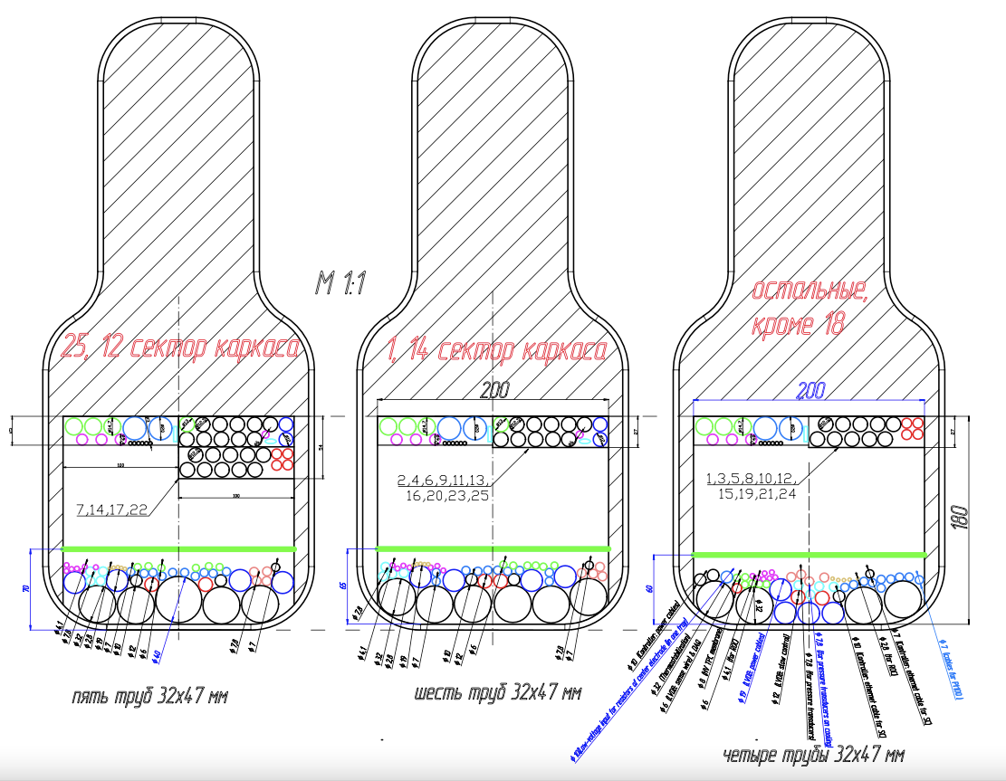
Electronics Platform and Cable routs to go inside of magnet yoke
Cables and pipes routs around barrel iron yoke to the Electronics platform
Occupancy of the windows in magnet yoke after cables and pipes installation.
Cable and cooling water/air pipes distribution in the windows of barrel yoke plates
Real scale modeling of Cable routs from detectors inside of the magnet Yoke to the Electronics platform

Slide 12
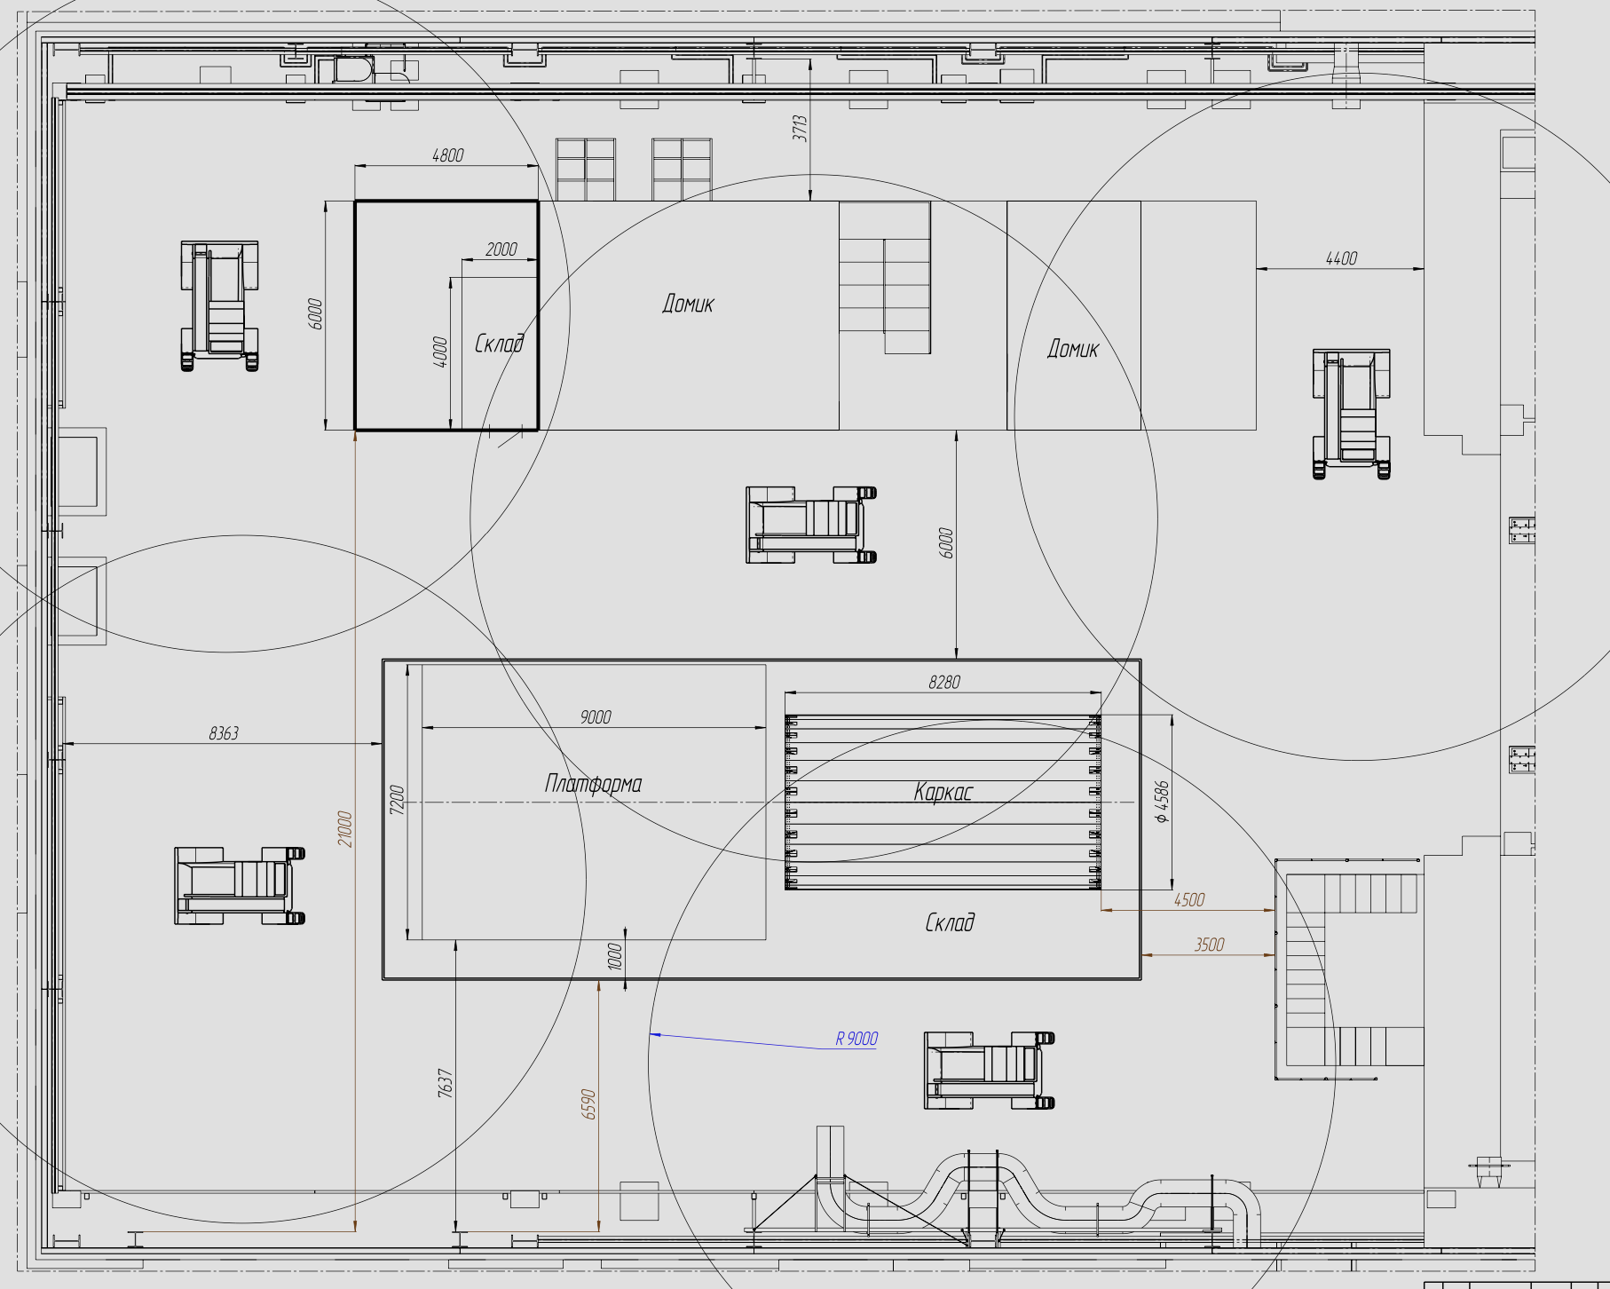
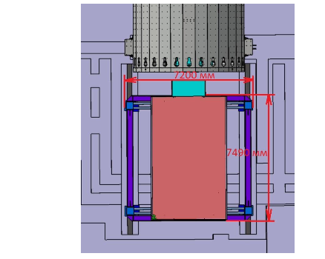
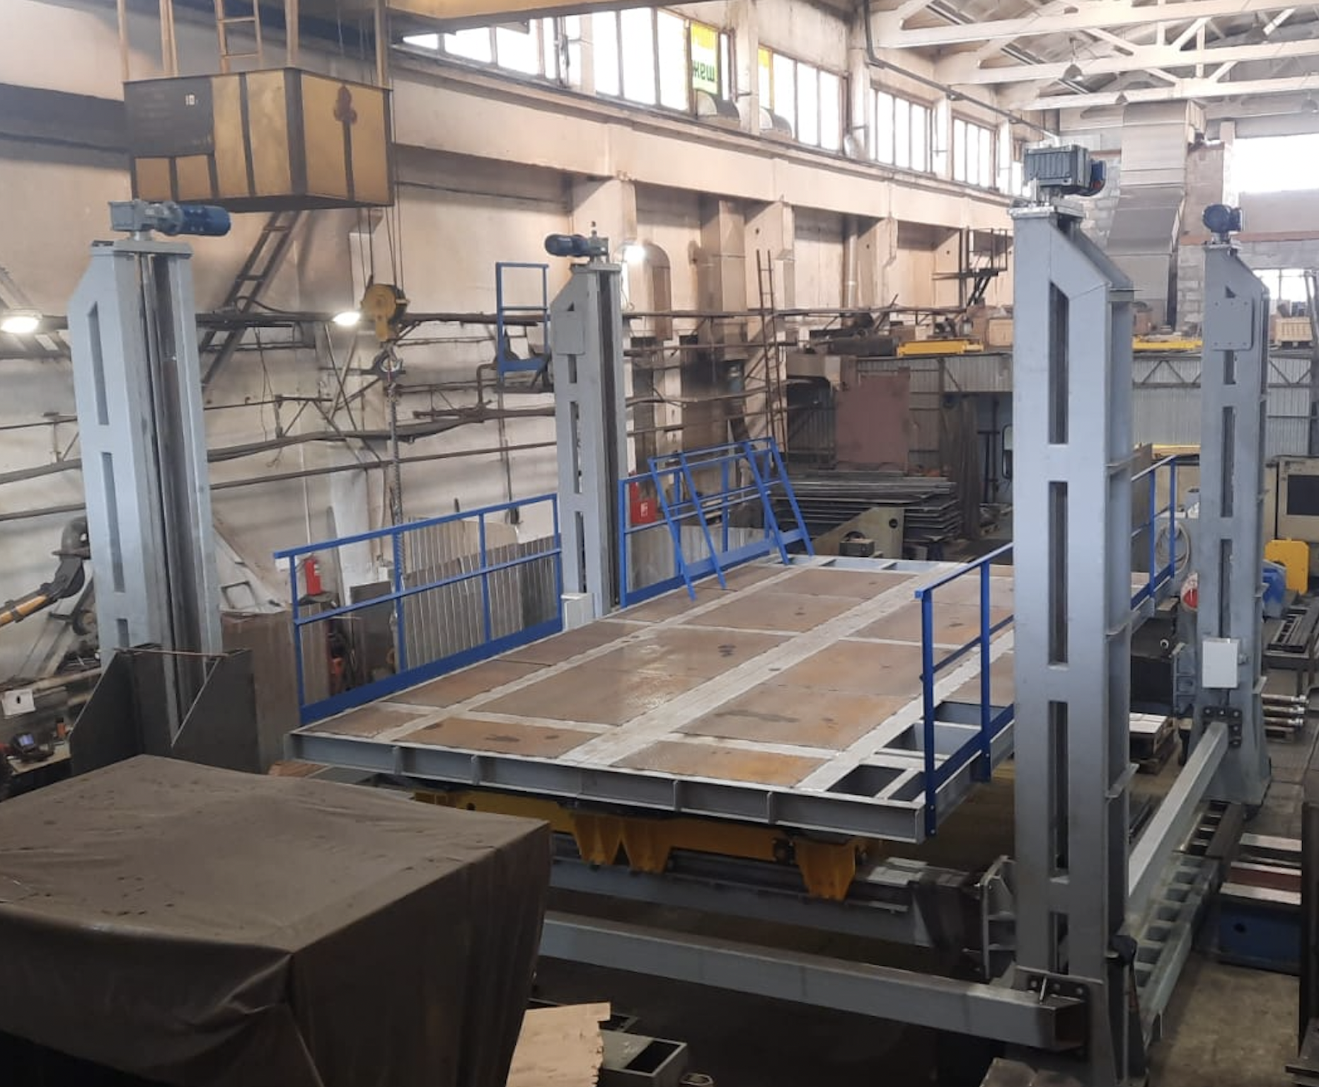
Testing of detectors installation procedure into Barrel
It is plan to do test before June 15 (leaving MPD Hall for the fire treatment of the roof constructions)
MPD Hall
MPD Control Room
MPD Pit
-319 cm
Lifting platform
Support frame

Slide 13
 | List of the activities towards preparation the MPD for running on the collider beams
1 | Subsystems of MPD: TPC , TOF, Ecal, FHCal and FFD, DAQ, Trigger | On the stage of production and tests
2 | Beam pipe | Prototyping showed that all technological operation are developed. Two Al working pipes are on the stage of production
3 | Support Frame for detectors fixation inside MPD | It is ready, waiting in the MPD hall for installation.
4 | Electronics Platform | In production, racks installation, cooling pipes mounting
5 | Cryogenics Infrastructure of the Solenoid. Gas&Liquid N₂ and He pipes, LHe, LN₂ tanks | Control systems of Solenoid and Refrigerator Good success have been achieved recently with these Control systems It looks like we can start Cooling process with Control systems
6 | Cooling systems for the FE electronics TPC and Ecal and thermostability of TPC | Problem with electronic components is solved. FEE cooling is in production, planned to be ready in November 2023, Cooling through External thermostabilizing panels of TPC body are expected Sept. 2024
7 | Equipment for detectors integration The lifting platforms Equipment for Ecal, TOF, TPC installation Platforms for FHCal fixation in the poles Equipment for beampipe installation | The first lifting platform comes to JINR in the end of April this year TOF device is ready, others in production Documentation is ready, some parts in production In production
8 | Colling water lines for Solenoid power supplies, Correction coils, Platform Cooling system and Detector’s cooling system | Pipes of all four lines of the Central system are mounted in the MPD Hall. Difficulties with the purchasing of electrical equipment of Central Cooler and purification of water. In December we will need cooled and filtered water to provide working conditions for Power supplies of Solenoid and Correction coils

Slide 14
Milestones of MPD assembling in 2020-2025
 | Year 2021
6 | July-Aug | Solenoid installation into Iron Yoke and alignment
7 | Aug - Dec | Electrical, pressure tests and vacuum tests
 | Year 2022
8 | Jan 20 - April 30 | Cables for Solenoid probes signals installation
9 | May 16 - Dec 25th | Assembling Iron yoke, Cryogenic platform and Cryostat. New LHe and LN pipes ordering
10 | Sept - Dec 30 | Cryogenic infrastructure for cooling down by temporary scheme, power Supply and Control system preparation
11 | Oct – February 15th , 2023 | Preparation power supply and Solenoid Control systems
 | Year 2023
12 | Jan 15 - April 15th | Preparation for Vacuum test of Solenoid with Cryostat
13 | April 20 May 15th | Vacuum tests
14 | May 15 - June 15th | Solenoid cooling down to Liquid Nitrogen temperature (-80K)
15 | June 15 – September 15 | Activities in the MPD Hall stopped
16 | October – December | Cooling down to the Liquid He temperature (-4K)
 | Year 2024
17 | January. - February 15 | Supplying the current to the solenoid and Correction coils
15 | March - May 15 | Magnetic Field measurements
15 | June 1 - June 10 | Support Frame installation
16 | June 20 – August 30th | Installation ECal sectors, Moving Platforms mounting
17 | Sept 1 – September 30th | Installation TOF modules, FHCal into poles
18 | Oct 1st - Nov 30 | TPC installation
19 | Sept 18 - Nov 30 | Cabling
20 | Dec 4 - Dec 25 | Installation of beam pipe
 | Year 2025
21 | Jan 10 - Feb | Move the MPD on Collider beam line, Commissioning

Slide 15
Thank you

