Slide 1


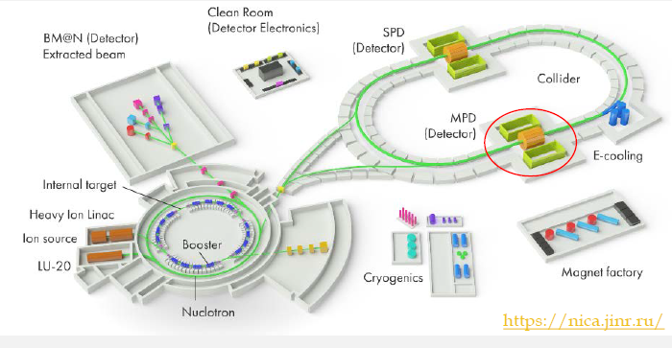
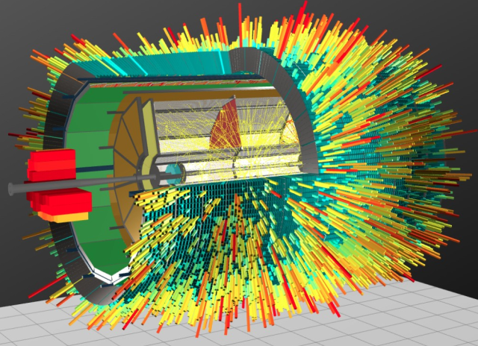
MPD TPC Status (18.04.2023)
  TPC:
    vessel assembly, ROC chambers, gating grid system
  Sub-systems:
    Electronics
    LV+HV system (CAEN)
    Gas and cooling systems
    Laser calibration
  Integration TPC to MPD
    Electronics platform
    Cabling and piping
    Installation TPC to MPD
  Time schedule
Presented by S.Movchan

Slide 2
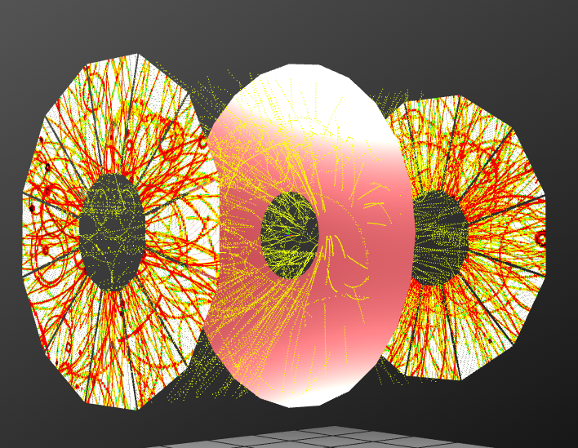
MPD TPC main parameters
Item | Dimension
Length of the TPC | 340cm
Outer radius of vessel | 140cm
Inner radius of vessel | 27 cm
Outer radius of the drift volume | 133cm
Inner radius of the drift volume | 34cm
Length of the drift volume | 170cm (of each half)
HV electrode | Membrane at the center of the TPC
Electric field strength | ~140V/cm;
Magnetic field strength | 0.5 Tesla
Drift gas | 90% Ar+10% Methane, Atmospheric pres. + 2 mbar
Gas amplification factor | ~ 10⁴
Drift velocity | 5.45 cm/µs;
Drift time | < 30µs;
Temperature stability | < 0.5°C
Number of readout chambers | 24 (12 per each end-plate)
Segmentation in φ | 30°
Pad size | 5x12mm² and 5x18mm²
Number of pads | 95232
Pad raw numbers | 53
Pad numbers after zero suppression | < 10%
Maximal event rate | < 7 kHz ( Lum. 10²⁷ )
Electronics shaping time | ~180 ns (FWHM)
Signal-to-noise ratio | 30:1
Signal dynamical range | 10 bits
Sampling rate | 10 MHz
Sampling depth | 310 time buckets

Slide 3
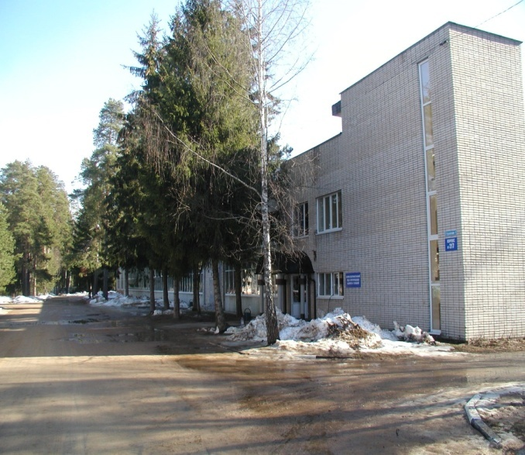
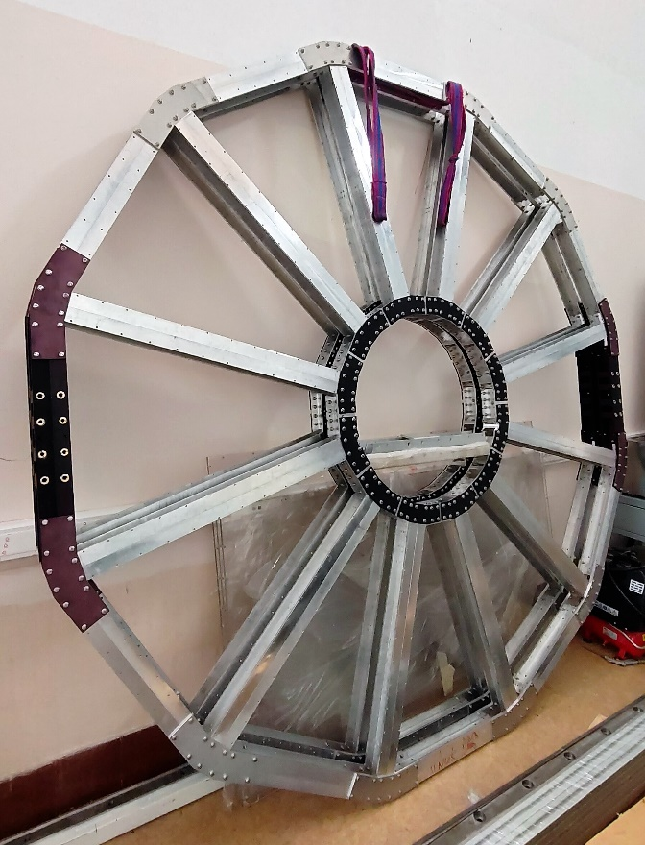
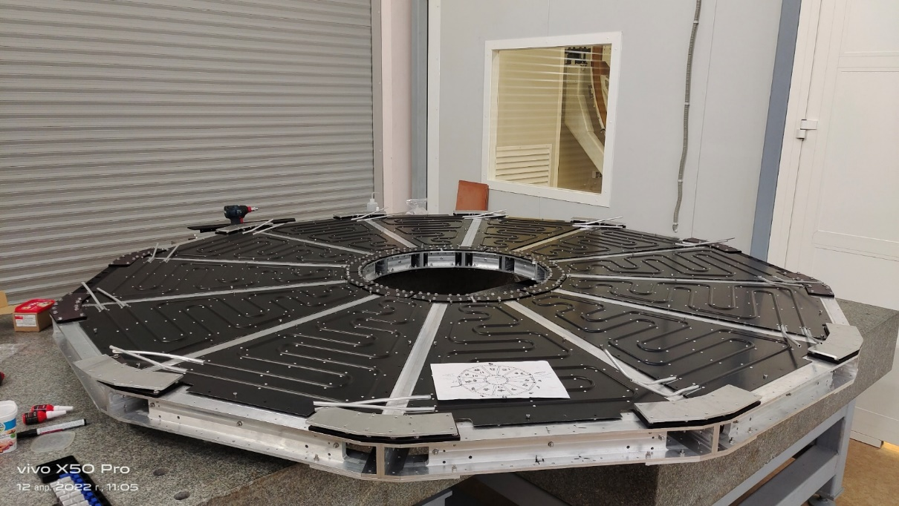
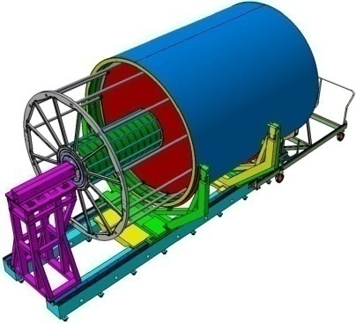
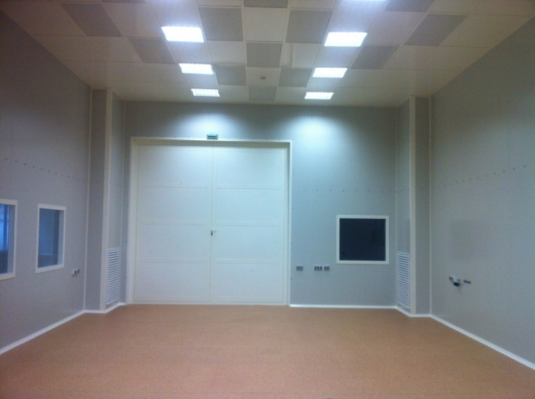
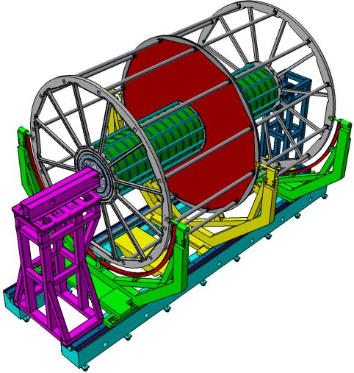
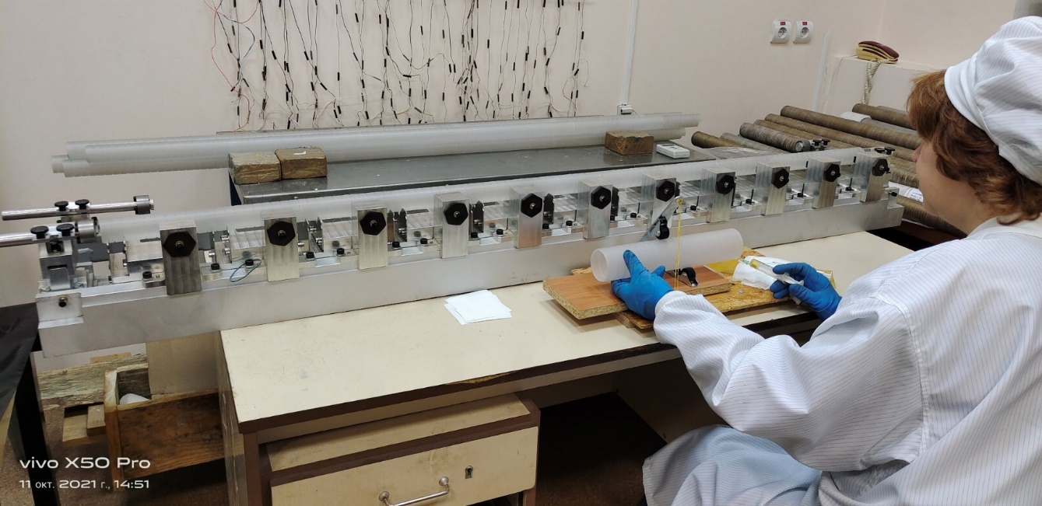
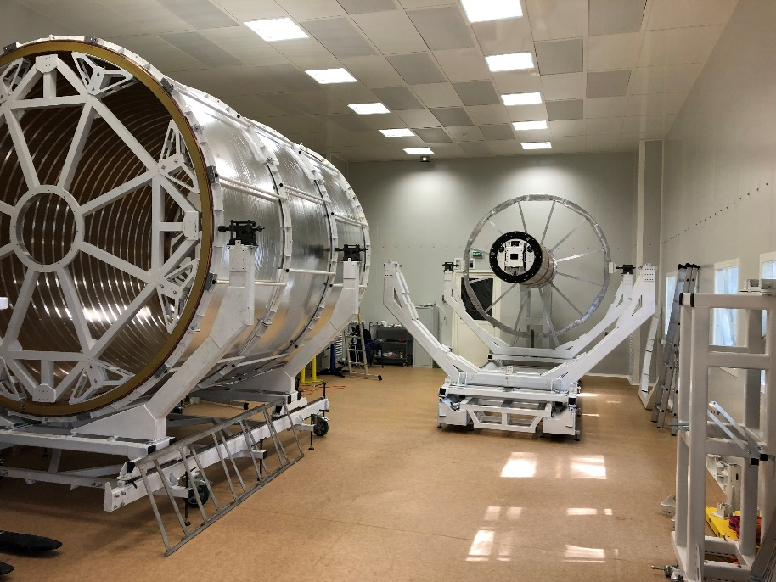
TPC vessel assembly
Bld. 217
Service wheel with thermal panels (12pc)
Both service wheels - assembled
ISO-6
  C1-C2 and C3-C4 cylinder – assembled
  TPC service wheels (2pc) - assembled
  HV membrane – tested
  TPC field cage assembly - July 2023
  TPC vessel ready – August 2023
Rods D=40 mm (24 pc) reassembled - ready
Rods D=60 mm (24 pc) – assembling in progress, ready - June 2023
TPC vessel assembly – in progress (see next slide)

Slide 4
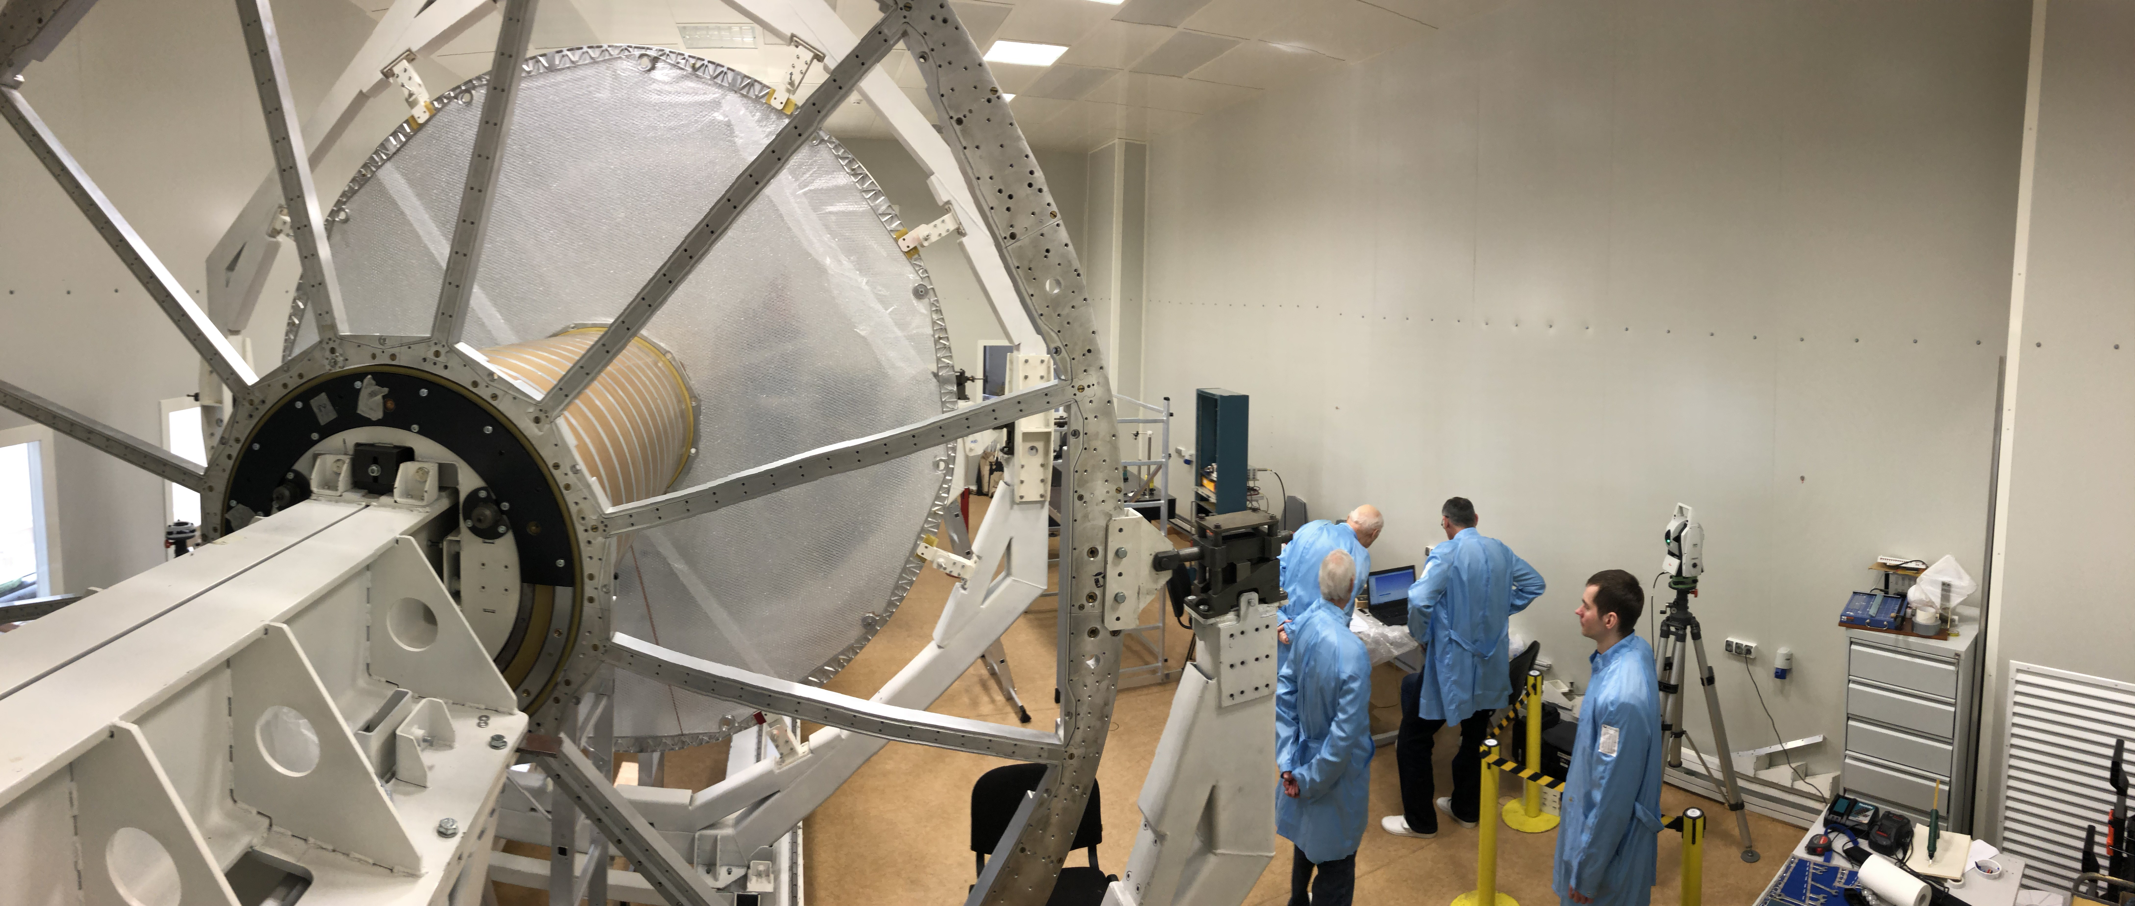
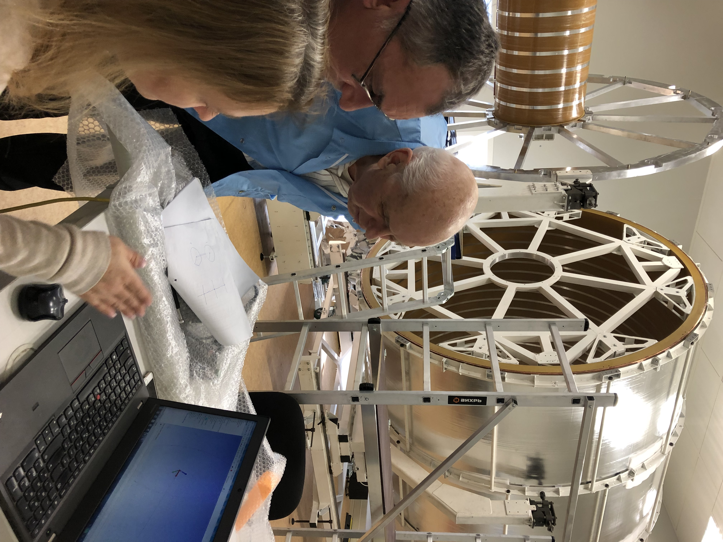
TPC vessel assembling
TPC body assembled with test rods for check TPC geometry by laser tracker
AT-402 (reflector type -TBR (R=6.35 mm), reflector center offset L== 12.00 mm):
2 flanges, HV electrode and C1-C2 cylinder - misalignment is about 1 mm
Goal – improve misalignment by factor х2

Slide 5
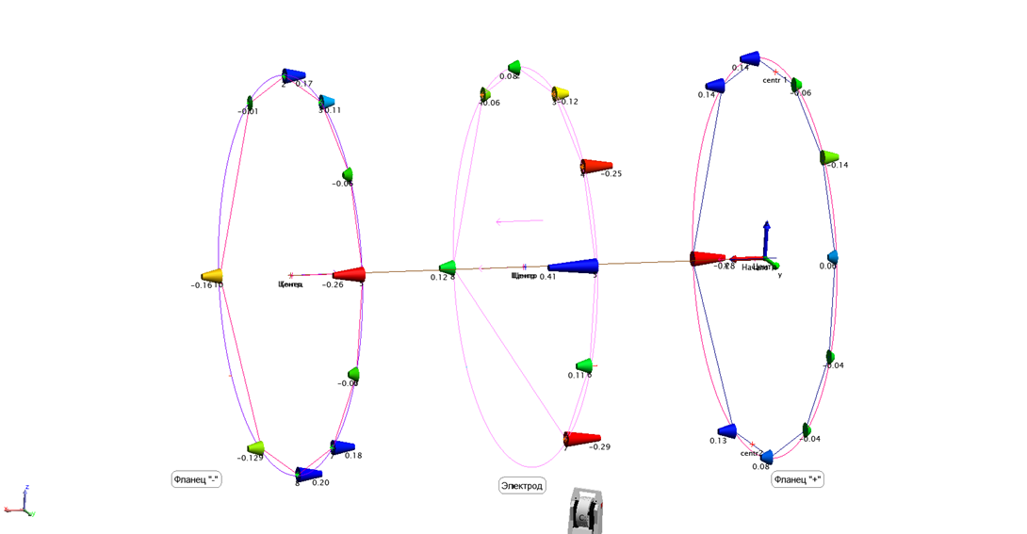
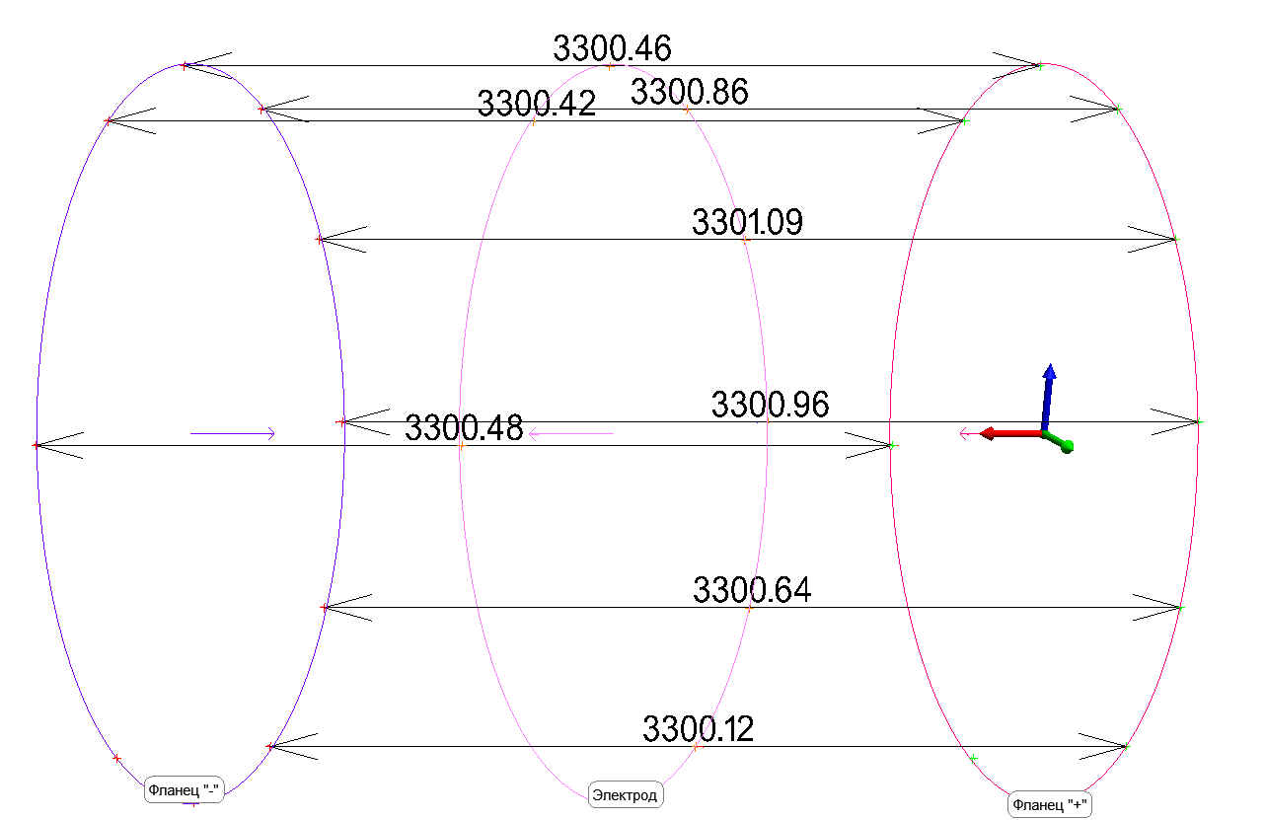
TPC vessel assembling
Flanges and HV electrode unflatness
Flange to flange distance
Flanges unflatness – about 0.5 mm
HV electrode unflatness – about 0.7 mm
L=(3300.5 +/-0.5) mm
(nominal – 3300.0 mm)

Slide 6
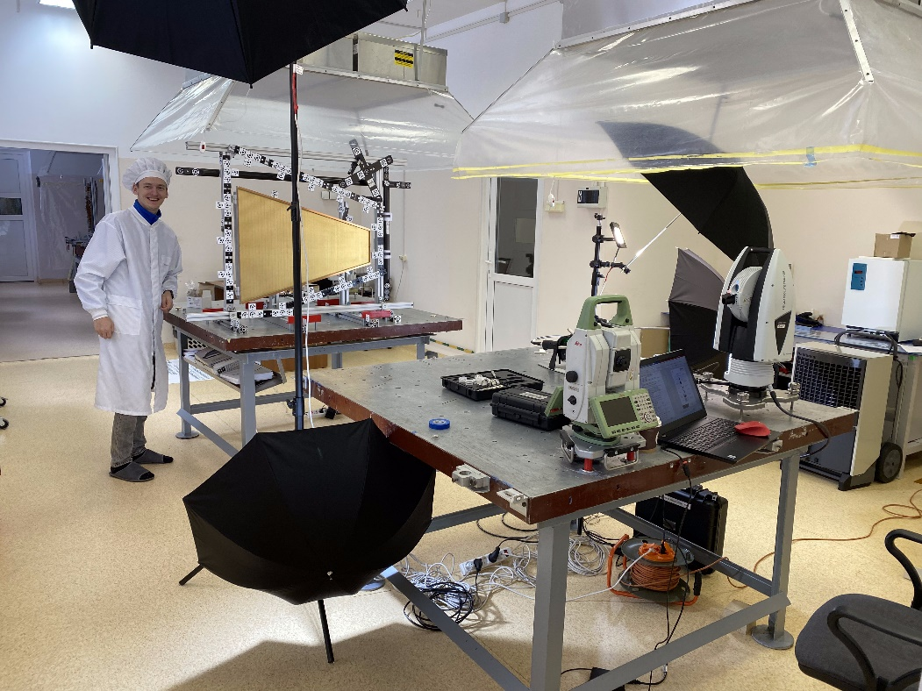
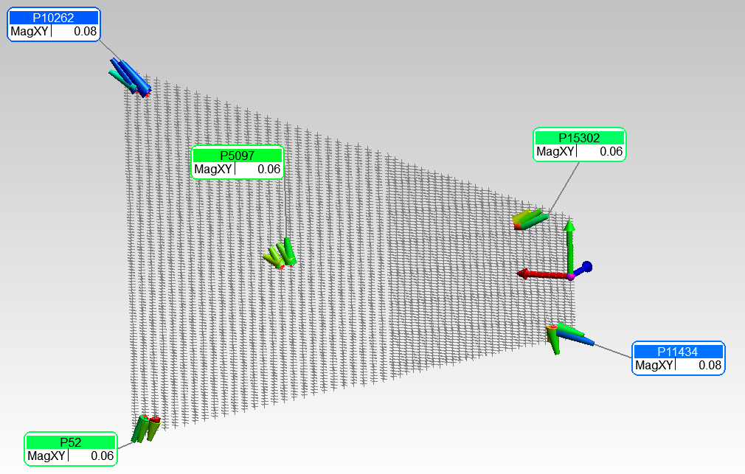
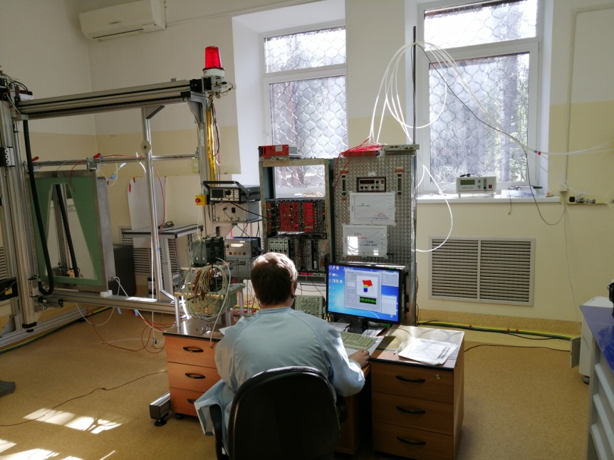
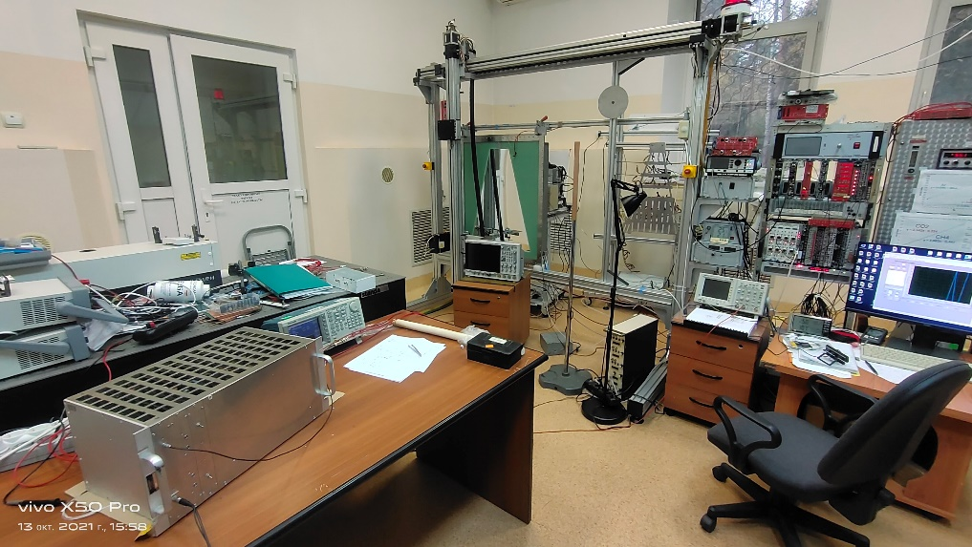
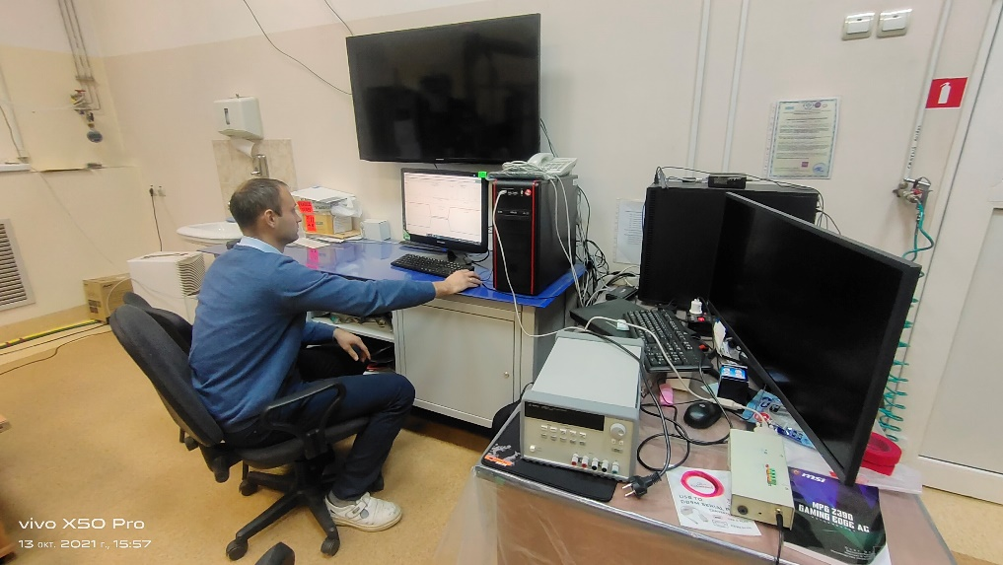
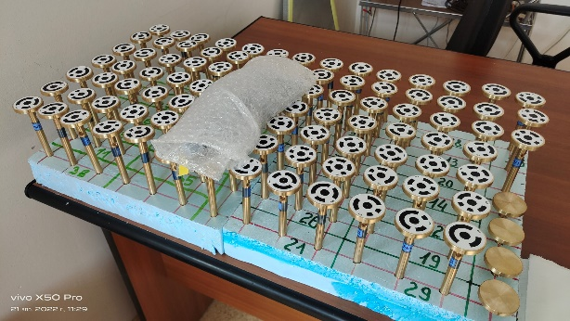
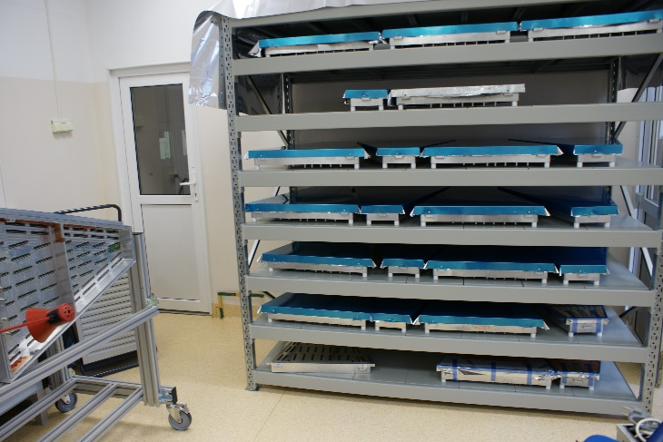
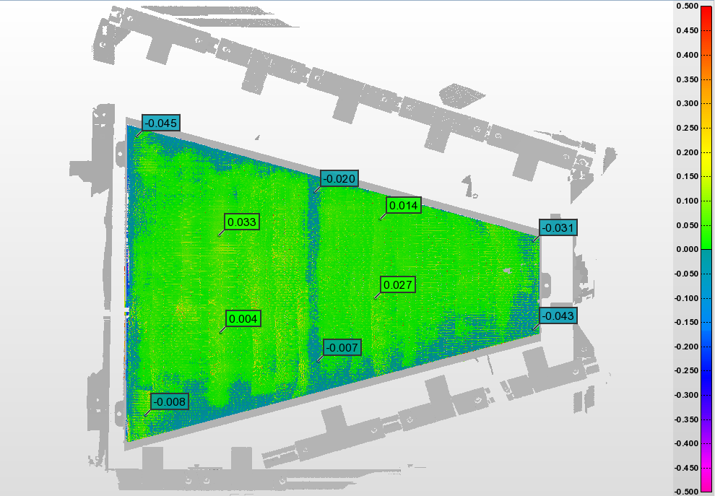
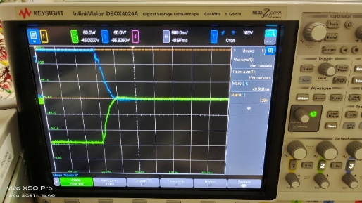
ROC chambers and gating grid system (GGS): status
Test set up for pads calibration
Check pads geometry
Test set up for ROC certification
ROC gating grid system: test set up
systematic - up to 150 mkm
Leica MS60 - 1 second resolution
Leica AT960 +/-10 mkm +5 mkm/m
Leica AT403 +/-15 mkm +6 mkm/m
Scanner AS1+AT960 +/-50 mkm
Full set of ROC alignment marks
24 pc ROCs – tested
Pad plane unflatness: example
Pulse rise time
- 500 ns, OK!
+/- 30 mkm
Summary:
- measurements to do for all ROCs
- calibration of ROC marks and
3968 pads respect to ROC
“reference hole” - in progress
24 pc serial ROCs + 4 spare – READY!
Mass-production – in progress
Delivery to JINR – Sept 2023

Slide 7
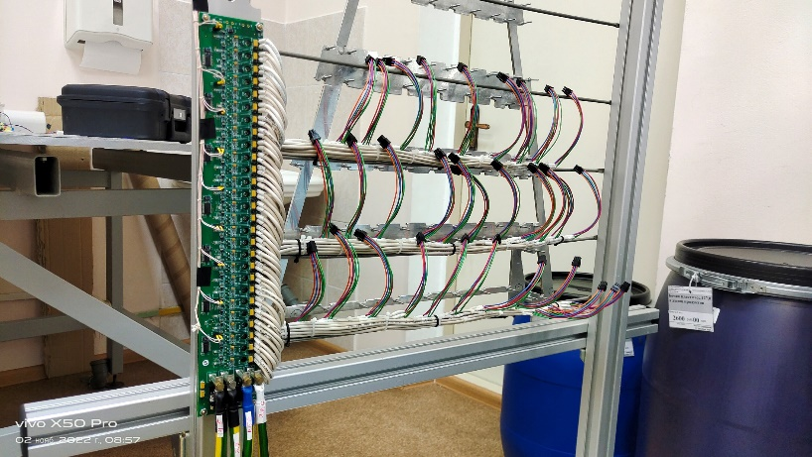
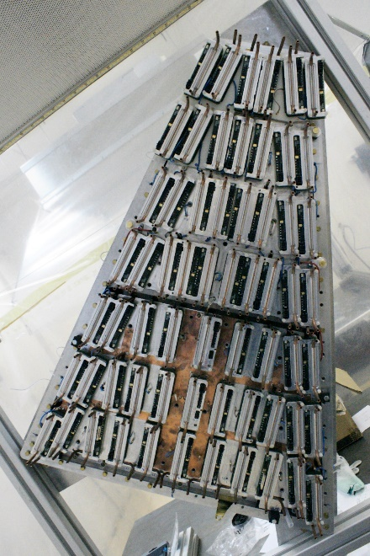
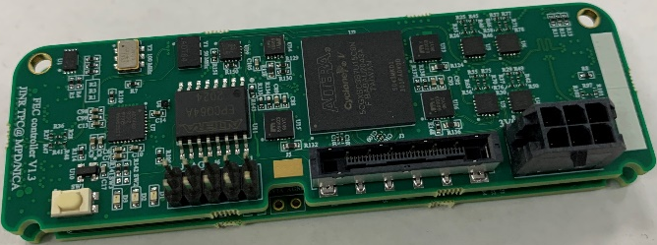
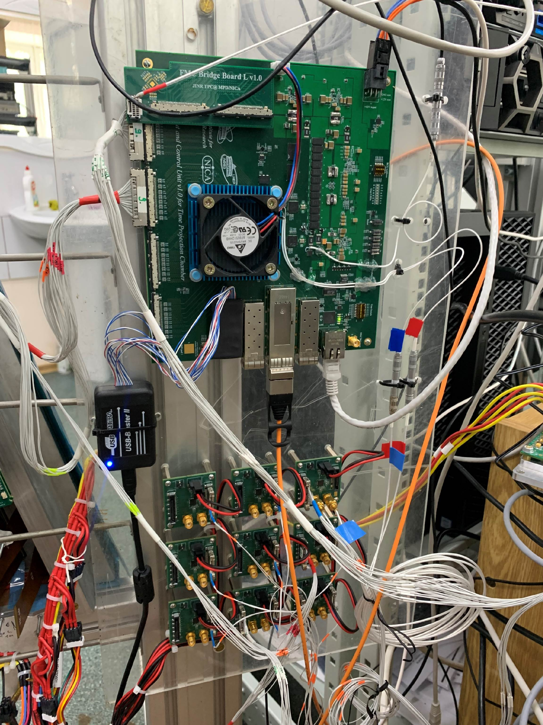
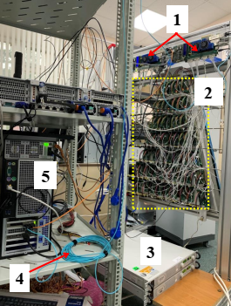
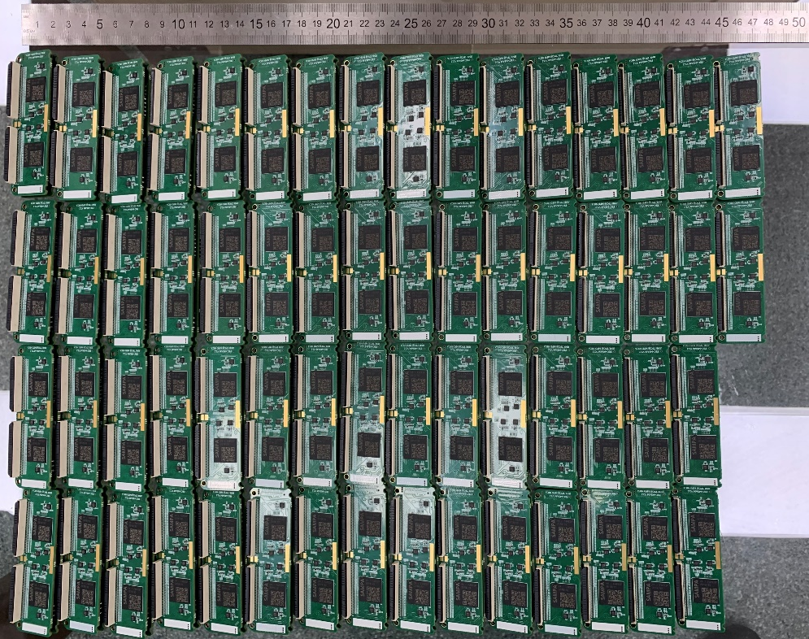
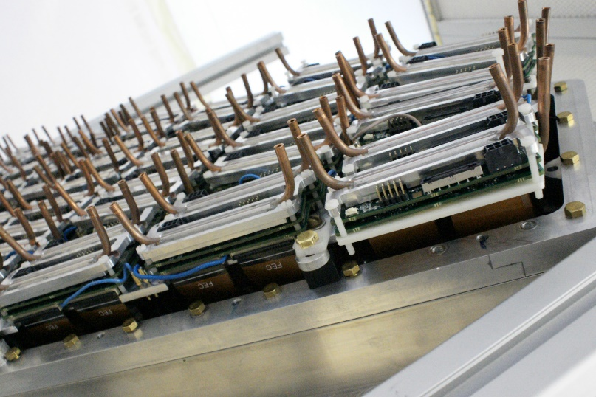
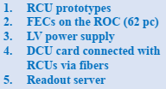
TPC Sub-systems: electronics
FE radiators (water cooling)
LVN9 stabilizer
Production version of the FE card:
DAQ prototype:
62 FE cards, RCU prototypes,
ROC, 2pc LVDBs, server interface
board - tests ongoing
RCU-64 controller:
testing with FEE
60 pc LVN9 were send back to Minsk:
- modification connection of power cables to LVN9 - in progress
- modification of LVN9 output voltages to FECs - in progress
- test of LVN9 with cooling radiator under full load (analog – 70 A, digital – 50 A) – in progress
N=967 pc
(65%)
967 FECs of 1500 were produced.
Tests of the FEC basic functionality were shown the target characteristics (noise and stability).
Testing of the readout system for one ROC is ongoing.
15 ROCs chambers can be completed
(from 24 ROCs)

Slide 8
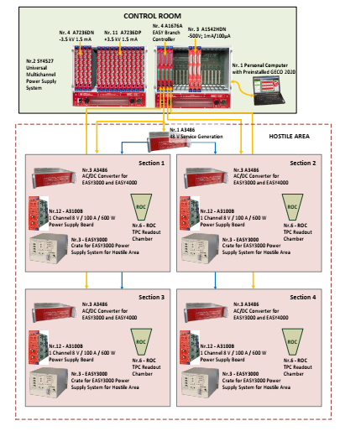
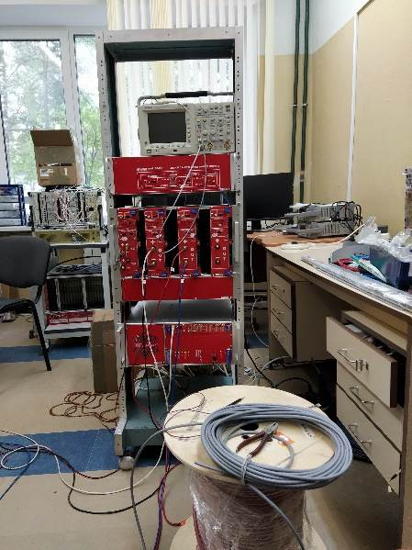
TPC Sub-systems: LV+HV (CAEN)
LV&HV system based on CAEN rad. hard design:
(up to 2000 Gauss and 15 kRad)
- power converters A3486 AC/DC (380 V -> 48 V) – 15+3 pc
- EASY3000 crates - 14+2 pc
- LV module - A3100B (8V/100A) - 48+8 pc
- LV module - A3100HBP (14V/50A) - 6 +2 pc
- HV modules –A3540P (+4kV/1mA) - 8+3 pc
- HV modules –A3540N (- 4kV/1mA) - 2+2 pc
Status:
LV+HV system: JINR-CAEN contract signed
Expected delivery date to JINR: August 2023
test system – tests ongoing
LV cables (halogen free, low smoke):
S=50 mm2 – delivered
HV cables - ordered

Slide 9
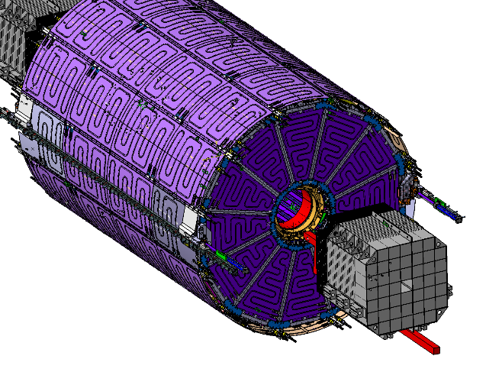
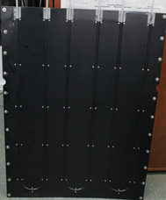
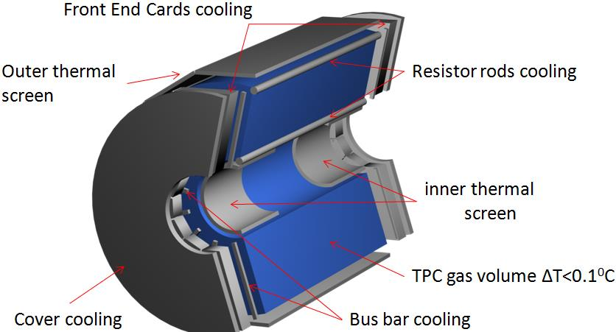
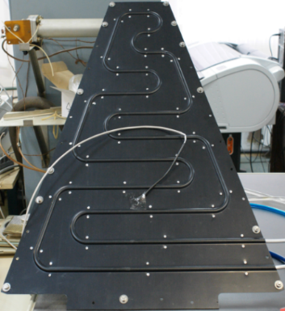
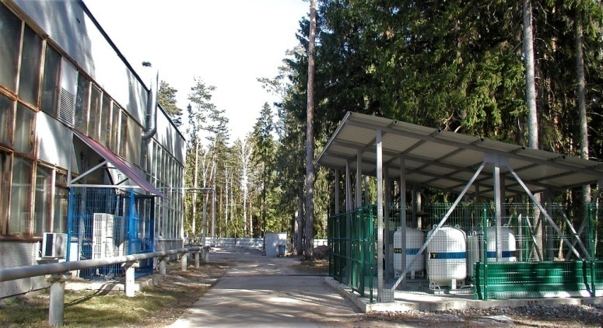
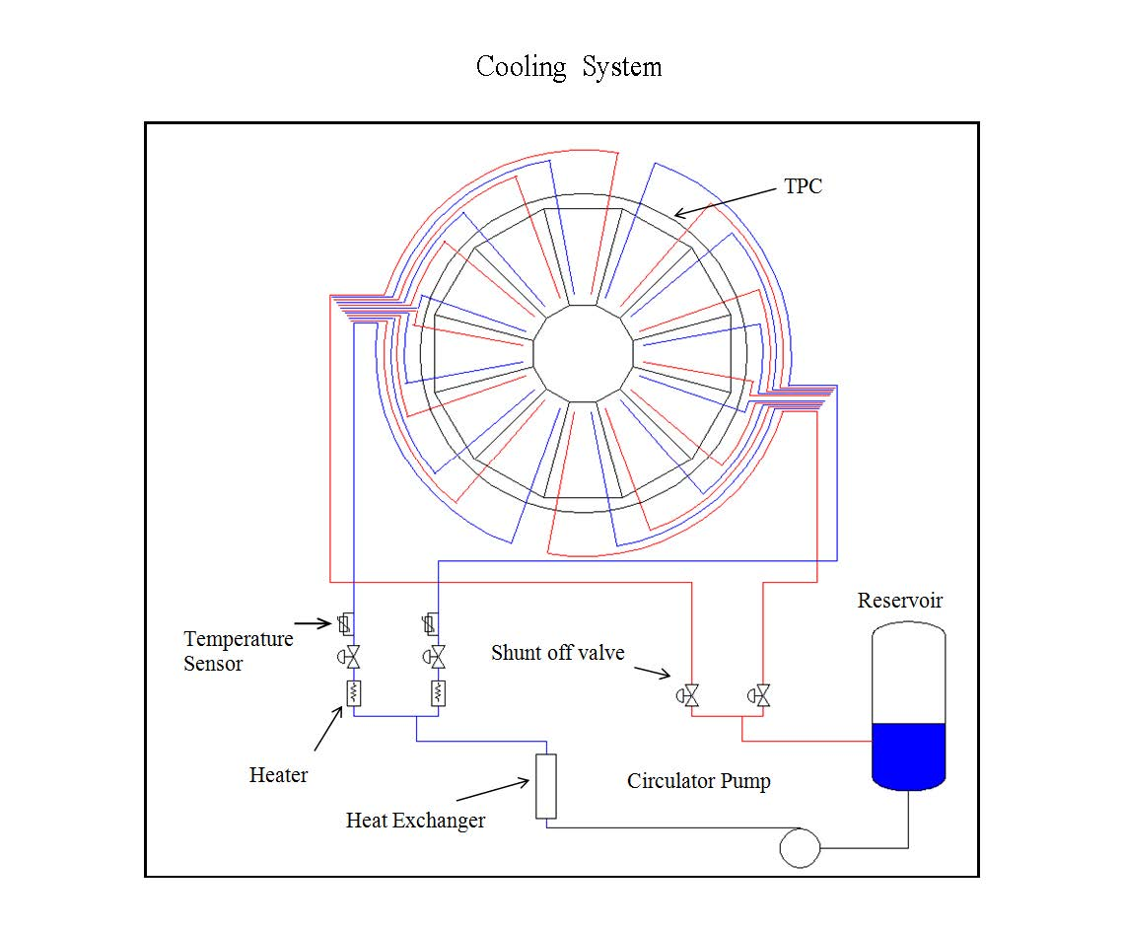
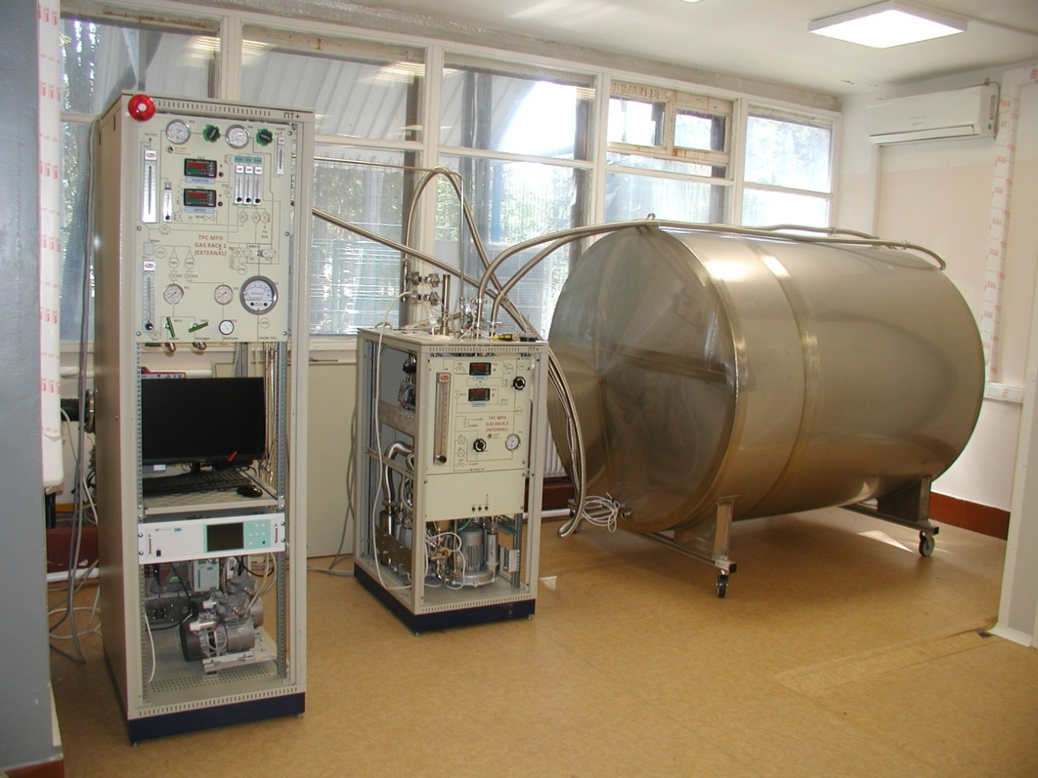
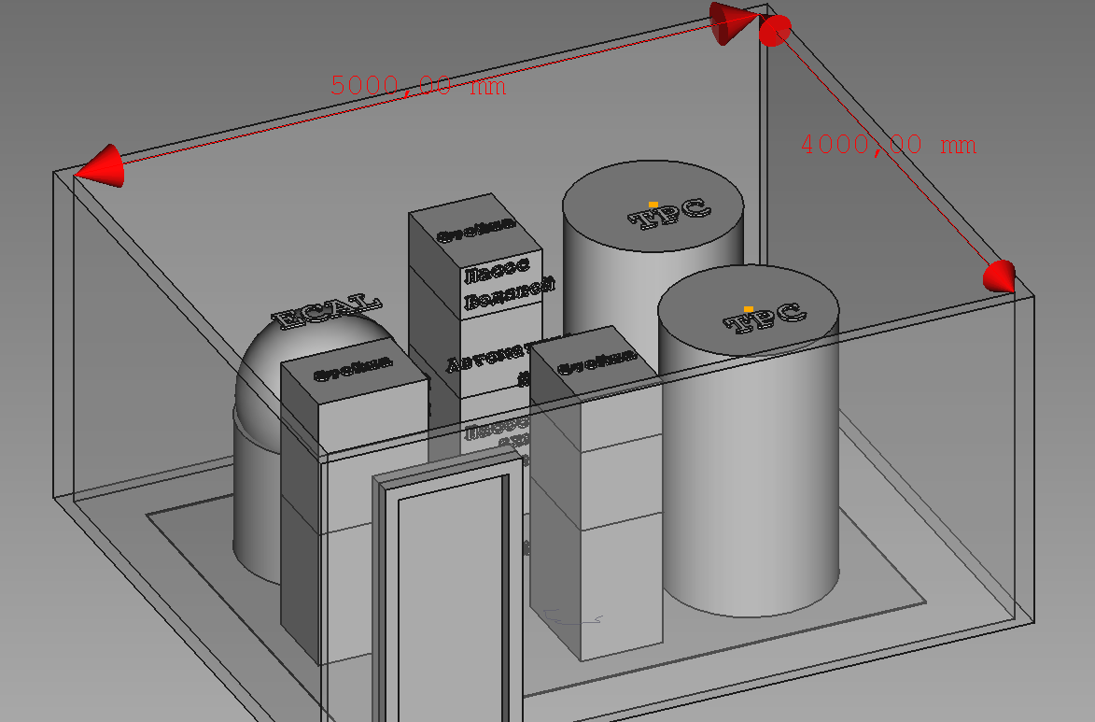
TPC Sub-systems: gas and cooling
Full set of panels – delivered
Gas system (Ar/CH4, 90:10)
Water cooling system
Gas supply
MPD hall
Racks
TPC volume
imitator
S=1.2x3.6 m2
h=2.2 m
MPD
contract JINR-INP BSU (Minsk) – in progress
delivery – 30 September 2023
operation under manual control – during beam test 2024
fully automatic control – 30 September 2024
Tests - in progress
(H20 and Q2 sensors are replaced)
S=4x5 m2
h=2.5 m
S.Movchan TPC assembling, XI collab. meeting, April 18-20 2023, Dubna, Russia

Slide 10
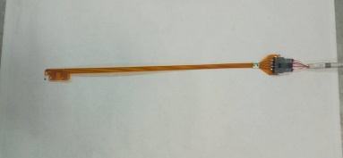
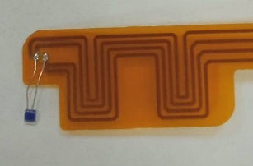
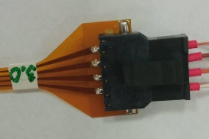
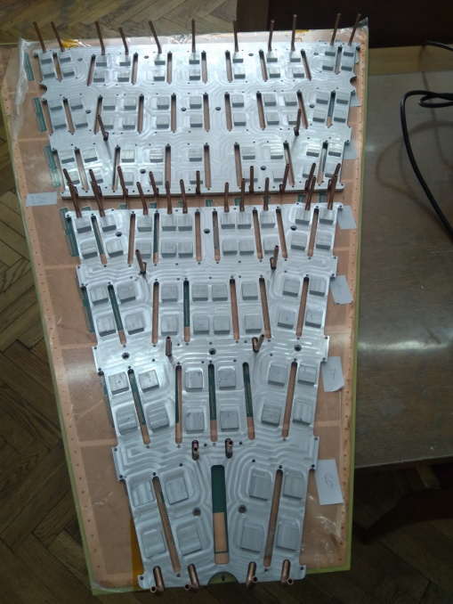
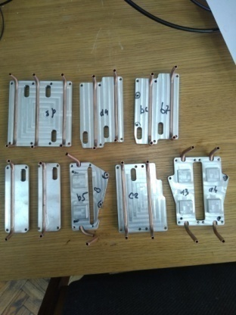
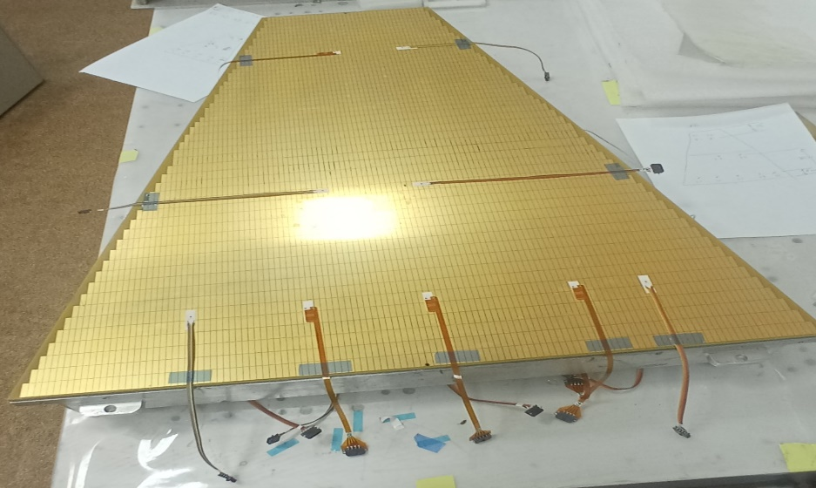
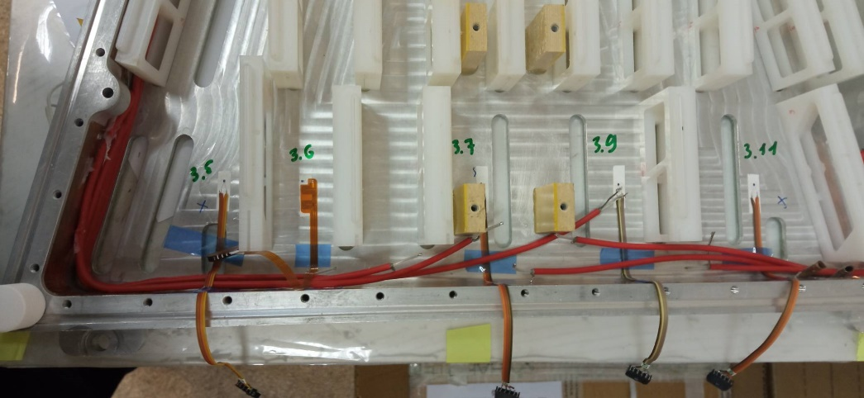
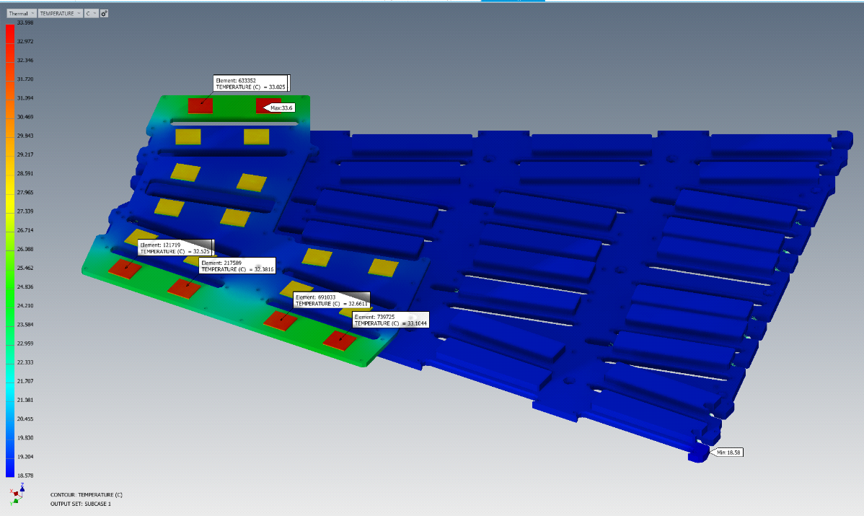


Cooling prototype
Bottom cooling plates
Set of top cooling plates
T sensor based on Pt100
7 sensors
7 sensors
Cu tube Din - 3.16 mm
Plates thickness - (4+4) мм
Cooling simulation (Autodesk inventor Nastran)
Electronics water:
T=19 C
ROC water: T=22 C
Air: T=23 C
Experimental and simulation
results are compatible

Slide 11






Cooling prototype: results
Set up
ROC + pad sensors
FE card sensors
LV power
Air: T=23 degree (C)
Water FECs T (C) | Water ROC T(C) | SAMPAs dT (C) | FPGAs dT (C) | Pads dT (C) | ROC dT (C) | T Min (C) | T Max (C) | Comments
17 | 25 | 3÷5 | 7 | 0.27 | 0.6 | 18 | 33
19 | 22 | 3÷5 | 7 | < 0.2 | 0.2 | 20 | 35 | optimum
Chiller

Slide 12






Serial Cooling system (INP BSU, Minsk): STATUS
Hydrodynamic pressure drop
for ROC chambers
NEW cooling system position –> 2-nd floor of a
additional platform – design and optimization in progress
dP ≤ 0.5 atm
Systems parameters optimization by
calculations – in progress
Water velocity: (1.5-2.5) m/s

Slide 13

Serial Cooling system: optimization
in progress …

Slide 14



Serial Cooling system: stAtus
in progress …

Slide 15








TPC Sub-systems: laser calibration
Scheme for ½ TPC
TPC
laser
laser
Laser “planes” - 4
Micro-mirrors bundles per plane - 4
Beams from micro-mirrors bundle - 7
Laser “tracks” (N =112х2) - 224
Laser beam splitter
Laser beam monitor
micro-mirror
bundles

Slide 16


NICA-MPD-Platform (NMP)
Common view
TPC equipment
TPC + ECAL
cooling
Design and integration –
in progress …

Slide 17

MPD electronic platform
TPC equipment in racks on the 4th floor
16

Slide 18


TPC cabling and piping
W side: cooling and gas pipes scheme
TPC list of cables and pipes

Slide 19


TPC cabling and piping
Structures for
cables and pipes
fixation
Prototype for cabling and piping
Integration …
TPC
Beam pipe
TPC+TOF+ECAL cabling – in progress
Piping – not started yet
Structure design - in progress

Slide 20







Tooling for Installation TPC to MPD
Bld. 217
Bld. 217 (MPD)
24 tons,
max=0.41 mm
Design under optimization,
Prototype 1:5 – June 2023
4 units for adjustment X, Y, Z
Tooling manufacture –
July 2023-Feb 2024
Delivery to JINR –
Spring 2024

Slide 21

Planning (draft)
in progress …

Slide 22
Time schedule
Status:
TPC assembling:
  Field cage assembly - July 2023
  HV tests - August 10 2023
  TPC vessel ready (glue by epoxy) - August 30 2023
  Laser beams position measurements - Sept 2023
  TPC vessel tightness measurements - Oct 2023
  24 ROC chambers installation - Nov-Dec 2023
  TPC tests: laser tracks and cosmic test - Jan-Sept 2024
  Integration TPC to MPD:
  TPC racks (8pc) + cabling - autumn 2023-2024
  TPC rails (2pc manufacture and delivery) - Oct 30 2023 on critical path !!!
  Rails installation to ECAL support structure - Nov 2023
  Tooling for installation TPC to MPD:
  Design optimization + prototype 1:5 - June 2023
  Tooling manufacture - July 2023 – Feb 2024 (8 month)
  Delivery to JINR - Spring 2024
  TPC+ECAL cooling systems: FE cooling - Nov 2023
  commissioning - Sept 30 2024
  TPC installation to MPD - Oct 1-Nov 30 2024
  MPD commissioning - Jan 10 - Feb 2025
Thank you !

