Slide 1
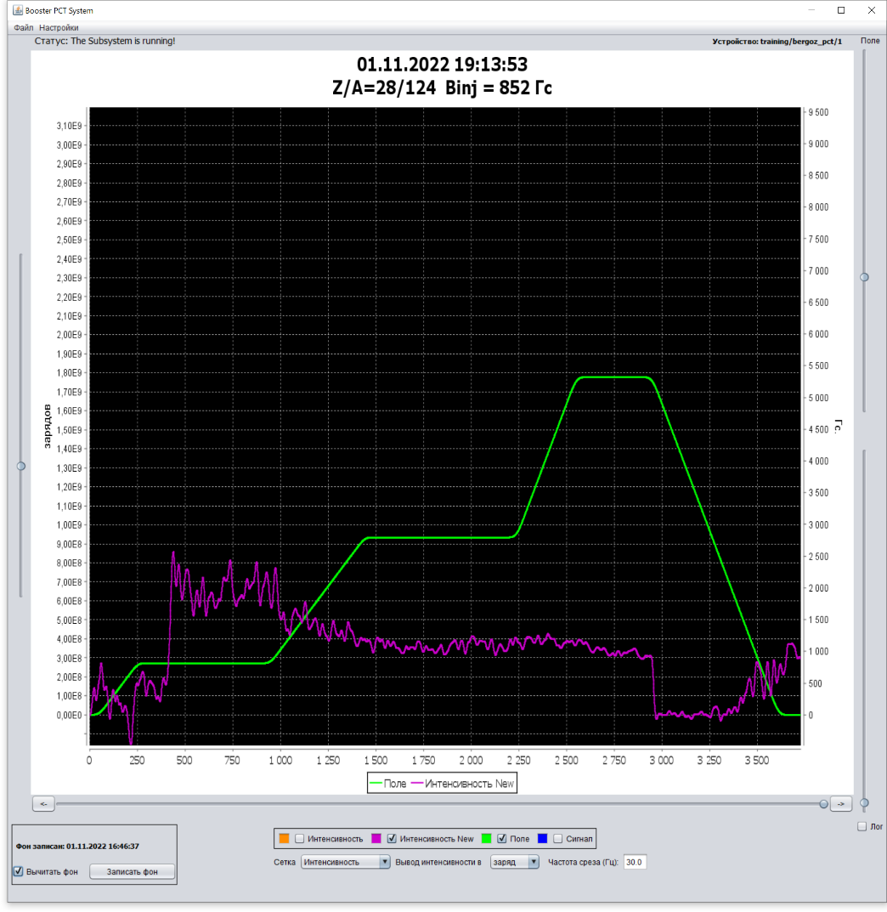
Construction and commissioning
of the NICA complex
A.Sidorin, on behalf of the AD
X Collaboration Meeting of the MPD Experiment at the NICA Facility
JINR, Dubna, April 18-20, 2023

Slide 2
Contents
Stages of the accelerator complex commissioning
Plans of the collider commissioning

Slide 3
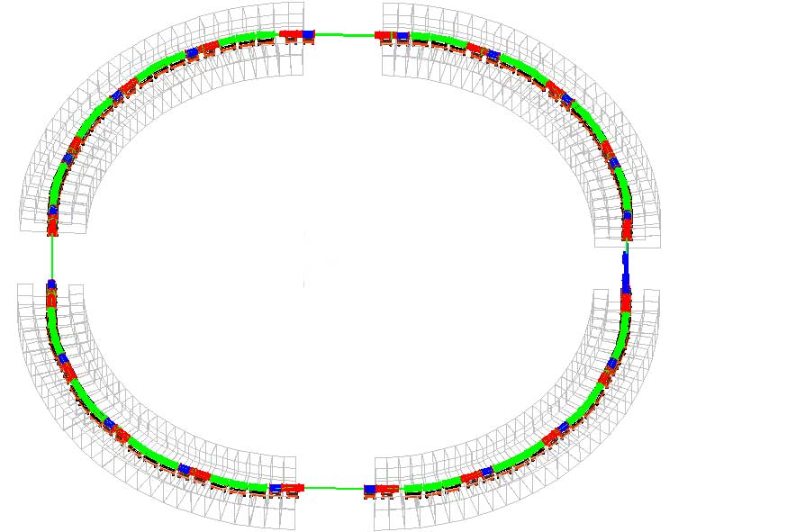
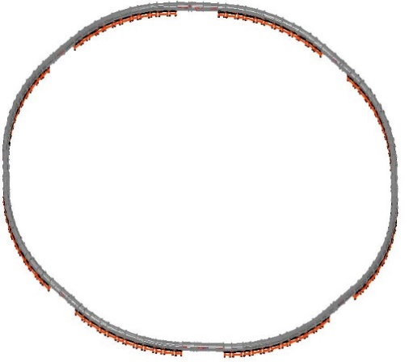
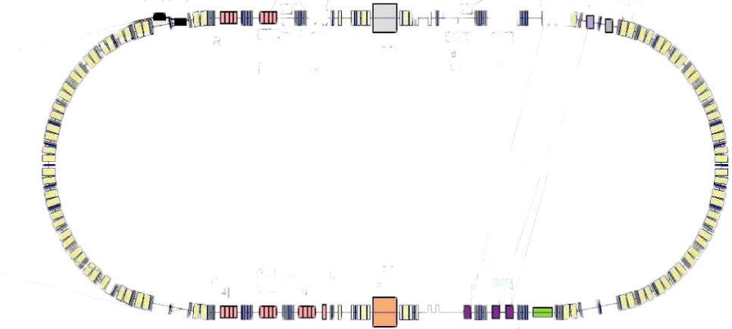
NICA accelerator complex
Linac HILac (3.2MeV/u)
ESIS KRION
Booster (25 Tm)
1(2-3) single-turn injection,
storage of 2 ×10⁹ ions,
acceleration up to 65 MeV/u,
electron cooling, acceleration
up to 587 MeV/u
Linac LU-20 (5MeV/u)
Ion sources
Fixed Target Area
Stripping (80%) ¹⁹⁷Au³¹⁺ => ¹⁹⁷Au⁷⁹⁺
Nuclotron (38.5 Tm)
injection of one bunch
of ≤ 1×10⁹ ions,
acceleration up to
1 - 3.85 GeV/u
Two SC rings of the collider
NICA – Stage II
L ≥ 10²⁷ см⁻²с⁻¹
~ 2 x 22 injection cycles
22 bunches per ring
Heavy ions: ESIS + HILac + Booster + Nuclotron

Slide 4
Stages of the accelerator complex commissioning
HILAC + transfer line to Booster
HILAC + Booster
HILAC + Booster + transfer line to Nuclotron
HILAC + Booster + Nuclotron + transfer line to BM@N
ESIS + HILAC + Booster + modified Nuclotron + transfer line to BM@N

Slide 5
ESIS + HILAC + Booster +
modified Nuclotron + transfer line to BM@N
ESIS Krion-6T installed and tuned at HILAC
- Nuclotron structure was modified for installation of fast extraction
Forth commissioning run:
from 20.09.2022 to 03.02.2023 Ar, Xe ions
Acceleration of Ar ions in the Booster, test of SOCHI
Tuning of Xe acceleration

Slide 6
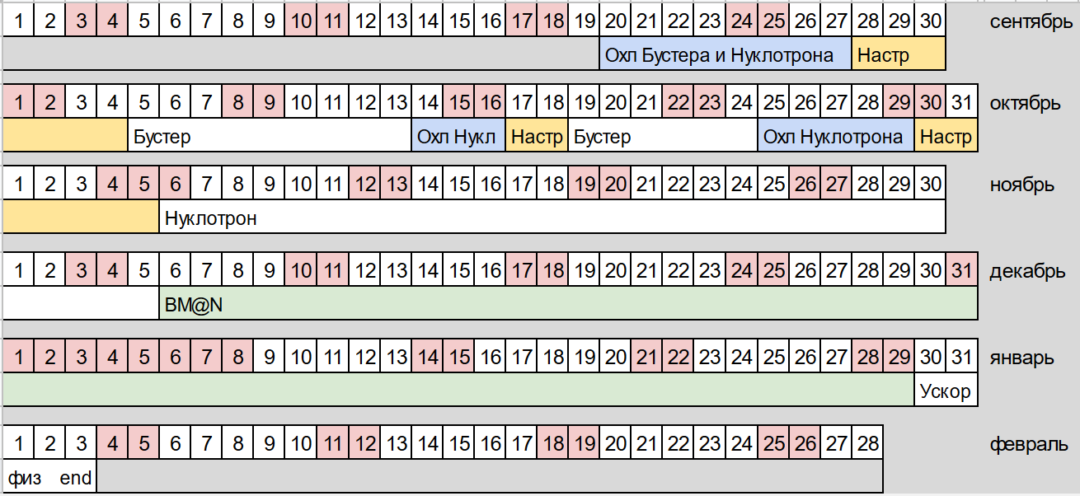
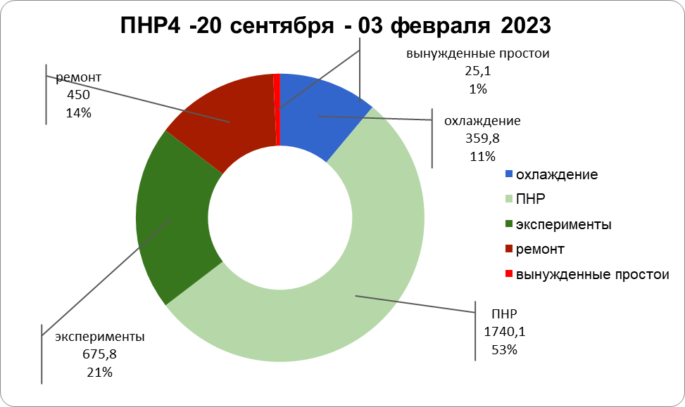
The timetable of the run (135.5 days)
Unexpected losses
repairment
cooling
Commissioning works
experiments

Slide 7
Beam acceleration and slow extraction
Intensity,
elementary charges
Field, Gs
Time, s
Beam acceleration in the Nuclotron up to 1.65 T magnetic field plateau (about 3.6GeV/u).
Intensity of the accelerated beam up to about 2⋅10⁷ ions.
Extracted beam spill duration up to 2 s (cycle period 12 s).

Slide 9
Plans of the collider commissioning
End of 2023 (may be beginning of 2024): technological run
Main limitations:
- completion of engineering infrastructure bld. 17
- Assembly of cryomagnetic system

Slide 10
Preliminary program of first technological collider run
- Insulating volume and beam pipe vacuum tests
Test of cryogenic system
Start of the collider control system
Test of the main power supply and cycle control system on equivalent load
Commissioning of thermometry system
Cooling of the rings
Commissioning of quench detection system
Commissioning of energy evacuation system
Test of the main power supply on superconducting load

Slide 11
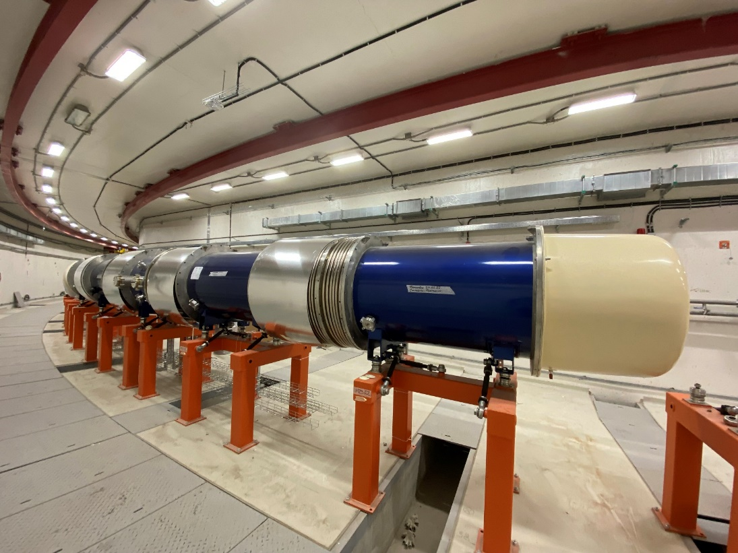
Status of the collider construction
A.Galimov
In June all the collider dipole magnets were installed
and mechanically adjusted in the collider tunnel, connected by pairs each to other.
The assembly of the collider is postponed until completion
of the engineering infrastructure mounting that is expected to the end of May 2023.
The collider ark dipole magnets in the tunnel

Slide 12
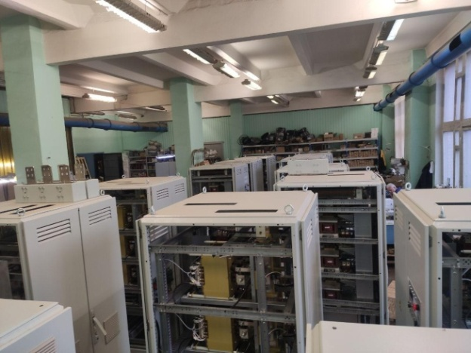
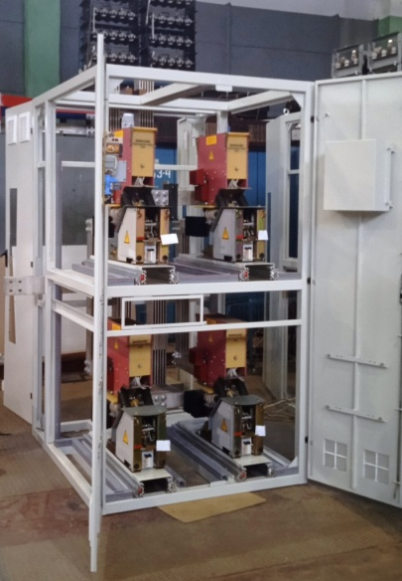
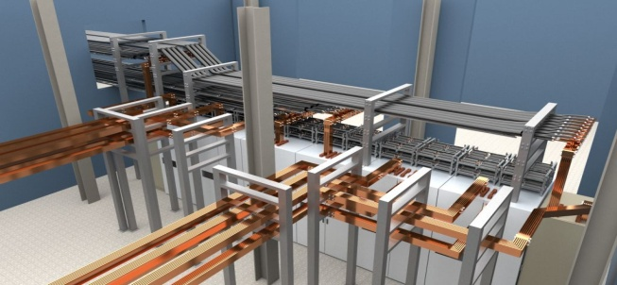
Collider power supply system
V.Karpinsky
Each collider ring has its own power supply system based on 3 main current sources:
PIT11-50, PIT01-40, PIT0.6-30.
2 sets of sources for both collider rings are manufactured by NPP "LM Inverter"
and transferred to VBLHEP.
12 electromechanical energy evacuation switches
are manufactured and located at VBLHEP
PIT 11-50 power supplies
Busbar model in rooms No. 240 and 109/1

Slide 13
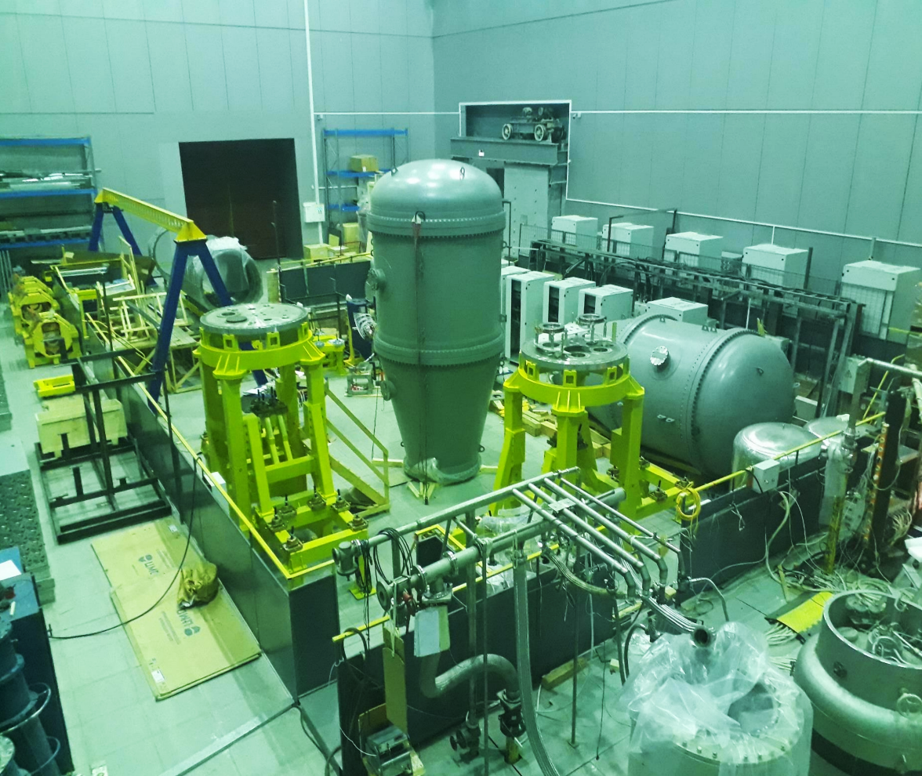
Electron cooling system
Test assembly of the collider electron cooling system was performed in October at Budker INP

Slide 14
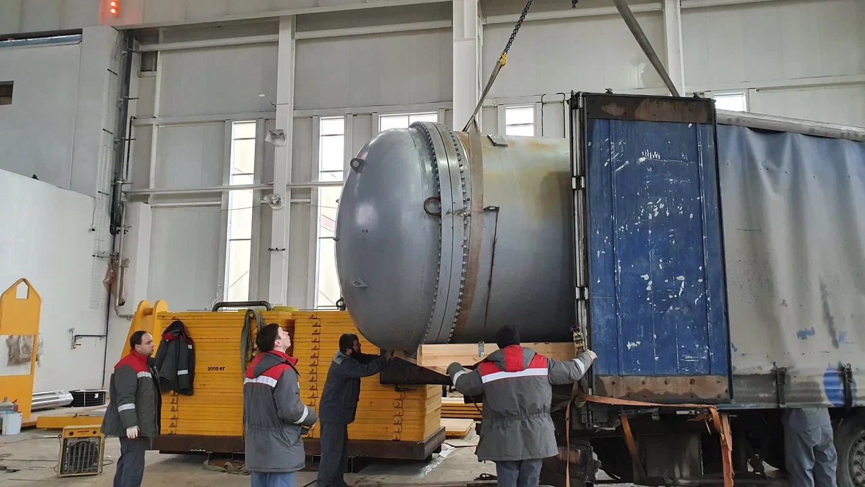
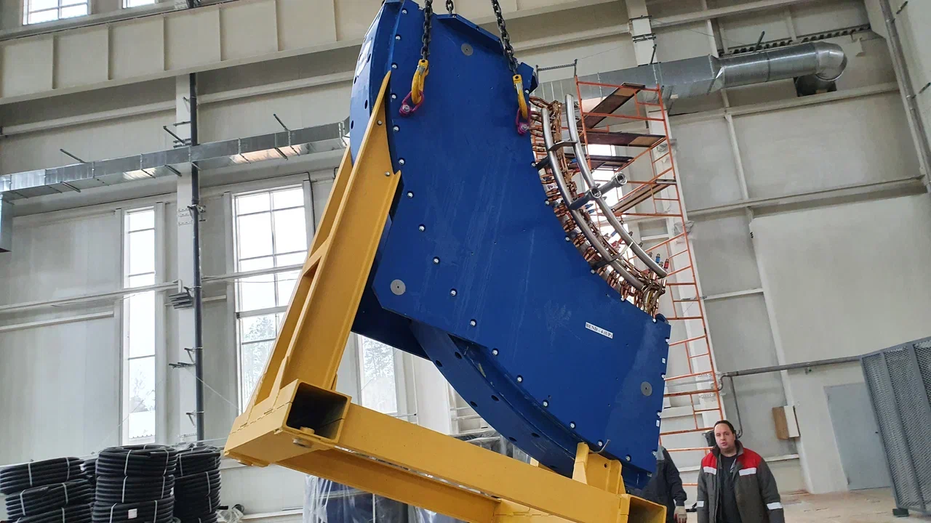
Electron cooling system
I.Meshkov
A.Sergeev
HV vessel
Toroidal solenoid
22 November – start of transportation of the cooler elements to JINR

Slide 15
2024: first beam run
Fast extraction from the Nuclotron
Assembly of the Nuclotron-Collider beam line
Injection into Collider
Synchronization, beam storage

