Slide 1
NICA-MPD PLATFORM STATUS
Author:
Alexander Fedunin
Sector No 3; Engineering Support Group
Joint Institute for Nuclear Research
XI MPD Collaboration meeting

Slide 2
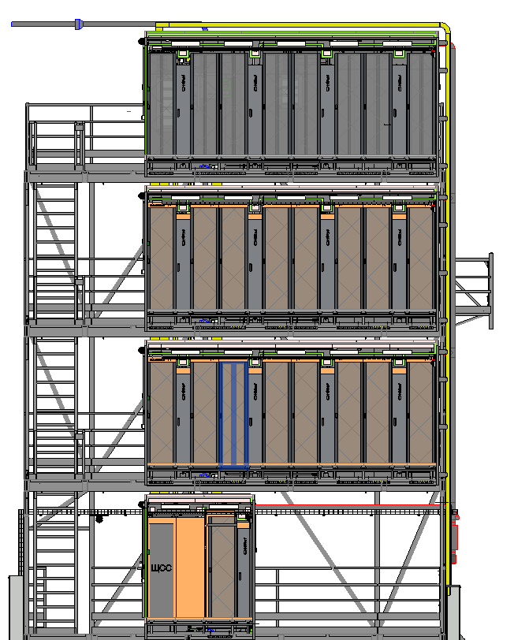
PARTS of NMP
IT RACKS on the NMP
Cooling System
Main electrical distribution board
Structed Cabling(fiber optic)
Access control and management system
CCTV video surveillance system
Аutonomous fire extinguishing system
Monitoring system
XI MPD Collaboration meeting

Slide 3
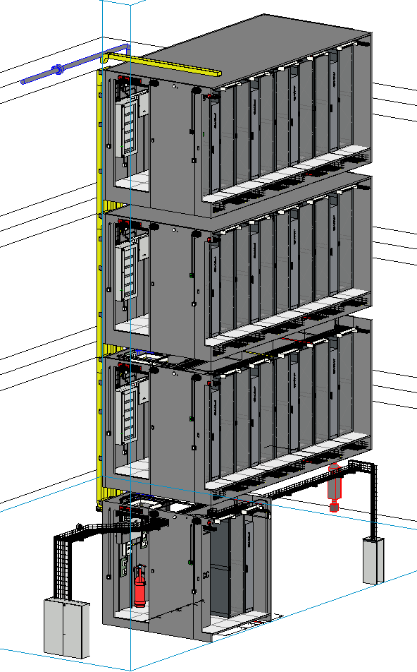
The NMP contains the electronics for collecting and processing data from the MPD.
XI MPD Collaboration meeting

Slide 4
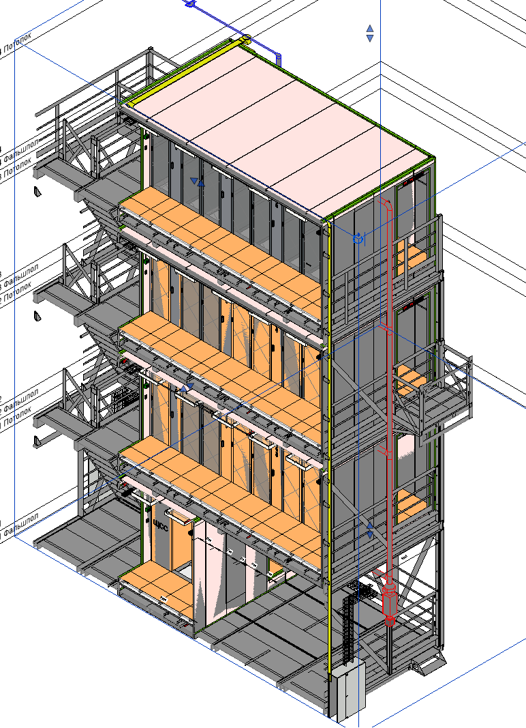
Platform (4 separate modules installed vertically)
Each module includes 1 room divided by 2 corridors
Inside modul there are racks with electronics, cooling and power supply equipment and other engineering systems
Three zones: cold corridor, hot corridor, space under the raised floor
Each floor has ventilation and air conditioning systems
XI MPD Collaboration meeting

Slide 5
IT RACKS on the NMP
First floor
Rack
Colling system
Hot corridor
Main
electrical distribution
board
1
Cold corridor
XI MPD Collaboration meeting

Slide 6
IT RACKS on the NMP
Second, third, fourth floor
Coling system
Rack
Hot corridor
1
2
3
4
5
6
7
8
Cold corridor
XI MPD Collaboration meeting

Slide 7
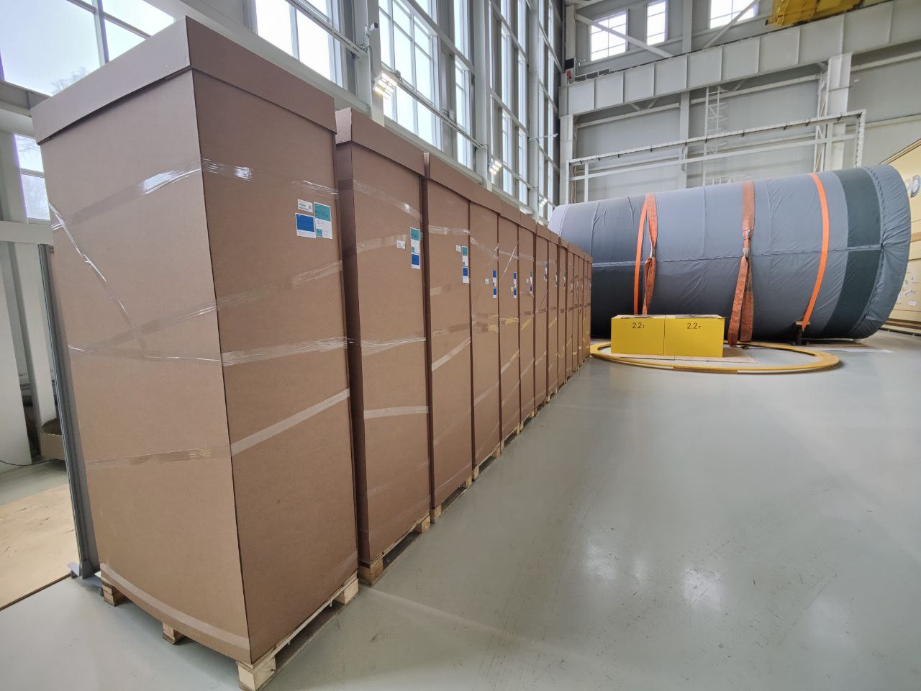
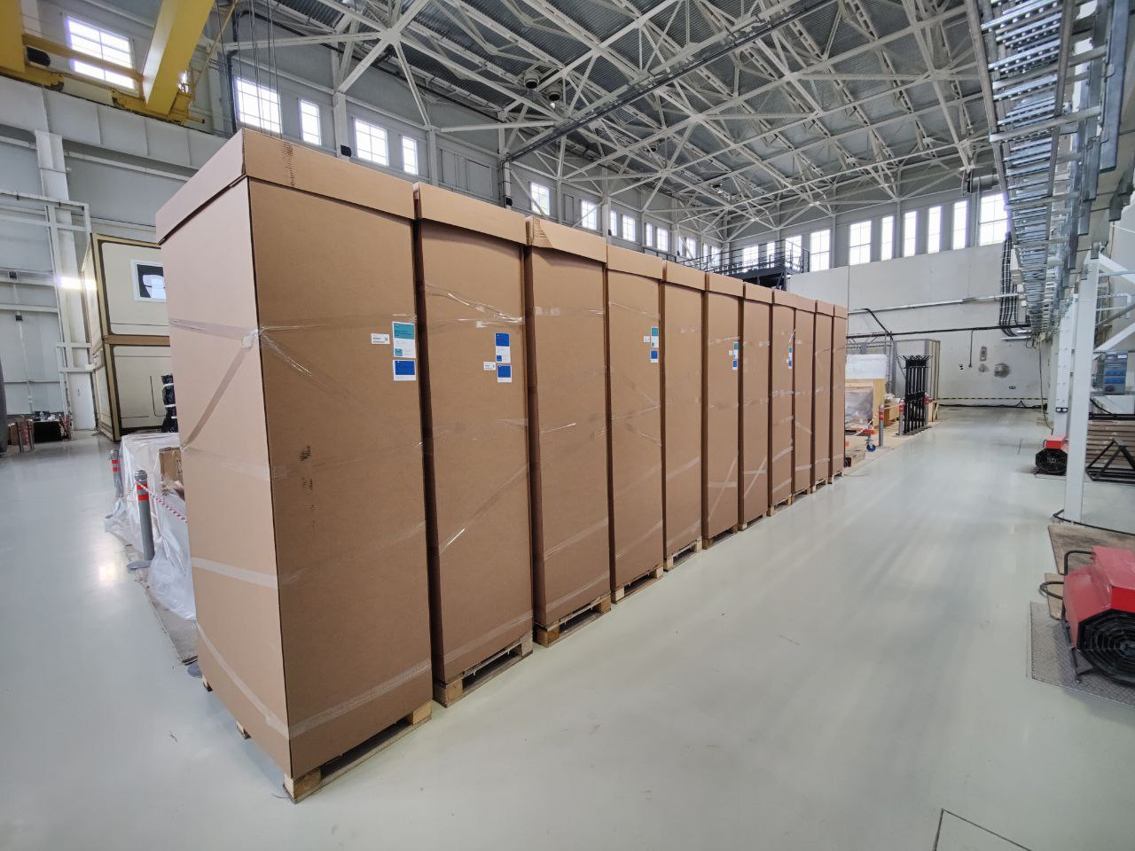
IT RACKS on the NMP
MPD equipment racks
Rack C3 ECO 48U 600*1200, black, perforated door
PDU controlled C3, 3 phases, 32A, C13-24, C19-12, 3 avt.in IEC 309, kab.3m
GreenMDC ventilation panel, active, 1U
XI MPD Collaboration meeting

Slide 8
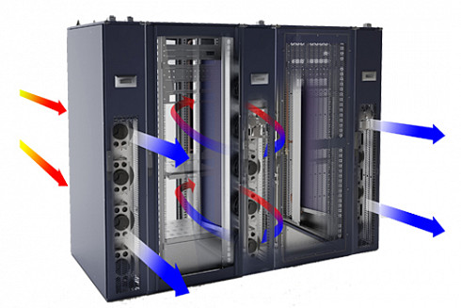
COOLING SYSTEM
The NMP cooling system is an integral part.
It is designed for:
Cooling equipment from overheating
Maintenance and regulation of the set air temperature
Ensuring round-the-clock and year-round temperature conditions.
A visual picture
XI MPD Collaboration meeting

Slide 9
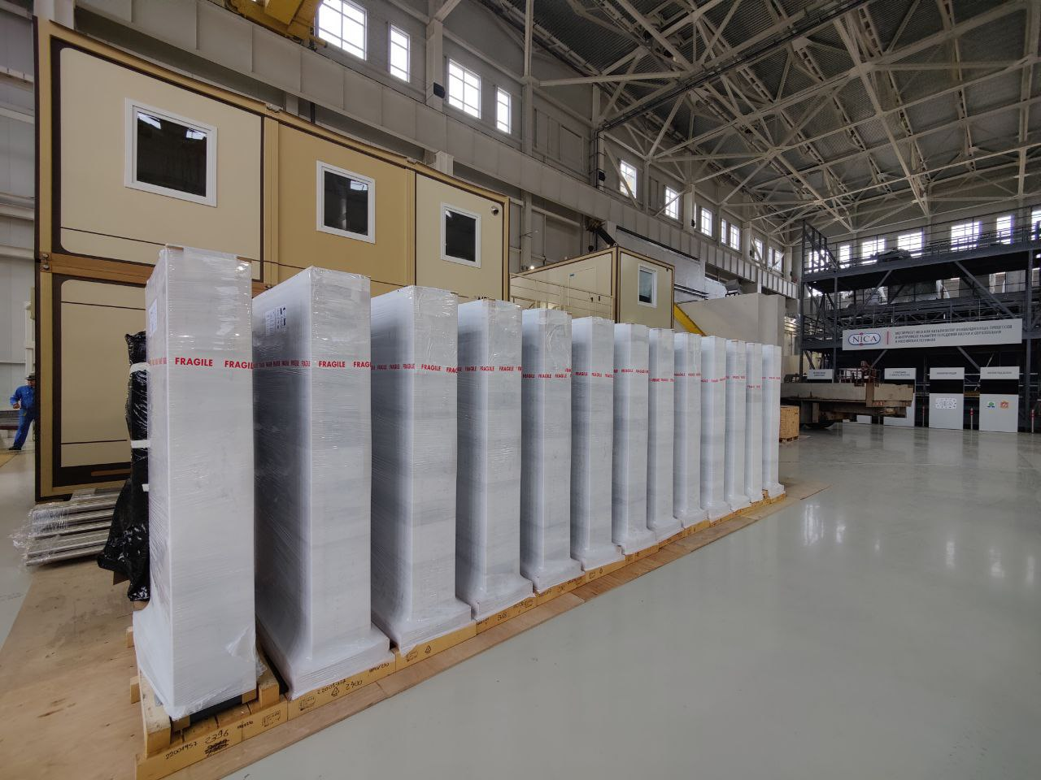
COOLING SYSTEM
Equipment cooling is provided by Hiref precision
XI MPD Collaboration meeting

Slide 10
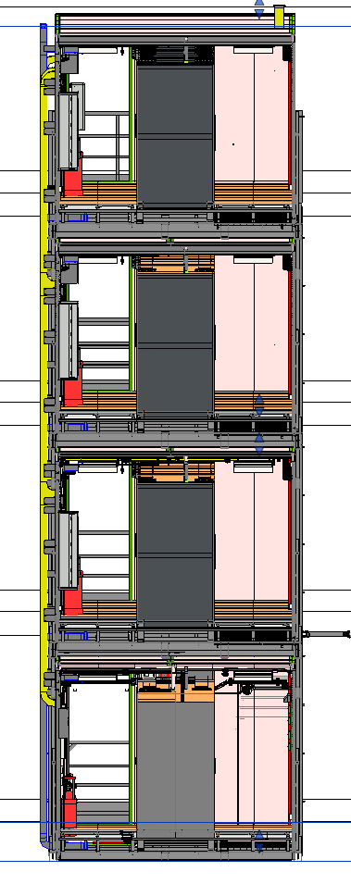
Main electrical distribution board
The platform power supply is isolated on each floor.
Each floor has its own power distribution board, which makes it possible to carry out preventive maintenance of the floor without shutting down the entire NMP
XI MPD Collaboration meeting

Slide 11
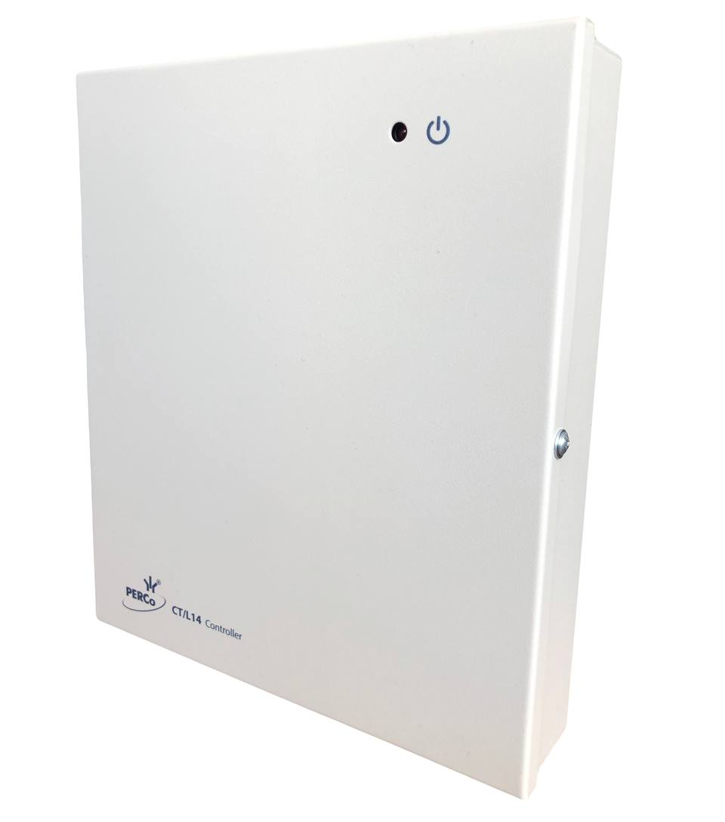
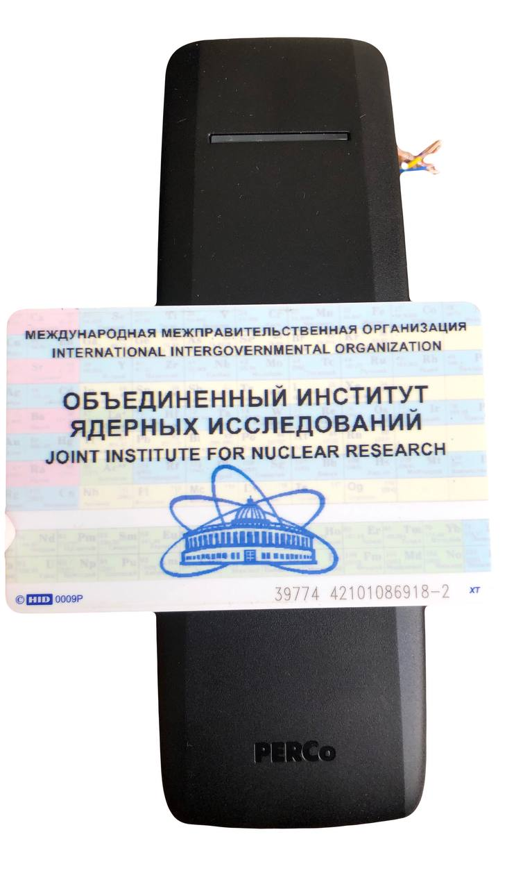
Access control and management system
Lock controller CL211.3
Universal controller CT/L14.1
JINR employees will be able to use their badge for access to all rooms
XI MPD Collaboration meeting

Slide 12
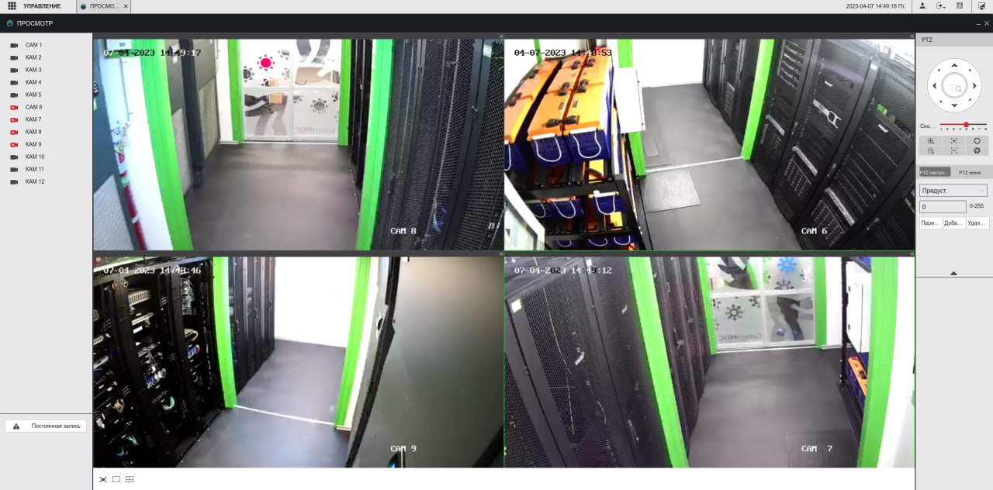
CCTV video surveillance system

Slide 13
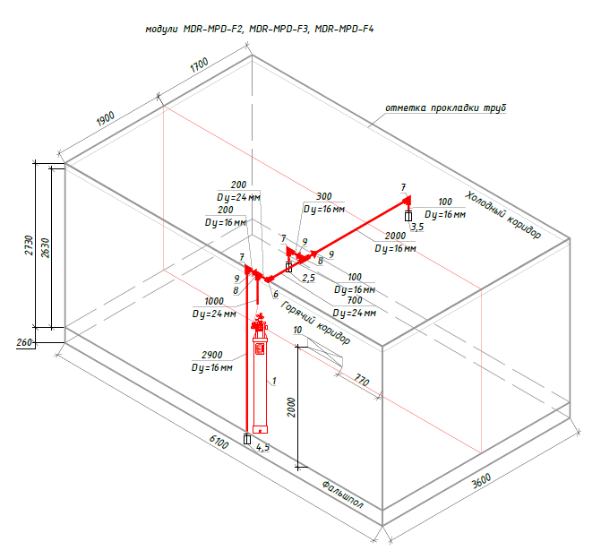
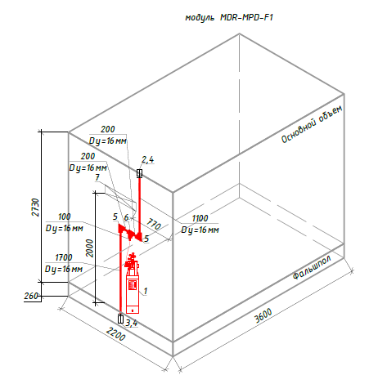
Аutonomous fire extinguishing system
Chladon 125 is used
XI MPD Collaboration meeting

Slide 14
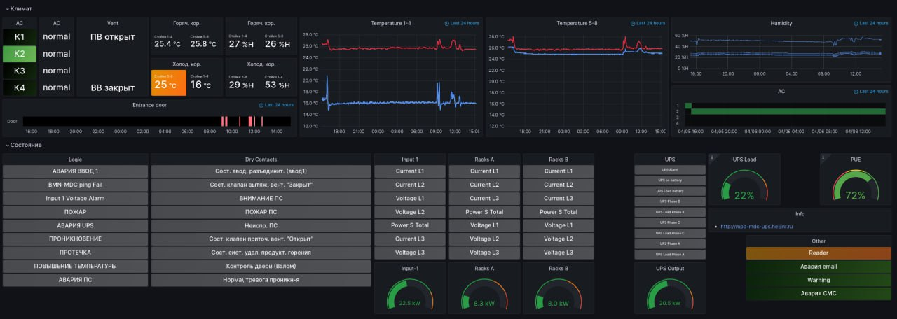
Monitoring system
XI MPD Collaboration meeting

Slide 15
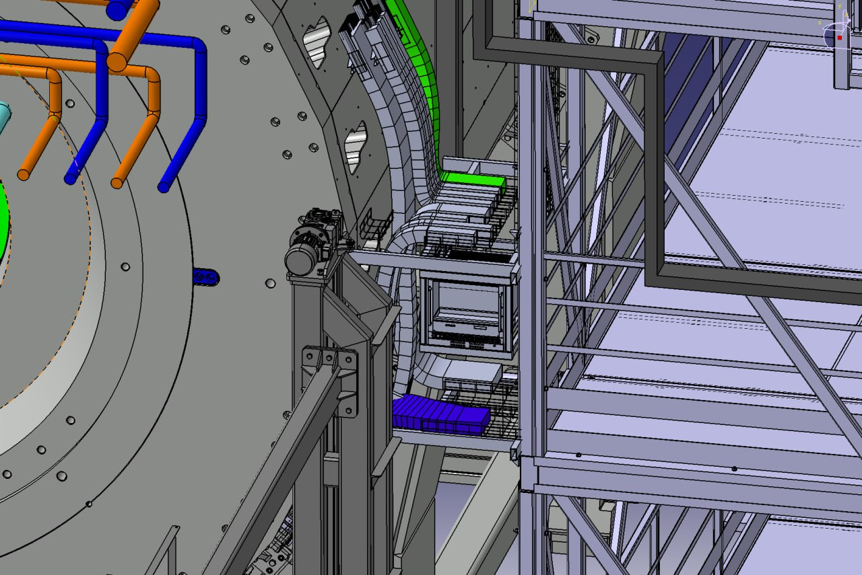
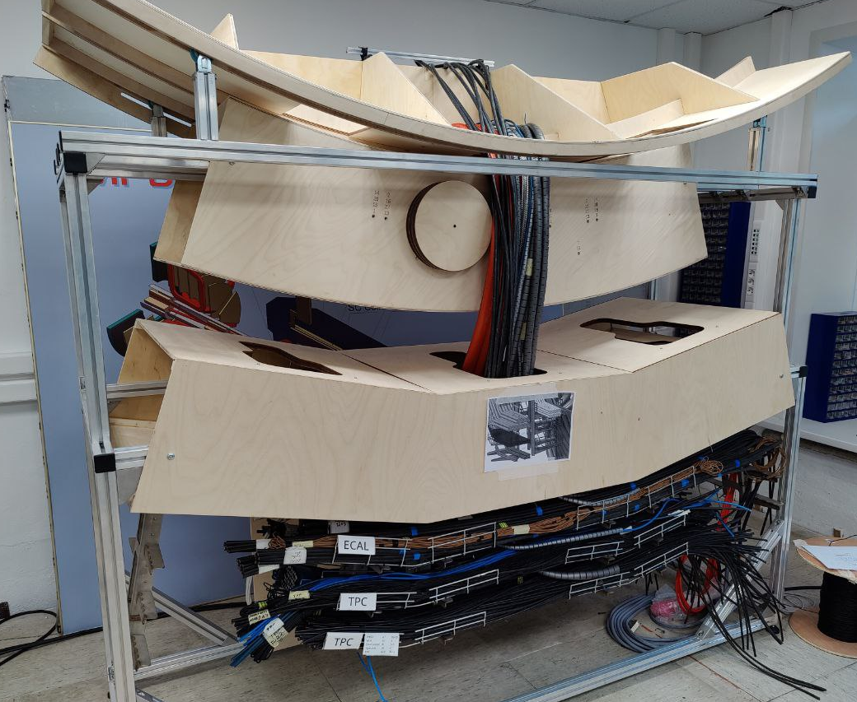
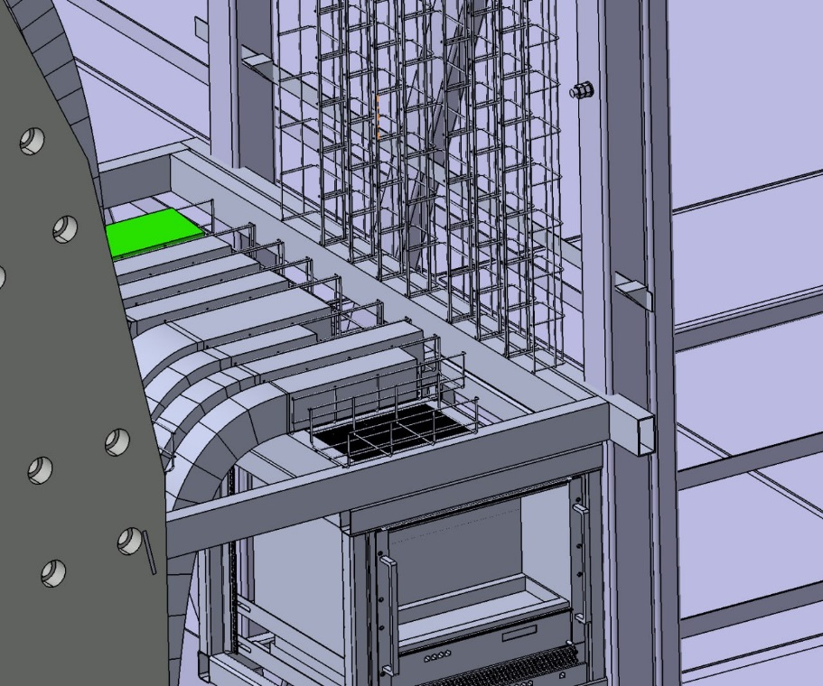
STRUCTED CABLING
XI MPD Collaboration meeting

Slide 16
Stages of work
 |  | April 2023 |  |  |  | May 2023 |  |  |  |  |  |  |  | May | June-September | September | October
 |  | 19 | 20 | 21 | 22 | 23 | 24 | 25 | 26 | 27 | 28 | 29 | 30 | 1-30 |  | 15-30 | 1-15
№ | Stage
1 | Delivery of all engineering systems to JINR
2 | Installation of metal structures
3 | Installation of basic structures
4 | Installation of raised floor and engineering networks
5 | Connecting the NMP water cooling system
6 | The closure of Building 17. Work is stopped
7 | Installation of the structure of the 4th floor and engineering systems
8 | Testing of all NMP systems
XI MPD Collaboration meeting

Slide 17
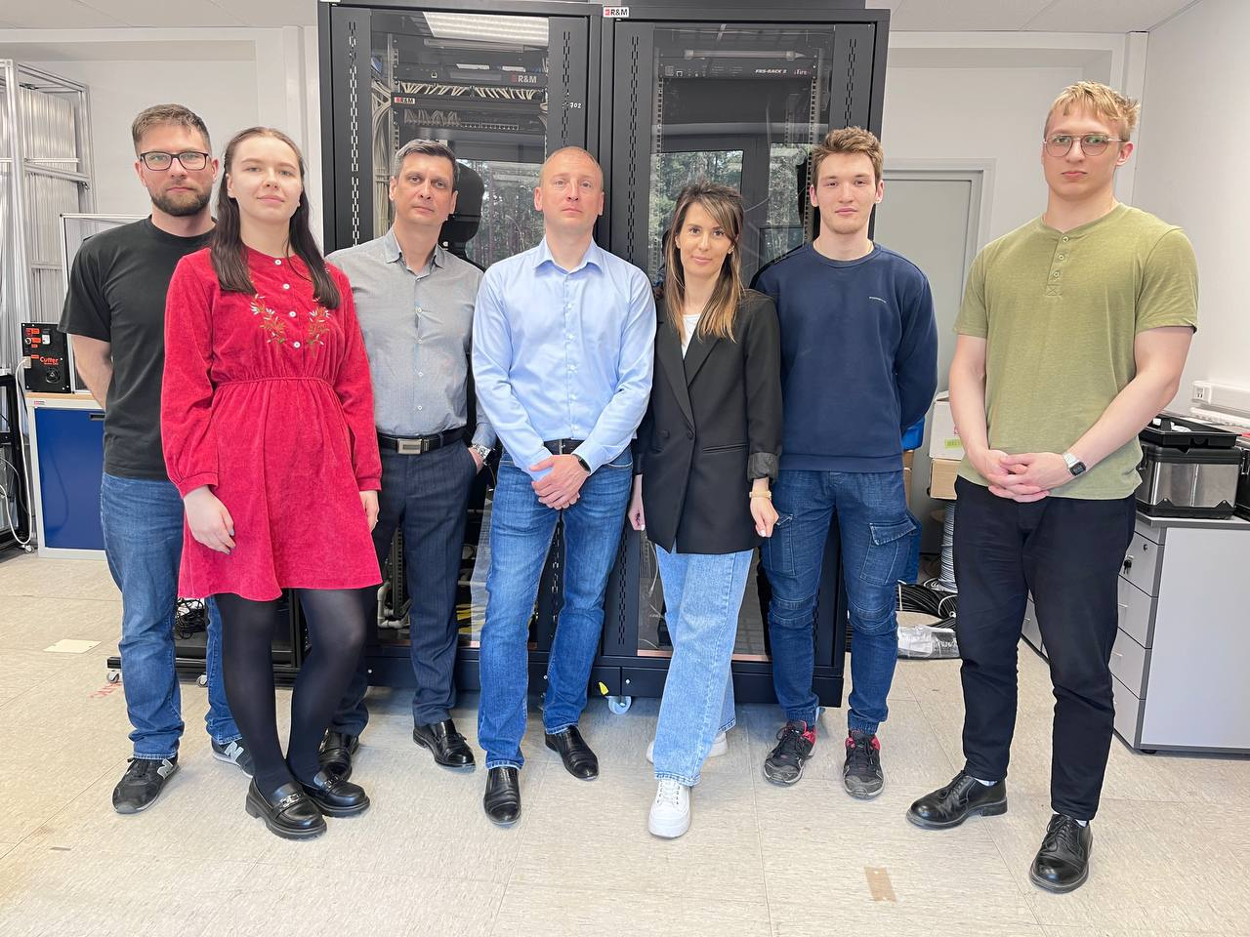
I want to thank my team and everyone who took part
XI MPD Collaboration meeting

Slide 18
Thank you For Attention
Author: Alexander Fedunin
Email: fediunin@lhep.ru
XI MPD Collaboration meeting

