Slide 1
Beams collision monitoring and
luminosity measurements in the
interaction point at MPD/NICA
A.Litvinenko ,JINR
(alitvin@jinr.ru)
on behalf of the working group

Slide 2
working group
JINR (Dubna)
S.G.Buzin, M.G.Buryakov, V. M.Golovatyuk, Z.A.Igamkulov, E.I.Litvinenko
JINR (Dubna) + Dubna State University
S.P.Avdeyev, A.I.Malakhov, G.D.Milnov,
A.G. Litvinenko
INR RAS (Moscow)
A.B.Kurepin,
Institute of Physics and Technology, MAS, Ulaanbaatar, 13330 Mongolia
M.Sovd, B.Otgongerel
Anyone wellcome

Slide 3
Time structure of AuAu collisions at NICA
Basic parameters (for $\sqrt{S_{NN}}=11 GeV$ )
Length (perimeter) of the ring $L=503,04 m$
Number of bunches $N_{b}=22$
$\text{Number} \text{of} \text{satellit}\text{е}\text{s}$ $N_{s}=44$
R.M.S. of particles in a bunch ${ σ}_{z}=0.6 m$
Time between bunches $t_{b−b}≈76.2 ns$
Time between bunch and $\text{satellite}{ t}_{b−s}≈25.4 ns$
Time of single interaction bunches $∆τ_{bb}≤{\left(6σ_{z}\right)}/{\left(2cβ\right)}≈6 ns$
Revolution frequency $f_{r}≈0.56∙{10}^{6} Hz$

Slide 4
Сollision types at NICA
$\text{satellit}\text{е}$-satellitе (s,s; $Z_{b,b}=0 m$)
bunch – bunch (b,b; $Z_{b,b}=0 m$)
bunch -satellitе (b,s; $Z_{b,b}=7.62 m$)
s,s
$$t=−25.4 ns$$
b,b
$$t=0$$
s,b
s,s
b,s
$$t=25.4 ns$$

Slide 5
Сollision types and counting rate
Luminosity
number of events
per second
(counting rate)
$$R_{i,j} =𝓛_{i,j}∙σ$$
$$\left\{\begin{aligned}i=b,s \\ j=b,s\end{aligned}\right.$$
cross section
$$\left[𝓛\right]={cm}^{−2}s^{−1}$$

Slide 6
Сollision types and luminosity
$𝓛_{b,b} = \left(N_{b}f_{r}\right)\frac{I_{b}I_{b}}{S_{eff,b,b}} ;N_{b}$=22; z=0 m
$𝓛_{s,s} = \left(N_{s}f_{r}\right)\frac{I_{s}I_{s}}{S_{eff,s,s}} ;N_{s}$=44; $S_{eff,s,s}$ = $S_{eff,b,b};\text{z}\text{=0}$ m
$𝓛_{s,b} = \left(N_{s}f_{r}\right)\frac{I_{s}I_{b}}{S_{eff,s,b}} ;N_{s}$=44 ; $Z_{bs}=±7.62 m$

Slide 7
Сollision types and luminosity
$$𝓛_{b,b}\left({см}^{−2}с^{−1}\right) = \left(22∙f_{r}\right)\frac{I_{b}^{2}}{S_{eff;b,b}}$$
$$𝓛_{s,s}\left({см}^{−2}с^{−1}\right) = \left(44∙f_{r}\right)\frac{I_{s}^{2}}{S_{eff;s,s}}$$
$$𝓛_{s,b}\left({см}^{−2}с^{−1}\right) = \left(44∙f_{r}\right)\frac{I_{s}I_{b}}{S_{eff;s,b}}$$

Slide 8
Сollision types and counting rate
$${R_{s,s}}/{R_{b,b}={2∙\left({I_{s}}/{I_{b}}\right)}^{2}}≤2∙{\left({10}^{−1}\right)}^{2}=0.02$$
$${R_{s,b}}/{R_{b,b}=2∙\left(\frac{I_{s}}{I_{b}}\right)∙\left(\frac{S_{eff;bb}}{S_{eff;sb}}\right)}$$
$$\frac{1}{S_{eff,bs}}=\int_{−∞}^{∞}{dz_{V}}\left(\frac{exp\left(−{{\left(z_{V}−l_{bs}\right)}^{2}}/{\left(σ_{z}^{2}\right)}\right)}{\sqrt{π}σ_{z}∙\left(S_{eff,⊥}\left(0\right)\right)\left(1+{\left({z_{V}}/{β_{IP}}\right)}^{2}\right)}\right)$$
$$\frac{1}{S_{eff,bb}}=\int_{−∞}^{∞}{dz_{V}}\left(\frac{exp\left(−{{\left(z_{V}\right)}^{2}}/{\left(σ_{z}^{2}\right)}\right)}{\sqrt{π}σ_{z}∙\left(S_{eff,⊥}\left(0\right)\right)\left(1+{\left({z_{V}}/{β_{IP}}\right)}^{2}\right)}\right)$$

Slide 9
Сollision types and counting rate
$${R_{s,s}}/{R_{b,b}=2∙\left(\frac{I_{s}}{I_{b}}\right)∙\left(\frac{S_{eff;bb}}{S_{eff;ss}}\right)≤0.02}$$
$\frac{1}{S_{eff,bb}}=\int_{−∞}^{∞}{dz_{V}}\left(\frac{exp\left(−{{\left(z_{V}\right)}^{2}}/{\left(σ_{z}^{2}\right)}\right)}{\sqrt{π}σ_{z}∙\left(S_{eff,⊥}\left(0\right)\right)\left(1+{\left({z_{V}}/{β_{IP}}\right)}^{2}\right)}\right)=6.85 {cm}^{−2}$
$$\frac{1}{S_{eff,bs}}=\int_{−∞}^{∞}{dz_{V}}\left(\frac{exp\left(−{{\left(z_{V}−l_{bs}\right)}^{2}}/{\left(σ_{z}^{2}\right)}\right)}{\sqrt{π}σ_{z}∙\left(S_{eff,⊥}\left(0\right)\right)\left(1+{\left({z_{V}}/{β_{IP}}\right)}^{2}\right)}\right)=4.14∙{10}^{−2}{cm}^{−2}$$
$${R_{s,b}}/{R_{b,b}=2∙\left(\frac{I_{s}}{I_{b}}\right)∙\left(\frac{S_{eff;bb}}{S_{eff;sb}}\right)≤0.6∙{10}^{−3}}$$

Slide 10
Cоnclusion I
Satellite-satellite collisions contribute no more than 2% to main bunch collisions.
Bunch-satellite collisions have a count rate less than three orders of magnitude compared to the count rate for collisions of the main bunches

Slide 11
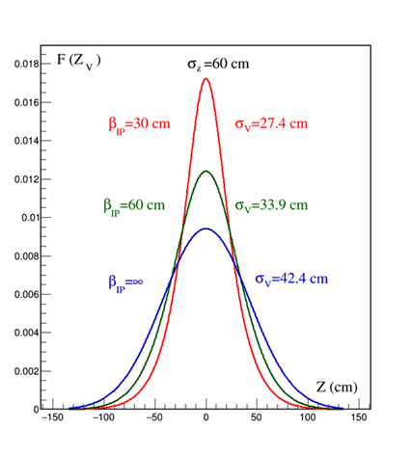
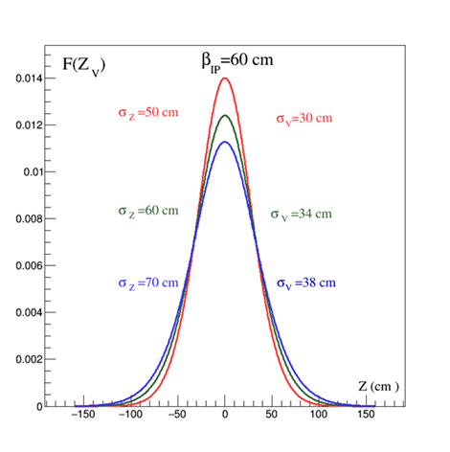
vertex distribution
$${\tilde{σ}}_{V}{≈(σ_{z}β_{IP})}/{\sqrt{2∙\left(β_{IP}^{2}+σ_{z}^{2}\right)}}$$
$$σ_{V}=34 cm$$

Slide 12
Time structure of AuAu collisions at NICA
Collision parameters (for $\sqrt{S_{NN}}=11 GeV$ )
Cross section for minimum bias event $σ_{AuAu}≈$ $6.2 b$
Max Luminosity $𝓛={10}^{27}{cm}^{−2}s^{−1}$
Counting rate $R=6200 s^{−1}=𝓛∙$ $σ_{AuAu}$
Scattering probability for a single crossing of bunches
$$w_{1}=\frac{R}{{f_{r}N}_{b}}≈5∙{10}^{−4}$$
Admixture of pile up events for $t≤100 ns$
$<{10}^{−4}$ negligible

Slide 13
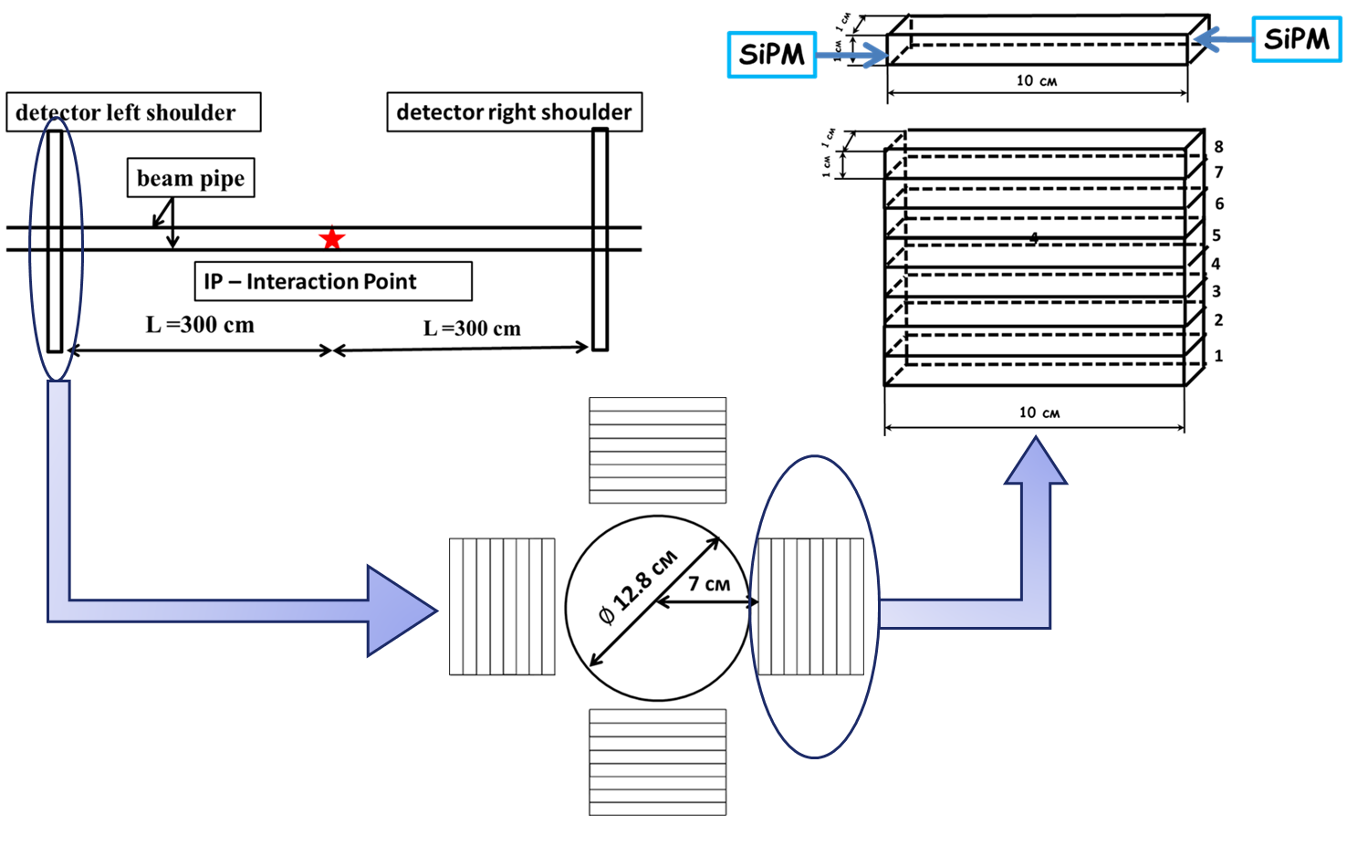
Detector

Slide 14
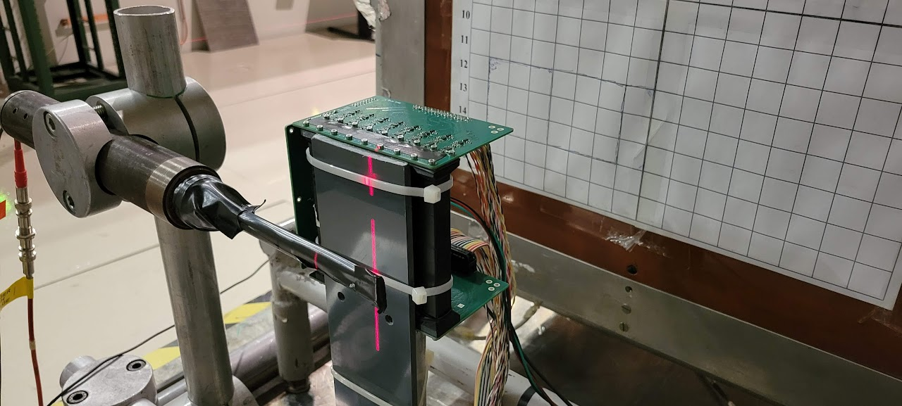
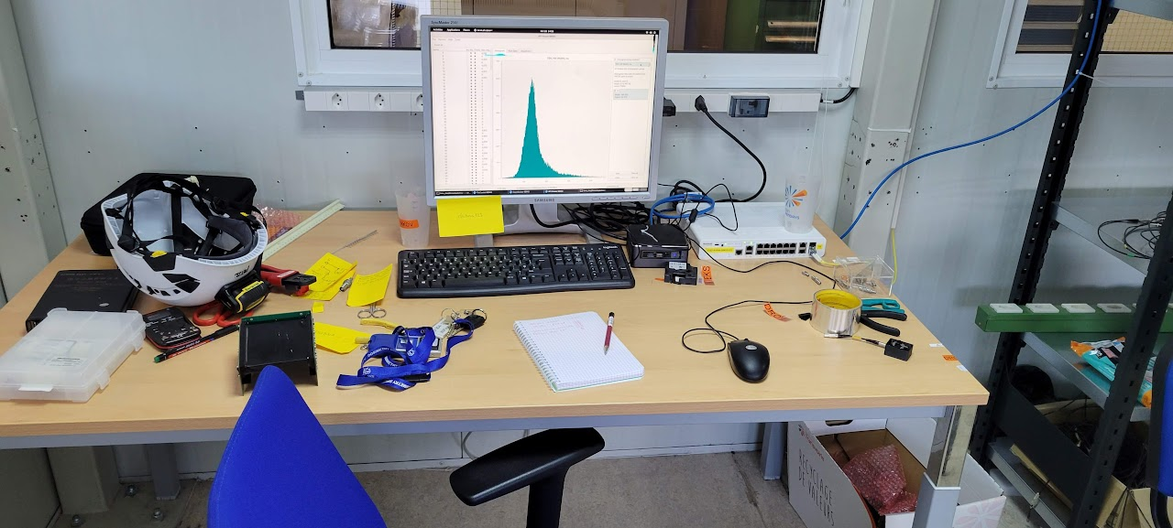
Beam test at CERN
S.G.Buzin, M.G.Buryakov
Two planes

Slide 15
Detector, carent status
Two planes assembled.
Test measurement results analysis are in progress..
A solution to the SiPM heating problem is being studied.
The design of the luminosity detector installation is being developed on the MPD and separately from the MPD.
TDR is in a preparation.

Slide 16
Some achievements
An article describing the operation of the detector (24 pages) will be published in No.5 (2023) of Nuclear Physics (Rus.).
An article on the study of the distribution of interaction vertices will be submitted for publication (Pepan Letters) no later than the end of May.
Received a grant from the Russian Science Foundation
(2 years, 3,000,000 ₽)

Slide 17
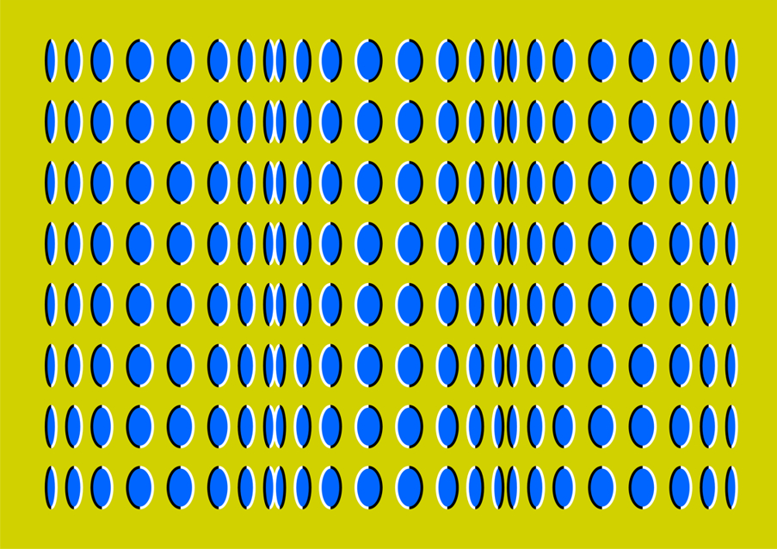
Backup slides

Slide 18
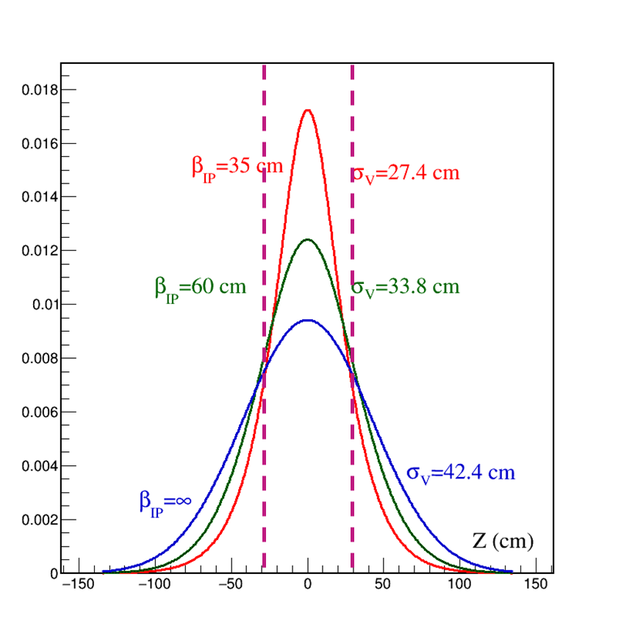
Efficiency, Luminosity and beta function
$$N_{L}=N_{R}=2.8∙{10}^{9}$$
$$σ_{x}=1.1 mm; σ_{y}=0.82 mm$$
$${−30 cm≤Z}_{V}≤30 cm$$
 | $$β_{IP}=35 cm$$ | $$β_{IP}=60 cm$$ | $$β_{IP}={10}^{4} cm$$
$$ℒ ({cm}^{−2}s^{−1})$$ | $$5∙{10}^{26}$$ | $$6.9∙{10}^{26}$$ | $$9.1∙{10}^{26}$$
Eff ($ε$) | 0.756 | 0.635 | 0.517
$$ℒ({cm}^{−2}s^{−1})ε$$ | $$3.8∙{10}^{26}$$ | $$4.4∙{10}^{26}$$ | $$4.7∙{10}^{26}$$

Slide 19
Tasks for the luminosity detector
finding the parameters of the collider, for the most efficient hit of bunches into each other;
finding the parameters of the collider that optimize the transverse profile of colliding beams;
selection of collider parameters that optimize the longitudinal position of the interaction vertex
two observables
the first one is the counting rate
the second one is the distribution of interaction vertices obtained from ToF

Slide 20
Ion guide on MPD
old
$$⊘$$
Ø 10 мм
new

Slide 21
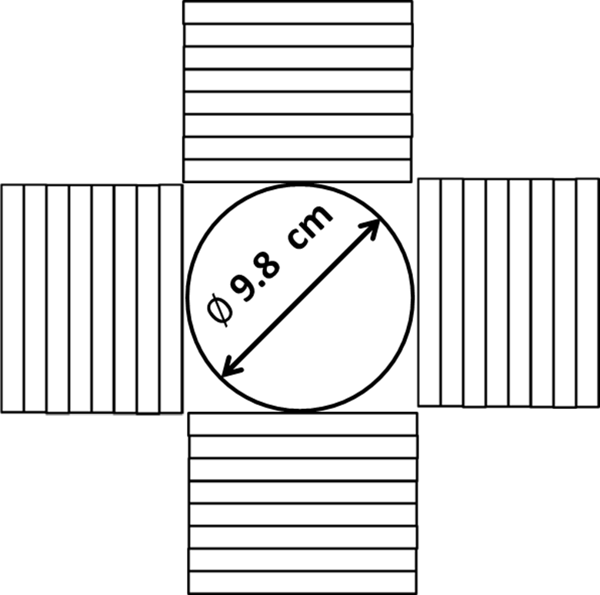
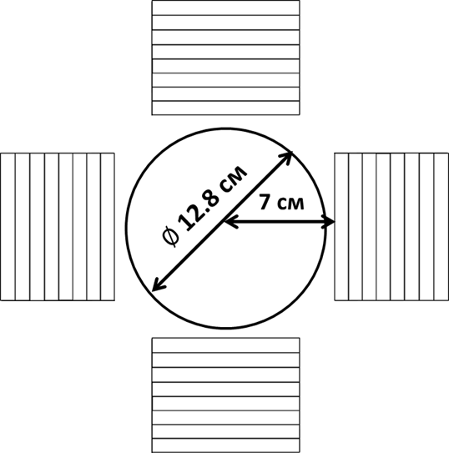
What has changed
since April this year
new

Slide 22
What has changed
since April this year
$$\sqrt{S_{NN}}=11 GeV$$
new
$$ε=82\%$$
$$ε=77\%$$
$$R≈4900 1/{s ;\left(≈1.4 \%\right)}$$
$$R≈4600 1/{s ;\left(≈1,5 \%\right)}$$
Efficiency = Detected/Produced
DCM-SMM (M. Baznat, A. Botvina, G. Musulmanbekov,
V. Toneev, V. Zhezher, //arXiv:1912.09277 [nucl-th], 2019)

Slide 23
Time of Flight for Left and Right Shoulders
$$T_{L/R}=min\left\{T_{L/R, i}\right\}$$
Trigger
$$\left|T_{L}−T_{R}\right|≤10 нс$$
Efficiency
$$ε=82\% →ε=77\%$$
Efficiency = Detected/Produced
DCM-SMM (M. Baznat, A. Botvina, G. Musulmanbekov,
V. Toneev, V. Zhezher, //arXiv:1912.09277 [nucl-th], 2019)

Slide 24
Transverse plane. Luminosity structure. Van der Meer scan.
$$𝓛\left(δX,δY\right)=f_{r}∙N_{b}∙\frac{N_{L}N_{R}}{S_{eff}\left(δX,δY\right)}$$
$N_{L}{, N}_{R}$-number of the beam ions in the left and right bunches
Van der Meer scan.
For normal distribution
$$𝓛\left(δX,δY\right)=f_{r}∙N_{b}∙\frac{N_{L}N_{R}}{4πσ_{x}σ_{y}}exp\left(−\frac{{δX}^{2}}{2σ_{x}^{2}}\right)∙exp\left(−\frac{{δY}^{2}}{2σ_{y}^{2}}\right)$$

Slide 25
Adjustment of beam convergence in the transverse plane
Conclusion I
estimated time to adjust the convergence of beams
in the transverse plane is about three hours
1.5 h – data taking;
1.5 h – setting collider modes;
$$𝓛={10}^{27} {cm}^{−2}s^{−1}$$
$$𝓛={10}^{25} {cm}^{−2}s^{−1}$$
$$δX$$ | $${{ N}_{tr}}/{(10 min)}$$ | Errors
$$0$$ | 2 760 000 | 0.06 %
$$δX=σ_{X}$$ | 1 764 025 | 0.07 %
$$δX=2σ_{X}$$ | 373525 | 0.16%
$$δX=3σ_{X}$$ | 30661 | 0.60%
$$δX$$ | $${{ N}_{tr}}/{(10 min)}$$ | Errors
$$0$$ | 27600 | 0.6 %
$$δX=σ_{X}$$ | 17640 | 0.75 %
$$δX=2σ_{X}$$ | 3735 | 1.6%
$$δX=3σ_{X}$$ | 307 | 5%

Slide 26
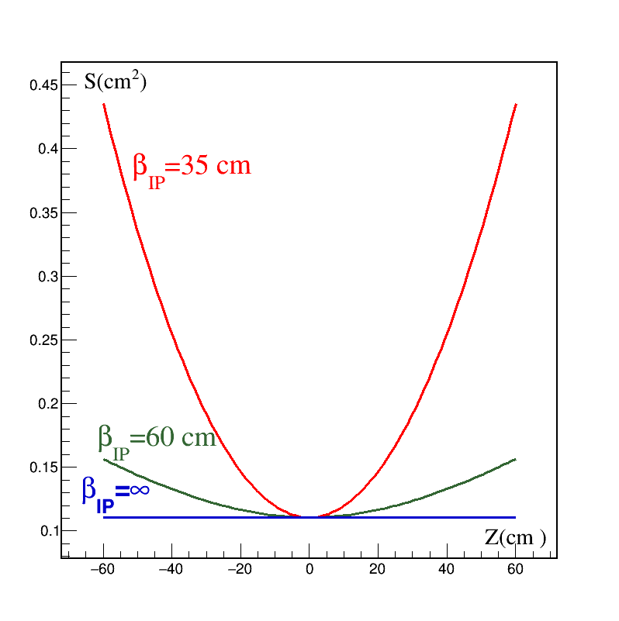
Beta function
Transverse area
$$S_{eff,⊥}\left(Z\right)=S_{eff,⊥}\left(0\right)\left(1+{\left(Z/{β_{IP}}\right)}^{2}\right)$$

Slide 27
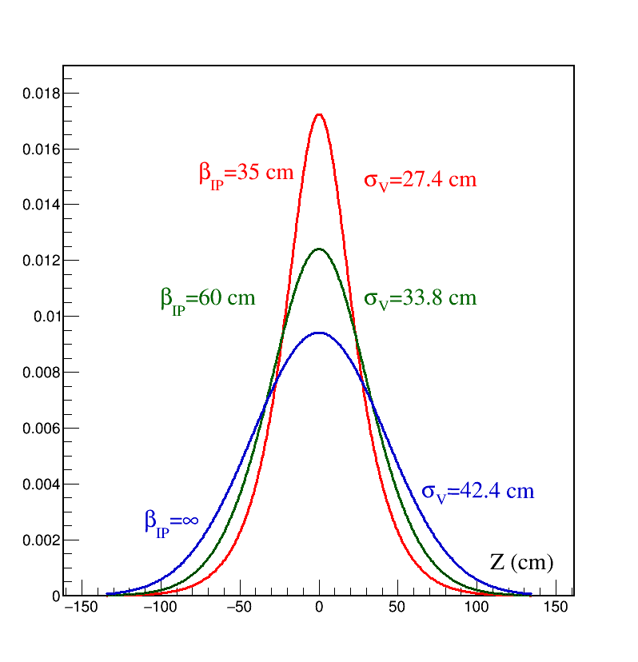
Distribution of interaction vertices
$$\left\{\begin{aligned}&P\left(Z_{V}\right)=N\frac{ exp\left(−{Z_{V}^{2}}/{σ_{Z}^{2}}\right)}{\left(1+{\left({Z_{V}}/{β_{IP}}\right)}^{2}\right)} \\ &N=\frac{1}{\int_{−∞}^{∞}{\frac{exp\left(−{Z_{V}^{2}}/{σ_{Z}^{2}}\right)}{\left(1+{\left({Z_{V}}/{β_{IP}}\right)}^{2}\right)} dZ_{V}}}\end{aligned}\right.$$

Slide 28
Efficiency, Luminosity and beta function
$$N_{L}=N_{R}=2.8∙{10}^{9}$$
$$σ_{x}=1.1 mm; σ_{y}=0.82 mm$$
$${−30 cm≤Z}_{V}≤30 cm$$
 | $$β_{IP}=35 cm$$ | $$β_{IP}=60 cm$$ | $$β_{IP}={10}^{4} cm$$
$$ℒ ({cm}^{−2}s^{−1})$$ | $$5∙{10}^{26}$$ | $$6.9∙{10}^{26}$$ | $$9.1∙{10}^{26}$$
Eff ($ε$) | 0.756 | 0.635 | 0.517
$$ℒ({cm}^{−2}s^{−1})ε$$ | $$3.8∙{10}^{26}$$ | $$4.4∙{10}^{26}$$ | $$4.7∙{10}^{26}$$

Slide 29
Vertex position
L
L
RS
LS
z
$$L−z$$
$$L+z$$
$T_{L}=\frac{L−z}{cβ}$ ; $T_{R}=\frac{L+z}{cβ}; τ=T_{R}−T_{L}=\frac{2z}{cβ}$
$$c=3∙{10}^{8}; β=p/{E; \sqrt{S_{NN}}=11→β=0.985≈1}$$
z$=\frac{1}{2}c∙τ→z\left(cm\right)=15∙τ(ns)$
$σ_{τ}=(300 ÷400) ps ; →σ_{z,τ}≈(4.5÷$ 6) cm

Slide 30
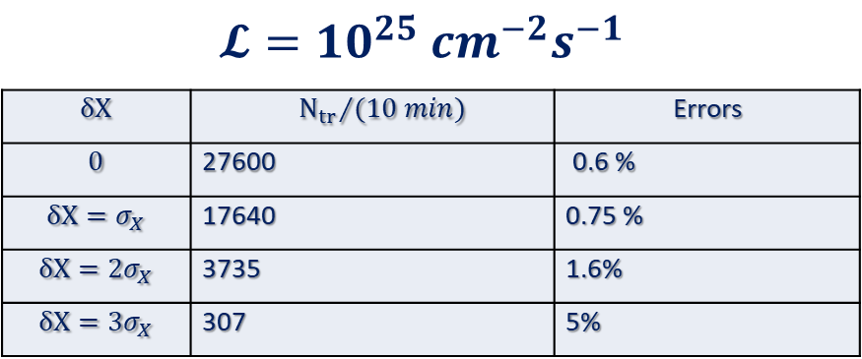
Z coordinate. Maximum of interaction point distribution from ToF
${\tilde{σ}}_{z}=\sqrt{\left(σ_{z,V}^{2}+σ_{z,τ}^{2}\right)}=34∙\left(1+0.016\right)$ cm
$$∆Z\left(cm\right)=\frac{{\tilde{σ}}_{z}}{\sqrt{N_{tot}}}=\frac{34∙\left(1+0.016\right) \text{cm}}{\sqrt{N_{tot}}}$$

Slide 31
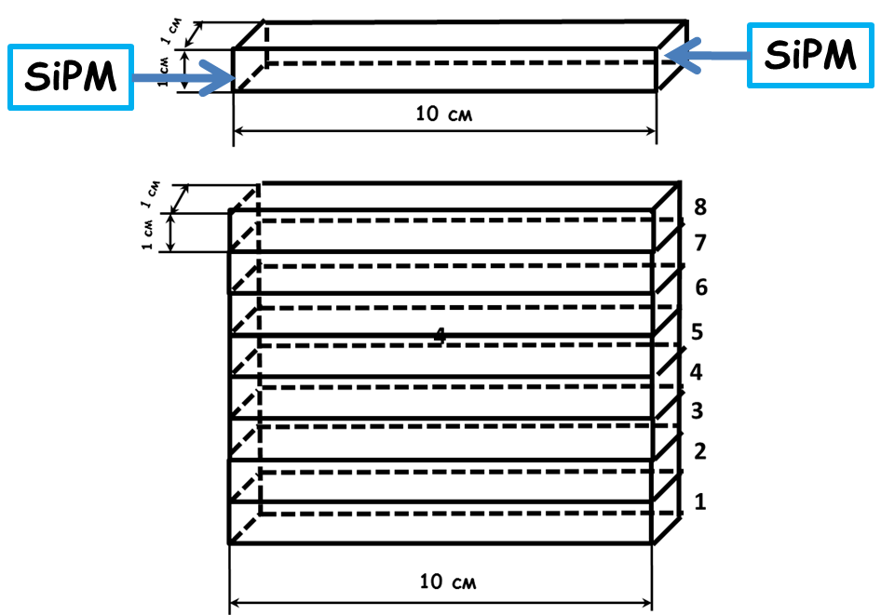
One plane of detector
The plane consists of $100x10x10 {mm}^{3}$ plastic scintillator (organic polystyrene (PS) scintillator with the addition of 1.5% p-terphenyl and 0.05% POPOP) strips viewed from both sides with silicon photomultipliers (SiPM HAMAMATSU S13360-6025CS)

Slide 32
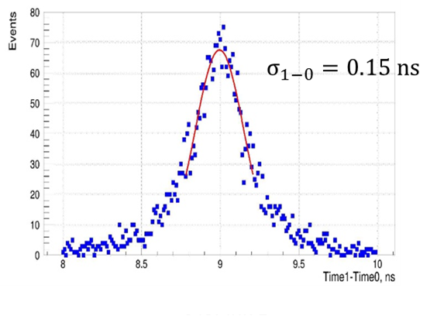
Space muons. ToF of counters
$$σ_{1−0}=\sqrt{2σ^{2}}→σ={σ_{1−0}}/{\sqrt{2}}$$
$$σ≈100 ps$$
G. D. Milnov et al., Physics of Particles and Nuclei Letters, 2022,
Vol. 19, No. 4, pp. 362–367.

Slide 33
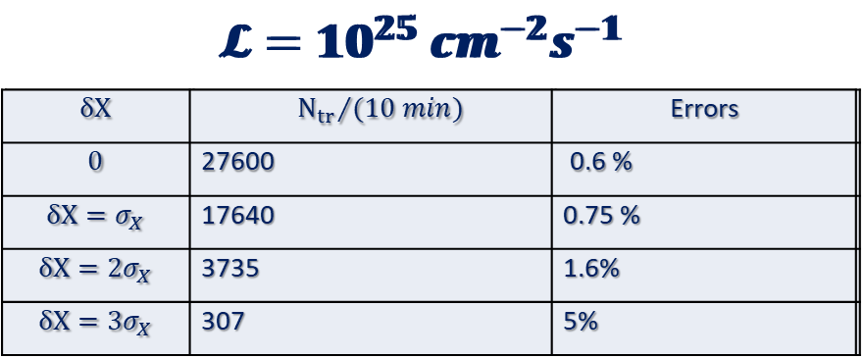
Adjustment of beam convergence along interaction line
Conclusion II
setting beam convergence along the collision axis
does not require record time-of-flight resolutions.
Even 400 picoseconds enough.
$$∆Z\left(cm\right)=\frac{{\tilde{σ}}_{z}}{\sqrt{N_{tot}}}=\frac{34∙\left(1+0.016\right) \text{cm}}{\sqrt{N_{tot}}}$$

Slide 34
Beam test at CERN
S.G.Buzin, M.G.Buryakov
Two planes

Slide 35
Backup slides

Slide 36
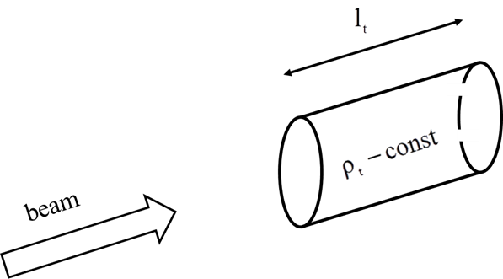
Fixed target luminosity
$$𝓛=\frac{N_{bm}N_{t}f}{S}$$
Nt - the number of target atoms in volume
through which the beam passes
N_{bm} - numbers of particles per burst
f - repetition rate
$S$ - transverse beam area

Slide 37
Fixed target luminosity
$𝓛=N_{bm}N_{A}\frac{{ρ\left(g/{{cm}^{3}}\right)l}_{t}\left(см\right)}{A_{t}}f$
Example
Nuclotron $f=0.1$ 1/s
$A_{t}=208$ (Pb)
$l_{t}$ = 0.1 cm
$N_{bm}$= ${10}^{10}$
$$𝓛=3.3∙{10}^{30} {cm}^{−2}s^{−1}$$

Slide 38
Time structure of AuAu collisions at NICA
Collision parameters (for $\sqrt{S_{NN}}=11 GeV$ )
Cross section for minimum bias event $σ_{AuAu}≈$ $6.2 b$
Max Luminosity $𝓛={10}^{27}{cm}^{−2}s^{−1}$
Counting rate $R=6200 s^{−1}=𝓛∙$ $σ_{AuAu}$
Scattering probability for a single crossing of bunches
$$w_{1}=\frac{R}{{f_{r}N}_{b}}≈5∙{10}^{−4}$$
Admixture of pile up events for $t≤100 ns$
$<{10}^{−4}$ negligible

Slide 39
Favorable conditions for creating
a “luminosity detector"
Topology of Au + Au collisions when in a cone $θ≤4^{0}$ along both beams many spectators are flying ($E_{s}{≈E}_{b}=5.5 GeV$) (${}_{79}^{}{Au )}$). Convenient for trigger.
Long time between neighboring collisions. No overlapping events.
The role of scattering on the residual gas is small.
Low counting rate.
Small energy.
Large asymmetry of events.

Slide 41
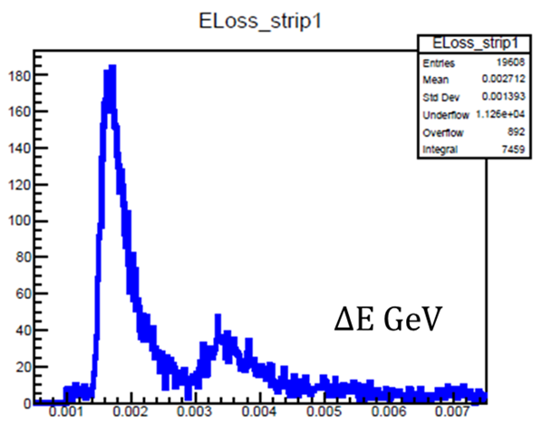
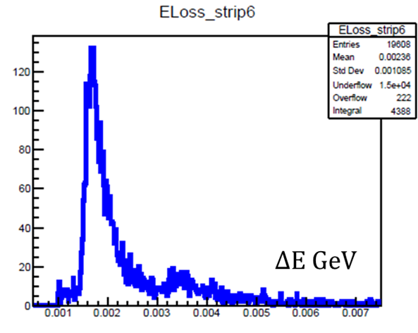
Simulation
Detector operating conditions $\left(\sqrt{S_{NN}}=11 GeV\right)$
Spectator energy $E_{S}≈5.5 {Gev}/c$
Energy loss spectrum in the scintillator

Slide 42
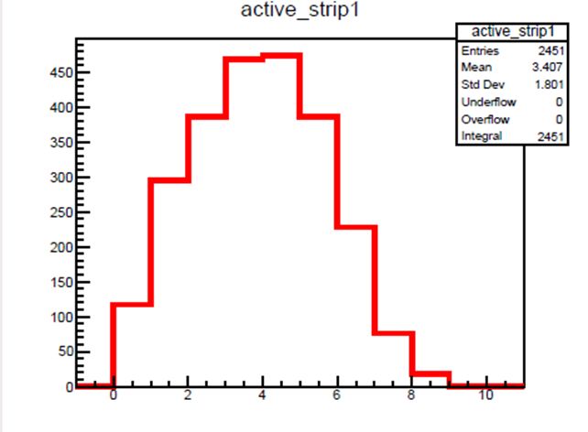
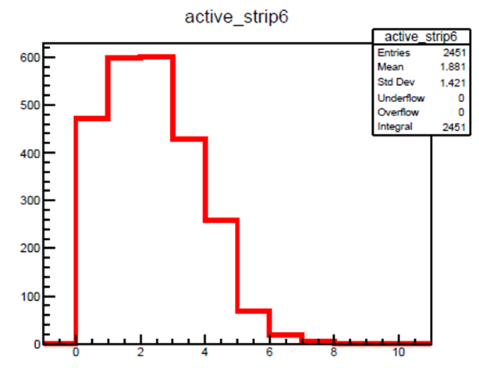
Simulation
Detector operating conditions $\left(\sqrt{S_{NN}}=11 GeV\right)$
strip occupancy (per 4 strips)
$${\left\langle n\right\rangle }_{6}=\frac{1.88}{4}=0.47$$
$${\left\langle n\right\rangle }_{1}=\frac{3.4}{4}=0.85$$

Slide 43
III. absolute luminosity
S. van der Meer, CERN-ISR-PO-68-31, 1968
van der Meer scan
at RHIC and LHC the van der Meer scan is commonly accepted procedure for calibration

Slide 44
Definitions and normalizations
$$𝓛= {\left(N_{L}N_{R}f_{r}N_{b}\right)}/{\left(S_{eff}\right)}$$
$$\frac{1}{S_{eff}\left(δX,δY\right)}=\left(\int_{−∞}^{∞}{dx}p_{┴}\left(x−{δX}/2\right)p_{┴}\left(x+{δX}/2\right)\right)∙\left(\int_{−∞}^{∞}{dy}p_{┴}\left(y−{δY}/2\right)p_{┴}\left(y+{δY}/2\right)\right)$$
$$\int_{−∞}^{∞}{\int_{−∞}^{∞}{d(δX)d(δY)}}\frac{1}{S_{eff}\left(δX,δY\right)}=1$$

Slide 45
III. absolute luminosity
$$𝓛=\frac{\frac{dR_{1,2}\left(0,0\right)}{dt}}{\iint{\frac{dr_{1,2}\left(δX,δY\right)}{dt}dδXdδY}}$$

Slide 46
stage 0
IN THE BEGINNING
$$B\sim N_{b}$$
$$S\sim {\left(N_{b}\right)}^{2}$$
$N_{b}(1/{bunch}$) | $$𝓛 ({cm}^{−2}s^{−1})$$ | $$N_{AuAu}\left(1/s\right)$$ | $$N_{𝓛D }\left(1/s\right)$$ | $$N_{AuAu}\left(1/m\right)$$ | $$N_{𝓛D }\left(1/m\right)$$ | $$B/S$$
$$2∙{10}^{9}$$ | $${10}^{27}$$ | $$6000$$ | $$4900$$ | $$360000$$ | $$294000$$ | $$<{10}^{−5}$$
$$2∙{10}^{8}$$ | $${10}^{25}$$ | $$60$$ | $$49$$ | $$3600$$ | $$2940$$ | $$<{10}^{−4}$$
$$2∙{10}^{7}$$ | $${10}^{23}$$ | $$0.6$$ | $$0.49$$ | $$36$$ | $$29.4$$ | $$<{10}^{−3}$$
$$2∙{10}^{6}$$ | $${10}^{21}$$ | $$0.006$$ | $$0.0049$$ | $$0.36$$ | $$0.29$$ | $$<{10}^{−2}$$

