Slide 1
FCalPulse modeling progress report
ATLAS-JINR FCalPulse project meeting
M. Manashova
13/02/2023

Slide 2
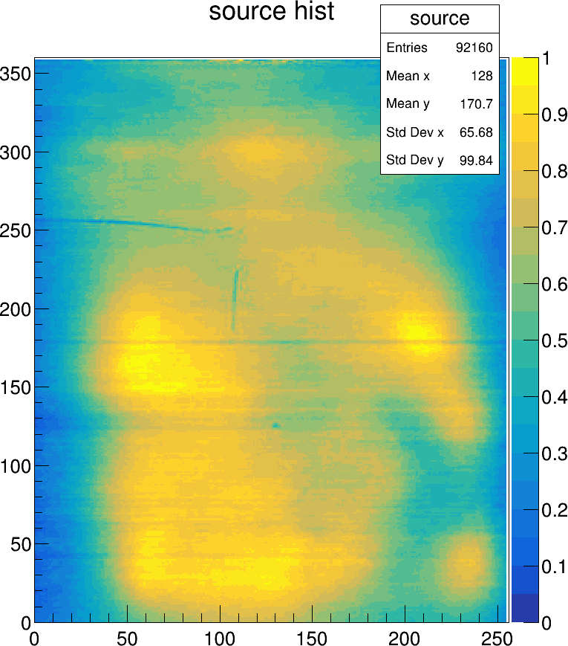
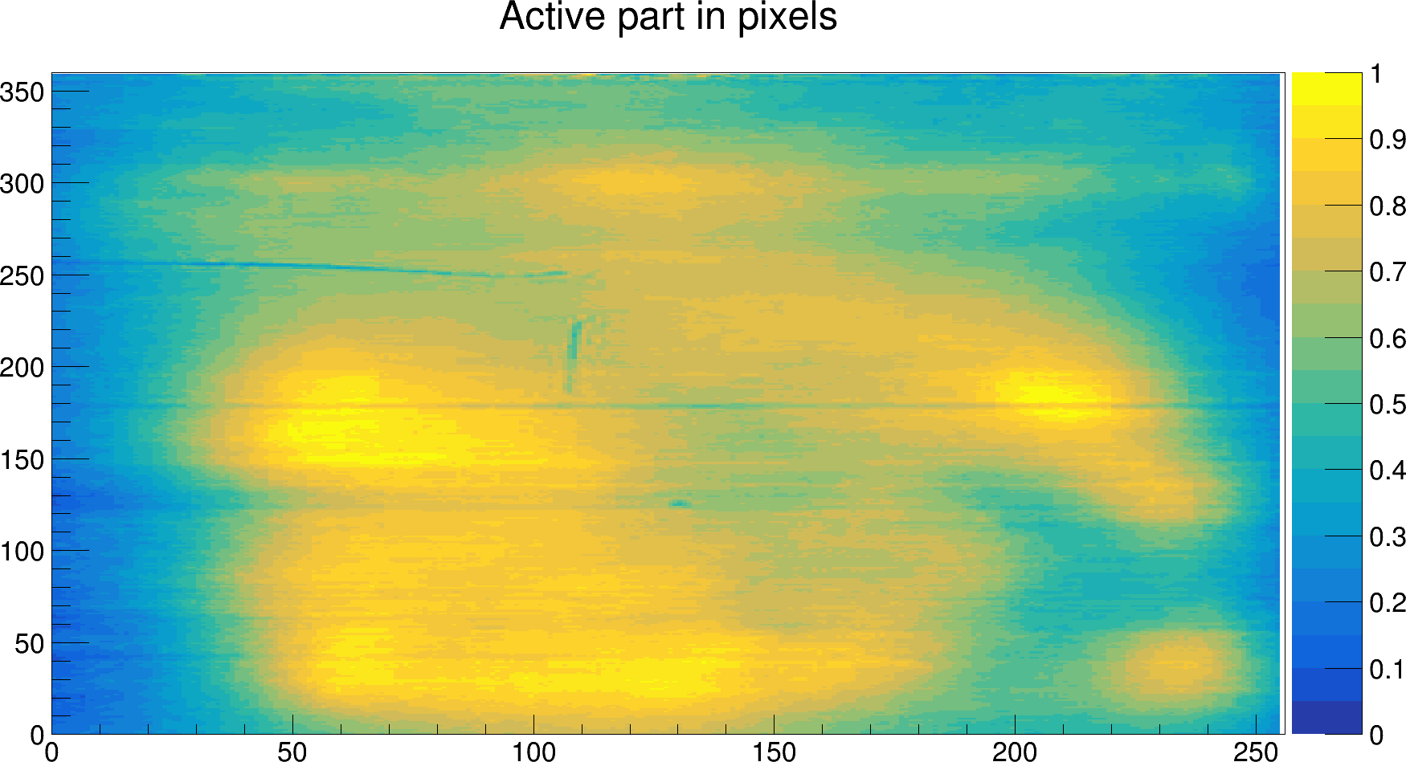
Сomparison of results
b)
a)
The results of the two-dimensional distribution of coordinates obtained by Tulgaa (a) and Munira (b)

Slide 3
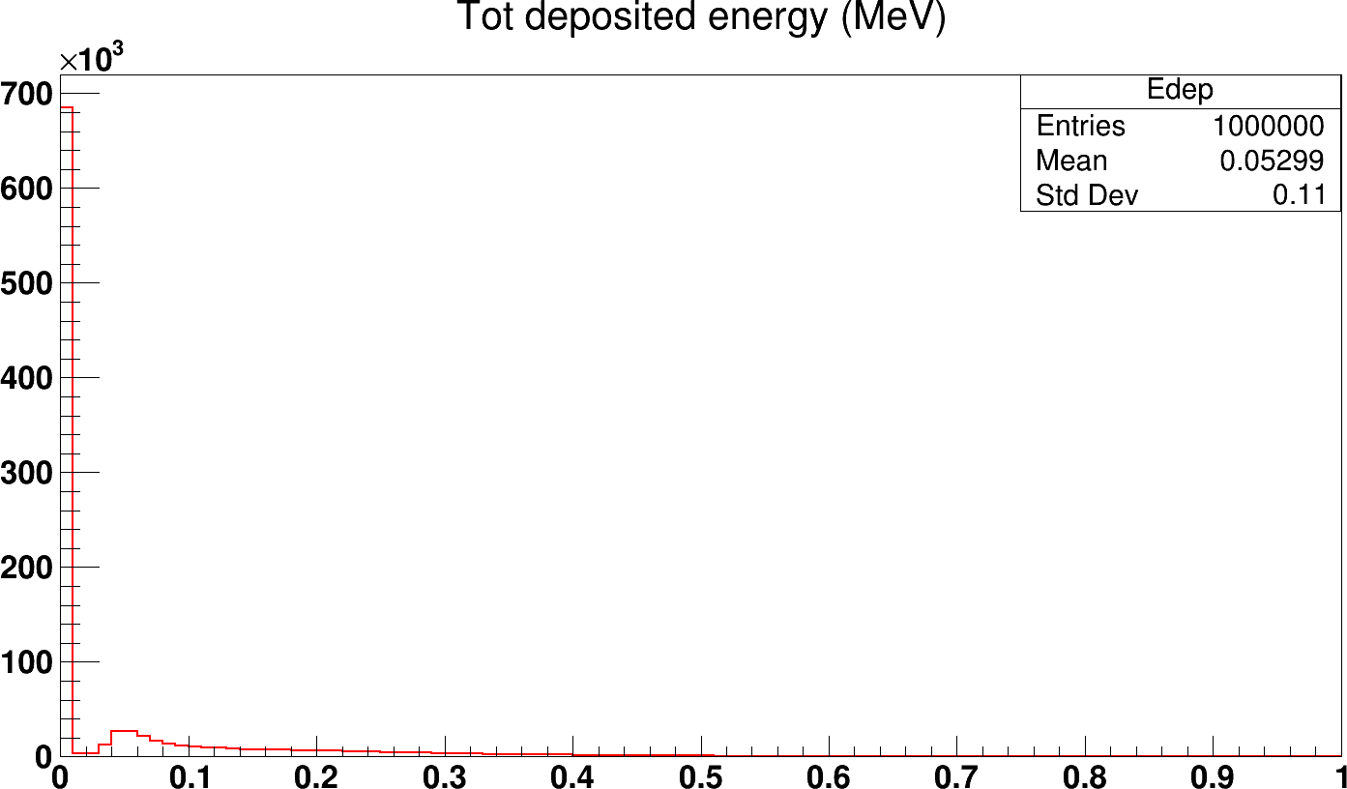
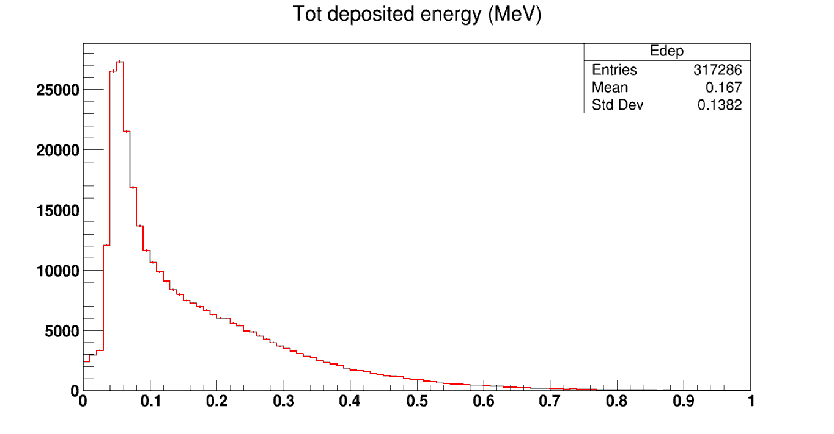
Distribution of deposited energy by one electron
а)
entries
Events with zero hit values were
removed and picture (b) was received
$$Number of events N_{events}={10}^{6}$$
𝐸_{𝑡𝑜𝑡}, MeV
b)
entries
After deleting events without hits,
317286 events remained
$$Number of events N_{events}={10}^{6}$$
𝐸_{𝑡𝑜𝑡}, MeV

Slide 4
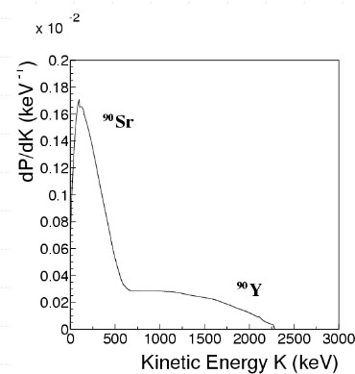
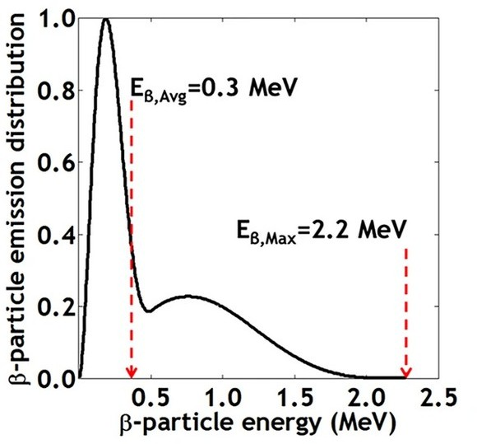
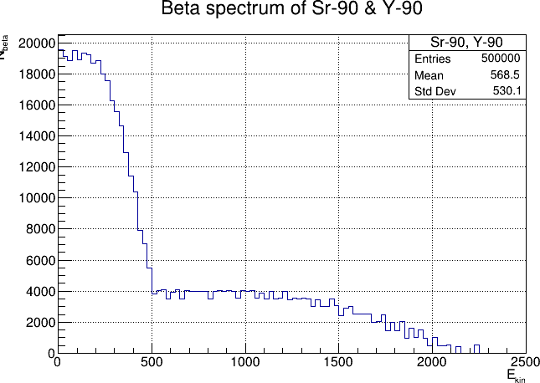
Spectrum of Sr-90 and Y-90
Dixon, J., Rajan, A., Bohlemann, S. et al. Evaluation of a Silicon 90Sr Betavoltaic Power Source. Sci Rep 6, 38182 (2016). https://doi.org/10.1038/srep38182
https://indico.cern.ch/event/618665 Result of John P. Rutherfoord
*Result of M.Manashova (JINR)

Slide 5
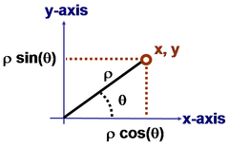
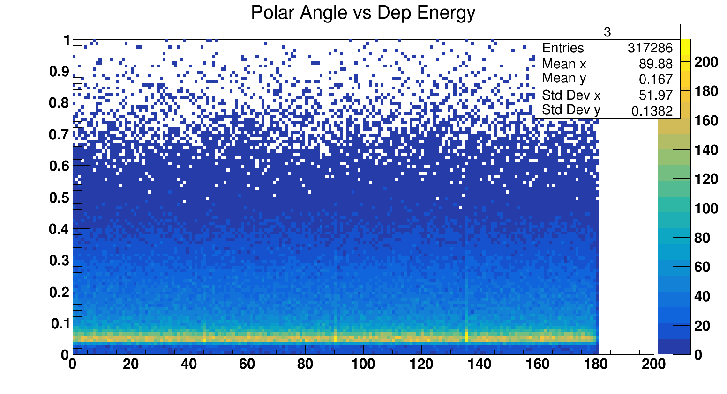
$$Number of events N_{events}={10}^{6}$$
entries
Distribution of distance in liquid argon by electrons from Sr-90
d, mm
Distribution of polar angles of electron emission from the foil
entries
$$ρ=\sqrt{x^{2}+y^{2}}$$
$$φ=arccos\frac{x}{ρ}$$
$$φ, rad$$
Edep
Distribution of the polar angle of electron
emission as a function of deposited energy
in LAr.
$$φ, rad$$

Slide 6
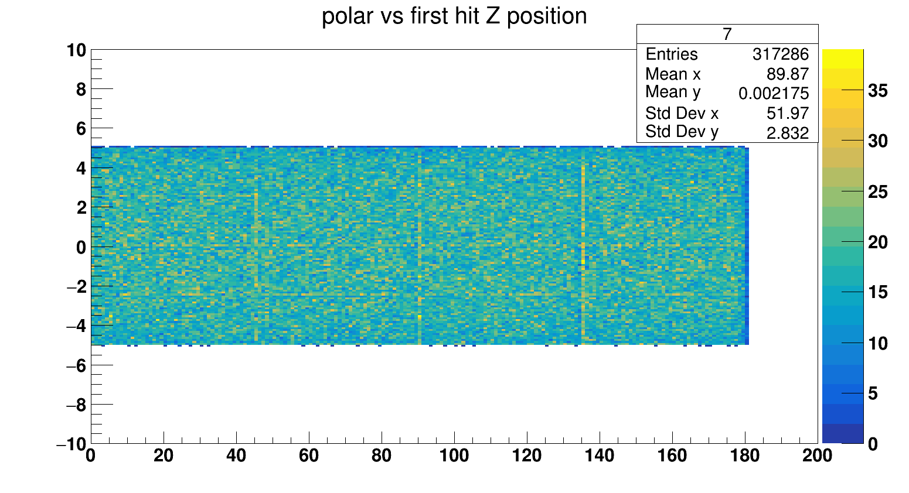
Z vs Phi
$$Number of events N_{events}={10}^{6}$$
Z, mm
$$φ, rad$$

Slide 7
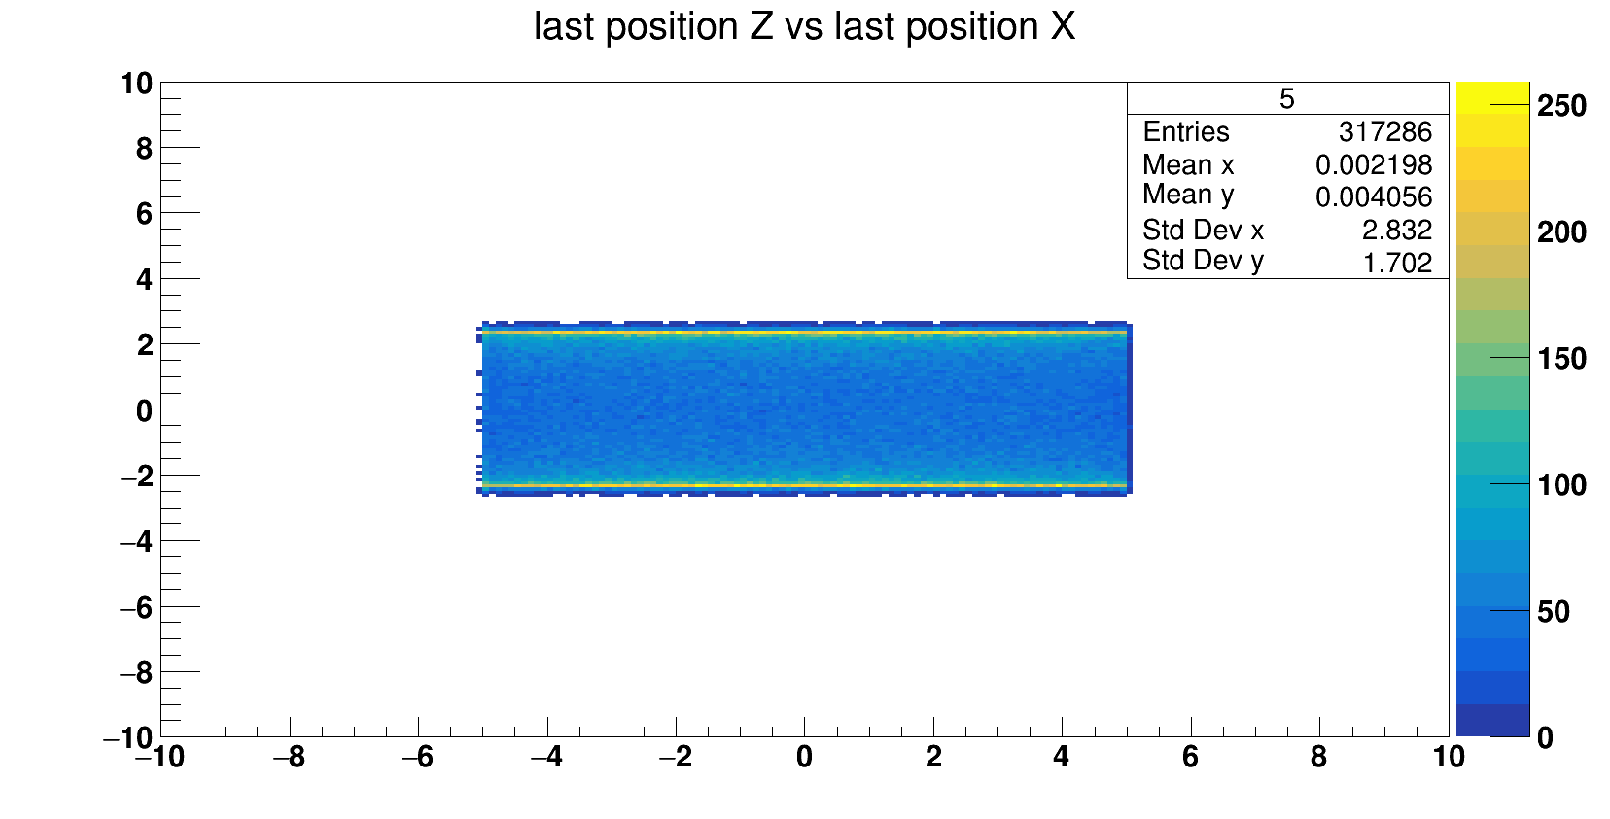
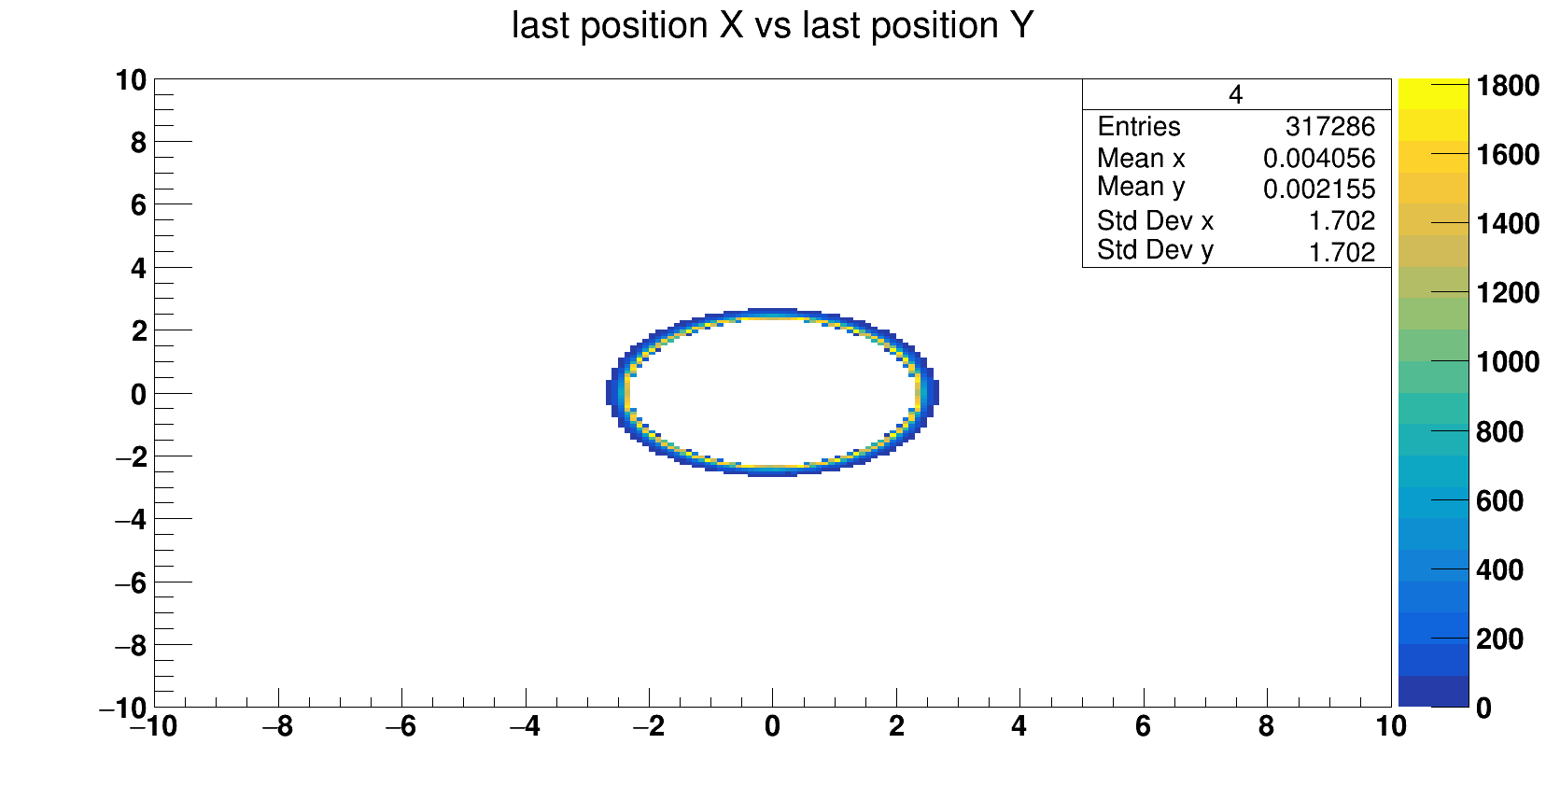
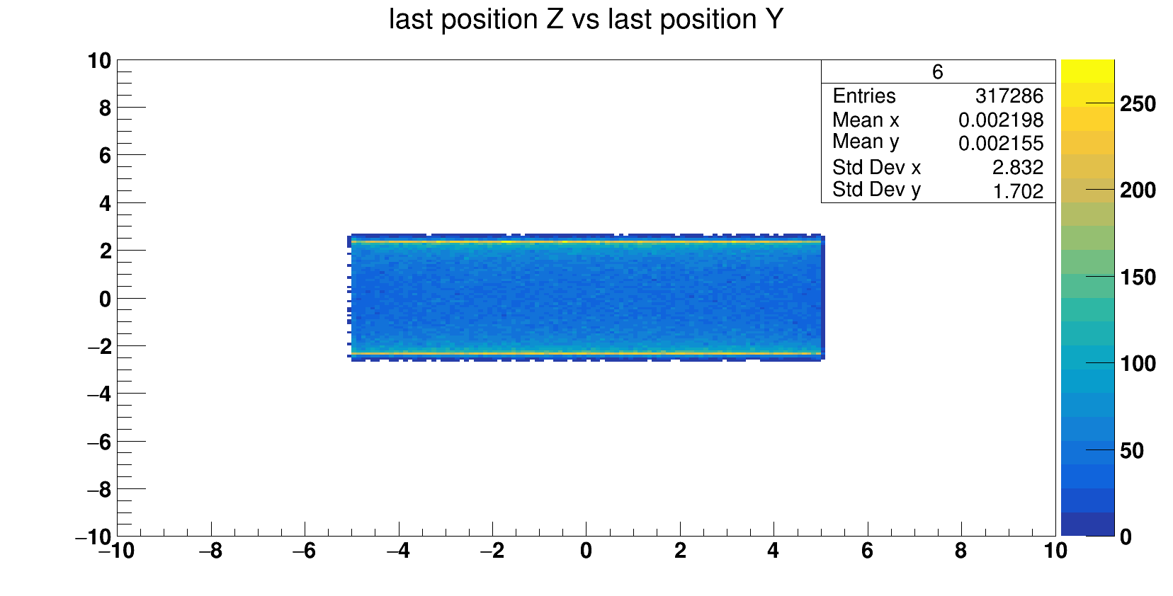
Z, mm
$$Number of events N_{events}={10}^{6}$$
X, mm
X, mm
Y, mm
Z, mm
Y, mm

Slide 8
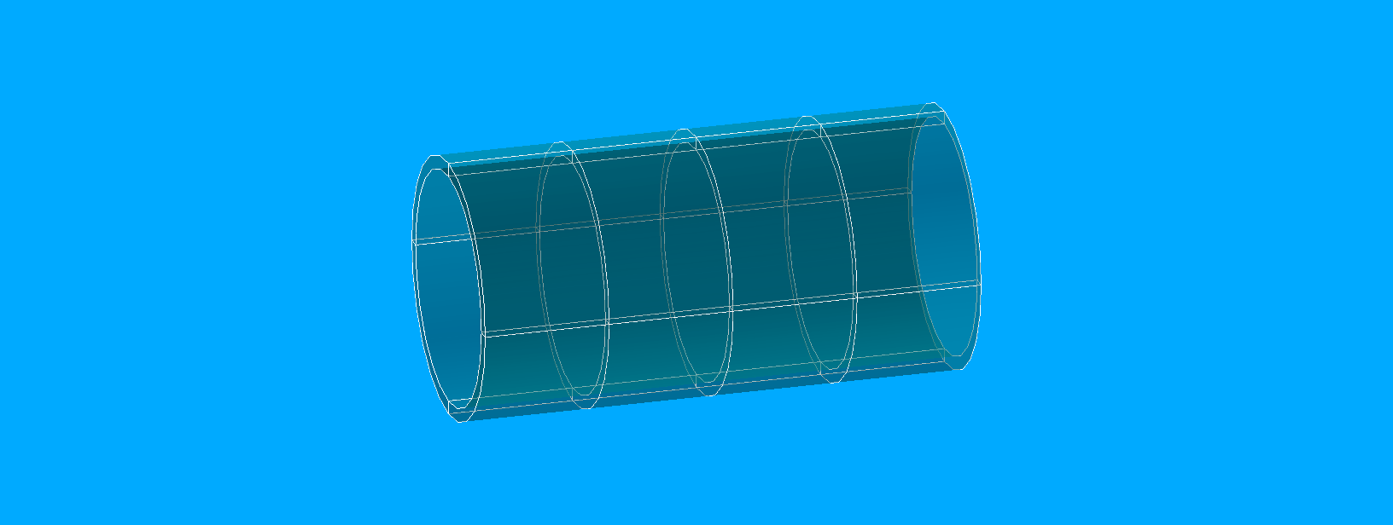
Split LAr volume 4x4

Slide 9
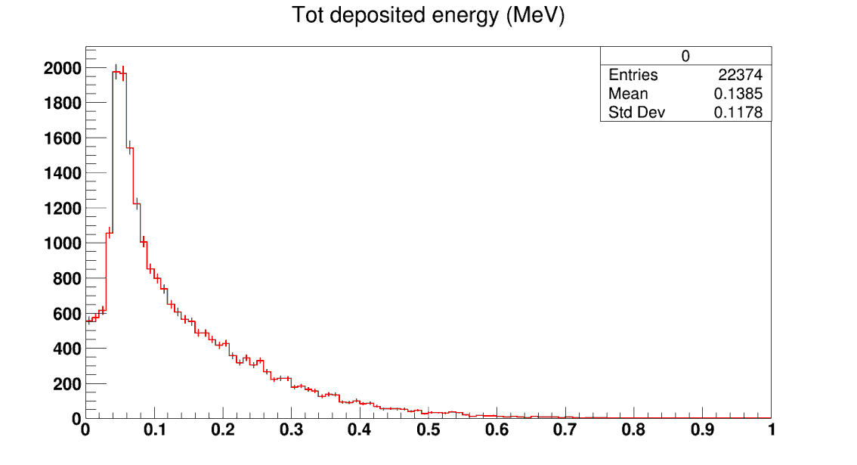
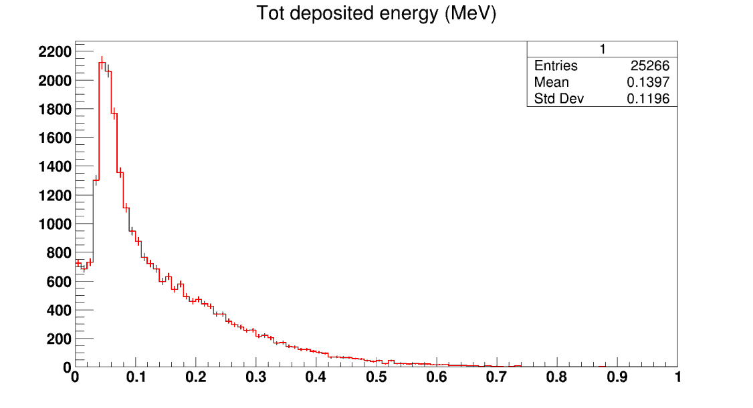
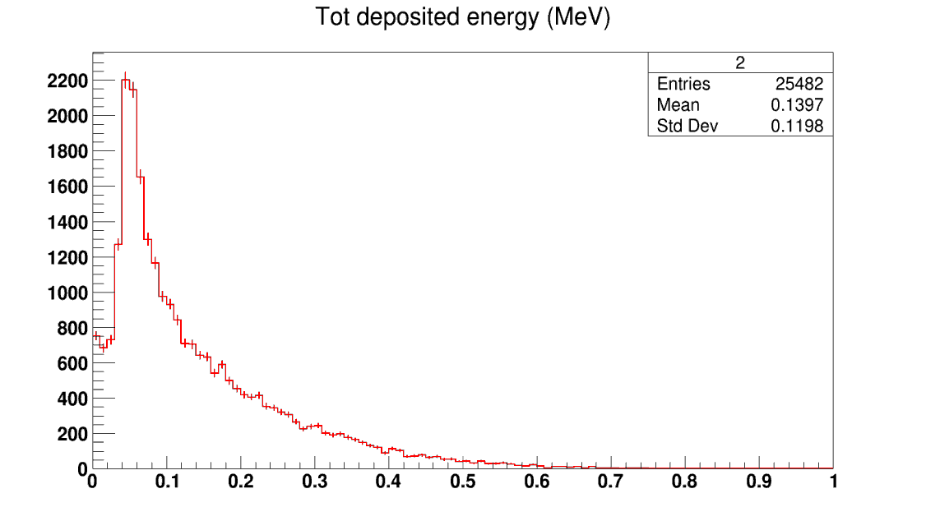
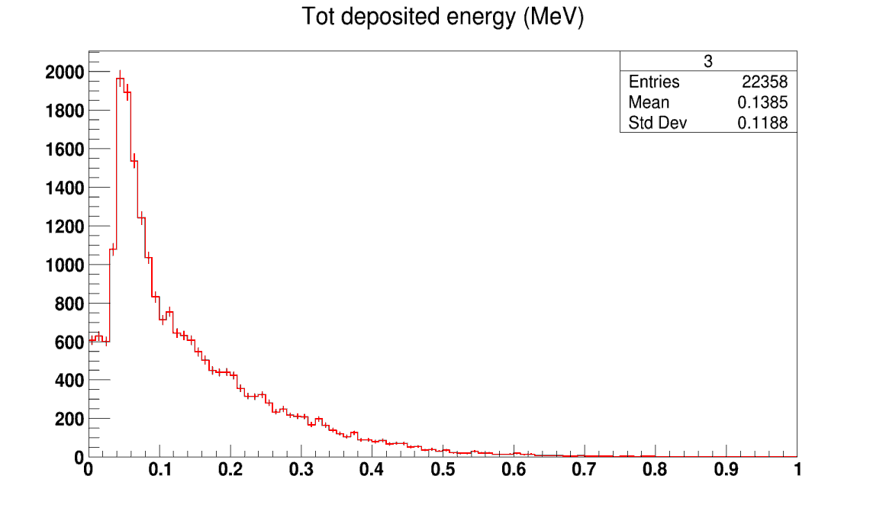

Slide 10
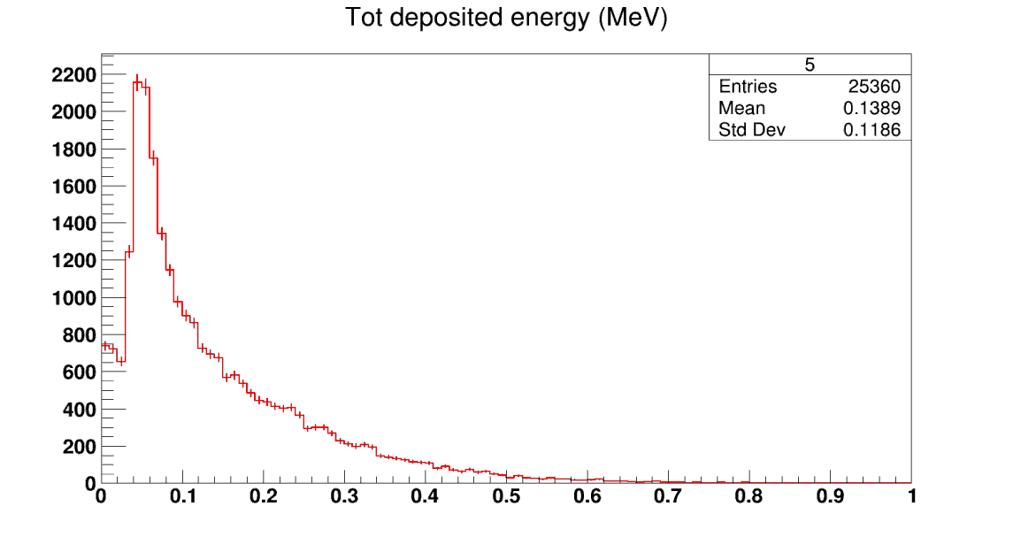
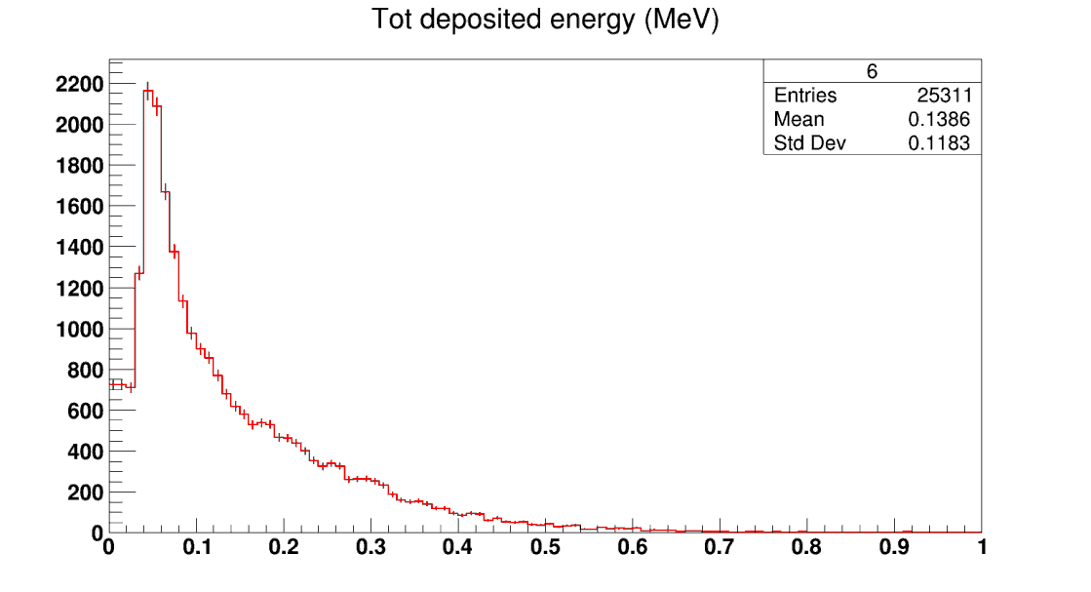
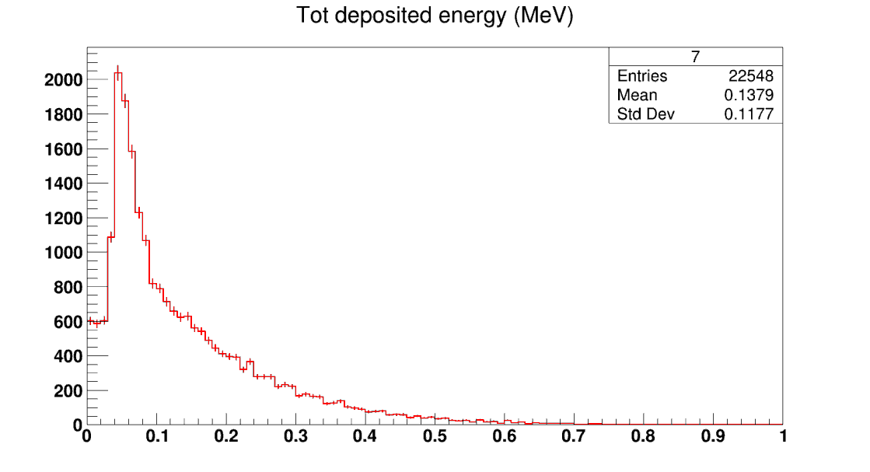

Slide 11
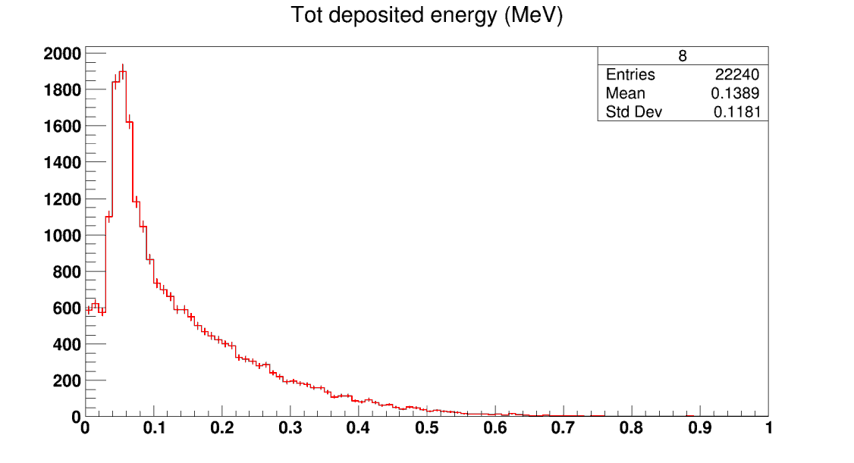
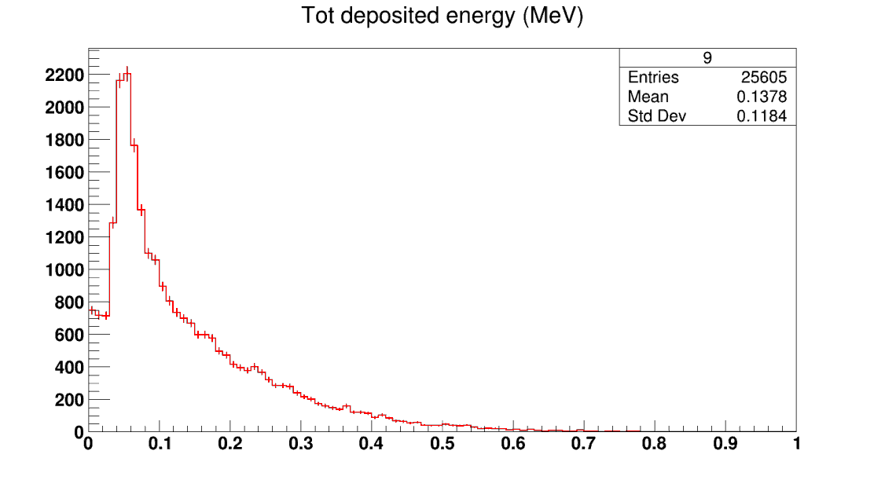
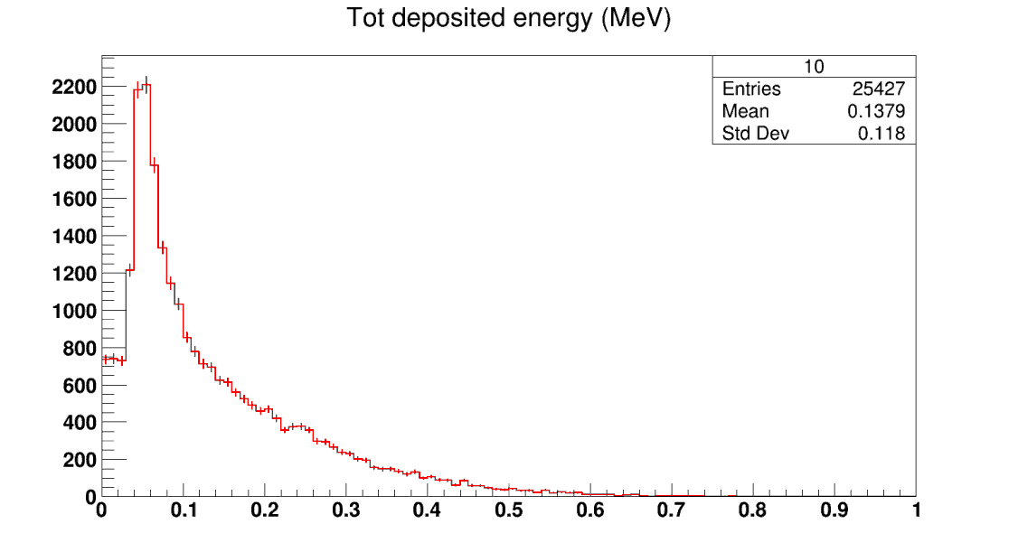
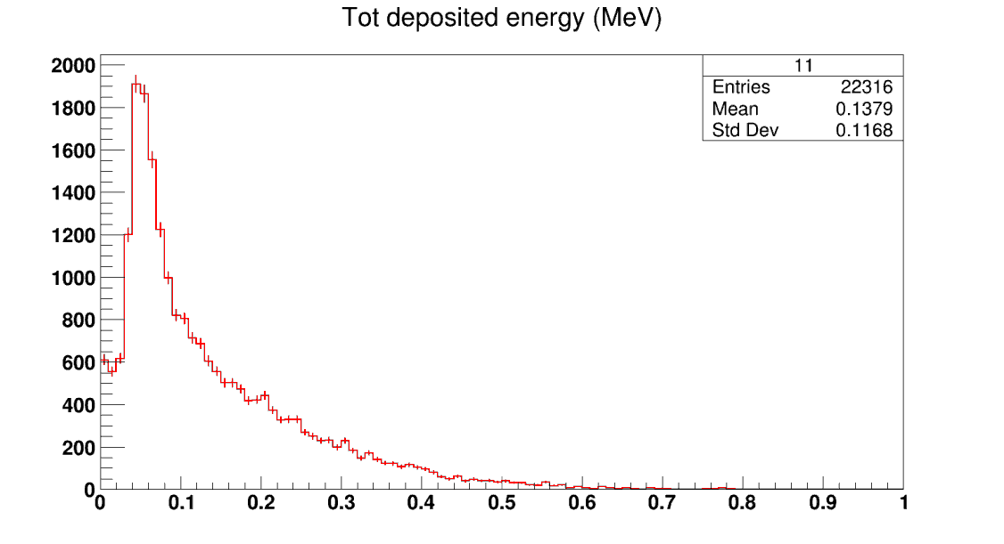

Slide 12
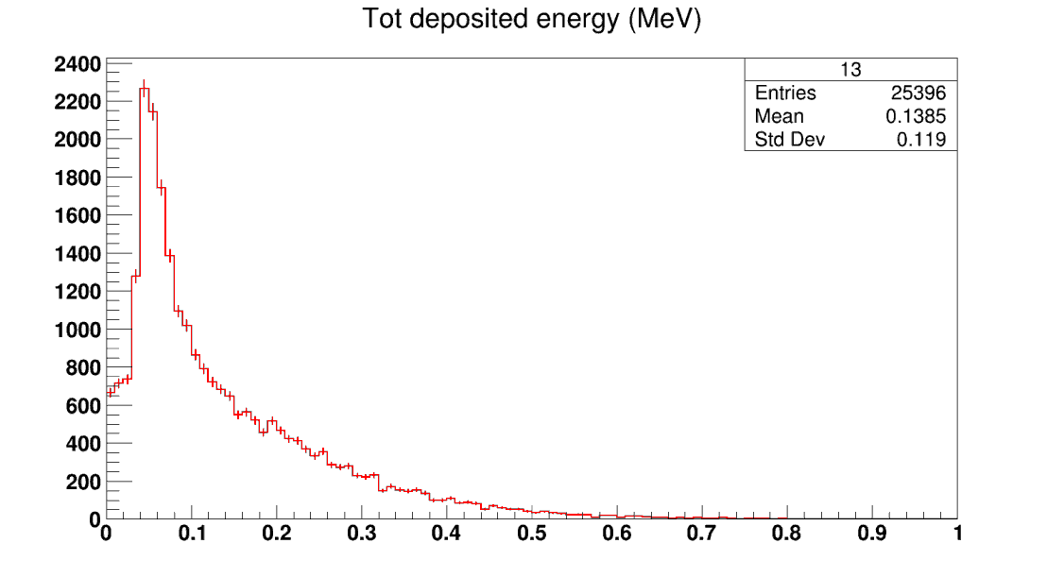
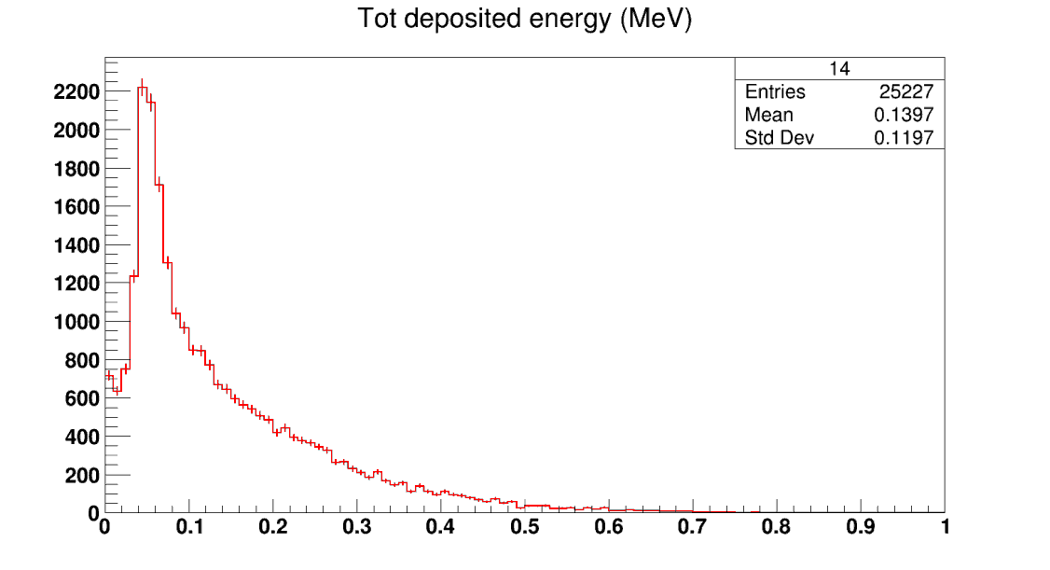
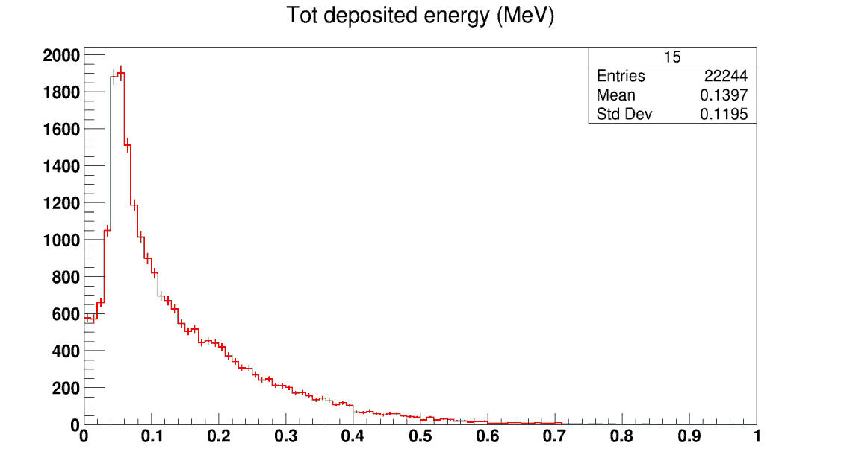

Slide 13
Number of events in cells
Z Phi | 0 | 1 | 2 | 3
0 | 22374±0,11 | 25266±0,11 | 25482±0,11 | 22358±0,11
1 | 22542±0,12 | 25360±0,11 | 25311±0,11 | 22548±0,11
2 | 22240±0,11 | 25605±0,11 | 25427±0,11 | 22316±0,11
3 | 22535±0,11 | 25396±0,11 | 25227±0,11 | 22244±0,11

Slide 14
Ionization energy loss of an electron
The minimum energy loss for light particles (minimum ionization) is about
dE/dx = 1.51 MeV/g/cm2
Using a density of ρ= 1.40 g/cm3 gives
dE/dx =2.11 MeV/cm
For every 25 eV of energy lost in the argon by such a high energy charged particle, one ion pair is created so a minimum ionizing particle traversing the gap produces about 8500 ion pairs/mm = 1.4 fC/mm of each charge along its track.
Munira Manashova

