Slide 1
FCalPulse modeling progress report
M.Manashova
01/03/2023

Slide 2
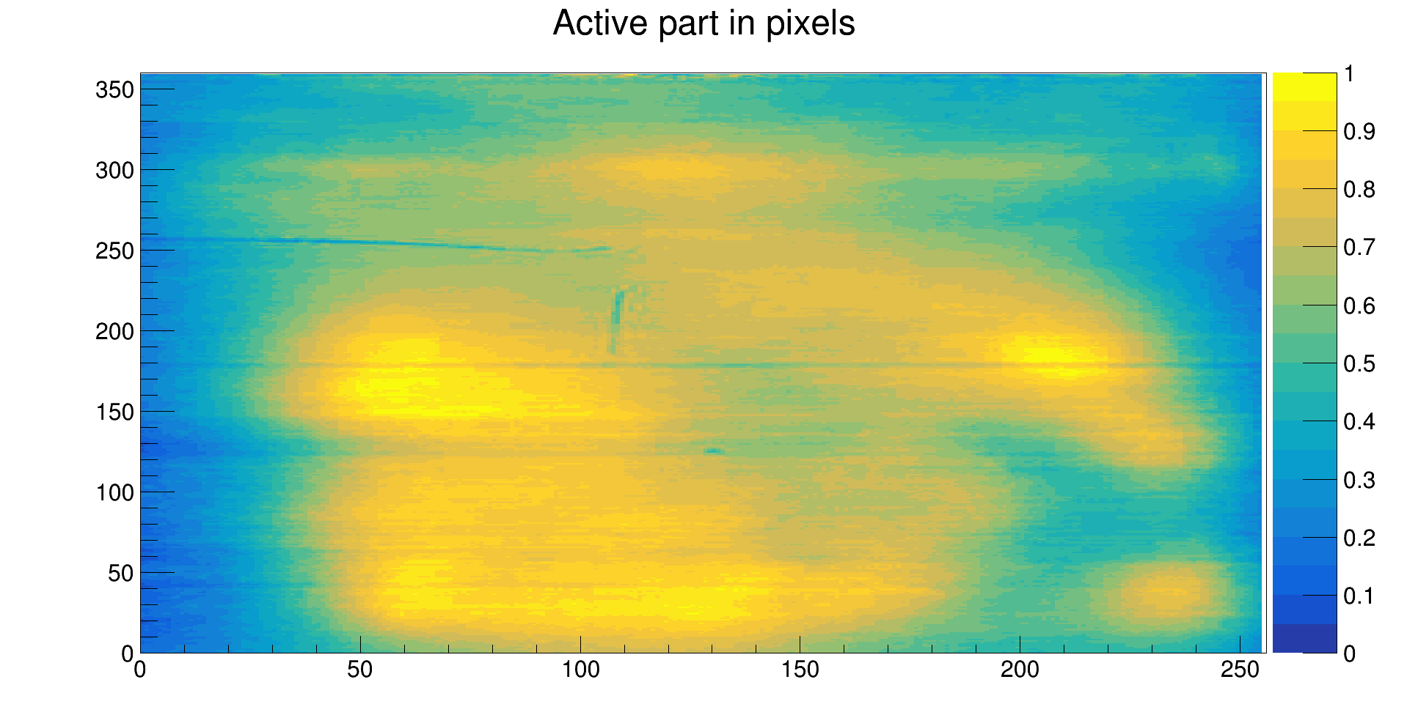
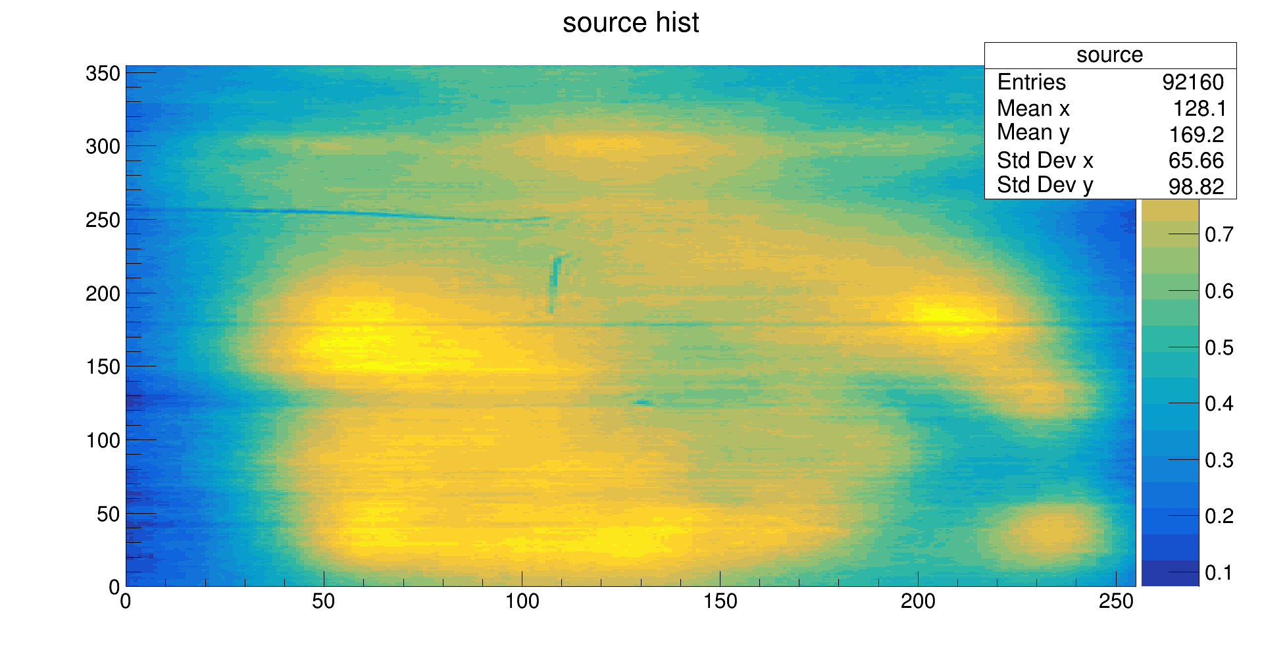
Film digitization
a)
b)
The results of the two-dimensional distribution of coordinates obtained by Tulgaa (a) and Munira (b)

Slide 3
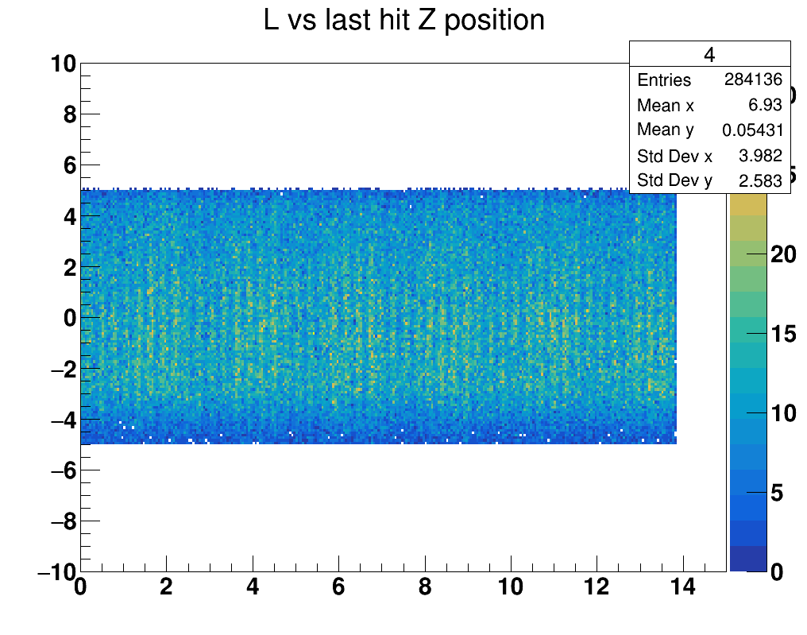
Z vs Phi

Slide 4
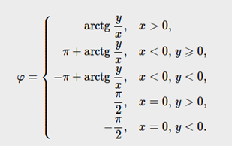
Implementation in MC
y, mm
360pc
Foil
Foil
1mm=25,4pc
255pc=10mm
360pc=14mm
Foil size
14mm
r=2,2mm
10mm
X,mm
255 pc
Z
L=r* ϕ
x=r*cos ϕ
y=r*sin ϕ
ϕ =L/r
r
L
Z
L
LAr
Foil

Slide 5
Conditions
$$R_{1}G_{1}B_{1}$$
II
I
$$\left|x\right|>0, y>0$$
ϕ=atan(y/|x|)
$$R_{2}G_{2}B_{2}$$
$$\left|x\right|<0, y>0$$
ϕ+90
III
IV
$$L_{1}$$
$$\left|x\right|<0, y<0$$
ϕ+180
$$\left|x\right|>0, y<0$$
ϕ+270
$$L_{2}$$
+
x=0, y>0 ϕ=π/2
x=0, y<0 ϕ=-π/2
$$L=nR+mG+kB,$$
$$n,m,k−coef.$$
$L$- luminosity
3 столбец куда/как?
Ekin*L X

Slide 6
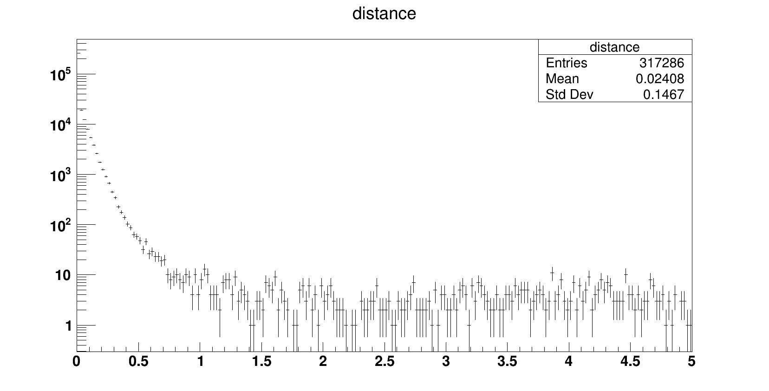
Distribution of distance in LAr
by electrons from Sr-90

Slide 7
Ionization energy loss of an electron
The minimum energy loss for light particles (minimum ionization) is about
dE/dx = 1.51 MeV/g/cm2
Using a density of ρ= 1.40 g/cm3 gives
dE/dx =2.11 MeV/cm
For every 25 eV of energy lost in the argon by such a high energy charged particle, one ion pair is created so a minimum ionizing particle traversing the gap produces about 8500 ion pairs/mm = 1.4 fC/mm of each charge along its track.

