Slide 1
SPD ECAL , April 2023 Status Report Oleg Gavrishuk, LVHE, Dubna, Russia
ECAL position inside of Cryostat
ECAL New Sizes corrected in 2023
Test results with new SiPm EQR15 11-6060D-S
New Sipm testing results
EC prototype cells 40x40 Cosmic test
Long time stability with new SiPm

Slide 2
ECAL with New Sizes in 2023

Slide 3
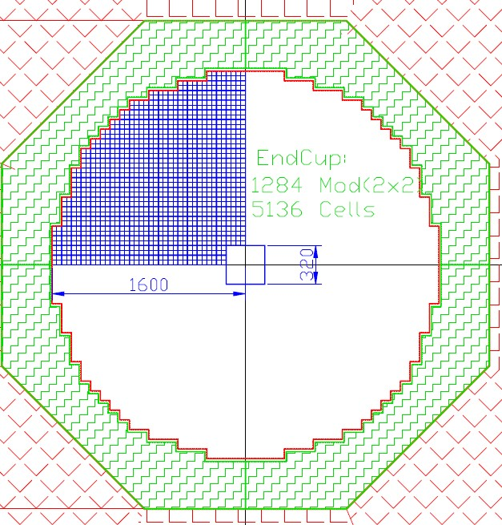
ECAL with New Sizes in 2023

Slide 4
ECAL composition with New Sizes in 2023
Barrel :
10 Rings – 1536 cells/Ring
Total Cells – 15360
ADC64 – 240
16ch Amplifiers – 960
Power units – 24
Weight – 38.4 tonn
ENDCUP:
Cells – 5136 / per EndCup
Total cells – 10272
ADC64 – 160
16ch Amplifiers – 642
Power units – 20
Total Weight – 256 tonn

Slide 5
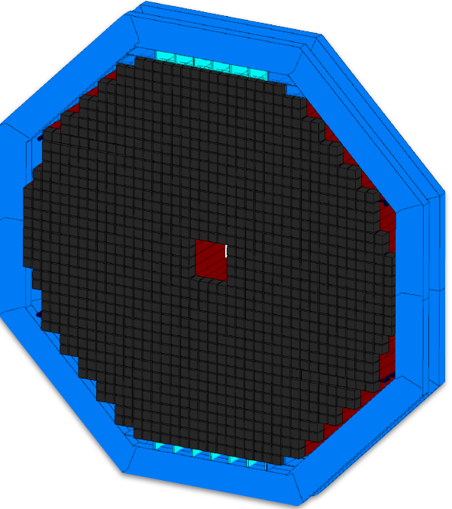
ECAL 3D View Barrel and Cup parts

Slide 6
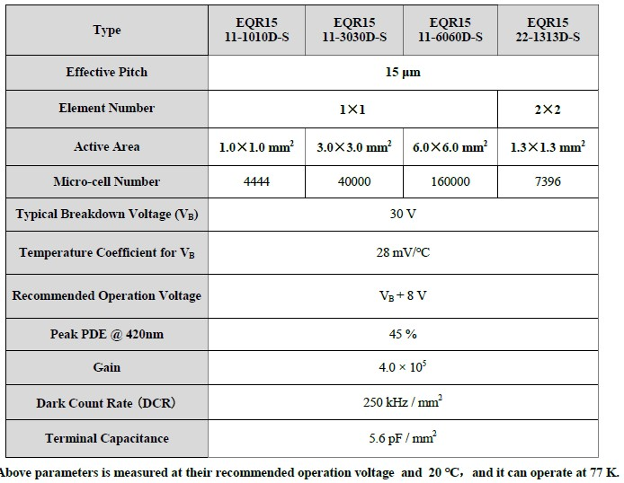

Slide 7
NDL SiPm Series EQR15 11-6060D-S www.ndl-sipm.net/PDF/Datasheet-EQR15.pdf
For a conventional SiPM, the quenching resistors are usually fabricated on the surface, and used to connect all APD cells to trace metal lines. In contrast, NDL SiPM employs intrinsic epitaxial layer as the quenching resistors (EQR), and uses a continuous silicon cap layer as an anode to connect all the APD cells. As a result, the device has more compact structure and simpler fabrication technology, allows larger micro cell density (larger dynamic range) while retaining high photon detection efficiency (PDE).
Для обычного SiPM гасящие резисторы обычно изготавливаются на поверхности и используются для соединения всех ячеек APD с металлическими линиями. Напротив, NDL SiPM использует собственный эпитаксиальный слой в качестве гасящих резисторов (EQR) и использует непрерывный слой кремния в качестве анода для соединения всех ячеек APD. В результате устройство имеет более компактную структуру и более простую технологию изготовления, позволяет увеличить плотность микроячеек (больший динамический диапазон) при сохранении высокой эффективности детектирования фотонов (PDE).
NDL (Novel Device Laboratory, Beijing) http://www.ndl-sipm.net/indexeng.html

Slide 8
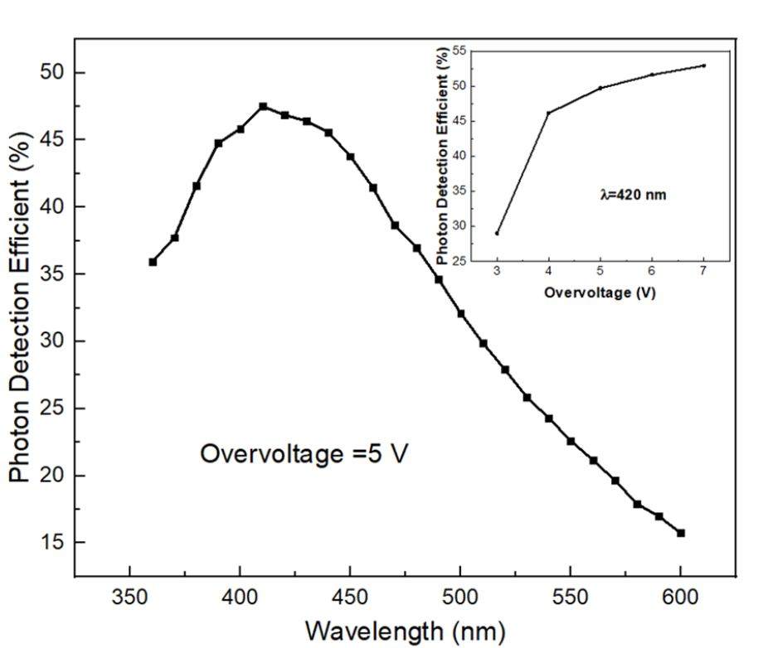
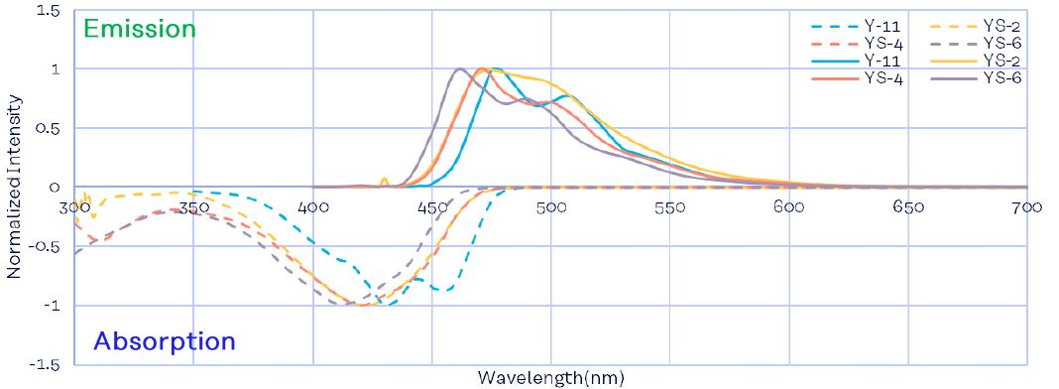
Photon Detection Efficient (PDE) correspond to WLS Emission spectra of Y11.
PDE close to flat maximum about 45% at 6-7 Overvoltage.

Slide 9
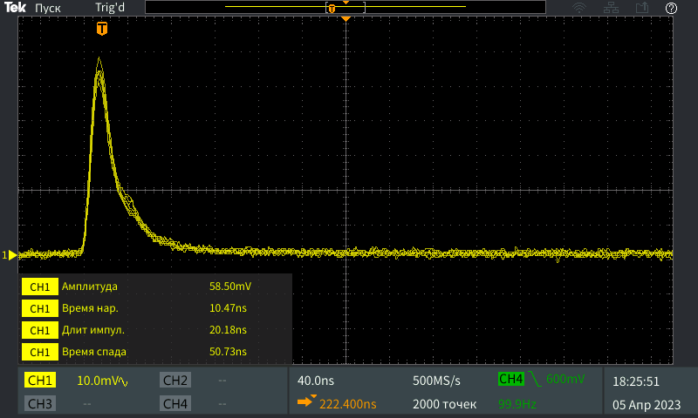
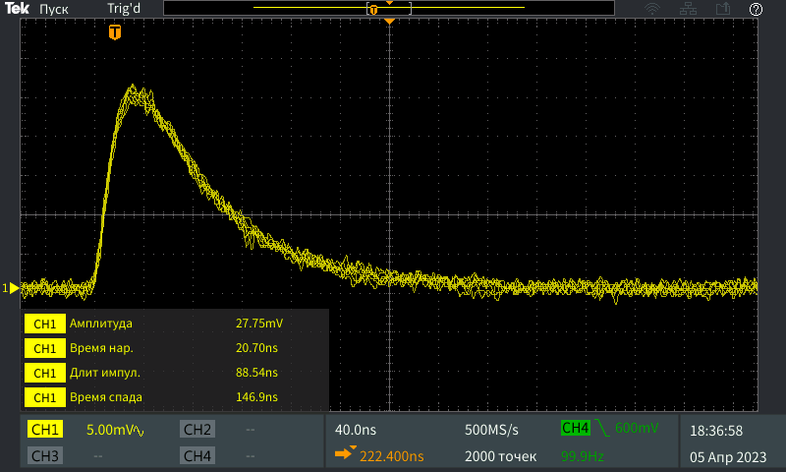
Pulse shape of SiPm with 15 µ pitch and 6x6 mm² size
EQR-15-60
Front – 10 ns
Length – 20 ns
HAMAMATSU S14160-6015
Front – 21 ns
Length – 89 ns

Slide 10
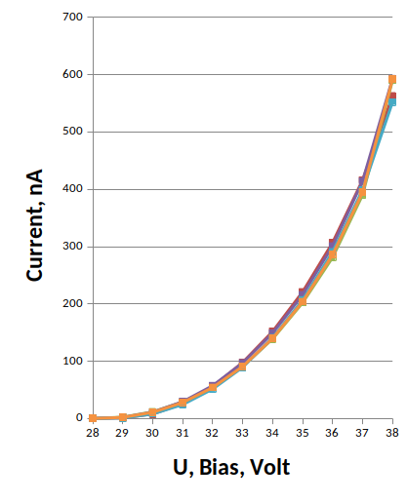
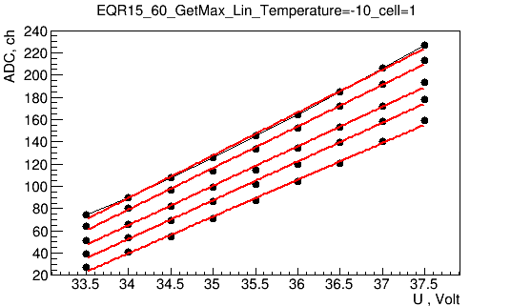
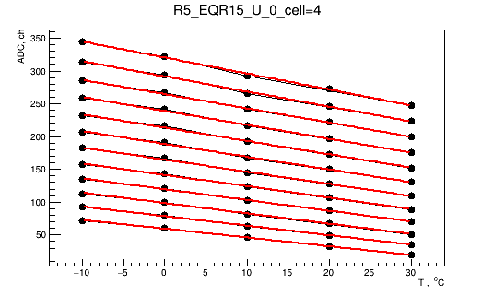
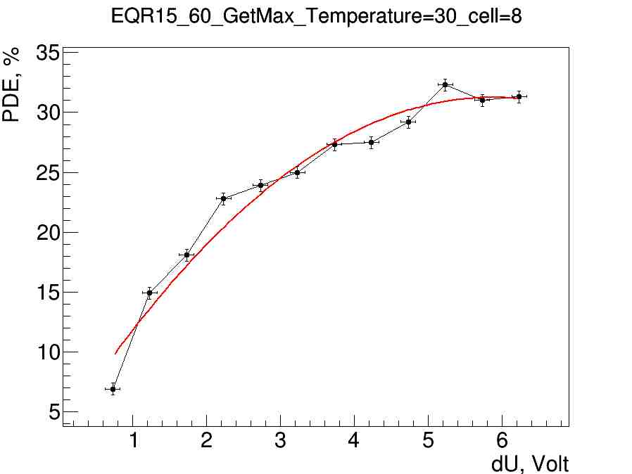
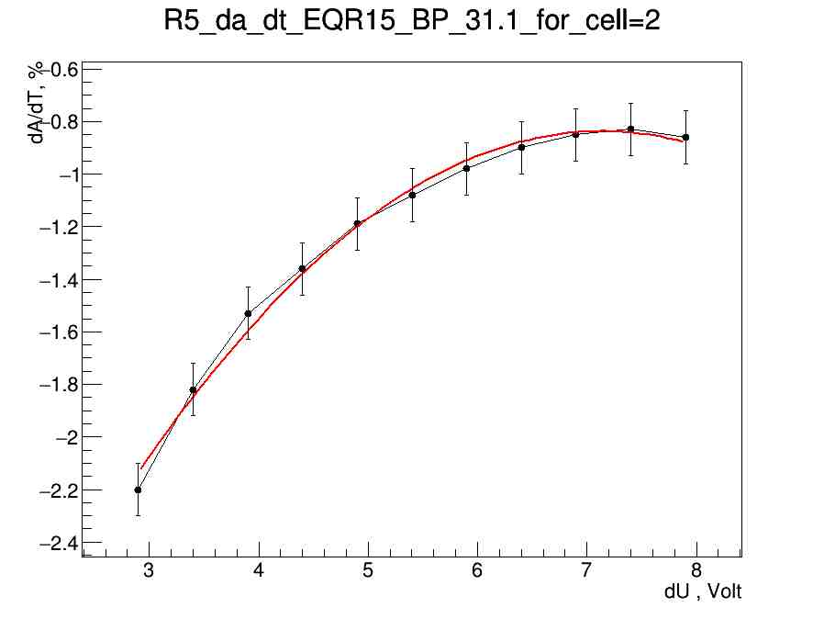
SiPm test Results
Dark Current measurements
Gain vs Overvoltage: dA/dU
Gain vs Temperature: dA/dt
PDE vs Overvoltage
Operation Volt. how to select it ?
Temperature stability studies

Slide 11
EQR15-60 Dark Current vs Bias voltage and its temperature dependences around operate Voltage
Dark Current vs Operation Bias (36-37 V) at room temperature (20 ⁰C)
is equal to 300-400 nA. Its are corresponded to the factory data and is similar HAMAMATSU too.

Slide 12
Gain vs Overvoltage allow obtain: slope=dA/dU vs U
Gain vs Temperature allow obtain:
slope=dA/dT vs T
U=38V
T=-10 ⁰C
dA/dT
dA/dU
T=+30 ⁰C
U=32V
K_{t}=dU/dT=dA/dT/dA/dU
The thermal stabilization coefficient (K_{t}) was defined as the ratio of the slope dA/dT to the slope dA/dU depending on the applied bias.

Slide 13
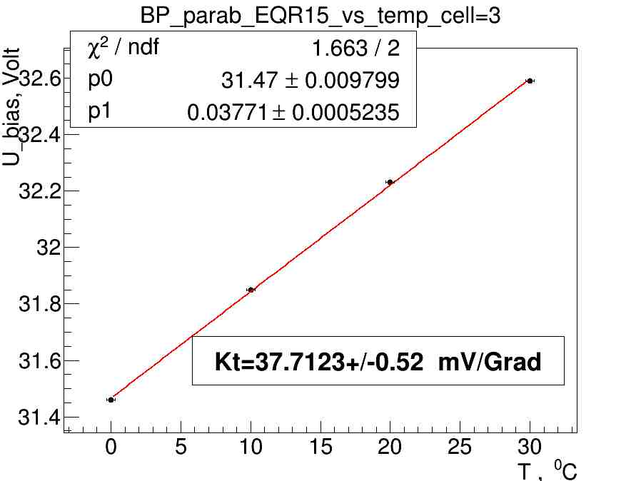
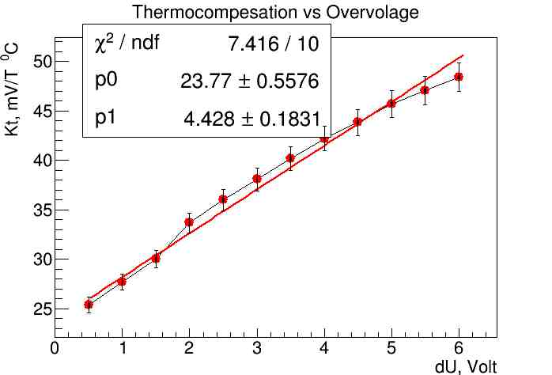
Break Point (Bp) was defined as extrapolation point of dA/dU to zero. Take assumption his linear behavior from Temperature we find that Bp=32 V at 20 ⁰C.
Kt=dU/dT=dA/dt/dA/dU fom previous slides we find that dependence from Overvoltage has linear behavior and equal to ~50 mv/⁰C at Operation point 5.5 V.
Operate point

Slide 14
Temperature sensitivity vs dU
Photon Detection Efficient vs dU
dA/dT vs dU
PDE vs dU
Operation point
Operation point
Operation point was found at dU=6.5 V take in account that:
dA/dT and PDE – has Plato in dU.
dA/dT has minimal value ~ 1%/⁰C , PDE close to maximal value ~ 32%.

Slide 15
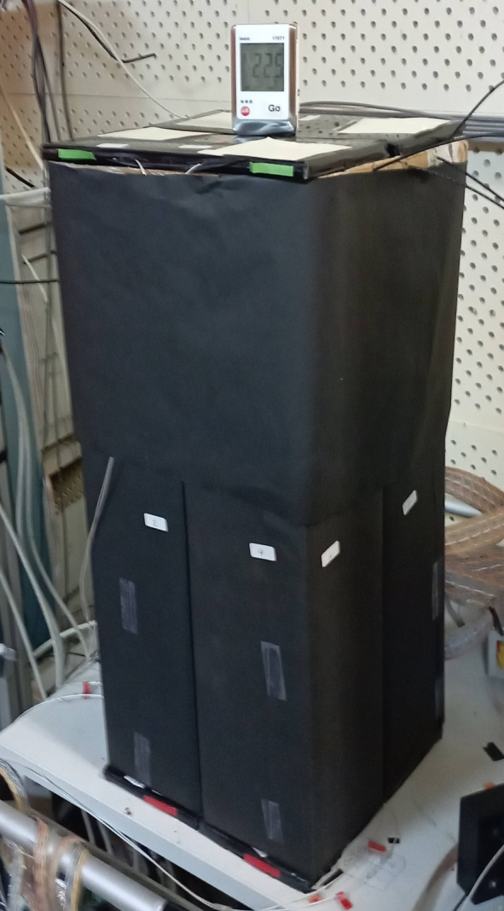
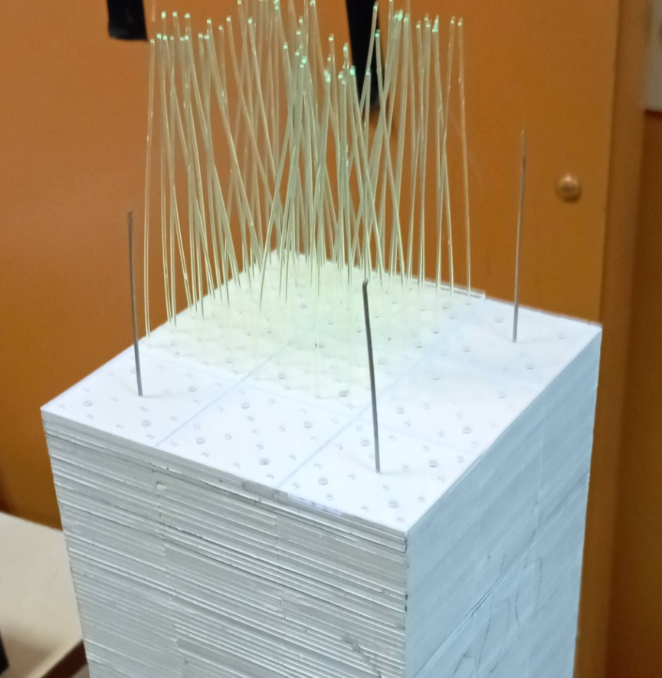
Test results with cosmic particles
Cosmic Rays
Setup of 4 modules. Each module consist from 9 cells of 4x4 cm². Totally tested 36 cells.
Sampling:
1.5 mm Scintillator
0.3 mm Lead
200 layers
Scintillator composition:
Polysterene
1.5% Paterphenyle
0.04% POPOP
Single Ecal module shown in assembling stage.
It is visible 9 cells as 3x3 matrix with WLS fibers (16 per cell). Y11(200) diameter 1.0 mm was used.

Slide 16
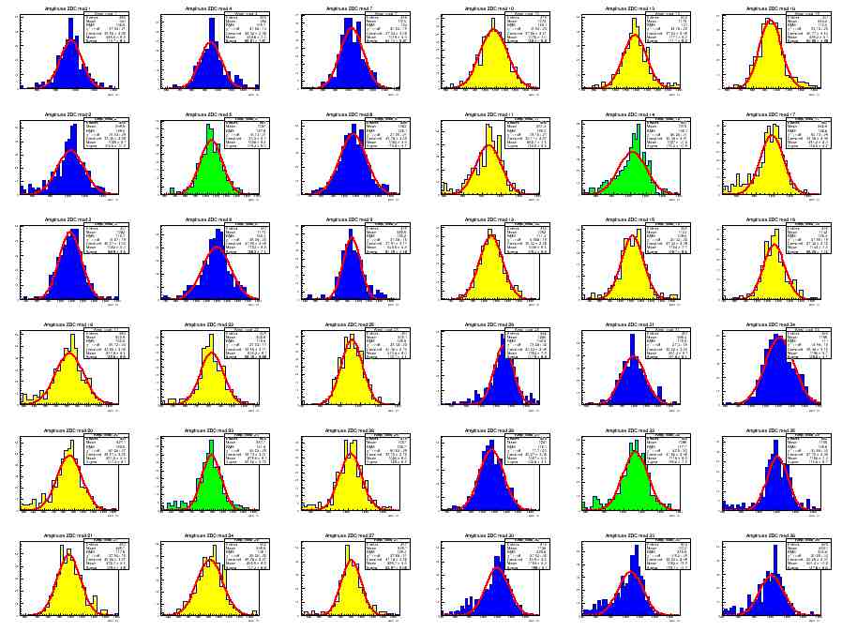
MIP spectra from 36 Cells. Top view shown on picture Above. One hit/event – applied selection criteria during analysis.
Calibration coefficients were found and normalized to 240 MeV.

Slide 17
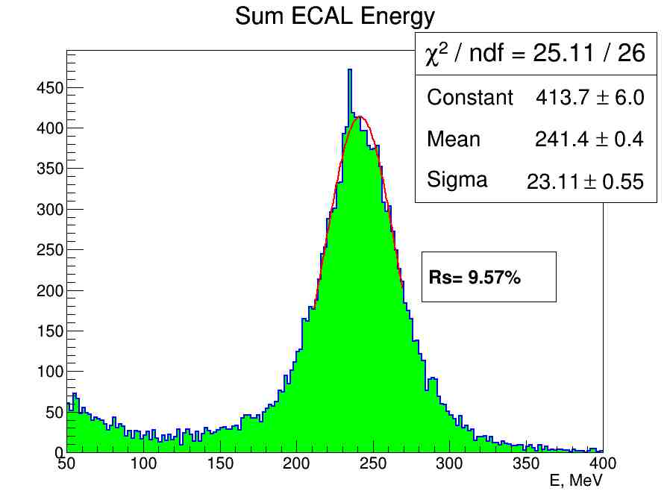
MIP spectra from 36 Cells as Total Sum take in account the Calibration coefficients normalized to 240 MeV. These Energy resolution corresponded to MC

Slide 18
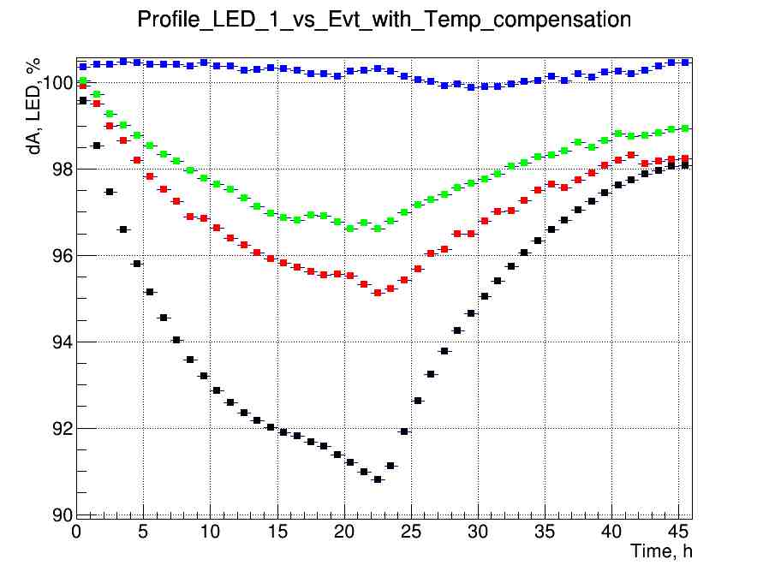
Kt=50 mV/⁰C
Kt=40 mV/⁰C
Kt=30 mV/⁰C
Kt=20 mV/⁰C
Test of long time Stability was done with different Kt for individual module.
The temperature variation from 20 to 30 ⁰C per day was applied.

Slide 19
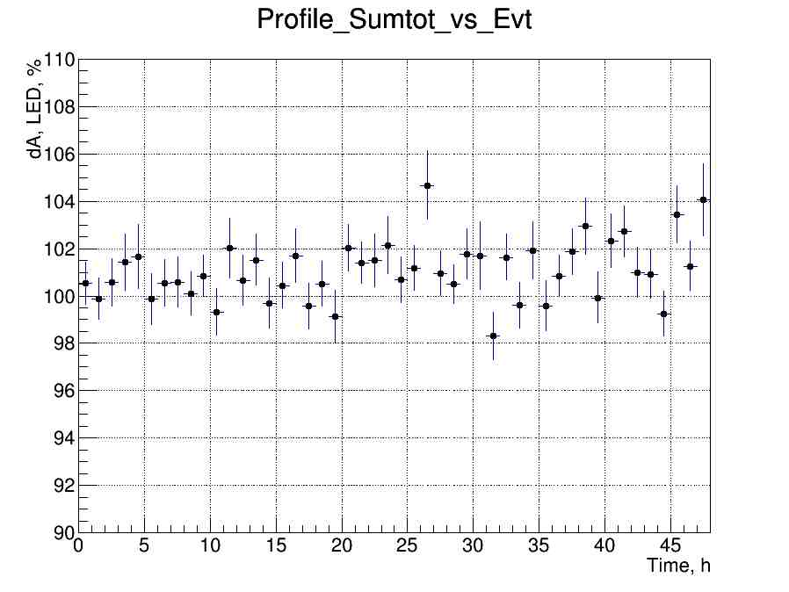
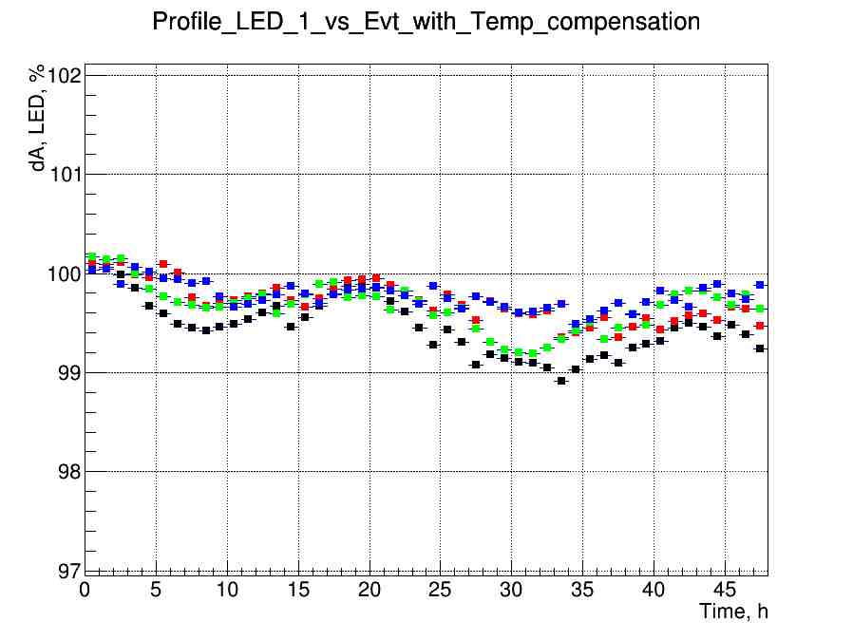
Kt=50 mV/⁰C
Long time stability for 4 modules shown +/-0.5% LED signal variation during 45 hours at Kt=50 mv/⁰C.
Profile Sum total of MIP signal shown ~1% variation during 45 hours.
This variation is not sensitive for MIP spectra with 9% resolution.

Slide 20
Conclusions
New ECAL geometry was designed in 2023
SiPm EQR15-60 China production were studied
New ECAL setup with cell size 4x4 cm² assembled
ECAL test in cosmic rays was done for:
Energy resolution estimation
Long time stability measurement

Slide 21
End of Report
Thanks for attention to All

