Slide 1
SPD Collaboration meeting, Dubna, 25 April, 2023 Range System Status Report G. Alexeev on behalf of SPD Muon Group
Main results:
- Mechanical FEA calculations for the final version of SPD setup conducted -> new/bigger SPD size
- Digital FDM-192 module ready for tests (reported at DAQ session by A. Nikolaev)
Current activities:
- Reconstruction of MDT’s assembly area (bld. 73) is in preparation
- Contract with Integral (Minsk) on Ampl-8.53 amplifier is under discussion
- Full size MDT plane prototyping with stand-imitator
- Trigger scintillators for the RS prototype ready
- Cherenkov counter test stand put in operation (at 45 atm/CO2)
Plans for the rest of 2023
Conclusion

Slide 2
New sizes of SPD: +10 cm/R & +/-15 cm/longitudinally, absorber structure of RS left the same (vertical cross section)
Main consequences of final/bigger size: 1) green light to design of solenoid, 2) more space for inner detectors,
3) higher load on support frame and infrastructure -> need to modify/strengthen them (done)
Total weight of new SPD setup: 1267 (+113) ton
Barrel: 536 (+54,4) ton (*)
End Caps: 471,3 (+23,3) ton
Support & Transportation: 119,7 (+35,3) ton
Inner detectors & Solenoid: 100 ton
Upper platform: 40 ton
…………………………………………………………….
(*) Barrel/8 modules = 67 ton (within crane capacity)
End Cap
End Cap
Barrel

Slide 3
The scope of conducted FEA calculations for the new/bigger size of SPD setup
All inner subsystems, except for solenoid, are kept with old weights
A. Samartsev:
The purpose of the calculations was to evaluate the overall ability of the RS structure, together with the detectors located inside the barrel, the equipment on the upper platform and the support-moving system as a joint force system, to bear the load from its own weight in several of the most critical (design) cases. Like that:
- the case of a fully assembled unit with closed EC doors, located on three roller sets
(six bottom carts);
- a previous case on 8 jacks (one of the possible working situations) ;
- a case with End Caps doors rolled to the maximum opening on 6 carts and additional supports at the ends of long rail beams.
1. The optimal locations for pairs of carts and pairs of jacks were selected to ensure uniform distribution of loads on the supporting elements for these cases.
2. A variant of strengthening the support-transport system was selected to ensure that the parameters of the stress-strain state of the load-bearing structure are not worse than those of the old SPD version.
3. For all considered cases, stresses do not exceed 600-700 kg/cm2, which is quite acceptable for ‘Steel 3’ material.
4. The main results of all considered options (power circuit, modeling of force and kinematic boundary conditions, selected distances for support elements) are presented on the slides.
To understand pictures:
- pink arrows and large red arrow - distributed loads from elements not considered in the power circuit (internal detectors and equipment on the upper platform) and the gravitational component;
- green arrows - modeling of supporting elements;
- the results (stresses, displacements) are shown by color spectrum, and in critical places by numerical values.

Slide 4
New SPD setup (quarter of setup is shown – due to symmetry of the simulation tasks)
New geometry of Range System as compared to ‘ideal’:
Vertical inner diameter -> ~ - 1mm
Horizontal diameter-> ~ +1mm
___________________________
No problems for solenoid and inner detectors!
Absorber slots in top module -> slightly increased (good for MDTs planes mounting)
Absorber slots in bottom module -> slightly decreased ~ - 1mm (take care during MDTs planes mounting!)
With magnetic field additional forces
(yellow arrows) setup must be considered also. They complicate picture for RS, but do not change the loads to the floor
End Cap

Slide 5
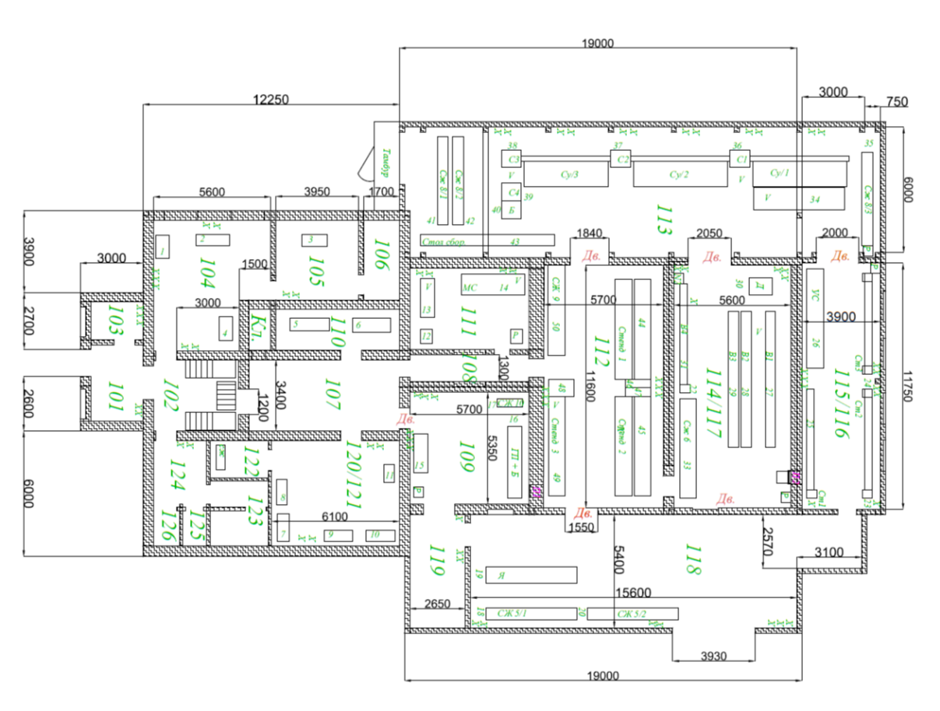
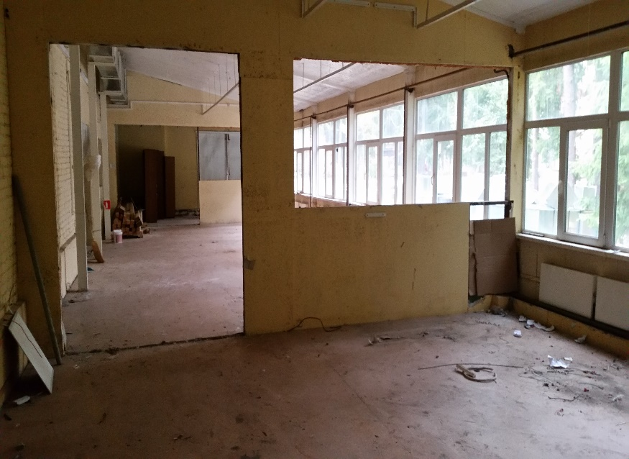
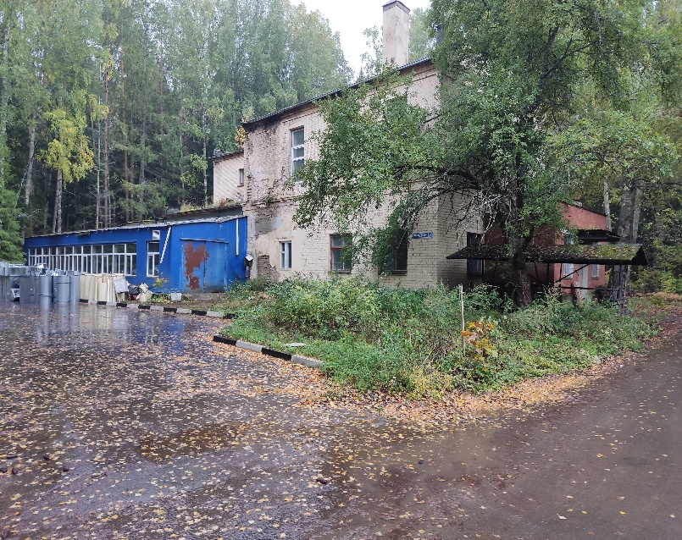
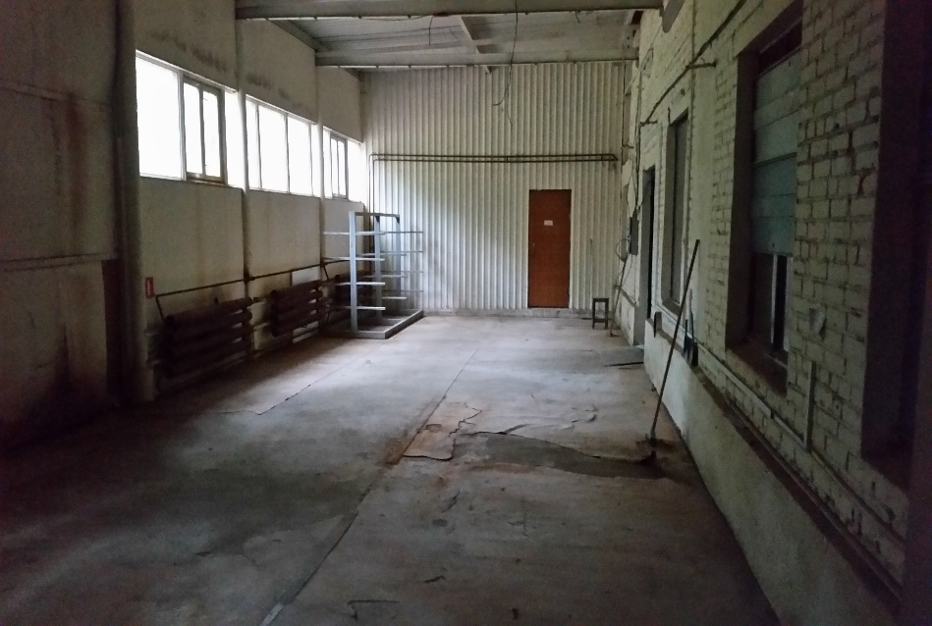
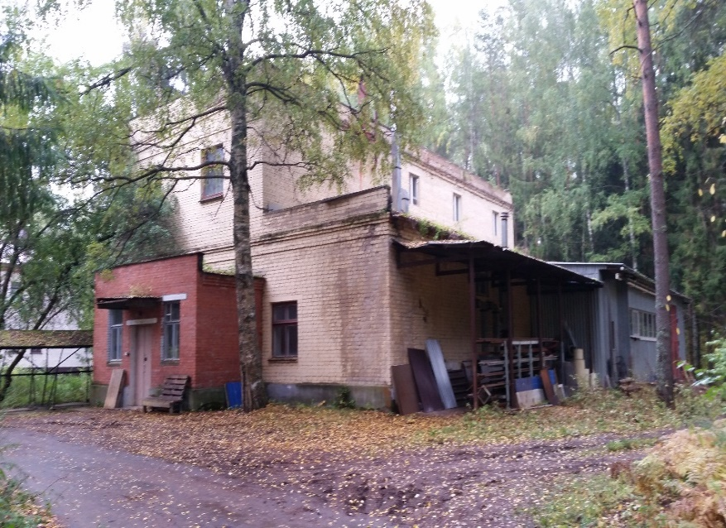
Basis for deployment of MDTs assemble and test areas
Bld.73, 1-st floor plan
MDTs assembly area
The start of works on the building is expected in II quarter 2023 –> first, JINR department will estimate the cost of reconstruction
Storage area

Slide 6
Development of low input impedance amplifier chips: from Ampl-8.3 to Ampl-8.53 _________________________________________________
To be used in RS analog front-end electronics
Ampl-8.3
Ampl-8.53
Used for:
D0/FNAL, COMPASS&AMBER/CERN, PANDA/FAIR (project) muon systems
R&D stage to the version
Ampl-8.52 tested at CERN and Minsk
Chip with new (compared to Ampl-8.52) optimized topology is being developed now in Minsk (group of M.A. Baturitsky)
Contract with Integral (Minsk) on Ampl-8.53 amplifier preproduction is under discussion. In case of signing the contract this summer we may have first bunch of chips in summer 2024

Slide 7
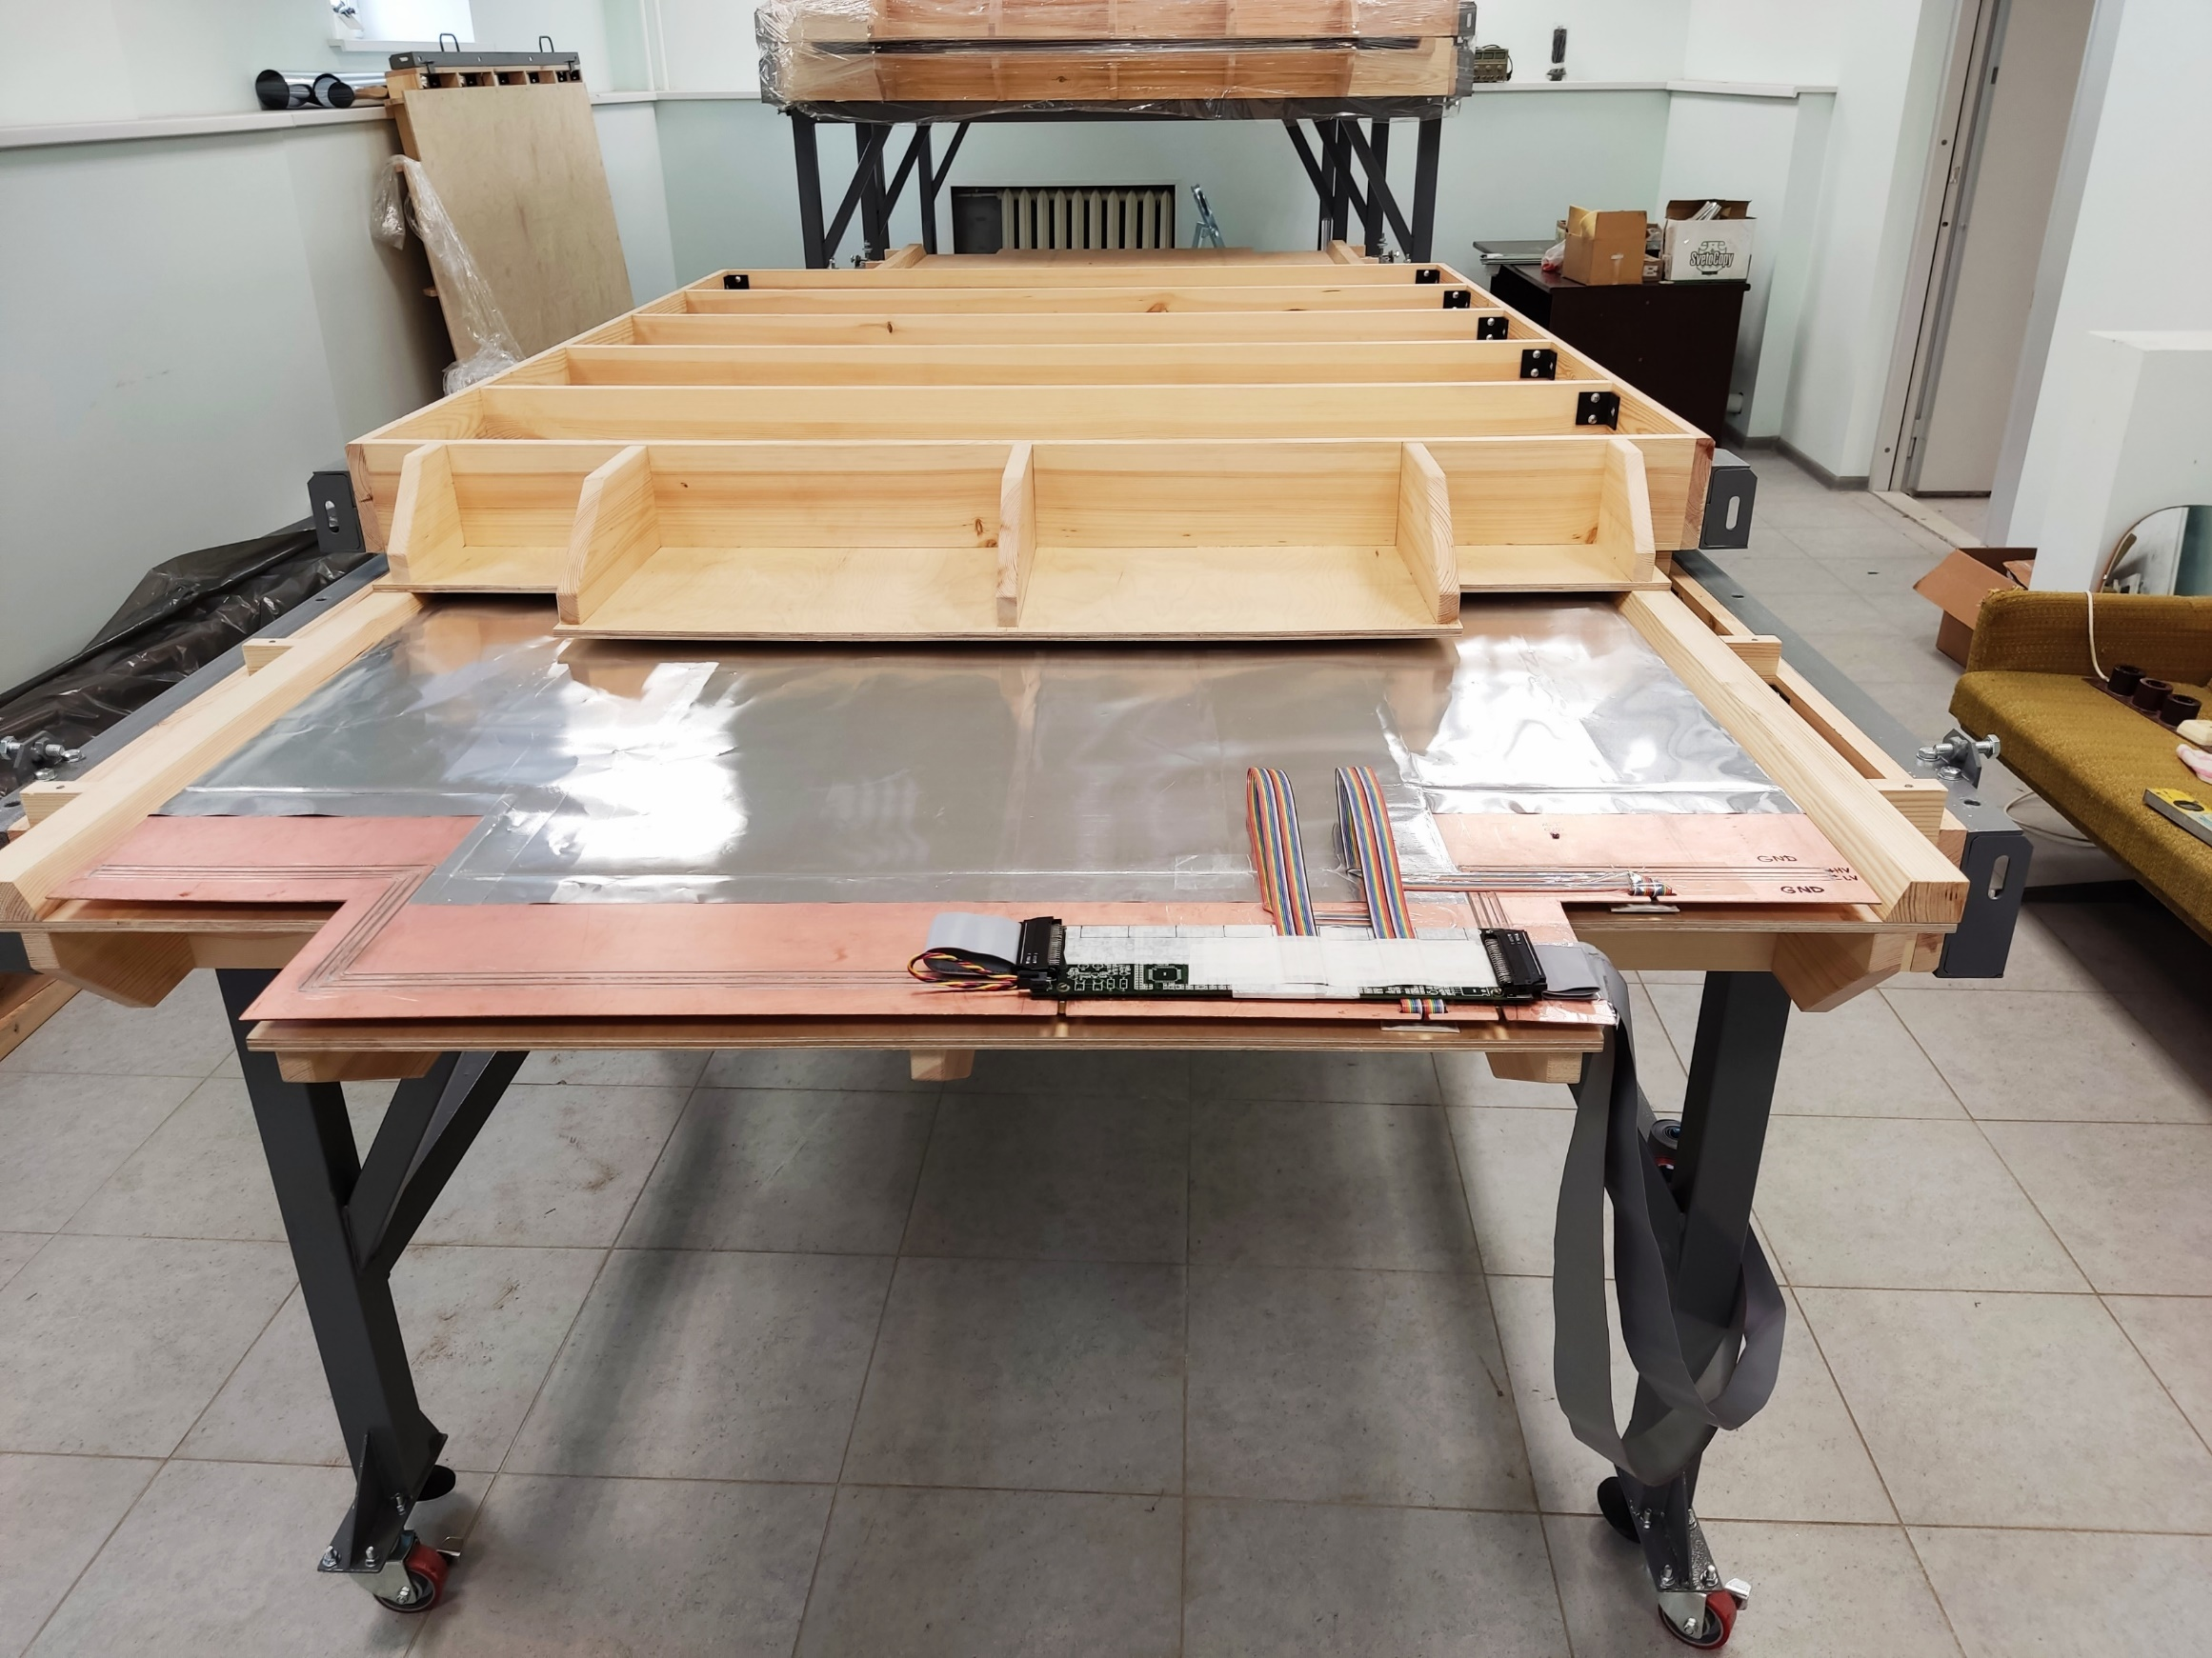
Full-size stand-imitator to study: optimal design of MDTs detecting layer with strip board, analog front-end electronic cards deployment for wires and strips readout, cabling in/out the absorber slot

Slide 8
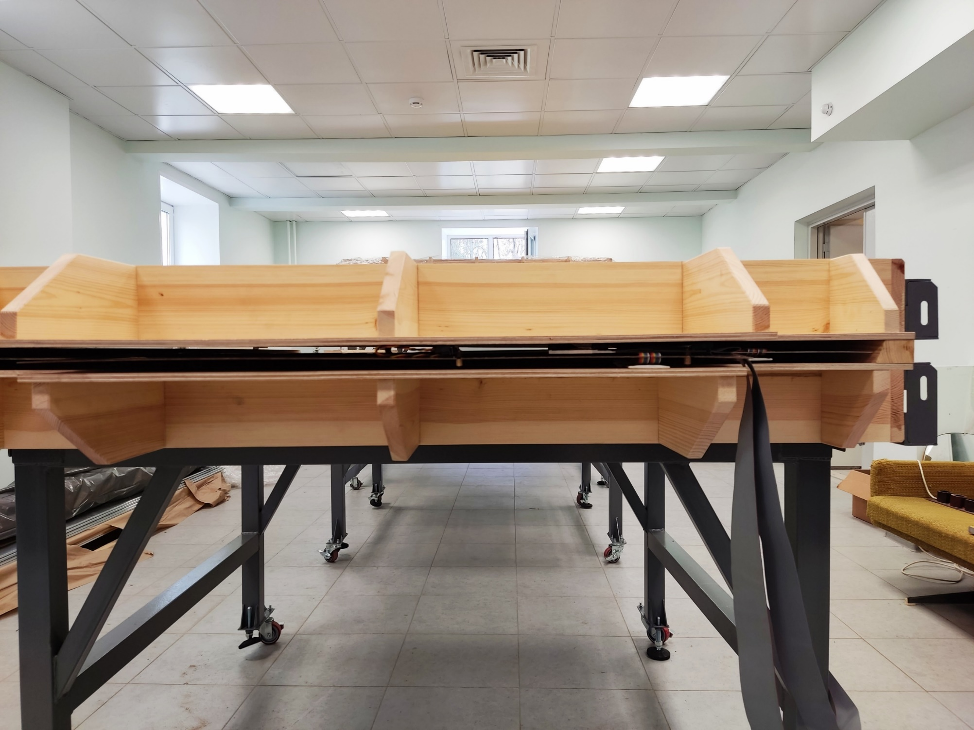
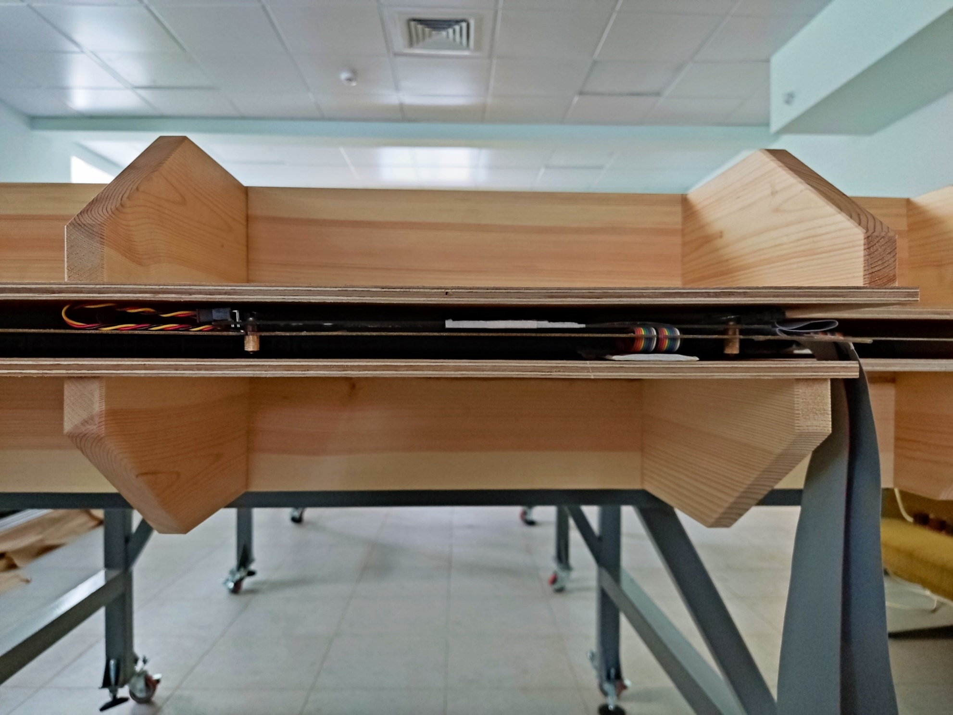
Detecting plane mockup (MDTs, strip board, analog FEE cards and cables) inside the slot 30 mm of stand-imitator: rather dense space !
30 mm
Preliminary impression after assembly of detector plane into the slot of stand-imitator -> 30 mm gap is close to practical limit

Slide 9
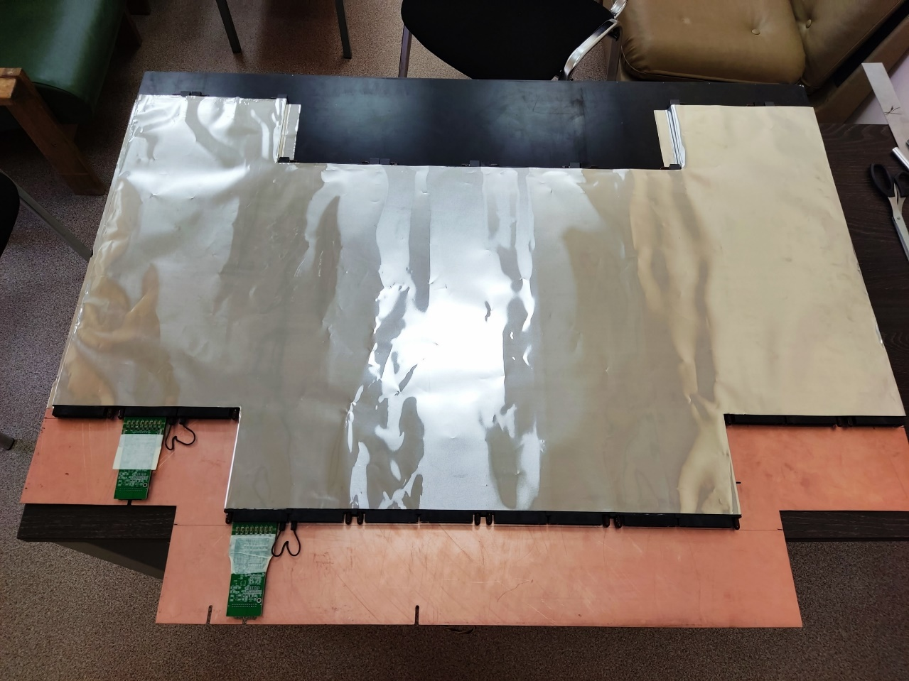
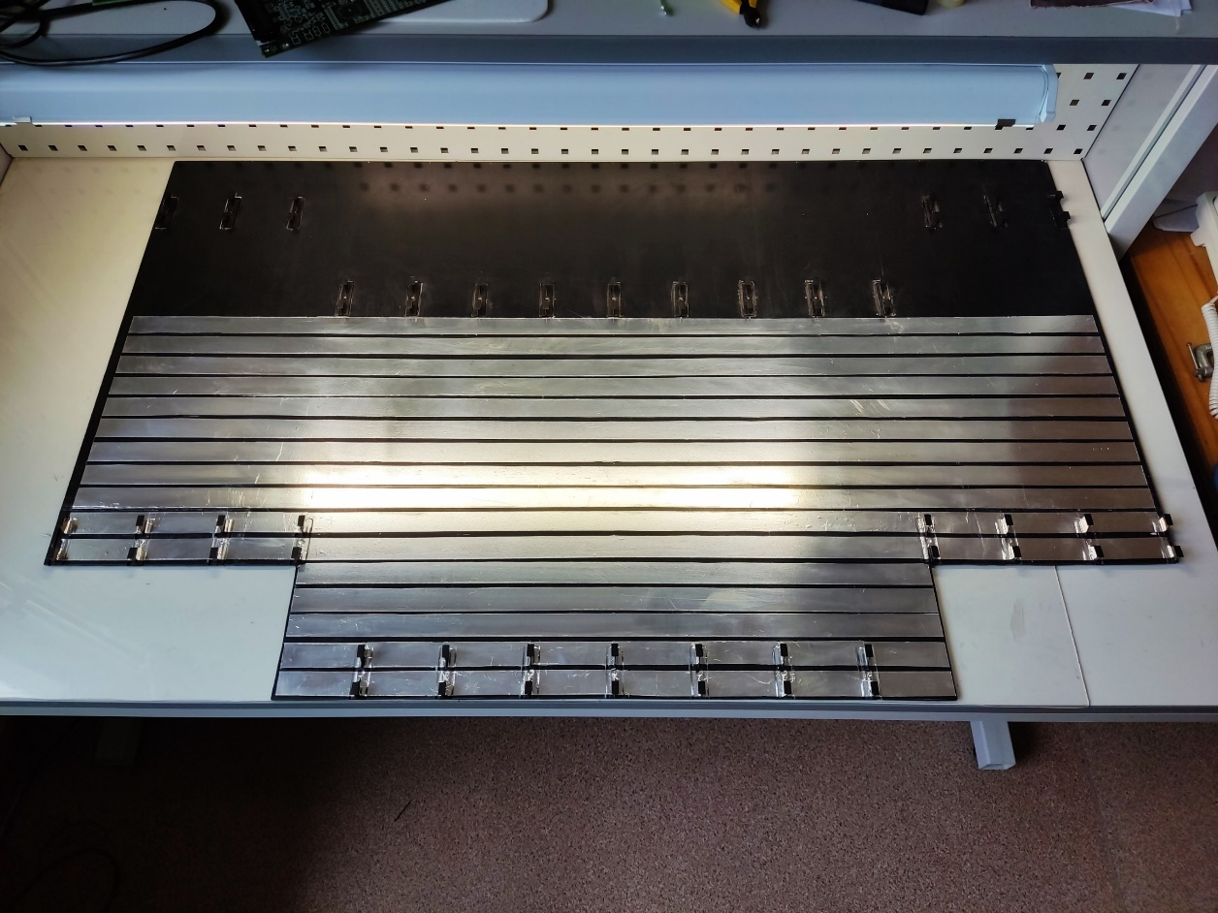
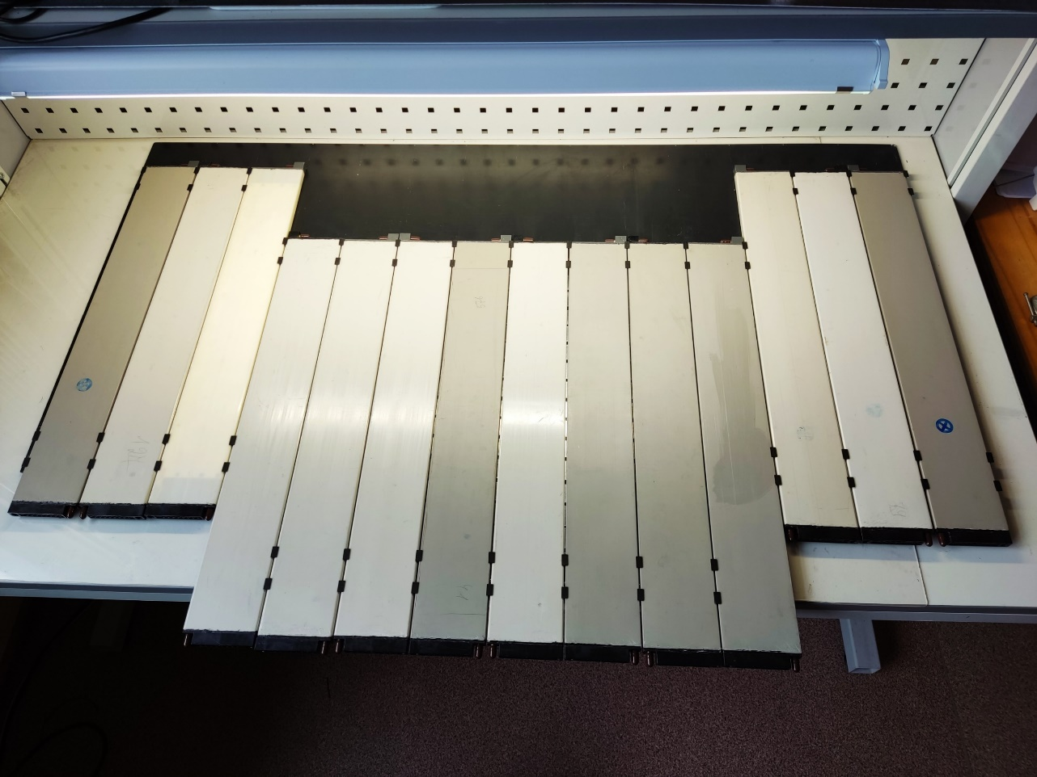
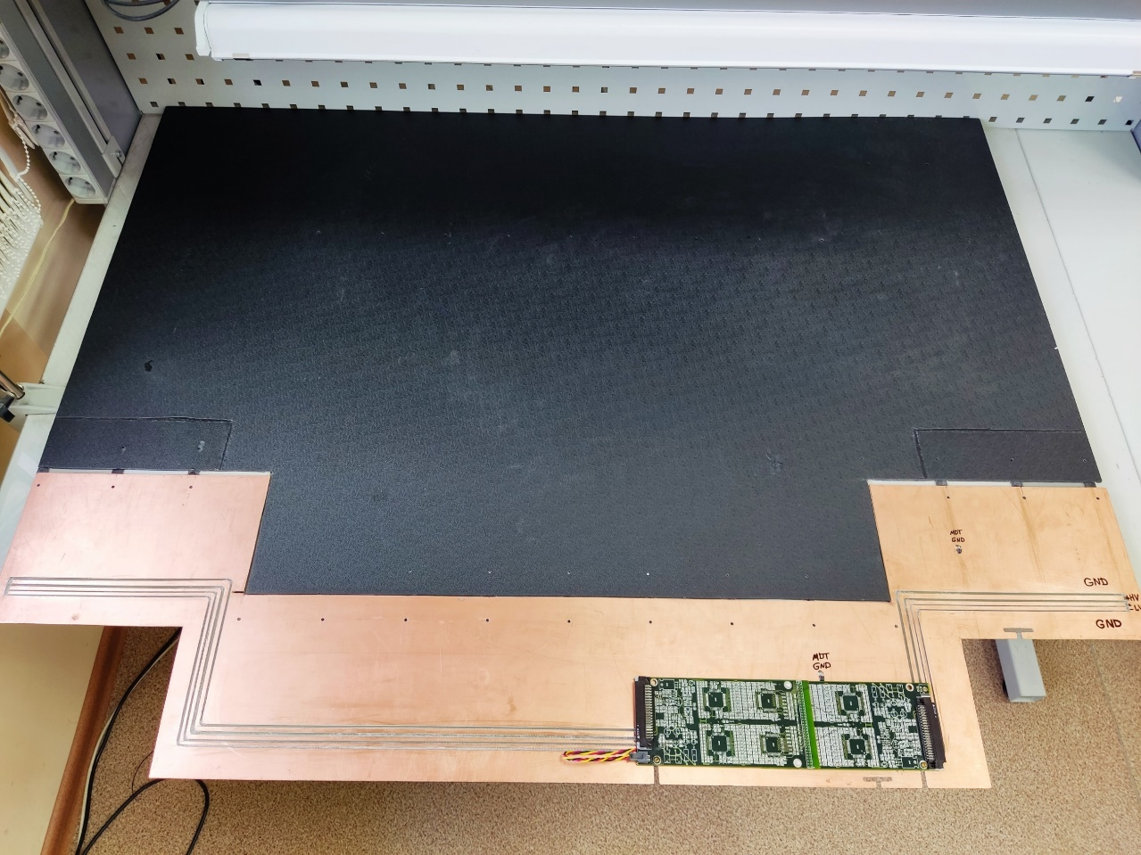
Mockup of detecting plane (MDTs, FEE cards, power distribution fiberglass board, cables)
Imitator of honeycomb strip board (4 mm thick)
Ground shielding (ALU film)
Strips (3 cm wide)
Wire readout board mockup)
Power distribution fiberglass board with HV, LV and ground bus
Rotated position
MDTs mounted onto strip board
Translator board mockup

Slide 10
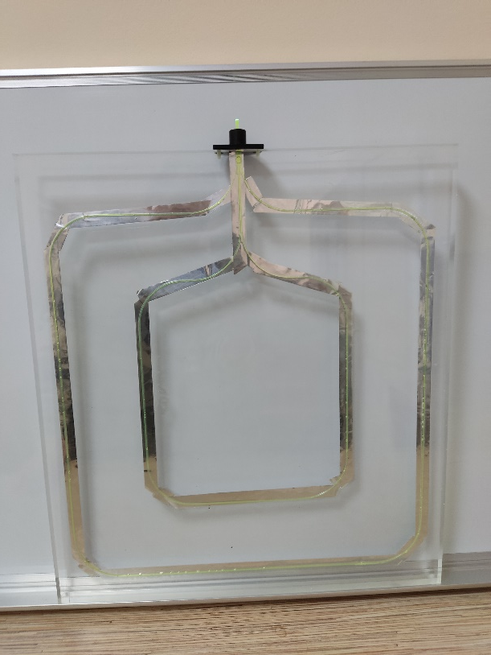
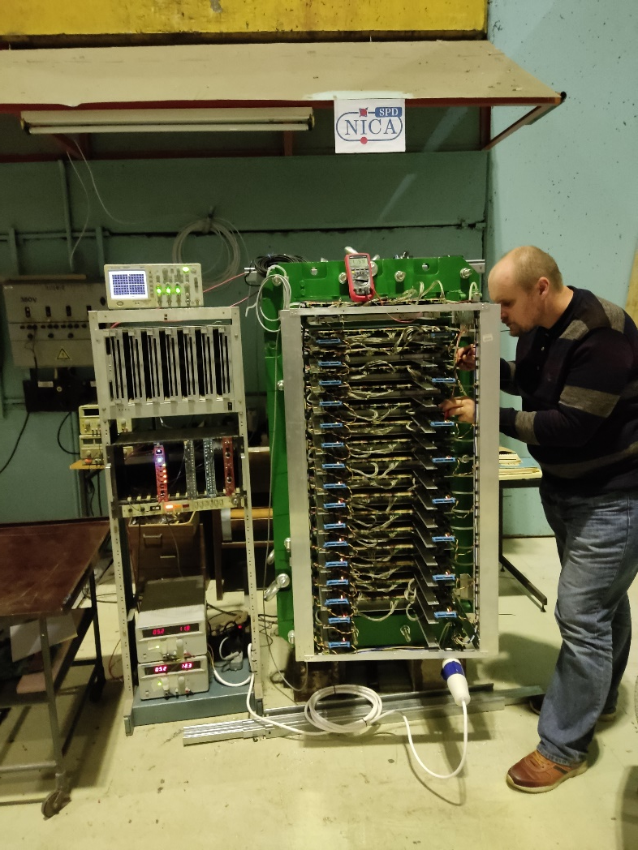
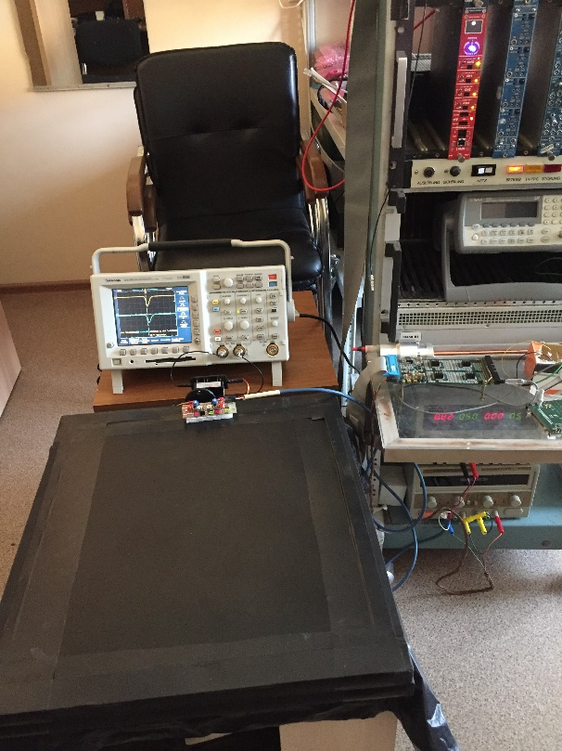
Trigger scintillators for RS prototype at Nuclotron test area are ready. RS prototype is fully operational (MDT detectors, front-end analog and digital electronics, gas system) except for DAQ system (pending installation of multiplexor modules from CERN… )
Reading out the plastic scintillator with wave-shifting fibers
Two trigger counters 50x45x2 cm3 with Hamamatsu Photo-sensors H10720
Position of cosmic trigger counters (top/bottom) at RS prototype

Slide 11
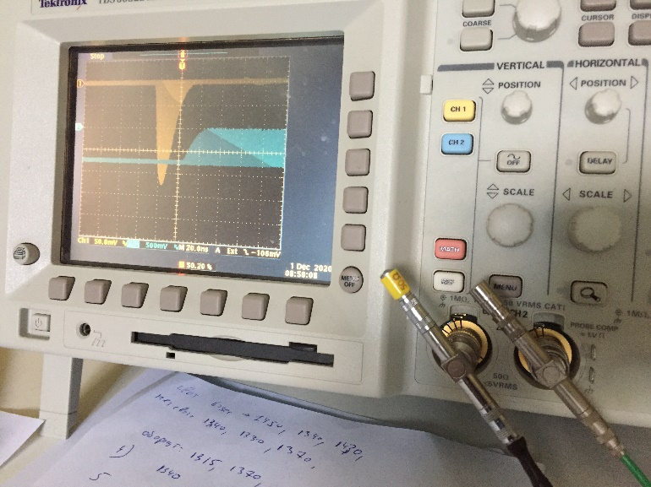
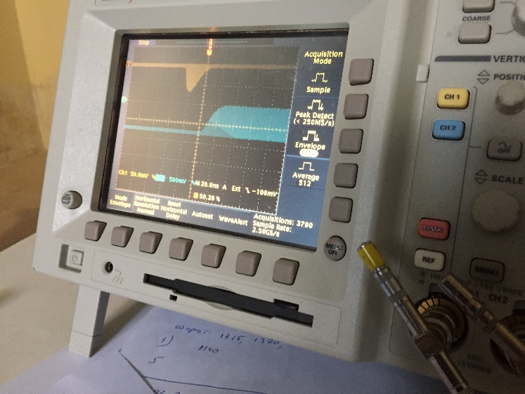
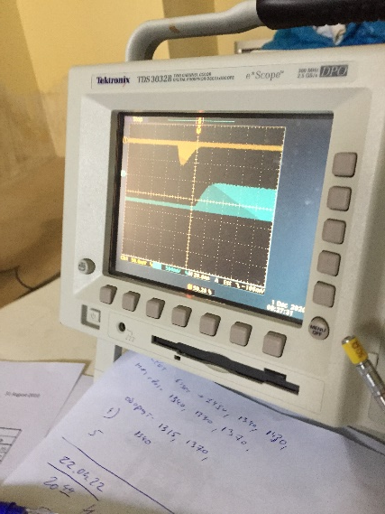
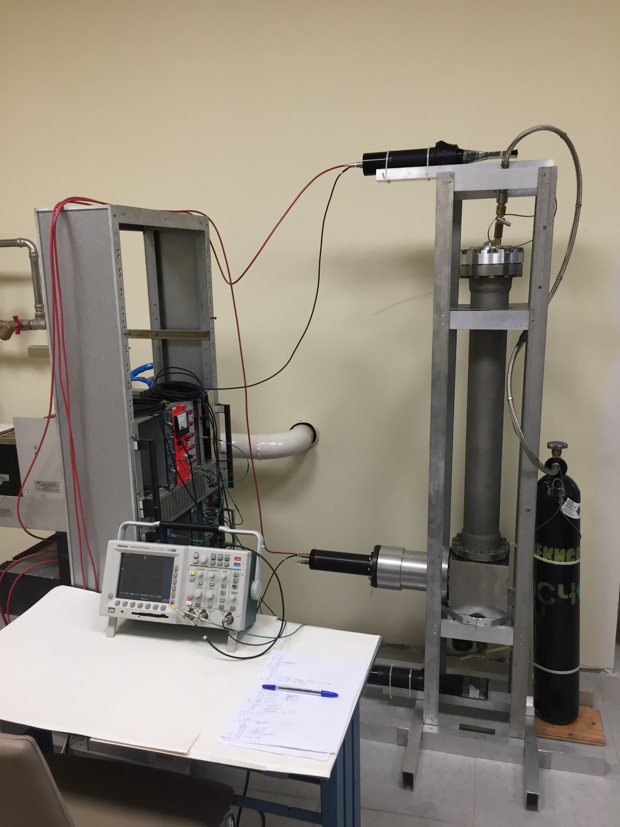
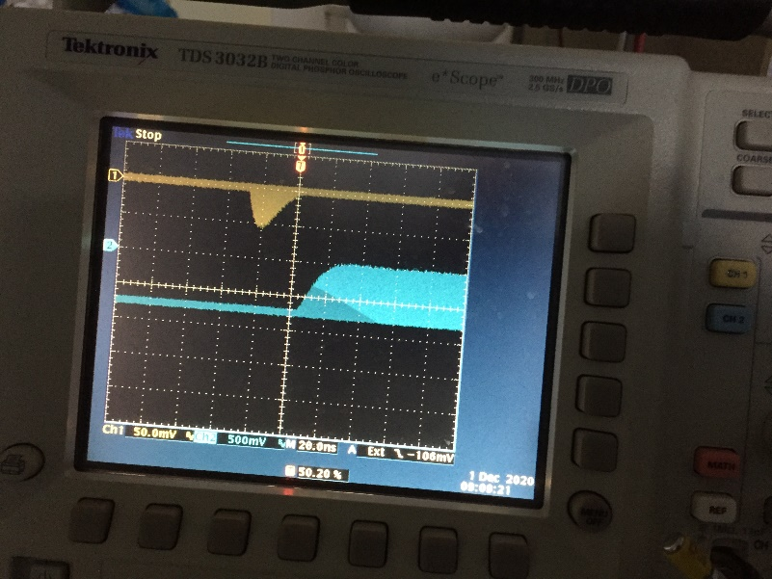
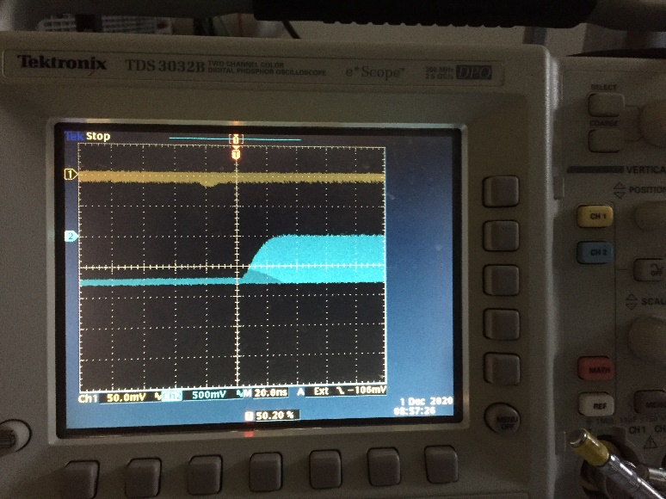
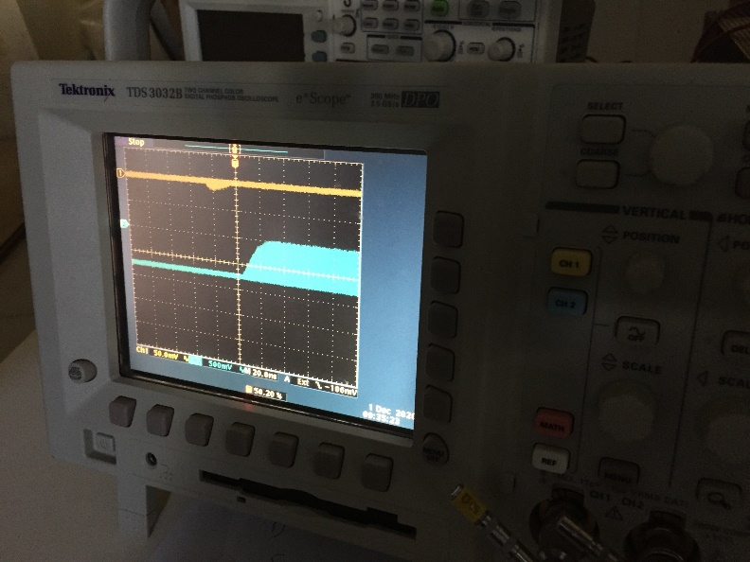
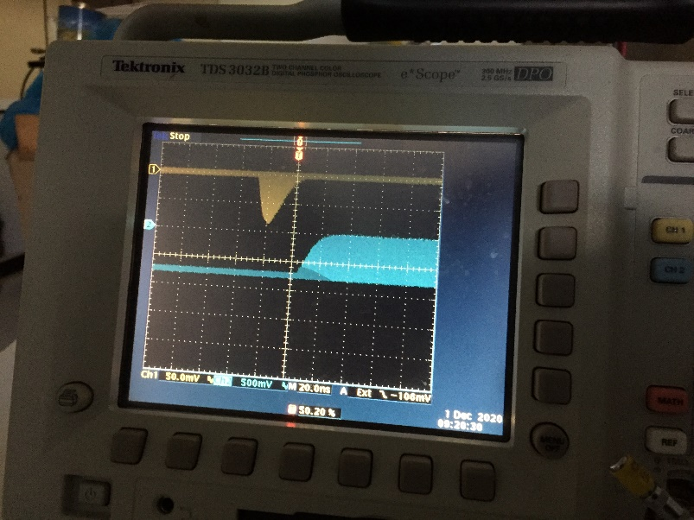
Cosmic test stand for pressurized Cherenkov counter (first Cherenkov signals are observed at high 45 atm with cosmic trigger)
Cherenkov signal
Scint. 1
Trigger signal
Cherenkov counter
Scint. 2

Slide 12
Plans for the rest of 2023
Repeat FEA mechanical calculations for SPD setup adding magnetic forces (after getting field information from Novosibirsk team)
Start reconstruction of bld. 73 (budget…)
Sign the contract with Minsk on Ampl-8.53 preproduction (budget…)
Continue MDT plane prototyping with stand-imitator
Put RS prototype in operation with DAQ at test area (depends on availability of multiplexor modules from CERN…)
Start study of pressurized Cherenkov counter with cosmic
Continue PID algorithms study

Slide 13
CONCLUSION
RS team is generally on track. No visible ‘show stoppers’ are indicated at the moment. The nearest practical tasks look feasible: reconstruction of MDTs assembly building, signing of contract on amplifier chips preproduction, but require adequate funding. R&D works are progressing.

Slide 14
Backup slides

Slide 15
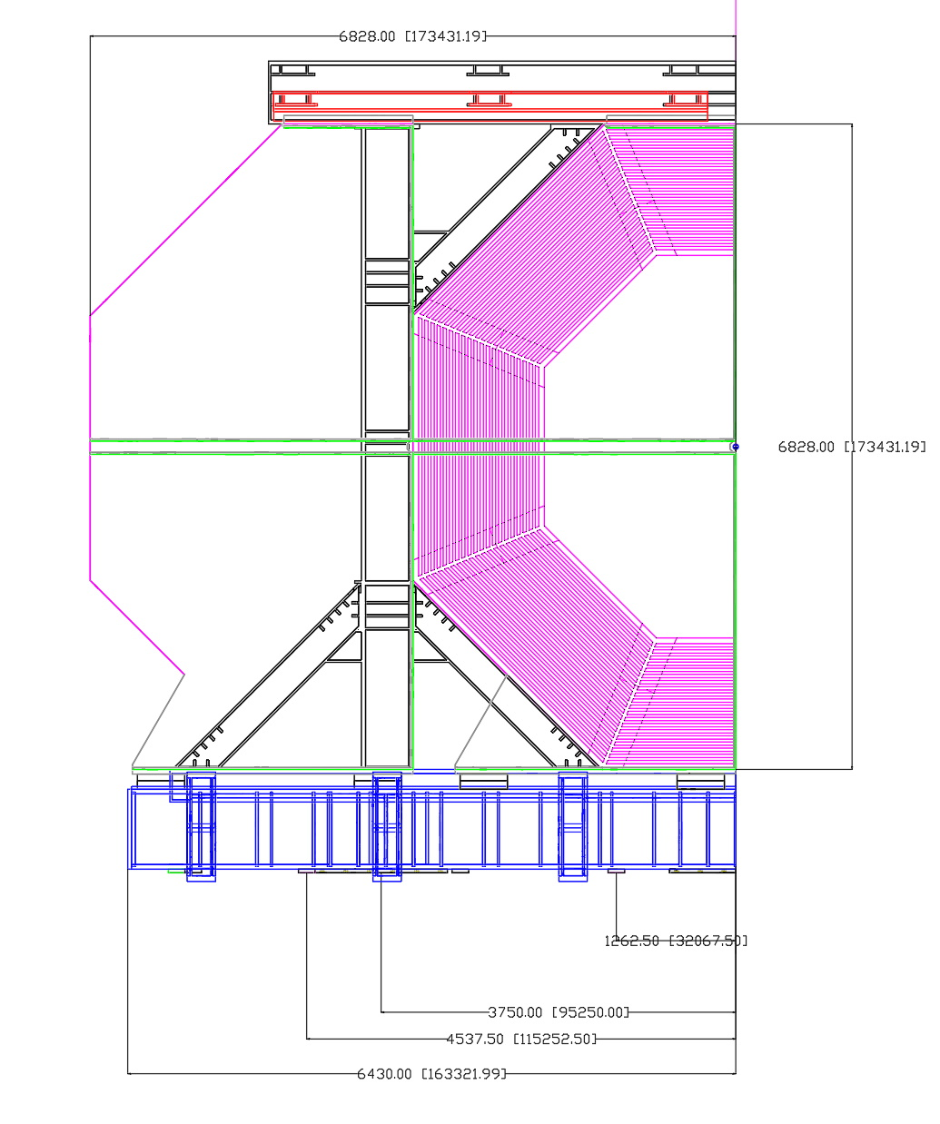
Distances for supporting elements in the considered cases

Slide 16
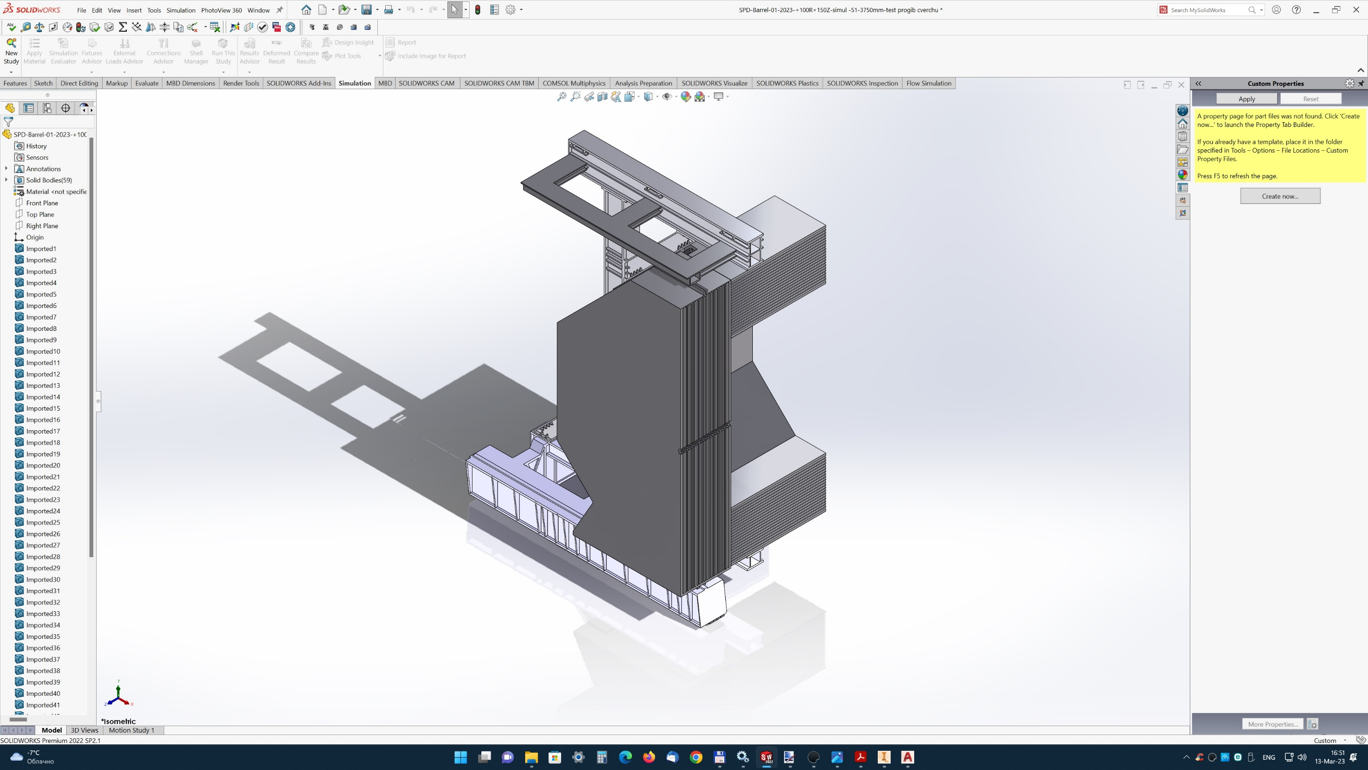
Closed sash case EC

Slide 17
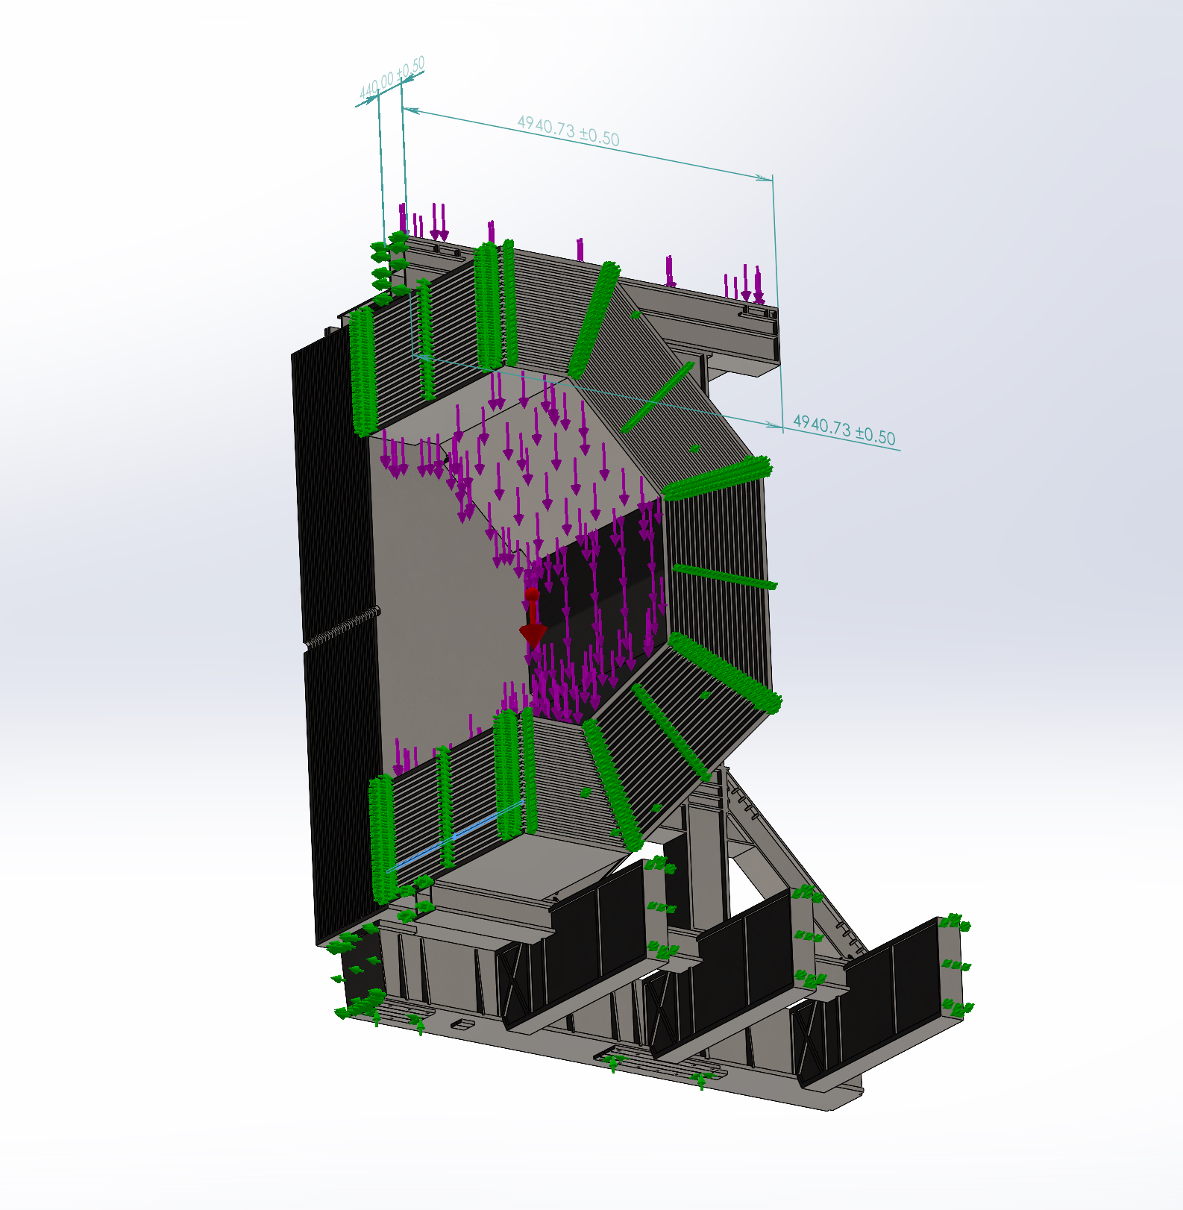
Force (loads) and kinematic (fastening of supporting elements) boundary conditions
Location of trolley supports (in the beam plane and 3750 mm from the beam plane)

Slide 18
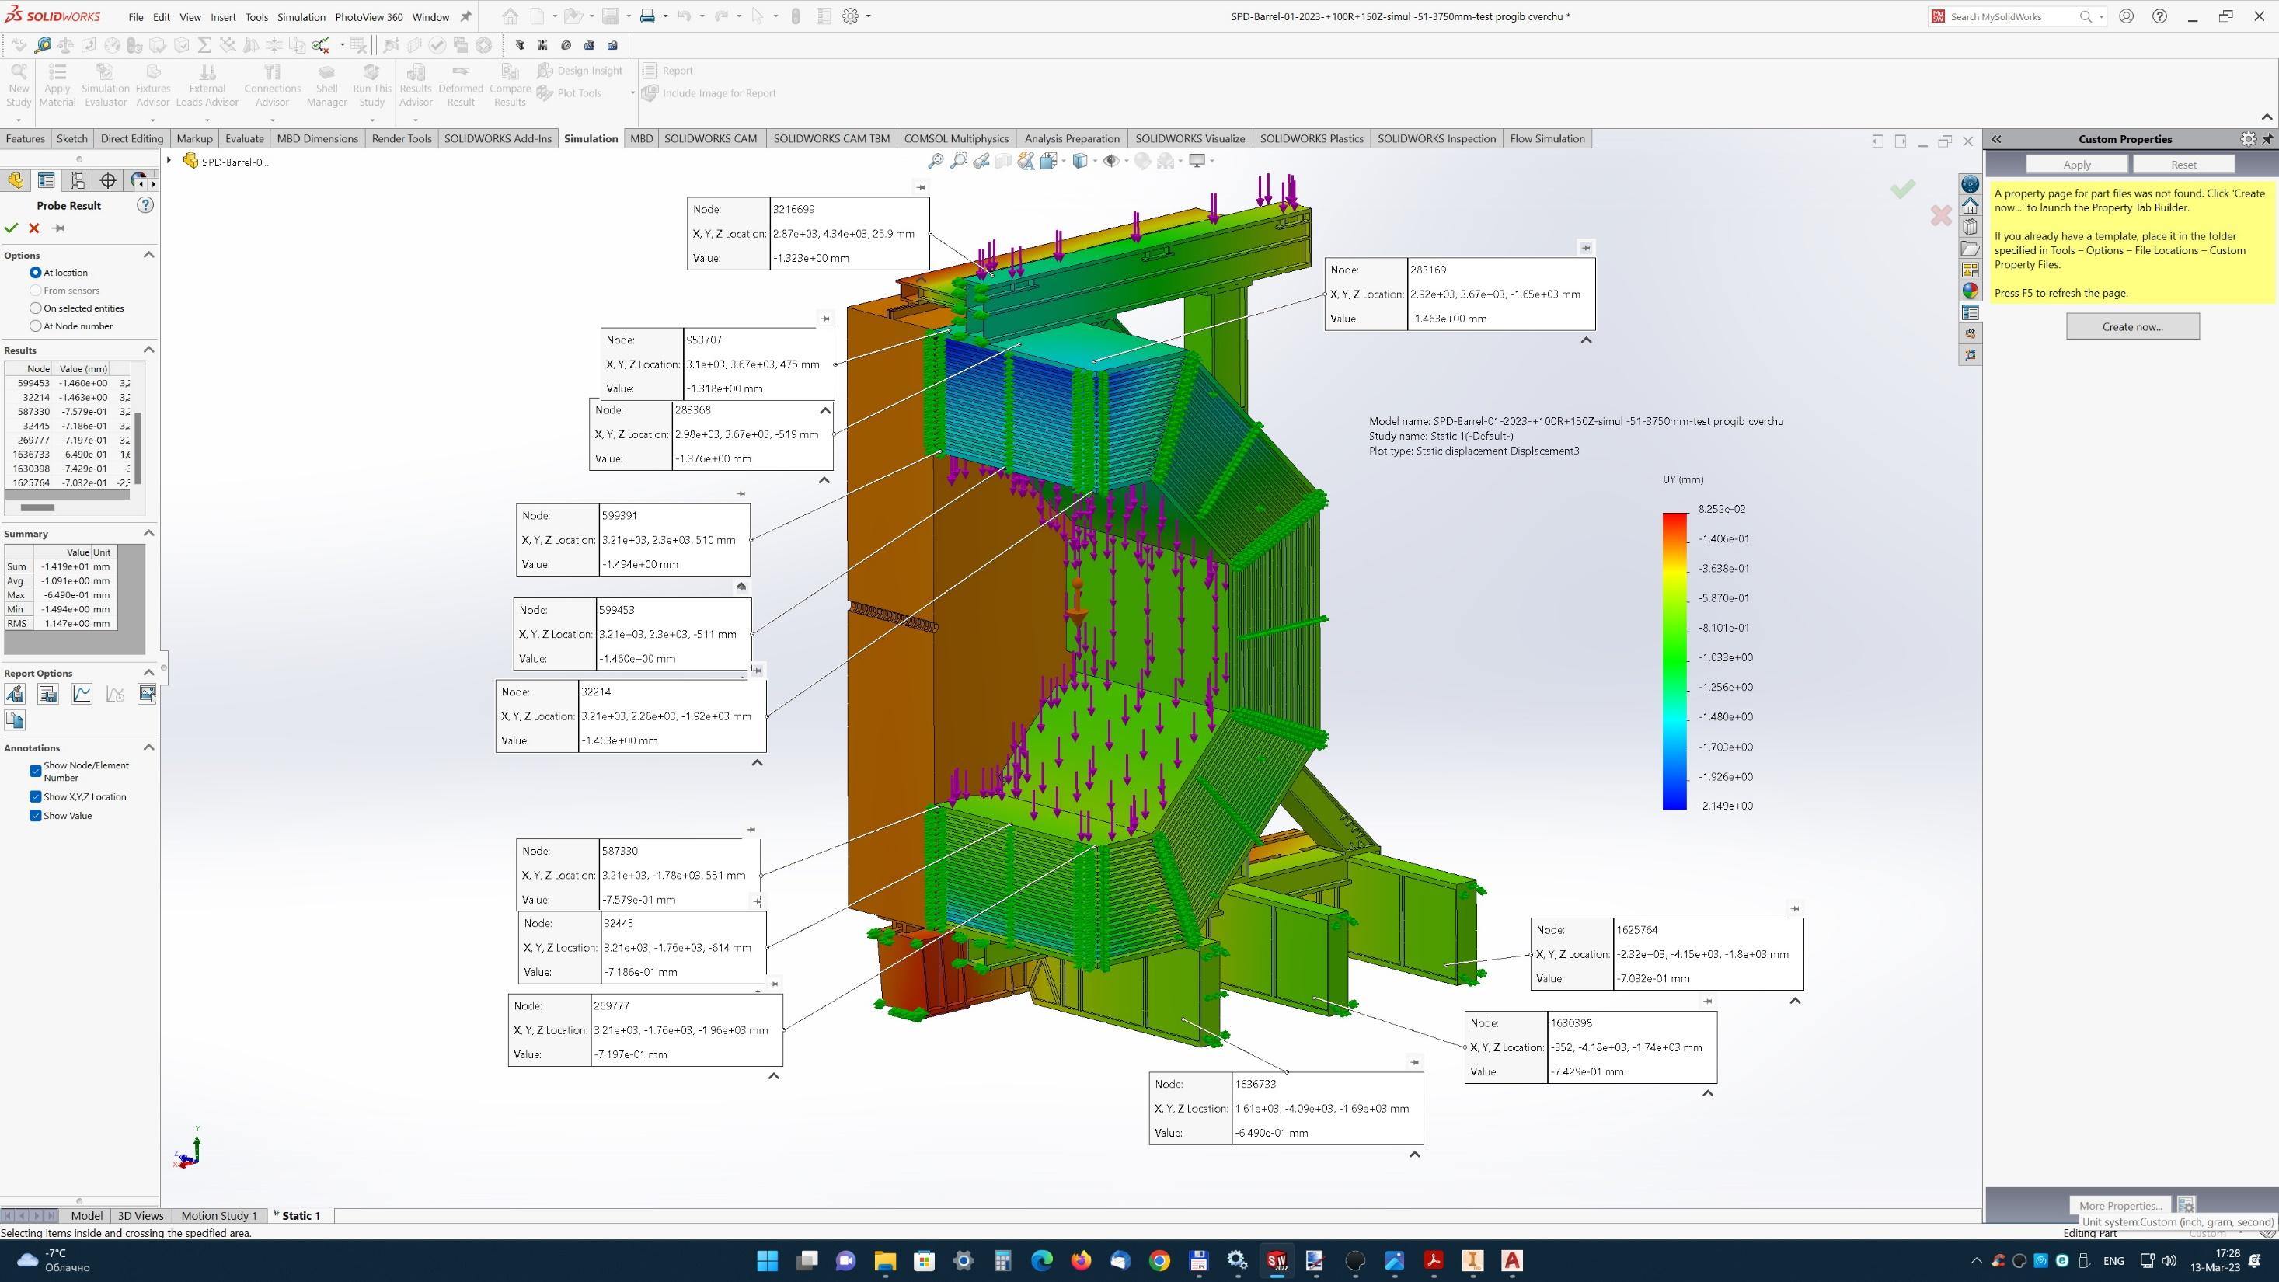
Offsets along Y axis

Slide 19
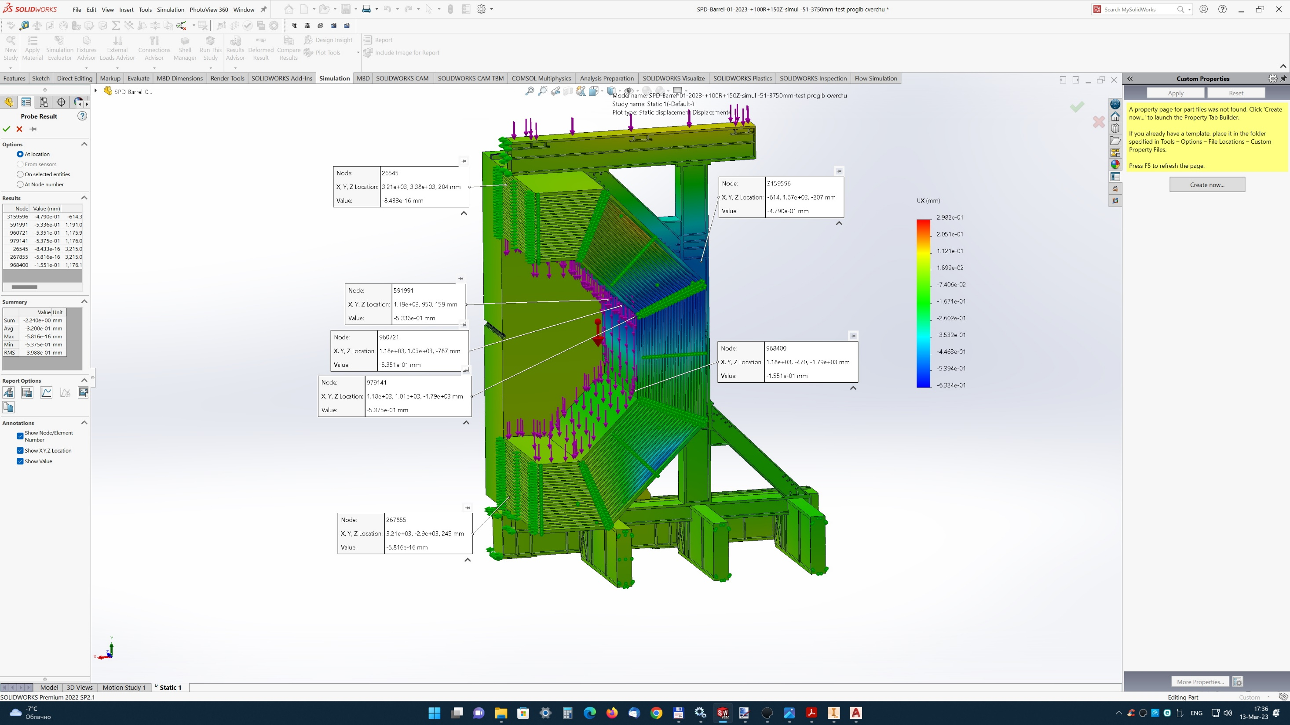
Offsets along the X axis - deformation
of inner Barrel area up to 0.53mm each side

Slide 20
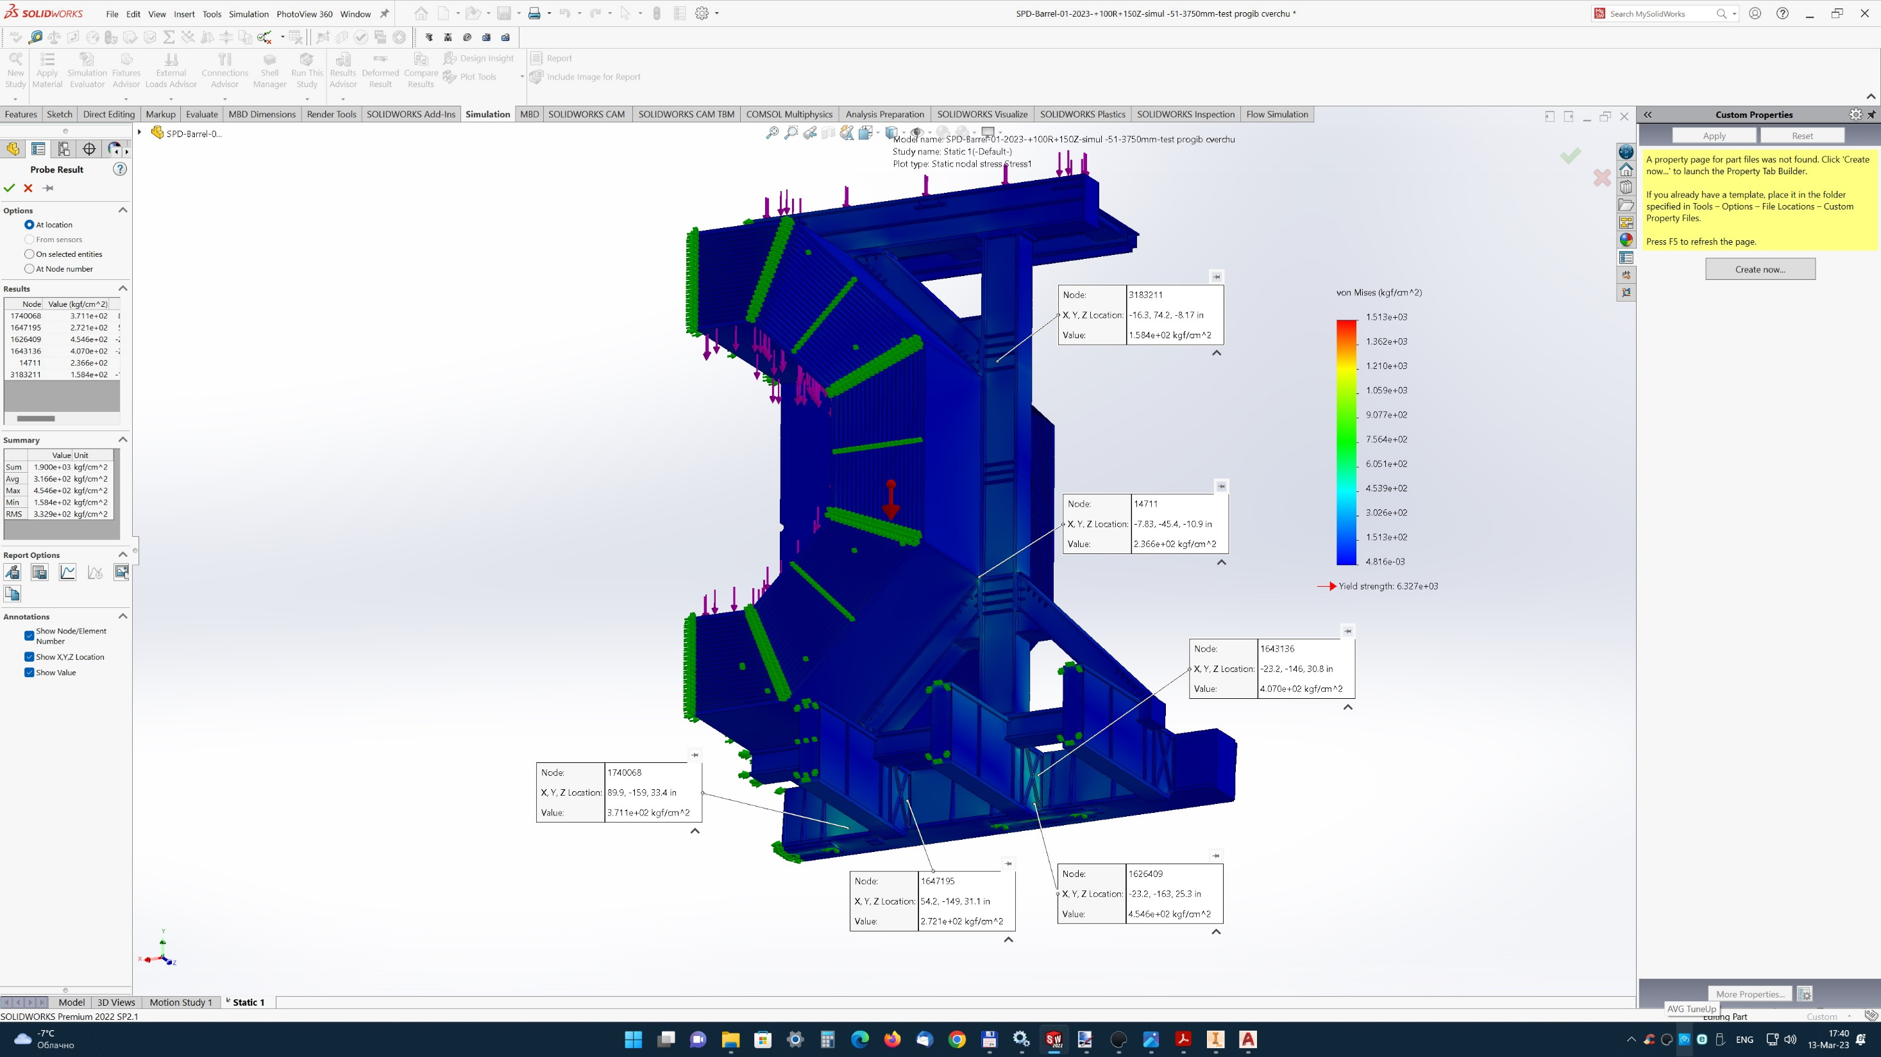
Stresses within normal limits: up to a maximum of 500 -600 kg / cm2

Slide 21
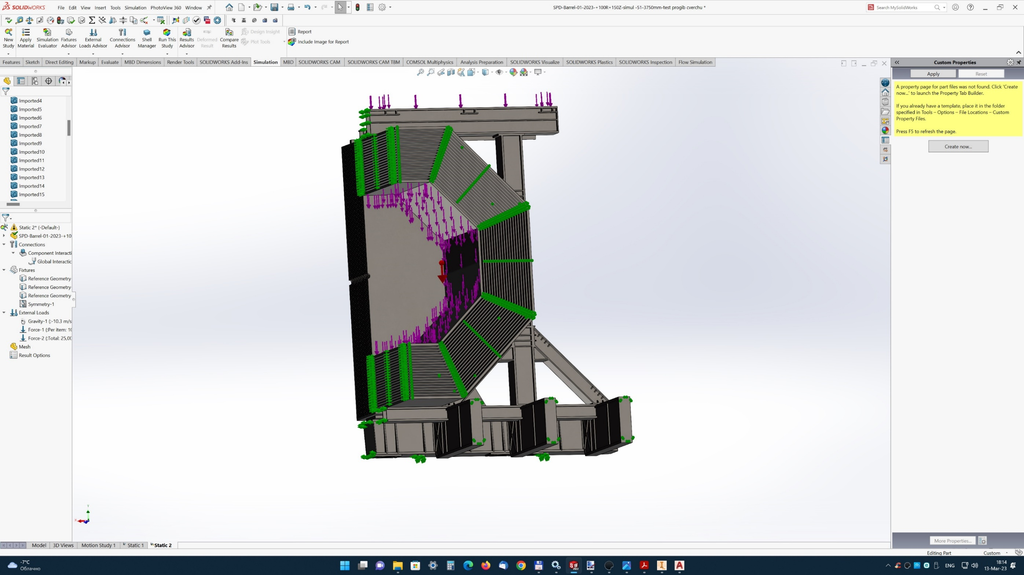
The case of closed sashes EC, on 4 pairs of jacks. In terms of movements - the worst of the cases considered: maximum movements 2.2-2.5 mm
Location of supports for jacks ( 1262 and 4537 mm from the beam plane)

Slide 22
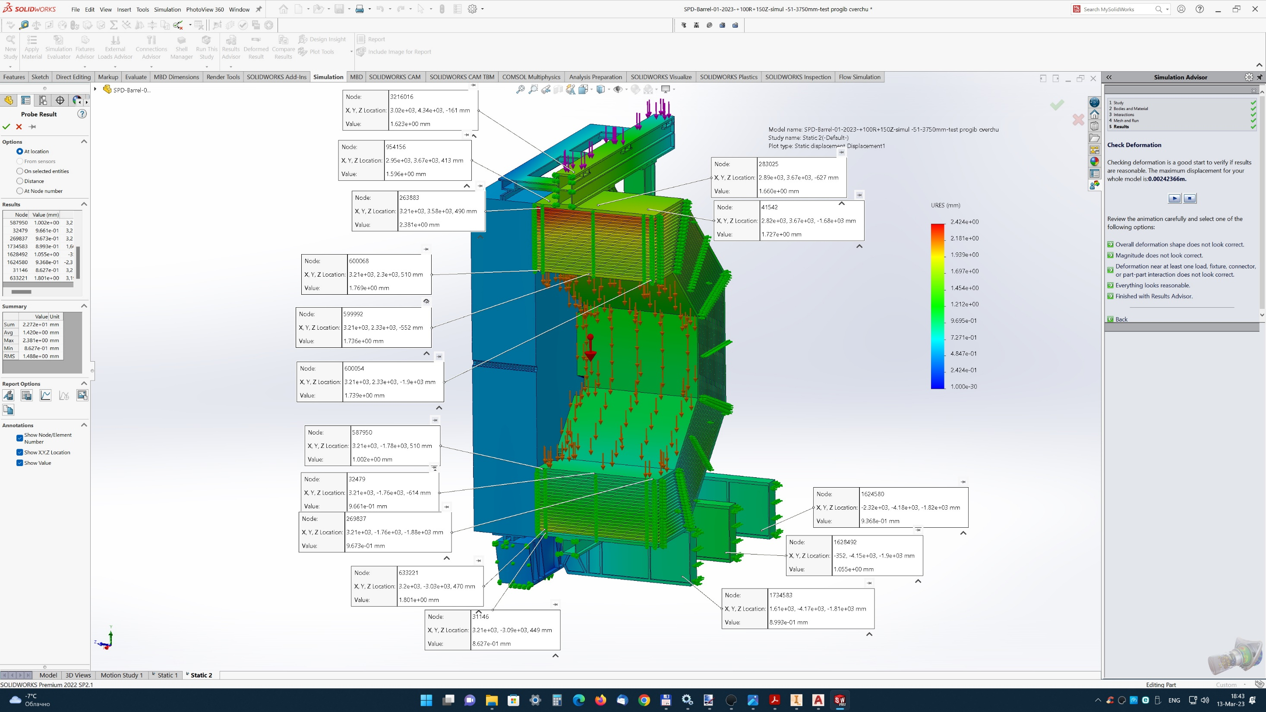
Offsets

Slide 23
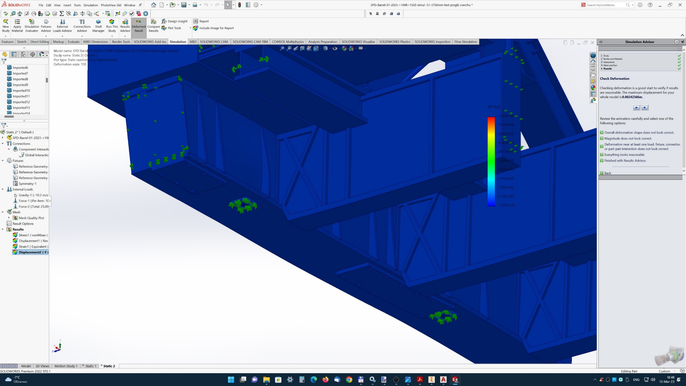
strain

Slide 24
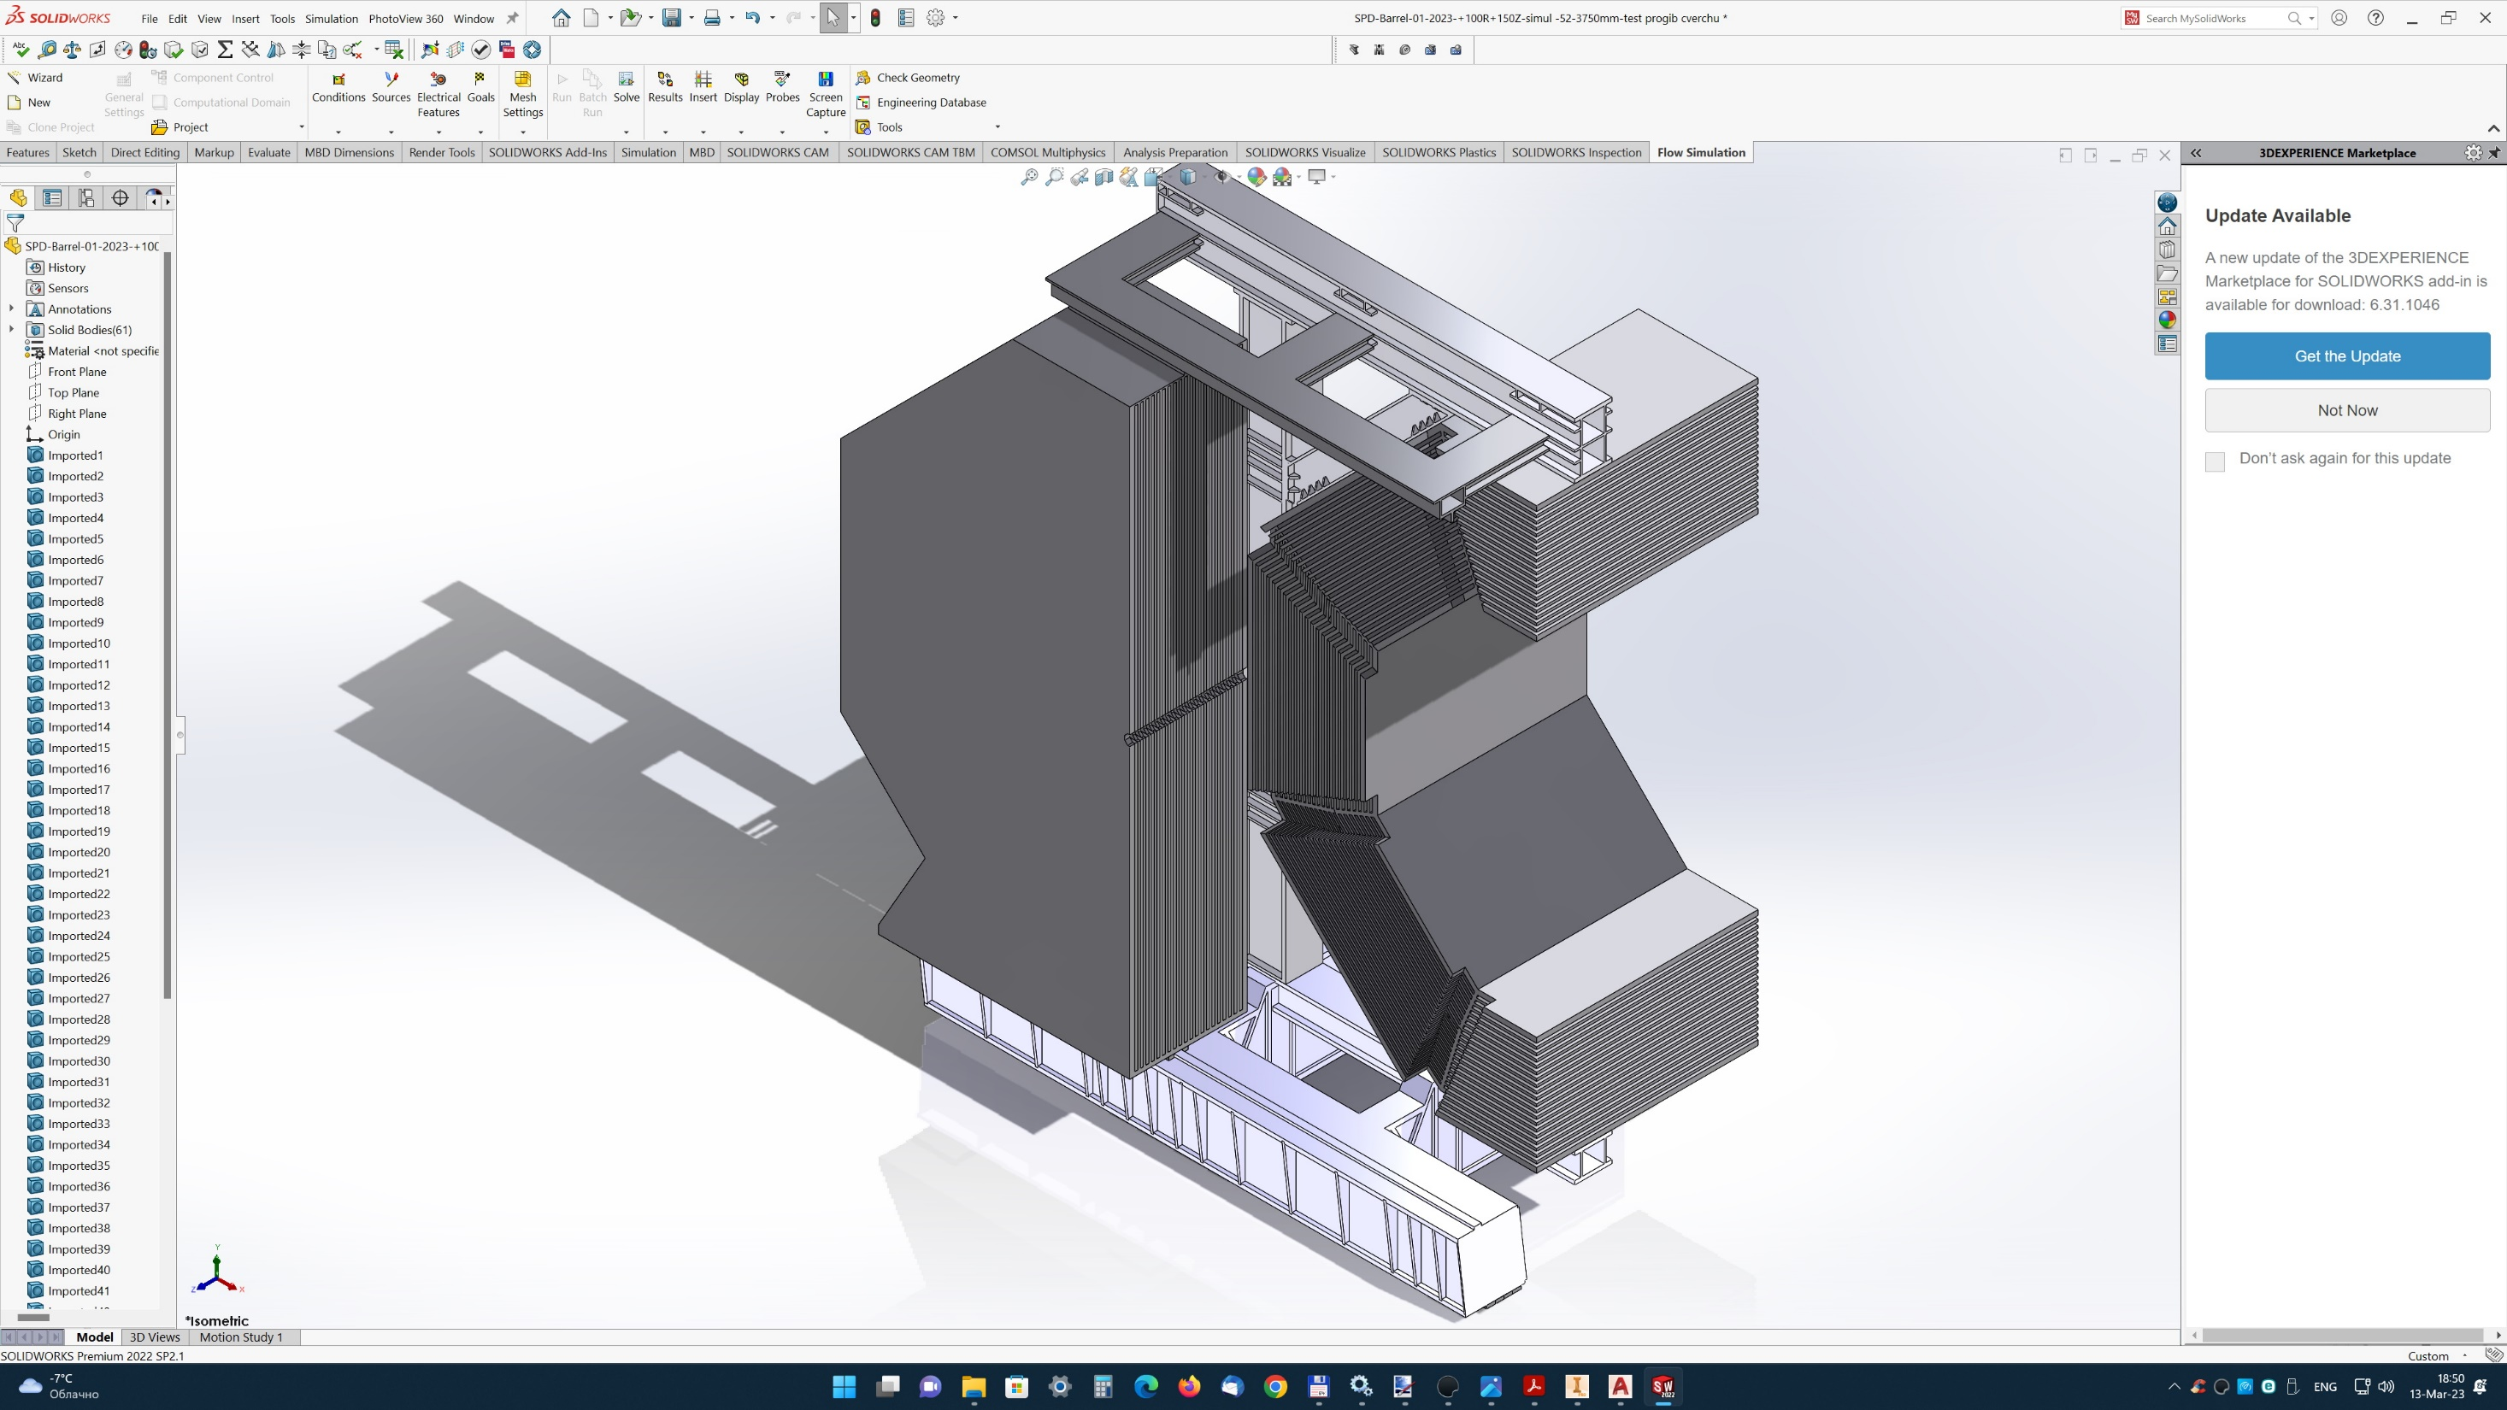
Case of extended sashes EC

Slide 25
Location of trolley supports and beam end console support

Slide 26
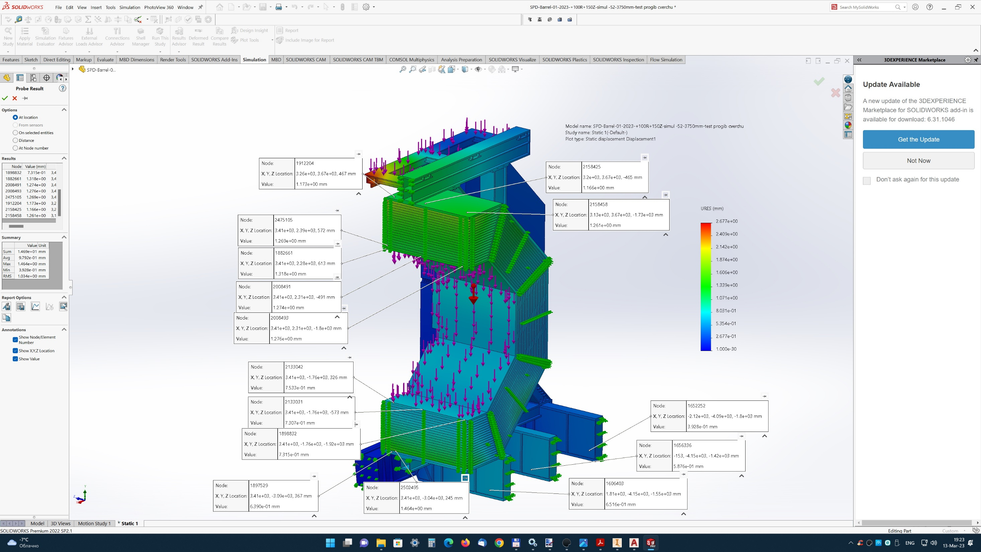
Offsets for the case of extended leaves - the situation is slightly better than in previous cases

Slide 27
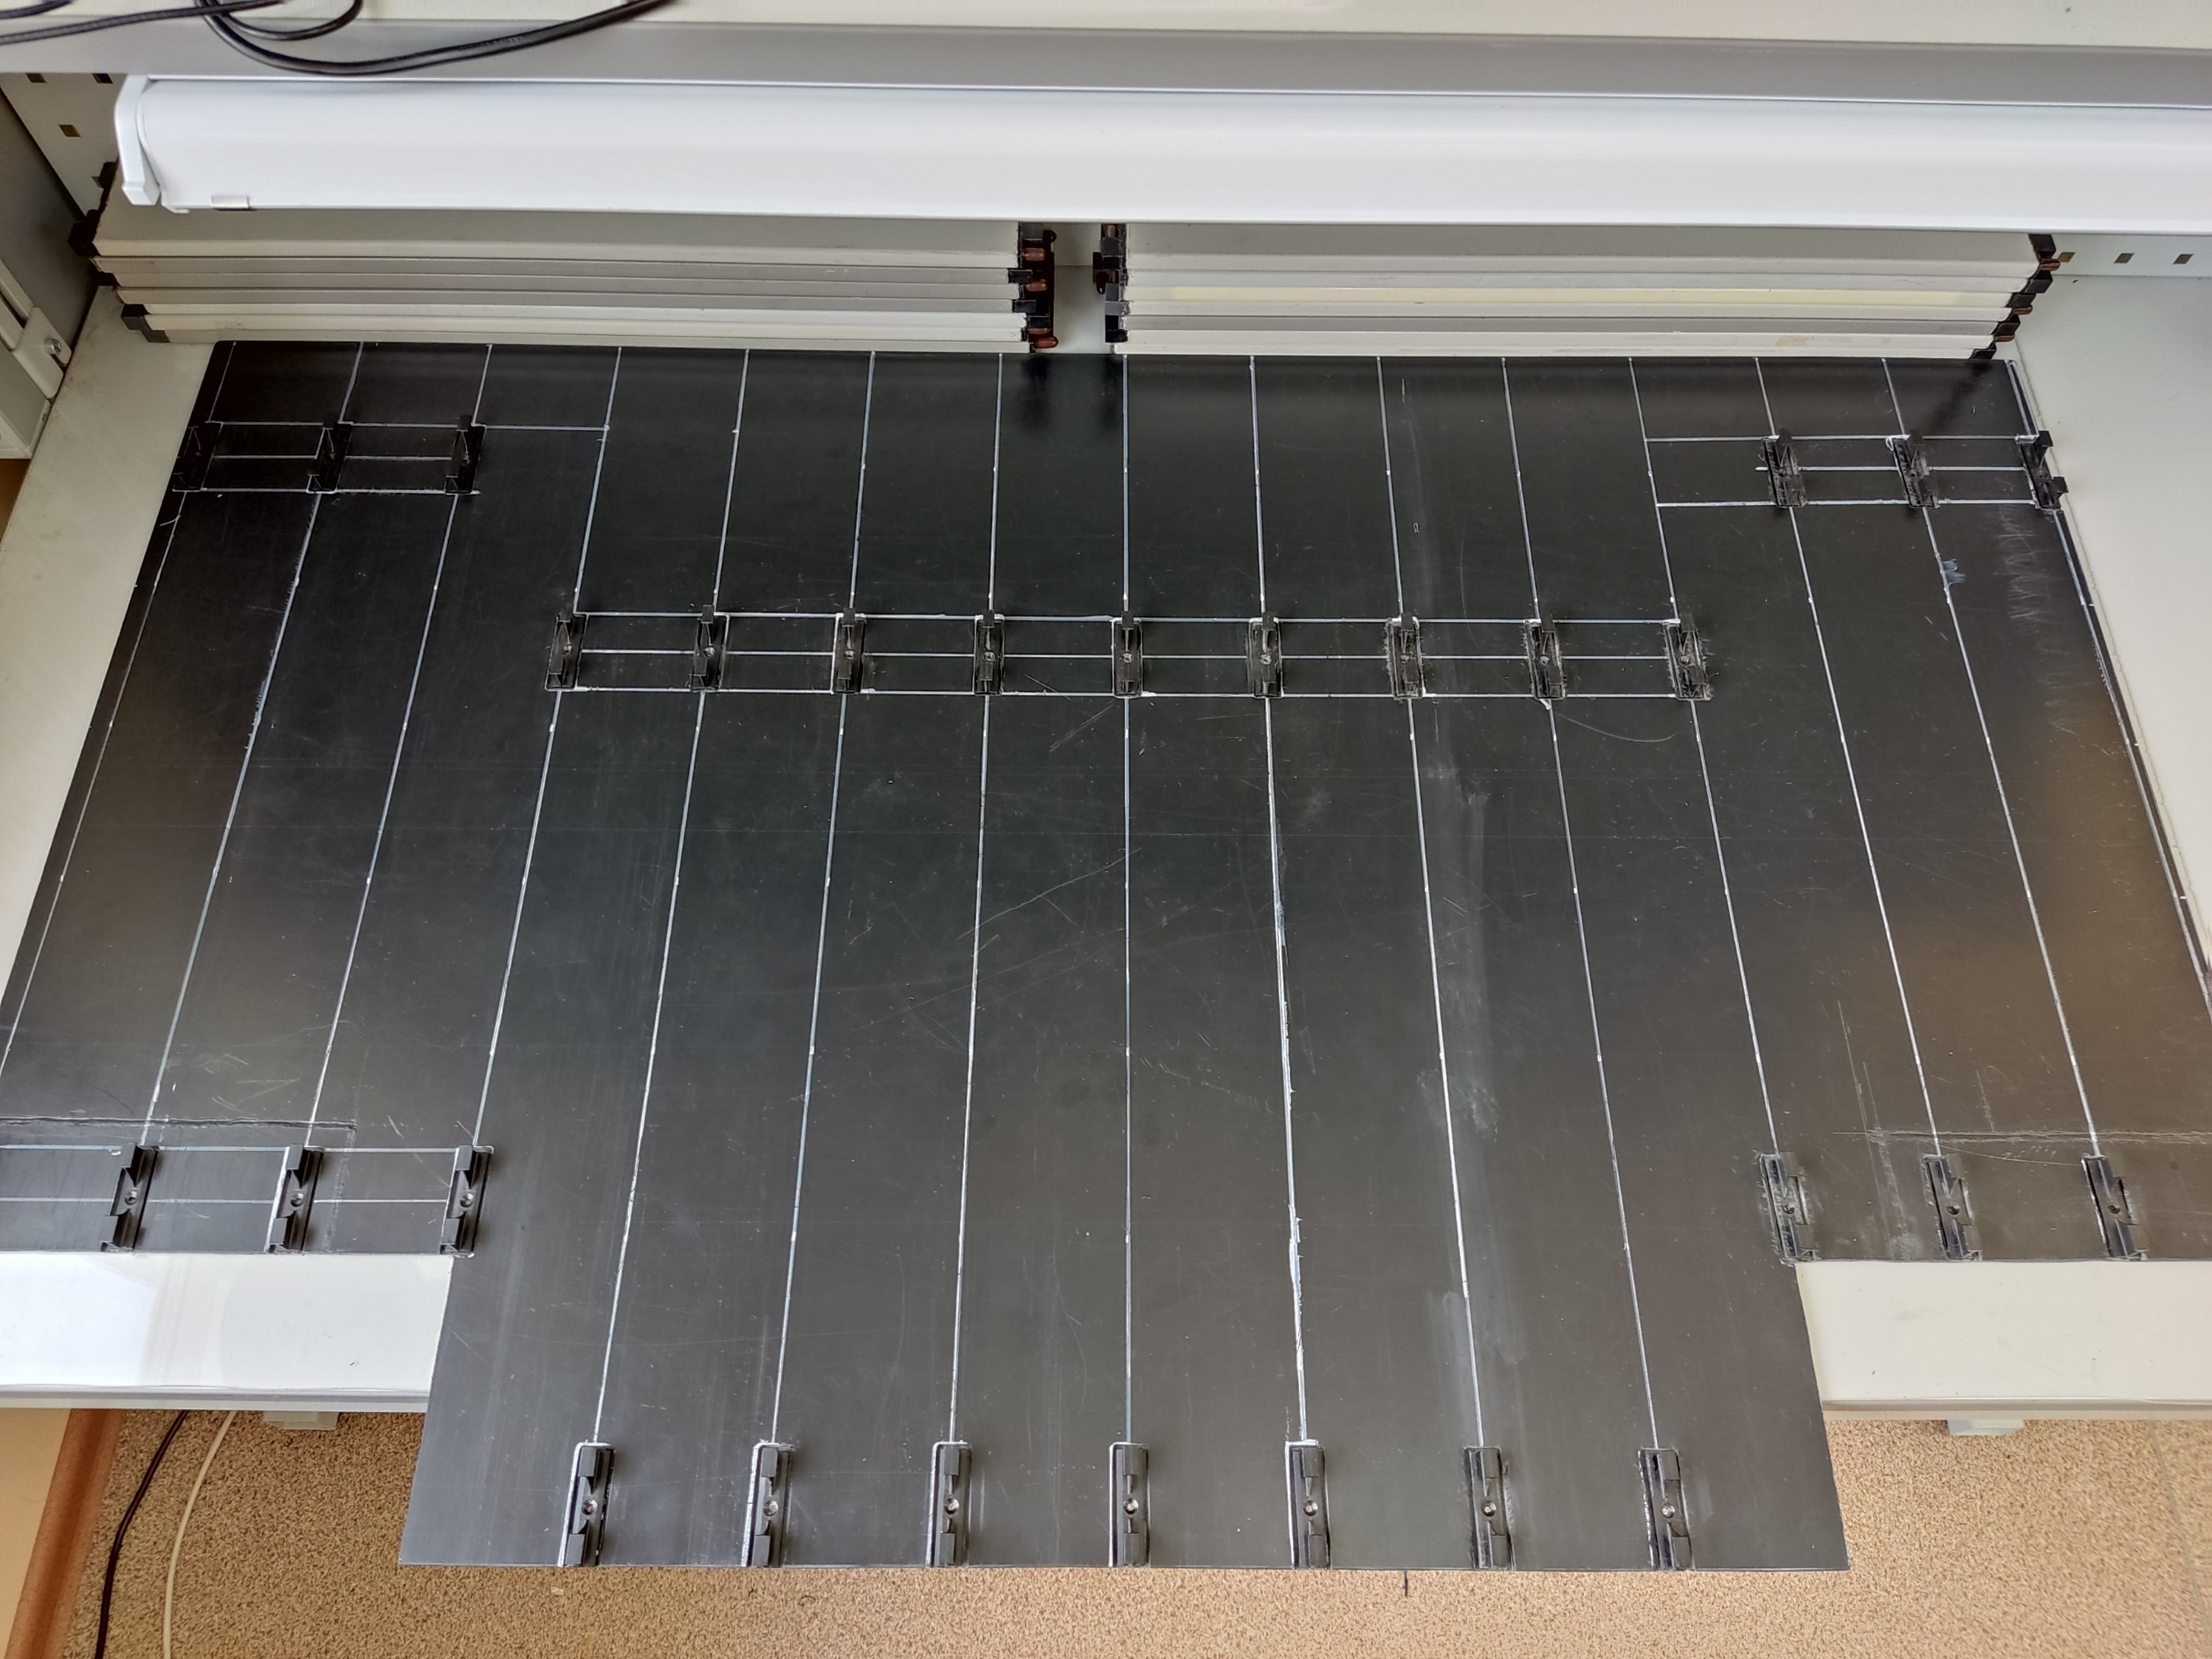
ABS plastic 4 mm thick - imitates the honeycomb filler of a strip board (“air gap”) with fixed blades (in reality, the blades will not be in a line (along one strip), but in a herringbone or zigzag pattern, to blur the increase in capacity by 4-5 strips)

