Slide 1
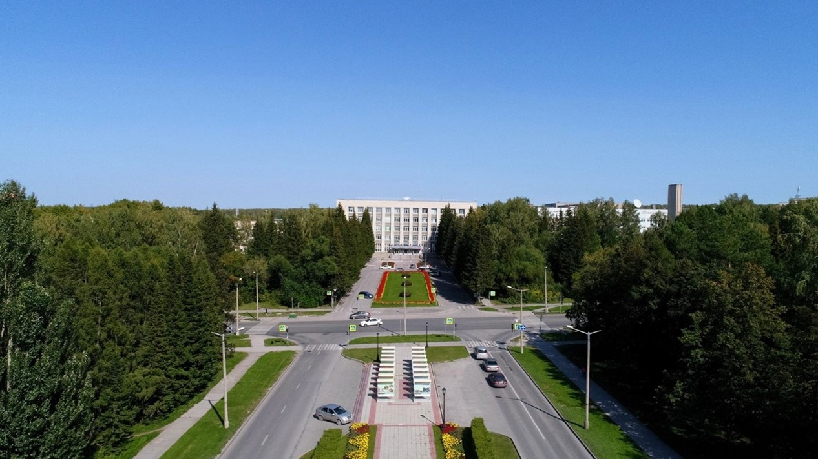
SPD solenoid
E.Pyata, S.Pivovarov, A.Erokhin, M.Kholopov, E.Antokhin, T.Bedareva, A.Orlova BINP, Novosibirsk

Slide 2
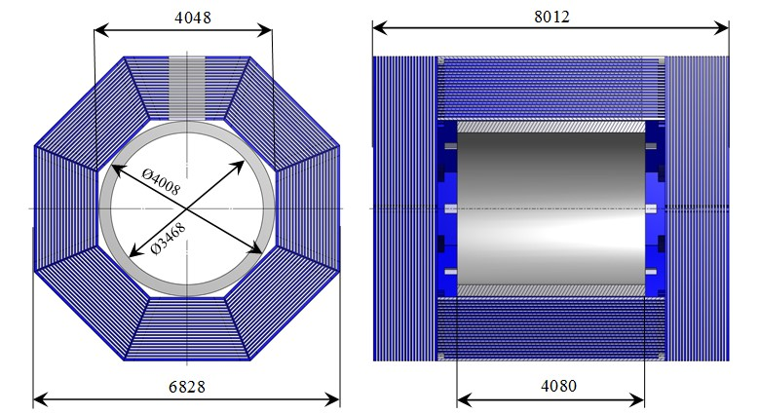
SPD solenoid
The magnetic field along the solenoid axis should be 1.0 T.
Main Dimensions and Parameters of the Magnet
The cryostat of the magnet with the coils, cold mass and thermal shields is located inside the yoke. A distribution box named Control Dewar is located on the upper octant of the yoke.
The overall dimensions are driven by the space planned for the detectors of SPD and the magnet field parameters. Outside diameter of the cryostat is 4008 mm and a gap between the yoke and the cryostat about 20 mm.
Radially a free diameter of 3468 mm is left for the SPD detectors. The length of the magnet is 4080 mm and the magnet should be installed symmetrically inside the iron yoke for magnetic flux return.
The total weight of the cryostat, transfer line and Control Dewar is ~24 t.

Slide 3
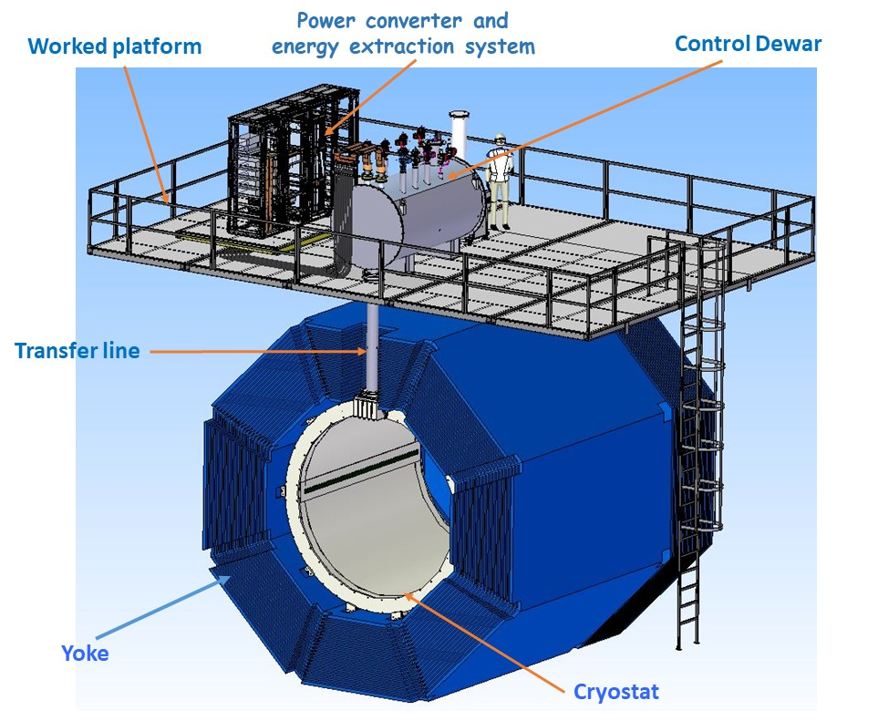
SPD solenoid
The magnetic field along the solenoid axis should be 1.0 T.
BINP presents our participation in SPD project with the following items:
Magnetic and engineering design of the magnet including tools and support;
Production and delivery of the magnet (consisting of the cryostat with cold mass, alignment components, proximity cryogenics, supports);
Power converter, energy extraction system, quench protection and instrumentation.

Slide 4
SPD solenoid design
• Magnetic design of the magnet including of calculations of the magnetic forces;
• Engineering design of the magnet including of calculations of all loads and forces;
• Design of the superconductive conductors, coils and cold mass;
• Design of the cryostat with alignment components, supports and suspend system;
• Design of the proximity cryogenics with flow scheme and all instrumentation for cryogenics and insulation vacuum for the cryostat and control Dewar, current leads;
• Design of the power supply system and energy extraction system;
• Development quench protection and detection scheme;
• Development of the procedures for assembly of the magnet and the preparation of installation solenoid into the yoke;
• Development of the worked conditions of the cryogenic system;
• Define the list of FAT and SAT and requirements for tests;
• Documentation which will include: 3D models, assembling drawings of important components, part lists, welding procedures, thermal calculations, calculations of the thermo-syphon circuit, mechanical calculations and a mechanical analysis with failure modes (e.g. loss of insulation vacuum), description of the cryogenic control system as well as Process and Instrumentation Diagrams for the cryogenic process.
Design works: 2023 – December 2024

Slide 5
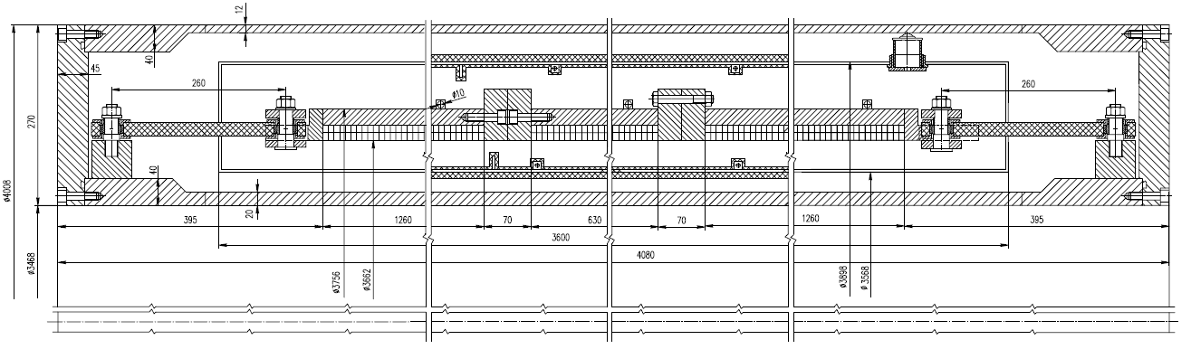
SPD coils
The cold mass of the SPD solenoid consists of three epoxy resin impregnated coils reinforced by shells made of structural aluminum.
Cryostat: OD – 4008 mm; ID – 3468 mm; Length - 4080 mm; Thickness – 270 mm;
Coils (3 pc.): Vertical winding PANDA conductor – 2 layers; Turns = 750.
Weight: - cryostat about 16200 kg
- thermo shields – 1020 kg
- coils about 5240 kg
Total: ~22 ton

Slide 6
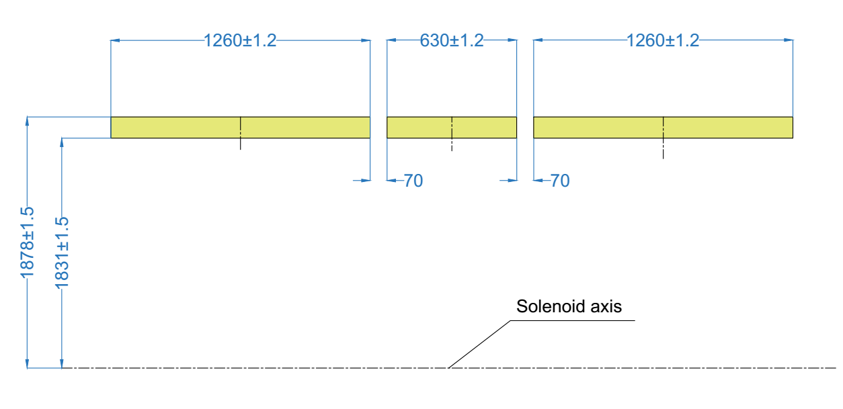
SPD coils
The cold mass of the SPD solenoid consists of three epoxy resin impregnated coils reinforced by shells made of structural aluminum.
The Upstream and Downstream winding packs are identical and feature 2 layers of 150 turns. The Center coil instead is smaller featuring 2 layers of 75 turns. The conductor is wound around the aperture with a tension. The coils should be prepared and impregnated in vacuum according to the standard BINP technological scheme TTS4 STO 103-2011.

Slide 7
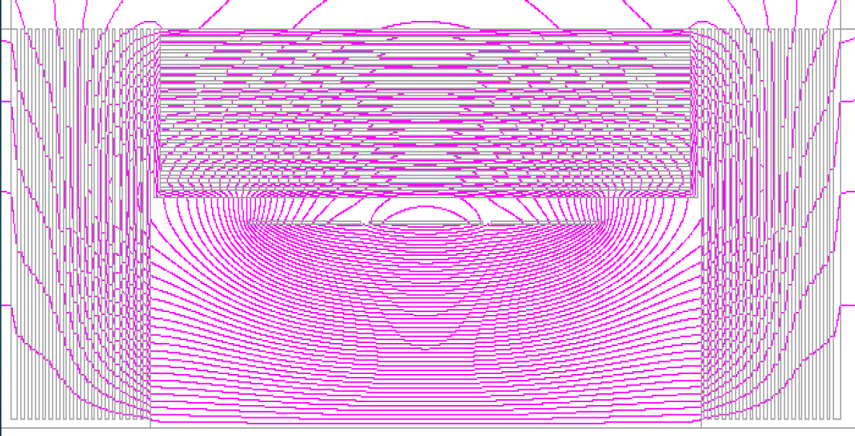
SPD magnet analysis
Input conditions for 3D simulations had been taken as:
The configuration of the superconducting coil and magnetic design according to the latest STEP model with three coils. The current of the coil is 5200 A.
The calculations were carried out on the 3D software package TELMA of Evgeniy Antokhin team.
General view of the magnet with magnetic field lines

Slide 8
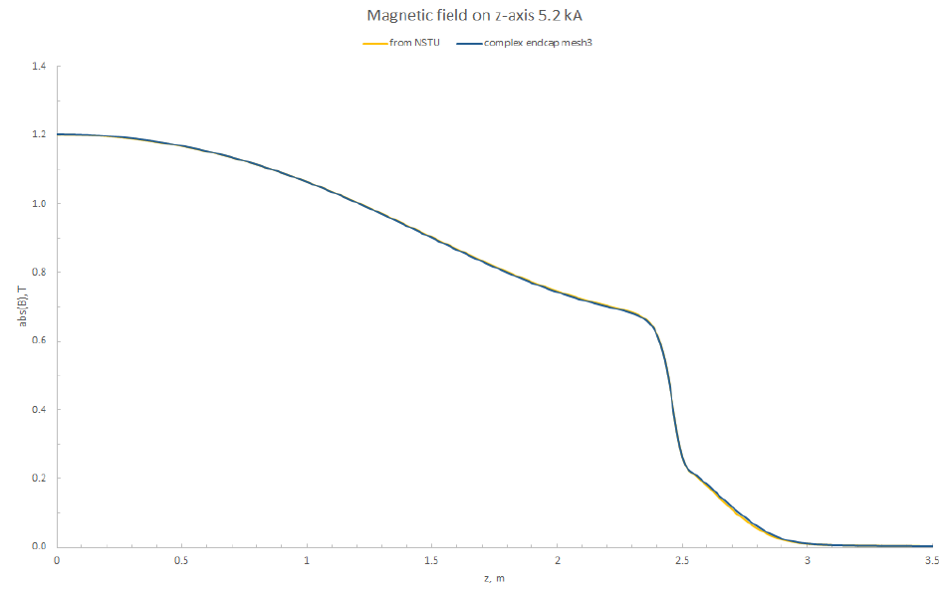
SPD magnet analysis
The current of the coil is 5200 A.
Longitudinal component of the magnetic field along the axis

Slide 9
SPD magnet analysis
The results of the estimated calculations for the magnetic forces acting on the coils during their displacement are shown in Table. These forces used for calculation mechanical loads on the supports system of the cryostat – yoke connections.
Magnetic force on coils
 | comp. | Left coil | Central coil | Right coil
F, kN | X (horiz.) | 0 | 0 | 0
 | Y (vert.) | 0 | 0 | 0
 | Z (long.) | 4748.0 | 0 | -4748.0
F, kN z +5 mm | X (horiz.) | 0 | 0 | 0
 | Y (vert.) | 0 | 0 | 0
 | Z (long.) | 4521.4 | -69.6 | -4743.4
F, kN y +5 mm | X (horiz.) | 0 | 0 | 0
 | Y (vert.) | -2152.8 | -1065.1 | -2152.8
 | Z (long.) | 4752.8 | -0.3 | -4753.3

Slide 10
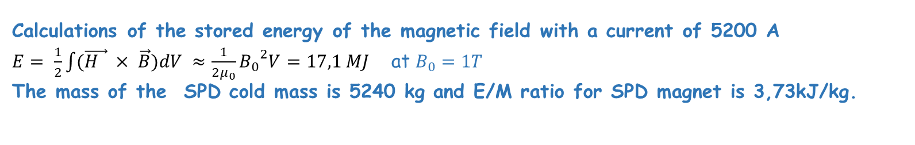
SPD stored energy
Calculations of the stored energy of the magnetic field with a current of 5200 A
$E= \frac{1}{2}\int{(\vec{H } × \vec{B}})dV ≈\frac{1}{2μ_{0}}{B_{0}}^{2}V=17,1 MJ$ at $B_{0}=1T$
The mass of the SPD cold mass is 5240 kg and E/M ratio for SPD magnet is 3,73kJ/kg.
Plot of the stored energy vs the E/M ratio of superconductive detector solenoids using a superconductive cable co-extruded in an Aluminum matrix.
The Value E/M 3,73 kJ/kg corresponds temperature smaller than 60K during quenches and permits to avoid an excessive thermo-mechanical stresses into the coils (smaller than 40 MPa).

Slide 11
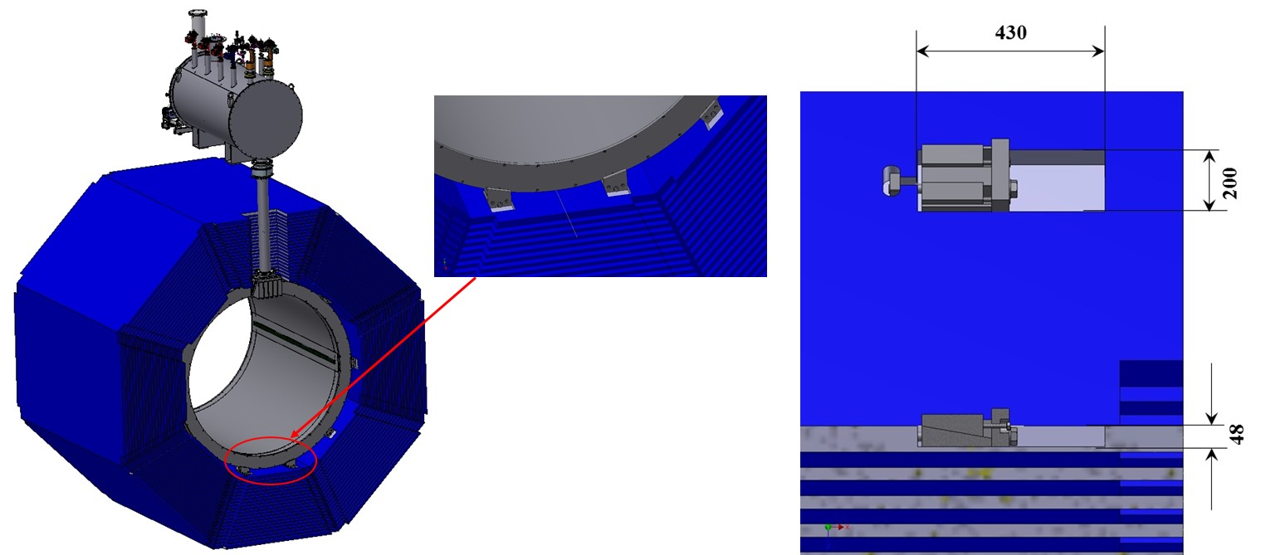
SPD magnet mechanical loads
Supports system of the cryostat – yoke connections and main dimensions of the supports.

Slide 12
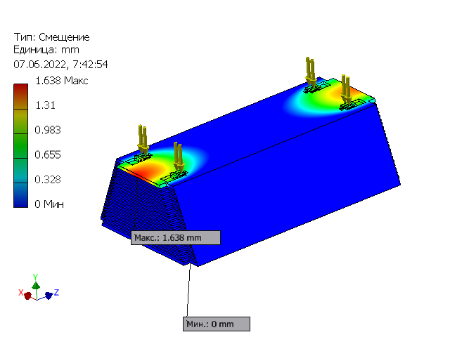
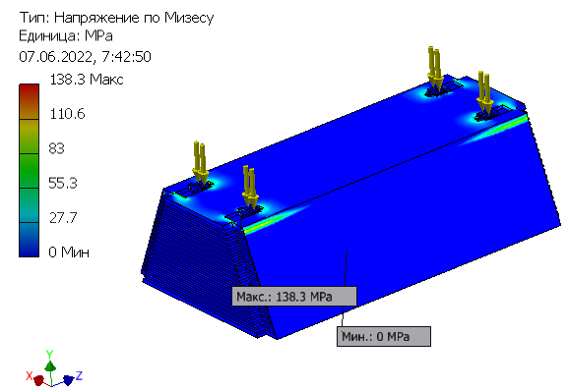
SPD magnet mechanical loads
Maximal stress - 138.3 MPa. Maximal deformation - 1,6 mm.

Slide 13
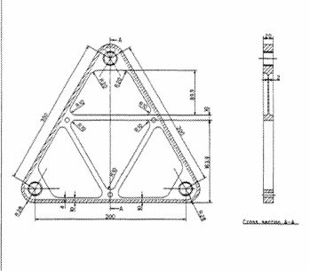
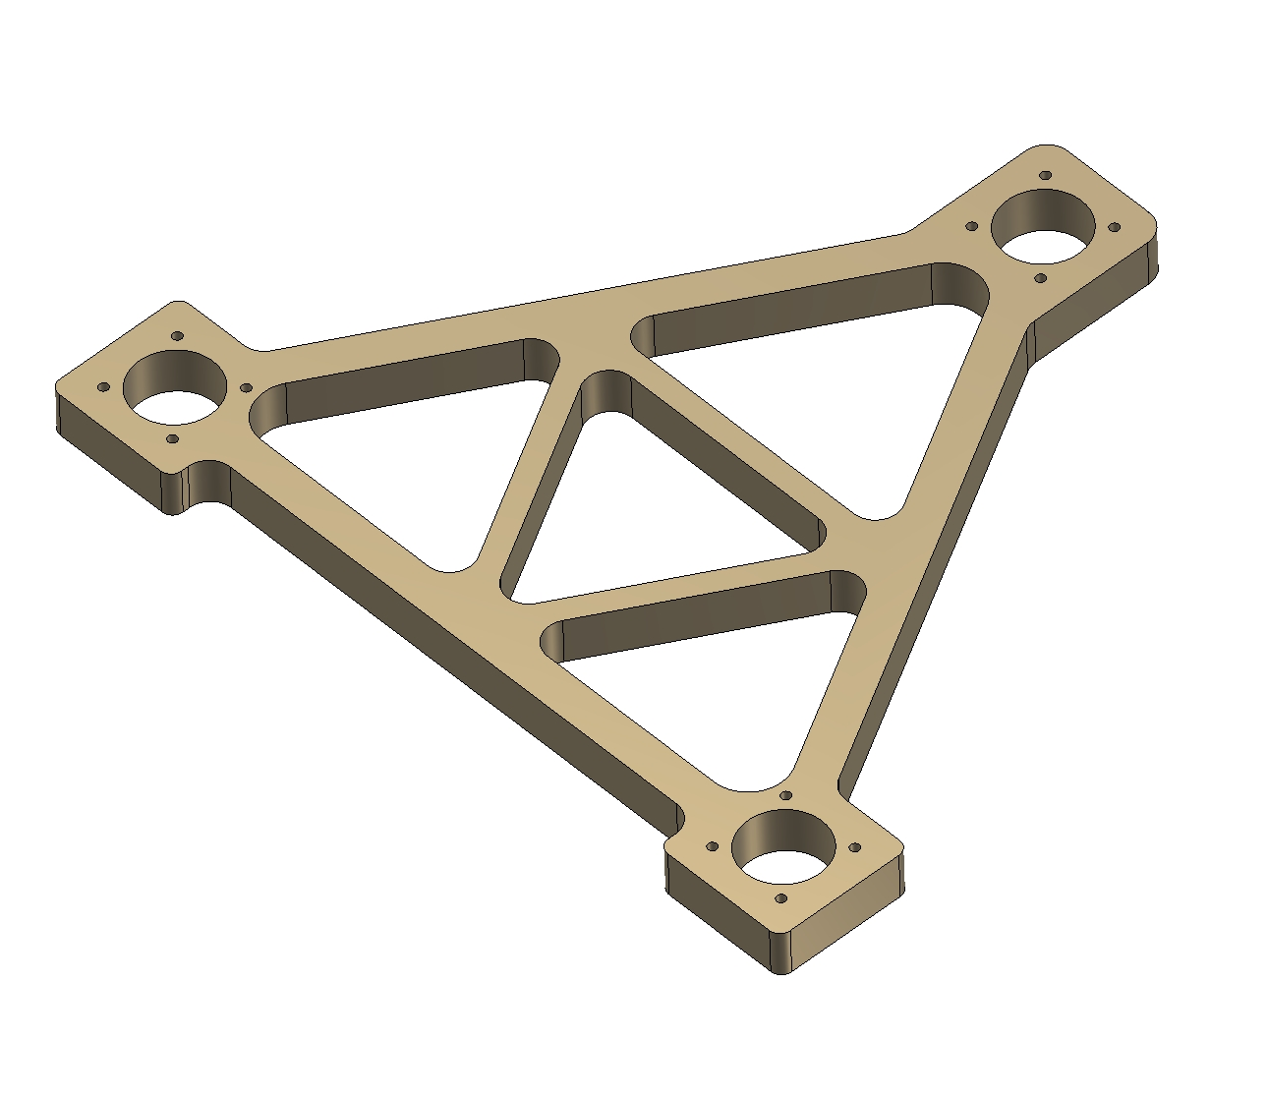
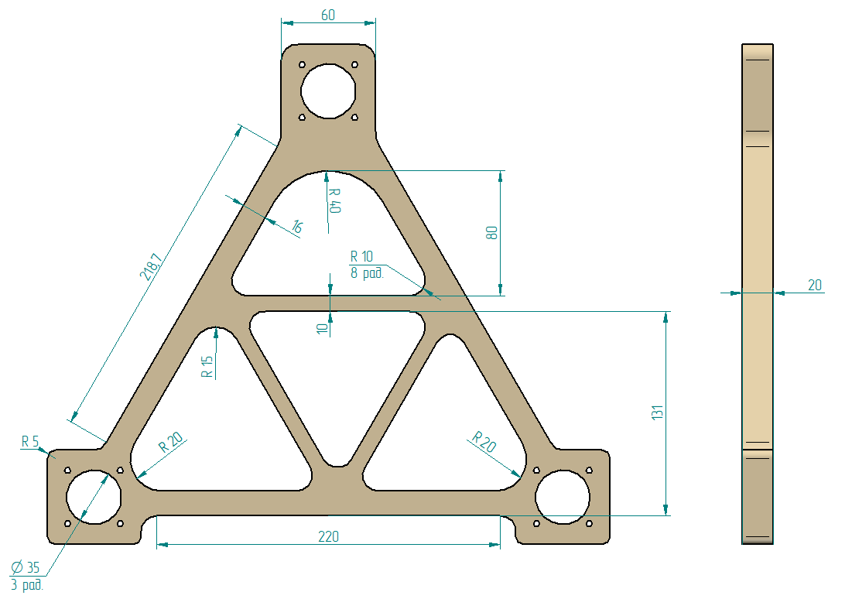
SPD solenoid. Cold mass support
Choice of a support system's type for SPD cold mass.
ATLAS type BINP 1st variant BINP 2nd variant

Slide 14
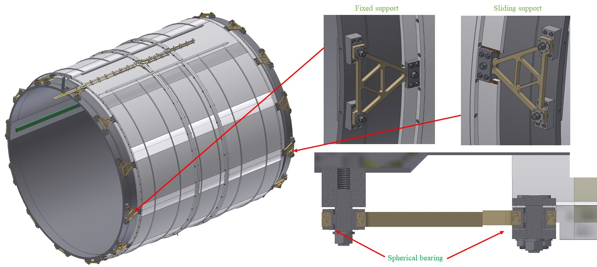
SPD solenoid (triangular supports)
Fixation of the cold mass is made with help of triangular supports are made of STEF-1, 12 pieces on each side. On one side the supports are fixed between vacuum shell and cold mass, the other side of the cold mass a type of connection of the supports is sliding to compensate temperature shrinkage of the coil. The Suspensions have spherical bearings to avoid bending during thermal changes in the dimensions of the cold mass.

Slide 15
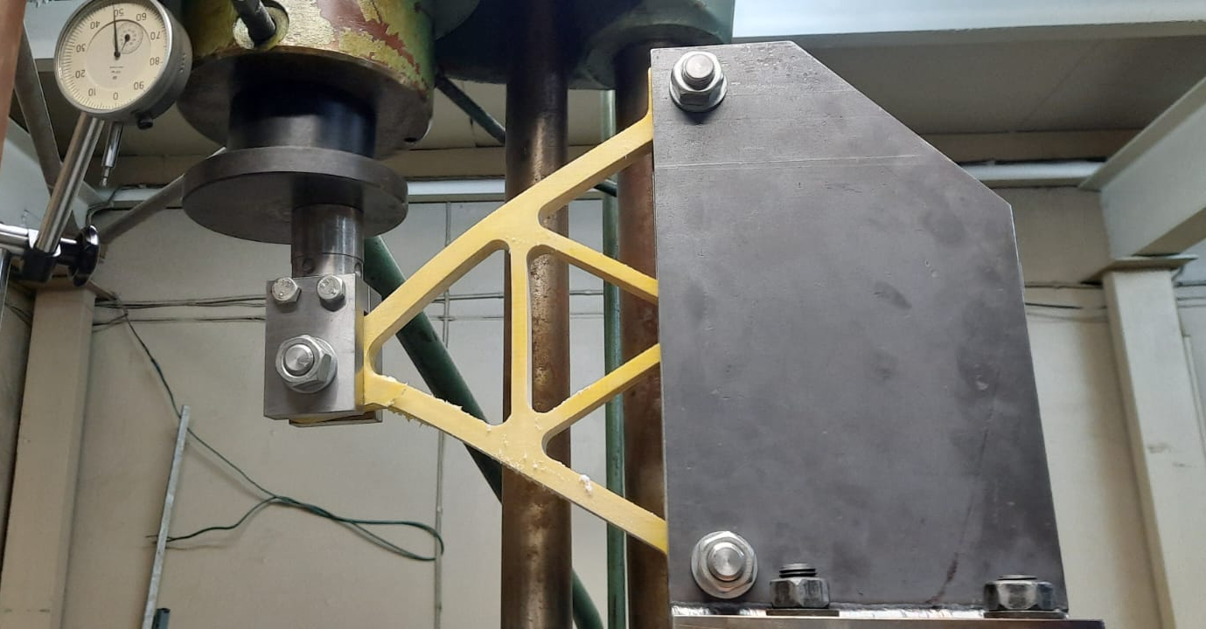
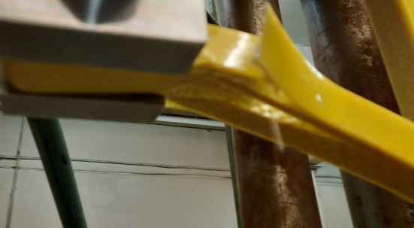
Destruction of the suspension 300К - 3920 kg
Destruction of the suspension 100К - 4250 kg
We produced and tested supports at 300K and 100K

Slide 16
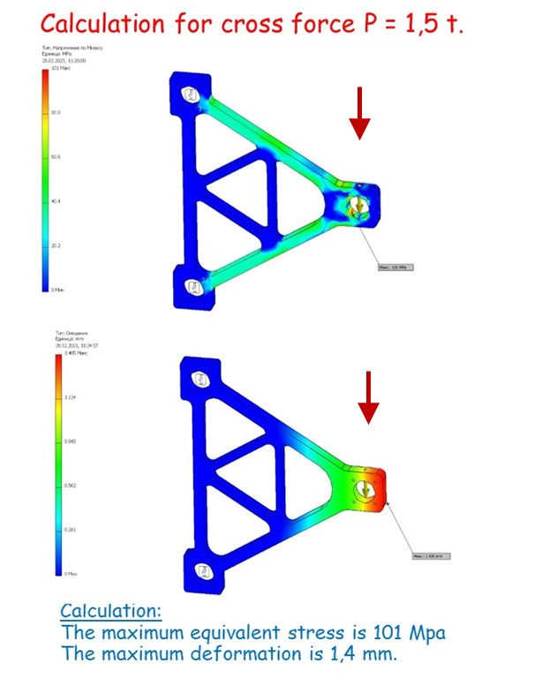
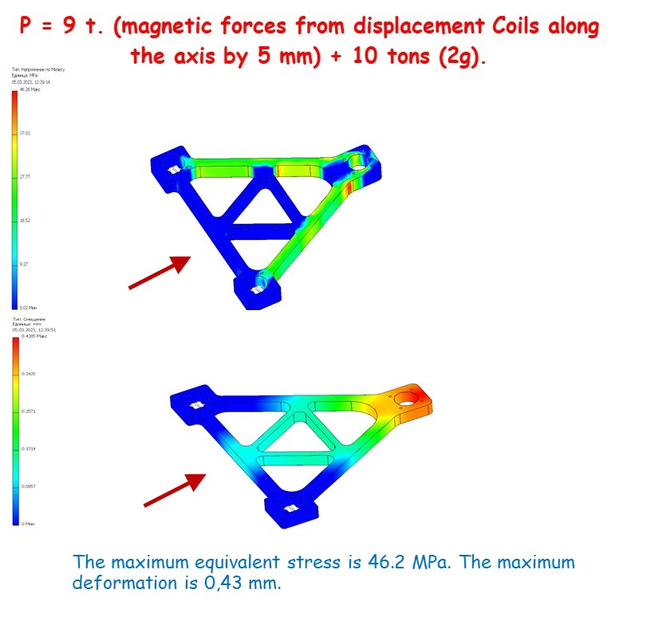
Supports 2nd variant

Slide 17
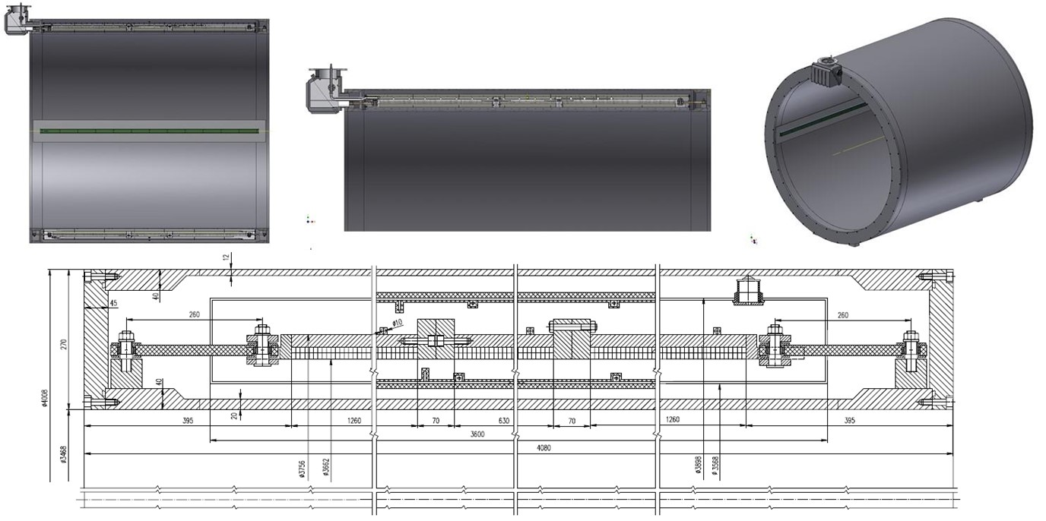
SPD solenoid cryostat
The nominal wall thickness is 12 mm for the outer cryostat shell and 20 mm for the inner shell. The thickness of the flanges is 40 mm. The thickness of the shells allows to minimize the displacement of the cold mass under the action of magnetic forces relative to its nominal position and the Calorimeter with total mass 60 ton into the cryostat.

Slide 18
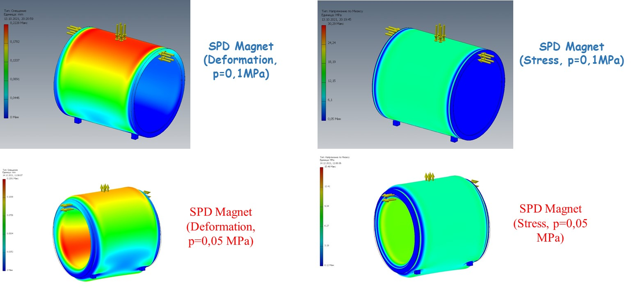
SPD solenoid cryostat
Calculation loads of the cryostat vacuum shell.

Slide 19
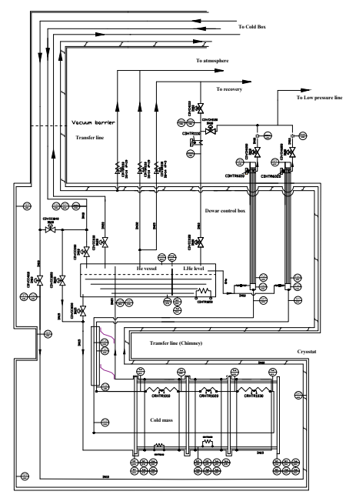
SPD solenoid. Flow scheme
The cryogenic system of the cryostat and the control Dewar shall be designed in order to take the loads resulting from all operation scenarios. Design pressure for all pipelines and helium vessel is 19 bar absolute (bar-a).
Liquid helium that is used for cooling the cold mass is fed from the liquefier at 4.5 K. Thermal shields of the solenoid surround the cold internal parts and are cooled by liquid nitrogen, which passes through a pipes of the heat exchanger of serpentine type.
The Process Flow Diagram (PFD) of the SPD cryogenic system has the same principle as for CMS solenoid (CERN) and PANDA (FAIR).

Slide 20
SPD heat loads
Table 1. Estimated heat loads of the SPD solenoid
T = 4,5 К | Heat loads
 | Worked condition | Without m.f. | With m.f.
Cryostat
Radiation | 7,8 | 7,8 | 7,8
Supports | 3,6 | 3,6 | 3,6
Eddy current loss in casing | - | - | 11,50*
Eddy current loss in conductor | - | - | 0,09*
Current leads, 4,5 kA B=1.0 T | 10 | 8 | 8
Distribution box**
Radiation | 0,55 | 0,55 | 0,55
Supports of the LHe vessel | 0,26 | 0,26 | 0,26
Cold control valves | 1,05 | 1,05 | 1,05
Safety relief valves | 3,22 | 3,22 | 3,22
Vacuum barrier | 0,35 | 0,35 | 0,35
Transfer line**
Radiation | 0,06 | 0,06 | 0,06
Supports | 0,20 | 0,20 | 0,20
Total | 27,09 | 25,09 | 36,68
* Data of PANDA solenoid

Slide 21
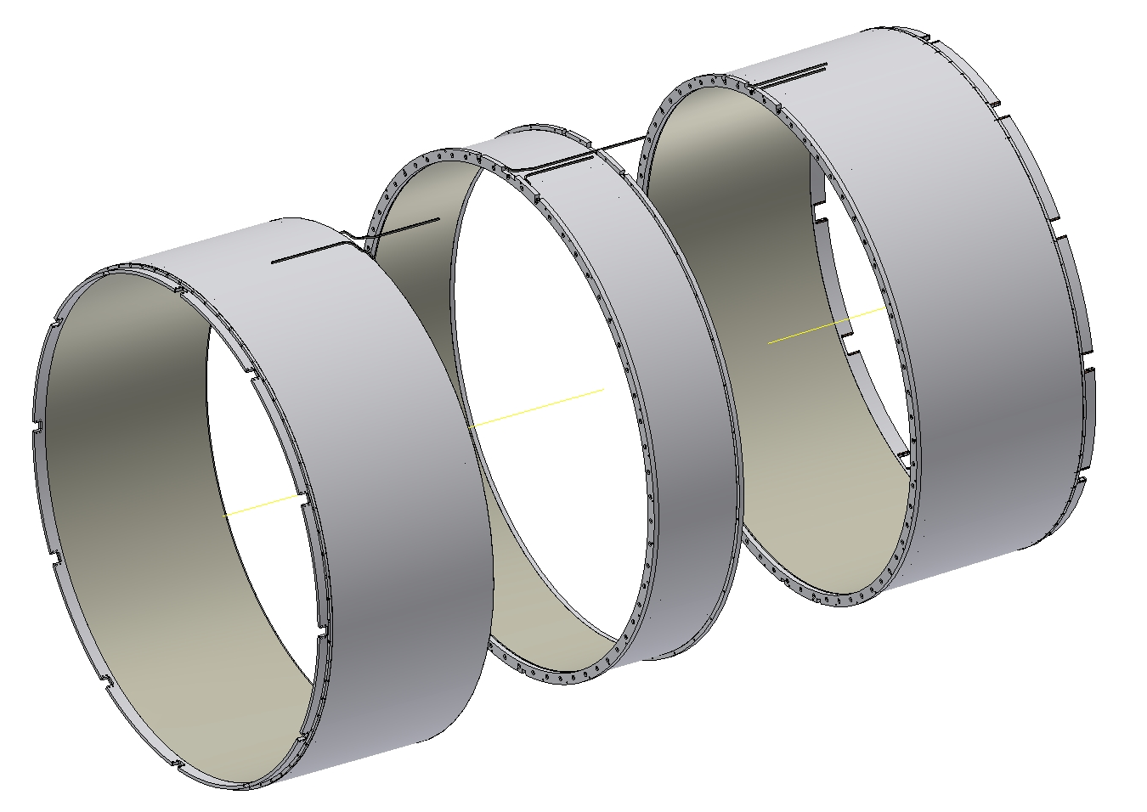
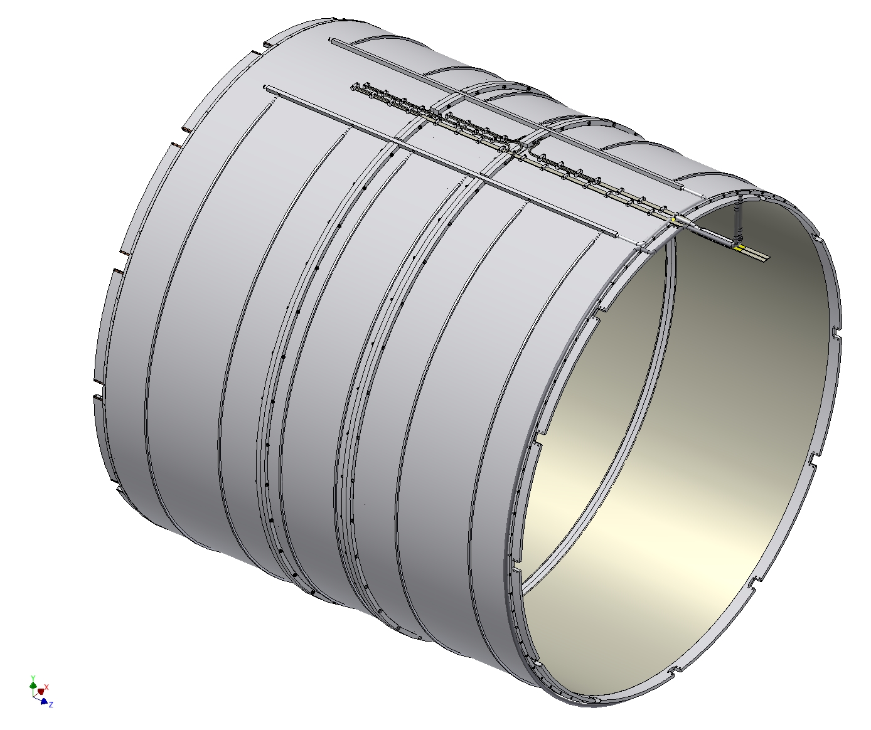
SPD solenoid.
Cold mass design.

Slide 22
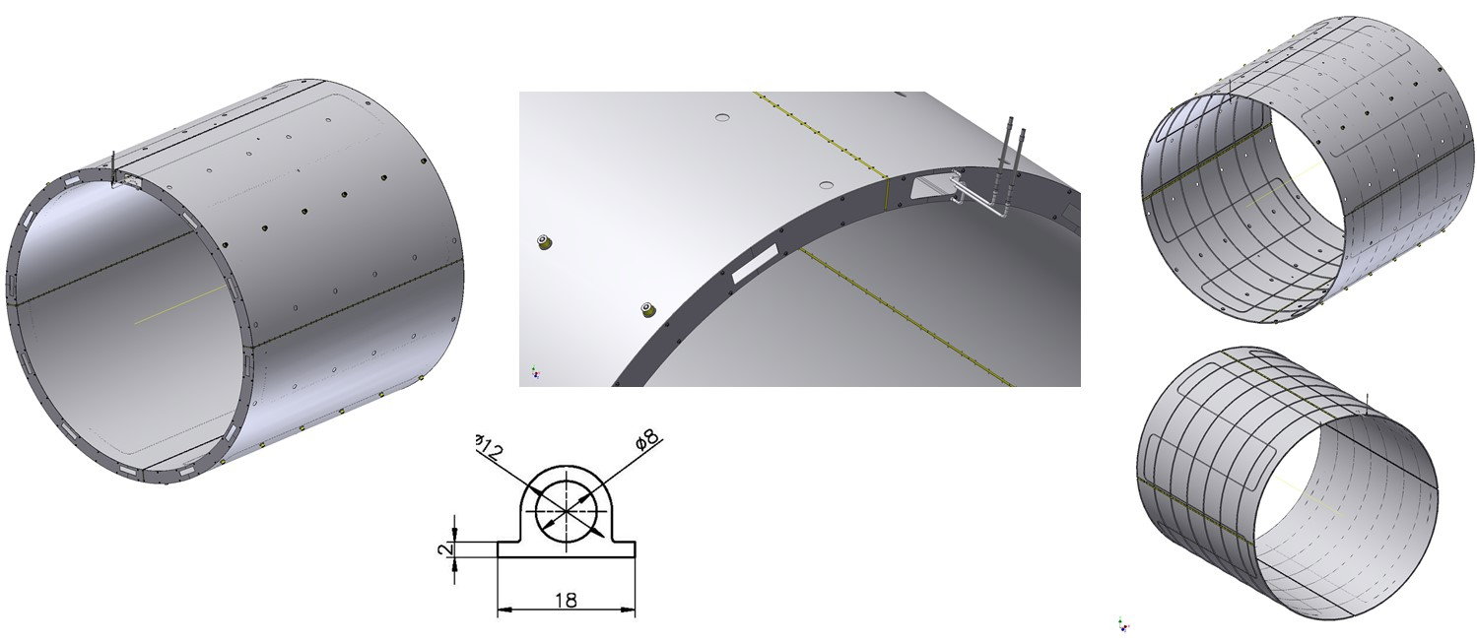
SPD solenoid. Thermal screen.
The cryostat thermal shield surrounds the cold mass with the coil. It consists of two cylindrical sectors and two flanges. The shield envelope is split up into electrically separated parts (quadrants) to avoid damage and deformations of the screen when the coil undergoes an emergency discharge. The quadrant shells are separated by gaps of about 14 mm by sheets of insulating material G10.

Slide 23
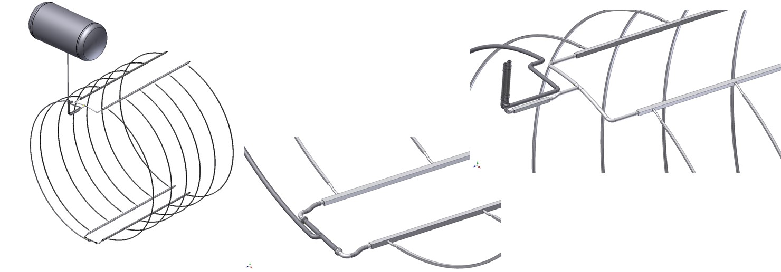
SPD solenoid. Cold mass cooling design.
The cryogenic scheme of the SPD solenoid relies on indirect cooling of the cold mass by circulating saturated helium at 4.5 K by natural convection.

Slide 24
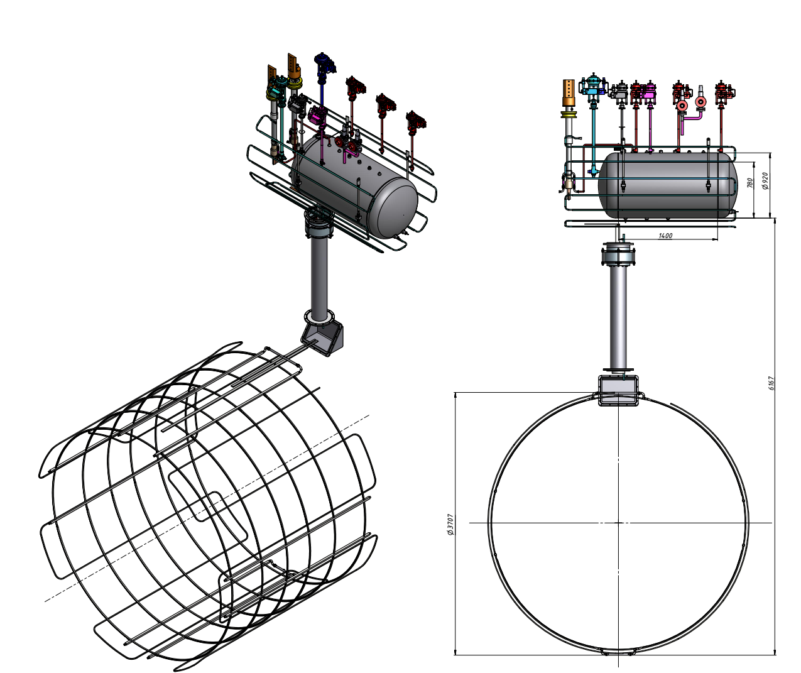
SPD solenoid. Cold mass cooling design.
The thermo-syphon circuit consists of a bottom and top manifolds connected by 12 parallel syphon tubes attached to the outer surface of the support cylinder of cold mass.
The cooling method chosen for the SPD magnet’s superconducting coil is based on the natural convection of liquid helium flow. It is a self-regulating thermosyphon circulation flow system. Natural circulation loop works on the principle that a heat load on the channels of the heat exchanger produces a two-phase flow that is on average less dense than the liquid phase.
Mass Helium flow SPD - 9-10 g/sec

Slide 25
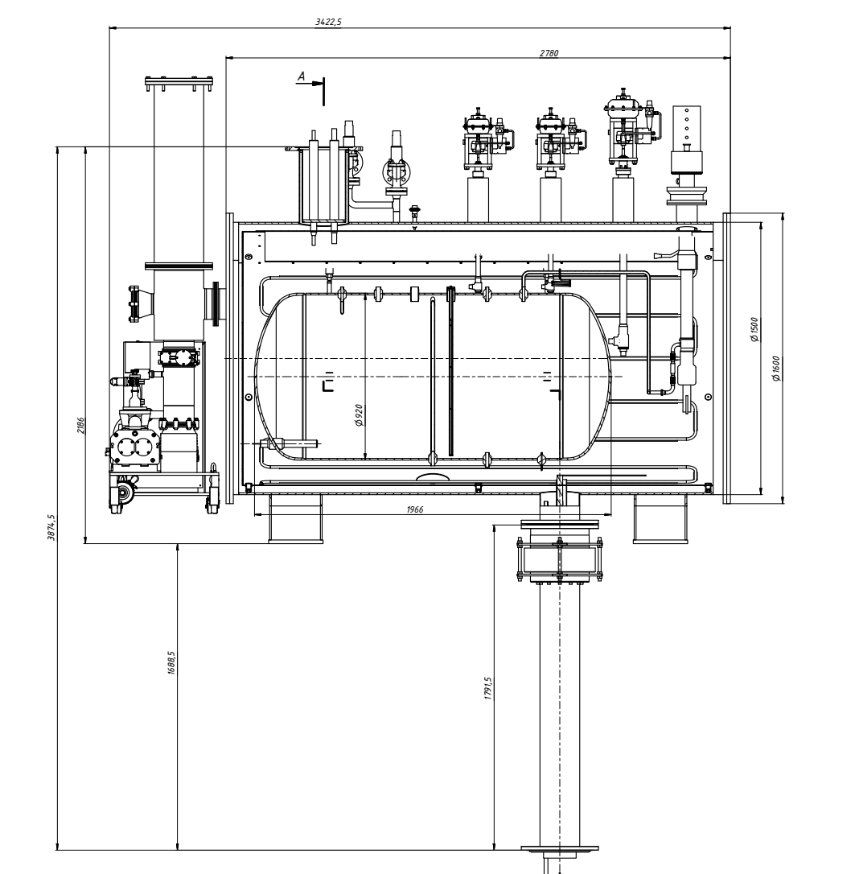
SPD solenoid. Distribution box
The distribution box includes cryogenic valves, safety relief valves, vessel with liquid helium 600l volume, instrumentation and current leads to ensure the operation of the solenoid.

Slide 26
SPD solenoid. Superconductor.
BINP suggest to use a superconducting NbTi/Cu wire based Rutherford cable co-extruded with a high purity aluminum-stabilizing matrix. This type of conductor was used for production larger detectors such as CELLO, CDF, TOPAZ, VENUS, ALEPH, DELPHI, CLEO, SDC, BELLE, ATLAS CS, ATLAS ECTs, ATLAS BT, CMS, Mu2e solenoids and PANDA.
The SPD solenoid is designed to operate at a current of 4,5 – 5,2 kA for vertical position of the conductor, i.e. about 24 – 28 % of its critical current at 4.5 K and 2,0 T peak magnetic field.
The insulated conductor dimensions at 4.5 K are 10.90 mm in width and 7.90 mm in height. The Rutherford cable is composed of 8 strands with a diameter of 1.40 mm and a Cu/SC ratio of 1.0. The critical current density of the superconductor at 4.2 K and 5 T shall be larger than 2800 A/mm2 to ensure a temperature margin for quench well above 2.0 K. The same type of the conductor is produced in Russia and used for the PANDA solenoid, FAIR, Darmstadt.

Slide 27
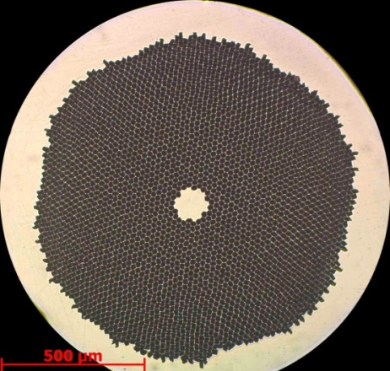
Conductor.
Production strands
Producer: “A.A. Bochvar High-technology Research Institute of Inorganic Materials” (JSC "VNIINM").
Protocol measurements 01-400/423 from 29.09.2021/18.10.2021
Superconductive NbTi strand PANDA solenoid
Parameter | Unit | Certified |  | 1-C2-1P-1-21/1 > 1400 m | 1-C2-1P-1-21/2-1-1-2 > 200 m
 |  | Value | Tolerance
Diameter filament | µm | < 20 | -
Diameter strand | mm | 1.400 | ± 0.005
Cu/SC ratio | - | .50/.50 | ± 0.05 | /0.5187 | /0.5132
Surface coating | - | none | - | none | none
NbTi J_{c} (at 4.2 K, 5 T) | A/mm² | > 2800 | -
Critical current (at 4.2 K, 5 T) | A | > 2160 | - | 2220 | 2175
n-value (at 4.2 K, 5 T) | - | > 30 | - | 71* | 70*
Conductor RRR | - | > 100 | - | 196 | 191
Twist direction | - | left | - | left | left
Twist pitch | mm | 25 | ± 5 | 22 | 21
Strand cross section
*Magnetic field value is 6 T
Table 1 NbTi/Cu strand mechanical and electrical specifications.

Slide 28
Conductor.
Production strands
Batch number / strand piece number | Diameter, mm (1,400 ± 0,005 mm) | Cu/SC ratio NbTi, % | Twist pitch |  | RRR
 |  |  | begin | end
1-C2-1P-1-21/1 | 1,4 | 0,5187 | 22 | 22 | 196
1-C2-1P-1-21/2-1-1-1 | 1,4 | 0,5140 | 21 | 22 | 207
1-C2-1P-1-21/2-1-1-2 | 1,4 | 0,5132 | 21 | 21 | 191
1-C2-1P-1-21/2-1-2 | 1,4 | 0,5126 | 22 | 22 | 205
1-C2-1P-1-21/2-2 | 1,4 | 0,5122 | 22 | 24 | 205
Table 2 Technical parameters
Batch number / strand piece number | Field, T | I_{c}, A (4,2 К; 0,1 mkV/sm) | n-value
1-C2-1P-1-21/1 | 8 | 789 | 35
 | 7 | 1253 | 52
 | 6 | 1746 | 71
 | 5 | 2220 (calc.) | -
1-C2-1P-1-21/2-1-1-1 | 8 | 750 | 35
 | 7 | 1208 | 53
 | 6 | 1694 | 71
 | 5 | 2175 (calc.) | -
1-C2-1P-1-21/2-2 | 8 | 750 | 36
 | 7 | 1200 | 50
 | 6 | - | -
 | 5 | 2165 (calc.) | -
Batch number / strand piece number | Sample | Measurement | Mechanical properties
 |  |  | Ultimate resistance, MPa | Yield strength, MPa
1-C2-1P-1-21/1 | 1n | 1 | 903 | 838
 |  | 2 | 897 | 836
 |  | 3 | 909 | 845
Table 3 Mechanical properties
Table 4 Critical current (at 4.2 K) and n-value (at 4.2 K) vs magnetic field.

Slide 29
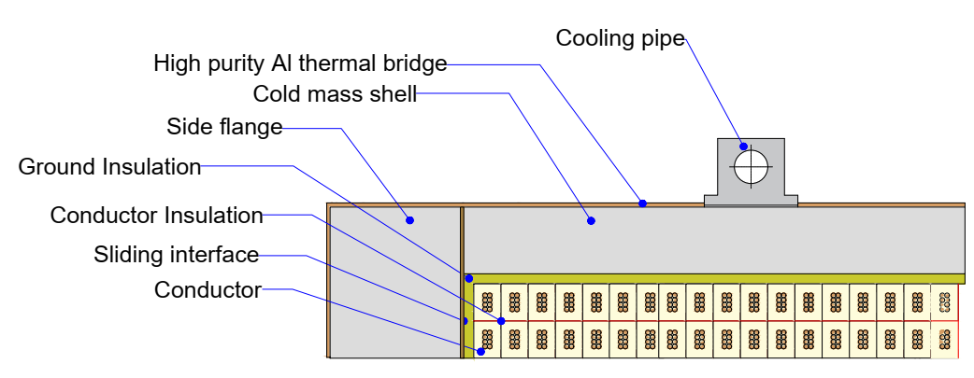
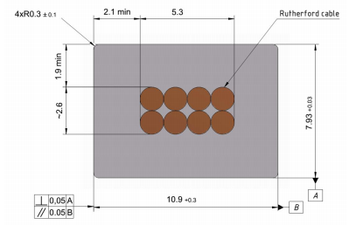
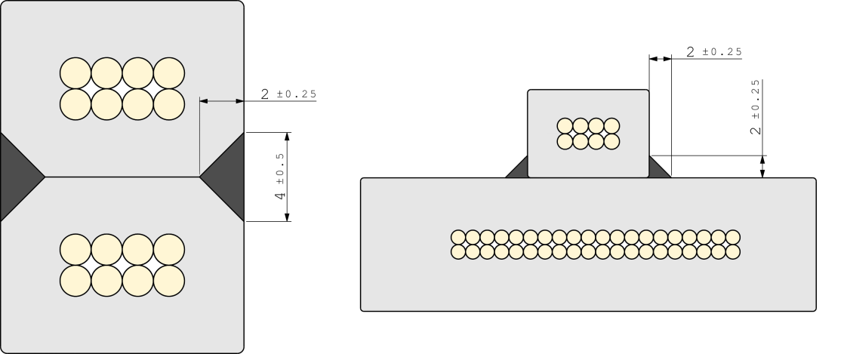
PANDA conductor
Rutherford cable, 8 strands, extruded in Al matrix
Thickness (after cold work) at 300 K | mm | 7.93 | ± 0.03
Width (after cold work) at 300 K | mm | 10.95 | ± 0.03
Critical current (at 4.2 K, 5 T) | A | > 14690
Critical current (at 4.5 K, 3 T) | A | > 16750
Overall Al/Cu/sc ratio |  | 10.5/1.0/1.0
Aluminum RRR (at 4.2 K, 0 T) |  | > 1000
Al 0.2% yield strength at 300 K | MPa | > 30
Conductor mechanical and electrical parameters.
Cold mass cross-section.
Layer-to-layer and coil-to-coil (left) and terminal (right) joint layouts.
Cross-section of the conductor.

Slide 30
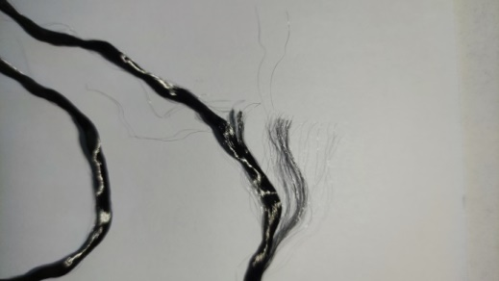
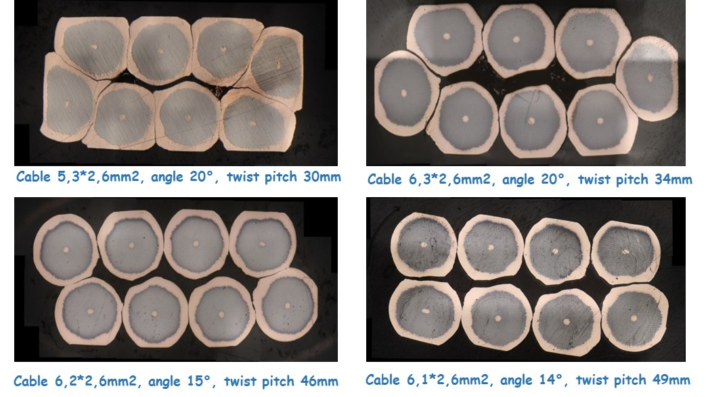
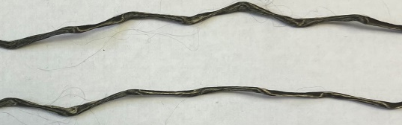
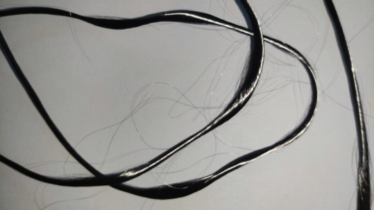
Conductor.
Optimization of the design of the SPD Rutherford cable
Picture of the nominal strand

Slide 31
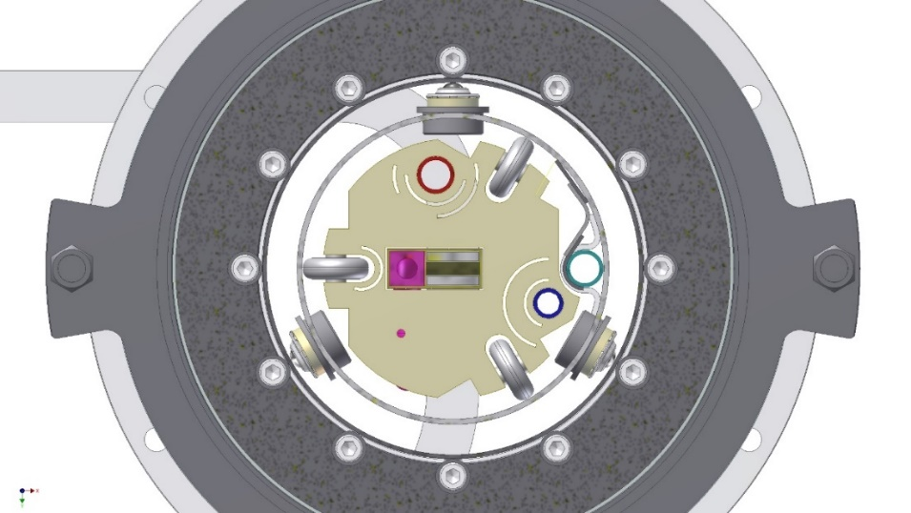
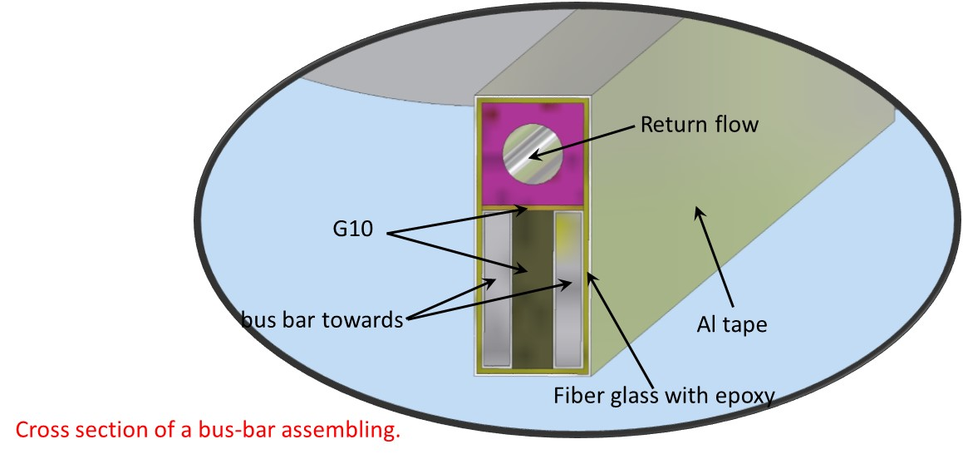
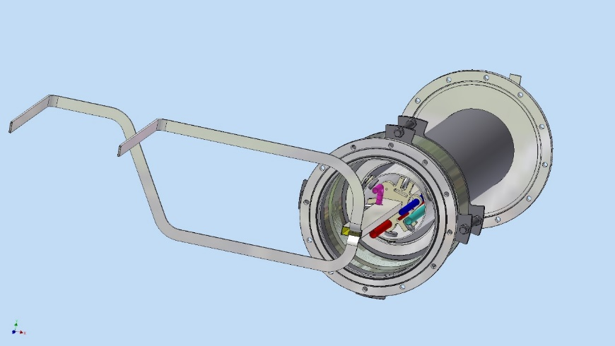
SPD solenoid. Distribution box and transfer line
The transfer line (chimney) connects the vacuum volumes of the cryostat and the control Dewar. The outer diameter of the chimney is 219.1 mm, the wall thickness is 2 mm. It encloses the superconducting bus bars, direct and return pipes for liquid helium flows 4,5K and supplied pipe with liquid nitrogen, measurement wiring, all of which are surrounded by a thermal shield with liquid nitrogen return pipe.

Slide 32
SPD Current Source and Energy Extraction System
Basic requirements for the Current Source and Energy Extraction System:
Current in a circuit 5200 A;
Current setup accuracy and longterm stability – 100ppm
The amount of the stored energy to be extracted ~ 20MJ. Stored energy should be extracted to the external dump resistor with the value of 0.1 Ohm. The active elements of the dump resistor should not be hotter than 100C;
Middle point should be introduced and grounded in order to minimize the voltage between the coil and ground.
Dump resistor should have as minimal as possible stray inductance and must be installed in parallel with the extraction switch;
The opening time of the energy extraction switch ~ 20ms;

Slide 33
SPD Current Source and Energy Extraction System
Powering circuit

Slide 34
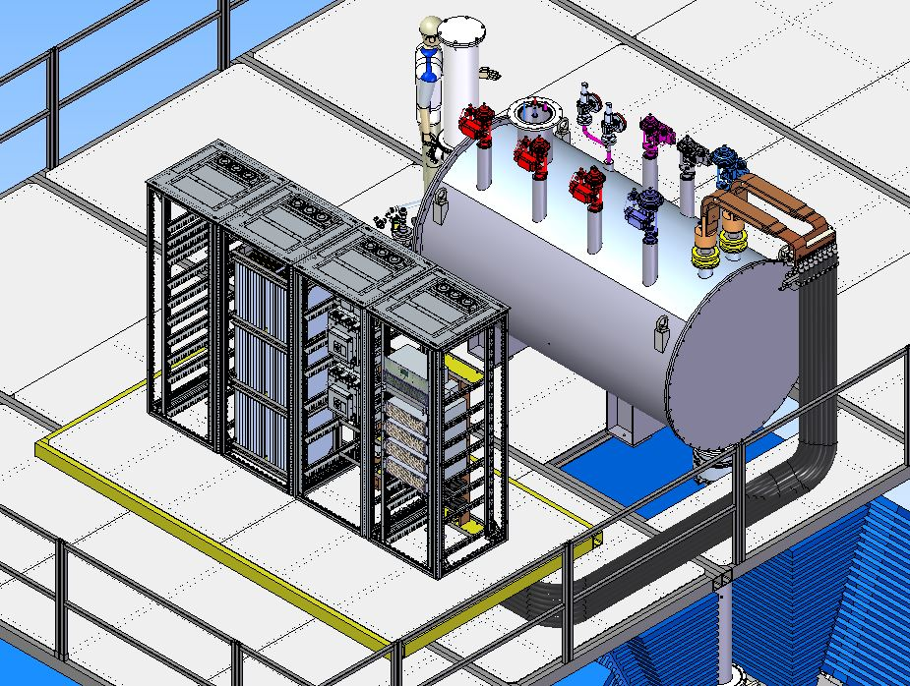
SPD Current Source and Energy Extraction System

Slide 35
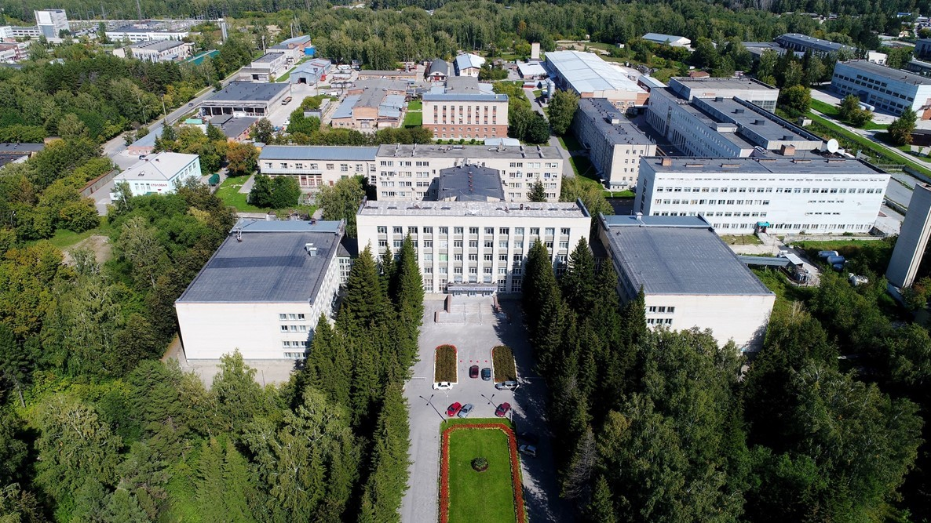
Thank you for your attention

