Slide 1
Straw barrel status report
Notes:
Good moning. I want to told about straw tracker in the different experiment.
1

Slide 2
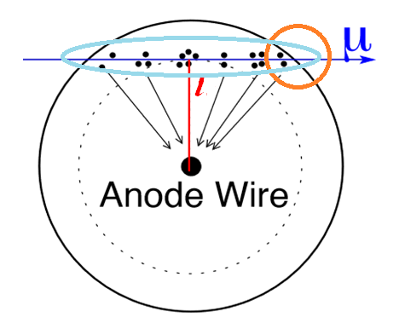
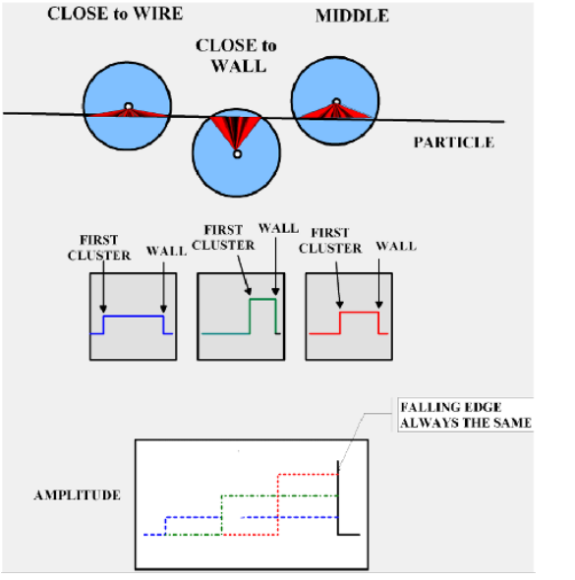
Detection process
Principle of a straw position measurement. A ionizing particle passes at the distance l from anode wire, creating ionization clusters along its path. The primary electrons will drift to the anode wire.
Explore the possibility of measuring the last electron in the track to use it as a trigger
It is necessary to measure the charge in the track to determine the value of dE/dx
Notes:
Principle of a straw position measurement. A ionizing particle passes at the distance r from anode wire, creating ionization clusters along its path. The primary electrons will drift to the anode wire. Measuring the drift time first came an electron we get the distance which flew from the anode a charged particle.
2

Slide 3
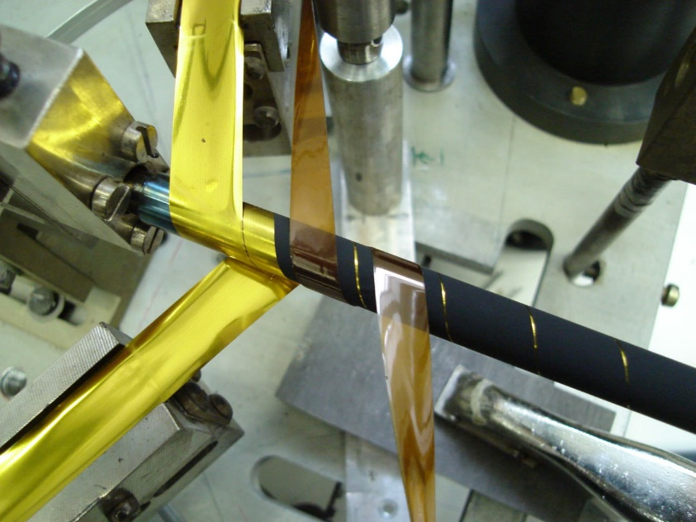
Mechanics
STRAW winding
Production- 1m/min
Lenth- 5.5m
Diameter-2,4,6,10,20mm
thickness-70+ um
STRAW welding
Production- 1m/min
Lenth- 5.5m
Diameter-от 5, 10, 20mm
thickness-15, 20, 36, 50 um
both of these technologies are well developed at JINR

Slide 4
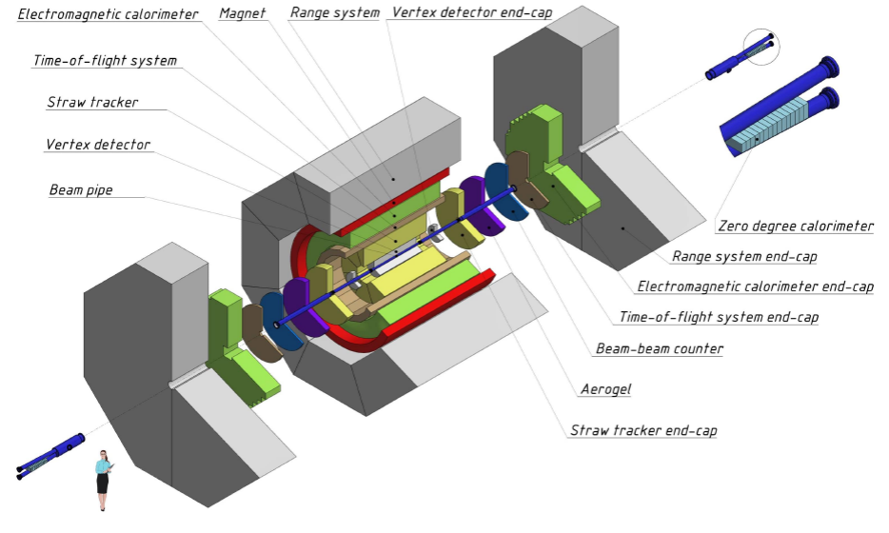
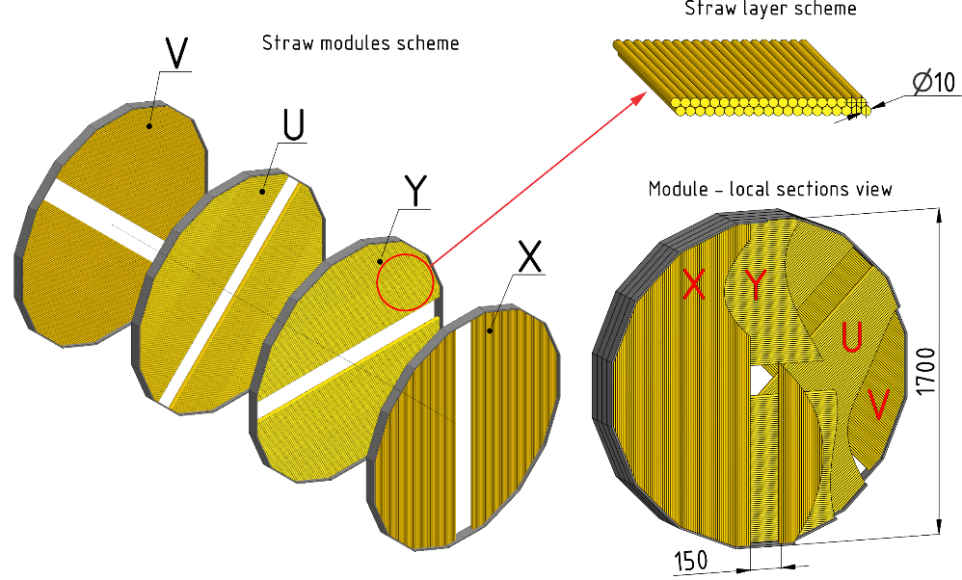
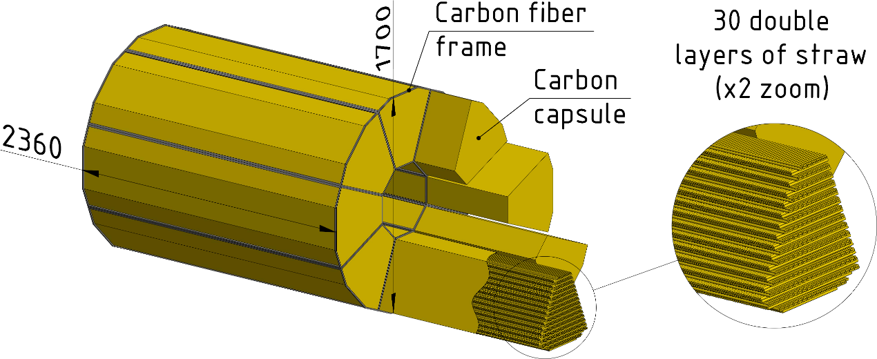
SPD NICA (JINR, Dubna)
Straw Tracker - the main tracking system of SPD
Straw diameter: 10mm thickness 36um PET
Expected spatial resolution of 150um
Barrel is made of 8 modules with up to 30 double-layers, with the ZUV orientation
Endcaps are made of 12 double-layers with the XYUV orientation
Vast experience in straw production in JINR for several experiment: COMPASS, NA-62, NA-64, SVD-2; prototypes for: CREAM, SHiP, COMET, DUNE.
Notes:
Main tracker system of SPD
Straw diameter 10mm thickness 36mkm PET
Spatial resolution of 150mkm
Barrel is made of 8 modules with up to 30 double-layers, with the ZUV orientation
Endcaps are made of 12 double-layers with the XYUV orientation
Vast experience in straw production in JINR for several experiment: COMPASS, NA-62, NA-64, SVD-2; prototypes for: CREAM, SHiP, COMET, DUNE.
4

Slide 5
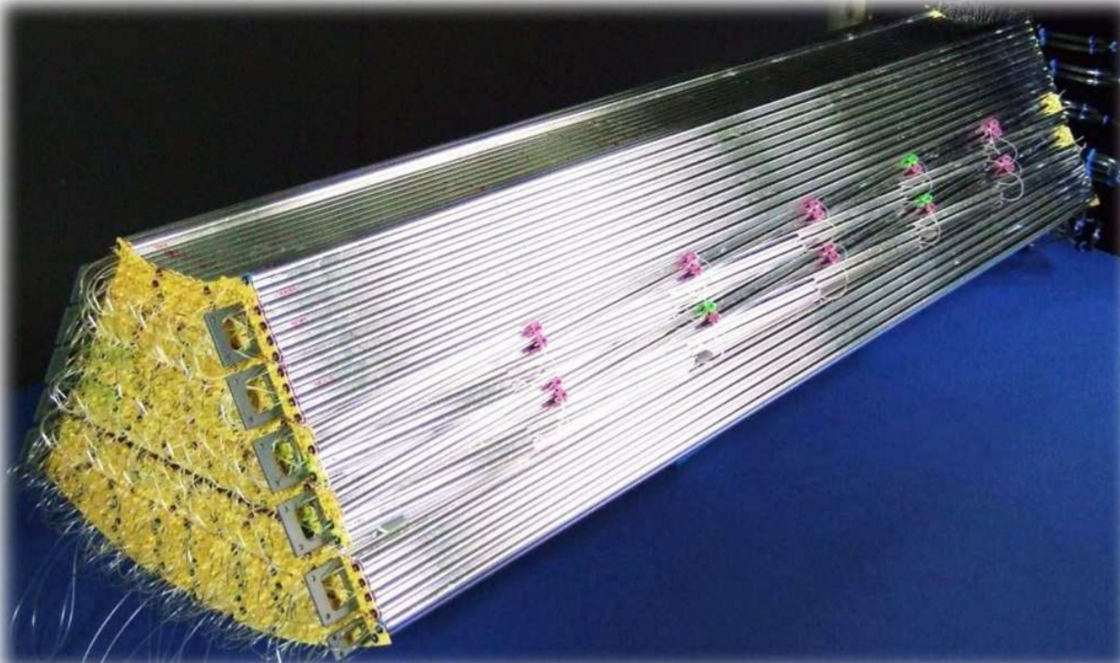
Similar TRACKER : PANDA (FAIR, Darmstadt)
Notes:
the next experiment is panda
the idea of the design seems very original to us
5

Slide 6
Total weight of straws – 60 kg

Slide 7
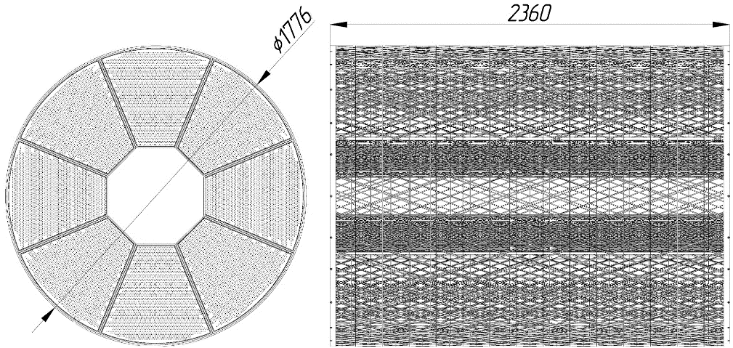
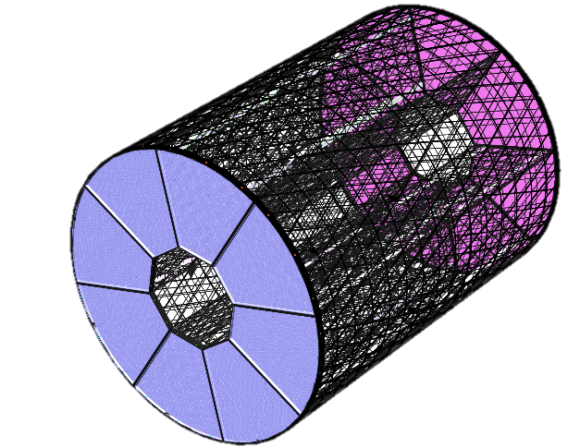
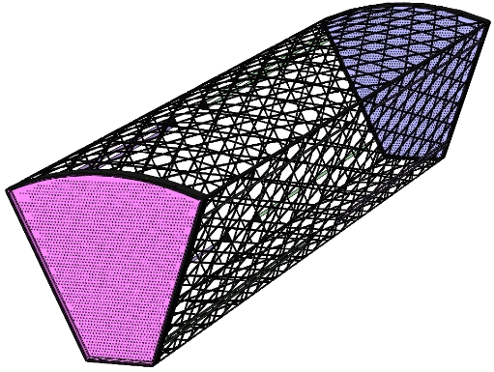
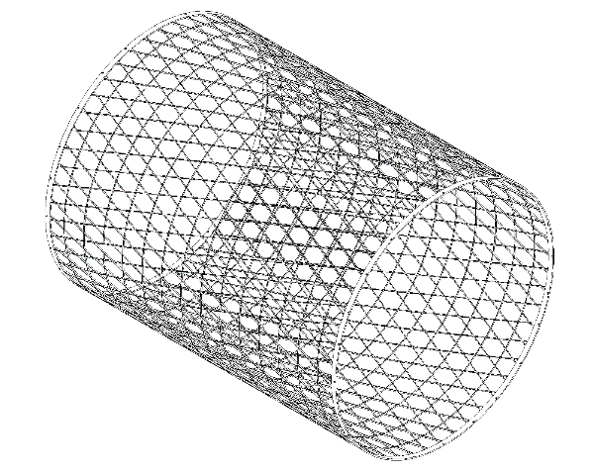
Barrel Straw Tracker
the frame of the octants is made of carbon fiber construction
the cross section of hydrocarbon threads is different, but in average about 8 mm²
the use of material that allows you to permanently preserve the geometry
11 kg
22 kg
Total 110 kg
Notes:
initially, the angle of intersection of the straws was considered 90°
now we have moved on to the angle between the straws of 5 degrees.
this solution has reduced the number of channels by 3 times and now the number of channels is about 20 thousand
7

Slide 8
Ongoing activities
Choice of the tracker readout electronics:
- several existing options are tested (talk by A.Zelenov)
- a concept of new ASIC is being developed based on the lab and test beam measurements (talk by A.Solin)
Studies of influence of the readout electronics parameters on the tracker performance
Testbeam and/or Garfield/LTSpice based parametrization of the straw response for SPDRoot (details: Thursday talk by S.Bulanova, poster by A. Mukhamejanova)
Developing the appropriate laboratory space for tracker prototyping, assembling, and testing

Slide 9
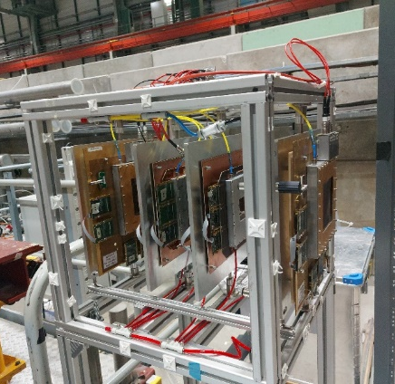
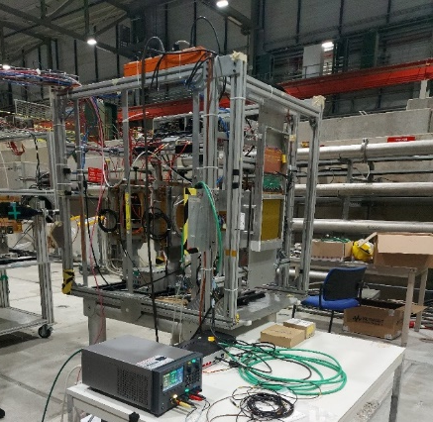
Setup 1
Electronics for straw tracker
during first testbeams 2021-2022 three types of existing ASICs were tested:
VMM3a was rejected due to the latching in the time-at-threshold mode
VMM3 concept was found to be promising but chip re-production is difficult
TIGER has better architecture but needs further development for the straw applications
thus a development of a new ASIC seems to be needed if both the time and charge should be measured
the design to be based on the lab and test beam studies and experience obtained with the existing ASICs
a common effort of SPD/DUNE/DRD1 experts
a possible reduced solution - time only measurements: for example, PETIROC (CMS iRPC readout)
the option to be investigated
Setup 2
Setup 3

Slide 10
Garfield++/LTSPice simulation studies
allows to investigate different readout electronics options :
straw signal from Garfield++ is interfaced to an electronics circuit model in LTSpice
to obtain a reliable result a good prediction of the straw signal is needed
Garfield/Garfield++ : good prediction of the drift time distribution but still problematic description of the avalanche development, i.e. the straw signal
work in a close contact with the Garfield++ developers is ongoing from December 2022
a test setup for gas gain measurements is developed and comparison of the measurements results to Garfield++ predictions are ongoing
a quick fix of the gas gain issue is used at the moment
LTSpice:
VMM3 model is tuned to the testbeam data
work on the realistic noise description is ongoing
next steps: TIGER and modified TIGER circuit models to be implemented
tracker response parametrisation for SPDroot:
first results for ultimate cases (maximal magnetic field, track angles) for MIP
next steps: predictions for other particles for PID performance evaluation

Slide 11
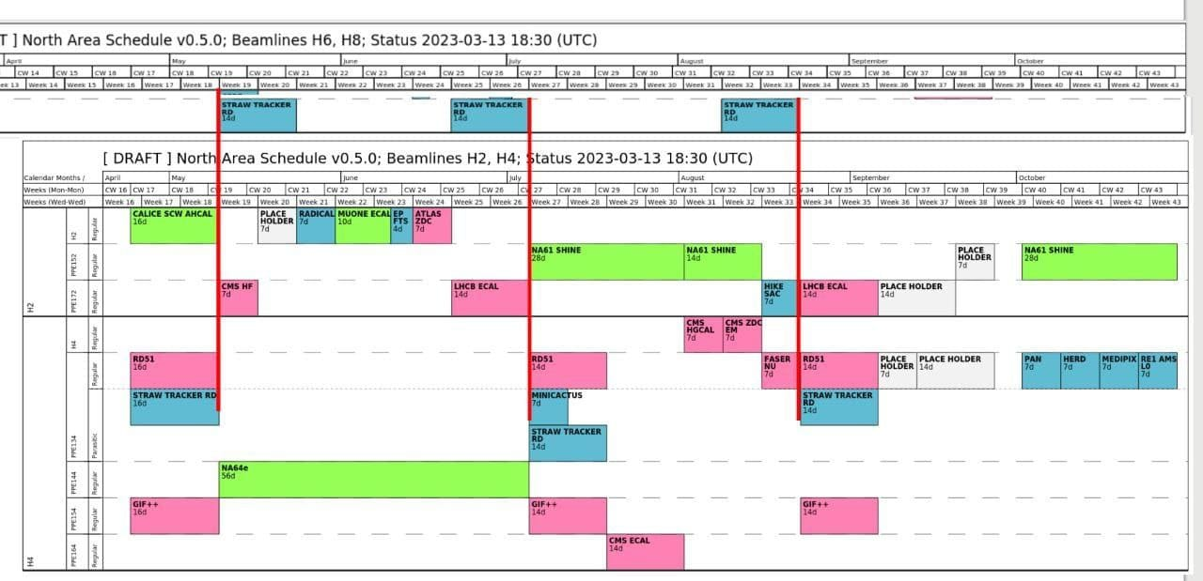
Test beam measurements and R&D
SPS muon test beam is a great possibility for
straws+readout electronics performance measurements including tests with the magnetic field
common work with electronics developers and experts (VMM3, TIGER)
Year 2023: 1.5 months of the dedicated beam time at H4 + 1.5 months of parasitic beam time at H8 beam lines
Straw technologies and readout electronics interests within ECFA Detector R&D:
new Detector R&D collaborations will replace the existing CERN RD collaborations from year 2024
though currently no JINR participation can be considered, search for common interests for future straw trackers (DUNE, SHiP, HIKE) is ongoing within DRD1
our colleagues from INP (Almaty) intend to join DRD1 and actively participate in working group meetings

