Slide 1
Straw endcap status report
K.Basharina, G.Kekelidze, V.Kramarenko, V.Lysan, V.Pavlov, A.Shunko,

Slide 2
Principle design of Straw endcap
Straw endcap
Proposal
X1
Detector arranged so - that they form an X, Y, U, V coordinate system at an angle of 45 degrees.
Each coordinate plane consists of two halves separated by a distance for installation on a vacuum tube - the gap.
The thickness of one coordinate plane is 30 mm
Eight coordinate planes are mounted together on the rigid flat table, forming a rigid block, 240 mm thick.
Eight coordinates straw layers
Eight coordinates straw layers
Y1
U1
V1
X2
Rigid flat table with bushings for end-cap mountiog (honeycomb)
Y2
U2
V2
General view of one endcap consisting of 8 coordinate planes
After assembling all eight planes, the flat table is removed
In total , 4608 straw are contained in two endcaps with a diameter of tubes 9,68 mm.
150
1580
1680
240

Slide 3
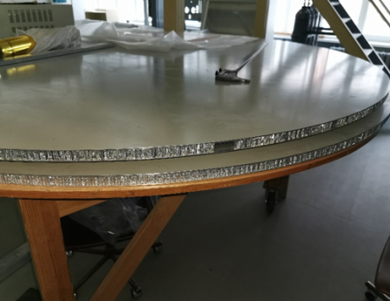
Principle design of one coordinate plane Straw endcap
Straw endcap
Proposal
144 straw top layers
Frame with motherboards
Beam pipe gap
144 straw top layers
One coordinate layer consists of a frame with 288 straw tubes,
9 (32 ch) motherboard.
Straw are glued on both sides
144 straw bottom layers
70
100
1540
1680
The straw planes are assembled on a rigid honeycomb board on a rotatable octagonal frame
The detector must have the shape of a disk,
have a relatively small central hole, which is defined by a beam pipe,
have a small amount of matter in the sensitive region of the detector.
The detection layers should be thin,
The number of layers should be sufficient to identify particles via dE/dx measurement.
Rigid flat table with bushings for mounting (honeycomb)
Bushing for assembling all endcap layers into a package
Motherboard
Ground Fiberglass+copper
144 straw top layers
Rigid frame Fiberglass+coppe
30
6
144 straw bottom layers
Rigid flat table for assembling
Epoxy compound

Slide 4
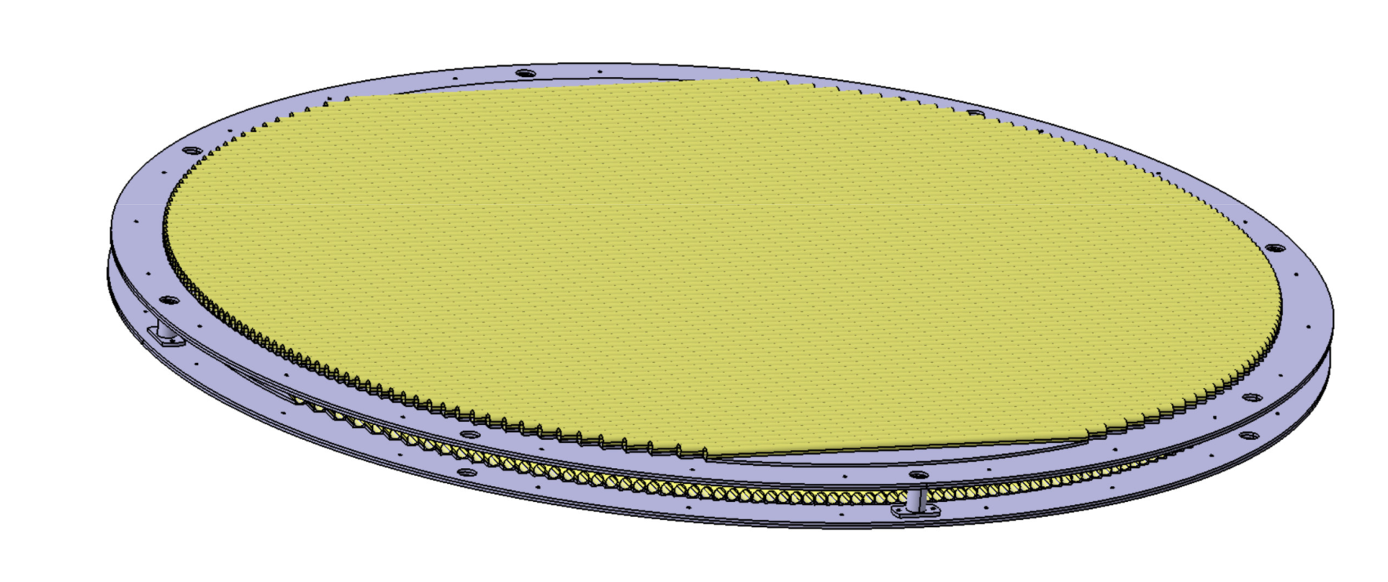
Creating a smaller scaled-down prototype
Diameter of frame 1 meter
Straw endcap
1 meter Prototype
The goal is to develop an assembly technology
and design of frontend electronics on a real wheel.
We are currently creating an endcap prototype.
The diameter of the prototype is 1 meter.
Prototype consists of 2 working planes rotated 90 degrees relative to each other.
Number of channels 320 straw tubes with 10 (32 ch) motherboard.

Slide 5
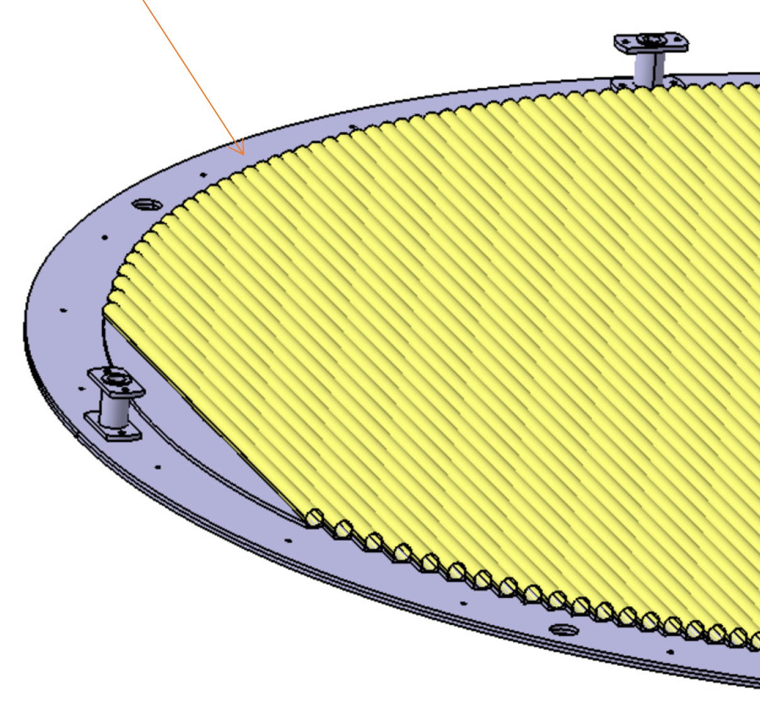
Straw endcap
1 meter Prototype
Now the drawings have been developed and transferred for manufacturing in LHEP
Mounting sleeve between layers
Frame dimensions 70 x 6 х Ø1000 mm

Slide 6
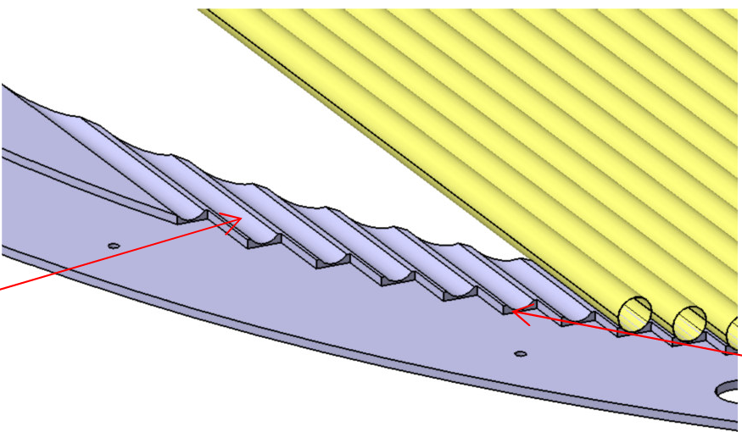
Straw endcap
1 meter Prototype
Creation of a scaled-down detector prototype
A special step is provided for the precise position of the tubes in the frame.
Also, It is convenient for trimming of tubes after gluing

Slide 7
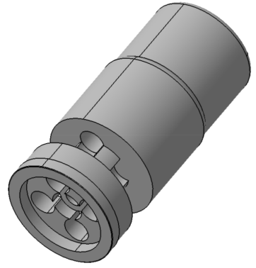
Straw end-plug
Straw endcap
1 meter Prototype
Developed and manufactured a 400 of end-plags on a 3D printer
Gas inlet 2mm tube
GRD connector
Pin
Hole for sealant
Straw tube

Slide 8
Straw endcap
1 meter Prototype
Deformation of the prototype frame
Preliminary calculations were performed in the “Ansys” program for the power frame of the SPD endcap straw detector.
We chose the frame thickness of A – 6 mm
Calculations are performed for different materials and different values of the width - B, and diameters - D of the circle power frame
Distributed load 0,6 kg/cm.
Young's Module for АМГ – 71 GPa
Young's Module for Carbon fiber – 200 Gpa
It can be seen from the calculations that when changing both the thickness of the power frame from 70 to 100 mm and the material from aluminum to Carbon fiber, the longitudinal and transverse deformation decreases by about 3 times.
Frame D=1000mm |  |  |  | Frame D=1900mm |  |  |  | Frame D=1900mm
АМГ |  | Carbon fiber |  | АМГ |  | Carbon fiber |  | Reinforced Carbon Fiber
В=70 | В=100 | В=70 | В=100 | В=70 | В=100 | В=70 | В=100 | В=70 | В=100
мм | мм | мм | мм | мм | мм | мм | мм | мм | мм
3,58 | 1,21 | 1,37 | 0,48 | 6,8 | 2,3 | 2,6 | 0,91 | 1,8 | 0,63
3,58 | 1,21 | 1,37 | 0,48 | 6,8 | 2,3 | 2,6 | 0,91 | 1,8 | 0,63
The maximum deformation is 0.9 mm. This value is slightly larger than required - 0.3 mm. However, we hope that the orthogonal arrangement of the layers will compensate for the longitudinal and transverse deformation.
The detector frame should be 100 mm wide (B) and will be made of carbon fiber

Slide 9
Straw endcap
1 meter Prototype
Deformation of the prototype frame
The maximum deformation is 0.9 mm. This value is slightly larger than required - 0.3 mm.
However, when assembling planes, we hope that the orthogonal arrangement of the straw layers will compensate for the longitudinal and transverse deformation.

Slide 10
Straw endcap
What's done
400 Straw tubes with diameter of 9,54 mm. were made for 1 meter prototype.
Investigation of mechanical and humidity properties of straw tubes.
Development and manufacture of end plugs and pins for 1 meter prototype.
Development of drawing of frame is completed for 1 meters prototype
The calculation of the deformation of the prototype frame has been made.
A device for cutting tubes in specified sizes has been developed.
What needs to be done
Documentation for mass production End-plugs should be prepared, development of the Mold will be made on POLYPAK (Dubna).
The development of frontend electronics (motherboard) for prototype.
The frame for straw tubes tension must be designed and made.
Creation of technology and tooling for Prototype assembly.
Test parameters of 1 meter prototype should be investigated on the stand by radia source.

Slide 11
Thank you for your attention

