Slide 1
Particle track reconstruction at scale: online tracking with PyTorch
Rusov D., Goncharov P., Nikolskaia A., Ososkov G., Zhemchugov A.
The study was carried out with the financial support of the Russian Science Foundation No. 22-12-00109

Slide 2
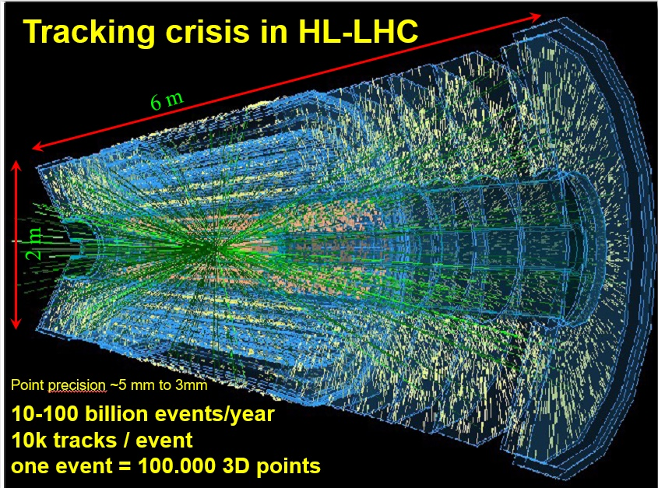
Problem Statement
Particle track reconstruction in dense environments such as the Run-4 detectors of the CERN High Luminosity Large Hadron Collider (HL-LHC) as well as MPD NICA is a challenging pattern recognition problem.
To achieve such high luminosity, the particles are not accelerated individually, but in bunches, so that the moments of collisions occur so close to each other that the event tracks overlap strongly.
For the SPD experiment, in which events are expected to arrive with a frequency of 3 MHz, the data acquisition is supposed to be performed in time slices, during one time slice up to 40 events with overlapping tracks may appear.
Of the entire stream of events, only a few percent are of interest to physicists.
Therefore, it is necessary to develop an intelligent online filter to sift out uninteresting events.

Slide 3
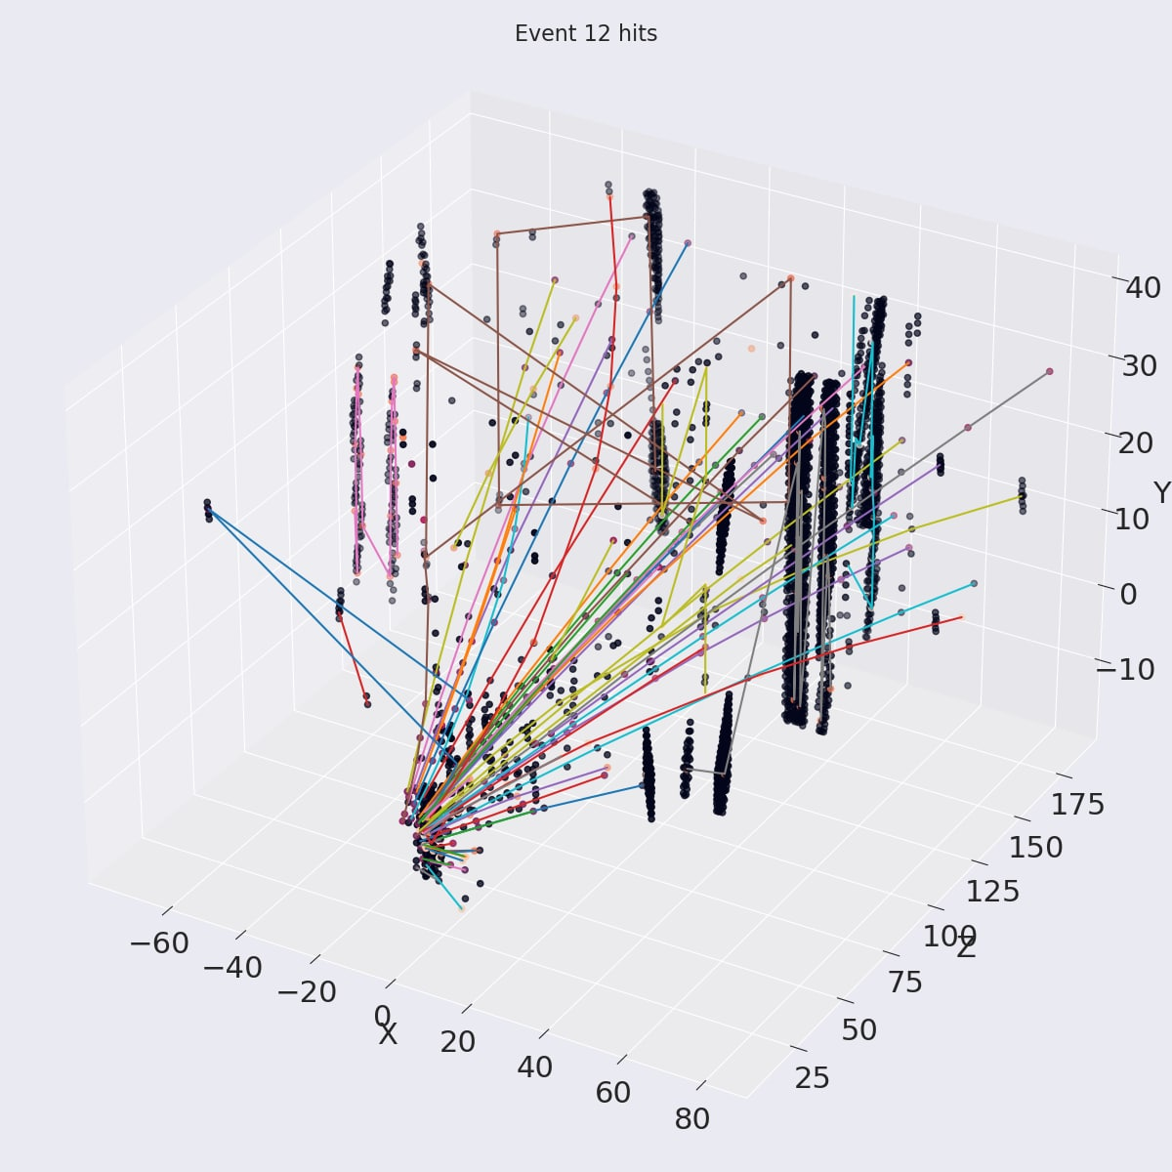
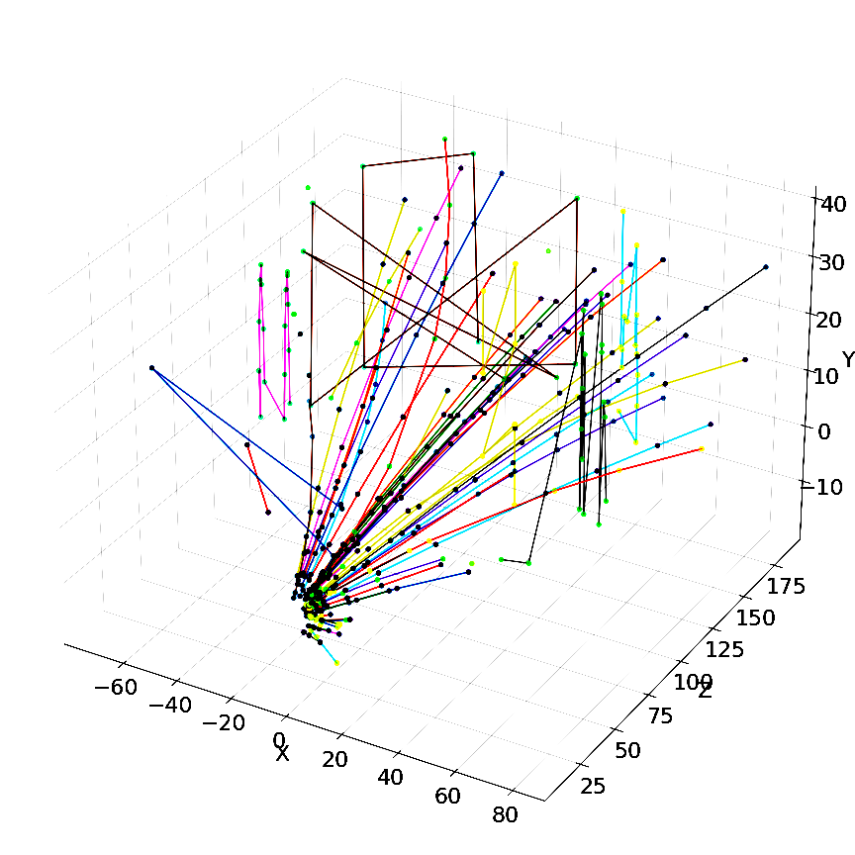
Deep Learning Comes to the Rescue
Deep learning algorithms bring a lot of potential to the tracking problem, due to
their capability to model complex non-linear data dependencies,
learn effective representations of high-dimensional data through training
parallelize easily on high-throughput architectures such as GPUs
What we propose for track building?
Reconstructed event
Neural network
(online)
Kalman filter (offline)
High recall, low precision
Very fast
High recall, high precision
Too slow
Spatial points: hits of event
Grouped hits: tracks

Slide 4
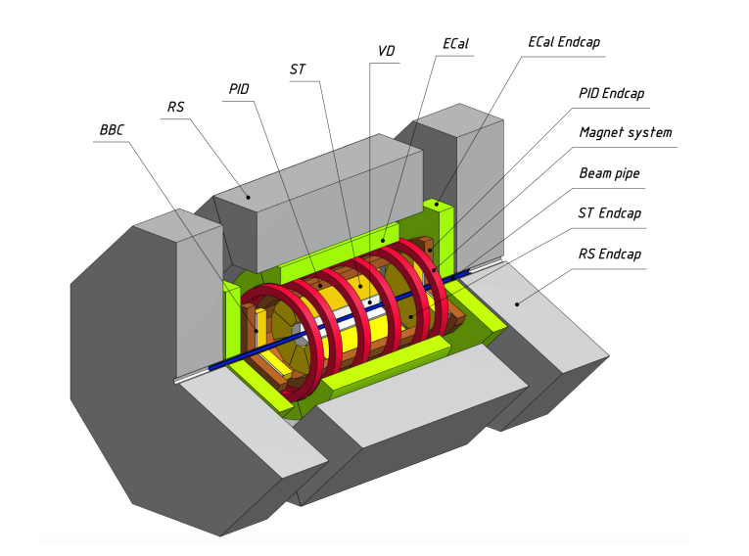
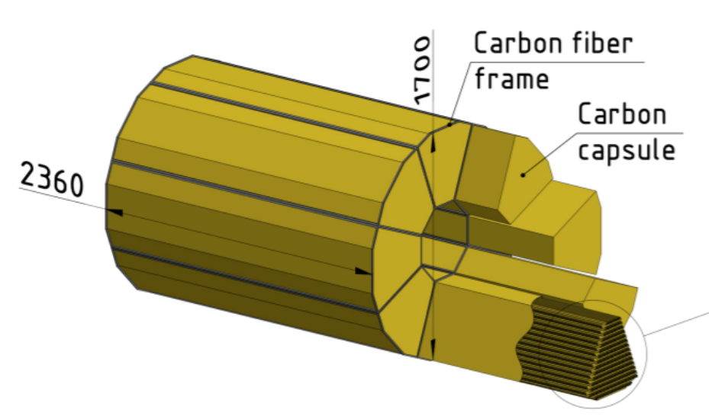
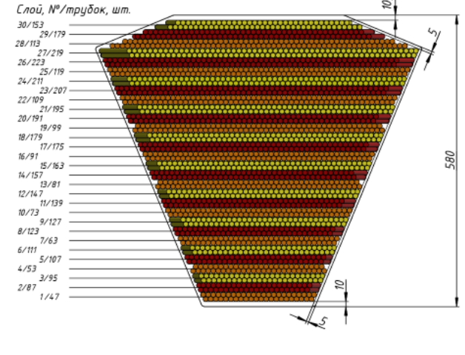
SPD Experiment
SPD (Spin Physics Detector) – is a future experiment of NICA facility in Dubna. The main goal of the experiment is to test the foundations of quantum chromodynamics (QCD).
Event data from SPD comes in the form of time slices with a length of 10 ms and about 40 events in time slice will be produced.
On average there are 200 tracks per time slice and 1100 hits (real and fake) per station.
As an online filter, the algorithm must allow processing over 1000 events per second.
(x2 zoom)
Without cover
Layer, № / tubes, pcs
General layout of the SPD setup
External view of the SPD straw detector (left) and its module in section (right)

Slide 5
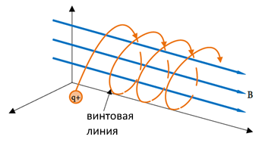
Events Data Generator
Generator is written as a simple Python program.
Multiplicity in each event is given by a random number from 1 to 10 tracks per event.
The transverse momentum of a particle is a random number with a uniform distribution in the range of values from 100 to 1000 MeV/s.
Vertex coordinates are also random in the volume corresponding to the area of particle collisions.
The particle trajectory is represented by a selection of points on a segment of a helix with a helix pitch $h= \frac{2π}{B}|\frac{m}{q}|vcosα$ and radius $R=\frac{1}{B}|\frac{m}{q}|vsinα$.
Detector configuration with 35 stations is considered.
Detector inefficiency is modeled by the probability of being “missed” for each hit independently. The detector efficiency values of 99% and 98% were used.
Helix

Slide 6
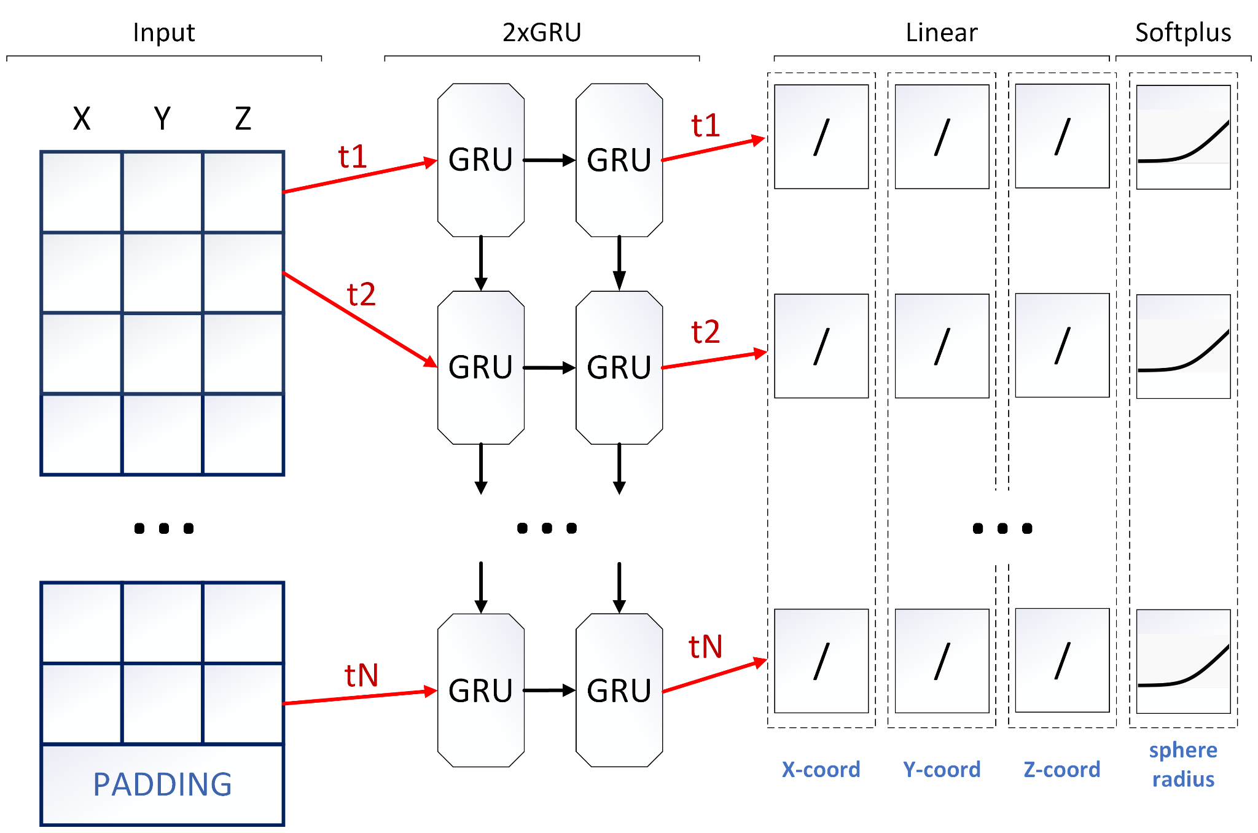
Local Tracking with TrackNET. Model overview
TrackNET model
How the model works?
TrackNET is a model for local track reconstruction.
Locality – one particular track-candidate during the prediction phase.
The model predicts the center and radius of the sphere where to search for the next hit.
All hits are placed in the spatial search index.
Only K nearest to the center of sphere hits are checked (setting K=1 leads to linear computational complexity).
Candidate tracks are extended by hits that fall into sphere.
Extended track-candidates are fed back to the model input.
Pros:
Fast
Lightweight
No problems with memory consumption
Each track can be processed separately in parallel
Cons:
lot of false positives or so-called ghosts, because of its local nature of prediction

Slide 7
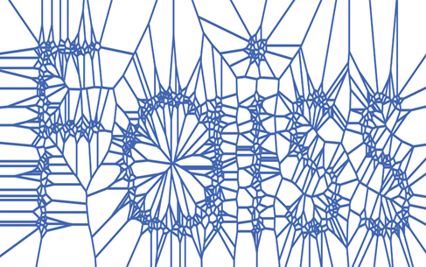
Local Tracking with TrackNET. Inference
1
2
Store all event hits in the index
SEARCH INDEX
4
Sphere centers (x, y, z)
Sphere predictions
(x, y, z, r)
5
1 nearest hit for each sphere center
3
7
Prolong candidates and pass them to the model
Check sphere attendance
6

Slide 8
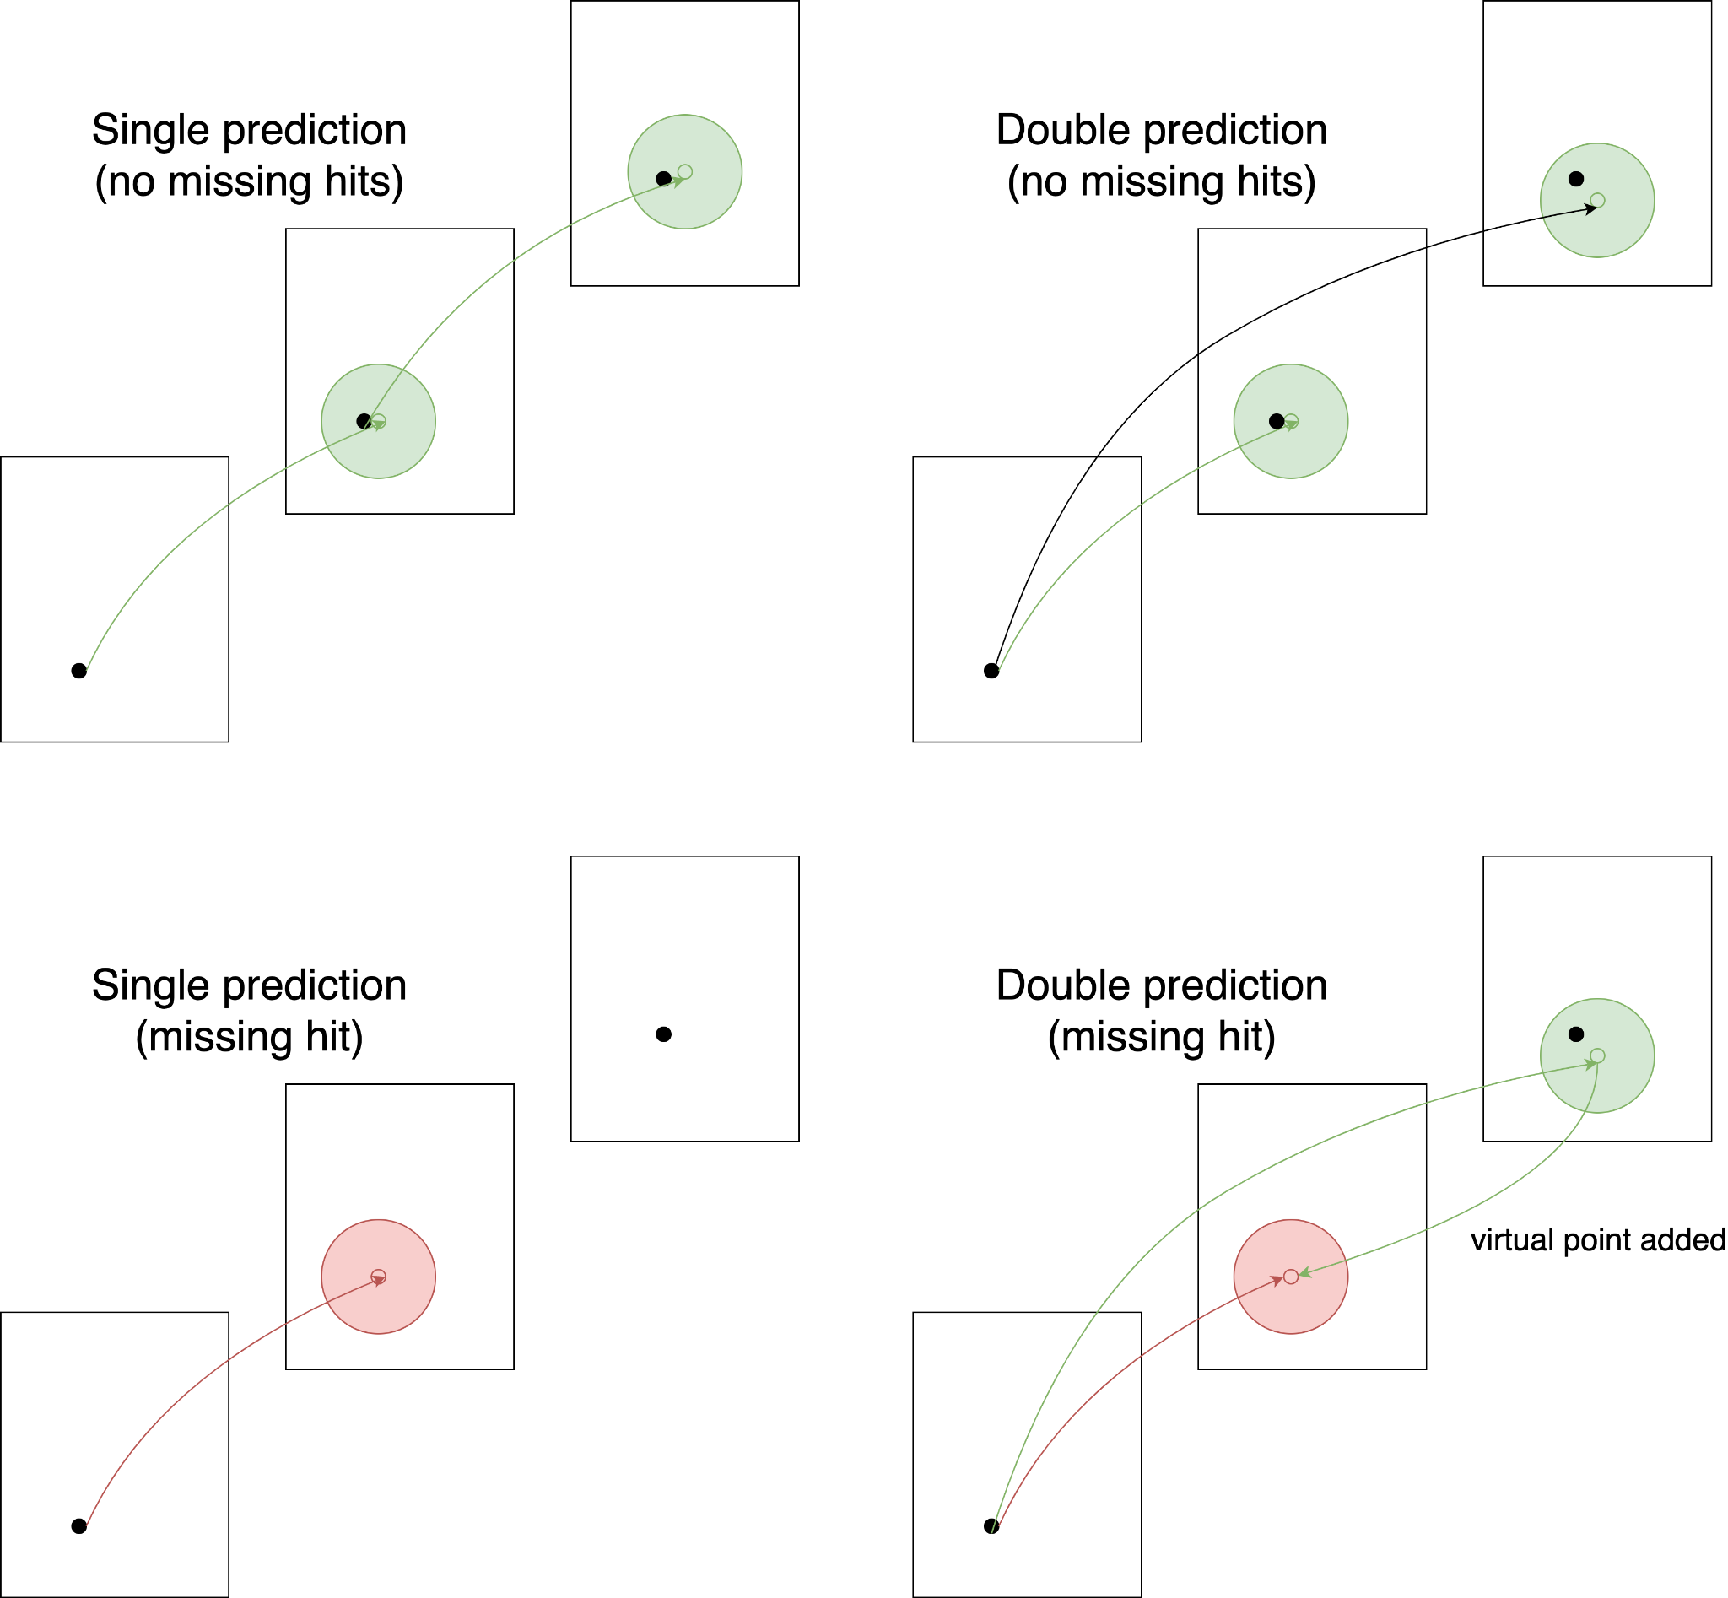
Dealing with detector inefficiency
Step ahead TrackNET:
The network contains all necessary information on how to extrapolate a track-candidate more than one hit ahead.
Predicts two steps ahead at once.
If hit is not found on the first sphere, the second sphere can be checked for the hit’s presence.
If there is a hit in the second sphere, track-candidate is prolonged with a virtual point – first sphere center.
Accuracy of the first prediction based on the single hit is lower, but model uncertainty as the sphere radius is larger, that allows model to find the next track hits.
Virtual point placed instead of missing second hit can confuse the model for the second prediction, so tracks without hits at first sphere are saved and prolonged later with virtual point and second sphere hit together.

Slide 9
Testing Results. Metrics
Testing setup:
200 000 events (5 000 time slices) for time slice evaluation
Xeon(R) Gold 6148 CPU @ 2.40GHz
NVIDIA Tesla V100 32GB
No tracks with less than 4 hits
 | TrackNET (100% efficiency) | Step ahead TrackNET (99% efficiency) | Step ahead TrackNET (98% efficiency)
Track efficiency (recall) (%) | 96,54 | 95,48 | 93,87
Track purity (precision) (%) | 94,75 | 94,74 | 93,46
Processing speed (time slice / sec) | 63,378 | 34,534 | 34,849
Processing speed (events / sec) | 2549,52 | 1381,39 | 1393,98

Slide 10
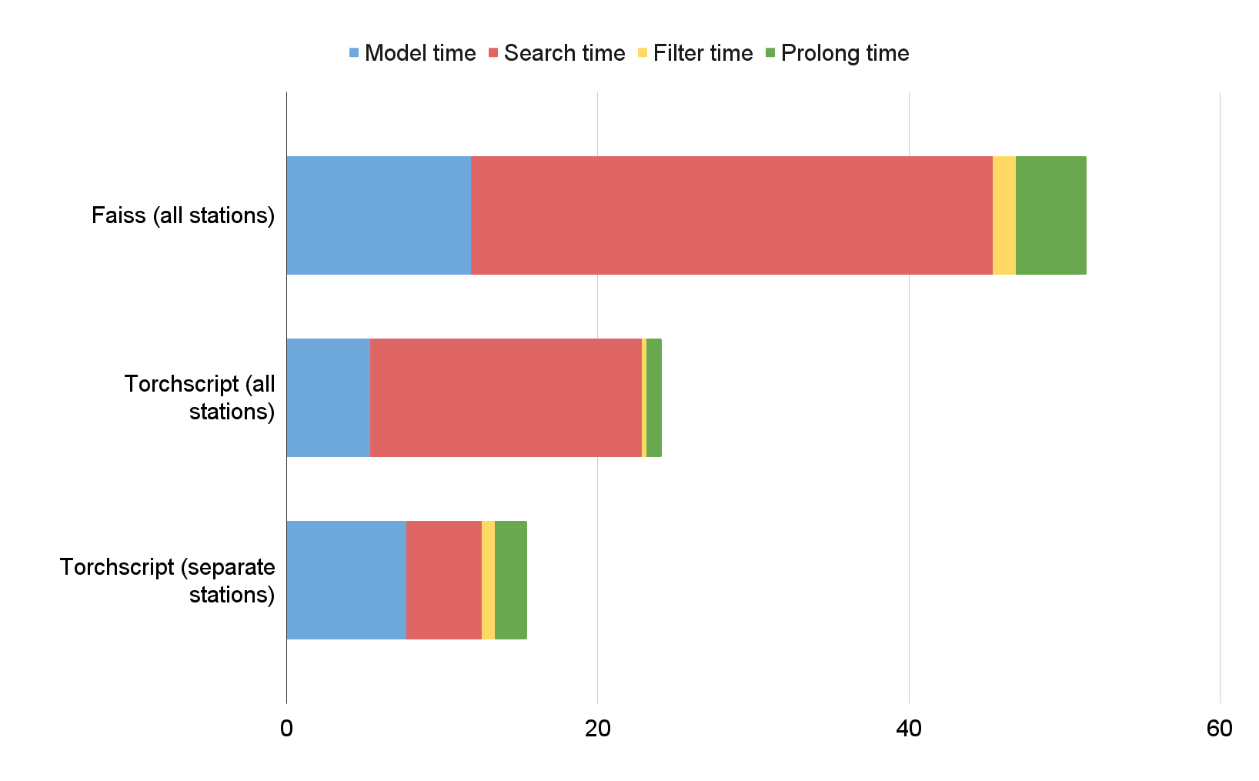
Testing Results. Time measurement
Main requirement for the approach in terms of speed is to be able to process at least 1000 events per second.
It could be done by optimization of time slice processing pipeline.
The most time consuming stages of inference are TrackNET model execution and spatial search for the nearest event hit.
The use of sophisticated algorithms of spatial search requires significant index building time, so in case of continuous event flow brute search approach fits better.
Spatial search was previously implemented with faiss, but showed high increase of the search time with search index size growth.
PyTorch implementation of euclidean distance can provide much more efficient processing of large batches using GPU.
To speed up the model inference and use the model in experiment software package, model was converted to TorchScript format.
Reducing the index size by splitting the event hits by station can also speedup the pipeline.

Slide 11
Conclusion and outlook
Applying the TrackNET model to SPD simulation data showed promising results in terms of track efficiency and purity.
Step ahead TrackNET model can’t find track with two missing hits in a row. Such situation can be considered as very rare, since the required detector efficiency should not be less than 98% (about 1% of tracks with two missing hits in a row in this case).
More complex simulation of SPD events is required. During the data acquisition from the straw tracker, special transformations are needed to obtain hits as spatial points. There is two main approaches: handling the left-right uncertainty and converting data to hits, or changing the model architecture to work with the signals right from the straw tracker without hit construction.
Event disentangling is needed after the track building. It can be done by event vertex approximation and further clustering.

Slide 12
Particle track reconstruction at scale: online tracking with PyTorch
Rusov D., Goncharov P., Nikolskaia A., Ososkov G., Zhemchugov A.
The study was carried out with the financial support of the Russian Science Foundation No. 22-12-00109

