Slide 1

Director’s Report: JINR News, Science, Prospects
G. Trubnikov
30 March 2023, Tsey, Severnaya Osetia

Slide 2
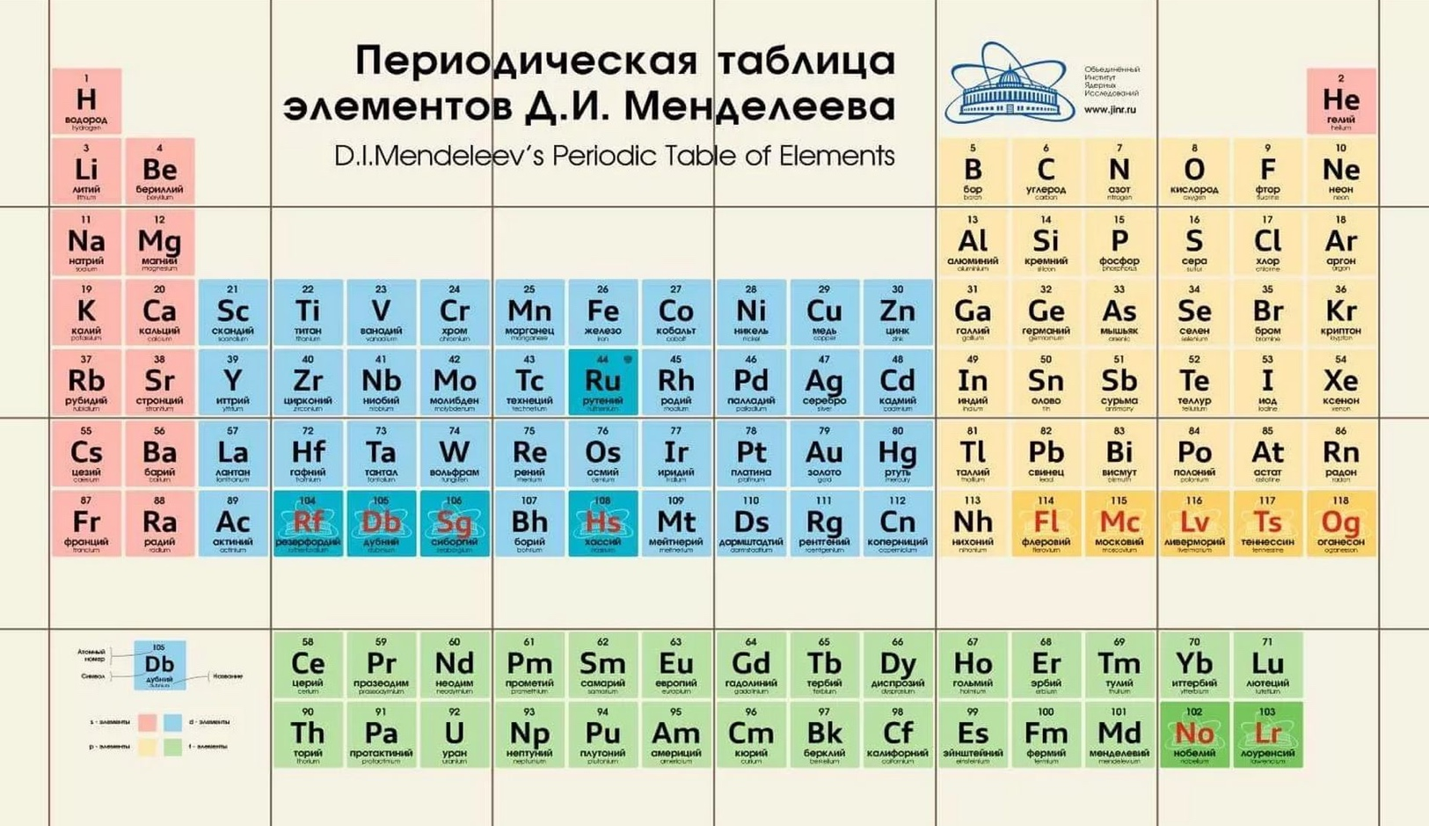
ОИЯИ на мировом научном глобусе
16 Стран-участниц
5 Асс.члены
900+ Партнероы
> 5200 чел
230 M$ бюджет
- Идея нейтринных осцилляций
- Антисигма-минус-гиперон
- Кумулятивный релятивистский эффект
- Открытие 11 новых элементов: 102-105,107,114-118.
- Ультрахолодные нейтроны
- Пострадиационная регенерация клеток
- Сверхтекучесть ядерной материи
- Цветовые заряды и правило кваркового счета
- Сверхнизкие температуры (мК)
- Гармоническое суперпространство
в суперсимметрии
- Новое поколение импульсных реакторов
- СП ускоритель релятивистских ионов Нуклотрон
- Фабрика сверхтяжелых элементов ДС-280
- "Байкал" нейтринный гигатонный телескоп
- Коллайдер NICA
- Гиперконвергентный ИТ-кластер
Notes:
2

Slide 3
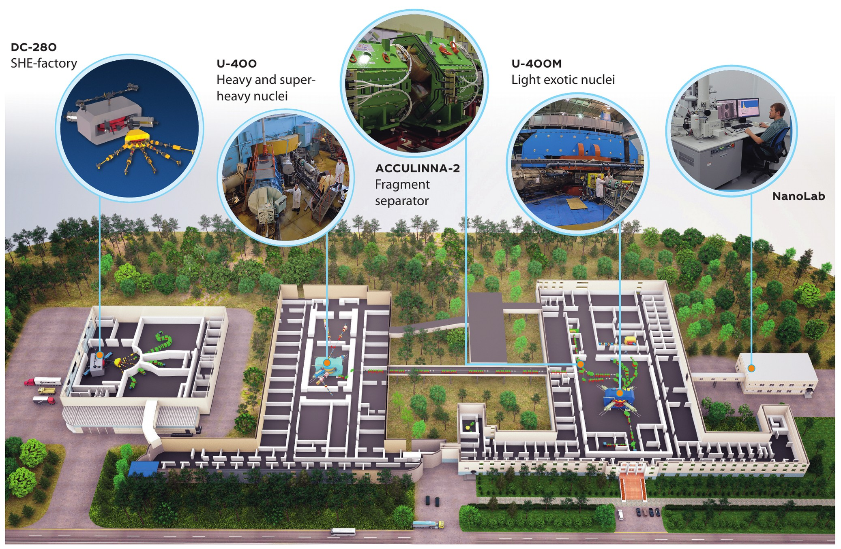
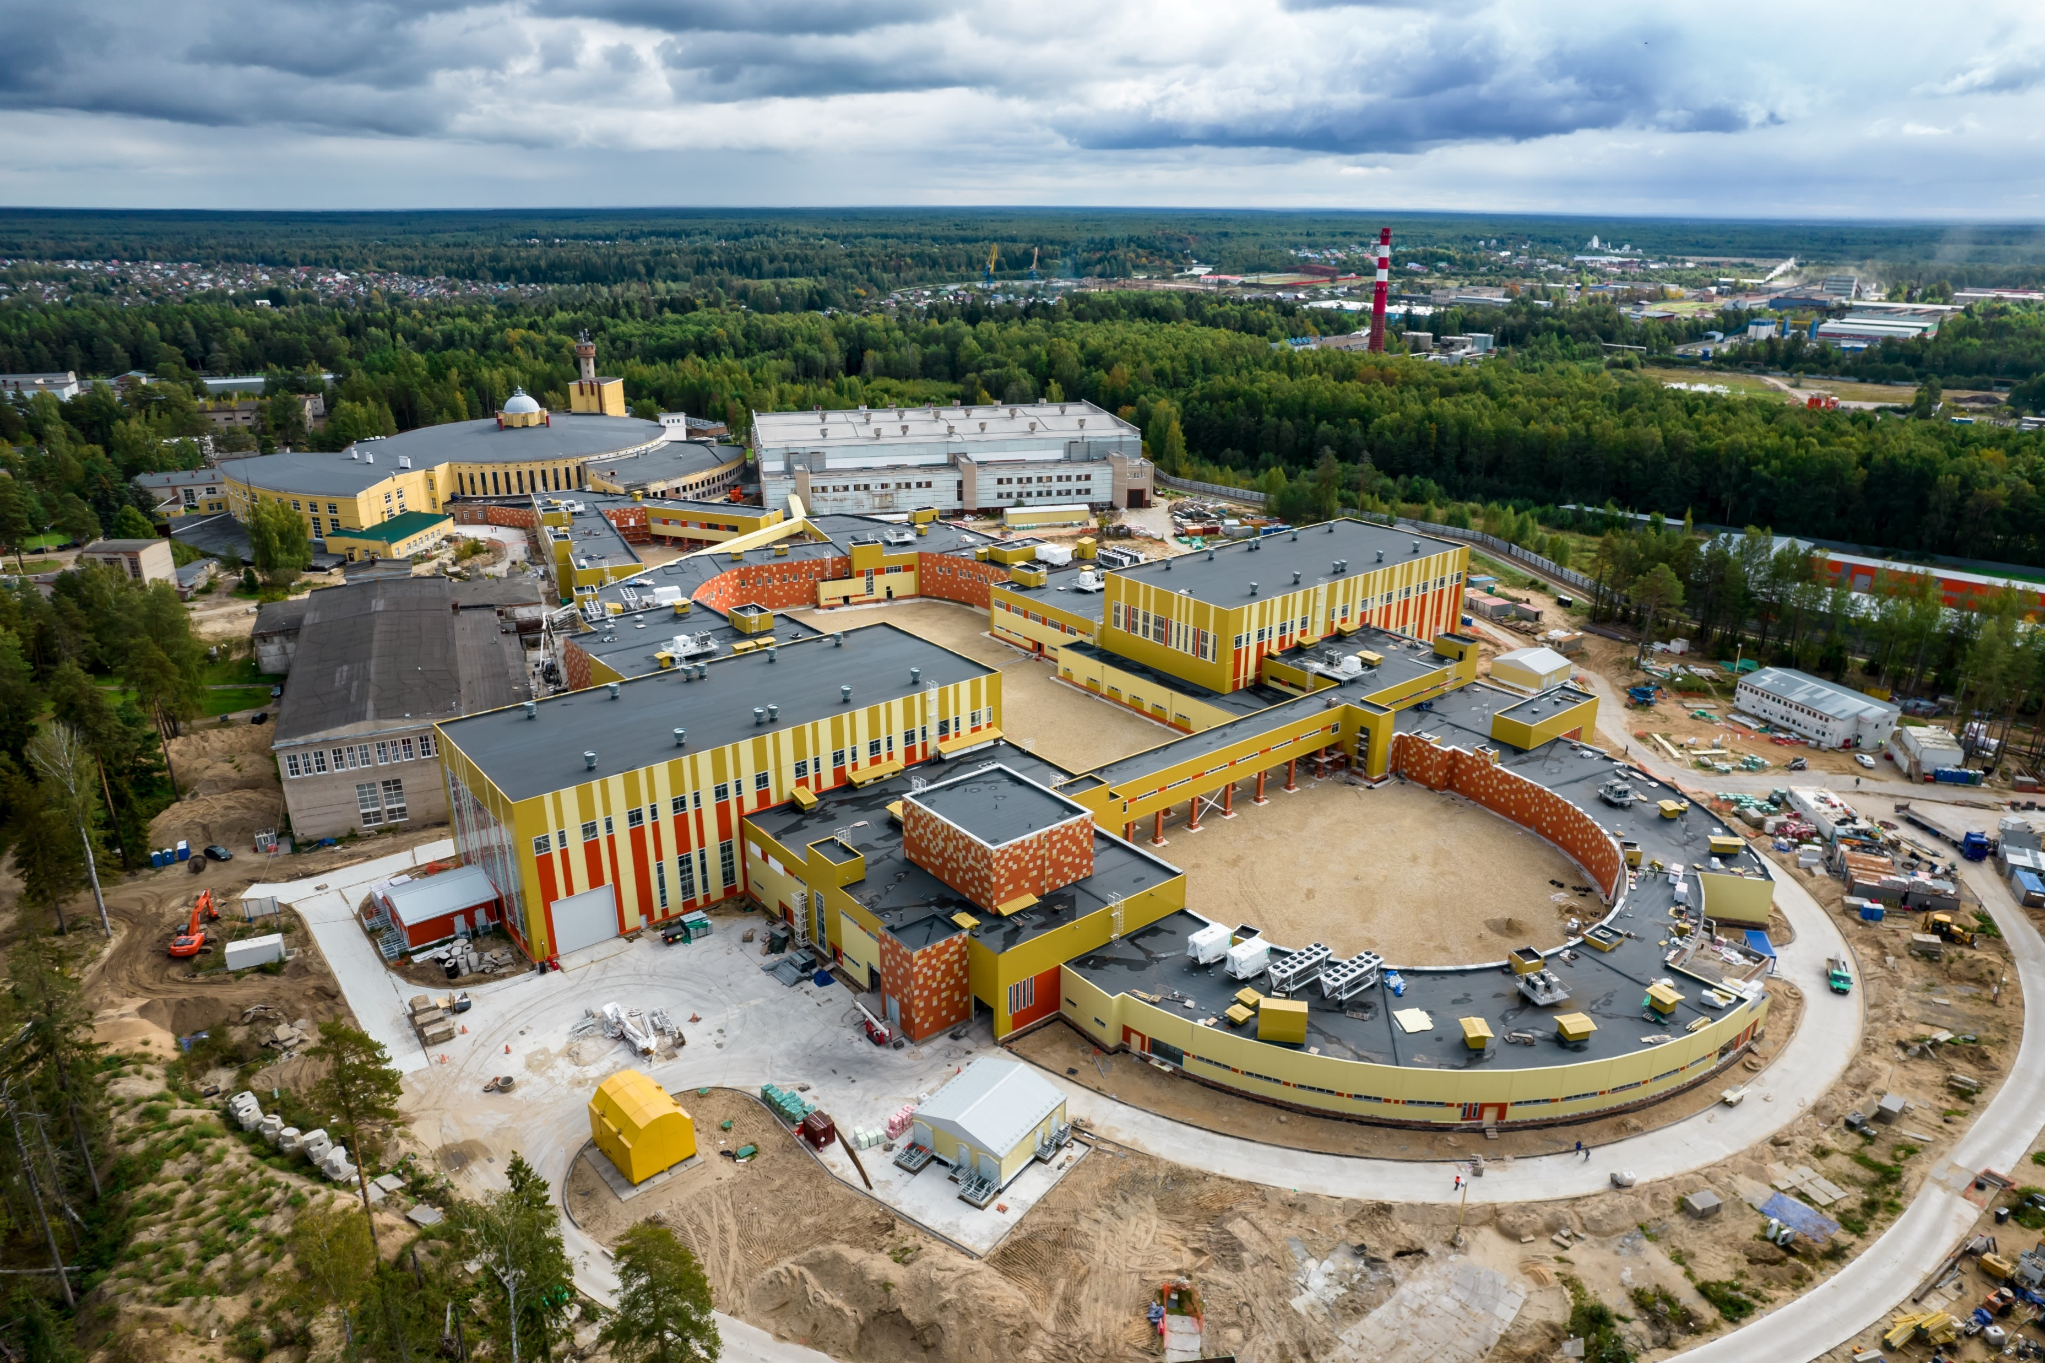
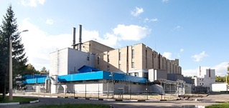
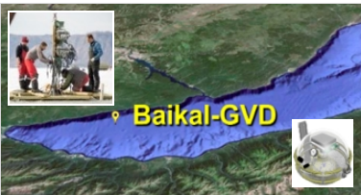

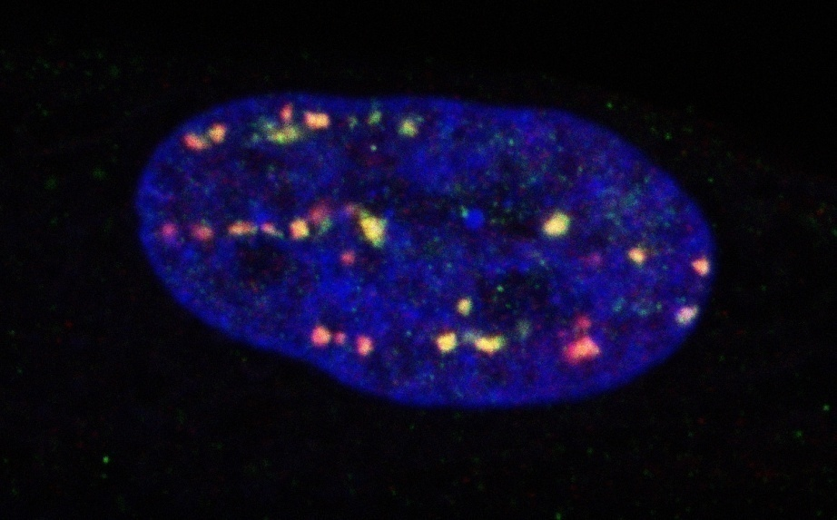
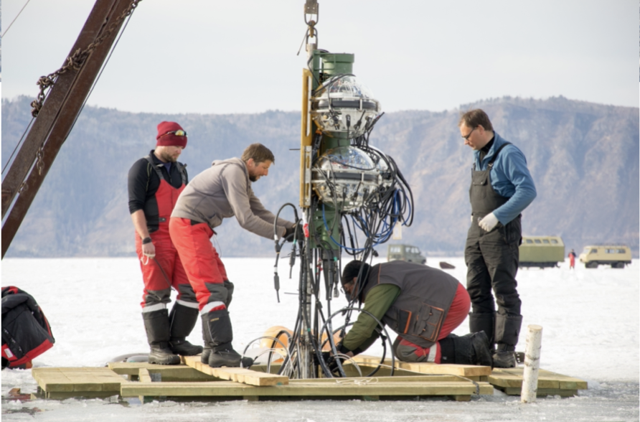
Flagship directions/projects of the JINR 7-year Plan
RHIP & Spin Physics
NICA complex
Low Energy Nuclear Physics (DRIBs – III)
Condensed matter and Neutron physics (IBR-2М+spectrometers)
ν & Astroparticle physics
Baikal-GVD
IT and HPC
MICC
Life Sciences
RB, AB, BM
Notes:
3

Slide 4
Distribution by fields of science
Global trends and JINR today
Large Research Infrastructures:
Large Hadron Collider (CERN)
European Spallation Source (ESS)
Facility for Antiproton and Ion Research (FAIR)
LBNF-DUNE (Neutrino experiment)
Future Circular Collider
SNOLAB (underground neutrino facility)
European Synchrotron Radiation Facility (ESRF)
Cubic Kilometre Neutrino Telescope (KM3NeT)
International Linear Collider
NICA (Nuclotron-based Ion Collider fAсility)
SCT (Super charm-tau factory)
Amundsen arctic research vessel
Extremely Large Telescope (ELT)
Square Kilometer Array (SKA)
…
The statutory for JINR fields of science occupy a priority position in the world scientific agenda and development of a large research infrastructure.
The analysis shows that almost half of modern projects in the field of basic sciences have accompanying programmes of applied research aimed at sustainable development goals (SDG).
Worldwide international dimension, the multi-disciplinary scientific programme and large infrastructure projects of JINR harmoniously complement the global scientific agenda and the worldwide landscape of mega-science infrastructure, assuming, along with the main goals in the field of fundamental research, the achievement of certain SDG.
Distribution by mission
Distribution by international dimension
About 40 LRI in a wide range of scientific fields that meet the criteria for a large research infrastructure (complexity, scale, uniqueness, mission), both operational and those under construction, as well as some planned ones – ICRI, GSF OECD, 2021

Slide 5

MEETINGS OF THE JINR SC AND PACs in NEW COMPOSITION
Latvia
Russia
Germany
Belarus
Mongolia
Czech Rep.
Poland
Ukraine
Kazakhstan
USA
Hungary
Moldova
France
Serbia
Romania
CERN
Georgia
Azerbaijan
Italy
South
Korea
Bulgaria
Uzbekistan
Armenia
China
Israel
Cuba
Egypt
Mexico
India
Vietnam
Brazil
South Africa
Chile
SC members
PAC members
Argentina

Slide 6
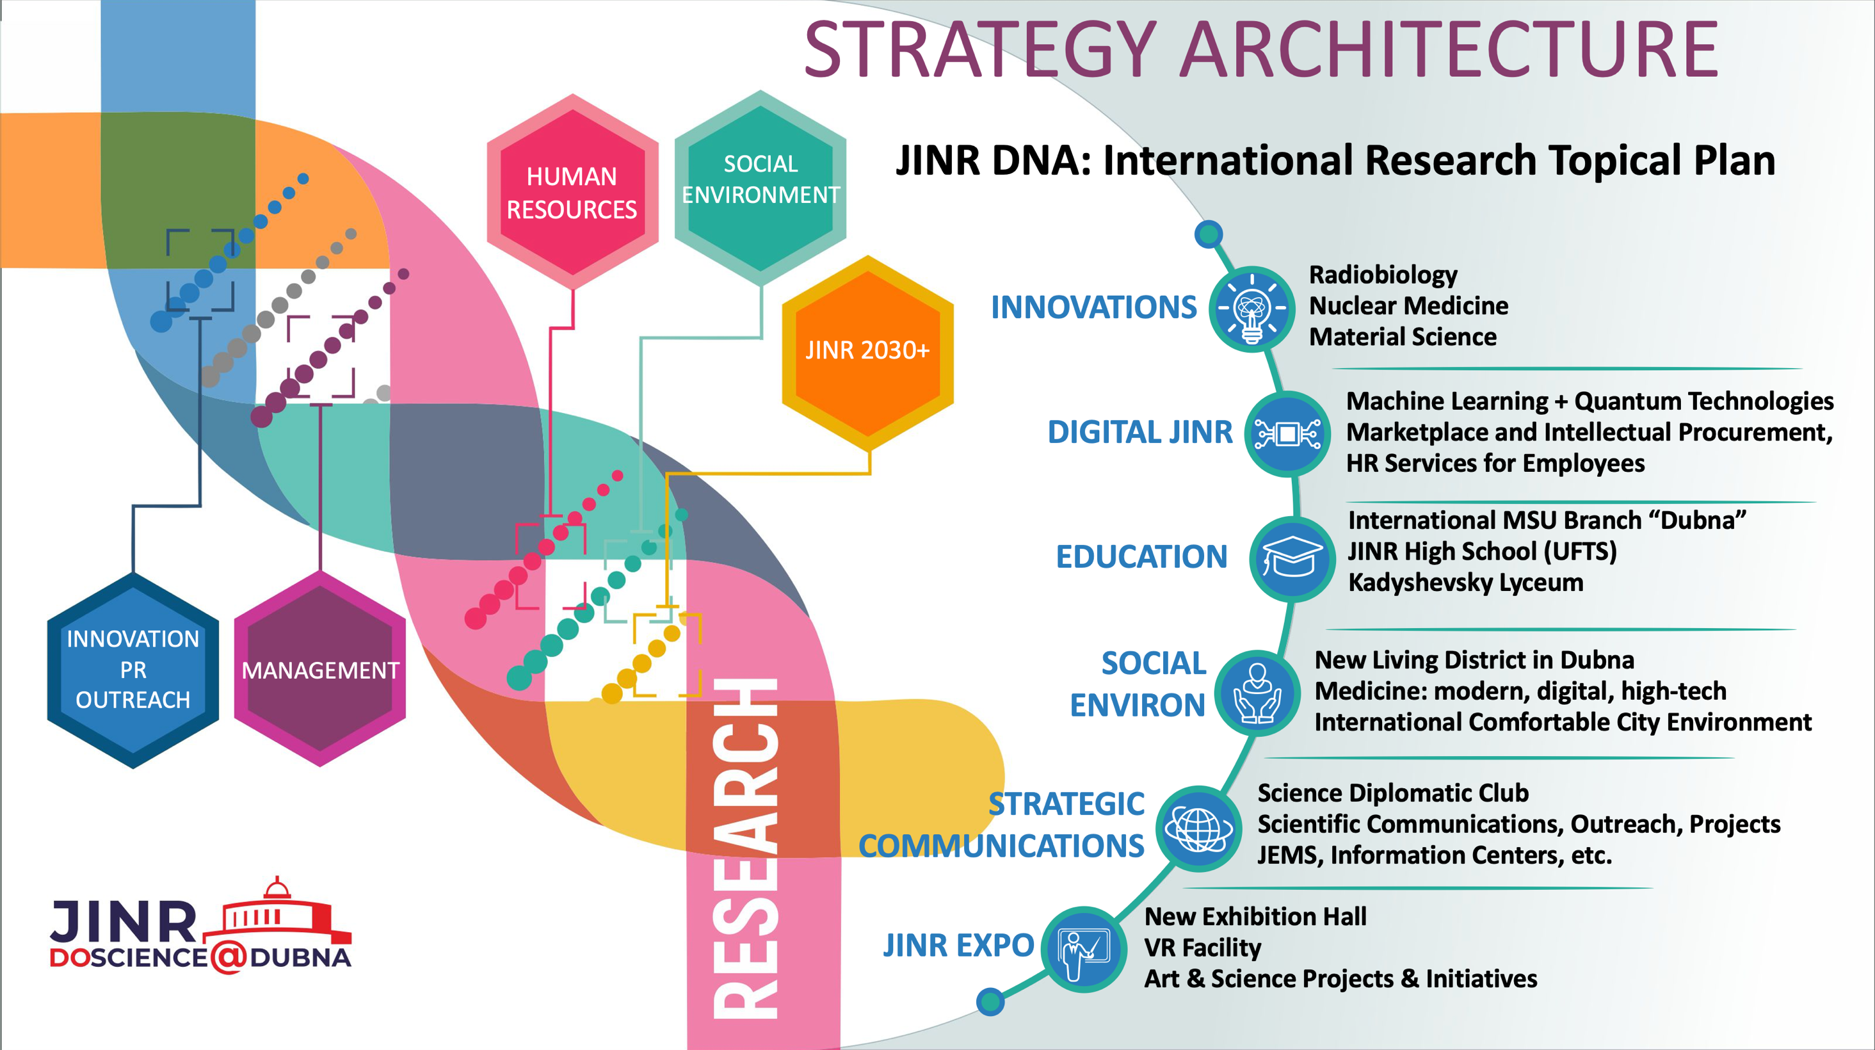
2030+

Slide 7
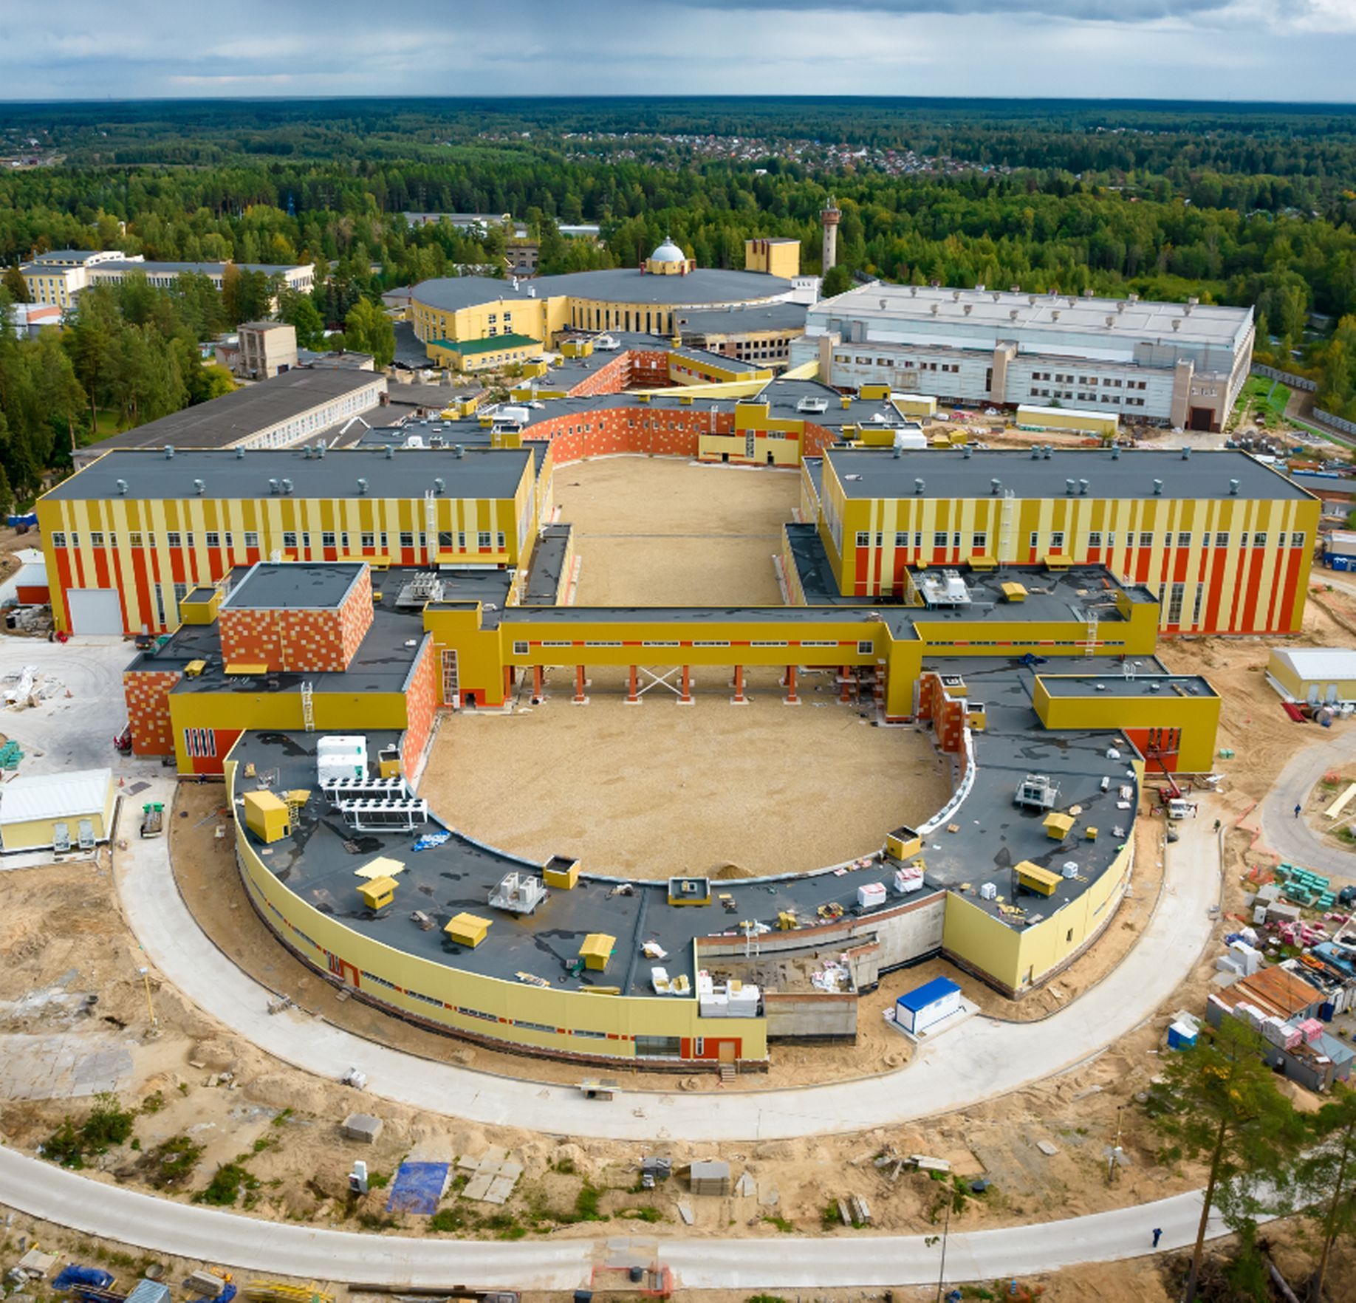
Relativistic Heavy Ion Physics and Study of nucleon structure. Near and Long-Term Future
The timely completion of the NICA project, its commissioning and steady and efficient operation.
Completion of the detectors: BM@N, MPD and SPD at NICA and successful data taking over the decades to come. JINR will make significant contribution to the basic configuration of the SPD detector.
After several years of running of MPD, an Upgrade is foreseen, responding to an increase in luminosity of NICA. Adding detectors in the forward region as planned.
Studies of possible future extension of NICA for acceleration of electrons, opening new physics potential via e-p and e-A collisions.
ARIADNA
BM@N
MPD
SPD
Notes:
For the next two decades, the principal focus in heavy ion physics and spin physics, that will influence to a large extent the JINR strategic development is the timely completion of the JINR flagship facility - NICA. The aim of the NICA project is to create a world-class experimental infrastructure for fundamental research in contemporary High Energy Physics (HEP), applied research, and in development of novel nuclear power technology. The format of close interlaboratory cooperation will contribute to the development of modern detectors and to further achievements in the area of high-temperature superconductivity. This base should be utilized by a global scientific community of users from member and non-member states of JINR.

Slide 8
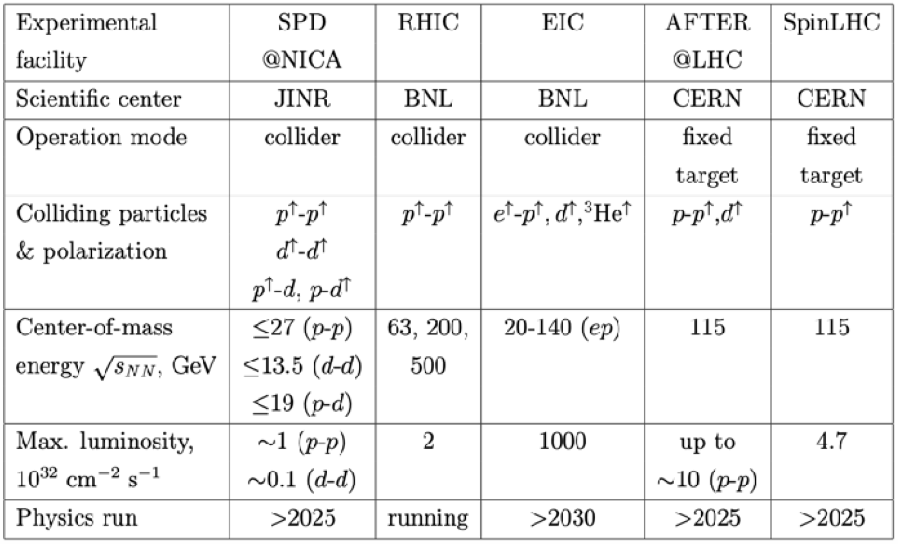

BM@N & MPD NICA SPD
The SPD experiment is aimed at studying the properties of strong interactions in the nonperturbative region, at measuring the proton and deuteron spin structures, and at the development of a three-dimensional model of the nucleon. It is unique in its methodology, breadth of coverage and variety of tasks.
MPD covers this interesting region providing powerful combination of large luminosity, collision energy and system size scan (including isobars), large and consistent acceptance, full centrality range.
NICA is complementary to existing and planned world facilities (FAIR, SPS), and will be a natural and necessary continuation and significant expansion of studies at RHIC BES.
Notes:
Advantages of the MPD & NICA
NICA covers an energy range where most important an interesting physics appears to take place - transition from hadronic to partonic effect dominance, possible appearance of first order phase transition in QCD phase diagram, transition from baryon to meson dominance in particle production. All of this is also connected to astrophysical studies which are strongly developing now and may pose additional questions for us. In summary there are a lot of interesting open questions and MPD has the capabilities to answer many of them.
MPD covers this interesting region providing powerful combination of large luminosity, collision energy and system size scan (including isobars), large and consistent acceptance, full centrality range.
NICA is complementary to existing and planned world facilities (FAIR, SPS), and will be a natural and necessary continuation and significant expansion of studies at RHIC BES.
Other facilities:
HADES and SIS18 provide energies below 3 GeV;
FAIR is not going to provide data before 2028 - so it will not provide data in timescale comparable to NICA;
SPS operates at higher energies, and is fixed target (and also mostly limited to highest centralities);
STAR BES (Beam Energy Scan) covered the energy range of 3-20, however:
- the data taking is finished,
- data sample of 100M at most energies may be
enough to "pose interesting questions", or
highlight the region of interest, but not provide
"definite answers",
- data below 8 GeV is in fixed-target mode,
- no collision system size scan was done,
- isobar run of RHIC showed new interesting physics
that may be explored at NICA.
BM@N
Baryonic Matter at Nuclotron (BM@N) experiment is focused on measurement of Au+Au collisions up to a kinetic beam energy of 3.8·A GeV in order to investigate the equation-of-state (EOS) and the microscopic degrees-of-freedom of QCD matter at neutron star core densities, as EOS defines relation between density, pressure, temperature, energy and isospin asymmetry of nuclear matter.
The “hot” topics of the experiment are:
Study isospin symmetric matter EOS at densities of ρ=3-5 ρ₀ (saturation density) by the following measurements:
- elliptic and direct flows of protons, mesons and hyperons,
- sub-threshold production of multi-strange hyperons and
anti-hyperons.
Constrain symmetry energy E_{sym} - difference between binding energy of isospin symmetric and asymmetric matter by the following measurements:
- collective flow of neutrons vs protons,
- sub-threshold production of particles with opposite isospin.
Searches for quark degrees-of-freedom and the critical endpoint of the first order phase transition at high baryonic densities.
Role of hyperons in neutron stars (ΛN and ΛNN interactions) by measurements of yields and lifetime of light hyper-nucleus at high baryonic densities.
О возможности изучения на NICA столкновений изобарных ядер, имеющих тот же атомный номер, но разный заряд: в частности - не можем ли мы столкнуть свинец-208 и висмут-208?
RICH закончил набор данных, но на последнем рабочем совещании (закрытом) они говорили об интересных результатах, которые могут быть очень важны для понимания структуры ядра. В этом плане низкие
энергии NICA могут быть дополнительным преимуществом. Если столкновения идут с большим прицельным параметром, то возникают
сильные электромагнитные поля и соответствующая физика - Chiral Magnetic Effect.
Есть давние работы по теме. Например, С.Волошин (Phys.Rev.Lett.105 (2010) 17230) предлагает сталкивать Ru-44 и Zr-40 (A=96).

Slide 9
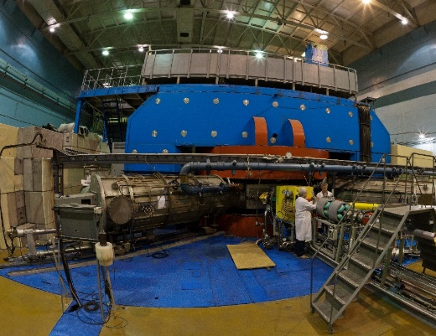
Synthesis of new elements @ SHE Factory
Radioactive Ion-Beam research Basic facility: U-400M
Nuclear reaction studies @ U-400R
Ambitions: up to 2.6 mA (U-beam)
10¹⁰⁻¹¹, smooth energy variation
Ambitions: E up to 80AMeV, I x 2
TARGETS:
Rosatom and ORNL (USA): Isotopically enriched heavy actinide materials;
Radiochemical Lab of class 1
Upgrade in 2023-25. Operation from 2026
Operation from end of 2023
Multinucleon transfer reactions:
Production of new isotopes of heavy,SH nuclei;
Study of properties of new nuclei.
Decay spectroscopy of heavy nuclei: actinides and light transactinides
Study of fusion-fission and quasifission reactions leading to heaviest nuclei
Low-energy and spontaneous fission of heaviest nuclei
Study of nuclei at high excitation energies (several hundred of MeV)
Nucleon halo, neutron skin;
Exotic decays:
b-delayed, 2p,2n radioactivity;
Soft excitation mode;
New magic numbers;
Spectroscopy of exotic nuclei;
Cluster states;
Reactions with RIBs;
Astrophysical applications.
BEAMS:
Production of high-intensity beams of ⁵⁰Ti, ⁵⁴Cr and others
New ECR-28 GHz (2024)
Notes:
Test reactions (2022-2023):
²³⁸U + ⁵⁴Cr → ²⁹²Lv*
²⁴²Pu + ⁵⁰Ti → ²⁹²Lv*
²⁴⁵Cm + ⁴⁸Ca→ ²⁹³Lv*
σ_{3n}= 4pb

Slide 10
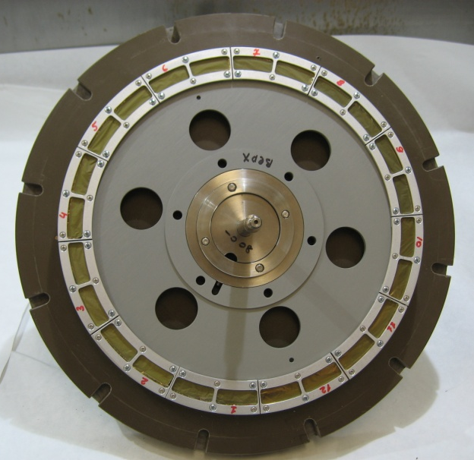
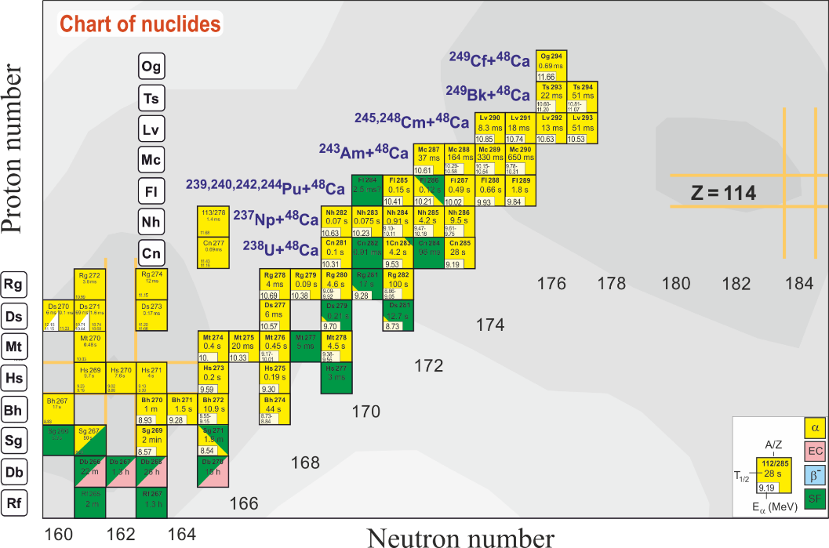
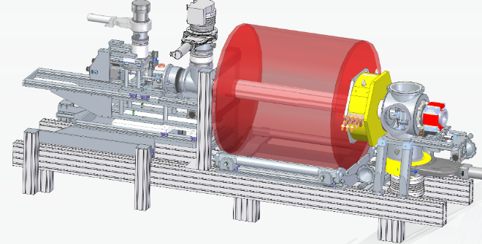
Synthesis of new elements @ SHE Factory
⁵⁰Ti + ²⁴⁹⁻²⁵¹Cf → 3n + ²⁹⁶⁻²⁹⁸120
⁵⁴Cr + ²⁴⁸Cm → 3n + ²⁹⁹120
TARGETS
⁵⁰Ti + ²⁴⁹Bk → 3n + ²⁹⁶119
Cooperation with Rosatom (Russia) and ORNL (USA):
Isotopically enriched heavy actinide materials
Radiochemical laboratory of class 1:
Stability studies;
Manufacturing and regeneration
298
Fl
known nuclei
BEAMS
Test reactions (2022-2023):
²³⁸U + ⁵⁴Cr → ²⁹²Lv*
²⁴⁴Pu + ⁵⁰Ti → ²⁹⁴Lv*
²⁴⁵Cm + ⁴⁸Ca→ ²⁹³Lv*
σ_{3n}= 4pb
Production of high-intensity beams of ⁵⁰Ti, ⁵⁴Cr and others
New ECR-28 GHz (2024)
Notes:
Experiments at the extremely low (σ<100 fb) cross sections:
- Synthesis of new SHE with Z = 119 and 120 in reactions with ⁵⁰Ti, ⁵⁴Cr ...;
- Synthesis of new isotopes of SHE;
- Study of decay properties of SHE;
- Exploring limits the Island of Stability;
- Study of excitation functions.
Experiments requiring high statistics:
- Nuclear spectroscopy of SHE;
- Precise mass measurements;
- Study of chemical properties of SHE.

Slide 11
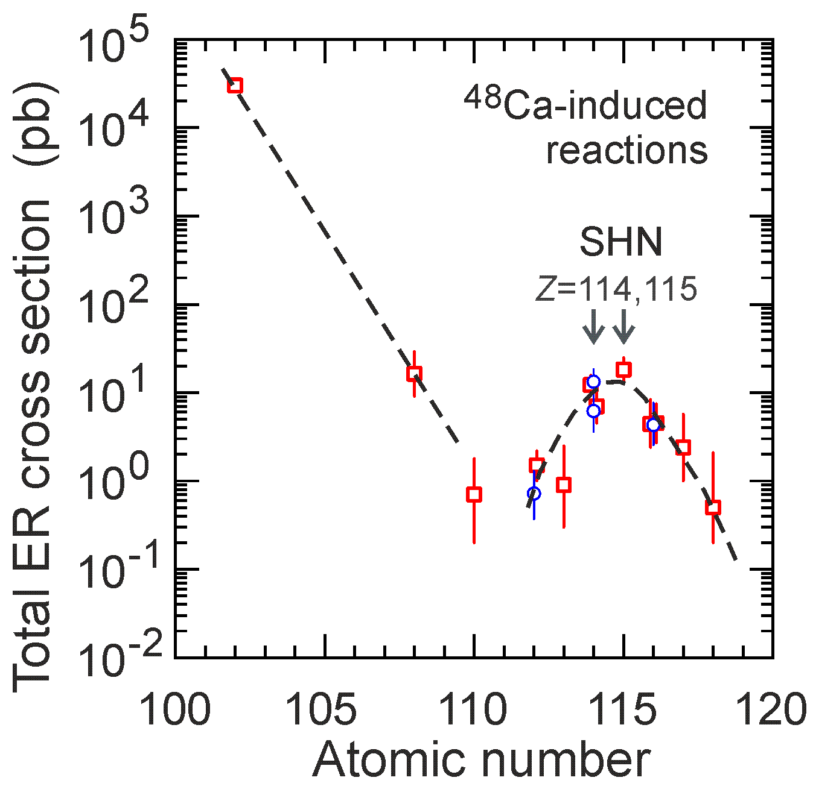
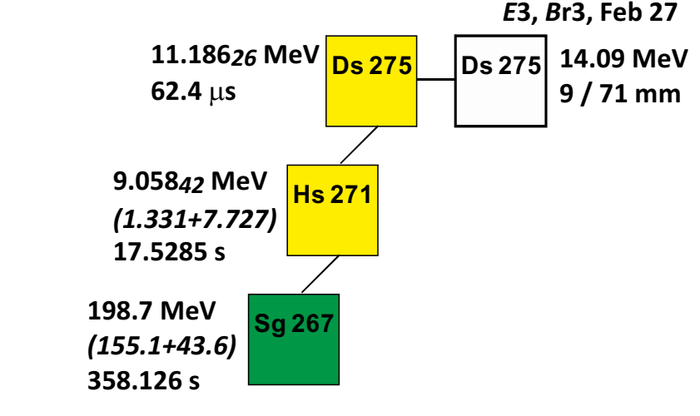
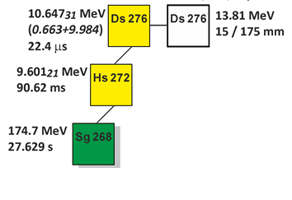
Towards element 120: the first experiment ⁴⁸Ca + ²³²Th→ ²⁸⁰Ds*
Stability and production cross section is expected to have a minimum for the element 110. The fission barrier is predicted to be 3.3 MeV only.
The same theory predicts 5.1 MeV barrier for the element 120.
The experiment was carried out at 3 different beam energies in June 2022, October 2022, February 2023.
7 events of the ²⁷⁶Ds and 1 of ²⁷⁵Ds synthesis were observed in experiment at extremely low cross section.
Four new isotopes (²⁷⁵Ds, ²⁷⁶Ds, ²⁷²Hs, and ²⁶⁸Ds) of superheavy elements have been discovered at the SHE Factory in addition to two another isotopes ²⁸⁶Mc, ²⁶⁴Lr discovered in 2021.
The experimental results are in agreement with expectations.
Experiment at even higher beam energy is planned for March 2023.

Slide 12
Nuclear reaction studies @ reconstructed U-400R
Multinucleon transfer reactions:
Study of reaction mechanism;
Production of new isotopes of
heavy and SH nuclei;
Study of properties of new nuclei.
Decay spectroscopy of heavy nuclei: actinides and light transactinides
Study of fusion-fission and quasifission reactions leading to heaviest nuclei
Low-energy and spontaneous fission of heaviest nuclei
Study of nuclei at high excitation energies (several hundred of MeV)

Slide 13
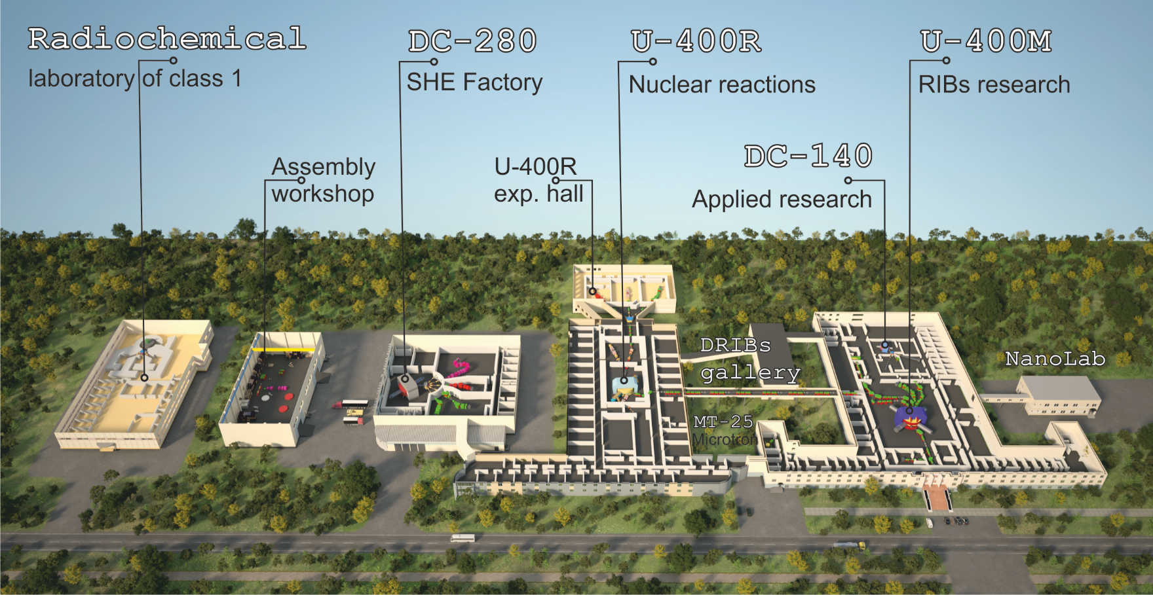
FLNR 2030
Notes:
A: Minimal+ program. RIBs on the base of the operating cyclotrons U400M+U400R
B: Maximal program. RIBs on the base of a tandem of new cyclotrons E1-E2 (100 AMeV), or 100 AMeV LINAC.

Slide 14

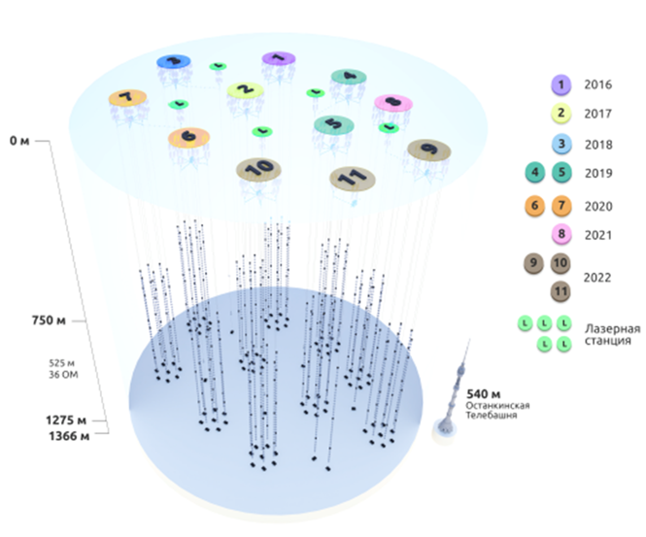
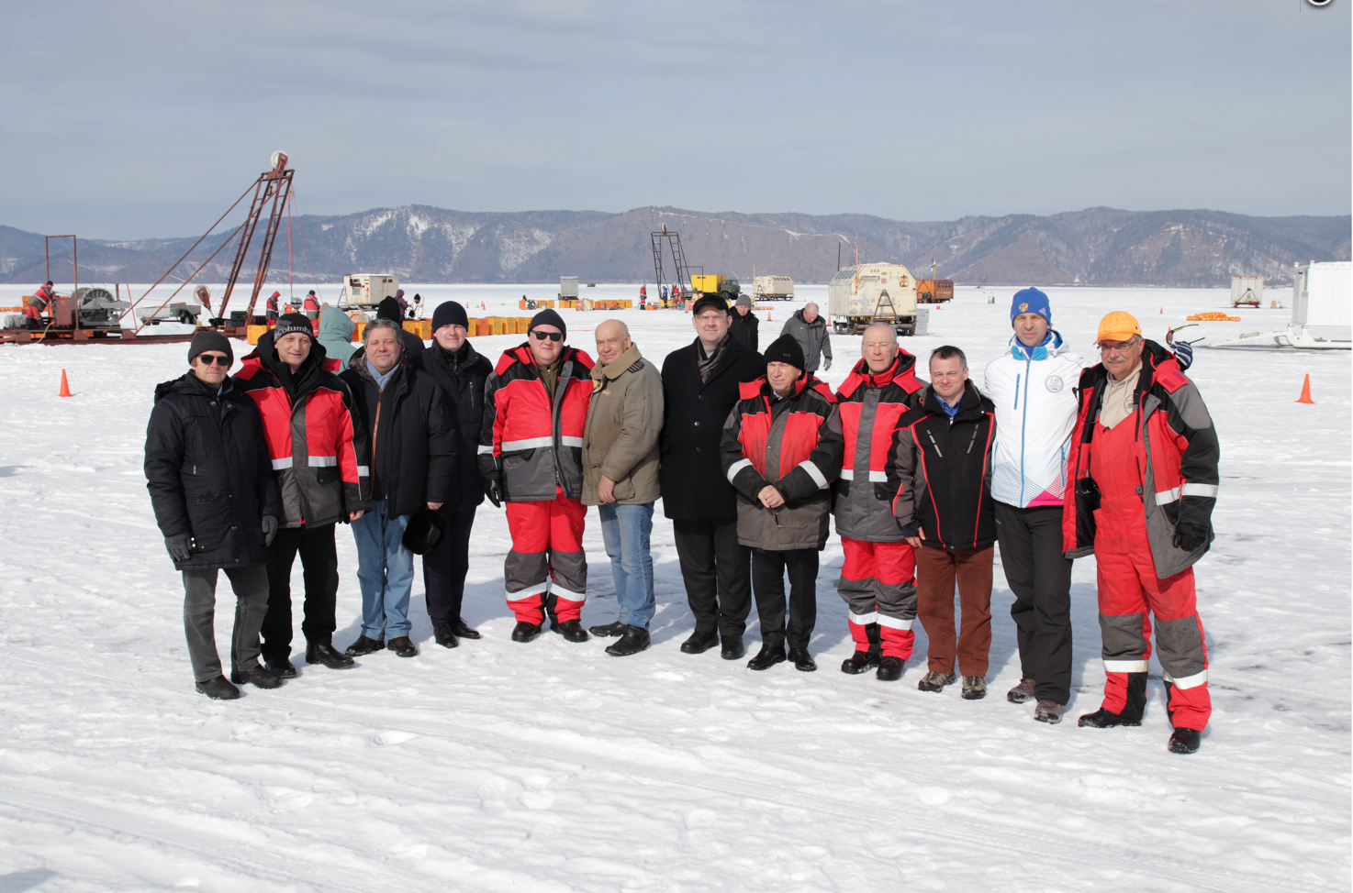
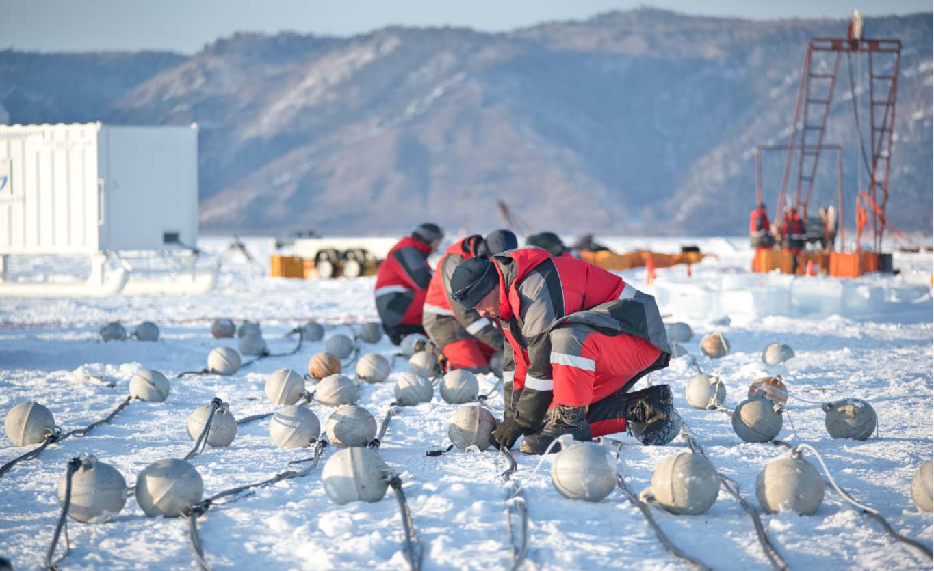
Baikal-GVD construction status
Status 2023: 12 clusters, 5 laser stations, experimental cluster prototype with new DAQ system
About 700 optical modules are assembled for deployment in 2023.
The collaboration is planning to install additional 2 new clusters in case a good external conditions (weather and ice).
The array from April’23 will contain 3456 optical modules
Notes:
At the last year, another 2 clusters were put into operation. At present Baikal-GVD comprises 10 clusters and 5 laser station (one of them is installed as an standard external string with 36 optical modules) with 2916 OMs. Moreover, experimental cluster prototype with new DAQ system (optical data transmission) on a base of CWDM with 2 strings was installed on spring 2022.

Slide 15
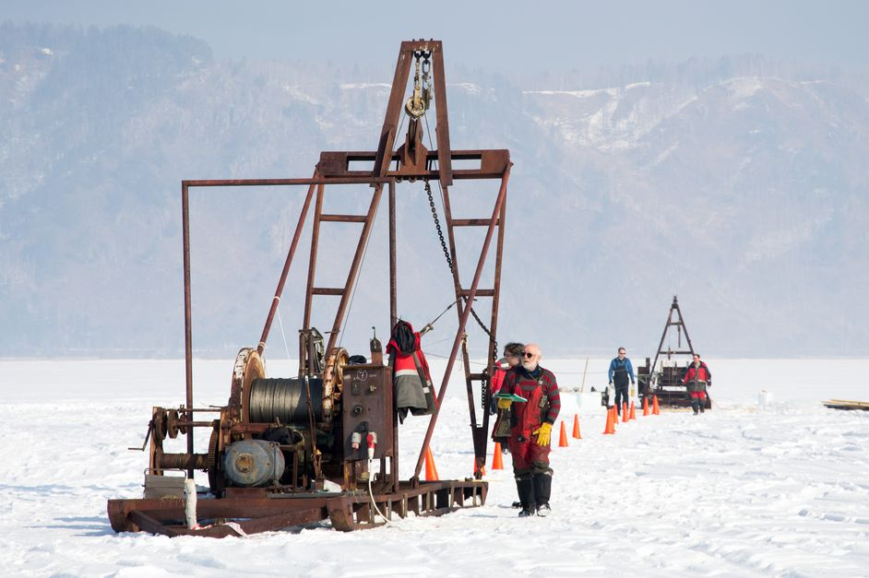
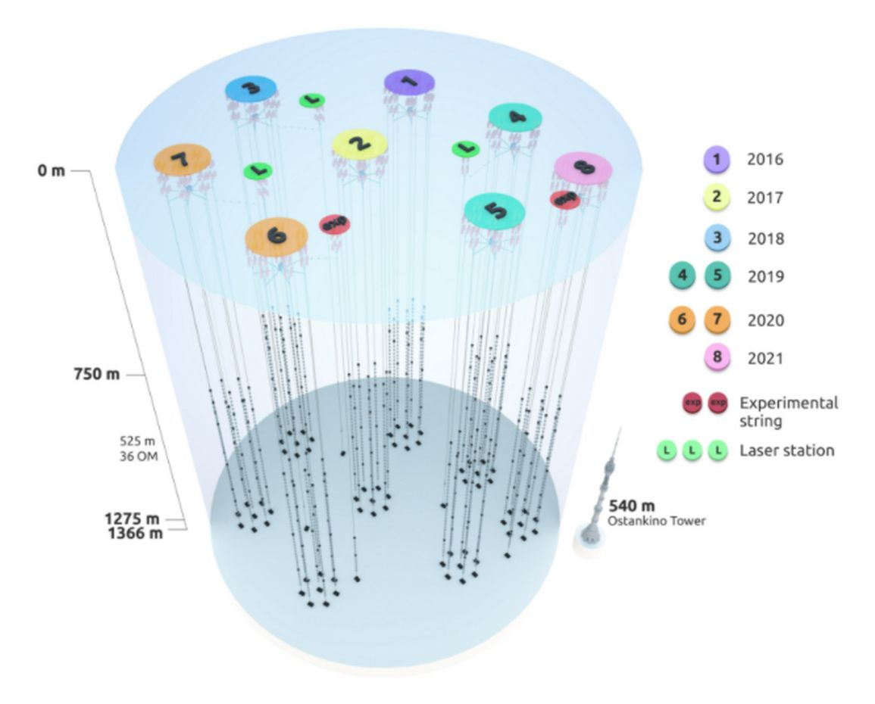
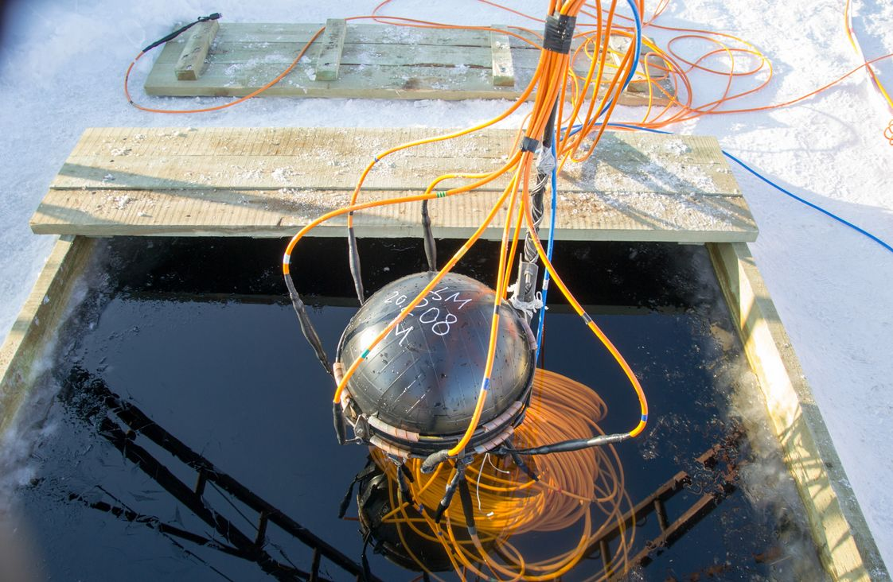
NEUTRINO AND ASTROPARTICLE PHYSICS
PROJECT BAIKAL-GVD
Baikal-GVD: Identification of astrophysical sources of ultra-high energy (exceeding tens of TeV) neutrinos. Actuality: their sources are still unknown. The identification of sources will help to elucidate mechanisms of galaxies creation and evolution.
Main advantage of Baikal-GVD: pure and t-stable water. Angular resolution of muon tracks 0.3-0.5 grad (IceCube: 0.5-1); angular resolution of shower direction 2-3 grad (IceCube: 15);
Northern detectors have better view to the Galaxy center.
Year | Number of clusters | Number of OMs
2016 | 1 | 288
2017 | 2 | 576
2018 | 3 | 864
2019 | 5 | 1440
2020 | 7 | 2016
2021 | 8 | 2304
2022 | 10 | 2880
2023 | 12 | 3456
2024 | 14 | 4032
Baikal-GVD: flagship experiment of JINR with a leading role in the collaboration. Gain new experience in the detector design, construction, deployment, maintenance, simulation and data analysis. Expected breakthrough discoveries.
More dense configuration, + light sensors, fiber vs Cu, smart data transmission, + radio-antennas → New Quality and Efficiency.
Global competence in 2030 horizon: Ice-Cube: 2025-2034 8km³ (w RA 100 km3 => PeV); Km3NET: few km³; Baikal-GVD (Phase II) = new type of OM, trigger-less operation, ML&AI, ~ 10 km³ ? (CDR in 2024).

Slide 16
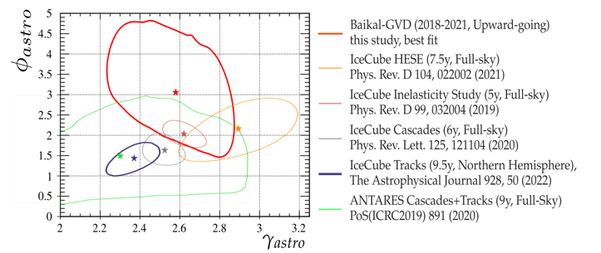
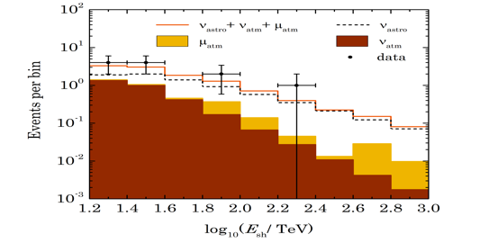



Search for astrophysical diffuse neutrino flux using Baikal-GVD
Data for 2018‒2021, 4928 days in equivalent for single-cluster
Shower detection channel:
Selected: 11 events
Expected:
0.5 events from atmospheric muons
2.7 events from atmospheric neutrinos
6.3 events for Baikal-GVD best fit of an
astrophysical flux parameters
Probability for the background-only
hypothesis (stat. + sys.)
P-value = 0.0024 (3.05σ)
Single power low spectrum model: :=1:1:1):
$$Φ^{ν+\overline{ν}}=3×{10}^{−18}φ_{astro}{\left(\frac{E}{{10}^{5}}\right)}^{−γ_{astro}}{\left(GeV{cm}^{2}ssr\right)}^{−1}$$
Baikal-GVD best fit parameters:
spectral index:
one flavor
normalization:
$$γ_{astro}=2.58$$
$$φ_{astro}=3.04$$
68%
Notes:
For the first time, after IceCube, the presence of an isotropic neutrino flux of astrophysical nature was confirmed according to Baikal-GVD data. Data from 2018-2021 were used. The dataset used was 4928 days of live time per cluster (configuration from 3 to 8 clusters). To isolate events of an astrophysical nature, a cascading channel for recording the interaction of neutrinos was used. The search for such events throughout the celestial sphere forces, because of the background from the cascades formed by atmospheric muons, to operate with energies above almost 100 TeV, where the detector's volume is not yet large enough to statistically significantly isolate events from extraterrestrial neutrinos. To reduce the energy threshold and increase the significance, the search was carried out on events from the lower hemisphere with the energy release of the shower (interaction energy) of more than 15 TeV.
11 events were selected, the reconstructed energy spectrum which is represented by points with statistical errors on the left graph. Calculations have shown that using such a selection for this sample of data, 0.5 events from atmospheric muons, 2.7 events from atmospheric neutrinos and 6.3 events from the astrophysical neutrino flux are expected (also represented in the figure energy spectrum of events). Thus, according to Baikal-GVD, the hypothesis of the absence of a neutrino flux of extraterrestrial origin is excluded at a statistically significant level, taking into account the systematics of 3.05 sigma. Assuming a model of the power spectrum of incoming radiation and the remoteness of the source sufficient for complete mixing of neutrino aromas, i.e. the ratio of aromas 1: 1: 1 (instead of 2: 1: 0 in the source), using the number of registered events and the measured energy spectrum, we obtain the values of the normalization coefficient of the spectrum per aroma and the indicator of the spectrum of the isotropic astrophysical neutrino flux. 2.58 and 3.04 respectively. The right picture shows the results of IceCube for different types of analysis, Antares and Baikal-GVD in the specified parameters. Dots indicate the most likely values for each analysis. The regions determine the permissible deviations of the most likely at level 1 sigma. At the moment, based on the results of the presented analysis, an article has been prepared, accepted for publication in Phys. Rev. D.

Slide 17
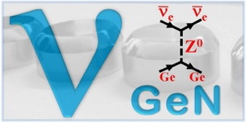
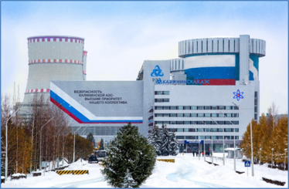
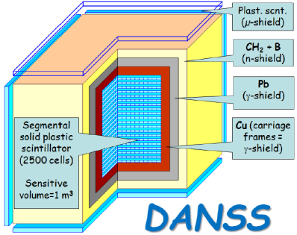


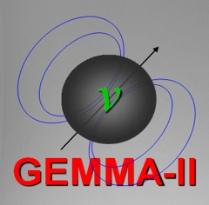



Non-accelerator neutrino physics and astrophysics
Projects: BAIKAL-GVD, SuperNEMO, GERDA (Legend), Monument, EDELWEISS/Ricochet, ΝgeN, DANSS, JUNO
Scientific directions:
– Double beta decay, neutrino nature: Majorana or Dirac; Nuclear matrix elements
– Fundamental neutrino properties (magnetic moment, mixture with a
sterile state, etc)
– Monitoring of nuclear reactors with neutrino detectors
– Direct and indirect search for Dark Matter
– Investigation of galactic and extragalactic neutrino sources
– Atomic processes accompanying radioactive decay
– Applied directions of research
Places: JINR, Underground laboratories, Nuclear reactors, Lake Baikal
Exp. Data Level&Scale | JINR recognition
Human Resources | Finance Resources
The major aims:
– BAIKAL-GVD: Observation of ultra-high energy astrophysical neutrinos; identification of their sources and nature
– DANSS: precision measurement of the spectrum of reactor antineutrinos
– RICOCHET: New physics with precision measurements at reactors.
– νGeN: search for magnetic moment of neutrino
– LEGEND: neutrinoless double-beta decay at 10²⁸ years
– Radiochemistry plus spectroscopy for astrophysics and nuclear medicine
Priorities
1
2
3
SuperNEMO, GERDA-LEGEND, nuGEN,
DANSS
DarkSide, TAIGA, MONUMENT
JUNO,
NOvA-DUNE, EDELWEISS

Slide 18

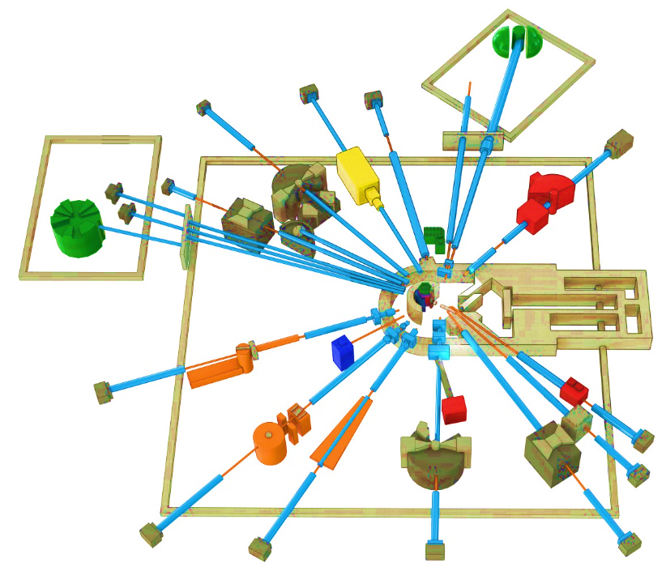
Condensed Matter Physics, Neutron Physics. Priority research in 2024-2030
THE IBR-2 FACILITY
SPECTROMETER COMPLEX
The service life of the core IBR-2 reactor is expected to end in 2032-35. The possibility to extend the operation of the IBR-2 until 2040 is being studied. To extend the reactor core campaign – new fuel (manufacture of FA with FR) around 2025.
Considering the present-day tendency, after 2030 only five sources will be available in Europe: ISIS (Didcot, UK), SINQ (PSI, Villige), FRM II (TU Munich), and two new sources: ESS (Lund, Sweden) and reactor PIK (NRC KI, Gatchina, Russia), both under construction with the start of operations planned for 2023-2024. Oak Ridge (STS SNS) –is planned in 2037.
Development of the basic configuration elements of the inverse geometry inelastic n-scattering spectrometer BJN.
Completion of basic configuration of the small angle n-scattering and imaging spectrometer.
BJN
(project)
HRFD
YuMO
EPSILON
DN-6
SKAT
RTD
KOLKHIDA
NERA
NRT
REMUR
FSS
REFLEX
DN-12
GRAINS
FSD
Modernization and reconstruction of spectrometers HRFD, YuMO, RTD, DN-6, DN-12, FSD, NERA, REMUR, REFLEX, SKAT, EPSILON, FSS, NRT, focused on improvement of technical parameters and extension of research capabilities.
Development of laboratory equipment for samples characterization and physical properties measurements.
Support and modernization of the complex of cryogenic moderators. New operating reliable UCN channel.
Notes:
Эксплуатационный проектный ресурс установки ИБР-2, как одного из лучших нейтронных импульсных источников заканчивается в 2032-35 годах. В настоящее время в ЛНФ изучается возможность продления кампании реактора до 2040 года. Для этого, в частности, необходимо изготовить дополнительную партию свежего топлива с аналогичными характеристиками до 2025 года.
Учитывая существующие тенденции, после 2030 года в Европе для проведения исследований будет доступно 5 источников, включая три действующих: ISIS (Didcot, UK), SINQ (PSI, Villigen, Switzerland), FRM II (TU Munich, FRG), и два новых, начало эксплуатации которых планируется в 2023- 2024 годах: (ESS (Lund, Sweden) and steady-state reactor PIK (PNPI NRC KI, Gatchina, Russia). Ввод в эксплуатацию 2-х мишенной станции на источнике (STS SNS) of Oak Ridge National Laboratory (USA) планируется в 2037 году. Таким образом, потребность в новом поколении высокопоточных источников нейтронов возрастает на фоне общего уменьшения их количества в мире.
Приоритетными задачами развития комплекса спектрометров реактора ИБР-2 будут являться:
Разработка и создание элементов основной конфигурации нового спектрометра неупругого рассеяния нейтронов в обратной геометрии BJN.
Завершение работ по разработке и созданию основной конфигурации спектрометра малоуглового рассеяния и имиджинга.
Модернизация и реконструкция действующих установок HRFD, YuMO, RTD, DN-6, DN-12, FSD, NERA, REMUR, REFLEX, SKAT, EPSILON, FSS, NRT, направленная на улучшение технических параметров и расширение экспериментальных возможностей.
Развитие лабораторного оборудования для характеризации образцов и измерений физических свойств.
Поддержка и модернизация комплекса криогенных замедлителей

Slide 19
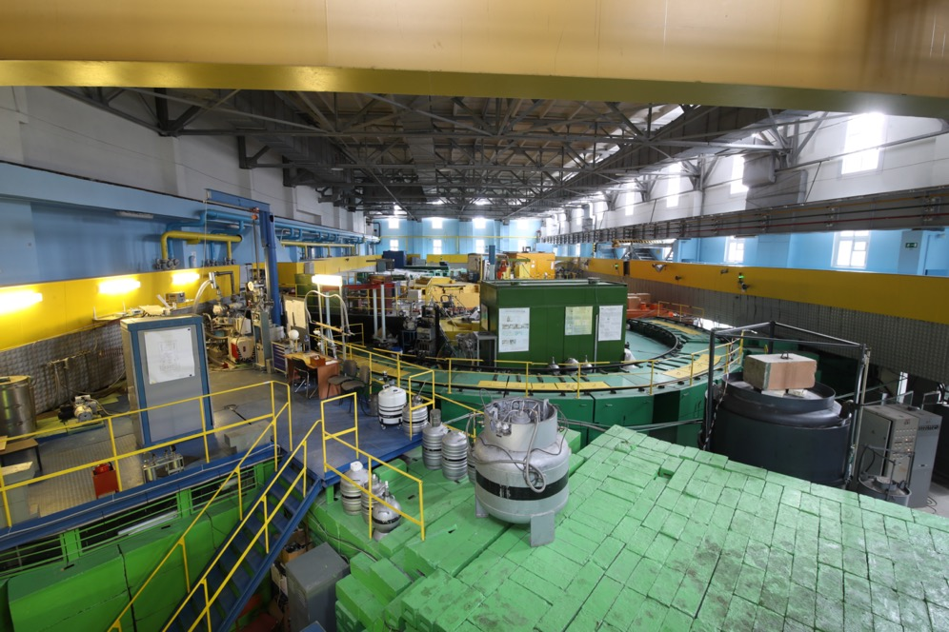
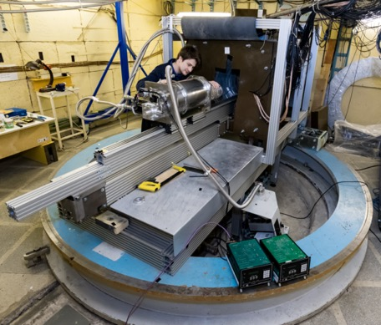
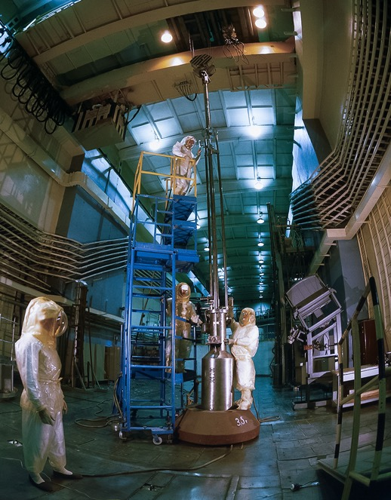
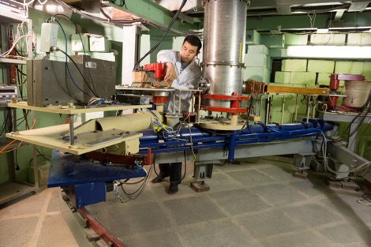
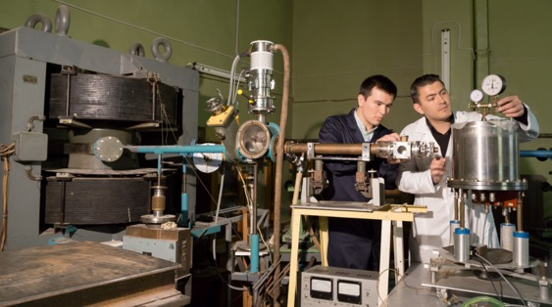
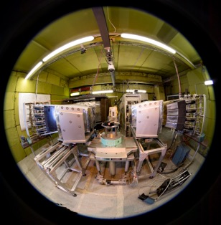
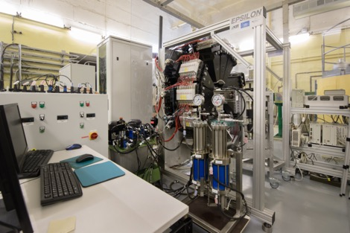
Лаборатория Нейтронной физики им. И.М.Франка
ИБР-2М ― единственный в мире реактор, работающего с переменным уровнем критичности. Средняя мощность – 2 МВт, пиковая мощность – 2 ГВт. Продолжается реализация международной пользовательской программы на пучках нейтронов реактора ИБР-2. Проект нового импульсного источника нейтронов 4-го поколения разрабатывается в партнерстве с ведущими научными организациями.
19

Slide 20
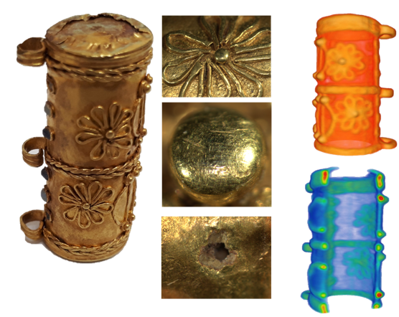
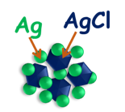

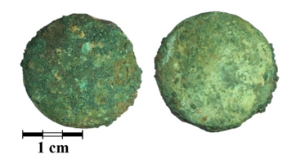
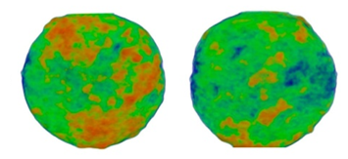
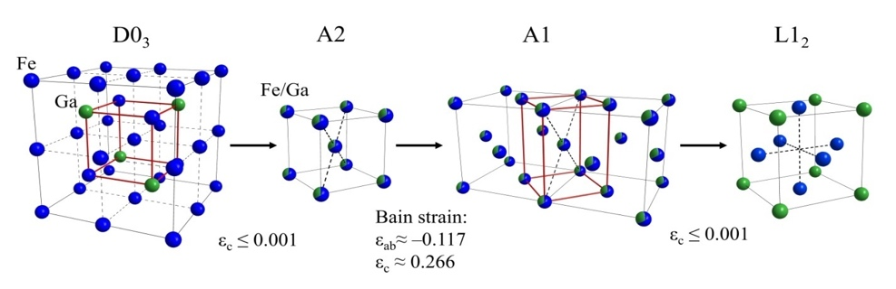
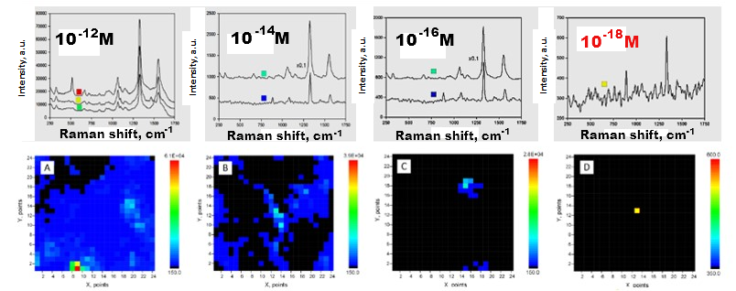
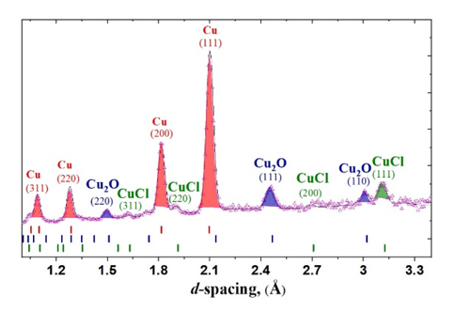
Физика конденсированного состояния. Методы нейтронного рассеяния
Life Sciences
Crystalline Materials
Applied Research
Структура биогибридных компонент
SANS
SAXS
Нейтронная томография древниз золотых амулетов
Структурная, электронная и магнитная фазовая диаграмма магнетита Fe3O4
Изотермические структурные фазовые переходы в гигантских FexGa магнитострикционных сплавах
Уникальные результаты контроля и подсчета одиночных молекул: SERS spectra (top row) and coresponding Raman maps (bottom row) for DTNB concentrations: (A) 10⁻¹² M, (B) 10⁻¹⁴ M, (C) 10⁻¹⁶ M, (D) 10⁻¹⁸ M
Нейтронная томография и дифракционные исследования монет древнегреческих религиозных монет – оболов Харона
Notes:
Основными научными результатами исследований конденсированных сред с помощью нейтронного рассеяния являются:
В области кристаллических функциональных материалов:
1.1 Определение структурной, магнитной и электронной фазовой диаграммы магнетита Fe3O4 в широком диапазоне термодинамических параметров (температур 4 – 300 К и давлений 0 – 40 ГПа). Решение подобной задачи стало возможным благодаря созданию нового дифрактометра ДН-6 для исследований при воздействии сверхвысоких давлений до 40 ГПа на реакторе ИБР-2, ставшего одной из ведущих мировых установок в данной области науки.
1.2 Исследование структурных особенностей и кинетики фазовых переходов в сплавах FexGa (x~27-28) с эффектом гигантской магнитострикции при вариации термодинамических условий, включая изотермическую выдержку и др.
2. В области наук о жизни:
2.1 Исследование структурных и антимикробных свойств новых биогибридных нанокомплексов, состоящих из липосом соевого лецитина, хитозана и наночастиц (НЧ) серебра/хлорида серебра, полученных из экстрактов растений с помощью “зеленого” синтеза.
3. В области прикладных исследований:
Исследование внутренней структурной организации и фазового состава объектов культурного наследия. На слайде в качестве примера приведены результаты исследований золотой амулетницы и древнегреческих культовых медных монет, известных, как “оболы Харона” с помощью методов нейтронной томографии и дифракции.
Достигнут высокочувствительный уровень регистрации спектра и визуализации молекул нитробензойной кислоты (TNB) на уровне одиночной молекулы методом гигантского комбинационного рассеяния – ГКР, (SERS in English). В качестве ГКР-активных подложек в работе использовались дендритные серебряные наноструктуры, на которые адсорбировались исследуемые молекулы из растворов различной концентрации. Результаты получены на рамановском микро-спектрометре “КАРС” ЛНФ. На центральном рисунке представлены ГКР-спектры (верхний ряд) и соответствующие им спектральные/рамановские карты (нижний ряд) молекул кислоты TNB при концентрациях аналита в диапазоне от 10⁻¹² М до ультранизкой аттомолярной концентрации 10⁻¹⁸ М (рис-D). Последняя соответствует визуализации одиночной молекулы c учетом указанной концентрации и поля зрения зрачка микрообъектива, использованного в работе.

Slide 21

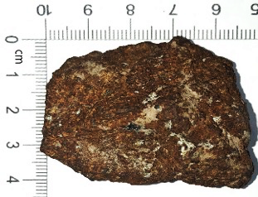
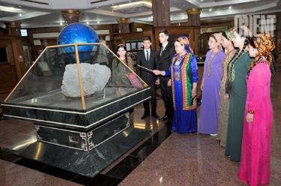
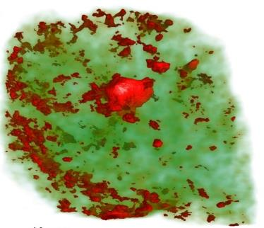
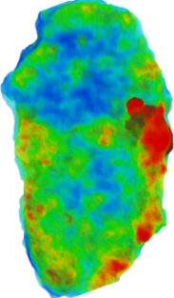
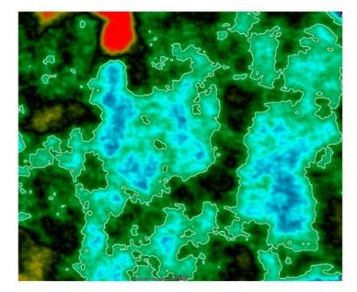


Нейтронная томография метеорита
Кунья-Ургенч («Туркменбаши»)
ТОП-10 крупнейших метеоритов
Нейтронная томография метеорита Кунья-Ургенч с металлическими включениями
Установка для радиографии и томографии на ИБР-2
«Полярные» диаграммы ориентации зерен металла Fe(Ni) внутри метеорита
Kichanov S. E. et al. // Meteoritics & Planetary Science 1–10 (2022), doi: 10.1111/maps.13903
Notes:
Meteorites are quite rare representatives of extraterrestrial matter. The meteorite ranked as the third largest in the world, fell on June 20, 1998, at 17:25 local time on a cotton plant of Daikhanbirleshik location close to Kunya-Urgench town, Turkmenistan. It is even noteworthy, that the second name of the Kunya-Urgench meteorite is “Turkmenbashi”, in honor of the former Turkmen President Saparmurat Niyazov. The fragment of the Kunya-Urgench meteorite was obtained from the meteorite storage collection of the Museum of the History of Astronomy of the Sternberg Astronomical Institute, Lomonosov Moscow State University, Russia with the assistance of the Euroasian Astronomical Society. The three-dimension (3D) arrangement of the internal components, as well as the morphological parameters of structural elements of the meteorite fragment, were studied at the neutron radiography and tomography facility NRT and DN-12 diffractometer, IBR-2 high-flux pulsed reactor, FLNP JINR. The composition of the dominant minerals, morphological and petrological features of the metal and silicate phases of the meteorite, the spatial arrangement and preferred orientation of the Fe-Ni metal inclusions were analyzed.
Метеориты — довольно редкие представители внеземной материи. Метеорит, занимающий третье место в мире по величине, упал 20 июня 1998 года в 17:25 по местному времени на хлопчатобумажный завод поселка Дайханбирлешик близ города Куня-Ургенч, Туркменистан. Примечательно даже, что второе название метеорита Куня-Ургенч – «Туркменбаши», в честь бывшего туркменского президента Сапармурата Ниязова. Фрагмент метеорита Куня-Ургенч был получен из коллекции метеоритного хранилища Музея истории астрономии ГАИШ МГУ им. М.В. Ломоносова, Россия, при содействии Евразийского астрономического общества. Трехмерное (3D) расположение внутренних компонентов, а также морфологические параметры структурных элементов фрагмента метеорита исследовались на установке нейтронной радиографии и томографии НРТ и дифрактометре ДН-12, высокопоточном импульсном реакторе ИБР-2, ЛНФ ОИЯИ. Проанализировано состав доминирующих минералов, морфологические и петрологические особенности металлической и силикатной фаз метеорита, пространственное расположение и преимущественная ориентация Fe-Ni металлических включений.

Slide 22


Сотрудничество ЛНФ ОИЯИ с организациями Минкультуры России
Соглашение о сотрудничестве с Государственным Институтом Искусствознания.
Межрегиональное агентство научной реставрации произведений искусства (2022) Физико-химические исследования настенной росписи XIV века для разработки проекта реставрации собора Рождества Пресвятой Богородицы Снетогорского женского монастыря в Пскове Государственный историко-культурный музей-заповедник Московский Кремль (2022 г.) В планах совместной работы изучение монументальной росписи Успенского собора Московского Кремля.
Методы исследования:
Элементный анализ:
Нейтронно-активационный анализ Экспресс-гамма-активационный анализ Рентгенофлуоресцентный анализ Молекулярный и минеральный анализ
Инфракрасная спектроскопия Рамановская спектроскопия
Микроскопические методы
Стратиграфия
Поляризованная микроскопия
Сканирующая электронная микроскопия с анализом и картированием EDX
Капельный химический анализ
Notes:
Cooperation Agreements were signed between the Neutron Activation Analysis Group IREN FLNP JINR and three organizations of the Ministry of Culture of the Russian Federation :
State Institute for Art Studies
Interregional Agency for Scientific Restoration of Works of Art
The Moscow Kremlin State Historical and Cultural Museum and Heritage Site
The results of study of the 12th century paintings from the St. George Cathedral of the Yuriev Monastery in Veliky Novgorod are published in one of the world's leading journals – Heritage Science
A study of the 14th century fresco painting of the Nativity of the Most Holy Theotokos Cathedral of the Snetogorskiy Convent in Pskov was carried out. Paint layers, plaster bases and binders were investigated. Neutron activation analysis and X-ray fluorescence analysis were used to determine the elemental composition of the samples. The molecular and mineral composition were revealed using InfraRed and Raman spectroscopy. Optical microscopy methods were used to visualize stratigraphy, and additionally polarization microscopy confirmed pigment composition. A set of complementary methods allowed us to obtain reliable results for development of the restoration project of the Cathedral, which will be submitted to the Ministry of Culture of Russia in October this year.
The plans for joint work include a study of the monumental painting of the Assumption Cathedral in the Moscow Kremlin
Подписаны Базовые соглашения о сотрудничестве (Протоколы о выполнении совместной научно-исследовательской работы)
Группы нейтронного активационного анализа ИРЕН ЛНФ ОИЯИ с тремя организациями Министерства культуры Российской Федерации:
Федеральное государственное бюджетное научно-исследовательское учреждение «Государственный институт искусствознания»
Акционерное общество "Межобластное Научно-Реставрационное Художественное Управление
Федеральное государственное бюджетное учреждение культуры «Государственный историко-культурный музей-заповедник «Московский Кремль»;
Результаты исследований живописи XII века из Георгиевского собора Юрьева монастыря в Великом Новгороде опубликованы в одном из ведущих профильных журналов – Heritage Science
Проведено исследование фресковой росписи Собора Рождества Богородицы Снетогорского монастыря в г. Псков. Исследованы красочные слои, штукатурные основания и связующие. Для определения элементного состава образцов применяли нейтронный активационный анализ и рентгенофлуоресцентный анализ. Молекулярный и минеральный состав выявлены с помощью инфракрасной и Рамановской спектроскопии. Дополнительно использовали методы оптической микроскопии для визуализации стратиграфии, а также поляризационную микроскопию. Комплекс комплементарных методов позволил получить достоверные результаты для составления проекта реставрации собора, который будет представлен в Министерство культуры в октябре текущего года.
В планах совместных работ – исследование монументальной живописи Успенского собора Московского Кремля

Slide 23

RESEARCH WITH ULTRACOLD NEUTRONS
Precision experiments in the field of low energy physics are a source of information about the properties of fundamental interactions, about the parameters of the SM and physics beyond the SM. A striking example is studies with UCN.
JINR provides FS for new neutron source (IBR-3 = “NEPTUNE”). The goal – is to have the best pulsed neutron source in the world by 2037: with brightness of 7*10^15 (for TN), and 9*10^14 (for CN)
Scientific program for UCN source in Dubna:
Measurement of the neutron lifetime (abs.error <1 sec).
Investigation of abnormal UCN losses
Non-stationary quantum effects and neutron optics
Dubna (Russia, JINR)
IBR 2 and at the future Neptune IBR 3
For IBR-3 the program will be extended
Search for the neutron Electric Dipole Moment
Quantization of neutron states in a gravitational field and search for new interactions
Neutron Microscopy
Notes:
Nowadays an actively developing and rather demanded field of research with neutrons is the ultracold neutron (UCN) physics. It allows to perform very precise experiments for testing the limits of the Standard Model (SM).
In spite of the fact that the ultracold neutrons were discovered at FLNP in 1968, there is no UCN source in Dubna now.
It is planned to build a UCN source at the IBR-2 reactor with world-class parameters.
With such a source the following experimental program will become possible:
measurement of the neutron lifetime with the accuracy of about 1 sec;
Investigation of abnormal UCN losses ;
study of non-stationary effects and neutron optics.
In the future, at IBR-3, with an increase in the intensity of the source, this program can be expanded with experiments, like:
search for the electric dipole moment of the neutron;
study of neutron quantum states in the gravitational field and search for new interactions;
development of neutron microscopy.

Slide 24

FLNP Long-term plan up to 2030
R&D of neptunium-nitride fuel of NEPTINE reactor (JSC VNIINM, 2022)
R & D for the development of fuel rods includes the following stages:
permit to use of nuclear materials, which is in federal ownership;
development of preliminary design specifications for neptunium nitride fuel;
development a complex of fuel characteristics’ measurement methods;
development a technology of fuel fabrication for experimental fuel rods;
carry out of fuel rods researches before reactor irradiation;
reactor irradiation of fuel rods (with dose of 77 dpa)
post-irradiation researches of fuel rods in hot cells
Notes:
The long-term plan for the development of the main elements of FLNP research infrastructure is presented in the table.

Slide 25









RADIATION RESEARCH IN LIFE SCIENCES
Mathematical Modeling
Main Research Fields:
Molecular Radiobiology
Radiation Cytogenetics
Radiation Physiology
Radiation Research
Radiation Genetics
Clinical Radiobiology
Radiation Neuroscience
Astrobiology

Slide 26







JINR’s radiation sources for radiobiological studies
Phasotron:
protons 170 MeV
U-400M cyclotron:
heavy ions 50 MeV/u (Li-Ne)
Nuclotron: heavy ions 0.3-1 GeV/u (H – Kr)
cyclotron MSC230
(since 2024):
protons up to 230 MeV
IBR-2, IREN: neutrons
SARRP: X-ray
Linac200:
electrons 20-200 MeV

Slide 27






Life Science
ОИЯИ стремится к активному развитию фундаментальных и прикладных направлений, связанных с Life Science. Реализуемая международная исследовательская программа, идейным центром которой является Лаборатория радиационной биологии ОИЯИ, предполагает развитие двух научных направлений:
науки о мозге (освоение космоса и борьба с неврологией); радиационная медицина (новые подходы к лучевой и радионуклидной терапии рака).
Используемая инфраструктура:
пучки тяжелых ионов сети АРИАДНА прикладных каналов NICA,
ионный циклотрон ЛЯР (DRIBSIII),
нейтроны реактора ИБР-2,
суперкомпьютерная инфраструктура ЛИТ.
Планируется разработка нового медицинского протонного циклотрона, технологий производства изотопов, развитие технологий биотомографии, биологической инфраструктуры, включающей исследования на молекулярном, клеточном и тканевом уровнях, использование технологий OMICS (геномика, транскриптомика, протеомика, метаболомика), а также работа с животными.
27

Slide 28






INNOVATIONS: International Centre for Nuclear Technologies Research: Status and Progress
Development of technologies and methods in the field of nuclear and radiation medicine, radiation materials science, advanced training of specialists for JINR Member States for radiation biology, medical physics, material studies.
OMICS@LRB and neuro-RB studies. Radiation neuroscience. Approaches to increase radiosensitivity: pharmaceuticals, transgene systems, targeted delivery (molecular vectors) and radionuclide;
ARIADNA. Applied beams@NICA: radiobiological studies (400-800 MeV/n); radiation testing of semiconductor electronics (3; 150-350 MeV/n); nuclear physics @ 1-4.5 GeV/n. Start in 2023;
DC-140 cyclotron for electronic component testing, radiation material science, track pore membrane research. 2021–2023;
SC proton cyclotron (MSC-230) for R&D in beam therapy: treatment planning; radiomodificators for γ− and p- therapy, flash-therapy, pencil beam (10 µA, >5 Grey/l @ 50 ms pulse). 2021–2024 (beam in 2023).
Radiochemical Laboratory Class-I for production of radioisotopes (Ac²²⁵, ^{99m}Tc), nuclear medicine R&D in photonuclear reactions @ 40MeV (e-beam, Rhodotron). 2022–2027.
DC-140 (construction phase)
Radiochemical Lab Class-I
MSC-230 (general view)
Notes:
28

Slide 29




1991
“ За безопасность необходимо платить, а за её отсутствие расплачиваться! ”
1956
Отрасли
Таможенный контроль
Атомная энергетика
Антитеррор
Металлургия
Полигоны ТБО и ТКО
Другие изделия
Радиационные мониторы
Паспортизаторы радиоактивных отходов
Программное обеспечение спектрометрических систем
Устройства для контроля радиационного загрязнения персонала
Портативные приборы
Передвижные комплексы
1968
2020+
1995
8,000 +
Радиационных мониторов серии «Янтарь» введено в эксплуатацию
20 +
Лет непрерывной исправной работы без капитального ремонта
500 +
Пунктов пропуска оснащено
Первые портальные мониторы серии «‎Янтарь»
50 +
Стран используют оборудование компании АСПЕКТ
Notes:
НПЦ «АСПЕКТ» был основан в 1991 году группой специалистов
Объединенного института ядерных исследований и завода «Тензор» в ответ на
растущую потребность в стране в современном спектрометрическом
оборудовании отечественного производства и для внедрения на коммерческой
основе научных разработок ОИЯИ. Первым директором нового предприятия стал
Недачин Юрий Константинович.

Slide 30


Мониторинг угловой микросейсмической активности. Использование Лазерного Инклинометра для долгосрочного прогнозирования землетрясений
В Армении в Международном геофизическом центре «Геофизическая обсерватория Гарни» находятся два ПЛИ. На Армянском нагорье ведется мониторинг угловой микросейсмической активности. В 2022 г. планируется модернизировать один ИМПЛ и в последующие годы создать сеть из нескольких КИПЛ с целью определения зон аккумуляции сейсмической энергии и прогнозирования землетрясений.
Подписано соглашение между ОИЯИ и Институтом сейсмологии АН РУз о создании сети из нескольких ЦПЛИ для долгосрочного мониторинга изменений земной поверхности для прогноза землетрясений.
ОИЯИ подписал соглашение с Камчатским филиалом Федерального исследовательского центра «Единая геофизическая служба Российской академии наук» и Камчатским государственным университетом имени В.И. Витус Беринг о начале работ по прогнозированию землетрясений и вулканической активности на Камчатке. Планируется доставка CPLI на Камчатку и совместные мониторинговые мероприятия.
ОИЯИ планирует совместные работы с Центром геофизического мониторинга Национальной академии наук Республики Беларусь по мониторингу микросейсмической активности на территории Республики Беларусь.
Notes:
Весной 2022 года в зале MPD были установлены два компактных прецизионных лазерных инклинометра (CPLI). Получены данные о микросейсмической активности техногенного характера, определены амплитуды углов колебаний пола в зале МПД.
Мониторинг колебаний основания зала МПД и опор магнитооптических элементов коллайдера NICA будет продолжен с установкой дополнительных МПЛ. В дальнейшем будут определены крупнейшие источники микросейсмических шумов и реализованы компенсирующие обратные связи элементов ускорителя для стабилизации орбит пучков и области их взаимодействия.

Slide 31
Environmental vibration levels – orders of magnitude, CERN site
LEP ground motion during 1 year
300 µm – 1 mm
Geophones
Alignment
Ground motion due to Lunar cycle (tides)
Several µm
Accelerometers
Cultural noise
Acoustic noise becomes very important
7 sec hum
100 nm, CLEX
10 nm, CLEX
Required vertical stability for all main linac quads for CLIC: 1 nm
Required vertical stability for Final Focus quads for CLIC: 0.1 nm
Correction with beam-based feedback
Mechanical stability of
main beam quadrupoles
“Slow” motion
“Fast” motion
A.Jeremie

Slide 32

ATF2 -> ILC + FCC(e-e) + CLIC + …
Demonstration
of nanometer-scale beam
(~44 nm achieved)
Beam stabilization
at nanometre level
Also:
- Beam tuning techniques: beam jitter characterization and amelioration, beam feedback + feed-forward
- Beam instrumentation: BPMs, transverse beam size …

Slide 33




IP on-line stabilization by beam
Resulting Beam Jitter
Luminosity achieved/lost [%]
 | B10
No stab. | 53% / 68%
Curr. stab. | 108% / 13%
Future stab. | 118% / 3%
D. Schulte, J. Pfingstner

Slide 34
THEORETICAL PHYSICS (BLTP)
Theory of
Fundamental
Interactions
Theory
of Atomic
Nucleus
Theory of
Condensed
Matter
Modern
Mathematical
Physics
Interlaboratory cooperation
Research and
educational project
DIAS-TH
“Dubna International
Advanced School of
Theoretical Physics”
VBLHEP Hot and dense nuclear matter in heavy-ion collisions
FLNP
Condensed Matter,
New materials
DLNP
Neutrino physics
FLNR
Superheavy and exotic nuclei
FLNR
Nanoporous 2D membranes,
Ion irradiation
MLIT
Lattice QCD calculations
DLNP Few-body systems,
Exotic nuclei
MLIT Computational methods for
nuclear physics and quantum chemistry
Human strategy:
Attraction of leading scientists
Attraction of young researchers
Stimulation of scientific activity
Scientific strategy:
Extension of international collaboration
Keeping up with current scientific trends
Interplay of research and education

Slide 35


Strategy for Information Technology and Scientific Computing at JINR
Scientific IT ecosystem:
It will be steady implementation/upgrades of
Networking (Tb/s range),
Computing infrastructure within the Multifunctional Information & Computing Complex (MICC) and
“Govorun” Supercomputer,
Data center infrastructure,
Data Lake & long-term storage
for all the experiments.
The development of new data processing and analysis algorithms based on
ML/DL,
artificial intelligence,
Big Data
Quantum technologies.
A variety of means will be used for IT specialists upskilling.
The coordinated development of interconnected IT technologies and computational methods

Slide 36



MICC as Resources Provider for NICA, LHC, HL LHC, Baikal-GVD, etc.
The are three pillars in HEP experiments: accelerators – detectors – computing.
To achieve physical results, HEP projects must proceed a huge amount of experimental data.
Distributed heterogeneous computing must be used in future to support strategic research.
The elaboration of new deep and machine learning algorithms for data processing and analysis will require support and development of a high-performance computing infrastructure.
RESEARCH ENVIRONMENT FOR SOLVING
RESOURCE-INTENSIVE TASKS OF JINR
WITH “GOVORUN” SUPERCOMPUTER :
RESEARCH ENVIRONMENT FOR SOLVING RESOURCE-INTENSIVE TASKS OF JINR:
Parallel computing
ML/DL/AI tasks
Quantum computing
Tools for data analysis and visualization
Calculations on application packages
Web services for application programs
Training courses
Needed computing for:
NICA Tier0 – Tier1 – number of Tier2
Baikal-GVD, NOvA, JUNO – all types of
resources
LHC@HL-LHC – Tier1 for CMS,
Tier2 for ATLAS, ALICE
Notes:
Big Data strategy at JINR includes Advanced analysis of experimental data; Detectors’ monitoring and operational support; Distributed computing operations and security support; Providing the BD infrastructure for users; Preliminary analysis of data sources and features; Preparing the Big Data storage and processing infrastructure (hardware, software, security); Introduction of the analysis method for tasks; Involving business analytics and visualization tools; Using the created platform for applications.
Стратегия больших данных в ОИЯИ включает расширенный анализ экспериментальных данных; Мониторинг детекторов; Распределенные вычислительные операции и поддержка безопасности; Предварительный анализ источников данных и признаков; Подготовка инфраструктуры хранения и обработки больших данных (аппаратное обеспечение, программное обеспечение, безопасность); Внедрение метода анализа задач; Привлечение инструментов бизнес-аналитики и визуализации; Использование созданной платформы для приложений; Предоставление инфраструктуры Больших данных для пользователей.

Slide 37




JINR Digital EcoSystem (DES)
The digital platform “JINR Digital EcoSystem ” integrates existing and future services
to support
scientific,
administrative and social activities,
maintenance of the engineering and IT infrastructures
to provide
reliable and secure access to various types of data
to enable
a comprehensive analysis of information
using
modern Big Data technologies and artificial intelligence.
Digital technologies
Digital infrastructures
IT specialists and users
Single access point to all services

Slide 38
DIGITAL JINR
Digital JINR
The digitalization of JINR will develop in two main directions - the digitalization of the areas of scientific activities and the digitalization of administrative processes, as well as the businesses of the self-financing divisions of the Institute.
The unifying element of these two directions is the creation of a unified architecture of information systems on the basis of which various services could be developed aimed at improving the efficiency of the Institute’s processes, as well as increasing employee satisfaction.
Digitalization in scientific activities
Digitalization in administrative processes
Responsible division – Laboratory of Information Technologies
Main projects:
1. Base digital platform for scientific and related services
2. Digital services mart – single access point
3. Collaborations and experiments support services (databases of technical documents, e-logging, infrastructure maps etc.)
4. Scientific activities analytics service (publications, collaborations, JINR overview, etc.)
Responsible division – Digital Services Development Department
Main projects:
Migration of all administrative processes (accounting, budgeting, human resources, procurement, etc.) from various old information systems to a new single system of ERP class.
Development and launch of a digital administrative services platform.
Development, launch and technical support of administrative digital services.

Slide 39







«Квантовый симулятор» на суперкомпьютере ГОВОРУН: InterLab Initiative
Creation of a physical quantum computer
Creation of a simulator of a quantum computer
Development of applied quantum algorithms
GPU
Simulation of real quantum systems
CPU
Наилучший результат при расчетах с помощью симулятора QuEST показали вычислительные узлы с большим объемом оперативной памяти (более 4 ТБ на узел). Показано, что на текущих ресурсах суперкомпьютера «Говорун» можно моделировать до 38 кубитов, однако для полного моделирования электронных оболочек сверхтяжелых элементов требуется не менее 118 кубитов.
Notes:
Квантовый компьютинг можно разделить на слои. К базовому слою относится создание физического квантового компьютера или его цифрового аналога – квантового симулятора. Второй слой – это разработка прикладных квантовых алгоритмов. На третьем – моделирование квантово-механических систем, в том числе для расчетов электронной структуры ядер, решения задач молекулярной динамики и т.д.
На суперкомпьютере «Говорун» была настроена программная среда, содержащая набор квантовых симуляторов, способных работать на различных вычислительных архитектурах.
Чтобы определить оптимальную вычислительную архитектуру, было проведено исследование с использованием симулятора QuEST. Наилучший результат обеспечили вычислительные узлы с большим объемом оперативной памяти (более 4 ТБ на узел). Было показано, что на текущих ресурсах суперкомпьютера «Говорун» можно смоделировать до 38 кубитов. Однако этого числа недостаточно для полного моделирования электронных оболочек сверхтяжелых элементов, например, для моделирования 118-го элемента необходимо 118 кубитов.
Quantum computing can be divided into layers. The creation of a physical quantum computer or its digital analogue, i.e. a quantum simulator, is on the base layer. The second layer is the development of applied quantum algorithms. The modeling of quantum-mechanical systems, including for calculating the electronic structure of elements, solving molecular dynamics problems, etc., is on the third layer.
A software environment that contains a set of quantum simulators, capable of running on a variety of computing architectures, was configured on the “Govorun” supercomputer.
A study was carried out using the QuEST simulator in order to select the optimal computing architecture. The best result was provided by compute nodes with a large amount of RAM (more than 4 TB per node). It was shown that up to 38 qubits could be simulated on the current resources of the “Govorun” supercomputer. However, this number is not enough for a complete simulation of the electron shells of superheavy elements, e.g. to simulate the 118th element, 118 qubits are required.
39

Slide 40








Quantum computing in the quantum robust control design
GOAL: Intelligent control of JINR physical experimental facilities
Robust control in unforeseen and unpredictable situations
USE@DO: Modern software technologies
Design of embedded intelligent controllers
PRODUCE: Intellectualization of innovative products
Communication of knowledge (master-slave system),
adaptation and teaching in industrial complexes
Expected results:
Applied library of quantum algorithms for JINR projects;
Quantum simulators for modeling quantum algorithms on the “Govorun” supercomputer;
Quantum control systems for NICA;
Intelligent cognitive quantum robust controllers for intelligent control systems;

Slide 41
Scientists and engineers of JINR are active participants of the projects of state-of-the-art international accelerator complexes: LHC, XFEL, FAIR, RHIC, GANIL, INFN centers, J-PARC, IMP CAS, HIAF, EIC, ILC, CLIC, FCC, etc. We will focus on R&D in the following areas:
BEAM PHYSICS AND ACCELERATOR TECHNOLOGIES
– highly charged intense ion sources for generating heavy-ion beams with a charge state (Z > 40+);
– superconducting magnetic technologies: high-field magnets with fields up to 14–20 T, fast-cycling high-field magnets (B > 4 T, ramp > 4 T/s), high-current cables and windings (I_cr >30 kA);
– studies in the field of high-temperature superconductivity, development of Dubna superconducting cable technologies;
– efficient fast cooling systems for intense hadron beams (~ 10–100 ms);
– superconducting resonators (RFQ and DTL) and cryomodules of RF structures for accelerating intense proton and ion beams, including those operating in the quasi-continuous mode at low initial particle velocities;
– research in the field of colliding beam accelerators: final optical structures, collision effects, focusing elements also based on radiation-resistant focusing on permanent magnets;
– issues of implementation of future colliders (FCC, ILC, CpeC, etc.);
– development of RF power systems based on solid-state power amplifiers;
– technologies of fast cycling synchrotrons for acceleration and accumulation of intense heavy-ion beams;
– R&D on beam therapy (flash, pencil beam, light ions, neutrons);
– deep machine learning for operation optimization and synchronization of systems of large accelerator complexes;
– development of modeling methods (including using artificial intelligence methods) of beam dynamics with the “real” accelerating and focusing electromagnetic fields in accelerator structures and in-flight beam parameters (emittance, intensity, charge composition, etc.).

Slide 42



Detector technology in fore-front experiments
ATLAS – calorimeters; muon spectrometer
of high-granularity timing detector,
enlargement of Micromegas technology.
ALICE – upgrade of PHOton Spectrometer.
CMS – muon system, calorimeters,
high-granularity endcap calorimeter.
ATLAS: Large Micromegas module production
COMET, NA62 - ultra-thin (12 µm) straw;
large area of straws in vacuum.
EDELWEISS – low radioactivity materials.
SuperNEMO - scintillator detectors;
low background measurements
with HPGe & BiPo d-etectors.
GERDA - automation of det. movement in gloves box.
PLI - New method to measure surface inclination
with nano-radian accuracy
MPD –TPC, TOF based on MRPC,
ECal with projection geometry.
required in
gravitational waves detect. (LIGO, VIRGO, Einstein),
colliders (LHC, NICA),
early warning of earthquakes.
BM@N, RD-51 – GEM chambers.
JUNO – high resolution liquid scintillators
DUNE – light detection in LAr TPC

Slide 43
TOPICAL PLAN for JINR Research and International Cooperation Structure
Section I include:
-projects
-subprojects (optional)
-activities (optional)
Human and financial resources – also Projects
II Theoretical Physics
III Particle Physics
IV Nuclear Physics
Sections II-X include:
-Themes
-Projects
-subprojects (optional)
-activities (optional)
Section VIII include R&D:
Detectors and accelerators
IBR-2
DRIBS-III
I
Basic scientific infrastructure projects
Topical Plan
V Condensed Matter Physics
IX
Analytical and Methodological Problems
of Scientific Research Organization
NICA
BAIKAL-GVD
VII Information Technology
VIII
Accelerator / Detector R&D, Applied research
VI
Life Sciences
X Educational Programme
SCIENTIFIC
DIRECTIONS

Slide 44




Directions of the Personnel Strategy 2024‒2030
Moscow Regional Physics and Mathematics Lyceum named after Academician V. G. Kadyshevsky
- Обновление персонала (непрерывное образование)
- Возможность выхода на пенсию (договор социальной поддержки)
- Изменение возрастной структуры
- Значительное увеличение ассоциированного персонала.
Moscow State Univ. Branch in Dubna
Departments of Elementary Particle Physics and
Department of Fundamental Nuclear Interactions
and
Departments at MIPT, MEPhI, SPbSU, Dubna University and several others.

Slide 45
Milestones of the 2024-2030
Reliable, ecosafe, globaly demanded Research Infrastructure (NICA, FLNR, IBR-2M, B-GVD, MICC): annual beam operation_av => +30%, N_users => +30%, N_publ => +20-30%.
JINR Human Capital (Staff) => + 1500 employes. (620 M$ => 820 M$ || 38% => 44%)
New Innovative Facilities: MSC-230 ~15M$, DC140 ~ 7M$, ARIADNA@NICA ~ 13M$
Feasibility Studies for New Large-Scale Projects: RCL, NEIF, NEPTUN, FRIB, others.
Budget (Integral) growth: 1.5 B$ => 2 B$
New quality and significant attractiveness of JINR2030:
Intellectual ECOSYSTEM ”Digital JINR”
New Educational Standards: Higher School in Dubna, Lyceum;
Development of a social environment: medicine, comfortable urban environment (>100 new flats), ”Ratmino” Guest House;
New countries in the orbit of JINR: Full Members,
Associate and Cooperative States. Proactive ISTC and Communications.

Slide 46
JINR regional cooperation approach – cluster programmes
Middle East
and Northern Africa region
JINR country
Egypt – member state
10 partner organizations
Hub organization
AAEA
MoU since 2016
Southwest Balkans
JINR country
Bulgaria – member state,
Serbia – associated member
5 partner organizations
Partners in region
3 Croatia
2 Slovenia
1 Montenegro
1 Northern Macedonia
BulgariaSerbia
Cuba
Egypt
Vietnam
India
ASEAN region
JINR country
Vietnam – member state
10 partner organizations
Partners in region
5 Thailand
1 Indonesia
Latin American region
JINR country
Cuba – member state
4 partner organizations
Partners in region
15 Brazil (2)
6 Mexico (1)
2 Argentina
2 Chile (1)
1 Ecuador
1 Peru
RSA
South African region
JINR country
South Africa – associated member
10 partner organizations
Partners in region
1 Botswana
Area of potential interests: East and Central Africa
Rwanda – East Africa Institute for Fundamental Research (ICTP partner), Centre of Nuclear Science and Technologies
Kenya – headquarter of the African Academy of Sciences
ROSATOM strategic partners: Namibia, Angola, Ghana, Kenya, Uganda
South Asian region
Partners in region
24 India
3 Pakistan
1 Bangladesh
1 Sri Lanka
Notes:
Региональный подход к международному сотрудничеству является эффективным способом развития контактов с новыми партнерами и этот подход уже используется для развития контактов в странах арабского мира. В 2019 году начата работа на пространстве АСЕАН. Также большой объем партнерской сети у ОИЯИ в Латинской Америке. Наряду с перечисленными приоритетными регионами, ОИЯИ имеет определенные наработки в Южной Азии, на Юге Африки и на Юго-Западных Балканах. Как правило, работа с регионом опирается на опыт одной из стран Института, являющейся «точкой притяжения» для региональной научно-исследовательской сети. Наиболее действенным инструментом расширения контактов ОИЯИ в регионах является программа долговременных стажировок на конкурсной основе. Данный подход не является новым, с конца 60х годов он успешно работал под названием «стипендиаты ОИЯИ». Благодаря возможности привлечения кадров из стран-неучастиц, обеспеченной поддержкой КПП, в настоящий момент в Институте работают сотрудники более чем из 30 стран мира. Позвольте мне обратиться к Вам, уважаемые Полномочные представители, за очередным подтверждением мандата дирекции в продолжении зарекомендовавшей себя практики долговременных стажировок для стран-неучастниц.

Slide 47





JINR - Mexico: new horizons of cooperation
Joint Declaration
MPD NICA, VBLHEP JINR
February 15-16, 2023, JINR, Dubna
Delegation of Mexico headed by H.E. Eduardo Villegas Megías,
Ambassador Extraordinary and Plenipotentiary of the United Mexican States
Highlights of the visit:
signing of the Joint Declaration of Intent between the National Council for Science and Technology of Mexico (CONACYT) & JINR;
report on JINR-Mexico cooperation by the President of the Mexican Physical Society Ana Maria Cetto at the session of the JINR Scientific Council;
acquaintance with the JINR infrastructure.
DC-280, LNR JINR

Slide 48














JINR-China: new horizons of cooperation
The People's Republic of China was one of the JINR founding states in 1956.
WANG Ganchang, prominent Chinese scientist and researcher, Academician of the Academy of Sciences of China was Vice-Director of JINR (1958-1960).
CPR was actively and fruitfully involved into JINR from 1956 to 1965.
26.08.2020, Agreement between the Ministry of Science and Technology of the China and the JINR on Participation in the Construction and Operation of the Complex of Superconducting Rings for Heavy Ions Colliding Beams NICA
In January/March 2023, JINR and China held 7 workshops with 24 scientific partner organizations from China: the common wish is to enhance the level of cooperation between JINR and China.
Acknowledging that JINR is currently recognized as one of the leaders in world science, successfully implementing international integration in scientific research,
Intending to enhance the level of participation of the China in JINR,
Reaffirming commitment to the peaceful use of research results,
21.03.2023

Slide 49
Знаменитый физик Виталий Гинзбург составил список актуальных и важных, по его мнению, проблем физики. Первый такой список появился в 1970-71 году и был опубликован в журнале «Успехи физических наук». Сейчас в список входит 30 пунктов:
Управляемая термоядерная реакция.
Сверхпроводимость при высокой и комнатной температурах.
Металлический водород. Другие экзотические субстанции.
Двумерные электронные жидкости (аномальный эффект Холла и прочее).
Некоторые проблемы твердого тела (гетероструктуры в полупроводниках, квантовые ямы и точки, зарядовые и спиновые волны, мезоскопия и прочее).
Фазовые переходы второго рода и связанные с ними эффекты.
Поверхностная физика. Кластеры.
Жидкие кристаллы. Ферроэлектрики. Ферротороики (Ferrotoroic).
Фуллерены. Нанотрубки.
Свойства вещества в сверхсильных магнитных полях.
Нелинейная физика: турбулентность, солитоны, хаос, странные аттракторы.
Разеры (Rasers), гразеры (Grasers) - лазеры на рентгеновских и гамма-лучах.
13.Сверхтяжелые элементы. Экзотические ядра.
Спектр масс элементарных частиц. Кварки и глюоны. Квантовая хромодинамика. Кварк-глюонная плазма.
Единая теория слабых и электромагнитных взаимодействий.
Стандартная модель. Массы нейтрино. Магнитные монополи. Фундаментальная длина.
Фундаментальная длина.
Нелинейные феномены в вакууме и сверхсильных электрических полях.
Несохранение CP-инвариантности.
Струны. М-теория.
Экспериментальная проверка Общей Теории Относительности.
Гравитационные волны и их детектирование.
Космологические проблемы. Инфляция. Связь космологии и физики высоких энергий.
Нейтронные звезды и пульсары. Сверхновые.
Черные дыры. Космические струны.
Квазары и ядра галактик. Образование галактик.
Проблема темной материи и ее детектирование.
Поиск ультравысокоэнергичных космических лучей.
Гамма-всплески (GRB). Гиперновые.
Нейтринная физика и астрономия. Осцилляции нейтрино.

Slide 50

Вопрос 1: Что такое тёмная материя?
Вопрос 2: Что такое тёмная энергия?
Вопрос 3: Каким образом образовались тяжёлые элементы: от ядер железа и до урана?
Вопрос 4: Обладают ли нейтрино массой?
Вопрос 5: Откуда появились частицы с ультра-высокими энергиями?
Вопрос 6: Нужна ли новая теория природы света и материи для того, чтобы объяснить что происходит при очень высоких энергиях и температурах?
Вопрос 7: Существуют ли иные новые состояния материи при ультра-высоких температурах и плотностях?
Вопрос 8: Являются ли протон стабильной частицей?
Вопрос 9: Что такое гравитация?
Вопрос 10: Существуют ли другие измерения кроме уже известных?
Вопрос 11: Как и откуда появилась Вселенная?
1662 год !

Slide 51

Matrix of JINR Key Projects
2020 | 2023 | 2026 | 2029 | ~ 2032 | ~ 2035 | ~ 2038
DRIBS, SHE-Factory
Operation and development
FRB @ Flerov Lab
R&D
Feasibility Studies + R&D
Decision
Phased construction
Operation
NICA MPD
Construction
Operation
upgrade
Operation
NICA SPD
R&D + Design
Construction and commissioning
Operation
upgrade
NICA - III (EIC, others)
Feasibility Studies + R&D
International Program + R&D
Technical design and prototyping
Operation
DNS-IV
Technical design and prototyping
Decision
Construction
Operation
Baikal - GVD
Construction and data acquisition
upgrade and data acquisition
Operation
ν & AP Physics
International scientific program
Life Science
Formulation of Internati-onal scientific program
International scientific program
FCC, ILC, GWI, …
Participation in Feasibility Studies, advanced R&D
Decision
Participation in construction
Innovation center
R&D + Design
Construction
Operation and regular modernization
Thank you !

