Slide 1
Chemistry of super heavy elements
at the SHE Factory
(state of art with my comments)
Yuri Oganessian
FLNR (JINR)
Workshop
Dec.19-20, 2022, FLNR. Dubna

Slide 2

SHE
SHE-Factory

Slide 3
SHE-Factory
TARGETS
Isotope production:
Pu 240-244
Cm 245-248
Bk-249
Cf-249-251
BEAMS
SETUPS
New accelerator & high beam dose of :
Ca-48
Ti-50
Cr-54
Ni-64
separators & detectors
of the new generation
Factor 3-5
is closely linked
to the intellect
To be increased
10 times
Factor 10-20
High-flux isotope reactor
SM-3 at Dimitrovgrad
New accelerator
DC-280
3 experimental halls
5 ion beam channels
Recoil
Separators
DGFRS-2
DGFRS-3
GASSOL (project)
Highly productive isotope
separator in Sarov
ROSATOM
isotopic enrichment of elements for acceleration
in Lesnoy

Slide 4
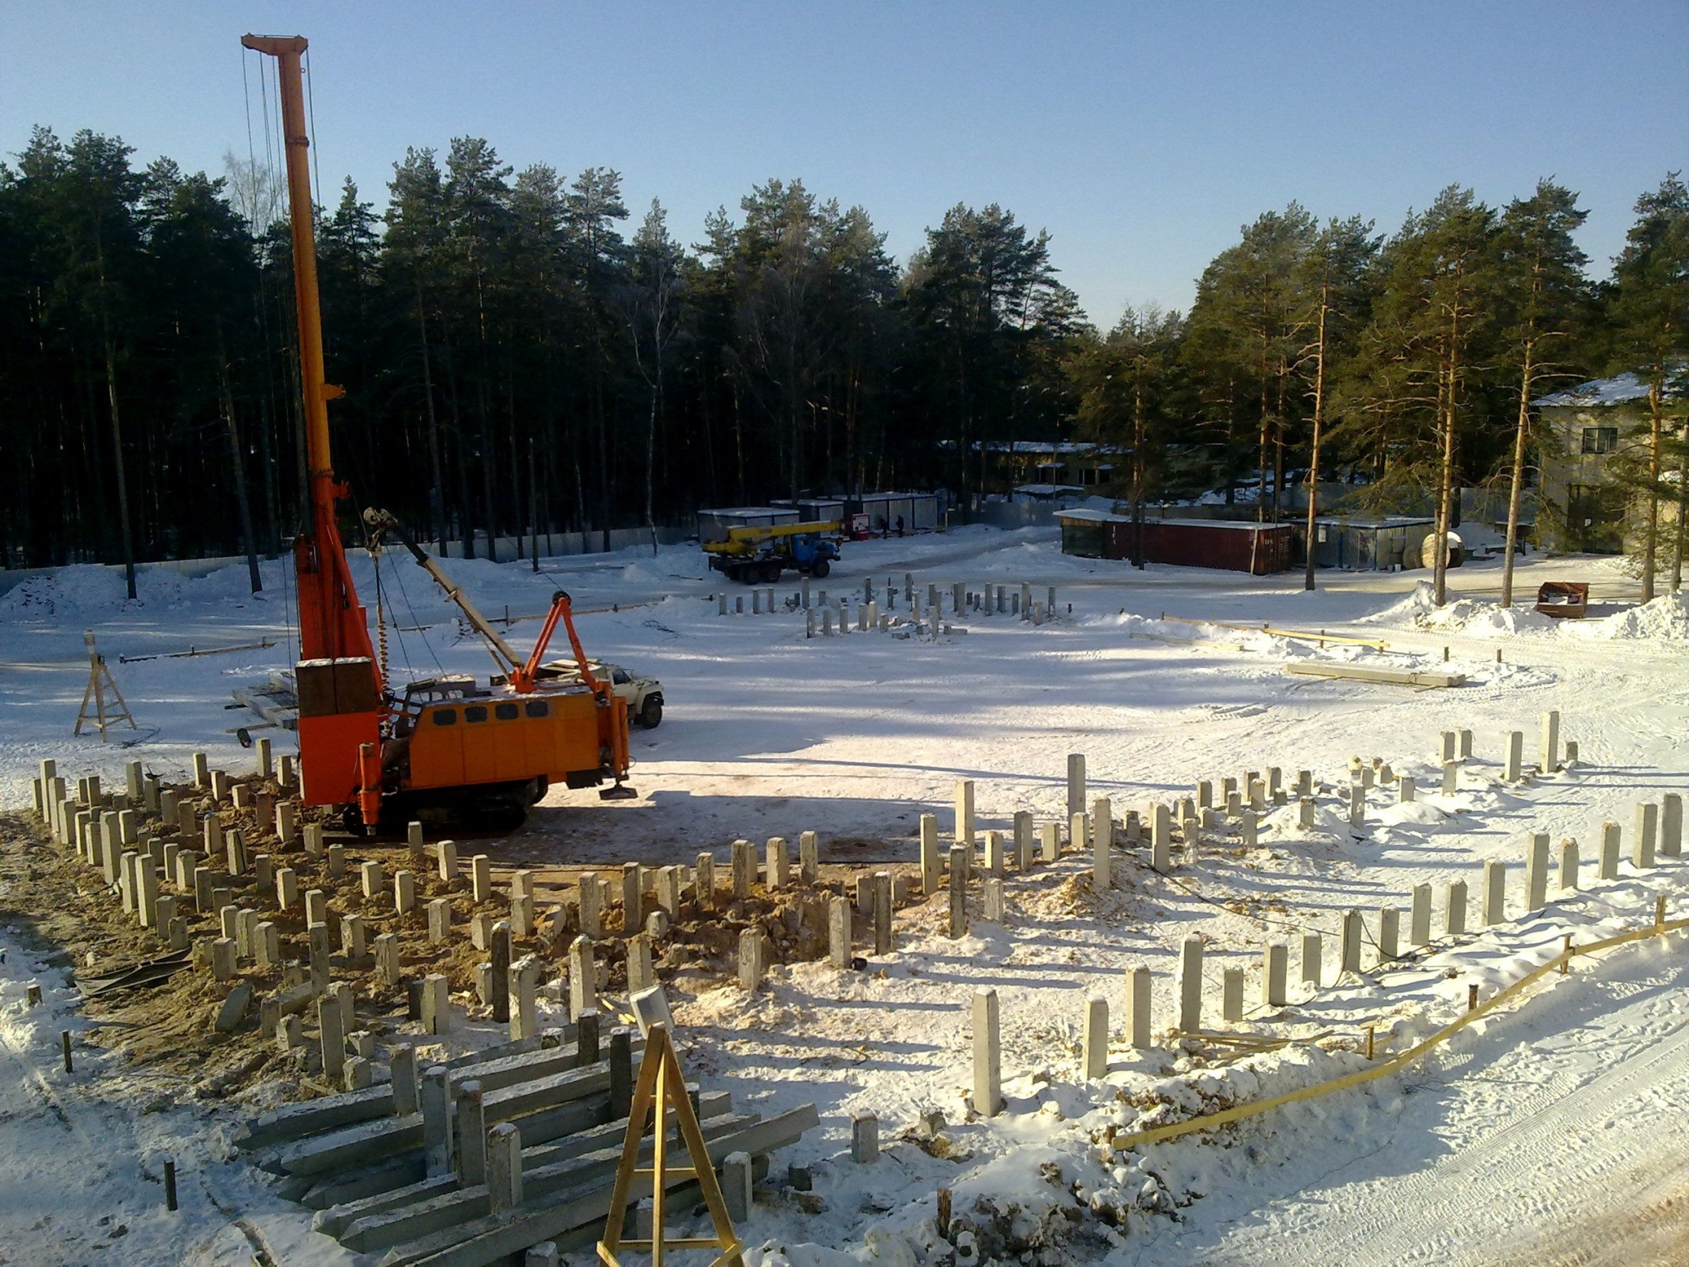
March 2012, Dubna
Yu. Oganessian Chemistry at SHE Factory, Dec. 19-20, 2022, JINR, Dubna

Slide 5
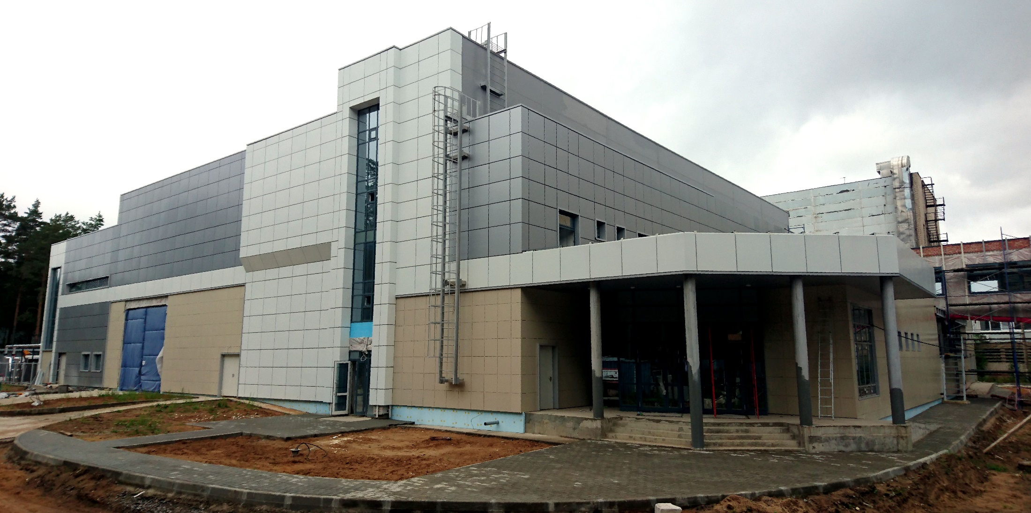
August 2017, Dubna
SHE-Factory
Yu. Oganessian Chemistry at SHE Factory, Dec. 19-20, 2022, JINR, Dubna

Slide 6
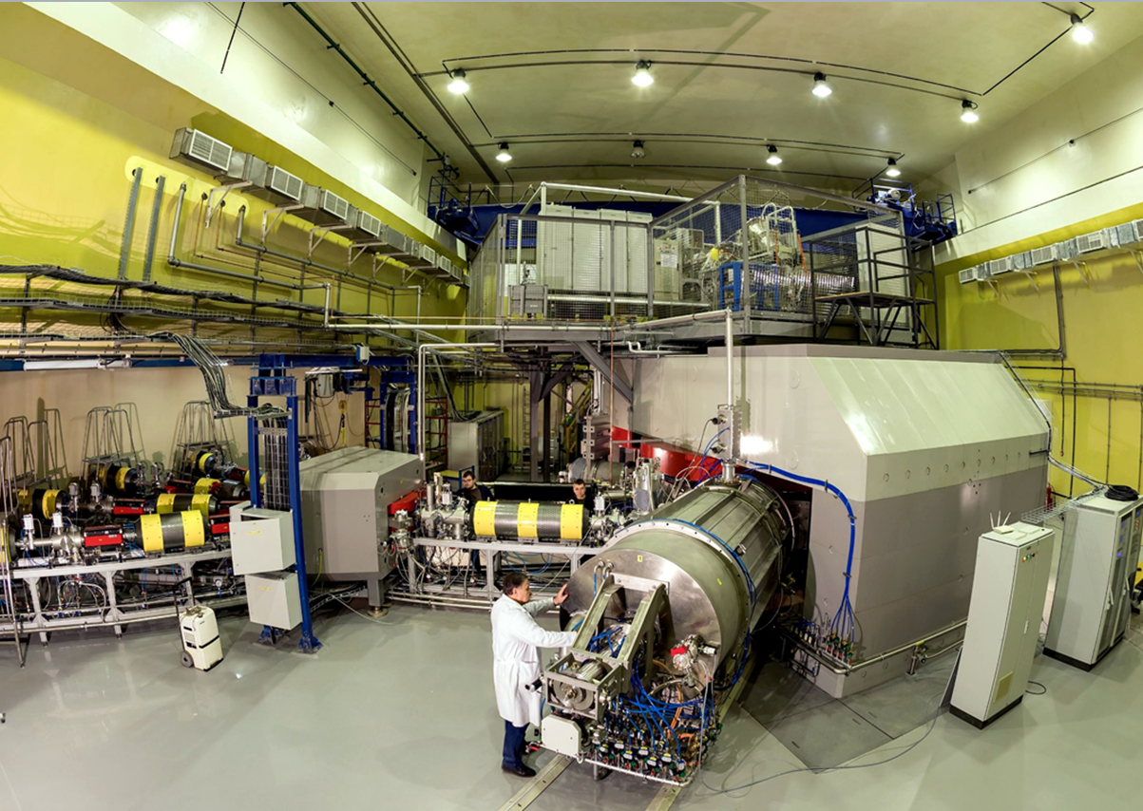
⁷Li – ⁴⁸Ca – ¹³⁶Xe | 10 pµA
²³⁸U | 0.01 pµA
March 2018, Dubna
New cyclotron DC-280
Yu. Oganessian Chemistry at SHE Factory, Dec. 19-20, 2022, JINR, Dubna
Notes:
SHE-Factory is equipped with new accelerator capable of deliver the ion beams with an intensity 10 times higher what we currently have.

Slide 7
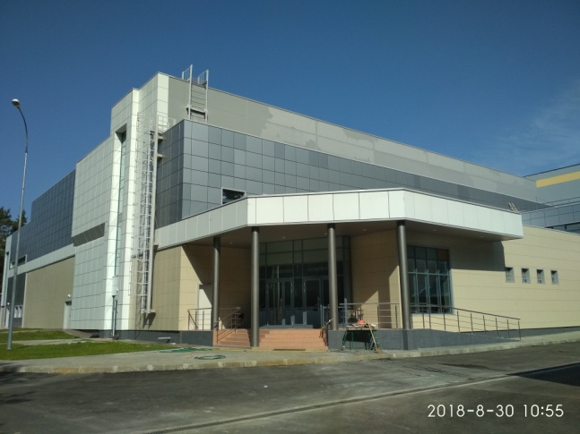
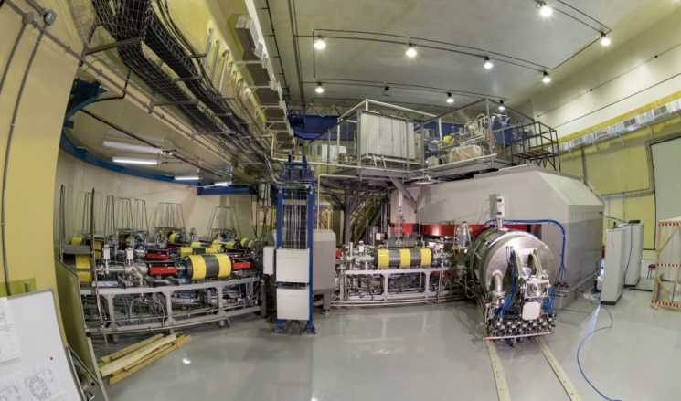
SHE Factory
Ion | Expected beam intensity of (4-8) MeV/A ions (pps)
¹⁸O | 1×10¹⁴
²⁰Ne | 1×10¹⁴
⁴⁰Ar | 1×10¹⁴
⁴⁸Ca | 6×10¹³
⁵⁰Ti | 3×10¹³
⁵⁴Cr | 4×10¹³
⁵⁸Fe | 4×10¹³
⁶⁴Ni | 4×10¹³
⁷⁰Zn | 2×10¹³
¹³⁶Xe | 2×10¹³
²³⁸U | 5×10¹⁰
New cyclotron DC 280
⁴⁸Ca | 4.7×10¹³ 4.1×10¹³
was was used
obtained in experiment

Slide 8
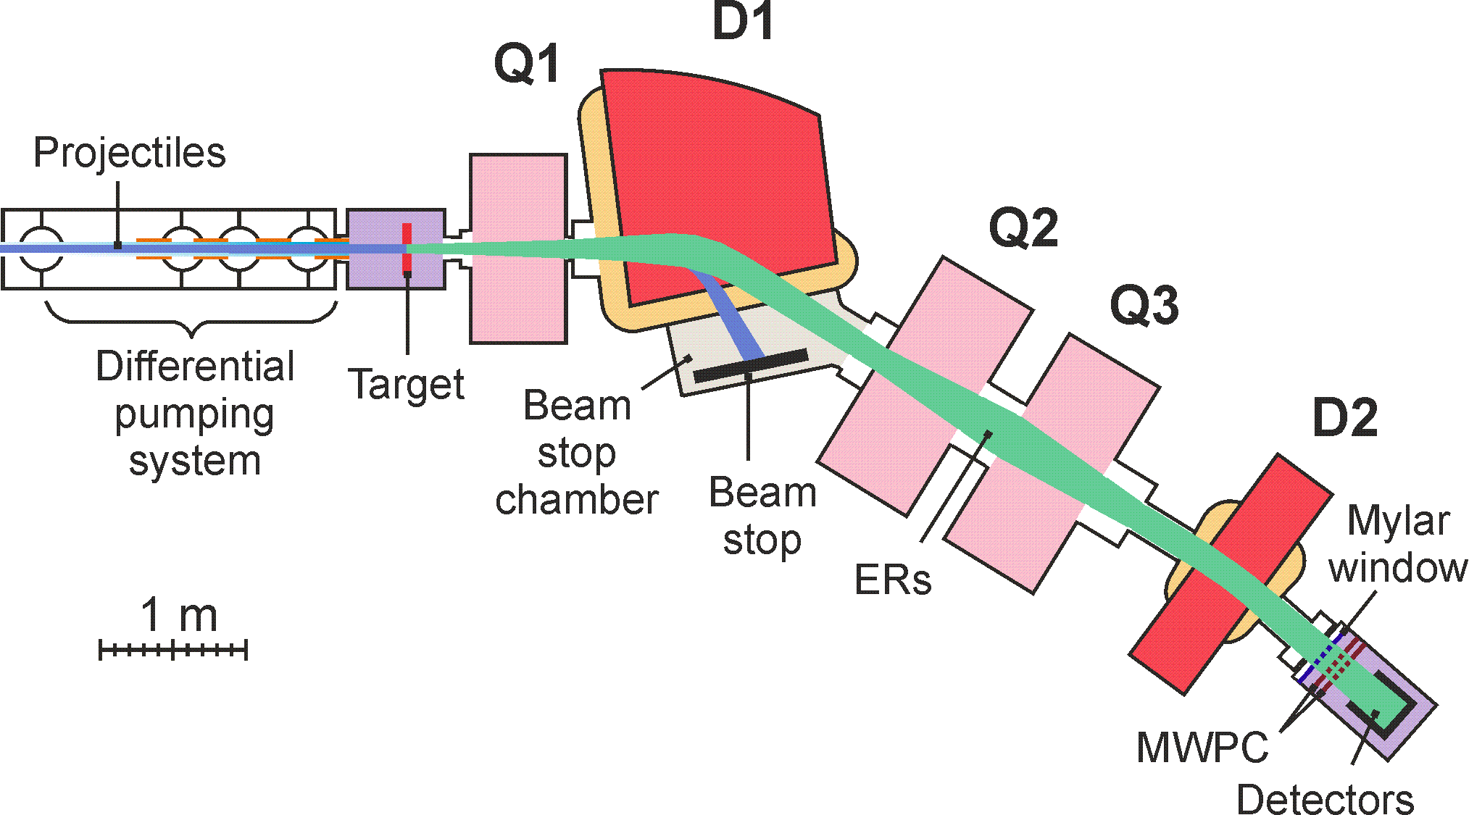
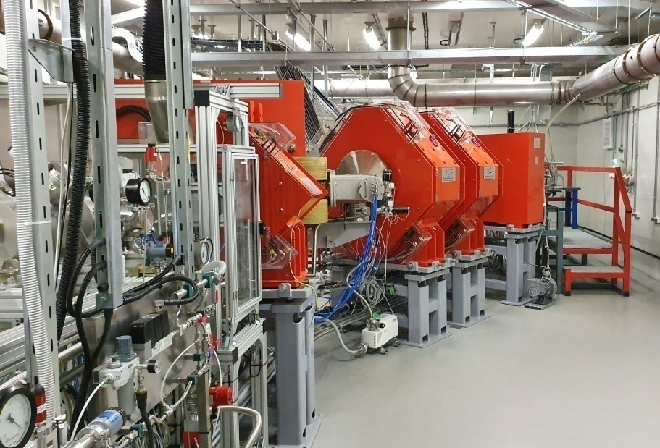
Dubna gas-filled recoil separator (DGFRS-2)
Transmission of EVR is
Increased by factor of 2
Suppression of background is
Increased by factor of 200

Slide 9
Experiments at SHE-Factory
Mc (Z=115)
3 events
2003
²⁴³Am + ⁴⁸Ca
125 events
2022
at SHE-Factory
What decay modes
does this nucleus have:
α, EC, SF?
Yu. Oganessian Chemistry at SHE Factory, Dec. 19-20, 2022, JINR, Dubna

Slide 10
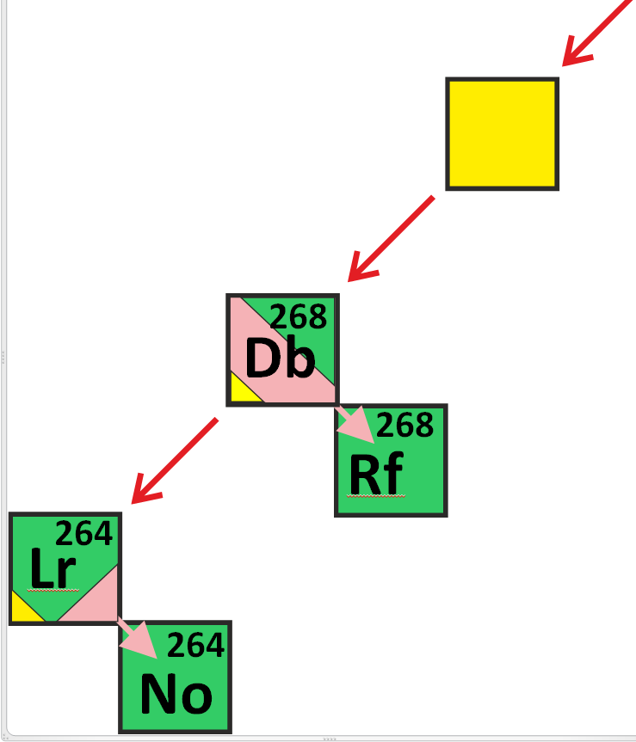
272
Bh
α₅
(T_{1/2} )_{exp} = 16 h
α₆
~ 50%
EC
~ 50%
T_{EC} ≈ 2-10 h
T_{SF} ≈ 1s
(T_{SF/EC} )_{exp}~ 5 h
Super-symmetric
spontaneous fission
T_{SF} ≈ 1s
Yu. Oganessian Chemistry at SHE Factory, Dec. 19-20, 2022, JINR, Dubna

Slide 11
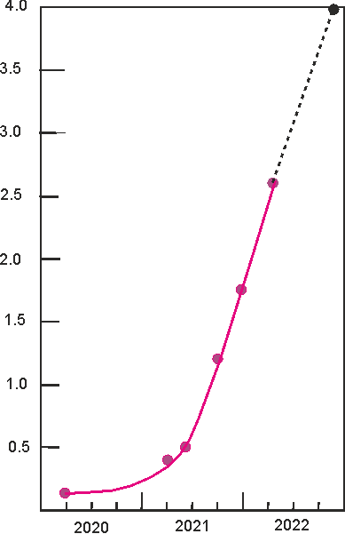
Progress at SHE-Factory
4.0
designed
3.5
Luminosity
(target 30 mg)
3.0
now at Factory
2.5
Luminosity (10³¹/cm²ˑs)
DC-280 + DGFRS-2
2.0
1.5
1.0
0.5
previous level
U-400 + DGFRS-1
0.0
2000
2020
2021
2022
year
Yu. Oganessian Chemistry at SHE Factory, Dec. 19-20, 2022, JINR, Dubna

Slide 12
Синтез новых элементов

Slide 13
Synthesis of new elements at SHE Factory
new projectiles
⁵⁴Cr + ²⁴⁸Cm → 3n + ²⁹⁹120
⁵⁰Ti + ²⁴⁹Bk → 3n + ²⁹⁶119
Alpha decay of new nuclei leads
to the known decay chains.
298
Fl
known nuclei
Test reactions:
²³⁸U + ⁵⁴Cr → ²⁹²Lv*
²⁴²Pu + ⁵⁰Ti → ²⁹²Lv*
²⁴⁵Cm + ⁴⁸Ca→ ²⁹³Lv*
σ_{3n}= 4pb
σ=0.02 pb, h_{t}=0.4 mg/cm², ε_{coll}=0.6, I_{beam}= 6 pμA → 1 event/month

Slide 14
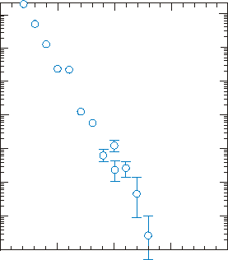
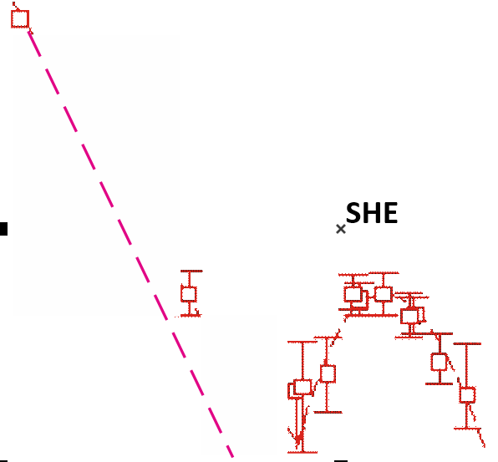
Neutron evaporation residues cross sections
(pb)
100000
Cross sections
10000
1000
100
⁴⁸Ca-induced
reactions
10
6.4
5.7
1
5.5
Cold fusion
4.1
5.6
0.1
0.01
100
105
110
115
120
Atomic number

Slide 15
CaO + Al → Ca + Al₂O₃
T ≥ 450⁰C
He
Extraction
Yu. Oganessian Chemistry at SHE Factory, Dec. 19-20, 2022, JINR, Dubna

Slide 16
CaO + Al → Ca + Al₂O₃
T ≥ 450⁰C
He
Extraction
Injection of Са vapor
600 – 1000⁰С
consumption: 0.5 mg/h
Hot reflector
Ta 1000⁰С
Yu. Oganessian Chemistry at SHE Factory, Dec. 19-20, 2022, JINR, Dubna

Slide 17
²³⁸U beam at SHE-Factory
50
32⁺
10
35⁺
39⁺
Beam intensity from the ion source (pµA)
42⁺
ECR 28 GHz
0.1
ECR 14 GHz
32⁺
5
6
7
8
9
10
E_{LAB} (MeVˑA)
Yu. Oganessian Chemistry at SHE Factory, Dec. 19-20, 2022, JINR, Dubna

Slide 18
Новые расчеты барьеров деления

Slide 19
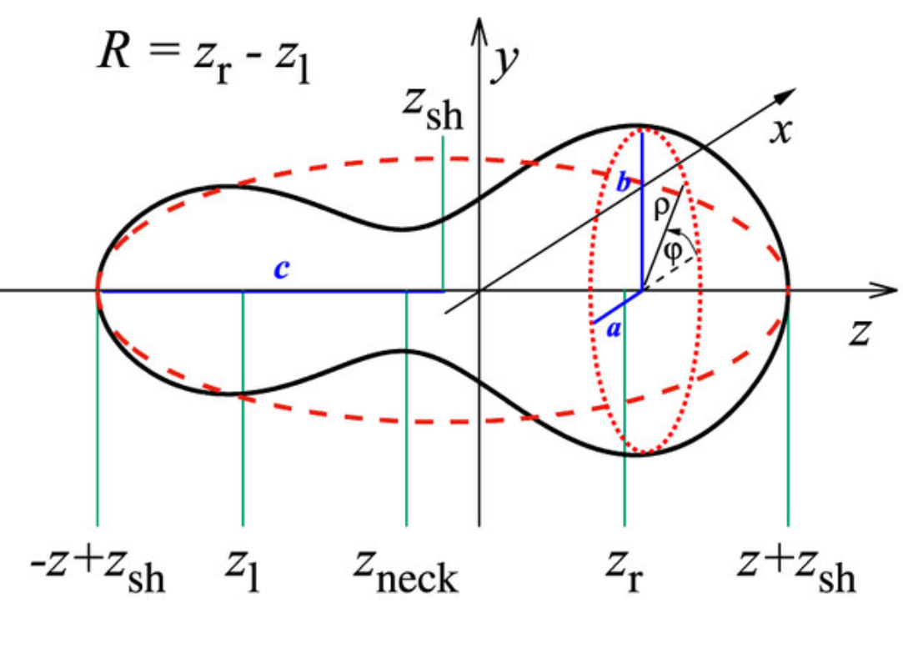
Fourier expansion of deformed nuclear shapes
Yu. Oganessian Chemistry at SHE Factory, Dec. 19-20, 2022, JINR, Dubna

Slide 20
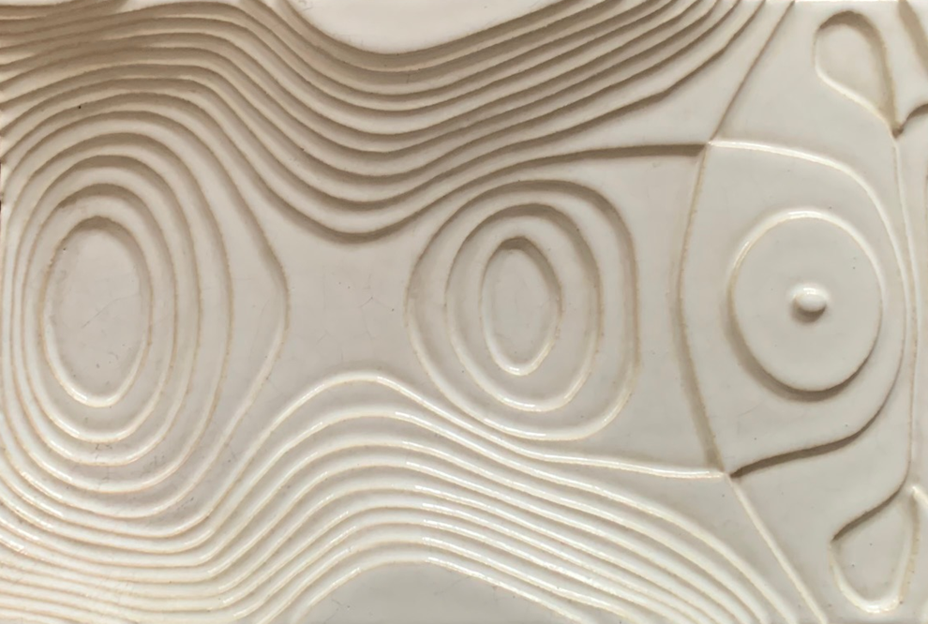
Potential energy surface of the ²⁴² Pu nucleus?
into the valley of fission
BOX
X
G
X
I
outer
barrier
inner
barrier
isomeric
state
ground
state
X
into the valley of fission
Yu. Oganessian Chemistry at SHE Factory, Dec. 19-20, 2022, JINR, Dubna

Slide 21
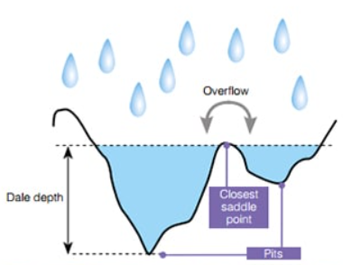
Fission Barrier Height Determination
Yu. Oganessian Chemistry at SHE Factory, Dec. 19-20, 2022, JINR, Dubna

Slide 22
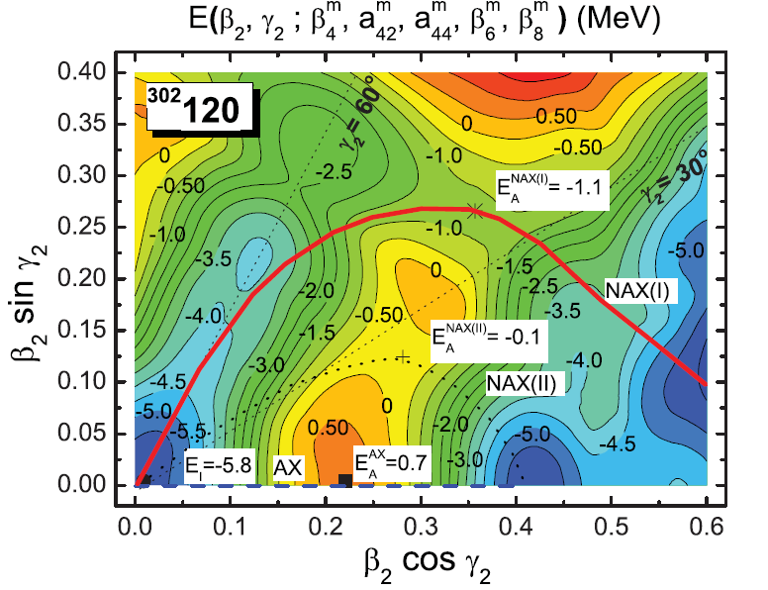
Yu. Oganessian Chemistry at SHE Factory, Dec. 19-20, 2022, JINR, Dubna

Slide 23
Neutron evaporation residues cross sections
(pb)
100000
Cross sections
10000
²³²Th+⁴⁸Ca → ²⁸⁰Ds
1000
²⁷⁶Ds
SF~ 80 µs
100
10
⁴⁸Ca-induced
reactions
6.4
5.7
1
5.5
Cold fusion
4.1
5.6
0.1
3.3
5.1
⁵⁴Cr+²⁴⁶Cm
0.01
²⁷⁶Ds
100
105
110
115
120
Atomic number

Slide 24
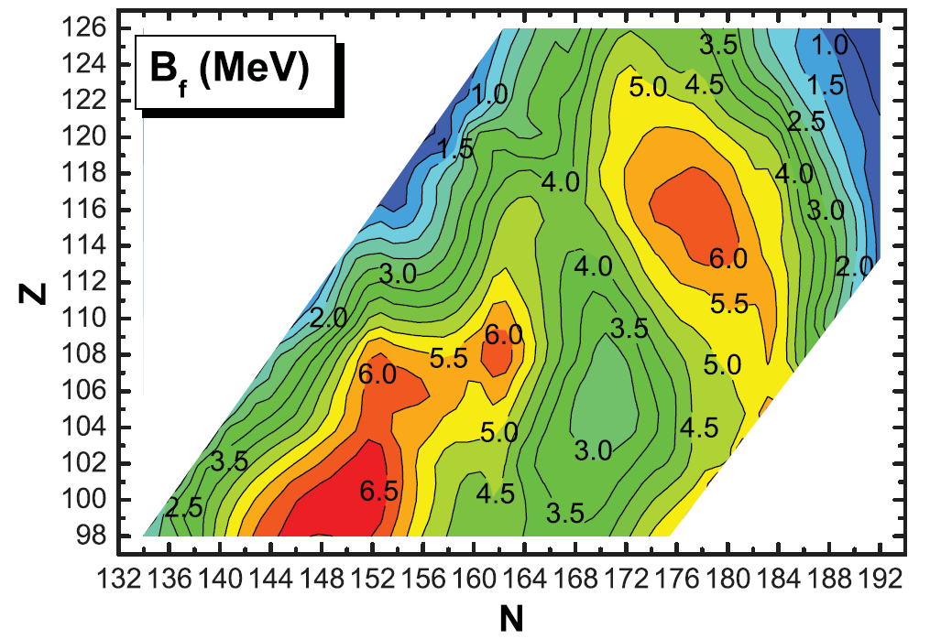
Fission barriers for even-even superheavy nuclei (MeV)
^{245, 246}Cm + ⁵⁴Cr
²⁴⁸Cm + ⁵⁴Cr
²⁴⁵Cm + ⁴⁸Ca
²⁴⁰Pu + ⁴⁸Ca
²³²Th + ⁴⁸Ca

Slide 25
Production of Trans-Uranium Isotopes at ORNL
100
Fm
Fm254
α
Fm255
α
Fm256
SF
Fm257
α, (n,f)
99
Es
Es253
α
Es254
α, β⁻,EC
Es255
β⁻
98
Cf
Cf249
α, (n,f)
Cf250
α
Cf251
α, (n,f)
Cf252
α, SF
Cf253
β⁻, (n,f)
Cf254
α, SF
97
Bk
Bk249
β⁻
Bk250
β⁻
Bk251
β⁻
96
Cm
Cm242
α
Cm243
α, (n,f)
Cm244
α
Cm245
α, (n,f)
Cm246
α
Cm247
α, (n,f)
Cm248
α, SF
Cm249
β⁻
Cm250
α, β⁻,SF
²⁴⁵Cm
²⁴⁶Cm
²⁴⁷Cm
²⁴⁸Cm
95
Am
Am241
α
Am242
β⁻,EC,(n,f)
Am243
α
Am244
β⁻
Am245
β⁻
Am246
β⁻
1.6ˑ10⁷y
94
Pu
Pu240
α
Pu241
β⁻, (n,f)
Pu242
α
Pu243
β⁻
Pu244
α
Pu245
β⁻
Pu246
β⁻
Yu. Oganessian Chemistry at SHE Factory, Dec. 19-20, 2022, JINR, Dubna

Slide 26
²³⁹⁻²⁴³
Pu
²⁴³⁻²⁴⁴
Am
²⁴⁴⁻²⁴⁹
Cm
²⁴⁹⁻²⁵⁰
Bk
²⁵⁰⁻²⁵²
Cf
z
245
248
²³⁹Pu
²⁴⁰Pu
²⁴¹Pu
²⁴²Pu
²⁴³Pu
²⁴³Am
²⁴⁴Am
²⁴⁴Cm
²⁴⁵Cm
²⁴⁶Cm
²⁴⁷Cm
²⁴⁸Cm
²⁴⁹Cm
²⁴⁹Bk
²⁵⁰Bk
²⁵⁰Cf
²⁵¹Cf
²⁵²Cf
10%
8.5%
1.5%
0.3%
36%
0.8%
Fission
Products
0.4%
Fission
Products
26%
Fission
Products
64%
Fission
Products
Fission
Products
Yu. Oganessian Chemistry at SHE Factory, Dec. 19-20, 2022, JINR, Dubna

Slide 27
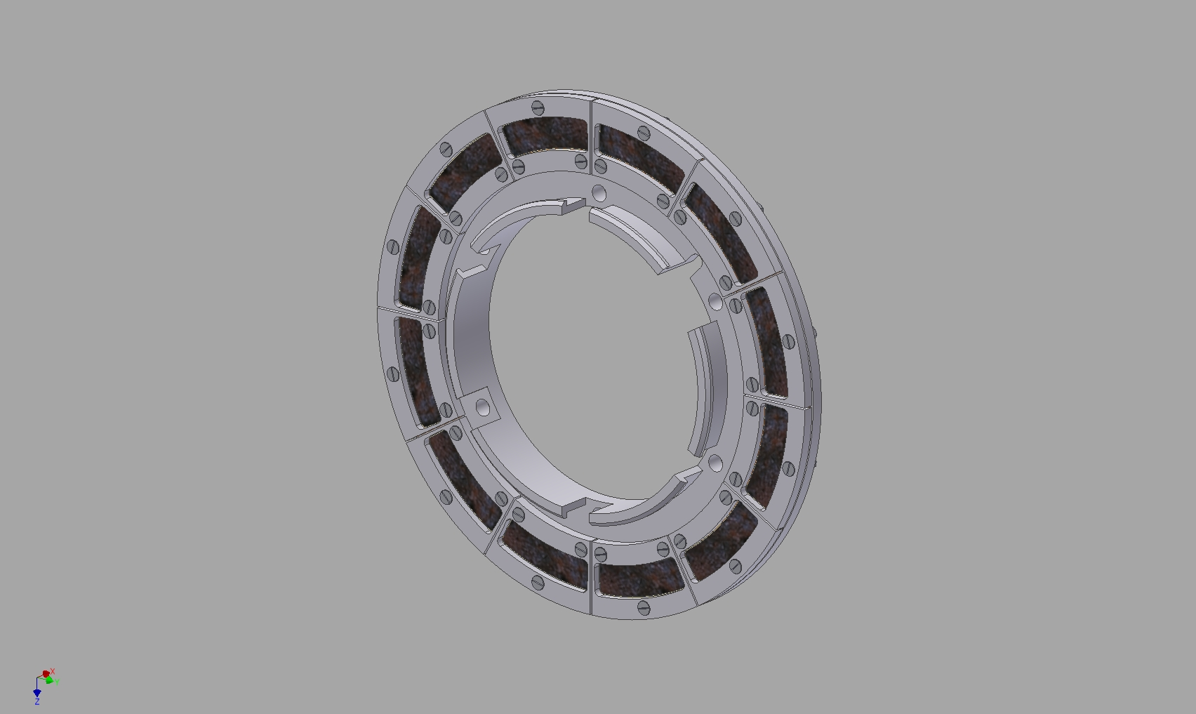
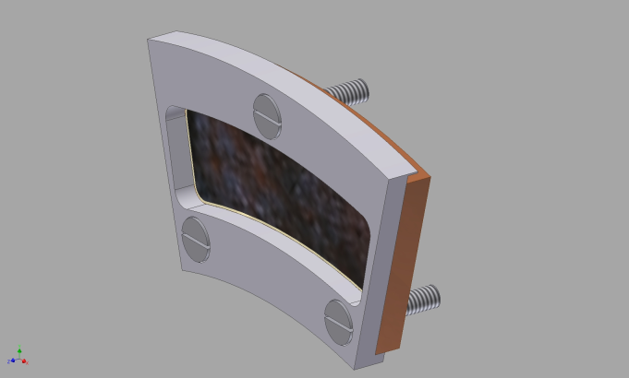
24 segments of rotational target made from mixed ²⁴⁵Cm
Total weight 60 mg
Total surface 150 cm²
Thickness 0.4 mg/cm²
^{Segment}
¹/₂₄
Yu. Oganessian Chemistry at SHE Factory, Dec. 19-20, 2022, JINR, Dubna

Slide 28
Химия сверхтяжелых элементов

Slide 29
Thermal adsorption of
elements 114-117
on the Au-surface
COLD
new setup (PSI)
He/Ar
Rn
SHE
1-3 cm³
He-filled
stopping chamber
Hg
from GASSOL

Slide 30
Super heavy atoms
Z | Isotope | Half-life
112 | ²⁸³Cn | 3.6 s
113 | ²⁸⁴Nh | 0.9 s
114 | ²⁸⁷Fl | 0.5 s
114 | ²⁸⁹Fl | 1.9 s
115 | ²⁸⁸Ms | 0,16 s
116 | ²⁹³Lv | 57 ms
117 | ²⁹⁴Ts | 51 ms
118 | ²⁹⁴Og | 0.6 ms
First experiment was conducted at Dubna
R. Eichler et al., Nature 447, (2007) 72
We start with DGFRS-3 separator
Certainly, the “relativistic effect will increase rapidly with increasing
atomic number of SHE, which may be observed today for all SHE
from 112 to element 118

Slide 31
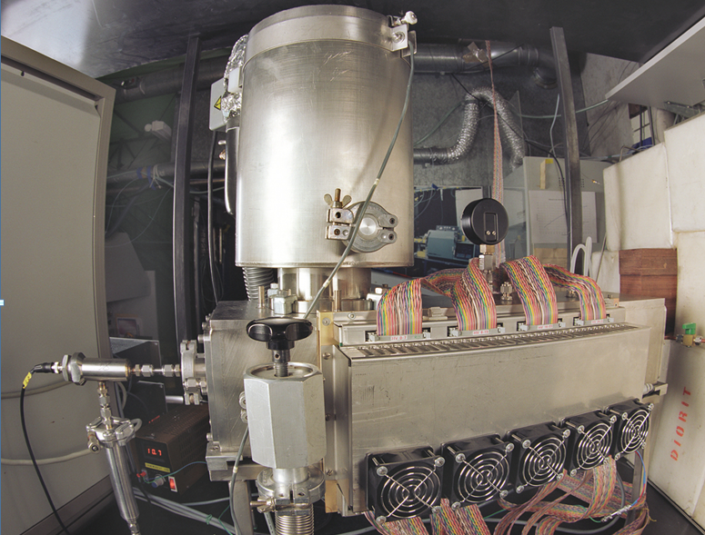
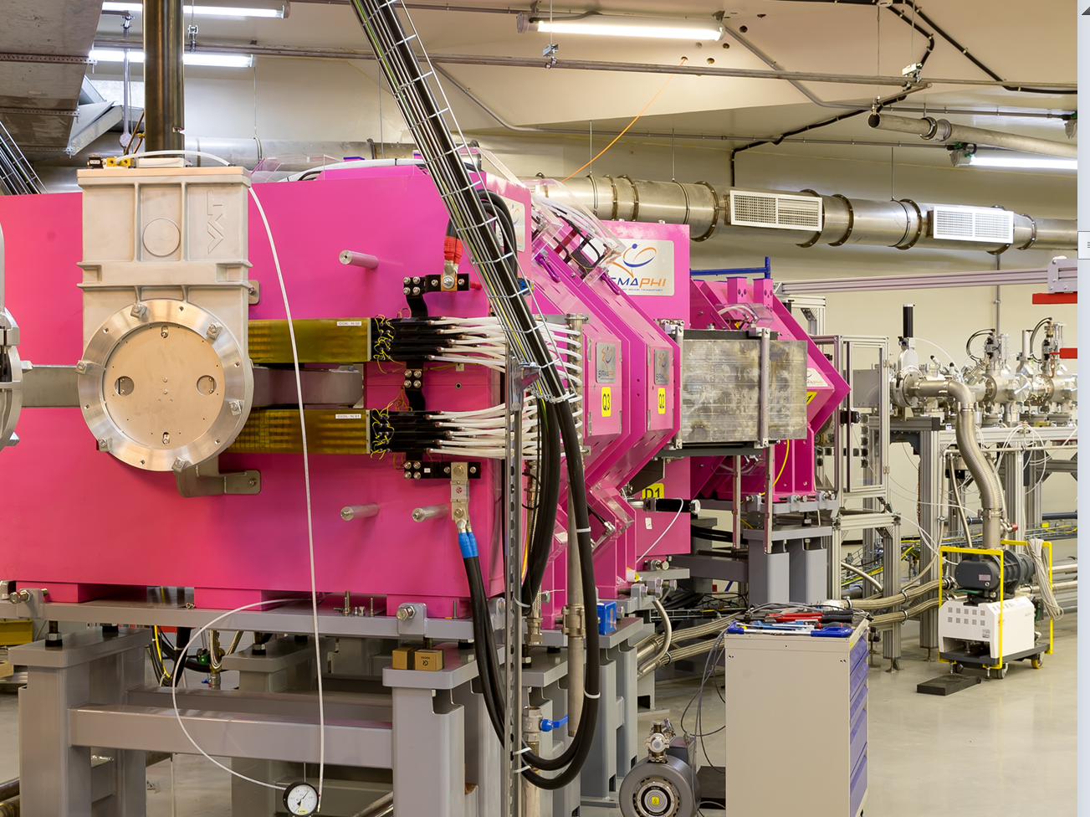
DGFRS-III separator
Targetbox
COLD
setup COLD (PSI)
Yu. Oganessian Heavy Ion Research at JINR, July 4-8, 2022,, St. Petersburg

Slide 32
Super heavy atoms
Z | Isotope | Half-life
112 | ²⁸³Cn | 3.6 s
113 | ²⁸⁴Nh | 0.9 s
114 | ²⁸⁷Fl | 0.5 s
114 | ²⁸⁹Fl | 1.9 s
115 | ²⁸⁸Ms | 0,16 s
116 | ²⁹³Lv | 57 ms
117 | ²⁹⁴Ts | 51 ms
118 | ²⁹⁴Og | 0.6 ms
GASSOL SC gas-filled solenoid will allow us to stop SHE in a small volume of 1-2 cm³ and study the isotopes
with T_{1/2} ≥ 30 ms
Yu. Oganessian Chemistry at SHE Factory, Dec. 19-20, 2022, JINR, Dubna

Slide 33
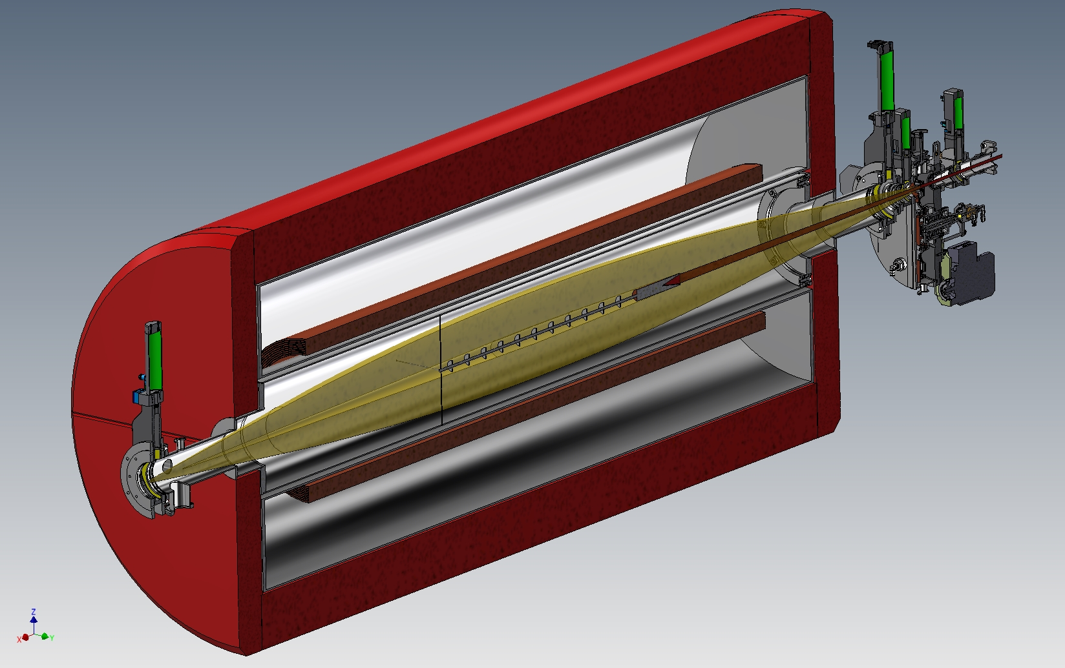
Superconducting gas-filled separator of super heavy elements
rotating
target
GASSOL
⁴⁸Ca
beam
axial screens
radial
screens
EVRs
beam
to He-gas
catcher
SC-coils
axial screens
beam stopper
recoil’s stopper
Yu. Oganessian Chemistry at SHE Factory, Dec. 19-20, 2022, JINR, Dubna

Slide 34
Relativistic Contraction
Z=118
n=2
n=3
n=4
n=1
Electron density (a.u.)
n=5
non
relativistic
correlation
effects
n=6
n=7
nucleus
Distance (in a_{B})
Yu. Oganessian Chemistry at SHE Factory, Dec. 19-20, 2022, JINR, Dubna

Slide 35
Noble gases
P. Schwerdtfeger et al. Angewandte Chemie (2020)
R
melting
room
temperature
Temperature (K)
boiling
NR
Rn
Kr
Xe
Ne
Ar
He
Atomic number
Yu. Oganessian Chemistry at SHE Factory, Dec. 19-20, 2022, JINR, Dubna

Slide 36
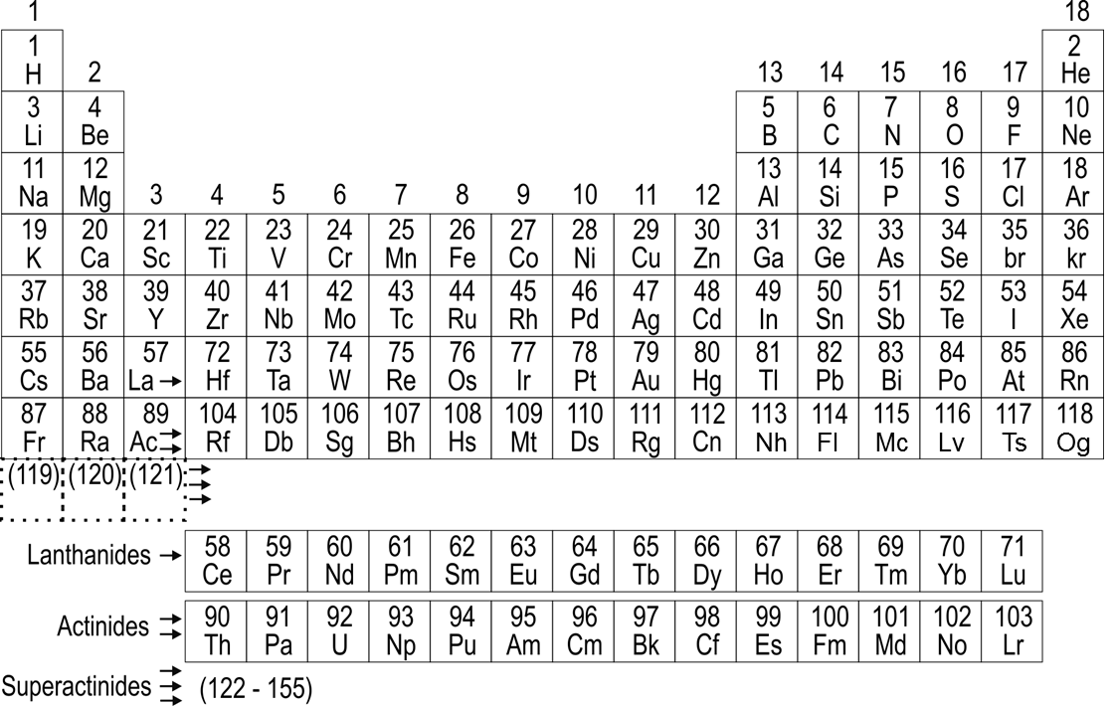
Periodic Table
calculated in the relativistic approximation
SHE
known
next
118
Og
(119)
(120)
(121)
121
122
123
The group difference will be greatly depressed or disappear
Superactinides
122
123
. . .155
Yu. Oganessian Chemistry at SHE Factory, Dec. 19-20, 2022, JINR, Dubna

Slide 37
Благодарю за внимание!

