Slide 1
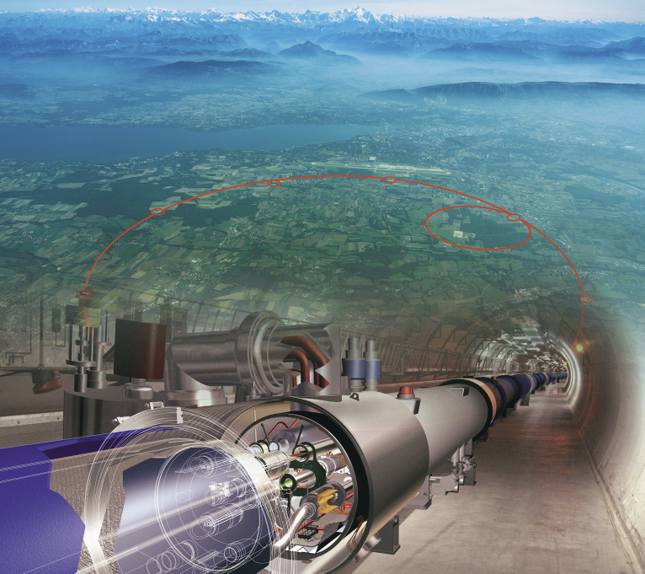

Physics beyond the Standard Model
at the LHC
Sergei Shmatov (JINR, Dubna)
shmatov@cern.ch shmatov@jinr.ru
27 August - 3 September, 2023
Minsk

Slide 2
11 talks with the LHC results at APMP2023
S.Shmatov “Physics beyond the Standard Model at the LHC”
Yu.Kulchitsky “Probe of Standard Model in pp collisions at 13 TeV by ATLAS and CMS at LHC”
V.Zykunov “Electroweak corrections to dilepton production at LHC: the Drell-Yan process vs. the Photon Fusion mechanism”
Yu.Kulchitsky “Two-particle Bose-Einstein correlations in pp-collisions at 13 TeV with ATLAS at LHС”
Yu.Kulchitsky “Study of KNO scaling in pp-collisions with ATLAS at LHC”
M.Savina “Portals to dark matter and search perspectives at the LHC”
V.Makarenko, D.Patskevich, V.Yanuts Study of LFV processes with CMS at LHC
V.Shalaev “Поляризационные эффекты в процессах парного рождения мюонов”
D.Budkouski “Jet flavour discrimination and measurement of gluon jet fractions at LHC”
K.Slizhevskii “Search for dark matter produced in association with a leptonically decaying Z boson with the CMS Experiment at the LHC”
Iu.Korsakov “Studying muon pair production based on open data from CMS”

Slide 3
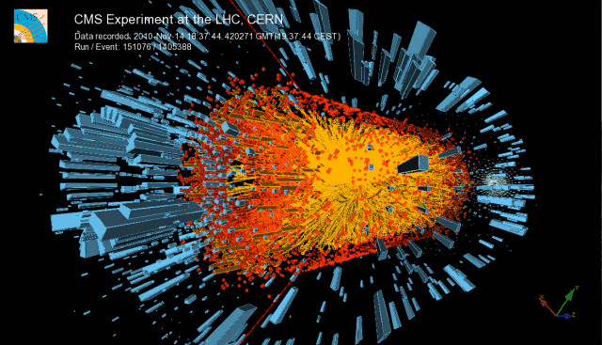
Content
Standard Model after over 10 Years of LHC Operations
Why we are still expecting the New Physics?
Conventional Signals (“standard candles”)
Higgs Boson as a Tool to Search for the New Physics
LLP Non-conventional Signals
LHC Prospects and Plans
Beyond the LHC

Slide 4
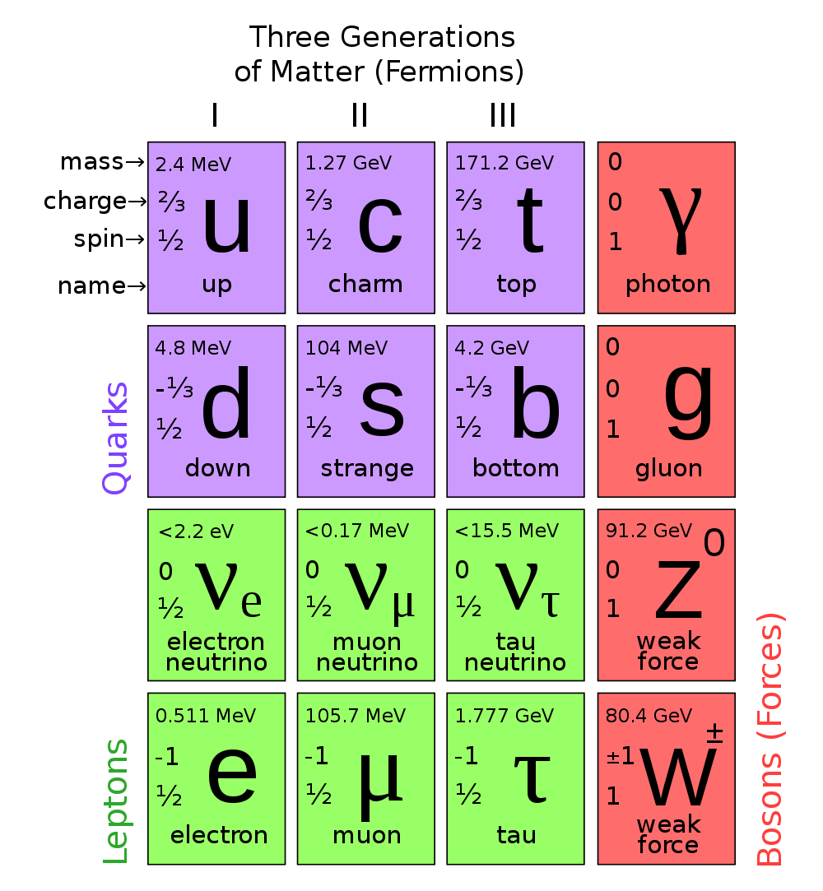
What we had before LHC?
SM is fully completed, expect for Higgs boson

Slide 5
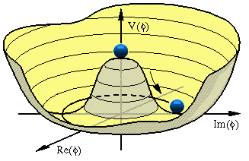

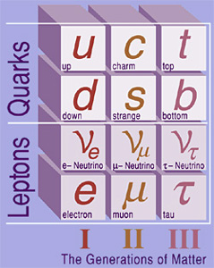
Is the Standard Model as Good as it Looks? or…
What about a mass generation mechanism?
  Higgs bosons? (Now – Yes)
Three generation of particles:
  why 3 (they can not be fixed in the framework of SM)?
  why do we need all of them?
Yukawa hierachy (explanation of mass patterns for quarks and leptons)
A lot of free parameters: gauge couplings, Yukawa coupling constants, CKM-mixing angles, Higgs vacuum expectation value, etc (in total, 26)

Slide 6
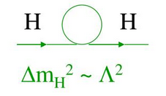
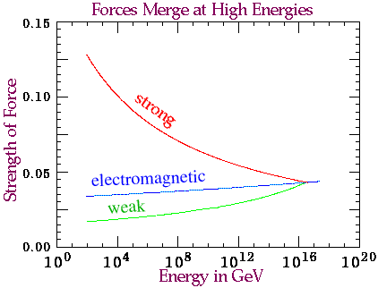
… why do we believe in something
beyond Standard Model?
Where is a gravity?
Hierarchy problem
  fine tuning of higgs mass is needed to “neutralize” contribution from high order corrections
  huge gap between Electroweak (10² GeV) and Planck scale (10¹⁹ GeV) scales), Gravity/EW ~ 10¹⁹/10² GeV?
Unification of Forces

Slide 7
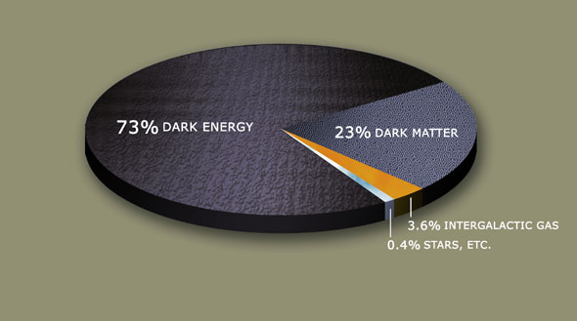
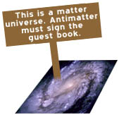
Related Сosmological and Astrophysical Problems
Dark Matter: what does it consist of?
CP-violation in Early Universe
Well, the Standard Model is not a ultimate theory!

Slide 8

The 11 Greatest Unanswered Questions of Physics (Discover, 2002) -6 are LHC related
What is dark matter ?
What is dark energy ?
How were the heavy elements from
iron to uranium made ?
Do neutrinos have mass ?
Where do ultrahigh-energy particles
come from ?
Is a new theory of light and matter needed
to explain what happens at very high
energies and temperatures ?
7. Are there new state of matter at ultrahigh
temperate and dentisity ?
8. Are protons unstable ?
What is gravity ?
Are there additional dimensions ?
How did the universe begin ?

Slide 9

What do we hope to see
beyond the SM?

Slide 10
How we can escape beyond the Standard Model
SU(3)_{с}×SU(2) ×U(1)?
Simplest extension of SM (based on SM gauge group)
  4 generation of fermions, q*, l*…
Extended gauge sector
  ExQCD (colorons, axigluons, diquarks etc)
  ExEW (W’, Z’, …)
  GUT (leptoquarks)
Extended Higgs Sector
  Higgs Doublet Models (HDM)
  Higgs in ED, Higgs-Radion mixing, composite Higgs (RS type)
Hierarchy problem
  SUSY (s-particles, LSP из RPV/split/GM SUSY…)
  Extra dimensions (ED)
    КК-modes of particles SM, KKPV, FCNC…
    microscopic black holes (semi-classical, string balls, quantum black holes)
  Technicolor (technibosons and technifermions, leptoquarks …)
  Compositeness
Dark Matter (EFT)
Will be discussed in details someday

Slide 11
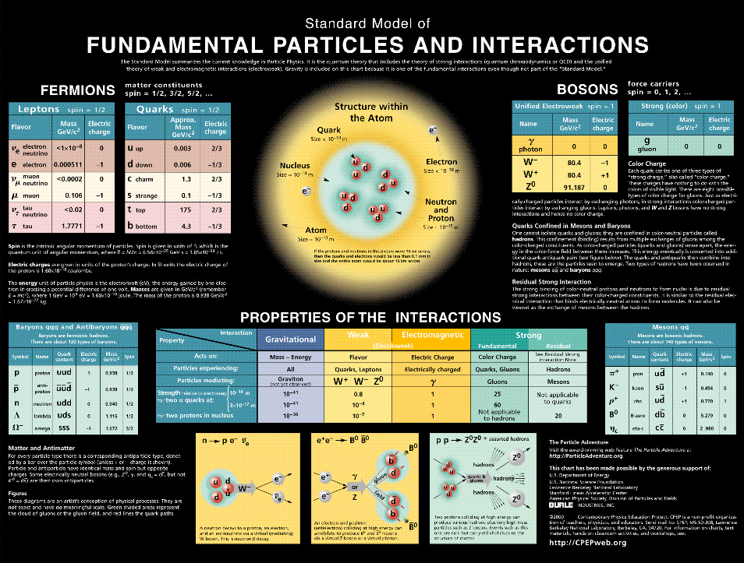
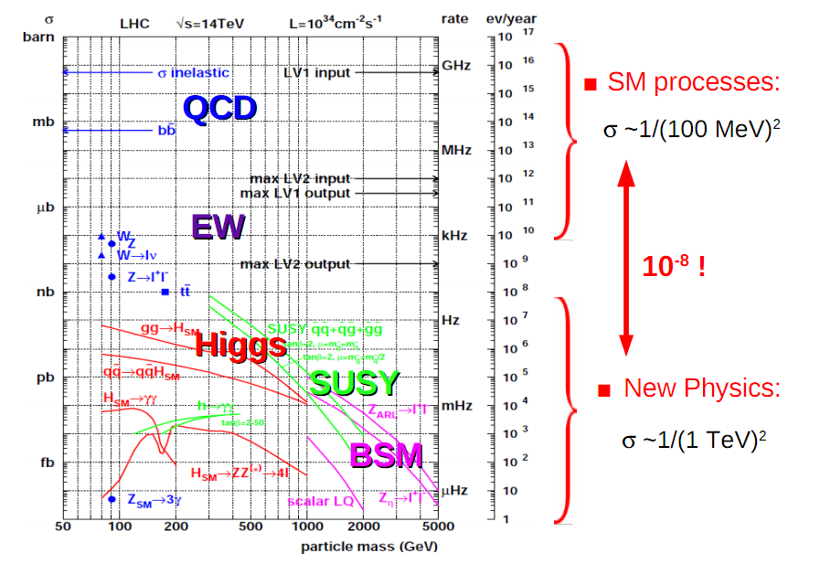
What do we know today about the Standard Model from LHC?

Slide 12
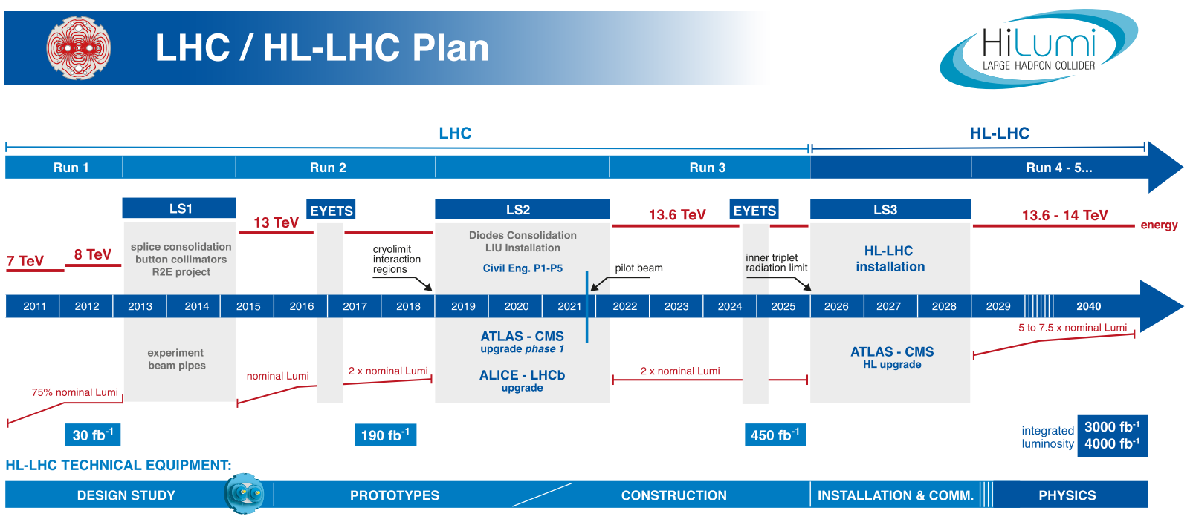
LHC Timeline and Data That We Have
L_{inst} = 2.1×10³⁴ cm⁻²s⁻¹
L_{nisyt} = 7.5×10³⁴ cm⁻²s⁻¹
We are here,
~70 fb⁻¹ @ 13.6 TeV

Slide 13
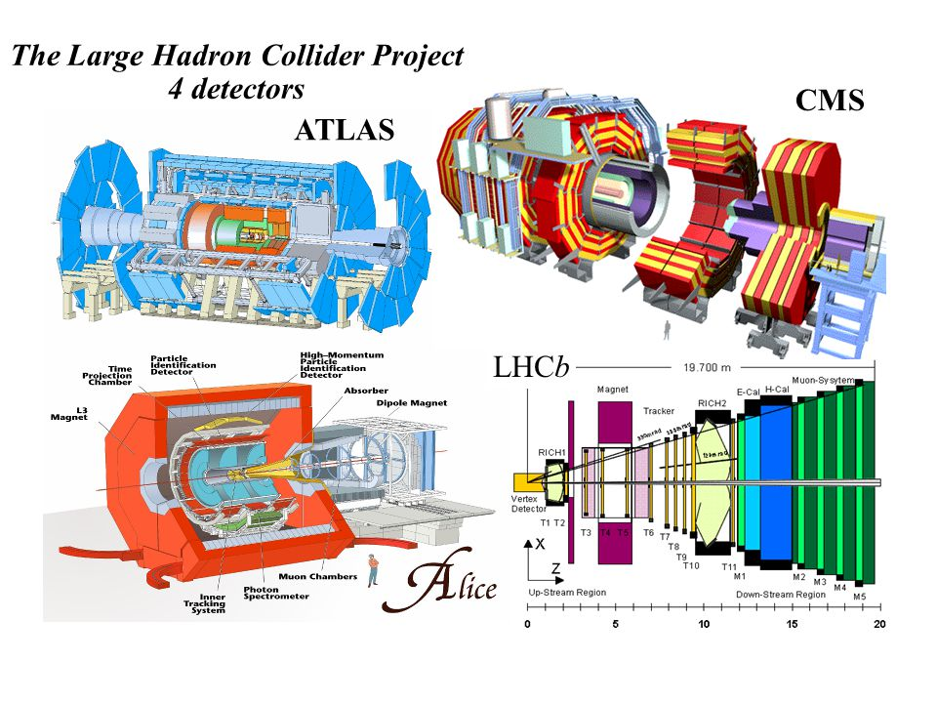
Experimental Facilities

Slide 14
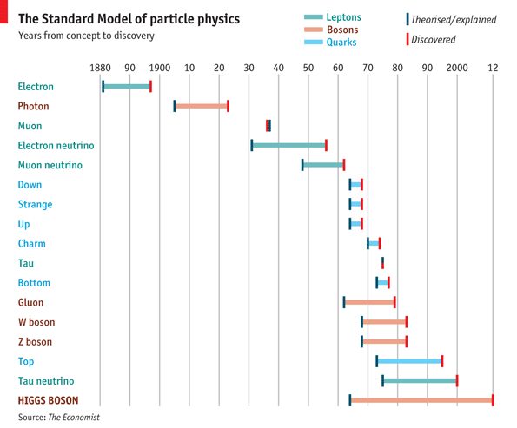
Re-Discovery of the Standard Model

Slide 15

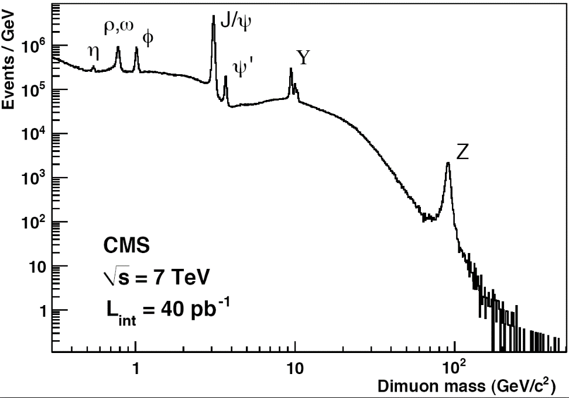
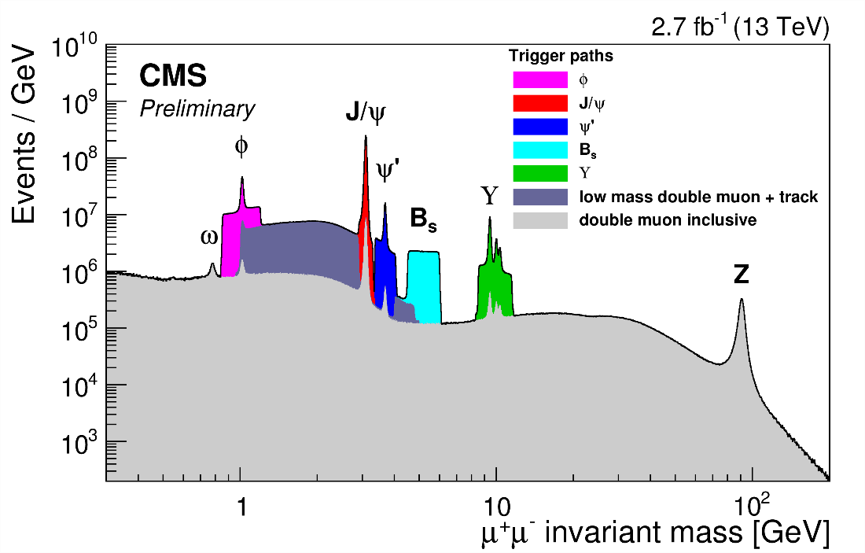
Re-discovery of the Standard Model
Observation of well-known SM objects and processes
  tests of detector systems
  software validation
  MC tunes, ..
Detected objects
  Muons (transverse momentum p_{T})
  Electrons (energy and tr. momentum p_{T})
  Photons (energy)
  Jets (energy)
  Tracks from charged particles (p_{T})
Dec 2010
Reconstructed objects
  Missing energy and p_{T}
    vectorial sum of all transverse momentum
  Resonances (W/Z, B-hadrons, etc)
  Tau-leptons
  b-jets
  t-quarks
  etc
+ well-know processes in SM
https://twiki.cern.ch/twiki/bin/view/CMSPublic/PhysicsResultsMUO

Slide 16
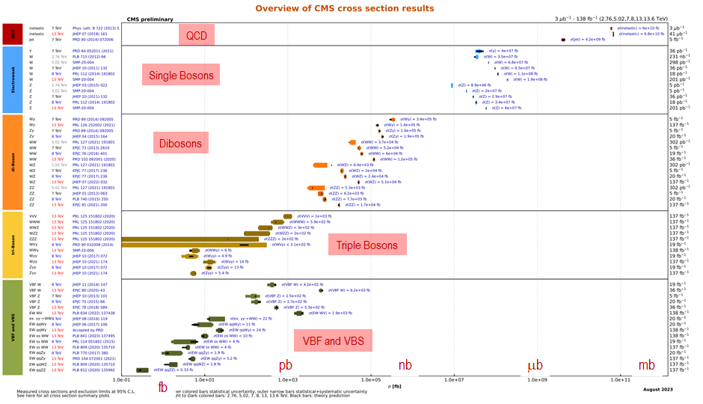
Summary of Standard Model Tests with EWK Bosons
Summaries of CMS cross section measurements
https://twiki.cern.ch/twiki/bin/view/CMSPublic/PhysicsResultsCombined
plots are updated for Summer 2023 conferences

Slide 17
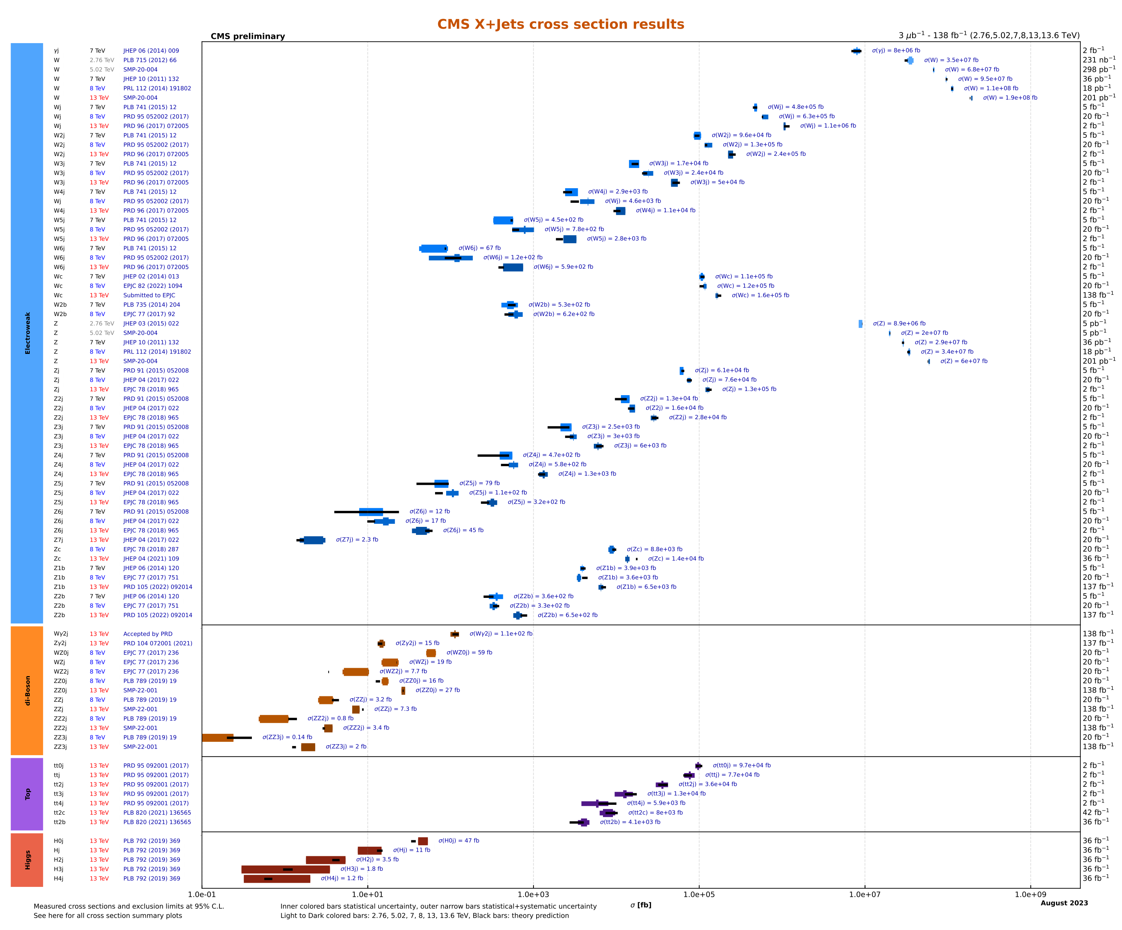
Summary of HLO Strinjent Tests
Summary of the cross sections standard model particles produced in association with jets
https://twiki.cern.ch/twiki/bin/view/CMSPublic/PhysicsResultsCombined
V+jets VV+jets
tt + jets
h + jets
up to 4 jets
plots are updated for Summer 2023 conferences
Agrees with the standard model prediction!

Slide 18

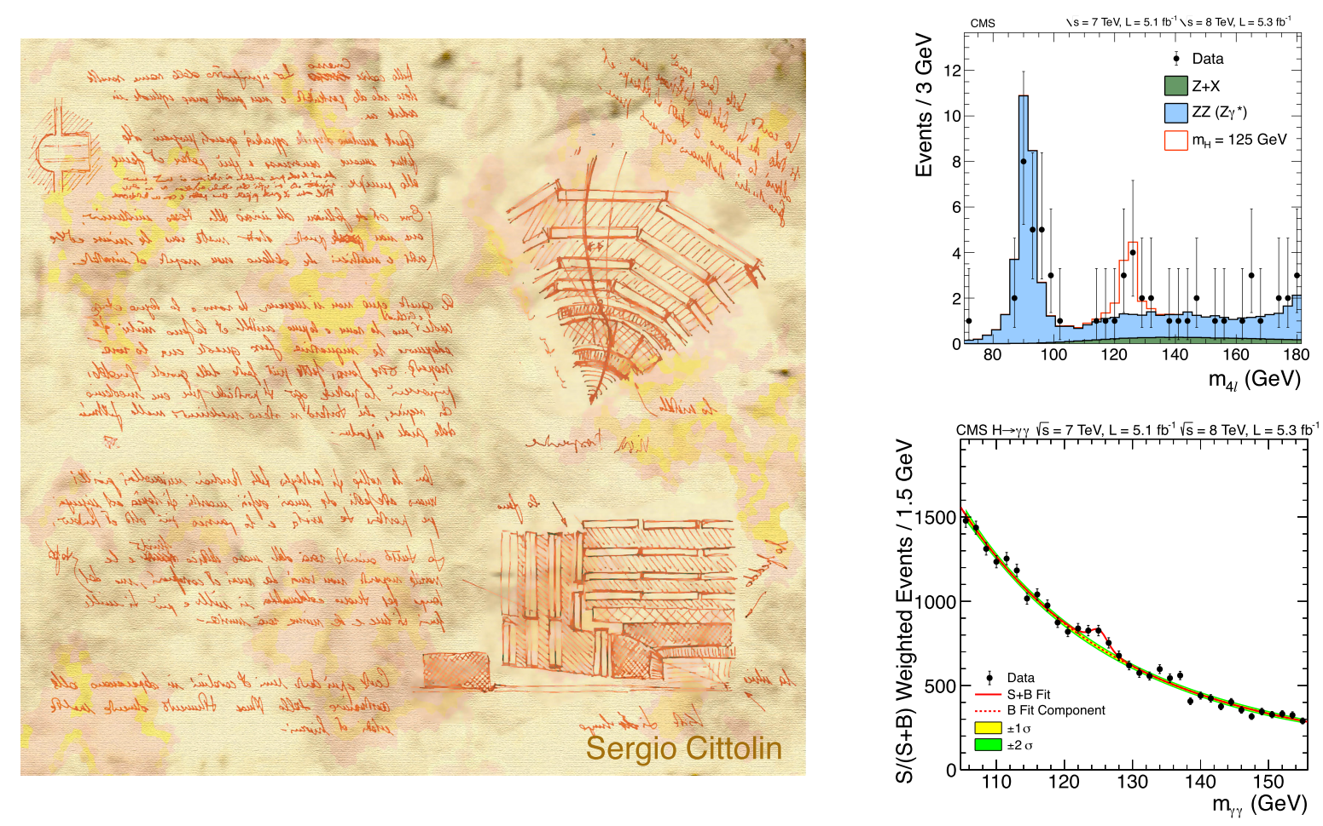

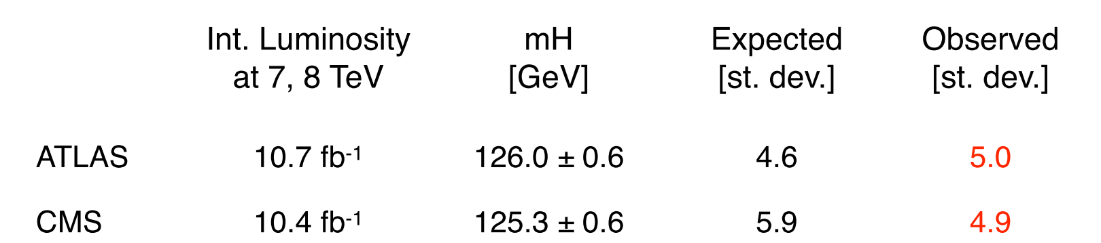
Higgs Physics
4 July 2012
Higgs announcement at CERN
From design
to discovery

Slide 19
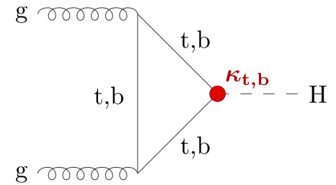
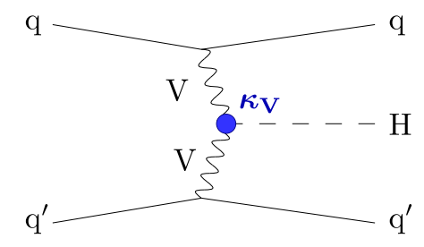
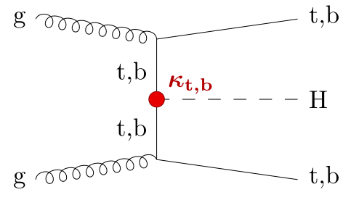
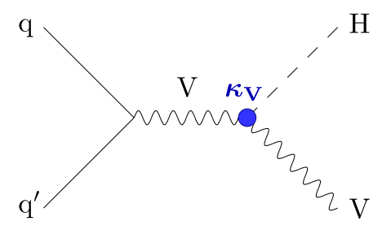
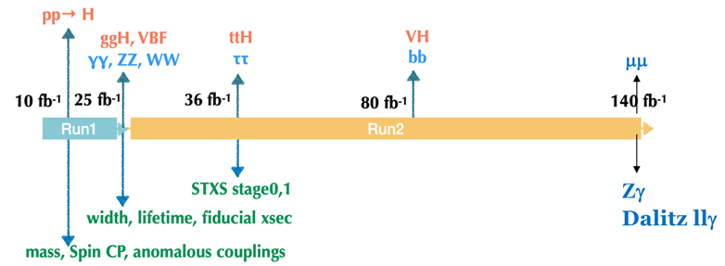
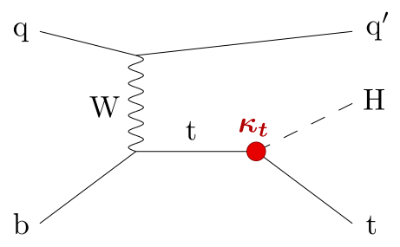
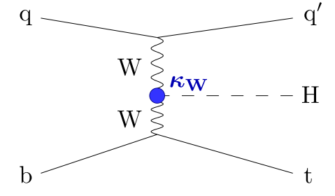

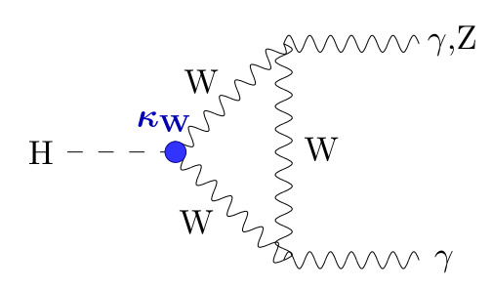
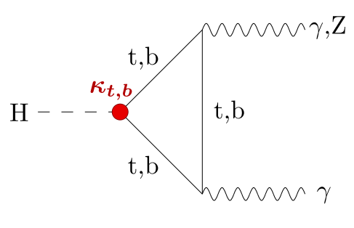
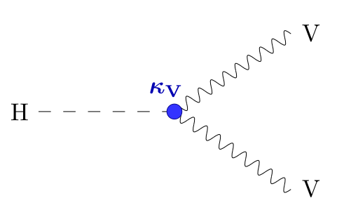
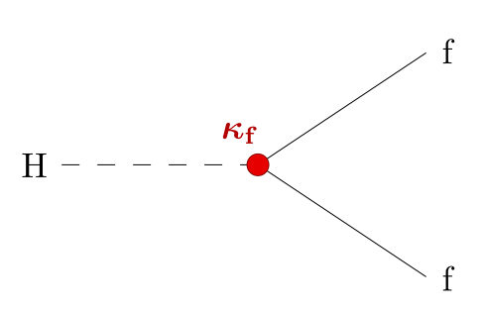
Higgs Story at the LHC
ggH
VBF
tt/bbH
VH
tH
h → Gauge Bosons
h → Fermions

Slide 20
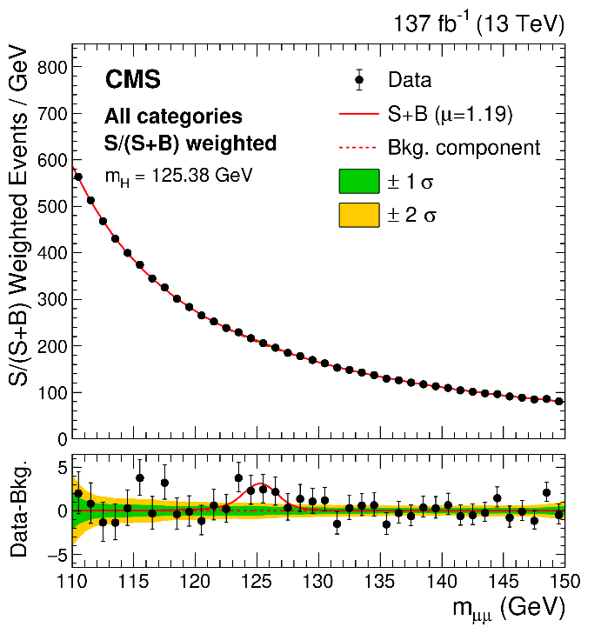
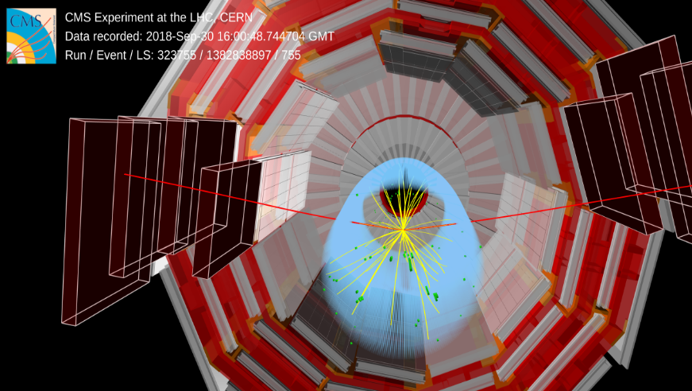
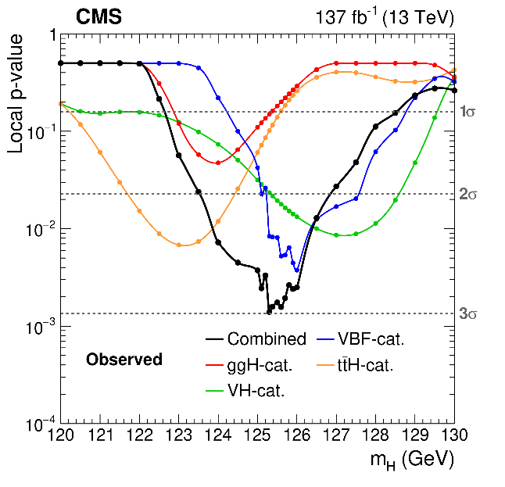
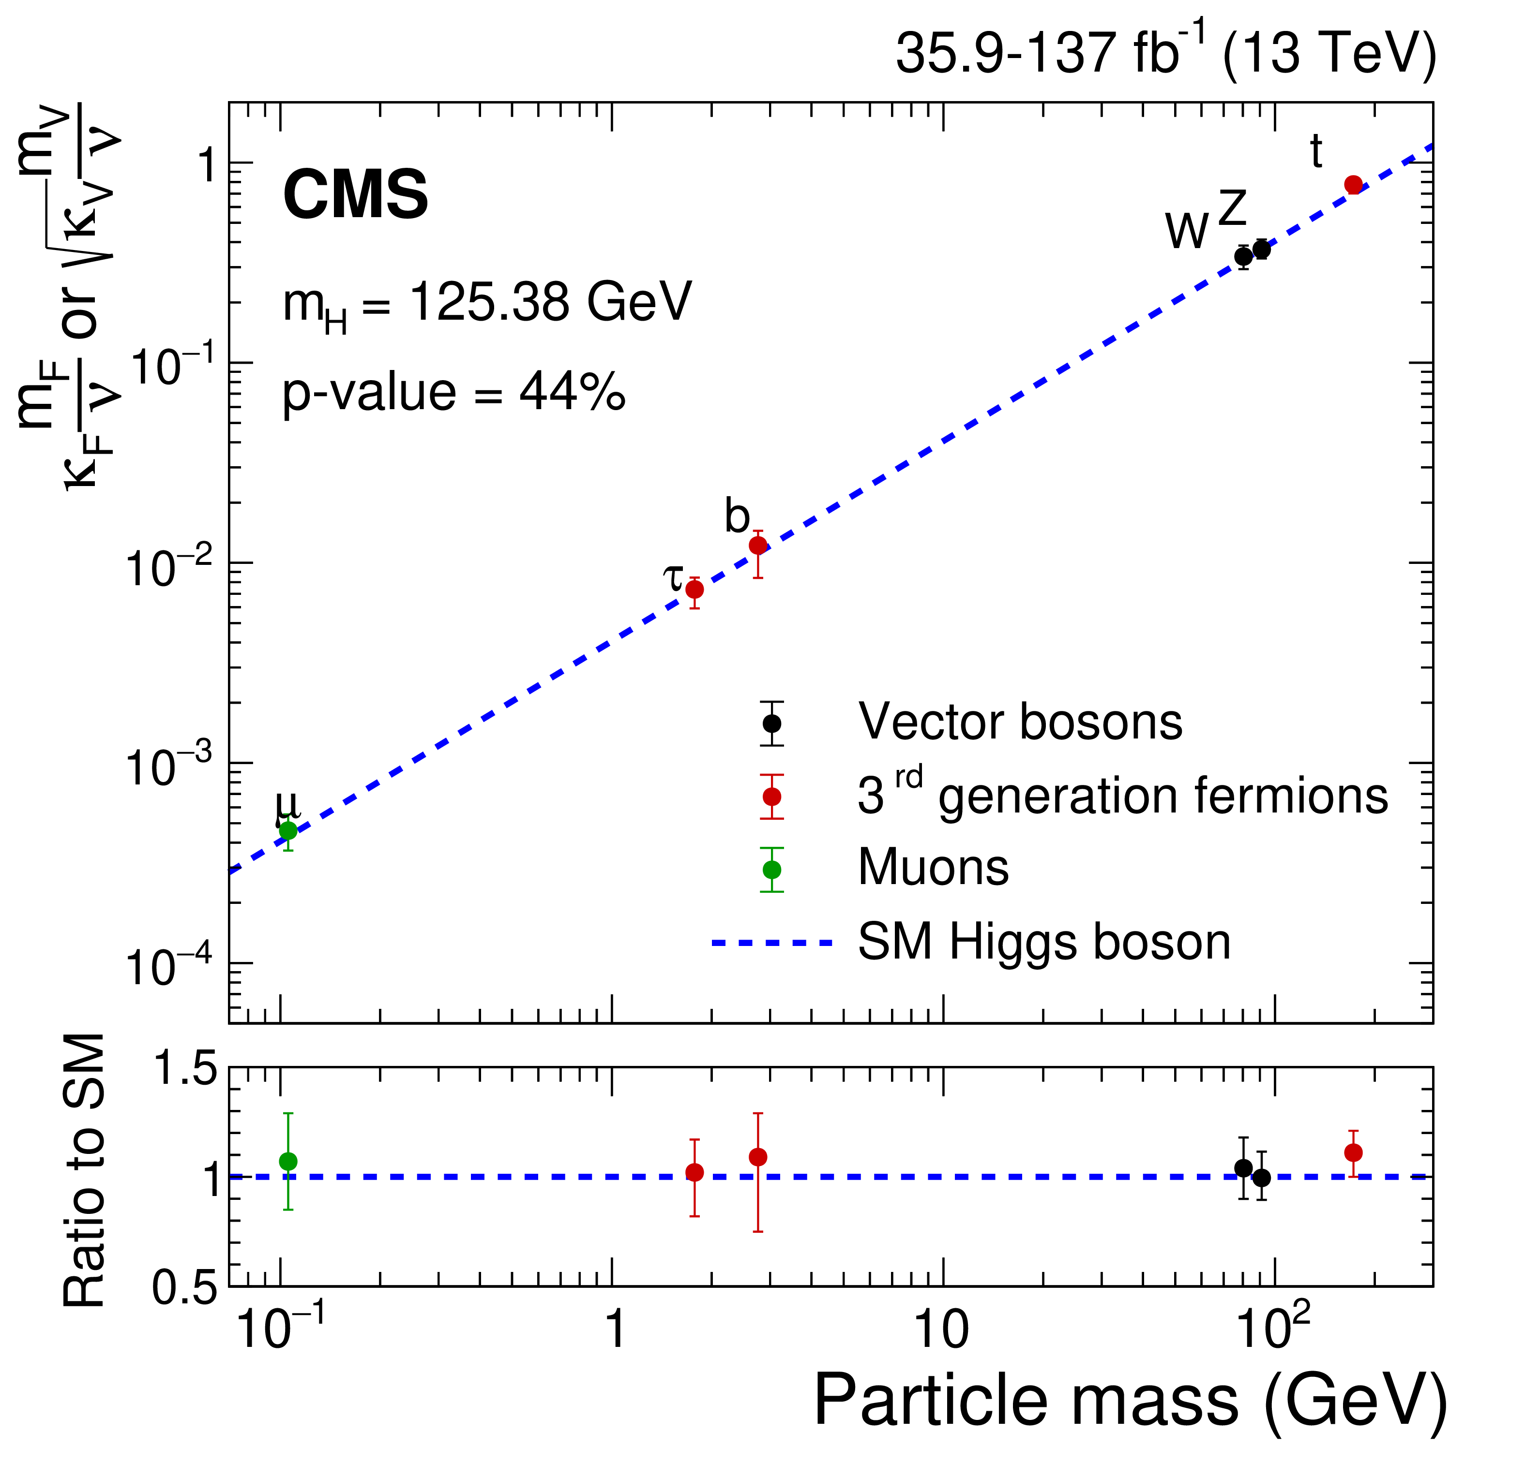
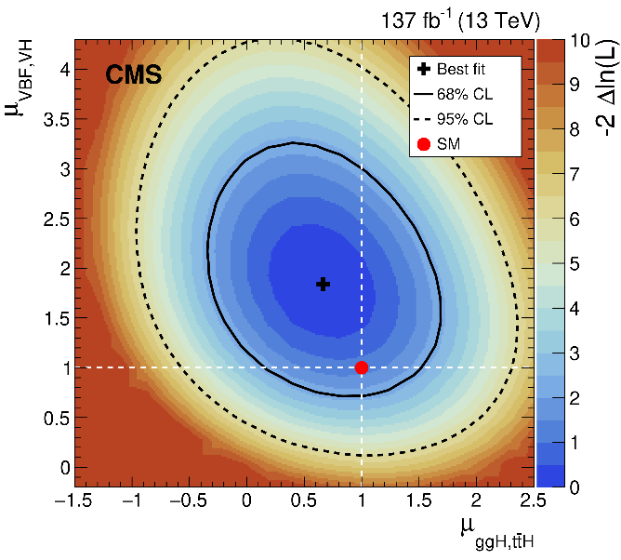
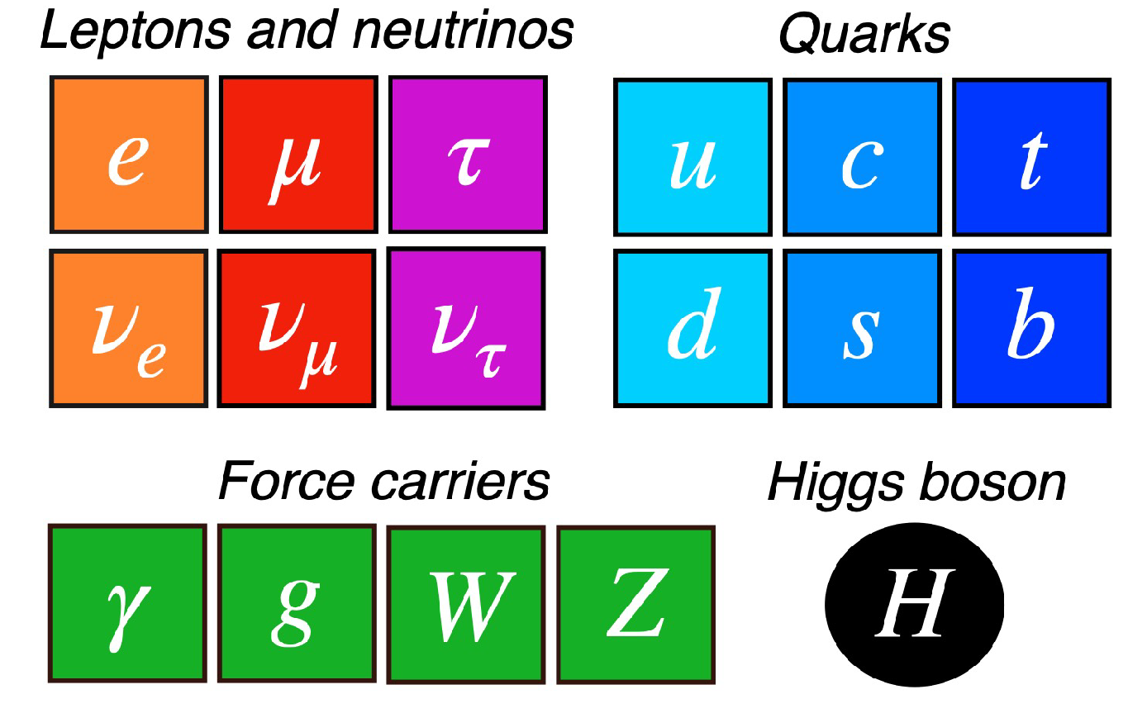

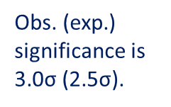
Rare Higgs Decay h → μμ
First evidence of the coupling of the Higgs boson with fermions of the second generation
JHEP 01 (2021) 148
H → μμ candidate in gluon fusion channel, m_{H} = 125.46 $±$1.13 GeV
targets
ggH, VBF , VH, ttH
best sensitivity
Drell-Yan background considerably reduced by VBF topology requirement (two forward jets)
Obs. (exp.) significance is 3.0σ (2.5σ).
$μ={1.19}_{−0.39}^{+0.40}$ ${(stat)}_{−0.14}^{+0.15} (syst)$
CMS Overview
20

Slide 21
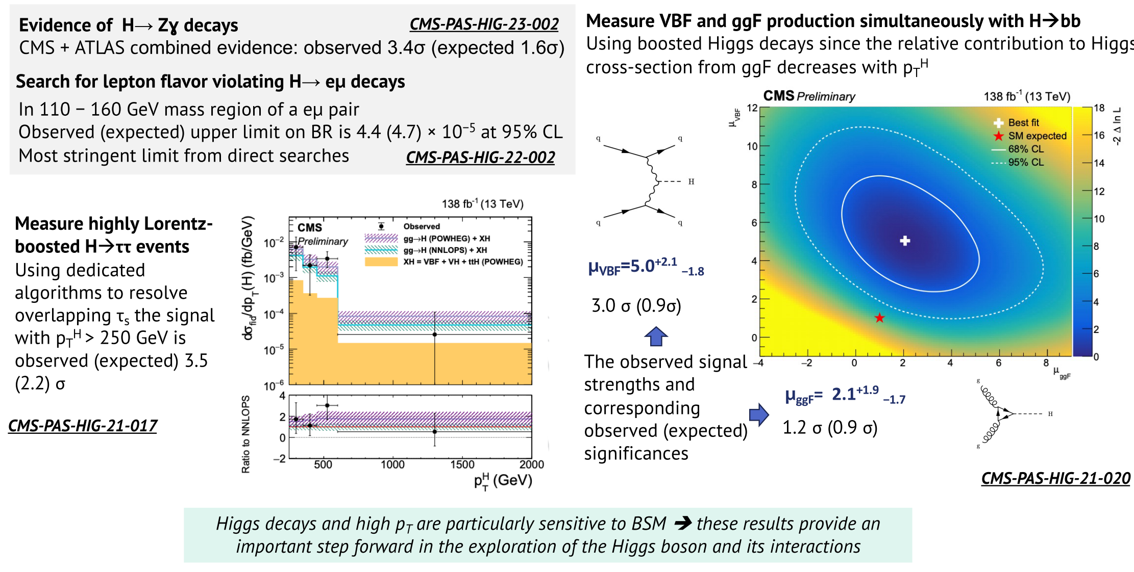

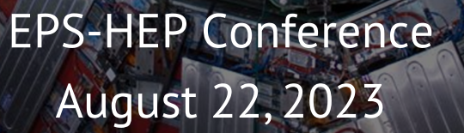
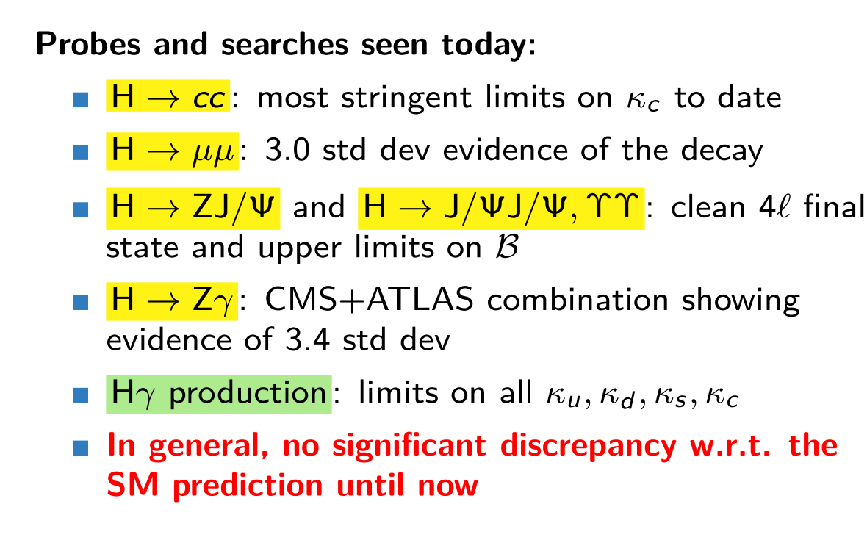
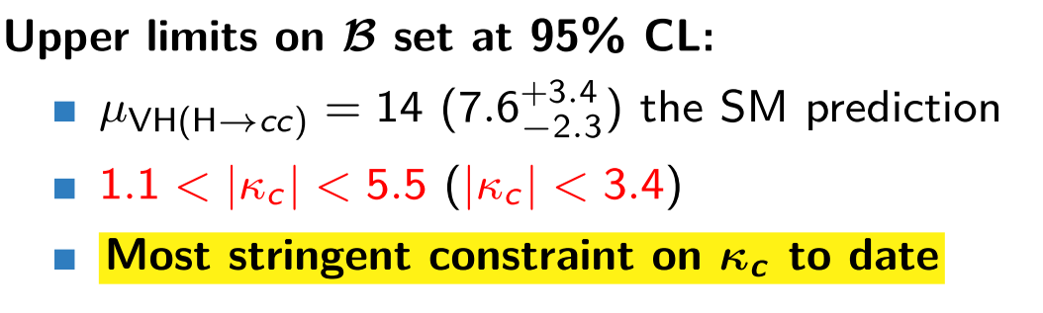
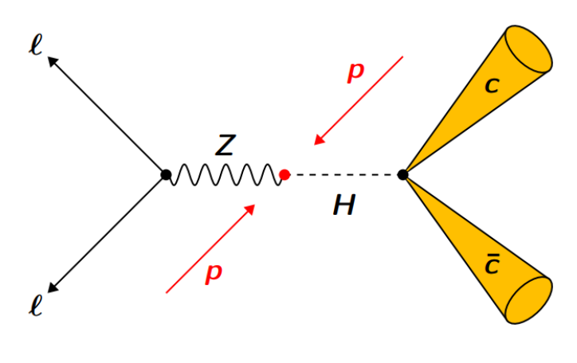


Rare Higgs Decays h → Zγ//VBF h → bb/h → eμ/h → cc
21

Slide 22
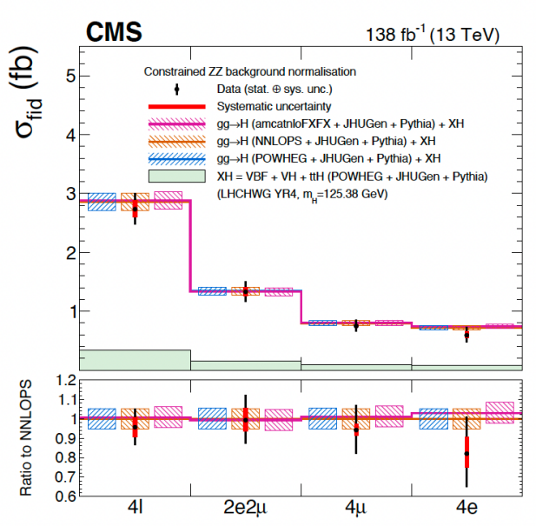
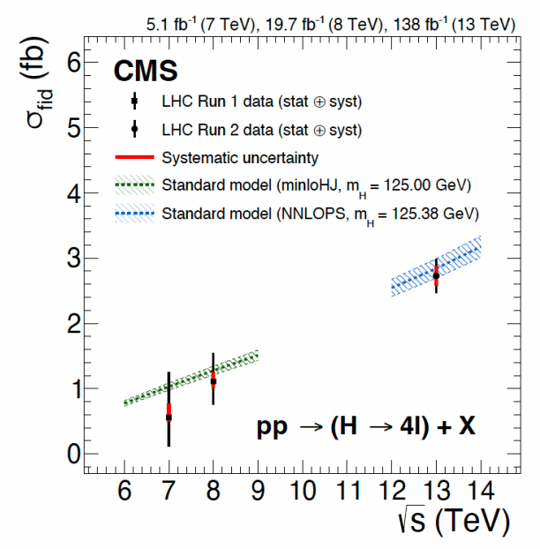
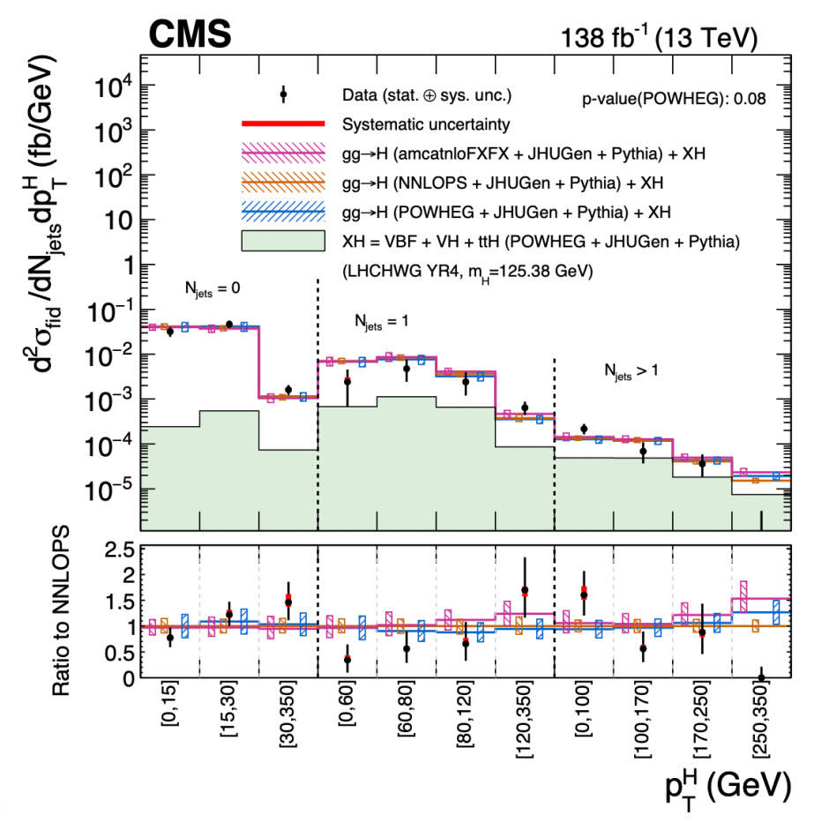
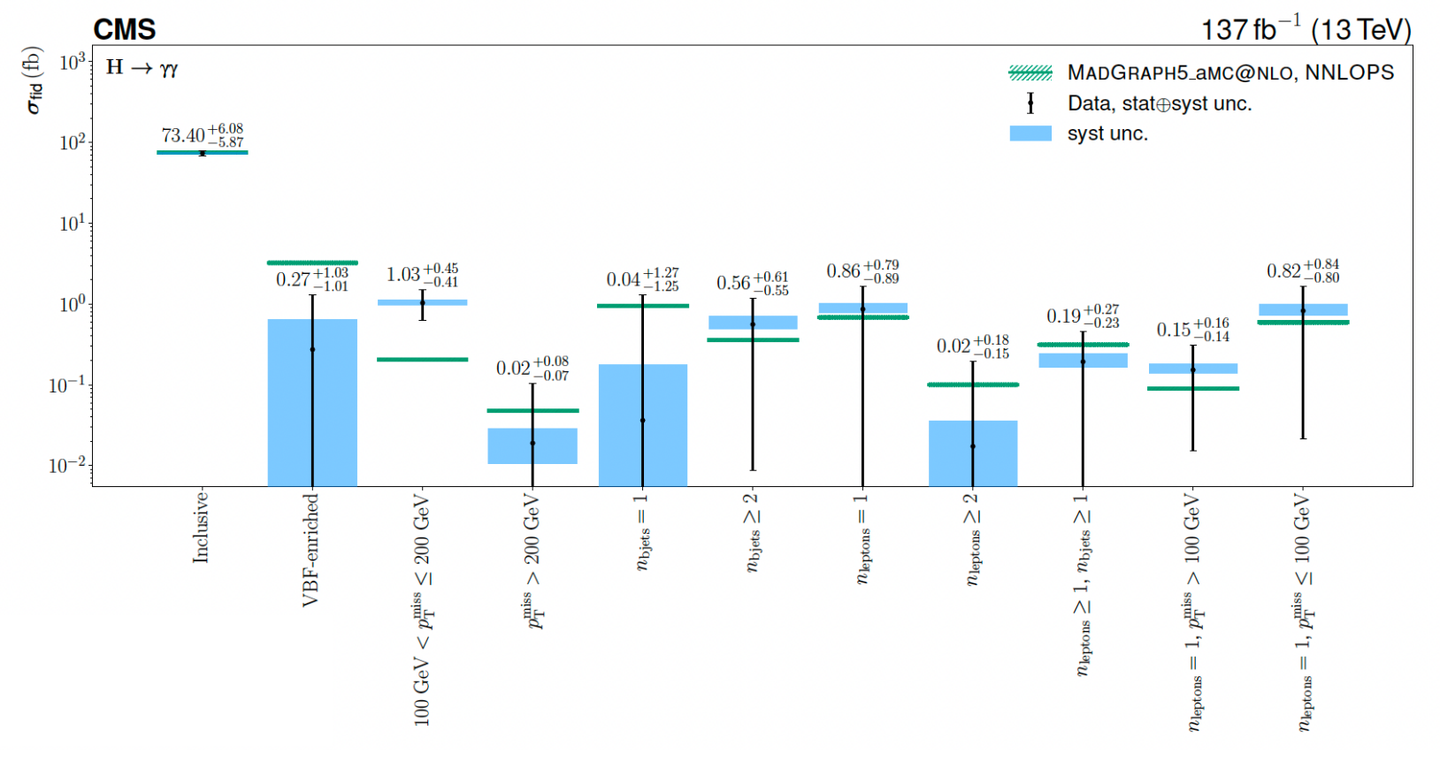
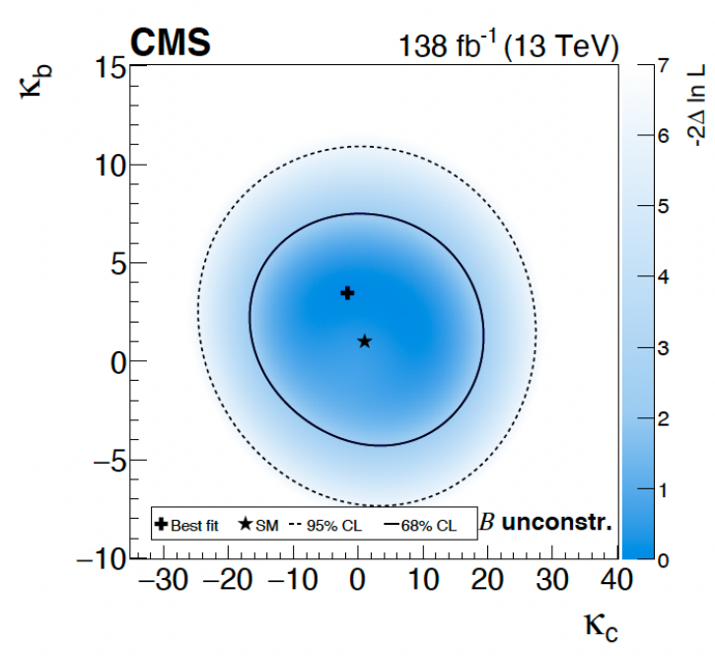

Higgs Inclusive and Differential Cross Sections
Differential cross sections
Unfold signal yields to cross sections
h → ZZ*, 4 final states
JHEP 08 (2023) 040
h → γγ, Incl./VBF
JHEP 07 (2023) 091
no significant deviation
from SM predictions

Slide 23
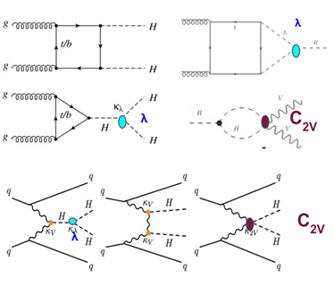
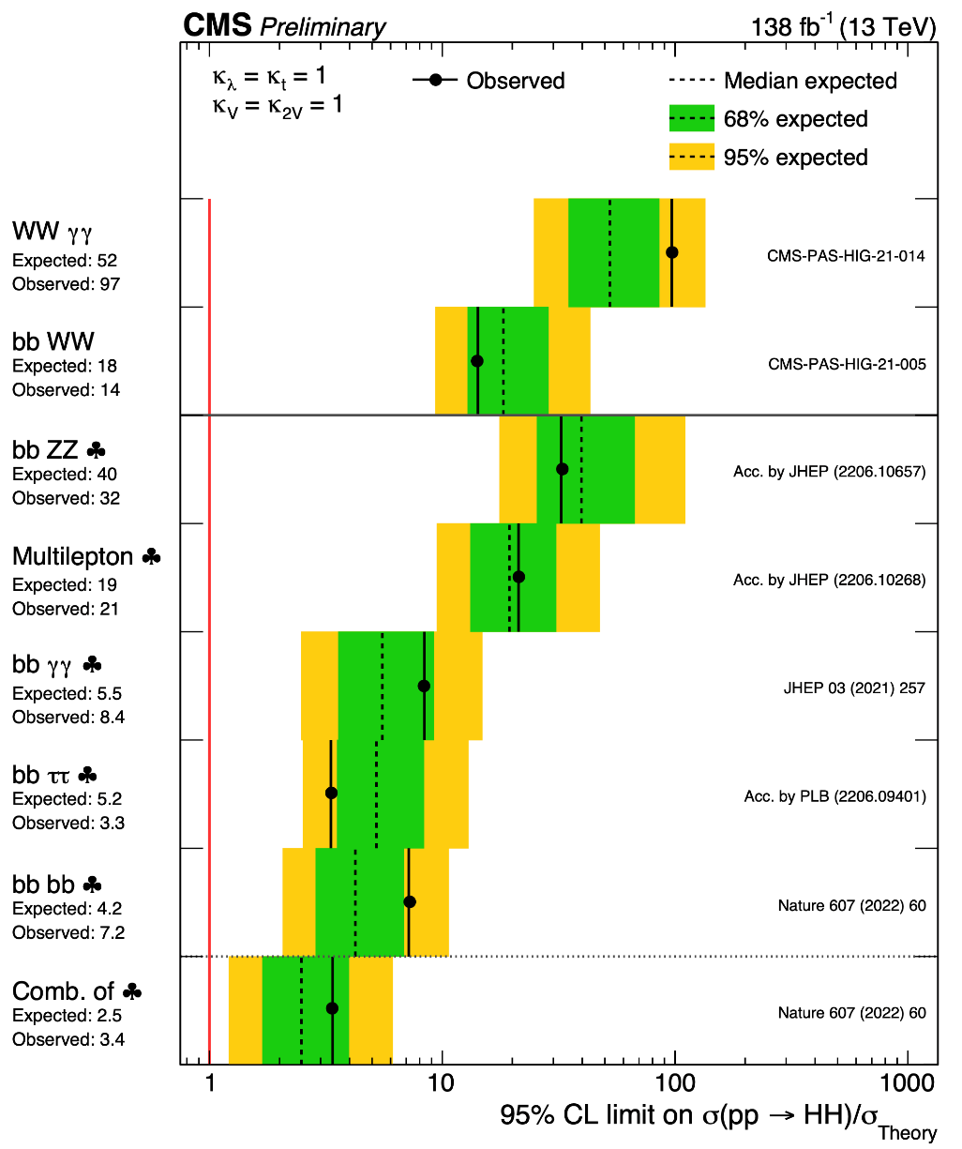



Search for pair-production of Higgs
Higgs self-coupling
Nature 607 (2022) 60-68
https://twiki.cern.ch/twiki/bin/view/CMSPublic/SummaryResultsHIG

Slide 24
Re-Discovery of the Standard Model

Slide 25

What do we have as a result?

Slide 26

Why we are still expecting the New Physics?

Slide 27







Higgs Portrait after 10 Years
During Run 2 of the LHC the experimental collaborations started to employ the combined data for precision measurements of Higgs properties (mass, width, couplings, CP, rare decays)
All main production mechanisms are observed, including h → bbar, ttH, VH
Mass of Higgs boson m_{h} is measured with an accuracy of 0.1% (!)
Precisions of cross section and branching ratio measurements in combined channel are down to 8.5% level
We have ~6-30% accuracy for measurements of couplings
The absolute value of a width is getting closer to the SM expectations (4.1 MeV). We still need to improve an accuracy.
Spin, parity, differential distributions do not contradict the SM

Slide 28
Why we are still expecting the New Physics?

Slide 29




A room in Higgs Sector
… but the current accuracy of Higgs coupling measurements is still insufficient to reject BSM Higgs hypothesis
EPJC 79 (2019) 421
Summary of Higgs Couplings Measurements
Measurements precision continuous increasing
Search for new higgs states and other BSM
  BSM effects on in the differential distributions

Slide 30





Another Hint from the Higgs: Flavour Universality
The properties of the Higgs h₁₂₅ agree fully with SM in decay into
gauge bosons
3rd generation fermions (t/b/τ)
and do not conflict with results for the 2nd generation (no deviations in cc/μμ decays after RUN2)
μμ: 3σ
CMS HL-LHC Projection
JHEP 01 (2021) 148
We do not know and will not know until the end of the LHC whether the coupling of the Higgs h₁₂₅ to 1st generation fermions is in a “standard” way or not.
If we have no Extra Higgses! (rare decays are enhanced within Extended Higgs Sectors)

Slide 31
Lepton universality in beauty-quark decays
SM
NP
arXiv:2103.11769 Nature 18, 277 (2022)
3.1 σ

Slide 32


W boson mass with the CDF II detector
7 σ, 8.8 fb⁻¹
Science Vol 376, 170-176 (2022)

Slide 33
Fermilab Muon g − 2 Experiment
for J=1/2

Slide 34



Analyses in the LHC Collaborations
Direct Searches for the Physics Beyond the SM
  Conventional Signals, such as new resonances in dileptons/diphotons/ dijets spectra or non-resonant signals, combinations of physics objects (leptons/photons/jets) and MET/ b/t-jets tags, high-multiplicity events, etc
SUSY
Extra Dimensions
Extended Gauge Sector
LQ/CI/Excited Fermions/B3G
  on-conventional Signals, for example displaced vertices/leptons/lepton-jets/dileptons from Long-Lived Particles or emerging jets/leptons from boosted heavy objects, $m≪p_{T}$ (i.e. high-p_{T} Z/W/h₁₂₅ bosons)
BSM-Higgs Physics
  Searches for the new Higgs states (from extended Higgs sector including SUSY)
  Probes for the New Physics with h₁₂₅ (Higgs as a tool for new discovery)
Check for discrepancies with data and search for new physics via Effective Field Theory
Precision Tests of SM
  Measurements of the W/Z, Drell-Yan (+ n jets) x-sections and angular characteristics
  Search for rare decays of B-mesons
  Observations of other rare process in top sector within SM (Wtb couplings, CP violating top quark couplings, flavor-changing neutral current interactions of the t-quark and h₁₂₅)
Long-Lived Particles (Dark Matter/Non-standard SUSY/Neutrino Masses/etc)
Extended Higgs and Dark Matter Sectors
Extra Higgses, Dark Matter, Flavour Universality Violation
Sergei Shmatov, Lomonosov 2023
29.08.2023

Slide 35




Conventional Signals
Heavy Resonances (extended gauge models, extra dimensions, technicolor) ⇒ dileptons, dijets, diphotons, ttbar, WZ
Non-Resonant Signals
Mono-particle + Missing ET (extended gauge models, extra dimensions, technicolor, SUSY) ⇒ mono-jet + MET, mono-photon + MET, mono-lepton + MET
Microscopic Black Holes (extra dimensions) ⇒ high-multiplicity events
Leptoquarks ⇒ lepton + jet
4th Generation ⇒ leptons/jets, dilepton

Slide 36

Direct Search for BSM: Conventional Signals
CI
Dark Matter
RPV SUSY
Extra Dimensions
Excited Fermions
Heavy Fermions
Leptoquarks
Heavy Gauge Bosons
1 TeV
10 TeV
30 TeV
https://twiki.cern.ch/twiki/bin/view/CMSPublic/SummaryPlotsEXO13TeV

Slide 37


Direct Search for BSM: SUSY Signals
https://twiki.cern.ch/twiki/bin/view/CMSPublic/PhysicsResultsSUS#Run_2_Summary_Plots_13_TeV

Slide 38








Searches for Heavy Resonances
New Physics (Z′/Z_{KK}/G_{KK}) contributions to SM processes
Dileptons, full RUN2 data
JHEP 07 (2021) 208
Wγ, full RUN2 data
PLB 826 (2022) 136888
RS1 graviton
Lepton flavor universality
Z’ boson
benchmark heavy scalar (vector) triplet bosons with masses between 0.75 (1.15) and 1.40 (1.36) TeV are excluded at 95% CL

Slide 39




What does Brazilian Flag mean?
Dimuon example
Extended gauge models
Models of low-energy gravity (RS1-type scenario of ED)
SM predictions
BSM predictions
SM predictions
Mass limit
Model-independent limits on cross section (in narrow width approximation, NWA)

Slide 40

Portals to Dark Sector
see talk by Maria Savina for details

Slide 41





Example of Dark Matter Searches in Dijets+Dileptons
We consider a model that assumes the existence of a single DM particle that interacts with the SM particles through a spin-1 mediator, which can be either a vector or axial-vector boson.
V/VA
vector mediator with small couplings to leptons, g_{DM} = 1.0, g_{q} = 0.1, g_{l} = 0.01
axial-vector mediator with equal couplings to quark and leptons: g_{DM} = 1.0, g_{q} = g_{l}= 0.1
g_{q}
g_{q}
5 parameters:
m_{DM}, m_{Med}, g_{DM}, g_{l}, g_{q}
DM-nucleon upper limits on the cross section

Slide 42



Some Selected Recent Excitements from LHC
RUN3 is a perfect judge for these challenges!

Slide 43

The case of the past days (γ γ excess in LHC data)

Slide 44

The case of the past days (excess in dijets and WZ)

Slide 45


Higgs Boson as a Tool to Search for the New Physics

Slide 46







Higgs Invisible Decays
The expected in SM h₁₂₅ the branching fraction h₁₂₅ → inv
$$ℬ(h_{125}{ZZ}^{∗}4)=0.12\%$$
Several BSM scenario anomalous and sizeable values, ℬ is significantly enhanced
a simple extension of the SM to provide a Dark Matter (DM) candidate and are able to predict the observed relic DM density vis s-channel $χχ→f\overline{f}$
PRD 105 (2022) 092007
0.18 (0.12)
Low-mass region in the spin-independent dark-matter-nucleon scattering cross section

Slide 47










Lepton Flavour Violation Higgs Decays (1)
The decays $H$ $eμ/μτ/eτ$ trough the LFV Yukawa couplings arising in two Higgs doublet models, extra dimensions, models with flavor symmetries, models of compositeness, etc
  to verify h₁₂₅ hypothesis, $m_{ll}= m_{h_{125}}$ (type 1)
  to search for new higgs states, $m_{ll}≠m_{h_{125}}$ ⇒ broad invariant mass region (type 2)
PRD 104 (2022) 032013
type 1, ggH, VBF

Slide 48







Lepton Flavour Violation Higgs Decays (2)
The ﬁrst direct search for LFV $H→μτ/eτ$ decays for an Extra Higgs mass in the range $200 GeV<m_{H}$< 900 GeV (neutral heavy Higgs boson)
type 2, ggH, τ lepton decay products are highly boosted
ε_{τ} ≈ 70% (DNN)
The observed (expected) upper
limits (95% CL) is
µτ: 51.9 (57.4) fb to 1.6 (2.1) fb
eτ: 94.1 (91.6) fb to 2.3 (2.3) fb
JHEP 03 (2020) 103

Slide 49





Searches for Low-Mass BSM Higgses/DM in h₁₂₅ Decays
If m_{H} > 2m_{X}, some BSM scenarios allow Higgs bosons decays via one or two hypothetical on-shell new (pseudo)scalar(s) decaying to a pair of SM particles.
$$h_{125}→ZZD/ZDZD/ss/aa→4l$$
$$h_{125}→AA→4γ$$
EPJ C 82 (2022) 290
CMS PAS HIG-21-016
ex. 2HDM, 2HDM+

Slide 50

Summary of 2HDM+S searches at 13 TeV
https://twiki.cern.ch/twiki/bin/view/CMSPublic/Summary2HDMSRun2

Slide 51
BSM Higgs/V′ in Decays into h₁₂₅(+X)
If m_{H} < 2m_{X} , the finals states are possible with h₁₂₅ and SM gauge bosons
PRD 105 (2022) 032008
EPJ C 81 (2021) 688

Slide 52


High-mass BSM Higgs/X in Decays into 2h₁₂₅

Slide 53






BSM Higgs/X in Decays into BSM Particles
$$X→aa→4b$$
CMS-PAS-B2G-20-003
A $→a\left(→χ\overline{χ}\right)h125→MET+$ $h125$
EPJC 79 (2019) 280
JHEP 03 (2020) 25
2HDM+a
h→ $b\overline{b},$new pseudoscalar in
invisible mode
Free parameters: m_{A}, m_{H}, m_{S}, mixing angle between a and A $sinθ$, VEV ratio for two higgs doublets $tanβ$, couplings to SM and DM particles
The analysis is restricted to the mass ranges m_{a} from 25 to 100 GeV and m_{X} from 1 to 3 TeV.

Slide 54


BSM Higgs/X in Decays into SM Particles
VBF tag, Charged Higgs boson mass explored: 200 – 3000 GeV
EPJC 81 (2021) 723

Slide 55


Direct Search for BSM: LLP Non-conventional Signals
a proper lifetime cτ₀ is greater than or comparable to the characteristic size of the (sub)detectors
small cτ₀ that comparable to the inner tracker size, no displaced tracks → “standard” prompt decay
intermediate cτ₀ → LLP
very large/infinite large cτ₀ → stable particles, “standard” MET signatures

Slide 56

Inelastic dark matter at the LHC/LLP
https://arxiv.org/abs/1901.04040

Slide 57

Overview of CMS Exotica LLP Searches
https://twiki.cern.ch/twiki/pub/CMSPublic/SummaryPlotsEXO13TeV/barplot_RPV_RPC_OLL.svg
RPV SUSY
RPC SUSY
to be presented
today!
Other
57
More results:
http://cms-results.web.cern.ch/cms-results/public-results/publications/EXO/LLP.html

Slide 58







Displaced Dimuons
arXiv:2205.08582
Dark photon and Scalar BSM Higgs
BSM Higgs
boson
Dark photon
LLP
SM Higgs boson mixes with the dark-sector Higgs boson
Three categories of events:
STA-STA, TMS-TMS, and STA-TMS
  No significant excess of events above the standard model background is observed. The results are interpreted as limits on the parameters of a these two models

Slide 59

Displaced Leptons
EPJC 82 (2022) 153
RPV SUSY, GMSB, and BSM Scalar Higgs
Leptons could have common or different vertexes
μμ, ee and eμ final states were used
Trigger and event selection exclusively on displaced leptons
leptons |d0| is the main discriminating variable (up to 10 cm)
Data driven background estimation
DL+b-jets
DL+jets
DL+MET
DL+DL
RPV SUSY
GMSB
BSM Scalar Higgs

Slide 60





Displaced Jets
the dark sector particles continue traveling for a long time and traverse several meters (Long-Lived Particles) before tunneling back into our visible universe (quarks or leptons)
the Higgs is likely to be one of the candidates for a messenger role
displaced jets
“muon” jets
$$h →SS→4l or 4q$$
PRL 127 (2021) 261804
CMS Physics Briefings
This exciting tool opens up a new program of searches for LLP in a wide variety of theoretical models

Slide 61






LPP + Z bosons
JHEP 03 (2022) 160
Used as a spectator in the event
The multiplicity of displaced jets $N_{j}^{dis}$ is the the main discriminator variable. Signal region is $N_{j}^{dis}$≥ 2
No excess over the expected SM event rate is observed.
New limits on branching Higgs to LLP scalar particles (S) are reached

Slide 62
DM Searches: Comparison with Higgs Portal

Slide 63

LHC Prospects and beyond
“The New Accelerator”
by H. G. Wells

Slide 64

LHC/High-Luminosity Timescale

Slide 65

HL-LHC Detector Upgrades

Slide 66

Data “Scouting”

Slide 67
RECAST в “black box”
Data from cosmic experiments
LHC data @ Collison
Ponits (different topolgies)
Artificial Intelligence (AI) based on Machine Learning (ML)
LHC data @ Further
Experiments (MATHUSLA, CODEX, FASER, etc)
Limits on model parameters
(masses of new particles, couplings, mixing parameters, etc.)
Fix-target experiments
(SHiP, NA64, etc)
Future Experiments
(@FCC)
Theoretical models

Slide 68


Run-3 High-Mass Reach

Slide 69


HL- LHC Projects (Higgs)

Slide 70



LHC Satellite Experiments
CMS/ATLAS
CMS
Phys. Rev. D 99 (2019) 015021
https://arxiv.org/abs/1901.04040
LHCb
ATLAS

Slide 71
LLP Lifetime

Slide 72


Slide 73





Future Circular Colliders (100 TeV pp)
Nature Physics 16, 402–407 (2020)
The launch
point is 2020

Slide 74


FCC Projections
Reach on the Higgs and anomalous gauge couplings
Constraints on the energy scale of effective field theory operators
Nature Physics 16, 402–407 (2020)

Slide 75

Precisions achievable at FCC-ee

Slide 76




e+e- Colliders

Slide 77



Higgs boson is found
Standard Model works
Extensive Searches for New Physics
  No significant signals
  A set of hints
  A number of future projects

Slide 78

Particle physics isn’t going to die — even if the LHC finds no new particles
Anyway…

Slide 79

The Hitchhiker's Guide to the Galaxy
by Douglas Adams

Slide 80

Оорт первый взглянул на звездное небо и заметил, что Галактика вращается
(с) Г. Проницательный

Slide 81

THANK YOU FOR YOUR ATTENTION!

Slide 82


Some Statistics from CMS
This talk are summarized the selected (by me) the recent CMS Results results (the SM, Higgs physics and BSM)
  LHCP2023, 22-27 May, Belgrad,
  EPS-HEP2023, 21-25 Aug 2023, Hamburg
  Recent CMS Briefings
1210 papers based on
collision data
(+25 on cosmic data)
Lomonosov2023 talks with the CMS Results
QCD and Heavy Ions
Olga Kodolova, QCD physics with CMS detector
Serguei Petrushanko, Latest results on heavy-ion physics..
D.Myagkov (MSU) Azimuthal anisotropy in Xe–Xe and Pb–Pb collisions..
Standard Model
Nikita Petrov, New resonances in J/psi J/psi mass spectrum at CMS
Kirill Ivanov, CMS results on heavy flavour spectroscopy and production
Ruslan Chistov, Searches for lepton flavour / universality violation at CMS
Maksim Sergeev, Recent CMS results on rare heavy flavour decays
Itana Bubanja, Inclusive production of vector bosons in CMS
Beyond the Standard Model
Maria Savina, Dark Matter Search at the LHC
http://cern.ch/cms-results/public-results/publications-vs-time/
35% of Standard Model (SMP/FSQ/BPH/TOP)
14% of Higgs Physics
36% of BSM Physics (EXO/B2G/SUSY)
11% of Heavy Ion
CMS Publications Page
https://cms-results.web.cern.ch/cms-results/public-results/publications/
CMS Public Results (newest)
https://cms-results-search.web.cern.ch/

Slide 83



Example of SM Physics Objects 2010-2015
CMS Muon System shows a excellent performance to detect different resonances
Dec 2010
https://twiki.cern.ch/twiki/bin/view/CMSPublic/PhysicsResultsMUO

Slide 84


LHC Timeline and Data That We Have
CMS Luminosity Information
https://twiki.cern.ch/twiki/bin/view/CMSPublic/LumiPublicResults
L_{inst} = 2.1×10³⁴ cm⁻²s⁻¹
L_{nisyt} = 7.5×10³⁴ cm⁻²s⁻¹
We are here
CMS Dataset RUN2
  ~163 fb⁻¹ of proton-proton collisions @ 13 TeV is delivered
  151.78 fb⁻¹ is recorded by CMS (data-taking efficiency ~93% )
CMS Dataset RUN3
  ~73.4 fb⁻¹ is already delivered @ 13.6 TeV during the RUN3
  63.7 fb⁻¹ is recorded by CMS (data-taking efficiency ~92% )
  ~93% of collected data “good for physics” in 2023 (91% in 2022)
  number of pp interactions per beam crossing (PU): ⟨μ⟩ = 52 for 2023 (46 for 2022)
  ~260 fb⁻¹ it is expected @ 13.6 TeV for the end of the RUN3 (450 fb⁻¹, in total
  for RUN1/2/3)
  pPb and PbPb Runs (see talk by Serguei Petrushanko)
CMS Data Quality Information
https://twiki.cern.ch/twiki/bin/view/CMSPublic/DataQuality

Slide 85


Production of SM Higgs boson
N(N)LO QCD + NLO EWK
ggH
43.9 pb⁻¹, ggH, 7M
3.77 pb⁻¹, VBF, 600K
1.36 pb⁻¹, WH, 200K
0.88 pb⁻¹, ZH, 140K
0.5 pb⁻¹, ttH, 80K
0.48 pb⁻¹, bbH, 77K
0.08 pb⁻¹, tH, 13K
@ m_{H} =125.38 GeV
VBF
tt/bbH
https://twiki.cern.ch/twiki/bin/view/LHCPhysics/CERNYellowReportPageBR
VH
tH

Slide 86







Higgs Width
On-shell measurements in γγ and ZZ (4l)
  total Higgs width of 4.1 MeV unmeasurably small, limited by
  detector resolution
  in assumption the lack of signal-background interference
  Γ_{H} < 1.1 GeV @ 95% CL in 4l
Off-shell measurements in ZZ for gg-production
  for
    on-shell (NWA) depends on Γ_{H}
    off-shell does not depend
PRD 99 (2019) 112003

Slide 87



Mass of “top”: Legacy of Run 1/2
~200M quark pairs in LHC Run 2 @ 13 TeV
precision ~0.3%

Slide 88






Running of the Top Quark Mass/Vtb
Beyond leading order in perturbation theory the strong coupling constant and the quark masses are subject to renormalization
Non-direct Vtb measurements
from B-hadron and t-quark decays (CKM unitarity,
generation number=3)
|V_{tb}| > 0.78 (CDF), 0.99 >|V_{t}b| > 0.9 (D0)
PLB 803 (2020) 135263
Direct Vtb measurements from single t-quark production in t-, Wt, s-каналах (σ ~ V_{tb}²)
PLB 808 (2020) 135609
Br (t → Wb) ≈ 1
f_{LV} =1 (no NP terms)
The running of m_{t} is found to be in agreement
with the RGE prediction within 1.1 σ
The no-running hypothesis is excluded at above 95% confidence level

Slide 89


Discovery of a New Boson: Significance
The probability that an observed excess was a statistical fluctuation of the background (p-value)
Notable values for an excess in particle physics are 3σ, or p-value = 0.0013; and 5σ, or p-value = 2.87 x 10⁻⁷. When we have an excess of 3σ we talk about an evidence, and when we have an excess of 5σ, we are facing a discovery.

Slide 90

Significance in Numbers

Slide 91





Статистический анализ
Событие (результат) называется “статистическими значимым”, если оно вряд
ли произошло случайно
p-valuе - вероятность получить результат, такой как наблюдается (или выше)
в предположении, что нуль-гипотеза верна
⇒ в нашем случае вероятность, того, что флуктуация фона достигли (или превысили) наблюденное значение
Нуль-гипотеза – основная проверяемая гипотеза (фон)
⇒ Нулевая гипотеза отвергается, когда значение p-value
меньше уровня стат. значимости α (по соглашению <0.05)
Масштабный фактор (strength factor)
σ_{SM} – сечение бозона Хиггса в CM, σ - гипотетическое сечение бозона Хиггса

Slide 92


Slide 93


Slide 94


Slide 95


Slide 96


Look Elsewhere Effect
@ A.Korytov

Slide 97


.
“Охота на Хиггса” в 2011 г
В 2011 эксперимент CMS исключает существование бозона Хиггса в диапазоне масс: 127-600 ГэВ при 95% C.L. (128-525 ГэВ при 99% C.L. )
ожидаемый предел в случае
отсутствия бозона Хиггса
зеленые и желтые области
соответствуют 68% и 95%
стандартным отклонениям от
ожидаемого предела
CMS-PAS-HIG-11-032
Публичные результаты совместного анализ данных экспериментов ATLAS и
CMS использовали меньшую статистику (до 2.3 фбн-1) и поэтому исключили
меньший диапазон возможных масс (141-476 ГэВ)

Slide 98


Обнаружение нового бозона в 2012 г.
Поиски бозона Хиггса в 2011-2012 гг. привели к открытию нового бозона
с массой 125.3 ± 0.4 (stat.) ± 0.5 (syst.) ГэВ (объявлено 4 июля 2012 г.)
Вероятность (р-value)
флуктуации фона до
наблюдаемого количества
событий в данных CMS.
Статистическая значимость превышения сигнала над уровнем фона составляет 4,9 сигма.
Совместный анализ только по наиболее чувствительным и высокоточным каналам (γγ и ZZ) дает 5,0 сигма.
Вероятность флуктуации фона на такую величину оценивается как 1/3000000.
σ/σ_{SM} = 0.87 ± 0.23
канал WW: наблюдается широкое
превышение событий над фоном в
массовом распределении на уровне
1,5 стандартных отклонений.
канал bb и канал ττ: не наблюдается превышения событий.

Slide 99


Two doublet Higgs Model (2HDM)
Способ организации хиггсовского и юкавского секторов без привязки к
остальным свойствам модели и даже без фиксации полной модели
4 варианта конструкции без FCNC (2HDM type II ↔ хиггсовский сектор MSSM)
2HDM: два комплексных скалярных дублета
⇒ 5 физических (наблюдаемых) состояний
нейтральные CP-четные h, H (смешивание с
углом α, настроечный предел: h ≡ h₁₂₅ без примеси H)
нейтральное CP-нечетное A
заряженные H⁺, H⁻
$v_{1}^{2}$+$v_{2}^{2}=v^{2}≡{\left(246 GeV\right)}^{2}, \frac{v_{1}}{v_{2}}≡tanβ$
MSSM
Параметры: $tanβ$, sinα, массовые параметры
Расширения: 2HDM+S (2HDM+a в контексте ТМ), 2HDM+Z’_{V}…

Slide 100
Portals to Dark Sector

Slide 101

The simplest DM: one DM particle + one mediator

Slide 102

Higgs Portal

Slide 103

MAssive Timing Hodoscope for Ultra-Stable neutraLpArticles
The full-scale detector could then become
operational by 2025-26.
CMS
https://arxiv.org/abs/1901.04040

Slide 104

Projected MATHUSLA sensitivity at the HL-LHC (1)
Exotic Higgs decays to LLPs
https://arxiv.org/abs/1901.04040

Slide 105


Projected MATHUSLA sensitivity at the HL-LHC (2)
“Dark Scalar” LLPs in the minimal SM+S extension where a scalar of mass mS mixes has mixing angle sin θ with the 125 GeV Higgs boson.
Right-Handed Neutrino LLP simpliﬁed model where the mixing with active neutrinos is dominated by the 2nd generation.
https://arxiv.org/abs/1901.04040

Slide 106


Простая реинтерпретация результатов
используем имеющиеся каналы наблюдения
доступны публичные результаты
топологии практически независимы
можно создать новые топологии событий
результаты могут быть абсолютно новыми
в перспективе возможность глобального фита по топологиям

Slide 107



Классические дилептоны: реинтерпретация EGM
Пример типичной реинтерпретации результатов поиска новых тяжелых резонансов
в рамках новых моделей BSM: использование модельно–независимый предела на
сечение для установления ограничений на массу новых узких резонансов со спином 1
и спином 2. Например, для расширенных калибровочных моделей GSM, LR и E₆
В приближении узкого резонанса NWA
EXO-19-019,
rev. 2021
коэффициенты, связанные с СФ
(модельно-независимые)
Первая реинтерпретация в данном канале,
начиная с RUN1
Позволяет в случае экспериментального обнаружения Z′ произвести отбор соответствующей ему модели

Slide 108



Темная материя на LHC: классические дилептоны
Максимально простая модель ТМ (Simplest DM model)
один векторный или аксиально-векторный переносчик (спин 1) взаимодействия СМ-ТМ (V/AV)
взаимодействие в s-канале (ДЯ-тип)
5 параметров:
m_{DM}, m_{Med}, g_{DM}, g_{l}, g_{q}
Два сценария (набора параметров)
векторный переносчик с подавленным лептонным сектором: g_{q} = 0.1, g_{DM} = 1.0, g_{l} = 0.01
аксиально-векторный переносчик с одинаковым взаимодействием с лептонами и кварками: g_{DM} = 1.0, g_{q} = g_{l} = 0.1
интерференция c переносчиками ДЯ (gamma/Z⁰) полагается несущественной (<5%)
JHEP 06 (2018) 120,
EXO-19-019, rev. 2021
M_{med} < 1.92 (4.64) TэВ при больших m_{DM} для векторного (аксиально-векторного) переносчика
M_{med} < 1.04 (3.41) TэВ при m_{DM} = 0

Slide 109






Сигнал типа 1: μ⁺e⁻ @ high-mass (1)
Дрелл-Ян-подобные процессы в s-канале
RPV SUSY
QBH
LFV EGM
JHEP 04 (2018) 073

Slide 110



Сигнал типа 1: μ⁺e⁻ @ high-mass (2)
Не избавляет от кинематического предела для резонансов! Но интересно =))
+ новые модели, выход за пределы квазиклассического приближения для МЧД
Z' gauge bosons with LFV transitions are excluded for masses up to 4.4 TeV
QBH limits are found between 3.6 and 5.6 TeV
resonant τ-sneutrino (can be LSP) production in R-parity violating supersymmetric models is excluded for masses below 1.7 TeV, for couplings λ₁₃₂=λ₂₃₁=λ′₃₁₁= 0.01.
JHEP 04 (2018) 073

