Slide 1
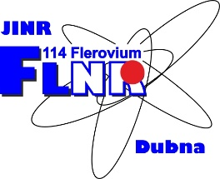
JOINT INSTITUTE FOR NUCLEAR RESEARCH
FLEROV LABORATORY OF NUCLEAR REACTIONS
“Ion-implantation nanotechnology and radiation materials science”
INSTITUTE OF RADIATION PROBLEMS, AZERBAIJAN NATIONAL ACADEMY OF SCIENCES
Speaker: Afsun S. Abiyev

Slide 2
Joint Institute for Nuclear Research
JINR Laboratories
JINR comprises seven Laboratories:
1. Laboratory of High Energy Physics
2. Laboratory of Nuclear Problems
3. Laboratory of Theoretical Physics
4. Laboratory of Neutron Physics
5. Laboratory of Nuclear Reactions
6. Laboratory of Information Technologies 7. Laboratory of Radiation Biology
http://www.jinr.ru/

Slide 3
Influance of Gamma Rays on TiN Nanoparticles. A.S. Abiyev, V.A. Turchenko, E.M. Huseynov
Aim of research
This study aims to investigate how gamma ray exposure influences the structural characteristics of titanium nitride nanoparticles, shedding light on their behavior under radiation. The findings will enhance our understanding of potential applications in radiation-sensitive environments.

Slide 4
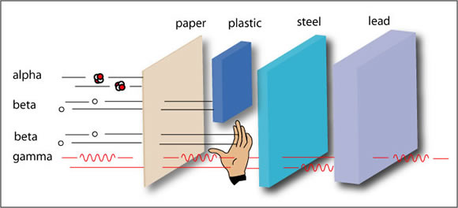
Interacting of Gamma Rays
The gamma ray can pass through many types of solid matters without interacting.

Slide 5
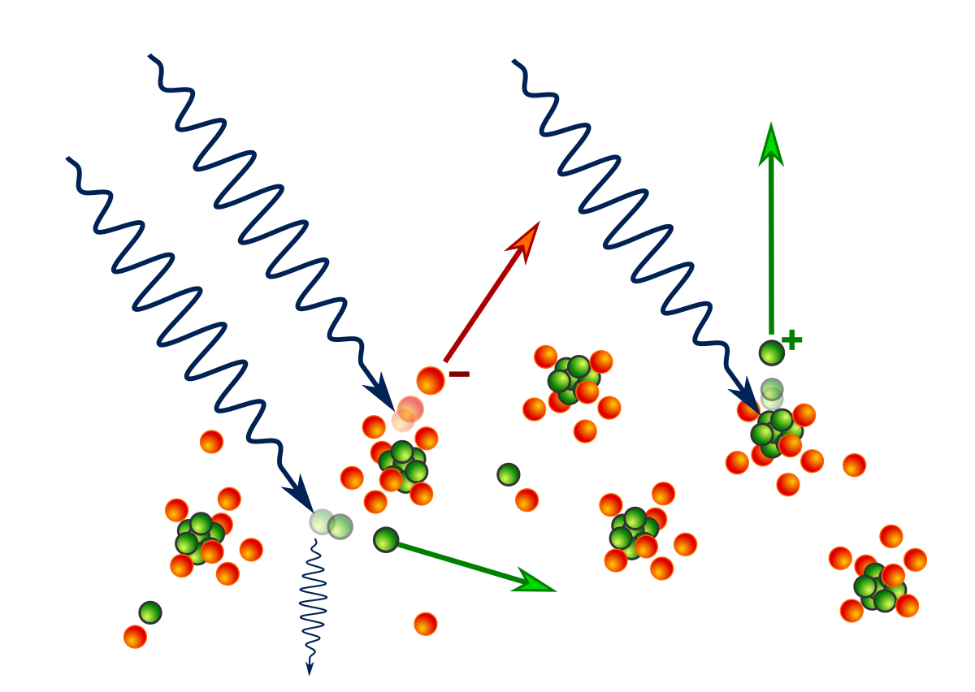
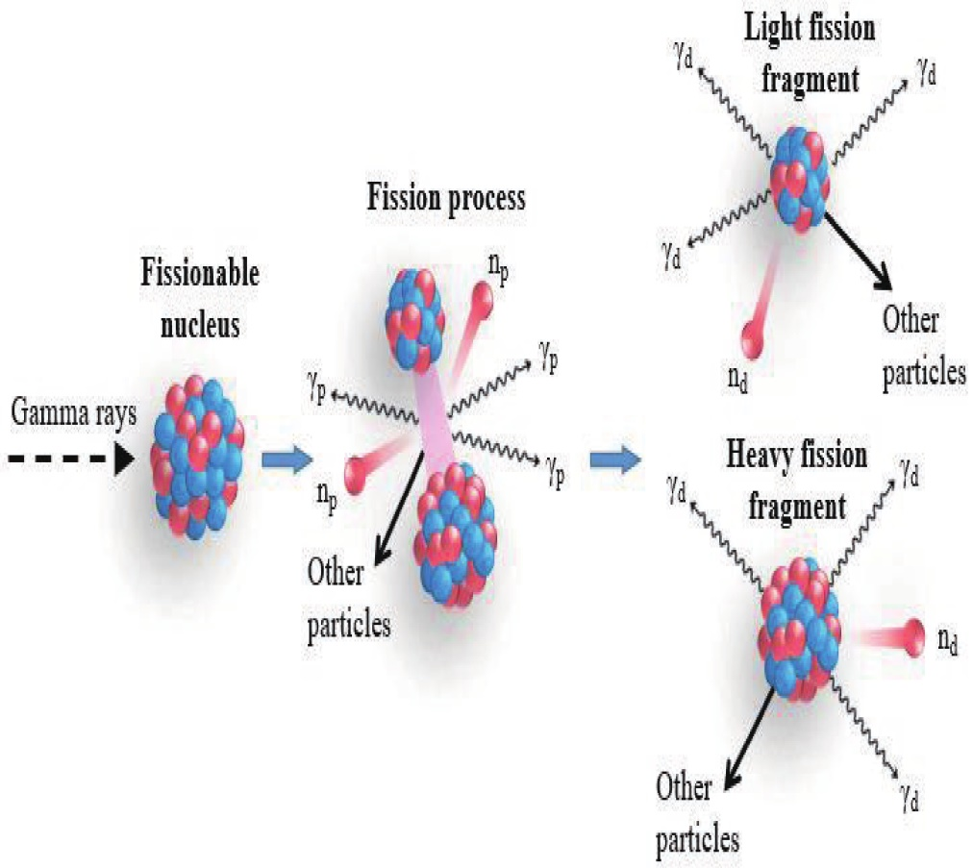
Photo-fission
Splitting into two or more fragments

Slide 6
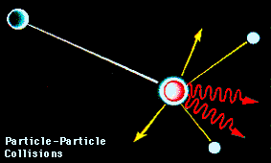
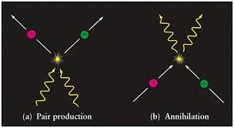
Pair Production
∙Transformation of gamma ray into matter and anti-matter particle pair.

Slide 7
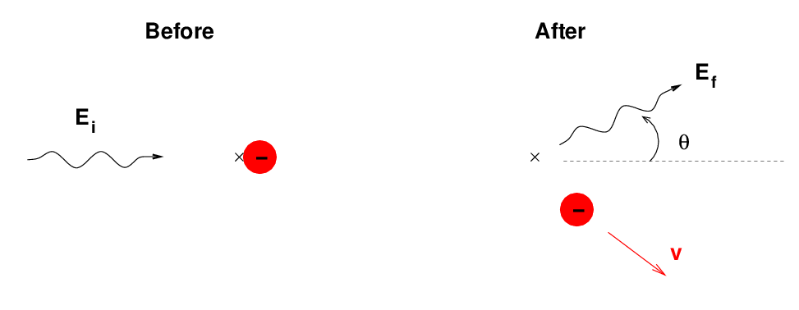
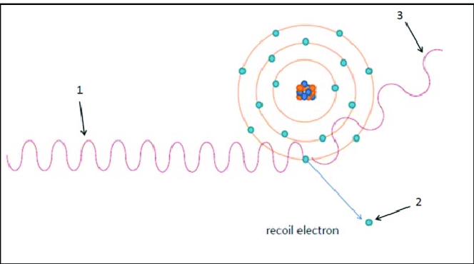
Compton Effect
Gamma ray push an electron out of the atom

Slide 8
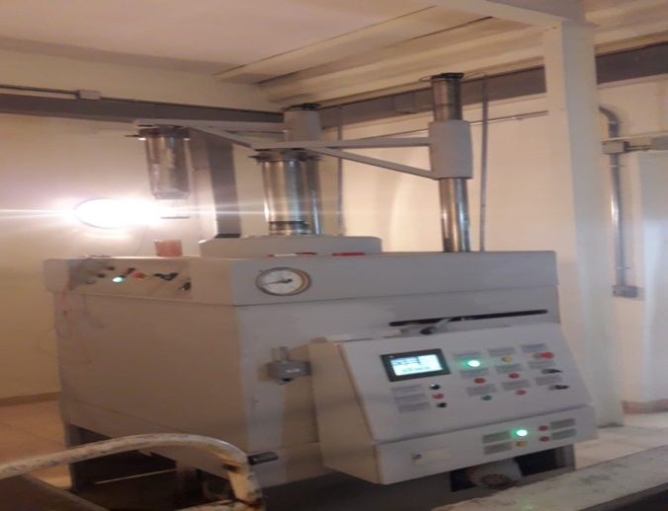
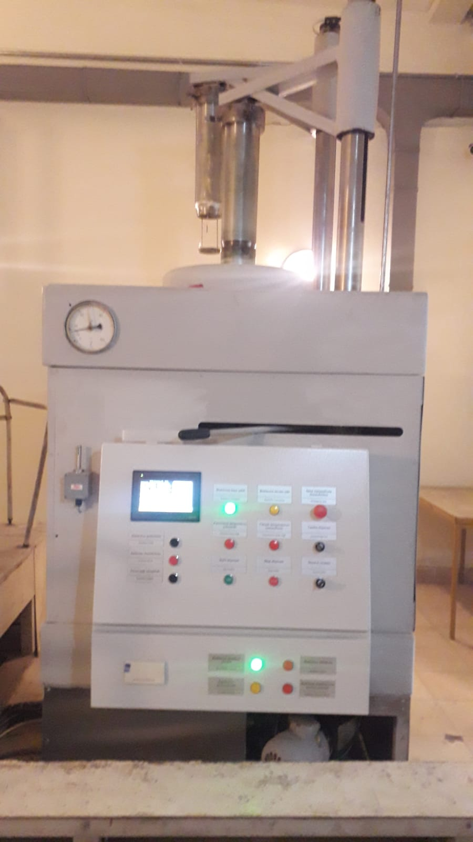
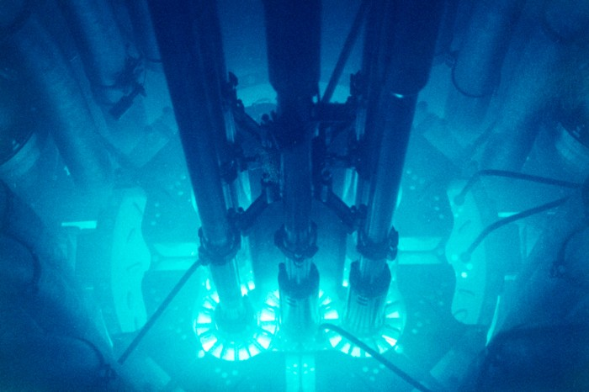
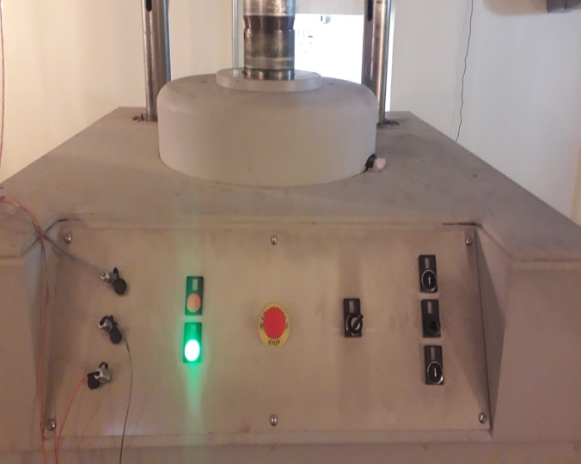
Gamma Radiation Device: MRH-Gamma-25

Slide 9
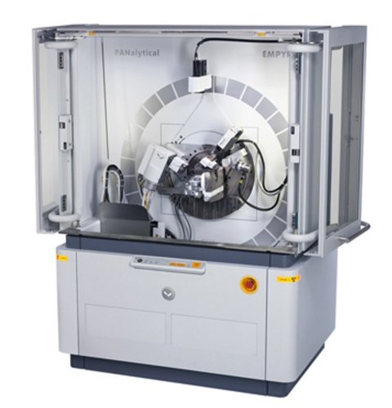
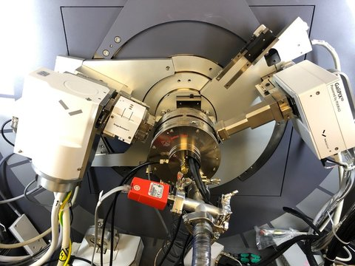
X-ray Device: EMPYREAN (Pananalitical)

Slide 10
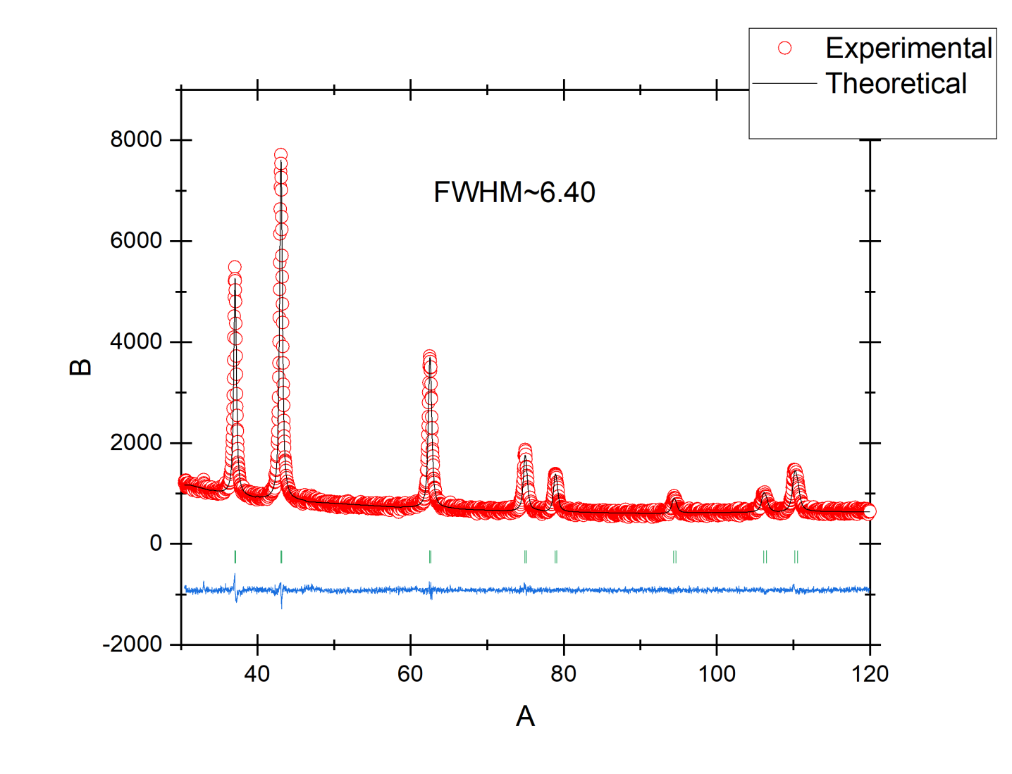
X-ray spectrum of TiN
The experimental results refined with Rietveld method with
FullProf program.

Slide 11
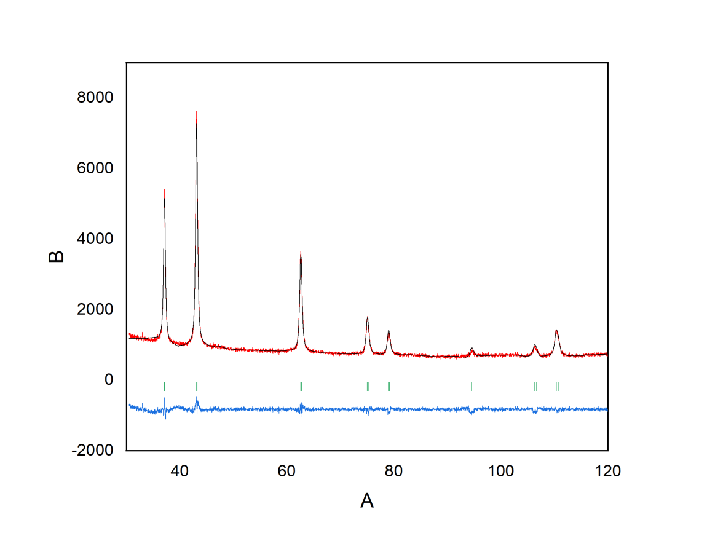
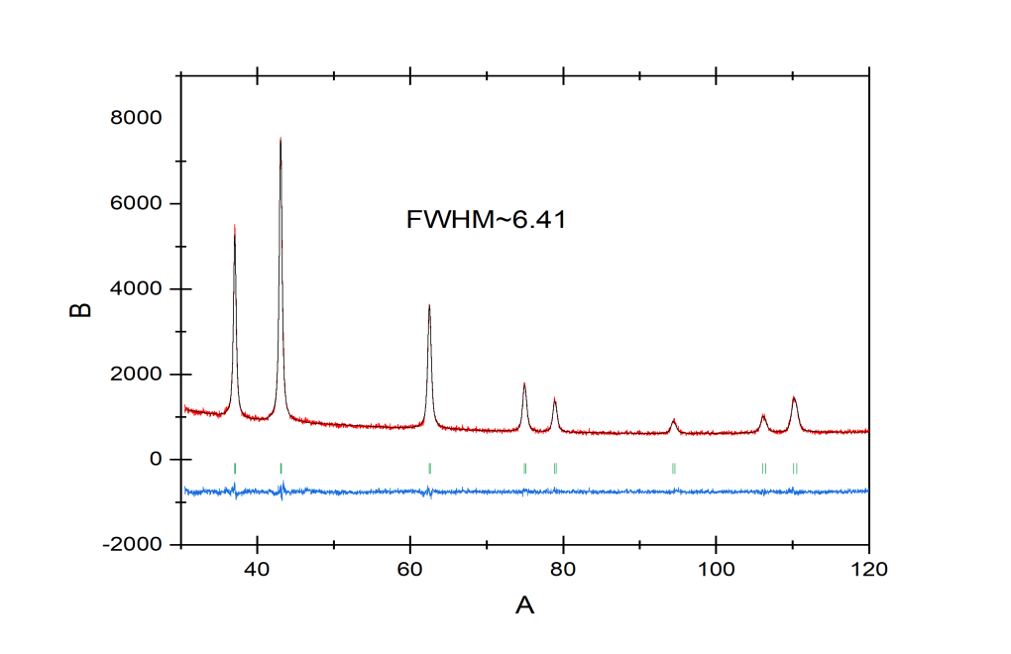
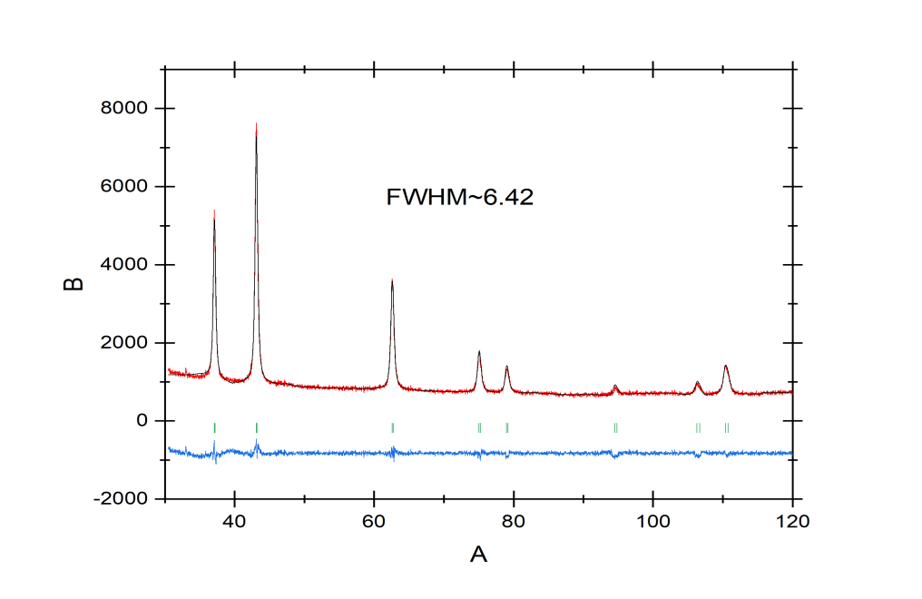
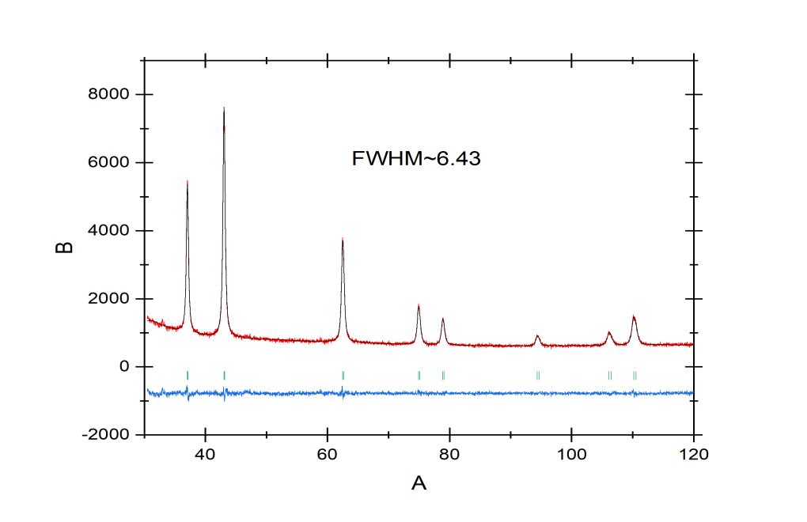
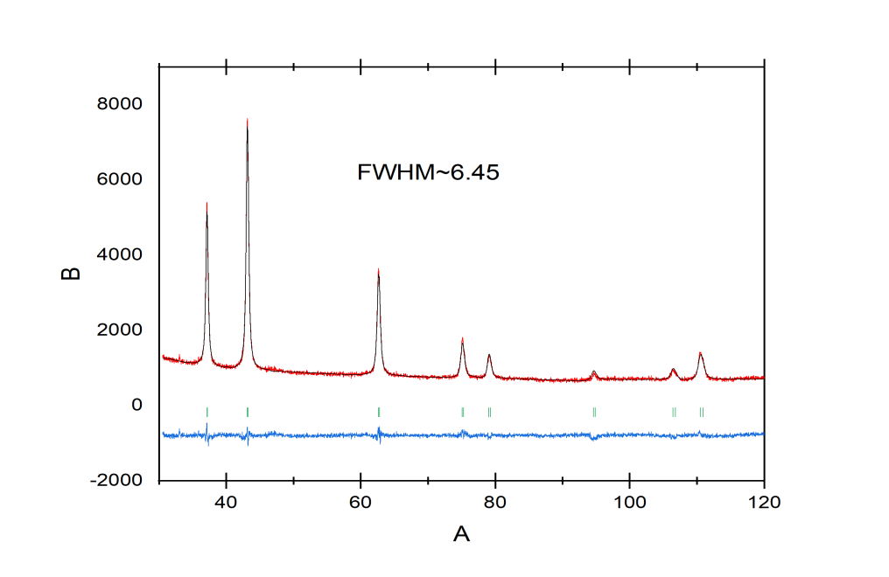
Changes in Spectra After Irradiation

Slide 12
Thanks for your attention.

