Slide 1
The effects of high pressure on the crystal structure and vibration spectra of layered perovskite-like Nd₂Ti₂O₇
A.G. Asadov^{1,2}, A.I. Mammadov², D.P. Kozlenko¹, R.Z. Mehdiyeva², S.E. Kichanov¹, E.V. Lukin¹, O.N. Lis^{1,3}
¹ Frank Laboratory of Neutron Physics, JINR, 141980 Dubna, Russia.
² Institute of Physics, Azerbaijan National Academy of Sciences, Baku AZ-1143, Azerbaijan.
³ Institute of Physics, Kazan Federal University, 420008, Kazan, Russia.
^{Speaker : Asif Asadov}

Slide 2
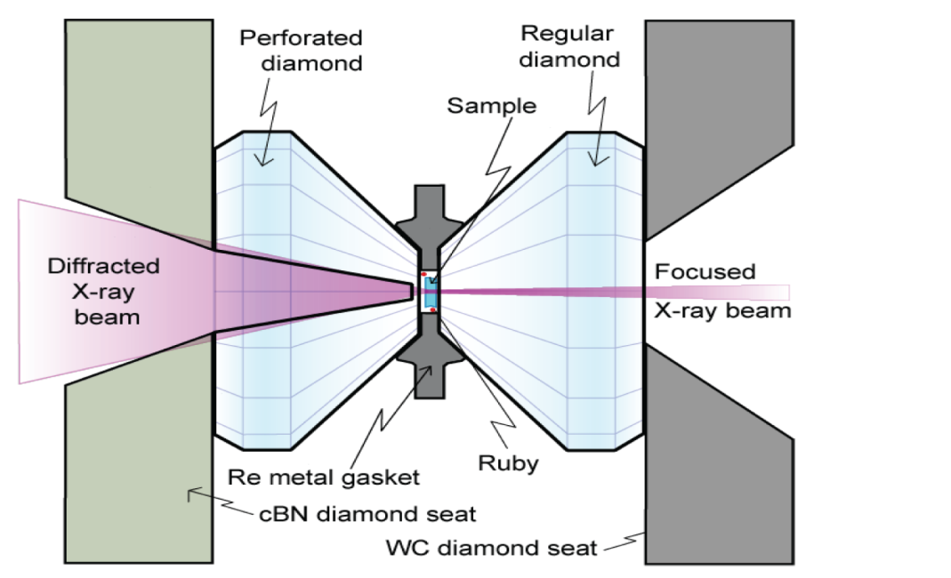
The Boehler-Almax Plate type diamond anvil cell
culets of 200 µm
Schematic representation of DAC
DAC overview (diamonds)
Rhenium gasket installation

Slide 3
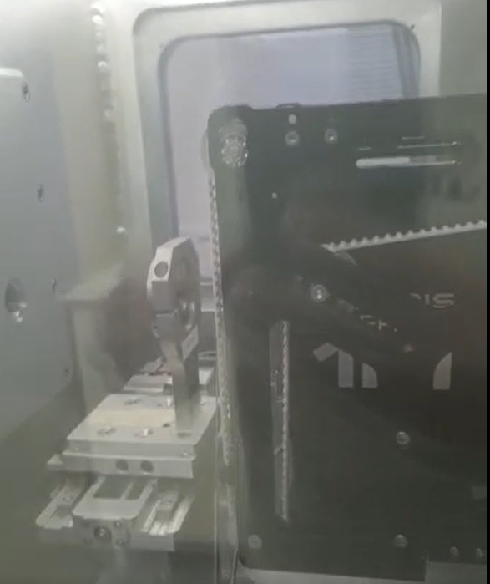
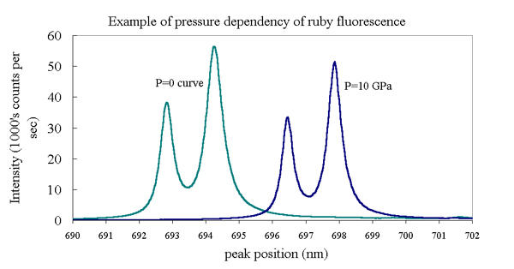
Installation To Xeuss3.0 X-ray diffractometer
Mo source (0.710781 Å)
DAC
Detector
Pressure mesurements with Ruby balls
DAC in Vacuum chamber
Debye – Scherrer rings
a and b are quasihydrostatic pressure

Slide 4
Discussions. Neutron diffraction
- Neutron diffraction of NTO confirms that, the sample posses to perovskite-like layered (PL) structure with TiO6 octahedras at ambient condition with P2₁ space group symmetry (monoclinic).
XV International School-Conference “Actual Problems of Physics Microworld” MINSK 2023.
a = 7.763(4) Å
b = 5.503(2) Å
c = 25.962(3) Å
β = 98.4(2)⁰
Reitveld refined (FULLPROF) Neutron diffraction data (high intensity mode) of NTO.
The P2₁ monoclinic structure of NTO at
ambient condition

Slide 5
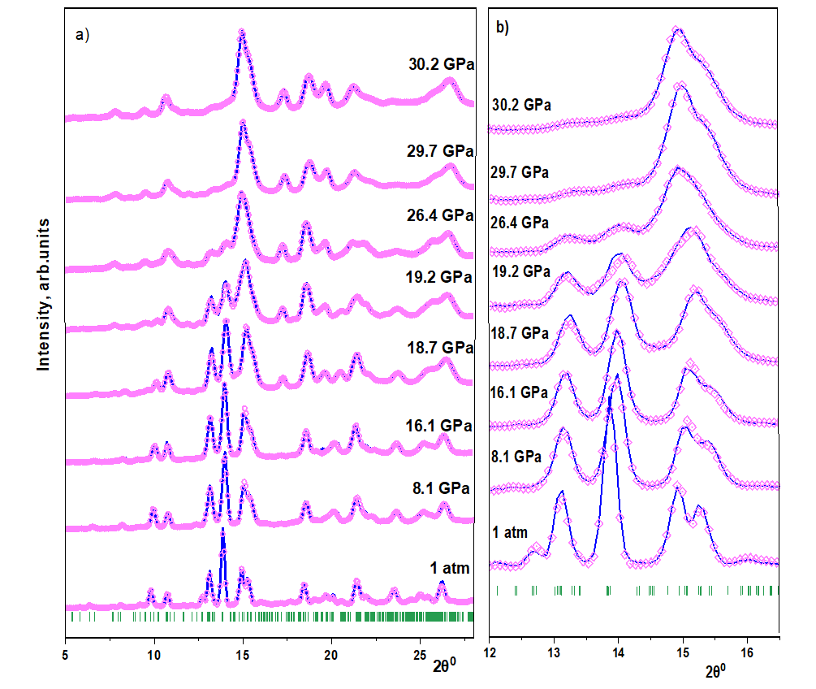
XRD pattern of NTO from 1 atm to 30.2Gpa measured by Xeuss3.0 diffractometer
- It seem that, there are some important modifications in pattern which start already from 18.7 Gpa to 26.4 Gpa and most noticeable part is 19.2 Gpa.
- From 0 Gpa to 18.7 Gpa there are not vital differences
*
*
*
*
*
*
XV International School-Conference “Actual Problems of Physics Microworld” MINSK 2023.
*
*
*
*
The X-ray diffraction patterns of Nd₂Ti₂O₇ at selected pressures and processed by the Rietveld method. “*” shows the new peak formation due to increasing pressure

Slide 6
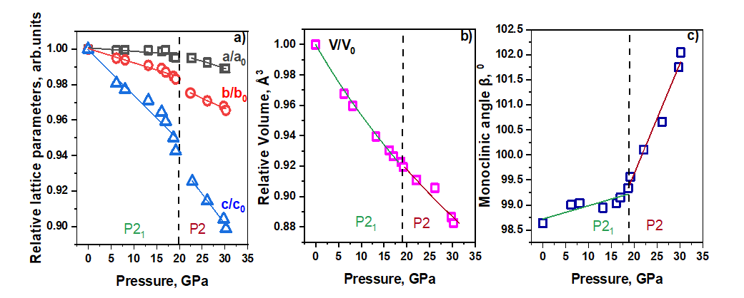
Pressure effect on Crystal
- Pressure induced changes in cell parameters and volume from 1 atm to 30.2 Gpa from up to bottom a, b, c, beta, volume respectively. Vertical bar line determine phase transition at 19.2 GPa.
k_{a} = 0.0009 GPa⁻¹
k_{b}= 0.0008 GPa-1 before phase transition ^{Compressibility}
k_{c} = 0.0026 GPa⁻¹
k_{a} = 0.00084 GPa⁻¹
k_{b} = 0.0015 GPa-1 after phase transition
k_{c} = 0.0040GPa⁻¹
XV International School-Conference “Actual Problems of Physics Microworld” MINSK 2023.
The Birch – Murnaghan fitting used for P – V relation with the B’ = 4.0(5)
and bulk modulus.
Low pressure: B₀=191.2(1) GPa.
High pressure: B₀=202.2(3) GPa.

Slide 7
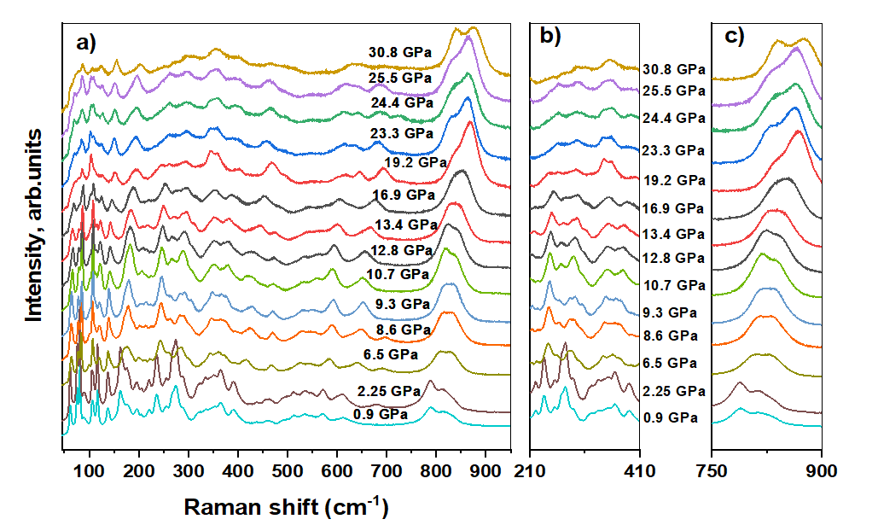
High-Pressure effect on Raman Spectra
XV International School-Conference “Actual Problems of Physics Microworld” MINSK 2023.
Both high pressure experiments for Raman and XRD made by DAC with 4:1 methanol-ethanol medium.

Slide 8
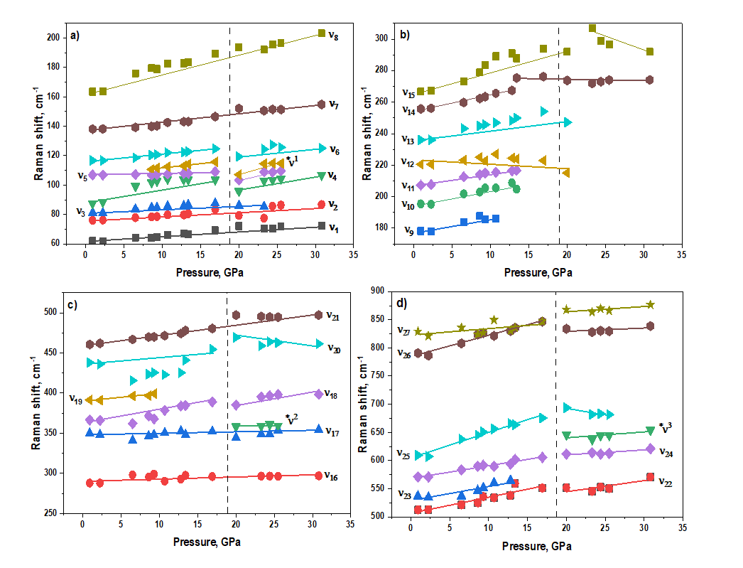
High-Pressure effect on Raman Spectra
XV International School-Conference “Actual Problems of Physics Microworld” MINSK 2023.
Shifts of Raman modes are linearly fitted and all modes show increasing tendency by increasing
pressure except ν₂₀ (O-Ti-O, Eg asymmetric stretch of TiO₆) and ν₂₅ (A1g, O-Ti-O symmetric stretch).
Vertical bar line determine phase transition at 19.2 GPa.

Slide 9
Results
The present research findings suggest the occurrence of anomalous changes in the refinement results obtained from the fullprof software in this study, particularly with respect to the cell parameters and volume dependence pressure. Specifically, the compound Nd₂Ti₂O₇ exhibits: Three orthorhombic modifications Pna21, Cmcm, and Cmc2₁ and four monoclinic modifications: P2, Pm, P2/m, and P2₁
1) The refinement analysis indicates that the initial structure corresponds to the P2₁ (4) monoclinic space group, but at a pressure above:
2) 18.7 GPa, peak broadening and the emergence of new peaks occur and new phase form at 19.2 GPa.
The present results provide evidence that the formation of new peaks may be attributed to:
3) A phase transition to the P2 (3) monoclinic phase
4) The latest findings suggest that the orthorhombic Cmc2₁ phase can also be assigned to the new phase.
Such a transition may be linked to:
1. The formation of a monoclinic superstructure (P2) or
2. The displacement of Nd³⁺ along the b-axis, as well as the tilting of TiO₆ octahedrons (Cmc2₁).
Both Raman and XRD results prove the results.
XV International School-Conference “Actual Problems of Physics Microworld” MINSK 2023.

Slide 10
Aim of the Research.
Rare earth titanium oxides are popular by their high Curie temperature (T_{c} > 1400⁰C) and as a piezoelectric material with high coercive field (E_{g}>45 kV/cm). Because of this characters this materials are at the focus of automation and aerospace industries. This kind of materials undergo phase transition at very high temperature (T_{transition}> 900⁰C)
Our research aims to investigate the decreased transition temperature of Nd₂Ti₂O₇ and its potential applications in modern technologies and research areas. Additionally, the study of the crystal behavior under extreme conditions using various experimental and theoretical methods. This research may provide valuable insights into the properties and behavior of rare earth titanium oxides, and inform the development of new and improved materials.
XV International School-Conference “Actual Problems of Physics Microworld” MINSK 2023.

Slide 11
THANK YOU FOR YOUR ATTENTION!!

