Slide 1
The XV-th International School-Conference of Micro-world Physics
Heaviest Nuclei and Atoms
Yuri Oganessian
Flerov Laboratory of Nuclear Reactions
Joint Institute for Nuclear Research
August 30, 2022, Minsk, Republic of Belarus

Slide 2
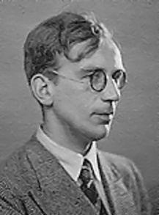
In attempts to describe the properties of nuclear matter, George Gamow made a daring assumption that atomic nucleus may be similar to a drop of positively charged liquid.
In fact, the density of nuclear liquid
is 10¹⁵ times more than that of water
Charged Liquid Drop Model
of the atomic nucleus.
G. Gamow, 1928.
George Gamow 1928
Yuri Oganessian Heaviest Nuclei and Atoms, XV-Int. School-Conference. Aug.27-Sep.03, Minsk, RB

Slide 3
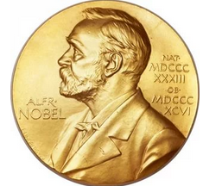
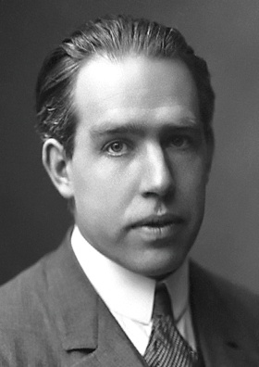
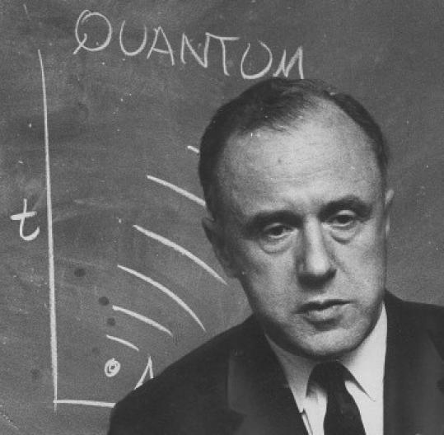
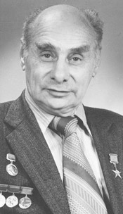
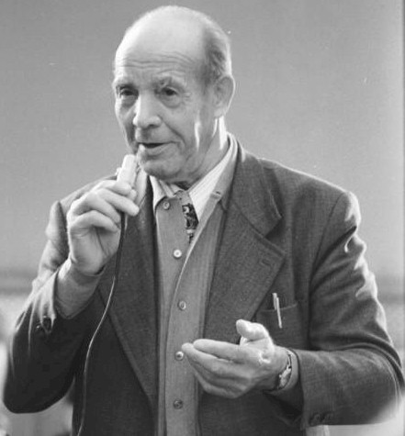
Nuclear fission
N. Bohr
J.A. Wheeler
1939
1940
G.N. Flerov
B_{f}=6 MeV
10¹⁶ years (exp.)
10⁻¹⁹ s
B_{f}=0
Z≥100
K.A. Petrzhak
Yuri Oganessian Mass limits of the nuclei and elements, Sept.1, 2022, MSU, Moscow

Slide 4
1956
1962
my first
experiment
Yuri Oganessian Mass limits of the nuclei and elements, Sept.1, 2022, MSU, Moscow

Slide 5
Discovery SF isomers
JINR, Dubna, 1962
10³⁰
Yuri Oganessian Heaviest Nuclei and Atoms, XV-Int. School-Conference. Aug.27-Sep.03, Minsk, RB

Slide 6
Nuclear Shells
Shell
correction
Fermi
energy
Mass defect of the atomic nuclei (MeV)
Liquid Drop Model
(1966)
The energy of nuclear levels
More
Bound
Less
bound
More
Bound
Mass number

Slide 7
Nuclear shells and
the “magic numbers”
Spontaneous
Fission
About 3000 nuclei
are known today
²⁰⁸Pb
Z=82
protons
126
¹⁰⁰Sn
Now let us consider the
nuclei heavier than lead
50
⁵⁶Ni
82
Among them
9 nuclei are doubly magic
⁴⁰Ca
¹³²Sn
28
50
20
“doubly magic”
nuclei
⁷⁸Ni
8
28
2
20
⁴⁸Ca
neutrons
2
8
¹⁶O
⁴He
Yuri Oganessian Heaviest Nuclei and Atoms, XV-Int. School-Conference. Aug.27-Sep.03, Minsk, RB

Slide 8
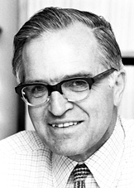
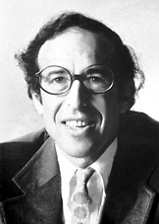
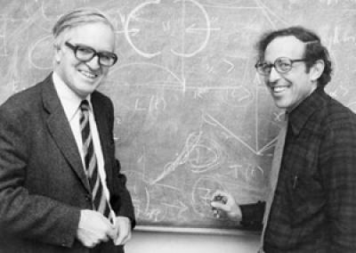
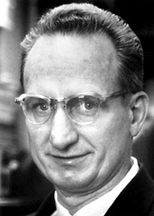
The Nobel Prize in Physics 1975
J. Rainwater
A. Bohr
B. Mottelson
"for the discovery of the connection between collective motion and particle
motion in atomic nuclei and the development of the theory of the structure
of the atomic nucleus based on this connection".
Yuri Oganessian Mass limits of the nuclei and elements, Sept.1, 2022, MSU, Moscow

Slide 9
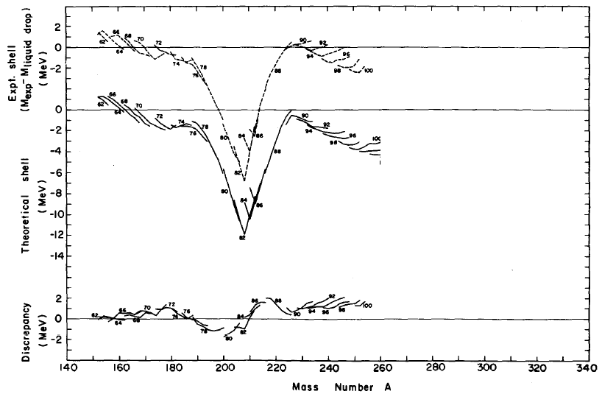
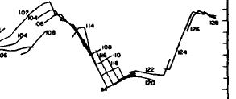
Shell effect in the nuclear ground states (mass defect)
Nilsson, Thompson, and Tsang, 1969
Experiment
²⁰⁸Pb
Theory
Z=108
N=162
Z=114
N=184
Z=82
N=126
Sobiczewski A, Gareev F A and Kalinkin B N
1966 Phys. Lett. 22, 500

Slide 10
8
0
6
-2
4
-4
2
-6
0
-8
0
-2
-2
-4
-4
-6
-6
-8
-8
0
0
-2
-2
-4
-4
-6
-6
-8
-8
Yuri Oganessian Heaviest Nuclei and Atoms, XV-Int. School-Conference. Aug.27-Sep.03, Minsk, RB

Slide 11
R. Smolańczuk, Phys. Rev. C 56 (1997) 812
Partial Spontaneous
Fission Half-Lives
SHE
Log T_{SF} / seconds
LDM
Parameter of fissility x
Yuri Oganessian Mass limits of the nuclei and elements, Sept.1, 2022, MSU, Moscow
Notes:
11

Slide 12
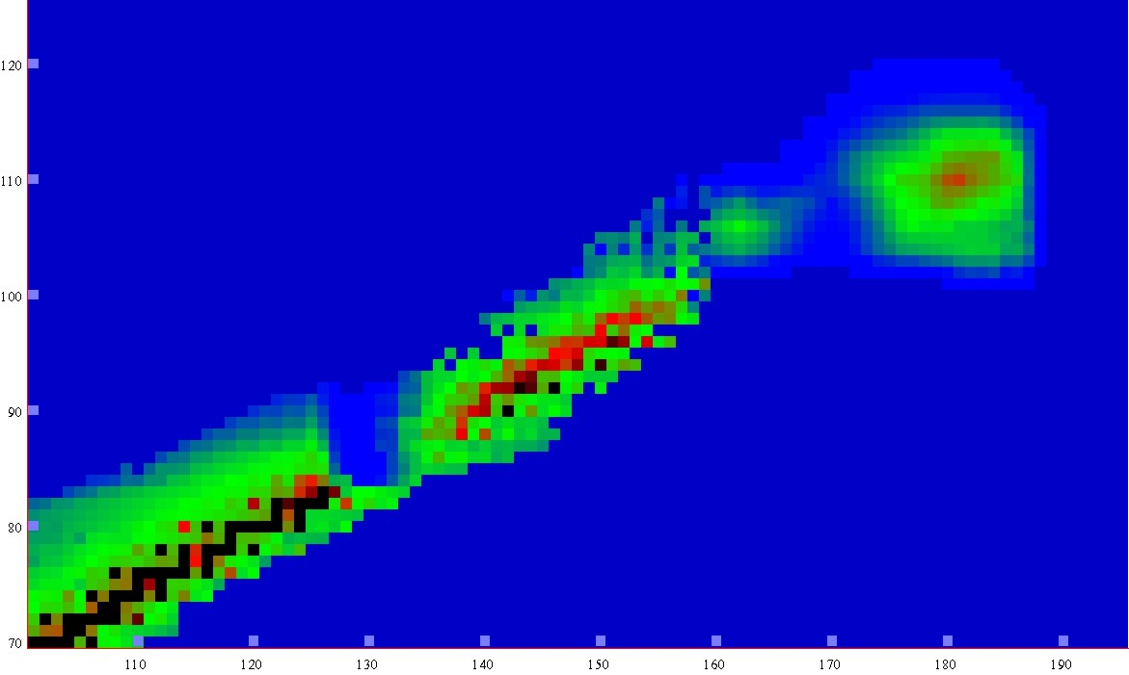
Half-lives
Macroscopic theory
-5
0
5
10
15
LogT_{1/2} s
New lands
New lands
1μs
1s
1h
d
1Myear
Island of
Stability
120
Island of
Stability
A limit of SHE
existence
Shoal
110
shoal
Proton number
T_{1/2} ≤ 10⁻¹⁴ s
Peninsula
100
peninsula
Sea of Instability
90
Continent
continent
80
70
100
110
120
130
140
150
160
170
180
190
Neutron number
Notes:
12

Slide 13
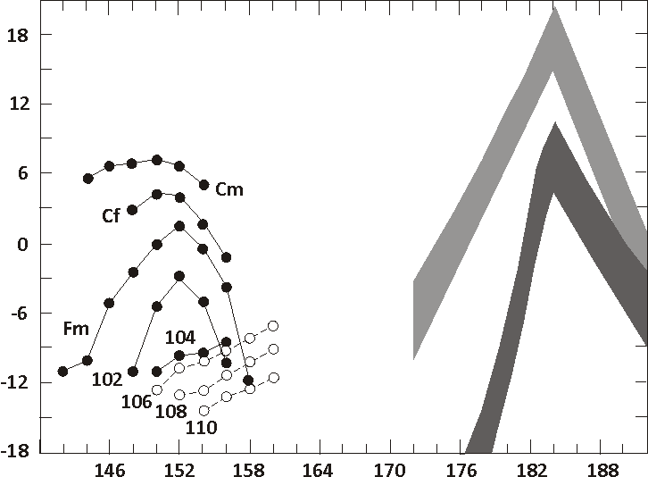
predictions
our World
Fiset and Nix
(1972)
Age of Earth
Log of the Spontaneous Fission Half Lives (years)
1 y
?
Randrup et al.
(1974)
1 s
Z=114
```````````````````````````
1 μs
Z=114
Z=110
Neutron number
Yuri Oganessian Heaviest Nuclei and Atoms, XV-Int. School-Conference. Aug.27-Sep.03, Minsk, RB
Notes:
Some very impressive predictions of the macro-microscopic model, where the stability of the nuclei at the top of the Island of Stability was estimated higher than the age of the Solar system, seemed at that time a strong exaggeration. At the same time, a strong increase in the stability of elements 110 and 114, as follows, is observed in the experiment.

Slide 14
Experimenters rushed to find this Island
1970-1985
Los Alamos (USA)
Berkeley (USA)
Dubna (JINR)
Oak Ridge (USA)
Mainz (Germany)
Darmstadt (Germany)
Orsay (France)
Würenlingen (Switzerland)
Tokyo (Japan) some later

Slide 15
The task of every laboratory was:
To find the method of producing
Search in nature:
earth/lunar objects, cosmic rays,
Artificial synthesis:
high-flux reactor,
nuclear explosion,
powerful accelerator
To develop setups:
separator/detector,
spectrometers,
chemical methods, etc.
Yuri Oganessian Heaviest Nuclei and Atoms, XV-Int. School-Conference. Aug.27-Sep.03, Minsk, RB

Slide 16
Unfortunately in all attempts super heavy elements
were not found
The problem of artificial synthesis of SHE is related
with reaction of synthesis
Notes:
16

Slide 17
Reactions of synthesis
Act.+⁴⁸Ca
Cold fusion
Nh
Light ions
target from
“peninsula”
Neutron
capture
Yuri Oganessian Heaviest Nuclei and Atoms, XV-Int. School-Conference. Aug.27-Sep.03, Minsk, RB
Notes:
17
17

Slide 18
Reaction of synthesis
artificial element made in
high flux nuclear reactor
target
n
48
288
292
from
accelerator
244
to separator
Ca
Pu
Fl
Fl
projectiles
n
n
rare and very
expensive isotope of Ca
fusion & cooling
Yuri Oganessian Heaviest Nuclei and Atoms, XV-Int. School-Conference. Aug.27-Sep.03, Minsk, RB

Slide 19
Targets
Isotope
enrichment (%)
ELEMENT
Isotope
Facility
112
²³³U SM-3 99.97
²³⁸U -
²³⁷Np SM-3 99.3
²⁴²Pu SM-3 99.98
²⁴⁴Pu HFIR 98.6
²⁴³Am SM-3 / HFIR 99.9
²⁴⁵Cm SM-3 / HFIR 98.7
²⁴⁸Cm HFIR 97.4
²⁴⁹Bk HFIR 97.3
²⁴⁹Cf SM-3 / HFIR 97.3
⁴⁸Ca -beam
113
Energy:
235-250 MeV
Intensity:
1.0 pμA
Consumption:
0.5 mg/h
114
115
116
117
118
Yuri Oganessian Heaviest Nuclei and Atoms, XV-Int. School-Conference. Aug.27-Sep.03, Minsk, RB
Notes:
19

Slide 20
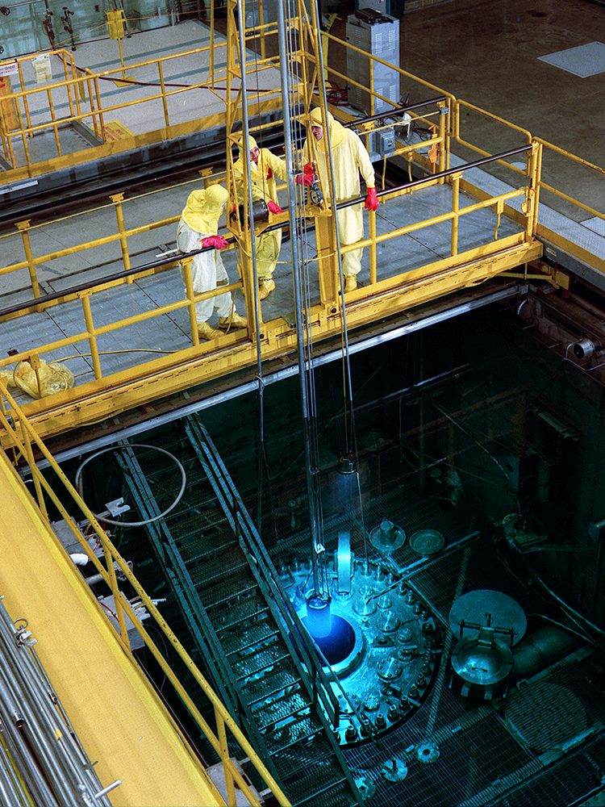
TARGET
Yu. Oganessian 2010
High Flux Isotope Reactor
Oak Ridge National Laboratory (USA)
22 mg of ²⁴⁹Bk
have been produced in 250 days irradiation
at HFIR (ORNL)
Yuri Oganessian Heaviest Nuclei and Atoms, XV-Int. School-Conference. Aug.27-Sep.03, Minsk, RB

Slide 21
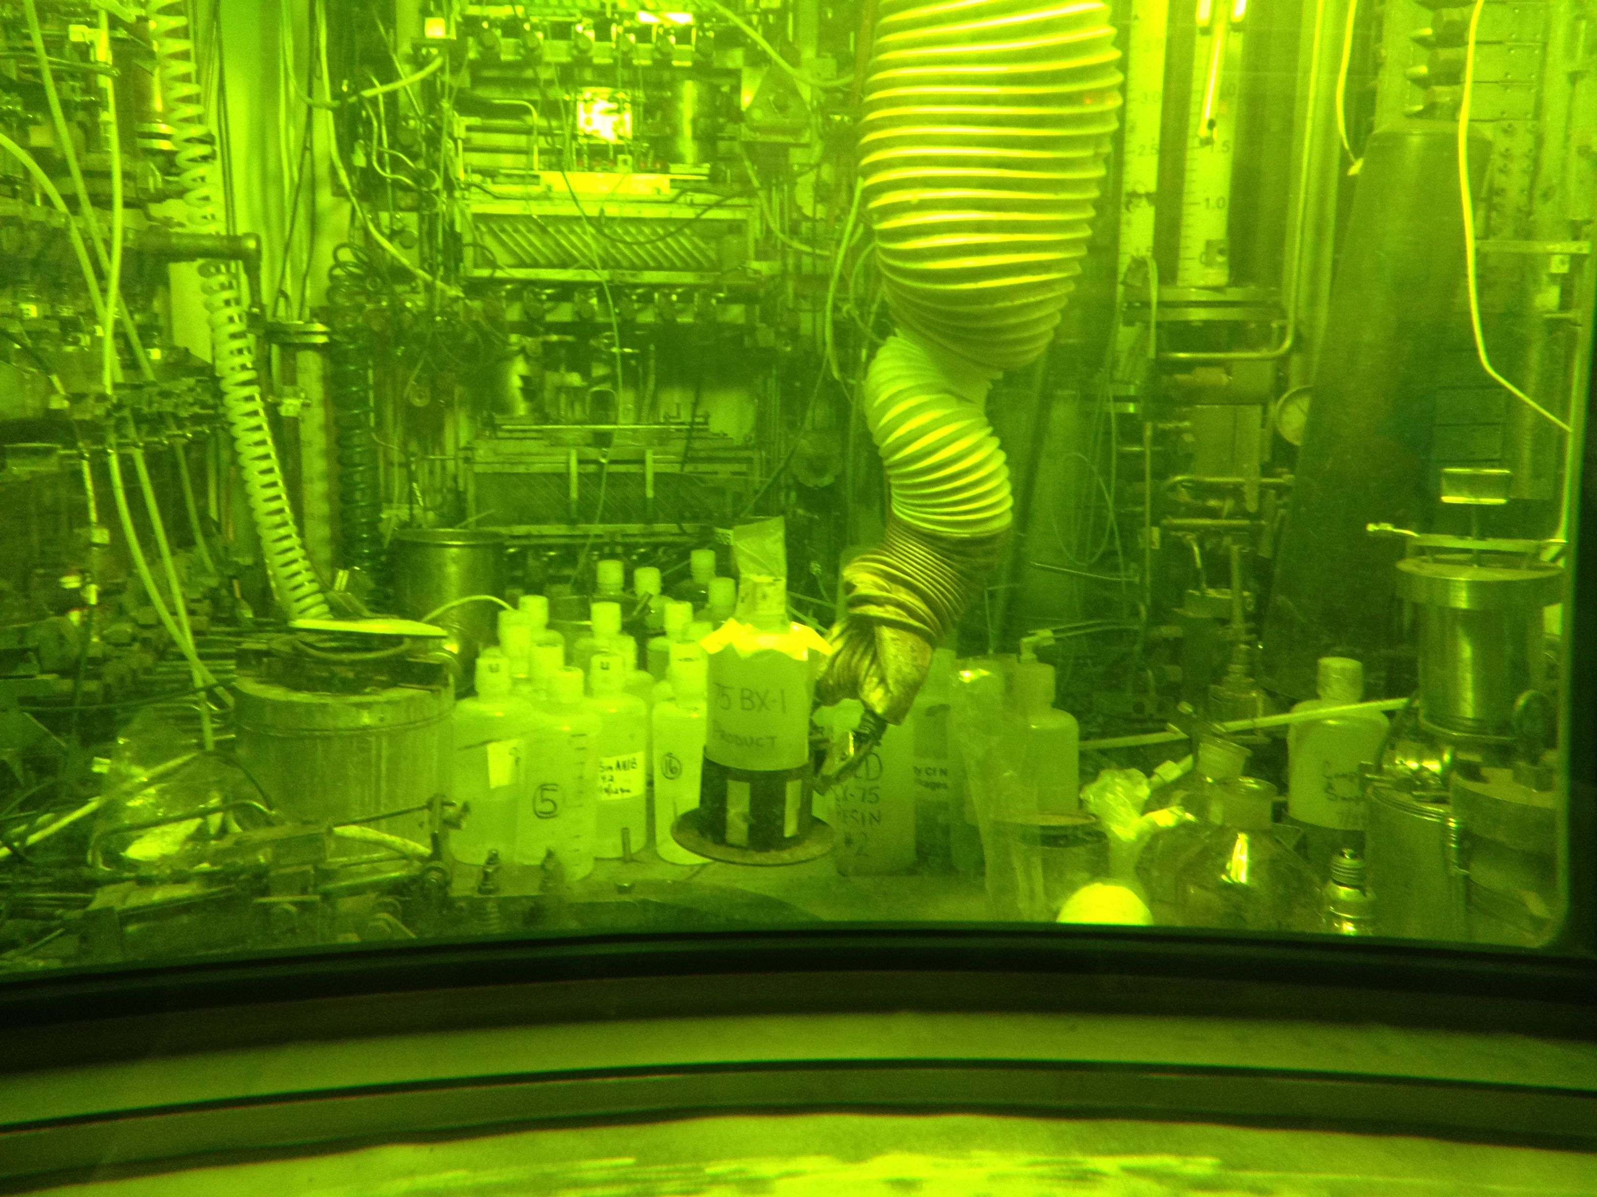
In solution
Oak Ridge National Laboratory, USA
hot chemical laboratory

Slide 22
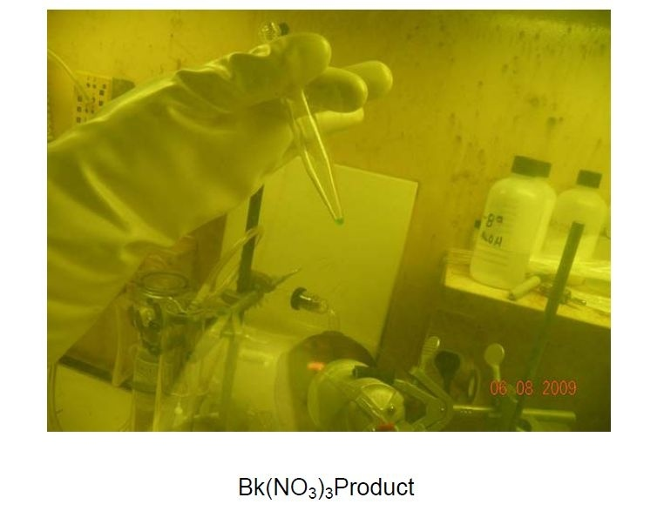
Yu. Oganessian 2010
50 Ci
50 Ci
Extracted target product - ²⁴⁹Bk for experiments
on the synthesis of elements 117 (Ts)
Yuri Oganessian Heaviest Nuclei and Atoms, XV-Int. School-Conference. Aug.27-Sep.03, Minsk, RB

Slide 23
Target
Target
310 μg/cm² BkO₂
on 1.5 μm-Ti foil
ω = 1700 rpm
6 cm²
60⁰
120 mm
Yuri Oganessian Heaviest Nuclei and Atoms, XV-Int. School-Conference. Aug.27-Sep.03, Minsk, RB

Slide 24
Dubna Gas-Filled Recoil Separator
A_{CN}-x
E_{R}
EVR
TOF
E_{R}
θ_{R} = 0⁰ ± 2.5⁰
50/s
⁴⁸Ca-beam
5·10¹²/s
²⁴⁹Bk-target
350 μg/cm²
Adam Sobiczewski, Acta Phys. Pol. B 41, 157 (2010).
Yuri Oganessian Mass limits of the nuclei and elements, Sept.1, 2022, MSU, Moscow
Notes:
Among all reaction products the neutrons evaporation residues have a maximal mass and minimal velocity.
The heaviest atoms collected on the focal plane where the detectors are located (upper figure).
After passing through the time-of-flight detectors, the recoils are implanted into the frontal detector, which determines its energy, time of arrival, and position of the implant on the detector surface. After the emission of first alpha particle from the implanted nucleus, the beam is turned off and all subsequent decays occur under low background conditions. This makes it possible to register the entire radioactive family from the decay of a super heavy nucleus: started by successive alpha decays and ending in spontaneous fission. In the experiment, the energies and the probability of decay of each nucleus - a member of the family are measured with high accuracy. (right figure).

Slide 25
Decay
chains
1999 - 2000
²⁴⁸Cm + ⁴⁸Ca →
²⁴⁴Pu + ⁴⁸Ca →
Z=116
0.06 s
114
2.5 s
114
0.7 ms
112
0.5 min
170 μs
110
11s
184

Slide 26
Z-even
Summary decay properties of the Z-even isotopes observed
in ²³⁸U, ^{240,242, 244}Pu, ^{245, 248}Cm and ²⁴⁹Cf + ⁴⁸Ca reactions
2015
Yu Ts Oganessian and V K Utyonkov,
Rep. Prog. Phys. 78 (2015) 036301
Yuri Oganessian Heaviest Nuclei and Atoms, XV-Int. School-Conference. Aug.27-Sep.03, Minsk, RB

Slide 27
Alpha - decay
Theory I. Muntian, Z. Patyk, and A. Sobiczewski
Phys. At. Nucl. 66, (2003)
Z-even
Exp.
Z-even

Slide 28
Spontaneous fission
even-even isotopes
R. Smolańczuk, PR. C 56 (1997) 812
SHN
SF critical
zone
Yuri Oganessian Heaviest Nuclei and Atoms, XV-Int. School-Conference. Aug.27-Sep.03, Minsk, RB

Slide 29
Z-odd
Summary decay properties of the isotopes of elements
113, 115, and 117 observed in ²³⁷Np, ²⁴³Am and ²⁴⁹Bk + ⁴⁸Ca reactions
Yu Ts Oganessian and V K Utyonkov,
Rep. Prog. Phys. 78 (2015) 036301
2010-2014
Yuri Oganessian Heaviest Nuclei and Atoms, XV-Int. School-Conference. Aug.27-Sep.03, Minsk, RB

Slide 30
55 new neutron-rich isotopes of the heaviest element where synthesized in nuclear reactions induced by Ca-48
2015
Islanders
Yuri Oganessian Heaviest Nuclei and Atoms, XV-Int. School-Conference. Aug.27-Sep.03, Minsk, RB

Slide 31
a nuclei with
Z ≥ 120 and A ≥ 300
may exist!
T_{1/2} = 0.7 ms
A=294
protons →
A=254
T_{1/2} = 50 ms
neutrons →
Yuri Oganessian Heaviest Nuclei and Atoms, XV-Int. School-Conference. Aug.27-Sep.03, Minsk, RB
Notes:
31

Slide 32
With Z > 40% larger than that of Bi, the heaviest stable element,
we see an impressive extension in nuclear survivability.
Although SHN are at the limits of Coulomb stability,
shell stabilization lowers ground-state energy,
creates a fission barrier,
and thereby enables SHN to exist.
.
The fundamentals of the modern theory
concerning the mass limits of nuclear matter
have obtained experimental verification
Yuri Oganessian Heaviest Nuclei and Atoms, XV-Int. School-Conference. Aug.27-Sep.03, Minsk, RB

Slide 33
Meanwhile, the discovery of the SHE,
like the opening of the Pandora's box, has poured out
many unexpected problems.
among them:
Where are the super heavy elements located
in the Periodic Table?
Are they similar to their light homologues?
Where is the boundary of the Periodic Table
and how many elements can it contain?
Yuri Oganessian Heaviest Nuclei and Atoms, XV-Int. School-Conference. Aug.27-Sep.03, Minsk, RB

Slide 34
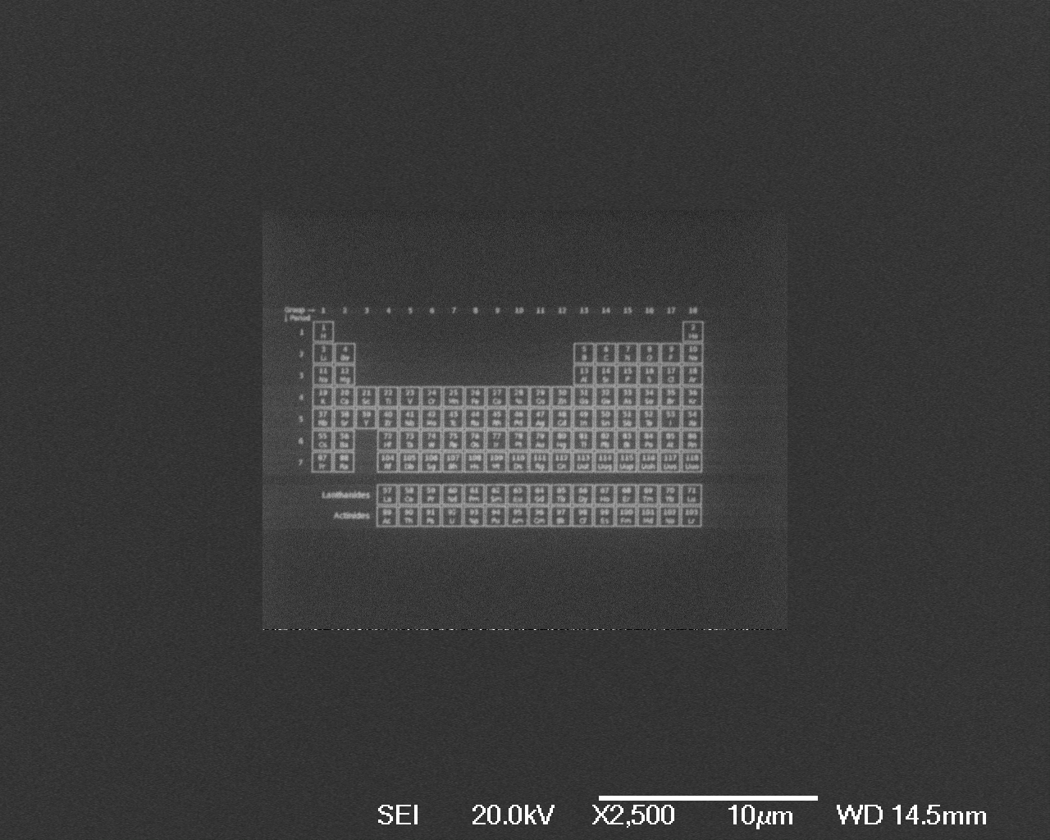
World’s Smallest Periodic Table
1/10th of the thickness of a human hair
Made by Electron Beam Lithography method
10 µm
20 µm
Andrei Khlobystov and his group
from Nottingham UK.

Slide 35
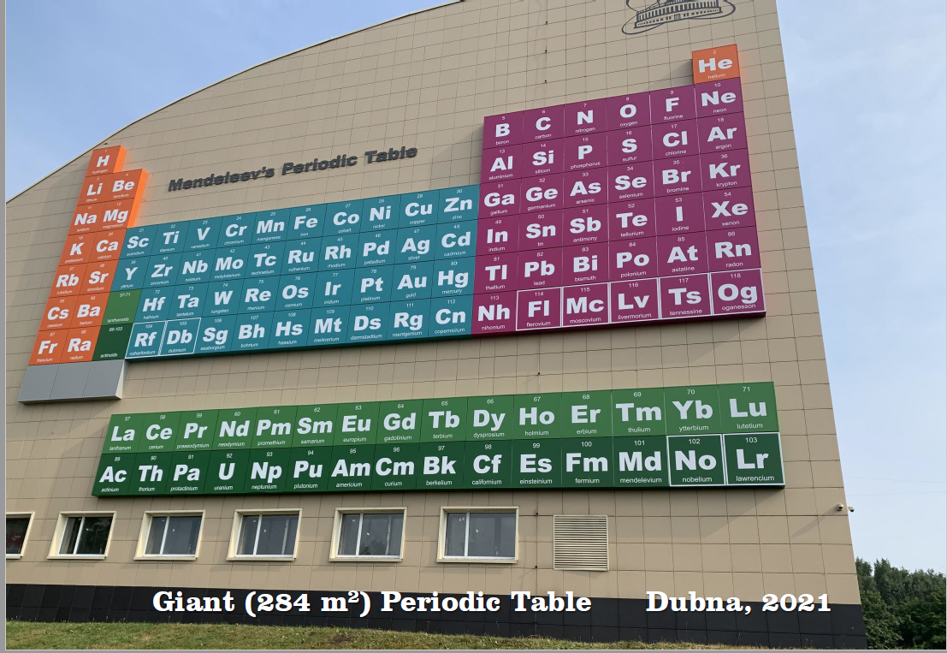
SH Islanders
daughter nuclides

Slide 36
Diving into the Dirac sea
E (keV)
positive energy continuum
500
1s_{1/2}
SHE
Z_{crit} ≈ 173 at R_{N} ≠ 0
0
Z
50
100
150
200
Z=137
at R_{N} ≠ 0
Z = Z_{cr}
-500
“atom” + positron
Z → (Ze⁻) + e⁺
negative energy continuum
occupied with electrons
Dirac sea
-1000
Yuri Oganessian Heaviest Nuclei and Atoms, XV-Int. School-Conference. Aug.27-Sep.03, Minsk, RB

Slide 37
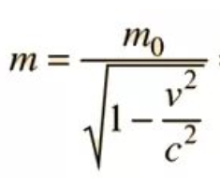
4m₀c²
3m₀c²
Z_{crit}
2m₀c²
Z=118
112
1s-electron total energy (MeV)
Au
m₀c²
0
0
0.2
0.4
0.6
0.8
1.0
ν/c
Yuri Oganessian Heaviest Nuclei and Atoms, XV-Int. School-Conference. Aug.27-Sep.03, Minsk, RB

Slide 38
Relativistic Contraction
Z=118
n=2
n=3
n=4
n=1
Electron density (a.u.)
n=5
non
relativistic
n=6
e-e correlation
n=7
nucleus
Distance (in a_{B})
Yuri Oganessian Mass limits of the nuclei and elements, Sept.1, 2022, MSU, Moscow

Slide 39
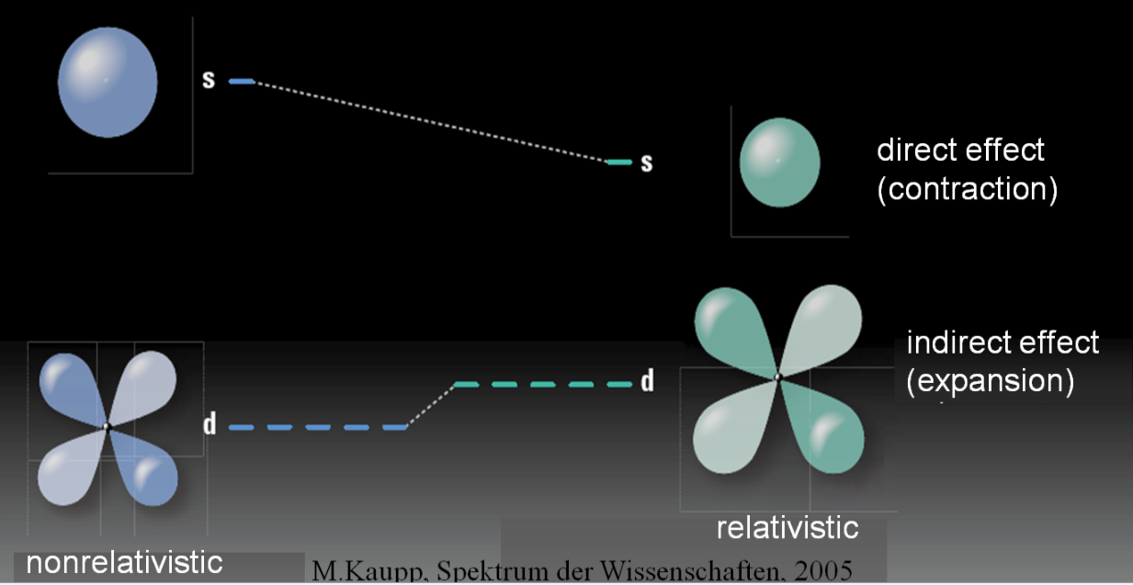
Relativity and /vs correlation
NR
R
Relativistic indirect effect:
destabilization of the d and f orbitals /density (correlation acts appositively)
Yuri Oganessian Mass limits of the nuclei and elements, Sept.1, 2022, MSU, Moscow

Slide 40
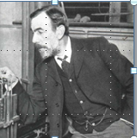
1
2
3
4
5
6
7
8
9
10
11
12
13
14
15
16
17
18
H
He
Li
Be
B
C
N
O
F
Ne
Na
Mg
Al
Si
P
S
Cl
Ar
K
Ca
Sc
Ti
V
Cr
Mn
Fe
Co
Ni
Cu
Zn
Ga
Ge
As
Se
Br
Kr
Sir
William
1904 Ramsay
Rb
Sr
Y
Zr
Nb
Mo
Tc
Ru
Rh
Pd
Ag
Cd
In
Sn
Sb
Te
I
Xe
Cs
Ba
La*
Hf
Ta
W
Re
Os
Ir
Pt
Au
Hg
Tl
Pb
Bi
Po
At
Rn
Fr
Ra
Ac**
Rf
Db
Sg
Bh
Hs
Mt
Ds
Rg
Cn
Nh
Fl
Mc
Lv
Ts
Og
119 120
Does element 118 look like a noble gas?
*
**
Tb
Ce
Pr
Nd
Pm
Sm
Eu
Gd
Dy
Ho
Er
Tm
Yb
Lu
Th
Pa
U
Np
Pu
Am
Cm
Bk
Cf
Es
Fm
Md
No
Lr
Yuri Oganessian Heaviest Nuclei and Atoms, XV-Int. School-Conference. Aug.27-Sep.03, Minsk, RB

Slide 41
Noble gases
P. Schwerdtfeger et al. Angewandte Chemie (2020)
boiling
R
melting
room
temperature
Temperature (K)
NR
According to
V. Pershina, V. Shabaev et al.,
in the 94% Og is a noble gas
Rn
Kr
Xe
Ne
Ar
He
Atomic number
Yuri Oganessian Heaviest Nuclei and Atoms, XV-Int. School-Conference. Aug.27-Sep.03, Minsk, RB
Notes:
It is possible that element 118 will not even be a gas at room temperature, as expected in the non-relativistic (NR) case. In relativistic calculations (R), the boiling point of Og rises to almost 180°C. At the same time, the Og is expected to be a low-melting semiconductor at room temperature.

Slide 42
Periodic Table
for elements with Z>121
Yuri Oganessian Heaviest Nuclei and Atoms, XV-Int. School-Conference. Aug.27-Sep.03, Minsk, RB

Slide 43
relativistic effect will manifest itself already
in synthesized SHEs
Z=118
SHE
Z=112-118
P. Indelicato et al. Theor. Chim. Acta 120, 495 (2011)
-0.4
In this area the “relativistic effect”
will have a strong influence on the
electronic structure and chemistry
of the heaviest elements
-0.6
1s-electron binding energy (MeV)
-0.8
173.17
-1.0
120
130
140
150
160
170
Atomic number
Yuri Oganessian Heaviest Nuclei and Atoms, XV-Int. School-Conference. Aug.27-Sep.03, Minsk, RB

Slide 44
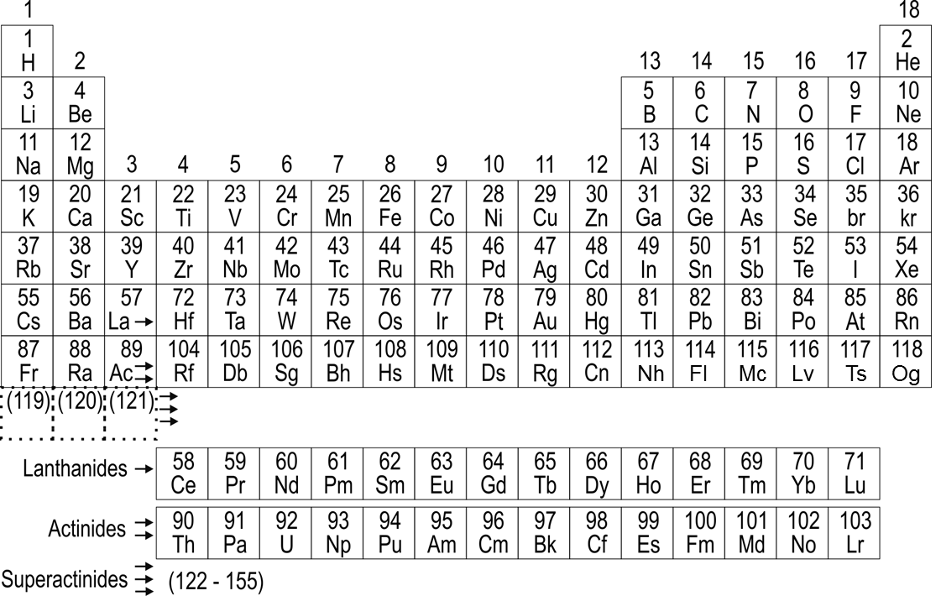
Periodic Table
calculated in the relativistic approximation
SHE
known
next
118
Og
(119)
(120)
(121)
121
122
123
The group difference will be greatly depressed or disappear
Superactinides
122
123
. . .155
Yuri Oganessian Heaviest Nuclei and Atoms, XV-Int. School-Conference. Aug.27-Sep.03, Minsk, RB

Slide 45

PROGRESS
SHE
SHE-Factory

Slide 46
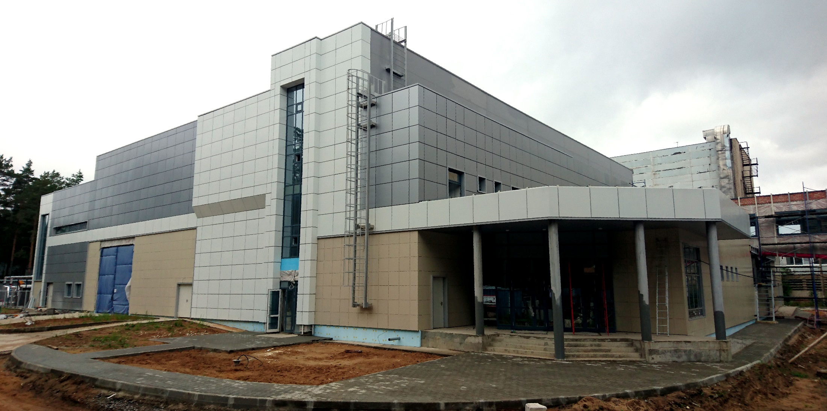
August 2017, Dubna
SHE-Factory
Yuri Oganessian Heaviest Nuclei and Atoms, XV-Int. School-Conference. Aug.27-Sep.03, Minsk, RB
Notes:
Progress of the research we associate, first of all, with an increase in the production of isotopes with Z=110–118 and advancement to heavier elements with Z=119 and 120 in a new laboratory - the SHE Factory.

Slide 47
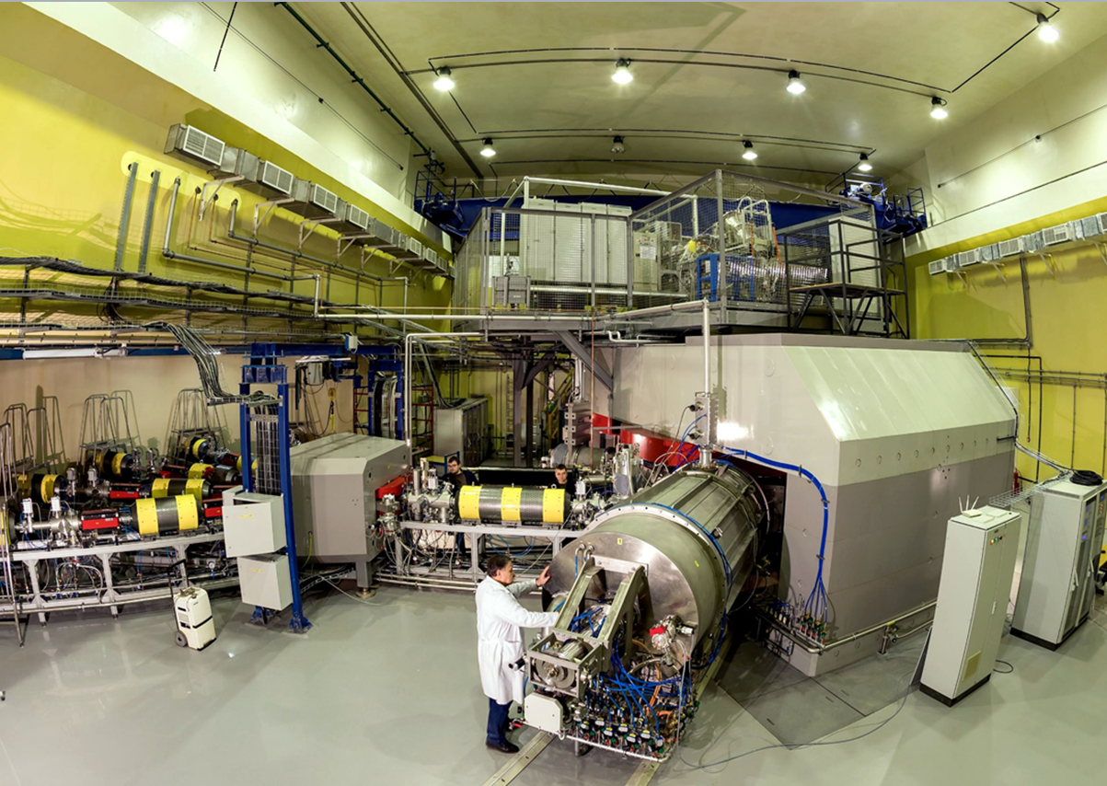
⁷Li – ⁴⁸Ca – ¹³⁶Xe | 10 pµA
With new ECR-28 GHz | ²³⁸U 3 pµA
New accelerator DC-280
Yuri Oganessian Heaviest Nuclei and Atoms, XV-Int. School-Conference. Aug.27-Sep.03, Minsk, RB

Slide 48
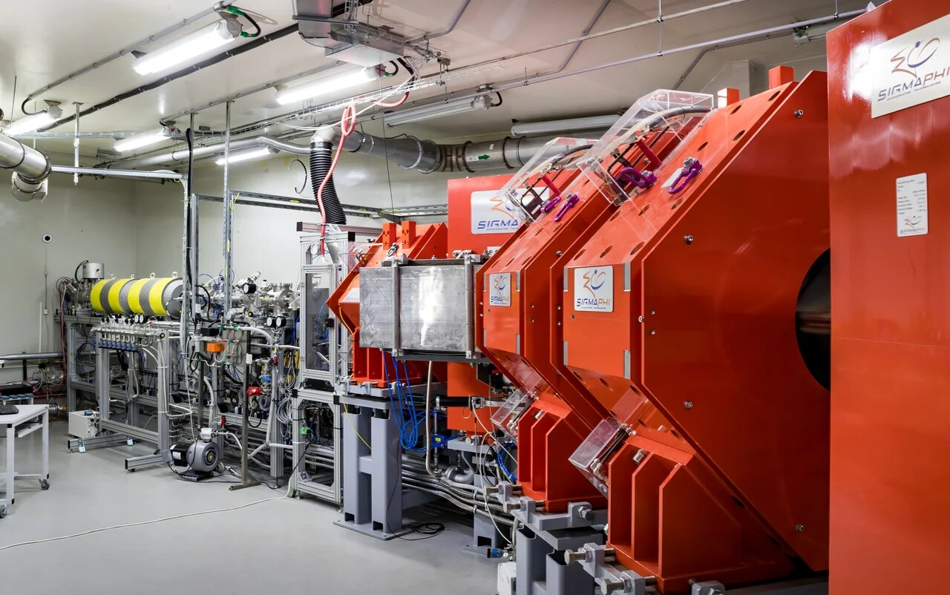
DGFRS-II separator

Slide 49
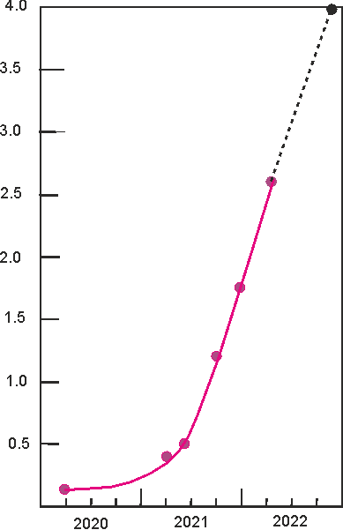
Progress at SHE-Factory
4.0
designed
3.5
Luminosity
(target 30 mg)
3.0
now at Factory
2.5
Luminosity (10³¹/cm²ˑs)
DC-280 + DGFRS-2
2.0
1.5
1.0
0.5
previous level
U-400 + DGFRS-1
0.0
2000
2020
2021
2022
year
Yuri Oganessian Heaviest Nuclei and Atoms, XV-Int. School-Conference. Aug.27-Sep.03, Minsk, RB

Slide 50
epilogue

Slide 51

SHE in Russia
PIK (Russia)
GSI (Germany)
JINR (Dubna)
GANIL (France)
SHE-Factory
SM-3 (Russia)
ВНИИЭФ (Саров)
FRIB (USA)
ЭХП (Россия)
INFN (Italy)
2
RIKEN (Japan)
LBNL (USA)
HFIR (USA)
IMF (China)
Heavy ion Accelerator fassilities
High Flux Neutron Reactors
Isotope Separators 1
Isotope Separators 2
Notes:
And over the next 150 years, the Periodic Table, as a pearl of knowledge, was perceived by human society with increasing interest. Many laboratories in the world created new facilities: nuclear reactors, accelerators, sophisticated setups. Many people of several generations are involved in the science of new elements.

Slide 52
Благодарю за внимание

Slide 53
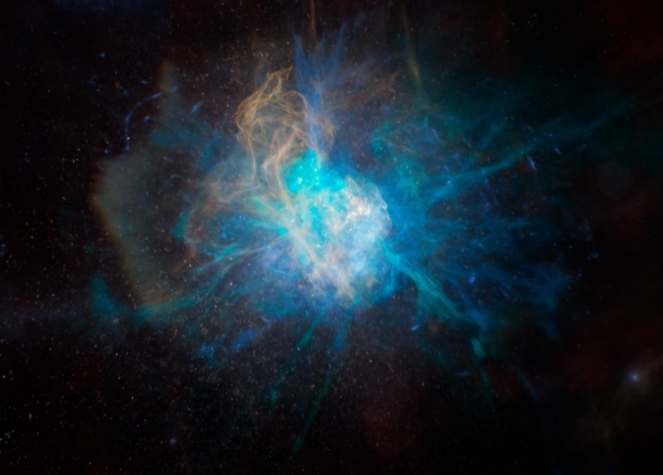
ЫГЗУКТЩМФSUPERNOVA
SUPERNOVA

Slide 54
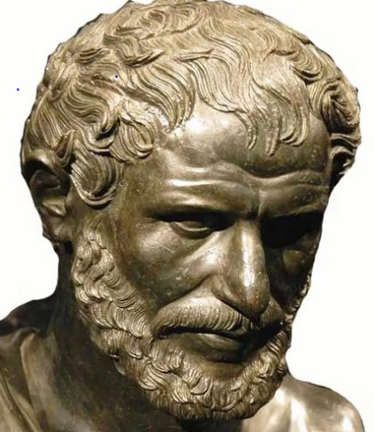
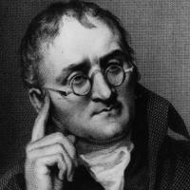
For more than 22 centuries
From Democritus (460 - 371 BC)
to Dalton (1766 - 1844)
it was assumed that the objects around us are made up of tiny indivisible particles – atoms interacting with each other.
Democritus 460-375 BC
“The building bricks – molecules – are complex compositions of different atoms in certain proportions”.
36 elements were known at that time
John Dalton 1808
Yuri Oganessian Heaviest Nuclei and Atoms, XV-Int. School-Conference. Aug.27-Sep.03, Minsk, RB

Slide 55
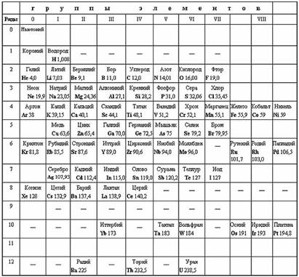
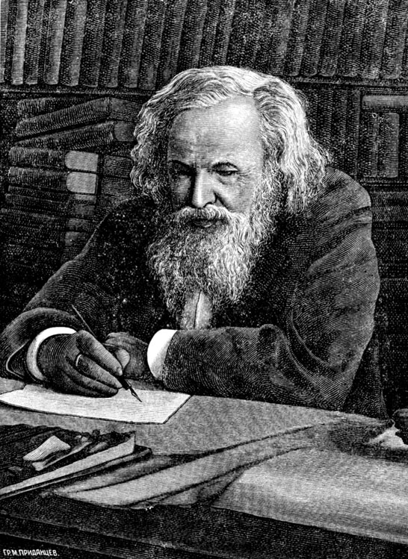
Genuine D.I.Mendeleev’s Table
Dmitri Mendeleev
1869
63 elements were already know by that time
Yuri Oganessian Heaviest Nuclei and Atoms, XV-Int. School-Conference. Aug.27-Sep.03, Minsk, RB

Slide 56
Mendeleev’s Table of chemical elements (1869) showed that their properties are regularly repeated with increasing the weight (atomic number) of the elements.
It follows that:
the atoms are not "building bricks",
They have themselves a complex internal structure.

Slide 57

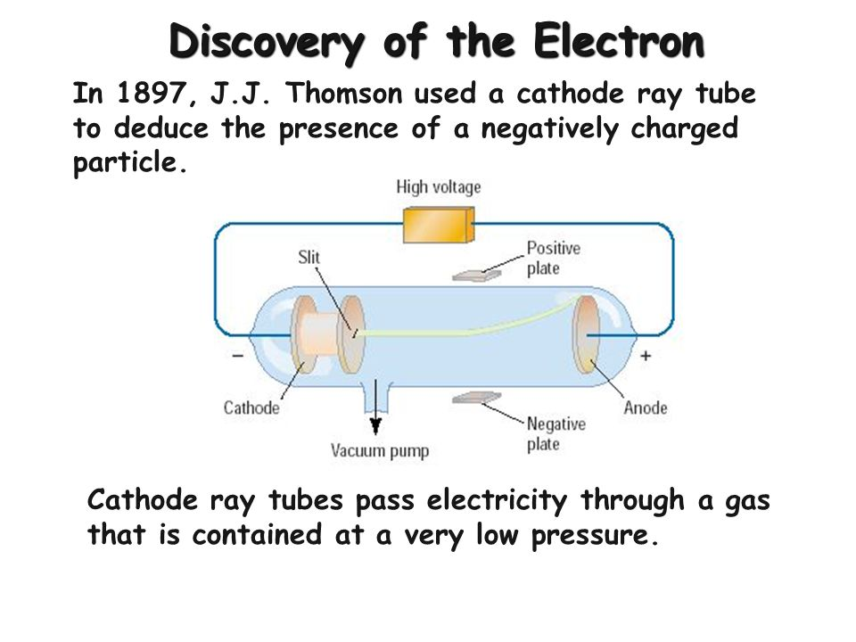
J.J. Thomson 1897
Yuri Oganessian Heaviest Nuclei and Atoms, XV-Int. School-Conference. Aug.27-Sep.03, Minsk, RB

Slide 58
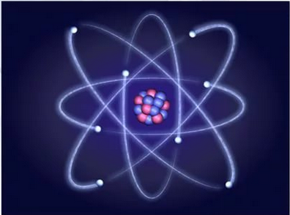
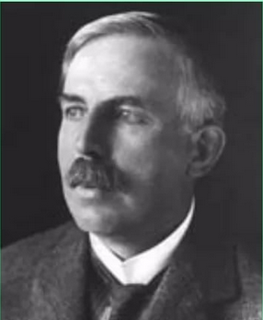
electron
Ernst Rutherford
1911
Nucleus
Yuri Oganessian Heaviest Nuclei and Atoms, XV-Int. School-Conference. Aug.27-Sep.03, Minsk, RB

Slide 59
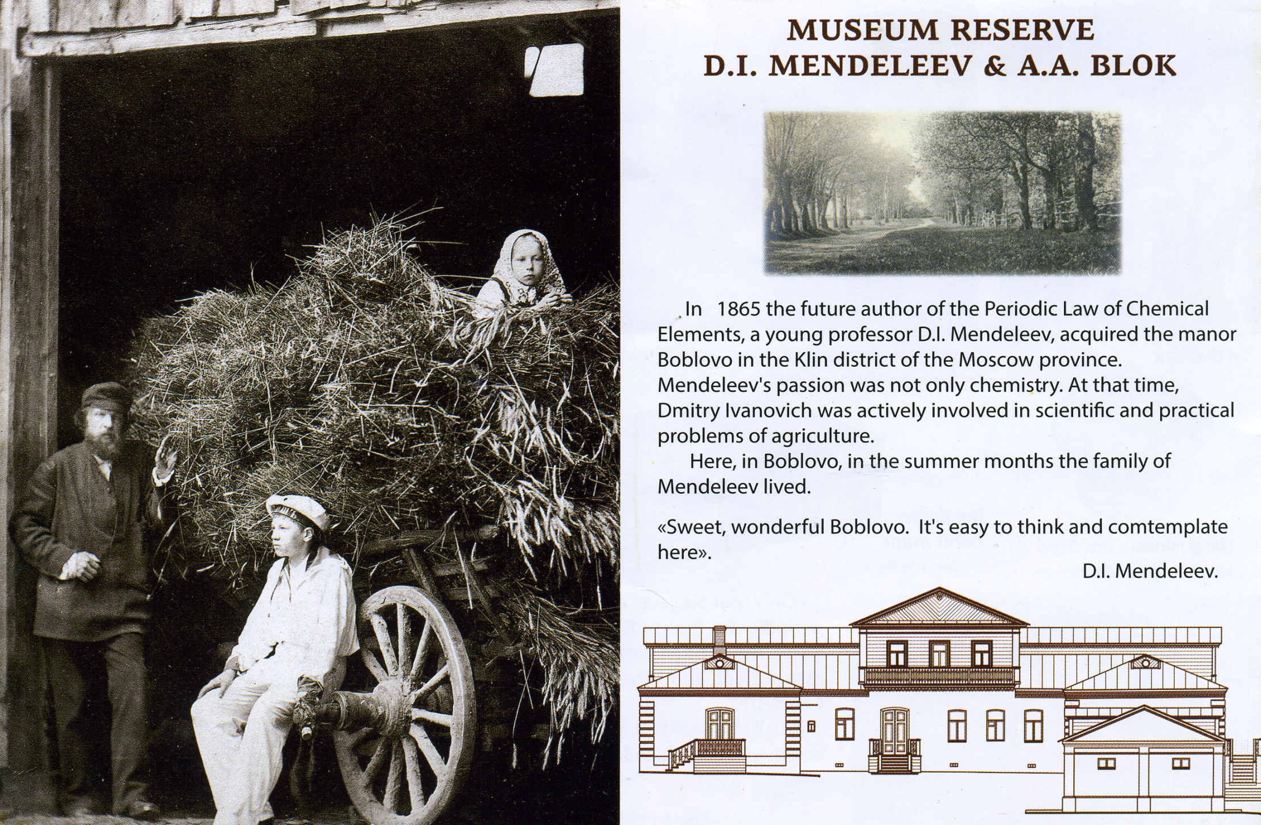
4 years before ...

Slide 60
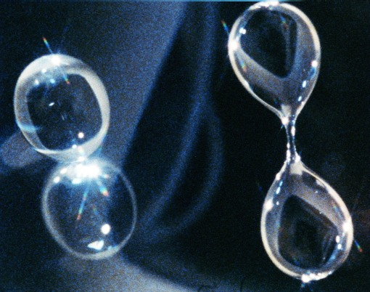
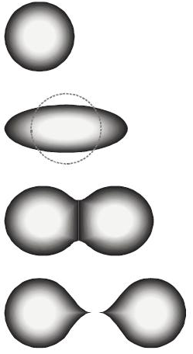
Stages of nuclear fission
A_{f2}
initial nucleus
A_{f1}
Shape evolution?
Drop of water in microgravity
NASA 2005
fission fragments
observed in the experiment
Yuri Oganessian Heaviest Nuclei and Atoms, XV-Int. School-Conference. Aug.27-Sep.03, Minsk, RB

