Slide 1
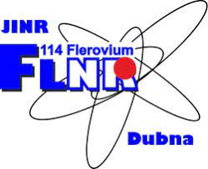
NUCLEAR REACTIONS FOR SYNTHESIS OF SHE M.G. ITKIS
XV International School-Conference "Actual problems
of the microworld physics"
Minsk, Belarus August 27-September 3, 2023

Slide 2
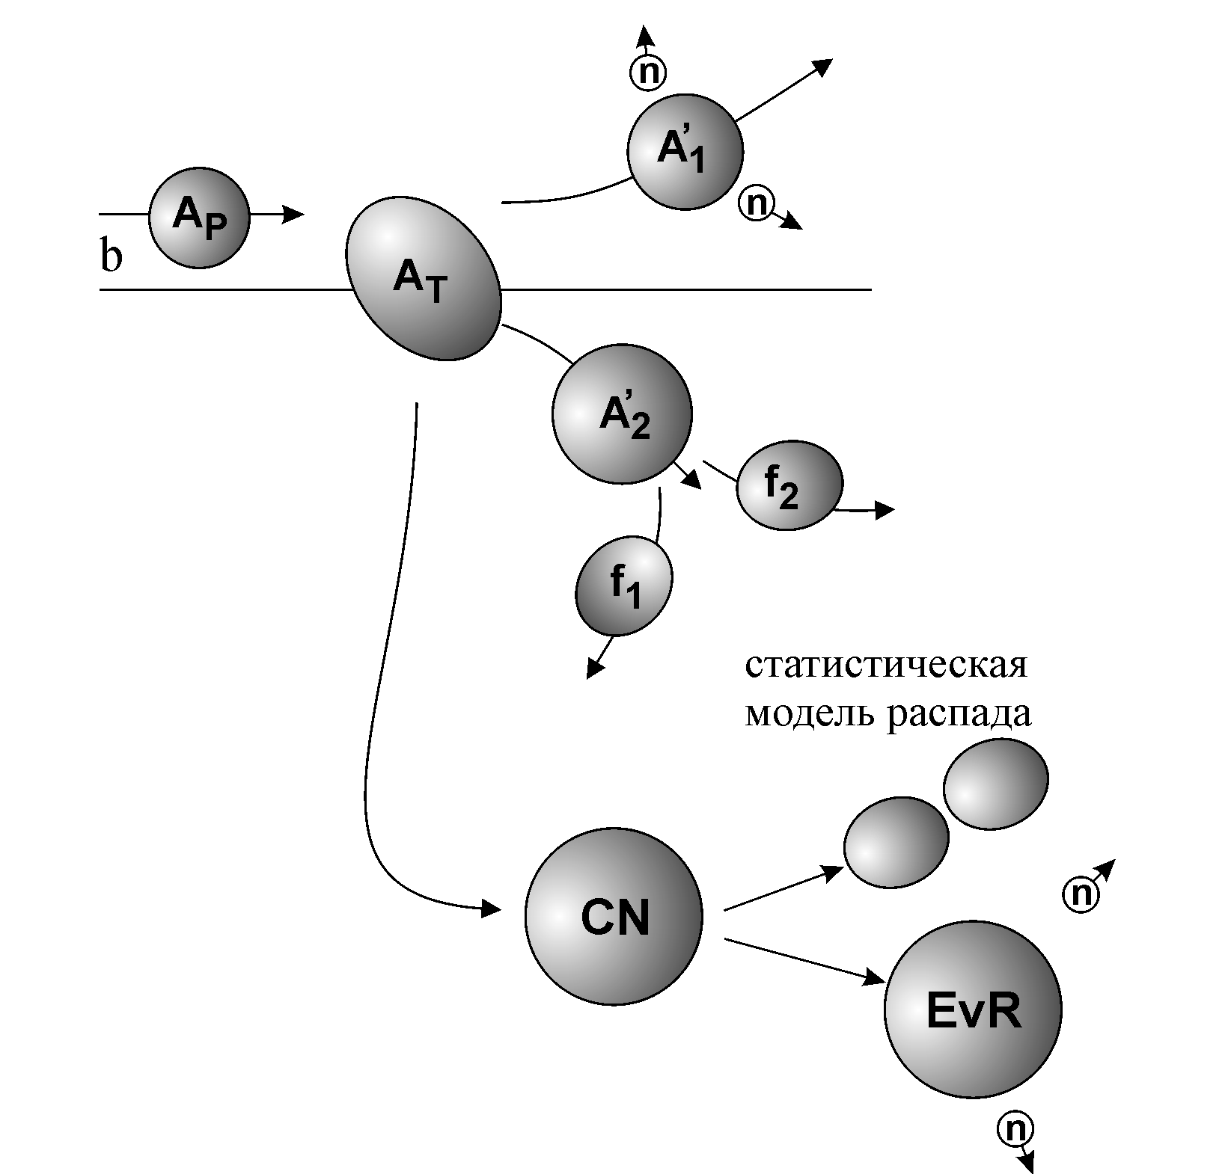
Mechanisms of reactions induced by heavy ions
Deep inelastic collisions, Quasi-fission
Sequential fission
Fusion-fission
Fusion
Fusion-survival

Slide 3
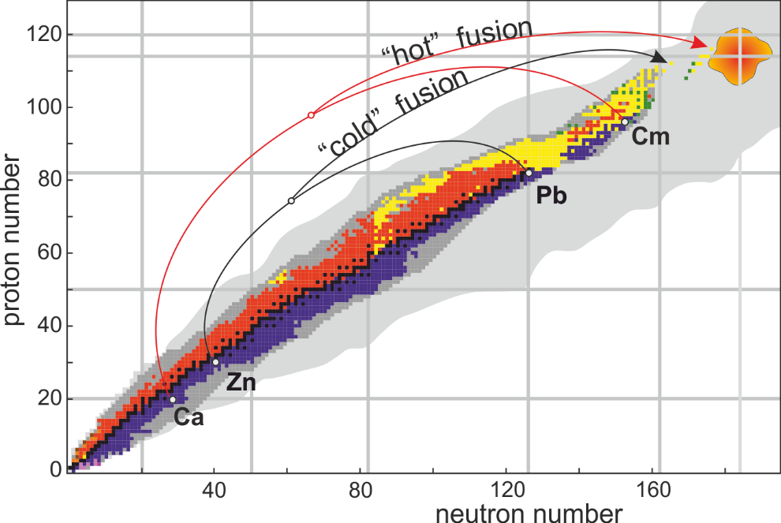
Synthesis of superheavy elements
“cold” fusion:
Proj. + ²⁰⁸Pb
“hot” fusion: ⁴⁸Ca₂₈+Act.

Slide 4
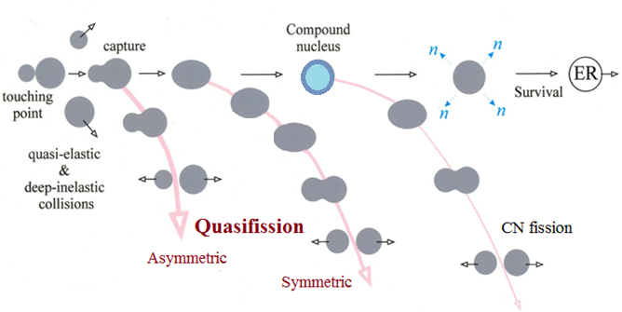
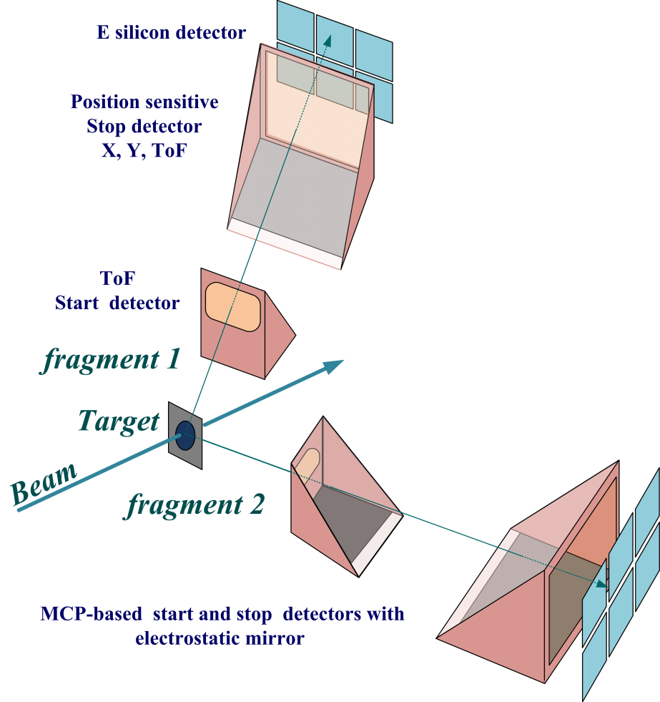
Reaction channels in the collisions of heavy ions
Double arm Time-of-Flight spectrometer
CORSET
to study binary channels in heavy-ion-induced reactions (fusion-fission, quasifission, deep-inelastic processes)
Time resolution | 150-180 ps
ToF base | 10-30 cm
Arm rotation range | 15°-165°
Solid angle | 100-200 msr
Angular resolution | 0.3°
Mass resolution | 2-4 u
Energy resolution | 1%
Notes:
at energies around the Coulomb barrier the complete fusion of two massive nuclei is suppressed by competing binary process, the quasifission (QF), in which the composite system separates in two main fragments without forming a CN.
QF happens to be the most important mechanism that prevents the formation of SHE in the fusion of heavy nuclei.

Slide 5
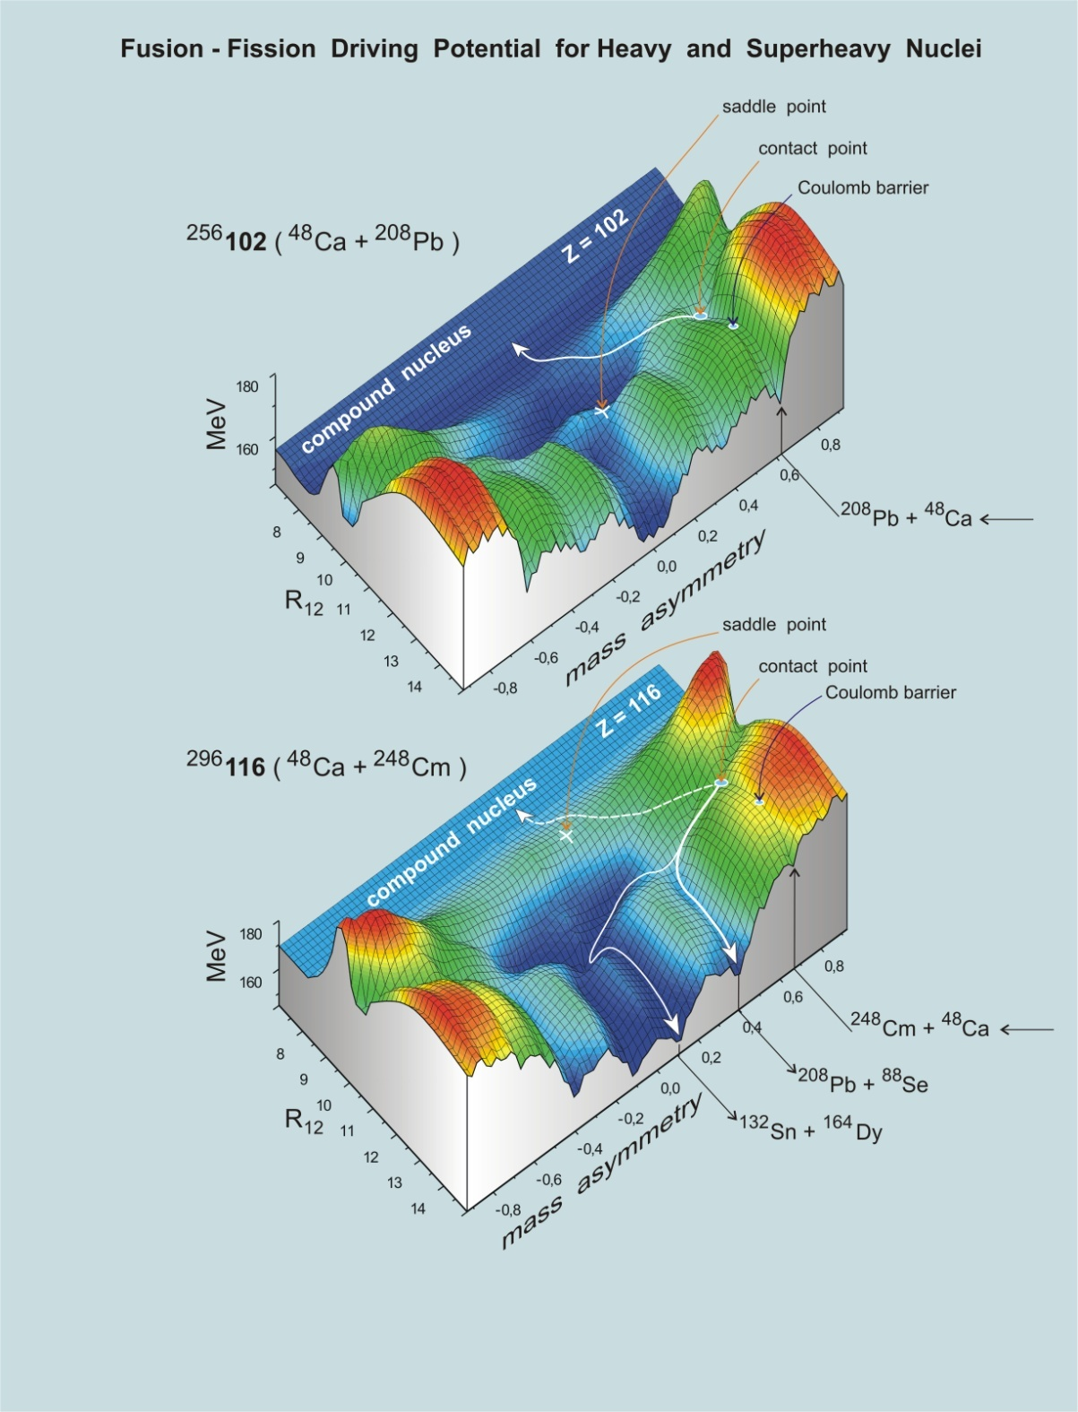
Calculated by V. Zagrebaev

Slide 6
Cold fusion
Hot fusion
Notes:
Cold and hot fusion reactions are characterized by a strongly different entrance channel. Cold fusion reactions involve ²⁰⁸Pb or ²⁰⁸Bi target nuclei and ER with an excitation energy of about 10-15 MeV which leads to a high survival against fission. Hot fusion reactions involve actinide target nuclei and lead to ER with excitation energy between 30 and 60 MeV, which results in higher neutron evaporation and lower survival against fission.
It is readily seen that in the transition from ⁵⁰Ti to ⁸⁶Kr the shape of mass-energy distributions of binary reaction fragments changes strongly due to the QF and deep-inelastic processes. For the ⁵⁰Ti ion the contribution of symmetric fragments into the capture cross-section is around 60%; in the case of ⁸⁶Kr QF and deep-inelastic scattering are dominant processes.
For the heaviest system ¹³⁶Xe + ²⁰⁸Pb the main process is deep-inelastic scattering
For the hot fusion reactions induced by ⁴⁸Ca ions the mass-energy distributions are similar for all the reactions: a pronounced asymmetric QF with heavy fragments near the double magic lead is observed.
The red rectangles show the regions of masses and TKE’s where the main part of CN-ﬁssion fragments is expected.
The comparison between the two sets of mass-TKE matrices shows convincingly that hot fusion reactions are more suitable for producing SHE.

Slide 7
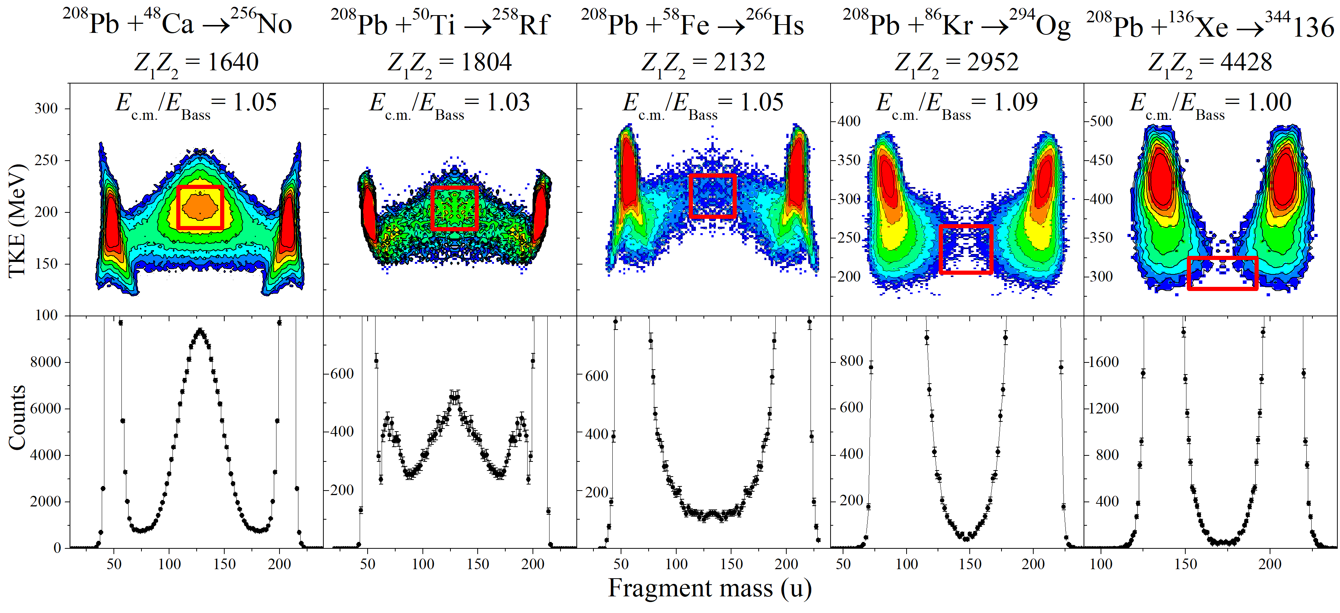
Cold fusion reactions

Slide 8
FLNR 1999
Cold fusion reactions
At the transition from No(Z=102) to Og(Z=118)
the capture cross section drops down
by a factor of 1.5*10³
the contribution of the symmetric fragments (A_{CN}/2±20)
to the capture cross section drops down
by a factor of 5*10⁵

Slide 9
Reactions with ⁴⁸Ca
E* ≈ 33 MeV
FLNR 1999
The sharp change of the MED triangular shape for the reaction ⁴⁸Ca + ²⁰⁸Pb, where Fusion-Fission process dominates, to the Quasifission shape of MED for the ²⁸⁶112-²⁹⁶116 nuclei.
The wide two-humped mass distribution with high peak of heavy fragment near double magic lead (M_{H}≈208 u) for the Quasifission process.
In spite of the dominating role of the Quasifission process for these reactions we assume that in the symmetric region of the fragment masses (A/2±20) FF process coexists with QF.
The Fusion-Fission mass distribution is asymmetric in shape with mass of the light fragment M_{L}≈132-134 u
Yield,%
Fragment mass (u)

Slide 10
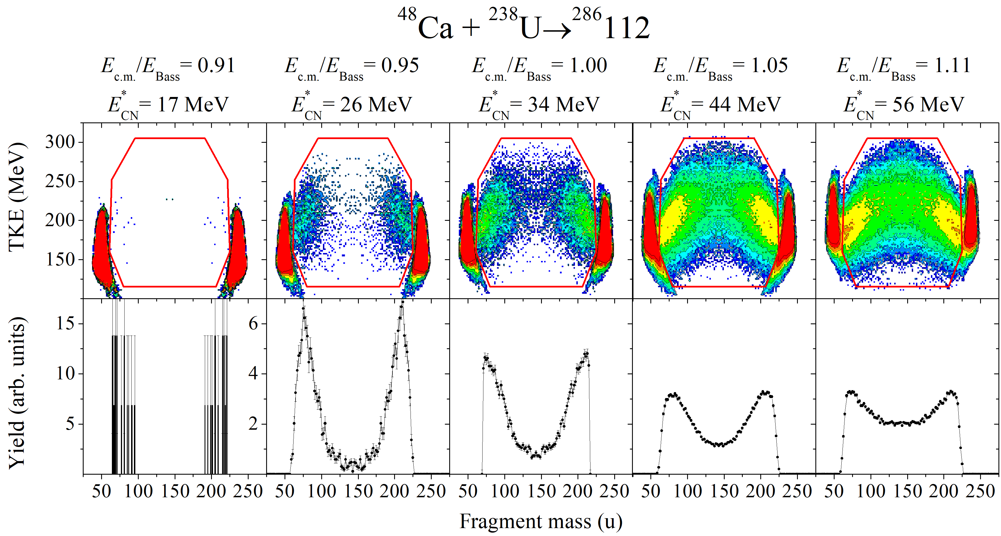
Mass and Energy distributions in the reactions leading to the formation of Z=112

Slide 11
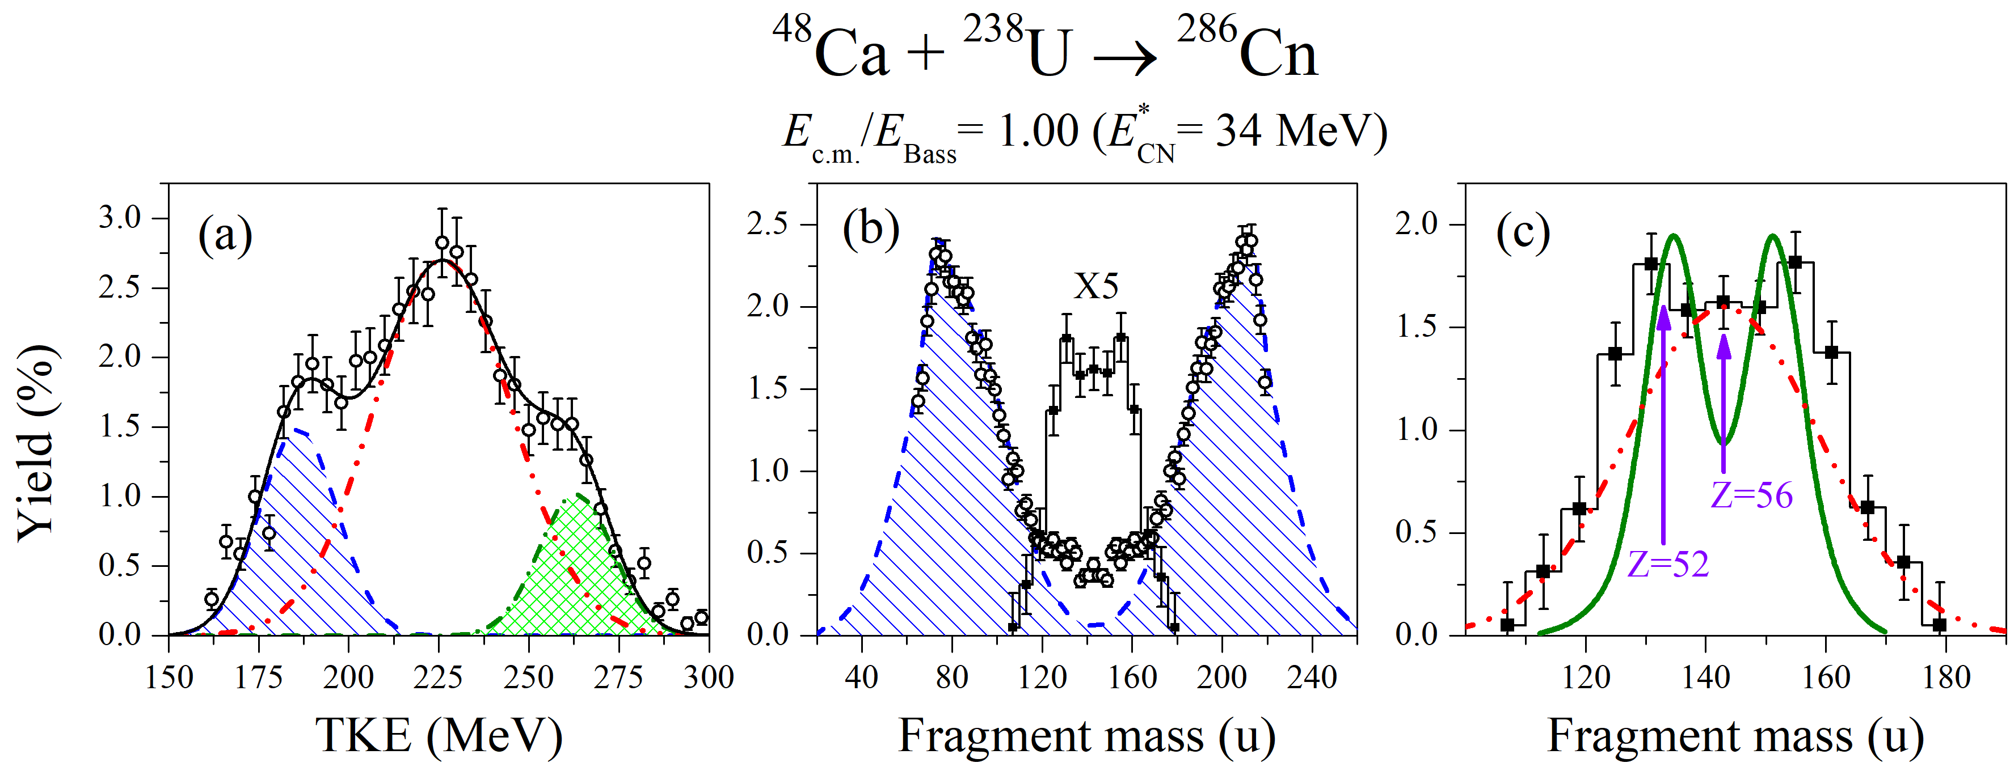
Cn (Z=112)
QF_{asym}
CNF
QF_{sym}
CNF
QF_{asym}
(a) Experimental TKE distribution of fragments (open circles) with masses A_{CN}/2 ± 20 u for the ⁴⁸Ca + ²³⁸U reaction at E_{lab} = 232 MeV
(b) Experimental mass distribution for fissionlike fragments (open circles); estimated asymmetric QF component (dashed blue line); deduced component for CN-fission and symmetric QF scaled up by 5 (filled squares)
(c) Deduced CN-fission and QFsym component (filled squares); dash-dot-dotted line is a Gaussian expected from the LDM;
solid green line is the calculated mass yield of ²⁸⁶Cn fission fragments at E* = 30 MeV from [N. Carjan, F.A. Ivanyuk, Yu.Ts. Oganessian, Phys. Rev. C 99, 064606 (2019)]

Slide 12
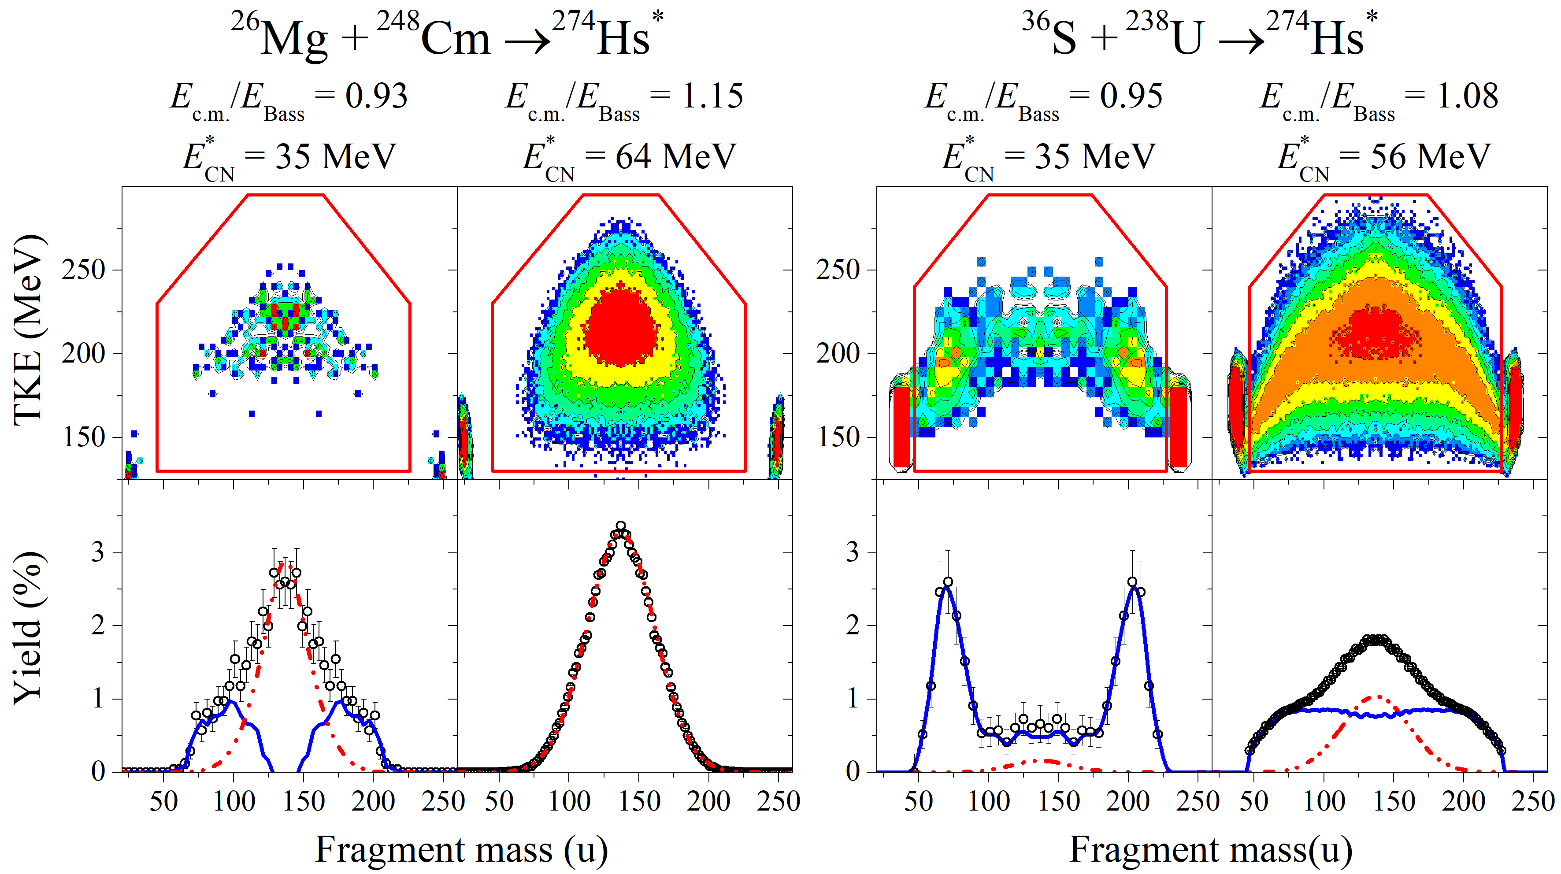
Mass and Energy distributions in the reactions leading to the formation of Hs (Z=108)
QF_{asym}
CNF

Slide 13
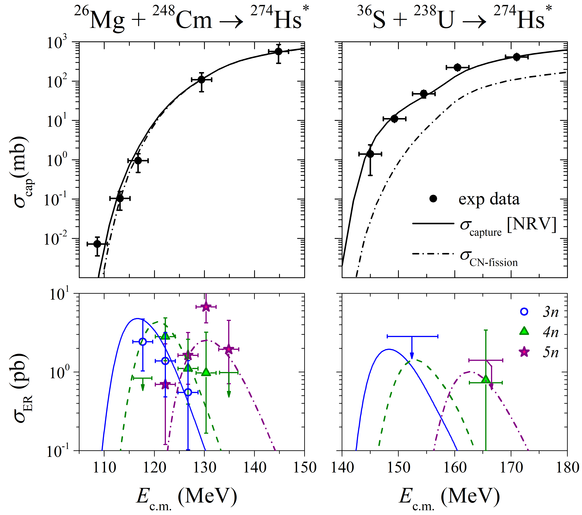
Capture, fusion-fission and ER cross sections for Hs (Z=108)
Cross sections for fissionlike fragments for ²⁶Mg + ²⁴⁸Cm and ³⁶S + ²³⁸U. Solid lines are the coupled-channels calculations with NRV code, dashed-dotted lines are the estimated CN-fission cross sections based on TKE analysis
Excitation functions for 3, 4, and 5n evaporation channels. The solid, dashed, and dashed-dotted curves are the ER cross sections for the 3, 4, and 5n channels evaluated using the values of σ_{CN-fission} and the following Eqs. :

Slide 14
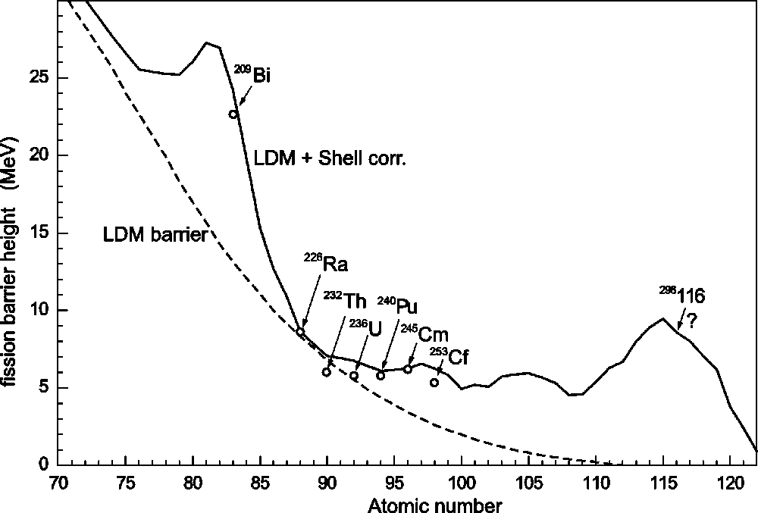
Fission barriers for heavy and superheavy nuclei

Slide 15
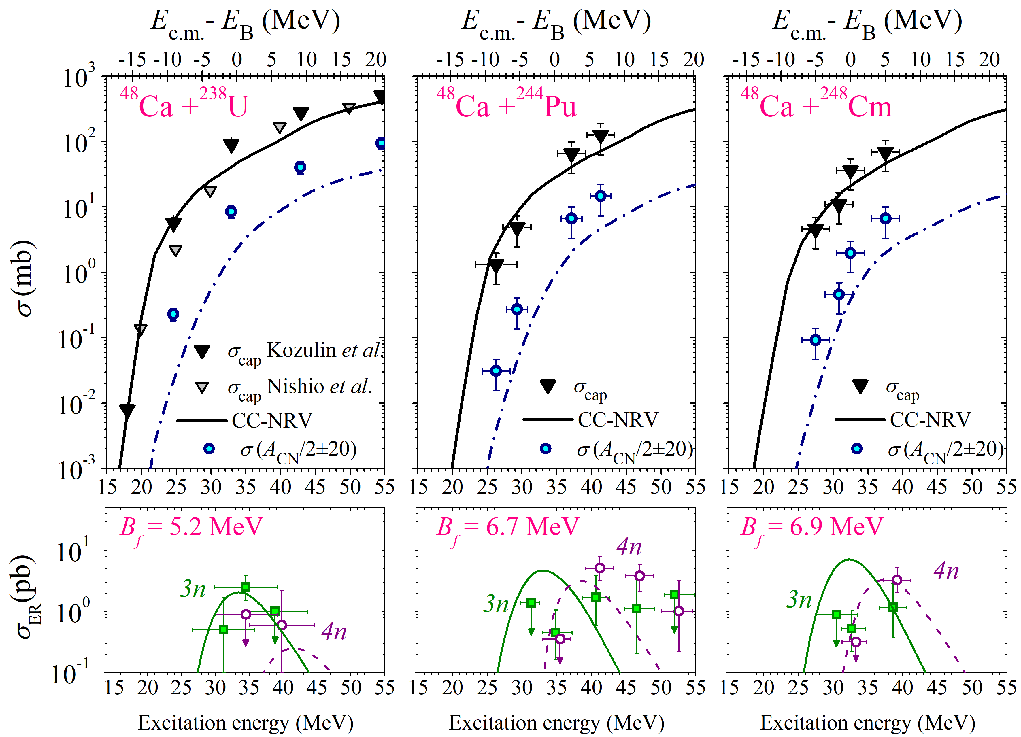
Capture, fusion-fission and ER cross sections
Cn (Z=112) Fl (Z=114) Lv (Z=116)
3n and 4n channels data are from Yu. Ts. Oganessian et al.
Phys. Rev. C 70 (2004) 064609

Slide 16
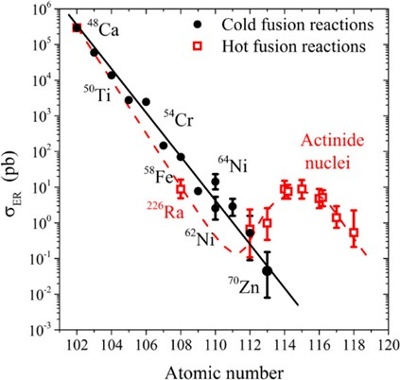
ER cross sections
for Cold and Hot fusion reactions

Slide 17
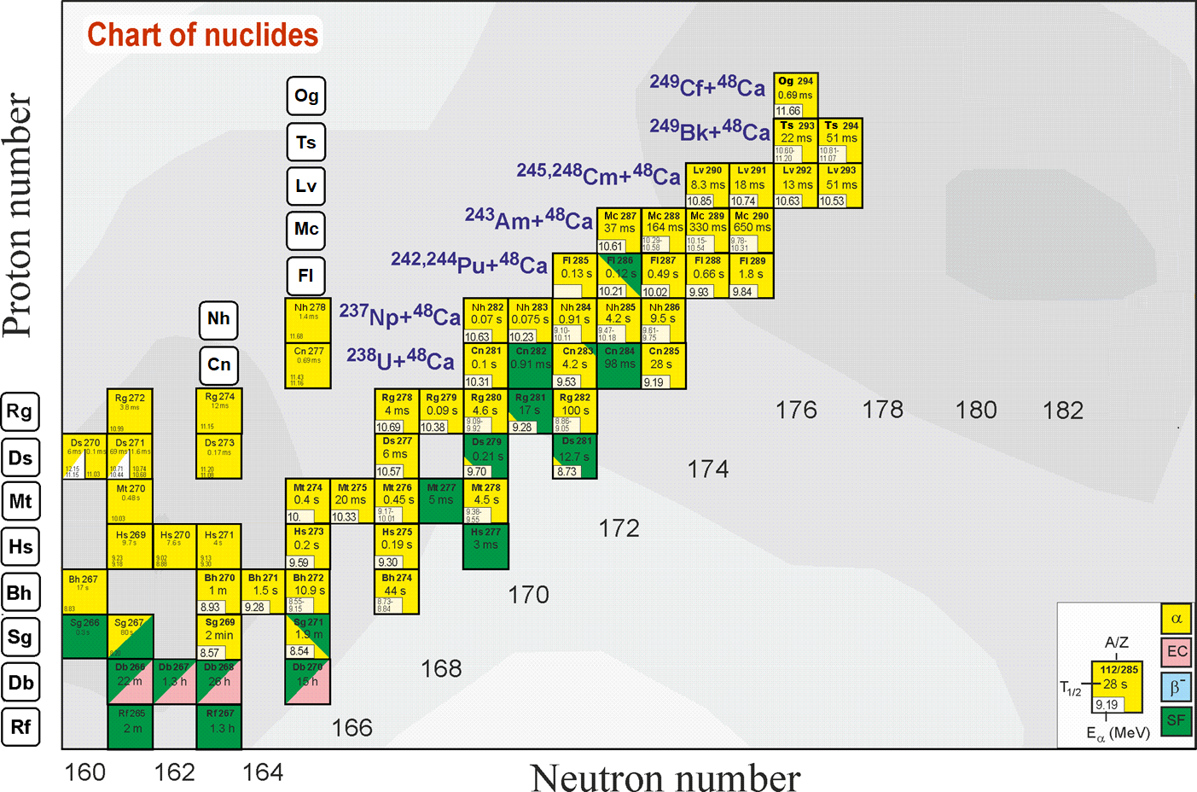
Search for superheavies
Z = 120
What is the next step?
Ti, Cr, Fe, Ni ?
Still far from the “island of stability” !!!
The excitation energies of CN formed in the reactions with Ti and Cr ions are 30-40 MeV at the Coulomb barrier energy that allows to observe 3n and 4n ER channels (similar to ⁴⁸Ca-induced reaction).
However, at the transition to the heavier projectiles, an increase in the Coulomb repulsion between the interacting nuclei gives rise to the quasifission and deep-inelastic processes, which strongly suppress the compound nucleus formation.
Z = 114
184
MNT reactions can be used to produce new neutron-rich SHE
Notes:
60 years ago The existence of island of stability in the region of nuclei with Z = 114 and N = 184 was predicted theoretically [A. Sobiczewski, F. A. Gareev, and B. N. Kalinkin, Phys. Lett. 22, 500 (1966)]
That caused the experimental investigations in the field of the superheavy element (SHE) synthesis.
Nowadays more than 30 isotopes of superheavy elements with Z = 108-118 have been synthesized both in cold an hot fusion reactions
In the Flerov Laboratory of Nuclear Reactions a great success was achieved in the synthesis of superheavy elements in hot fusion reactions of ⁴⁸Ca ions with actinide target nuclei.
Unfortunately, nuclei with Z > 118 cannot be synthesized in ⁴⁸Ca-induced reactions since ²⁴⁹Cf is the heaviest target material available for these purposes.
One of the possible pathways to synthesize new isotopes of superheavy elements with Z = 118 -126 is the reactions of actinide targets with Ti, Cr, Fe and Ni ions.
The interest in damped collisions of heavy nuclei is conditioned by the necessity to find new ways to produce neutron-rich superheavy elements (SHE). Few years ago the inverse (antisymmetrizing) quasifission (QF) process, was proposed to produce SHE in the collisions of transactinides [1]. The low-energy damped collisions of intermediate mass nuclei are less difficult for experimental study than the reactions with transactinides. One may expect that the antisymmetrizing shell effect will be similar in both cases [2].
To study the role of shell effects in inverse QF, the binary reaction channels in the reactions ^{156,160}Gd + ¹⁸⁶W at the Coulomb barrier energy have been investigated. In these reactions the projectile and target nuclei are located between the closed shells with Z = 50, N = 82 (double magic tin) and Z = 82, N = 126 (double magic lead) which should play a significant role in the nucleon transfer process. To form lead-like fragment the projectile nucleus has to transfer about 22 nucleons to the target.

Slide 18
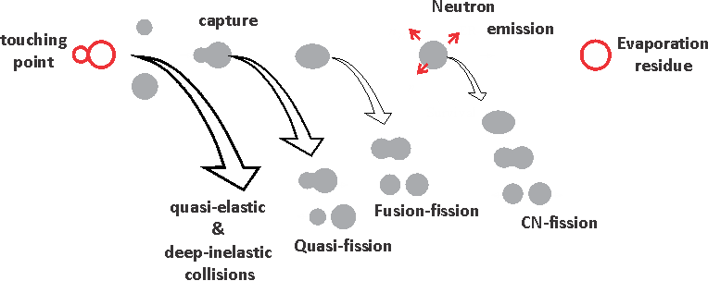
Traffic lights
The first
traffic lights
⁵⁰Ti
⁵⁴Cr
The second
traffic lights
Z=120
touch
capture
survival
asymmetric
quasifission

Slide 19
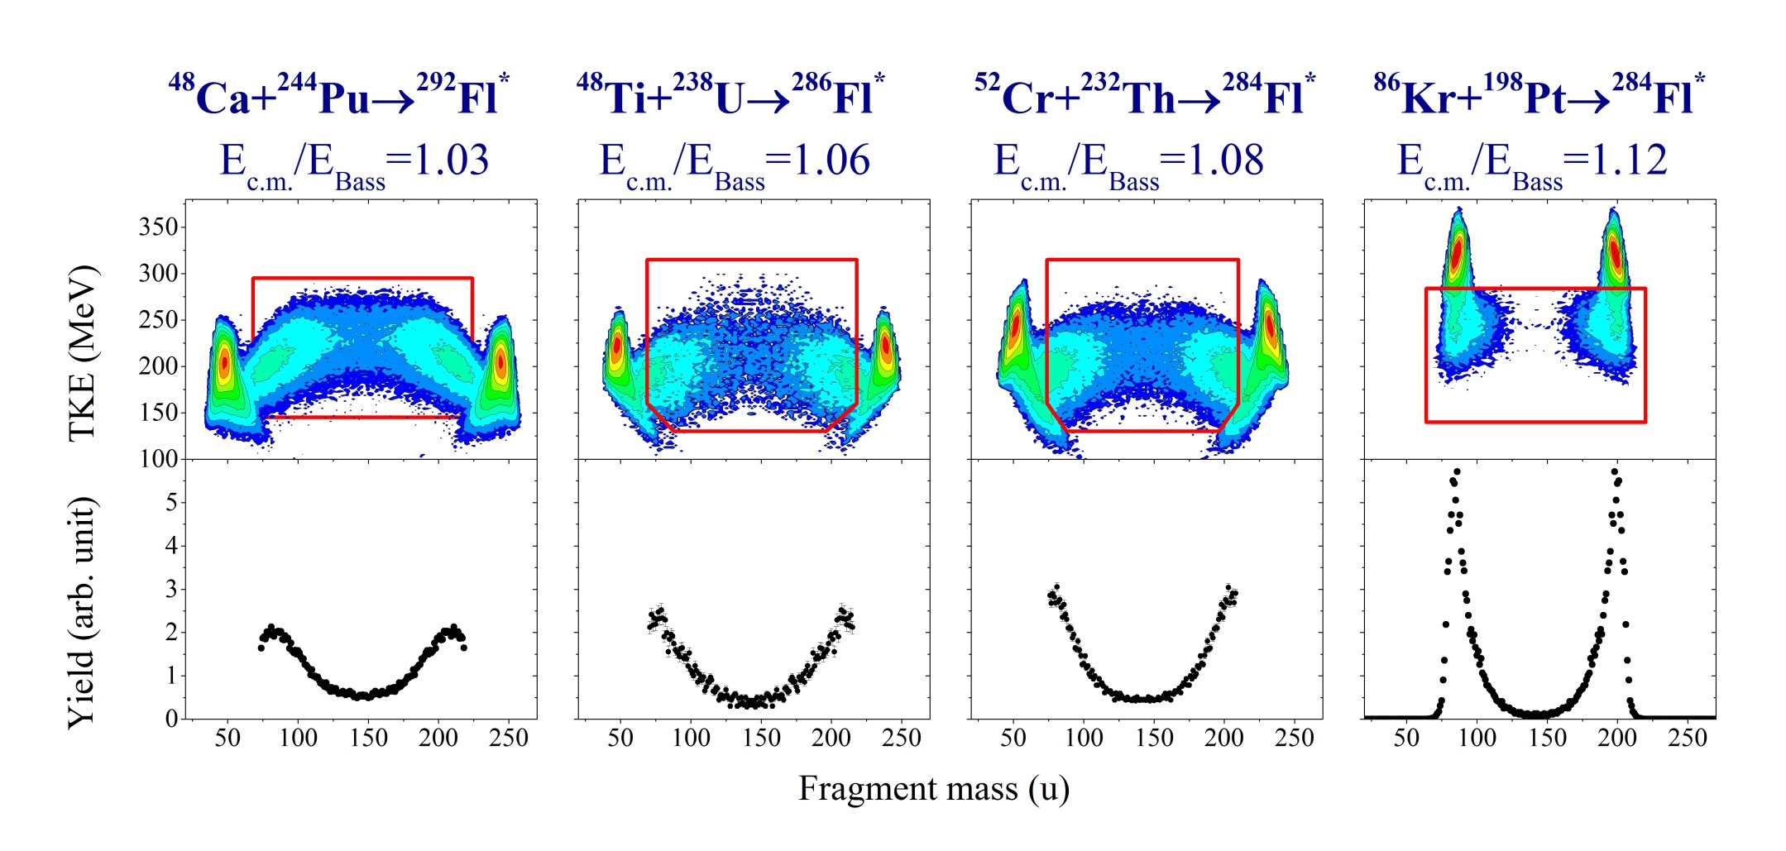
Mass and Energy distributions in the reactions leading to the formation of Fl (Z=114)
QF+CNF
QF+CNF?
QF+CNF?
QF
QF increases
CNF decreases
Z_{t}Z_{p} = 1880
X_{m} = 0.721
Z_{t}Z_{p} = 2024
X_{m} = 0.776
Z_{t}Z_{p} = 2160
X_{m}= 0.806
Z_{t}Z_{p} = 2808
X_{m} = 0.917

Slide 20
Cross sections of symmetric fragment formation
For 4n channel (E*= 40–50 MeV):
⁴⁸Ca + ²³⁸U → ⁴⁸Ca + ²⁴⁴Pu
σ(A_{CN}/2±20) drops ∼2 times
⁴⁸Ca + ²³⁸U → ⁴⁸Ti + ²³⁸U
σ(A_{CN}/2±20) drops ∼10 times
For 3n channel (E*= 30–40 MeV):
⁴⁸Ca + ²³⁸U → ⁴⁸Ca + ²⁴⁴Pu
σ(A_{CN}/2±20) drops ∼10 times
⁴⁸Ca + ²³⁸U → ⁴⁸Ti + ²³⁸U
σ(A_{CN}/2±20) drops ∼100 times
3n
4n
For the studied reactions the excitation energies at the barrier energy vary strongly (36 MeV for Ca + Pu, 44 MeV for Ti + U and 41 MeV for Cr + Th)
It leads to decrease of CS for the Ti + U and Cr + Th for 3n ER channel

Slide 21
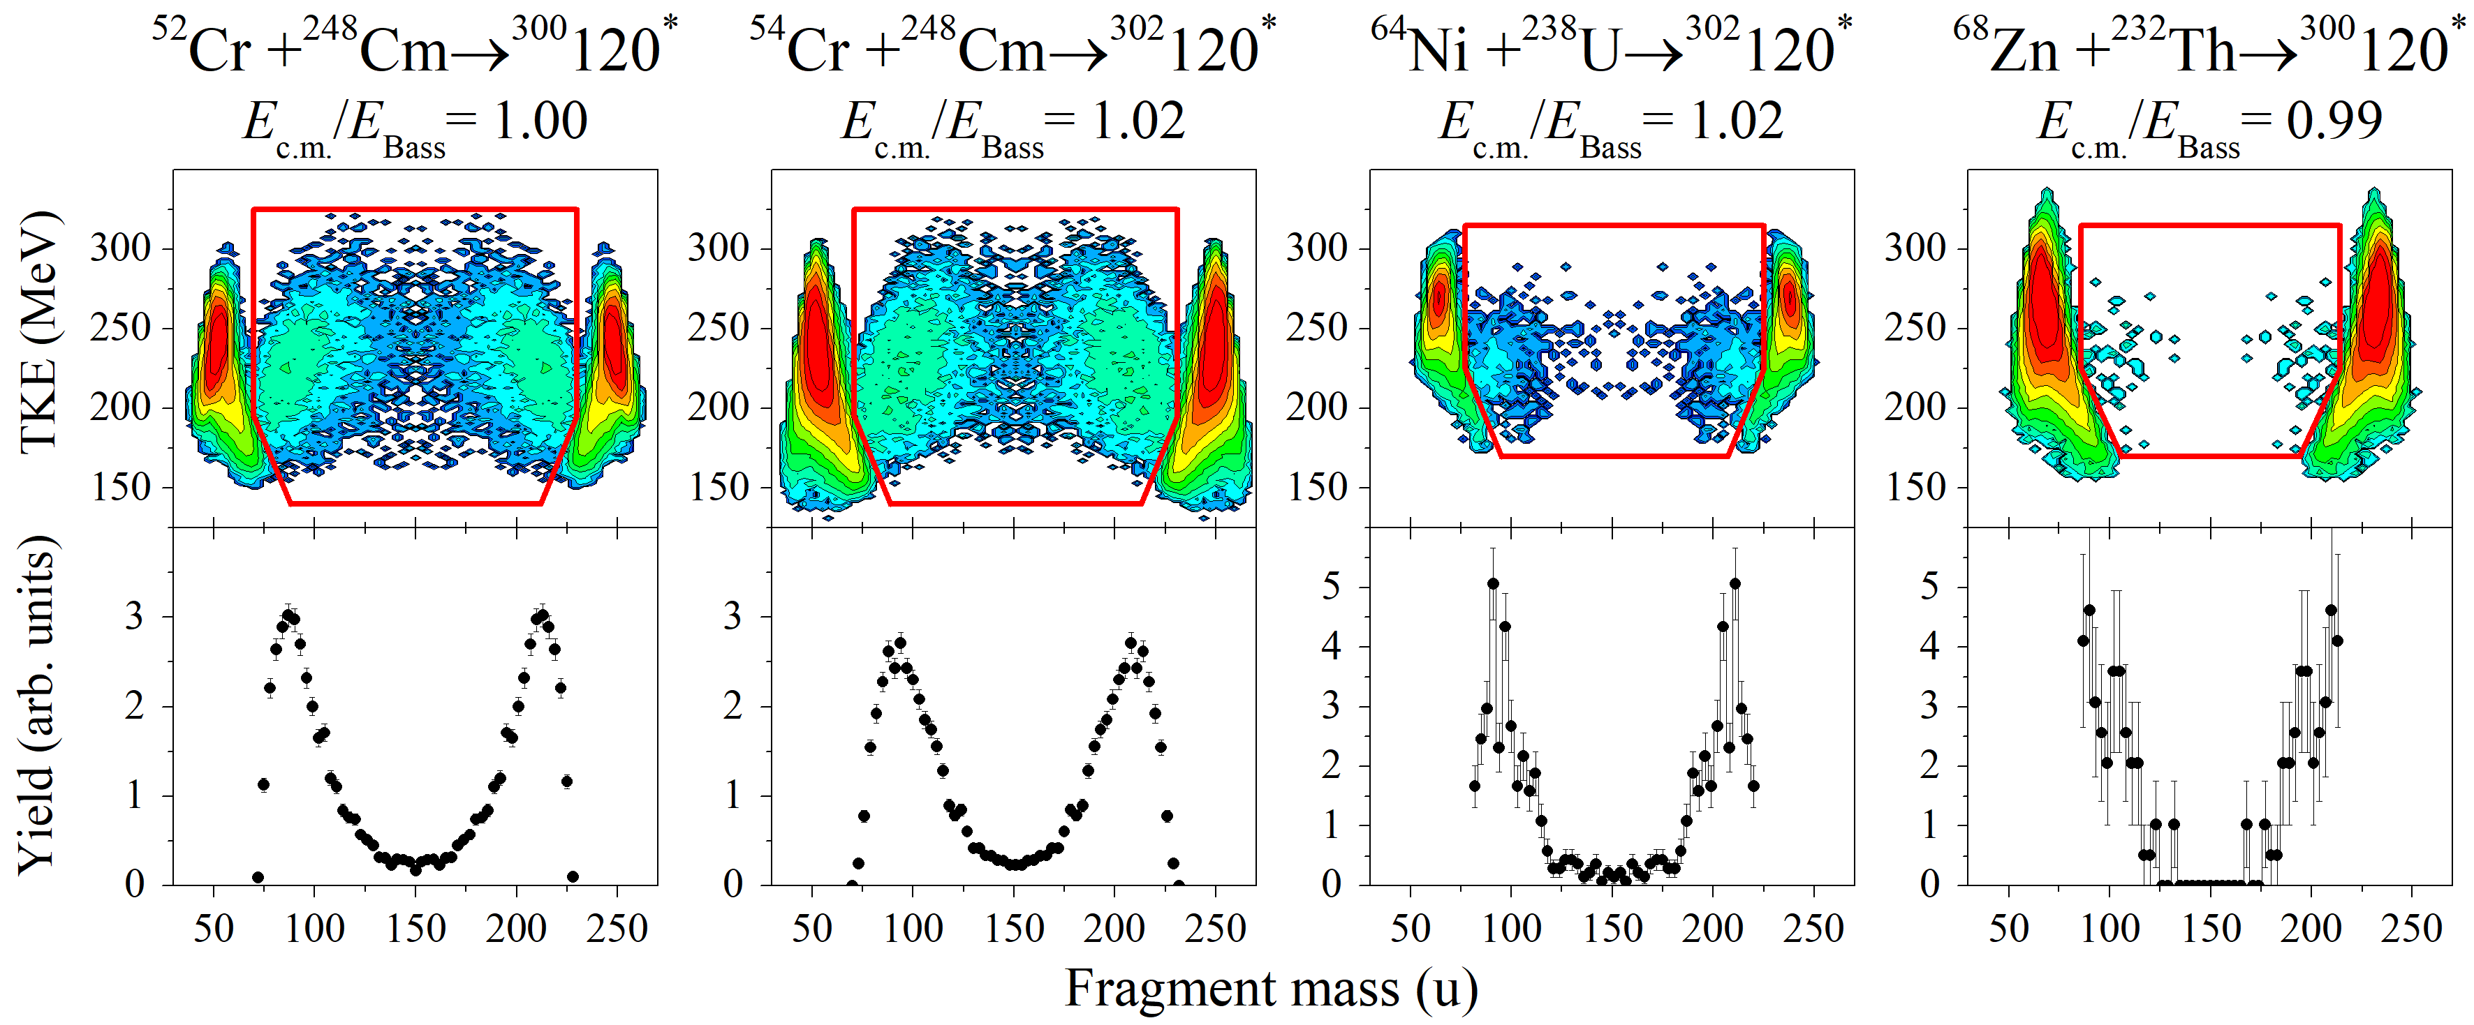
Mass and Energy distributions in the reactions leading to the formation of Z=120

Slide 22
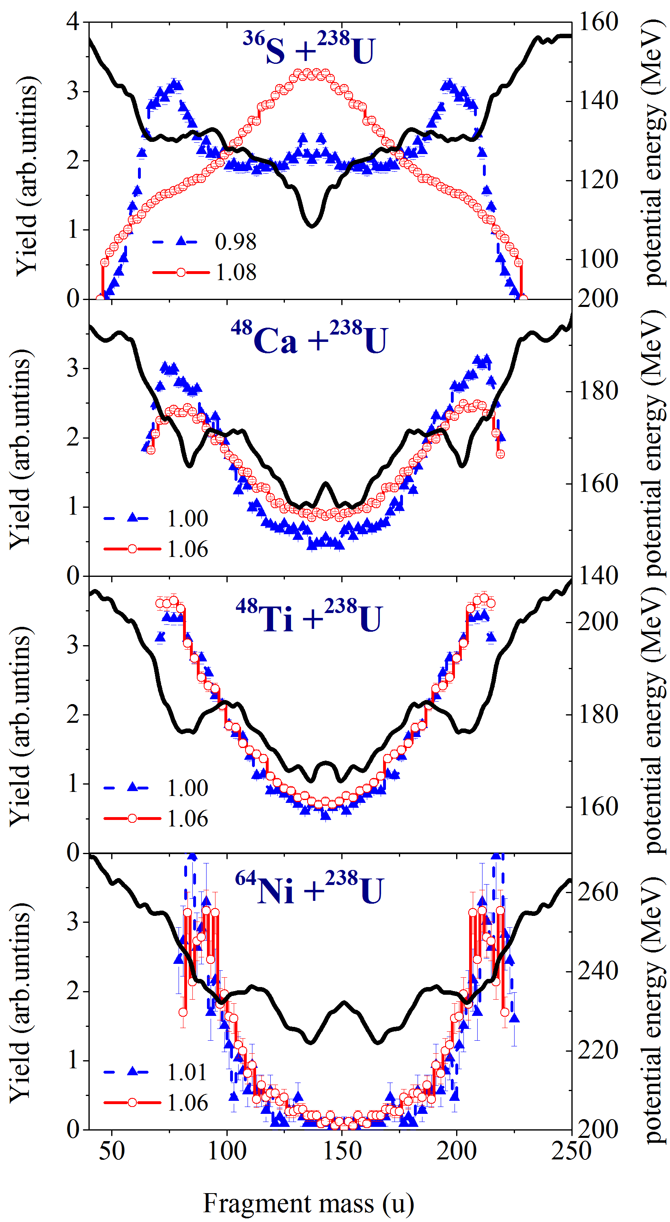
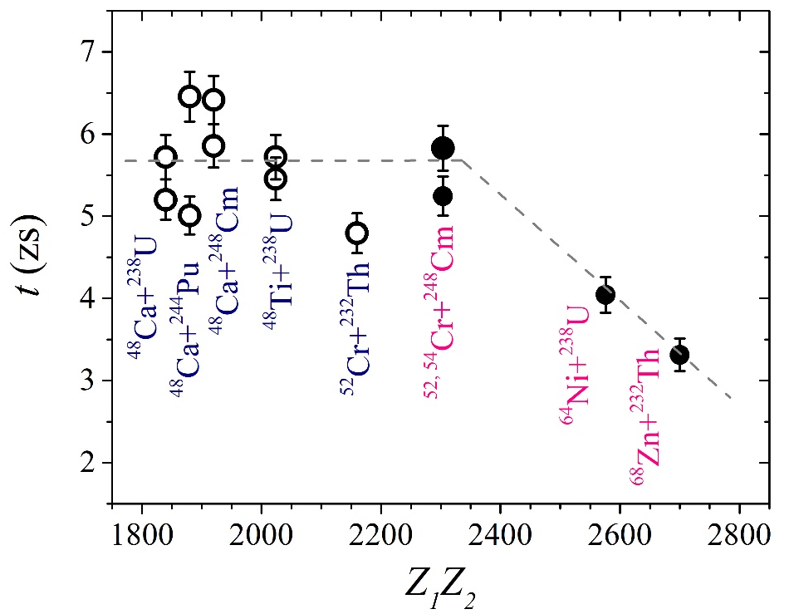
Asymmetric quasifission
J.Toke, NPA 440, 327 (1985)
K.V. Novikov et al., PRC 102, 044605 (2020)

Slide 23
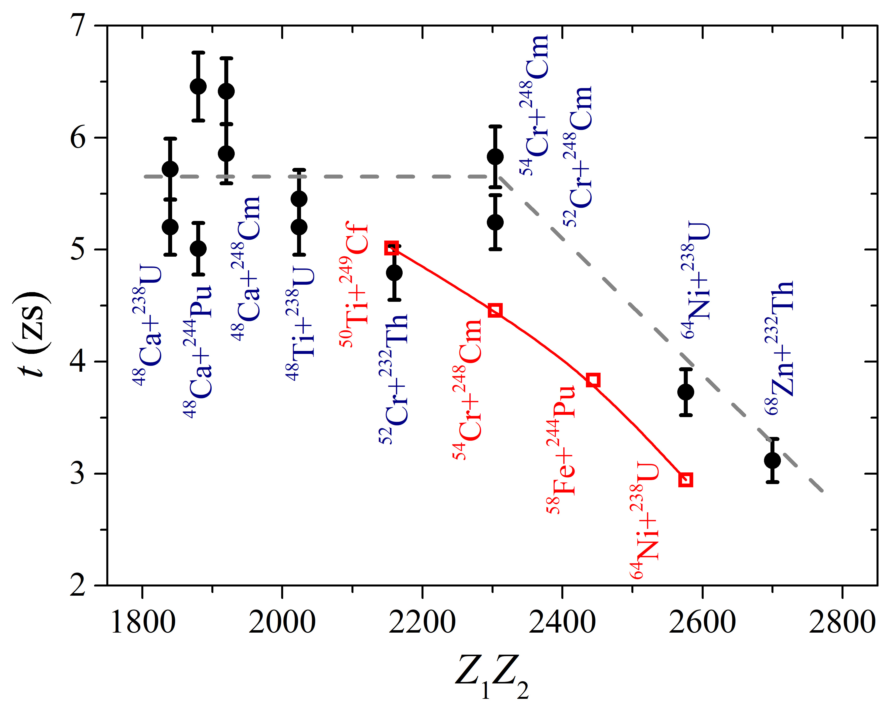
Asymmetric Quasifission Interaction Time
Estimated time for asymmetric QF process for the reactions of ⁴⁸Ca,⁴⁸Ti, ^{52,54}Cr, ⁶⁴Ni, and ⁶⁸Zn with actinide nuclei together with the interaction time for ⁵⁰Ti + ²⁴⁹Cf, ⁵⁴Cr + ²⁴⁸Cm, ⁵⁸Fe + ²⁴⁴Pu, and ⁶⁴Ni + ²³⁸U [H. M. Albers et al., Phys. Lett. B 808, 135626 (2020)]
at energies near the Coulomb barrier.

Slide 24
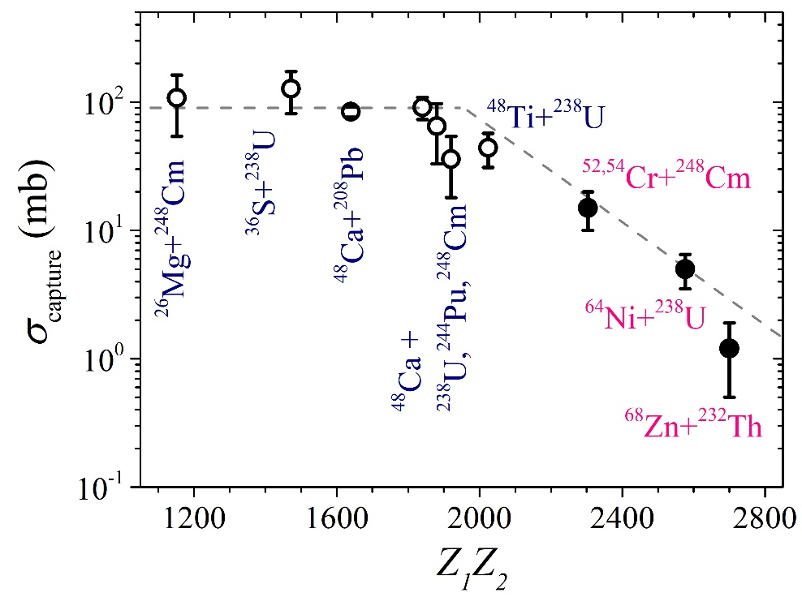
The capture cross sections at E_{c.m.}/E_{B} ≈ 1.00-1.02
σ_{capture} = σ_{QF} + σ_{CNF} + σ_{ER}

Slide 25
Fusion Probability in Cold and Hot fusion reactions

Slide 26
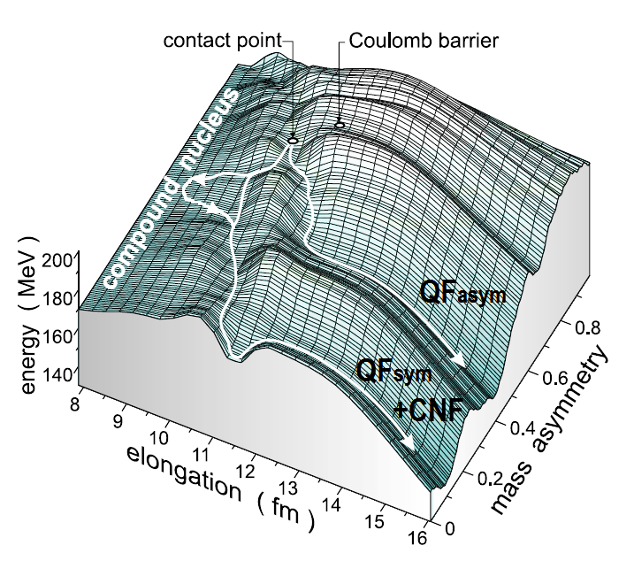
TKE distributions
CNF
QF_{asym}
QF_{sym}
A_{CN} /2±20 u
Notes:
It is clearly seen that the TKE distributions change markedly showing nearly Gaussian shape in the case of ³⁶S and ⁴⁸Ca ions and two-humped shape for the reactions with ⁴⁸Ti and ⁶⁴Ni.
One may speculate about the presence of other processes together with the CN fission in the symmetric mass region for ³⁶S, ⁴⁸Ca, ⁴⁸Ti, ⁶⁴Ni + ²³⁸U reactions.
We assume that the mass-symmetric fragments may be formed by three different modes: CN fission, symmetric QF (QFsym) and a tail of asymmetric QF process.
To evaluate the contribution of the CN-fission process in the symmetric mass region we decomposed the TKE distributions as a sum of three Gaussians. One of them is associated with the CN-fission process (filled region). We fix mean value and variance of this component to the values obtained from the systematics
The low energy component is attributed to QFasym while the high energy one is connected with QFsym.

Slide 27
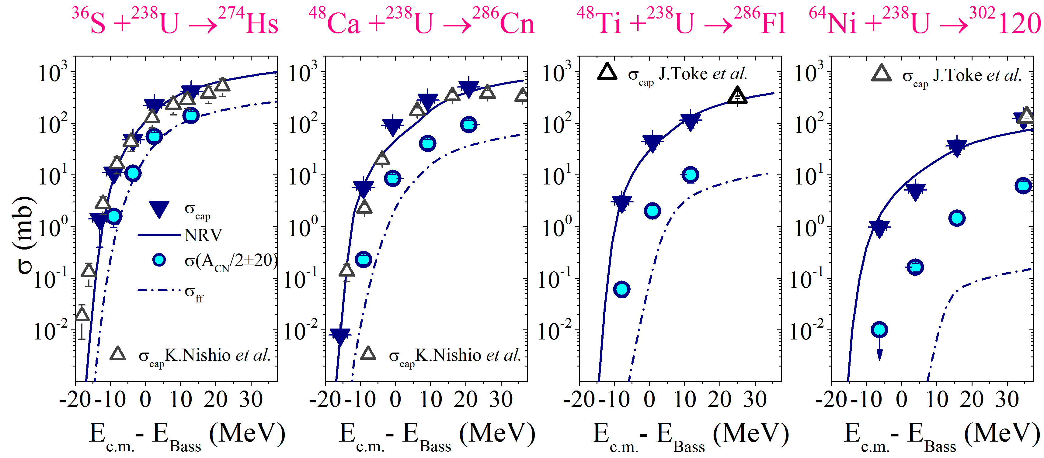
Capture, symmetric fission (A/2±20) and CN-fission (upper limit) cross sections in the reactions with ³⁶S, ⁴⁸Ca, ⁴⁸Ti and ⁶⁴Ni
Z_{t}Z_{p} = 1472
Z_{t}Z_{p} = 1840
Z_{t}Z_{p} = 2024
Z_{t}Z_{p} = 2576
E.M. Kozulin et al., PRC 94, 054613 (2016)
Notes:
The absolute differential cross sections for all fissionlike events observed in the reactions ³⁶S, ⁴⁸Ca, ⁴⁸Ti, ⁶⁴Ni + ²³⁸U were measured at an angle θ_{c.m.} ≈ 90° at energies near the Coulomb barrier.
Capture cross sections σ_{capture} for all fissionlike events were estimated assuming that the angular distribution is proportional to sin⁻¹θ_{c.m.} This procedure seemed the most reasonable since detailed angular distributions are not available at present, as well as any model (theory) for the angular distribution of fragments produced in the QF process
The cross sections for the formation of symmetric fragments with masses A_{CN}/2±20 u as well as CN-fission cross section σ_{ff} deduced from the obtained fusion probabilities and capture cross sections are also presented (dashed-dotted lines)
The capture cross sections decrease at the transition from ³⁶S ions to ⁶⁴Ni.
At energies above the barrier the capture cross sections for the reactions ³⁶S + ²³⁸U and ⁴⁸Ca + ²³⁸U are close to the geometrical cross sections, while for the ⁴⁸Ti + ²³⁸U reaction it is about 60% of geometrical cross section and about 15% in the case of the ⁶⁴Ni ions.

Slide 28
Fusion Probability
Fusion
Probability
drops down
⁵⁰Ti + ²⁴⁸Cm → ²⁹⁸Og
>10 times
50-100 times

Slide 29
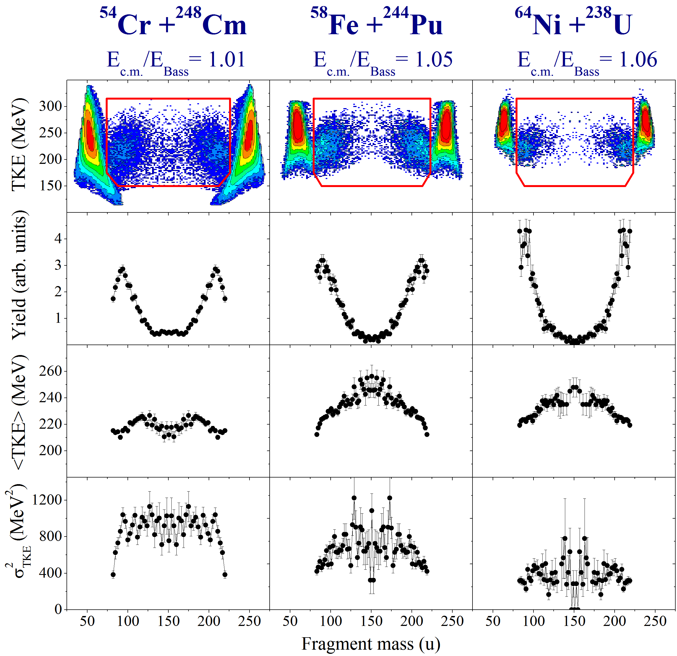
Mass and Energy distributions in the reactions
leading to the formation of Z=120

Slide 30
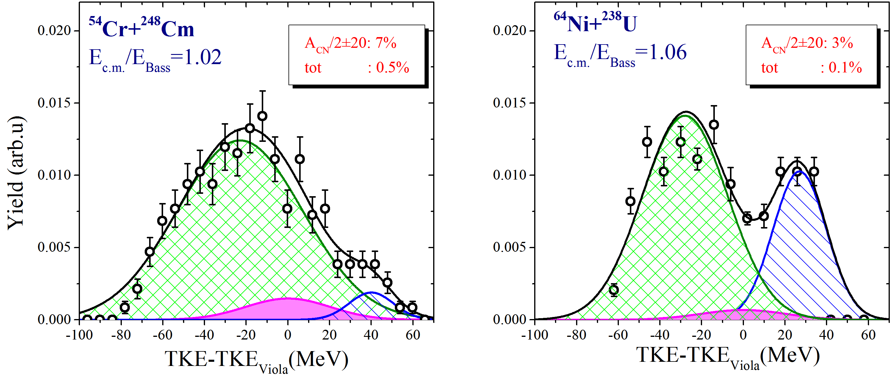
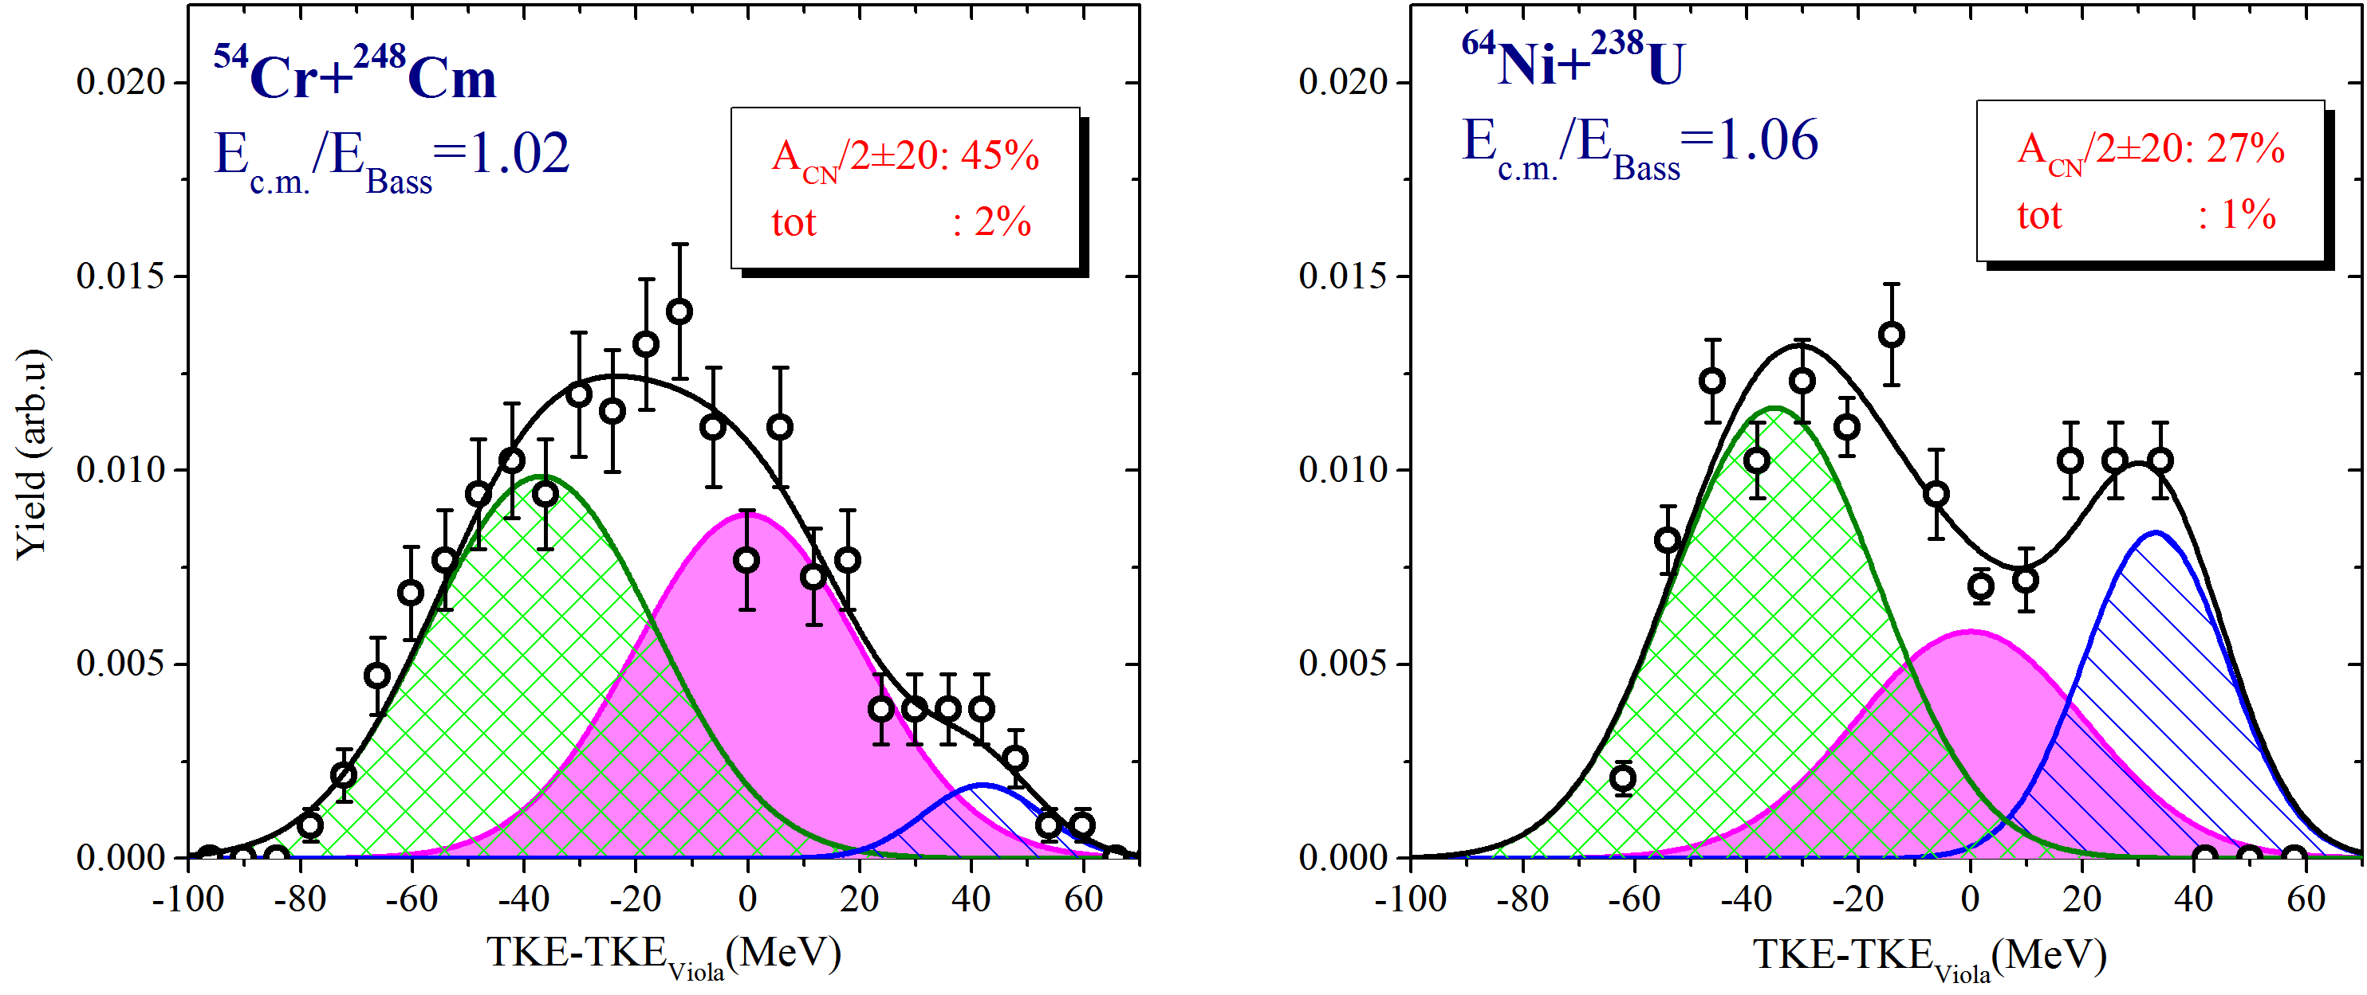
TKE distributions for symmetric fragments
Maximal contribution of CN-fission component
Variance of QFasym is fixed

Slide 31
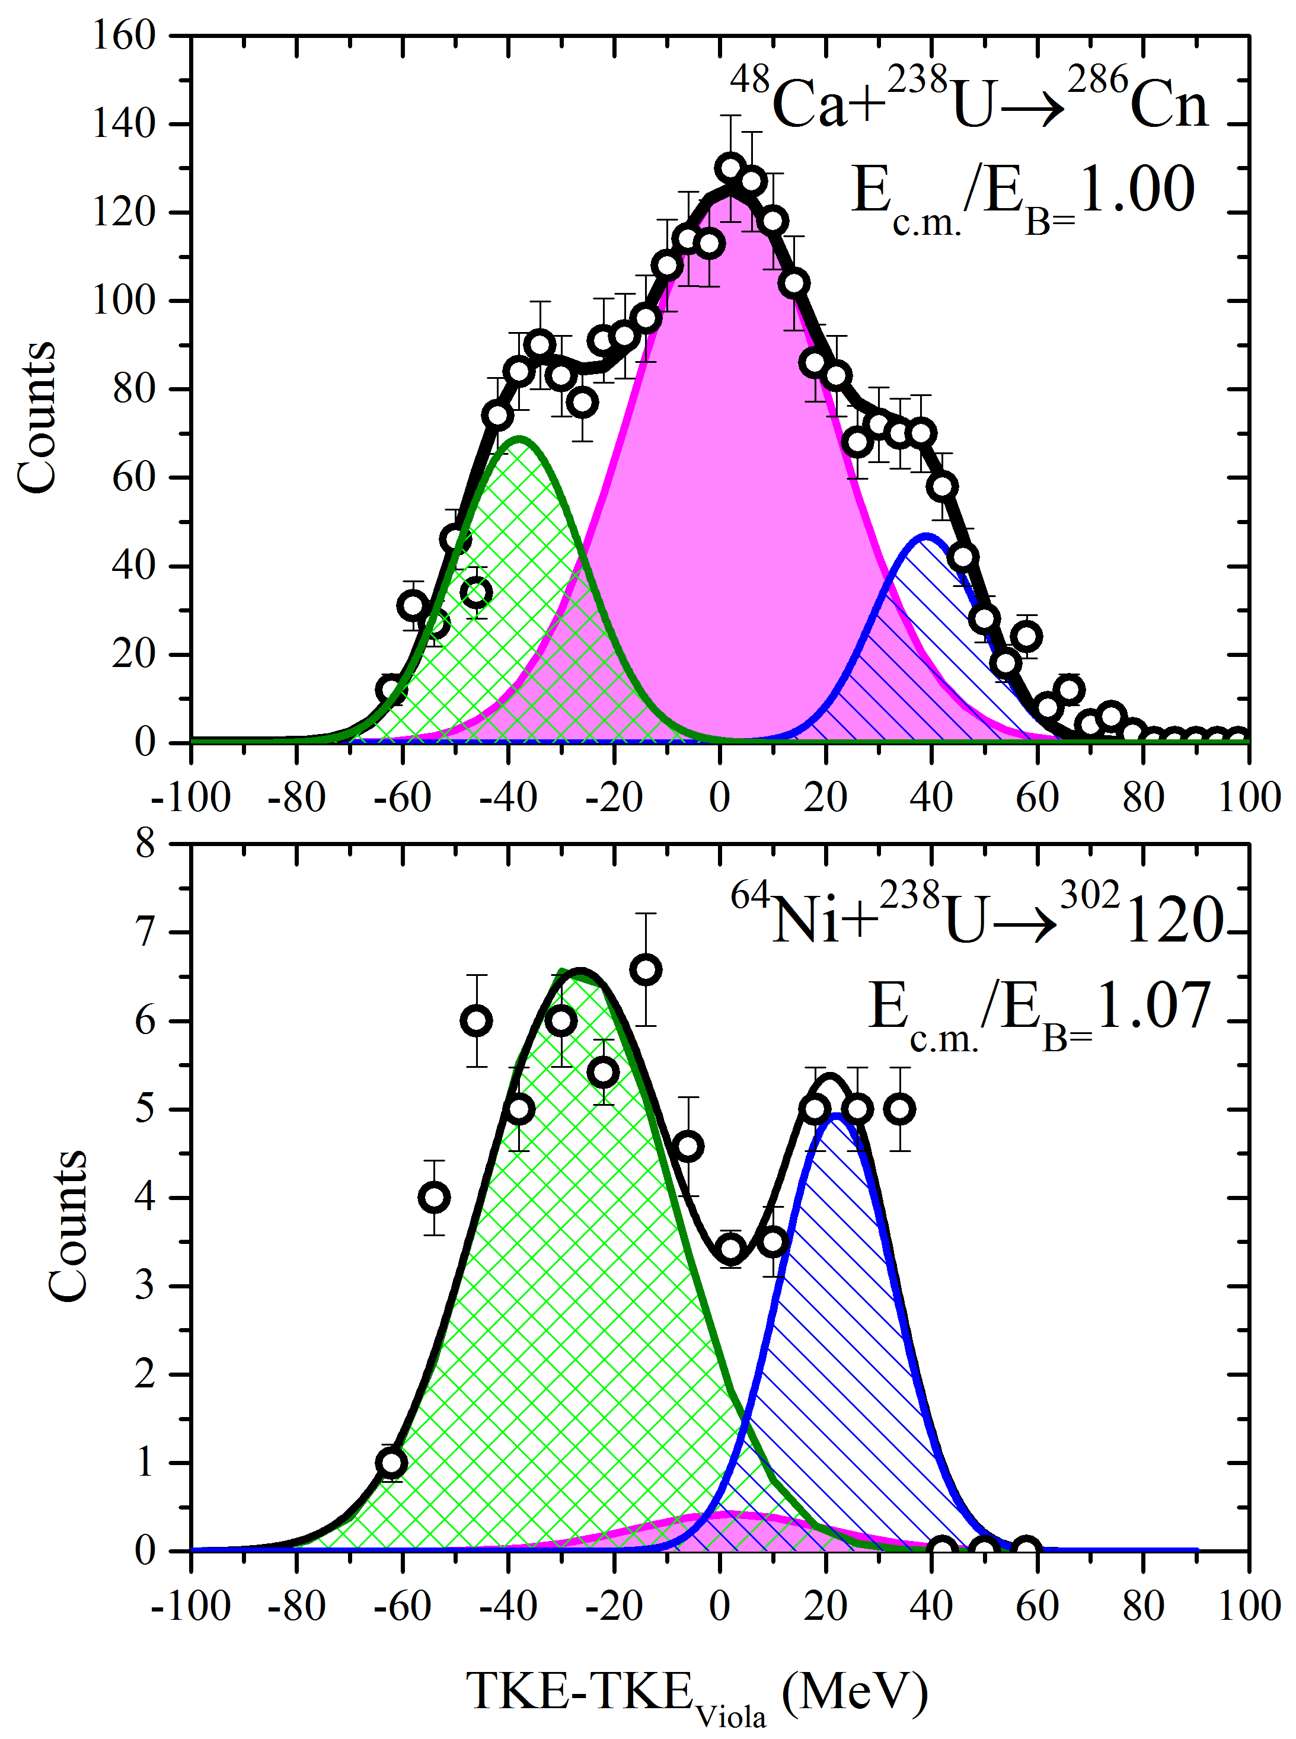
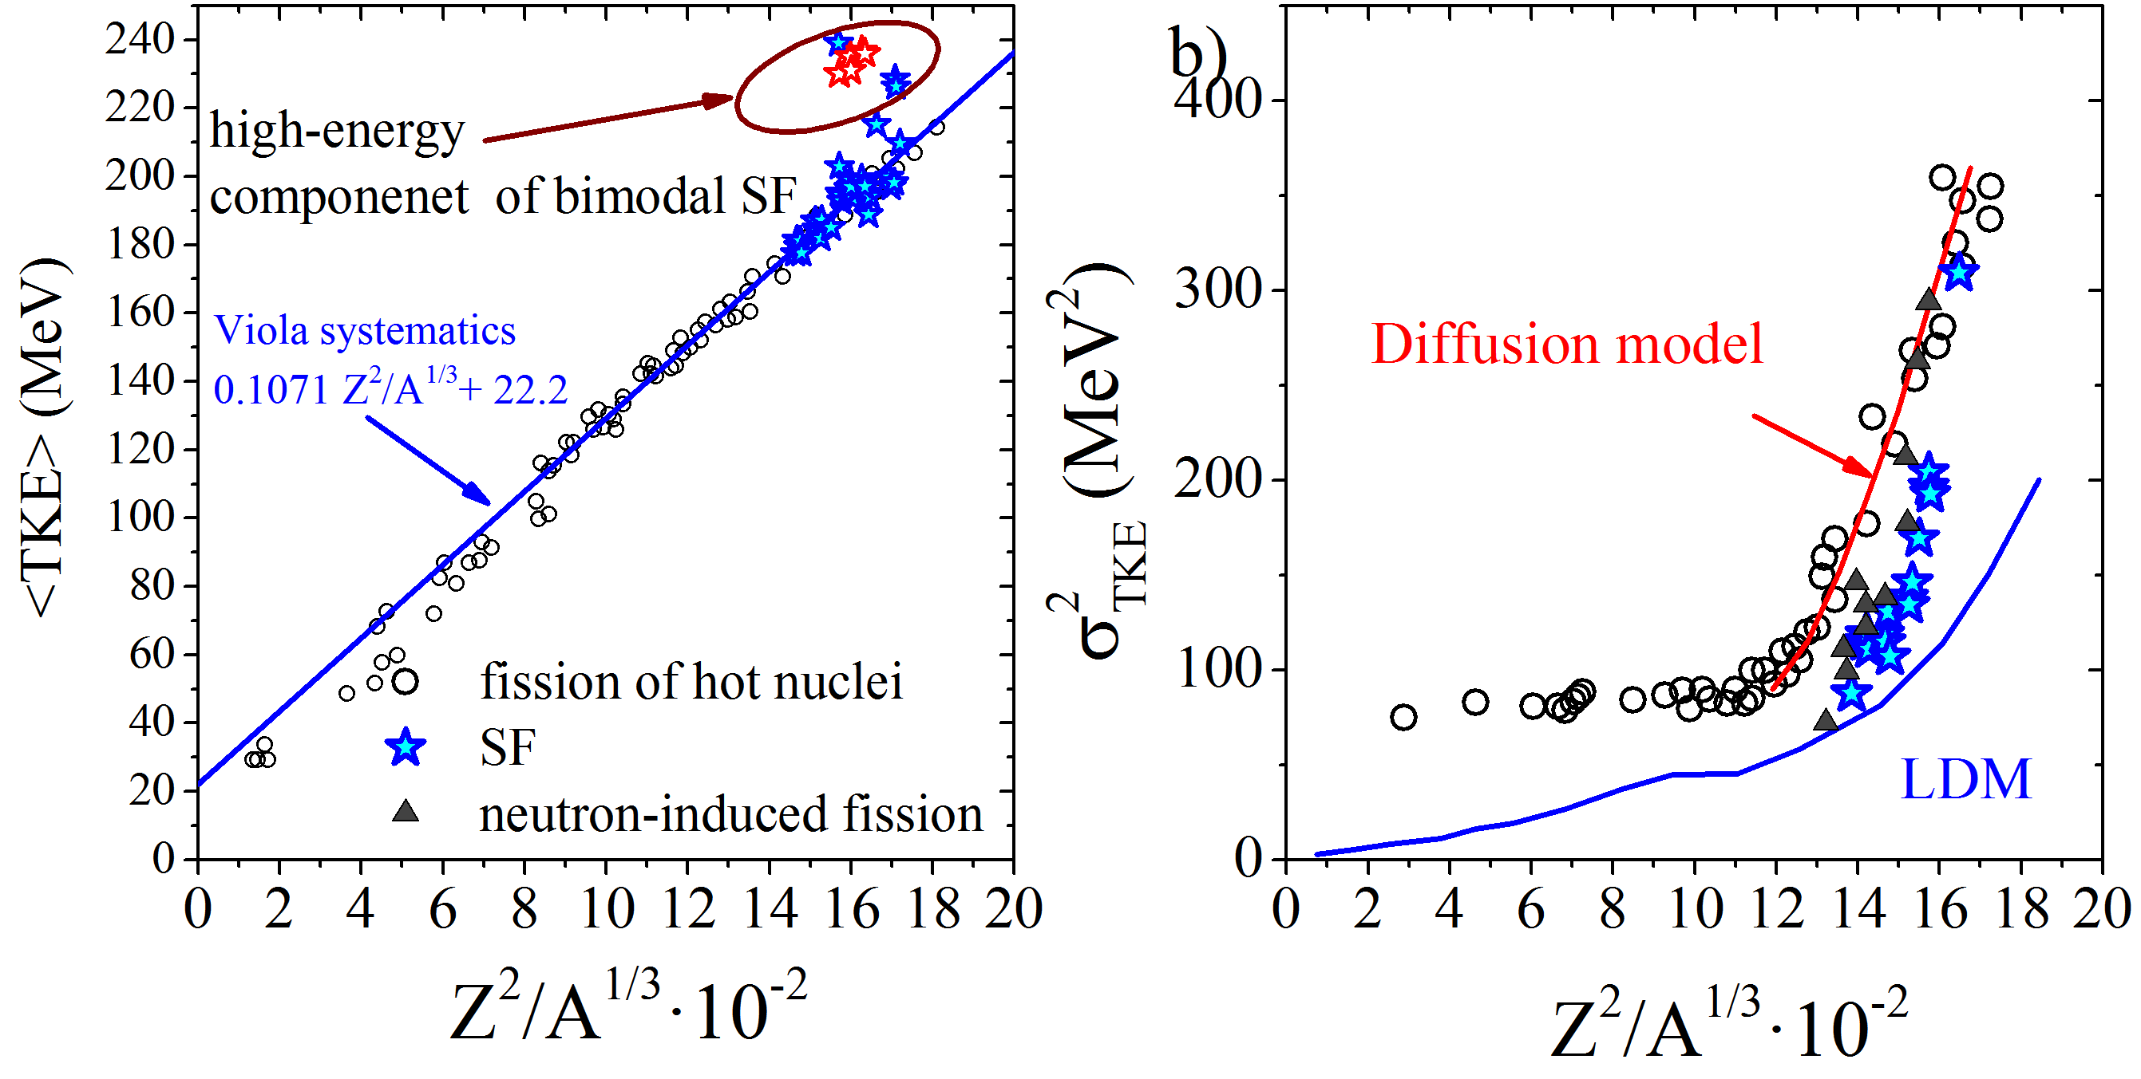
TKE distributions of symmetric fragments
E.M. Kozulin et al., PLB 686 (2010)
A_{CN}/2±20u
M.G. Itkis, Phys. Part. Nucl. 29 (1998)

Slide 32
Reaction mechanisms in dependence on Z₁Z₂
Z₁Z₂ | Reactions with actinide targets | Reaction mechanisms
1472 | ³⁶S + ²³⁸U (Z_{CN} = 108) | At energies below the Coulomb barrier the dominant reaction channel is asymmetric quasifission. At energies above the barrier, the upper limits for CN-fission is ∼30%.
1840÷ 1920 | ⁴⁸Ca + ²³⁸U,²⁴⁴Pu,²⁴⁸Cm (Z_{CN} = 112, 114, 116) | The dominant process is asymmetric quasifission. At energies above the barrier, the upper limits for CN-fission is ∼5-10%.
2024÷ 2304 | ⁴⁸Ti + ²³⁸U, ⁵²Cr + ²³²Th, ^{52,54}Cr + ²⁴⁸Cm (Z_{CN} = 114, 114, 120) | The dominant process is asymmetric quasifission. At energies above the barrier – the upper limits for CN-fission is ∼0.1-1%.
2576÷ 2700 | ⁶⁴Ni + ²³⁸U,⁶⁸Zn + ²³²Th (Z_{CN} = 120) | The dominant processes are deep-inelastic collisions and a few nucleon transfer. The formation of symmetric fragment even in QF is strongly suppressed.

Slide 33
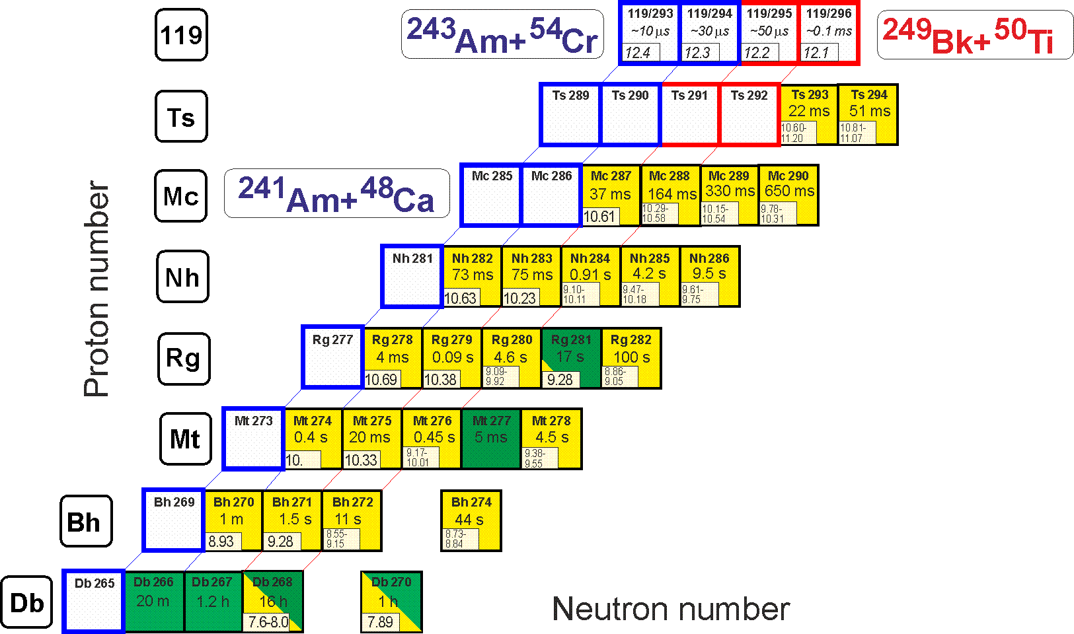
Synthesis of Element 119: ²⁴³Am+⁵⁴Cr (1) ²⁴⁹Bk+⁵⁰Ti (2)
σ = 0.05 pb, h_{t} = 0.4 mg/cm², ε_{coll} = 0.7+, I_{beam} = 3 pμA → ≈1 event per month

Slide 34
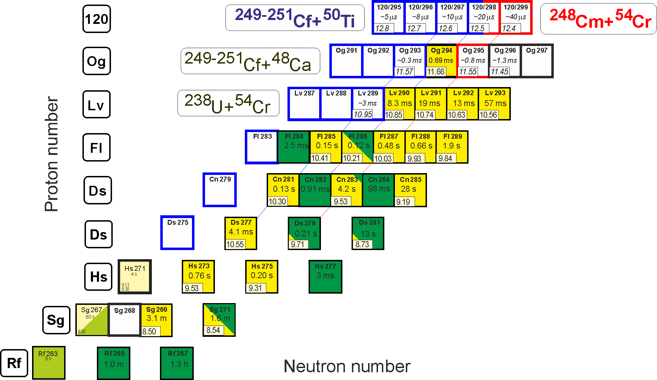
Synthesis of Element 120: ²⁴⁹⁻²⁵¹Cf+⁵⁰Ti (1) ²⁴⁸Cm+⁵⁴Cr (2)
σ = 0.05 pb, h_{t} = 0.4 mg/cm², ε_{coll} = 0.7+, I_{beam} = 3 pμA → ≈1 event per month

Slide 35
Search for superheavies
What is the next step?
Ti, Cr, Ni, Fe ?
Z = 120
Still far from the “island of stability” !!!
The limitation to form more neutron-rich superheavy nuclei by complete fusion reactions with stable beams triggers the search for other SHE production approaches.
Z = 114
184
MNT reactions can be used to produce new neutron-rich SHE
Notes:
50 years ago The existence of island of stability in the region of nuclei with Z = 114 and N = 184 was predicted theoretically [A. Sobiczewski, F. A. Gareev, and B. N. Kalinkin, Phys. Lett. 22, 500 (1966)]
That caused the experimental investigations in the field of the superheavy element (SHE) synthesis.
Nowadays more than 30 isotopes of superheavy elements with Z = 108-118 have been synthesized both in cold an hot fusion reactions
In the Flerov Laboratory of Nuclear Reactions a great success was achieved in the synthesis of superheavy elements in hot fusion reactions of ⁴⁸Ca ions with actinide target nuclei.
Unfortunately, nuclei with Z > 118 cannot be synthesized in ⁴⁸Ca-induced reactions since ²⁴⁹Cf is the heaviest target material available for these purposes.
One of the possible pathways to synthesize new isotopes of superheavy elements with Z = 118 -126 is the reactions of actinide targets with Ti, Cr, Fe and Ni ions.
The interest in damped collisions of heavy nuclei is conditioned by the necessity to find new ways to produce neutron-rich superheavy elements (SHE). Few years ago the inverse (antisymmetrizing) quasifission (QF) process, was proposed to produce SHE in the collisions of transactinides [1]. The low-energy damped collisions of intermediate mass nuclei are less difficult for experimental study than the reactions with transactinides. One may expect that the antisymmetrizing shell effect will be similar in both cases [2].
To study the role of shell effects in inverse QF, the binary reaction channels in the reactions ^{156,160}Gd + ¹⁸⁶W at the Coulomb barrier energy have been investigated. In these reactions the projectile and target nuclei are located between the closed shells with Z = 50, N = 82 (double magic tin) and Z = 82, N = 126 (double magic lead) which should play a significant role in the nucleon transfer process. To form lead-like fragment the projectile nucleus has to transfer about 22 nucleons to the target.

Slide 36
²³⁸U+²³⁸U→²⁰⁸Pb*+²⁶⁸No*
Cross section of No after deexcitation
σ∼10⁻⁷mb
²³⁸U+²³⁸U→²⁰⁸Pb*+²⁶⁸No* → ²⁰⁸Pb* +ff1+ff2
Primary formation cross section of No σ∼10 mb

Slide 37
⁴⁸Ca + ²⁴⁸Cm ( E_{c.m.}/E_{B} = 1.00)
Normal
← Quasifission →
Inverse
¹⁶⁰Gd + ¹⁸⁶W
(E_{c.m.}/E_{B} = 1.01)
The inverse quasifission process proposed to produce SHE in collisions of transactinides and the role of shell effects in inverse QF can be studied in the experiments with less heavy nuclei [V. Zagrebaev and W. Greiner, J.Phys.G 34 (2007) 2265].

Slide 38
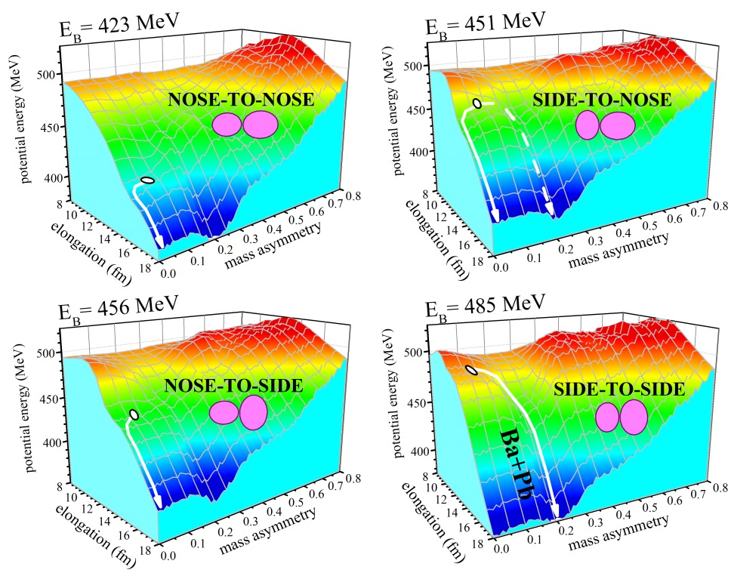
Choice of interacting energy for ²³⁸U+²³⁸U test
Barrier | MeV | AMeV
Nose-To-Nose | 700 | 5.9
Nose-To-Side | 760 | 6.4
Side-To-Side | 800 | 6.7
Bass | 754 | 6.3
The energy of 7MeV/nucl is higher than the barrier for Side-To-Side collision for the reaction ²³⁸U+²³⁸U. It increases the probability to transfer large numbers of nucleons between the interacting nuclei.
¹⁶⁰Gd+¹⁸⁶W
Calculated by A. Karpov
From E.M. Kozulin et al, Phys.Rev. C96, 064621 (2017)
50
Times!

Slide 39
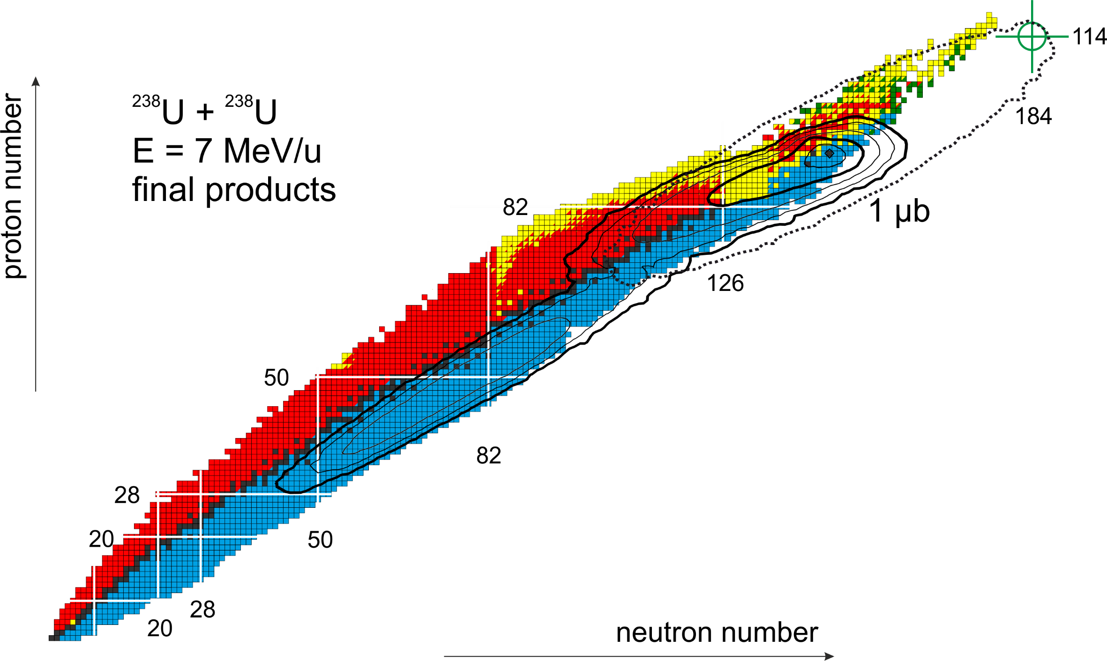
Multinucleon transfer processes in U + U reaction
excited
cold

Slide 40
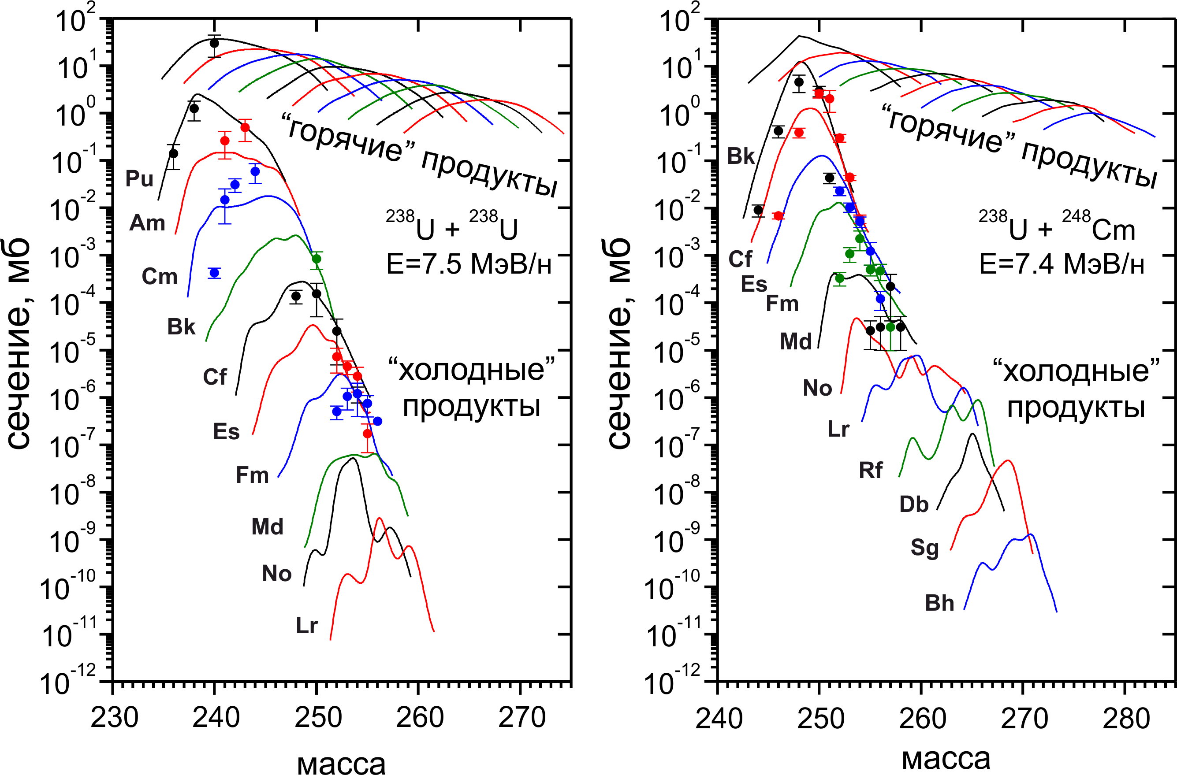
transtarget products in the U + U, Cm reactions
hot products
hot products
E=7.5 MeV/n
E=7.4 MeV/n
cross section, mb
cold products
cold products
mass
mass
V.V. Saiko and A.V. Karpov, EPJA (2022)

Slide 41
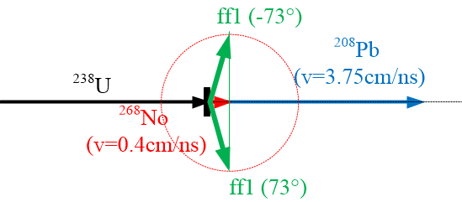
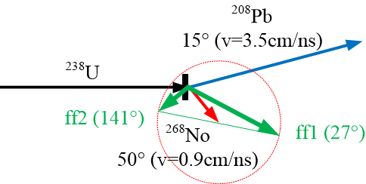
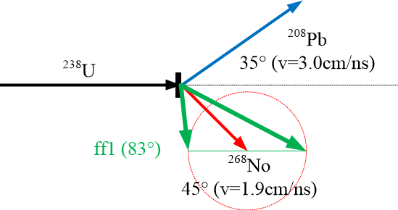
²³⁸U + ²³⁸U
E_{lab} = 1666 МэВ (7 AMeV)
CORSET
Ec.m. | 833MeV
Ec.m./EC | 1.13
Ɵ grazing | 50°
σ(Pb_15°) | 4.3mb/sr
σ(Pb_35°) | 3.6mb/sr
Mass separator
SHELS

Slide 42
²³⁸U+²³⁸U (6.2AMeV)
Test experiment
CORSET (1 day)
Simultaneous measurement of two correlated reaction fragments allows to increase the reliability of the extraction of the binary channels from the possible contribution of other processes occurring in the ²³⁸U + ²³⁸U reaction.
GANIL PAC Meeting, June 09-10, 2016, Caen, France
Notes:
In 2015, in the framework of the collaboration between the FLNR (JINR) and IN2P3 - GANIL (Caen, France) a test experiment of a few UT's (T14-02) has been performed in G2 cave. The mass and energy distributions of fragments in the reaction ²³⁸U + ²³⁸U at an energy of 6.2 MeV/nucleon (Fig.(a)) have been measured using the double-arm time-of-flight spectrometer CORSET [4]. The high time and position resolutions of the spectrometer allow to investigate the fine structures in mass-energy and angular distributions of reaction products obtained in the heavy-ions-induced reactions. The obtained results show that the parameters of the spectrometer are appropriate for the investigation of the mass and energy distributions of the fragments formed in the reaction ²³⁸U+²³⁸U. The obtained experimental cross sections of fragments lighter than uranium are in a good agreement with the measurements performed with VAMOS spectrometer that proves the reliability of the measured mass distribution (Fig.(b)). In our measurements the cross section of the formation of transuranuim fragments was extended up to the fragments with masses 255 u. Fig.(b). The obtained cross section for these fragments is about 100 microbarn. This test shows that the resolution of the CORSET spectrometer allows one to distinguish unambiguously the U elastic from the Pb isotopes.

Slide 43
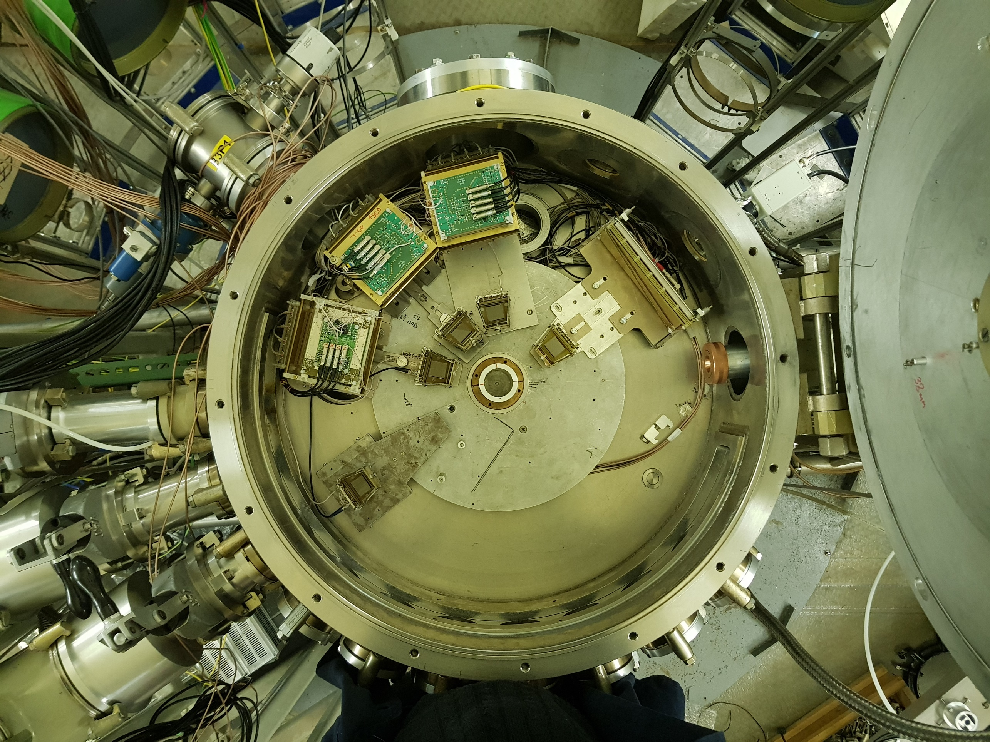
²⁰⁸Pb(θ_{lab}=35º)
²⁰⁸Pb(θ_{lab}=15º)
FF(θ_{lab}=141º)
FF(θ_{lab}=27º)
No(θ_{lab}=45º)
FF(θ_{lab}=90º)

Slide 44
Estimated counting rates for triple coincidence:
Pb and two fragments of fission of No
Target thickness 200μg/cm²
Beam intencity 0.1pnA (6⋅10⁸ particles)
Irradiation time 1 day (24 h)
 | Pb 15° | Pb 35°
Elastic scat | 24⋅10⁶ | 10⁶
Pb | 10³ | 10³
FF_det1 (27°) | 57 | 95
FF_det2(80°) |  | 78
FF_det2(131°) | 22
FF1&FF2 | 12 ev (1.2%) | 37 ev (3.7%)

Slide 45
Thank you for attention!

