Slide 1
Flerov Laboratory of Nuclear Reactions
Experimental studies of light nuclei
far from the β-stability lines
Sergey Sidorchuk
Minsk, 27 August – 3 September 2023

Slide 2
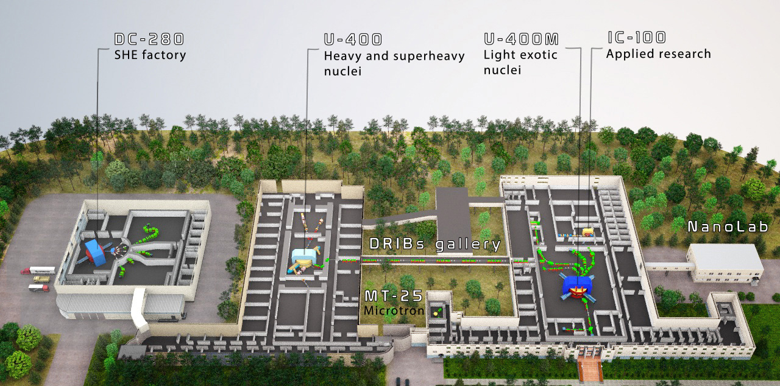
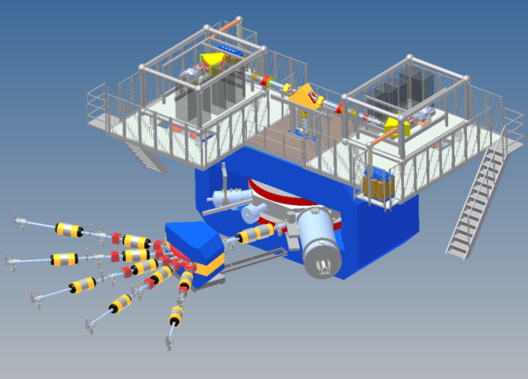

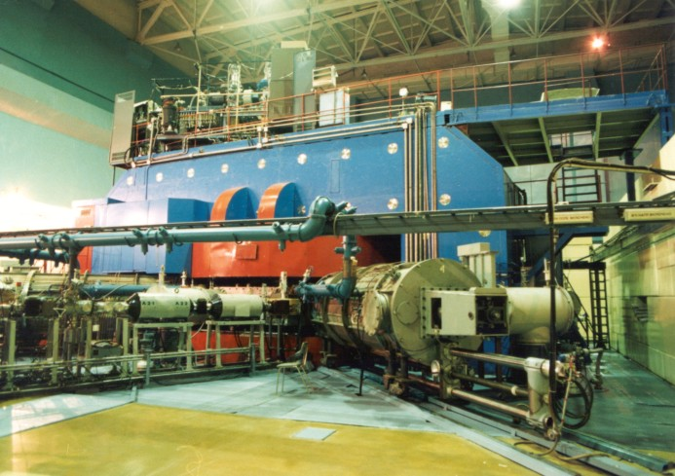

Slide 3
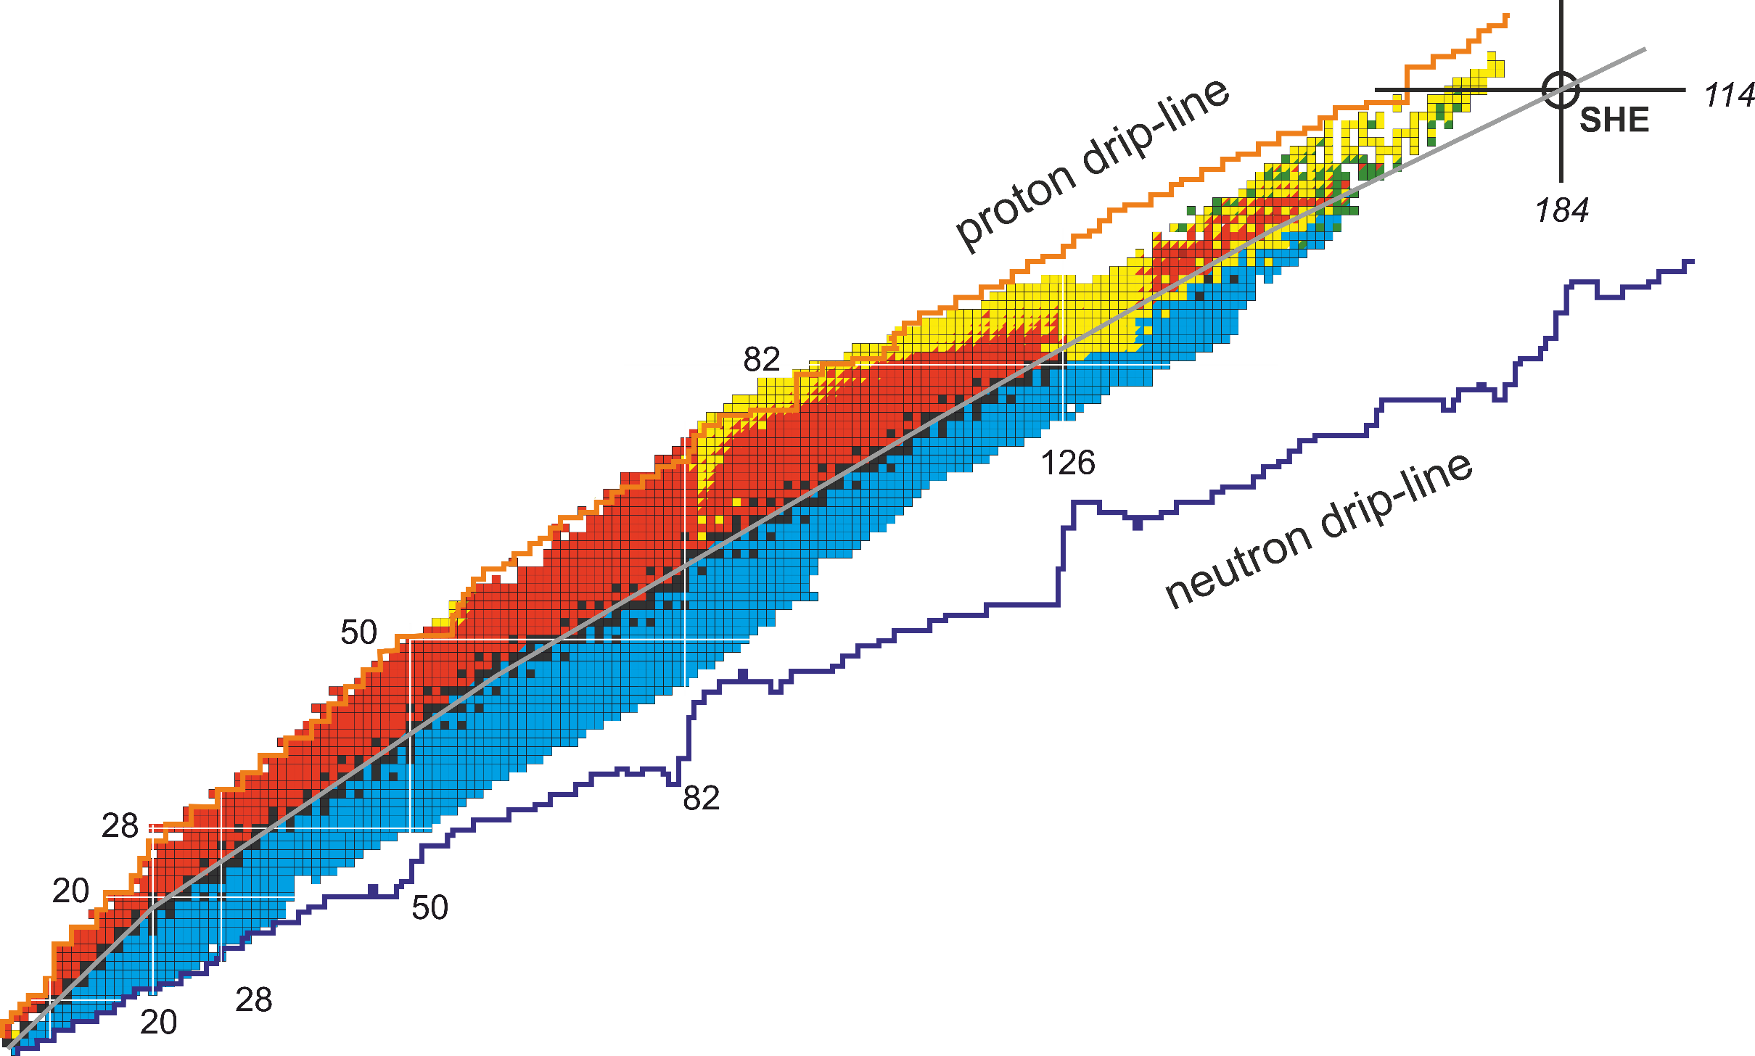
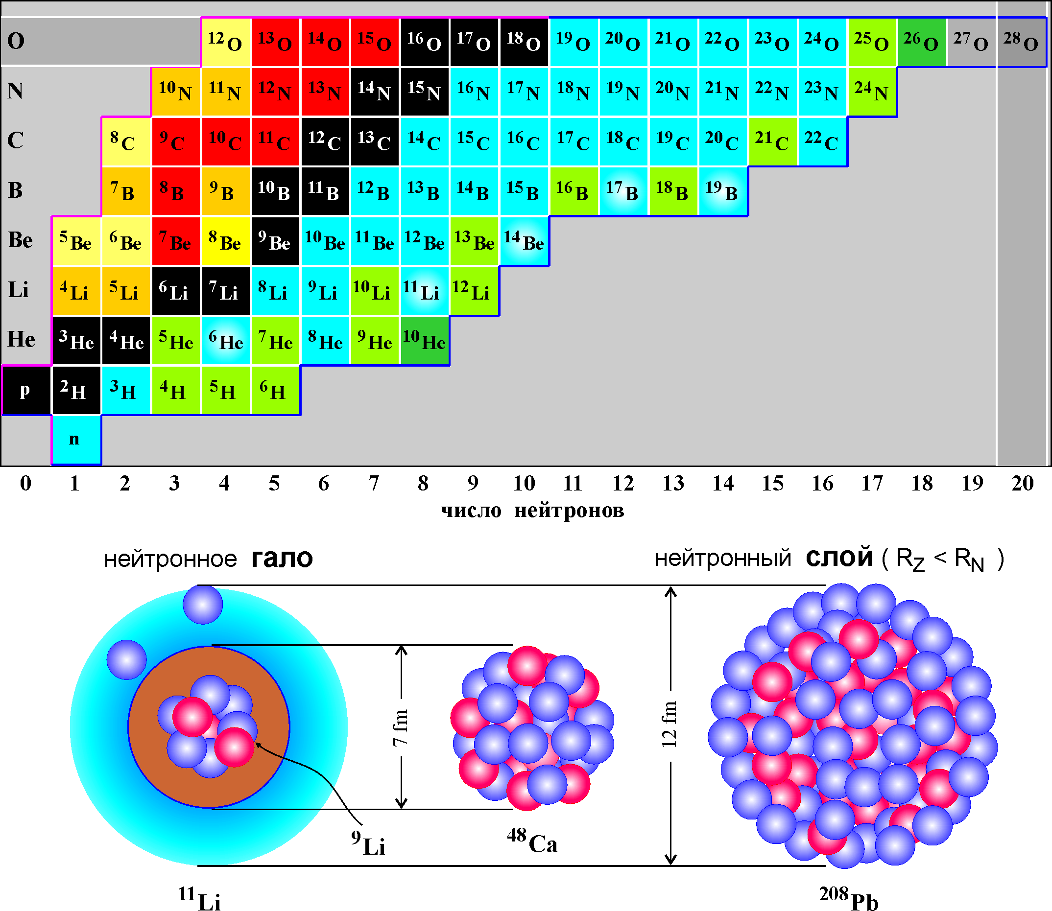
Study of heavy and superheavy nuclei:
synthesis and study of properties of super-heavy elements;
chemistry of new elements;
fusion-fission;
α-, β- and γ-spectroscopy of heavy nuclei.
DC280,
U400
Stability island
number of protons
IC100,
APCenter
Radiation effects and physical groundwork of nanotechnologies.
number of neutrons
Experiments with secondary beams of light radioactive nuclei:
properties and structure of light exotic nuclei near and beyond
the drip lines;
reactions with exotic nuclei.
U400M

Slide 4
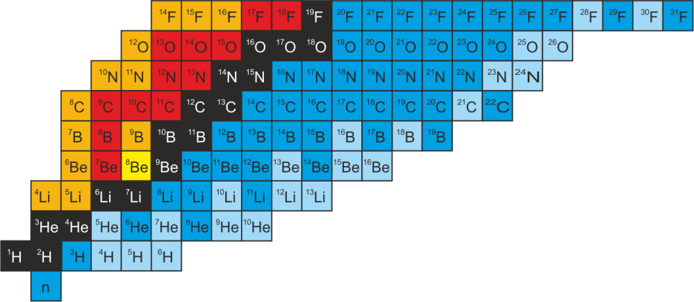
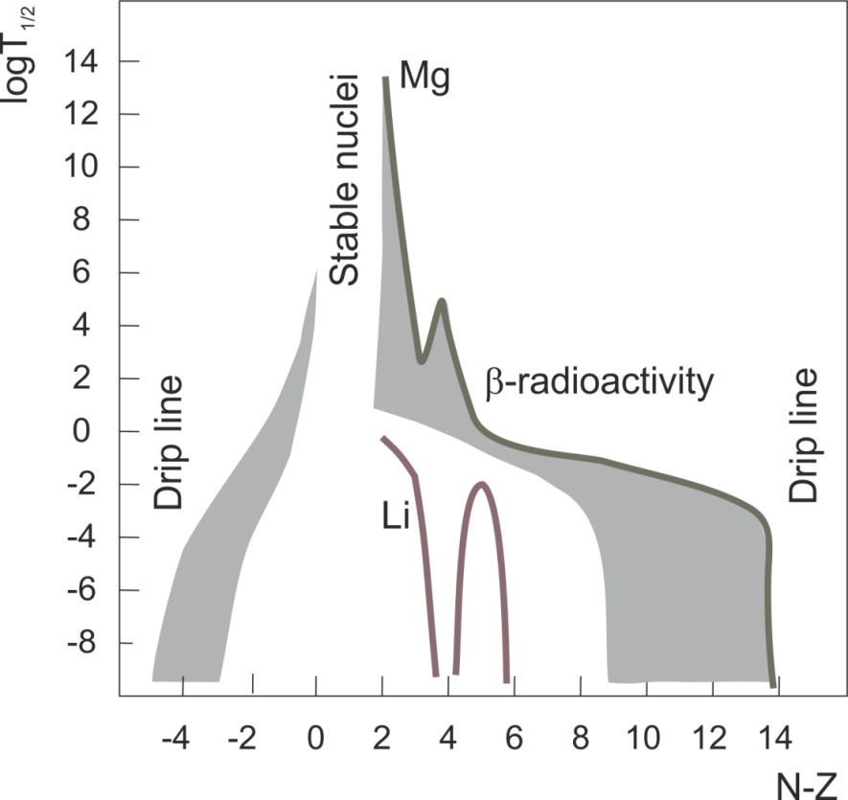
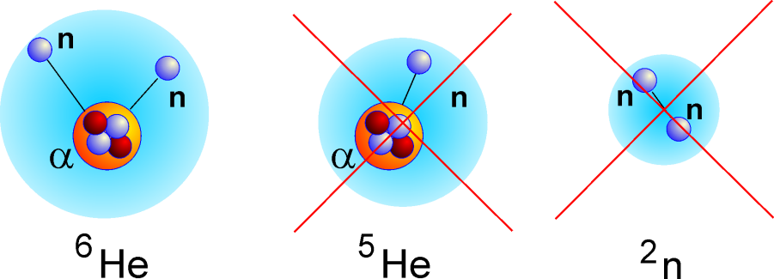
The lightest nuclei far from the β-stability line
1. Acceleration of stable nuclei (¹¹B);
Fragmentation of primary nuclei on a production target
(¹¹B-3p=⁸He).
2. Separation of radioactive short-lived nuclei (⁸He);
Reactions of secondary nuclei on a “physical target”:
proton removal ⁸He-p=⁷H,
charge exchange ⁸He-p+n=⁸H,
2n transfer ⁸He+2n=¹⁰He.

Slide 5
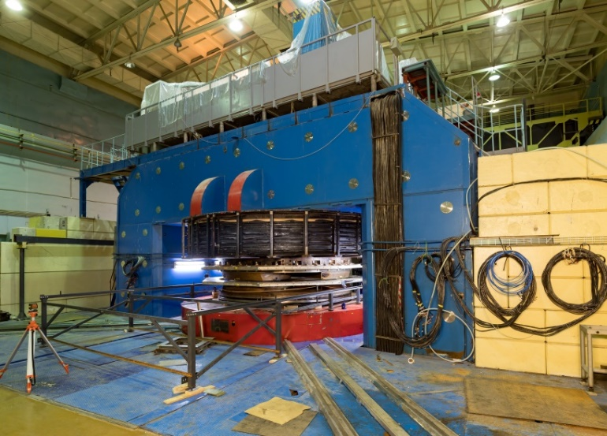
U400М: completion of modernization and launch in 2023
Primary beams
Ion | 2023
 | E (MeV/u) planned | I(pμA) planned
⁷Li | 39 | 10
¹¹B | 33 | 6
¹⁵N | 51 | 2
¹⁸O | 40 | 1.5
²²Ne | 50 | 1
³⁶S | 44 | 0.2
⁴⁸Ca | 38 | 0.1
Secondary beams
RIB* | Intensity, pps (at 1 pμA) | Energy, MeV/A
⁶He | 1x10⁷ | 22
⁸He | 8x10⁴ | 23
¹¹Li | 7x10³ | 33
¹⁴Be | 2x10³ | 35
²⁴O | 2x10³ | 23
²⁸S | 1x10³ | 38
Replacement:
Damaged winding;
Vacuum system;
Control system;
Radiation safety system
Expected results of the upgrade in 2023:
Stable operation;
Improved beam quality;
Increase of beam intensities.

Slide 6
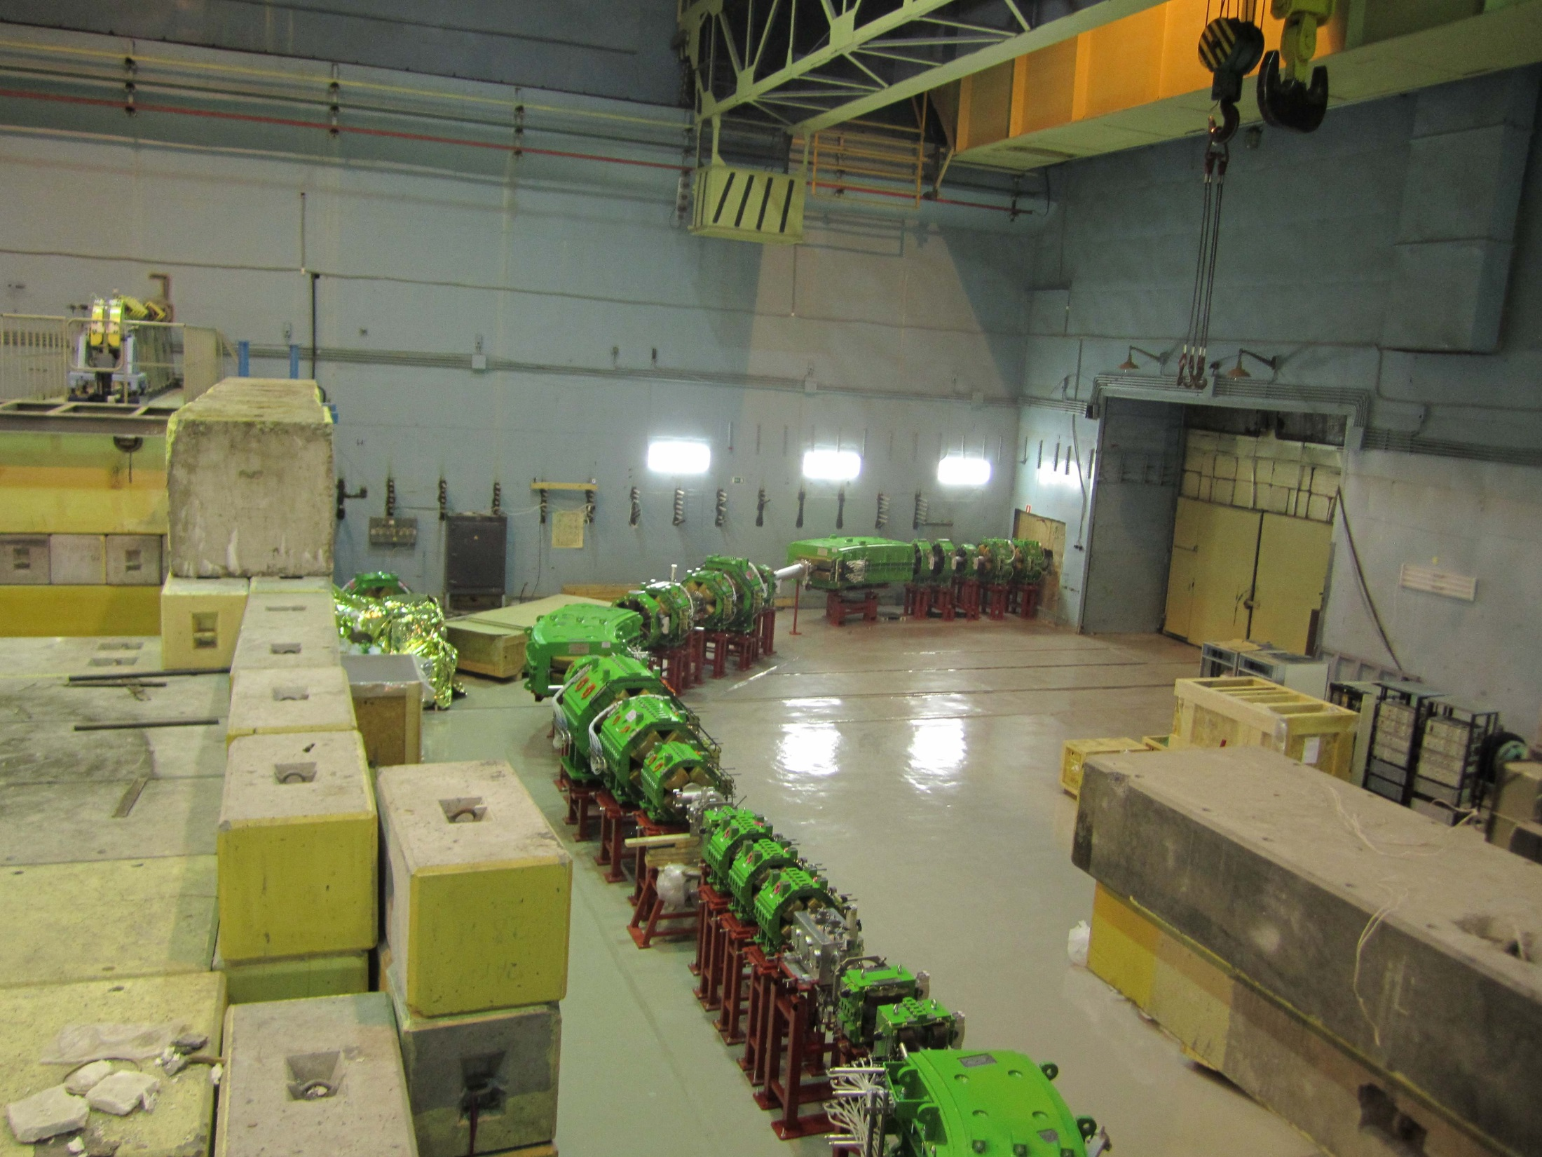
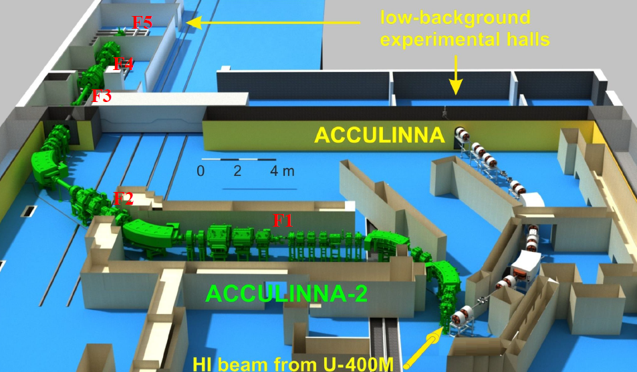
In-flight separation of secondary beams
Physical target
Production target
Primary beam 10¹² s⁻¹
Secondary beam 10⁵ s⁻¹
Notes:
Another experimental approach is illustrated here. This is a rather modest facility we are going to put in operation by the end of the year in the Flerov Laboratory in Dubna. It’s not a factory as we can nor afford to build 2 factories simultaneously. Nevertheless it’s powerful tool for studies of nuclei far from stability – fragment-separator shown with green.

Slide 7
Neutron Momentum Distribution in the ⁴H cms
The simplest case: ⁴H in the reaction t + d→ p + t +n
Processes in the t+p+n Output Channel:
Transfer Reaction t + d → p + ⁴H
p-n Final State Interaction (FSI_{pn}) t + d → p + (p+n)*
Quasifree Scattering (QFS) of the Triton on the Proton bound in the Deuteron
Transfer Reaction t + d → n + α*

Slide 8
Очень экзотические задачи: ⁷H, ¹⁰He, 4n
¹¹Li + d → ⁷H + ⁶Li
⁸He + d → ⁷H + ³He
¹¹Li + d → ¹⁰He + ³He
¹⁴Be + d → ¹⁰He + ⁶Li
⁸He + t → ¹⁰He + p
⁹He
¹⁰He
P1/2
⁵He
⁶He
⁷He
⁸He
⁴H
⁵H
⁶H
⁷H
P3/2
³He
⁴He
²H
³H
S
protons
neutrons
protons
neutrons

Slide 9
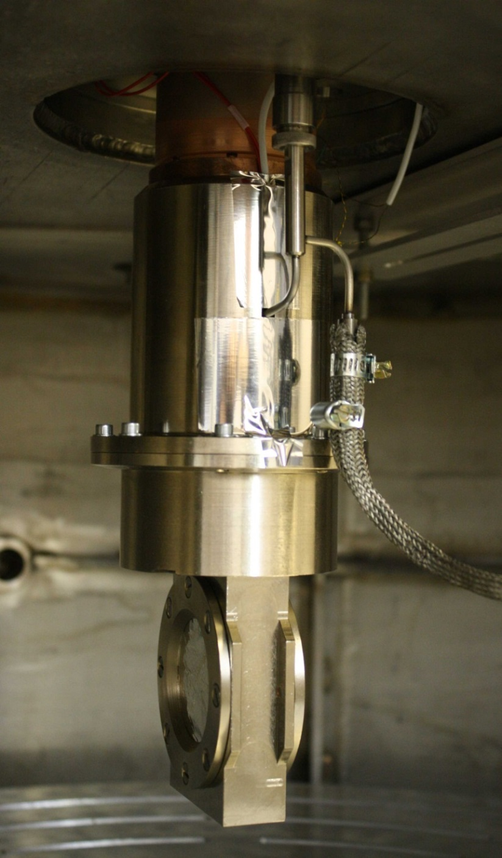
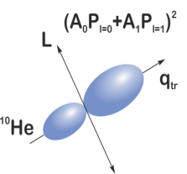
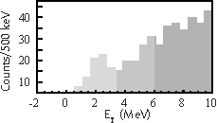
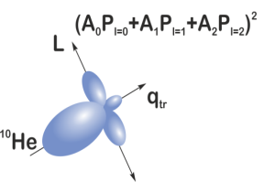
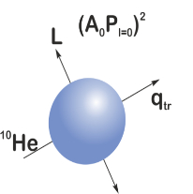
Криогенная газовая мишень
A
A+2
2n
³H
p
1⁻
2⁺
0⁺
Почему тритий?
Необходимый нейтронный избыток;
Энергия отделения двух нейтронов от тритона (около 8.4 МэВ) является минимально возможной;
Ядро отдачи - протон. Малая ионизирующая способность протона позволяет проводить измерения в низкофоновой кинематической области, соответствующей вылету протона с малой энергией под углом, близким к 180^{о} по отношению к направлению налетающей частицы.

Slide 10
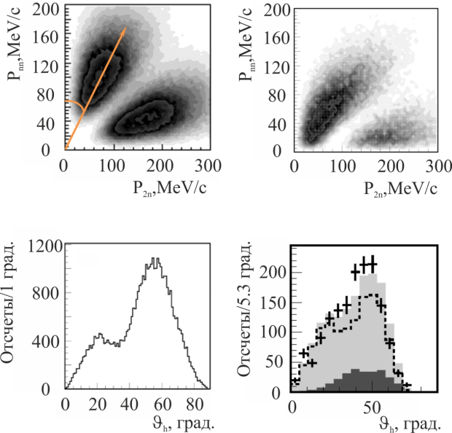
⁶He+⁴He. Свободное упругое рассеяние
⁶He
⁶He
n
n
⁴He
⁴He
α
⁶He
⁴He
динейтрон
2n
⁴He
⁶He
сигара
⁶He+⁴He. Квазисвободное упругое рассеяние
⁶He
2n
ψ
α
n
α
n
α
А
⁴He
α

Slide 11
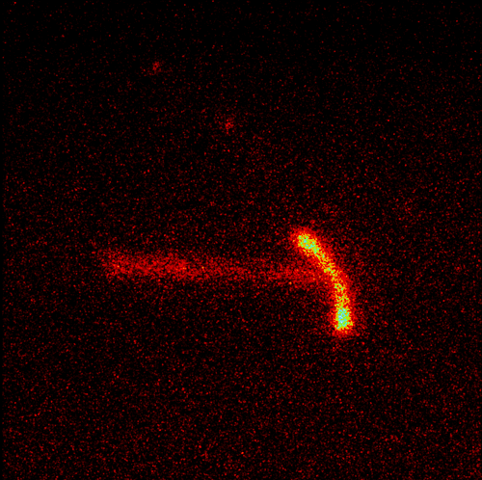
2-proton radioactivity
Lifetime o 2p-emitters varies from some picoseconds to some milliseconds
^{66,67}Kr
^{62,63}Se
^{58,59}Ge
⁵⁴Zn
⁴⁸Ni
⁴⁵Fe
³⁴Ca
³⁰Ar
²⁶S
typical situation in stable nuclei
sequential decay
true 2p-decay, strict definition
¹⁹Mg
^{15,16}Ne
CCD
⁴⁵Fe

Slide 12
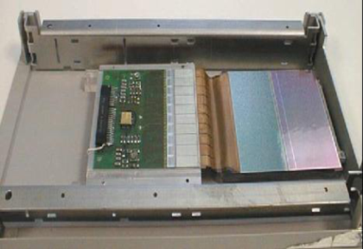
¹⁹Mg, T_{1/2}⁓4 ps
is the kind of a borderline phenomenon between radioactivity and nucleon instability
Microstrip technology: accuracy <100 μm
¹⁷Ne
²⁰Mg
¹⁹Mg

Slide 13

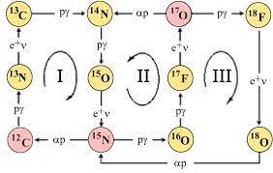
Resonances play a crucial part in nucleosynthesis:
Berillium-8 & Hoyle state
α+α→⁸Be_{gs} → α+α
E_{r} = 94 keV, Γ = 5.6 eV
N_{αα}/N_{α} ⁓ 10⁻¹¹ (ρ=10⁵ g/cm³, T=10⁸ K)
α
¹²С
⁸Be_{gs}+α→¹²C*_{Hoyle} →α+α+α
⁸Be_{gs}+α→¹²C*_{Hoyle} →¹²C_{gs}+γ
E_{r} = 7.7 MeV (287 keV above the 3α threshold),
Γ_{3α} = 8.9 eV, Γ_{γ} = 3.6 meV
α
α
Neon-17 & by-path for ¹⁵O
7/2- 2.99
E*, MeV
5/2⁺ 2.65
2
1/2⁺ 1.92
2⁻ 1.9
p
1⁻ 1.67
p-thershold
5/2⁻ 1.76
1.48
0⁻ 1.48
p
1
p
2p
3/2⁻ 1.29
2p-thershold
0.94
¹⁵O+2p
¹⁶F+p
¹⁷Ne

Slide 14
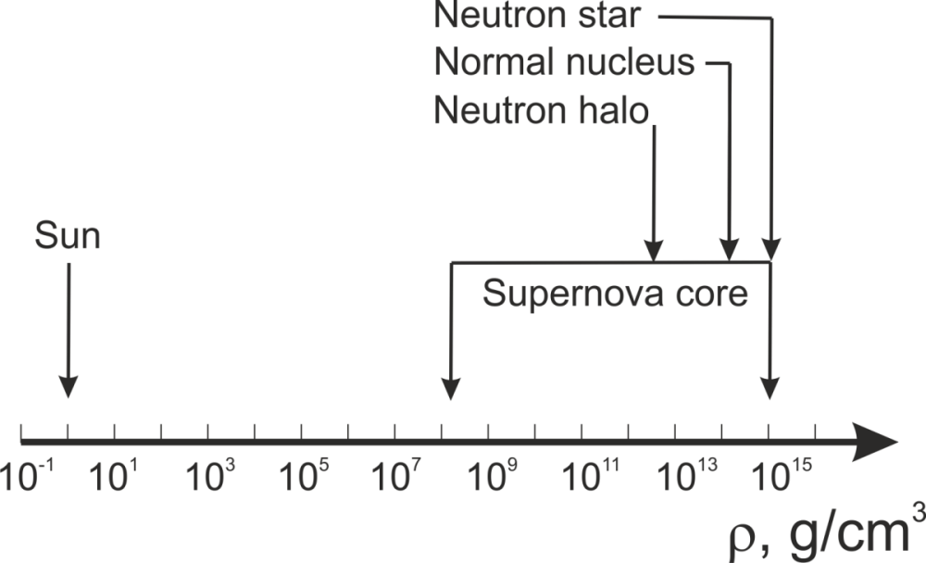
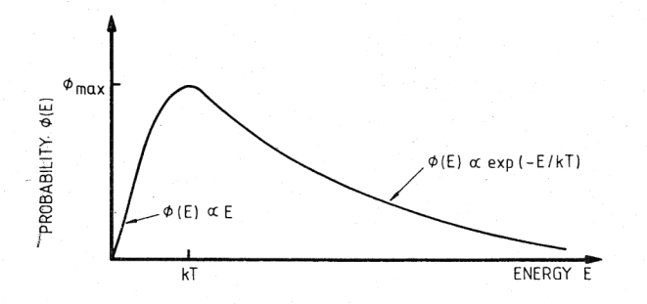









E
d + n
p + n + n
E
d + n
p +n + n
Q = -2.2 MeV
Q = +2.2 MeV
T
T
Скорость двутельной реакции
[(толщина мишени $ρ_{t}σ_{2}$) Х (поток $vρ_{p}$)]:
Скорость трехтельной реакции
[(толщина мишени $ρ_{2t}σ_{3}$) Х (поток $vρ_{p}$)]:
$$r_{2}=ρ_{p}ρ_{t}vσ_{2}$$
$ρ_{2t}=ρ_{t}P_{2}=\frac{1}{2}V_{i}{ρ_{t}}^{2};(P_{2}=\frac{V_{i}ρ_{t}}{2}$)
$$ρ_{2t}σ_{3}= \frac{1}{2}V_{i}{ρ_{t}}^{2}σ_{3}$$
$$r_{3}=ρ_{2t}σ_{3}ρ_{p}v=\frac{1}{2}ρ_{p}V_{i}{ρ_{t}}^{2}vσ_{3}$$
$$\frac{r_{3}}{r_{2}}=\frac{1}{2}V_{i}ρ_{t}\frac{σ_{3}}{σ_{2}} ⁓ 3⋅{10}^{−13}ρ_{t}\left[g {cm}^{−3}\right]\frac{σ_{3}}{σ_{2}}$$
$$p+p→d+e^{+}+ν$$
σ⁓10⁻⁴⁷ cm⁻²
$$p+p+n→d+n$$
σ⁓10⁻²⁶ cm⁻²

Slide 15
«Квазисвободные» реакции на виртуальных частицах можно использовать для изучения трехтельных взаимодействий
⁶He
⁶He
2n
2n спектатор, не участвует во взаимодействии
α
α
n
n
Мишенное ядро (³He)
α
Виртуальная α-частица
Продукты реакции
α +³He→α+ ³He
³He
³He
⁶He
α спектатор, не участвует во взаимодействии
⁶He
α
α
n
n
Мишенное ядро (³He)
2n
α
Виртуальные нейтроны
Продукты реакции
n+n+³He→α+n
³He
n

Slide 16
Planned research areas for 2024 – 2030
Structure of neutron-rich isotopes and breakdown of the shell structure:
(t,p) and (d,p) reactions: ⁶⁻¹⁰He, ¹¹⁻¹³Li,¹³⁻¹⁶Be etc.
Impact of the reaction mechanism on population
of low energy spectra of exotic nuclear systems;
Exotic radioactivity
(formation of 2-p radioactive nuclei in (³He,n) reactions, ²⁶S, 3/2⁻ ¹⁷Ne);
Isotopic symmetry of nuclear reactions
(³H,³He) and (³He,³H);
⁷H? ⁸He(t,α), ¹¹Li(t,α).
¹⁴Be
-p
¹¹Li
-α
⁸He
¹⁰He
+2n
Instrumentation Development
In-beam detectors;
Neutron detector array (increase in number of modules);
Charged particles detector arrays (angular and energy acceptance);
RF-kicker (operational run with an ion beam);
Zero-angle spectrometer hodoscope;
Cryogenic tritium target.

Slide 17
THANK YOU!

