Slide 1


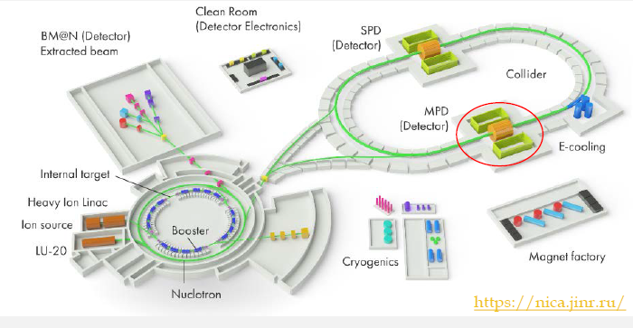
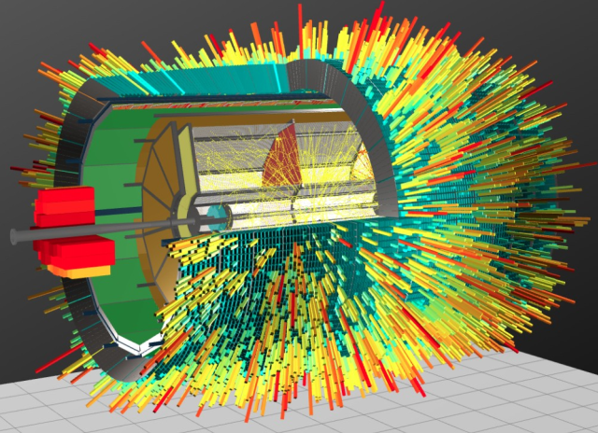
MPD TPC Status (30.08.2023)
  TPC:
    vessel assembly, ROC chambers, gating grid system
  Sub-systems:
    Electronics
    LV+HV system (CAEN)
    Gas and cooling systems
    Laser calibration
  Integration TPC to MPD
    Electronics platform
    Cabling and piping
    Installation TPC to MPD
  Time schedule
Presented by S.Movchan
TPC team – 23 (JINR) + 25 (Belarus)
S.Movchan MPD TPC status, XV-th international school “Actual problems of microworld physiscs”, Minsk, Belarus, August 30 2023

Slide 2
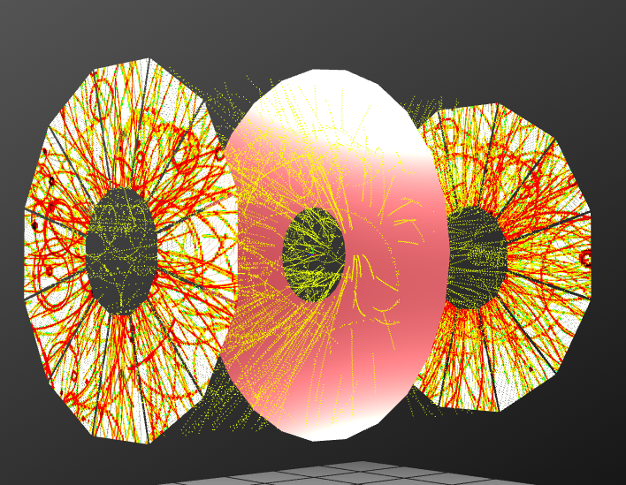
MPD TPC main parameters
Item | Dimension
Length of the TPC | 340cm
Outer radius of vessel | 140cm
Inner radius of vessel | 27 cm
Outer radius of the drift volume | 133cm
Inner radius of the drift volume | 34cm
Length of the drift volume | 170cm (of each half)
HV electrode | Membrane at the center of the TPC
Electric field strength | ~140V/cm;
Magnetic field strength | 0.5 Tesla
Drift gas | 90% Ar+10% Methane, Atmospheric pres. + 2 mbar
Gas amplification factor | ~ 10⁴
Drift velocity | 5.45 cm/µs;
Drift time | < 30µs;
Temperature stability | < 0.5°C
Number of readout chambers | 24 (12 per each end-plate)
Segmentation in φ | 30°
Pad size | 5x12mm² and 5x18mm²
Number of pads | 95232
Pad raw numbers | 53
Pad numbers after zero suppression | < 10%
Maximal event rate | < 7 kHz ( Lum. 10²⁷ )
Electronics shaping time | ~180 ns (FWHM)
Signal-to-noise ratio | 30:1
Signal dynamical range | 10 bits
Sampling rate | 10 MHz
Sampling depth | 310 time buckets

Slide 3
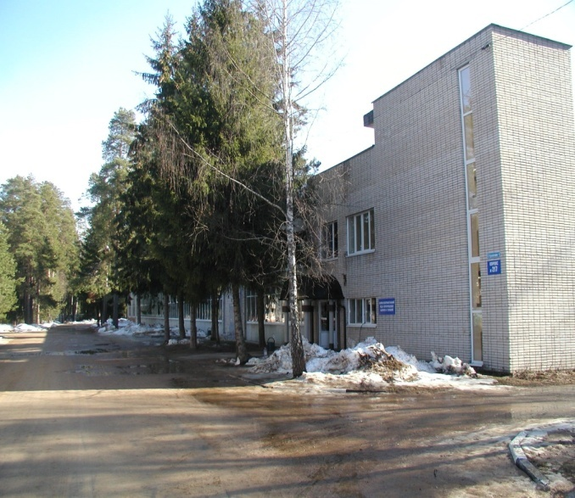
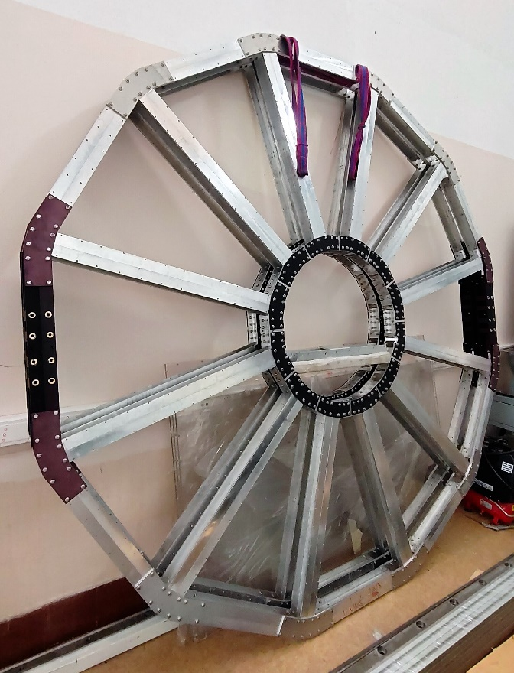
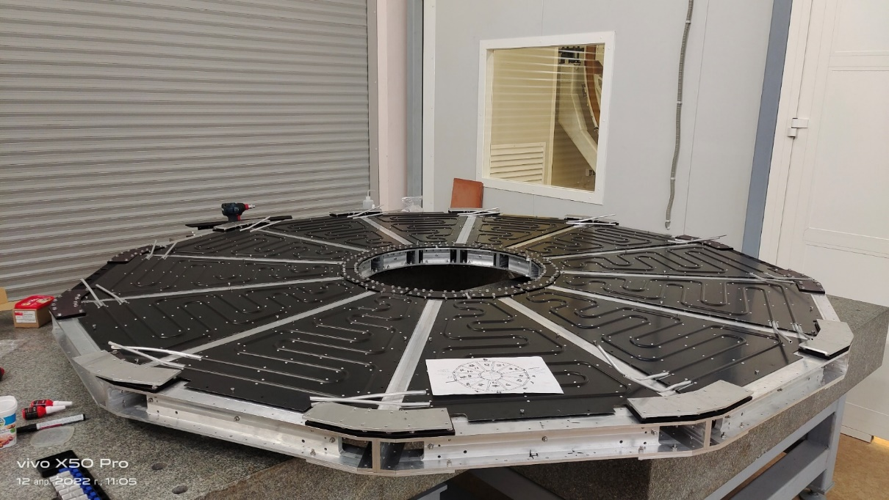
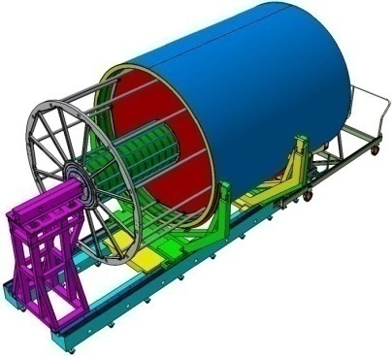
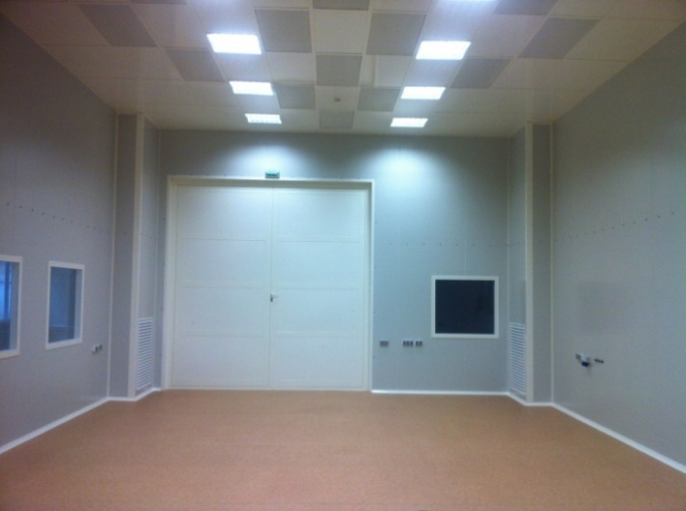
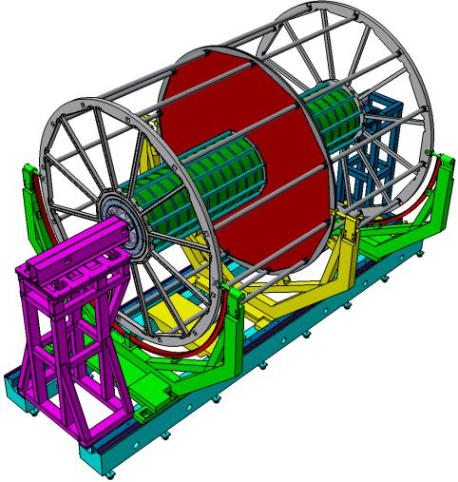
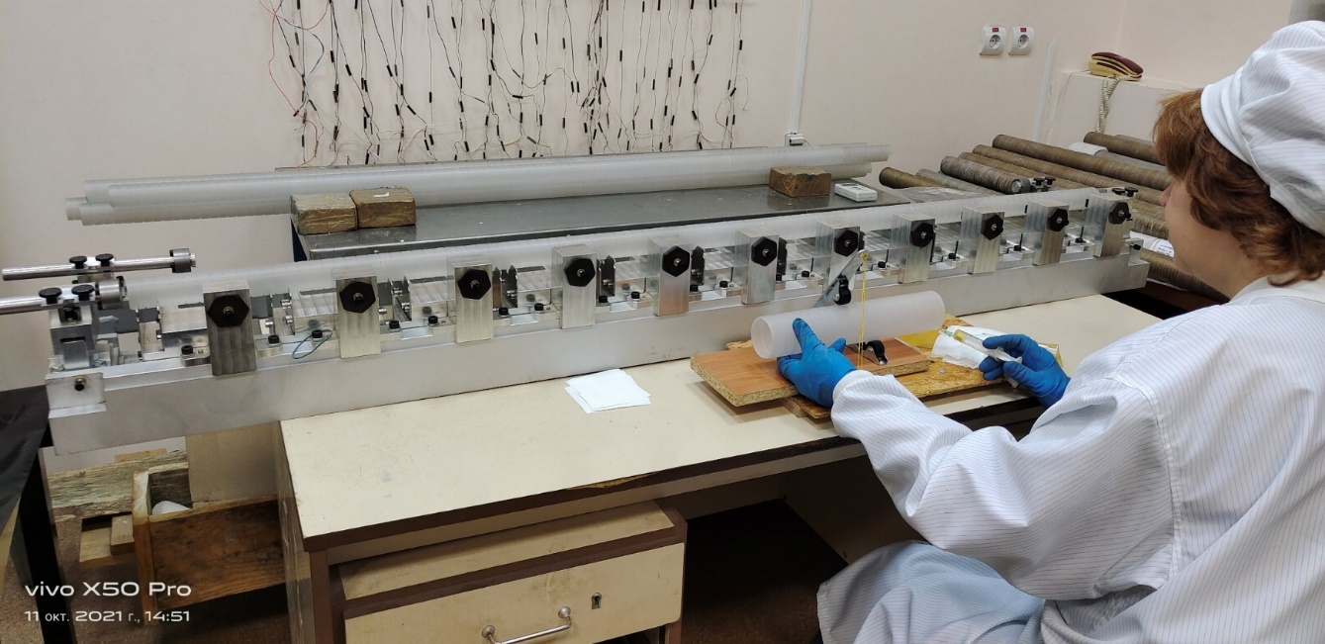
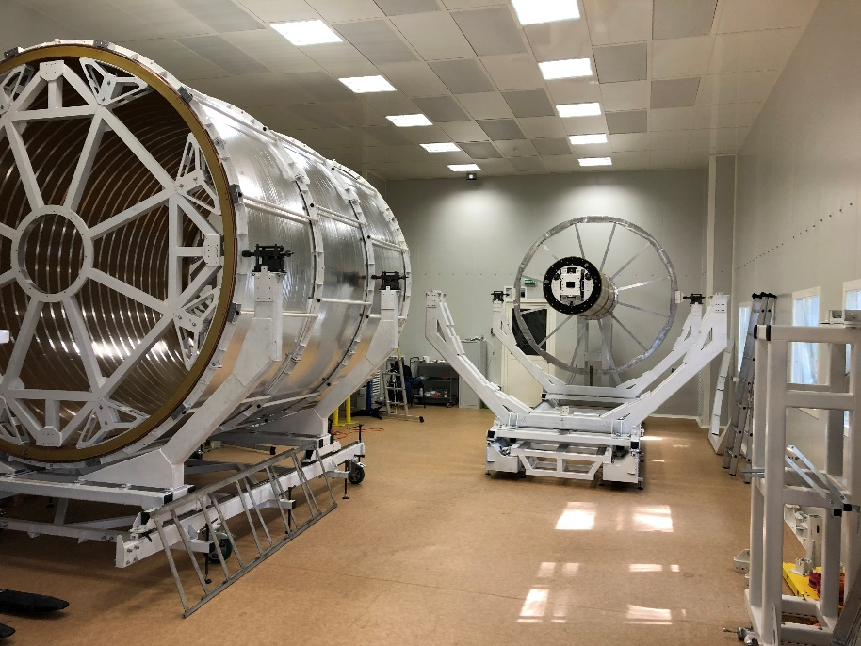
TPC vessel assembly
Bld. 217
Service wheel with thermal panels (12pc)
Both service wheels - assembled
ISO-6
  C1-C2 and C3-C4 cylinder – assembled
  TPC service wheels (2pc) - assembled
  HV membrane – tested
  TPC field cage assembly - Dec 15 2023
  TPC vessel ready – Dec 30 2023
Rods D=40 mm (24 pc) reassembled - ready
Rods D=60 mm (24 pc) – assembling in progress, ready – Oct 10 2023
TPC vessel assembly – in progress (see next slide)

Slide 4
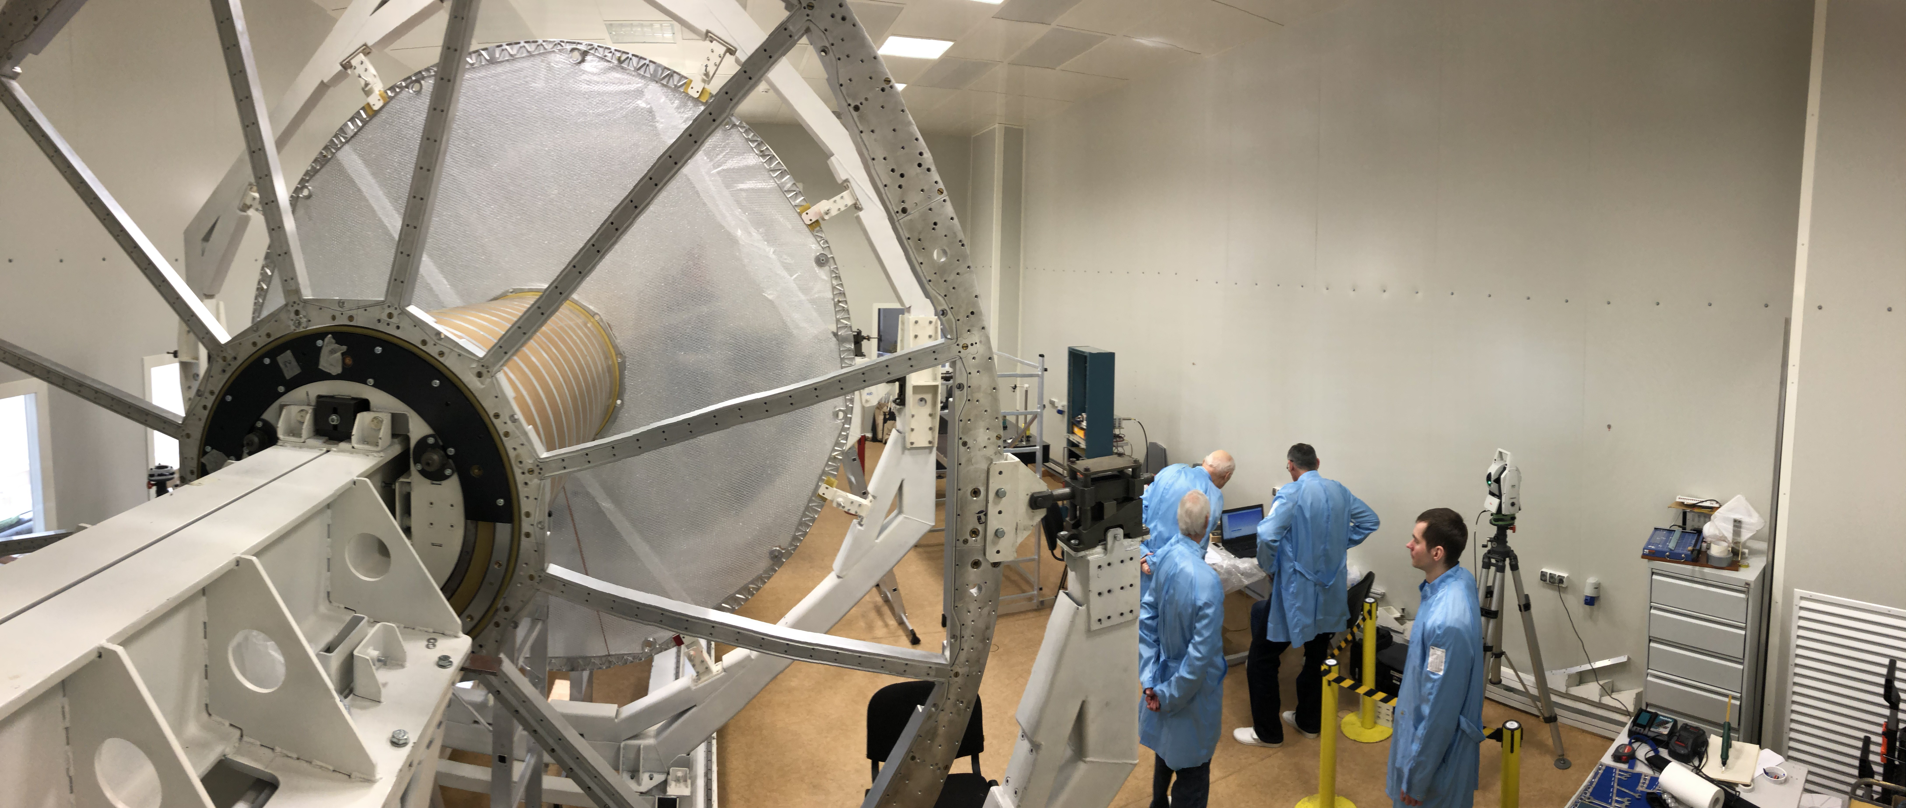
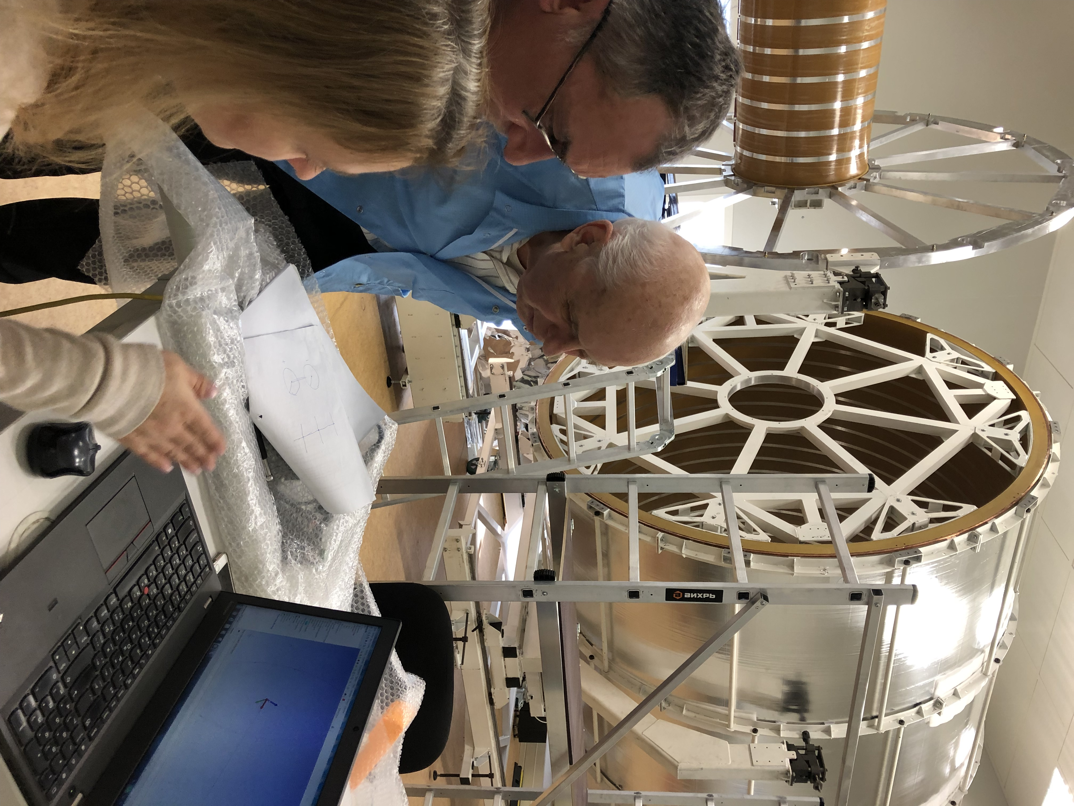
TPC vessel assembling
TPC body assembled with test rods for check TPC geometry by laser tracker
AT-402 (reflector type -TBR (R=6.35 mm), reflector center offset L== 12.00 mm):
2 flanges, HV electrode and C1-C2 cylinder - misalignment is about 1 mm
Goal – improve misalignment by factor х2

Slide 5
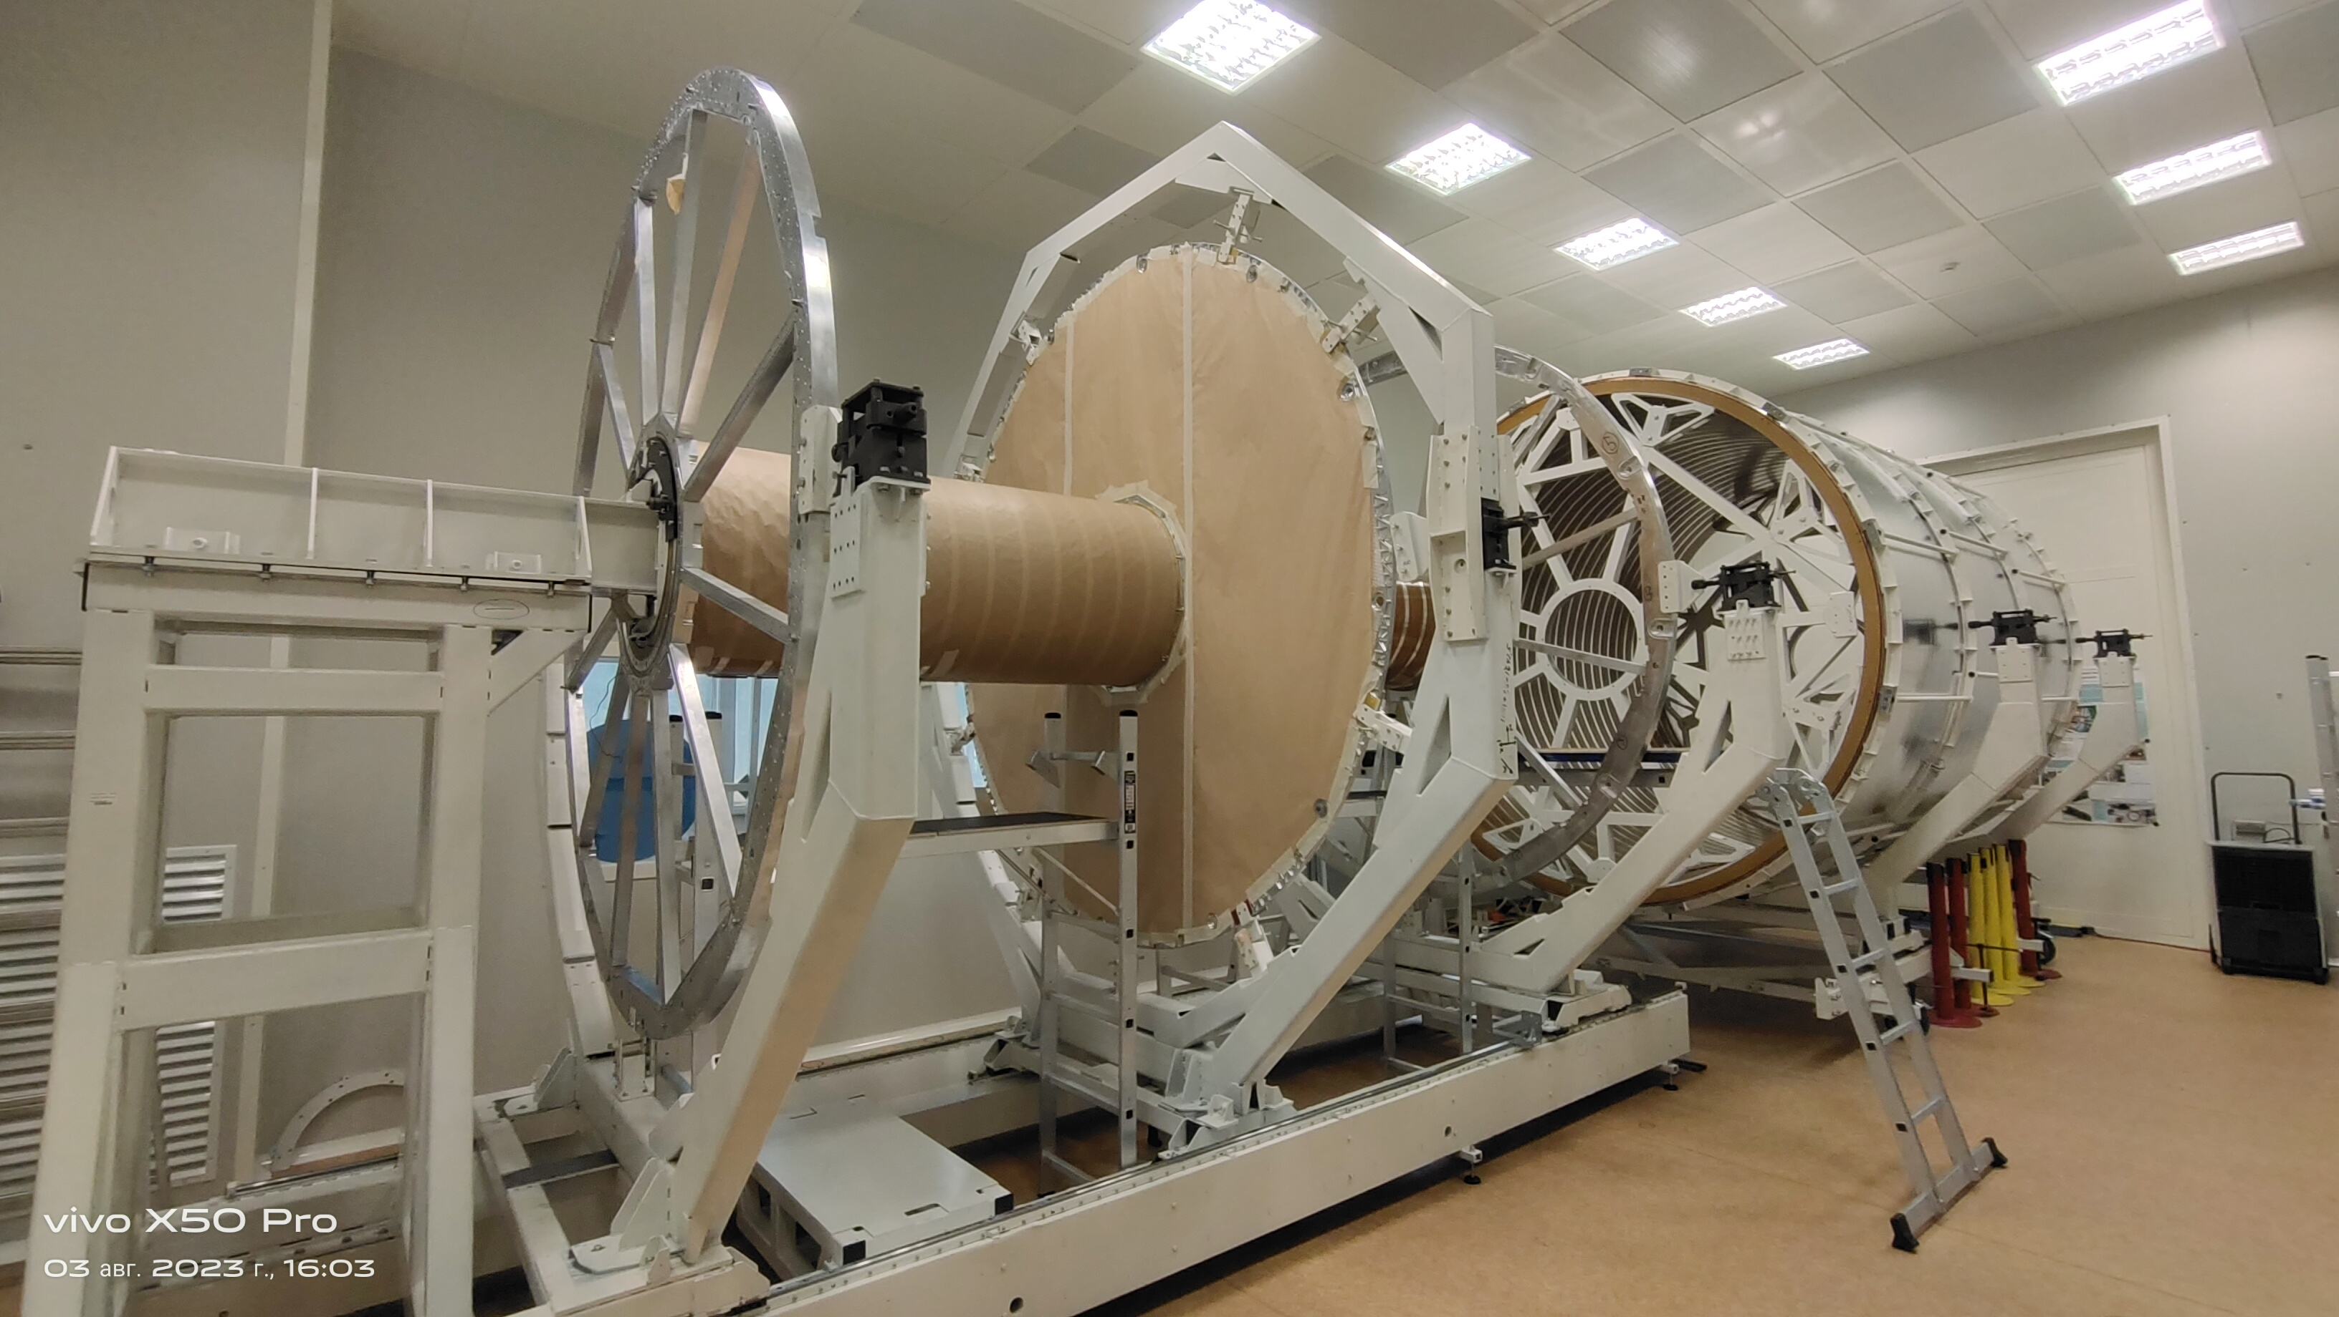
TPC vessel assembling
11/07/2023 - Both flanges and HV electrode: alignment to do and all elements glued to C1-C2

Slide 6
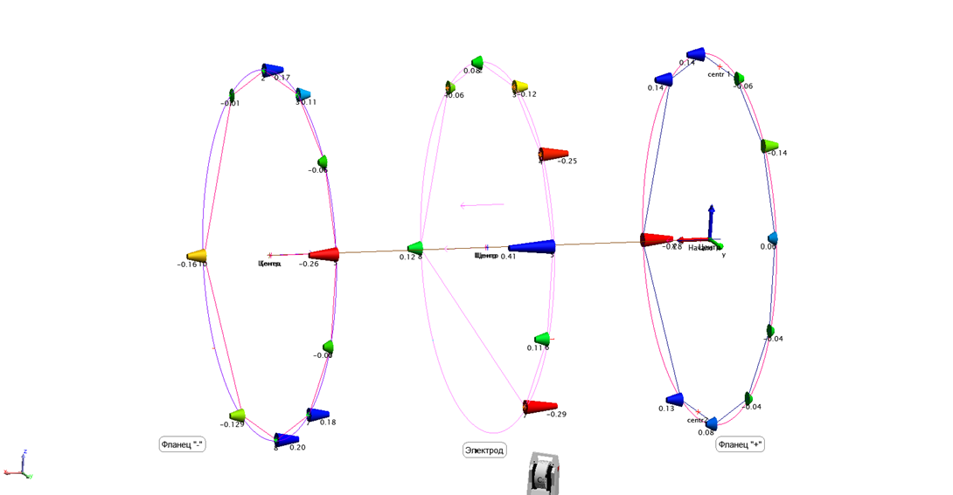
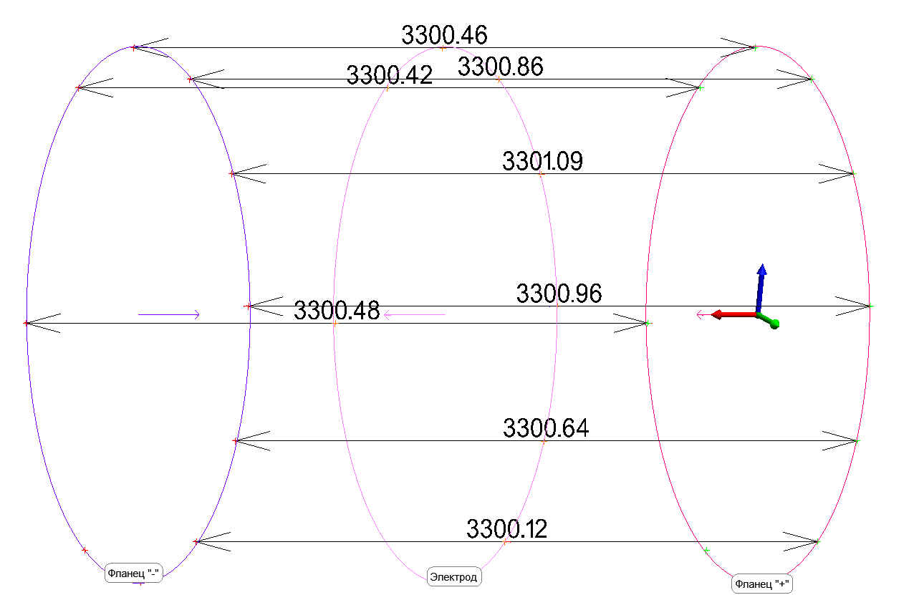
TPC vessel assembling
Flanges and HV electrode unflatness
Flange to flange distance
Flanges unflatness – about 0.5 mm
HV electrode unflatness – about 0.7 mm
L=(3300.5 +/-0.5) mm
(nominal – 3300.0 mm)

Slide 7
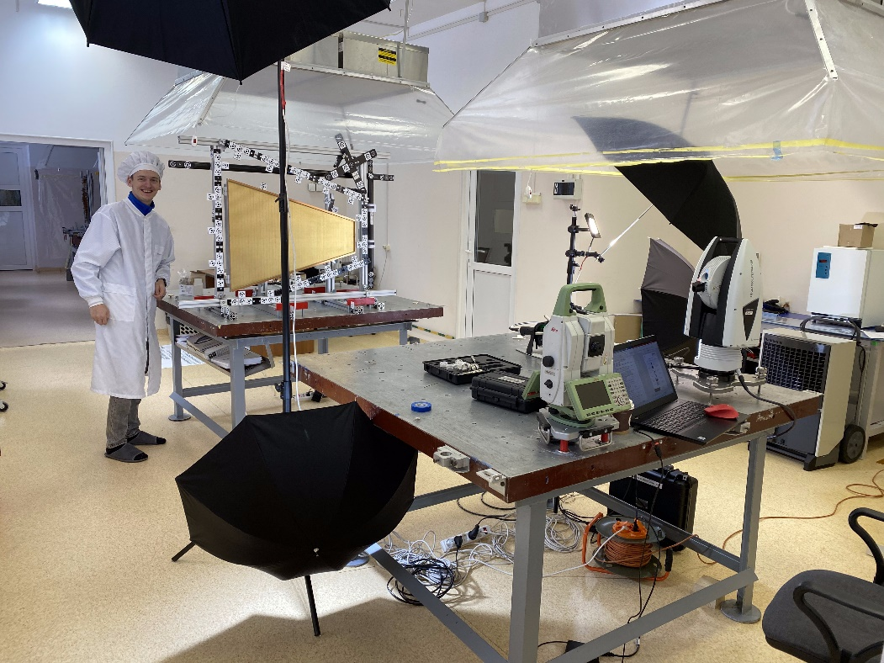
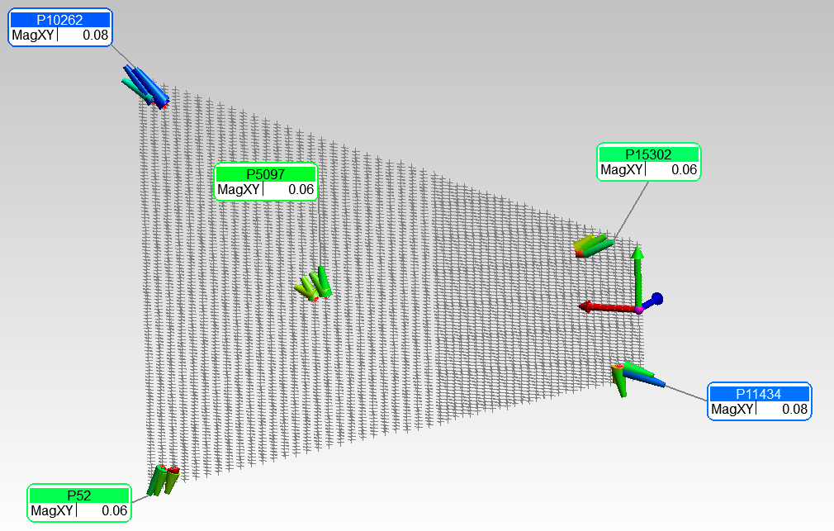
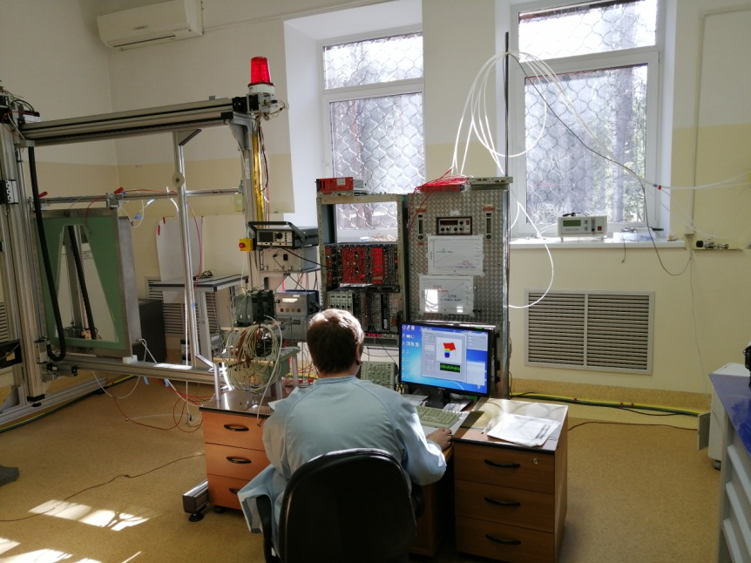
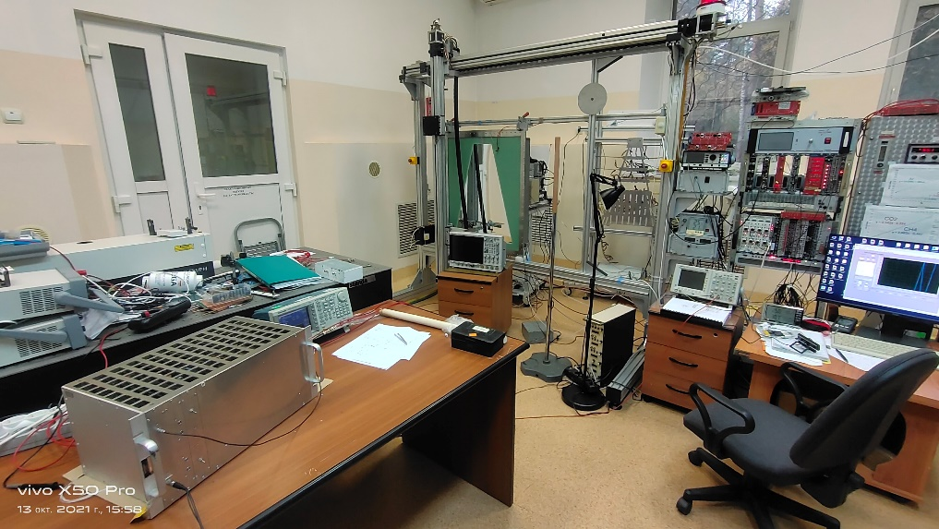
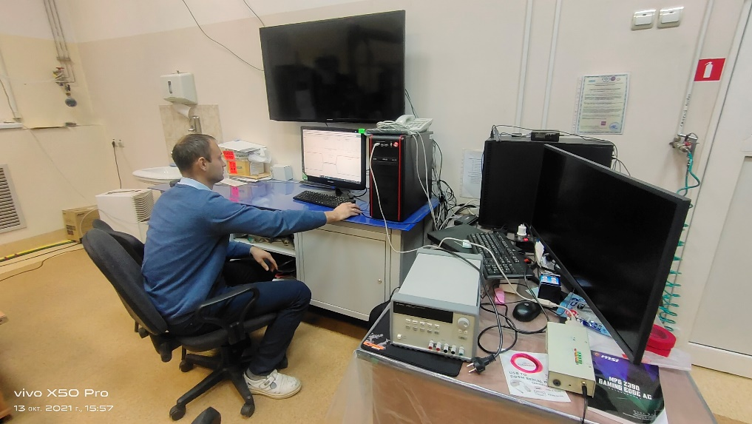
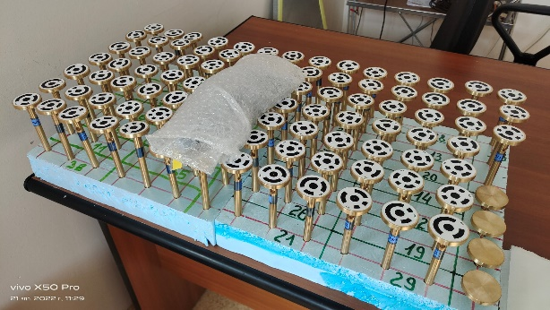
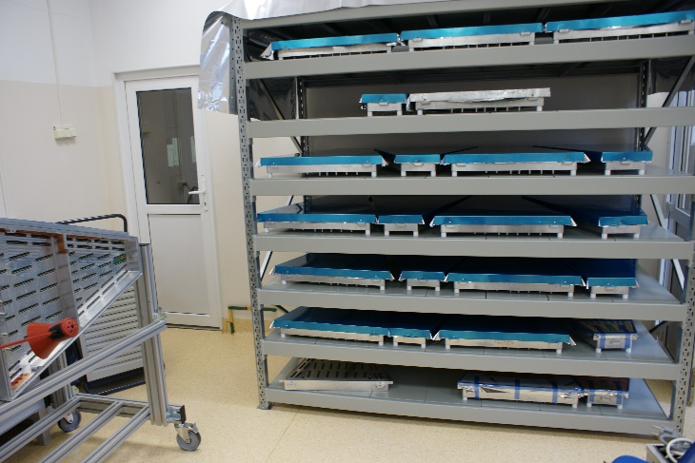
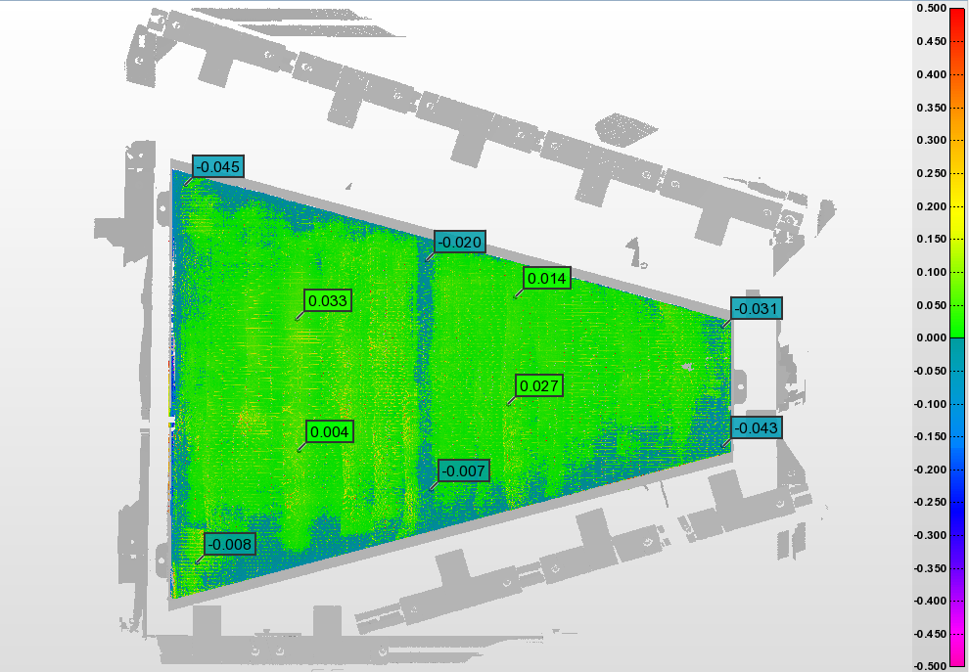
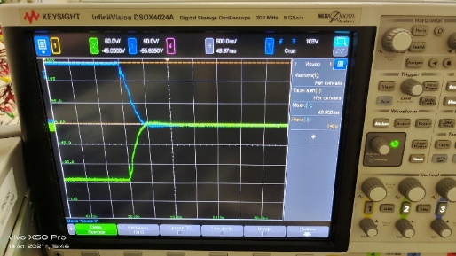
ROC chambers and gating grid system (GGS): status
Test set up for pads calibration
Check pads geometry
Test set up for ROC certification
ROC gating grid system: test set up
systematic - up to 150 mkm
Leica MS60 - 1 second resolution
Leica AT960 +/-10 mkm +5 mkm/m
Leica AT403 +/-15 mkm +6 mkm/m
Scanner AS1+AT960 +/-50 mkm
Full set of ROC alignment marks
24 pc ROCs – tested
Pad plane unflatness: example
Pulse rise time
- 500 ns, OK!
+/- 30 mkm
Summary:
- measurements to do for all ROCs
- calibration of ROC marks and
3968 pads respect to ROC
“reference hole” - in progress
24 pc serial ROCs + 4 spare – READY!
Mass-production – in progress
Delivery to JINR – Dec 2023

Slide 8
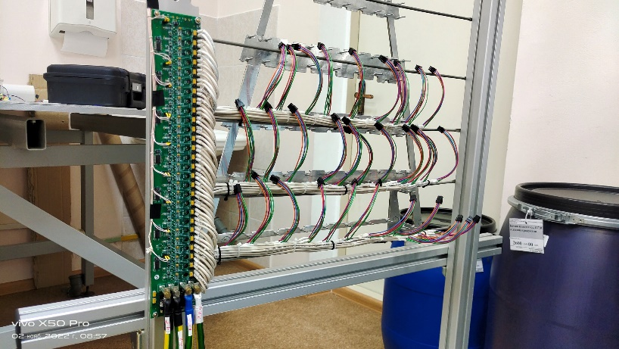
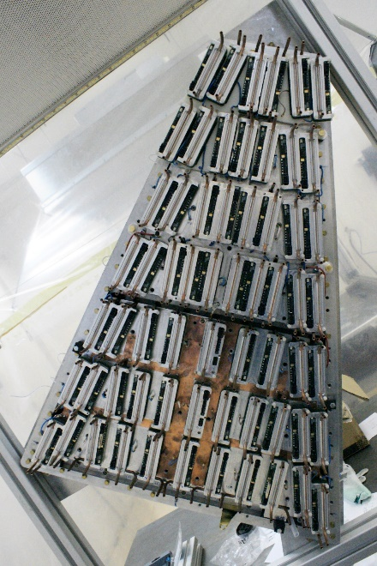
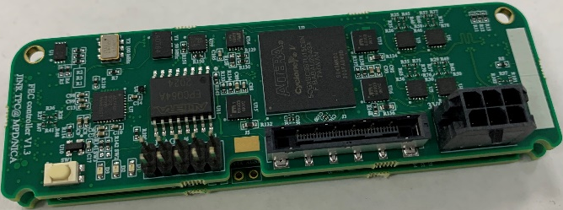
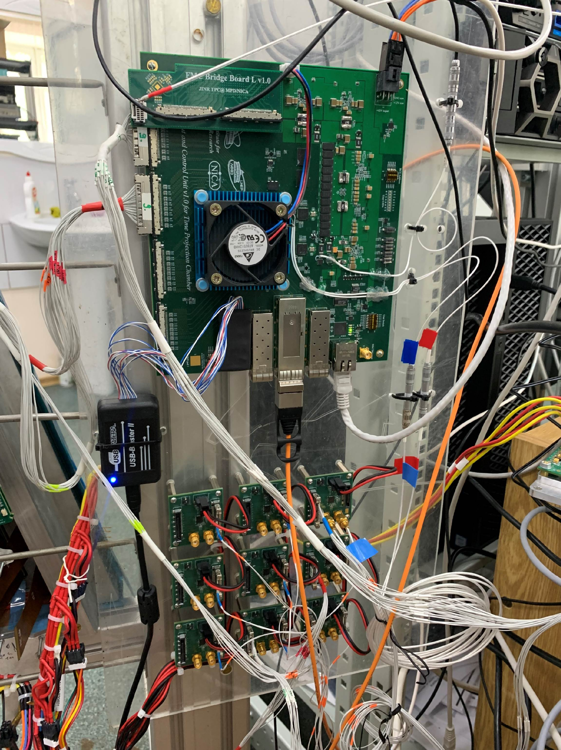
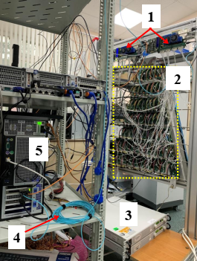
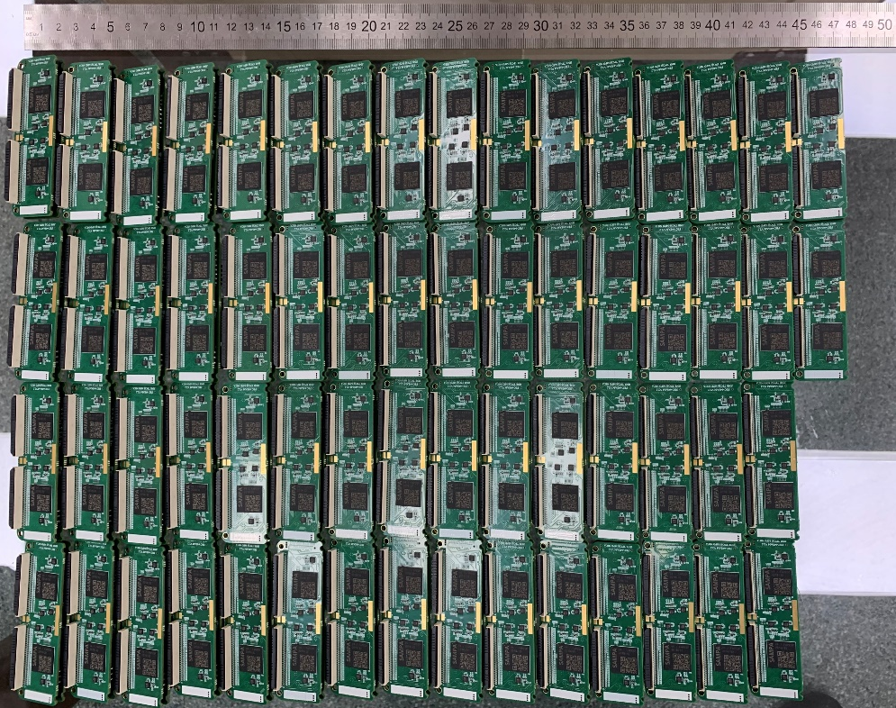
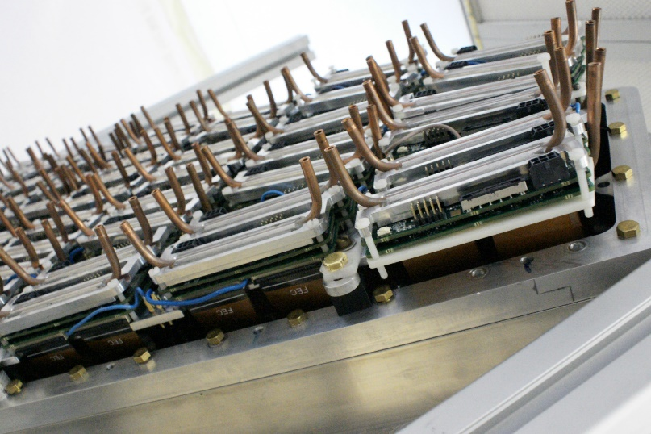
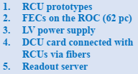
TPC Sub-systems: electronics
FE radiators (water cooling)
LVN9 stabilization module
Production version of the FE card:
DAQ prototype:
62 FE cards, RCU prototypes,
ROC, 2pc LVDBs, server interface
board - tests ongoing
RCU-64 controller:
testing with FEE
60 pc LVN9 (INP BSU, Minsk):
- modification connection of power cables to LVN9 - in progress
- modification of LVN9 output voltages to FECs - in progress
- test of LVN9 with cooling radiator under full load (analog – 70 A, digital – 50 A) – in progress
N=967 pc
(65%)
967 FECs of 1500 were produced.
Tests of the FEC basic functionality were shown the target characteristics (noise and stability).
Testing of the readout system for one ROC is ongoing.
15 ROCs chambers can be completed
(from 24 ROCs)

Slide 9
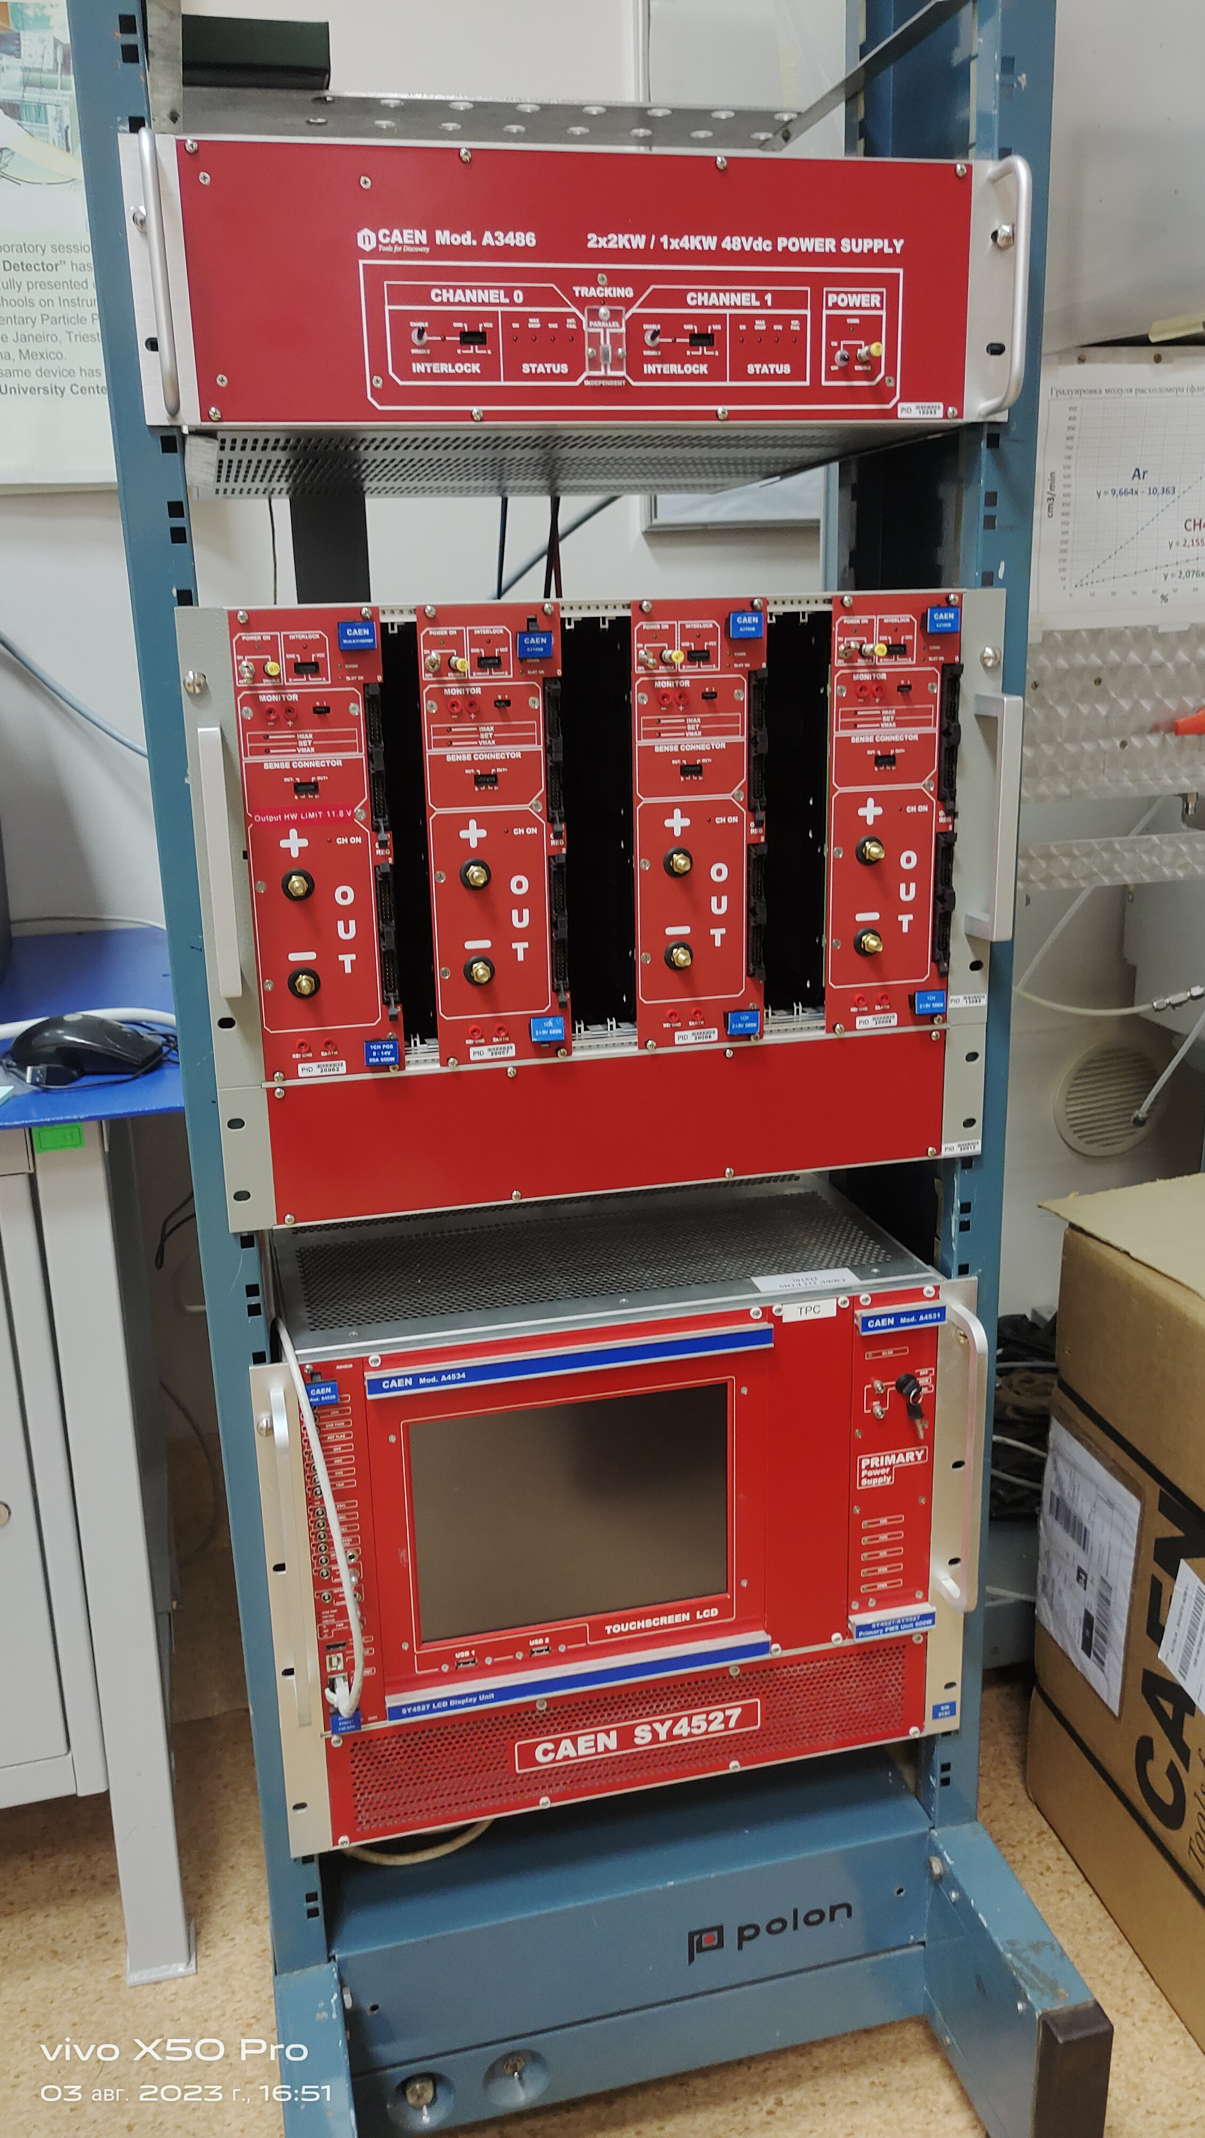
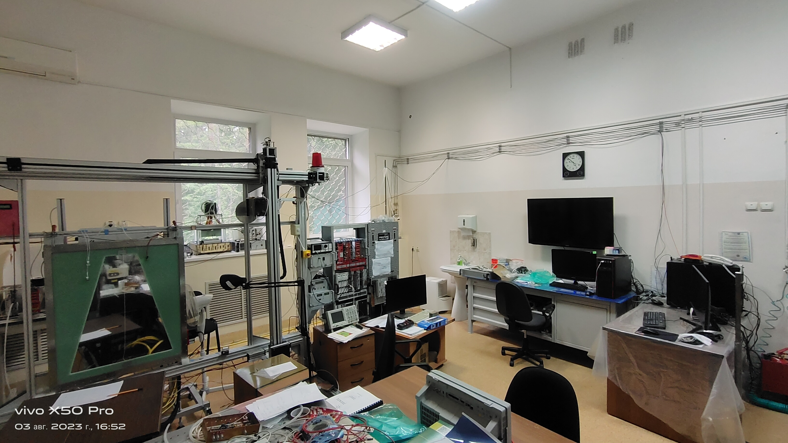
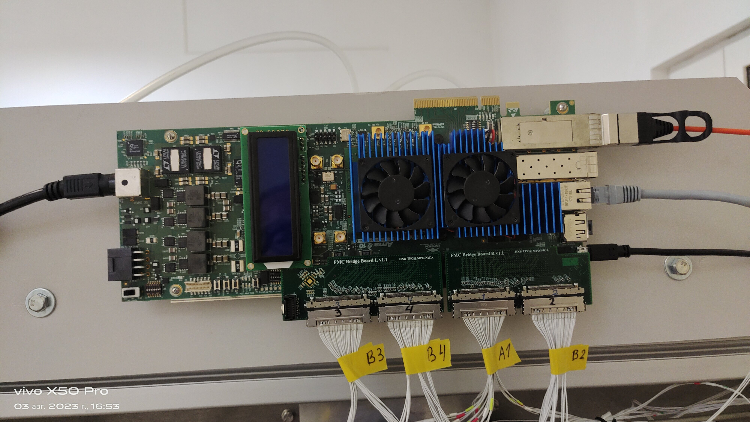
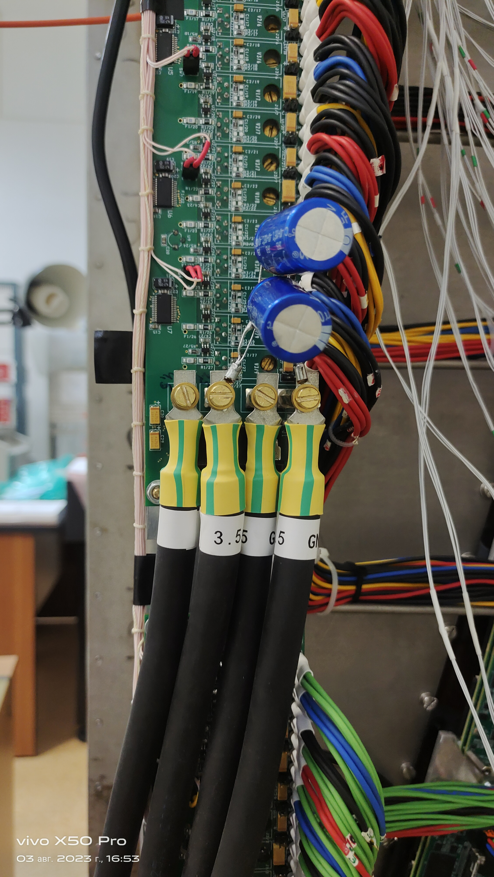
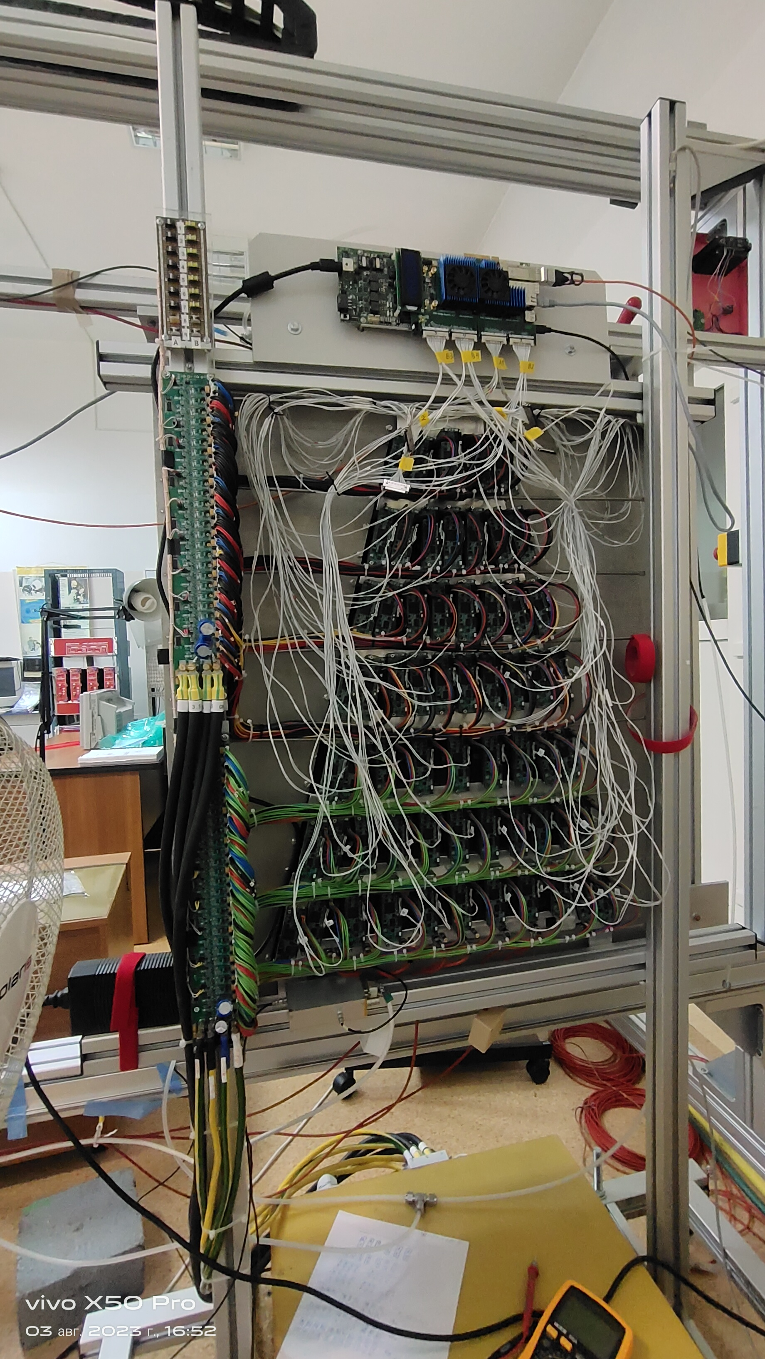
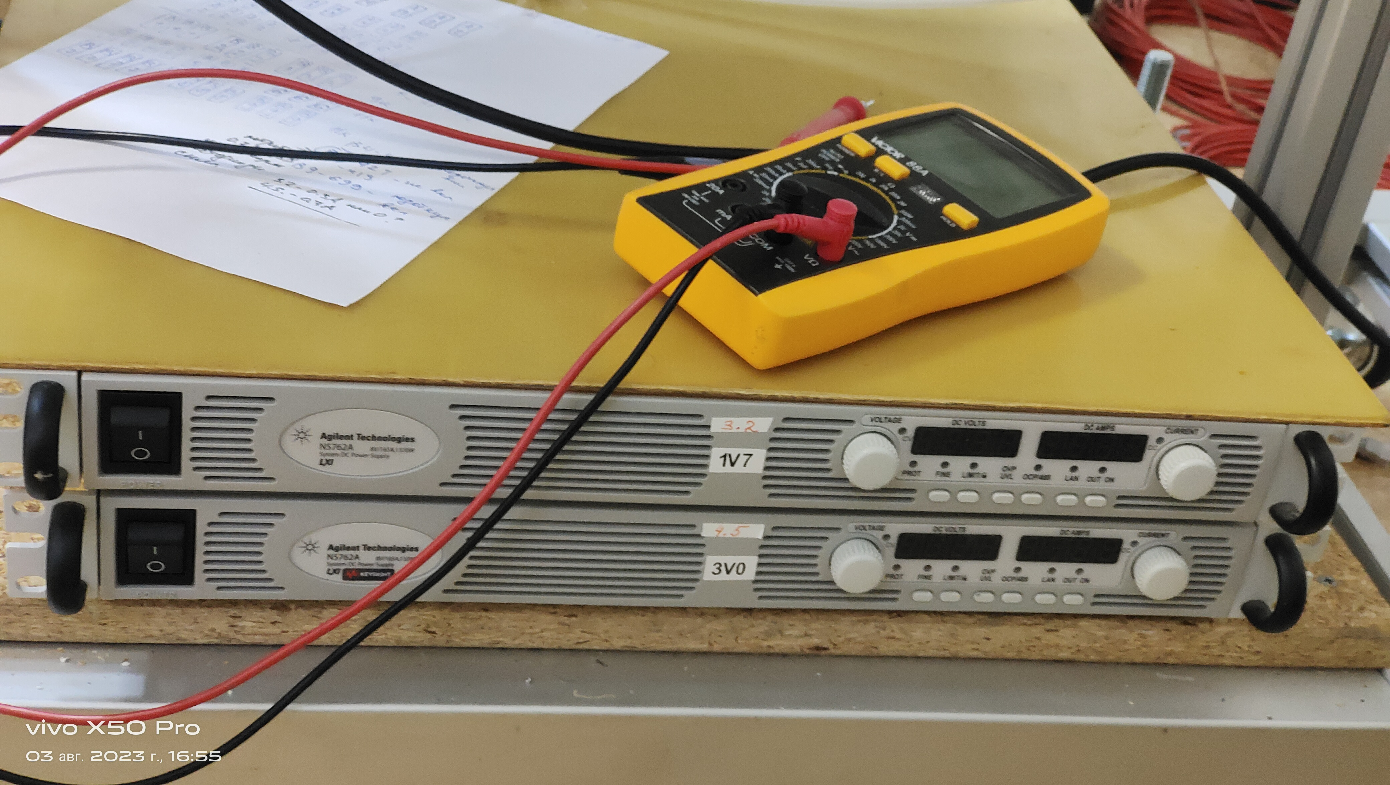
TPC Sub-systems: ROC + electronics test setup
Controller
CAEN LV power supplies
LV Power supplies
in progress …
LVDB
62 FE cards

Slide 10
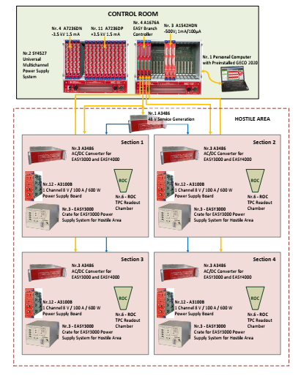
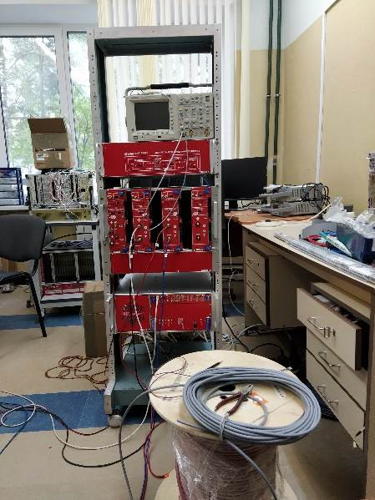
TPC Sub-systems: LV+HV (CAEN)
LV&HV system based on CAEN rad. hard design:
(up to 2000 Gauss and 15 kRad)
- power converters A3486 AC/DC (380 V -> 48 V) – 15+3 pc
- EASY3000 crates - 14+2 pc
- LV module - A3100B (8V/100A) - 48+8 pc
- LV module - A3100HBP (14V/50A) - 6 +2 pc
- HV modules –A3540P (+4kV/1mA) - 8+3 pc
- HV modules –A3540N (- 4kV/1mA) - 2+2 pc
Status:
LV+HV system: JINR-CAEN contract signed
Expected delivery date to JINR: September 2023
test system – tests ongoing
LV cables (halogen free, low smoke):
S=50 mm2 – delivered
HV cables - delivered

Slide 11
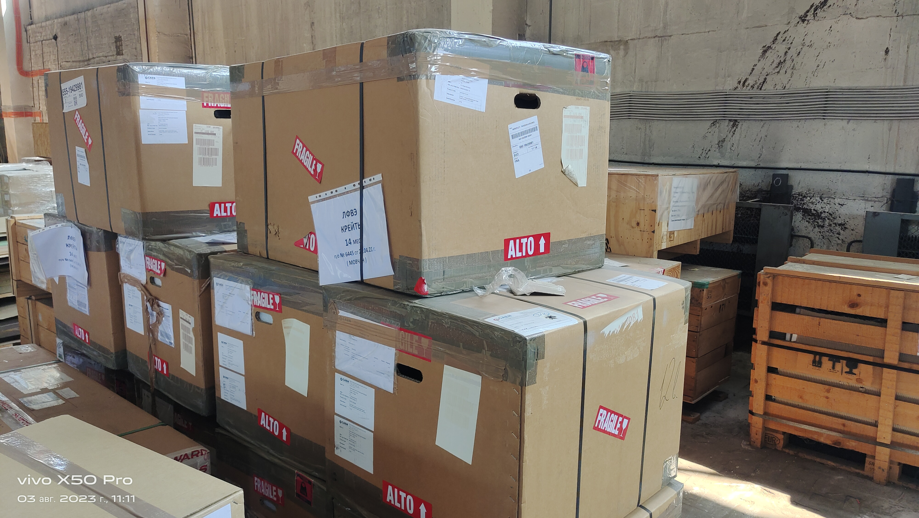
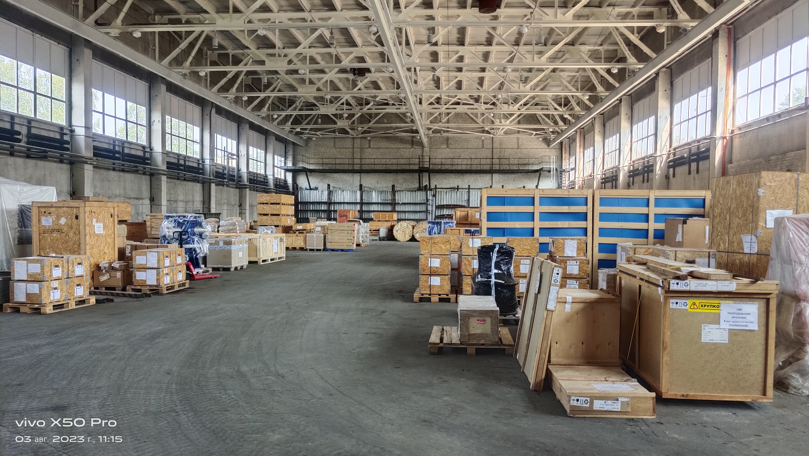
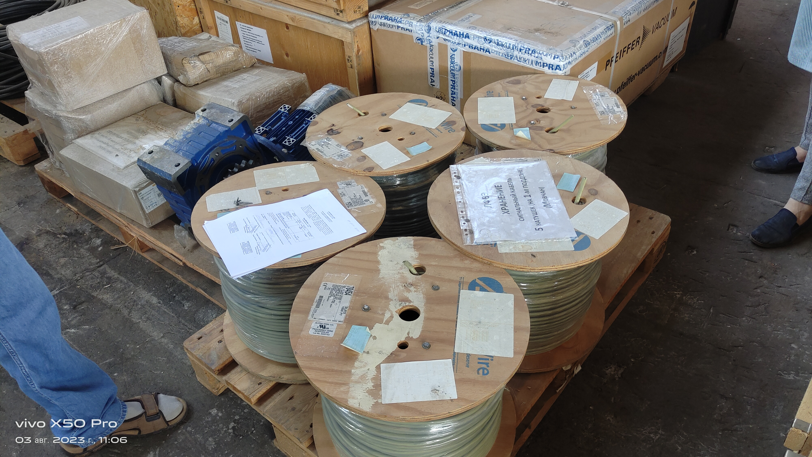
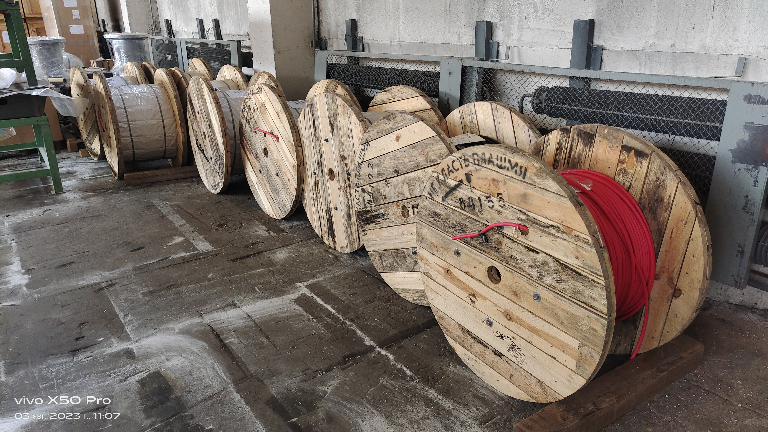
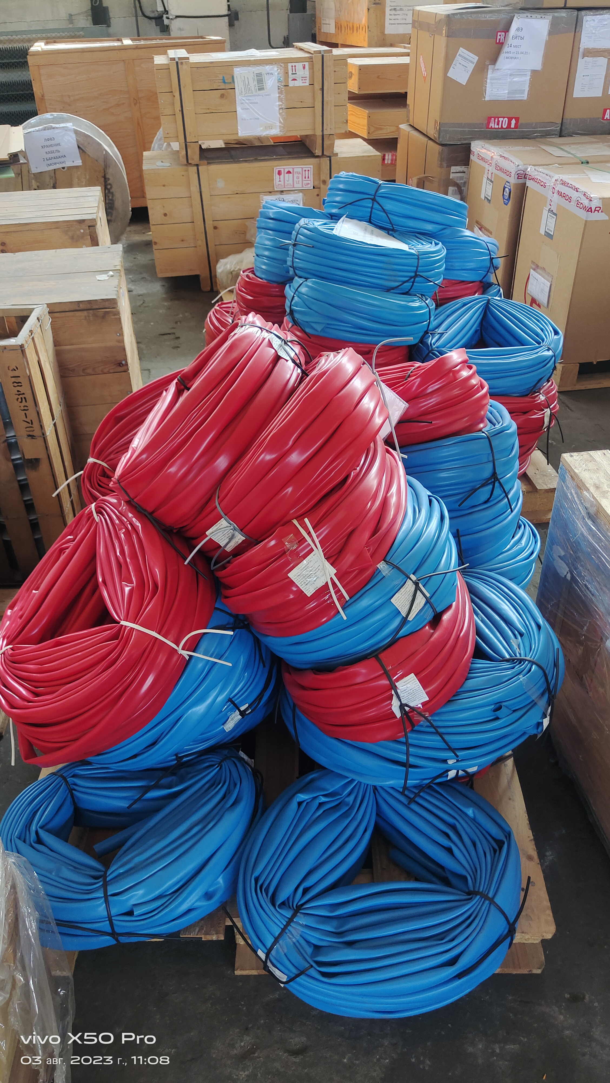
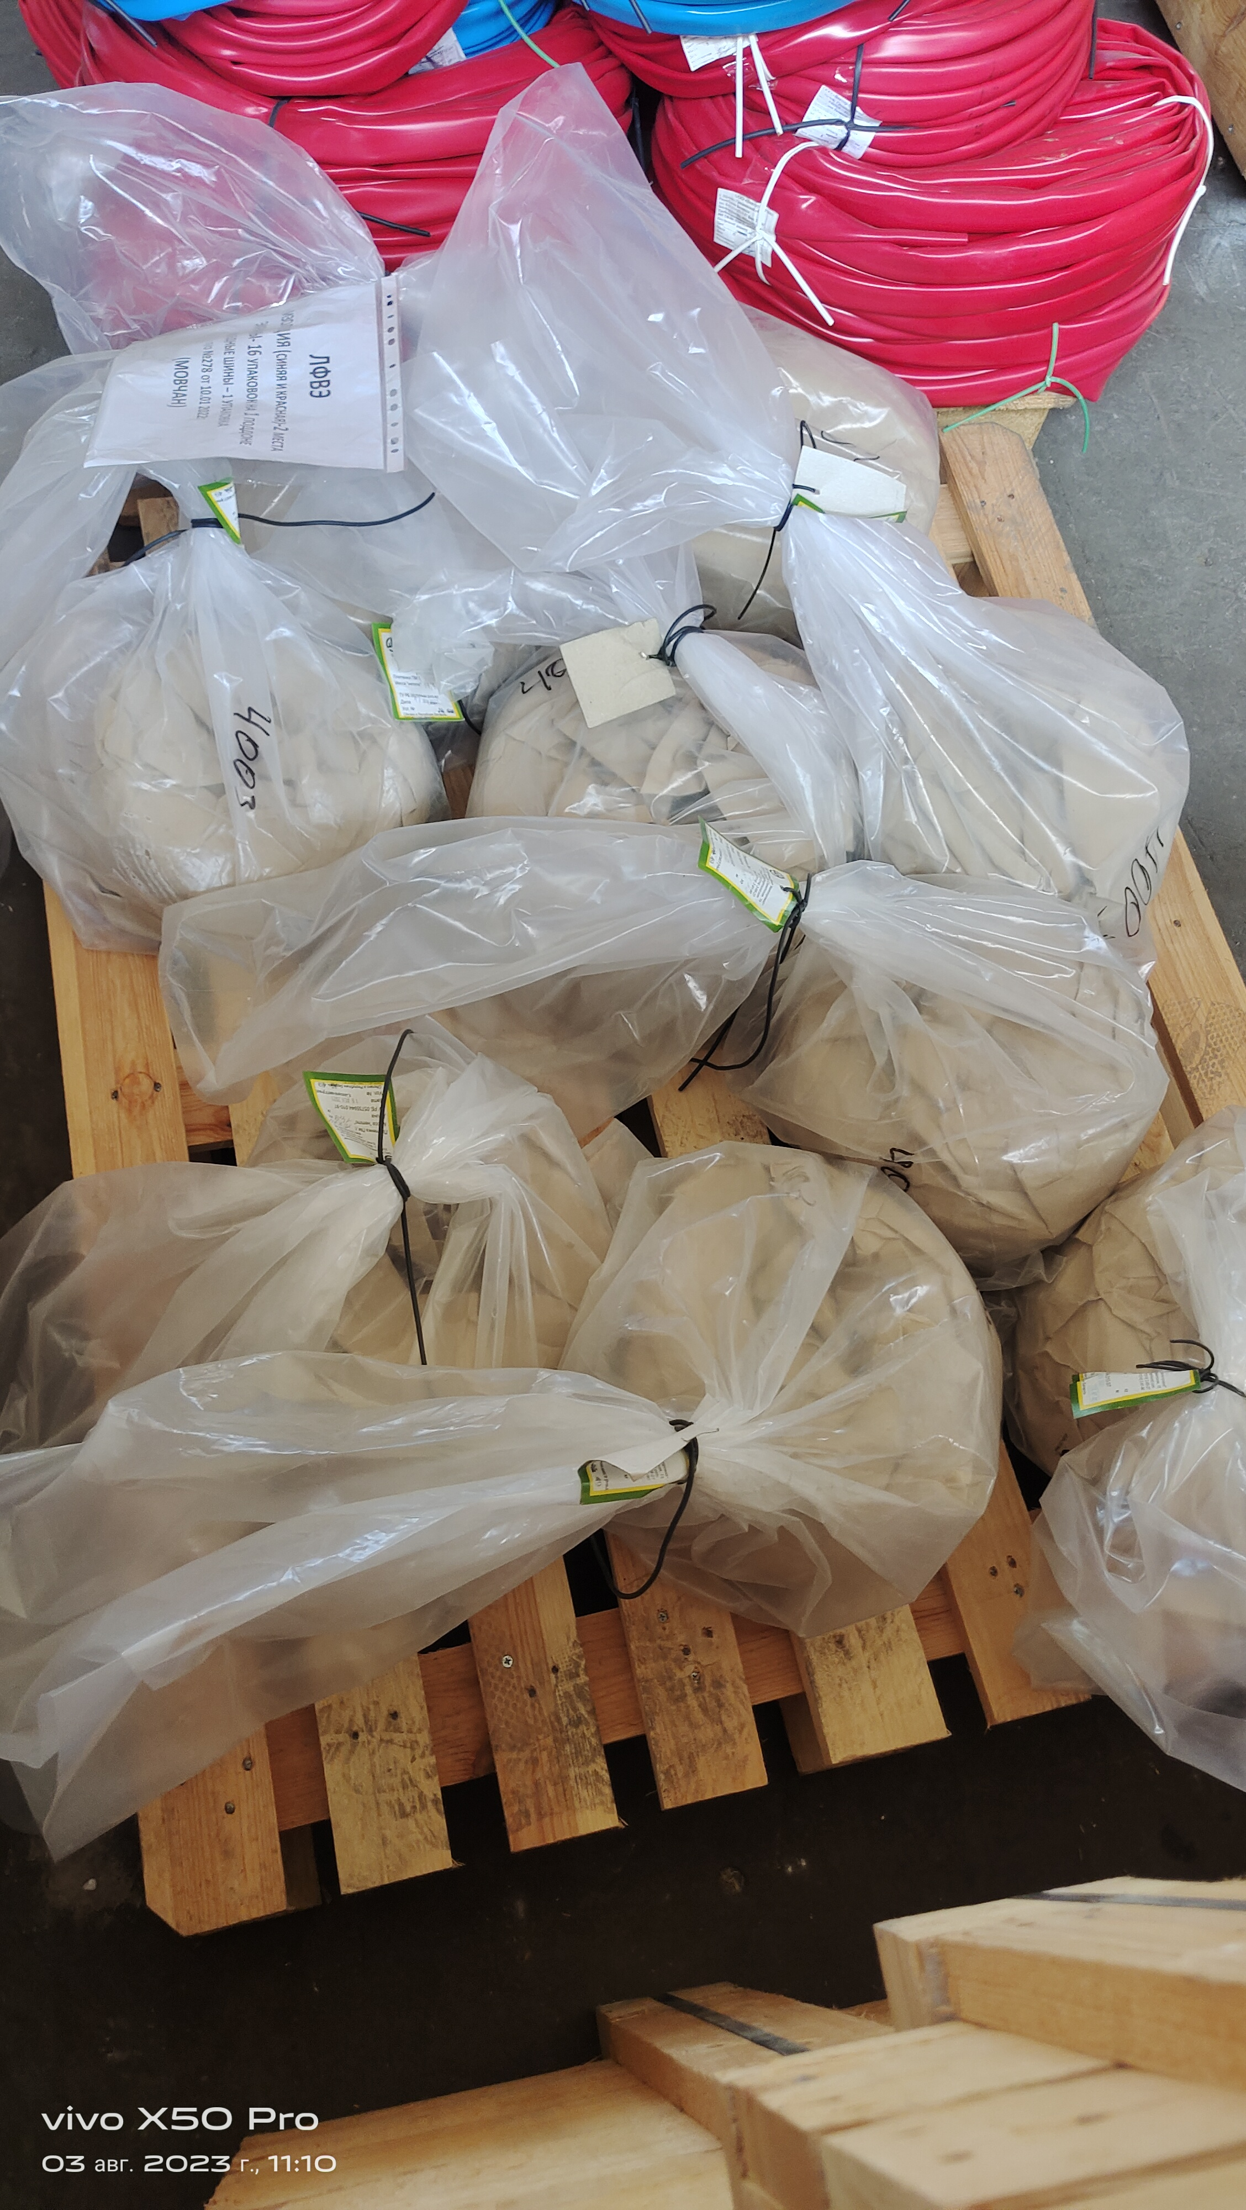
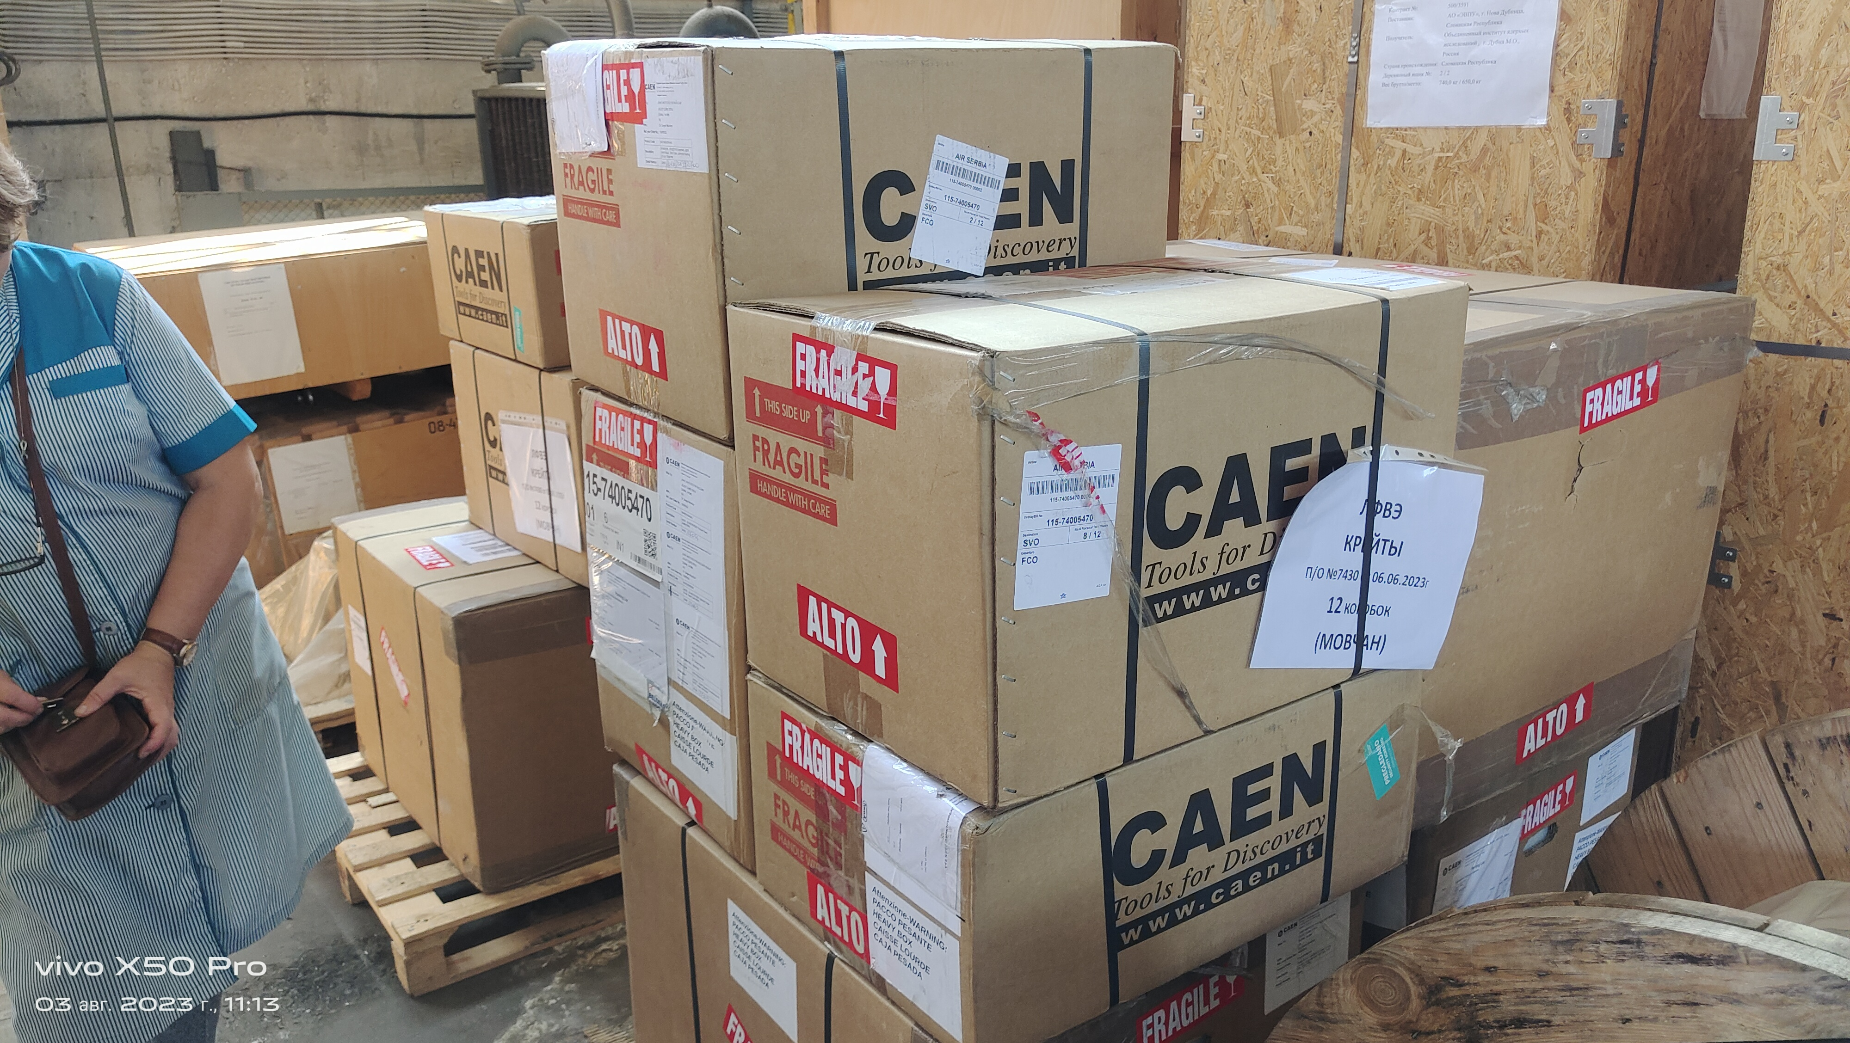
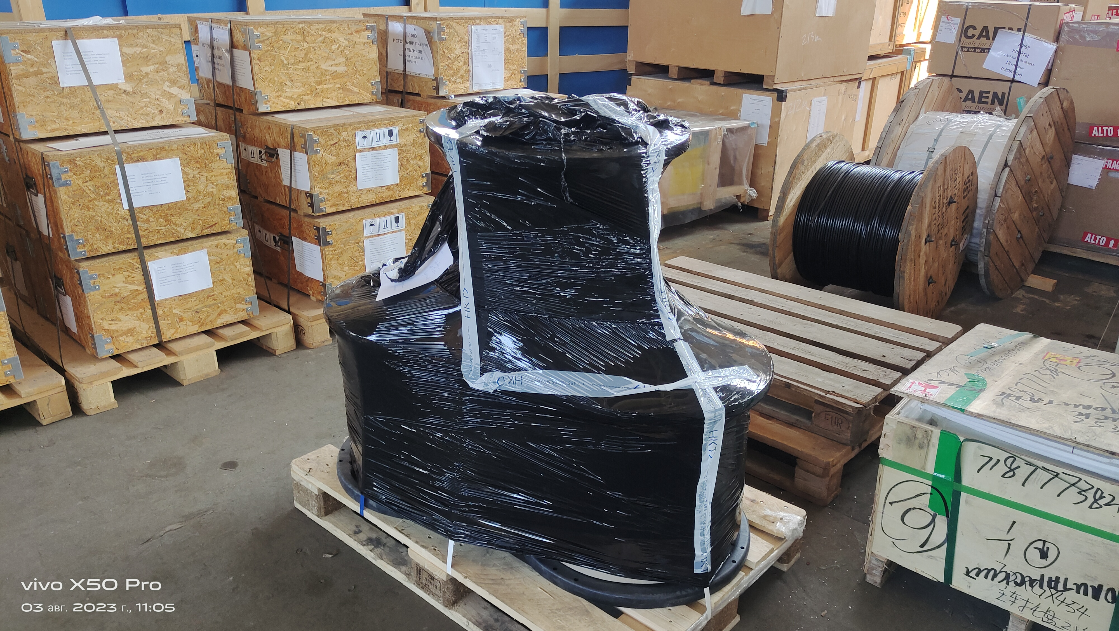
Storage of TPC Cables and equipment at JINR
Slow Control
CAEN EASY3000 crates
CAEN HV system
CAEN LV modules 60pc –
will be delivered in September
LV cables
LV protection
LV EM shielding

Slide 12
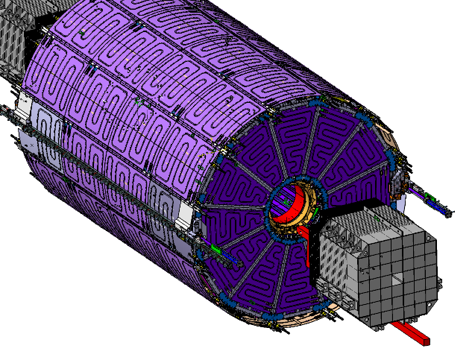







TPC Sub-systems: gas and cooling
Full set of panels – delivered
Gas system (Ar/CH4, 90:10)
Water cooling system
Gas supply
NEW cooling system position –> 2-nd floor of a
additional platform – design and optimization in progress
Racks
TPC volume
imitator
MPD
MPD
design and optimization -
in progress …
contract JINR-INP BSU (Minsk) – done, team – about 15 persons
components delivery – September 30 ÷ up to end of 2023
fully automatic control – 30 September 2024
Tests - in progress
(H20 and O2 sensors are replaced)

Slide 13





TPC Sub-system: Serial Cooling system
Hydrodynamic pressure drop
for ROC chambers
System concept
dP ≤ 0.5 atm
design fix – November 2023
Systems parameters optimization by
calculations – in progress
1. About ROC+FE cards cooling and it optimization with help of prototype - see next talk of A.Makarov
2. The computer-aided design of cooling system - see next talk of A.Fedotov
Water velocity: (1.5-2.5) m/s

Slide 14








TPC Sub-systems: laser calibration system
Scheme for ½ TPC
TPC
laser
laser
Laser “planes” - 4
Micro-mirrors bundles per plane - 4
Beams from micro-mirrors bundle - 7
Laser “tracks” (N =112х2) - 224
Laser beam splitter
Laser beam monitor
micro-mirror
bundles

Slide 15


Integration: NICA-MPD-Platform (NMP)
Common view
TPC equipment
Integration – in progress …

Slide 16

TPC equipment in racks on the 4th floor
mapping – in progress …

Slide 17


TPC cabling and piping
W side: cooling and gas pipes scheme
TPC list of cables and pipes
Cables and pipes integration – in progress …

Slide 18


TPC cabling and piping
Structures for
cables and pipes
fixation
Mockup for cabling and piping
Integration …
TPC
Beam pipe
TPC+TOF+ECAL cabling – in progress …
Piping – not started yet
Structure design - in progress

Slide 19





Tooling for Installation TPC to MPD
Bld. 217
Bld. 217 (MPD)
24 tons,
max=0.41 mm
Tooling design - finished
Prototype 1:5 – done (July 2023)

Slide 20



Tooling for Installation TPC to MPD (Minsk): prototype 1:5
Prototype 1:5
Side view
Front view
Some improvements – to do and finished
Contract – Sept-Oct 2023
Tooling manufacture – 9 months
Delivery to JINR –August 30 2024

Slide 21
Time schedule
Status:
TPC assembling:
  Field cage assembly - Oct 30 2023
  HV tests - Nov 10 30 2023
  TPC vessel ready (glue by epoxy) - Nov 30 2023
  Laser beams position measurements - Dec 10 2023
  TPC vessel tightness measurements - Dec 30 2023
  24 ROC chambers installation - Jan-Feb 2024
  TPC tests: laser tracks and cosmic test - May-Sept 2024
  Integration TPC to MPD:
  TPC racks (8pc) + cabling - Start from Nov 2023 ÷ 2024
  TPC rails (2pc manufacture and delivery to JINR) - Dec 30 2023
  Rails installation to ECAL support structure - 2024 …
  Tooling for installation TPC to MPD:
  Design optimization + prototype 1:5 - done
  Tooling manufacture - 9 months (expected start - Nov 2023)
  Delivery to JINR - August 30 2024
  TPC+ECAL cooling systems: installation - Oct 2023 ÷ Feb 2024
  commissioning - Sept 30 2024
  TPC installation to MPD - Oct 01 ÷ Nov 30 2024
  MPD commissioning - Jan ÷ Feb 2025
Thank you !

Slide 22
Belarus contribution to TPC
Mechanics («ARTMASH», Minsk):
  - MPD mockup 1:5
  - TPC flanges (2 pc ) + HV electrode (1 pc)
  - service wheel (2pc)
  - FE cooling radiators (30 sets)
  - LVN9 cooling radiators (9 pc)
  - installation TPC to MPD tooling 1:5 (1 pc)
  - Prototype “TPC rail 3 meters” (1 pc)
  Electronics (INP BSU):
  - LVN9 stabilization module (48 pc)
  - burning test setup for tests of FE electronics (1 pc)
  - setup for test FE cards (1pc)
  - test of FE cards (600 pc) – in progress
  - system for anode signal measurements (96ch) – in progress
  - gate system for ROC chamber (24ch) – in progress
  Cooling system for TPC + ECAL (INP BSU - full responsibility)
  - cooling setup for tests (1pc)
  - galvanic couple protection (Al-stainless steel and Cu-stainless steel )
R&D (INP BSU, ):
- ThGEM: tests and study
- DLC like protection from sparks in the gas detectors
- DLC study: structures and long term stability
- metalize nuclear membrane like mesh for electrons and ions
MPD and SPD detectors grounding (Институт Энергетики БАН)
НИИ ЯП БГУ, НИИ Физ.-хим. проблем БГУ, БГУ, ООО «Вист групп сенсор», УП «АРТМАШ», Институт энергетики …
Afanasiev K.
Akulich V.V.
Bayev V.
Drapezo A.P.
Fedotov A.
Fedotova Yu.A.
Galkin Ya.
Haluza A.
Kunts A.
Lushachkin D.
Litomin A.
Losev A.
Savitskiy S.N.
Savitskiy S.S.
Senkevich V.
Shmanai E.
Tchekhovskiy V.
Yuhno Yu.М
Vaschilenko M.
Zur I.
…
sorry if anybody forgotten
Many Thanks!!!!

Slide 23
Time schedule

