Slide 1



INNOVATION AND DIGITAL DEVELOPMENT AGENCY,
AZERBAIJAN
JOINT INSTITUTE FOR NUCLEAR RESEARCH,
RUSSIA
INSTITUTE OF RADIATION PROBLEMS,
AZERBAIJAN
Silicon photomultipliers with deep pixels
Akbarov R., Sadygov Z., Tyutyunnikov S.
MAPD collaboration
JINR, factory «Mikron» (Russia)
IP and IRP (MSE RA), IDDA (Azerbaijan)
Zecotek Photonics (Canada)
Factory «MIMOS» (Malaysia)
Minsk 2023

Slide 2
Talk Outline
Brief development history
Basic designs
Operating parameters
Application

Slide 3
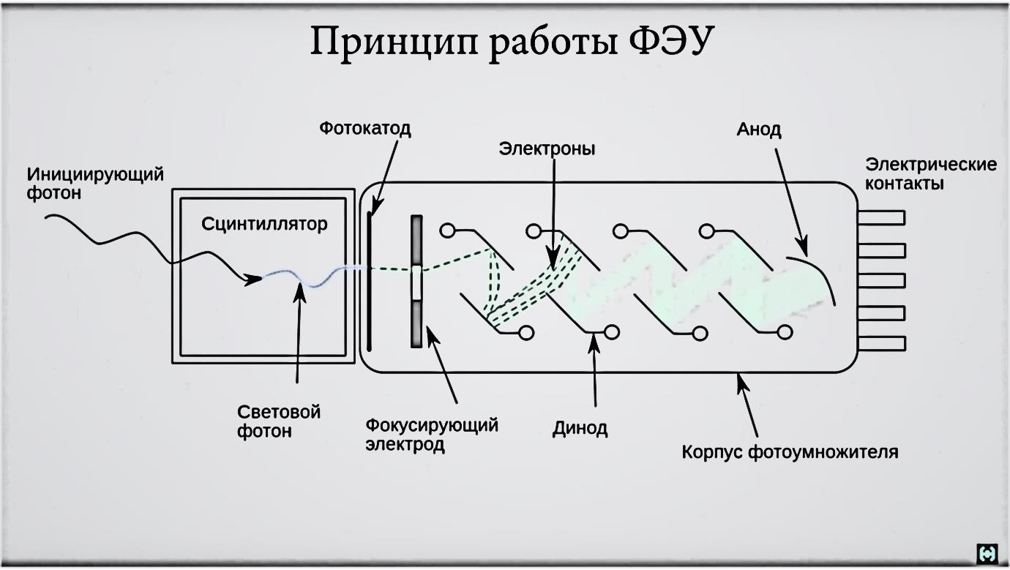
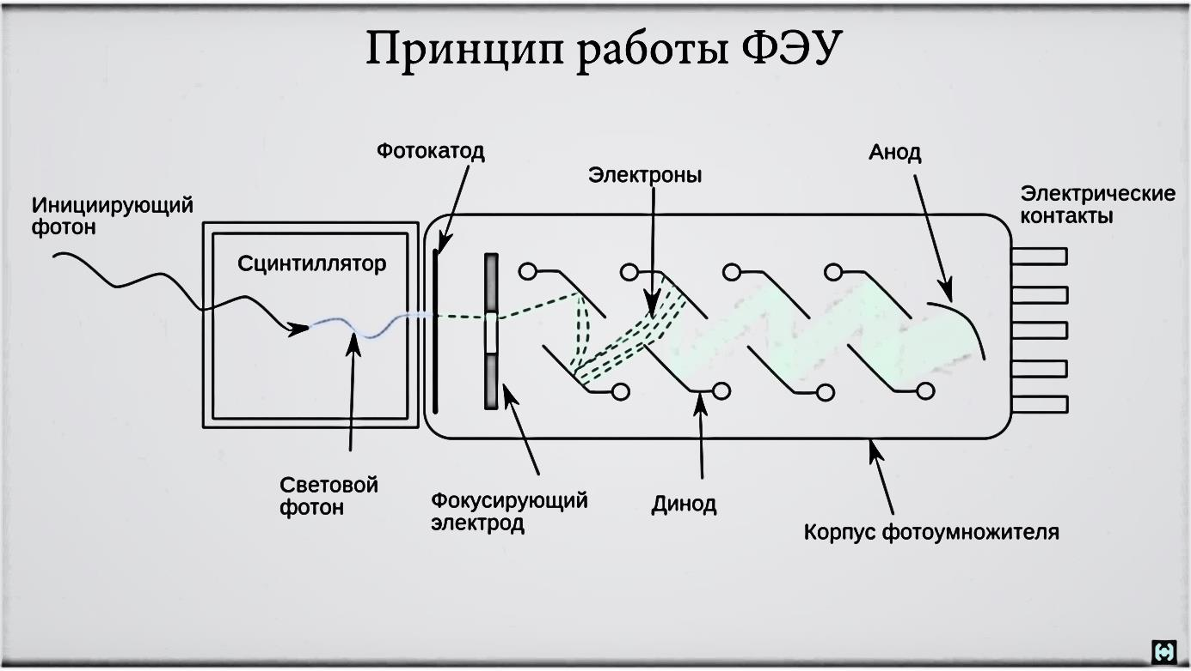
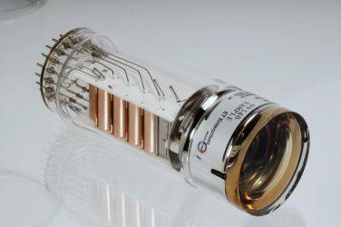
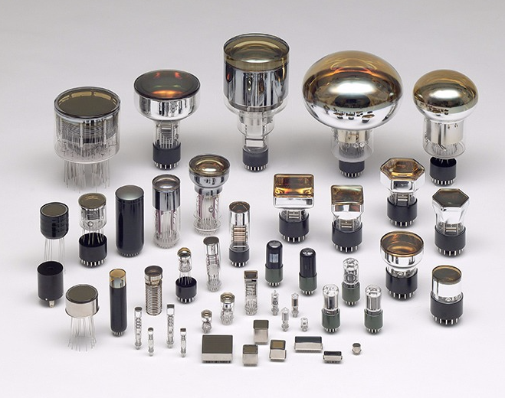
Photon counters – vacuum photomultiplier tubes (PMTs)
photocathode
electrons
anode
electrical
contacts
photon
of light
Main disadvantages
1. Sensitivity to magnetic fields.
2. High voltage (300-4000V)
3. Dimensions and mechanical fragility
focusing electrode
dynode
photomultiplier housing

Slide 4
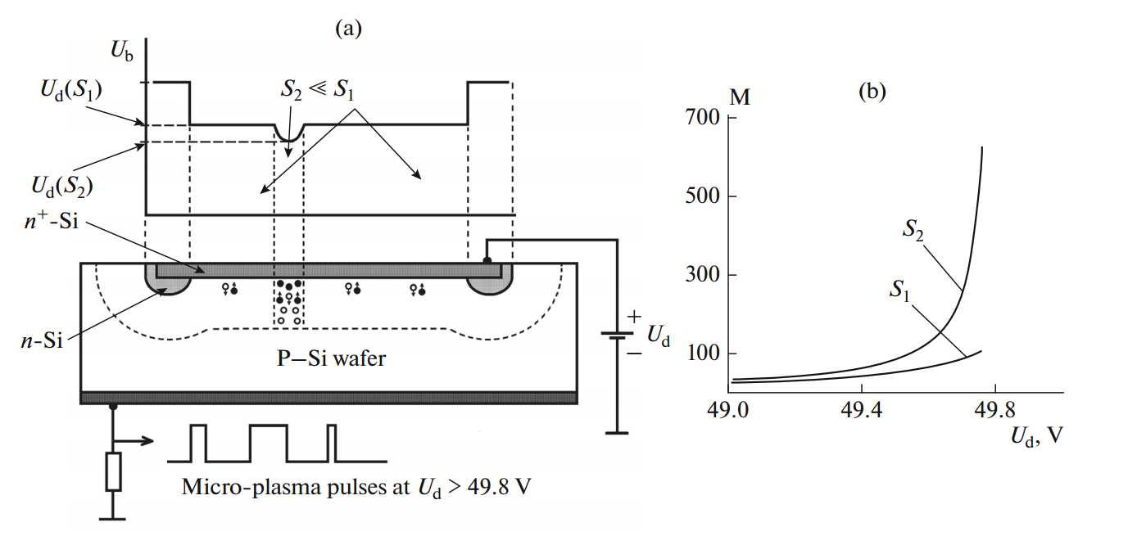
The main problems of traditional avalanche photodiodes (APDs)
The development of APDs with high gains and low noise has been hampered by the following problems:
Various inhomogeneities of a semiconductor crystal, leading to a local uncontrolled avalanche process and to failure of the device.
High excess noise of the avalanche process at high multiplication factors.
Therefore, it was necessary to develop other avalanche structures!

Slide 5
Multilayer avalanche structures
MOS structure
MRS structure
M≈ 30
M≈ 1000
Disadvantages
Injection and capture of hot charge carriers in the volume of oxide
Recovery time >1ms
Pulse mode didn't help
Disadvantages
Spreading of an enhanced charge along the Si–SiC interface.
As a consequence, the change in the multiplication factor over the entire sensitive area of the device.
A. Gasanov, V. Golovin, Z. Sadygov and N. Yusipov “An avalanche detector on the basis of metal-resistive layer-semiconductor,” Sov. Tech. Phys. Lett. 14, 313 (1988). https://journals.ioffe.ru/articles/viewPDF/31222.

Slide 6
Avalanche microchannel MRS structure
One of the ways to prevent the spreading of mobile charges along the Si-SiC interface is the formation of a matrix of individual p-n junctions on the semiconductor surface, which form independent multiplication channels. Tests of experimental samples of microchannel MRS photodetectors fabricated on a silicon substrate showed that the gain of the photodetector is 1000 times higher than the corresponding parameter of the base sample.
A. Gasanov, V. Golovin, Z. Sadygov, N. Yusipov. Russian patent No. 1702831, priority dated September 11, 1989
A. Gasanov, V. Golovin, Z. Sadygov and N. Yusipov. Letters JTP, 1990, t.6, в.1, p.14-17.

Slide 7
Disadvantages of the microchannel avalanche MRS photodetector
The presence of a layer of silicon carbide and a semitransparent metal layer on the surface of the active region of the photodetector significantly reduced its quantum efficiency in the visible spectral region.
The avalanche region of the photodetector was located directly under the contact regions with a thickness of at least 1 μm and an impurity concentration of at least 10¹⁹ cm^{–3}; therefore, a significant part of the charge carriers created by light did not reach the avalanche region.
Therefore, new developments were required, as a result of which modern MAPDs (or silicon photomultipliers) appeared.

Slide 8
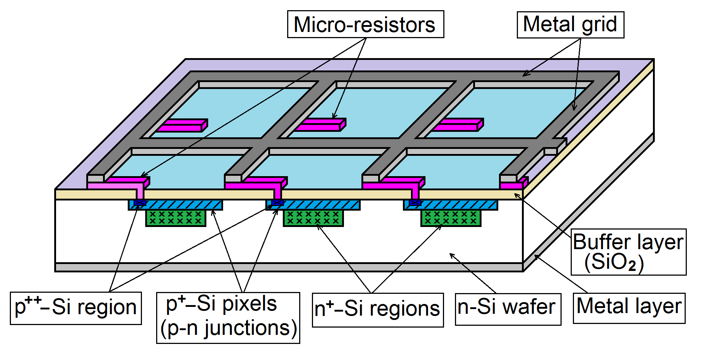
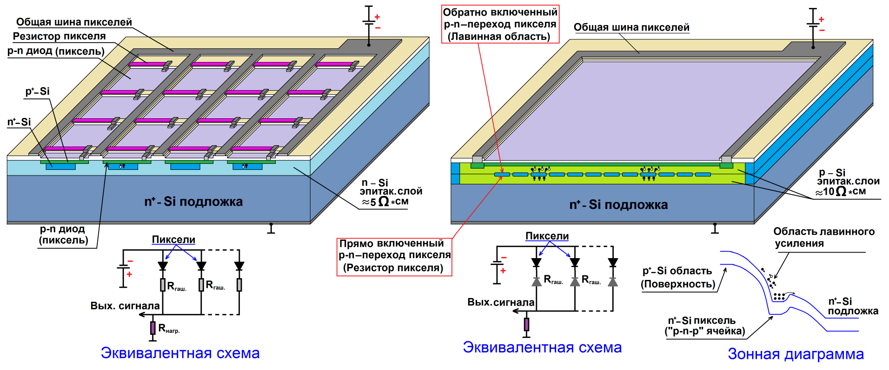
MAPD with individual micro-resistors
Pixels
Out siq
Equivalent circuit
This is the first type of MAPD with individual film resistors, which has a high quantum efficiency in the visible region of the spectrum. In the scientific literature, MAPDs based on this design are often referred to as "Silicon Photomultipliers (SiPM)" or "Micro Pixel Photon Counters (MPPC)".
Z. Ya. Sadygov. Russian patent No. 2102820, priority: 10/10/1996, published: 01/20/1998.

Slide 9
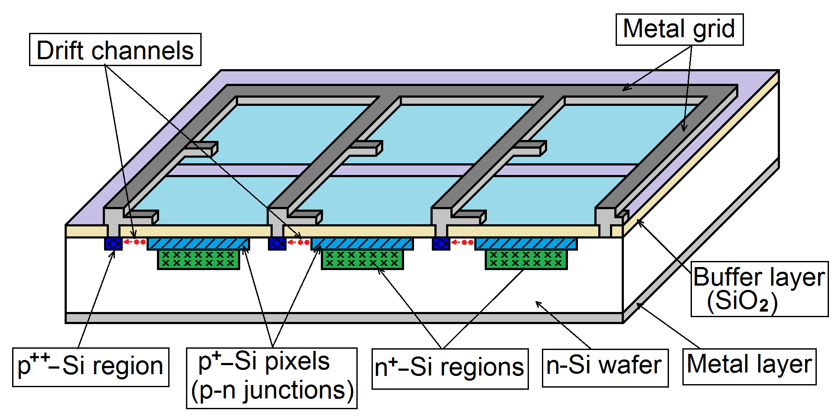
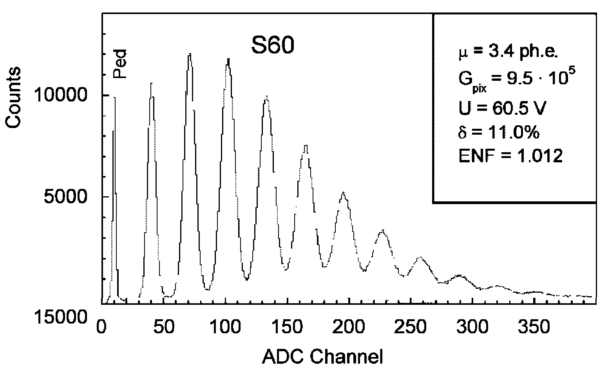
MAPD with a surface drift channel
This is the second type of MAPD, which is characterized by the fact that it uses the resistance of charge carriers drift from the region of pixels to individual drains connected to a common metal contact as an avalanche-quenching resistance.
Z. Sadygov. Russian patent No. 2086047 dated 07/27/1997.
N. Anfimov et al., Nucl. Instr. and Meth. A 572 (2007) 413.

Slide 10
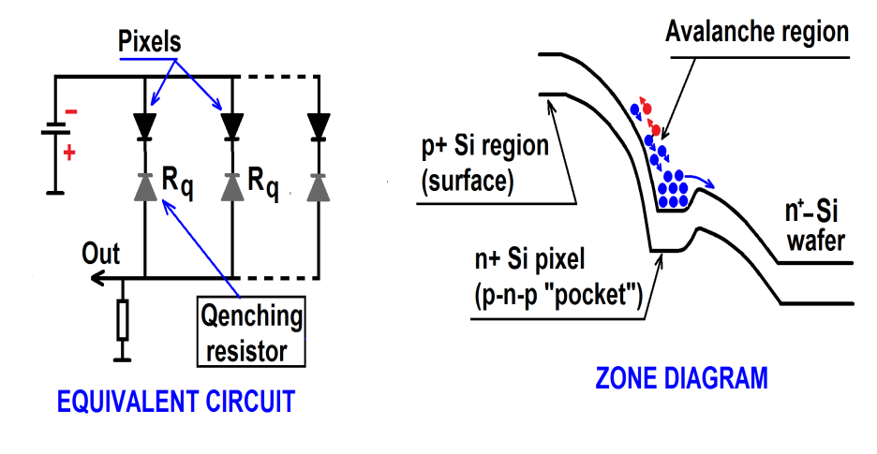
MAPD with depth pixels
n⁺⁺ -Si
p-Si
This is the third type of MAPD and differs from previous avalanche photodetectors in that it has "deeply buried" pixels. One of the advantages of this MLPD is that a much higher pixel density can be achieved in it than in other types.
Z. Ya. Sadygov. Patent Russia No. 2316848, priority dated 06/01/2006.
Z. Sadygov, A. Olshevski, I. Chirikov, I. Zheleznykh, A. Novikov. Nucl. Instrum. and Methods in Phys. Res. A 567 (2006), 70–73.

Slide 11
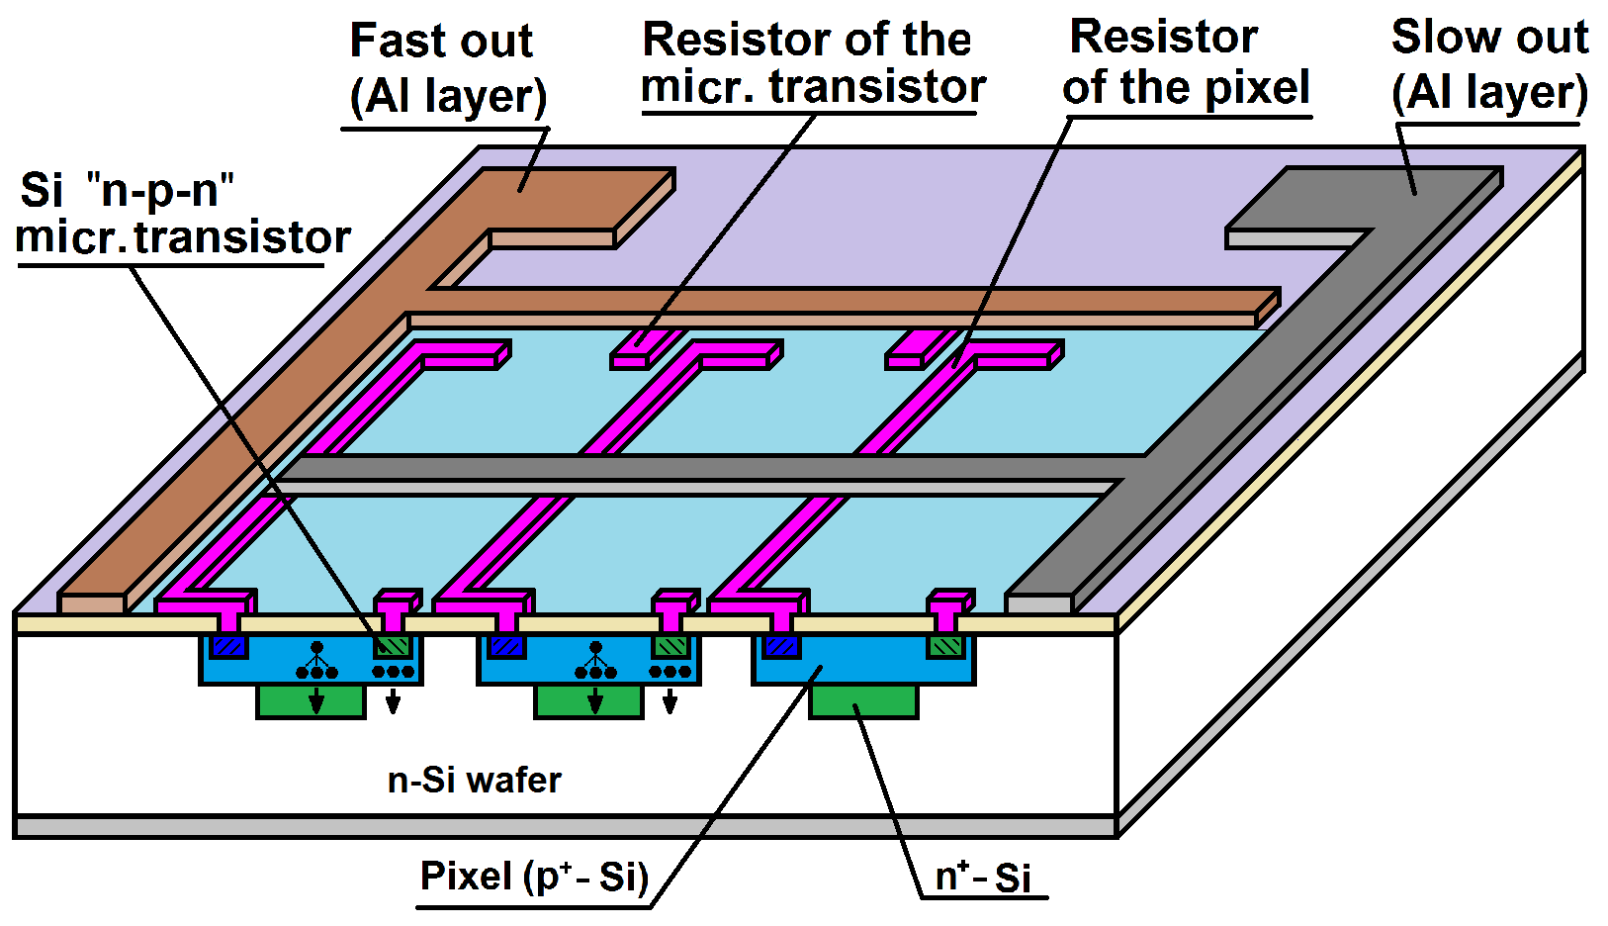
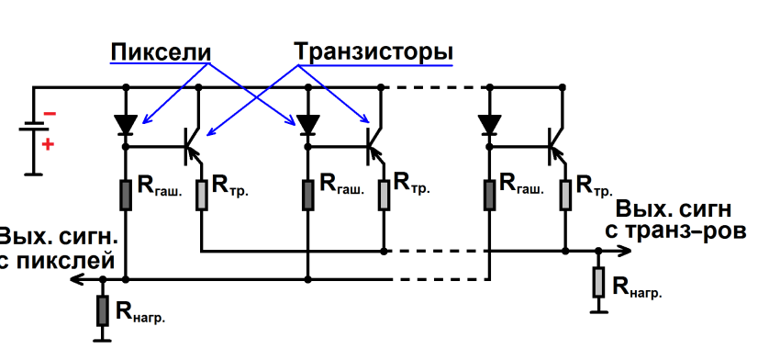
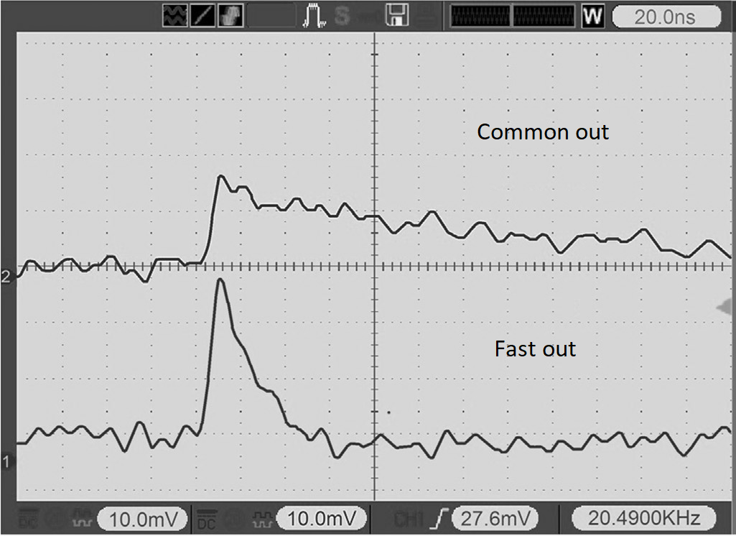
MAPT – Micropixel avalanche phototransistor
Pixels
Transistors
Si n-p-n
MAPT contains a matrix of micropixels with individual quenching resistors and a matrix of microtransistors with individual ballast resistors. The device has two independent signal pickup outputs: common output and a fast output.
Z. Sadygov et al. Patent of Russia No. 2528107, priority dated 04/16/2013.
A. Sadygov et al., Nucl. Instrum. Meth. A 845 (2017) 621.

Slide 12
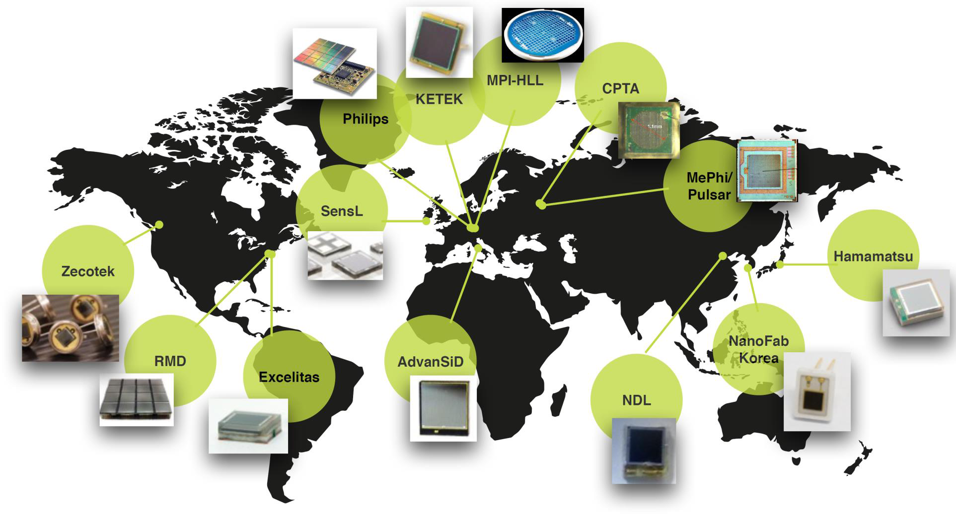
The main manufacturers of MAPD of the first design
(or SiPM)
W. Ootani ICEPP, University of of Tokyo. Special Workshop on Photon Detection with MPGDs. June 10th, 2015 CERN

Slide 13
Parameters of our MAPD
 | MAPD-3B | MAPD-3NK | MAPD-3NM-1lot | MAPD-3NM-2lot | MAPT
Active area, mm² | 3×3 | 3,7×3,7 | 3,7×3,7 | 3,7×3,7 | …
Pixel diam, mkm | 2 | 7 | 7 | 12 | …
Pixel density, pix/mm² | 40 000 | 10 000 | 10 000 | 5 000 | …
Breakdown voltage, V | ~66 | ~88 | ~71 | ~51 | …
Gain | 10⁴ | 10⁵ | 10⁵ | 10⁵ | ...
PDE, % | 15 | 28 | 33 | 37 | …
Dark current, nA | ~50 | ~1000 | ~200 | ~100 | …
Capacity, pF | 215 | 190 | 230 | 160 | …

Slide 14
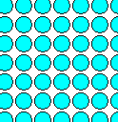
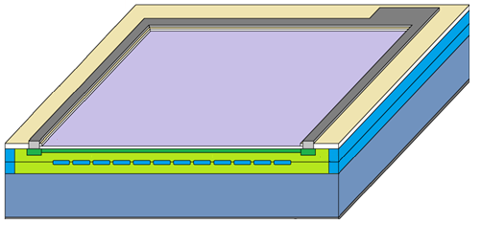
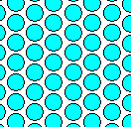
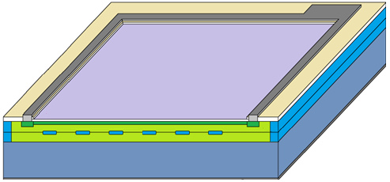
MAPD-3NK
MAPD-3NM-2lot

Slide 15
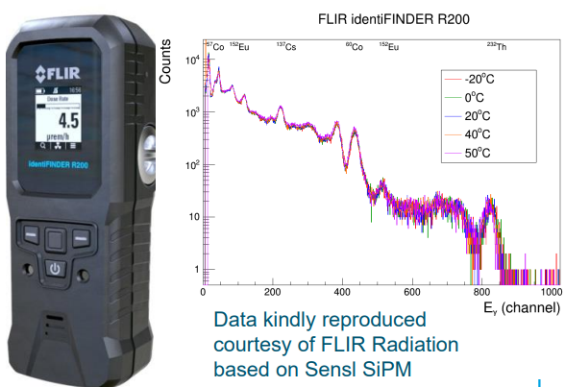
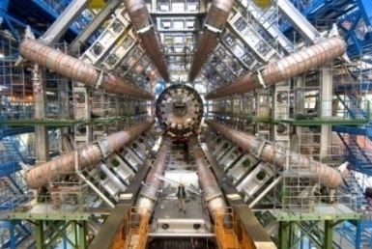
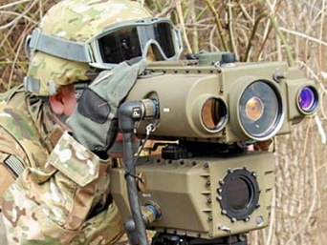
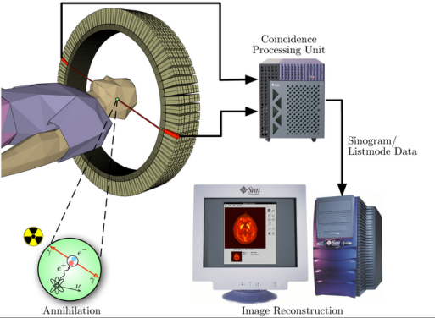
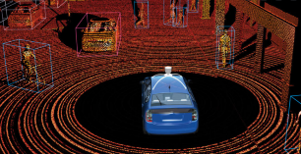
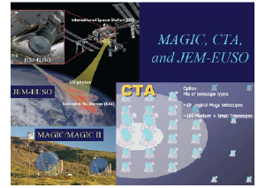
MAPD fields & application
Dosimetry and spectroscopy
Calorimeter readout in magnetic fields
Medical imaging (PET…)
Space applications
Laser Imaging, Detection and Ranging systems

Slide 16
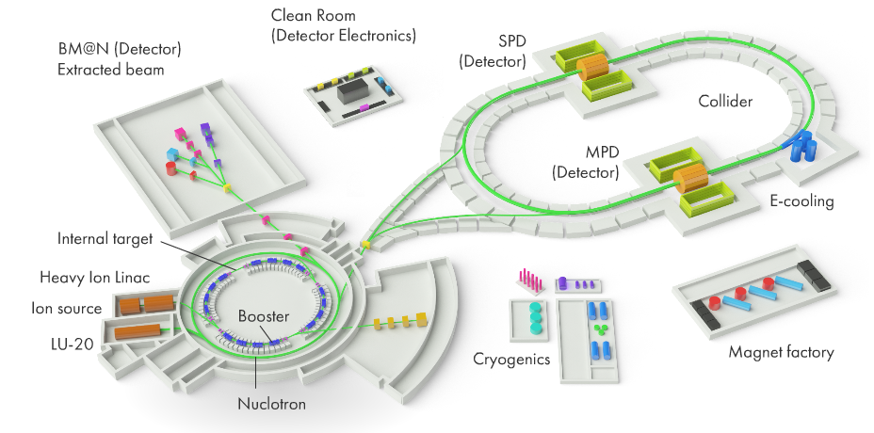
NICA project. MPD detector.
Calorimeter (ECAL) in the COMPASS project (CERN)
https://nica.jinr.ru/ru/projects/mpd.php

Slide 17
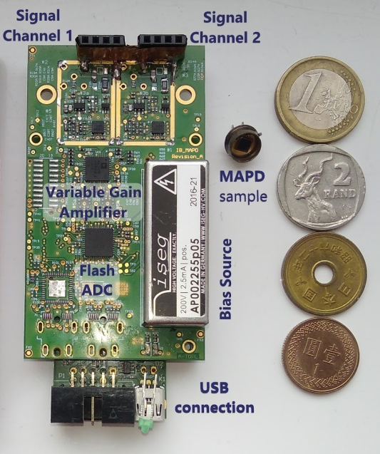
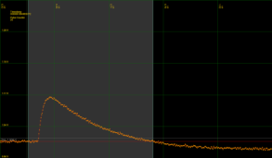
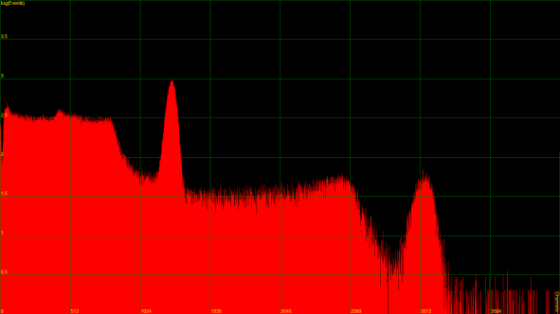
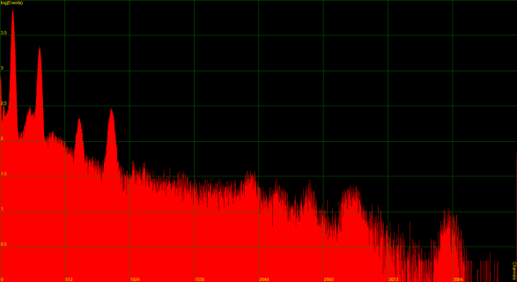
Detector module SPECTRIG MAPD
In collaboration with the Institute of Experimental and Applied Physics, Prague, Czech Republic.
Dual channel module.
Powered by 5V USB port
Voltage converter up to +200 V
Amplifying block up to 30 dB
ADC block.
Availability of own software
Does not require additional power
Compact.
https://doi.org/10.1016/j.nima.2020.164440
https://doi.org/10.1088/1748-0221/16/07/P07020
https://doi.org/10.1038/s41598-022-20006-z

Slide 18
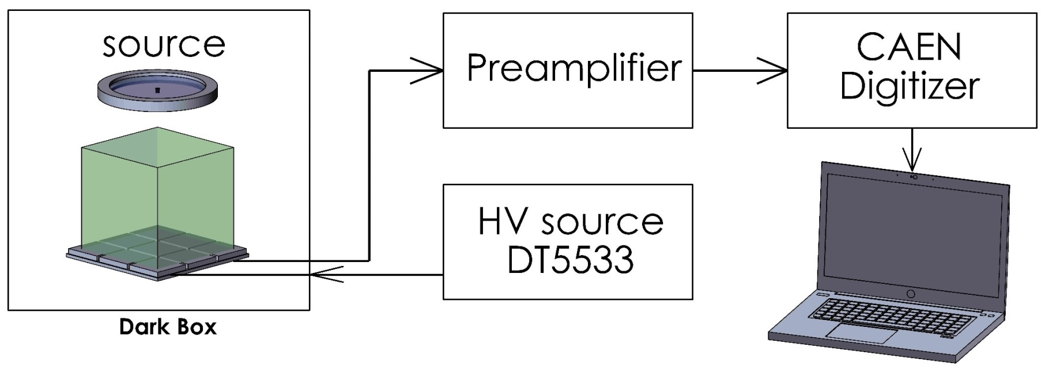
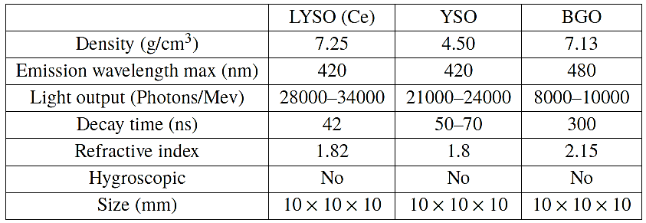
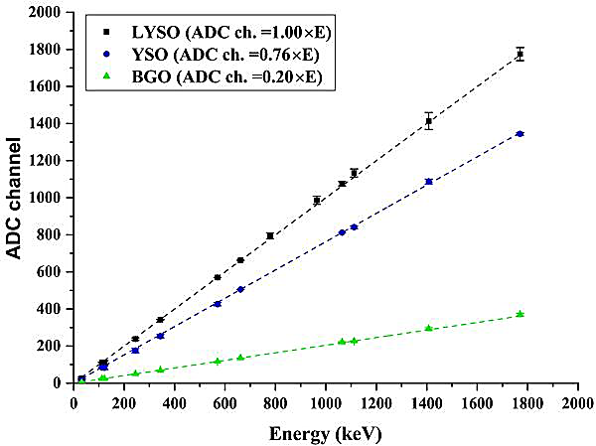
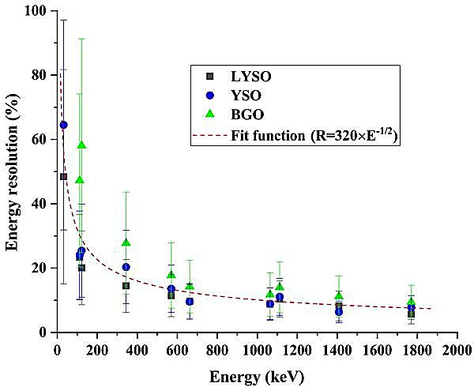
Scintillation readout with MAPD array for gamma spectrometer
MAPD-3NK
Source:
Co-57
Cs-137
Eu-152
Bi-207
The energy resolution was 9.25% (LYSO), 9.28% (YSO), and 14.33% (BGO) for 661.7 keV gamma-rays of Cs-137.
https://doi.org/10.1088/1748-0221/15/01/C01001

Slide 19
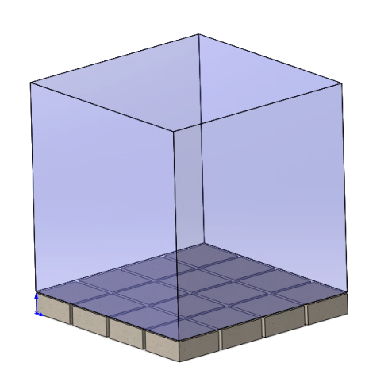
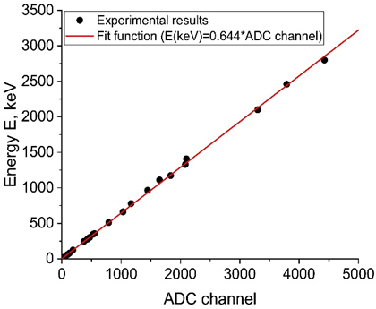
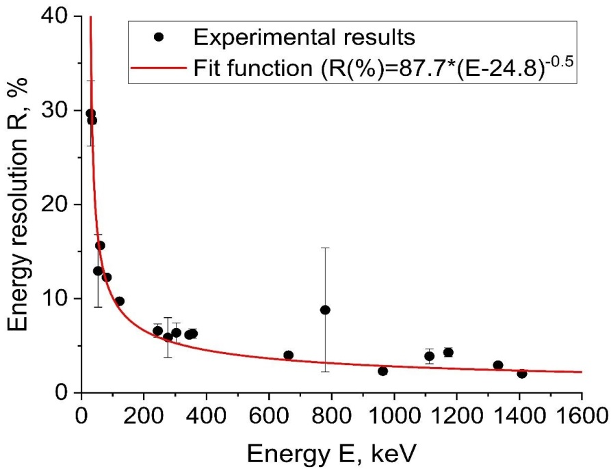
Gamma-ray spectroscopy with MAPD array in the readout of LaBr₃:Ce scintillator
MAPD-3NM | LaBr3:Ce
Density (g/sm³) | 5,2
Wavelehgth (nm) | 380
Light output (Photons/MeV) | 68000
Decay time (ns) | 17
Size (mm) | 15×15×15
Energy calibration
30 keV – 4440 keV
The obtained energy resolution for the 662 keV gamma-rayswas equal to 4%.
https://doi.org/10.1088/1748-0221/16/07/P07020

Slide 20
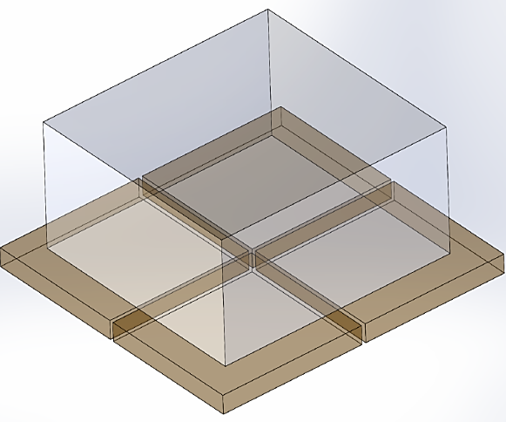
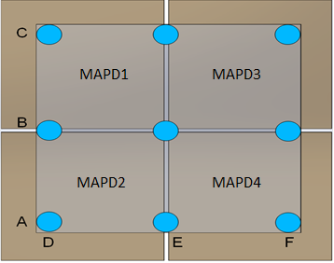
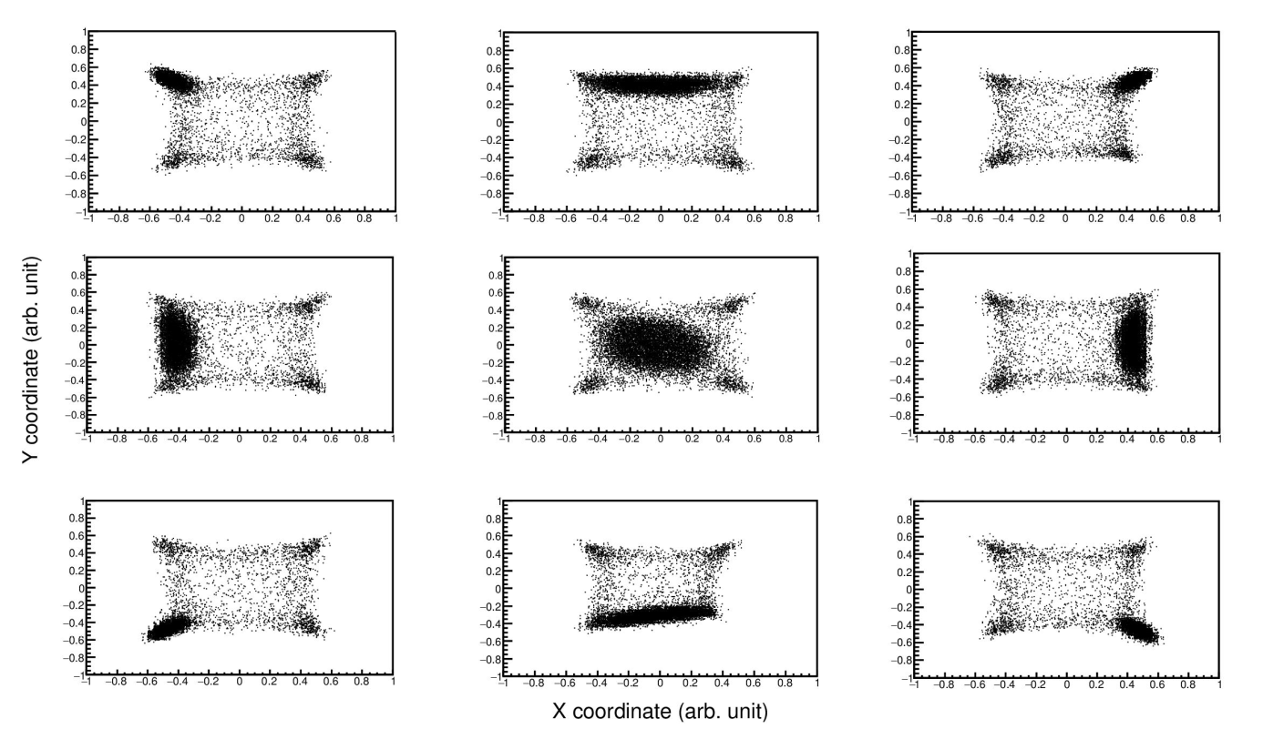
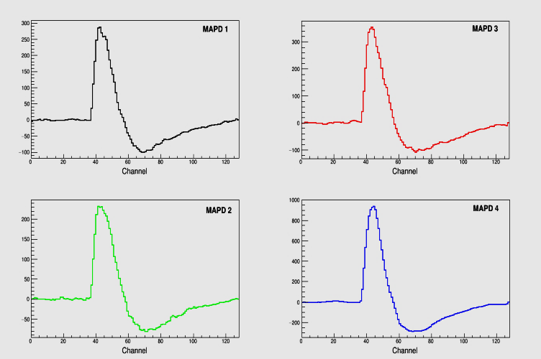


A position sensitive alpha particle detector based on a LYSO crystal and a MAPD
LYSO (6*6*2 mm3)
$$X=\frac{\left(A_{MAPD1}−A_{MAPD3}\right)+\left(A_{MAPD2}−A_{MAPD4}\right)}{A_{MAPD1}+A_{MAPD2}+A_{MAPD3}+A_{MAPD4}}$$
$$Y=\frac{\left(A_{MAPD1}−A_{MAPD2}\right)+\left(A_{MAPD3}−A_{MAPD4}\right)}{A_{MAPD1}+A_{MAPD2}+A_{MAPD3}+A_{MAPD4}}$$
MAPD’s
Source: Am-241 (5.5 MeV)
Spatial resolution was 2mm
http://isinn.jinr.ru/proceedings/isinn-24/pdf/ahmadov.pdf

Slide 21
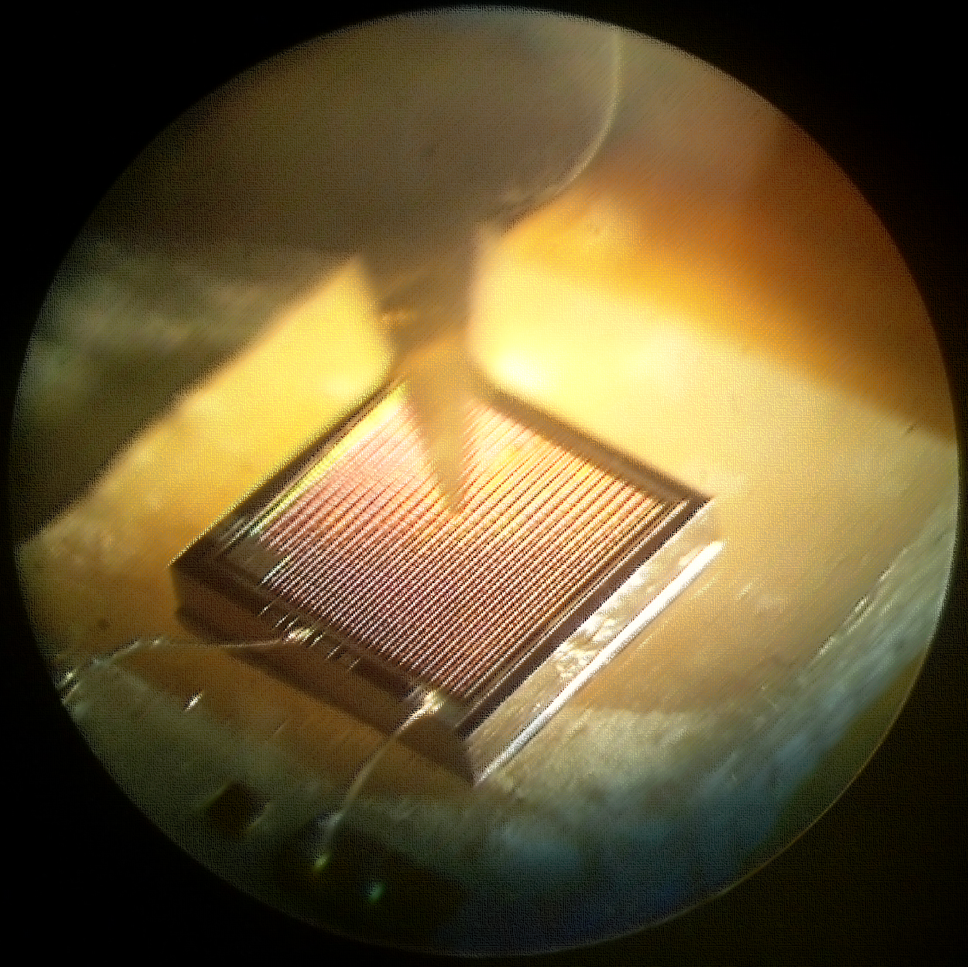
Thank you
for your
attention!
2018

Slide 22
 | MAPD-3NK | MAPD-3NM-1lot | MAPD-3NM-2lot | MPPC S14160-3015 | SenseL J-30020 | SenseL C-3mm-20u | Ketek PM3315-WB
Active area, mm² | 3,7×3,7 | 3,7×3,7 | 3,7×3,7 | 3x3 | 3,07 × 3,07 | 3x3 | 3x3
Pixel diam, mkm | 7 | 7 | 12 | 15 | 20 | 20 | 15
Number of pixels | 133000 | 135000 | 66500 | 39984 | 14410 | 10998 | 38800
Pixel density, pix/mm² | 10 000 | 10 000 | 5 000 | 4443 | 1529 | 1222 | 4311
Breakdown voltage, V | ~88 | ~71 | ~51 | ~38 | ~24,4 | ~24,4 | ~27
Gain | 10⁵ | 10⁵ | 10⁵ | 10⁵ | 10⁶ | 10⁶ | 10⁶
PDE, % | 27 | 33 | 37 | 32 | 38 | 31 | 31
Dark current, nA | ~1000 | ~200 | ~100 | ~80 | ~500 | ~400 | 190
Capacity, pF | 190 | 230 | 160 | 530 | 1040 | 770 | 800

