Slide 1

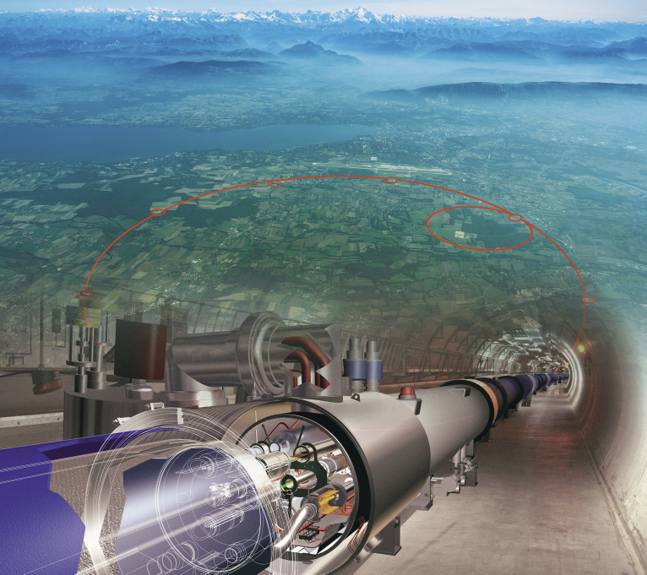
Portals to Dark Matter and Search Perspectives at the LHC
The XVth International School-Conference “The Actual Problems of Microworld Physics”, Minsk, Belarus, September 1, 2023
Maria Savina, BLTP JINR
Maria.Savina@cern.ch

Slide 2
Dark matter candidates:
stable (non-interacting directly, MET signatures)
electrically neutral
a mass reachable at the LHC
interaction transfer to a visible sector – portals to DM,
mediators (“messengers”), simplified models of
DM/SM interaction)
advantages and drawbacks of a phenomenological approach

Slide 3
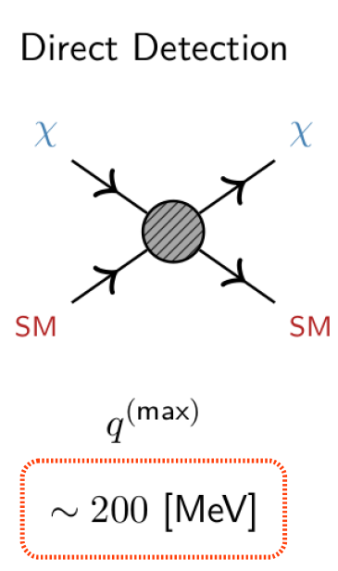
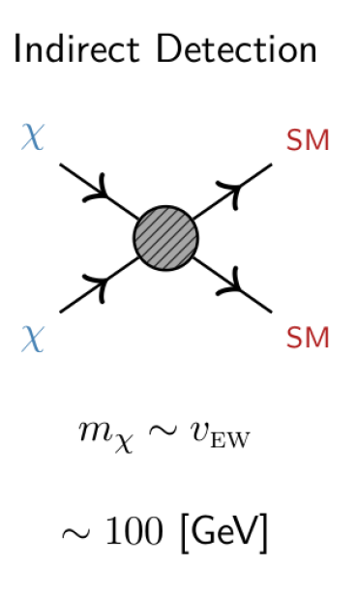
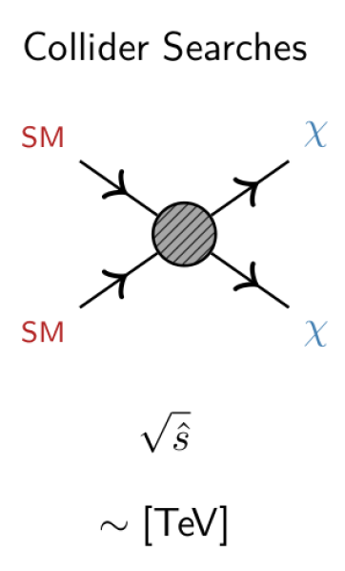
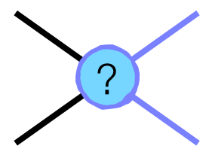
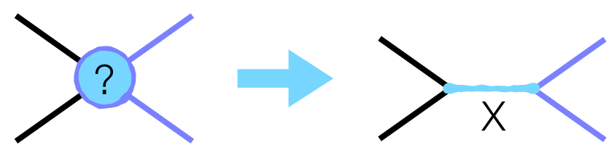
How to search?

Slide 4
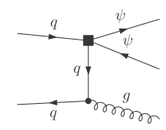
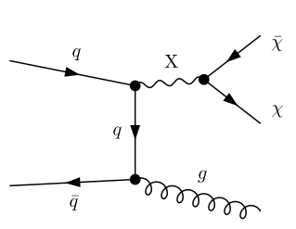
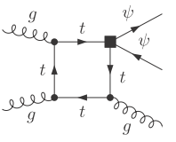
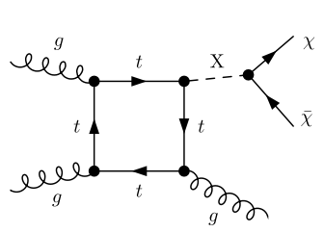
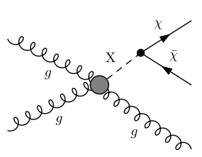
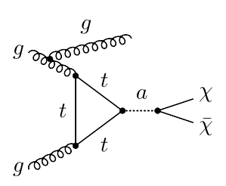
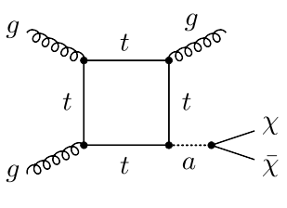
From EFT to simplified models
Х
Х

Slide 5
Portals to DM: DM particle(s) + mediator(s)
Visible sector: SM
H, q, l, G, V…
mediator: S_{med}, M_{med}
Hidden sector: DM
Φ, S..,Ψ.., V’…
g_{f,V,H}
g_{DM}
only one/a few DM particle(s):
S_{DM} = 0, ½, 1…, M_{DM}
S=0,1/2, 1…
Model free parameters:
a mass of mediator(s) and DM particle(s), couplings to the visible and hidden sector, mixing angle(s)

Slide 6
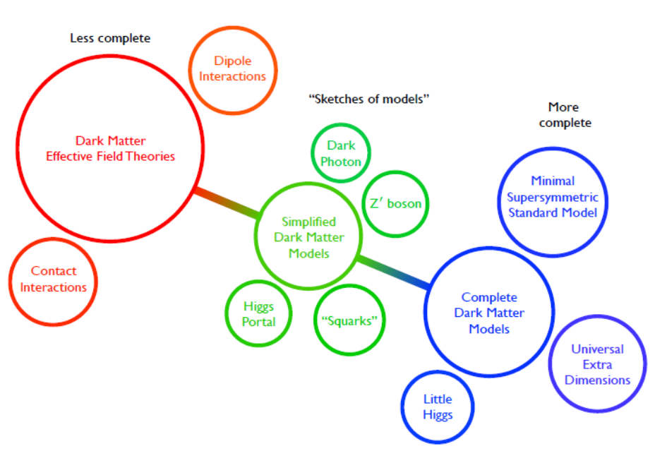
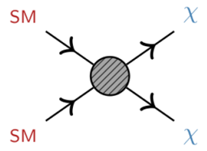
Dark matter approaches: from EFT to complete models
Notes:
6

Slide 7
DM signatures
Prompt DM production
LLP signatures

Slide 8
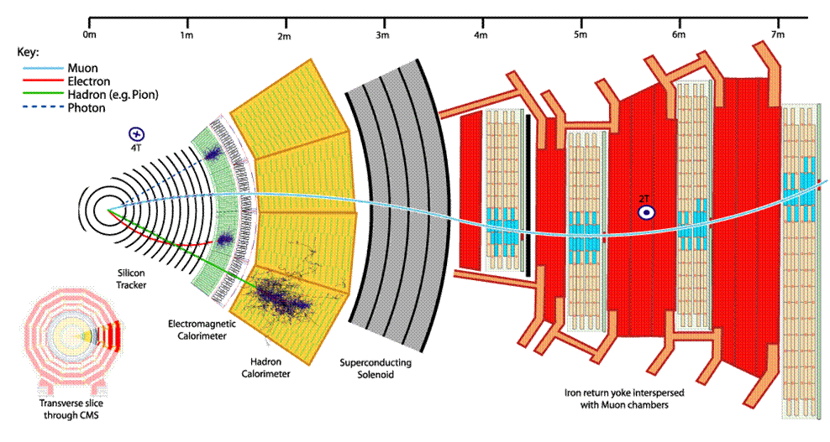
Prompt (“ordinary”) signatures

Slide 9
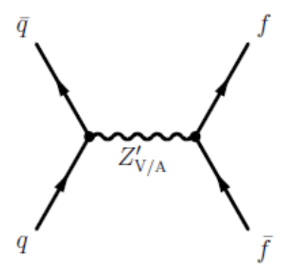
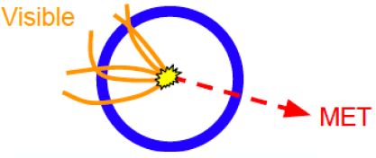
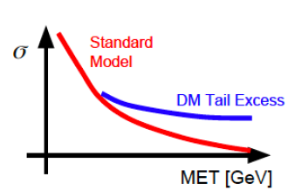
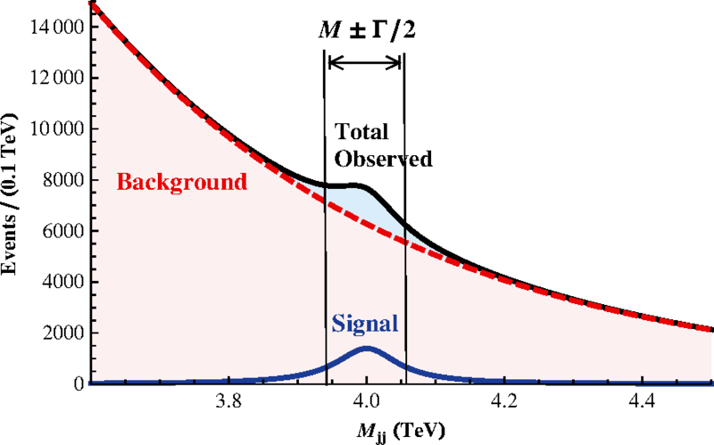
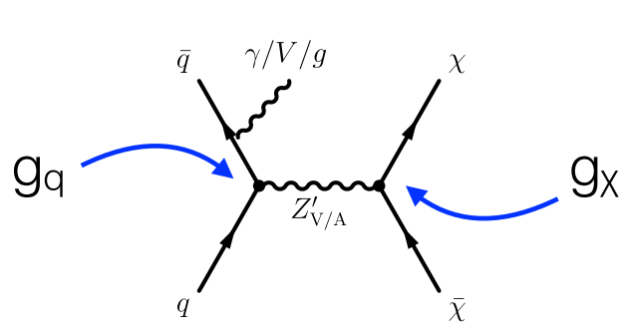
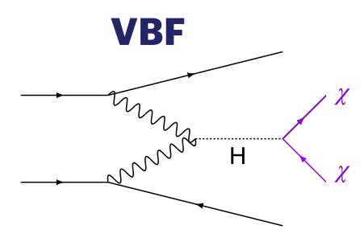
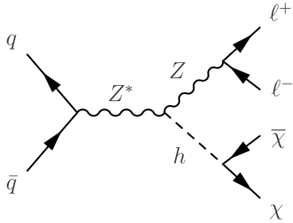
Prompt DM signatures
fully visible (a new resonance
in dijet/dilepton/diboson etc. spectra)
MET - decay to DM particle pair
(+ a visible “tag”
X(=jet/gamma/Z/H)
V/VA
g_{q}
g_{q,l}
non-standard properties of SM particles
(higgs sector – higgs boson pair production,
h₁₂₅ to invisible…)
flavor violating processes
on-shell
off-shell
MET
Visible, sst

Slide 10
Prompt DM production I & II:
fully visible + MET

Slide 11

Spin of DM mediator: Higgs/gauge (or both) portals to dark matter
Higgs portal: DM interacts with our world only through coupling with the Higgs sector →
special importance of Higgs connected studies
Additional higgs bosons needed to accommodate DM → an extended Higgs sector. How to extend?
SM style…
SM + one singlet (real/complex) – SM + S, the simplest singlet-doublet model (the doublet corresponds to the SM)
SM + one doublet (real/complex) – 2H(iggs)D(oublet)M(odel), flavor conserving 4 types (type II – MSSM), 5 physical states: h, H (CP-even), A (CP-odd), $H^{+/−}$ ; h–H mixing, “the aligment (decoupling) limit” → h₁₂₅ = h
SM + doublet + scalar singlet (r/c) – 2HDM+S or N(ext/non-minimal)2HDM, flavor conserving 4 types (type II – NMSSM), 7 physical states, one is the pseudoscalar → 2HDM+a in the simplified description
SM + 2 doublets – 3HDM etc.
and non-SM style (SM: isosinglet and isodoublet reps. under SU(2) weak symmetry group). Then how?
isotriplet representations of SU(3) for Higgs fields (Georgi-Machacek model etc.)…
Bright experimental signatures: extra Higgs states, neutral and (doubly)charged, CP-odd and CP-even ones, lighter and heavier than the SM Higgs h₁₂₅
Also: gauge portal → the (axial)vector mediator and double portal → both vector + scalar mediators

Slide 12
The simplest s-channel DM: V/AV or S/PS mediator + one DM particle
SM+V/AV, SM+S/P. Free parameters:
m_{med}, m_{DM}, g_{DM}, g_{l}, g_{q} – five only (four only when g_{l}=0 – “leptophobic” mediator,
or limitations from the Drell-Yan for “leptophilic” mediator)
(axial)vector mediator
visible process «tag»
(Mono Х, where
Х is a jet/photon/W/Z,/H)
Invisible final state DM pair
(pseudo)scalar mediator

Slide 13
Simplified Dark matter Model (SMD), (pseudo)scalar mediator S/PS
One S/PS mediator, one spin-1/2 DM particle (a piece of Higgs portal singlet-isodoublet model in some limit)
φ/a
MET
visible
Model parameter set:

Slide 14

SM + scalar SU(2) singlet model (SM+S)
The simplest case: one additional scalar boson S: SU(2) real singlet
See, f. e. arXiv:1903.03616
$A potential:$
$V\left(Φ,S\right)=−m^{2}Φ^{+}Φ−μ^{2}S^{2}+λ_{1}{\left(Φ^{+}Φ\right)}^{2}+λ_{2}S^{4}+λ_{3}Φ^{+}ΦS^{2 }$, $Φ$ – SM complex doublet, S –SM singlet
Five free parameters: couplings $λ_{1,2,3}$ and non-zero VEVs v and x for SM doublet and additional singlet. $tanβ≡\frac{v}{x}$
Physical neutral spin-0 states h, H with mixing between them, $\cos{α}$
Free parameters in terms of observable fields: a new scalar mass M_{S}, mixing angle α and $tanβ$
Total and partial H->hh widths: $Γ_{tot}{=sin}^{2}αΓ_{SM,tot}+Γ_{H→hh}$
Decoupling regime: $sinα→0$, the light higgs state h has properties identical to the SM
h₁₂₅ ones, heavy H does not contribute
Model limit planes as $(sinα,M_{S})$ and $(sinα,tanβ)$
Limits on the model, both from theory and experiment (see the next slide):
Perturbative unitarity, EW precision data on S, T, U param. + singlet-induced NLO correction to W mass,
perturbativity of the couplings $λ_{1,2,3}$ and finite potential bound

Slide 15

SDM S/PS mediator decays
Narrow width approx. (NWA)
Minimal width
Decay dominantly into DM/SM
particles
m_{MED}, GeV
Off-shell production

Slide 16
MET spectra, SDM scalar mediator
approximate scaling above 350-400 GeV

Slide 17
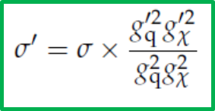
SDM scalar mediator: MET spectra and scaling for x-secs
different couplings
different
widths
M_{DM}=10 GeV
M_{DM}=1000 GeV
M_{med}=500 GeV

Slide 18

Fully visible $t\overline{t}t\overline{t}$ FS
Model non-specific
limits for generalized
treatment
of S, PS mediators
EPJC 80 (2020) 75
For more details see a talk by Varun Sharma
on DM@CMS!

Slide 19
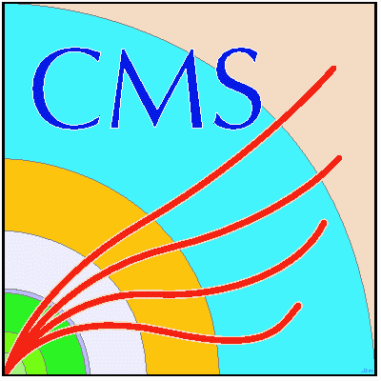
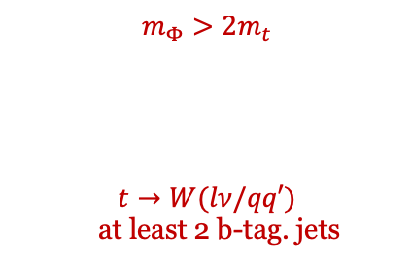


$t\overline{t}$/ $t\overline{t}$ + $E_{T}^{mis}$, generalized interpretation for S/PS
$$m_{Φ}>2m_{t}$$
$$t→W(lν/qq′)$$
at least 2 b-tag. jets
$$t\overline{t}$$
$t\overline{t}$ + $E_{T}^{mis}$, full RUN 2
The channel provides
the most stringent limits !
pseudoscalar
ATLAS-CONF-2020-003
JHEP 04 (2020) 171

Slide 20
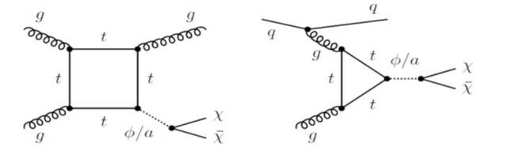
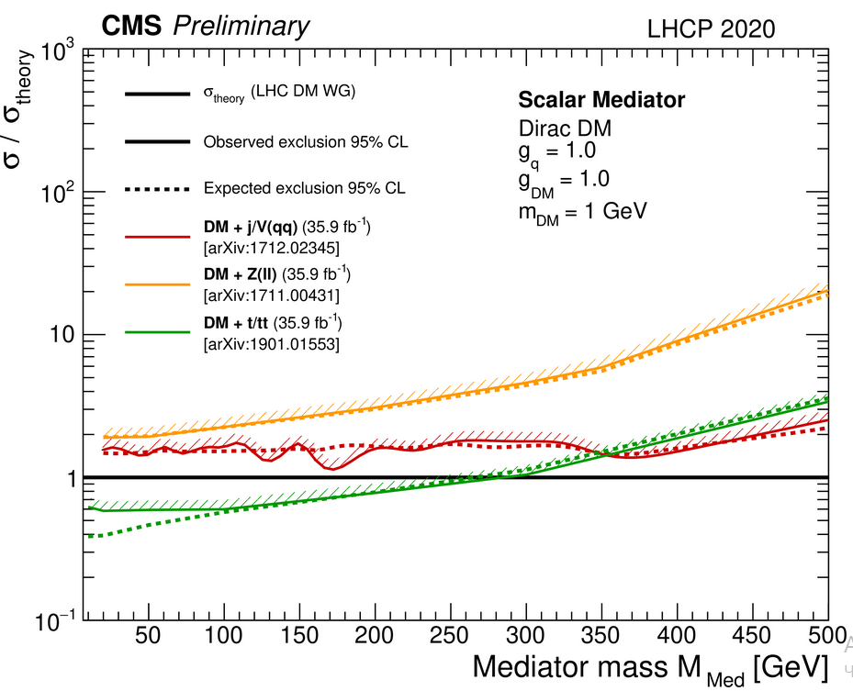
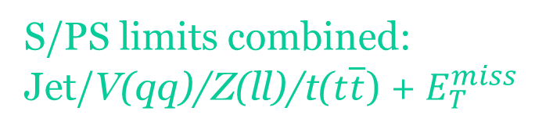
S/PS limits combined:
Jet/V(qq)/Z(ll)/t($t\overline{t}$) + $E_{T}^{miss}$
CMS EXO summary plots
ATLAS DM summary plots
Model non-specific interpretation

Slide 21
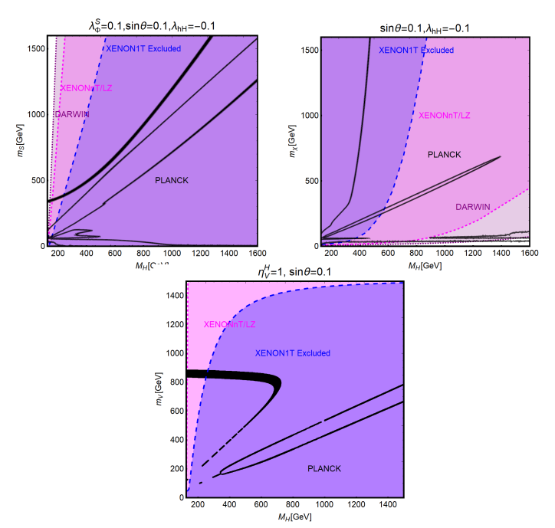
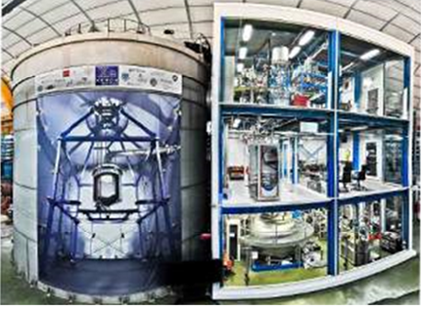
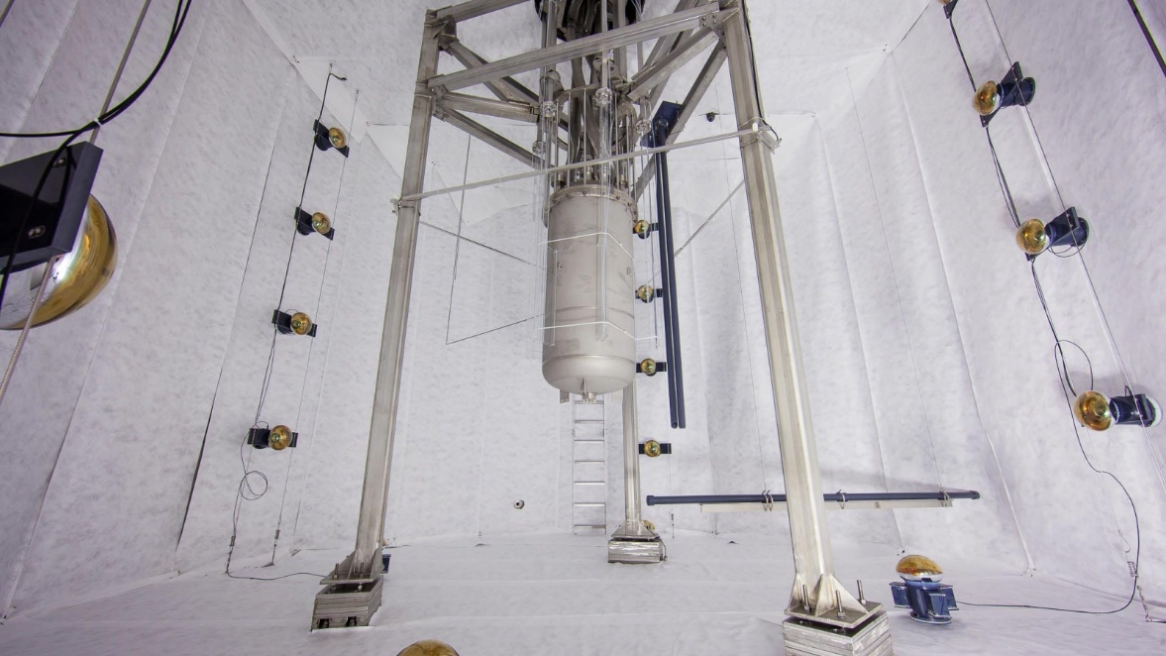
SM+S DM direct detection limits
XENON 1T
almost closed !!
Scalar DM
Fermion DM
Vector DM
LUX-ZEPLIN (LZ)

Slide 22
SDM, V/AV mediator
NB:
1. AV: pert. unitarity violation
due to DM Yukawa couplings
non-perturbativity for
m_{DM}>>m_{med} →
2. Z’ couples only to q →
anomalies → new VLL
ρ limit for V, EWPO

Slide 23




The simplest s-channel DM: (axial)vector mediator V/AV
One DM particle (spin-1/2), one mediator + SM, fully visible decay
JHEP 05 (2020) 033
V/VA
g_{q}
g_{q,l}
$$Γ_{med}=\frac{3{\left(g_{q}^{′}\right)}^{2}M_{med}}{2π}$$
$$\frac{(18g_{q}^{2}+1)M_{med}}{12π}$$
M_{med}
mediator on/off-shell production, dijet/dilepton FS
A cross section as a function of the 3 parameters : M_{med}, g_{q}, g_{l}
m_{DM} = 1 GeV (can differ)
limits on g_{l} from DY (the V mediator): g_{l} ≤ 0.01
Universal quark coupling:
$$g_{q}^{′}=\frac{g_{q}}{\sqrt{1+1/{\left(3N_{q}(M_{med})q_{q}^{2}\right)}}}$$
$$N_{q}(M_{med})=\sum_{q}{{\left(1−4\frac{m_{q}^{2}}{M_{med}^{2}}\right)}^{1/2}\left(1+2\frac{m_{q}^{2}}{M_{med}^{2}}\right)}$$
$$g_{q}^{′}=\frac{g_{B}}{6}$$
Notes:
23

Slide 24
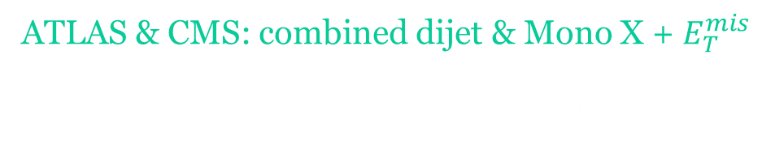
ATLAS & CMS: combined dijet & Mono X + $E_{T}^{mis}$
interpretation for leptophobic AV mediator
On-shell production
Visible (ffbar) and invisible (X+MET) channels combined

Slide 25
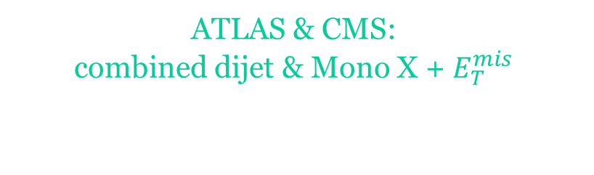
ATLAS & CMS:
combined dijet & Mono X + $E_{T}^{mis}$
interpretation for leptophobic V mediator

Slide 26
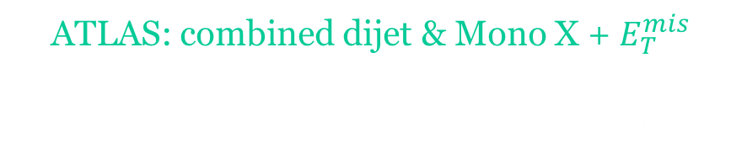
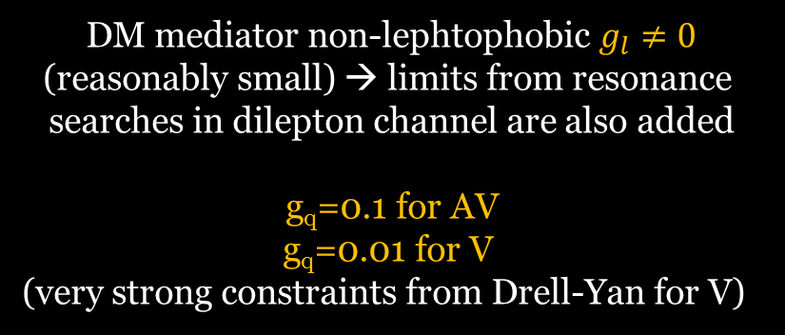
ATLAS: combined dijet & Mono X + $E_{T}^{mis}$
interpretation for leptophilic V(AV) mediator
DM mediator non-lephtophobic $g_{l}≠0$
(reasonably small) → limits from resonance
searches in dilepton channel are also added
g_{q}=0.1 for AV
g_{q}=0.01 for V
(very strong constraints from Drell-Yan for V)

Slide 27
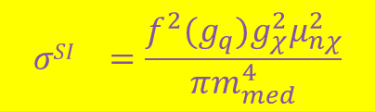
ATLAS: combination of collider and DD
constraints on DM
interpretation for leptophobic and leptophilic
V mediator, σ^{SI}
leptophobic
leptophilic
A comparison of the inferred limits with the
constraints from direct-detection experiments
on spin-independent WIMP-nucleon scattering
cross- section
$${σSI}_{}=\frac{f^{2}(g_{q})g_{χ}^{2}μ_{nχ}^{2}}{πm_{med}^{4}}$$
See a talk by Fady Bishara on EFT for
DD experiments and collider data decoding!

Slide 28
DD: суммарные ограничения разных экспериментов
neutrino floor

Slide 29

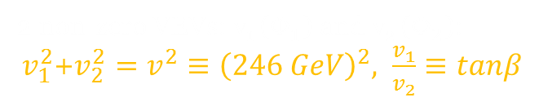
Next step: Two doublet Higgs Model (2HDM)
Two complex scalar doublets, $Φ_{1}$ and $Φ_{2}$, 8 real d.o.f, after SSB –
5 physical scalar states:
neutral CP-even h,H
neutral CR-odd A
charged H⁺, H⁻
Mass hierarchy is not fixed exactly, but the state h considered light and
the rest 4 are considered heavy.
Decoupling limit: (H does not contribute)
Most LHC studies, including for dark matter, are done in this limit
2 non-zero VEVs: v₁ ($Φ_{1}$) and v₂ ($Φ_{2}$):
$v_{1}^{2}$+$v_{2}^{2}=v^{2}≡{\left(246 GeV\right)}^{2}, \frac{v_{1}}{v_{2}}≡tanβ$
4 types of flavor conserving models
MSSM

Slide 30
2HDM, couplings to SM fermions and gauge bosons, normalized to these of the SM
coupling in Yukawa sector like in the SM (MFV), the strongest with the third generation

Slide 31
2HDM+S extension
PRD 90, 075004 (2014)

Slide 32

2HDM+S light pseudoscalar production and decays
PRD 90, 075004 (2014)
$$ζ=m_{s}^{2}/v^{2}$$

Slide 33
SDM with (pseudo)scalar mediator: SCC_{b}, SCC_{t}, 2HDM(+a)
S/PS simplified vs extended: model specific vs model non-specific channels
S, PS

Slide 34



From the simplest to simplified DM (V/AV mediator)
Extended gauge portal DM: 2HDM-based DM; Dark portal, t-channel VFC SDM… (primary area of interest during RUN3 period and beyond)
The simplified vs the simplest DM:
SM → extended higgs/gauge sector: extra states = extra graphs
One DM particle/mediator + SM
f, χ
$$h(b\overset{̿}{b})/Z(ll)$$
V/VA
VBC
2HDM+$Z_{V}^{′}$
Z_{VFC}
g_{q}
g_{q,χ}
new couplings
new states
flavor violation
$$\overset{̿}{f},\overset{̿}{χ}$$
“powerful”/specific signatures: one for many models / specific for the selected theoretical scenario
not only s-channel processes
Notes:
34

Slide 35

2HDM+$Z_{V}^{′}$ MET spectra vs SDM S/V

Slide 36
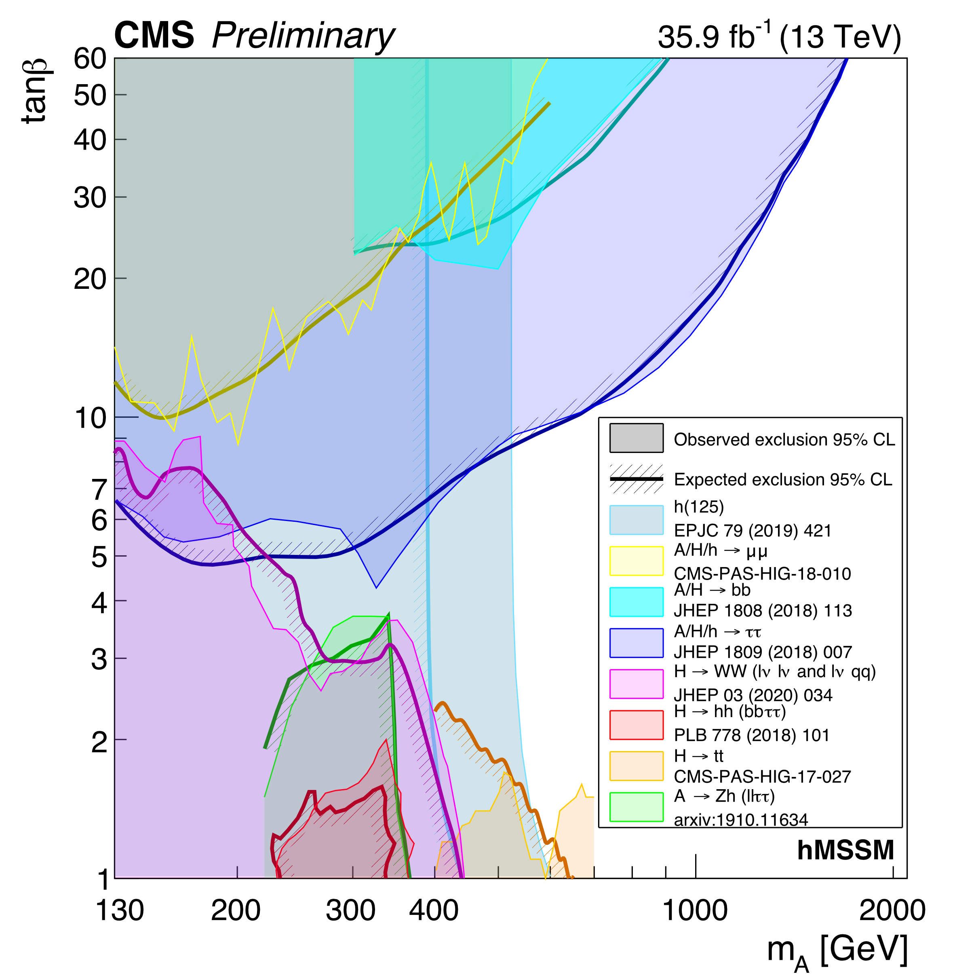
2HDM hMSSM combined results, RUN2
H → ZA (A → ZH) → llbb
H⁺ → tb

Slide 37
Astrophysics constraints on 2HDM Type-II DM (MSSM)

Slide 38
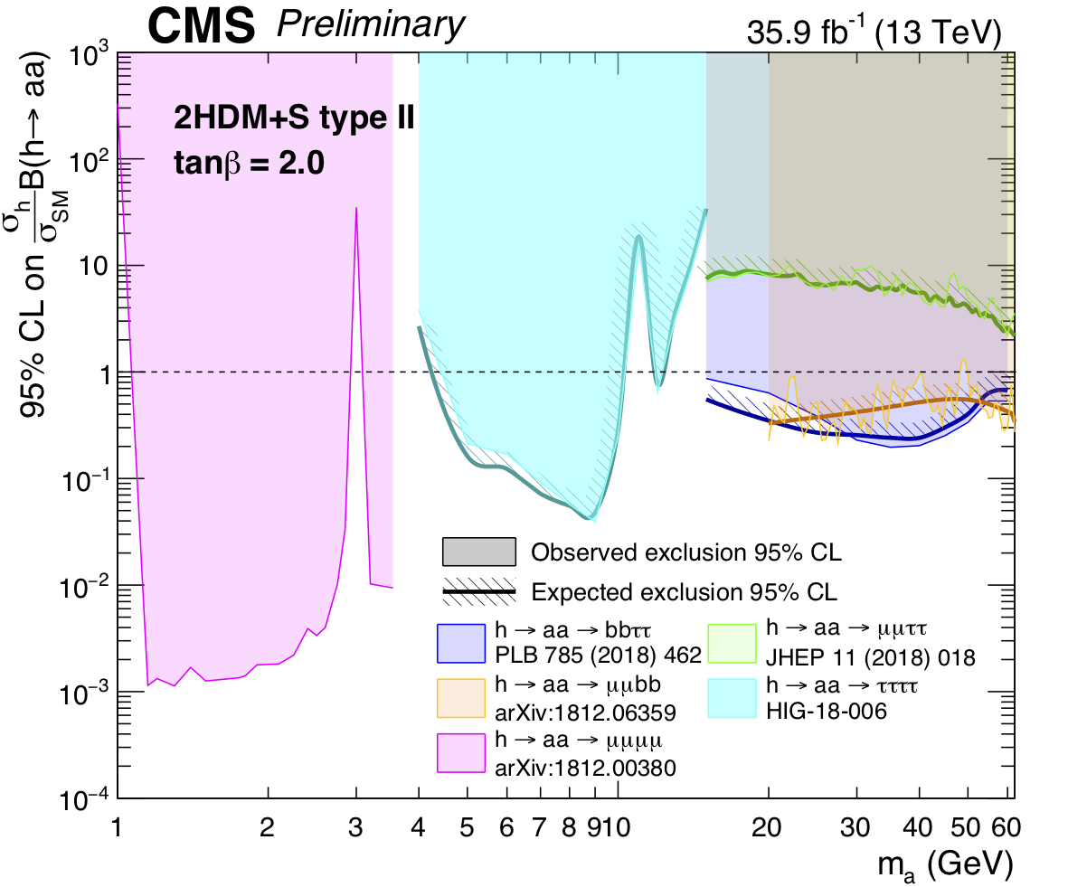
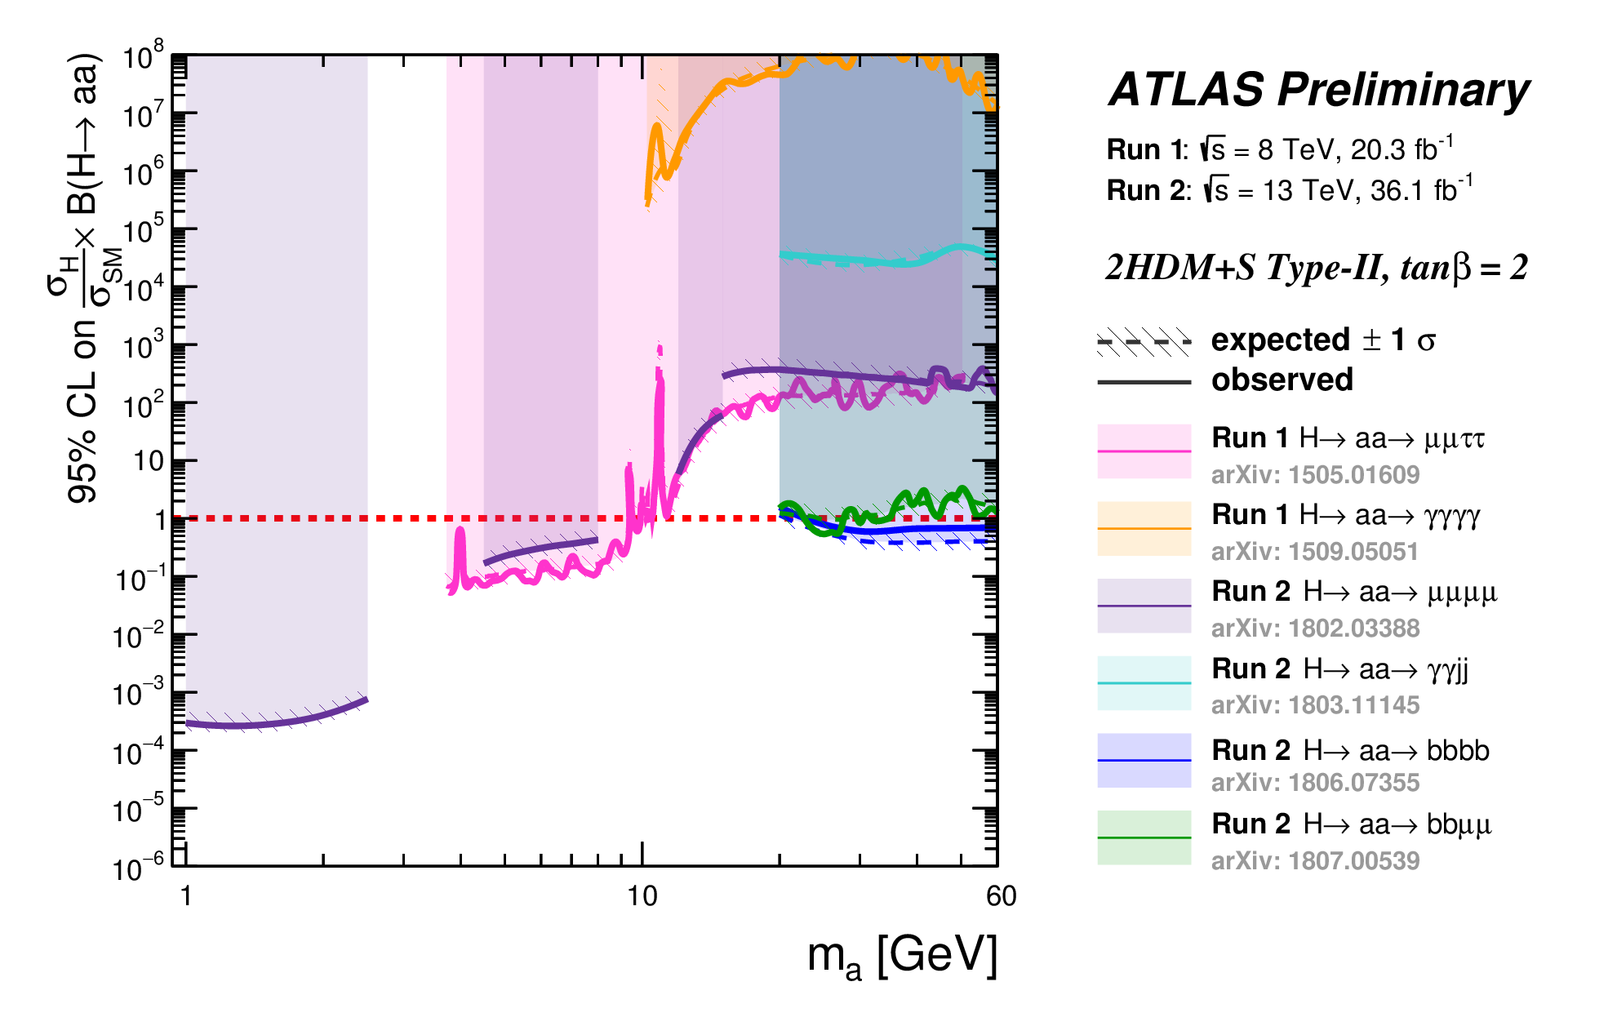
Light PS in 2HDM+S type II combined results, RUN 1+2
h₁₂₅→ aa→ 4b/2b2μ/4τ/2b2τ/2μ2τ/4μ/ggγγ
More detail see in talks by Ren-Jie Wang for NMSSM and
by Adam Bailey for 2HDM + comprehensive list of analyses
“Strictly” model search following from
expected properties:
m_{a}<1/2 m_{h125}
light additional pseudoscalar a in NMSSM,
Higgs sector structure is identical to
type II 2HDM +S, mixing in higgs sector only!
m_{a}<1/2 m_{h125}

Slide 39

Mono h + $E_{T}^{mis}$, boosted$b\overline{b}$ pair, 2HDM+a interpretation
EPJC 79 (2019) 280
For more details on this analyses
see a talk by Varun Sharma
2HDM+a
Decay h→ $b\overline{b}$ , new pseudoscalar in invisible mode
Free parameters of a simplified description used in
an analyses: m_{A}, m_{H}, m_{S}, mixing angle between a and A $sinθ$, VEV ratio for two higgs doublets $tanβ$, couplings to SM and DM particles

Slide 40
2HDM+a limits combined: h($b\overline{b}$/γγ) /Z($q\overline{q}$/ll) +$E_{T}^{mis}$+h(invisible) for S/PS
An example of 2HDM+a limit comparison
with the relic density derived for
the light pseudoscalar mass value m_{a}=250 GeV
JHEP 05 (2019) 142

Slide 41


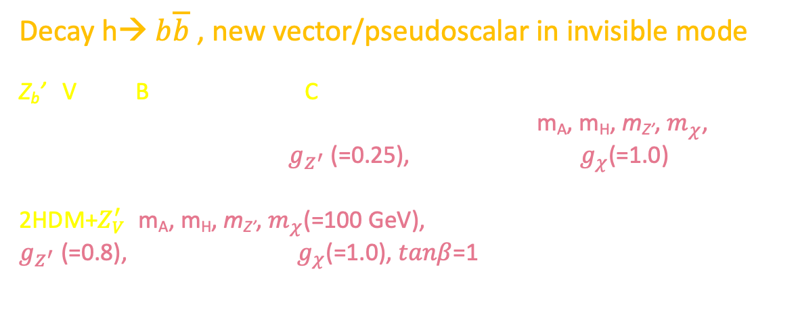
Mono h($b\overline{b}$) + $E_{T}^{miss}$, SDM $Z_{V}^{′}$ interpretations
Decay h→ $b\overline{b}$ , new vector/pseudoscalar in invisible mode
Z_{b}’ : Vector Baryon-number-Charged mediator (VBC)
Free parameters of the SDM used in the analyses: m_{A}, m_{H}, m_{Z’}, $m_{χ}$, coupling $Z_{V}^{′}$ to SM matter $g_{Z^{′}}$ (=0.25), coupling to DM $g_{χ}$(=1.0)
2HDM+$Z_{V}^{′}:$m_{A}, m_{H}, m_{Z’}, $m_{χ}$(=100 GeV), coupling $Z_{V}^{′}$ to SM matter $g_{Z^{′}}$(=0.8), coupling to DM $g_{χ}$(=1.0), $tanβ$=1
$$h(b\overset{̿}{b})/Z(ll)$$
VBC
2HDM+$Z_{V}^{′}$
EPJC 79 (2019) 280
ATLAS-CONF-2018-039
Z_{b}’
Z_{b}’
Notes:
41

Slide 42
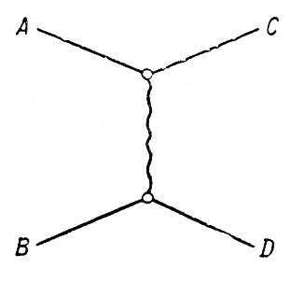
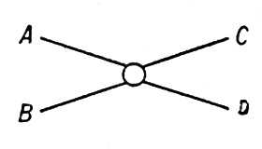

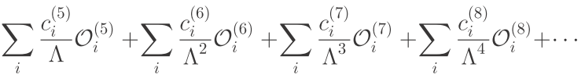








Exotic higgs decays h → Za, Z →ll, a →2 gamma
CMS PAS HIG-22-003
The first search of such type for axion-like particles (ALPs) at the LHC. Pseudoscalar portal, the light enough ALP, Z⁰-ALPs interactions
propagator
$$\overline{ψ}$$
$$\overline{q}$$
$$\overline{ψ}$$
$$\overline{q}$$
EFT
A
$$ψ$$
$$q$$
$$ψ$$
$$q$$
C_{i} are Wilson coefficients in the EFT approach that describe the ALP/SM couplings

Slide 43
Exotic higgs decays h → Za, Z →ll, a →2 gamma
CMS PAS HIG-22-003
The first search of such type for axion-like particles (ALPs) at the LHC. Pseudoscalar portal, the light enough ALP, Z⁰-ALPs interactions
propagator
$$\overline{ψ}$$
$$\overline{q}$$
$$\overline{ψ}$$
$$\overline{q}$$
EFT
A
$$ψ$$
$$q$$
$$ψ$$
$$q$$
C_{i} are Wilson coefficients in the EFT approach that describe the ALP/SM couplings

Slide 44
Exotic higgs decays h → Za, Z →ll, a →2 gamma
Limit on , when ALP decays
exclusively in a diphoton, Λ is large
CMS PAS HIG-22-003

Slide 45

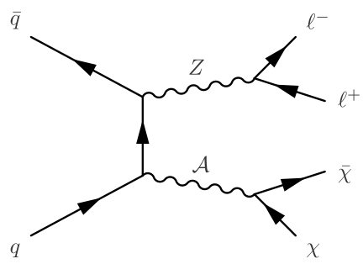
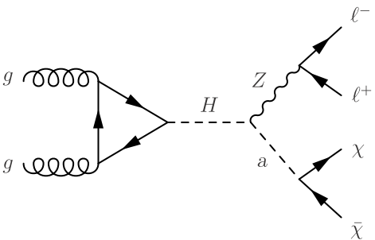




Mono Z(ll) + $E_{T}^{miss}$, different SDM interpretations
2HDM+a
Higgs portal
(h → invisible)
V/AV
V
AV
2HDM+a
EPJC 81 (2021) 13
Notes:
45

Slide 46
2HDM+a DD combined results, 2016-2017
neutrino
floor
    LHC Dark Matter Working Group: Next generation spin-0 dark matter models

Slide 47
2HDM+a DM relic density predicted
    LHC Dark Matter Working Group: Next generation spin-0 dark matter models

Slide 48




2HDM+$Z_{V}^{′}$ extension and “double portal”
additional gauge group U(1) → SSB → a new massive vector boson $Z_{V}^{′}$
Z’ can mix with Z
coupled only to right-handed quarks (“baryonic” vector mediator)
in higgs sector interacts only with higgs doublet which coupled to up-type fermions
A new decay mode: $Z_{V}^{′}$ → Ah, h = the SM higgs (decoupling limit), A = CP-odd neutral
2HDM state
s-channel exchange and visible dilepton FS (plus invisible
“classic” MET+jet) is non-specific signatures for extended
versions – only a part of possible signature volume
Specific model limits come, f.e. from Mono H(=h₁₂₅) + MET:
H($b\overline{b}/γγ$/ll) + $E_{T}^{mis}$
The signature can be also interpreted in terms of 2HDM+a parameters
2HDM+$Z_{V}^{′}$ vs V(VA)

Slide 49





Dark Higgs model, resolved decay of s(W⁺W⁻) + $E_{T}^{miss}$
“Double portal”: both “dark higgs” s and massive $Z_{V}^{′}$
coupled to SM.
A new higgs state is weakly mixed with SM h,
a new U(1)’ → SSB(s) → massive $Z_{V}^{′}$ coupled to quarks
only
s → W⁺W⁻ decay dominates at large s mass values
arXiv:1701.08780
Model parameters : m_{s}, m_{Z’}, $m_{χ}$, g_{q}, $g_{χ}$, sinθ (h–s mix.)
CMS-PAS-EXO-20-012
Notes:
49

Slide 50
Dark Higgs model, resolved decay of s(W⁺W⁻) + $E_{T}^{miss}$
CMS PAS EXO-21-012

Slide 51

Prompt DM production III:
non-standard Higgs properties
https://twiki.cern.ch/twiki/bin/view/CMSPublic/PhysicsResultsHIG
https://twiki.cern.ch/twiki/bin/view/AtlasPublic/HiggsPublicResults

Slide 52


Heavy scalar X→HH, combination
CMS HIG summary plots
X can be connected to gg
via vector-like fermion
loop, op. Dim5
PLB 800 (2020) 135103
Also complementary studies $X→ZZ→4l/2l2q$/2$l2ν$; WW → $2l2q$/$lν2q$
with a higher sensitivity in low mass region:
JHEP 03 (2020) 034 and
PRL 122, 121803 (2019)

Slide 53


Resonant Higgs boson pair production X -> HH, interpretation for scalar mediator
Also see a talk by Ke Li for a list of ATLAS & CMS HH analyses
H - SM Higgs boson, X - a new heavy scalar
EWK singlet interpretation
4V/2V2b/4b/2b2τ combination
PLB 800 (2020) 135103
$$tanβ=1.0$$
$$tanβ=2.0$$
Results obtained for M_{S}=260 GeV
Invalid parameter space regions where $Γ_{hh}>10\%$.

Slide 54
Combination of h₁₂₅ → invisible searches for ttbar and VH
resolved/boosted ttbarH
CMS HIG-21-007,
arXiv:2303.01214 [hep-ex]

Slide 55
Combination of h₁₂₅ → invisible searches
CMS HIG-21-007
ATLAS HIGG-2021-05

Slide 56



Prompt DM production IV:
flavor violating processes
RPV SUSY
Flavorful Higgs model
Flavor violating Z’

Slide 57


Flavor-changing vector mediator Z_{VFC}, non-resonant production
same-sign top pair
t → u transition via exchange by Z_{VFC}
on-shell
off-shell
$t$+$E_{T}^{mis}$
Model parameters:
$m_{V}$, $m_{χ}$(=1.0 GeV), $g_{χ}$, g_{SM}=a
JHEP 12 (2018) 039
s-channel
JHEP 05 (2019) 41
t-channel

Slide 58


$t$+$E_{T}^{mis}$ : CCS_{t} interpretation
Resonant production of Colored Charge-2/3
Scalar mediator preferably coupled to the
upper component of the third generation
(CCS_{t}) with DM particle emission.
“fermionic portal”
Decay $φ→tχ$, $m_{φ}$, $m_{χ}$ and couplings $y_{φt}$, $λ_{φd,s}$
JHEP 05 (2019) 41
scalar mass
$m_{φ}$ up to 3.4 TeV are excluded at 95% CL for $m_{χ}$ = 10 GeV, y = 0.4 and $λ_{φd,s}$= 0.2

Slide 59


SDM models and signatures
Generalized or model specific search, combinations of visible and MET signatures
The (axial)vector mediator
The (pseudo)scalar mediator
V(ector)/A(xial)V(ector) | dijet (dilepton), diboson hW/Z pair, $t\overline{t}$ resonance
V(ector)F(lavour)C(changing) | t+$E_{T}^{miss}$, same-sign tt
V(ector)B(aryon-number)C(harged) | h($b\overline{b}$/γγ/ττ) +$E_{T}^{miss}$
2HDM+$Z_{V}^{′}$ (vector 2HDM based) | h($b\overline{b}$/γγ/ττ) +$E_{T}^{miss}$, diboson W/Z/h pairs, $t\overline{t}$ resonance
Dark higgs $Z_{V}^{′}$+s | s($b\overline{b}$) +$E_{T}^{miss}$
S(calar)/PS(eudoscalar) | jet/V/h+$E_{T}^{miss}$, $t\overline{t}$($b\overline{b}$) resonance, $t\overline{t}$($b\overline{b}$)+$E_{T}^{miss}$, h→ inv, X→ hh
S(calar)C(olor)C(harged)_{b} | $b(b\overline{b}$) +$E_{T}^{miss}$
SCC_{t} | t($t\overline{t}$) +$E_{T}^{miss}$
2HDM+a (pseudoscalar 2HDM based) | h+$E_{T}^{miss}$, Z(ll)/V(qq’)/Z($q\overline{q}$)+$E_{T}^{miss}$, h→ inv, X→ hh, diboson Zh(+$b\overline{b}$), $t\overline{t}$($b\overline{b}$) resonance, $t\overline{t}$($b\overline{b}$)+$E_{T}^{miss}$, $t\overline{t}t\overline{t}$
A key: separation/reinterpretation and a wide complementary search with all available signatures

Slide 60

DM projections for RUN 3 and HL LHC
t-channel
s-channel
arXiv:1905.00892
High mass tail – and the end of story?
t-channel contributions

Slide 61
DM connected LLP signatures

Slide 62
Dark sector with Long-Lived Particles at the LHC
LLP White Paper:
arXiv:1903.04497
LLP theory motivations:
arXiv:1806.07396
LLP:
a proper lifetime cτ₀ is greater than or comparable to the characteristic size of the (sub)detectors
small cτ₀ that
comparable to the
inner tracker size, no
displaced tracks →
“standard” prompt decay
intermediate cτ₀ → LLP
very large/infinite
large cτ₀ → stable particles, “standard” MET signatures
displaced jets
Notes:
62

Slide 63
The origin of LLP – where do they come from

Slide 64
Displaced jets (hadron/lepton)
A pair(s) of displaced jets and at least one secondary vertex (SV)
Many DM models
Besides DM: GMSB/Split/RPV SUSY,
exotic Higgs decay (H → SS)…

Slide 65


Dark photon, prompt/displaced jets
The coupling to SM particles
proportional to electric charge
1 or 2 loops: naively ${10}^{−5}≲ε≲{10}^{−3}$
$$α^{′}=ε^{2}α_{EM}$$
LLP

Slide 66

Dark photon from dark SUSY, displaced LJ
SUSY portal
h – Higgs boson (visible)
n₁ – neutralino,
n_{D} – dark neutralino
γ_{D}→γ conversion, ε
See also full RUN 2 statistics of 137 fb⁻¹ analyses for γ_{D} in VBF
and ZH associated prod. and for the light narrow vector
resonance Z_{D} -> $μμ$ in Backup slides

Slide 67



Higgs decay to dark photons: displaced muon jets
CMS-PAS-EXO-20-014
Z–Z_{D} conversion, ε²
Higgs – dark higgs conversion, κ
Notes:
67

Slide 68
Search for prompt GeV-scale dimuon resonance
minimal dark photon model and
light scalar decay to dimuon (2HDM+S)
interpretations
CMS PAS EXP-21-005
See also backup for Higgs→
displaced muon pair analyses,
CMS PAS EXO-20-014

Slide 69
LLP decays in the CMS Muon system
CMS PAS EXO-21-008
A unique technique for LLP decays reconstruction in the muon system
Sensitivity to long lived scalars with masses between 0.4 and 55 GeV
Decays in hadronic showers (bbbar, ddbar, K⁺K⁻, K⁰K⁰ , 2π, 2τ, 2γ etc.)
Interpretations for dark showers and twin Higgs models

Slide 70
LLP decays in the CMS Muon system
CMS PAS EXO-21-008
A unique technique for LLP decays reconstruction in the muon system
Sensitivity to long lived scalars with masses between 0.4 and 55 GeV
Decays in hadronic showers (bbbar, ddbar, K⁺K⁻, K⁰K⁰ , 2π, 2τ, 2γ etc.)
Interpretations for dark showers and twin Higgs models

Slide 71

Search for inelastic DM with two displaced muons + MET
CMS EXO-20-010
Inelastic DM – dark photon A’ (m_{A’}, kinematic
mixing ε), and two closely degenerated by mass
DM states (mass splitting Δ, mass of χ₁ m₁),
LLP χ₂( lifetime cτ), dark gauge-fermion
coupling α_{D}
LLP
10-40% of m₁
$$y≡ε^{2}α_{D}{\left(\frac{m_{1}}{A^{′}}\right)}^{4}$$
The interaction strength
The first LHC search of such a type – mixed LLP + MET signature
A pair of displaced muons (soft, collimated)
Large MET collimated with muons
IS energetic jet as a tag

Slide 72
Search for inelastic DM with two displaced muons + MET
CMS EXO-20-010

Slide 73
Dark QCD: emerging jets/dark showers
One of the most striking DM-targeted signatures (Dark QCD →
dark showers)
Tracks start near the edge of the tracker, in the ECAL and HCAL
and even in the inner muon stations

Slide 74
Dark QCD
Mediator (X_{d}):
1. Scalar charged under both colour and
dark colour
2. Vector Z_{d} coupled to quarks and dark quarks

Slide 75
Dark QCD
Mediator (X_{d}):
1. Scalar charged under both colour and
dark colour
3. Higgs h₁₂₅ coupled to quarks and dark quarks

Slide 76
Dark QCD. Dark shower classification
Semi-visible jets
If dark sector is approximately conformal –
“soft bombs” instead of jets
(Soft Unclustered Energy Patterns – SUEP)

Slide 77

Resonant production of strongly coupled DM for semivisible jets
Hidden valley concept, hidden sector, new non-abelian
symmetries in DS, strongly interacting DM (“dark QCD”),
vector mediator Z’. A large-scale suppression of SM/DM
interactions, “semivisible” jet substructure
JHEP 06 (2022) 156
CMS EXO-19-020
semi-
visible jets
DM part
(visible) +
SM part
(invisible)
xsec., m_{Z’},
$m_{dark}$, $g_{dark}$,
r_{inv}

Slide 78
Resonant production of strongly coupled DM for semivisible jets
The first CMS study of jet ivsisible contribution with dark sector I
nterpretation. The fraction r_{inv} of stable invisible dark hadrons in between
0 (dijet, small MET) and 1 (large MET)
JHEP 06 (2022) 156
CMS EXO-19-020
See also backup for LLP dark showers – emerging jet signature

Slide 79
Dark QCD, emerging jets

Slide 80
Dark sector LLP future

Slide 81
LLP future

Slide 83


Slide 84
Backup slides

Slide 85
LHC Dark Matter Working Group documents for RUN 2 analyses
        arXiv:1507.00966
        arXiv:1603.04156
        arXiv:1506.03116
Simplified DM models – main requirements:
  1. Minimal set of DM fields, s- and t-channel mediated models
  2. Minimal set of physically relevant parameters (couplings, masses and widths)
  3. Minimal flavor violation (MVF): new interactions are invariant under global flavor symmetry group
  or all violating transitions are governed by the CKM matrix (SM FCNC structure, also CPV)
DM mediator(s): spin-0, ½, 1
  1. The (axial)vector Z’, spin-1 – gauge portals
  2. The (pseudo)scalar, spin-0 – Higgs portals (special importance of Higgs connected studies).
  3. Fermionic portals, spin-1/2 – SUSY, dark SUSY… (often – with flavour violation)
  4. “Double” (scalar-vector) portals…
DM particle(s): spin-0, ½, 1 (and even spin-2 for Kaluza-Klein DM in TeV-scale gravity models)
  Spin-1/2 DM: for fermion case only one DM particle → nonperturbative description for the scalar mediator
  (see f. e. arXiv:1903.03616) → need to extend fermion sector
    Isodoublet-isosinglet model (faces difficulties in imposing collider and astrophysical constraints
    for minimal mediator models, higgs portals)
    New vector-like fermion family (VLL, VLQ, VLF in general)
  Spin-0 DM: inert higgs doublet
  Spin-1 DM: dark photon
Notes:
85

Slide 86
Brief introduction in 2HDM’s

Slide 87
2HDM, couplings to SM fermions and gauge bosons, normalized to these of the SM
coupling in Yukawa sector like in the SM (MFV), the strongest with the third generation

Slide 88


FV 2HDM: additional sources of EWSB
The origin of the 1st and 2nd generation fermion masses is NOT h₁₂₅
There are additional sources of EWSB

Slide 89


Flavorful 2HDM couplings for heavy neutral H
https://twiki.cern.ch/twiki/bin/view/LHCPhysics/LHCHXSWG3Flavorful 2HDM

Slide 90



Flavorful vs FC 2HDM
Phys. Rev. D 94, 115032 (2016)
Neutral H decay modes

Slide 91


Flavorful vs FC 2HDM
Neutral H production in F2HDM
Phys. Rev. D 94, 115032 (2016)
H production in “an usual” 2HDM

Slide 92
LHC limits on F2HDM
Non-standard phenomenology → the standard searches are not necessarily the most sensitive !
most stringent
constraints
Phys. Rev. D 94, 115032 (2016)

Slide 93
Flavorful 2HDM
RUN 2 analyses

Slide 94
Properties of the SM-like h₁₂₅ in F2HDM
SMEFT
LHC data on h₁₂₅ rates, RUN2
decoupling
limit
Universal for t, b, τ
→ 2HDM type I

Slide 95



FV decays: h₁₂₅ → μτ/eτ, LHC RUN2
JHEP 06 (2018) 001

Slide 96
h₁₂₅ → μμ and h₁₂₅ → cc decays in F2HDM
cc
h₁₂₅ → μμ,
November 2020
μμ

Slide 97

h₁₂₅ → μμ and h₁₂₅ → cc decays in F2HDM
cc
h₁₂₅ → $c\overline{c}$,
November 2020
μμ

Slide 98
OS
SS
Additional fermions in extended DM models
Heavy leptons in Type-III seesaw
ATLAS Collab., arXiv:2008.07949
Two lepton FS, the same- and opposite-sign
2 Z₂-odd fermion triplets, Y=0 SU(2)_{L} + neutral singlet
(DM heavy sterile neutrino), mixing,
the lightest neutral state N⁰.
H→ invisible limit gives m_{DM}>1/2 m_{h}

Slide 99
Additional fermions in extended DM models
Heavy neutral leptons (HNL) in Type-I Seesaw
ATLAS Collab., arXiv:1905.09787
Three leptons
(e,mu combinations)
produced at the
interaction point
Veto on same-flavor
opposite-charge
topologies
Displaced signature
plus prompt lepton
from W decay

Slide 100
From a talk by Miaoran Lu at the LHCP2020, on behalf of the ATLAS & CMS Collaborations

Slide 101
Additional fermions in extended DM models
From a talk by Miaoran Lu at the LHCP2020, on behalf of the ATLAS & CMS Collab.
vector-like quark search

Slide 102

Dark Higgs model, h₁₂₅-s mixing, resolved jets + MET
“Double portal”: both “dark higgs” s and massive $Z_{V}^{′}$
coupled to SM.
A new higgs state is weakly mixed with SM h,
a new U(1)’ → SSB(s) → massive $Z_{V}^{′}$ coupled to
quarks only
b-jets: resolved or
merged
Model parameters : m_{s}, m_{Z’}, g_{q}, $m_{χ}$, $g_{χ}=g^{′}q_{χ}$, $q_{χ}$=q_{s}/2
ATL-PHYS-PUB-2019-032

Slide 103
Signatures and benchmark models
LLP White paper – arXiv:1903.04497

Slide 104

Inelastic dark matter at the LHC/LLP
https://arxiv.org/abs/1901.04040
Dark photon
Heavy neutral leptons (quarks)
Dark GB and/or Higgs(es)…
Higgs/GB/gluon/SUSY portals
    (Asymmetric DM/
    Baryogenesis)
      Dark SUSY
      Dark QCD
    Twin Higgs
    ALPs (CP-violation)…
DS: small couplings, compressed spectra, large hierarchy → large cτ
Notes:
104

