Slide 1
Multiparticle production in $φ^{4}$ theory: method of singular solutions and numerical results
based on 2212.03268 [hep-ph]
S.V. Demidov, B.R. Farkhtdinov^{1,2}, D.G. Levkov
¹Institute for Nuclear Research of the Russian Academy of Sciences
²Moscow Institute of Physics and Technology

Slide 2
Multiparticle production
Multiparticle probabilities
Perturbation theory
Exponentiation

Slide 3
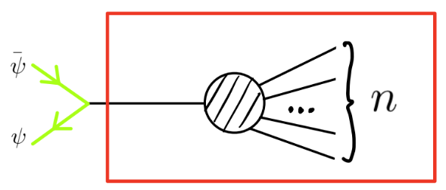
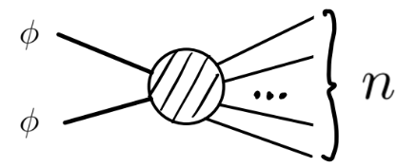
Multiparticle processes
Processes with $n≫1$ bosons in the final state and $n_{i}≪λ^{−1}$ in the initial
Examples

Slide 4
Amplitudes on threshold
In theory $S\left[φ\right]=\frac{1}{2}∫d^{4}x(−φ□φ−m^{2}φ^{2}−{λφ}^{4}/2)$
LSZ reduction

Slide 5
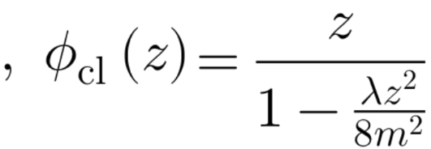
Tree-level
One can use relations for a solution $φ_{cl}$ $[$Brown, 1992]
and replace $e^{ip_{a}x_{a}}\left(−p_{a}^{2}+m^{2}\right)\frac{δ}{δρ}$ by $\frac{δ}{δz}$ in LSZ
$A_{1→n}^{tree}={\left.{\left(\frac{∂}{∂z}\right)}^{n}φ_{cl}\right|}_{z=0} =n!{\left(\frac{λ}{8m^{2}}\right)}^{\frac{n−1}{2}}$, n — odd, $E\left[φ_{cl}\right]=0$
Factorial growth!

Slide 6
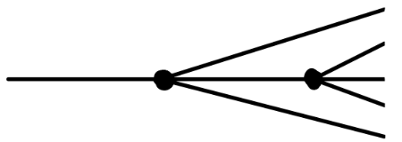
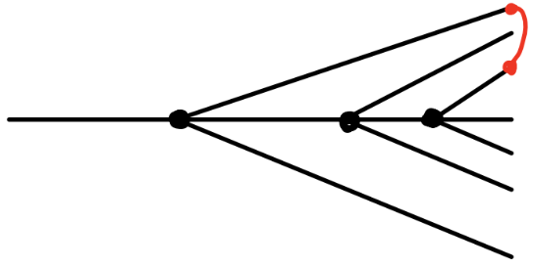
Counting diagrams
The number of tree diagrams
The same $n!$
The number of one-loop diagrams
is $n!n^{2}$

Slide 7
One-loop correction
One-loop correction [Voloshin, 1992]
$$A_{1→n}^{1−loop}=A_{1→n}^{tree} Bλ\left(n^{2}+O\left(n\right)\right)$$
$B=const, n≫1$
Indeed has ${n!n}^{2}$
$A_{1→n}^{1−loop}$ includes quantum correction to $φ_{cl}(t)$

Slide 8
Amplitudes and probabilities
Correction near the threshold [Libanov et al., 1994]
$$A_{1→n}^{tree}\left(p_{1},…,p_{n}\right){≈A}_{1→n}^{tree}\left(0\right)e^{−\frac{5}{6}εn}, ε=\frac{E}{n}−m≪m$$
Estimation for the probability
$P_{1→n}\left(ε\right)=\int{\frac{{\left|A_{1→n}\right|}^{2}}{n!}\prod_{i}{\frac{d^{3}p_{i}}{2ω_{i}}≈}\frac{{\left|A_{1→n}(0)\right|}^{2}}{n!}}×\left(phase vol.\right)∝n!$
Growth persists!

Slide 9
Failure of perturbation theory
Perturbative series for $A_{1→n}$ [Argyres, 1993]
$$A_{1→n}=n!{\left(\frac{λ}{8m^{2}}\right)}^{\frac{n−1}{2}}\left[1+\#λ\left(n^{2}+…\right)+\#λ^{2}\left(n^{4}+…\right)+… \right]$$
At $L$ loops leading at $n≫1$ contribution ${∝n!\left(λn^{2}\right)}^{L}$
Blow up at $n≳λ^{−1}$

Slide 10
Series resummation
Resummation of leading at $n≫1$ contributions in all loops gives
$$A_{1→n}^{resummed}=A_{1→n}^{tree}exp\left(Bλn^{2}\right)(…)$$
$B$ is the same as in the one-loop ${∝n}^{2}$ term[Libanov et al., 1994]
At $n≫1$
$$A_{1→n}^{tree}∼\sqrt{n!}\exp\left(n/2\ln{λn}−n/2\right)$$
Amplitude
$$A_{1→n}^{resummed}∼\sqrt{n!}\exp\left(F_{A}(λn)/λ\right)$$
Exponential form ≟ Semiclassical treatment

Slide 11
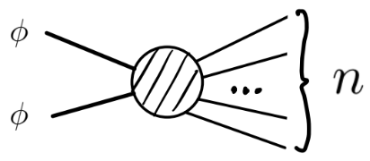
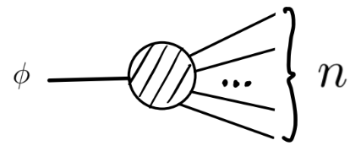
The exponent
Conjectures [Libanov et al., 1994]
$P_{few→n}(ε)∼e^{F(λn, ε)/λ}$, $n≫1, λn,ε=const$. $F(λn,ε)$— “holy grail” function
$F(λn,ε)$ does not depend on the initial state if $n_{i}≪λ^{−1}$
Semiclassical limit: $λ→0;λn,ε=const$
or etc.

Slide 12
2. Method of singular solutions
Formulation
Numerical implementation
Verification
[Son, 1995]

Slide 13
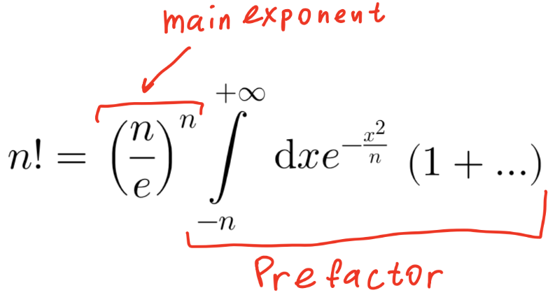
Stirling's approximation ($n≫1$)

Slide 14
Landau method in QM
In QM one can consider
$\hat{O}$can be $\hat{x},{ \hat{x}}^{2}, \hat{p},$ etc. — answer is insensible
$x_{∗}$ is a singular point of $V$ $⇒$ singular solutions in path integral
We need only exponential accuracy

Slide 15
Probability
Our aim is inclusive probability
$P_{n}\left(E\right)≡\sum_{f}{{\left|\left\langle f;E, n\left| \hat{S}\hat{O}\right|\left.0\right\rangle \right.\right|}^{2}}=∫D[f,φ]e^{W/λ}∼e^{F(λn, ε)/λ}$,
where
$$ε=E/n−m$$
$\hat{O}\left|\left.0\right\rangle \right.$ — initial state with $n_{i}≪λ^{−1}$ particles

Slide 16
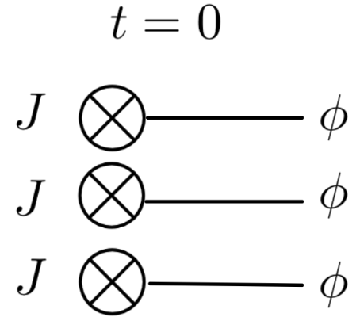
Initial state
$${\hat{O}}_{J}|\left.0\right\rangle =\exp\left(−\frac{1}{λ}∫d^{3}x J\left(x\right)\hat{φ}\left(0,x\right)\right)\left.|0\right\rangle$$
Creates $n_{J}∝J^{2}/λ$ particles
$n_{J}≪λ^{−1}$ or $J→0$ $⇒$universality
A$t 1≪n_{J}≪λ^{−1}$ we can
Calculate semiclassically
Use universality

Slide 17
Saddle point
We compute
$P_{n}^{J}\left(E\right)≡\sum_{f}{{\left|\left\langle f;E, n\left| \hat{S}{\hat{O}}_{J}\right|\left.0\right\rangle \right.\right|}^{2}}=∫D\left[f,φ\right]e^{\frac{W_{J}}{λ}}∼e^{F_{J}(λn, ε)/λ}$,
Universality: $P_{n}\left(E\right)=\lim_{J→0}{P_{n}^{J}(E)}$
$F_{J}\left(λn, ε\right)=W_{J}[φ_{cl}]$ and $φ_{cl}$ obeys (with BC)
$$□φ_{cl}\left(x\right)+m^{2}φ_{cl}\left(x\right)+φ_{cl}^{3}\left(x\right)=iJ\left(x\right)δ(t)$$

Slide 18
3. Probabilities as functions of $λn, ε$
Suppression exponent and amplitudes
Limit $λn≫1$
Limit $ε≫m$

Slide 19
Example of typical behavior
Tree-level (known from literature):
$$F=λn\ln\left(\frac{λn}{16}\right)−λn+λn f\left(ε\right)+O{\left(λn\right)}^{2}$$
Linear fit:
$$F=f_{∞}\left(ε\right)λn+g_{∞}\left(ε\right)$$
$ε=\frac{E}{n}−m$
$P_{n}\left(E\right)∼e^{F/λ}$

Slide 20
Numerical suppression exponents
$ε=\frac{E}{n}−m$
$F$ become closer, when $ε$ grows
$P_{n}\left(E\right)∼e^{F/λ}$

Slide 21
$f_{∞}$ as a function of $ε$
$F→f_{∞}\left(ε\right)λn+g_{∞}\left(ε\right)$ for $λn≫1$
$f_{∞}$ grows to −2.57 ± 0.06 for $ε→∞$
$ε=\frac{E}{n}−m$
fit

Slide 22
Amplitudes at threshold ($ε→0$)
In the limit $ε→0$ one can estimate
$P_{n}\left(E→mn\right)≈{\left|A_{n}\right|}^{2}×$ phase volume$≈e^{F(λn,ε≤m)}$
Can get $\left|A_{n}\right|=exp⁡(F_{A}/λ)$ from $F(λn,ε≤m)$ via extrapolation $ε→0$

Slide 23
Fitting of $F_{A}(λn)$
$F_{A}=\frac{λ}{2}\lim_{E→nm}{\ln{\frac{P_{n}\left(E\right)m^{4−2n}}{phase vol.}}}{}$
Tree-level:
$$F_{A}^{tree}=\frac{λn}{2}\ln\left(\frac{λn}{8}\right)−\frac{λn}{2}$$
“One-loop”:
$$F_{A}^{1−loop}=F_{A}^{tree}+\frac{{\left(λn\right)}^{2}3^{3/2}}{32π^{2}}\ln{(2+√3)}$$
Fitting strategy is the same as for $F$

Slide 24
Conclusions
We calculated “holy grail” function $F\left(λn,ε\right)$
$$P_{n}\left(E\right)\overset{→}{λn→+∞}e^{nf_{∞}+{g_{∞}}/λ}$$
Generic?
Suppression
?

Slide 25
Limit $J→0$
After $φ_{cl}$ is found, we calculate
$$F_{J}=2λET−λnθ−2λImS\left[φ_{cl}\right]−2Re ∫d^{3}x J\left(x\right)φ_{cl}(0,x)$$
Then take the limit
$$F\left(λn,ε\right)=\lim_{J→0}{F_{J}(λn, ε)}$$
Solutions become singular in the limit
$E_{i}=0$, $E_{f}=E$ $⇒$ discontinuity:
$iJ\left(x\right)δ\left(t\right)⇒$ energy changes at $t=0$
$J=0⇒$energy conservation conflicts with BC

Slide 26
Example of a solution

