Slide 1
Electromagnetic interactions of the deuteron at low and intermediate energies
E. Kokoulina, M. Levchuk, M. Nevmerzhitsky, R. Shulyakovsky

Slide 2
Deuteron research as a way to study neutron
Due to the absence of a free dense neutron target, reactions on a nucleus, primarily on a deuteron, is a source of information about the neutron and about the "elementary" amplitudes of interaction on it.

Slide 3
Interest in the studied reactions is due to the following reasons
Electromagnetic reactions on the nucleon provide possibility to study the structure of the nucleon at medium and large distances.
Compton scattering is the source of nucleon polarizabilities. Photoproduction of a pion on a nucleon:
source of multipole expansion coefficients, etc.;
pion – Goldstone QCD boson, a consequence of chiral symmetry breaking;
the possibility of additional study of nucleon-nucleon and pion-nucleon interactions.

Slide 4
Compton scattering on the deuteron and neutron polarizabilities

Slide 5
Nucleon polarizabilities
Nucleons are particles with an internal structure, the existence of which is manifested, among other things, in electromagnetic interactions.
Under the action of an external electromagnetic field, nucleons exhibit the property of polarizability. In the presence of an external field, the nucleon is deformed, acquiring additional energy
$$V_{pol}\left(r\right)=−\frac{1}{2}4π[αE^{2}\left(r\right)+βH^{2}(r)]$$

Slide 6
Contribution to the scattering amplitude
where $e(e^{′})$ and $k(k^{′})$ are the polarization and momentum vectors of the initial (final) photon, $ω$ is the photon energy.

Slide 7
Compton scattering on the proton
The expansion of the differential cross section in the laboratory system, taking into account the polarizabilities, has the form
– Powell cross section of photon scattering by a point charged particle of spin ½ with an anomalous magnetic moment

Slide 8
Compton scattering on the neutron
The expansion of the differential cross section in the laboratory system, taking into account the polarizabilities, has the form
In Compton scattering on a neutron, polarizabilities appear at ω⁴

Slide 9
Baldin sum rule
One can calculate the sum of the polarizabilities by (Baldin, 1960)
with $ω_{0}$ is the photoabsorption threshold on the nucleon (Levchuk & L’vov, 2000)
in units ${10}^{−4} {Fm}^{3}$

Slide 10
Experimental data for the proton
An analysis of experimental data on the differential cross section of Compton scattering on a proton at energies $ω<150 MeV$ gave the values
and

Slide 11
Experimental data for the neutron
There are related difficulties:
the absence of a dense, stable neutron target;
smallness of the differential cross section for Compton scattering on a neutron.
Neutron scattering in the Coulomb field of heavy nuclei (Enik, 1997):

Slide 12
Experimental data for the neutron
Theory (Levchuk, L’vov, Petrun’kin, 1994)
Experiment (Kossert et al., 2002)
Scattering angle – ${136}^{0}$
Photon energy – $200 ÷400 MeV$

Slide 13
Experimental data for the neutron
One can measure$α_{s}=\frac{α_{p}+α_{n}}{2}, β_{s}=\frac{β_{p}+β_{n}}{2}$ and use known proton data

Slide 14
Experimental data for the neutron
Thus, the result of data processing within the framework of the model (Levchuk & Lvov, 2000) gives us the following values

Slide 15
Experimental data for the neutron

Slide 16
Results

Slide 17
Incoherent pion photoproduciton on the deuteron in threshold energy region $$γd→πNN$$

Slide 18
Research motivation
Previously available experimental data described energies above 200 MeV (with a threshold about 150 MeV).
2018: The first measurements of the cross sections of the reaction $γd→π^{−}pp$ in the threshold energy region $E_{γ}<160$ MeV
(MAX IV laboratory, Lund university).

Slide 19
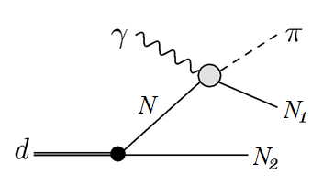
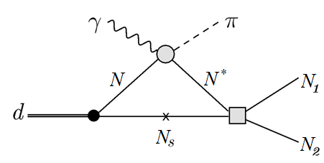
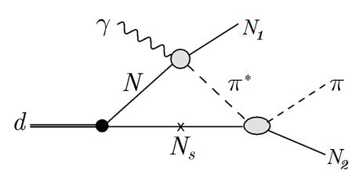
Diagrammatic model

Slide 20
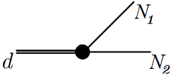
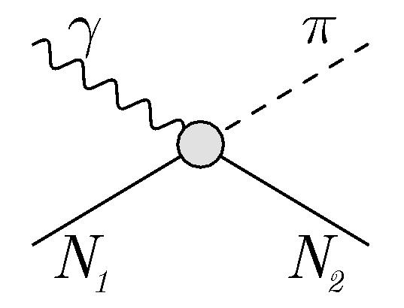
Diagrammatic model
For the deuteron vertex, the deuteron wave function from CD-Bonn NN-potential is used.
For the pion photoproduction on the nucleon, MAID07 model is used
The pp-scattering amplitude is obtained by solving the Lippmann-Schwinger integral equation for CD-Bonn potential.
The πN-scattering amplitude is the solution of the Lippmann-Schwinger equation for the separable potential constructed in the work
Machleidt, R. High-precision, charge-dependent Bonn nucleon-nucleon potential / R. Machleidt // Phys. Rev. C – 2001. – Vol. 63, № 2 – 024001(32).
A unitary isobar model for pion photo- and electroproduction on the proton up to 1 GeV / D. Dreсhsel [et al.] // Nucl. Phys. A – 1999. – Vol. 645, Iss. 1. – P. 145–174.
Nozawa S., Blankleider B., Lee T. S. H. Nuclear Physics A, 1990, vol. 513, iss. 3–4, pp. 459–510.

Slide 21
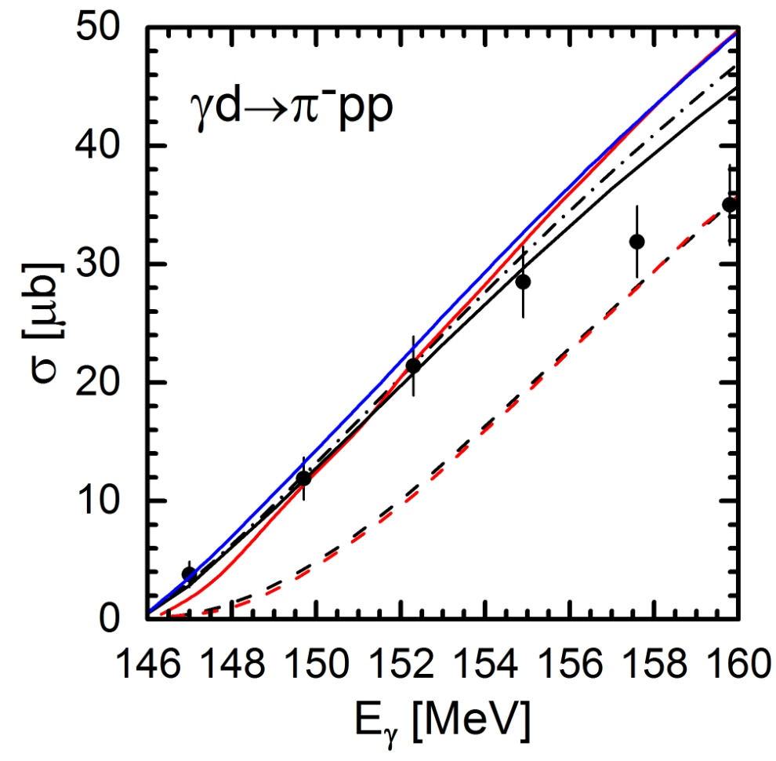
Energy dependence of the total cross section of the reaction $γd→π^{−}pp$
Experimental data: MAX IV Laboratory, Lund University (2018).
Solid red line:
Near-threshold π – photoproduction on the deuteron / Strandberg, B. [et al.] // Phys. Rev. C. – 2020. – Vol. 101, Iss. 3 – 035201(7).
Solid blue line:
Near-threshold incoherent pion photoproduction on the deuteron with final-state interaction effects / E. M. Darwish [et al.] // Annals of Physics. – 2019. – Vol. 411 – 167990(26).

Slide 22
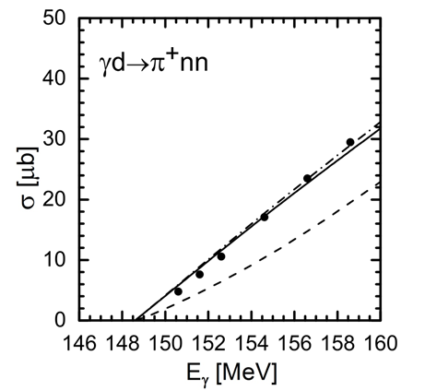
Energy dependence of the total cross section of the reaction $γd→π^{+}nn$
It is noteworthy that the behavior of the data on reaction is similar to the given theoretical predictions for the reaction
²H(γ,π⁺)nn total cross section from threshold to ΔE=22 MeV / E. C. Booth [et al.] // Phys. Rev. C – 1979. – Vol. 20, № 4 – P. 1217–1220.

Slide 23
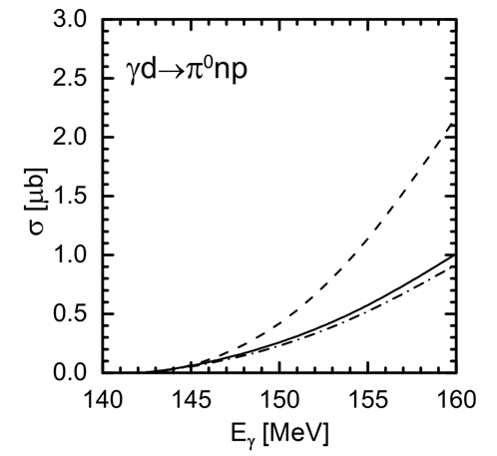
Energy dependence of the total cross section of the reaction

Slide 24
Single spin asymmetries
$Σ=\frac{{(dσ/dΩ_{π})}^{∥}−{(dσ/dΩ_{π})}^{⟂}}{{(dσ/dΩ_{π})}^{∥}+{(dσ/dΩ_{π})}^{⟂}}=−\frac{1}{S}2\int_{q_{min}}^{q_{max}}{fq^{2}dq∫dΩ_{P} }Re\sum_{m_{2}m_{1}m_{d}}{〈m_{2}m_{1}\left|T\right|+1m_{d}〉{〈m_{2}m_{1}\left|T\right|−1m_{d}〉}^{∗}}$
$T_{11}=\frac{1}{S}\sqrt{6}\int_{q_{min}}^{q_{max}}{fq^{2}dq∫dΩ_{P} Im\sum_{m_{2}m_{1}λ}{\left(〈m_{2}m_{1}\left|T\right|λ+1〉−〈m_{2}m_{1}\left|T\right|λ−1〉\right){〈m_{2}m_{1}\left|T\right|λ0〉}^{∗}}}$
$T_{20}=\frac{1}{S}\frac{1}{\sqrt{2}}\int_{q_{min}}^{q_{max}}{fq^{2}dq∫dΩ_{P} Re \sum_{m_{2}m_{1}λ}{\left({\left|〈m_{2}m_{1}\left|T\right|λ−1〉\right|}^{2}+{\left|〈m_{2}m_{1}\left|T\right|λ+1〉\right|}^{2}−2{\left|〈m_{2}m_{1}\left|T\right|λ0〉\right|}^{2}\right)}}$
$T_{21}=\frac{1}{S}\sqrt{6}\int_{q_{min}}^{q_{max}}{fq^{2}dq∫dΩ_{P} Re\sum_{m_{2}m_{1}λ}{\left(〈m_{2}m_{1}\left|T\right|λ−1〉−〈m_{2}m_{1}\left|T\right|λ+1〉\right){〈m_{2}m_{1}\left|T\right|λ0〉}^{∗}}}$
$T_{22}=\frac{1}{S}2\sqrt{3}\int_{q_{min}}^{q_{max}}{fq^{2}dq∫dΩ_{P} Re\sum_{m_{2}m_{1}λ}{〈m_{2}m_{1}\left|T\right|λ−1〉{〈m_{2}m_{1}\left|T\right|λ+1〉}^{∗}}}$

Slide 25
Angular distributions of single spin asymmetries for the reaction $γd→π^{−}pp$at various photon lab-energies

Slide 26
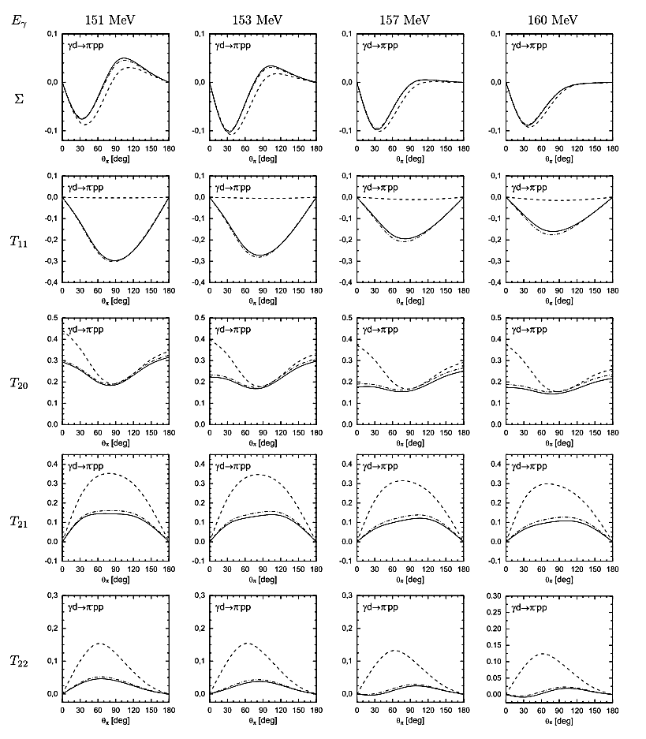

Slide 27
Angular distributions of single spin asymmetries for the reaction $γd→π^{+}nn$at various photon lab-energies

Slide 28
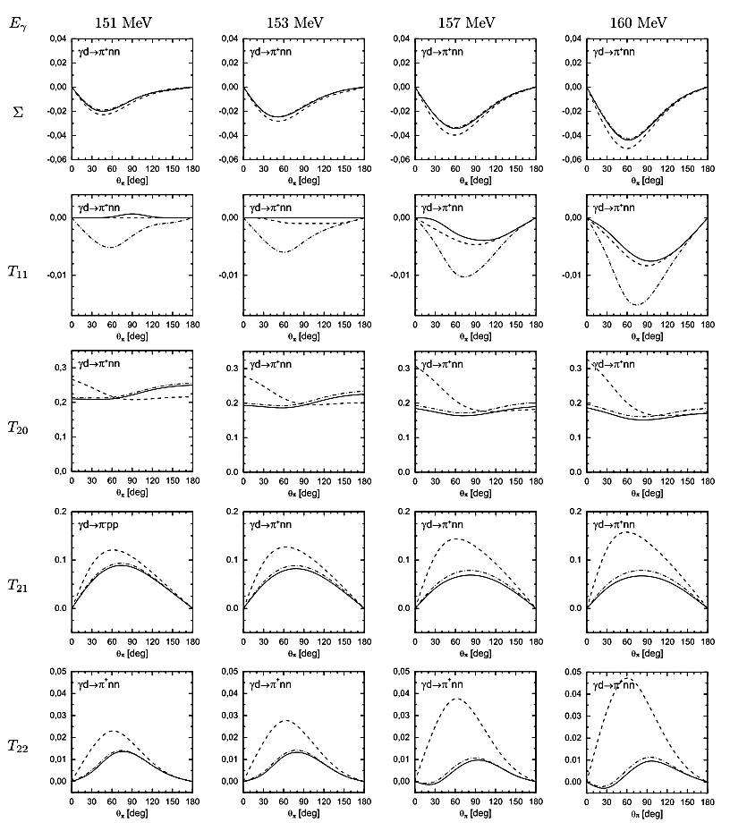

Slide 29
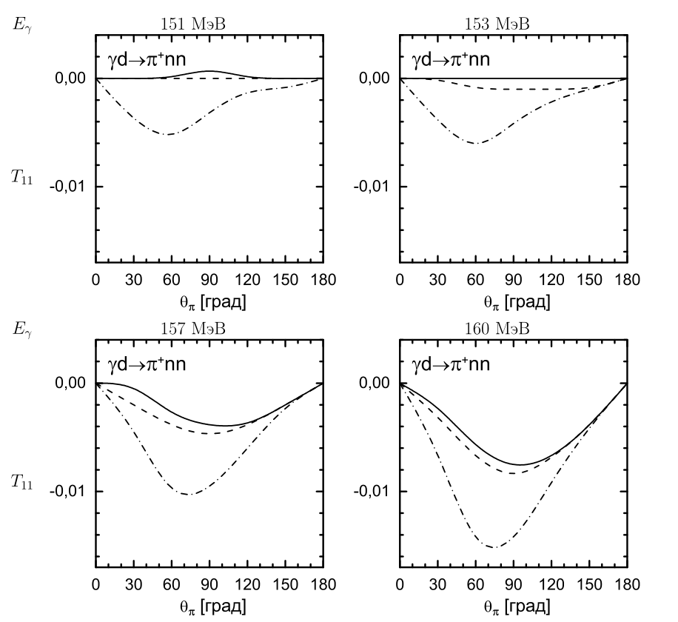
$γd→π^{+}nn$
$T_{11}$

Slide 30
Angular distributions of single spin asymmetries for the reaction $γd→π^{0}np$at various photon lab-energies

Slide 31
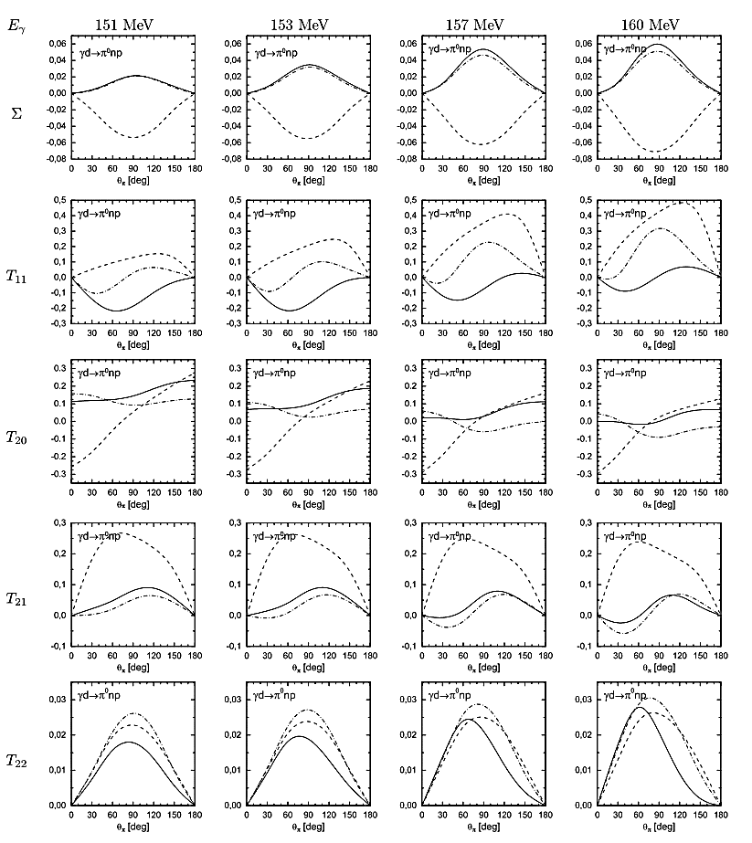

Slide 32
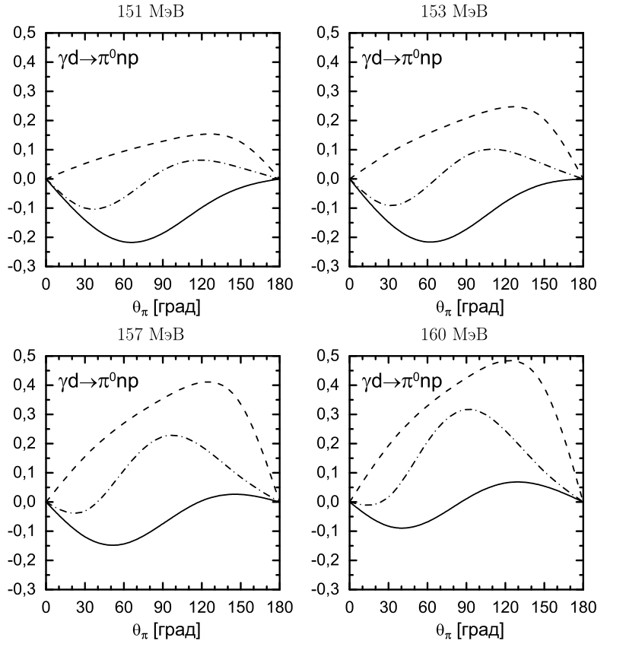
$γd→π^{0}np$
$T_{11}$

Slide 33
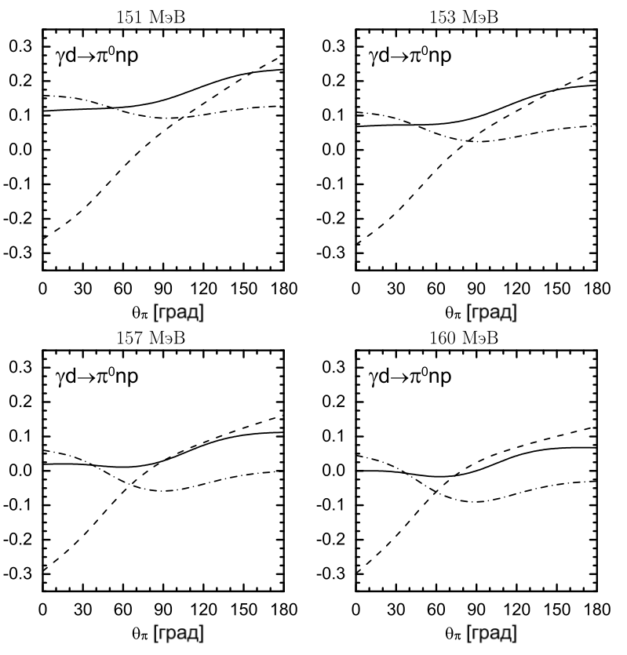
$γd→π^{0}np$
$T_{20}$

Slide 34
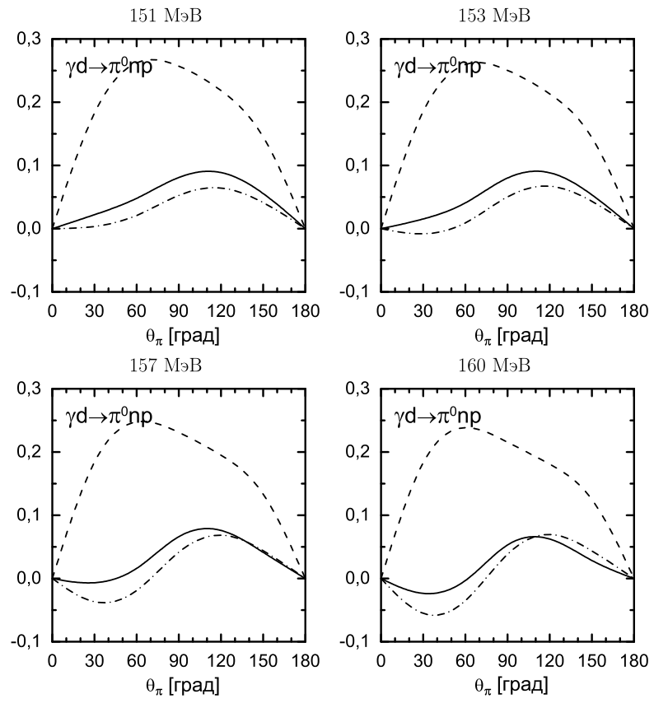
$γd→π^{0}np$
$T_{21}$

Slide 35
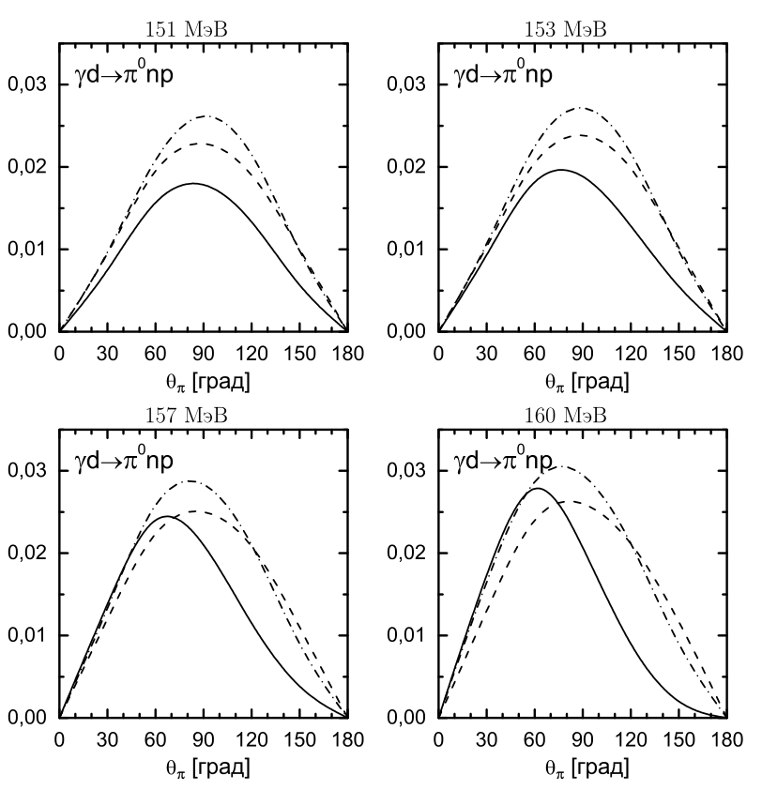
$γd→π^{0}np$
$T_{22}$

Slide 36
Conclusion
Total cross sections for $γd→πNN$ in threshold energy region:
$γd→π^{+}nn$ – good agreement.
$γd→π^{−}pp$ – good agreement up to $E_{γ}=155 MeV$, but for $158$ and $160 MeV$ data are overestimated.
Single spin asymmetries for $γd→πNN$ in threshold energy region:
There is a relatively large contribution of the diagram with $πN$ rescattering for some asymmetries. That may provide a tool for studying the pion and $πN$ interactions.

Slide 37
The tensor analyzing power component $T_{20}$ in the reaction $γd→π^{0}d^{′}$ in $Δ$ resonance region

Slide 38
Research Motivation
In 2020, the data for unique measurements of the tensor analyzing power $T_{20}$ for the reaction $γd→π^{0}d$ were published. The measurements were performed at VEPP-3 electron storage ring at the Budker Institute of Nuclear Physics in Novosibirsk, Russia.
Measurement of the tensor analyzing power $T_{20}$ for the reaction $γd→π^{0}d$ / V.V. Gauzshtein [et al.] // Eur. Phys. J. – 2020. – Vol. 56, No. 6. – 169 (7).

Slide 39
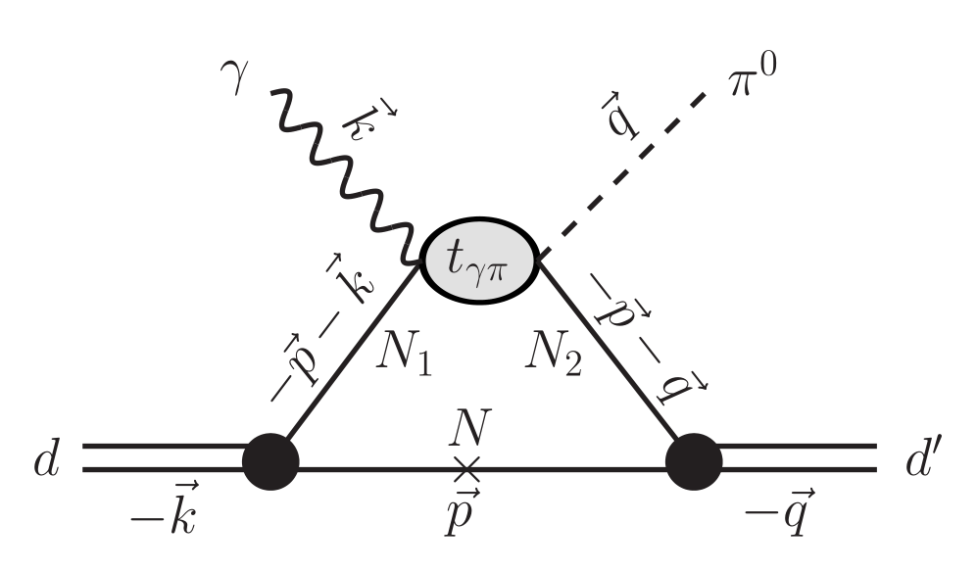
Model of the reaction
We work in the framework of the plane wave impulse approximation (PWIA).

Slide 40
Model of the reaction
For the deuteron vertex, we use the deuteron wave function obtained from CD-Bonn NN potential.
For $γN→πN$ elementary amplitude we use unitary isobar model MAID07 in CGLN parameterization.
A unitary isobar model for pion photo- and electroproduction on the proton up to 1 GeV / D. Dreсhsel [et al.] //Nucl. Phys. A – 1999. – Vol. 645, Iss. 1 – P. 145–174.
Relativistic Dispersion Relation Approach to Photomeson Production / G.F. Chew [et al.] / Phys. Rev. – 1957. – Vol. 106, No. 6. – P. 1345–1355.

Slide 41
Potential dependence of the results for $T_{20}$
Black line: CD-Bonn;
Blue line: V18;
Red line: Nijm93.
The results for NijmII coincide with the results for V18.

Slide 42
Model dependence of the results for $T_{20}$
Experimental data: V.V. Gauzshtein [et al.] // Eur. Phys. J. – 2020. – Vol. 56, No. 6. – 169 (7).
Black lines: MAID07 + CD Bonn deuteron wave function (our results).
Blue lines: Coherent $π^{0}$ and $η$ photoproduction on the deuteron / S.S. Kamalov, L. Tiator, C. Bennhold // Phys. Rev. C – 1997. – Vol. 55, No. 1 – P. 98–110.
Red lines: MAID07 + CD Bonn wave function (E.M. Darwish // Private communication).
Cyan line: Coherent pion photoproduction on the deuteron in the $Δ$ resonance region / P. Wilhelm, H. Arenhövel // Nucl. Phys. A. – 1995. – Vol. 593. – No. 4. – P. 435–462.

Slide 43
THANKS FOR YOUR ATTENTION!

