Slide 1
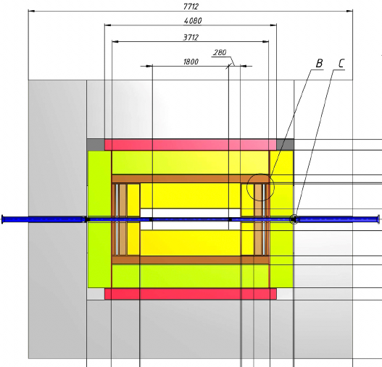
Aerogel RICH detector in the endcap region
In the updated detector scheme the space available
for the aerogel detector is increased up to 300 mm.

Slide 2
Aerogel RICH detector in the endcap region
In the updated detector scheme the space available
for the aerogel detector is increased up to 300 mm.
Principle of the particle identification with aerogel RICH

Slide 3
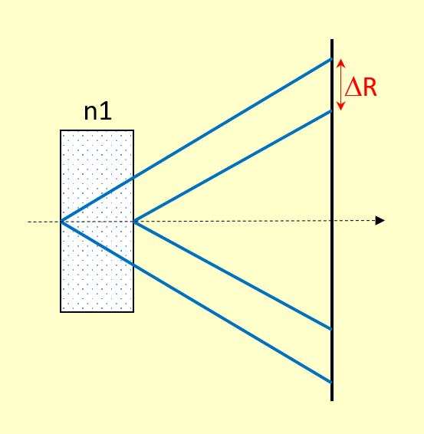
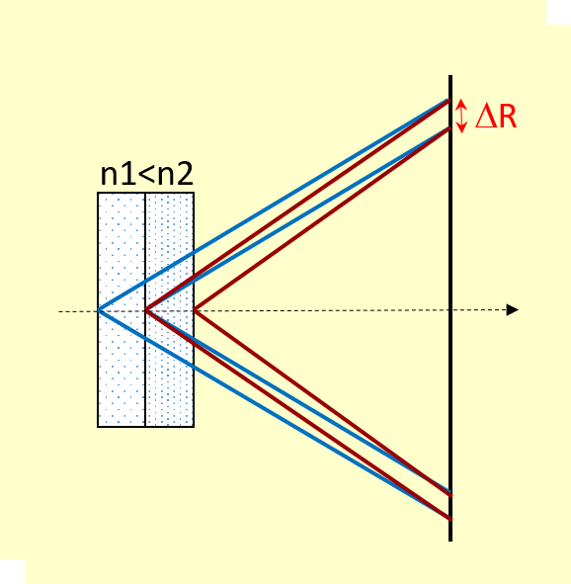
RICH detector extends the momentum range of identification
compared with the threshold counter suggested in TDR.
Proximity focusing RICH counter has two (or more)
aerogel layers with different refraction indices n.
With optimal selection of the refractive indices,
such structure allows to shrink the width ΔR
of the Cherenkov ring and hence to decrease
dependence of the Cherenkov angle resolution
on the aerogel thickness.
θ
d
L
ΔR = d· tgθ
ΔR = d/2 · tgθ
In SPD the distance L ≈ 200 mm between the aerogel and the detector plane is affordable.

Slide 4
There exists an optimum value of n₂ for a given n₁ :
n₂ – n₁ = d/(n₁·L) · [n₁² – 1 – (mc)²/p²]
T.Iijima et al. NIM A548 (2005) 383
d – thickness of each of the two aerogel layers
L – length from the center of the 2nd radiator to the detector plane
m, p – mass and momentum of a particle
For different particles (π,K,p) and momenta the optimum is slightly different.
Example:
at n₁=1.045, d=20mm and L=200mm the optimum n₂ values for pions and kaons are:
Momentum, GeV/c | 1 | 2 | 3 | 4 | 5
n₂^{π} | 1.052 | 1.053 | 1.054 | 1.054 | 1.054
n₂^{K} | - | 1.048 | 1.051 | 1.052 | 1.053
The width of the ring ΔR is 3.5-6 mm
at n₁=1.045, in the momentum
range of 1 to 5 GeV/c.

Slide 5
The Cherenkov ring radius is different for different momenta and the particle type,
and this is used for identification.
At n=1.05 and L=200 mm the radius R of the Cherenkov ring on the photon detector plane
and the difference of radii ΔR for different particles (in mm) are:
Momentum GeV/c | R_{π} | R_{K} | R_{p} | ΔR_{π-K} | ΔR_{K-p} | ΔR_{π-p}
1 | 58 | --- | --- | --- | --- | ---
2 | 63 | 39 | --- | 24 | --- | ---
3 | 63 | 54 | 12 | 9 | 42 | 51
4 | 63 | 58 | 43 | 5 | 15 | 20
5 | 63 | 61 | 51 | 2 | 10 | 12
Hence for particle identification up to 4 GeV/c, coordinate resolution of the photon detector
is required not worse than 5 mm.

Slide 6
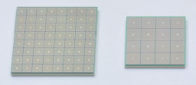
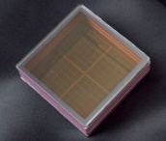
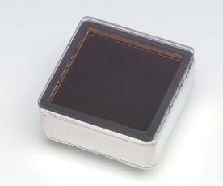
Requirements to the photon detector:
ability to detect single photons
high photon conversion efficiency
coordinate resolution ≤ 5 mm
operation in the magnetic field
efficiency in the ultraviolet region
Photon detector in each of the endcaps should cover
the surface about 2 m².
Options for the photon detector
MPPC arrays
hybrid APD
CsI+gas detector
multi-anode PMT

Slide 7
Requirements to the photon detector:
ability to detect single photons
high photon conversion efficiency
coordinate resolution ≤ 5 mm
operation in the magnetic field
efficiency in the ultraviolet region
Photon detector in each of the endcaps should cover
the surface about 2 m².
Options for the photon detector
MPPC arrays
too noisy at low threshold
hybrid APD
no chance to buy
CsI+gas detector
multi-anode PMT

Slide 8
CsI
In the previous talk on Cherenkov detectors (16.02.2023) a proximity focusing counter
with a solid state CsI photocathode and a gas coordinate detector was considered.
A reasonably high number of photoelectrons (30 – 80) was estimated assuming
no absorption/scattering of photons in aerogel and gas in the expansion region.
This assumption is not valid:
spectral sensitivity region of CsI lies in the 140-200 nm wavelength region
but light scattering strongly increases with decrease of the wavelength,
σ_{scat} ~ 1/λ⁴
While at λ=400 nm transmittance length in aerogel (n=1.05) is about 40 mm,
at 140-200 nm it becomes very short, and most of photons cannot leave aerogel.
No CsI detectors with aerogel radiators has been built.

Slide 9
Multi-anode photomultipliers as detectors of Cherenkov photons
Microchannel plate based multi-anode PMT
is a good candidate:
can work in the magnetic field
good spectral response range
high photon conversion efficiency
high gain
Hamamatsu MCP PMT
R10754-07-M16
matrix 4x4 anodes
anode size 5.28x5.28 mm
PMT size 27.6x27.6 mm
QE = 23% at λ=380 nm
gain 10⁶
~60% active area
thickness 17 mm

Slide 10
Multi-anode photomultipliers as detectors of Cherenkov photons
Microchannel plate based multi-anode PMT
is a good candidate:
can work in the magnetic field
good spectral response range
high photon conversion efficiency
high gain
Hamamatsu MCP PMT
R10754-07-M16
matrix 4x4 anodes
anode size 5.28x5.28 mm
PMT size 27.6x27.6 mm
QE = 23% at λ=380 nm
gain 10⁶
~60% active area
thickness 17 mm
In Russia microchannel plates are produced by the enterprise “Baspik” (Vladikavkaz).
Multi-anode PMT with MCP from “Baspik” could be produced by the company “Ekran FEP”
(«Экран ФЭП») in Novosibirsk.
Both companies expressed their interest in development of the PMT with our technical specifications.

Slide 11
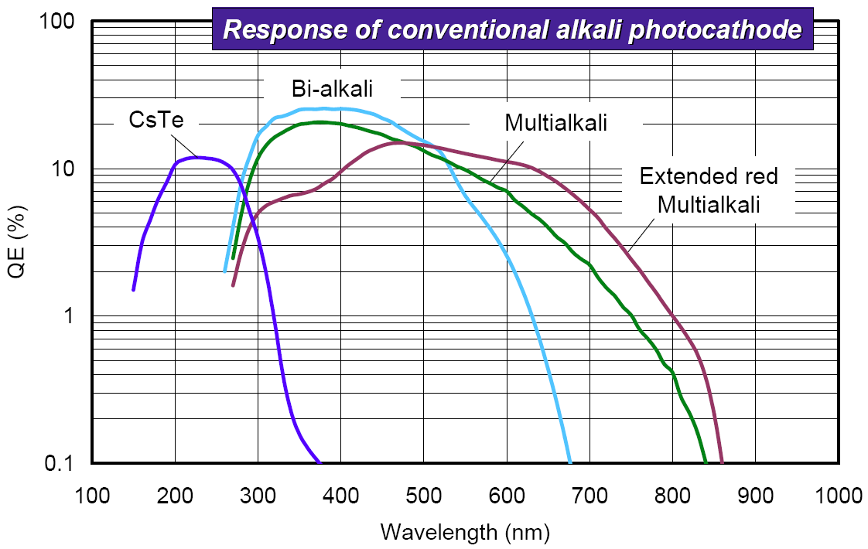
What signal can we have in SPD with the PMT as a photon detector?
The most suitable type of the photocathodes
for detection of the Cherenkov light is Bi-alkali
(Sb-K-Cs, Rb-Sb-Cs), with sensitivity extending
from ~260 to 650 nm and maximum QE≈20%
between 300 and 500 nm.

Slide 12
What signal can we have in SPD with the PMT as a photon detector?
The most suitable type of the photocathodes
for detection of the Cherenkov light is Bi-alkali
(Sb-K-Cs, Rb-Sb-Cs), with sensitivity extending
from ~260 to 650 nm and maximum QE≈20%
between 300 and 500 nm.
N = 2παl (1/λ₁ – 1/λ₂) sin²θ
Parameters used in calculation of the p.e. number:
aerogel thickness 20 mm, n=1.045 + 20 mm, n=1.055
effective area of the MCP 60%
sensitive area of the detector 60%
quantum efficiency 20% at 300-500 nm
10% at 270-300 and 500-550 nm

Slide 13
 | π | K | p
1 GeV/c | 44 | --- | ---
2 | 52 | 21 | ---
3 | 54 | 41 | 1
4 | 54 | 46 | 26
5 | 54 | 49 | 36
The number of photoelectrons calculated
without account of the light losses

Slide 14
 | π | K | p
1 GeV/c | 44 | --- | ---
2 | 52 | 21 | ---
3 | 54 | 41 | 1
4 | 54 | 46 | 26
5 | 54 | 49 | 36
The number of photoelectrons calculated
without account of the light losses
Transmission length at λ=400 nm (from BELLE-II):
47 mm at n= 1.0451
36 mm at n= 1.0547
Then, in our case (20mm n=1.045 + 20mm n=1.055)
transmission will be (roughly) ≈60%
and the number of photoelectrons,
i.e. points on the Cherenkov ring
 | π | K | p
1 GeV/c | 26 | --- | ---
2 | 31 | 13 | ---
3 | 32 | 25 | ---
4 | 32 | 28 | 16
5 | 32 | 29 | 22

Slide 15
If we would have MCP PMT with 8x8 anodes, each anode 5x5 mm,
and the PMT size 50x50 mm, then to cover the aperture 2 m²
of one endcap we need ~800 photomultipliers.
Much depends on the quality and price of the PMT from Baspik/Ekran FEP.
We are waiting for the cost estimation from developers/manufacturers.

Slide 16
If we would have MCP PMT with 8x8 anodes, each anode 5x5 mm,
and the PMT size 50x50 mm, then to cover the aperture 2 m²
of one endcap we need ~800 photomultipliers.
Much depends on the quality and price of the PMT from Baspik/Ekran FEP.
We are waiting for the cost estimation from developers/manufacturers.
Meanwhile, due to uncertainty with the multi-anode MCP PMT availability,
I believe we should keep the threshold version as a backup solution
and start R&D activity for this option.

Slide 17
If we would have MCP PMT with 8x8 anodes, each anode 5x5 mm,
and the PMT size 50x50 mm, then to cover the aperture 2 m²
of one endcap we need ~800 photomultipliers.
Much depends on the quality and price of the PMT from Baspik/Ekran FEP.
We are waiting for the cost estimation from developers/manufacturers.
Meanwhile, due to uncertainty with the multi-anode MCP PMT availability,
I believe we should keep the threshold version as a backup solution
and start R&D activity for this option.
Thank you for attention

Slide 18
Spare slides

Slide 19
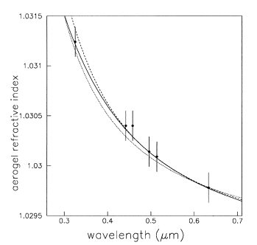
Chromatic abberation
R. De Leo et al. NIM A547 (2001) 52.

Slide 20
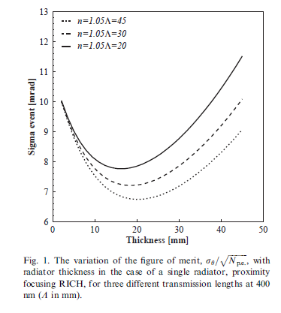
Optimum thickness ≈ 20 mm
T.Iijima et al. NIM A548 (2005) 383

Slide 21
The Cherenkov angle is affected by the following errors (ALICE RICH TDR, 1998):
The chromatic error, related to variation of the radiator refractive index n with the photon energy.
(2) The geometric error, related to the spread of the emission point along the particle path in the
Cherenkov radiator. It depends on the ratio between the radiator thickness and the proximity gap width.
(3) The localization error, related to the precision with which the photon coordinates can be measured.
It is determined by the photon detector characteristics (pixel size).
(4) The track incidence angle error, related to the particle angle and to the precision of the tracking
devices.
σ_{θ}^{ring} = σ_{θ}^{single} / √N_{p.e.}

