Slide 1
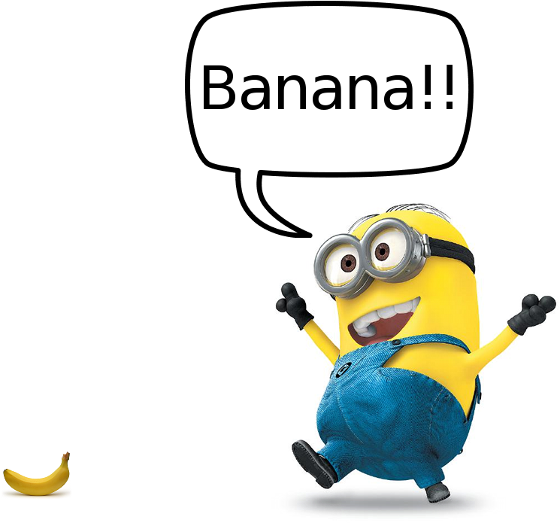
Banana-plot creation details
21.03.2023
Sergey, Dosbol, Vitaly & Dmitriy

Slide 2
Straw relative position:
Source: Dosbol presentation
R_{tube} = 5 mm
Anode_{d} = 30 micron
V_{a} = 1750 V
Track_{count} = 50 000
Ar/CO₂ : 70/30
Gas gain = 90 k (exp)
Pressure & Temperature: 1 atm & 20º C
Eμ = 1 GeV
No attachment
Track match condition:
R_{tube} – r_{R} - eps < r_{L} < R_{tube} - r_{R} + eps
eps is just a algorith parameter
default value = 25 μm
r_{L}
r_{R}
μ

Slide 3
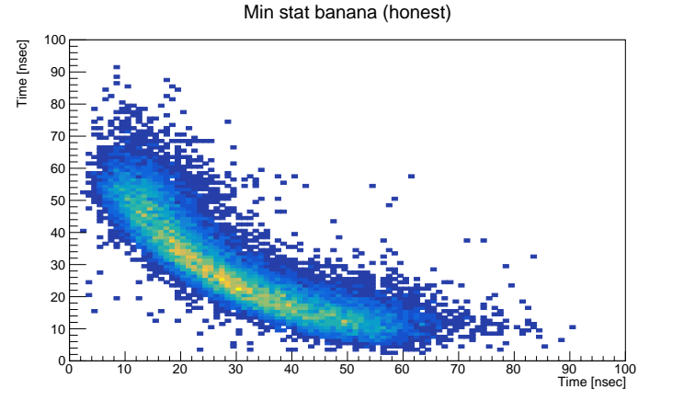
Sergey’s old result (Garfield simulation)

Slide 4
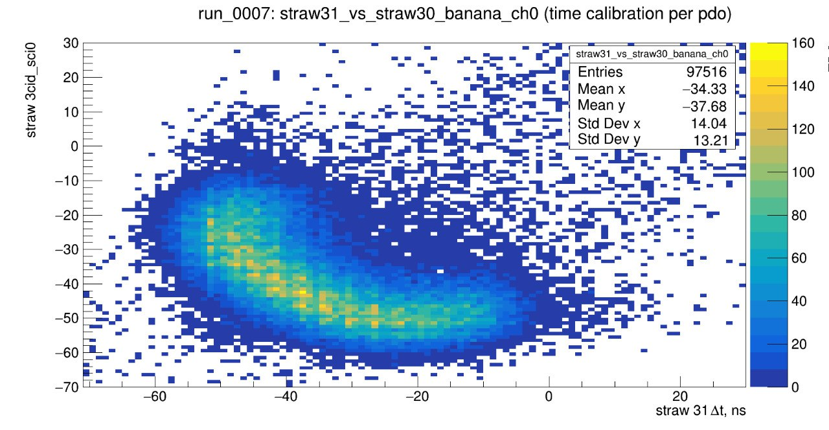
Test beam banana example
Source: Vitaliy’s images

Slide 5
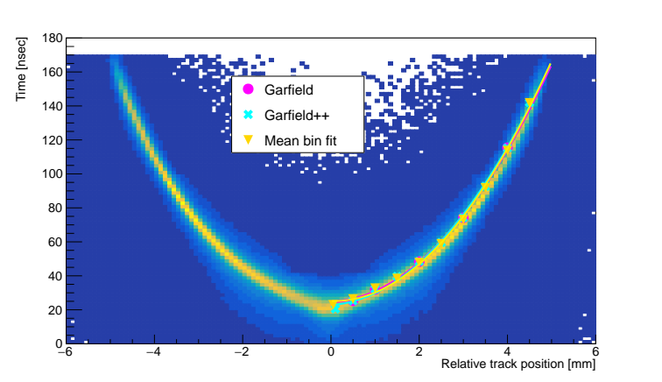
NA62 R-T relation
Source: NA62 Dosbol’s root data
Note: error is higher
due many wires but
negative tracks only

Slide 6
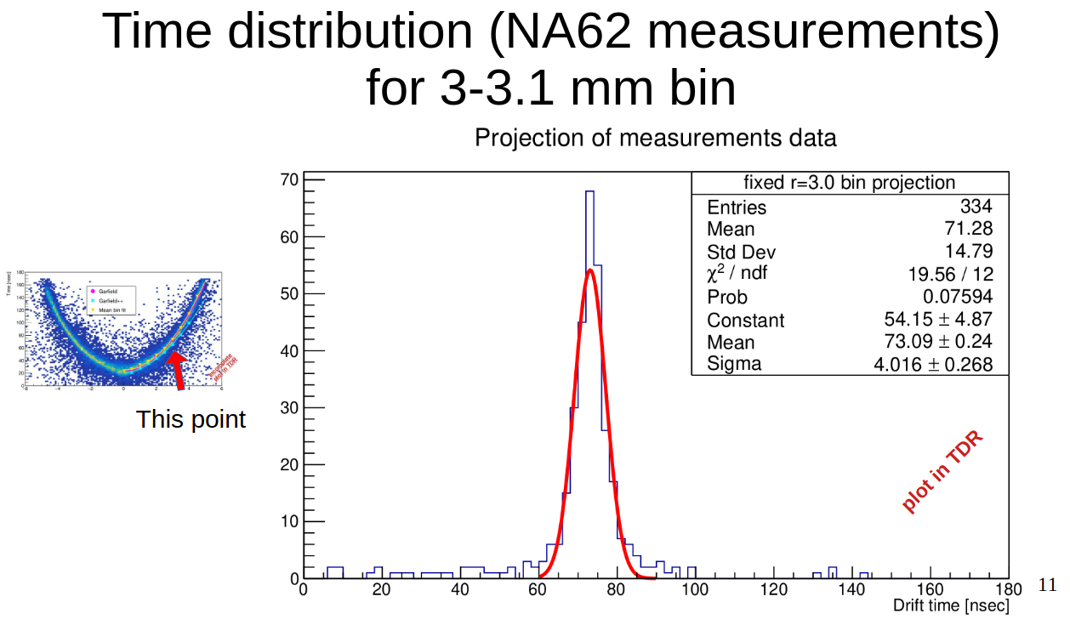
Source: Sergey’s TDR presentation slide
Note: single wire data
<номер>

Slide 7
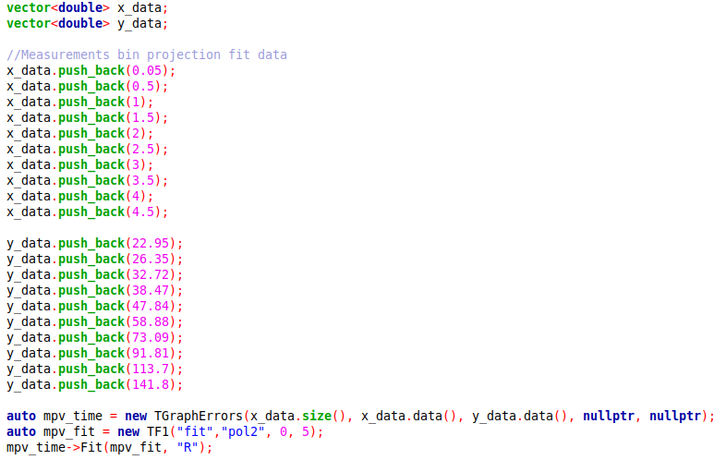
Test beam MPV parameterisation

Slide 8
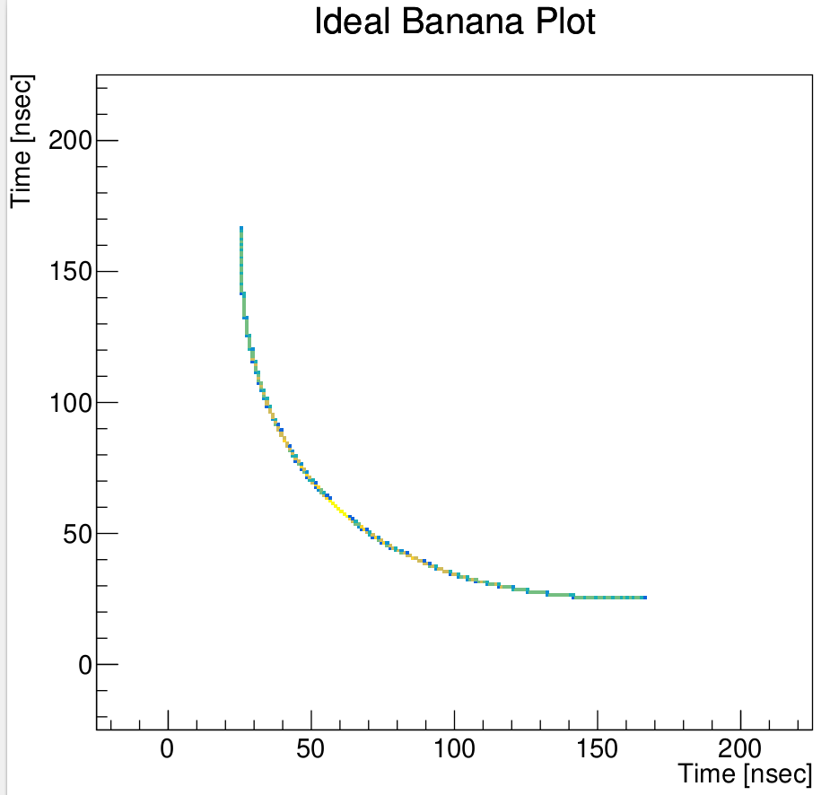


Slide 9
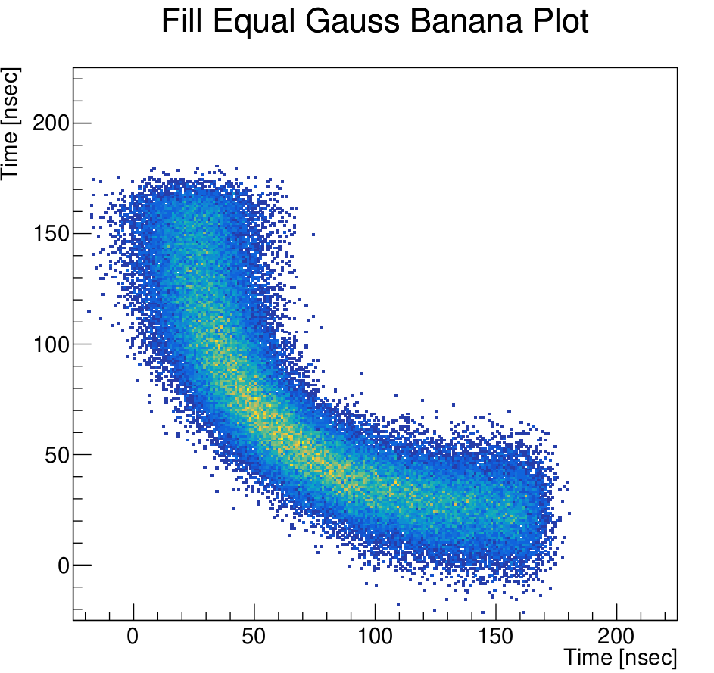
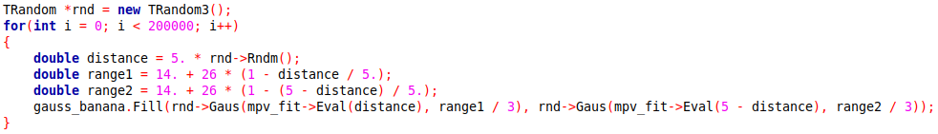

Slide 10
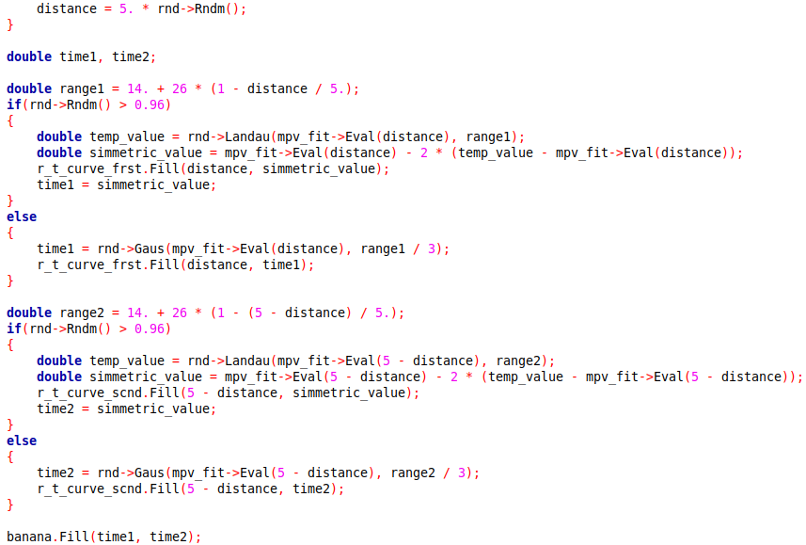
Crystal ball distribution imitation

Slide 11
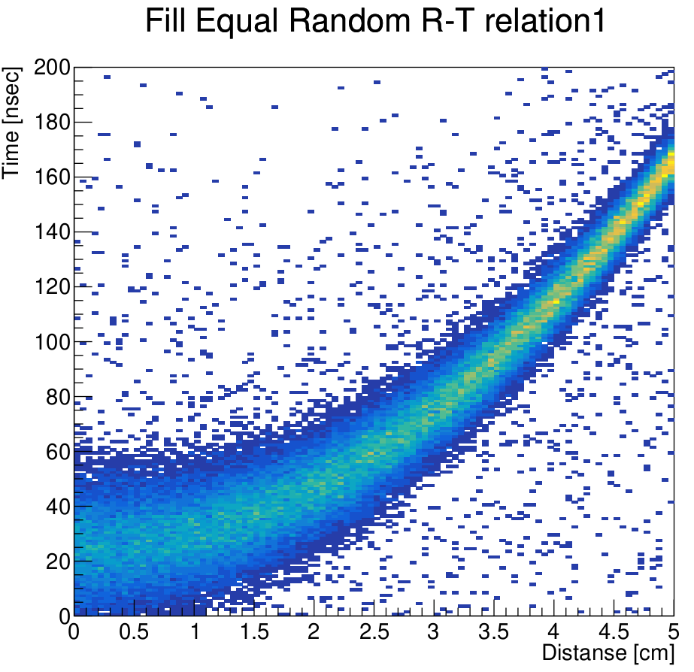
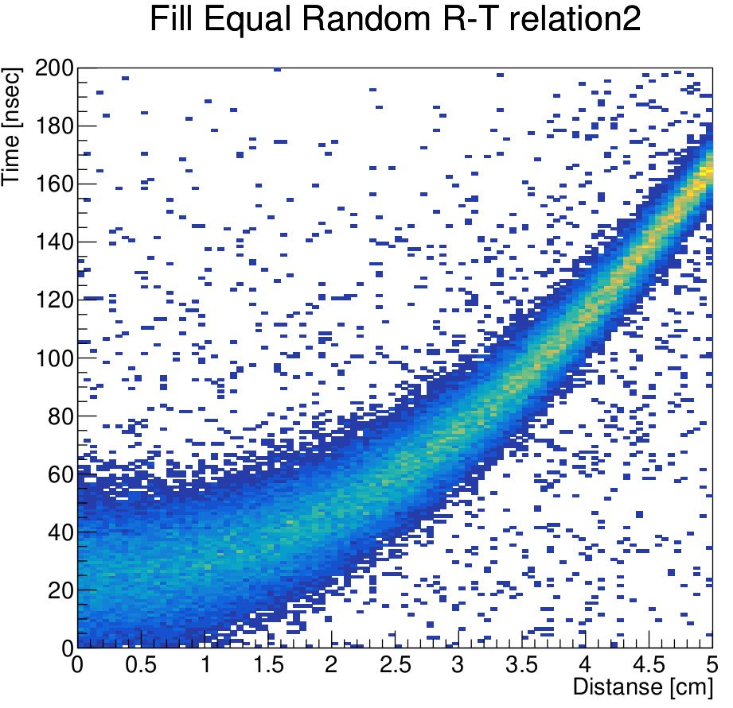

Slide 12
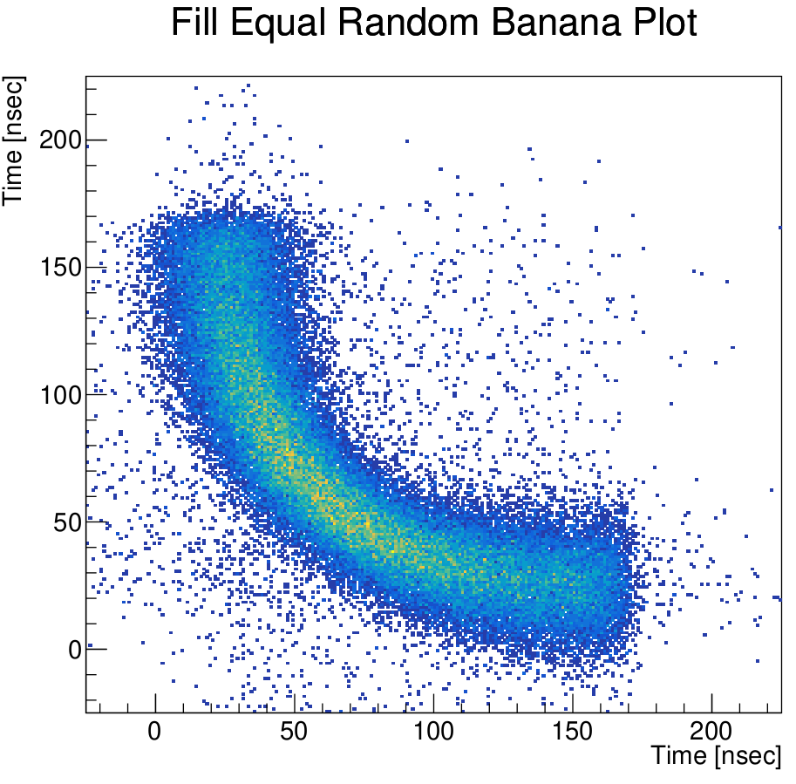

Slide 13
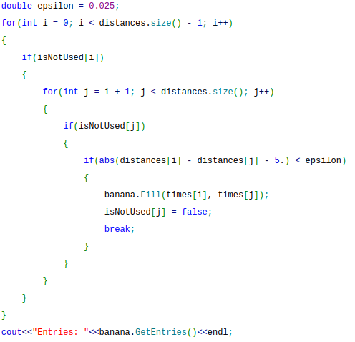
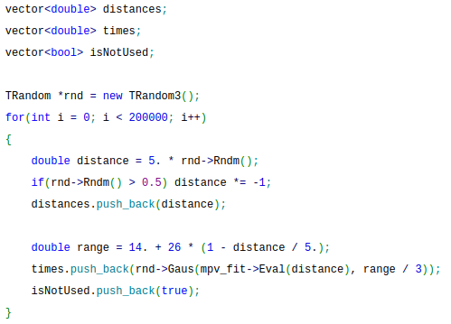
Bana reconstruction from simulated data
//half of the 2D hist bin width
//neagtive coord = 2
R_{tube} – r_{R} - eps < r_{L} < R_{tube} - r_{R} + eps

Slide 14
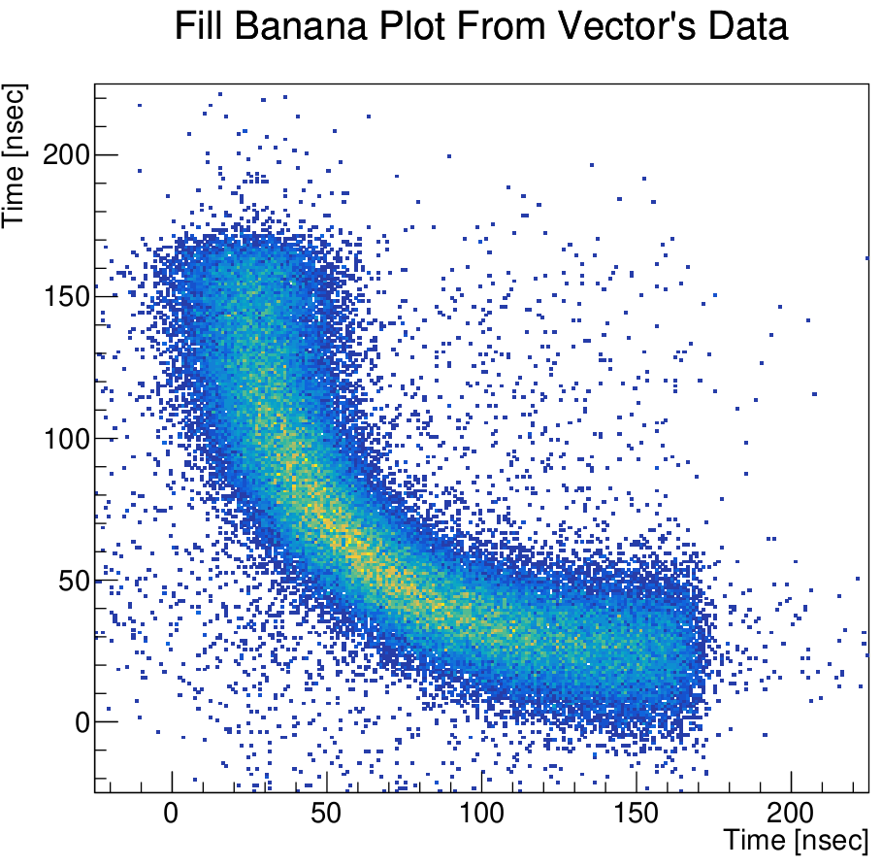
Note: lesser events; see slide #10
200k events → 100k pairs but ~73450 entries

Slide 15
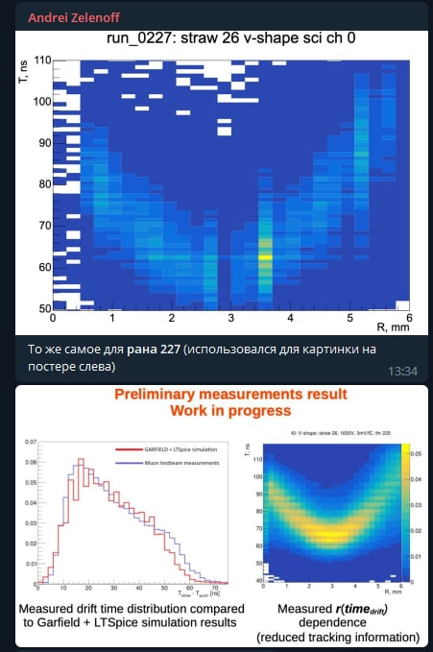
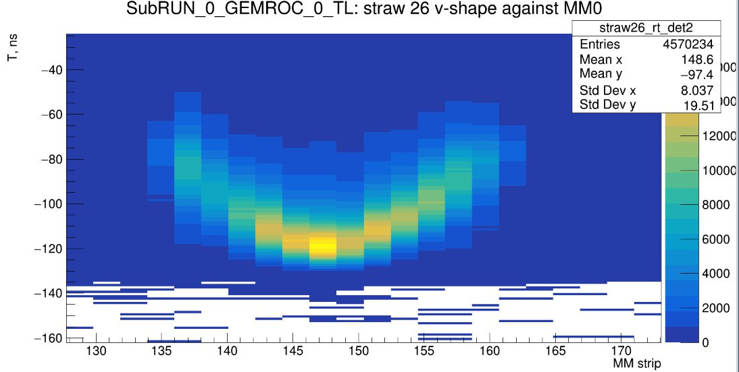
R-T curve reweight
Source: Dmitriy’s tg correspondence

Slide 16
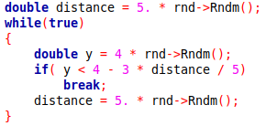
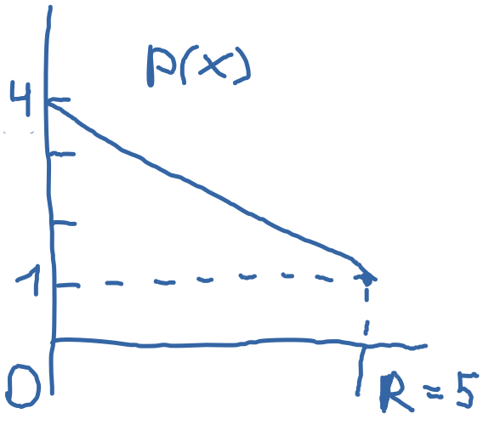
Irregular track positions distribution

Slide 17
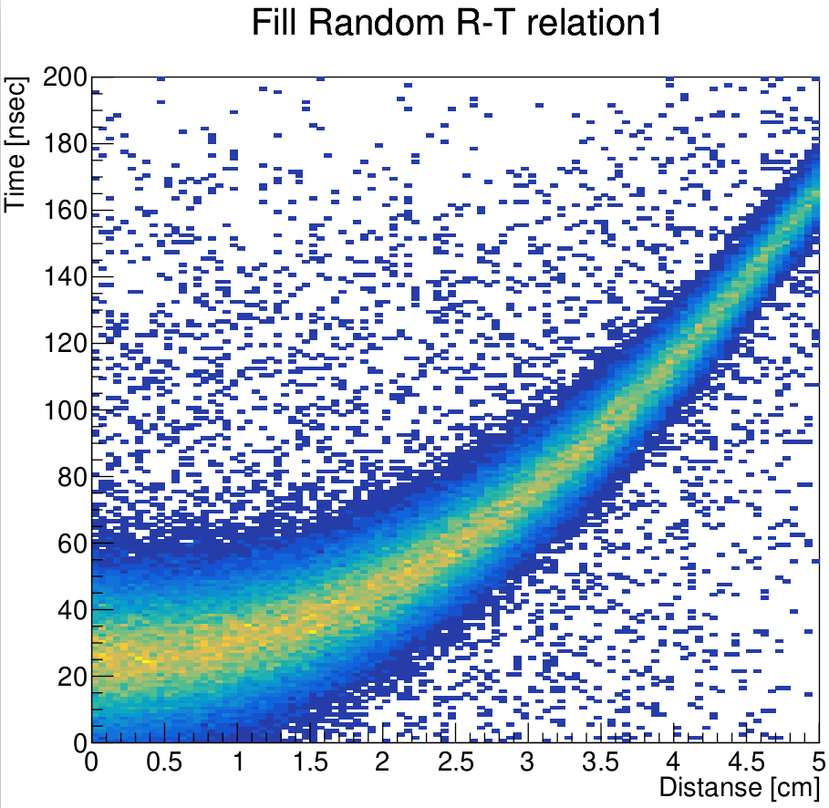
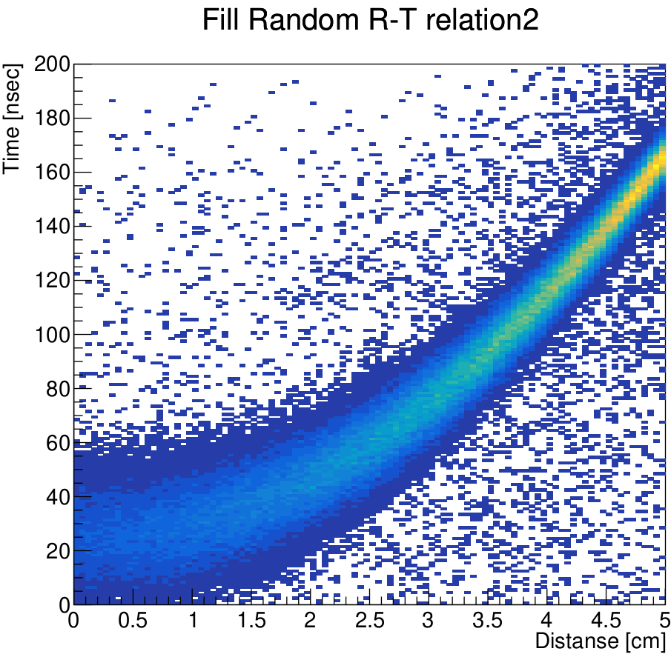

Slide 18
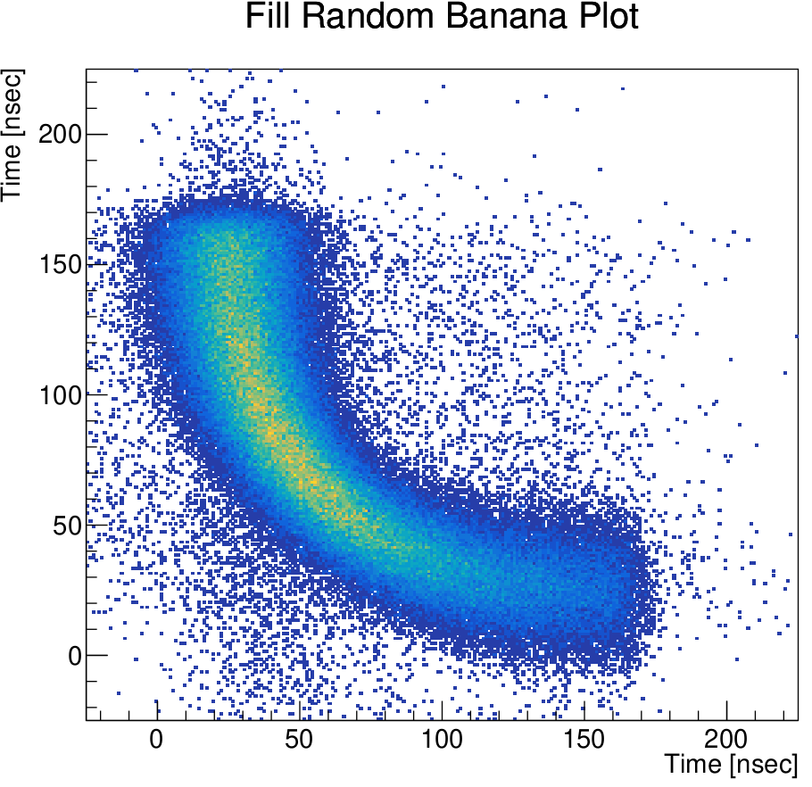

Slide 19
Overall:
Symmetry of the banana image with respect to the y=x curve is necessity but insufficiency condition for uniform tracks distribution
Is NA62 r-t data was renormalized?

