Slide 1
Selected problems in the description of the synthesis of SHE
Michał Kowal, NCBJ

Slide 2
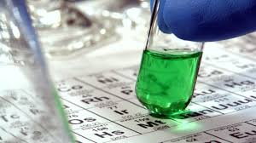
Outline:
New elements
Reaction mechanism
Cross sections – predictions
Extra stable SHE ?

Slide 3
2000
Borrowed from Yu.Ts. Oganessian.

Slide 4
2018

Slide 5


Slide 6

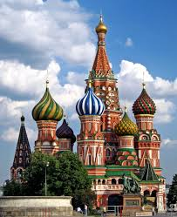

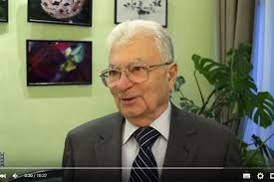

NEW Elements:
113: nihonium (Nh) 115: moscovium (Mc) 117: tennessine (Ts) 118: oganesson (Og)

Slide 7
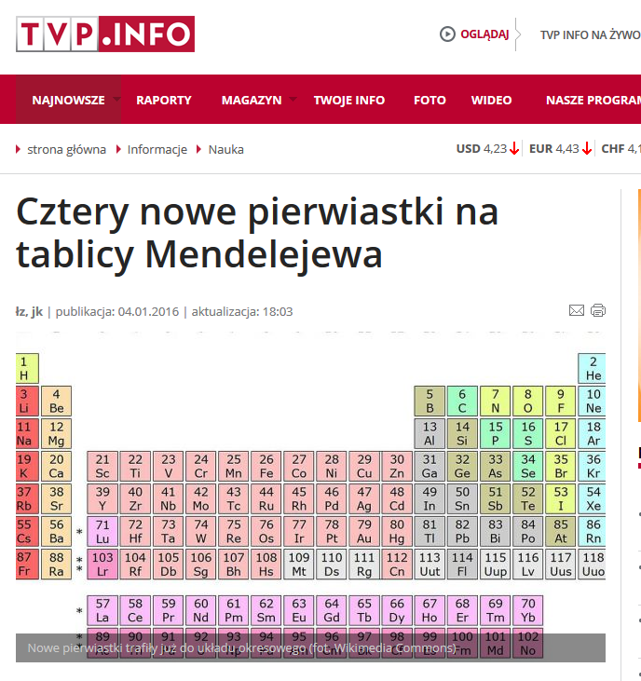
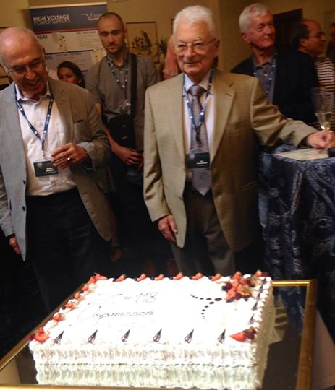

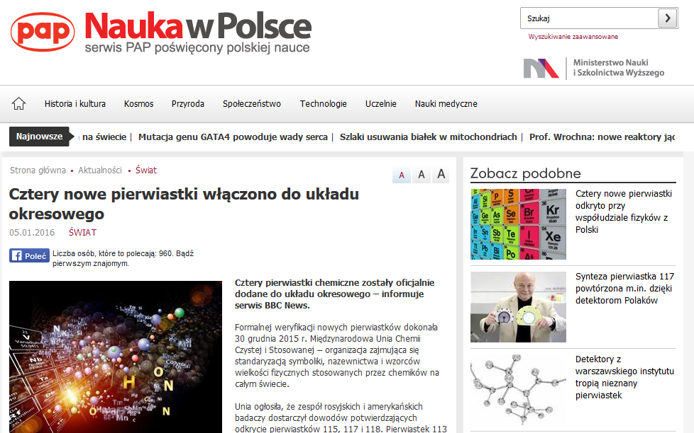
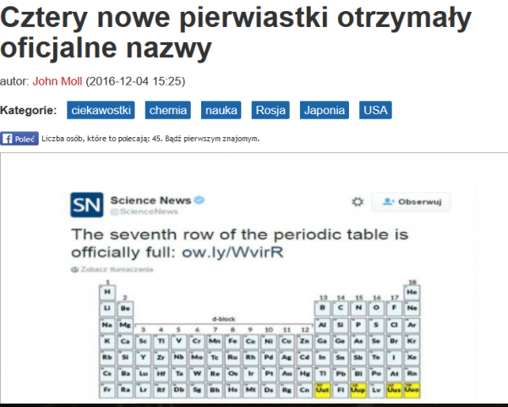

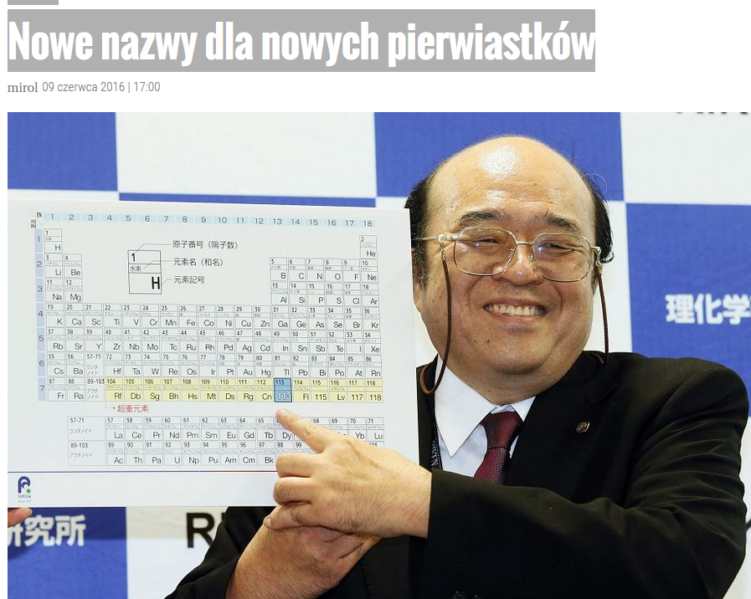
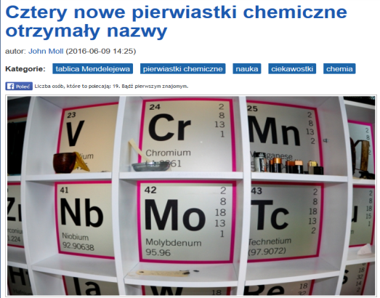

Slide 8
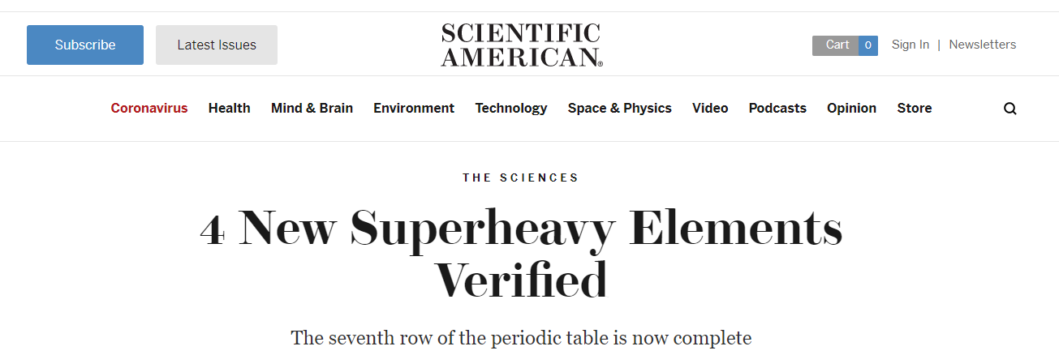
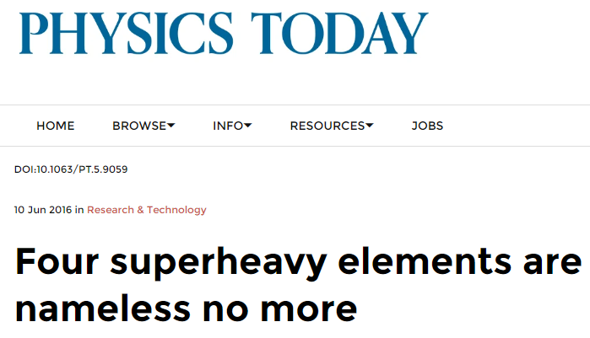
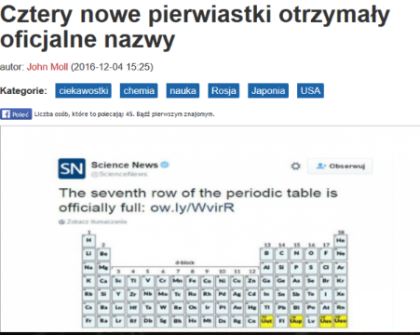

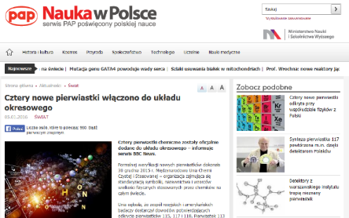





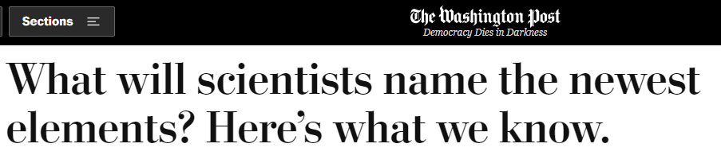

Slide 9
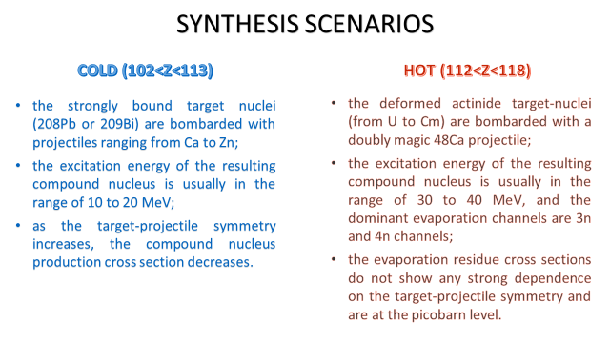
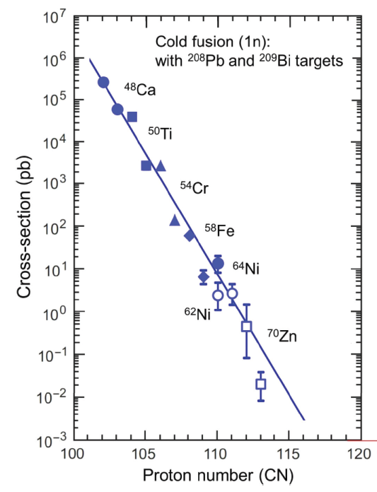

Slide 10
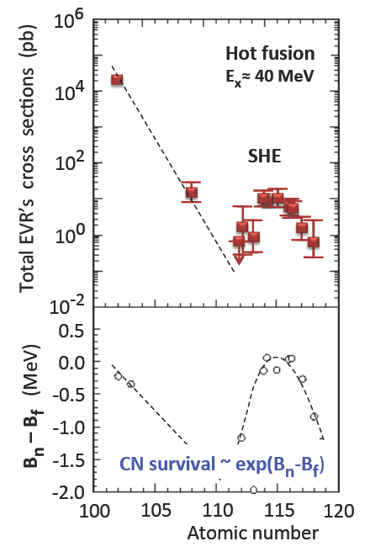

Slide 11
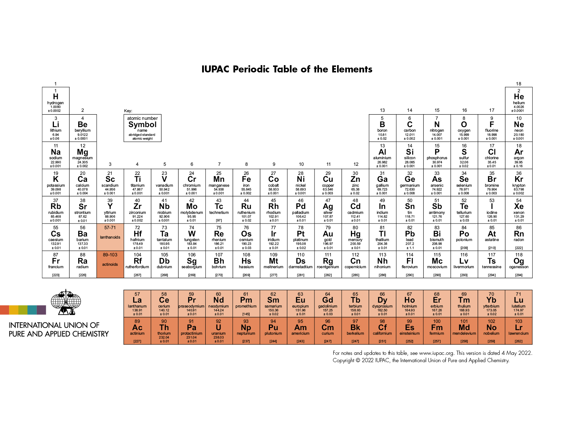

Slide 13
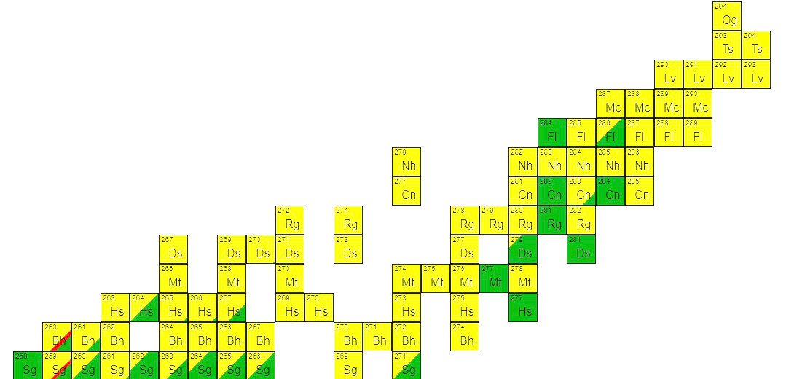
Attempts of going beyond the reactions Act. + ⁴⁸Ca by using heavier projectiles like ⁵⁰Ti, ⁵⁴Cr, ⁵⁸Fe, and ⁶⁴Ni gave no results so far.
BUT
All heavier actinides with Z>98 live to short that one could perform target with them.
There is no link between cold & hot scenarios.
To produce more & more heavier nuclei the mass and charge of projectile should be increased but it pulls an increase of the Coulomb repulsion what drastically reduces the cross sections.
Not all superheavy (SH) isotopes
Z < 118 have been produced yet.
Produced nuclei lies belong to the far “island of stability” of superheavy elements.

Slide 14
In the case of super-heavy nuclei, tasks for theory are always very strongly related to experimental progress and understanding what the experiment brings.
my wish list for theory:
TKE or mass distribution;
Diabatic vs. Adiabatic proces;
Cross sections predictions for new elements (Z=119.Z=120…);
The hindrance mechanism of fusion:
  stochastic nature
  role of angular momentum
  friction & memory effects
Properties of exotic configurations;
  shapes;
  excited states;
  K-isomers (2qp & 3qp & 4qp…) – chance for long-lived systems;
Pairing;
Odd SH nuclei;
Fission problem (collective coordinates, mass tensor, induced vs. spontaneous fission).

Slide 15
the overarching goal of the models is:
to determine the most appropriate projectile-target combination
to predict the optimal bombardment energy in the entrance channel at which the production cross-section is the most significant
to explain the fusion process in heavy-ion collisions

Slide 16
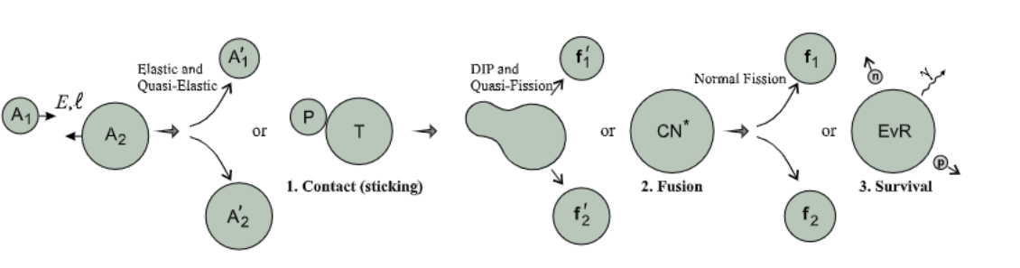
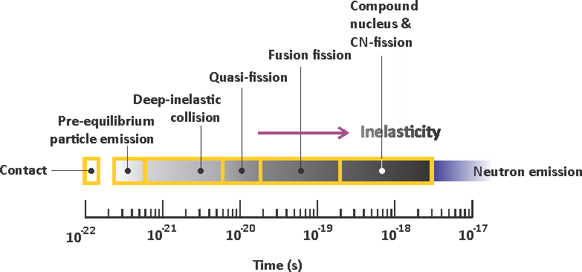
Fig from Valeri Zagrebaev
Fig from Jurij Oganiesian

Slide 17
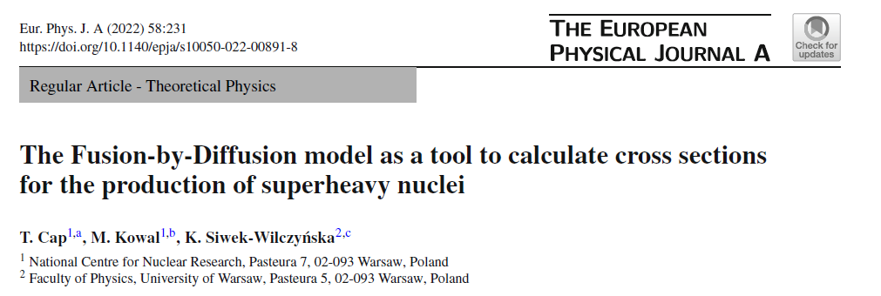
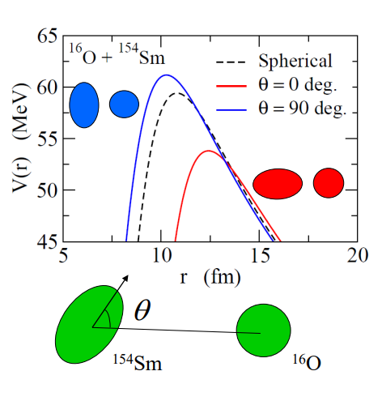
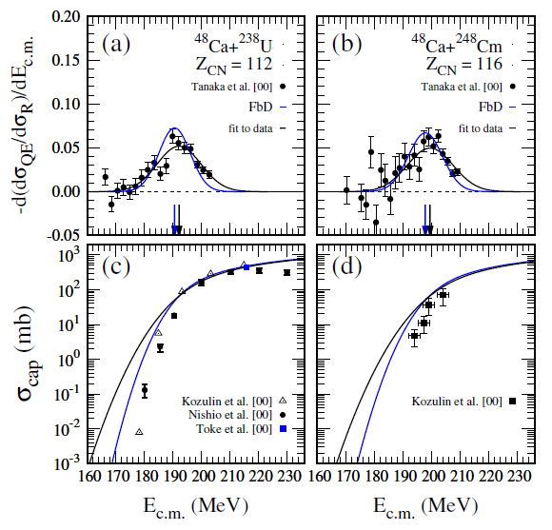

Slide 18
Basic assumptions:
After the capture stage, the internal mass asymmetrical conditional saddle point - the fusion barrier - must be overcome by the system.
The stochastic nature of the fusion process is accompanied by dissipation of energy and angular momentum.
All nucleons are transformed from projectile to the target by a diffusion process.
Fusion - By - Diffusion - Smoluchowski equation
W. J. Świątecki, K. Siwek-Wilczyńska, and J. Wilczyński
Phys. Rev. C 71, 014602 (2005).
Di - Nuclear - System - master equation
G.G. Adamian, N.V. Antonenko, Eur. Phys. J. A (2022).

Slide 19
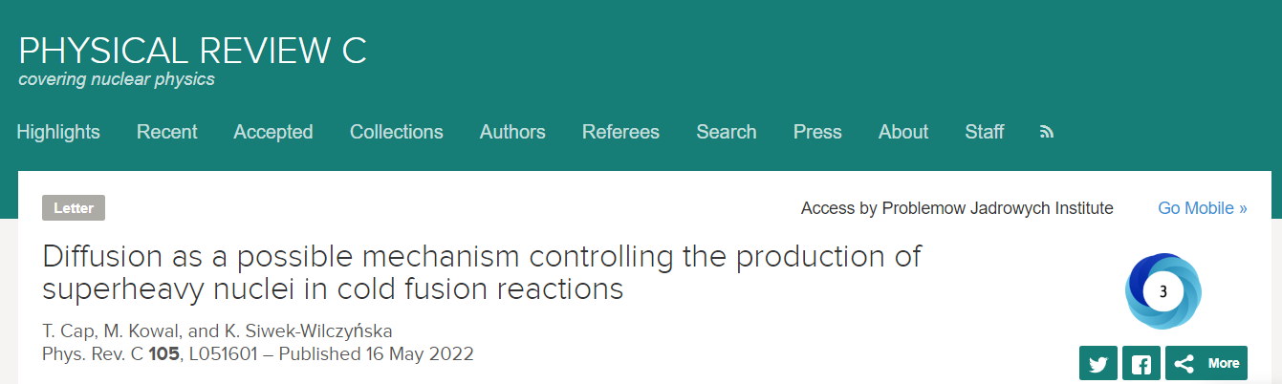
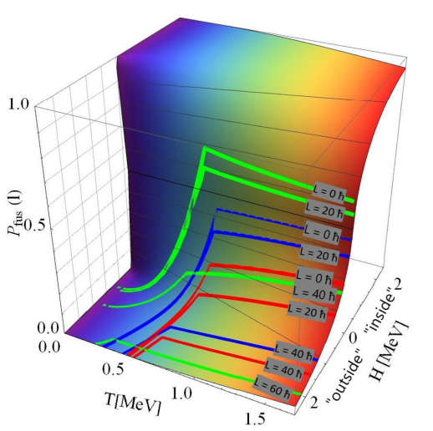
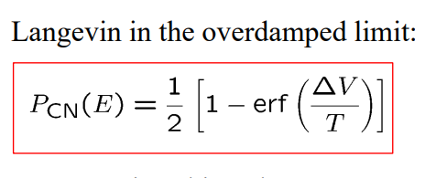

Slide 20

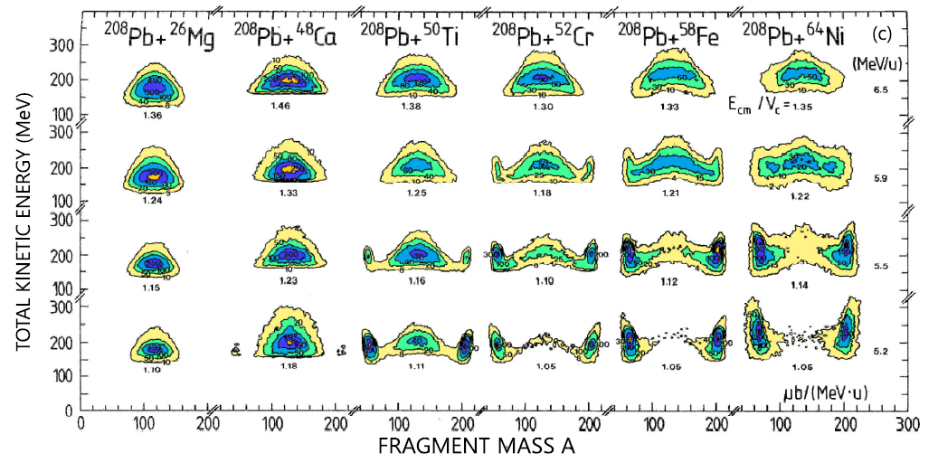
Experimental studies of the competition between fusion and quasifission in the formation of heavy and superheavy nuclei, D.J. Hinde, M. Dasgupta, E.C. Simpson, Progress in Particle and Nuclear Physics, Volume 118, May 2021, 103856.

Slide 21


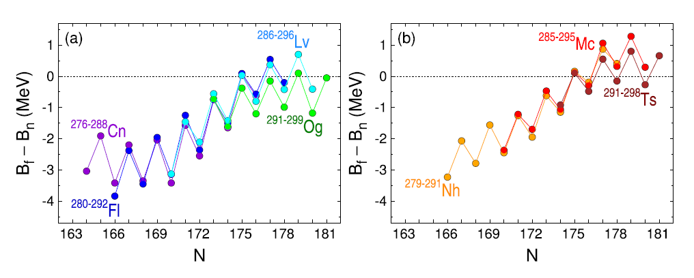
U>Bn>Bf>T

Slide 22
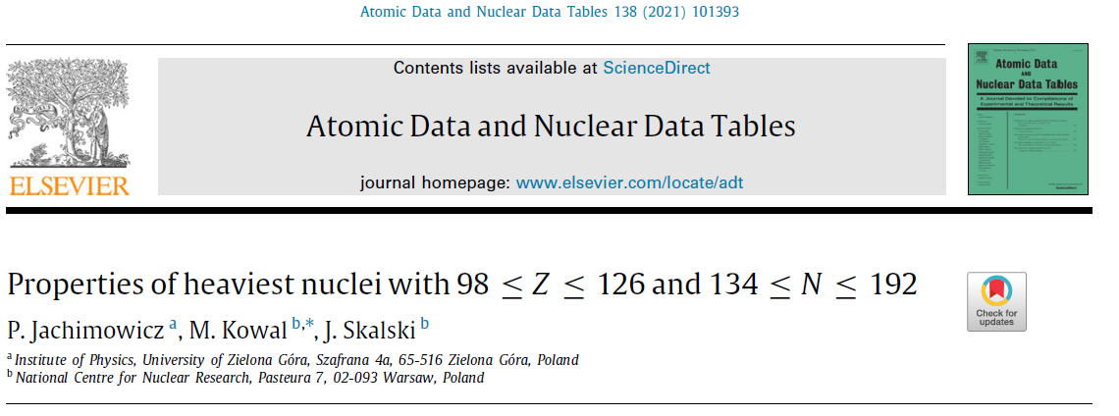
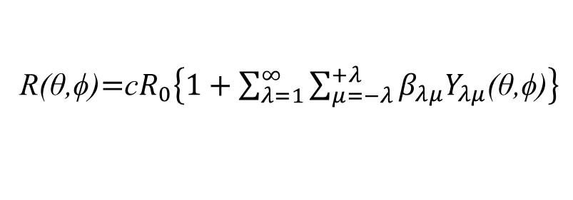
application of ADNT2021 tables to estimate the chances of producing new elements
Microscopic-macroscopic method
R(θ,ϕ)$=$c$R_{0}\left\{1+\sum_{λ=1}^{∞}{\sum_{μ=−λ}^{+λ}{β_{λμ}Y_{λμ}\text{(}\text{θ}\text{,}\text{ϕ}\text{)}}}\right\}$
I. Muntian, Z. Patyk and A. Sobiczewski, Acta Phys. Pol. B 32, 691 (2001).
H. J. Krappe, J. R. Nix and A. J. Sierk, Phys. Rev. C20, 992 (1979).
S. Cwiok, J. Dudek, W. Nazarewicz, J. Skalski and T. Werner, Comput. Phys. Commun. 46, 379 (1987).

Slide 23
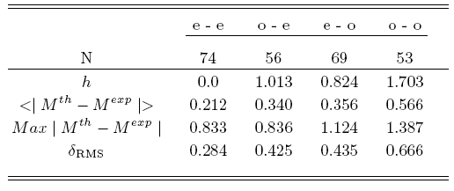

SH masses (g.s.) for 1305 nuclei (including odd & odd-odd systems)
A fit to exp. masses Z>82, N>126 (number of nuclei: 252)
P. Jachimowicz, M. Kowal, and J. Skalski, Phys. Rev. C 89, 024304 (2014).
Seven dimensional minimization is performed using the gradient method
For odd system, additionally the minimization over configurations at every step of the gradient procedure has been done.
For odd and odd-odd systems there are 3 additional parameters – macroscopic energy shifts (they have no effect on Q alpha and fission barriers)

Slide 24
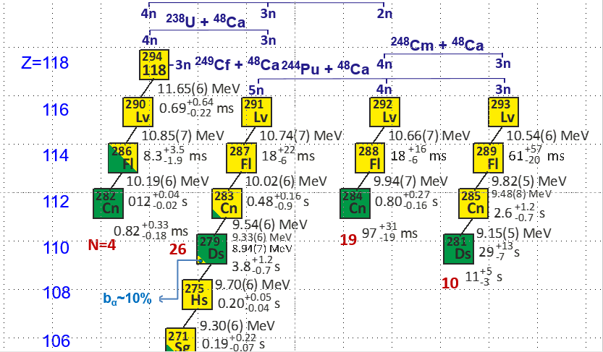

Slide 25
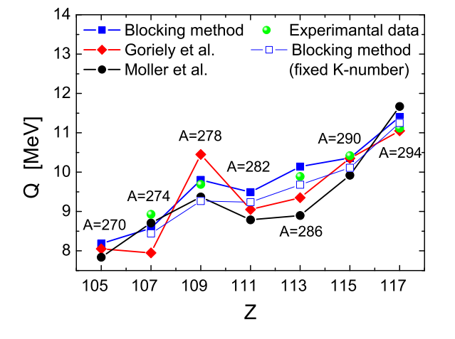
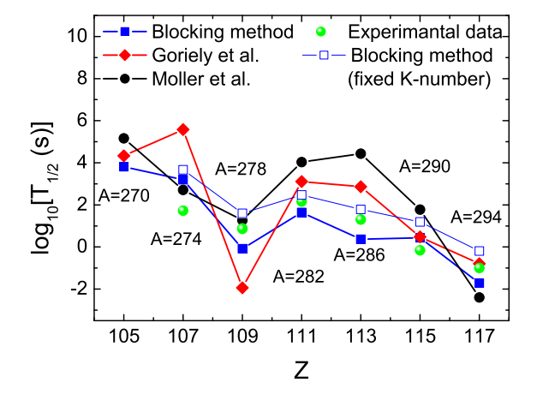
Calculated vs experimental
Q_alpha & half-lives for the decay chain of
Z = 117, A = 294.
P. Jachimowicz, M. Kowal, and J. Skalski
Phys. Rev. C 89, 024304 – Published 5 February 2014

Slide 26

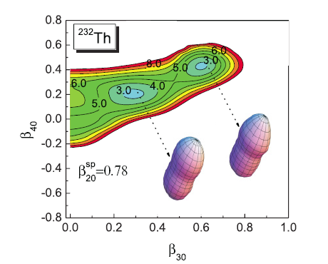
Search for Saddles
Which deformation/constrain parameters to use?
(An arbitrary shape of a drop requires infinite number of coordinates)
How many deformations/consrains are sufficient?
(At present, the practical restrictions by available computation resources confine one to 5 - 6 coordinates when performing calculations for many nuclei)
Fragment of the energy surface for 232Th projected on the (β30,β40) plane by fixing β20 = 0.78 and minimizing over β50,β60,β70,β80; the minima correspond to shapes lying slightly beyond the second saddle
Adiabatic fission barriers in superheavy nucleiP Jachimowicz, M Kowal, J Skalski
Physical Review C 95 (1), 014303 (2017)

Slide 27

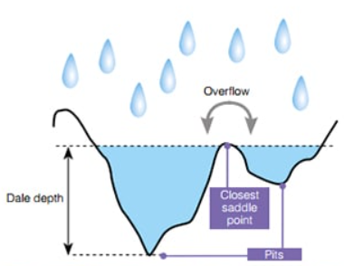
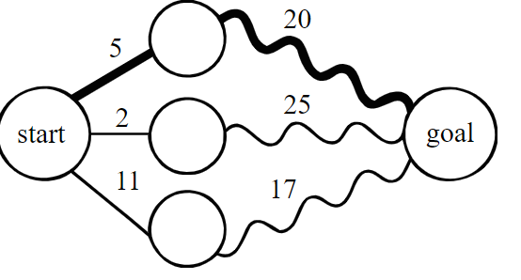
Search for Saddles
How to represent many-dimensional landscapes?
(Any n-dimensional landscape with n ≥ 3 is difficult to visualize. For a long time, two-dimensional energy maps serving the search for fission saddles were obtained by minimizing over the remaining, i.e. over the other n − 2, shape coordinates. This was an obvious and easiest choice, especially in the selfconsistent studies, which are based on the minimization with constraints. )
How to search for saddles?
(Saddles on the energy landscape are neither minima nor maxima, therefore a proper method of search for them is required, different from the minimization)
Mathematical Art
by Henry Segerman
IWF
DPM

Slide 28
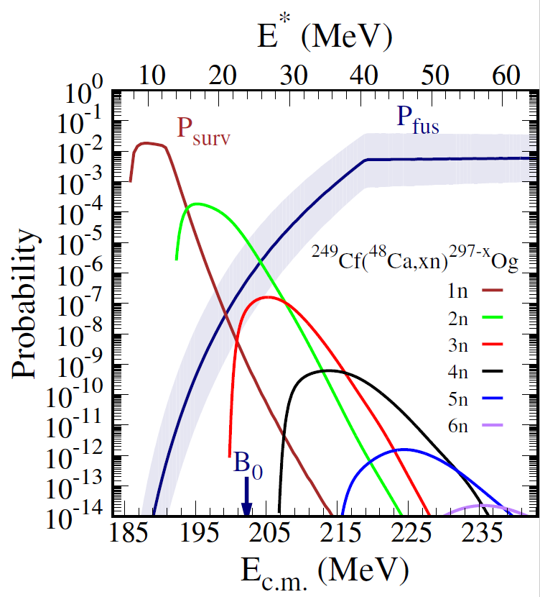
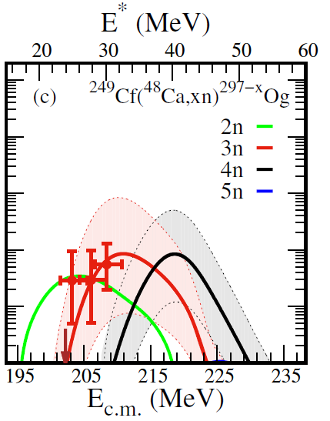
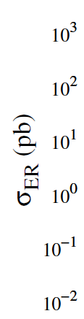
_{Averaged survival probability}
_{Averaged fusion}
_{probability}
_{1 pb}
_{3n}
_{3n}
_{4n}
_{4n}

Slide 29
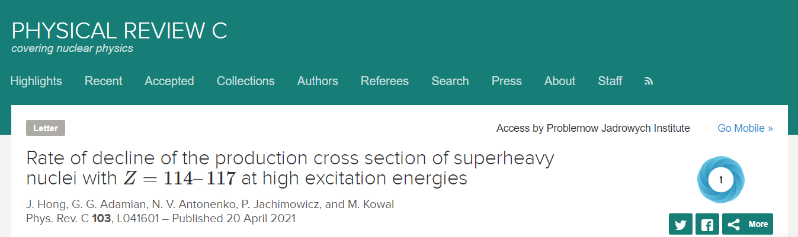
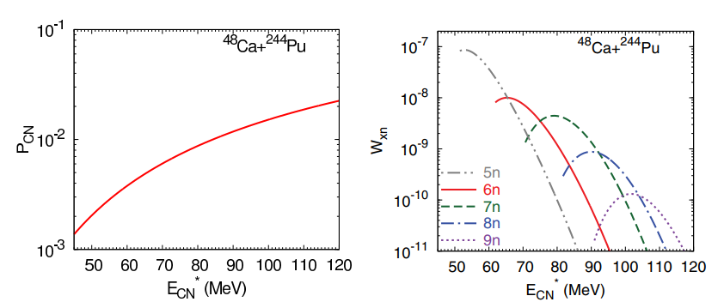
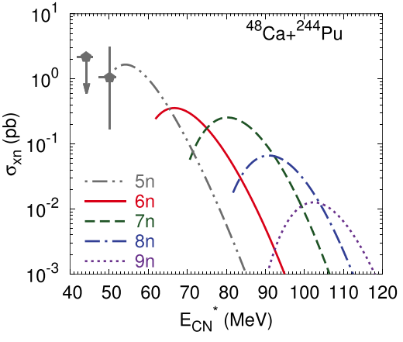
the decline of the cross section with increasing excitation energy unexpectedly turned out to be relatively weak. This intriguing behavior may open up a new window for the study and the production of new isotopes

Slide 30
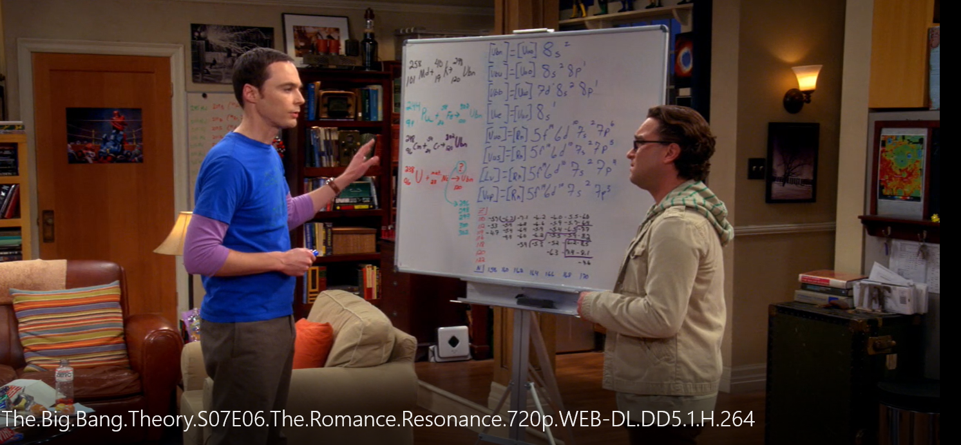
What Next ?

Slide 31
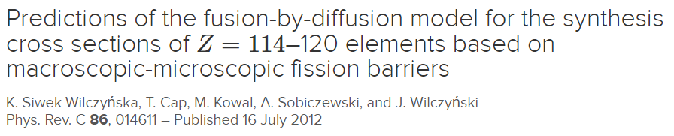
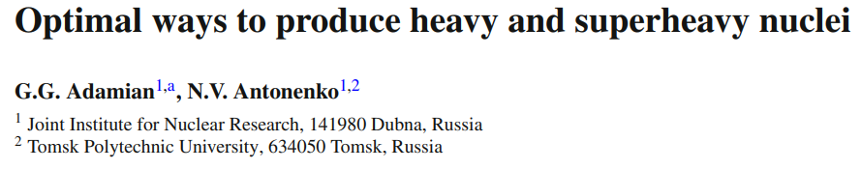
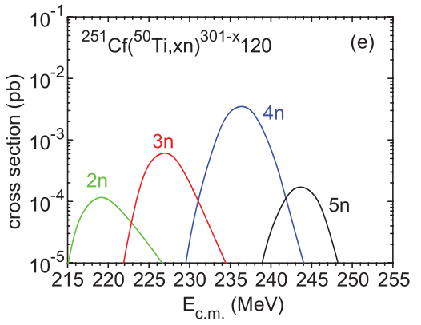
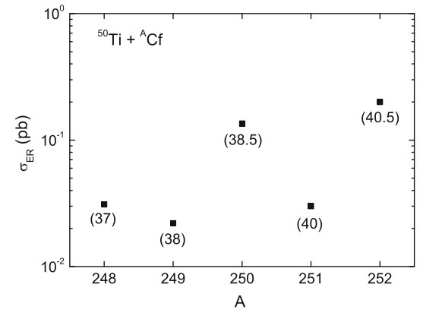
Z=120 (predictions)

Slide 32
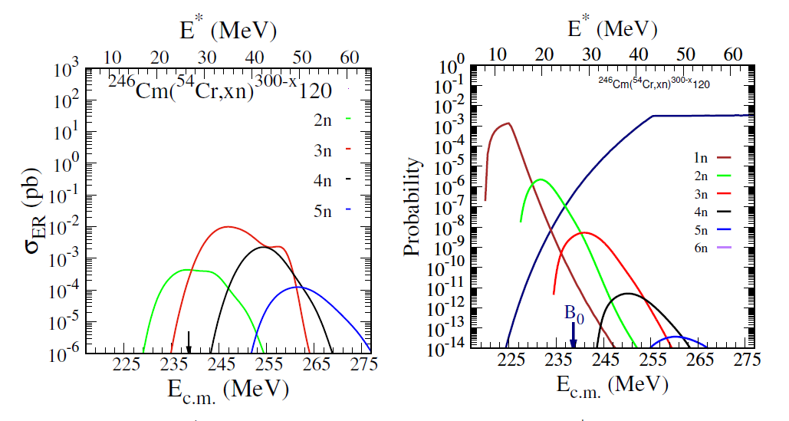
Z=120 (predictions) - FBD

Slide 33


extreme properties:
SERUM?
Candidates are high-K isomers or ground-states, for which increased stability is expected due to some specific hindrance mechanisms.

Slide 34







Unique blocked orbitals may hinder
alpha transitions.
The effect of a reduced Q alpha for
g.s. -> excited state (top panel)
on the life-times (below)
according to the formula by Royer.
$${ΔQ}_{α}$$
g. s.
$$Ψ_{g.s.}$$
$$Q_{α}$$
ex. s.
$$Ψ_{g.s.}$$
$$Q_{α}$$
$${ΔQ}_{α}$$
g. s.
$${Ψ′}_{g.s.}$$

Slide 35





IS THE LACM ADIABATIC OR NON ADIABATIC ?
To CROSS or NOT to CROSS ?
Q
Landau – Zener effect
2Δ
Diabatic
ADiabatic
W. Nazarewicz, Nucl. Phys A 557 (1993).

Slide 36
Adiabatic vs. Diabatic
In the mean field calculations of PES s there are no perfect quantum numbers, because the real symmetries of many body Hamiltonian are spontaneously broken in the intrinsic system nucleus can split at all.
ADIABATIC
DIABATIC
the residual interactions leads to the single particle level repulsion => strong mixing between two surfaces and the wave functions are strongly mixed
Process is slow
the configurations are completely separated and the collective motion is concentrated in each potential surfaces separately => the levels retain their quantum number.
Process is fast
What are the conditions for the many – body system to give up its quantum characteristic ?

Slide 37
Fixing the g.s. configuration rises the barrier by 6 MeV. ~(75%)!!!
Even if configuration is not completely conserved, a substantial increase in fission half-life is expected.
G.S. configuration:
P:11/2+ [6 1 5]
N:13/2- [7 1 6]
P. Jachimowicz, M. Kowal, and J. Skalski, Phys. Rev. C 92, 044306 (2015).

Slide 38
Summary:
On the basis of systematic calculations for 1364 heavy and superheavy nuclei, including odd systems, we have found a few candidates for high-K ground states in superheavy nuclei.
Exceptionally untypical high-K intruder contents of the g.s. found for some nuclei accompanied by a sizable excitation of the parent configuration in daughter suggest a dramatic hindrance of the –alpha decay.
The calculated configuration-preserving fission barrier in 272Mt is by 6 MeV higher than the one minimized over configurations. Even if configuration is not completely conserved, a substantial increase in fission half-life is expected.
A particular situation occurs above double closed subshells: N = 162 and Z = 108 where two intruder or-bitals: neutron 13/2− from j=15/2 and proton 11/2+ from i=13/2 spherical subshells are predicted. These orbitals combine to the 12− g.s. in Z = 109, N = 163.

Slide 39
Speculations:
There is a possibility, that one such high-K ground- or low-excited state may be the longest lived superheavy nucleus e.g. 272Mt~1h.
102 | Nobelium | ²⁵⁹No | 58 minutes | Isotopes of nobelium
107 | Bohrium | ²⁷⁰Bh | 3.8 minutes | Isotopes of bohrium
109 | Meitnerium | ²⁷⁸Mt | 7.6 seconds | Isotopes of meitnerium
111 | Roentgenium | ²⁸²Rg | 2.1 minutes | Isotopes of roentgenium
113 | Ununtrium | ²⁸⁶Uut | 19.6 seconds | Isotopes of ununtrium
115 | Ununpentium | ²⁸⁹Uup | 220 milliseconds | Isotopes of ununpentium
116 | Livermorium | ²⁹³Lv | 61 milliseconds | Isotopes of livermorium
117 | Ununseptium | ²⁹⁴Uus | 78 milliseconds | Isotopes of ununseptium
118 | Ununoctium | ²⁹⁴Uuo | 890 microseconds | Isotopes of ununoctium

Slide 40
Speculations:
One cannot exclude that such long-lived superheavy configurations were already produced before, but setup and electronics dedicated to the milliseconds measurements could not detect objects living much longer. This intriguing possibility should be check at first. Q_alpha of 266Mt is 10.32 to 11.76 MeV.
“Calculated data of excited levels of the odd-odd nucleus 266109 are not yet available. But the structure of the neighboring odd nuclei [8] suggests a rather complicated level and decay scheme for 266109 by the coupling of the odd proton and neutron in various possible Nilsson states. This could explain the wide spread of α energies from 10.5 to 11.7 MeV.”
S. Hofmann et al. , Z. Phys. A 358, 377-378 (1997).

Slide 41
Central Open Questions/Problems:
What are the conditions for the many – body system to give up its quantum characteristic ?
How to calculate the stability of odd nuclei (fission & alpha half – lives) ?
How realy strong is the hindrance against fission?
-Problem of mass parameters for odd systems!
-How many colective variables is enough ?

Slide 42




Slide 43

SH fission barriers (s.p.) for 1305 nuclei (including odd & odd-odd systems)
range of proton numbers: 92 < Z < 126 neutron numbers: 134 < N < 192
For all investigated nuclei saddle points were searched on five dimensional deformation space:
Triaxiality and octupole components are included.
For odd nuclei at each grid point we are looking for a low laying configuration blocking particles on levels from the 10-th below to 10-th above the Fermi level.
To search for saddle points the ,,immersion" method is applied.

Slide 44

Odd-multipoles
At each (first and second) saddles previously found, minimization over reflection-asymmetric variables i.e.: 30; 50; 70 has been done.
Since majority of the saddles are non-axial, the most general version of our numerical code was used. Both axial- and reflection symmetries were broken at the same time:
We have found the points where extrema can be expected.
Fortunately, it turned out that octupole effect manifests itself only where triaxiality is absent !!!
IWF analysis only on axially symmetric dimensional grid

Slide 45


Odd-multipoles
After interpolation in all directions the grid contains 1.690.730.496 points!
We performed 7DIM analysis for nuclei for nuclei for which the effect of minimization was greater than 300 keV.
127 nuclei fulfilled this contractual condition

Slide 46
fusion probabilities -reaction mechanism –
the hindrance mechanism

Slide 47








Slide 48






Slide 49



Slide 50


The pxn−and αxn−evaporation channels allow us to obtain an access to the isotopes which are unreachable in xn−evaporation channels due to the lack of proper projectile-target combination. Thus, employing the reactions suggested, one can produce the heaviest isotopes closer to the center of the island of stability.

Slide 51



$${}_{}^{48}{Ca}+{}_{}^{232}{Th}⇒{}_{}^{277}{Ds}+3n;$$
$$σ_{3n}=0.1 pb$$
Since the probability of fusion of PCN decreases with the
growth of Z1Z2 it is clear that the minimum production cross
section for the Ds nucleus is mainly due to the minimum
survival probability Wxn value or the minimum stability
The calculated production cross sections clearly indicate the border nucleus Ds between the island of stability of superheavy nuclei and the mainland with a relatively large number of neutrons. We revealed that the dependence of the production cross section on the atomic number Z from Hs to Lv has a minimum in the Ds nucleus

Slide 52



Slide 53




K. Siwek-Wilczynska, T. Cap, M. Kowal, A. Sobiczewski, and J. Wilczynski, Phys. Rev. C 86, (2012).

Slide 54



P. Jachimowicz, M. Kowal, and J. Skalski, Phys. Rev. C 95, 014303 (2017).
K. Siwek-Wilczyńska, T. Cap, and M. Kowal
Phys. Rev. C 99, 054603 (2019)

Slide 55






Slide 56







Z=122
A=288
Superdeformed oblate superheavy nucleiP Jachimowicz, M Kowal, J Skalski
Physical Review C 83 (5), 054302

Slide 57


Theory vs. Theory
WS – Our
FRLDM – P. Moller et al.
SkM* – A. Staszczak et al.
RMF – H. Abusara et al.
– EXP (DUBNA)
P. Jachimowicz, M. Kowal, and J. Skalski, Phys. Rev. C 95, 014303 (2017).
6 MeV !

Slide 58

Fission Barrier

Slide 59


The systematics of the s_{inj} used to predict cross sections for Z = 119
The reaction ⁴⁸Ca +²⁵²Es predicted to have
measurable cross section

Slide 60

Z=119 (predictions) - FBD

