Slide 1
From fusion to multinucleon transfer reactions
The Conference "Heaviest nuclei and atoms" April, 24-30, Yerevan, Armenia
G.N. Knyazheva
Flerov Laboratory of Nuclear Reactions, JINR

Slide 2
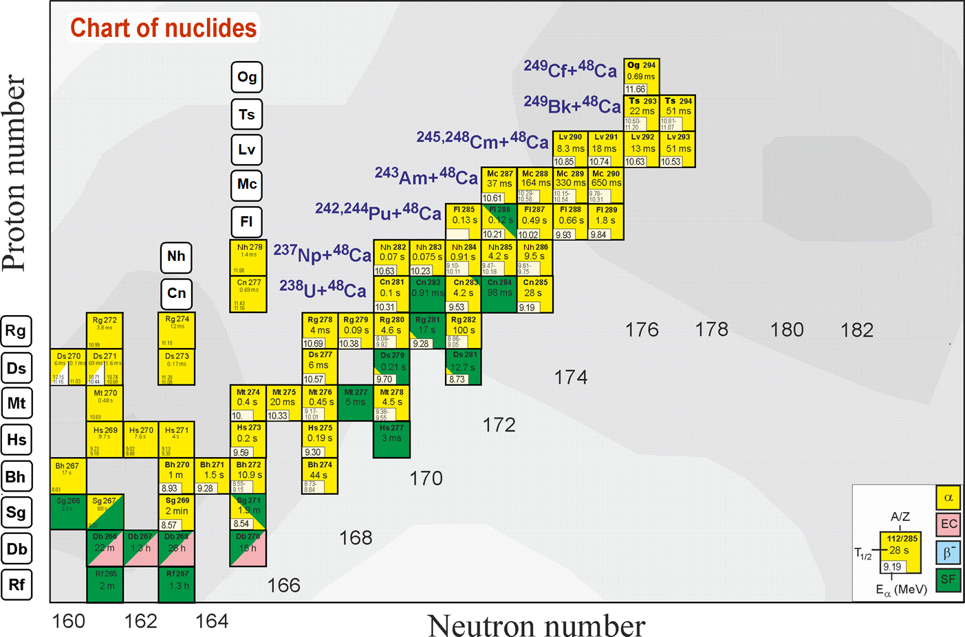
Search for superheaviest nuclei
What is the next step?
Ti, Cr, Ni, Fe ?
Z = 120
Still far from the “island of stability” !!!
The limitation to form more neutron-rich superheavy nuclei by complete fusion reactions with stable beams triggers the search for other SHE production approaches.
Z = 114
184
MNT reactions can be used to produce new neutron-rich SHE
Notes:
50 years ago The existence of island of stability in the region of nuclei with Z = 114 and N = 184 was predicted theoretically [A. Sobiczewski, F. A. Gareev, and B. N. Kalinkin, Phys. Lett. 22, 500 (1966)]
That caused the experimental investigations in the field of the superheavy element (SHE) synthesis.
Nowadays more than 30 isotopes of superheavy elements with Z = 108-118 have been synthesized both in cold an hot fusion reactions
In the Flerov Laboratory of Nuclear Reactions a great success was achieved in the synthesis of superheavy elements in hot fusion reactions of ⁴⁸Ca ions with actinide target nuclei.
Unfortunately, nuclei with Z > 118 cannot be synthesized in ⁴⁸Ca-induced reactions since ²⁴⁹Cf is the heaviest target material available for these purposes.
One of the possible pathways to synthesize new isotopes of superheavy elements with Z = 118 -126 is the reactions of actinide targets with Ti, Cr, Fe and Ni ions.
The interest in damped collisions of heavy nuclei is conditioned by the necessity to find new ways to produce neutron-rich superheavy elements (SHE). Few years ago the inverse (antisymmetrizing) quasifission (QF) process, was proposed to produce SHE in the collisions of transactinides [1]. The low-energy damped collisions of intermediate mass nuclei are less difficult for experimental study than the reactions with transactinides. One may expect that the antisymmetrizing shell effect will be similar in both cases [2].
To study the role of shell effects in inverse QF, the binary reaction channels in the reactions ^{156,160}Gd + ¹⁸⁶W at the Coulomb barrier energy have been investigated. In these reactions the projectile and target nuclei are located between the closed shells with Z = 50, N = 82 (double magic tin) and Z = 82, N = 126 (double magic lead) which should play a significant role in the nucleon transfer process. To form lead-like fragment the projectile nucleus has to transfer about 22 nucleons to the target.

Slide 3
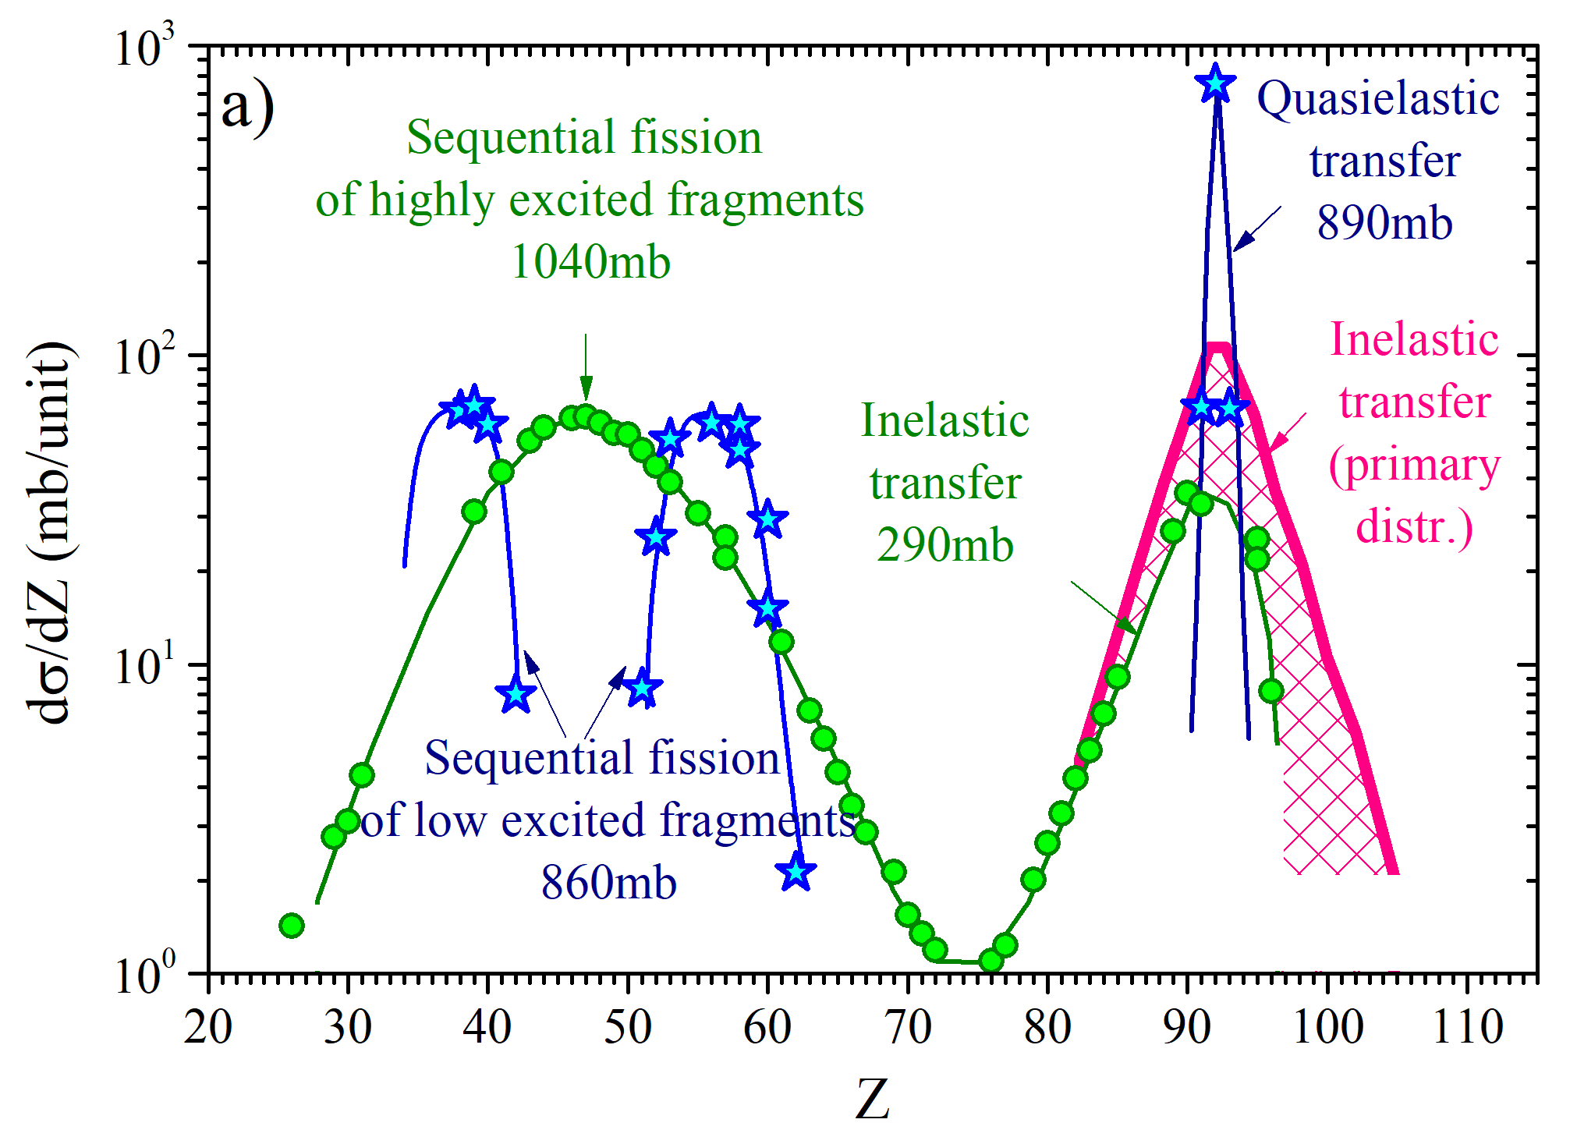
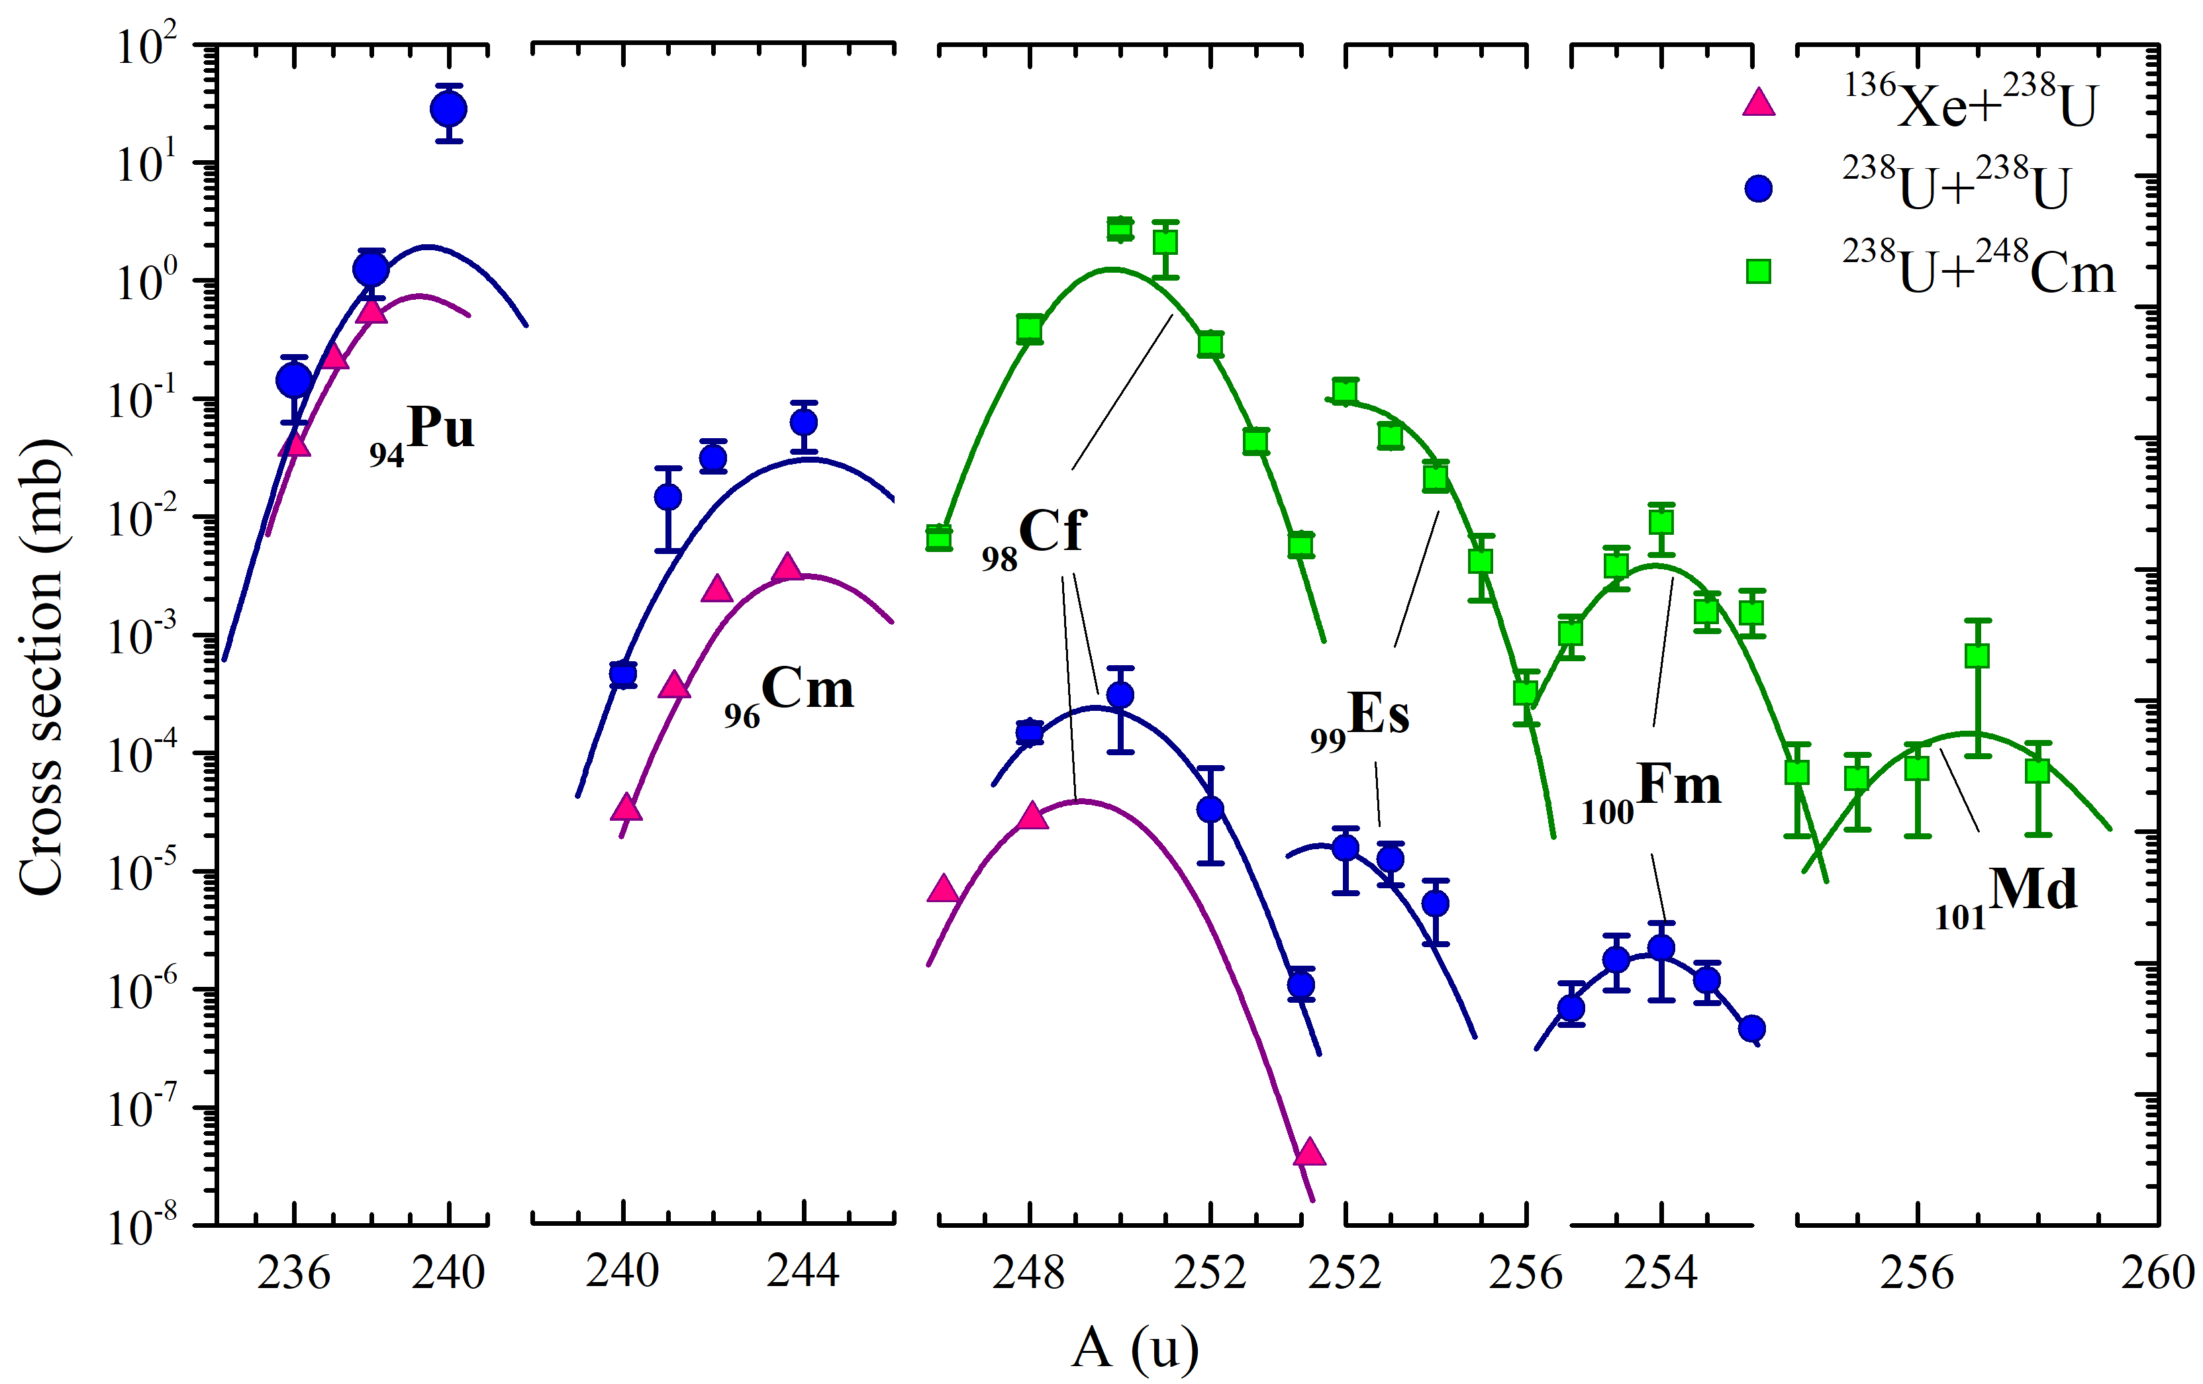
Radiochemical study of the reaction ²³⁸U+²³⁸U
M. Schädel et al., Phys. Rev. Lett. 41, 469 (1978)
M. Schädel et al., Phys. Rev. Lett. 48 (1982) 852
Charge distribution of fragments formed in the reaction ²³⁸U+²³⁸U at the interaction energy E_{lab} ≤ 7.5 MeV/nucl.
Production cross sections of trans-uranium nuclei in the reactions ¹³⁶Xe+²³⁸U, ²³⁸U+²³⁸U and ²³⁸U+²⁴⁸Cm at the interaction energy E_{lab} ≤ 7.5MeV/nucl.

Slide 4
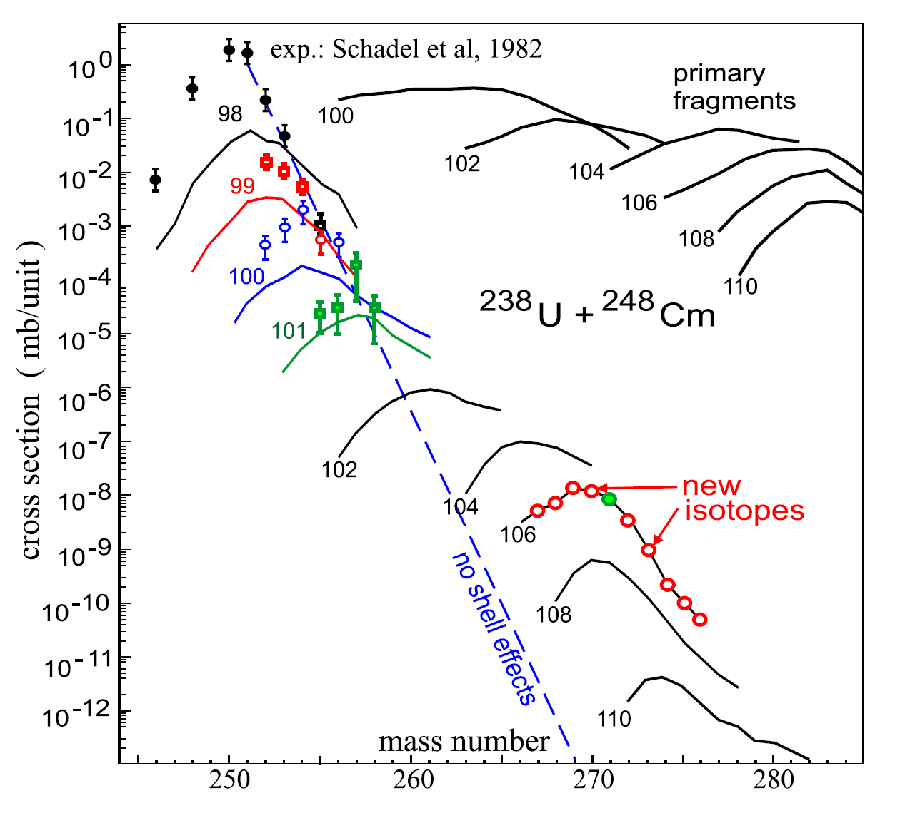
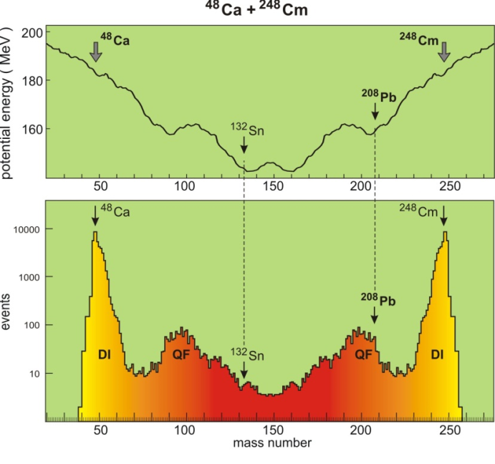
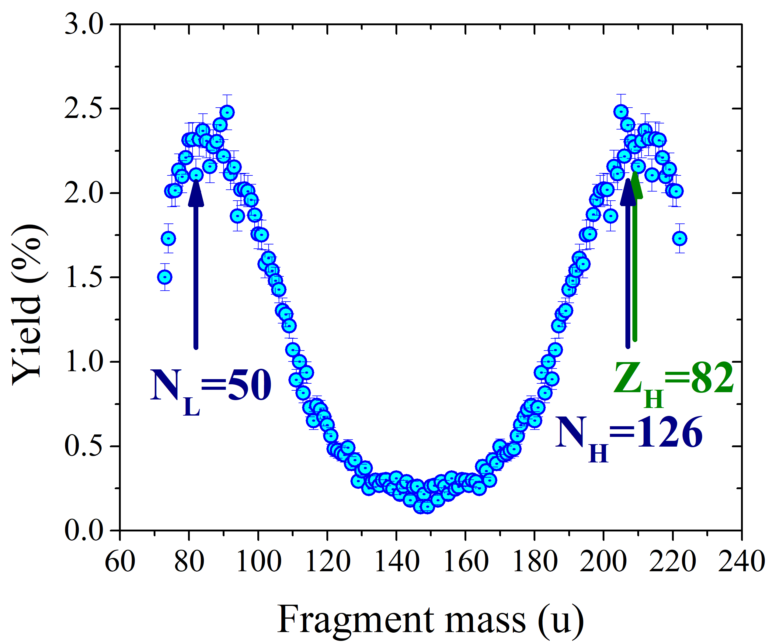
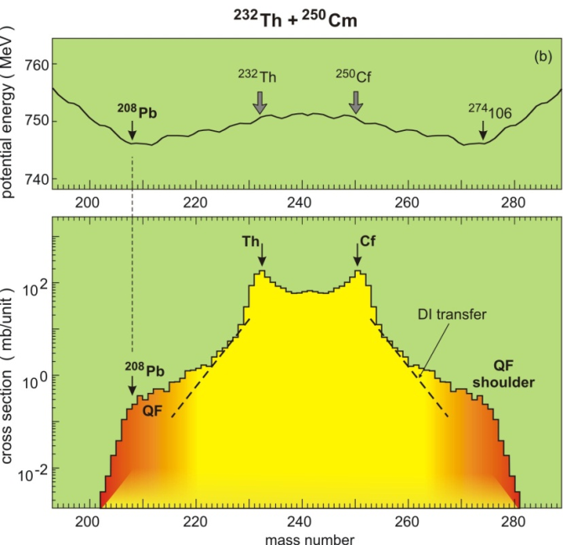
Shell effects in MNT reactions
V. Zagrebaev and W. Greiner, Nucl. Phys. A 834 (2010) 366c

Slide 5
Antisymmetric effect of lead shell in the reaction ¹⁶⁰Gd+¹⁸⁶W
V. Zagrebaev and W. Greiner,
J.Phys.G 34 (2007) 2265

Slide 6
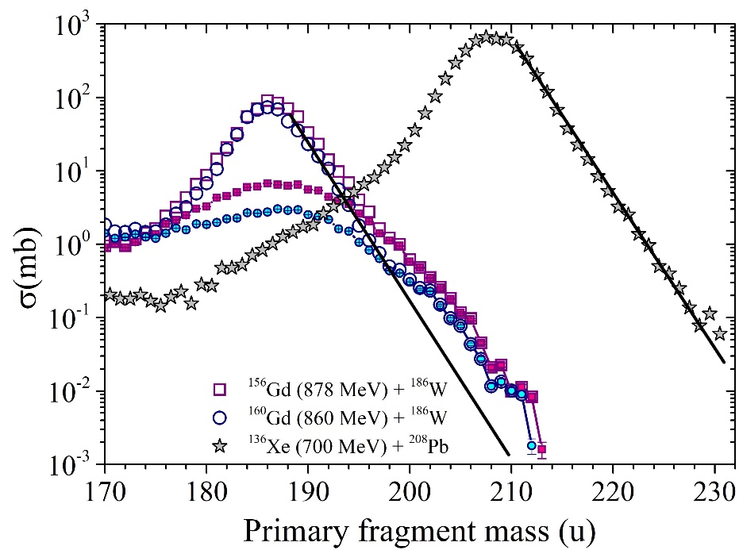
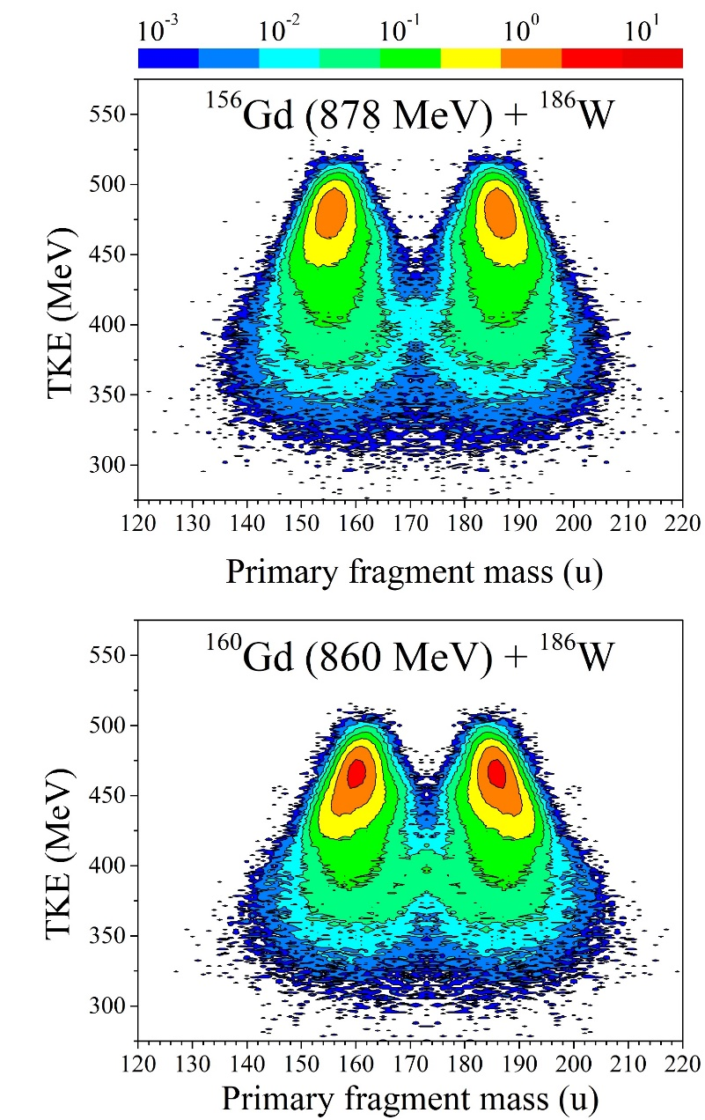
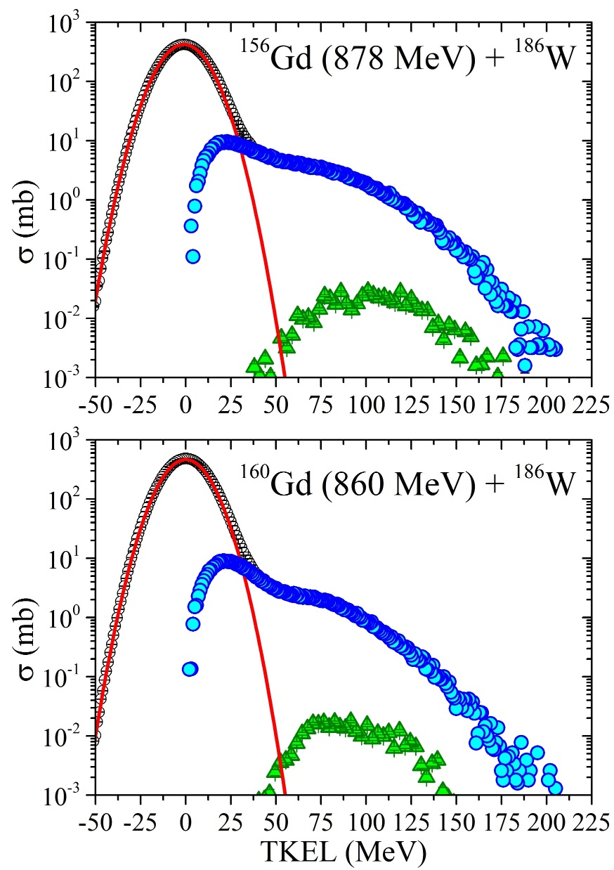
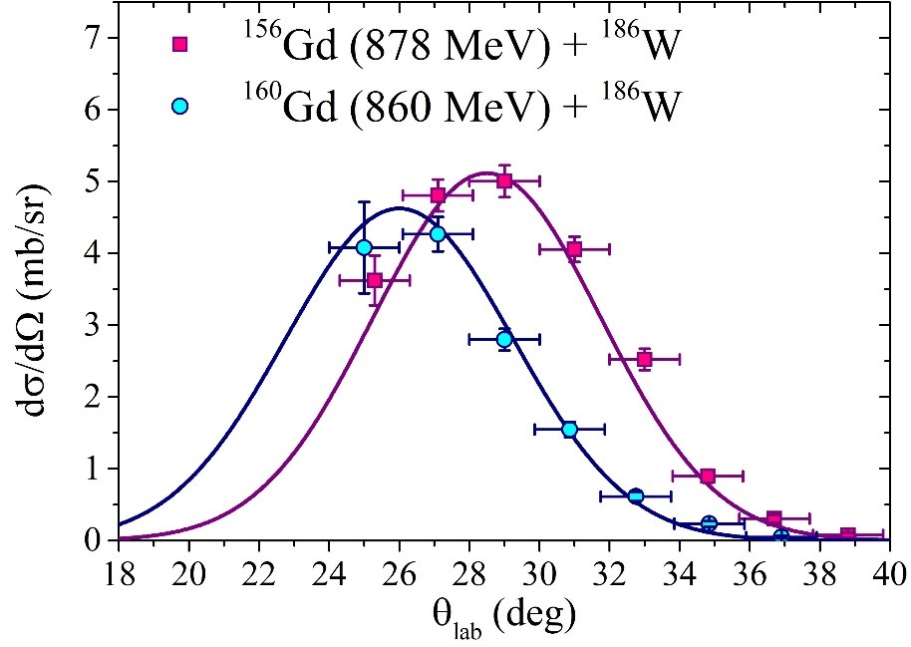
Primary MNT fragments formed in the W+Gd reactions
M >200 u
Angular distribution for lead-like fragments
M >200 u
θ_{Gr}
From E.M. Kozulin, V.I. Zagrebaev, G.N. Knyazheva et al., Phys. Rev. C 96, 064621 (2017)

Slide 7
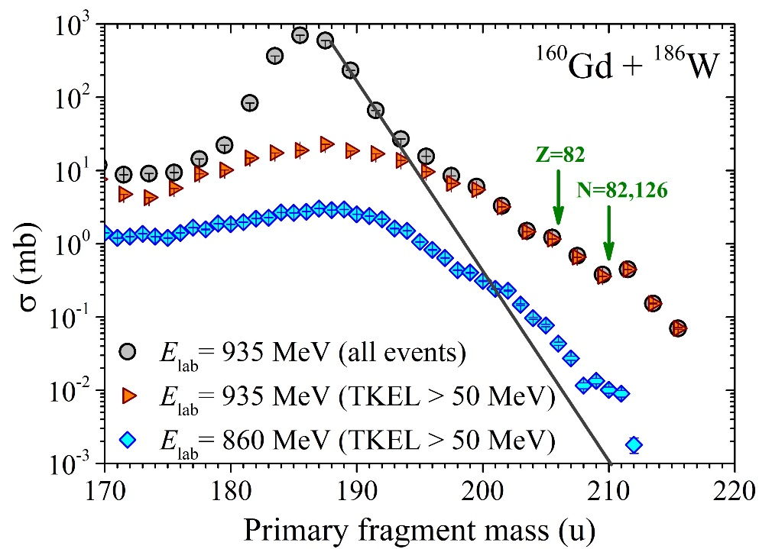
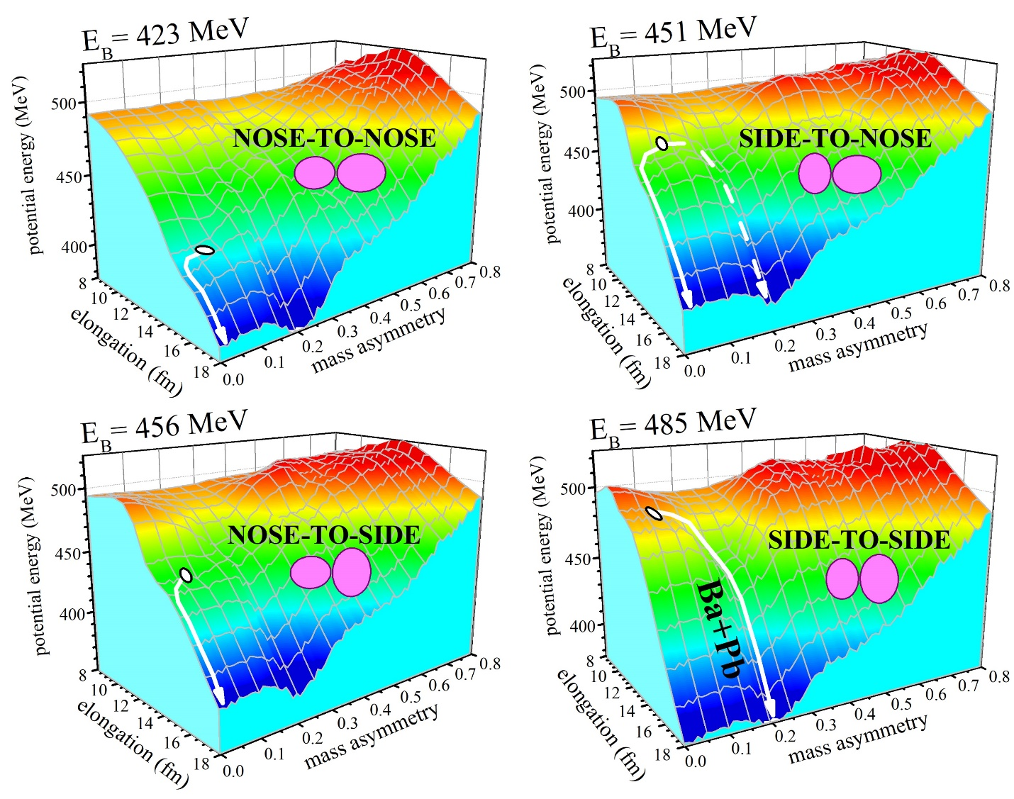
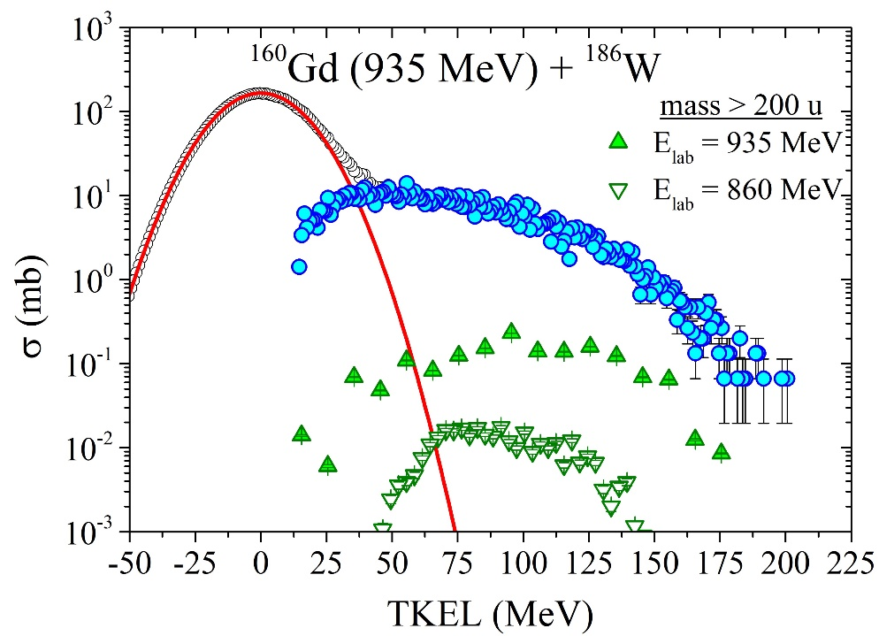
Orientation effect in the W+Gd reactions
50
Times!
Potential energy surfaces for the reaction ¹⁶⁰Gd+¹⁸⁶W calculated for nose-to-nose, nose-to-side, side-to-nose and side-to-side orientations of colliding nuclei. The barrier energies for these configurations are indicated at the top of each plot.

Slide 8
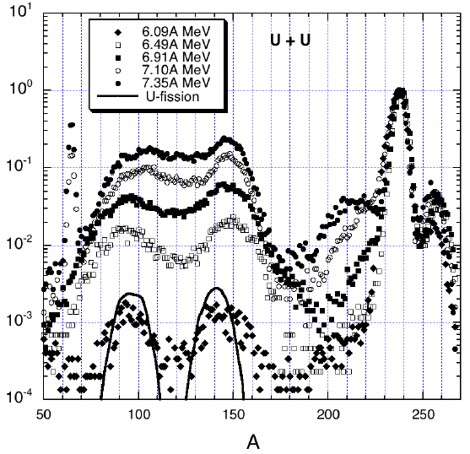
²³⁸U+²³⁸U experiment using VAMOS spectrometer
VAMOS spectrometer
S. Heinz et al., Ganil 2008

Slide 9
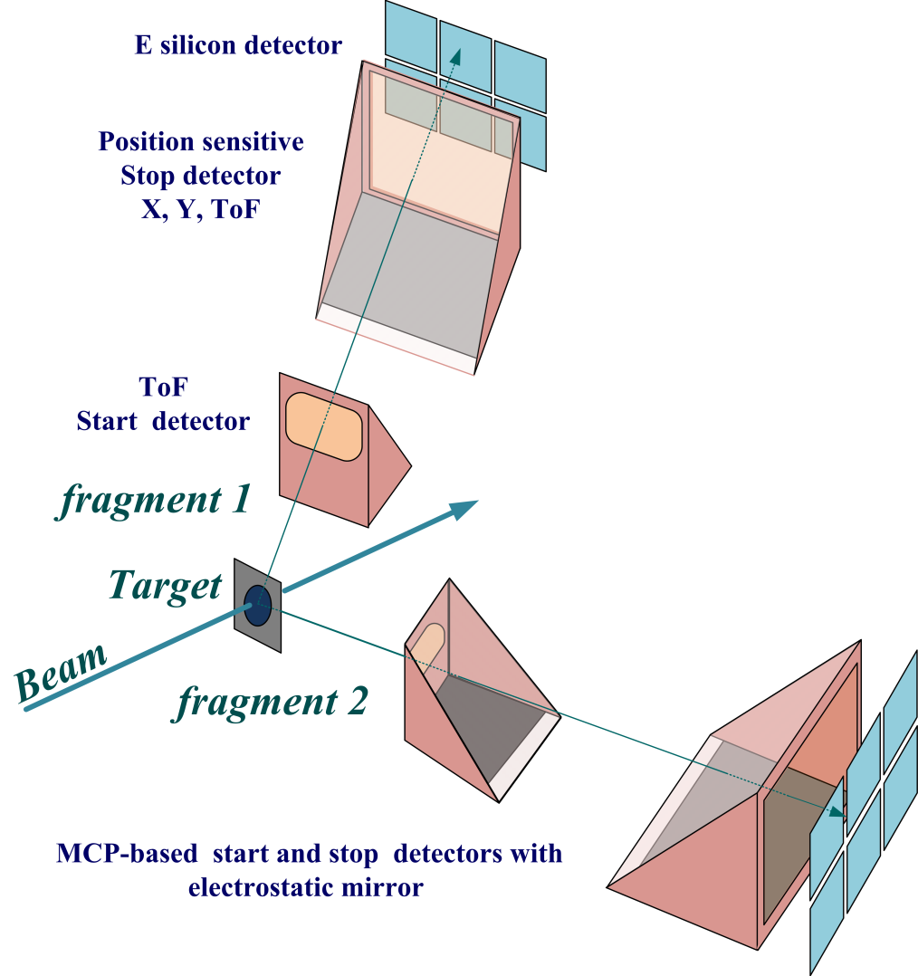
²³⁸U+²³⁸U (6.2 AMeV) test experiment using CORSET
The coincident measurement of both reaction fragments allows to increase the reliability of the selection of binary reaction channel from the other processes occurring in the ²³⁸U + ²³⁸U reaction.
Notes:
In 2015, in the framework of the collaboration between the FLNR (JINR) and IN2P3 - GANIL (Caen, France) a test experiment of a few UT's (T14-02) has been performed in G2 cave. The mass and energy distributions of fragments in the reaction ²³⁸U + ²³⁸U at an energy of 6.2 MeV/nucleon (Fig.(a)) have been measured using the double-arm time-of-flight spectrometer CORSET [4]. The high time and position resolutions of the spectrometer allow to investigate the fine structures in mass-energy and angular distributions of reaction products obtained in the heavy-ions-induced reactions. The obtained results show that the parameters of the spectrometer are appropriate for the investigation of the mass and energy distributions of the fragments formed in the reaction ²³⁸U+²³⁸U. The obtained experimental cross sections of fragments lighter than uranium are in a good agreement with the measurements performed with VAMOS spectrometer that proves the reliability of the measured mass distribution (Fig.(b)). In our measurements the cross section of the formation of transuranuim fragments was extended up to the fragments with masses 255 u. Fig.(b). The obtained cross section for these fragments is about 100 microbarn. This test shows that the resolution of the CORSET spectrometer allows one to distinguish unambiguously the U elastic from the Pb isotopes.

Slide 10
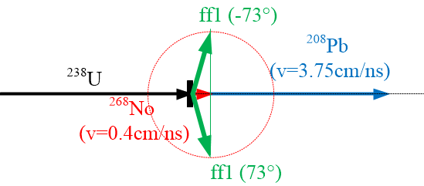
The study of MNT fragments formed in the reactions with ²³⁸U
Expected reaction channel
(due to the influence of the double magic lead shell)
²³⁸U+²³⁸U→²⁰⁸Pb+²⁶⁸No
The formed primary fragment ²⁶⁸No has rather high excitation.
The fission probability of this primary fragment is several orders of magnitude higher than its survival after deexcitation.
ff₁
ff₂
CORSET
Mass separator

Slide 11
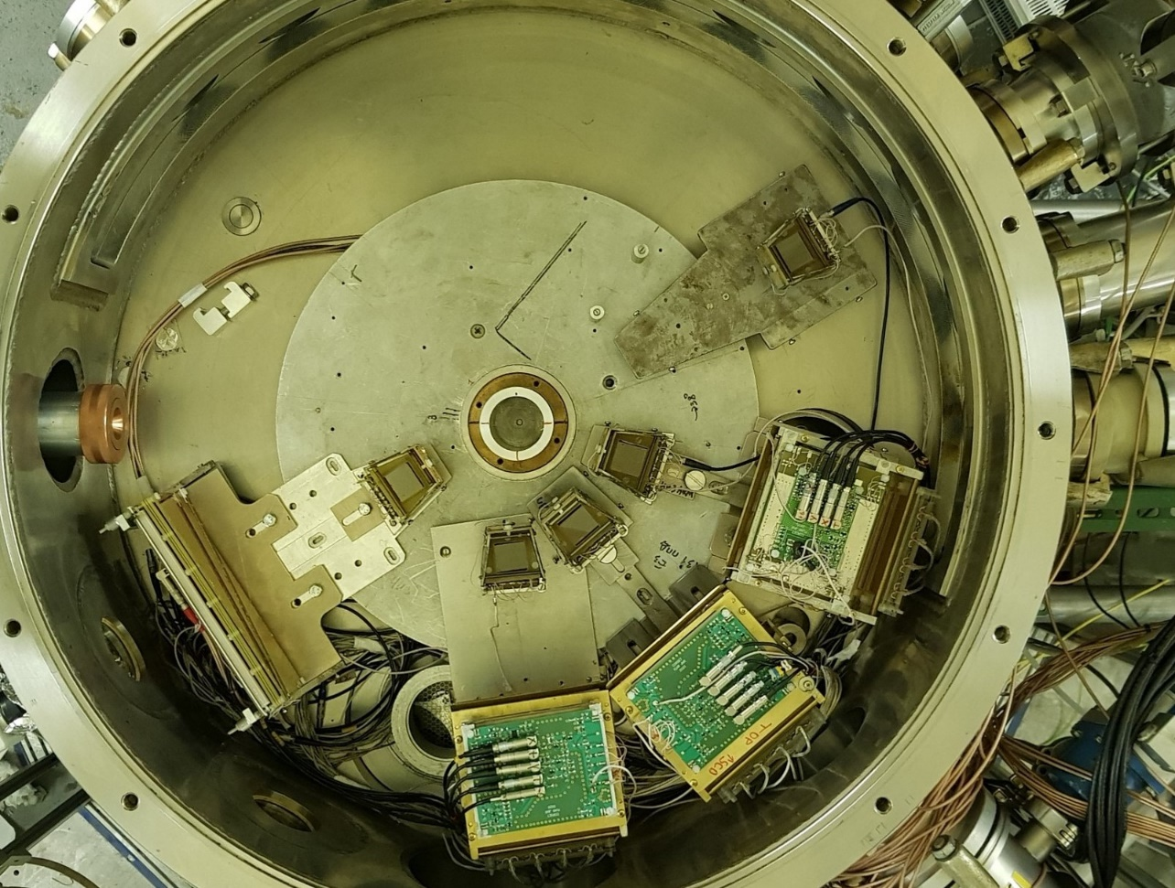
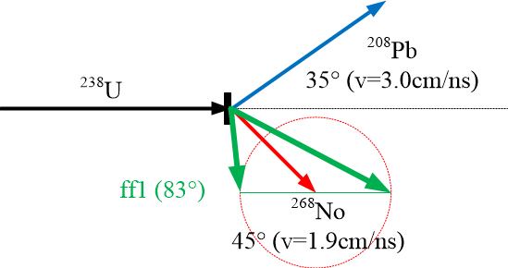
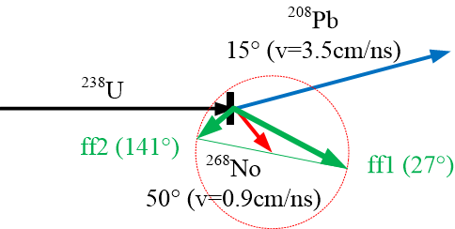
The study of MNT fragments formed in the reactions with ²³⁸U
²³⁸U + ²³⁸U
E_{lab} = 1666 MeV (7 AMeV)
CORSET
Mass separator

Slide 12
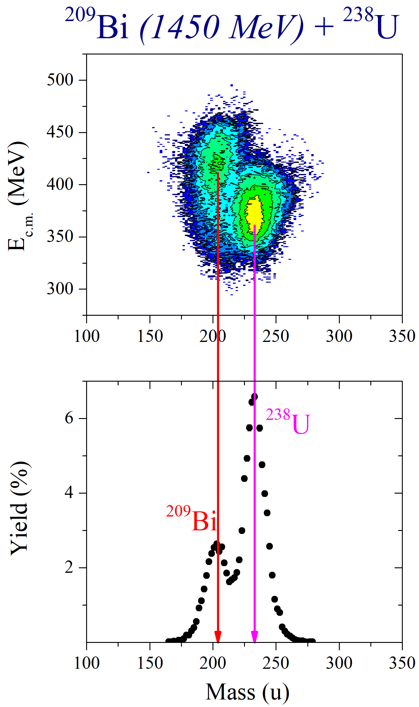
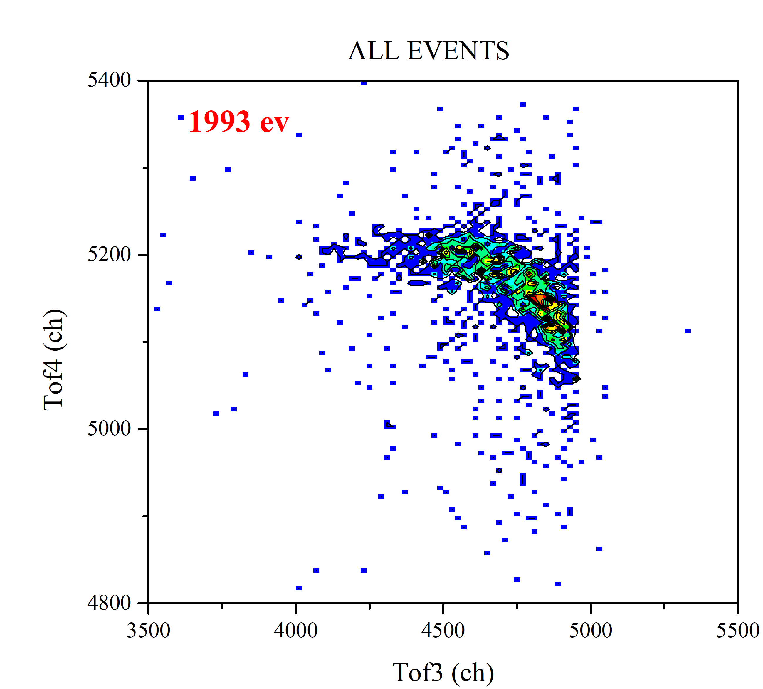
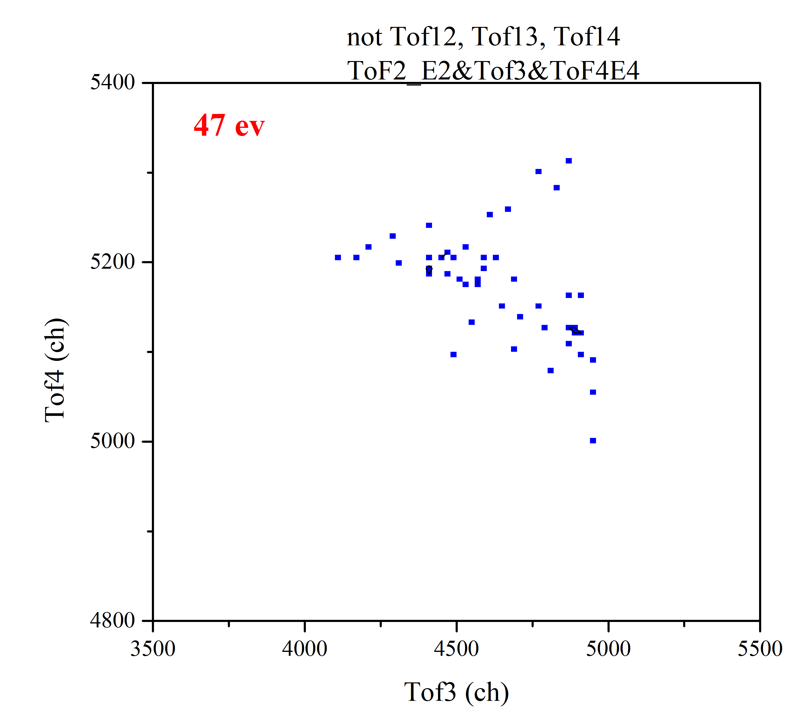
Test experiment ²⁰⁹Bi+²³⁸U
TLF (~Np)
ff
ff
PLF (~Pb)
θ_{grazing} (Bi) | 53°
Ntotal (TofE2) | 4×10⁶
N(PLF) TKEL>10MeV | 2×10⁵
N ff | ∼50
Efficiency ff | ∼0.06%

Slide 13
Conclusion
The experimental investigation of MNT reactions shows the enhanced yield of products with masses heavier than the target mass that conﬁrms the important role of the closed shells at Z = 82 and N = 82, 126 in inverse quasifission process in low-energy damped collisions. The orientation effect caused by the strong deformation of colliding nuclei can give a gain in the yield of heavy target-like fragments.
Thereby, low-energy multinucleon transfer reactions are a promising pathway for producing new neutron-rich isotopes. One of the advantages of the multinucleon transfer reactions is a narrow angular distribution of the reaction products, thus, for their registration it is not necessary to use wide-aperture spectrometers.
As a first step in this study the measurement of production cross section of nobelium nuclei (complementary fragment to double magic lead) in the reaction ²³⁸U+²³⁸U is necessary. Unfortunately, the survival probability of No isotopes formed in this reaction is several orders of magnitude lower that their decay via fission.
To study the formation of three fragments (lead-like fragment and both fission fragments of nobelium) the CORSET setup has been modified. The test experiment ²⁰⁹Bi+²³⁸U demonstrated that the spectrometer allows to measure mass and energy distributions of binary fragments, as well as three fragments (lead-like + sequential fission of No fragments).

Slide 14
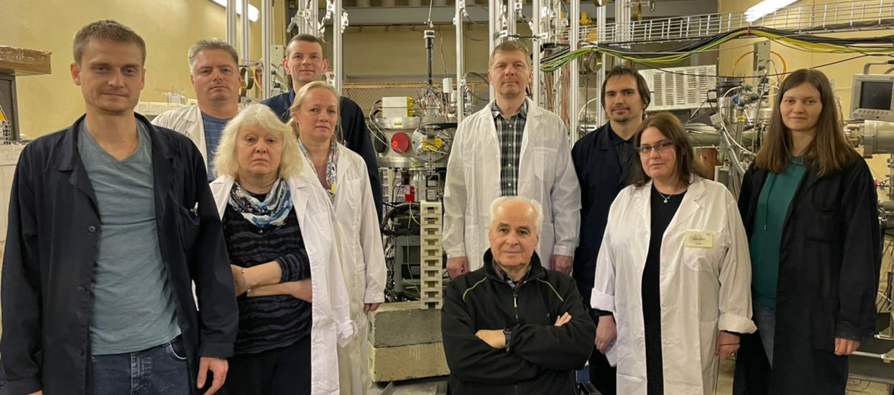
CORSET team
Thank you for your attention!

