Slide 1
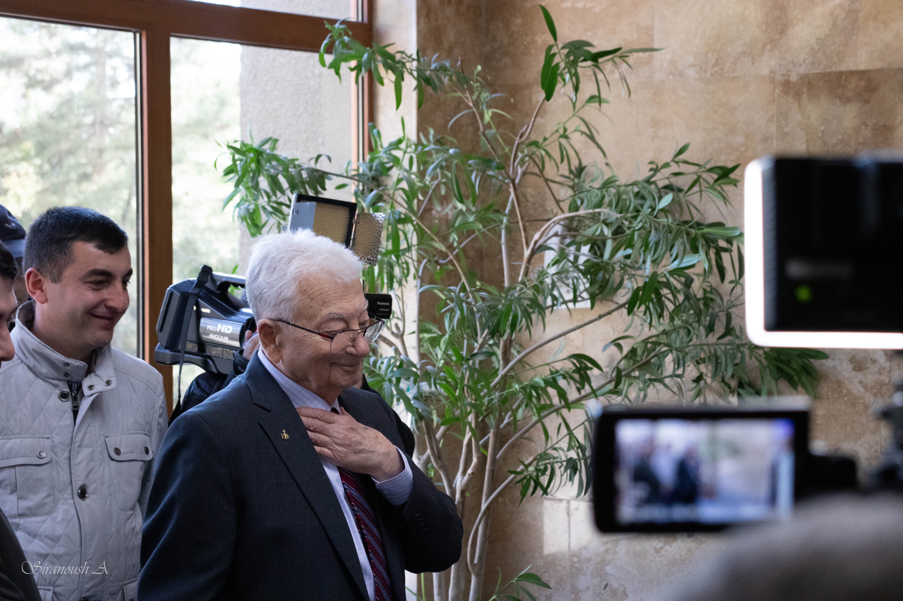
Superheavies in Space
Ani Aprahamian
Alikhanyan National Science Laboratory of Armenia (YerPhi)
University of Notre Dame, Notre Dame, IN USA
Science Brings Nations Together
IUPAP Conference “Heaviest nuclei and atoms”
April 25-29, 2023
Notes:
It is a special honor for me to be here with all of you to celebrate the 90th birthday of Yuri Oganessian…
Science Brings Nations Together….has been the motto of Yuri’s work…and appropriate that we recognize it today…

Slide 2
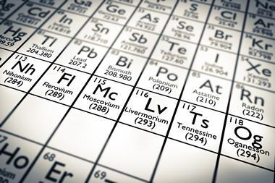
Science Brings Nations Together
From ⁴⁸Ca induced reactions
Z=174

Slide 3


YerPhi
Science Brings Nations Together
IUPAP Conference “Heaviest nuclei and atoms”
April 25-29, 2023

Slide 4
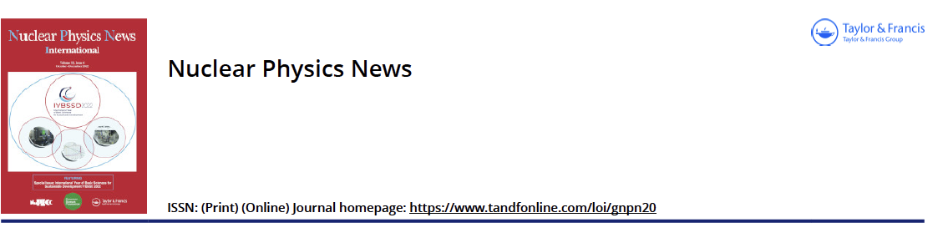
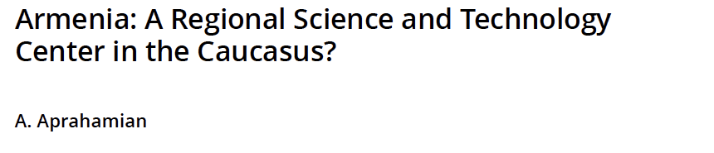

Slide 5
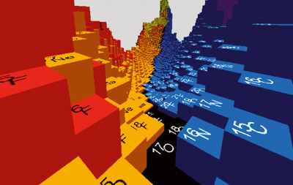
Superheavies
In
Space
Notes:
Fission has been studied for over 80 years now…..but new interest and research revealed many new aspects!

Slide 6
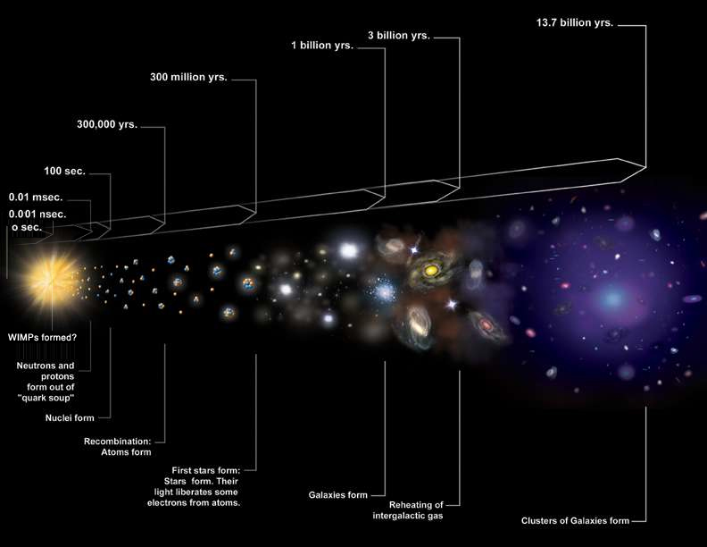
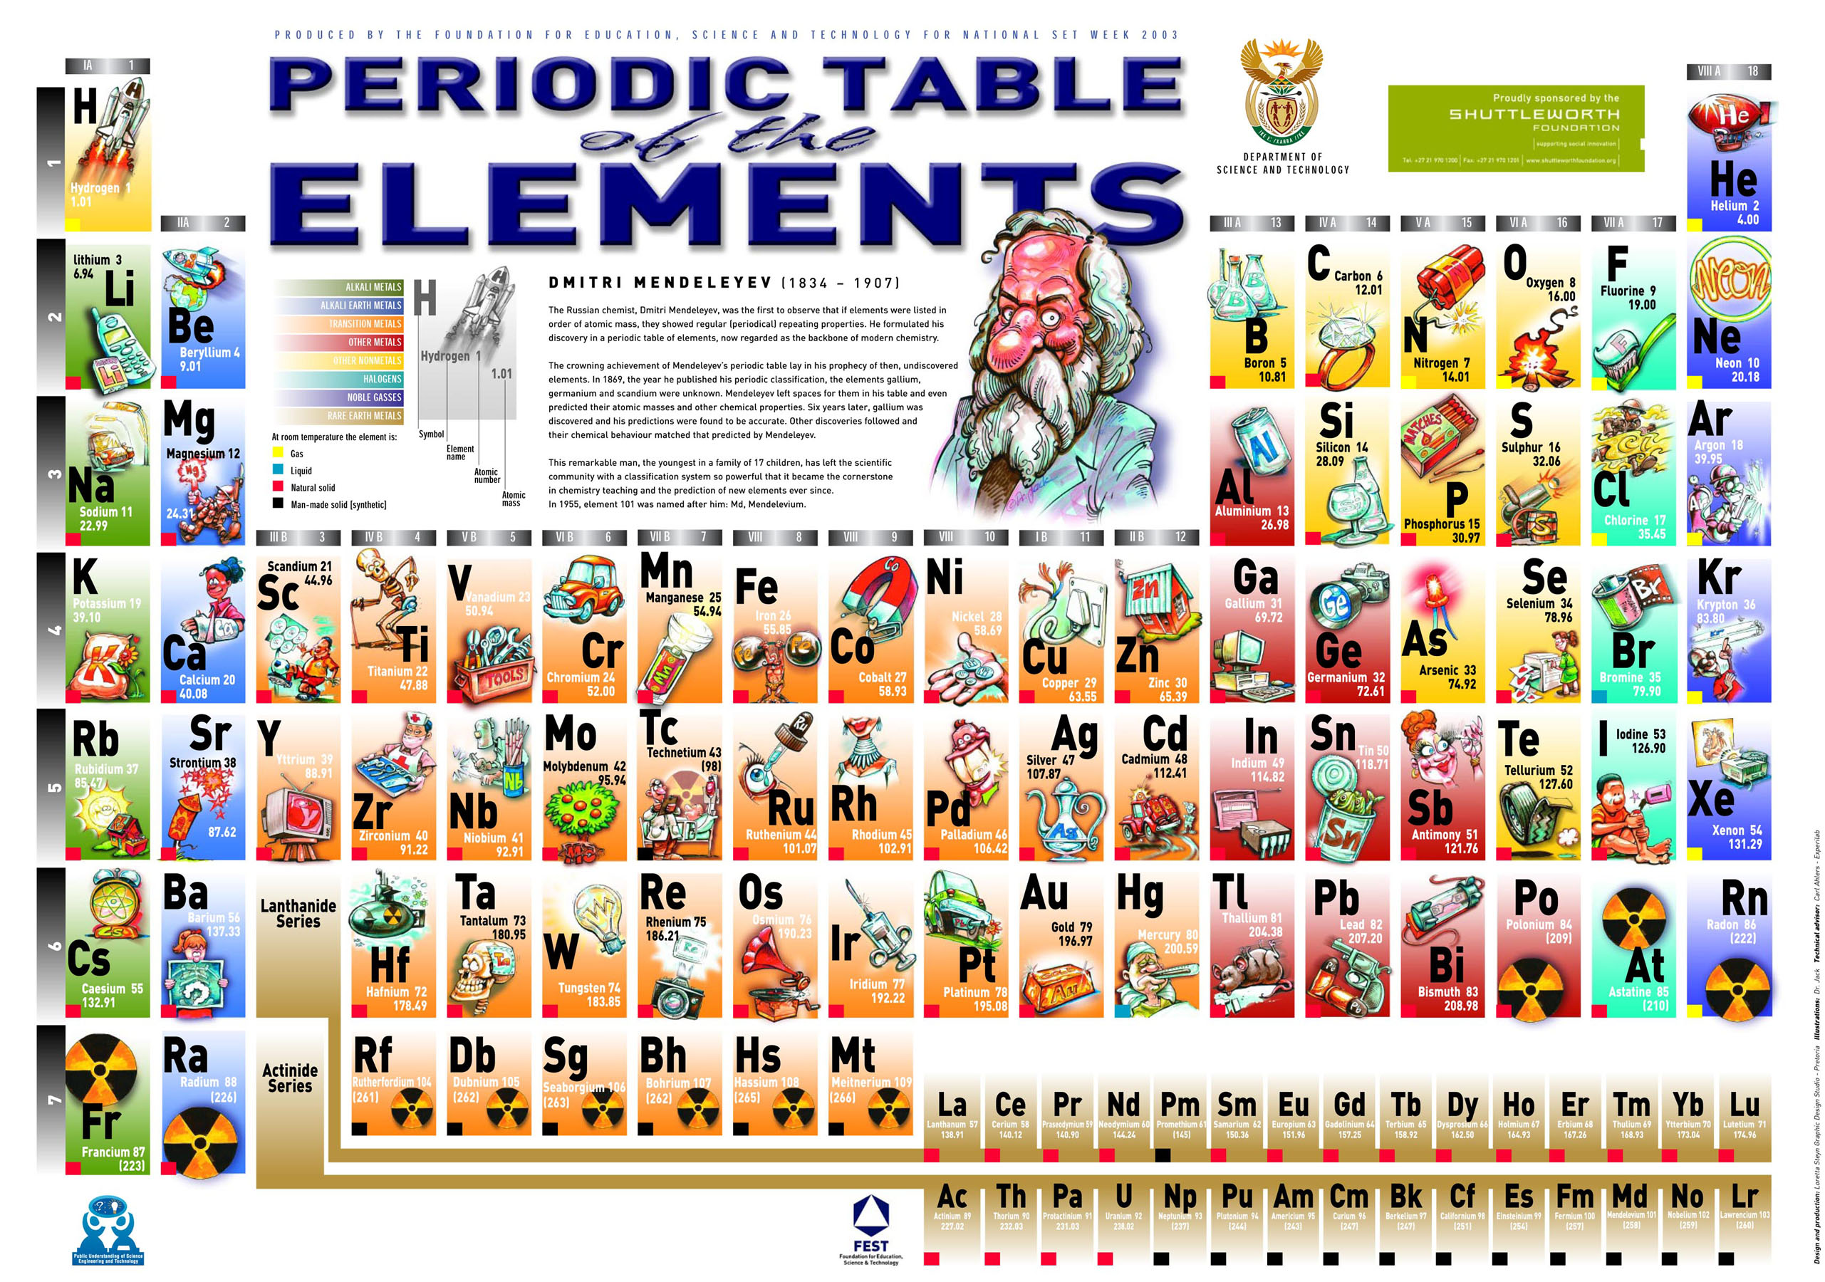
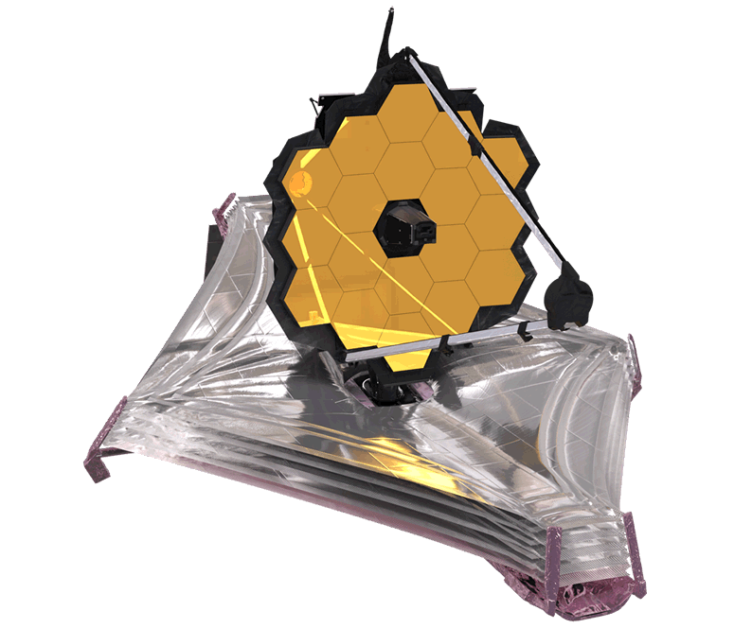
James Webb
Notes:
THE TIME LINE OF THE UNIVERSE….SHORTLY AFTER THE BIG BANG…NUETRONS AND PROTONS FORM…THE PRIMORDIAL ELEMENTS…STARS…
THE EVOLUTION OF STARS TO THE PRESENT DAY SYSNTHESIS OF THE ELEMENTS AS WE KNOW IT TODAY…

Slide 7
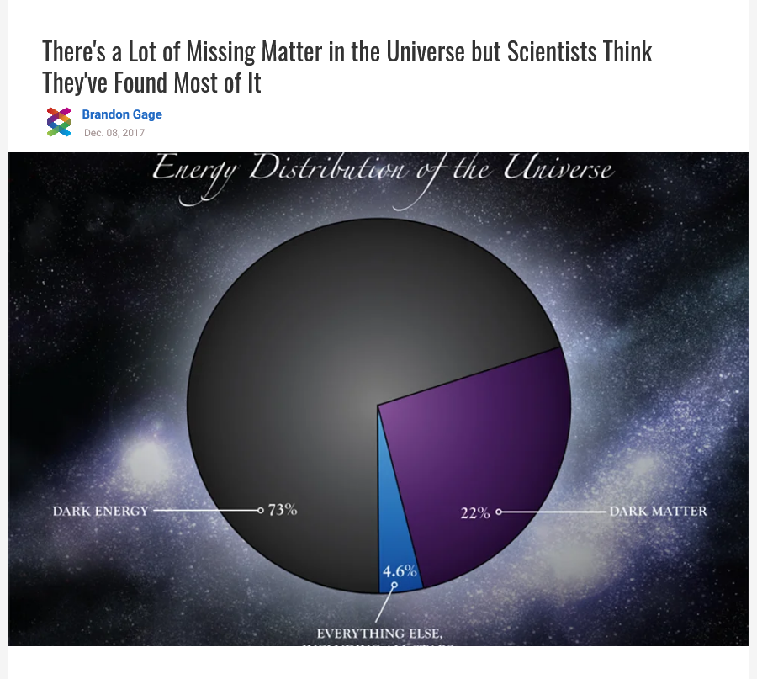
Big Overarching Science Questions
The fate of baryonic matter
The origin of biological elements
The chemical evolution of our universe
Baryonic Matter
Notes:
…the energy distribution of the cosmos….leaves us less than 5% of the visible universe to solve the
the overarching astrophysical questions…..

Slide 8
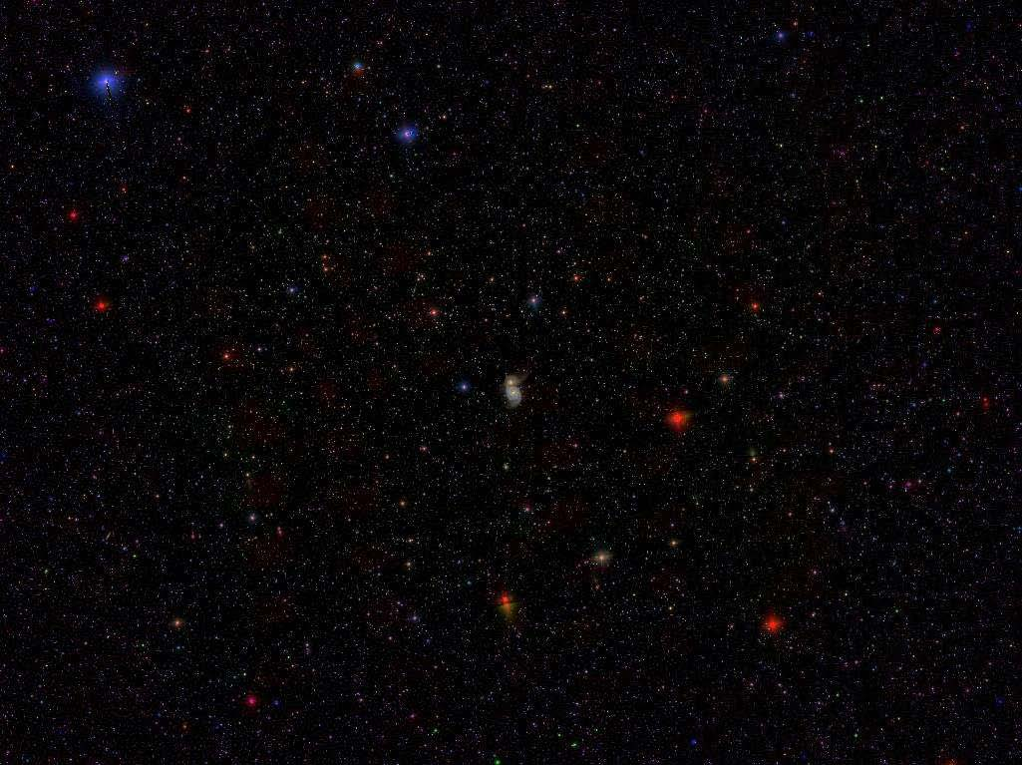
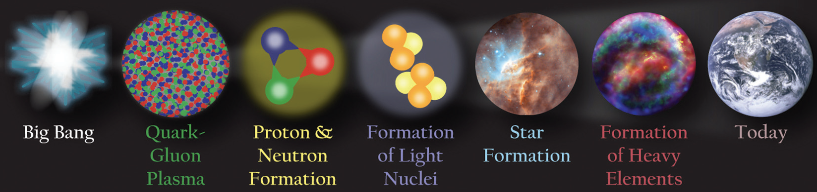
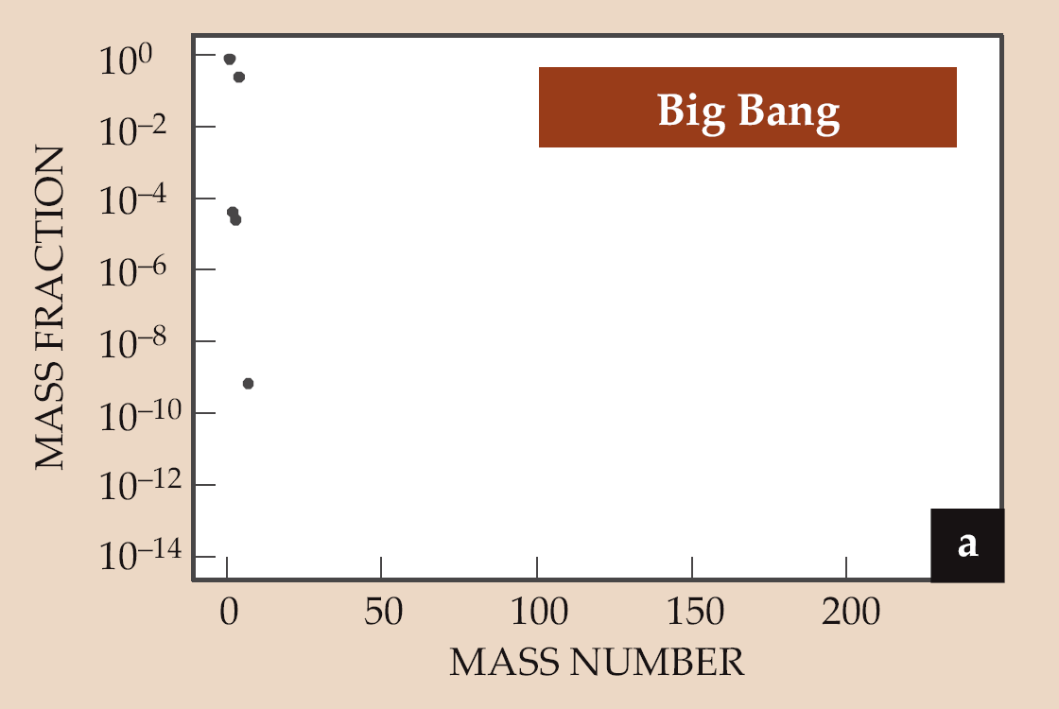
How were elements Fe to U made?
Notes:
Over 99.9 percent of the mass of all the universe comes from the nuclei found at the center of every atom. These nuclei are made of protons and neutrons that themselves formed a few microseconds after the big bang as the primordial liquid known as quark-gluon plasma cooled and condensed. bEntire history of the universe entangled with the nuclear physics….Welll we know what the nuclear physics has to be….neutron induced and prominent features that can be related to nuclear physics
Use..observed abundance pattern to understand….process…

Slide 9
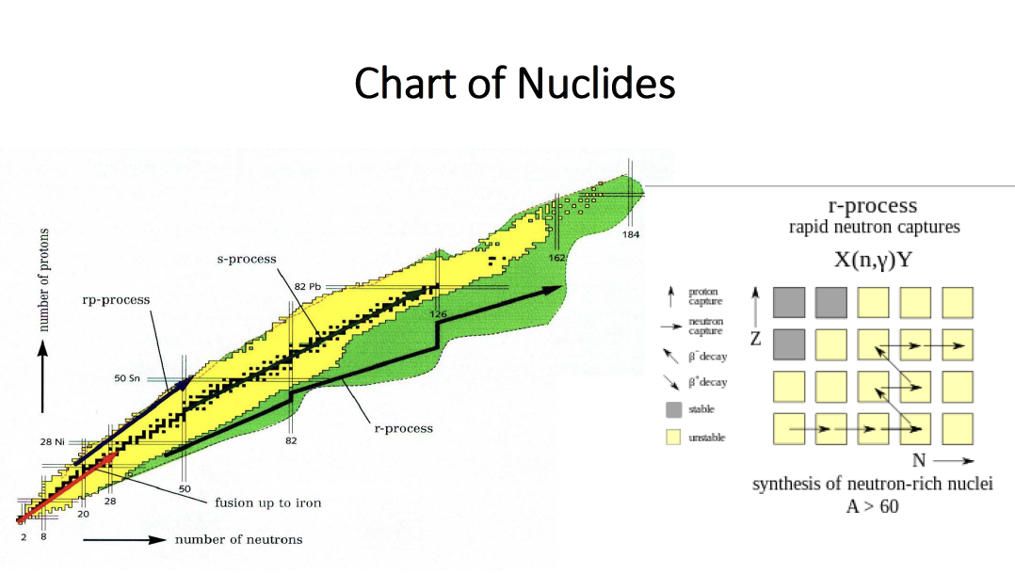
Slow and Rapid Neutron Capture

Slide 10
Reactions of synthesis
Act.+⁴⁸Ca
Cold fusion
Nh
Light ions
Neutron
capture
Yu. Oganessian SHE – meeting at JINR, June30 – July2, 2021, Dubna, Moscow reg.
Notes:
10
10
Let's look at the situation with popular picture, which shows: the end of the “continent” of stable nuclei, the Th and U “peninsula” along with neighboring transuranic elements and the mystical “Island of Stability”. What ship (reaction) could be taken to sail to this Island?
1. The synthesis of nuclei in sequential neutron capture in high-flux nuclear
reactors or even in huge neutron fluxes of nuclear explosions does not
allow move further than fermium-257.
2. The use of light ions (up to neon) allows us to travel only half the way to
the coveted Island.
3. In the reactions of cold fusion of massive nuclei with great difficulty only
three atoms of element 113 were obtained. But they are located much to
the left of Stability Island.
There are too few neutrons in colliding nuclei. This is a fundamental limitation for this method of synthesis.

Slide 11

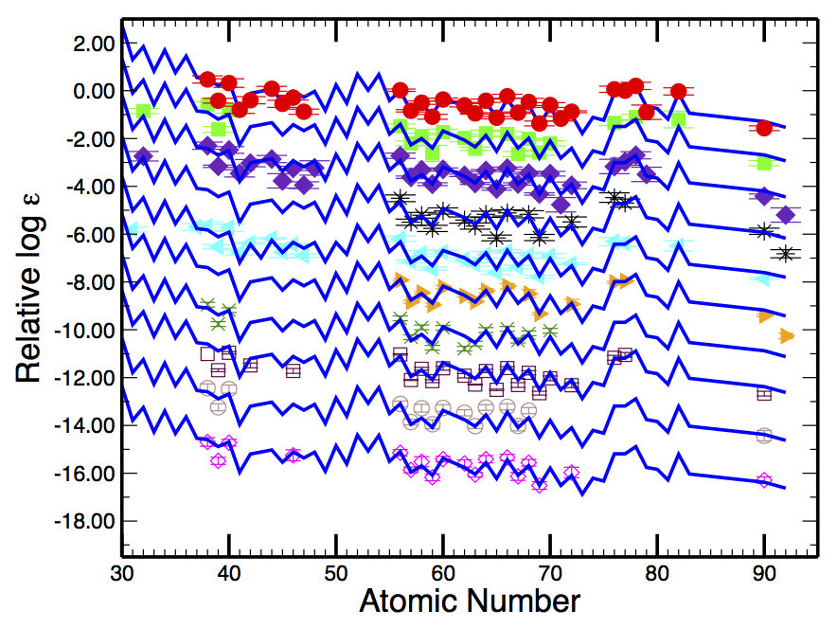
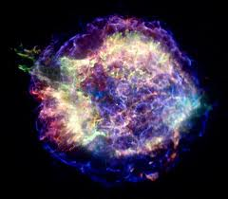
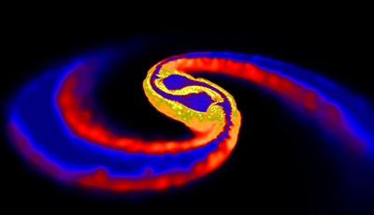


r-process
Cowan et al. 2011
Origin of more than 50% of all the elements beyond iron
Site of r-process is still one of open challenges in all of physics today
Temperature, density as a function of time, initial compositions, neutrons
Notes:
Boromean rings represent the three foci of my research…the Materials is 20% of effort and not funded by NSF….Structure and Astrophysics 40% each…
Each ring or area of research is focused on the developmentof new technologies or tools to investigate the relevant problems

Slide 12
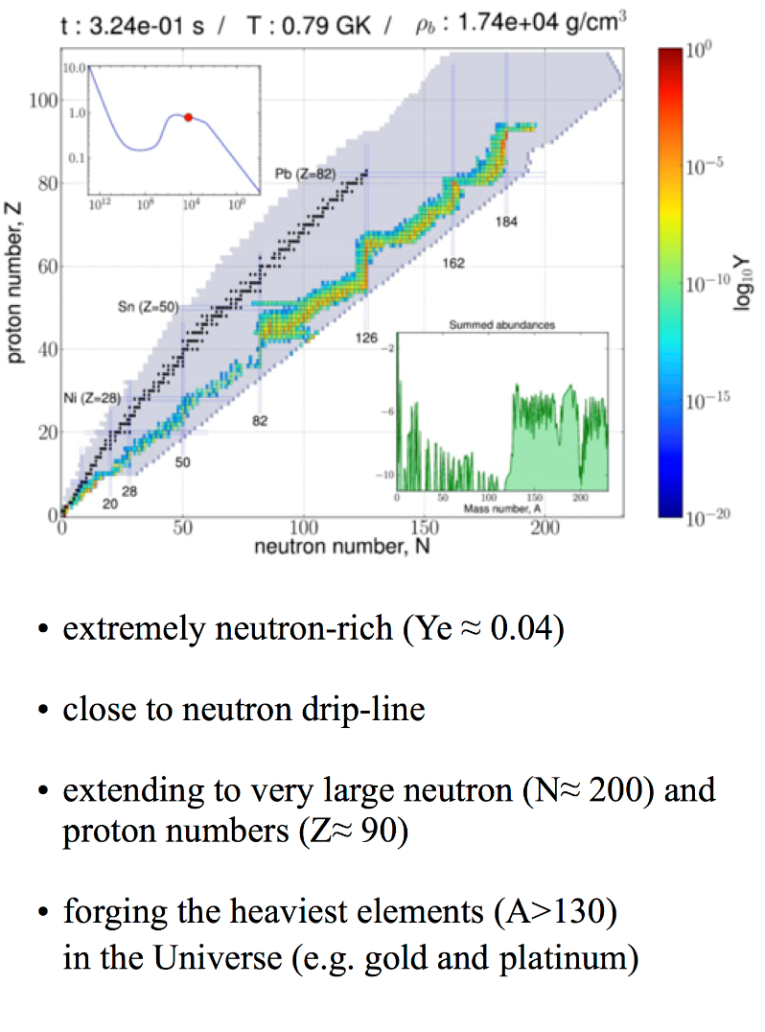

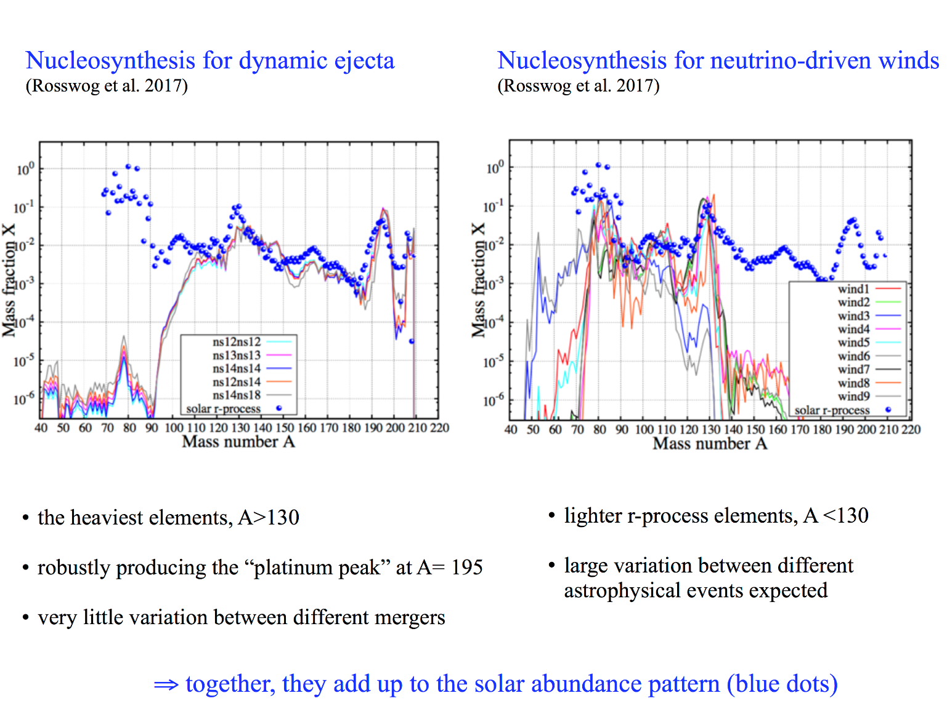
The science question over the last decades – the site of the r-process
Merging neutron stars versus core collapse supernovae, gravitational wave detection identified neutron star mergers as source of the very heavy elements!

Slide 13
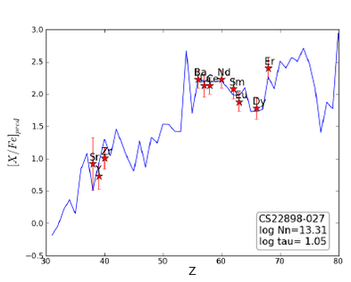
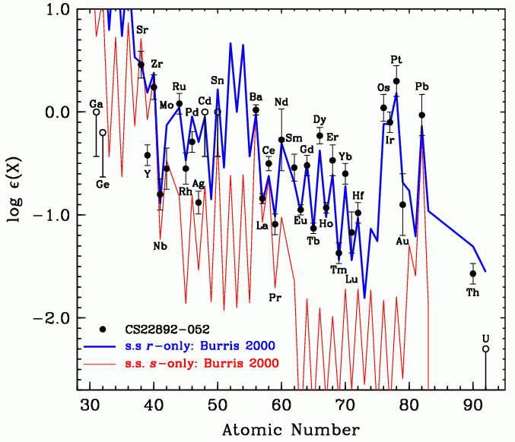
Abundances from other neutron induced nucleosynthesis processes
The s-process in comparison to the r-process.
The scaling depends on the strength of the
s-process neutron source
The i-process in CEMP stars, again the scale depends on the strength of neutron source

Slide 14
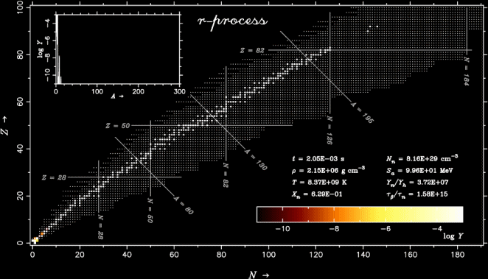

Slide 15
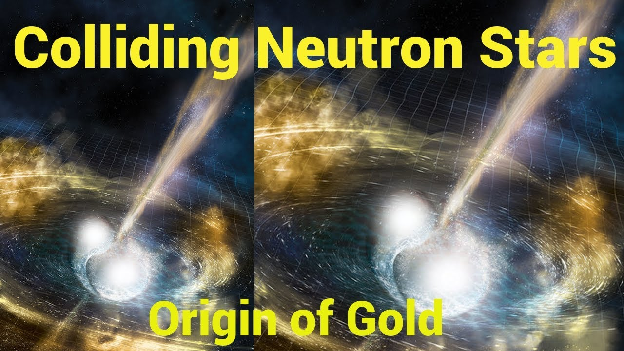
?
GW170817
Notes:
The merger event…..The 21st century is young….and the simultaneous observation of gravitational waves and light…..
may yet be one of the greatest scientific observations of our
Century…
But scientists were not the only ones who were excited about this…..there were also clever financial specialists paying attention…

Slide 16
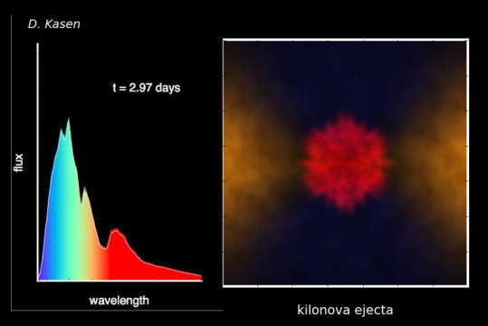
70 Electromagnetic Transients …Light
Notes:
Question arise…..establish that a merger is a potential site for the r-process….

Slide 17
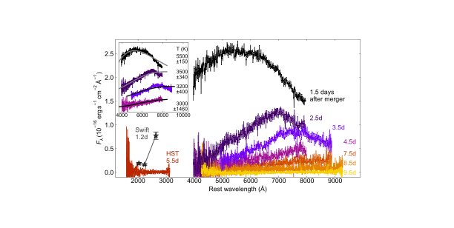
Lu visible signatures go into the IR
Big Question: Fission

Slide 18
What is the Role
of
Nuclear Fission?
Actinides?
Notes:
Fission has been studied for over 80 years now…..but new interest and research revealed many new aspects!

Slide 19
Macro – microscopic theory
(Liquid Drop energy + Shell corrections)
120
Z
²⁹⁸Fl
110
²⁷⁰Hs
²⁵²Fm
Island of SHE
100
²³⁸U
90
140
150
160
170
N
180
190
Yu. Oganessian SHE – meeting at JINR, June30 – July2, 2021, Dubna, Moscow reg.

Slide 20
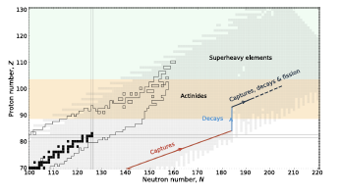
E. M. Holmbeck, European Physical Journal A, 59:28 (2023)

Slide 21
Are superheavy elements produced in the r-process?
Notes:
Blinnikov mentioned the Lattimer and Schramm….predictions….

Slide 22
r-process idea from weapons tests: B²FH
Reviews of Modern Physics 29(4),547 (1957)
Z=99 Es
Z=100 Fm
R. Hoff, August 21, 1978
Neutron star: 10⁴³ or 10⁴¹ neutrons/cm²

Slide 23
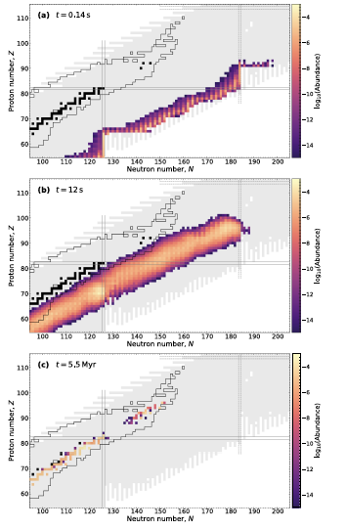
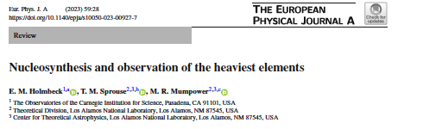
Snapshots of Simulations
Input is limited to what we know

Slide 24
Did the r-process go
to the actinides?
Evidence?
²³²Th: 14 billion years
²³⁵U: 700 million years
²³⁸U: 4.5 billion years
Input to Z=110
A=290 produced
Notes:
How far did it go? And what are the signatures? Fission and fission barriers and fission fragment distributions are all input theoretically
Experiments…focused on short lived fission products…
Long lived ones expensive to measure and difficutl

Slide 25
Open Challenges to Nuclear Physics
resulting from the neutron star merger
Aprahamian
NuPECC in Sept. 2021

Slide 26
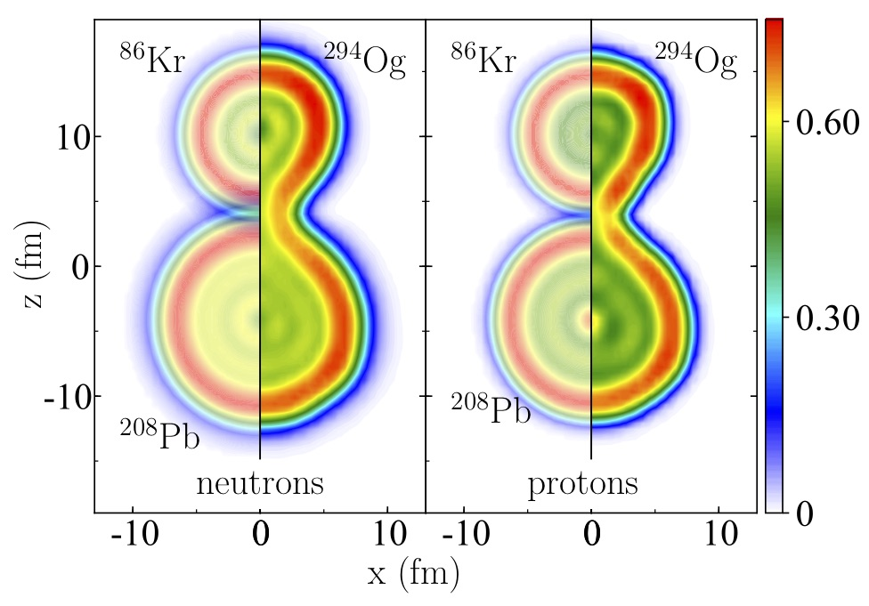
Cluster decay becomes the main fission mode
²⁹⁴Og→ ²⁰⁸Pb+⁸⁶Kr₅₀
Z. Matheson et al., Phys. Rev. C 99, 041304(R) (2019)
Robust prediction: extremely asymmetric fission
Courtesy of W. Nazarewicz

Slide 28
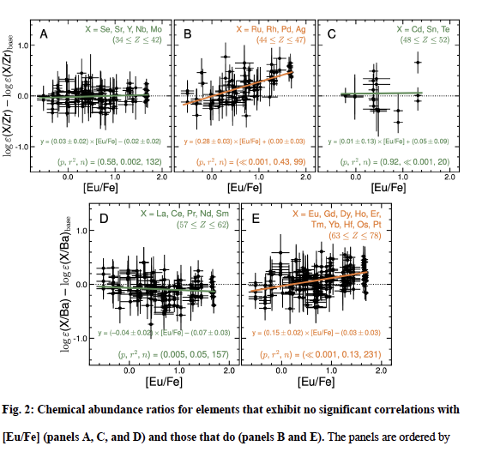

Observations of r-process enhanced Stars
Ru, Rh, Pd, Ag
Eu, Gd, Dy, Ho, Er,
Tm, Yb, Hf, Os, Pt

Slide 29
Conclusion: Superheavies are most probably made in the r-process!
Questions Remain
Did the merger indeed make the actinides?
How far did the nucleosynthesis go?
What is the role of fission ?
What type of fission?
Were the superheavies populated?
Are there more robust signatures that we could look for?
Fission: LLNL – DUBNA – AANL
Fission: LLNL – DUBNA – AANL

Slide 30

Yuri Ts. Oganessian

Slide 31
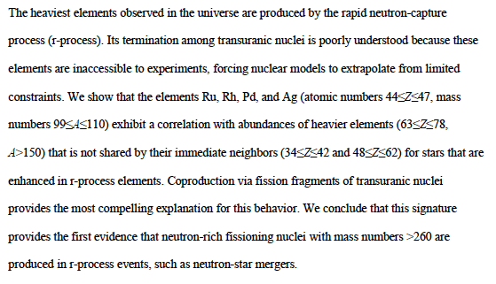
Ranking of 10 longest-lived isotopes:
106Ru
103Ru
111Ag
105Rh
112 Pd
109 Pd
113 Ag
105 Ru
112Ag
111Pd
107Rh

Slide 32


Slide 33
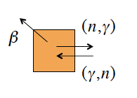
R-process Sensitivity Studies
How do you decide which nuclei to measure
What is the required precision?
Nuclear masses
β-decay rates
n- capture
β-delayed n-emission
Fission
Notes:
Boromean rings represent the three foci of my research…the Materials is 20% of effort and not funded by NSF….Structure and Astrophysics 40% each…
Each ring or area of research is focused on the developmentof new technologies or tools to investigate the relevant problems

Slide 34
 | Ranking of 10 longest-lived isotopes:
 | 106Ru | 374 days
 | 103Ru | 39 days
 | 111Ag | 7.45 d
 | 105Rh
 | 112 Pd
 | 109 Pd
 | 113 Ag
 | 105 Ru
 | 112Ag
 | 111Pd
 | 107Rh

Slide 35
Experimental reach for the present and future…
Radioactive Ion Beam Facilities
RIKEN
CPT at CARIBU
ISAC at TRIUMF
★
Mumpower, Surman, McLaughlin, Aprahamian
Progress in Particle and Nuclear Physics 86, 2016 Tables available: F values

Slide 36
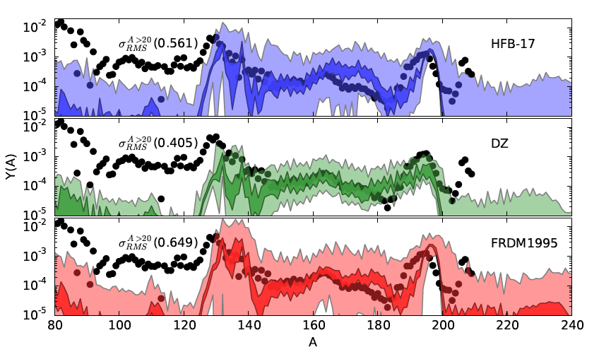
Hot r-process trajectory
Mumpower, Surman, Aprahamian, CGS15 proceedings
Uncorrelated nuclear mass uncertainties and r-process abundance predictions

Slide 37
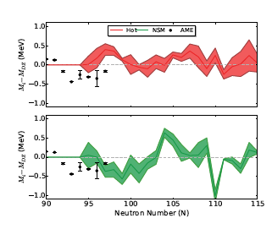
Mumpower, McLaughlin, Surman, and Steiner, Ap. J. 2016

Slide 38
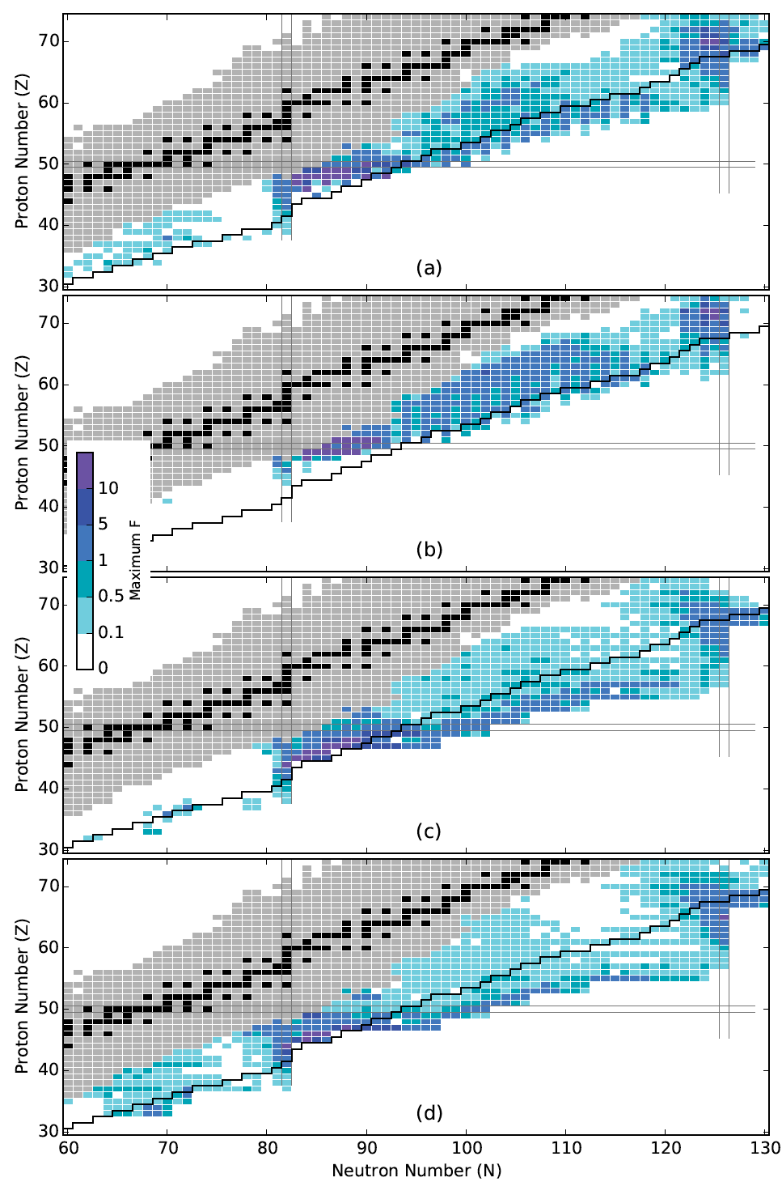
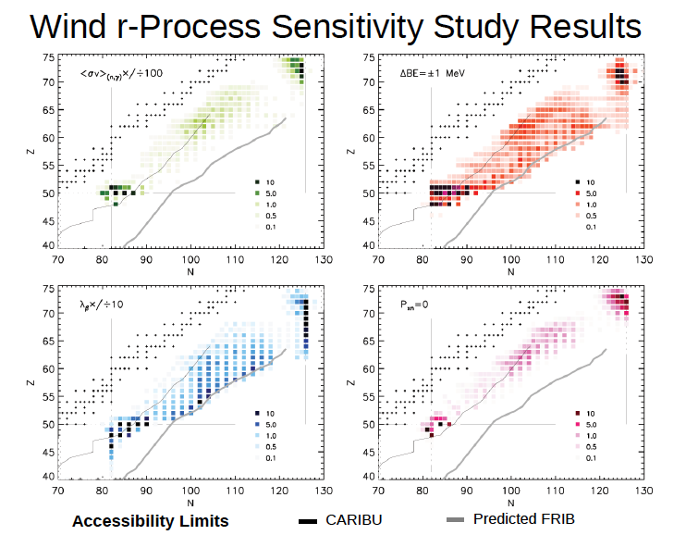
Mumpower, Surman, McLaughlin, Aprahamian
Progress in Particle and Nuclear Physics 86, 2016
F- values available and provide motivations to rib facilities worldwide
FRIB
Low entropy hot wind
High entropy hot wind
Cold wind
Neutron Star Merger
Notes:
Which nuclei to measure and how precisely…

Slide 39
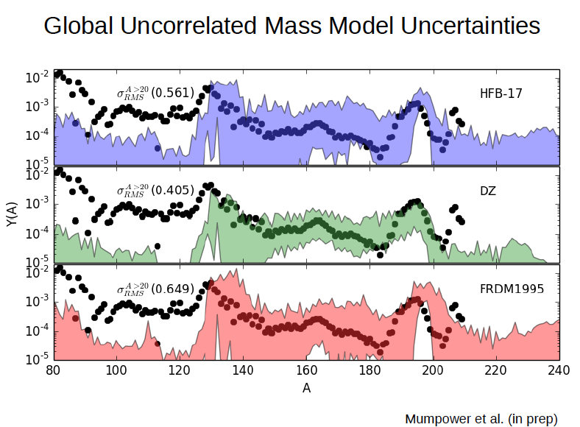
ΔBE=+/- 0.5 MeV
Notes:
Boromean rings represent the three foci of my research…the Materials is 20% of effort and not funded by NSF….Structure and Astrophysics 40% each…
Each ring or area of research is focused on the developmentof new technologies or tools to investigate the relevant problems

Slide 42
The precision required to measure masses
Hot r-process trajectory rms error reduced to 100 keV
Mumpower, Surman, McLaughlin, Aprahamian
Progress in Particle and Nuclear Physics 86, 2016
Notes:
Boromean rings represent the three foci of my research…the Materials is 20% of effort and not funded by NSF….Structure and Astrophysics 40% each…
Each ring or area of research is focused on the developmentof new technologies or tools to investigate the relevant problems

Slide 43
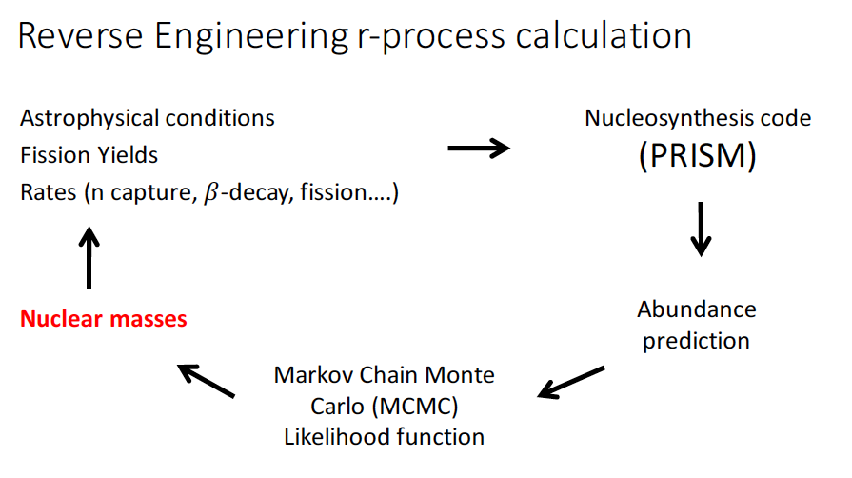
Using Nuclear Properties to predict site of an r-process
Mumpower, McLaughlin, Surman, and Steiner
J. Phys. G: Nucl. Part. Phys. 44, 034003 (2017)
Notes:
Boromean rings represent the three foci of my research…the Materials is 20% of effort and not funded by NSF….Structure and Astrophysics 40% each…
Each ring or area of research is focused on the developmentof new technologies or tools to investigate the relevant problems

Slide 44
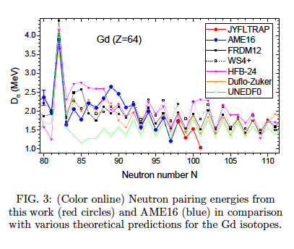
TOF-ICR: JyFLTRAP
Phys. Rev. Lett. 120, 262701, 2018
Notes:
Boromean rings represent the three foci of my research…the Materials is 20% of effort and not funded by NSF….Structure and Astrophysics 40% each…
Each ring or area of research is focused on the developmentof new technologies or tools to investigate the relevant problems

Slide 45
Orford et al., Phys. Rev. Lett. 120, 262702 (2018)
Merger accretion disk wind scenario
Varying thermodynamics has little effect
Notes:
Varying thermodynamics has little impact….the masses make a huge difference….

Slide 46
Future Measurements of Masses
Beta-Delayed Neutrion Emission Probabilities
R-process Sensitivities and Measurements
How do you decide which nuclei to measure
What is the required precision?
Courtesy of N. Vassh
Notes:
Boromean rings represent the three foci of my research…the Materials is 20% of effort and not funded by NSF….Structure and Astrophysics 40% each…
Each ring or area of research is focused on the developmentof new technologies or tools to investigate the relevant problems

Slide 47
Windows on the Universe
GW170817
~ 70 other electromagnetic observatories
Notes:
Boromean rings represent the three foci of my research…the Materials is 20% of effort and not funded by NSF….Structure and Astrophysics 40% each…
Each ring or area of research is focused on the developmentof new technologies or tools to investigate the relevant problems

Slide 48
Implications to nuclear physics
Notes:
Boromean rings represent the three foci of my research…the Materials is 20% of effort and not funded by NSF….Structure and Astrophysics 40% each…
Each ring or area of research is focused on the developmentof new technologies or tools to investigate the relevant problems

Slide 49
Many questions answered but many others remain:
Emerging New Areas:
Notes:
Boromean rings represent the three foci of my research…the Materials is 20% of effort and not funded by NSF….Structure and Astrophysics 40% each…
Each ring or area of research is focused on the developmentof new technologies or tools to investigate the relevant problems

Slide 50
Are superheavies made in the r-process?
Notes:
Boromean rings represent the three foci of my research…the Materials is 20% of effort and not funded by NSF….Structure and Astrophysics 40% each…
Each ring or area of research is focused on the developmentof new technologies or tools to investigate the relevant problems

Slide 51
Are there other longer lived fission products that can
prove the population of the actinides?
Notes:
Exotic fission modes?

