Slide 1


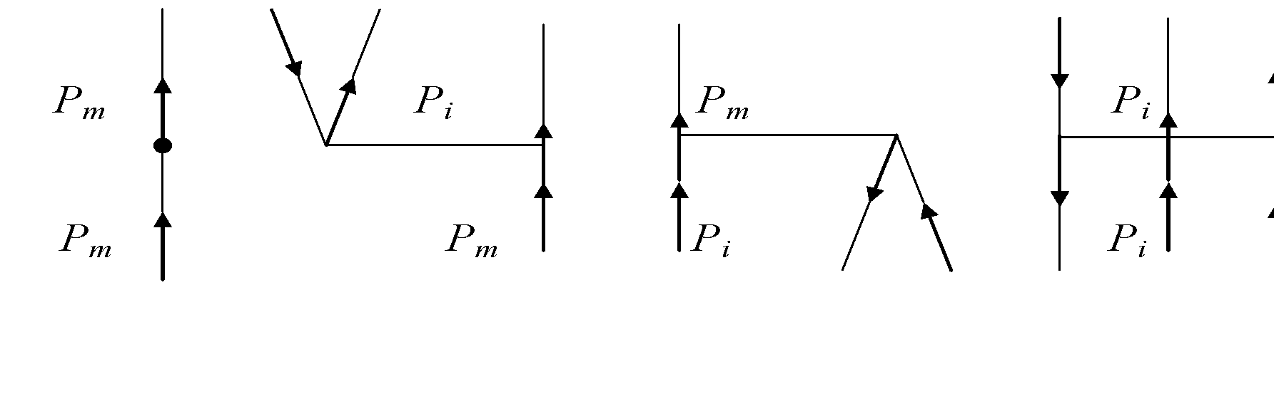
IUPAP Conference “Heaviest nuclei and atoms”, April 25-30, 2023
National Academy of Science of the Republic of Armenia, Yerevan
Ephraim Eliav
Benchmark atomic electronic structures calculations at the edge of Periodic Table
26 April 2023

Slide 2
What are we interested in?
Heavy and superheavy (Z > 100) atoms and ions
Basic properties: ionization potentials (IPs), electron affinities (EAs), spectra, polarizabilities (α), PNC , hyper-fine structure…
Accuracy:
Benchmark - to be useful in experiments and novel theories:
  Reliable predictions for planning the measurements
  Identification of transition lines
  Extraction of important nuclear properties
  Prediction and understanding of trends in Periodic Table where experiment is not yet available (i.e. superheavy elements (SHE))
  Realistically, we want to achieve accuracy on the order of a few meV

Slide 3
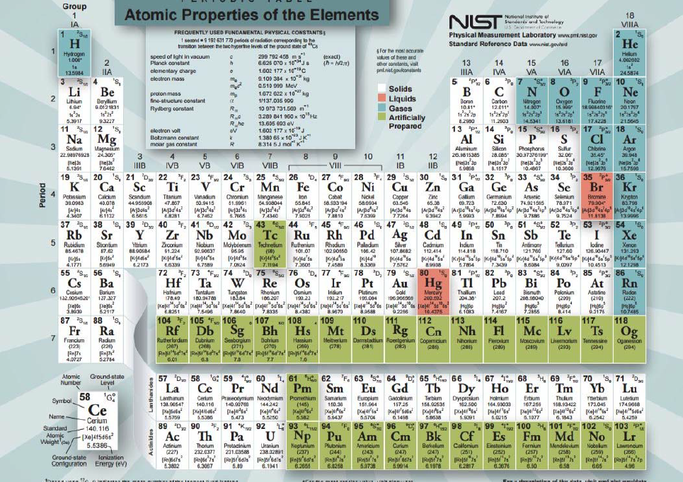
Heavy and super-heavy general open shell (neutral or charged) elements
could exhibit computational challenges due to:
  A dense (quasi-degenerate) and complicated electronic spectrum.
  Relativistic, QED, nuclear and electron correlation
  (dynamic and nondynamic) effects in such systems could be comparable,
  nonadditive and strongly intertwined.
Benchmark “right for the right reason” treatment of relativity, QED and correlation
1) simultaneously, and on equal footing, by tunable and controllable fashion
2) up to high orders
3) size-intensively and size-consistently

Slide 4
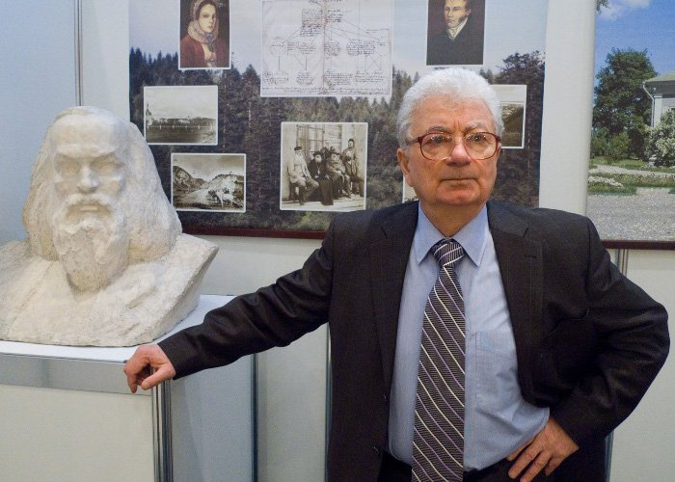
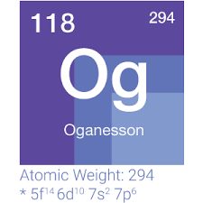
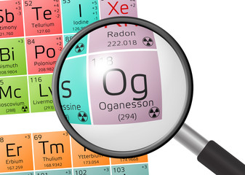
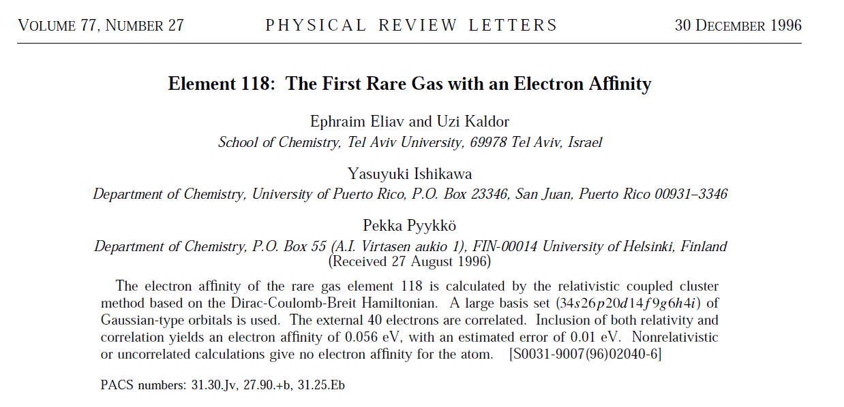
Relativity and correlation interplay: Oganesson (E118) – the first chemically “active” Inert Gas
Oganesson - the last synthesized and recently introduced (2016) Element in the Periodic Table (Eka-Radon).
A tiny interplay between high-level relativity and electron correlation. Nonrelativistic or uncorrelated calculations give no electron affinity for the element E118 - Oganesson.
QED contribution large ( about 5-10%) (EE, et al, PRA, 67, 020102 (2003))

Slide 5
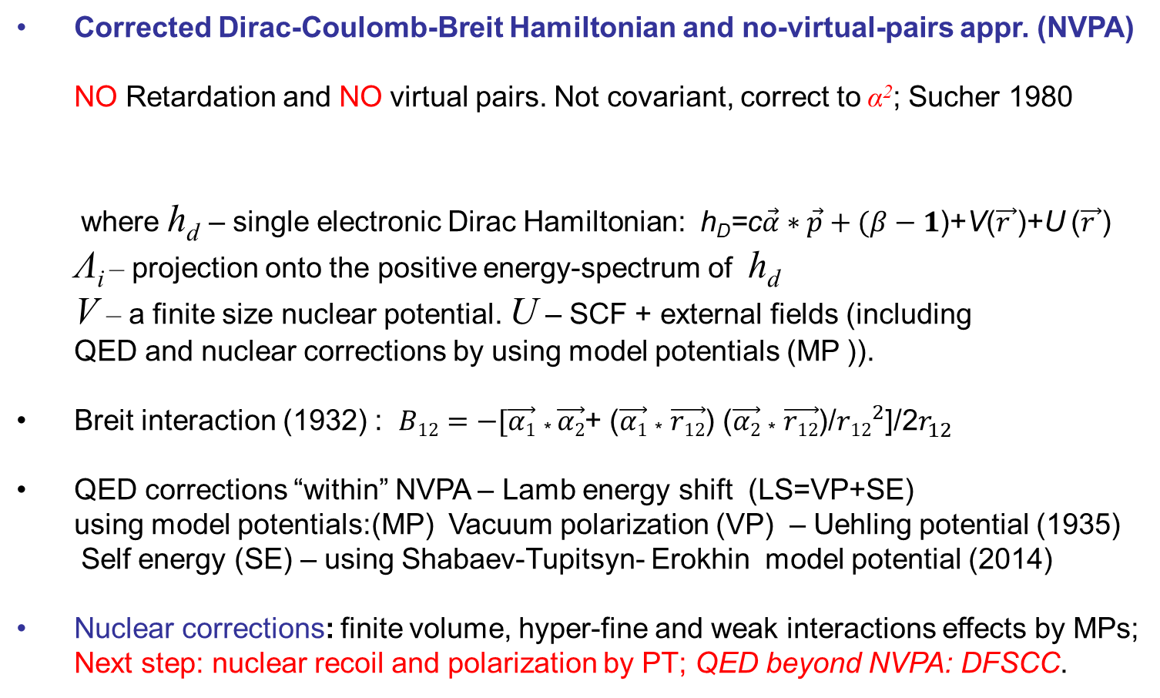
Current best framework of relativity treatment
Corrected Dirac-Coulomb-Breit Hamiltonian and no-virtual-pairs appr. (NVPA)
NO Retardation and NO virtual pairs. Not covariant, correct to α²; Sucher 1980
where h_{d} – single electronic Dirac Hamiltonian: h_{D}=c$\vec{α}∗\vec{p}+(β−1$)+V($\vec{r }$)+U ($\vec{r }$)
Λ_{i} – projection onto the positive energy-spectrum of h_{d}
V – a finite size nuclear potential. U – SCF + external fields (including QED and nuclear corrections by using model potentials (MP )).
Breit interaction (1932) : $B12=−[\vec{α1}$ * $\vec{α2}$+ ($\vec{α1}$ * $\vec{r12}$) ($\vec{α2}$ * $\vec{r12}$)/${r12}_{}^{2}$]/2$r_{12}^{}$
QED corrections “within” NVPA – Lamb energy shift (LS=VP+SE) using model potentials:(MP) Vacuum polarization (VP) – Uehling potential (1935)
Self energy (SE) – using Shabaev-Tupitsyn- Erokhin model potential (2014)
Nuclear corrections: finite volume, hyper-fine and weak interactions effects by MPs;
Next step: nuclear recoil and polarization by PT; QED beyond NVPA: DFSCC.

Slide 6
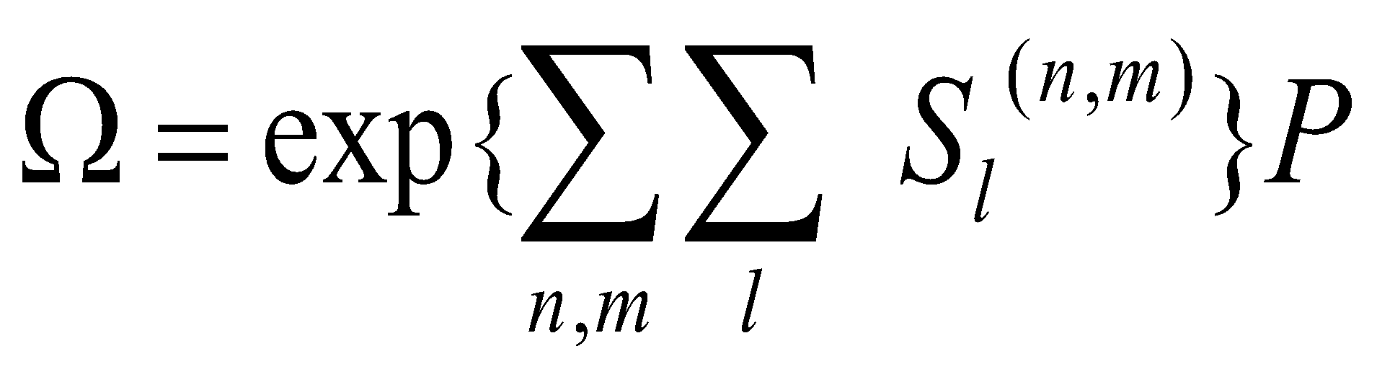
Benchmarking with the 4-c Relativistic Fock-space CC
common Fermi vacuum (P – closed shell single reference state); and a unique set of excitation operators S_{l}^{(n,m)} (n,m) – Fock-space sector with n – holes, m - particles)
direct folded (QED-renorm.)
Solved using subsystem embedding condition (SEC) : “sector-by-sector” Diagonalization of the H_{eff}^{(k,m)}=P ^{(k,m)}(HΩ)_{conn} P ^{(k,m)} or Intermediate Hamiltonian (IH) (solves the intruder states problem) gives simultaneously all the transition energies with respect to closed shell reference.
Size-extensivity is maintained independently for core and valence electrons.
Natural framework for development of the correlation methods based on many-body Hamiltonians with variable number of particles ; (QED : Generalized Fock-space parameterization: ^{[k]}S_{l}^{(n,m)} k- number of uncontracted virtual photons leads to “double” Fock-space CC approach)

Slide 7

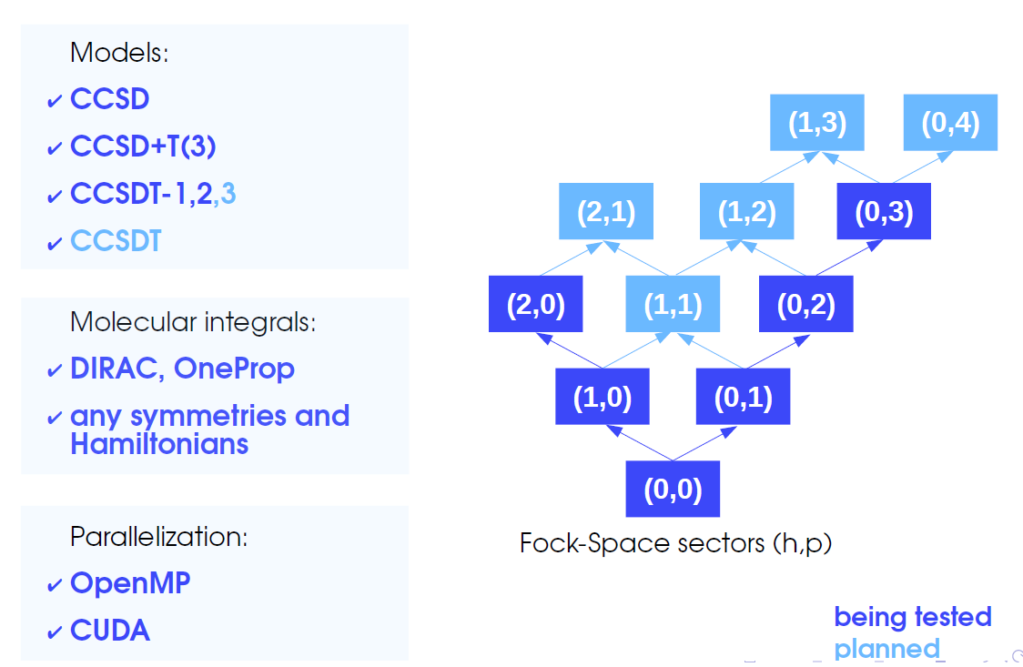
Advanced R-FSCC software: the EXP-T code
A. Oleynichenko, A. Zaitsevskii, E. Eliav,
Program Package Communications in Computer and Information Science 1331:375-386 (2020) [http://qchem.pnpi.spb.ru/expt]
(3,0)
CCSDTT
(1,1)
Notes:
The EXP-T program has been interfaced with the DIRAC code and can use all possible relativistic Hamiltonians, programed there. Recently the General Relativistic non-local shape consistent potential of Titov and Mosyagin were also incorporated into Dirac program by Oleynichenko.

Slide 8
Applications to SHEs (Z > 100) with experimentally known properties
(“atom-at-time” technique)

Slide 9
Predicted spectrum of atomic No
Borschevsky, A., EE, Kaldor U., et al, Phys. Rev. A 75, (2007), 042514.
Experiment | +QED | IHFSCC | State
6.63±0.08⁽¹⁾, 6.635 ±0.030⁽²⁾ | 6.635 | 6.646 | 5f¹⁴7s² ¹S₀ (IP), ev
 | 18879 | 19028 | 5f¹⁴7s7p ³P₀ (EE), cm⁻¹
 | 20454 | 20605 | 5f¹⁴7s7p ³P₁
 | 25374 | 25527 | 5f¹⁴7s7p ³P₂
29961⁽²⁾ | 30056 | 30224 | 5f¹⁴7s7p ¹P₁
 | 28338 | 28496 | 5f¹⁴7s6d ³D₁
 | 28778 | 28935 | 5f¹⁴7s6d ³D₂
 | 29897 | 30040 | 5f¹⁴7s6d ³D₃
 | 32892 | 33071 | 5f¹⁴7s6d ¹D₂
Experiments on atomic No spectra measurements (“atom-at-time” technology)
JAEA labs; [an efficient surface ion-source and a radioisotope detection system
coupled to amass separator], T.Sato et al., JACS, 140, 14609, 2018
(2) GSI, [Laser resonance ionization spectr.], M. Laatiaoui, et al, Nature 538, 495, 2016

Slide 10

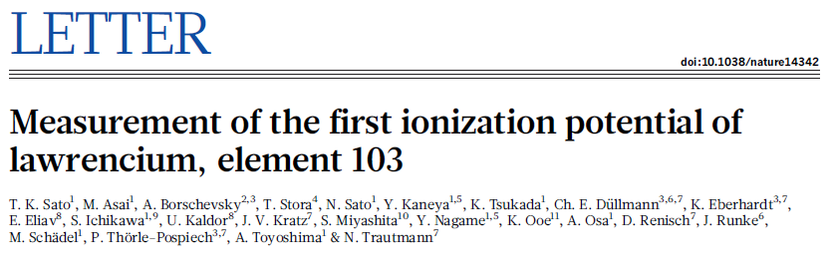
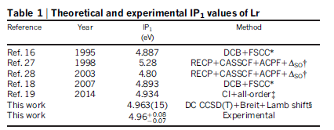
The first ever measured IP for superheavy (Z> 100)
element, produced by “atom-at-time” technology.
The GS of Lr has been confirmed to be 7s²p_{1/2}

Slide 11
Applications to SHEs with no experimentally known properties
Theoretical predictions of extended Periodic Table.

Slide 12
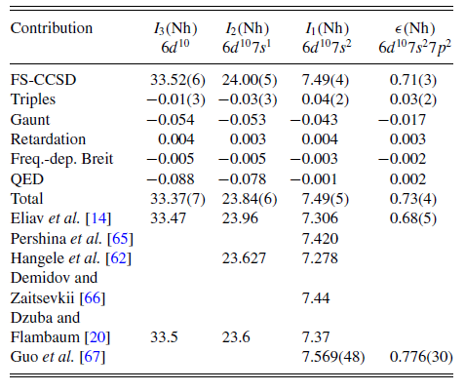
IPs and EA of Nh: Kaygorodov, et al, PRA,105,062805 (2022);
Guo, et al, JPB, 55, 155003 (2022)
FSCC scheme:
SSR-CCSDTQ+B+QED

Slide 13
Ea of Oganesson: recent developments
Reference | Method | Ea, eV
Eliav, et al, PRL, 77,5350 (1996) | FSCCSD+Breit | 0.056(10)
Goidenko, et al, PRA,67,020102 (2003) | FSCCSD+Breit+QED | 0.058(3)
Lackenby, et al,PRA, 98, 042512 (2018) | CI+MBPT (+Breit+QED) | 0.096
Guo, et al, ACQ,83,107(2021) | SR-CCSDT(Q)+Breit+QED | 0.080(5)
Kaygorodov, et al, PRA,104,012819(2021) | FSCCSDT+Breit(ω)+QED | 0.076(4)

Slide 14
Spectra of Ra and element E120
cm⁻¹ |  | Ra |  | E120 [cm⁻¹]
 |  | IHFSCC | Exp. | IHFSCC
IP |  | 42608 | 42573 | 47191
nsnp | ³P₀ | 13093 | 13078 | 15648
 | ³P₁ | 14017 | 13999 | 17587
 | ³P₂ | 16675 | 16689 | 25192
 | ¹P₁ | 20792 | 20716 | 27513
(n-1)dns | ³D₁ | 13827 | 13716 | 22903
 | ³D₂ | 14021 | 13994 | 23034
 | ³D₃ | 14839 | 14707 | 23782
 | ¹D₂ | 17159 | 17081 | 27247
ns(n+1)s | ³S₁ | 26762 | 26754 | 30862
ΔE |  | 139

Slide 15
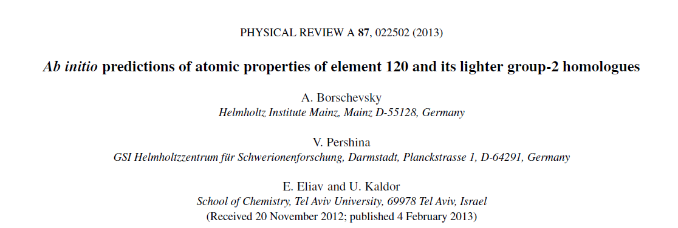
Spectra of Ra and element E120
cm⁻¹ |  | Ra |  | E120 [cm⁻¹]
 |  | IHFSCC | Exp. | IHFSCC
IP |  | 42608 | 42573 | 47191
nsnp | ³P₀ | 13093 | 13078 | 15648
 | ³P₁ | 14017 | 13999 | 17587
 | ³P₂ | 16675 | 16689 | 25192
 | ¹P₁ | 20792 | 20716 | 27513
(n-1)dns | ³D₁ | 13827 | 13716 | 22903
 | ³D₂ | 14021 | 13994 | 23034
 | ³D₃ | 14839 | 14707 | 23782
 | ¹D₂ | 17159 | 17081 | 27247
ns(n+1)s | ³S₁ | 26762 | 26754 | 30862
ΔE |  | 139

Slide 16
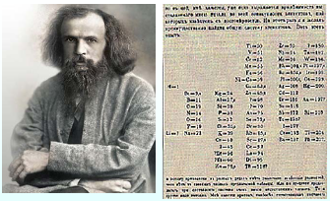
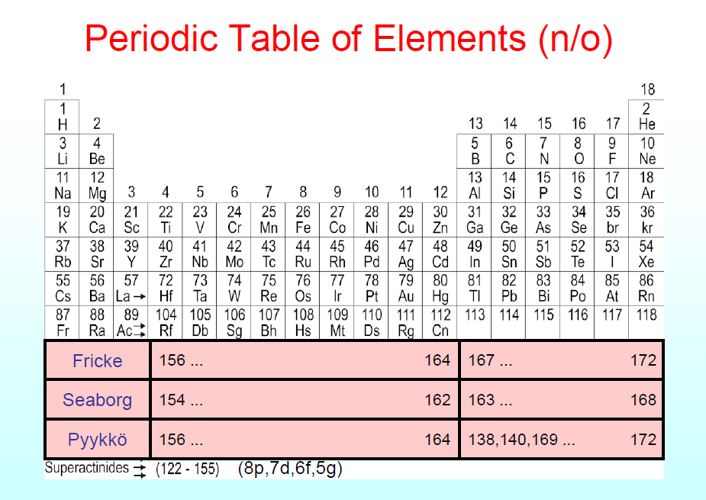
Extended Periodic Table of Elements
Nh
Fl
Mc
Lv
Ts
Og
167 168 169 170 171 172
163 164 165 166 167 168
139 140
167 168 169 170 171 172

Slide 17
IH-RFSCC electronic configurations and properties of SHE with 164 ≤ Z ≤ 174 (unpublished)
Z | Configuration | Possible group | Period | Properties (eV) IP EA
164 | [Og]8s²5g¹⁸6f¹⁴7d¹⁰8p_{1/2}² | 12, 14 | 8 | 7.513 0.071
165 | [Og]8s²5g¹⁸6f¹⁴7d¹⁰8p_{1/2}²9s | 1 | 9 | 5.652 0.987
166 | [Og]8s²5g¹⁸6f¹⁴7d¹⁰8p_{1/2}²9s² | 2 | 9 | 7.345 0.518
167 | [Og]8s²5g¹⁸6f¹⁴7d¹⁰8p_{1/2}²9s²8p_{3/2} | 15 | 8 | 6.639 1.290
168 | [Og]8s²5g¹⁸6f¹⁴7d¹⁰8p_{1/2}²9s²8p_{3/2}² | 16 | 8 | 8.055
169 | [Og]8s²5g¹⁸6f¹⁴7d¹⁰8p_{1/2}²9s²9p_{1/2}²8p_{3/2} | 15 | 8 | 8.968 2.518
170 | [Og]8s²5g¹⁸6f¹⁴7d¹⁰8p_{1/2}²9s²9p_{1/2}²8p_{3/2}² | 16 | 8 | 9.975
171 | [Og]8s²5g¹⁸6f¹⁴7d¹⁰8p_{1/2}²9s²9p_{1/2}²8p_{3/2}³ | 17 | 8 | 10.917 3.922
172 | [Og]8s²5g¹⁸6f¹⁴7d¹⁰8p⁶ 9s²9p_{1/2}² | 18 | 8 | 11.967 <0
173 | [Og]8s²5g¹⁸6f¹⁴7d¹⁰8p⁶9s²9p_{1/2}²10s | 1 | 10 | 3.070 0.478
174 | [Og]8s²5g¹⁸6f¹⁴7d¹⁰8p⁶9s²9p_{1/2}²10s8d | 4 | 9 | 3.614
Notes:
Three closed shell systems E164 (eka-Cn or eka Fl), E166(eka-E120, alkali earth ), E172 (eka-Og)
Elements E167 and E169 (Eka-Moskowium,E115)
Elements E168 and E170 (Eka-Liwermorium, E116)

Slide 18
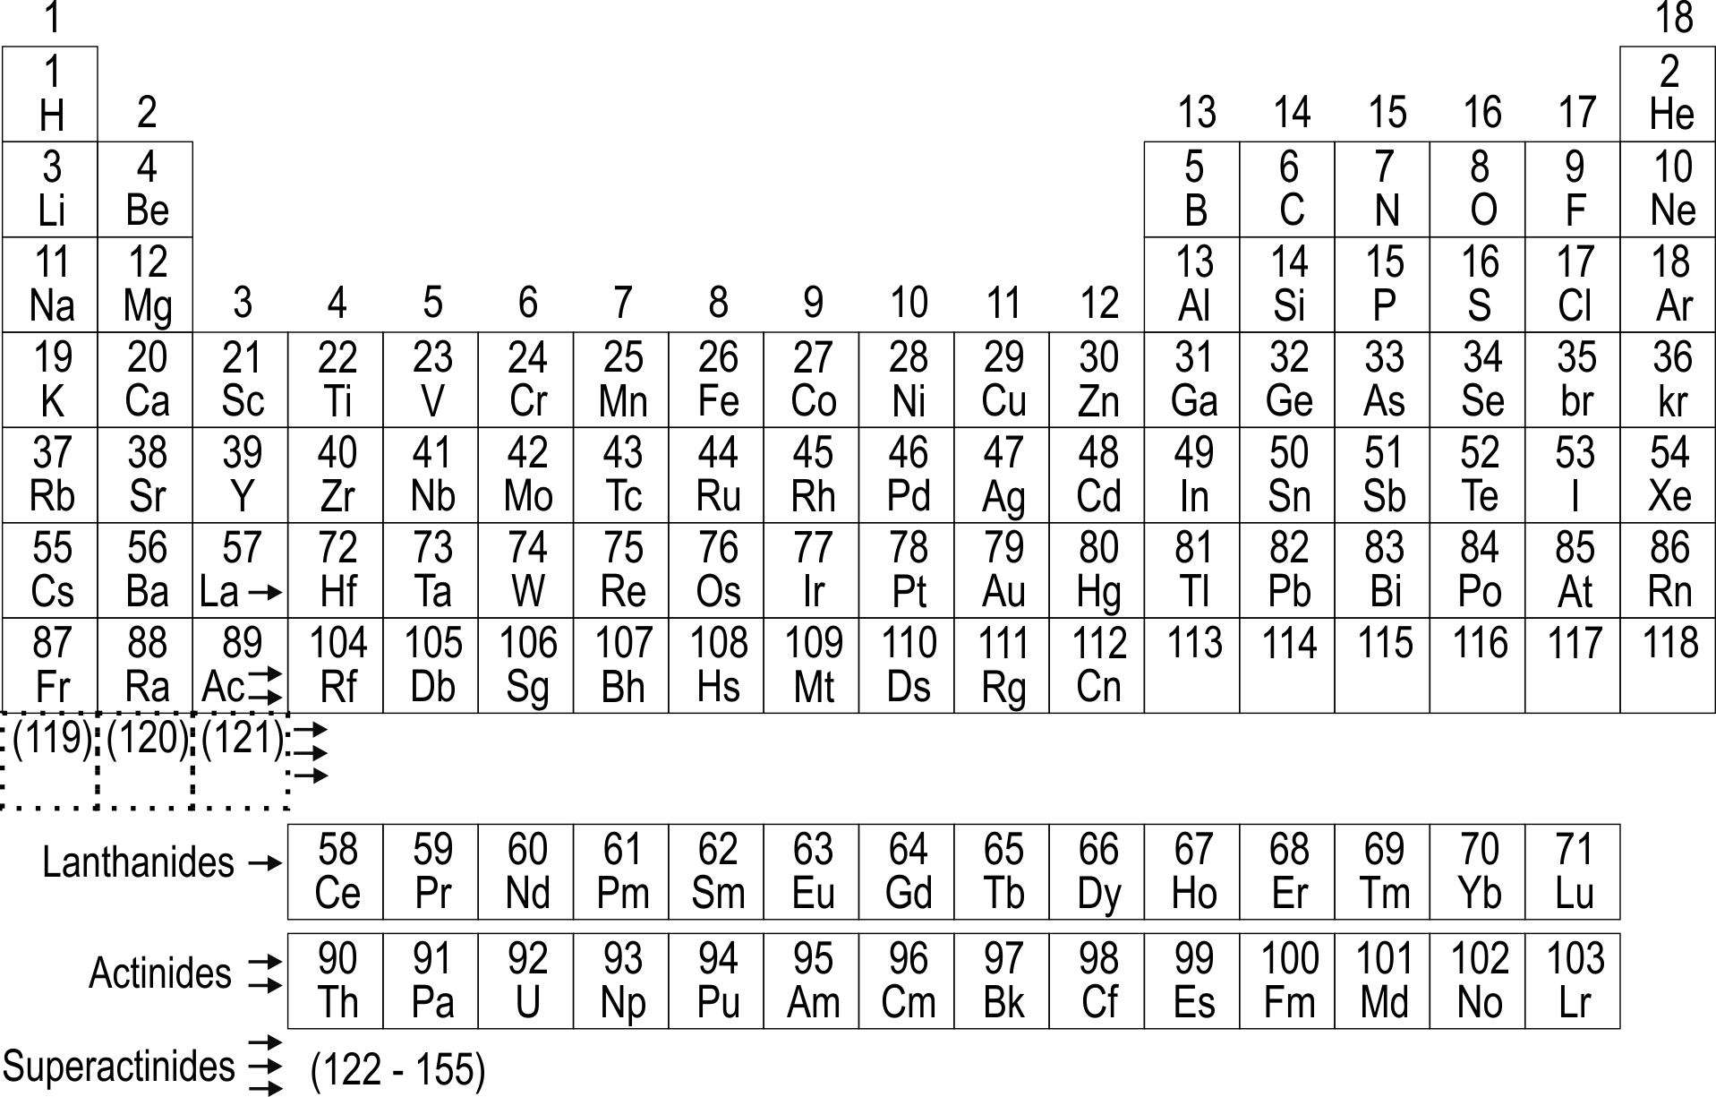
Possible variant of Periodic Table (unpublished)
Fl
Mc
Og
Nh
Lv
Ts
121-163 [(2)p_{1/2}+(14)f+(18)g+(10)d)] |  | 164 | ?? | 164 | 167 169 | 168 170 | 171 | 172
165
165 | 166 | ??? | 174
173
??
Closed shell GS configurations:
E164, E165⁺, E166²⁺ ([Og]8s²5g¹⁸6f¹⁴7d¹⁰8p_{1/2}²)
E166, E167⁺, E168²⁺ ([Og]8s²5g¹⁸6f¹⁴7d¹⁰8p_{1/2}²9s²)
E172, E171⁻, E173⁺, E174²⁺ ([Og]8s²5g¹⁸6f¹⁴7d¹⁰8p⁶9p_{1/2}²9s²)
Closed shell lower lying ES configurations:
E168 ([Og]8s²5g¹⁸6f¹⁴7d¹⁰8p⁶ )
E170 ([Og]8s²5g¹⁸6f¹⁴7d¹⁰8p⁶9s²)

Slide 19
Conclusions
R-FSCC is powerful and flexible computational approaches suitable for precise calculation of properties of heavy and SHE open shell systems.
Excellent agreement with experiment where data are available and reliable predictions of spectra and other properties.
News from the 8th and higher periods
The periodic Table concept on it’s SHE edge should be changed and reformulated:
  Simple Madelung rules do not work!
  JJ (and intermediate) coupling instead of LS should be used. Many super-actinides SHEs will have combinations of multiple LS-configurations with compatible weighs.
  The “one-to-one” relationship: single LS configuration shell corresponds to single cell of Periodic Table does not work! (multiply filled and empty cells could exist).
  Jumps to the next period and back could happen.
  End of Periodic Table:
    Nuclear stability perspective: minimal time of isotope survival 10⁻¹⁴ sec needed for element formation could limit Z<170
    Atomic structure stability perspective: elements with Z > 173 (supercritical atoms) will be still stable till the SHE with a valence open shell configuration “diving” to the Dirac sea
Notes:
(W. Nazarewicz, TAN2019)

