Slide 1



Superheavy Element Chemistry & co in Switzerland
Robert Eichler :: Lab Head Radiochemistry :: Paul Scherrer Institut
"Heaviest nuclei and atoms" Yerevan April 24-30 2023

Slide 2
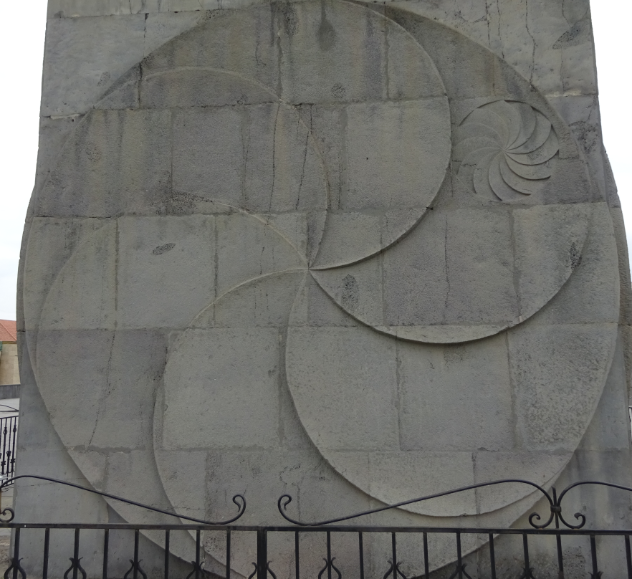
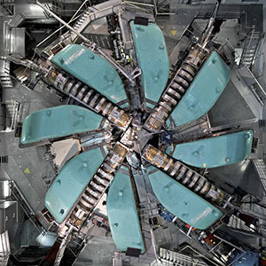
Sincere congratulations Yuri!
Cascades Monument Yerevan
PSI Philips Cyclotron

Slide 3
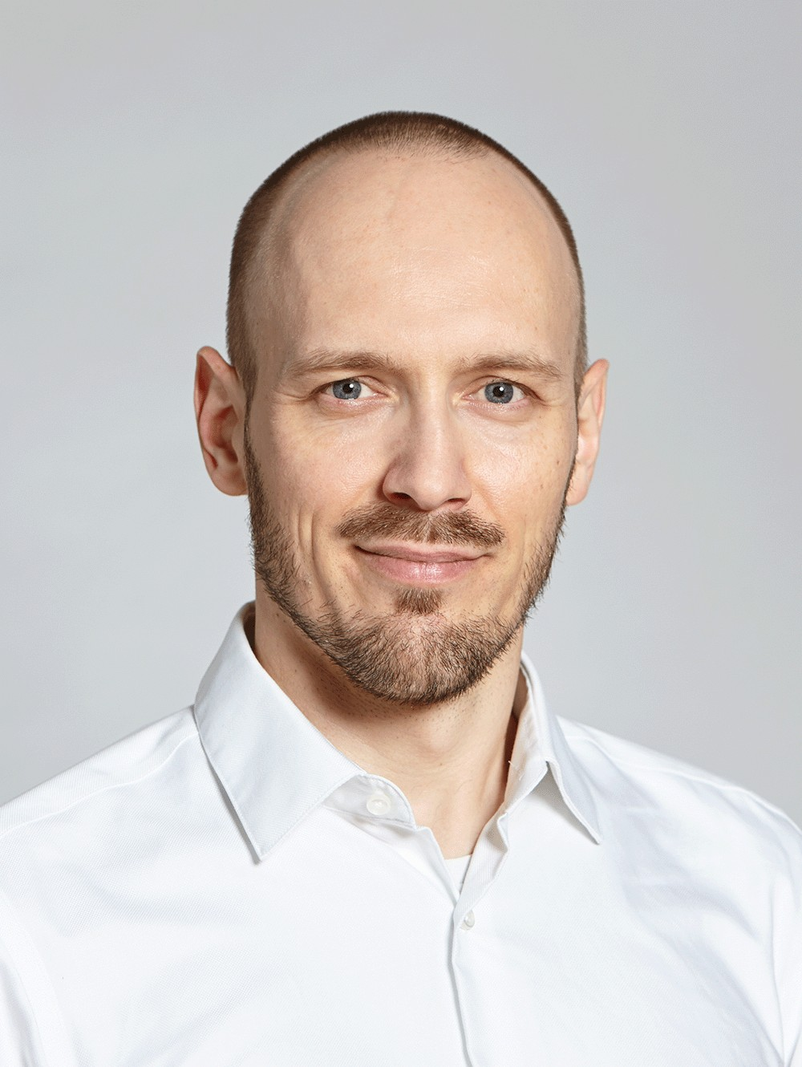
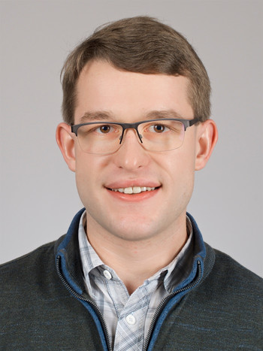
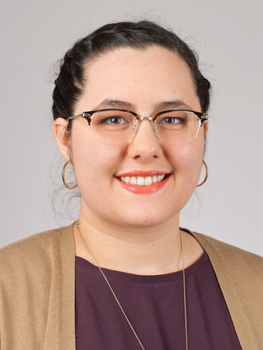

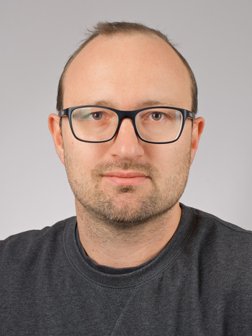
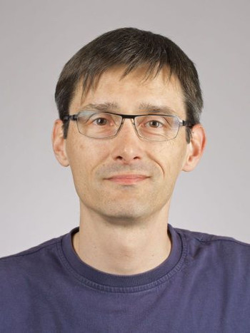
SNSF funded Project: 2 Student programs
Lead by Patrick Steinegger
Program 1: Investigation of element Nh in vacuum chromatography
- Georg Alexander Tiebel
Program 2: Investigation of element Nh in gas phase chromatography
- Jennifer Marie Wilson
With intense support of :
R. Dressler D.Herrmann A. Vögele

Slide 4
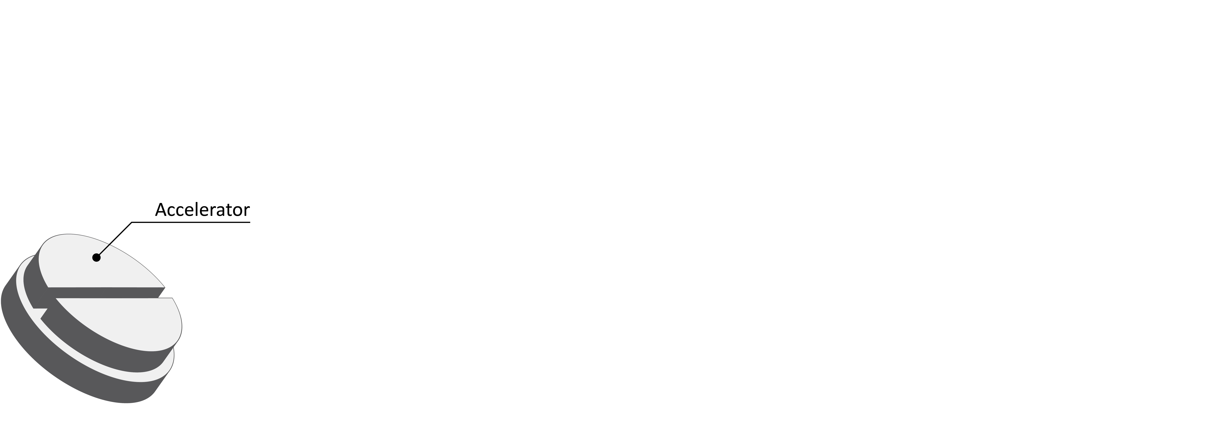
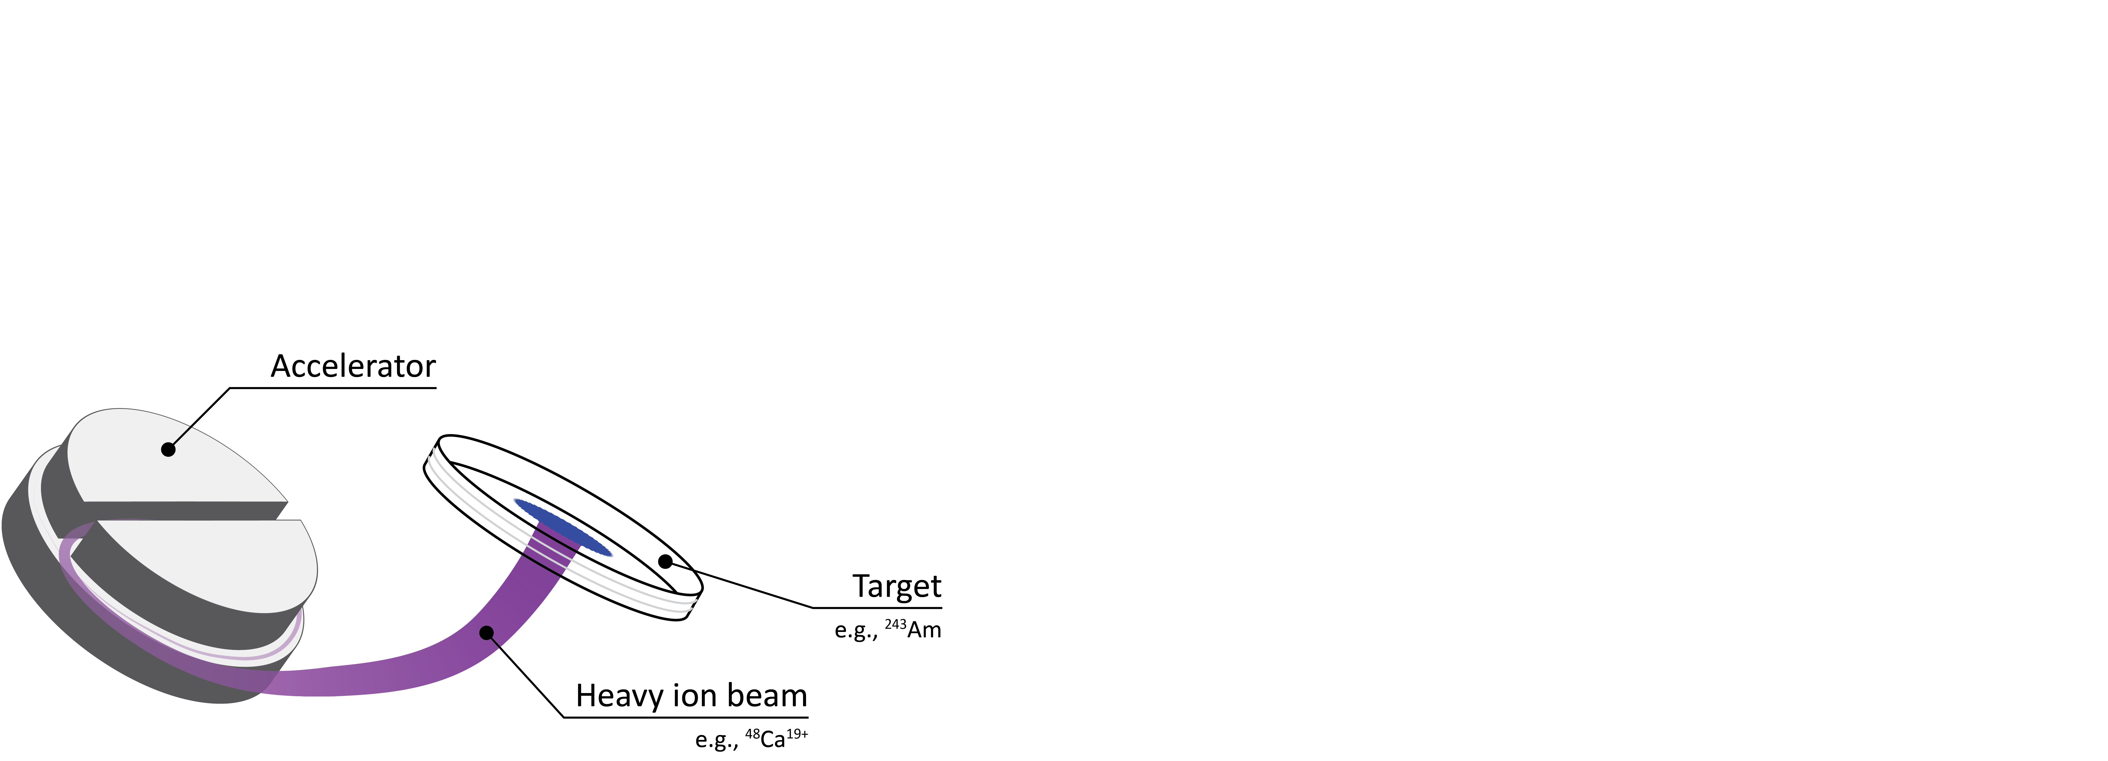
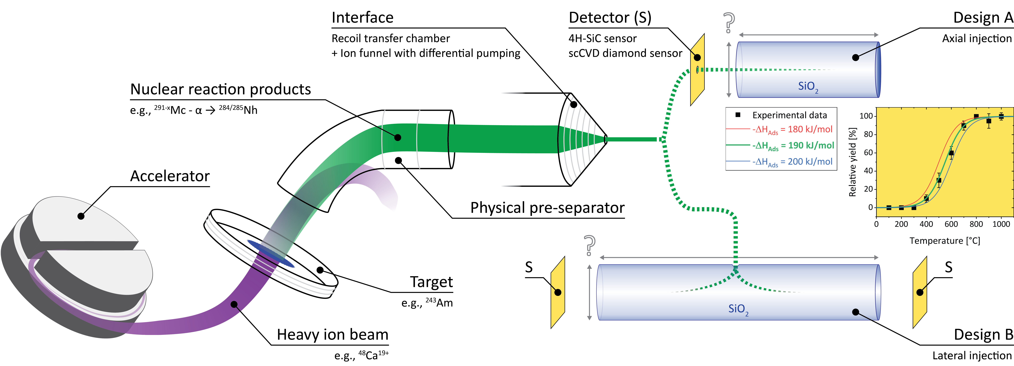
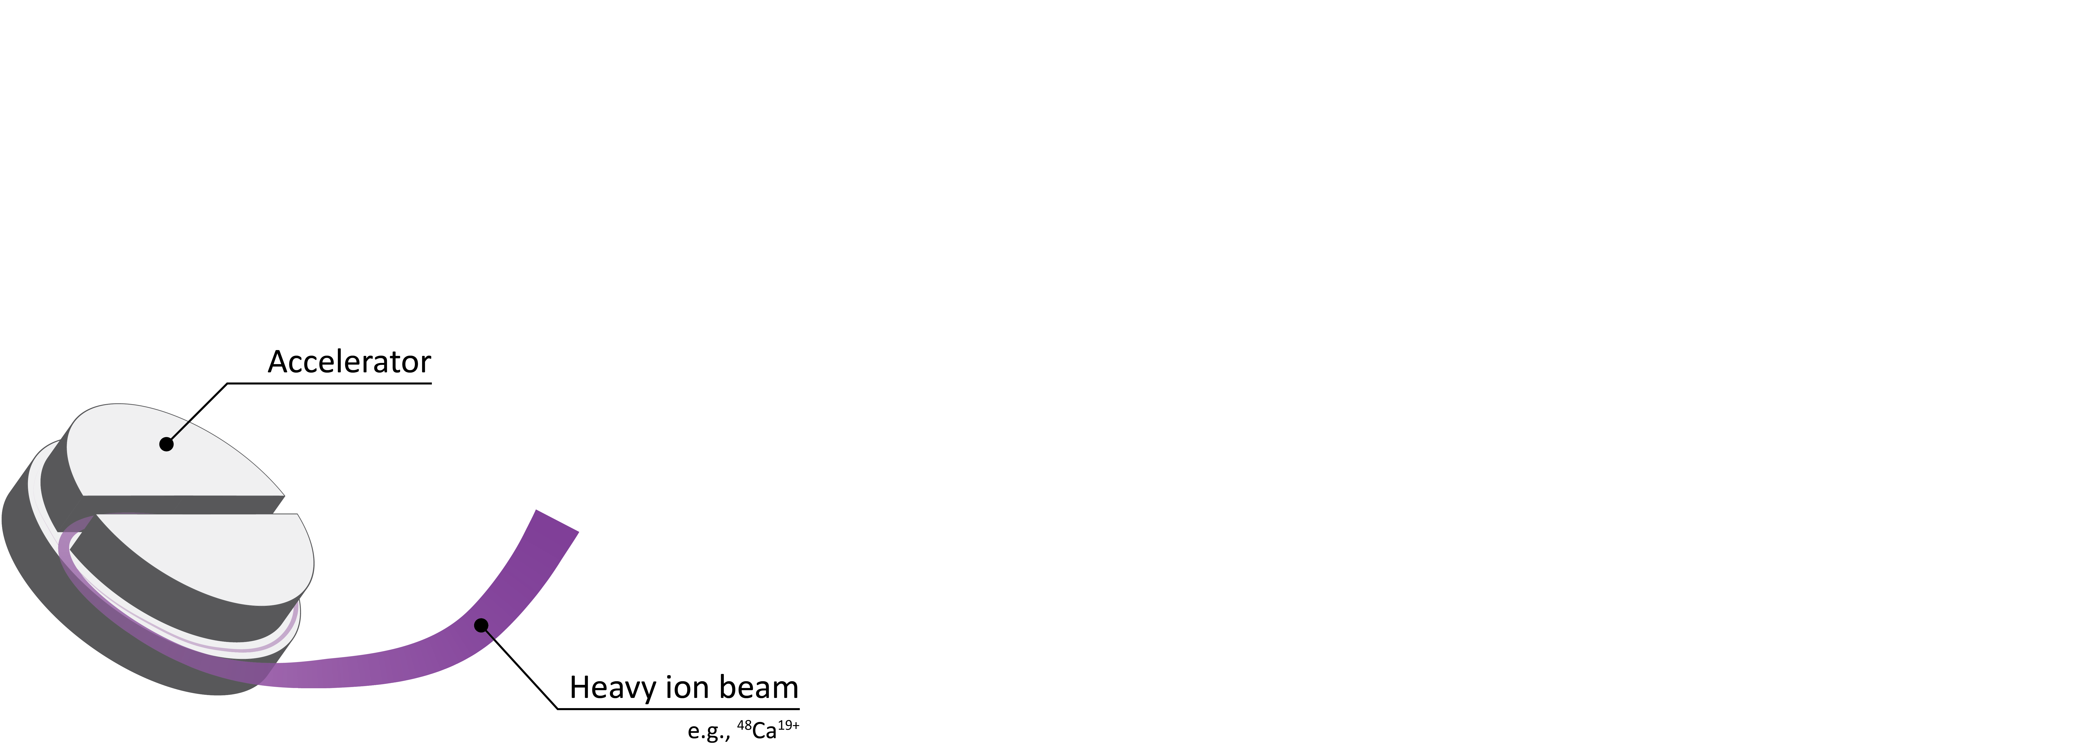
Program 1: Vacuum - Experiment design
T_{iso}
T_{iso}

Slide 5
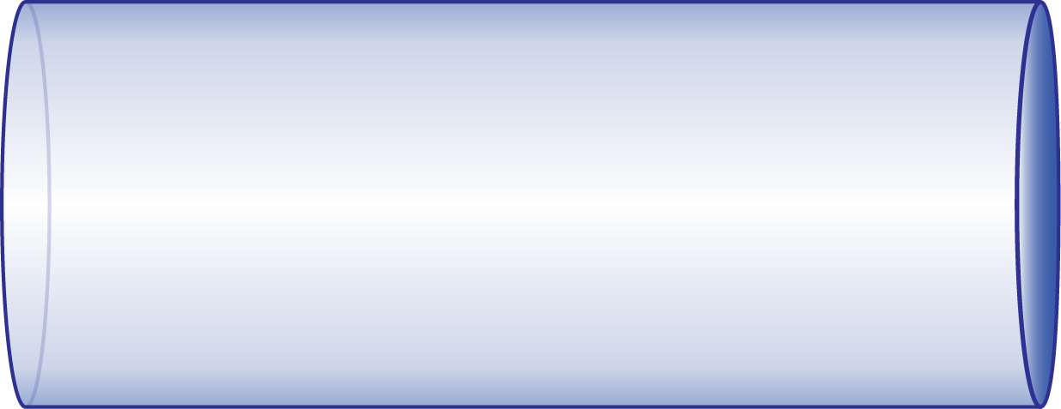
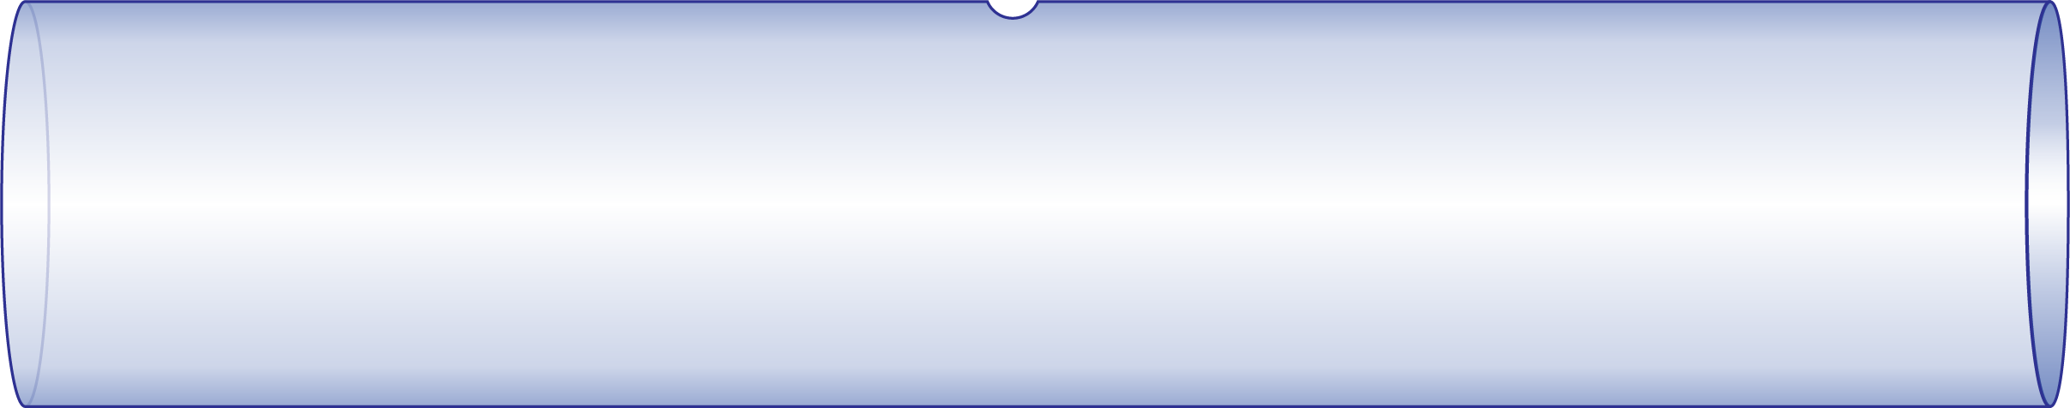
Program 1: Vacuum - Monte Carlo simulations
Detector on one-side open column (Design A)
Detectors on two-side open column (Design B)

Slide 6
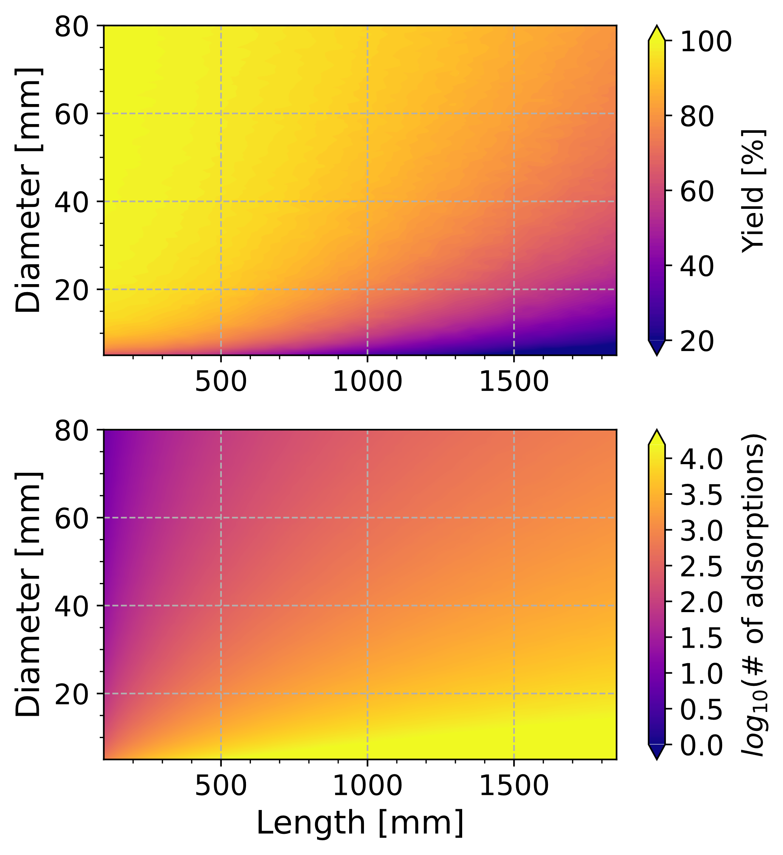
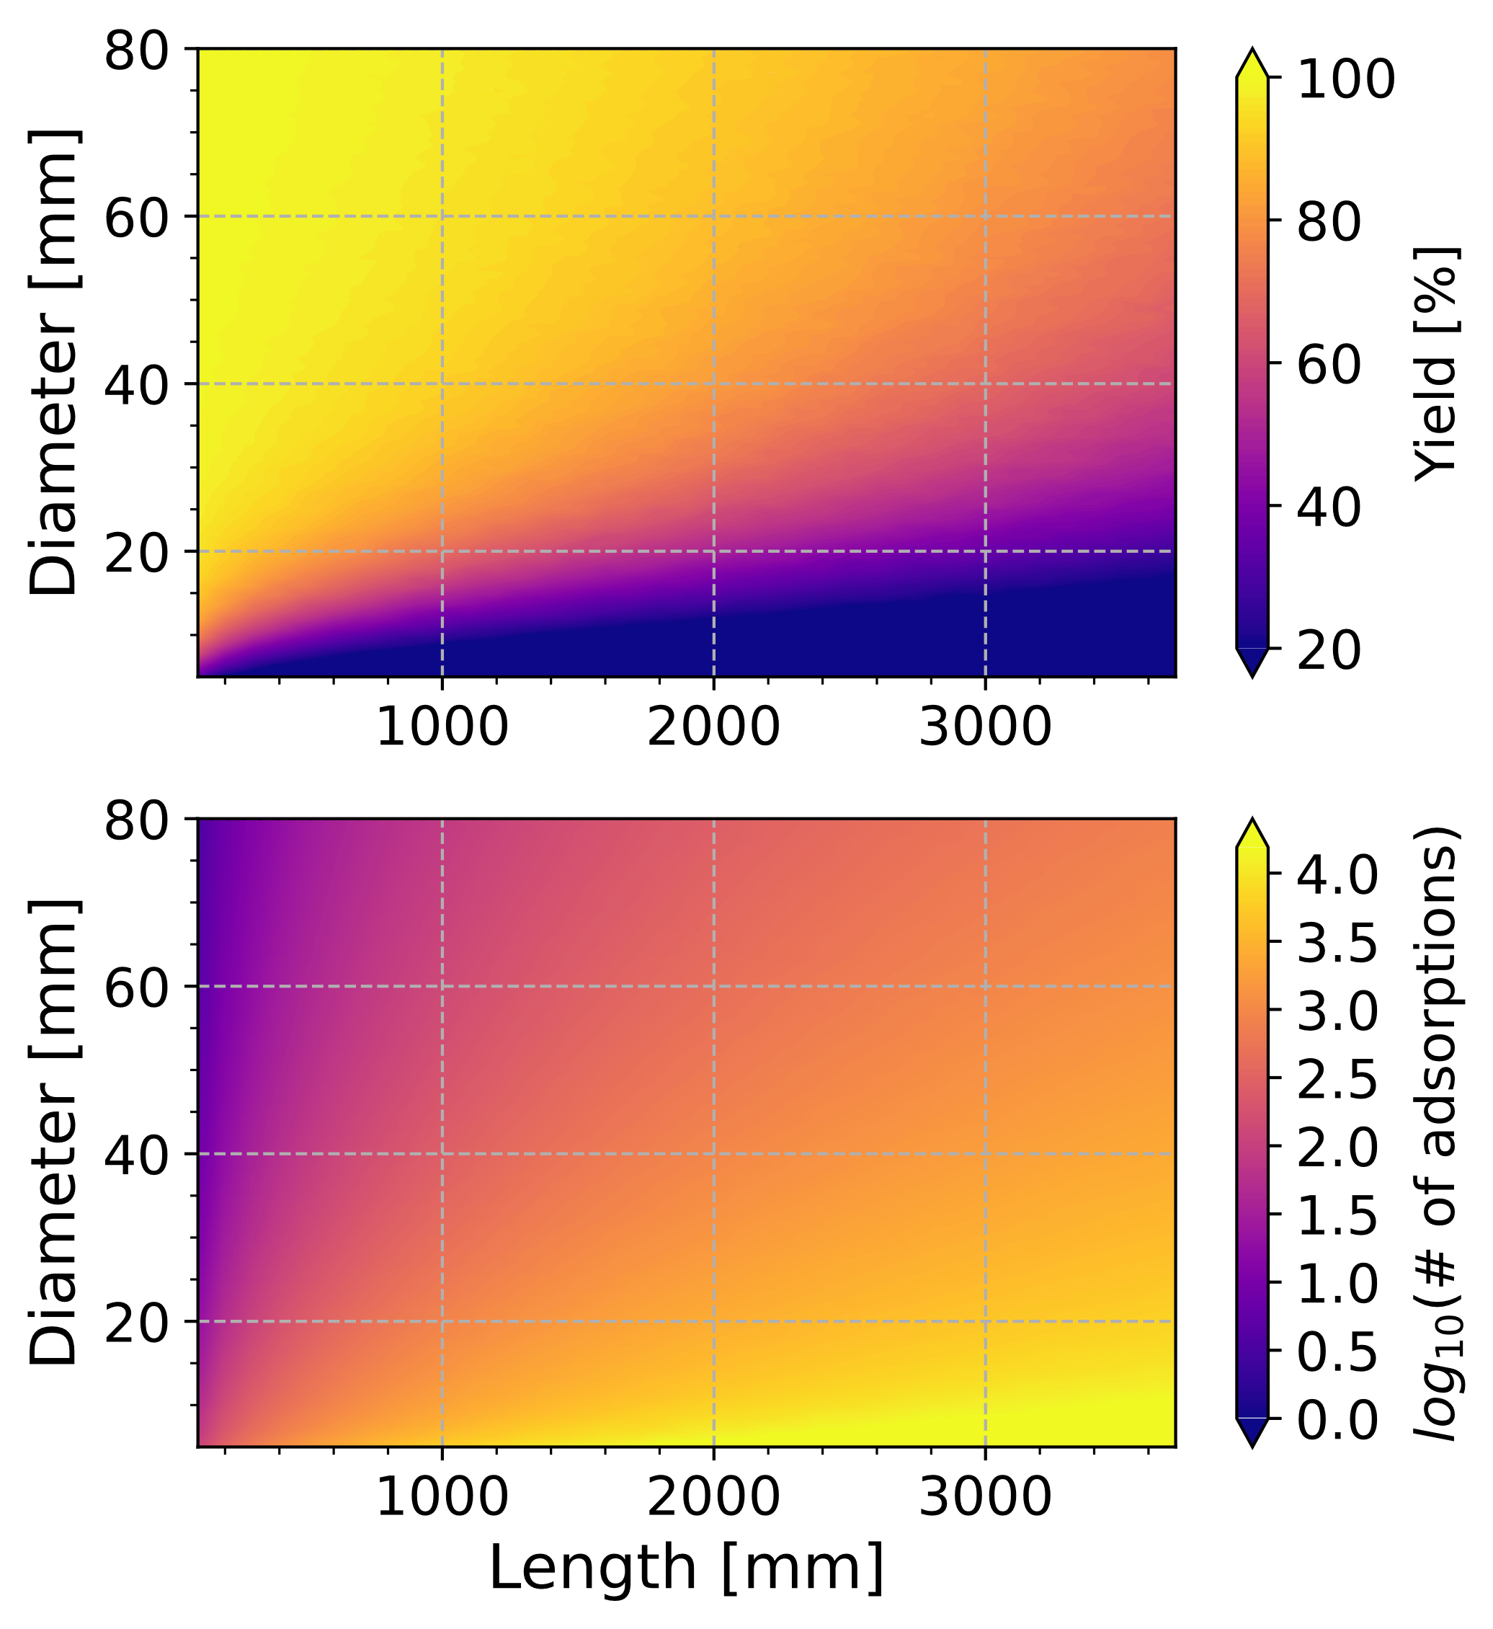
Program 1: Vacuum - Monte Carlo simulations
Minimized surface retention, limited nuclear lifetime: ²⁸⁴Nh with $t_{0.5}=0.97 s$ on fused silica
Design A
Design B
Statistics
Chemistry
V. Pershina, M. Iliaš, A. Yakushev, Inorg. Chem. 2021, 60, 9796–9804.

Slide 7
Program 1: Vacuum - Monte Carlo simulations
Optimized column:
25 mm ∅
50 cm L
T_{iso}=1000°C
Unknown adsorption
properties
²⁸⁴Nh

Slide 8
Program 1: Vacuum - Transfer of NRPs
Notes:
thermalization of NRPs in a gas
well-focused, low energy ion beams guided into IVAC
low implantation depths [14].
low extraction efficiencies 30% to 40%

Slide 9
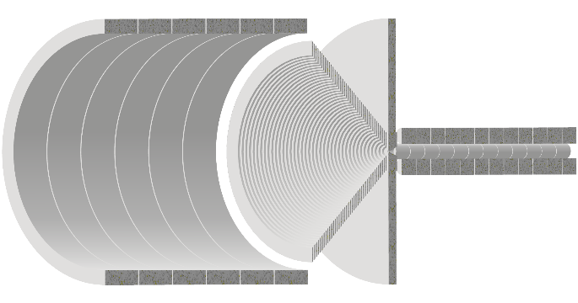
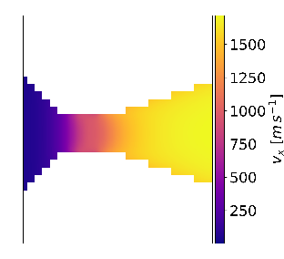
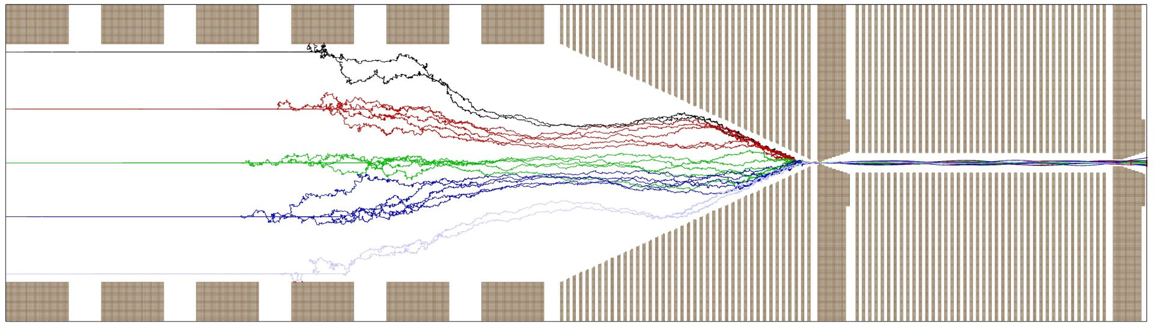
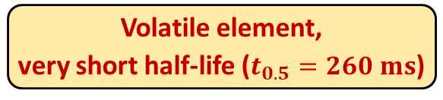
Program 1: Vacuum - Ongoing & Near Future
On-going construction with help from
TU Munich and GSI Darmstadt
simulations of ion funnel for differential pumping stage with SIMION and COMSOL
Proof of principle
Experiment in August 2023 @
¹⁴⁴Sm(⁴⁰Ar, 6n)¹⁷⁸Hg
Volatile element,
very short half-life ($t_{0.5}=260 ms$)

Slide 10
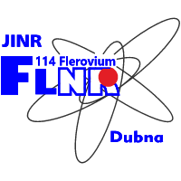
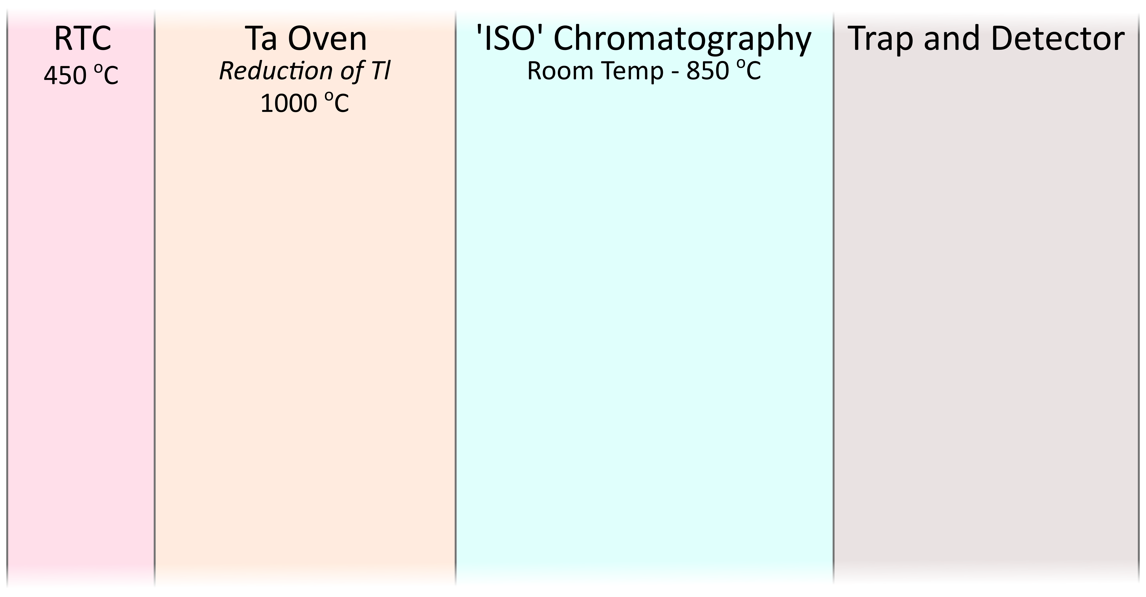
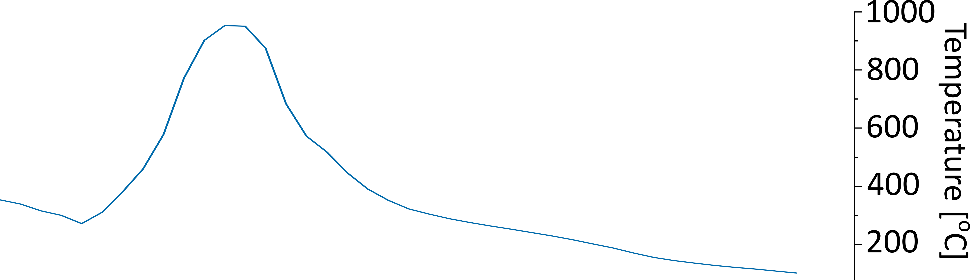
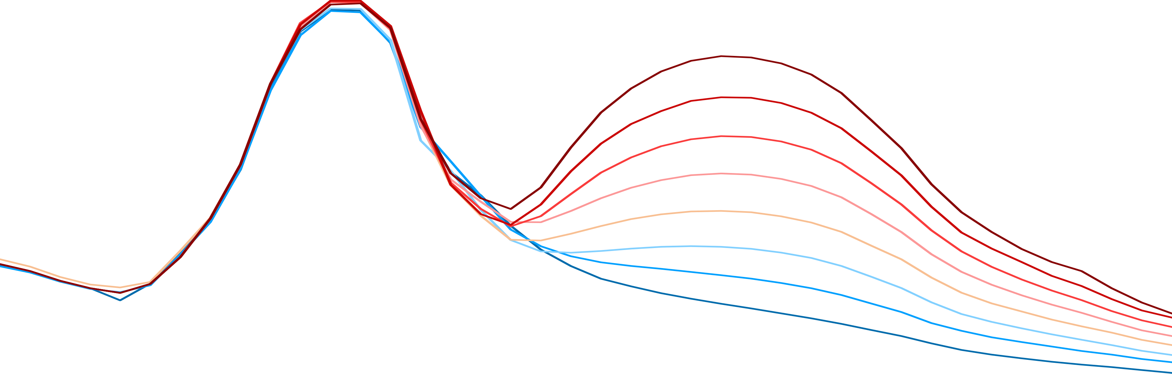
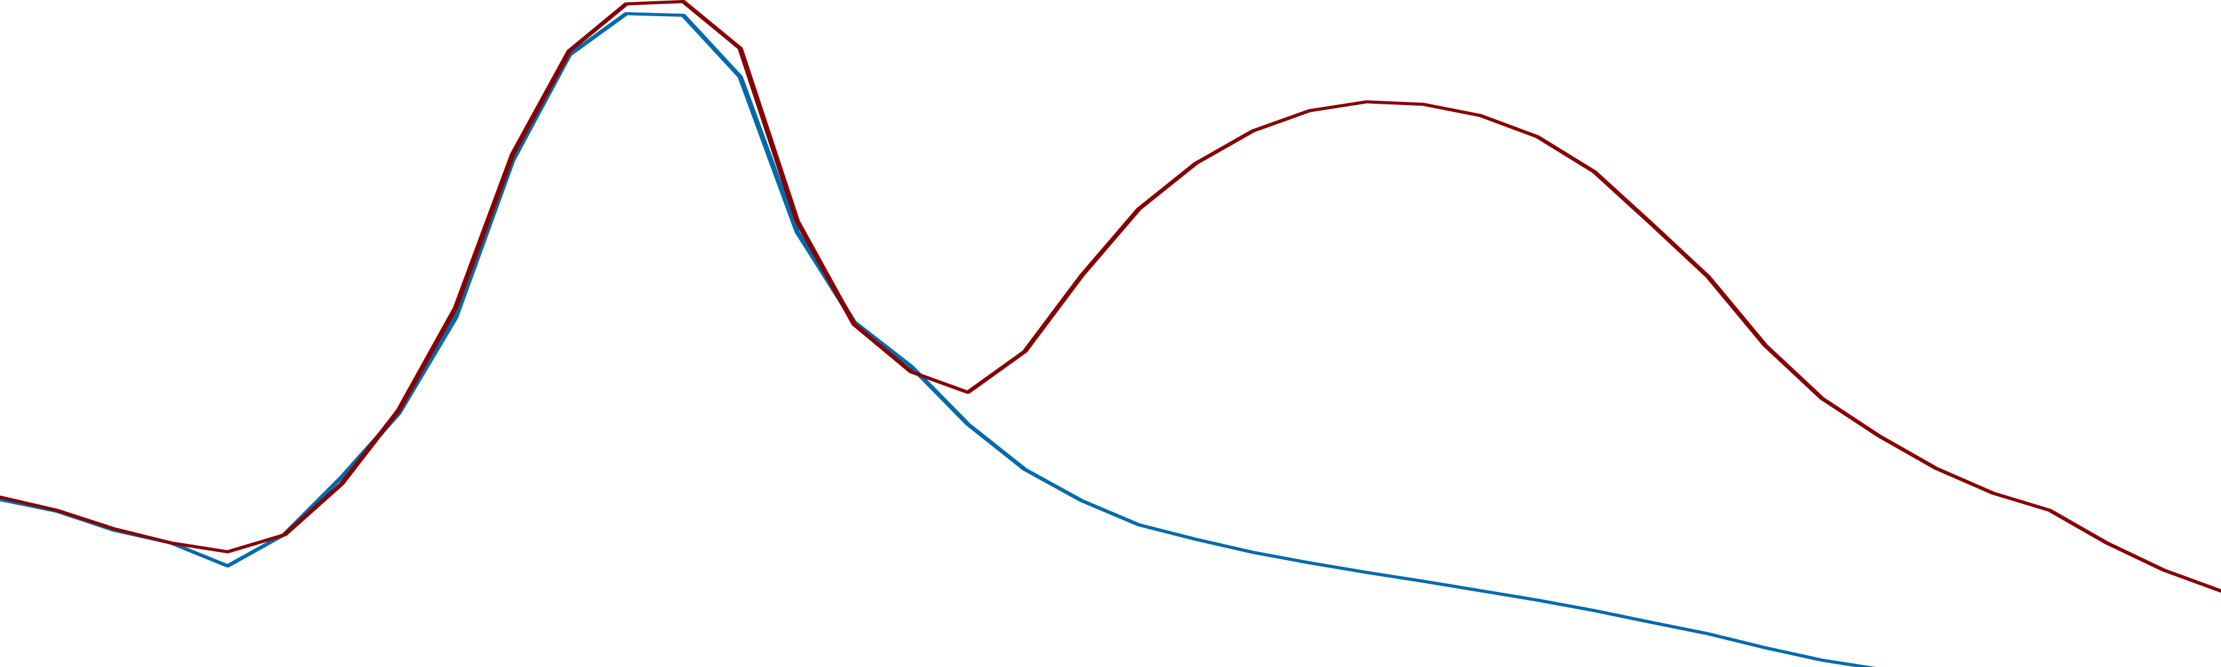
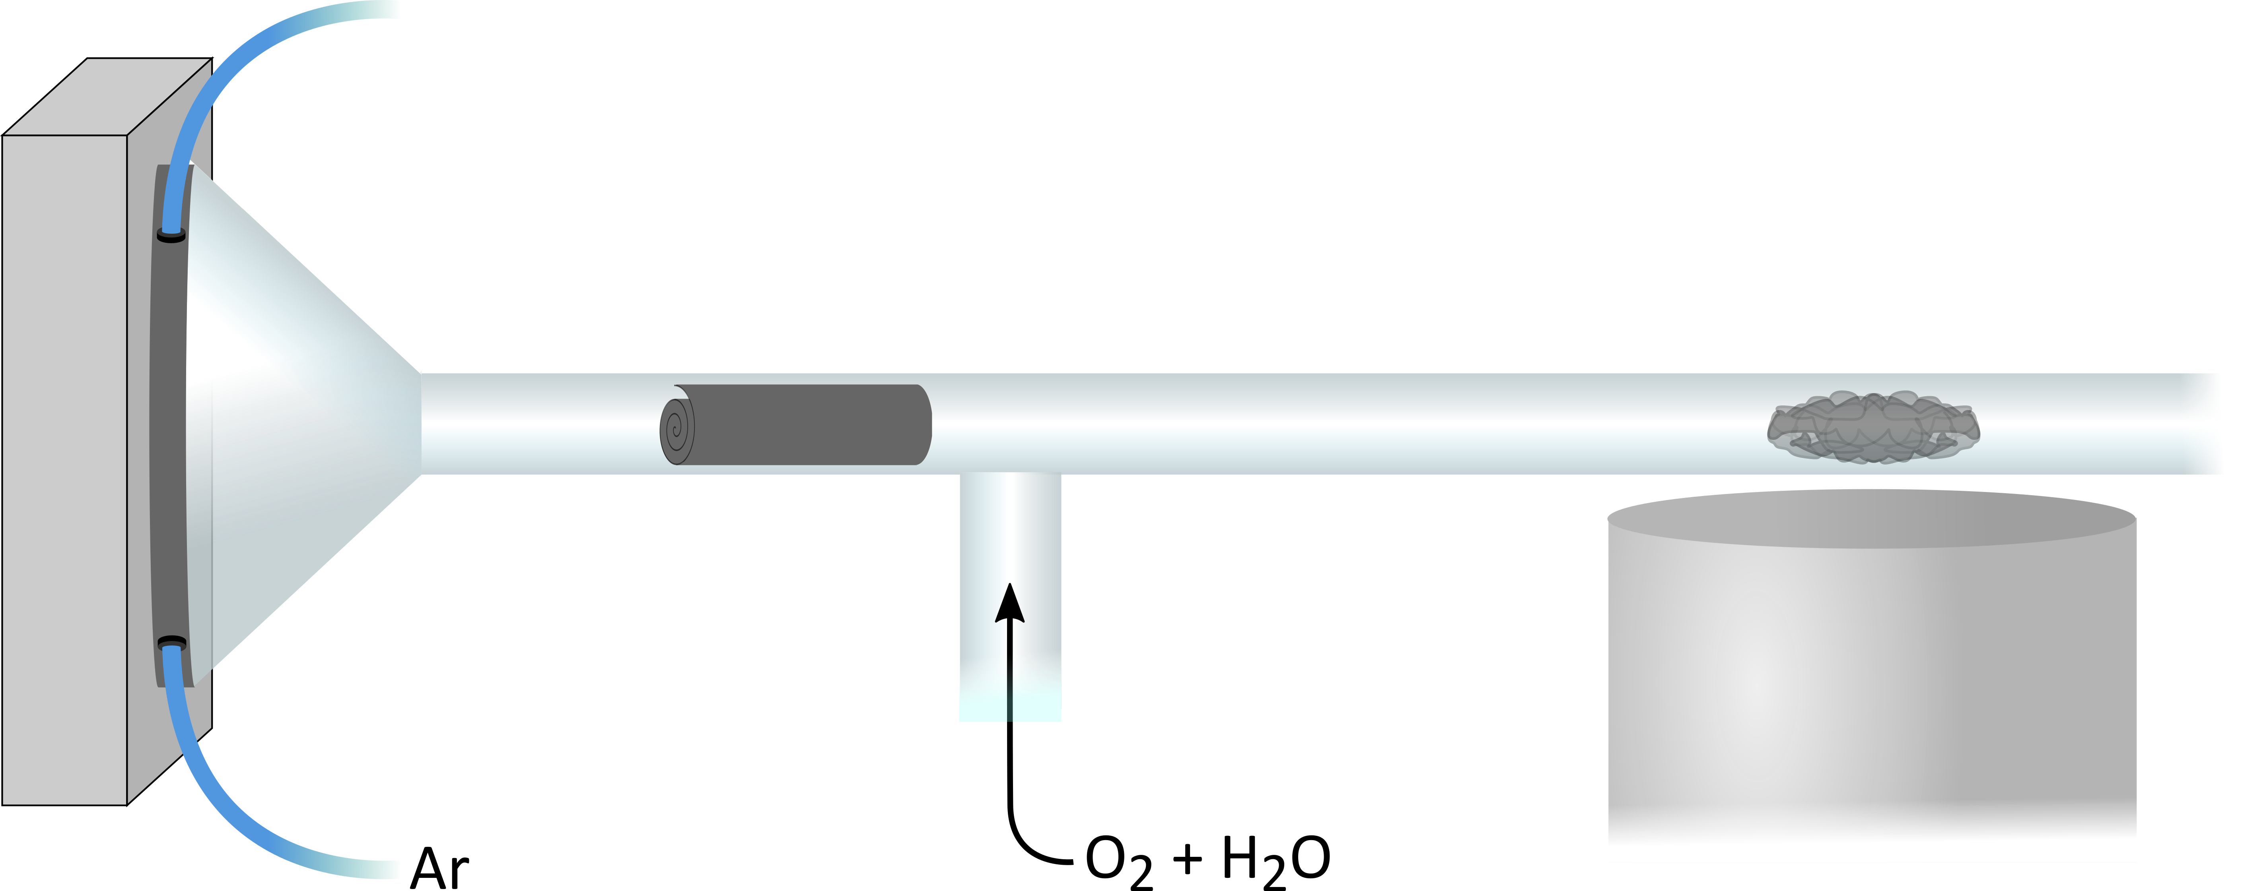
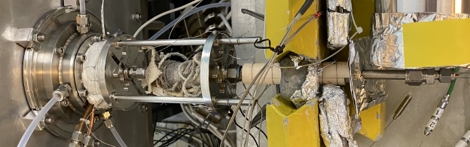

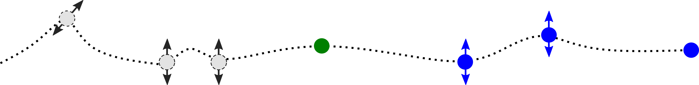


Program 2: Gas phase - Setup at JINR/FLNR
HPGe
$γ$-detector
100%
-ΔH_{ads} = 120 kJ / mol
Relative yield
-ΔH_{ads} = 130 kJ / mol
-ΔH_{ads} = 140 kJ / mol
0%
50
100
150
200
250
300
350
400
450
500
550
800
Temperature [⁰C]
[1] Pershina, V. et al. (2021). Inorg Chem, 60 (13).

Slide 11
Program 2: Gas phase - External Chromatogram
Experiment #1
Experiment #2
Only Ar
Ar & O₂ + H₂O
Notes:
Transition: recall this is solid-gas chromatography, thus the surface is extremely important. Within the external chromatograms we can visually see the change occurring through the experimental points. Around the same temperatures, the surface is also changing.

Slide 12
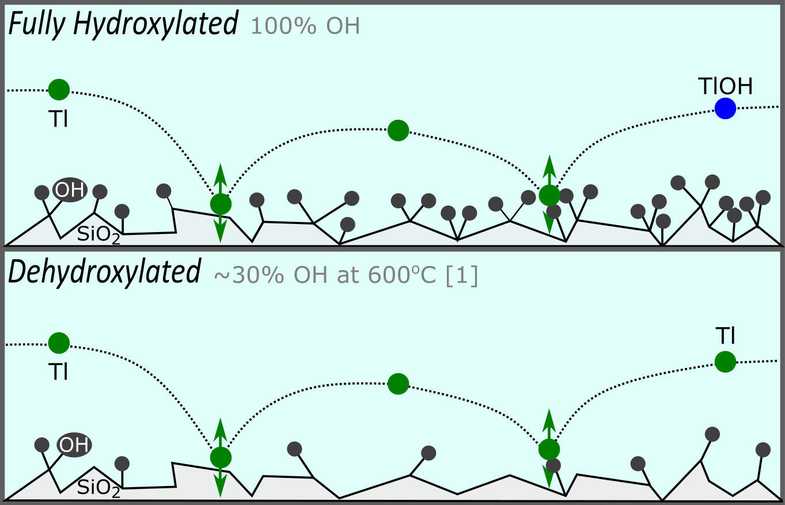
Program 2: Gas phase - Fused Silica Surface
[1] Zhuravlev, L.T. (1987). Langmuir, 3 (316-318).

Slide 13
Theory says: Yes

Slide 14
Program 2: Gas phase - Preliminary Results

Slide 15

Program 2: Gas phase - Near Future
May 2023

Slide 16

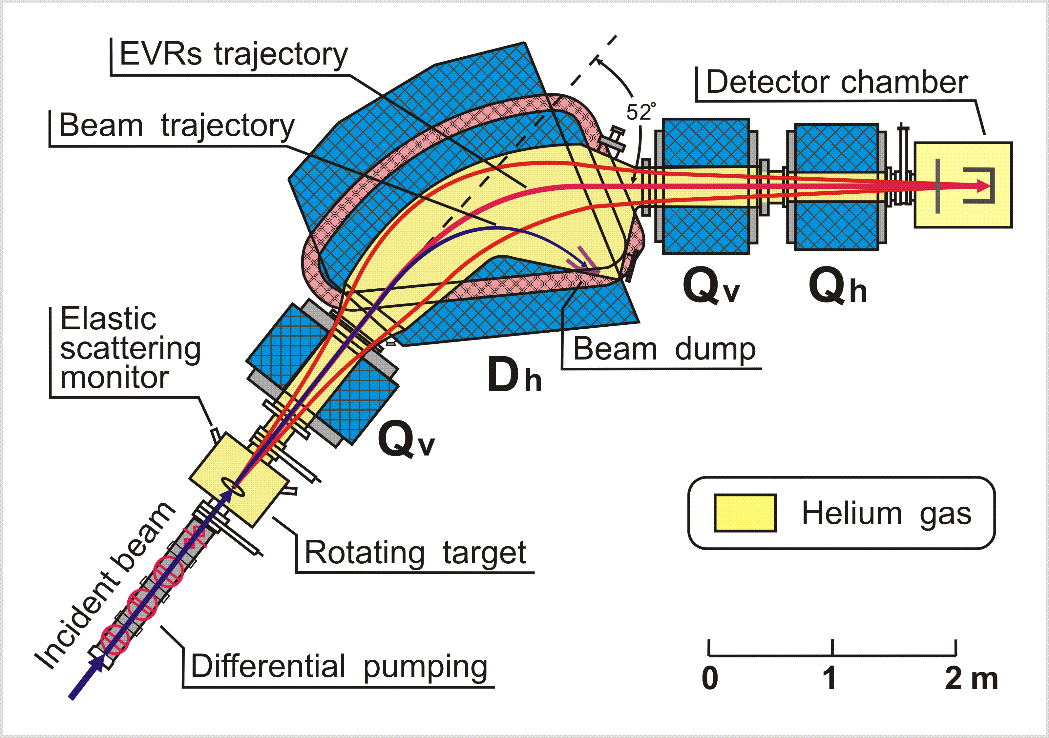
Program 2: Gas phase - Near Future
Tl/Fr on-line model experiments behind SHANS I separator using a setup adapted from what was prepared for the FLNR Fl/Cn experiment (July 2023)
Nh/NhOH experiments behind SHANS II separator using the optimum conditions to prevail one stable chemical state (September 2023)
First Generation:
Recoil stopping
Hot Ta surface
IMP-Gradient Detector

Slide 17
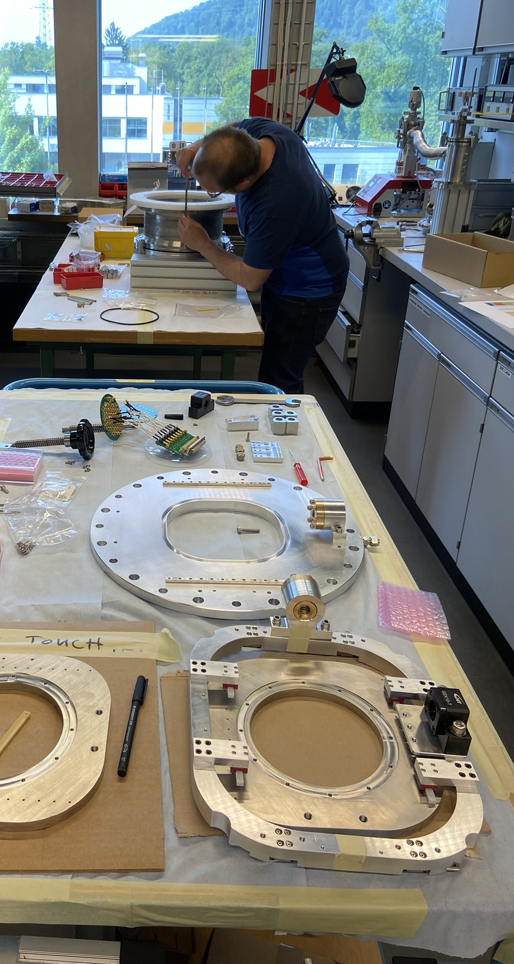
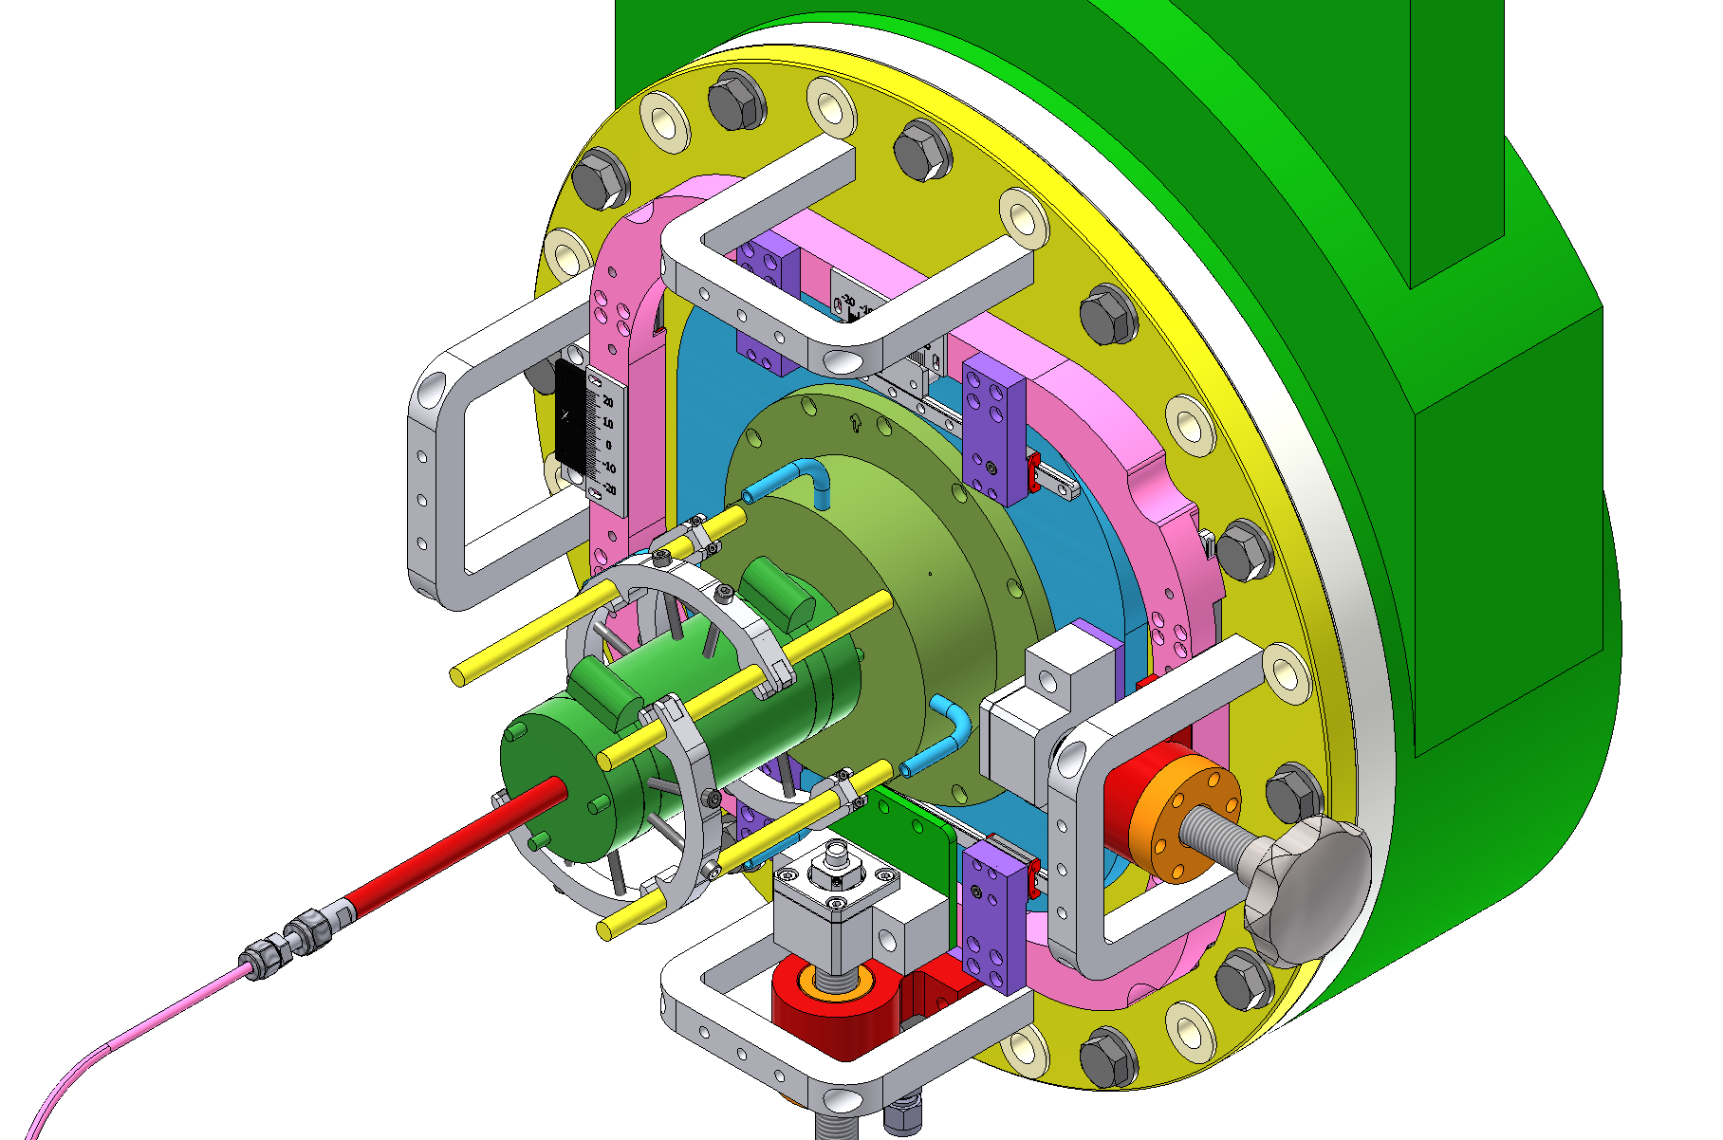
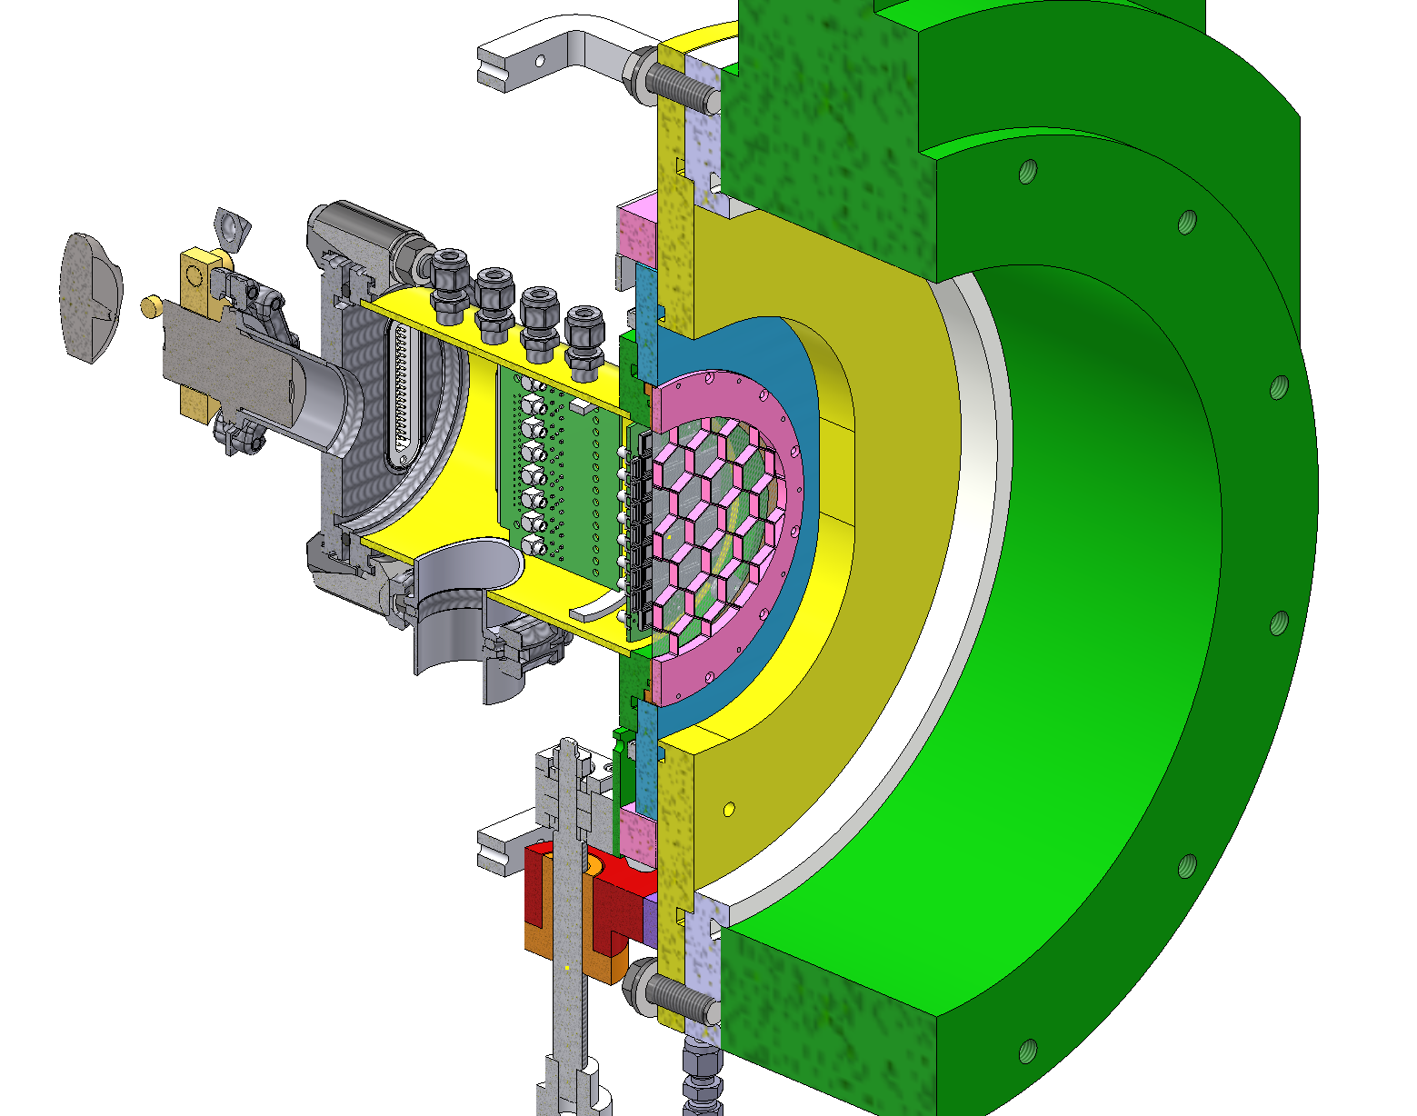
Program 2: Gas phase – Setup for IMP
Focal plane: Recoil Transfer Chamber

Slide 18
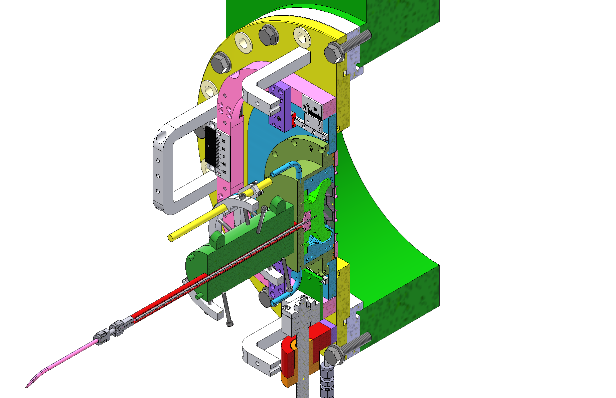
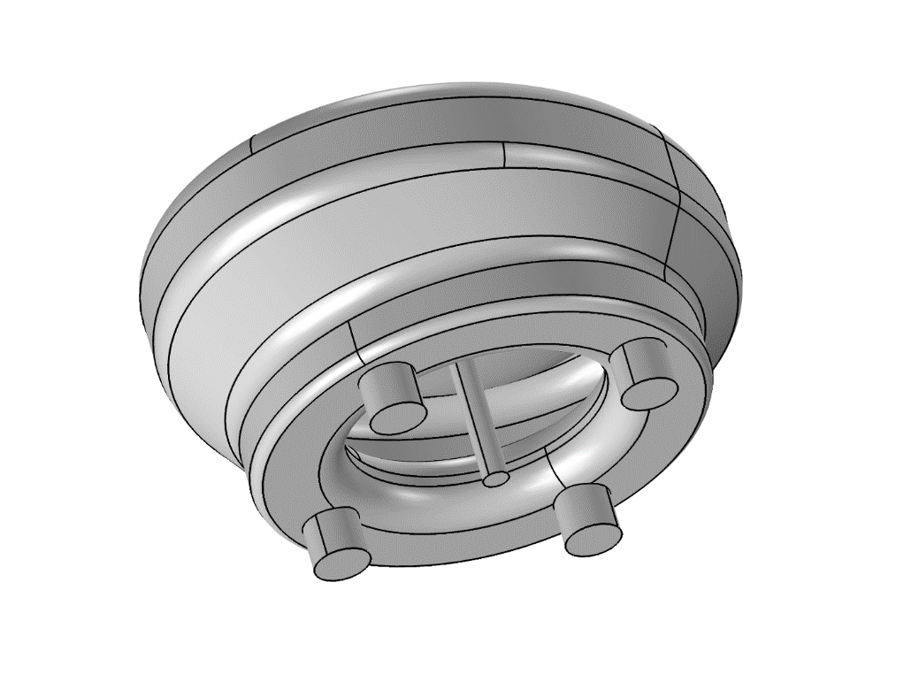
Program 2: Gas phase – Setup for IMP
Focal plane: Recoil transfer chamber
Oven for Ta
EVRs
60 x 80 mm²
The inner volume of the
recoil transfer chamber for
finite element simulations
< 60 cm distance
to detector
Mylar window

Slide 19
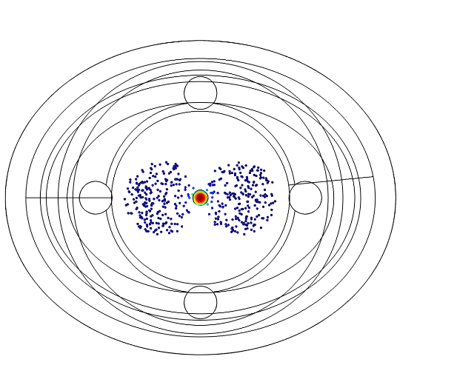
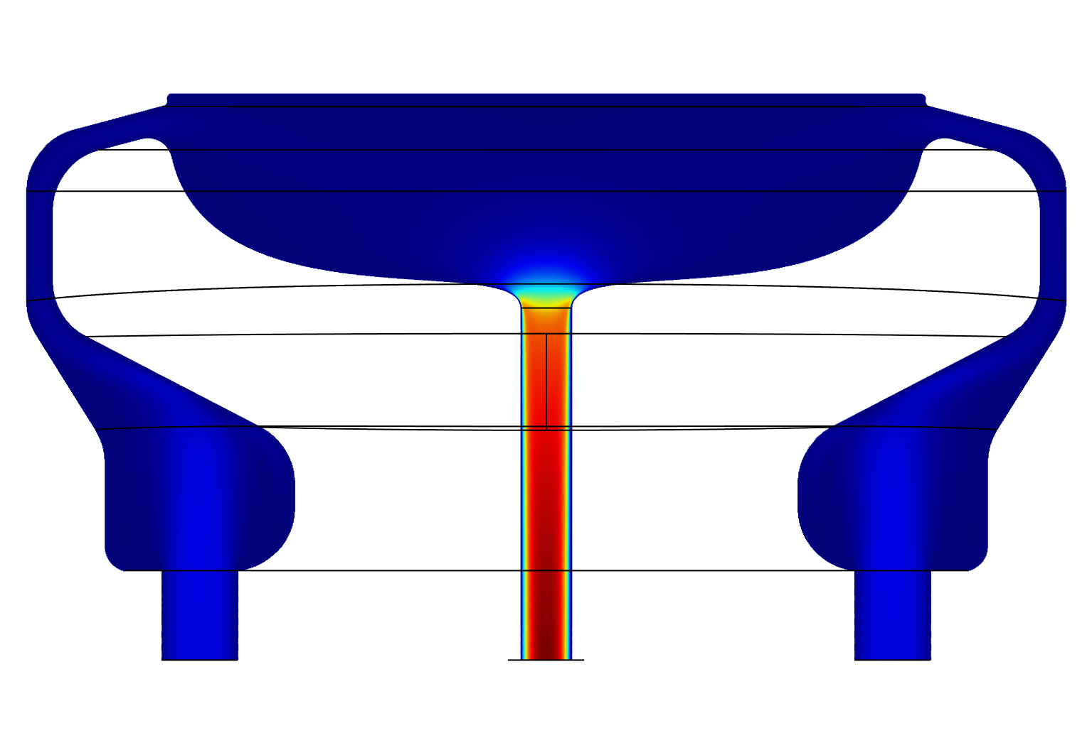
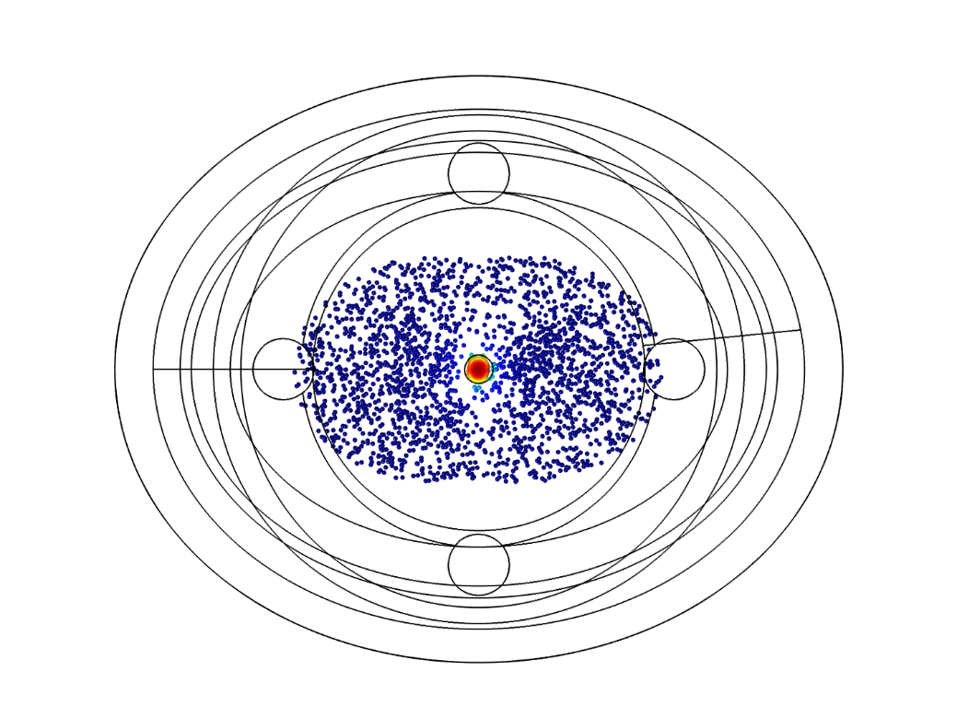
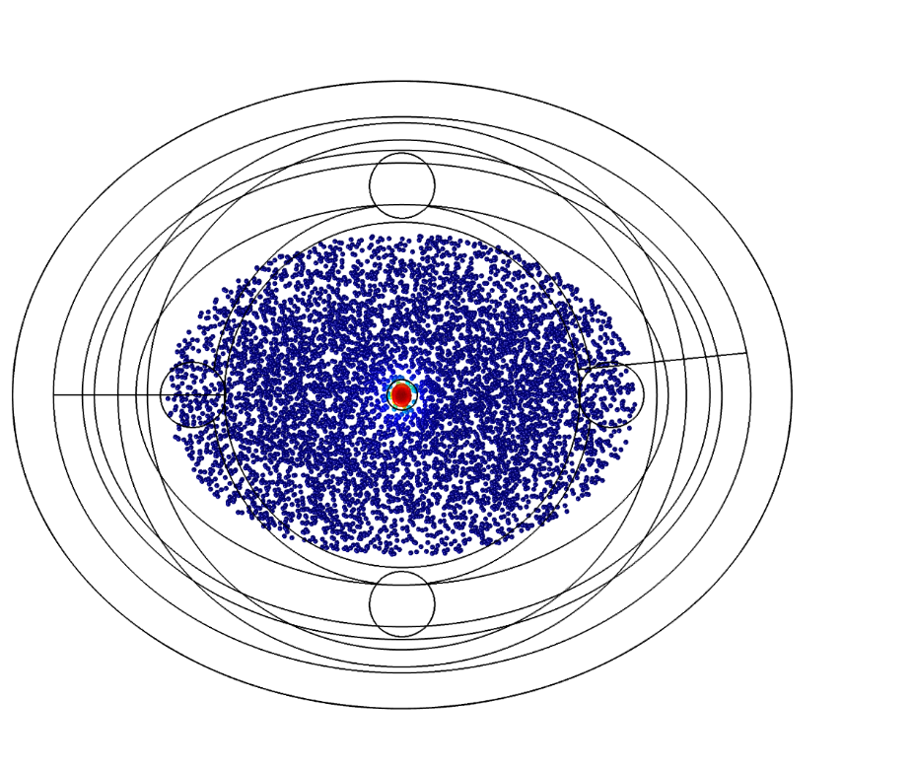

Program 2: Gas phase – Setup for IMP
Focal plane: finite element simulations, particle tracing
2 l/min, Ar
1 mm
8 mm

Slide 20
Program 2: Gas phase – Setup for IMP
Focal plane: finite element simulations
3 l/min, Ar
Chromatographic resolution
2 l/min vs. 3 l/min Ar
Fl-287

Slide 21
Program 2: Gas phase - Near Future
First Generation:
Second Generation:
Recoil stopping
Hot Ta surface
IMP-Gradient Detector
Recoil stopping
Hot Ta surface
Isothermal column
IMP-Gradient Detector
or PSI-HT-Thermochromatgraphy

Slide 22
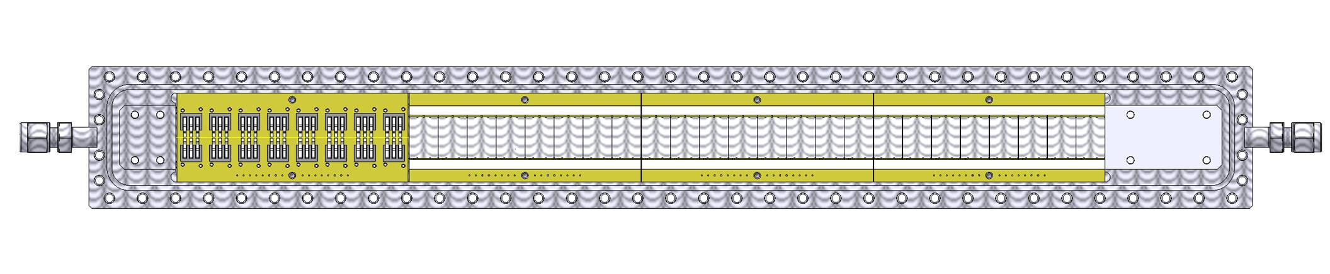
Programs 1+2: High temperature online thermochromatography
[1] [2] Pershina, V. et al. (2021). Inorg Chem, 60 (13). [3] Serov, A. et al. (2013). Radiochim Acta, 101 (7). [4] Steinegger, P. et al. (2016). J Phys Chem C, 120 (13).

Slide 23
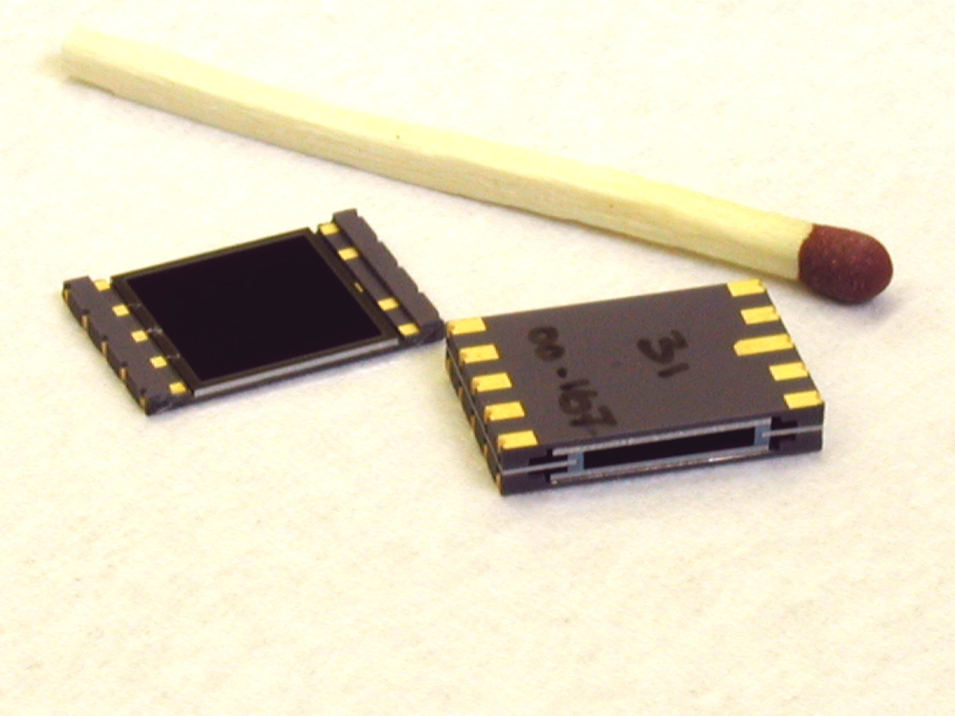
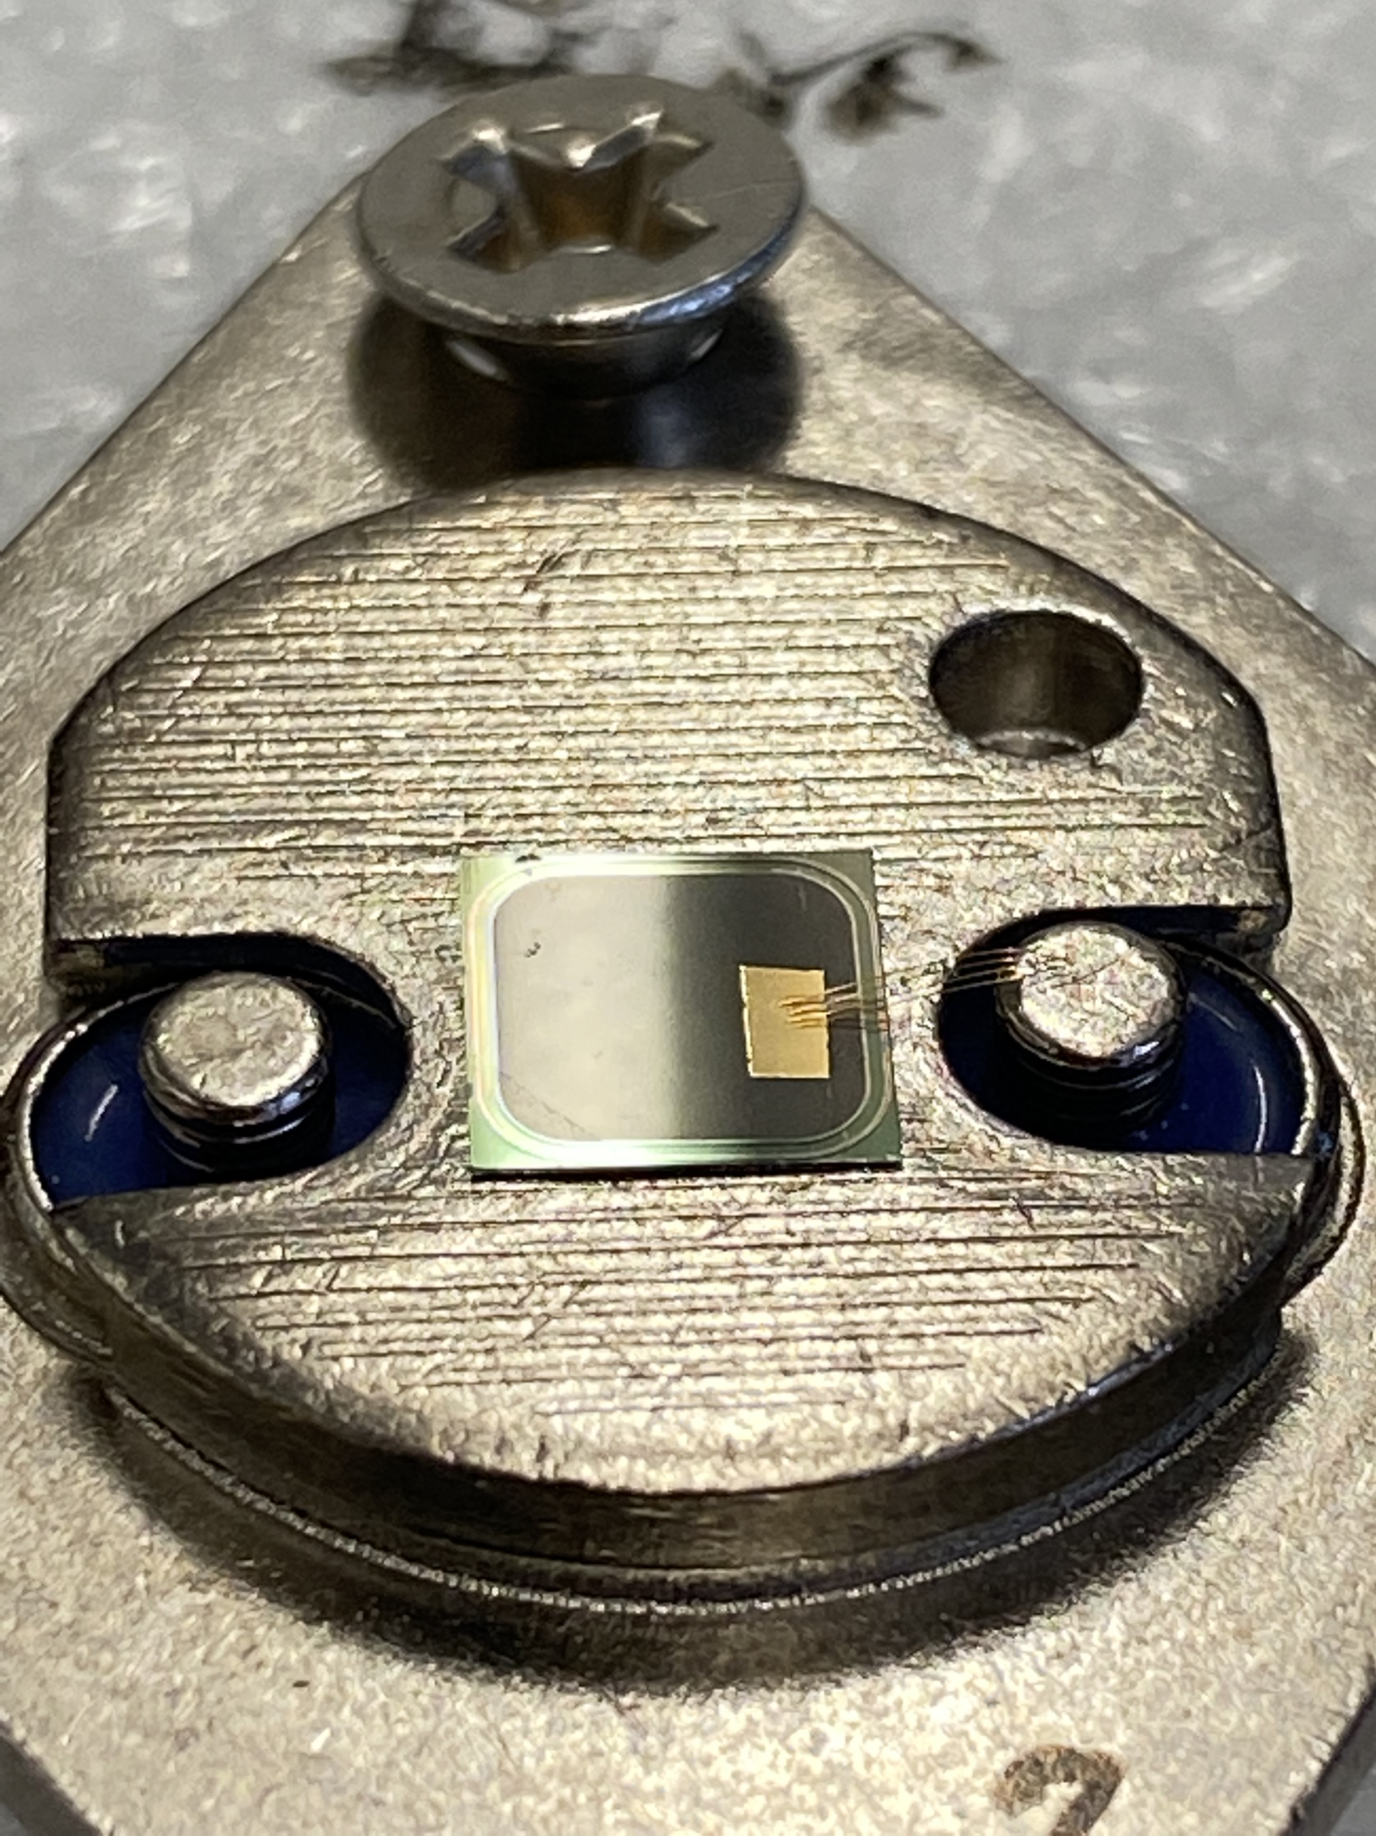
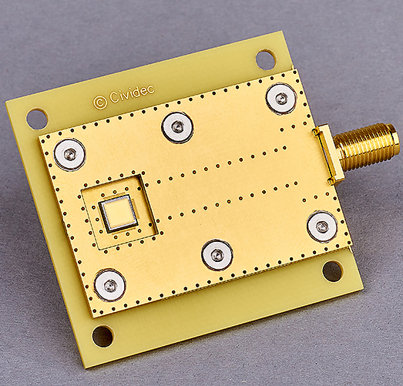


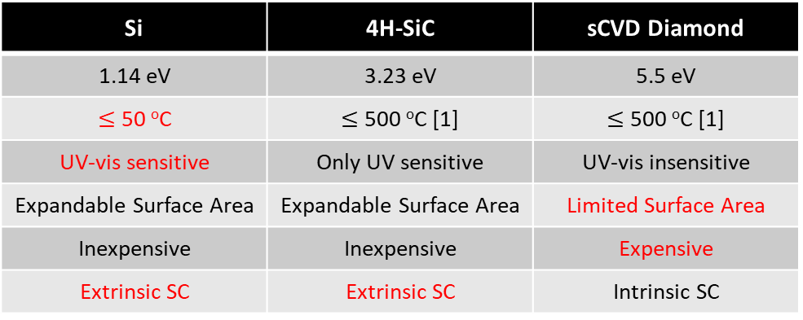
$\text{Programs}\text{ 1+2:} α$-Spectroscopy for SHEs
Si | 4H-SiC | sCVD Diamond
1.14 eV | 3.23 eV | 5.5 eV
$≤$ 50 ºC | $≤$ 500 ºC [1] | $≤$ 500 ºC [1]
UV-vis sensitive | Only UV sensitive | UV-vis insensitive
Expandable Surface Area | Expandable Surface Area | Limited Surface Area
Inexpensive | Inexpensive | Expensive
Extrinsic SC | Extrinsic SC | Intrinsic SC
[1] C. Weiss, J. Wilson, et. al., Nucl. Inst. Meth. A, 2022, 1040.

Slide 24
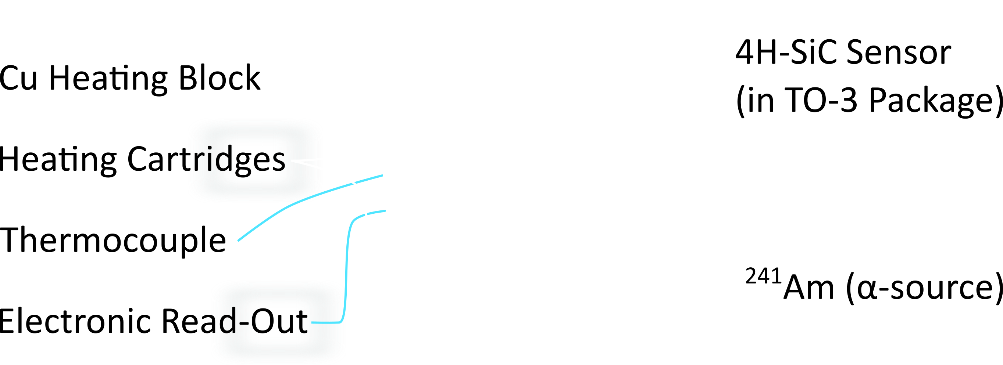
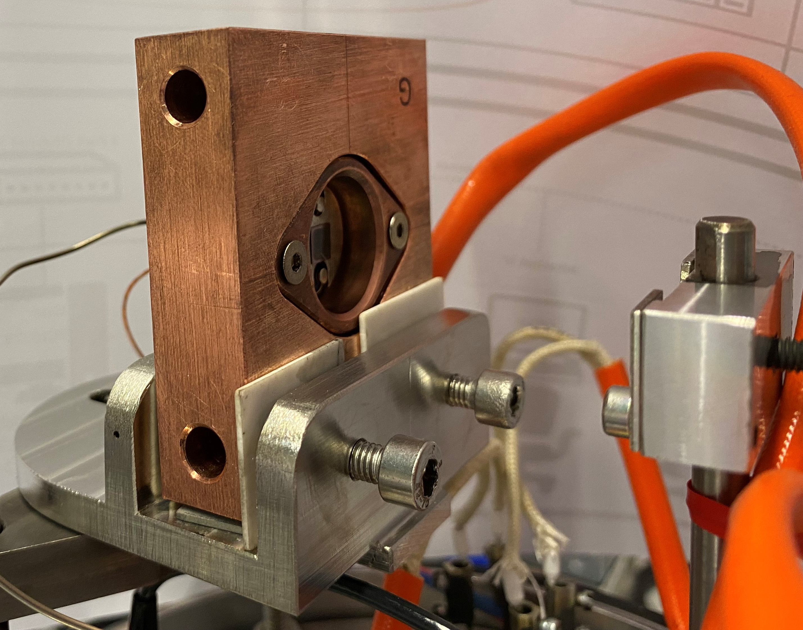
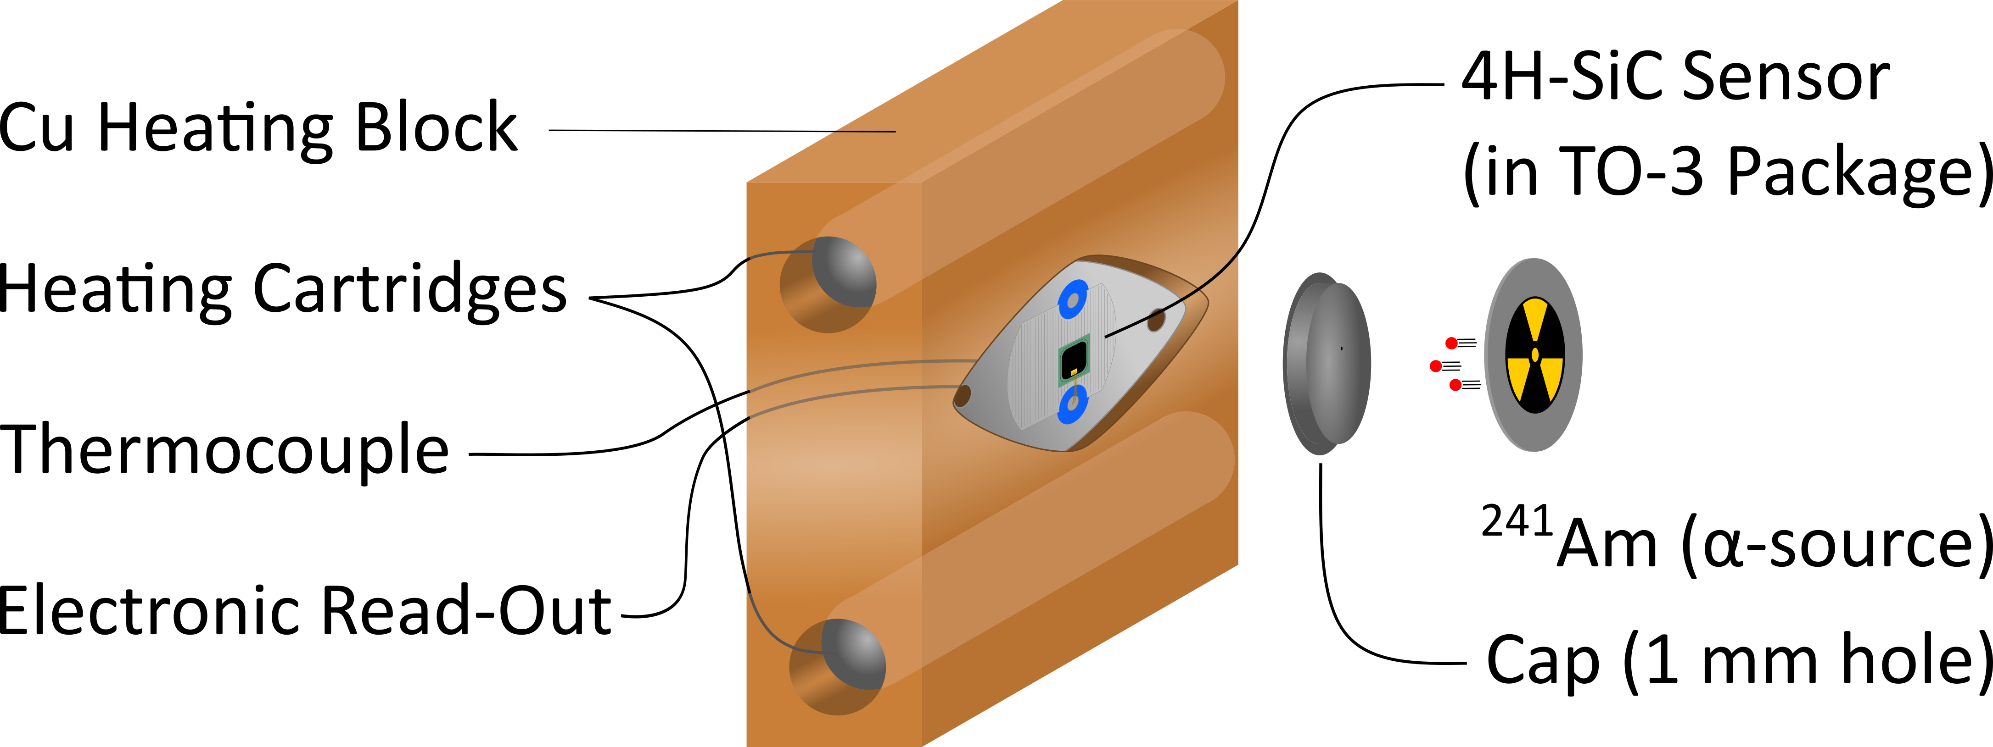
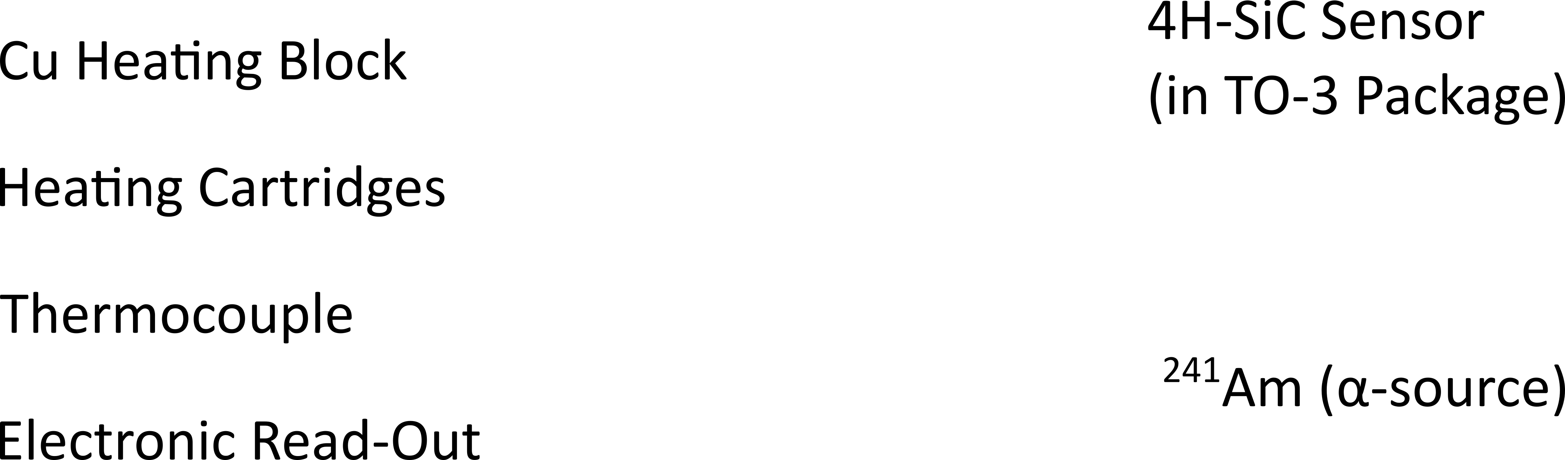
Programs 1+2: Setup (in vacuo)
Notes:
Brief overview of setup
Highlight: thermocouple is touching the back of the TO-3 package

Slide 25
Programs 1+2: Results
During Sea-Saw-Step Heat
100^{O}C
200^{O}C
300^{O}C
300^{O}C
400^{O}C
400^{O}C
500^{O}C
Spectroscopic resolution: ≈1%
Energy (mV)

Slide 26
Programs 1+2: Outlook
Notes:
Add important graphs for conclusion

Slide 27
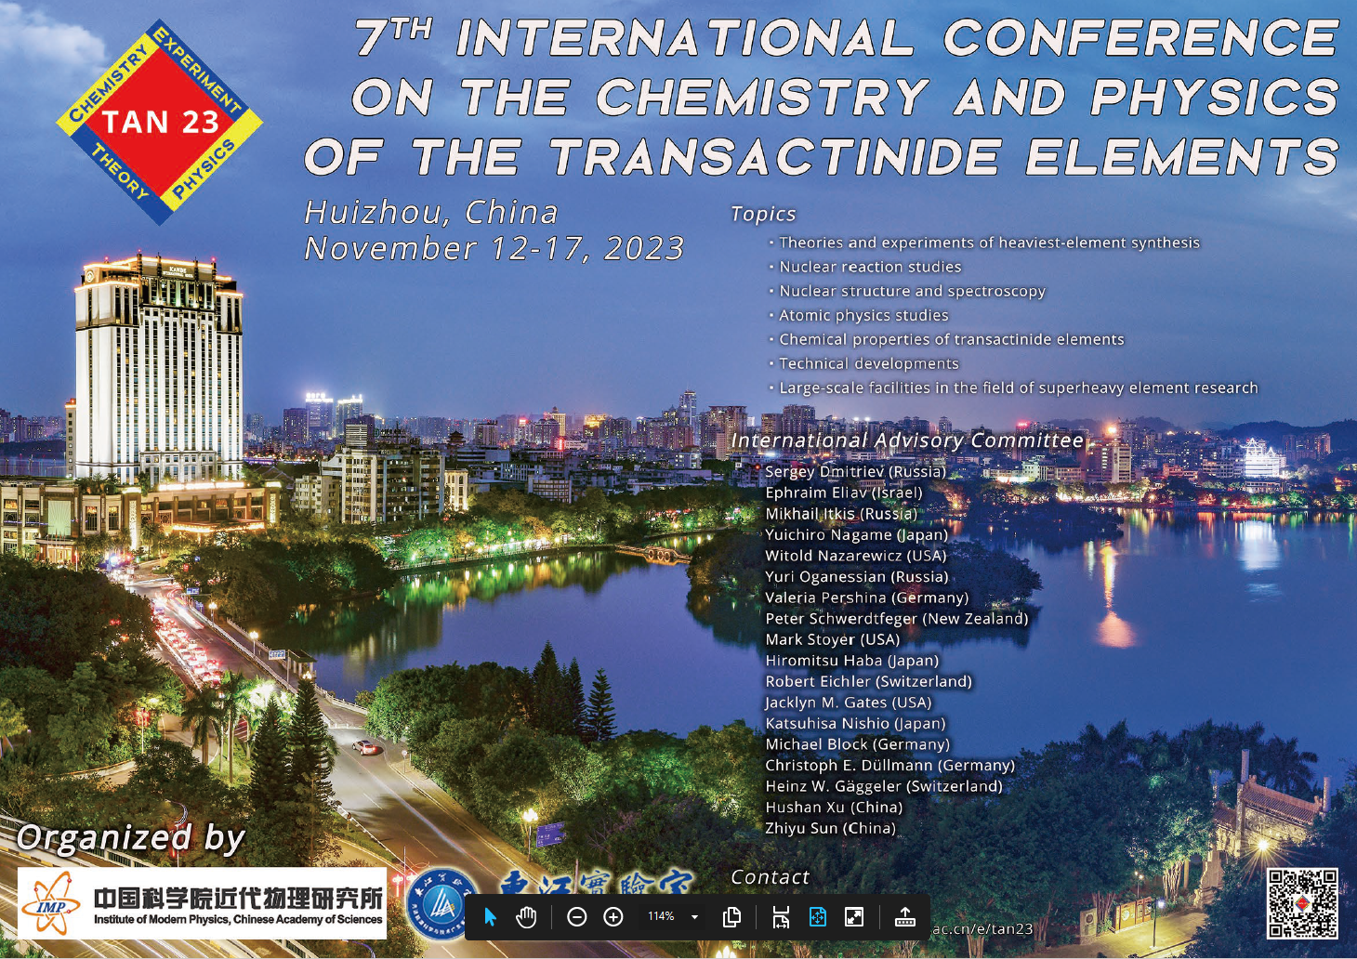

Slide 28
Wir schaffen Wissen – heute für morgen
Take home…
PSI keeps on Nh
Topic still attractive
With Swiss universities academic connection is secured

Slide 29
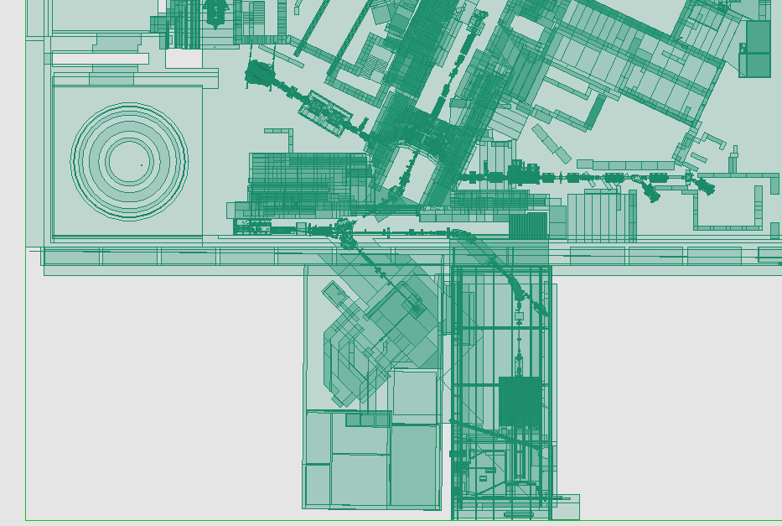
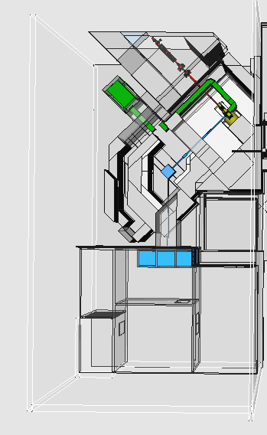
New TATTOOS Facility Design

Slide 30


Production in Spallation of Ta & U/Th
10¹³
10¹²
10¹¹
10¹⁰
10⁹
10⁸
10⁷
Tantalum
Activity [Bq]
6 d irr. Uranium
10¹³
10¹²
10¹¹
10¹⁰
10⁹
10⁸
10⁷
Activity [Bq]
6 d irr. Thorium
>50% of known
radionuclides assessable!

Slide 31
RILIS & Mass separation under design

Slide 32









TATTOOS part of 70 MCHF-IMPACT Proposal to the Roadmap of Swiss Research Infrastructures (2025-28) (accepted by SNF & ETH-Council 2023)
Nuclear Medical Practitioners Say…YES
TATTOOS
…in and abroad
https://www.psi.ch/en/impact
© PSI

