Slide 1
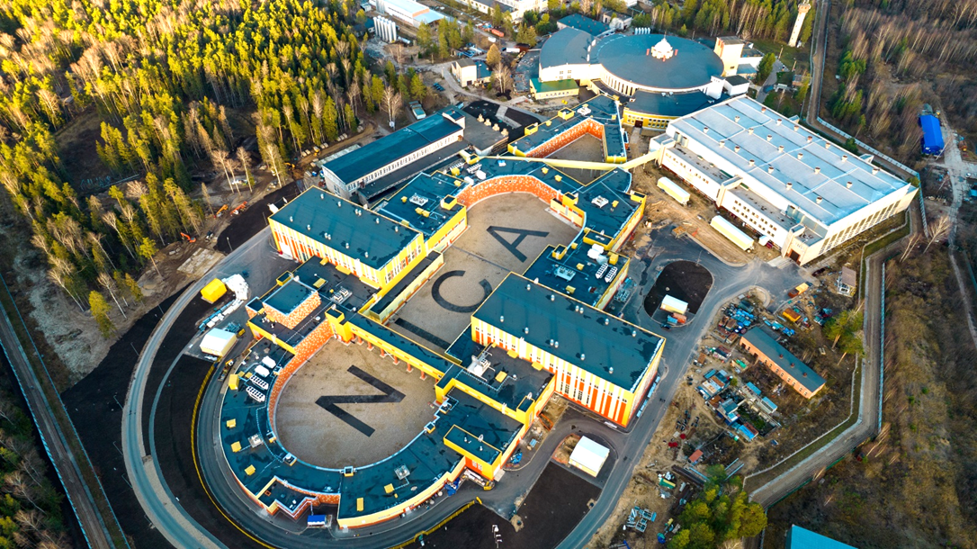
NICA accelerator complex
A.Butenko on behalf of the team
UIPAP Conference “Heaviest nuclei and atoms”, Yerevan, April 2023

Slide 2
Introduction (complex NICA)
Two LINACs & ion sources
LU-20/LILAc (light & pol. ions)
HILAC (heavy ions)
The Booster ring
The Nuclotron ring
Collider systems status

Slide 3
NICA complex layout
Collider
Fixed target area
BM@N
Two linacs:
HILAC & LILAC
Nuclotron
Two Linear Injectors & sources
Booster
Booster & beam line
Nuclotron ring
Beam lines @ fixed target area
Collider ring

Slide 4
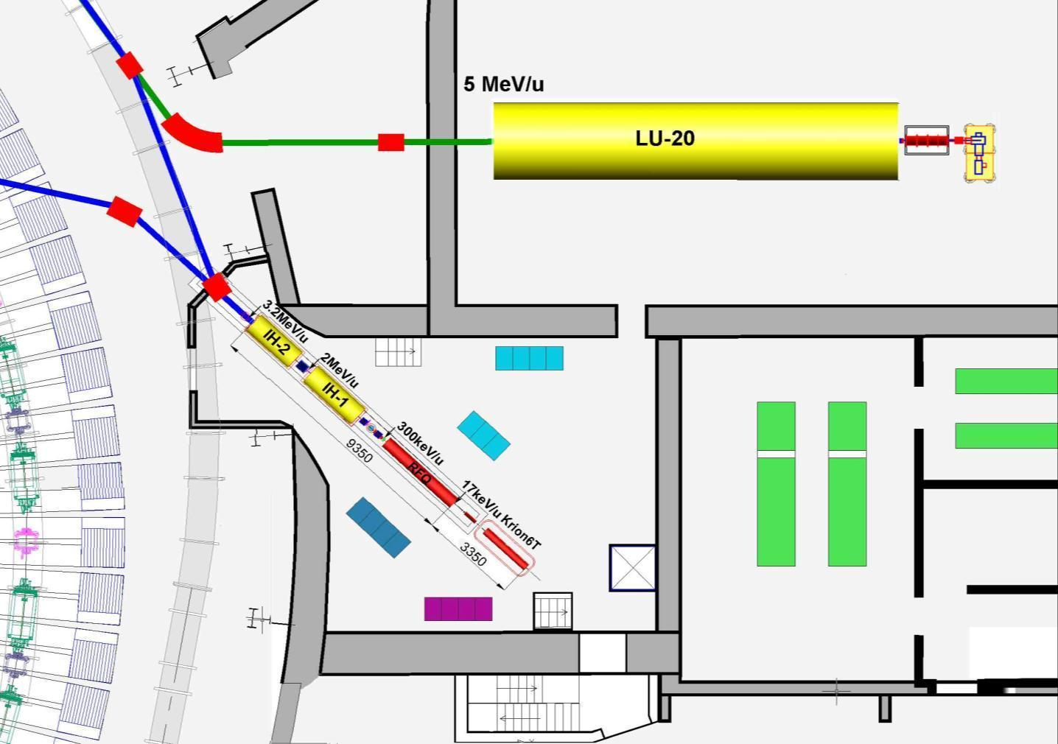
Layout of the linear Injectors
p↑, d↑, ions Z/A>0,3
Booster
Injection
channel
Ions Z/A>0,3
LIS
RFQ
SPI
p↑,d↑
10mA
LU-20 building
HILAc
HILAc building
^{Booster}
Nuclotron
RF amplifier for LU-20

Slide 5
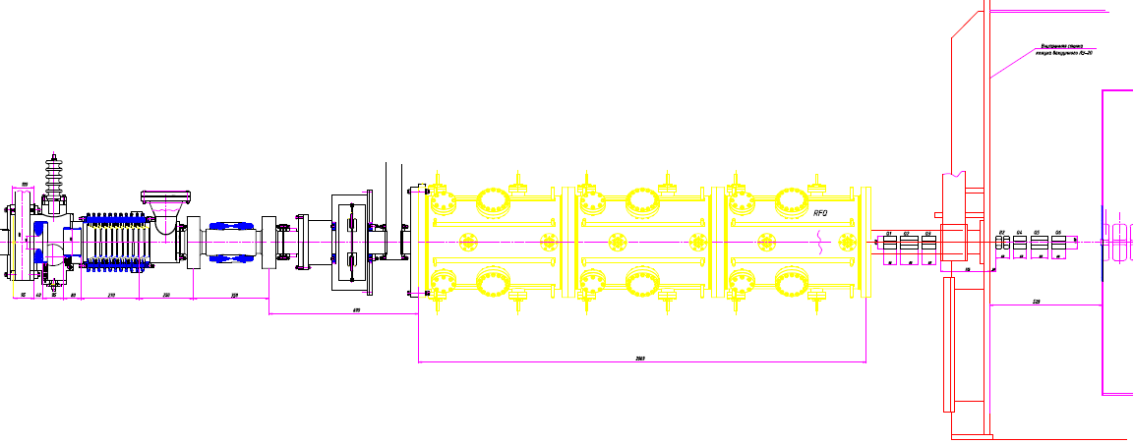
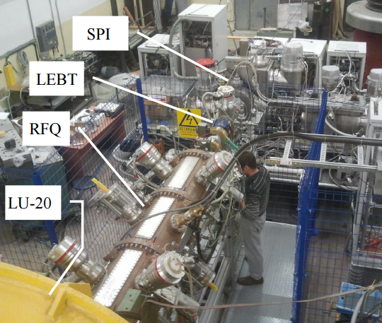
New fore-injector for LU-20 + SPI for polarized p & d
Designe has been started in 2012 In collaboration with ITEPH, MEPHI, Snezhinsk.
LEBT + Buncher
4 wane RFQ
(3 sections)
MEBT LU-20
QT + Bu +QT
Commissioned in 2016
4 Nuclotron beam RUNs
was provided
source
The SPI-project was started more then 10 year ago.
Main purpose is to provide the intensity of the accelerated polarized beams (D+,H+) up to 10¹⁰ p/pulse
The SPI provided by polarized d & p Nuclotron complex during two beam RUNs in 2016-17.

Slide 6
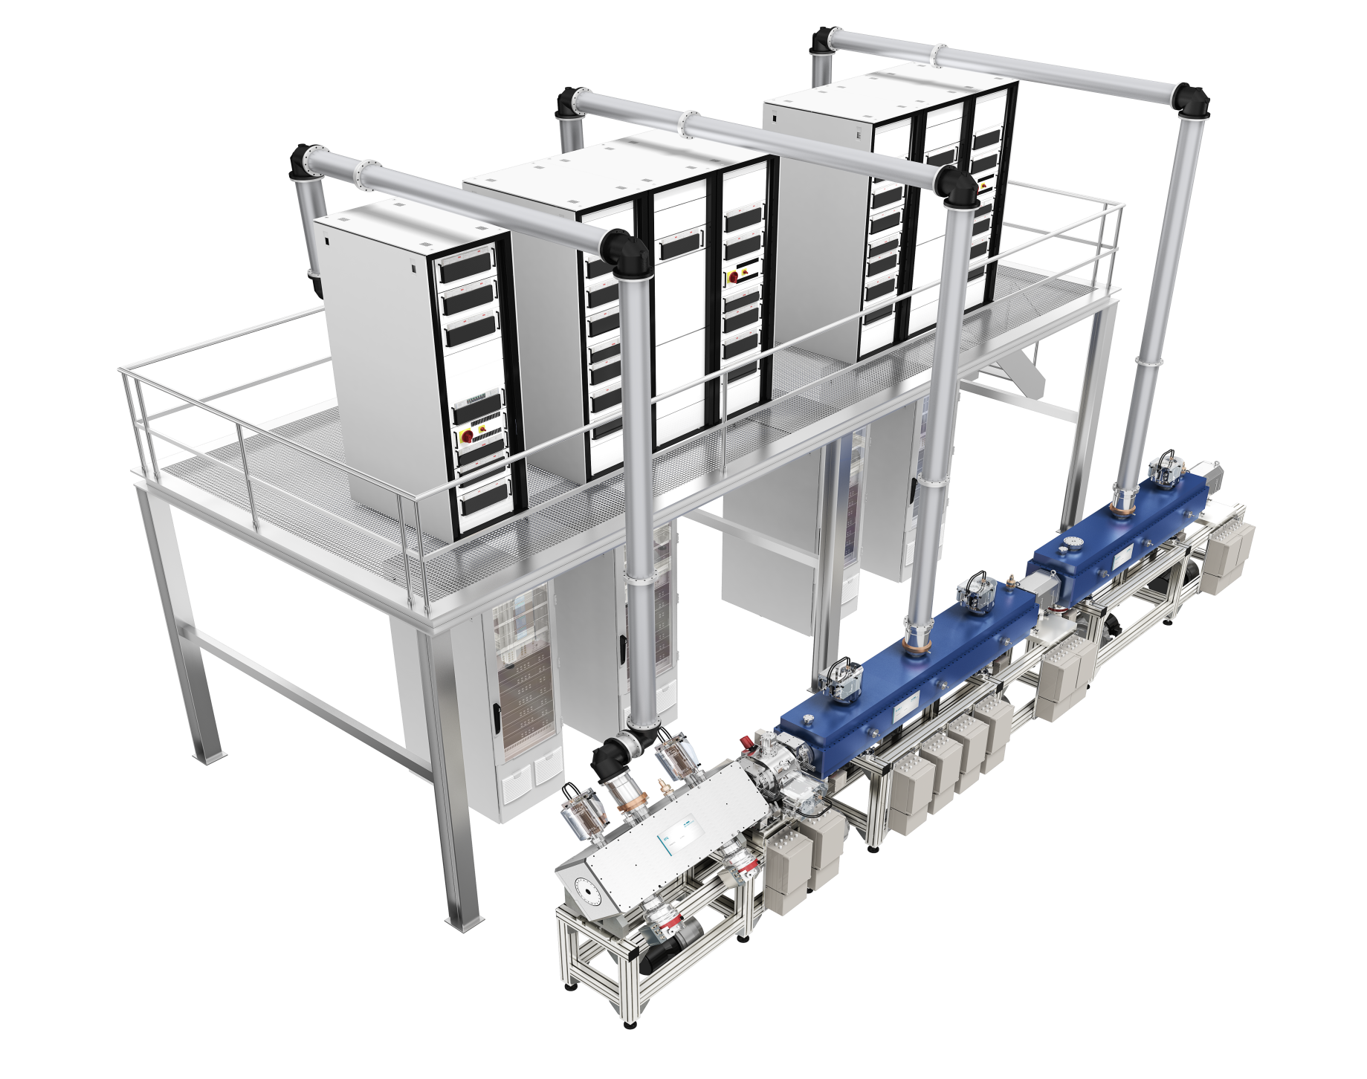
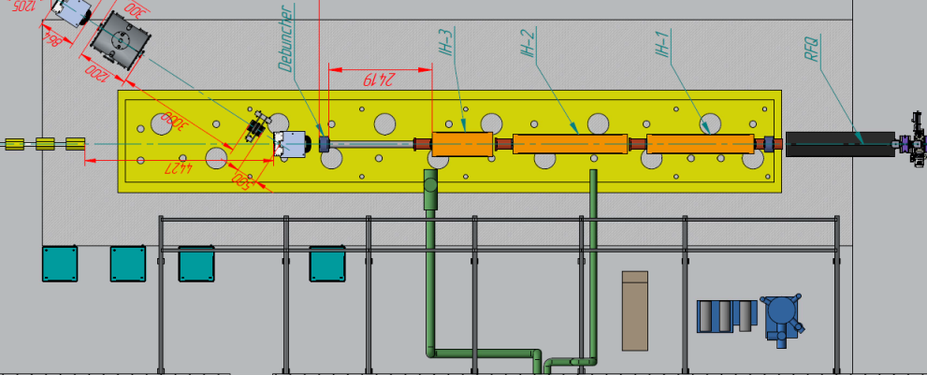
Layout of the linear Injectors
The new Light Ions Linac LILAC
p↑, d↑, ions Z/A>0,3
Booster
Injection
channel
Ions Z/A>0,3
LIS
RFQ
SPI
p↑,d↑
10mA
7 MeV/u for A/q<3, 13 MeV for protons
LU-20 hall
HILAc
HILAc building
^{Booster}
Nuclotron
RF amplifier for LU-20

Slide 7
Layout of the linear Injectors
p↑, d↑, ions Z/A>0,3
Booster
Injection
channel
Ions Z/A>0,3
LIS
RFQ
SPI
p↑,d↑
10mA
LU-20 building
HILAc
HILAc building
^{Booster}
Nuclotron
RF amplifier for LU-20

Slide 8
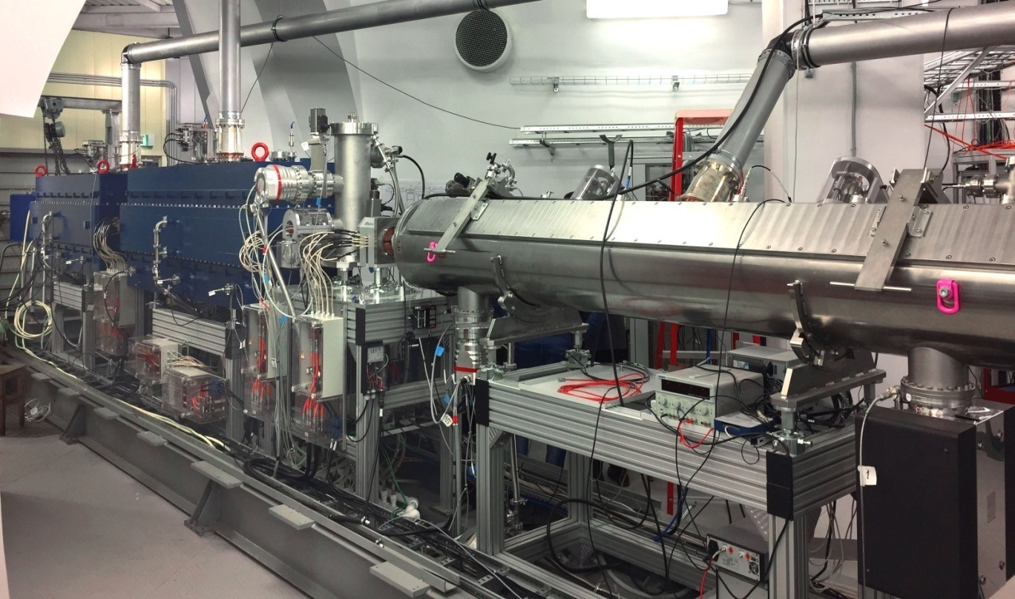
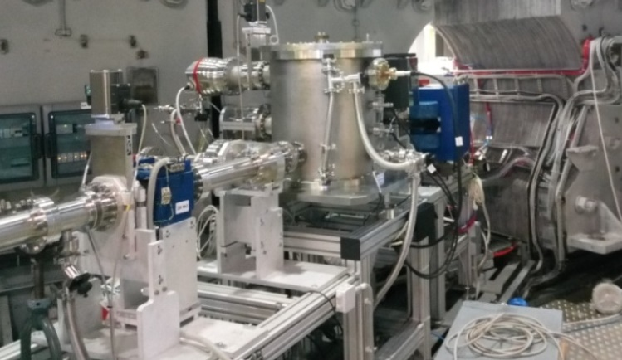
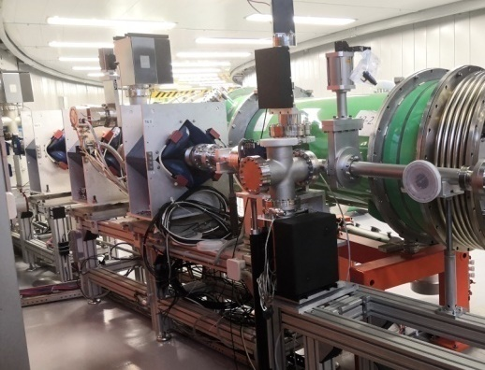
HILAC & Booster injection beam line
BEVATECH Germany
Stable and safe operation during Booster commissioning with Fe ¹⁴⁺ and Xe ²⁸⁺ beams
Heavy Ion Linear Accelerator
Commissioned in 2018
A/q (Target Ion Au³¹⁺) | 6.25
Beam current | < 10 emA
Repetition rate | < 10 Hz
Output energy | 3.2 MeV/u
Transmission of 2mA Fe¹⁴⁺ ions beam up to 75% from RFQ to the exit of the HILAc, 3.2 MeV/u

Slide 9
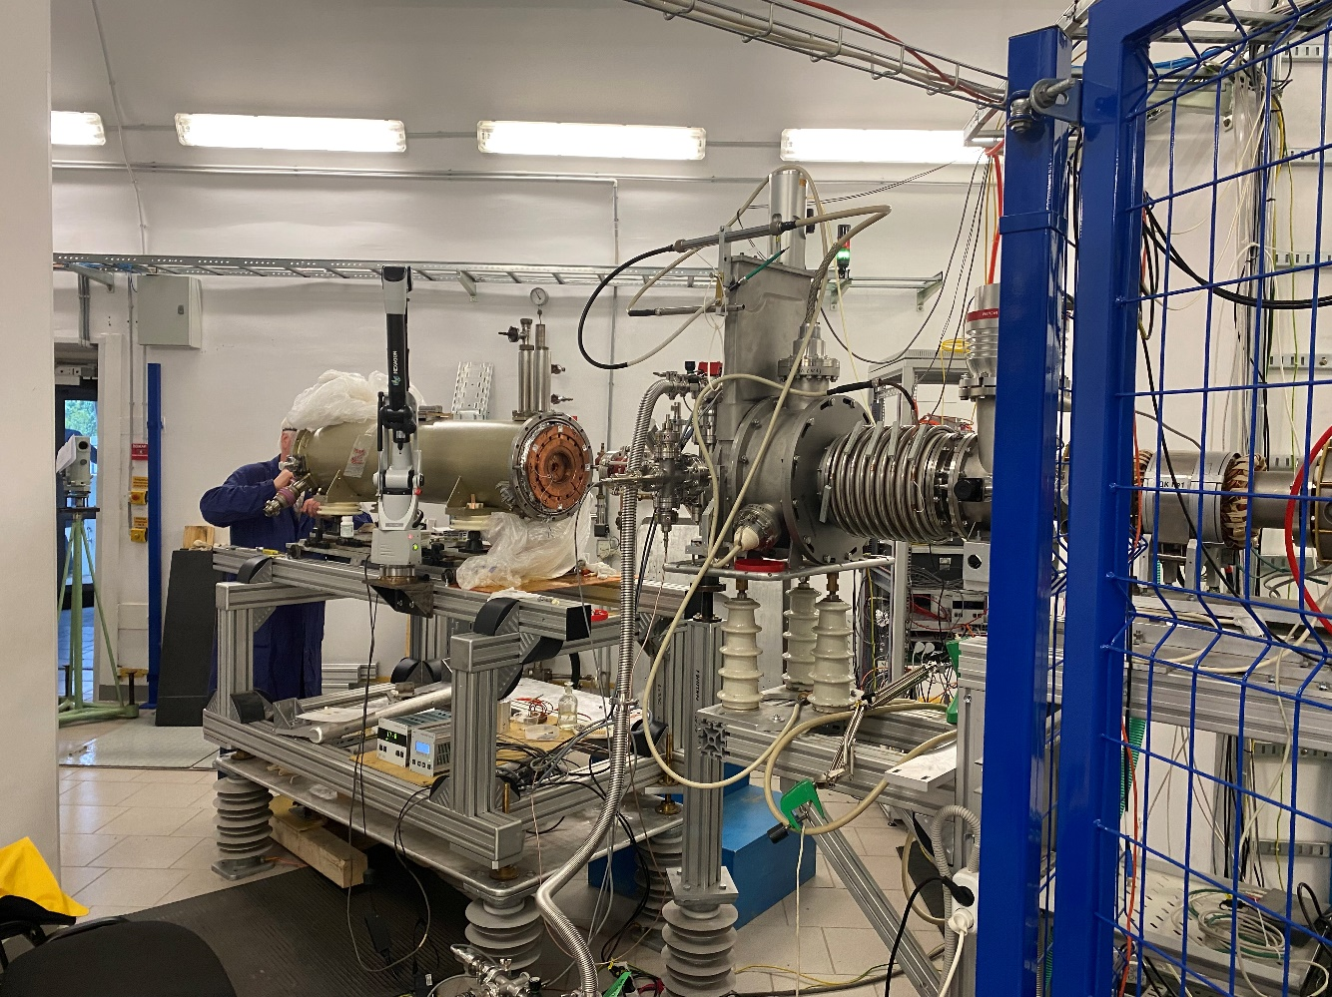
Run at HILAC with KRION source
KRYON source at the HILac
In April 2022 the run at HILAC accelerator was started for optimization
of Ar and Xe beams generation and acceleration up to 3.2 MeV/n
KRION-6T alignment on the HILac axis on high Voltage terminal

Slide 10
Introduction (complex NICA)
Two LINACs & ion sources
LU-20/LILAc (light & pol. ions)
HILAC (heavy ions)
The Booster ring
Beam transfer line
The Nuclotron ring

Slide 11
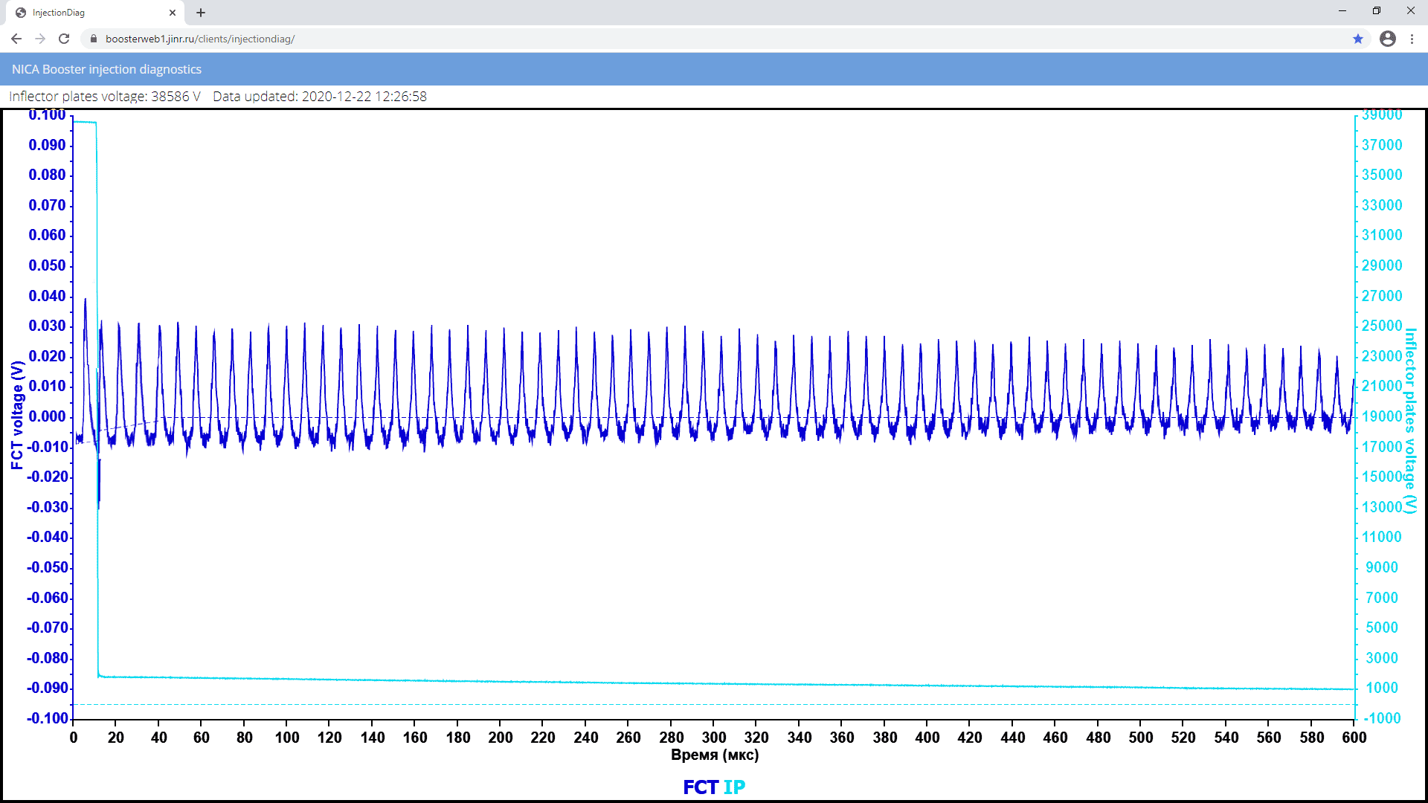
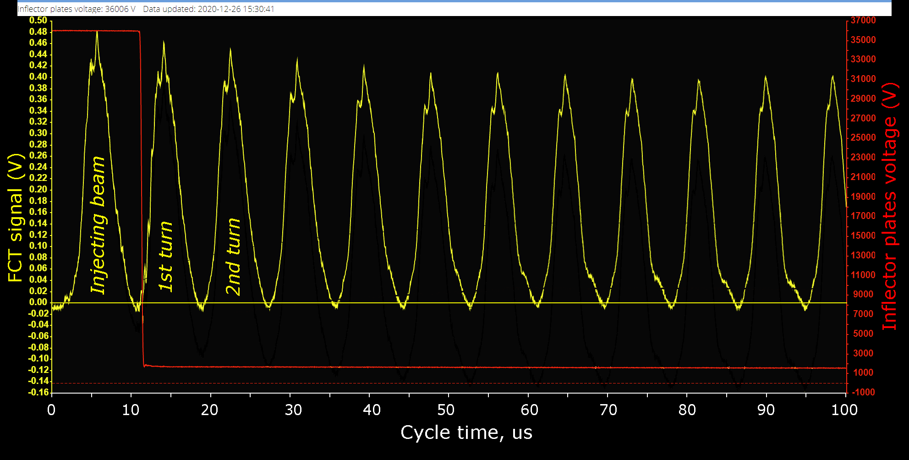
Beam injection & circulation
19.12.2020, 19:56 Moscow time. First beam in the ring.
Fast Current Transformer (FCT)
22.12.2020
Circulating beam
at the injection energy 3.2 MeV/u
600 ms circulation of He¹⁺
26.12.2020
Beam losses < 10%
just on the first 5 turns.

Slide 12
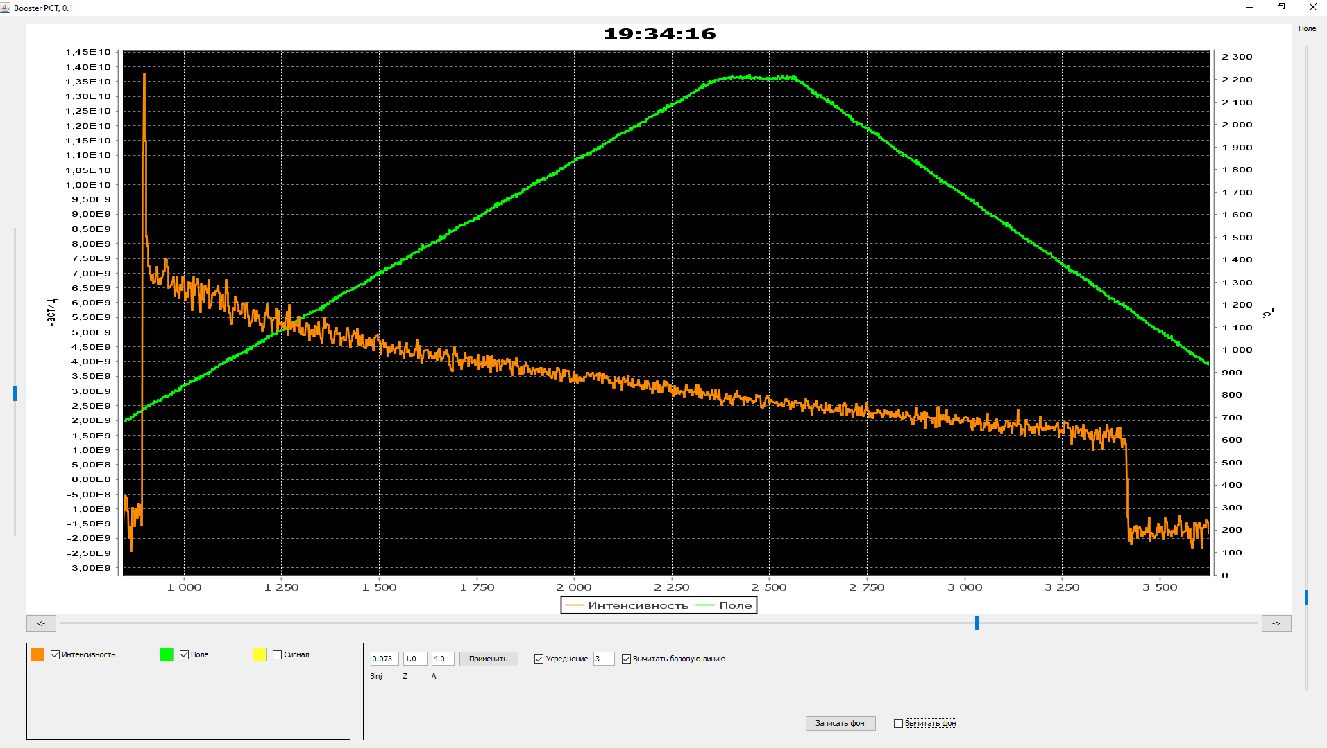
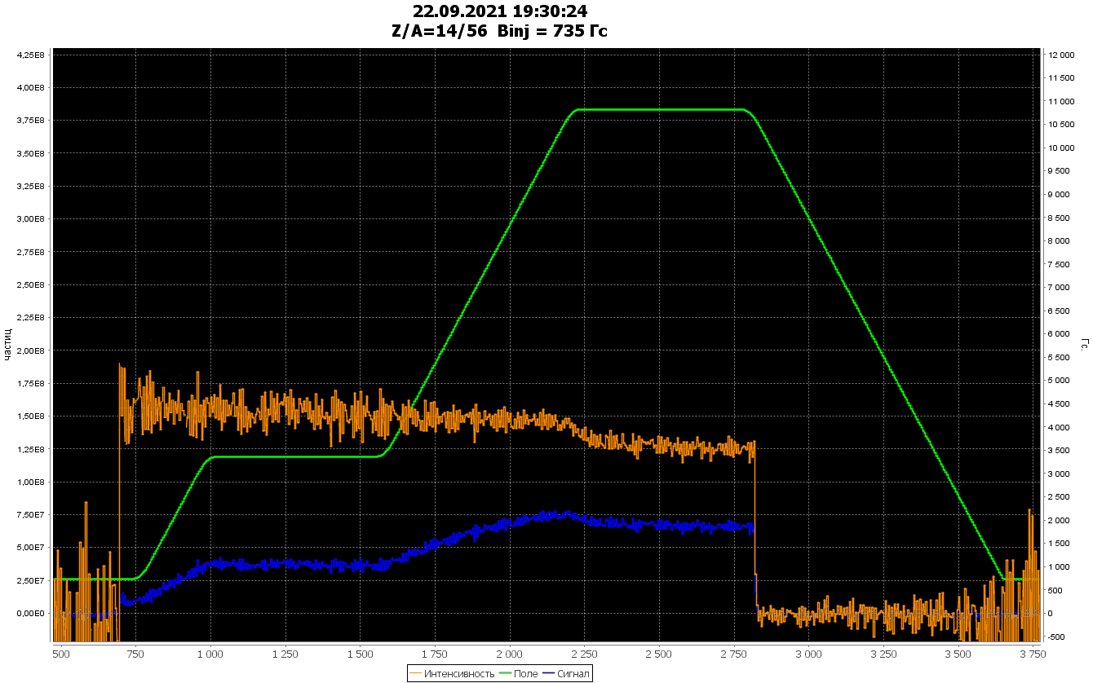
Beam acceleration
Parametric beam current transformer signal (DC mode)
Cycle-1 of commissioning
20 of December 2020 He¹⁺
Injection
Circulation
100 MeV/u
Magnetic field
Beam Intensity
PCT signal when beam injecting into rising field, capturing (~60%), accelerating & decelerating:
no transient losses on the MF table & after.
Acceleration
He¹⁺
Deceleration
Magnetic field
RF off
RUN-1
1000 1500 2000 2500 3000 3500
Cycle time, ms
Cycle 2 of commissioning
14-23 of September 2021 Fe¹⁴⁺
RUN-2
RF capturing 5 harm.
Acceleration
Re-capturing 1 harm.
Fe¹⁴⁺
Injection
Circulation
65 MeV/u
Acceleration
Circulation
578 MeV/u
Beam injection with adiabatic capturing 5 harmonic (>95%),
accelerating up to 65 MeV/u,
recapturing 1 harmonic (close to 100%)
acceleration up to 578 Mev/u
with project ramp dB/dt = 1.2 T/s
Magnetic field 1,2 T/s
500 1000 1500 2000 2500 3000 3500
Cycle time, ms

Slide 13
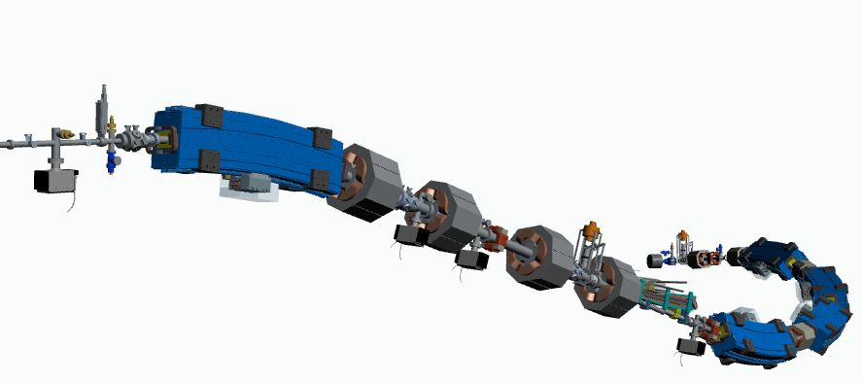
Beam extraction & transfer line
3-rd str. sect.
Contract with BINP
Beam fast extraction section
Circulating beam
To Nuclotron
3D model of the transfer line

Slide 14
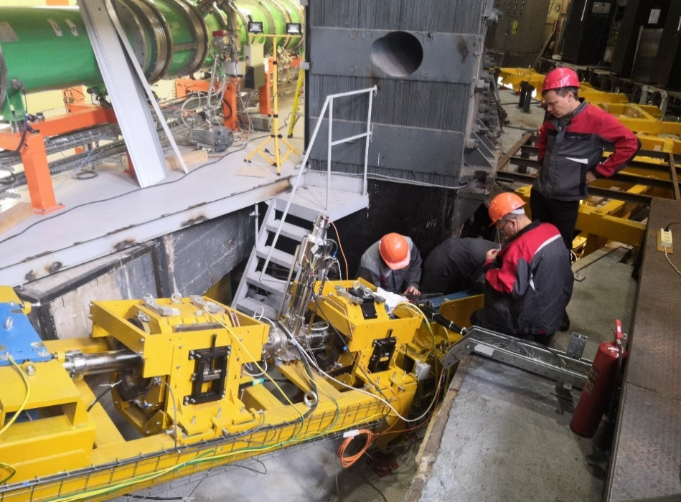
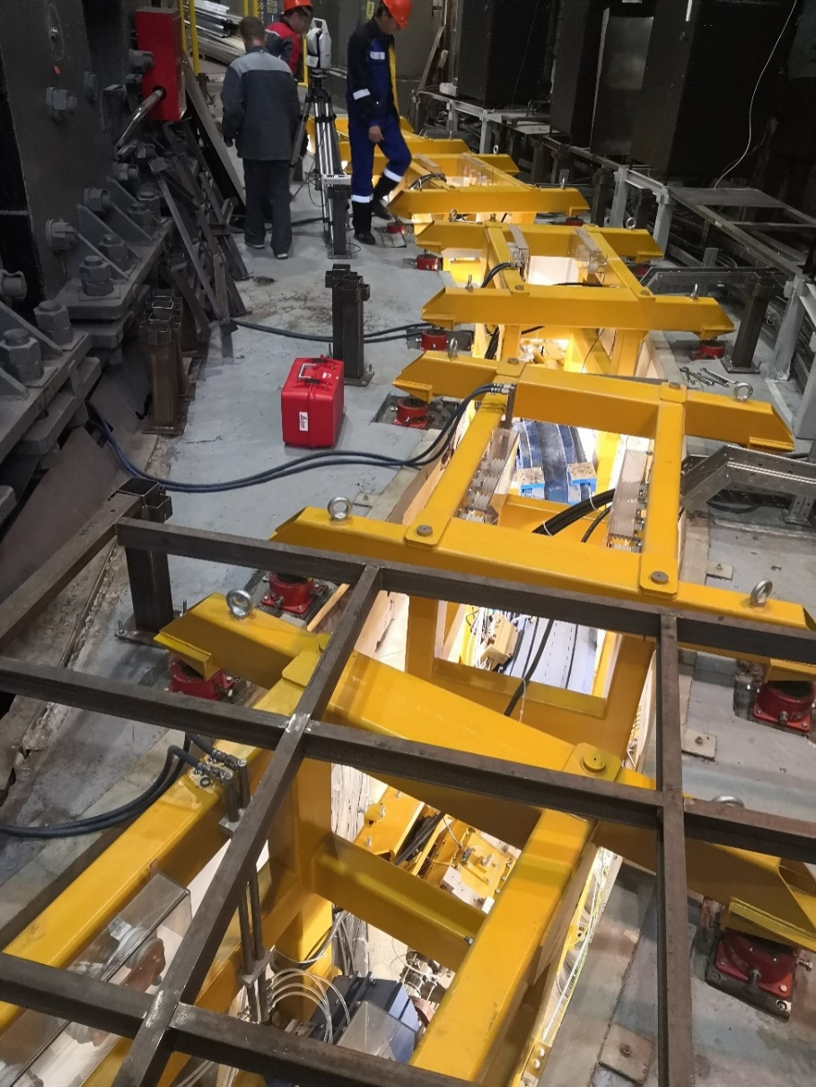
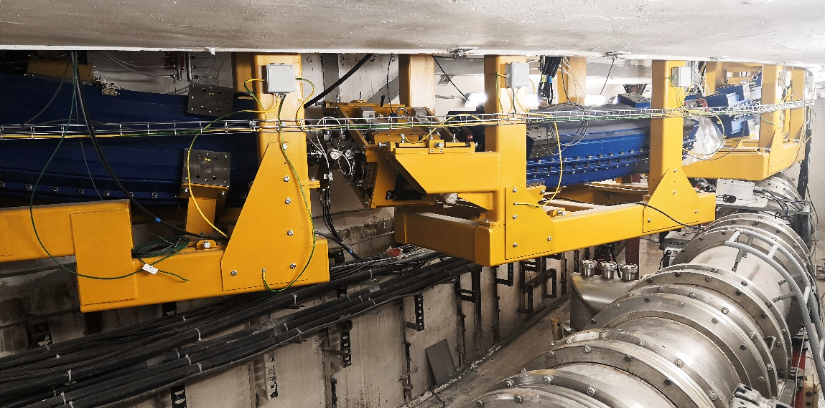
Beam extraction & transfer line
Autumn of 2021 for the Run#2

Slide 15
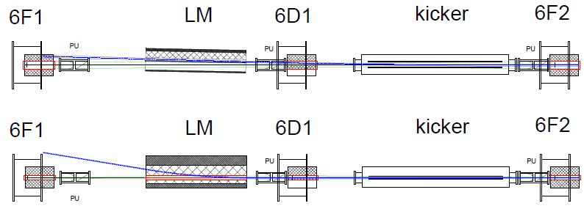
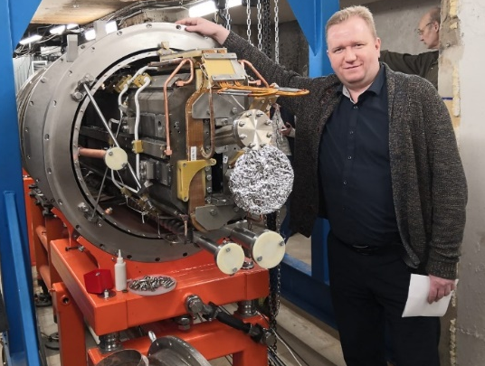
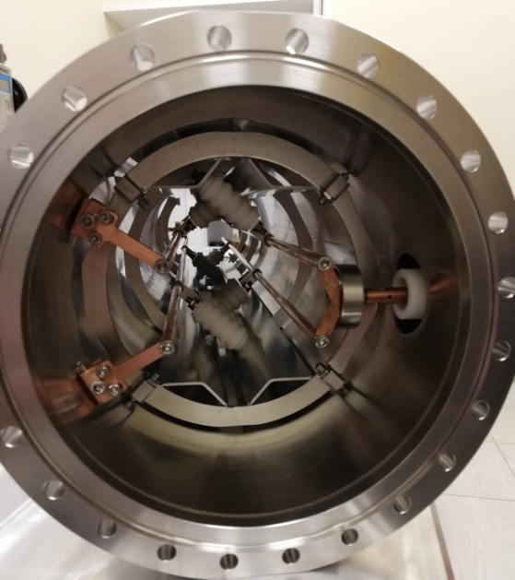
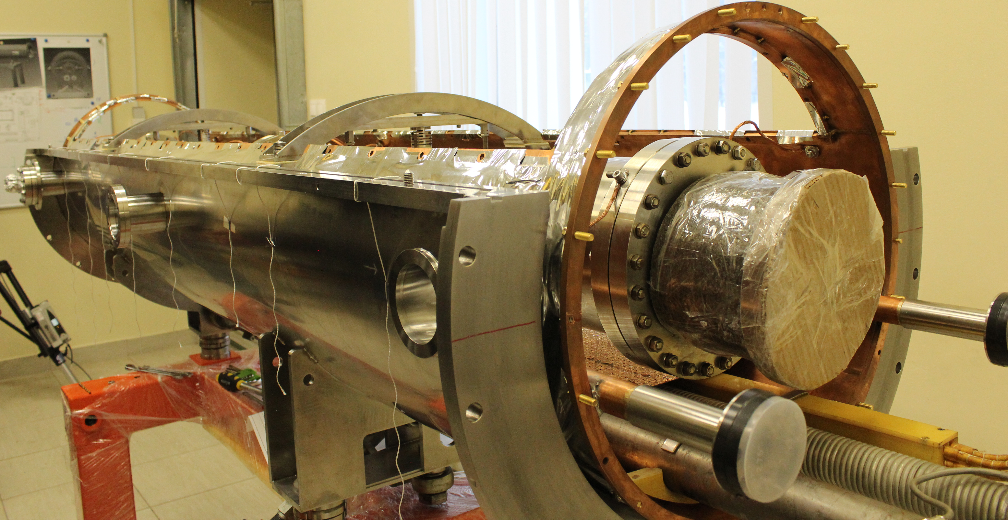
Beam injection to the Nuclotron ring
Installation finished 31 of Dec. 2021
Four-rod
kicker
Designed – JINR,
fabricated – VST (Belgorod)
SC Lambertson magnet
15

Slide 16
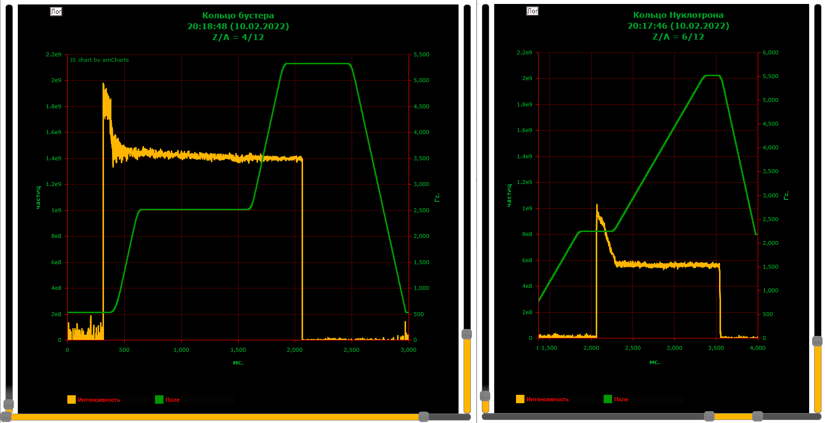
Main results of RUN-3 (Booster + Nuclotron)
Winter 2022
Beam intensity in the Booster intensity in the Nuclotron
Intencity
Nucloton field
RF capture
Beam transfer with stripping С4+/С6+ transmission 70%
Acceleration
Booster field
Booster and Nuclotron beam DC current transformers signals

Slide 17
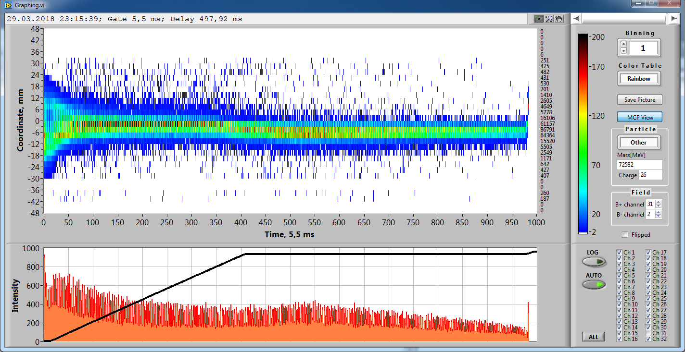
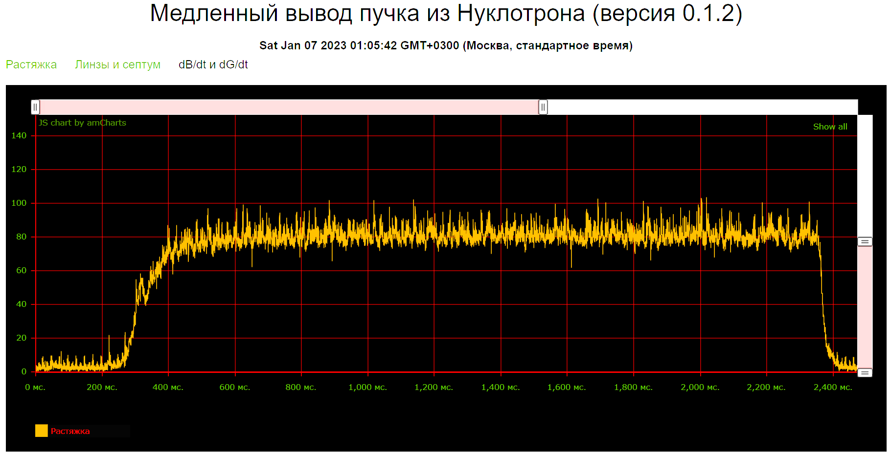
Heavy ion beams acceleration
Jan. 2023
¹²⁴Xe⁺⁵⁴ beam extraction (3,9 Gev/u) RUN #4 at NICA complex
¹²⁴Xe 1*10⁷ T_{spill} = 3 s, k_{dc}= 99%

Slide 18
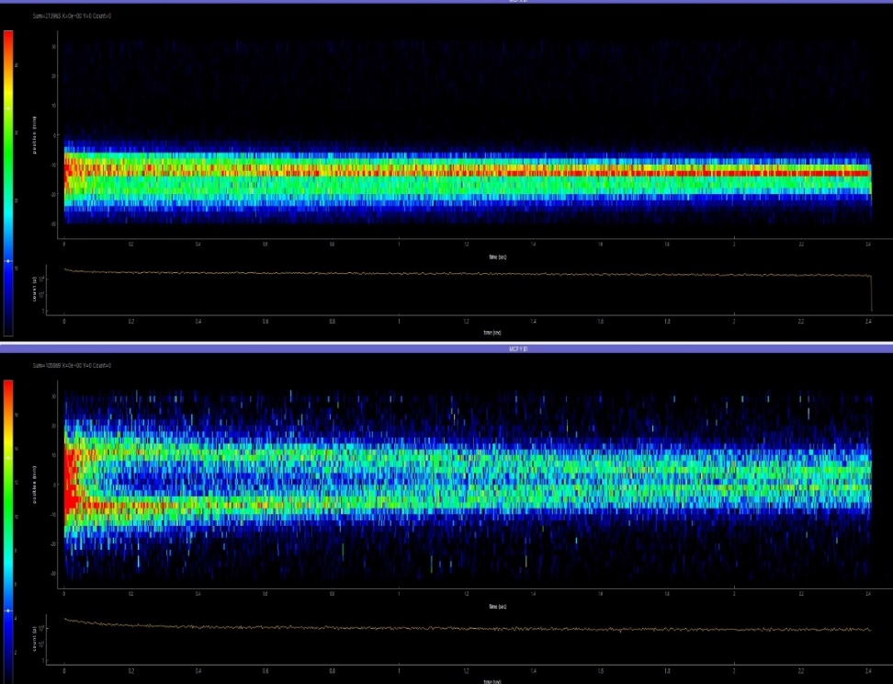
Electron cooling of Xe beam
Booster electron cooling
¹²⁴Хе ²⁸⁺ at injection energy
Transverse cooling
Electron energy 1,93 keV
Electron current 150 mА
Dynamics of the cooling process
Profile width
Signals from
Ionization profile monitors
during beam circulation with const. W
Time, ms
Stable operation of the cooling system during a few shifts

Slide 19
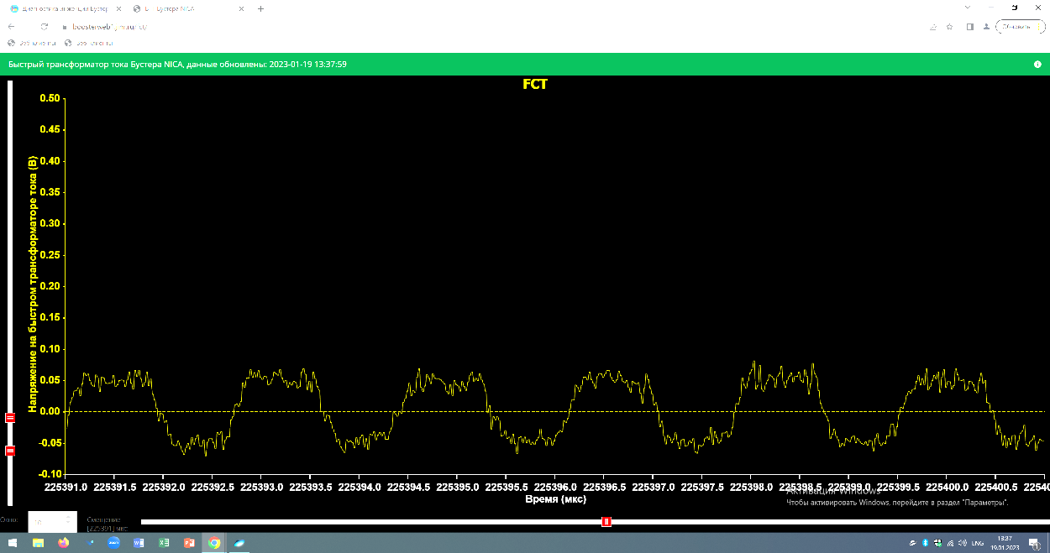
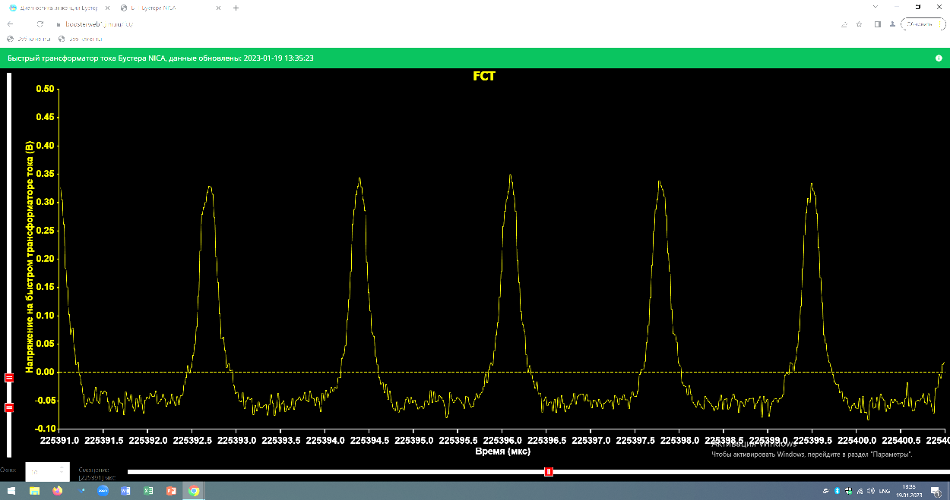
Electron cooling of Xe beam
I.Meshkov
A.Sergeev
Longitudinal cooling
Without cooling
Bunch length
measured with FCT
With cooling

Slide 20
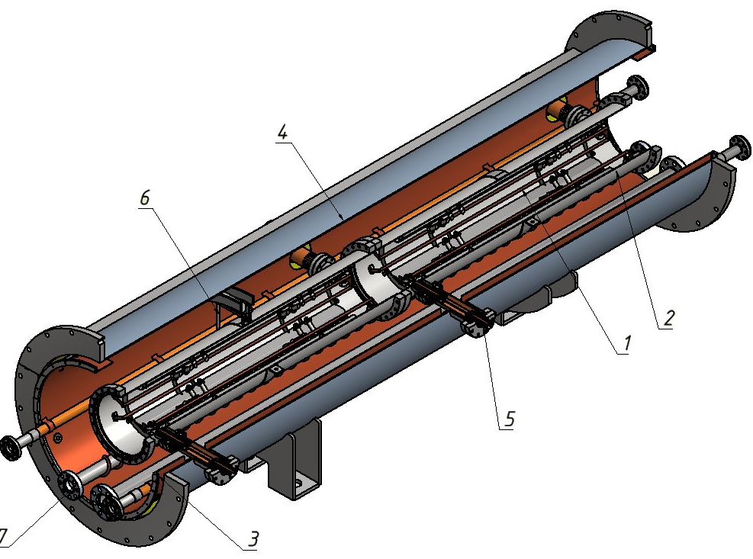
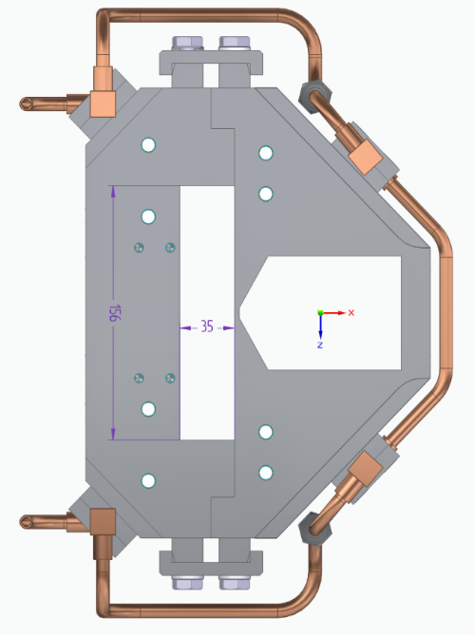
Fast extraction from the Nuclotron
Design development is in the progress
Delays:
Due to delays of LM for injection;
Due to delays of injection Kicker;
3 section kicker
Manufacturing
LM1
Not for start configuration
LM2
Final stage of redesign
Limitation of extracted beam energy by factor 1,6 (~2 GeV/u for Bi)
Doubling of injection LM with the same design and tooling for higher current;

Slide 21
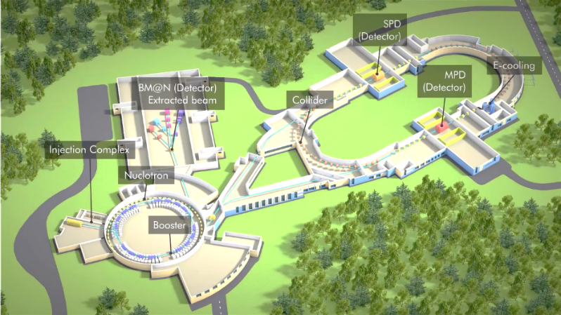
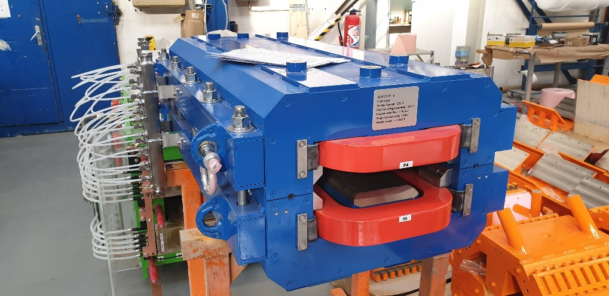
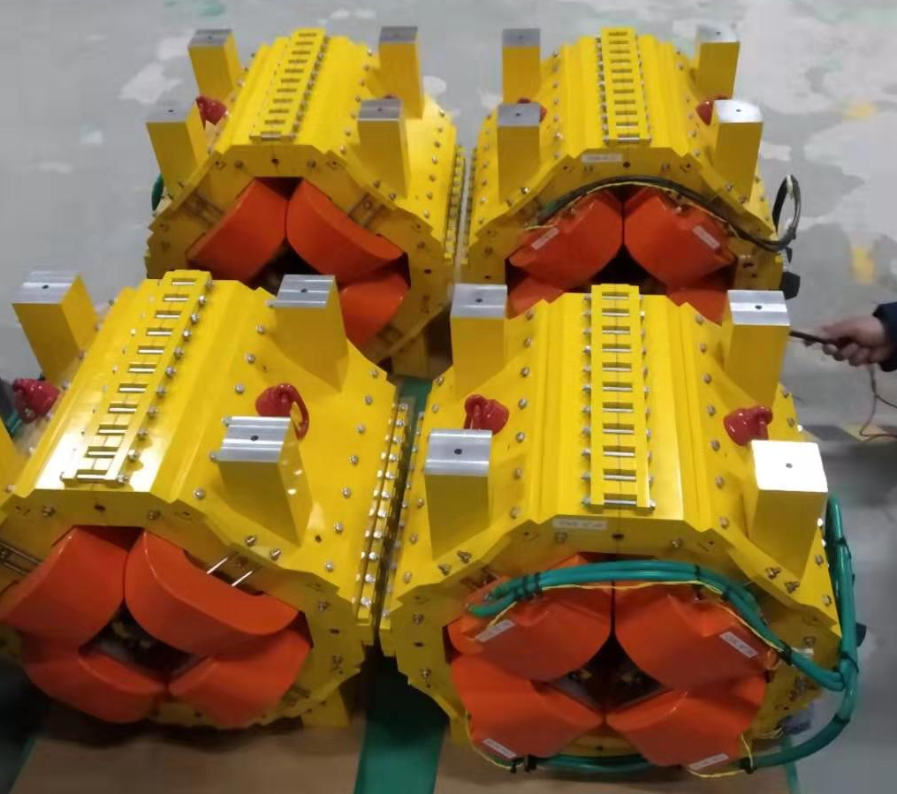
Nuclotron-Collider beam transport channel
Sigma Phi
Nuclotron-Collider transfer line is under delivery and construction by Sigma Phi
Magnetic element | Number | Effective length, m | Max. magnetic field (grad), T (T/m)
Long dipole | 21 | 2 | 1.5
Short dipole | 6 | 1.2 | 1.5
Quadrupole | 28 | 0.35/0,52 | 31
Steerer | 33 | 0.466 | 0.114
90% of magnets delivered to JINR in February 2021
January 2022 – delivery of first parts of PS, beam diagnostics, support stands.
Fabruary 2022 – delivery of vacuum equipment.
July 2022 – second part of power supplies, profile monitors, control system.
September 2022 – start of commissioning of the channel equipment.
December 2022 – commissioning of the channel with a beam.
BLOCKED

Slide 22
Introduction (complex NICA)
Two LINACs & ion sources
LU-20/LILAc (light & pol. ions)
HILAC (heavy ions)
The Booster ring
The Nuclotron ring
Collider systems status

Slide 23
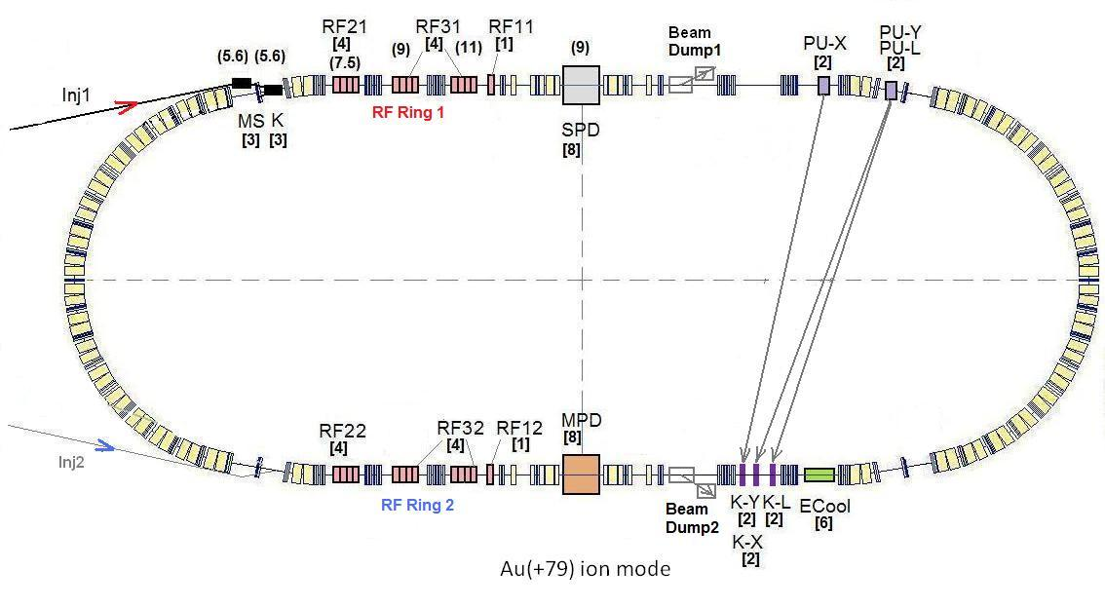
Collider rings
SPD
Start configuration of Collider
RF-1 (barrier voltage) for ion storage
RF-2 in a reduced version: 2 cavities per ring instead of 4 (50% of HV)
1 channel of S-cooling per ring (cooling in longitudinal space)
Basic configuration
RF-1 (barrier voltage) for ion storage
RF-2 project version = 8 cavities
RF-3 project version = 16 cavities
S-cooling (project vers.)
E-cooling
Back loop system
Result: 22 bunches of the length σ∼2 m
per ring that L~5E25 cm⁻²⋅s⁻¹.
Result: 22 bunches of the length σ∼0.6m
per ring that L~1E27 cm⁻²⋅s⁻¹.
MPD
Notes:
The lattice design and prototyping of most collider elements are completed. The ring circumference is twice as one of the Nuclotron. For the gold beam a Luminosity at the energy above 10 GeV per nucleon will be 10 to the 27

Slide 24
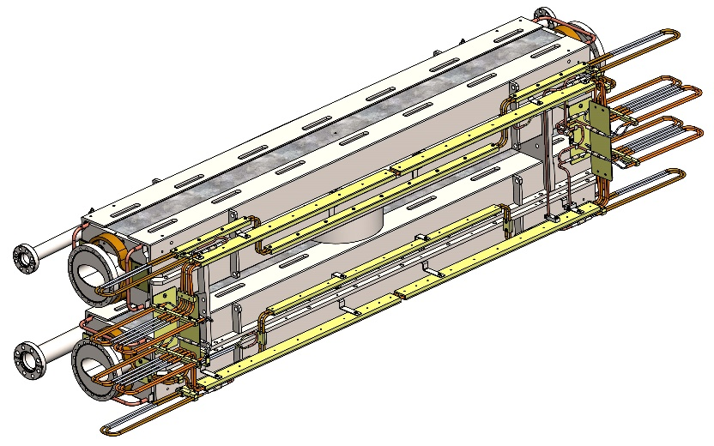
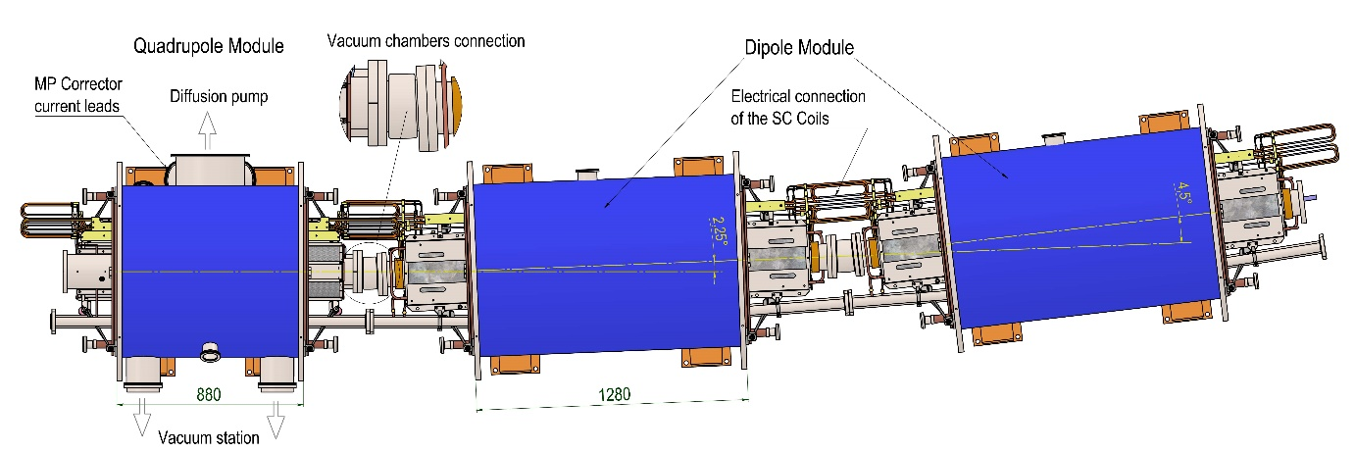
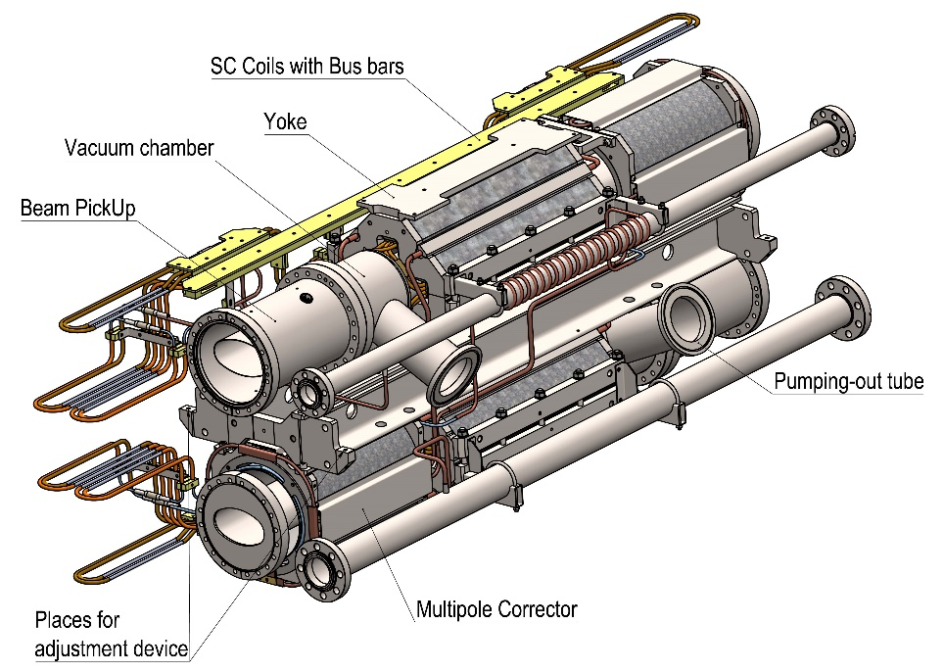
Collider SC magnetic system
Parameter | Dipole | Lens
Number of magnets | 80+8* | 86+12**
Max. magnetic field (gradient) | 1.8 T | 23.1 T/m
Effective magnetic length | 1.94 m | 0.47 m
Beam pipe aperture (h/v) | 120 mm / 70 mm
Distance between beams | 320 mm
Overall weight | 1670 kg | 240 kg
*- the magnets for the vertical movement of the beams
**- the final focus lens.
Production of magnets and doublet lenses 2018-2023

Slide 25
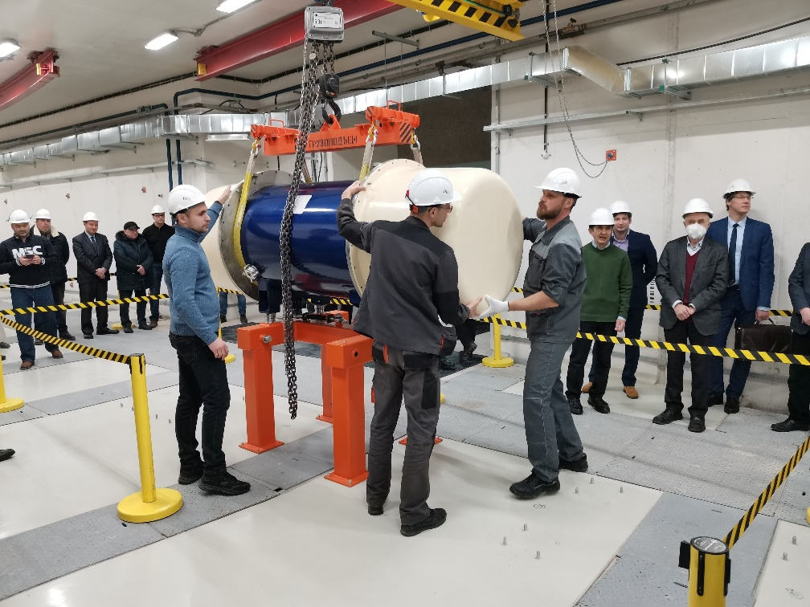
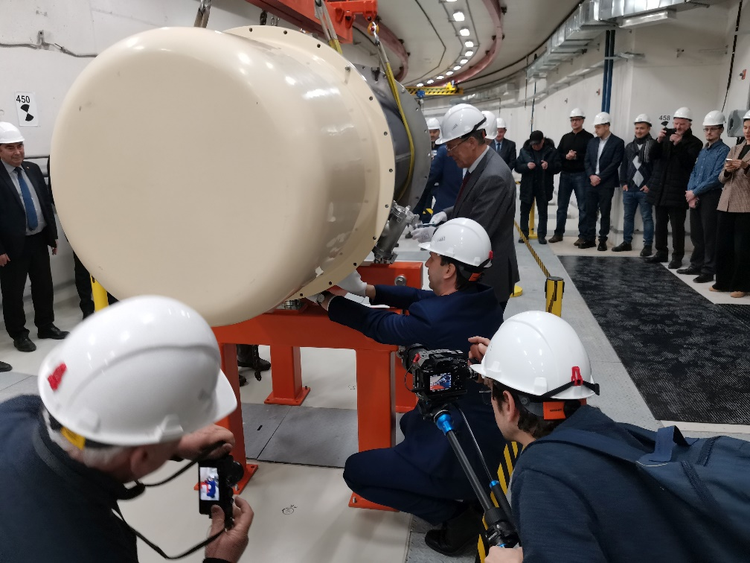
Collider SC magnetic system
First collider magnet in the tunnel
On 28 December, 2021 the first dipole magnet was installed
in the collider tunnel

Slide 26
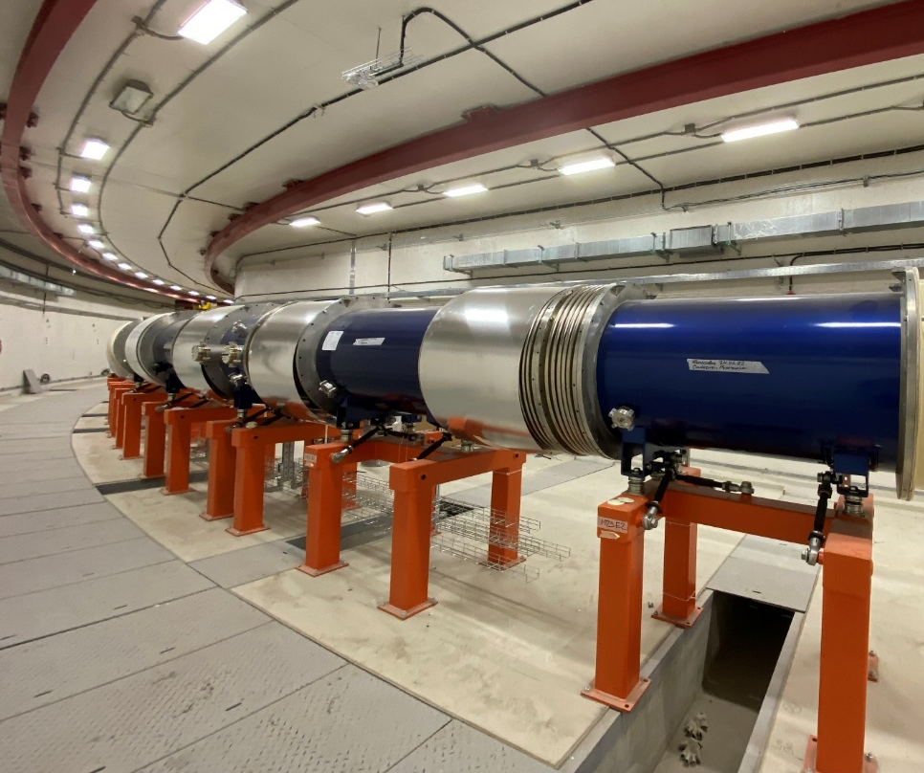
Collider SC magnetic system
Status:
100% dipoles are installed and aligned;
40% of quads are installed in tunnel;
BV dipoles are under manufacturing;
Quads for straight sections are under assembling and testing;
Final focus quads are under assembling.

Slide 27
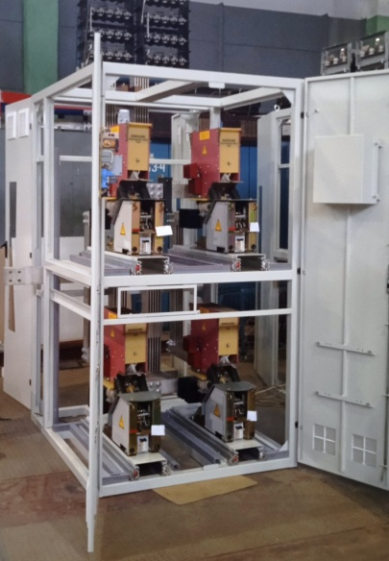
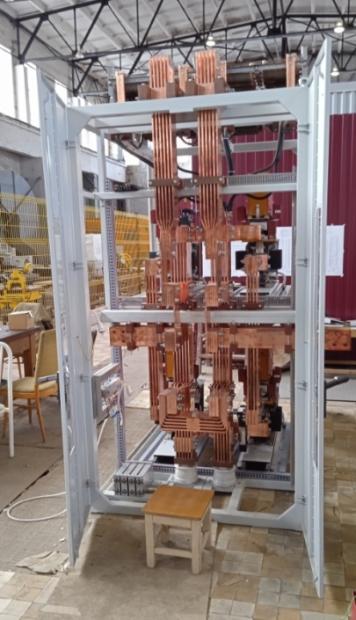
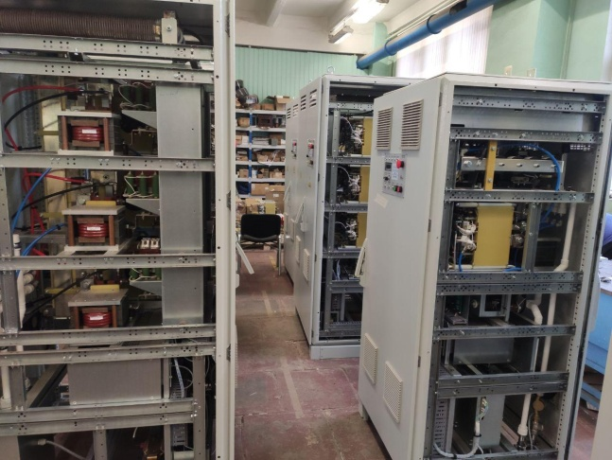
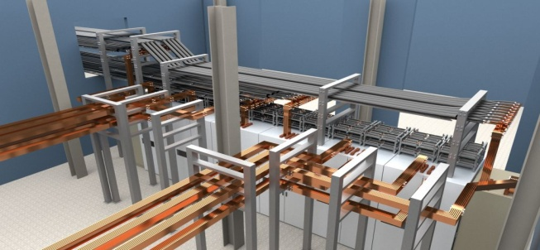
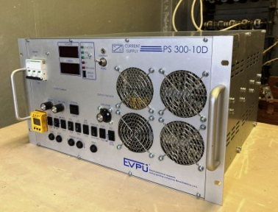
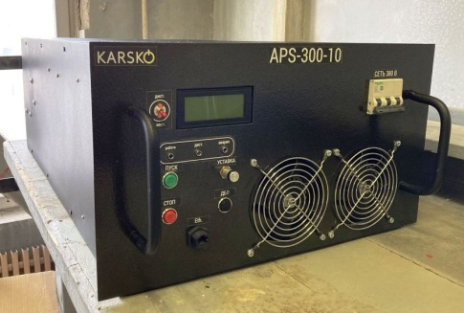
Collider power supply system
Each collider ring has its own power supply system based on 3 main current sources
2 sets of main PS for both collider rings are manufactured by NPP "LM Inverter"
and delivered to JINR.
12 energy evacuation keys
was constructed and tested
Busbars system model in b.17
68 Additional power supplies (10В х 300А)

Slide 28
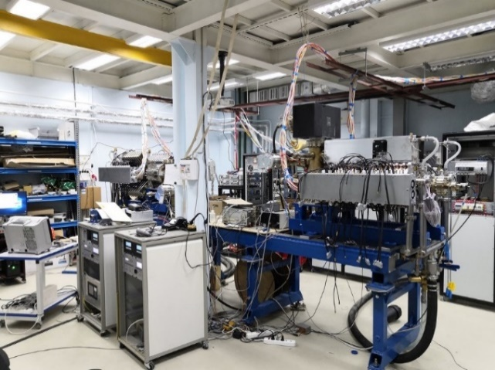
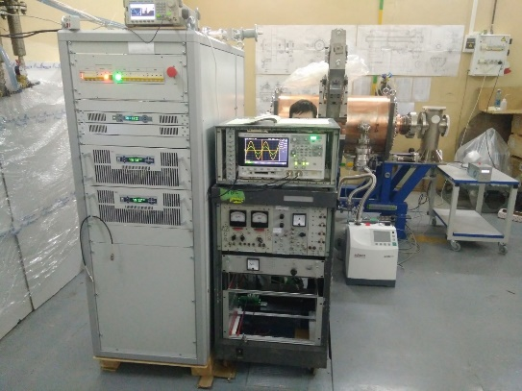
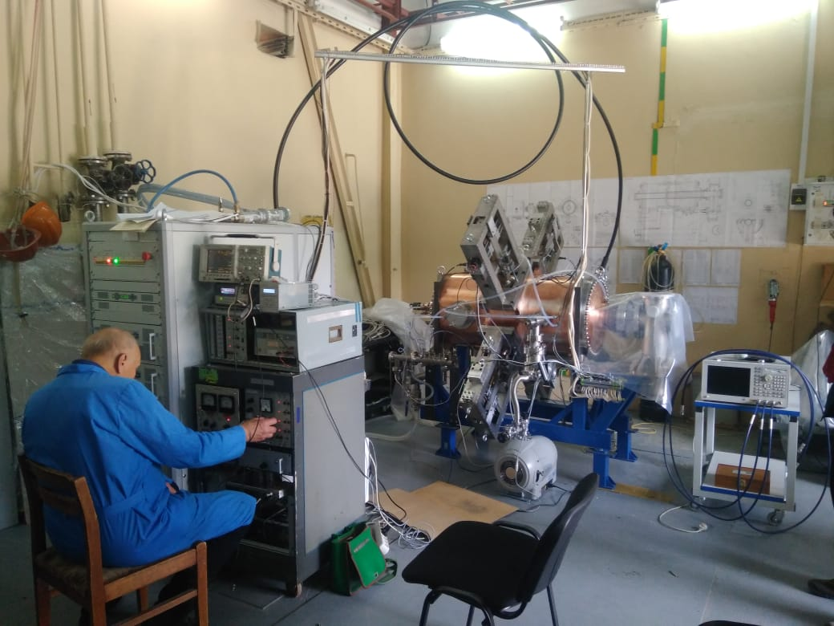
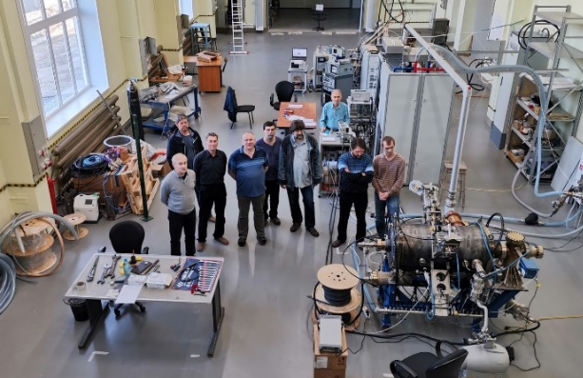
Barrier bucket RF1 and harmonic RF2-RF3 (26 units)
RF1 cavity in BINP
RF2 under tests BINP
RF3 under tests BINP
Two RF1 cavities delivered to JINR in 2019
4 RF2 cavities for base configuration, passes trough vacuum tests, installation
in 2q of 2023
RF3 cavity in BINP
16 RF3 cavities for
full configuration,
Shipment - end of 2023,
beam tests – 2024
RF1 cavity in JINR
RF2 cavity in JINR

Slide 29
Electron Cooling System
Contract with BINP
Parameter | Value
Electron energy, MeV Energy instability, ΔE/E | 0.2 – 2.5 ≤ 1⋅10⁻⁴
Electron beam current, A | 0.1 – 1.0
Cooling section length, m | 6.0
Solenoid magnetic field, T Field inhomogeneity, ΔB/B | 0.05 – 0.2 ≤ 1⋅10⁻⁵
Main parts of the E-Cooler delivered to JINR and stored in SPD hall.
Beginning of mounting – Sumer 2023 First beam tests – Autumn 2023
29

Slide 30
Synchronization and LLRF system
COZYLAB
Synchronization: 317+31+91 channels. LLRF: 30 channels
Stage 1 (T0 + 7 months) | Development of the NICA Injection complex (Booster+Nuclotron) Synchronization system, its testing on the Executive’s site, and its delivery to the Customer. Two LLRF Prototypes are provided up to this stage and testing is started during the Nuclotron-Booster run.
2.Stage 2/ (T0 + 13 months ) | Development of the first revision of NICA Injection complex LLRF system and on-site testing; Development of NICA Collider Synchronization System
3.Stage 3/ (T0 + 19 months ) | Development and testing of the final revision of synchronization and LLRF systems of the NICA complex.
4.Stage 4/ (T0 + 21 months ) | Services for mounting, final software installation and testing of the NICA Accelerator complex Synchronization and LLRF systems./
5.Stage 5 (T0 + 25 months ) | Services for SAT and commissioning of the NICA Accelerator complex Synchronization and LLRF systems.
Start of Contract with COSY Lab – November 2021
Synchronization and LLRF of Booster and Nuclotron – December 2022
Mounting and testing of NICA synchronization and LLRF – October 2023
30

Slide 31
Preliminary program of the first technological collider run (2023/2024)
- Insulating volume and beam pipe vacuum tests (leakage tests)
Test of cryogenic system
Start tuning of the collider main control system
Test of the main power supply and cycle control system on equivalent load
Commissioning of thermometry system (more then 2000 sensors)
Cooling of the rings (arc to arc separately)
Commissioning of quench detection system (more then 600 detectors)
Commissioning of energy evacuation system
Test of the main power supply on superconducting load
Increasing of main magnetic field & SC magnetic system training

Slide 32
Thank you for attention

