Slide 1
Pre-scission approach to fragment masses: from super- symmetric to super-asymmetric fission
Nicolae Carjan, Fedor Ivanyuk, Yuri Oganessian
“Superheavy nuclei and atoms”, Yerevan, Armenia, April 25-29, 2023

Slide 2
Pre-scission point model approach to the fission of very heavy and super-heavy nuclei
Abstract. The achievements of the pre-scission point model :
N. Carjan, F. Ivanyuk, Yu. Oganessian, G. Ter-Akopian,
Nucl. Phys. A 942 (2015) 97
are reviewed in this talk.
Short comment on the model.
In any scission-point model it is E_{def} along the scission-line that determines the main features of the calculated distribution: the most probable masses and the relative intensities of the fission modes; the assumption being that equilibrium is attained for all collective degrees of freedom normal to the fission direction. No assumption is made concerning the motion in the fission direction which is described by the shape parameter α in our model.
There is only one parameter T_{coll}. It has no physical meaning. It controls the overall width of the distribution . When comparing with data, it accounts also for the finite mass resolution.
Why do we use this model? It is simple and successful as it will be shown. Our model is briefly presented next.

Slide 3
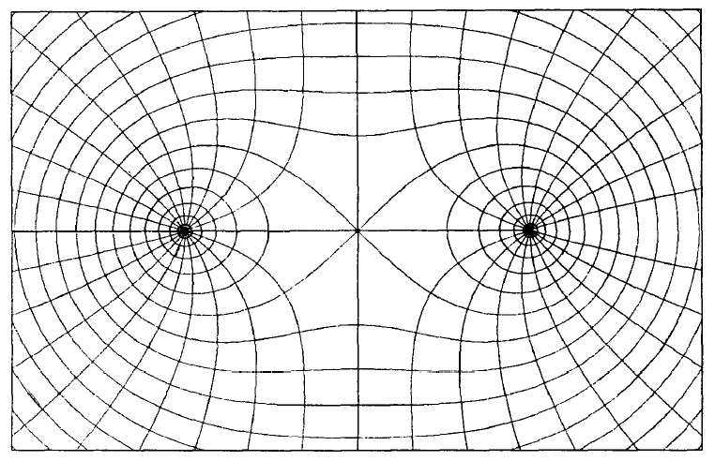
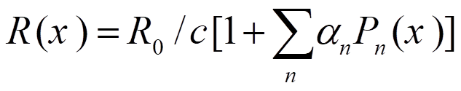
An improved version of Wilkins scission
point model, Phys. Rev. C 14, 1832 (1976),
is used:
a) Nuclear shapes described
by generalized Cassini ovals
(R,x) is an orthogonal
coordinate system
introduced by V. Pashkevich,
Nucl. Phys. A 169, 275 (1971).
R₀ is one of the basic lines.
α=1 defines the Bernoulli lemniscate,
i.e., the configuration with zero neck.
b) Since the neck ruptures at finite radius
(2 fm), V. M. Strutinsky, N. Ya. Lyashchenko,
N. A. Popov, Nucl. Phys. 46, 639 (1963),
the distributions are calculated “just before
scission” (α=0.98) and not when
the fragments are already separated as in
the original model.
Volume conservation

Slide 4
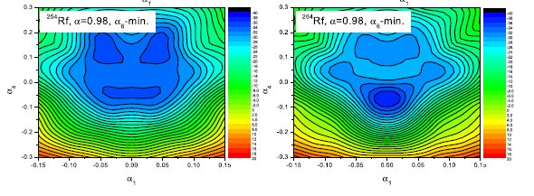
As previously mentioned, the only physical ingredient is the potential energy of deformation obtained by Liquid-Drop model + Strutinsky shell correction:
E_{def} (shape) = E_{LD} (shape) + E_{shell} (shape)
V. M. Strutinsky, Nucl. Phys. A 95, 420 (1967)
Such potential energy surfaces (PES) are calculated just before scission (α = 0.98)
as a function of the three most relevant deformation parameters:
α₁ (mass asymmetry) , α₃ (octupole deformation) and
α₄ [acting on the quadrupole elongation of each fragment makes the scission
shape more compact (α₄ <0) or more elongated (α₄ >0)].
In addition we minimize with respect to α₂ and α₅ (or α₆).
An example of PES for ²⁵⁴Rf and ²⁶⁴Rf showing the well known transition from asymmetric to symmetric fission in isotopes from fermium to seaborgium.

Slide 5
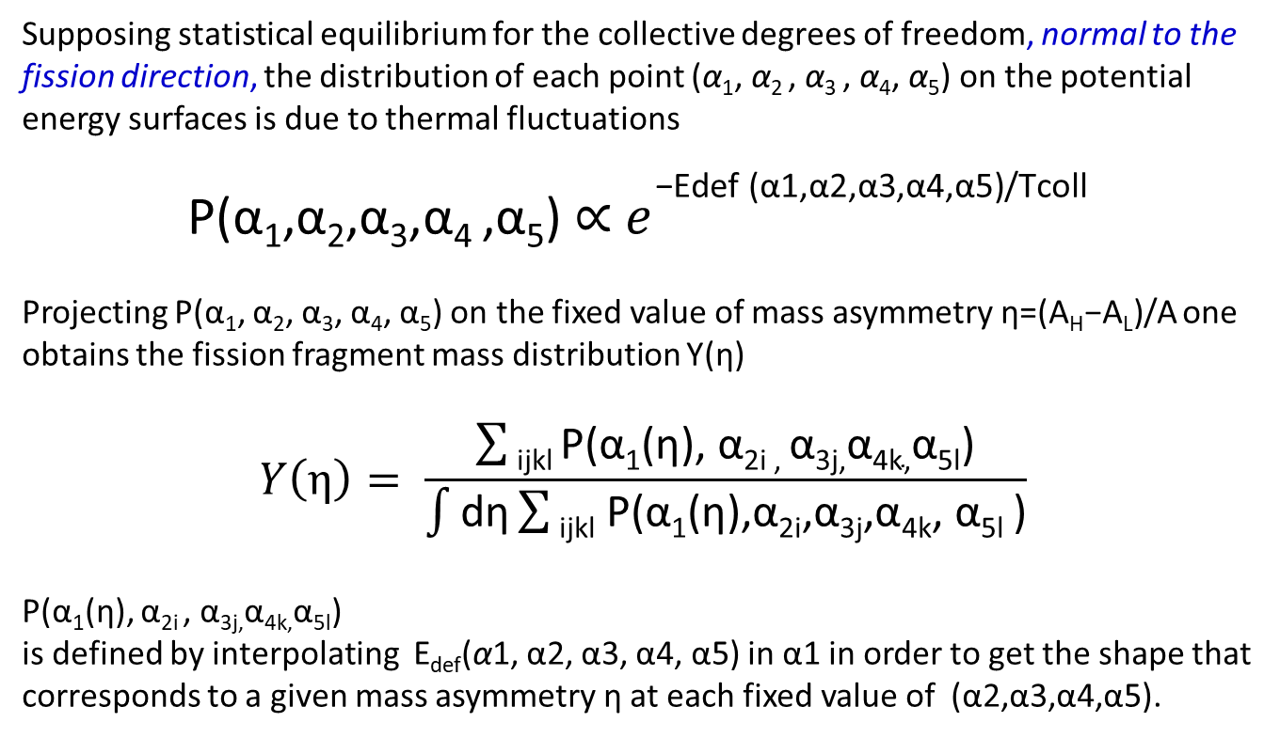
Mass distribution of the fission fragments
Supposing statistical equilibrium for the collective degrees of freedom, normal to the fission direction, the distribution of each point (α₁, α₂ , α₃ , α₄, α₅) on the potential energy surfaces is due to thermal fluctuations
$$\text{P}\text{(}\text{α}\text{1}\text{,}\text{α}\text{2}\text{,}\text{α}\text{3}\text{,}\text{α}\text{4 }\text{,}\text{α}\text{5}\text{)} \text{∝} e^{\text{−}\text{Edef}\text{ (}\text{α}\text{1,}\text{α}\text{2}\text{,}\text{α}\text{3}\text{,}\text{α}\text{4,}\text{α}\text{5}\text{)/}\text{Tcoll} }$$
Projecting P(α₁, α₂, α₃, α₄, α₅) on the fixed value of mass asymmetry η=(A_{H}−A_{L})/A one obtains the fission fragment mass distribution Y(η)
$$Y\left(η\right)= \frac{\sum{\text{ijkl} \text{P}\text{(}\text{α}\text{1}\text{(}\text{η}\text{),} \text{α}\text{2}\text{i}\text{ , }\text{α}\text{3}\text{j}\text{,}\text{α}\text{4}\text{k}\text{,}\text{α}\text{5}\text{l}\text{)}}}{\int{\text{d}\text{η}\sum{\text{ijkl} \text{P}\text{(}\text{α}\text{1}\text{(}\text{η}\text{),}\text{α}\text{2}\text{i}\text{,}\text{α}\text{3}\text{j}\text{,}\text{α}\text{4}\text{k}\text{, }\text{α}\text{5}\text{l}}\text{)}}}$$
P(α₁(η), α_{2i} , α_{3j,}α_{4k,}α_{5l})
is defined by interpolating E_{def}(α1, α2, α3, α4, α5) in α1 in order to get the shape that corresponds to a given mass asymmetry η at each fixed value of (α2,α3,α4,α5).

Slide 6
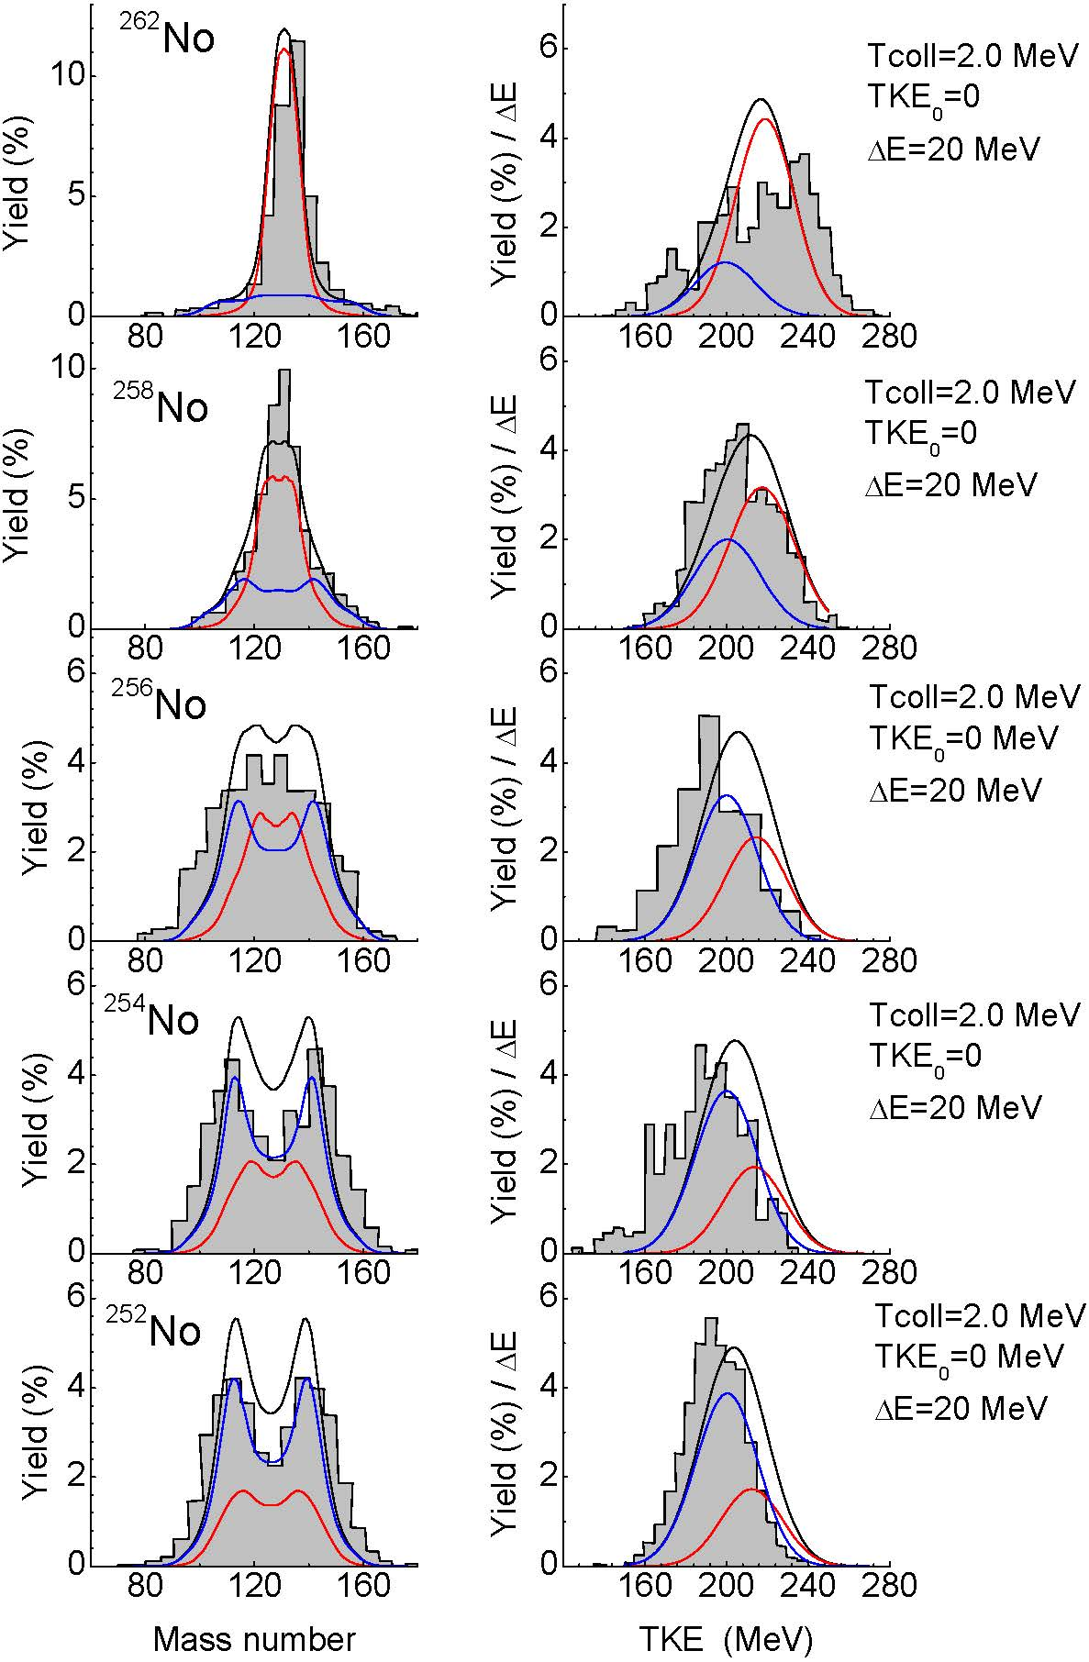
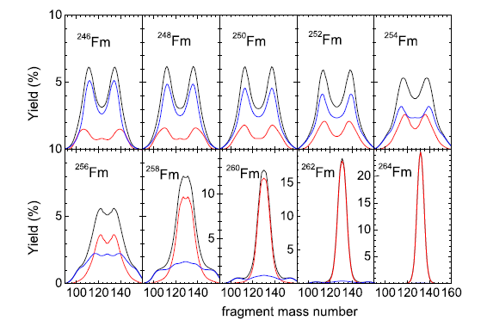
Unexpected accomplishments
It explains the bi-modal fission of heavy actinides. The double inversion of these two modes that occurs with increasing mass A is, for the first time, clearly demonstrated to be the cause of the transition from asymmetric to symmetric fission. Use of α₁ ,α₄ ,α₆ at α=0.98 is enough.
Surprisingly good agreement when comparing with existing data
N.Carjan, F. Ivanyuk, Yu. Oganessian, Journal of Physics: Conf. Series 863 (2017) 012044
Decomposition of the total mass distribution (black) into two fission modes : compact (red) and elongated (blue)

Slide 7
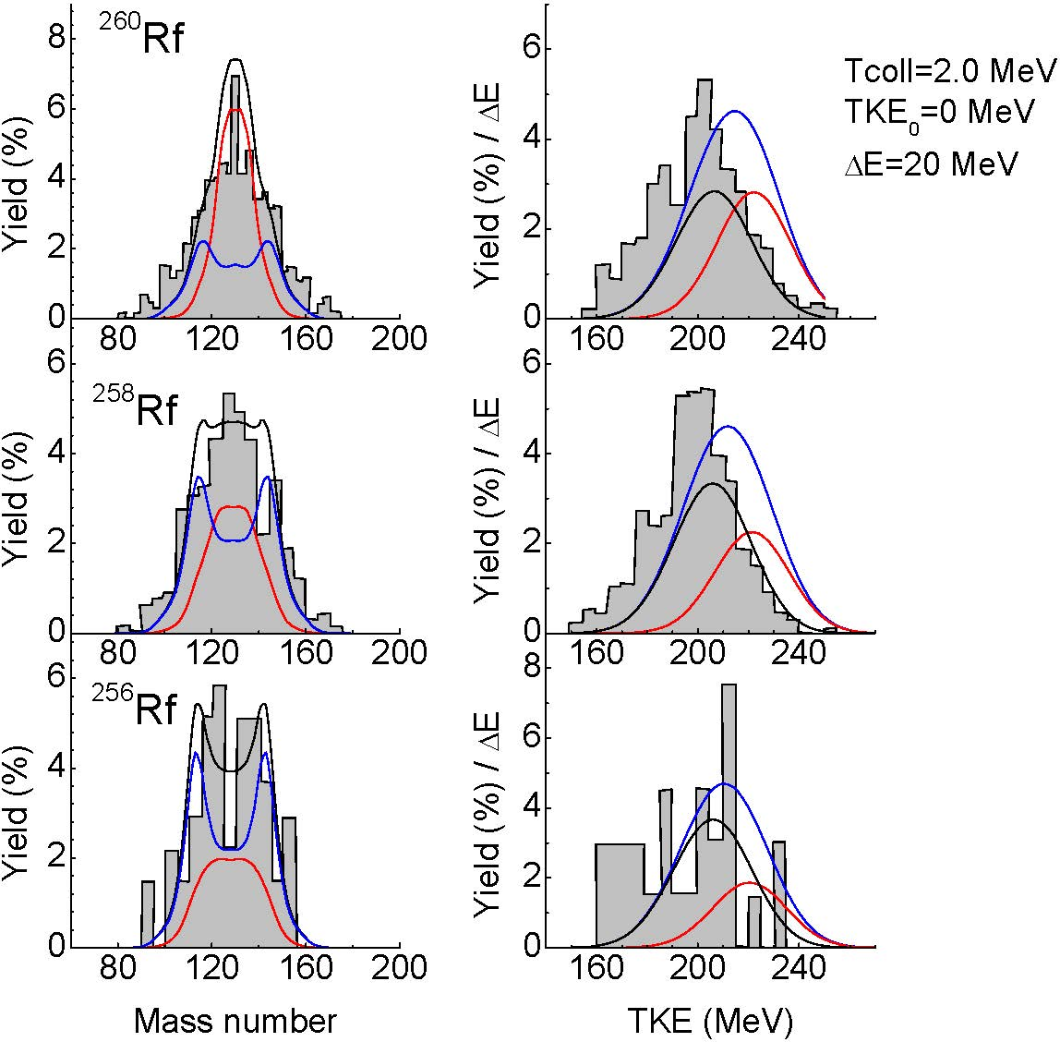
The same good agreement for Rf isotopes
Comparison with data from the SF of ²⁶² Rf (last measured)
M.R. Lane et al. PRC 53 (1996) 2893
FWHM = 22 amu

Slide 8
Synopsis of fission fragment mass distributions for isotopes of Fm, No, Rf and Sg (chosen before the transition point from asymmetric to symmetric fission). T_{coll} =1.5 MeV (shaded).
Results with T_{coll} =0.75 MeV are also presented (thin blue) for comparison.
Super-symmetric
fission (FWHM ≤ 8 amu)

Slide 9
Incursion into the region of super-heavy elements
Super-heavy nuclei that undergo spontaneous fission have already been observed in experiments with ⁴⁸Ca projectiles in Dubna:
(Z,N) = (110,169), (110,171), (111,170), (112,170) and (112,172).
However, the statistics was not sufficient to build distributions.
Yu. Oganessian, V. Utyonkov, Rep. Prog. Phys. 78 (2015) 036301
F.-P. Hessberger, Eur. Phys. J. A 53 (2017) 75
Next talk (A. Svirikhin) will present an updated situation.
The production cross sections of these nuclei are only few picobarns. Such experiments could be considered at the SHE-Factory constructed at FLNR of JINR-Dubna .
Irrespective how difficult is to produce these nuclei the result is worth the effort. Just an example: if ¹³²Sn is the reason for asymmetric fission of actinides (where it is a heavy fragment) then it should also produce asymmetric fission in the super-heavy region (this time being a light fragment). To test this inference is crucial. For the same reason, the SHE may fission into three fragments (two ¹³²Sn and the rest).

Slide 10
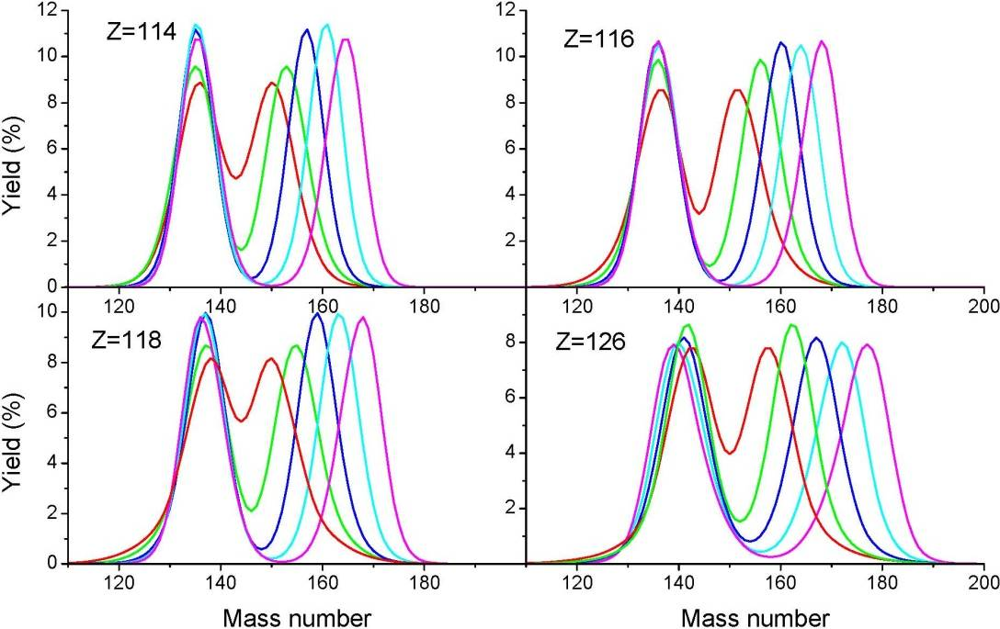
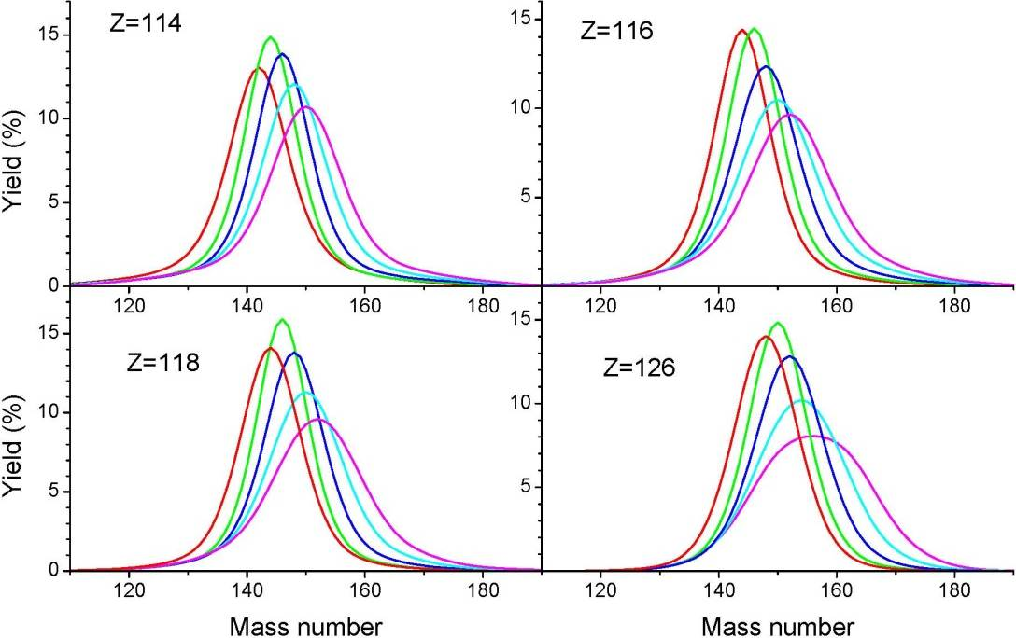
Is, in our model, the SHE fission symmetric or asymmetric?
To answer this question, fragment mass distributions for even-even isotopes of Fl, Lv, Og and Z=126 were calculated in N. Carjan, F. A. Ivanyuk, Yu. Oganessian, Nucl. Phys. A 968 (2017) 453. The isotopes are separated by 4 amu starting at A = 284, 288, 288 and 300
respectively. the octupole deformation at scission plays a crucial role in controlling the asymmetry of the mass distribution.
with α₃ without α₃
The mass division is asymmetric and the position of the light fragment peak is constant (A_{L}=136)
The mass division is symmetric in all cases, the narrowest distribution having
N_{L}=N_{H}=87 (a neutron deformed shell known already in the 50’s).
G. Scamps and C. Simenel, Impact of pear-shaped fission fragments on mass-asymmetric fission in actinides, Nature (London) 564, 382 (2018).

Slide 11
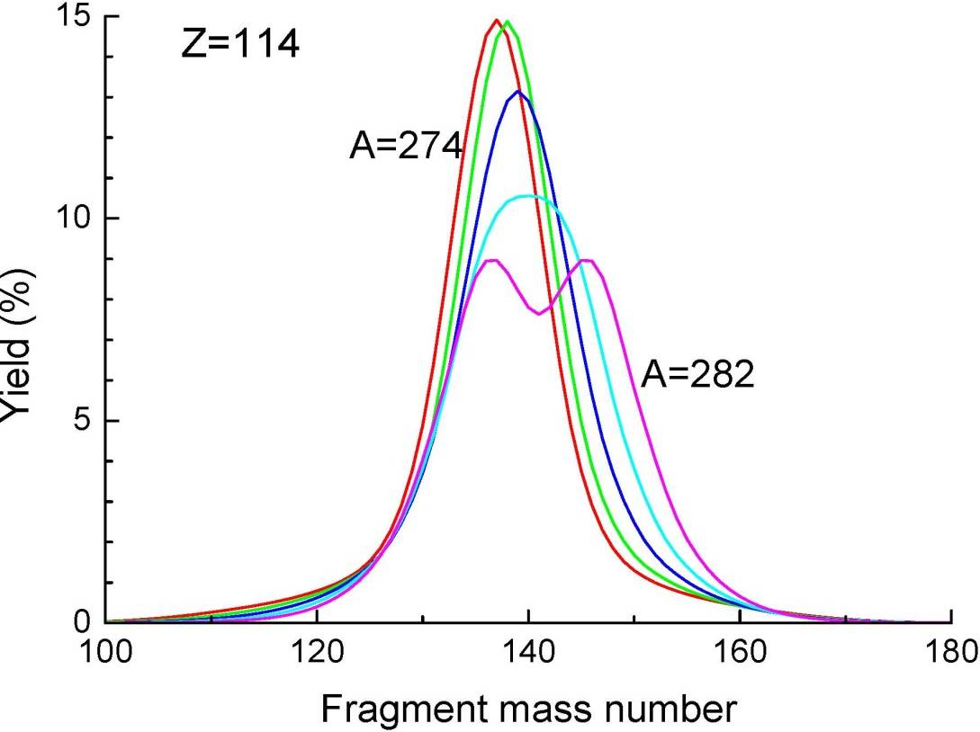
Is there a continuity between the two regions of nuclei that we studied?
Mass distributions for neutron deficient isotopes of Fl calculated with α₃.
A transition asymmetric (²⁸²Fl) to symmetric (²⁷⁸Fl) fission takes place with decreasing mass.
As discussed, the same type of transition occurs in trans-fermium elements but in the opposite direction. Therefore the fission of SHE and of heavy-actinides join smoothly.
Parentheses: In the latter nucleus the neutron numbers of the fragments (N_{L} and N_{H}) are equal to 82 (278=114+2x82) showing again that the magicity of the neutrons is the decisive factor.

Slide 12
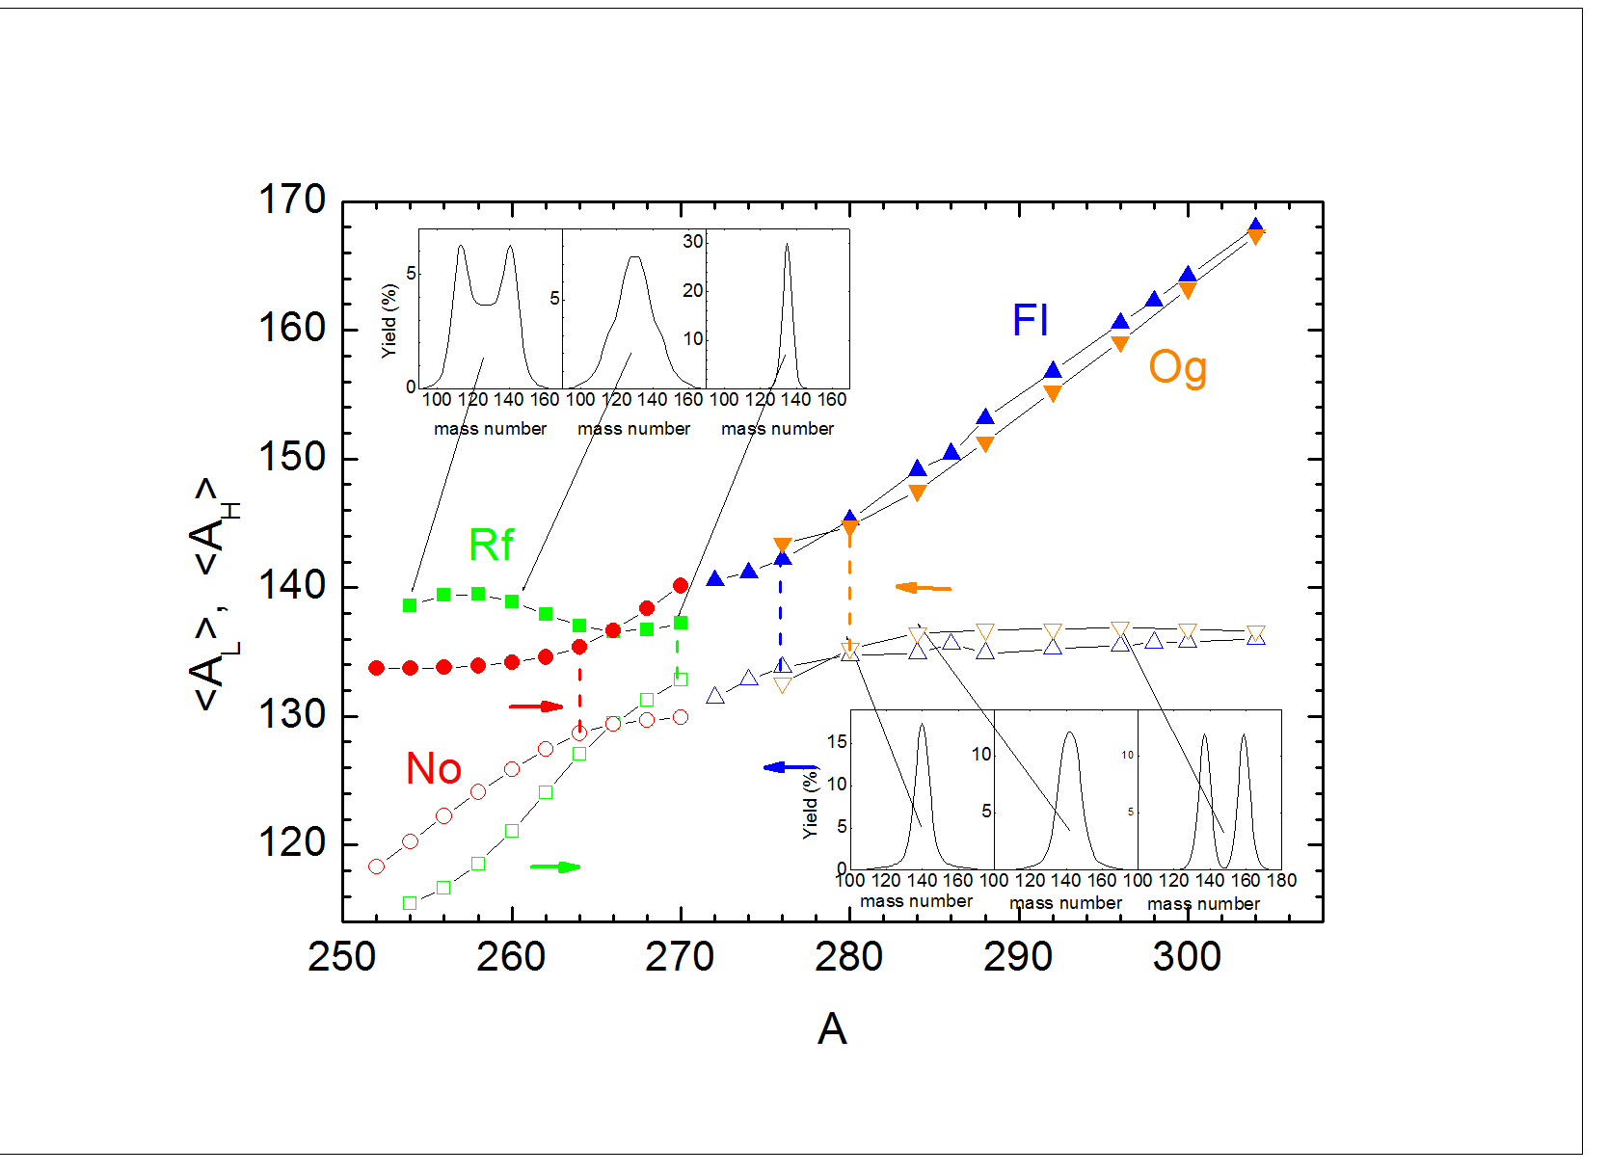
Synthesis of the results obtained showing consistency between the two regions where calculations have been performed. The transition from asymmetric to symmetric fission (arrows) and the narrowest symmetric fission (dashed verticals) are indicated for each series of isotopes

Slide 13
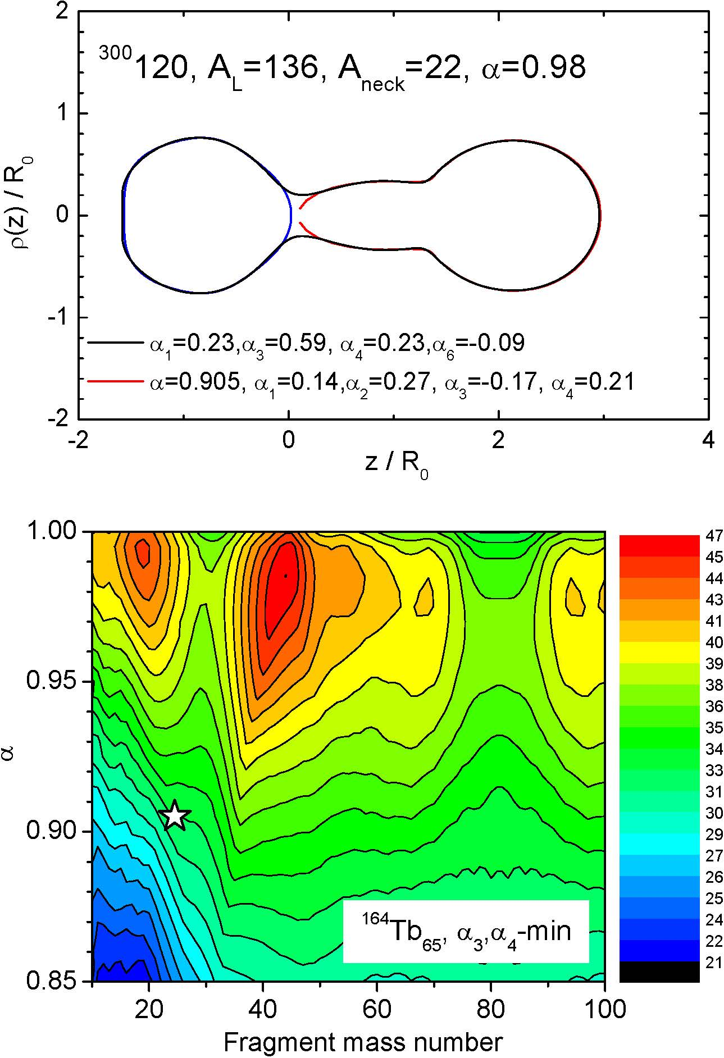
Minimization with respect to α₃ leads to “ternary” scission shapes:
one almost spherical fragment with A_{L} ≈ 136 and one very deformed (pear-shaped) complementary fragment
Will the very deformed heavy-fragment undergo a second fission or will it recover a compact shape?
In other words: is the fission of SHE binary or sequential-ternary?
Z=120

Slide 14
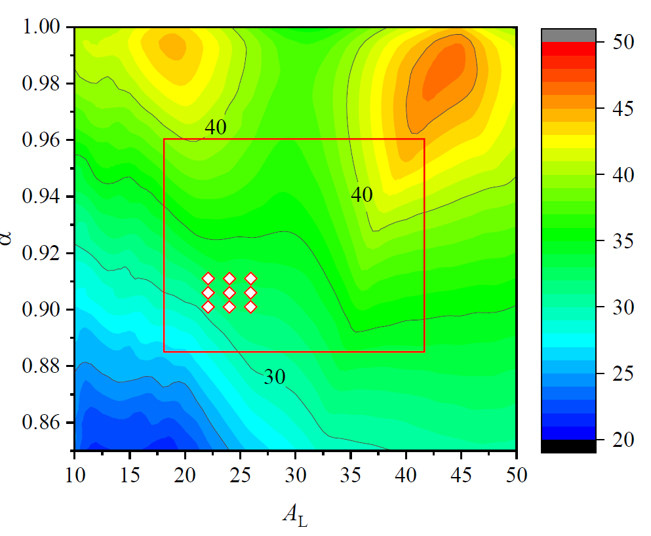
Potential energy of deformation for ¹⁶⁴Tb

Slide 15
The development of the shape of the deformed fragment is calculated by means of the
Metropolis method. It consists of two parts:
1. Each configuration c has a specified set of "neighbours" {c'}.
2. When the system is at the configuration c, the next configuration in the sequence is sampled
as follows: first, a tentative next configuration, c',
is selected randomly from the set of neighbours and it is then decided whether the system
makes a "step" to that new configuration c' or remains at the current configuration c.
The Metropolis step probability is given by
P(step) = 1 if W(c‘) > W(c)
= W(c‘) / W(c) if W(c‘) < W(c)
Namely, if the statistical weight of the tentative configuration is greater than that of the
current configuration then the step probability is one, and in the opposite case, then the
probability of taking the tentative configuration is W'/W and the probability of staying in
the current configuration is 1 - W'/W. In the present work, we assume that the statistical
weight is proportional to exp(-V(c)/T), where T is the temperature of the system.
In the actual calculation, we take δA = 0.5 and δα = 0.0025. For simplicity, we use the
fixed temperature T to calculate the step probability. We continue the random walk until
the sample reaches either α = α_{MAX} = 1.0 or α = α _{MIN} = 0.85. Fission probability
is calculated by dividing the number of samples that reach α _{MAX} by that of all samples.

Slide 16
Fission probability (Second fission)
T=1MeV | A_{L}=22 | 24 | 26
α=0.910 | 1.2×10⁻⁴ | 4.8×10⁻⁴ | 9.4×10⁻⁴
0.905 | 5.5×10⁻⁵ | 2.3×10⁻⁴ | 5.1×10⁻⁴
0.900 | 2.4×10⁻⁵ | 1.0×10⁻⁴ | 2.8×10⁻⁴
T=1.5MeV | A_{L}=22 | 24 | 26
α=0.910 | 1.3×10⁻³ | 3.2×10⁻³ | 5.4×10⁻³
0.905 | 7.5×10⁻⁴ | 1.9×10⁻³ | 3.4×10⁻³
0.900 | 4.2×10⁻⁴ | 1.1×10⁻³ | 2.2×10⁻³

Slide 17
Concluding remarks:
1) The agreement with data (especially for Fm isotopes) is semi-quantitative in the sense that the transition from symmetric to asymmetric fission is not as sharp as observed experimentally. The macroscopic-microscopic model used averages over neighbouring nuclei. Therefore sharp transitions from one nucleus to another are not expected to be obtained.
2) An interesting result is the extremely narrow mass distribution of the
heaviest calculated isotopes (FWHM ≤ 8 amu). To distinguish it from the regular symmetric fission we call this type of fission “super-symmetric”.
3) For all SHE studied, we predict asymmetric fission if one does include the octupole deformation and symmetric fission otherwise.
In addition of making the light fragment spherical, α₃ creates a highly deformed pear-shaped heavy fragment at scission rising the question whether a sequential fission of the latter is possible as expected from general considerations (two ¹²³Sn and the rest). The probability of this ternary fission mode is found to be 10⁻⁴ to 10⁻³

Slide 18
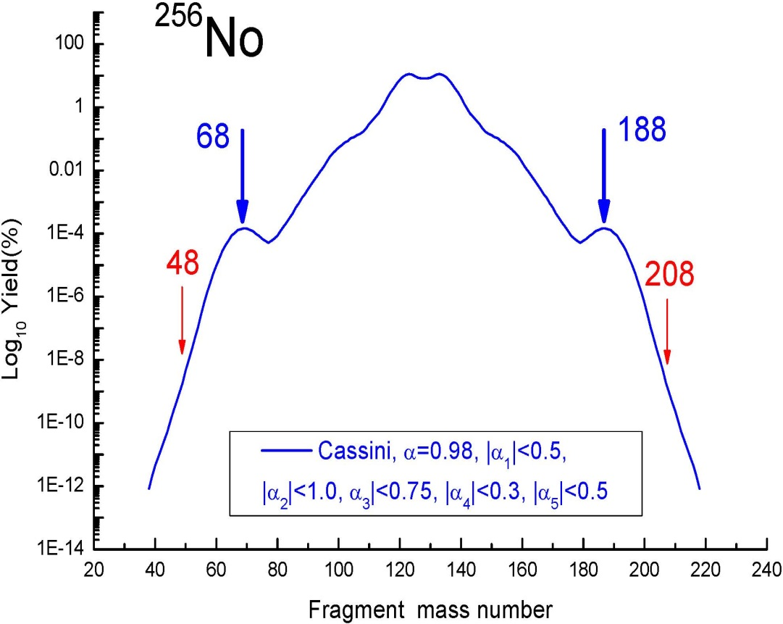
New Calculations for Super-Asymmetric Fission
In order to study the super-asymmetric fission, new calculations for a wider domain of fragment masses are performed. In particular we are interested in the region around A_{H}=208. α₁ ,α₂ ,α₃ ,α₄ were used at α=0.98. The parameter α₂ was for long time ignored.
We start with the case of ²⁵⁶No (sf).
Both the position and the intensity of the super-asymmetric peak are in agreement with data taken at Lohengrin (ILL) for (n_{th},f) reactions on actinide targets from U to Cf.
D. Rochman et al.,
Nuclear Physics A 735 (2004) 3

