Slide 1
Spontaneous fission characteristics of heaviest nuclei synthesized in FLNR
Alexandr Svirikhin
Joint Institute for Nuclear Research, Dubna
The International Conference
"Heaviest nuclei and atoms"
25 – 29 April 2023, Yerevan, Armenia

Slide 2
Spontaneous fission characteristics of heaviest nuclei synthesized in FLNR
The brief review of SF systematics
Results obtained in FLNR so far
The opportunities of the FLNR experimental equipment for the spontaneously fissioning SHE study.
Notes:
In this section, my colleagues describe in detail the most important characteristics of induced and spontaneous fission. So I’ll just remind you the basic patterns presented on these systematics, and I’ll go to the description of the experiments aimed to study spontaneous fission in FLNR.

Slide 3
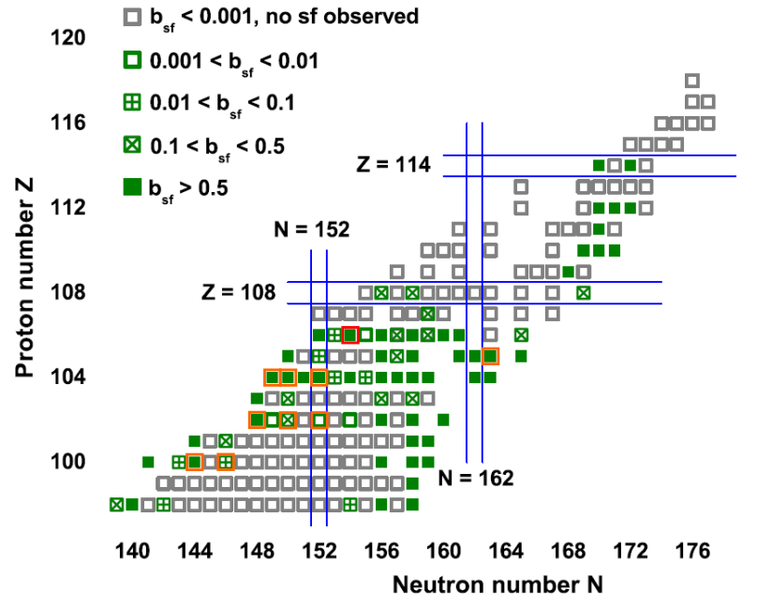
the isotopes for which spontaneous fission branches have been reported so far.
F.P. Hesberger - Eur. Phys. J. A (2017)53, 75
The orange and red boxes – SF nuclei which have been studied on the VASSILISA (SHELS) separator
Notes:
As you can see on this image, a significant proportion of nuclei heavier than fermium decays by spontaneous fission.

Slide 4
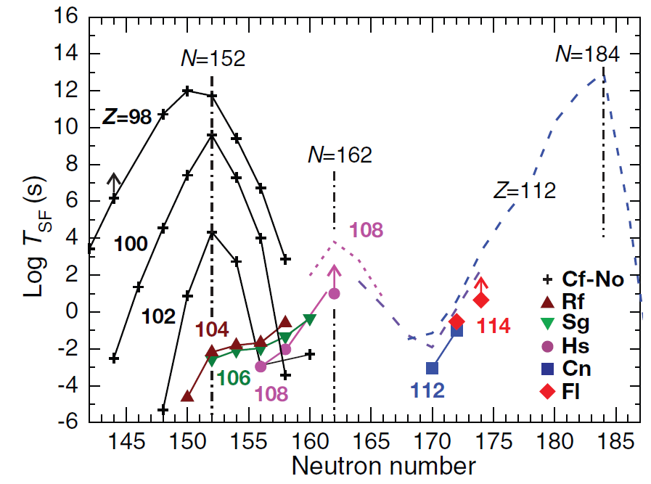
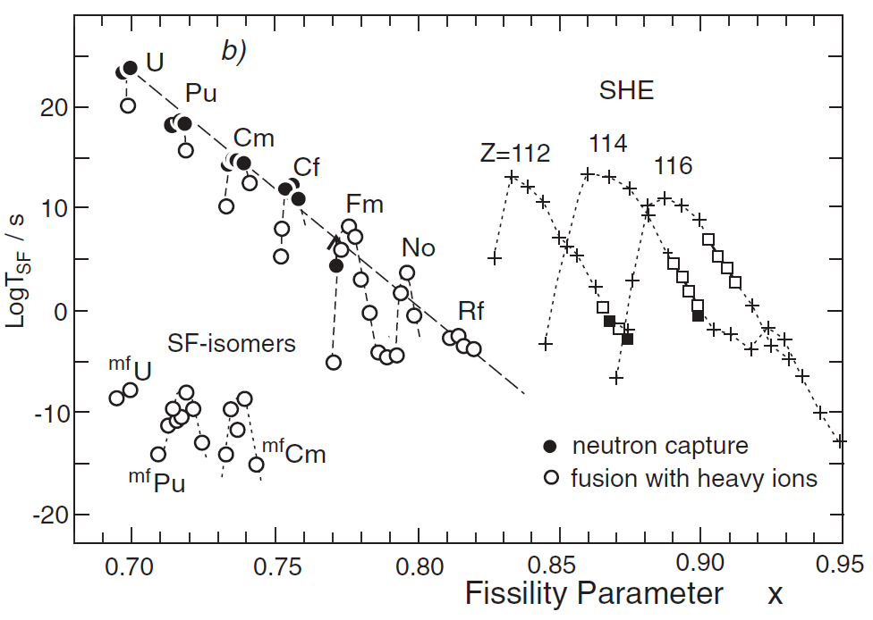
Common logarithm of partial spontaneous fission halflife
versus neutron number for even–even isotopes of elements
with Z = 98–114.
Half-lives with respect to SF as a function of the fissility parameter (Z²/A).
Yu.Ts. Oganessian and V.K. Utyonkov
Rep. Prog. Phys. 78 (2015) 036301 (22pp)
Notes:
Presently the available information on the spontaneous fission of heavy elements mainly concerns
partial half lives, TKE and mass distributions of fission fragments from spontaneous fission.

Slide 5
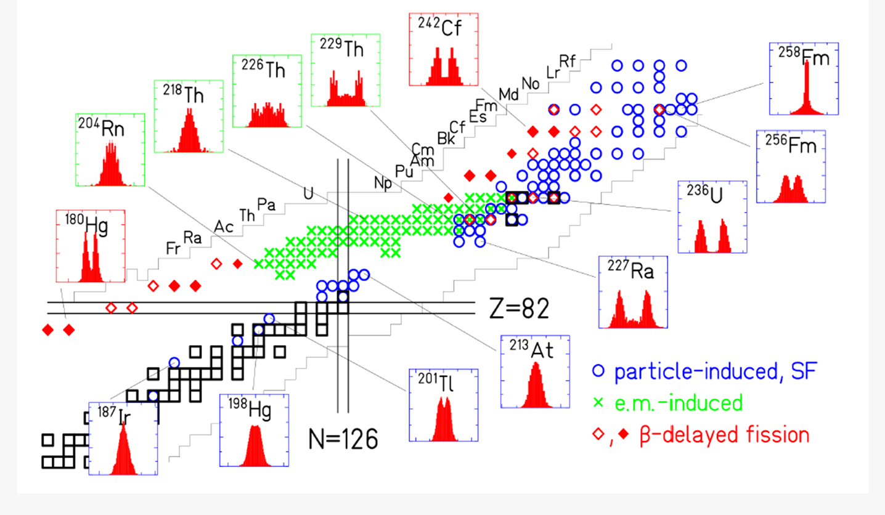
General view on the systems for which mass or nuclear-charge distributions
have been measured.
K.H. Schmidt, B. Jurado, Rev. Prog. Nucl. Fiss (2018)
Notes:
Super-Short Mode (Brosa) manifests itself only when both light and heavy fission fragments are close in their nucleon composition to the double magic tin with A132.
The phenomenon of Bimodal fission was discovered in the 1980’s for the case of spontaneous and low energy fission of nuclei in the Fm-Rf region
Some spontaneously fissioning isotopes of Fm, Md, and No were found to exhibit symmetric fragment mass distributions, whose widths are changing very rapidly from nucleus to nucleus. For example, for spontaneous fission of 258Fm the mass distribution is unusually narrow, while for the neighboring nucleus 259Md with only one more proton it is rather broad. Even more spectacular are the distributions of TKE, which are double humped.
the high-energy mode is linked to a narrow mass distribution while the low-energy mode has a wide mass distribution.
By theory, bimodal fission is explained by the existence of two different paths on the potential energy surface leading to fission
One path is described by the LDM, while for the other path shell effects play an important role. The LDM path leads to elongated scission configurations while the shell effect path corresponds to compact configurations. Both paths result in symmetric (or nearly so) mass distributions, but the high TKE valley is narrower while the low TKE valley is much wider. This explains the difference in width of the mass distributions.

Slide 6
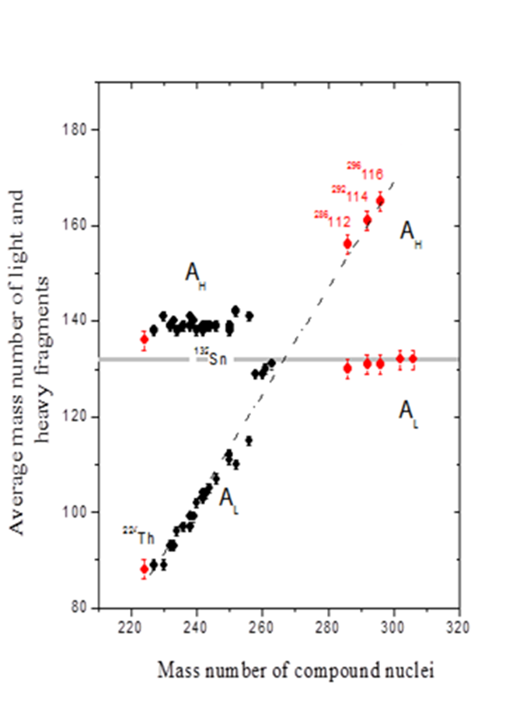
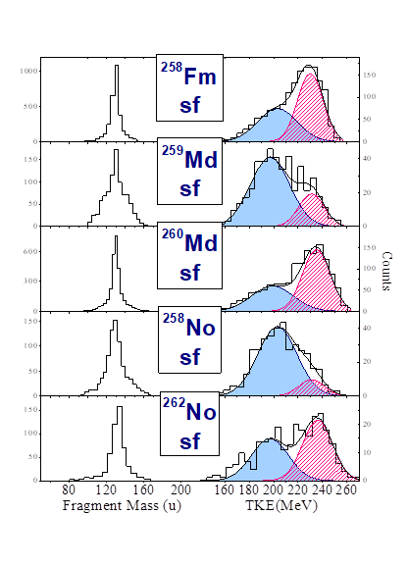
Notes:
Super-Short Mode (Brosa) manifests itself only when both light and heavy fission fragments are close in their nucleon composition to the double magic tin with A132.
The phenomenon of Bimodal fission was discovered in the 1980’s for the case of spontaneous and low energy fission of nuclei in the Fm-Rf region
Some spontaneously fissioning isotopes of Fm, Md, and No were found to exhibit symmetric fragment mass distributions, whose widths are changing very rapidly from nucleus to nucleus. For example, for spontaneous fission of 258Fm the mass distribution is unusually narrow, while for the neighboring nucleus 259Md with only one more proton it is rather broad. Even more spectacular are the distributions of TKE, which are double humped.
the high-energy mode is linked to a narrow mass distribution while the low-energy mode has a wide mass distribution.
By theory, bimodal fission is explained by the existence of two different paths on the potential energy surface leading to fission
One path is described by the LDM, while for the other path shell effects play an important role. The LDM path leads to elongated scission configurations while the shell effect path corresponds to compact configurations. Both paths result in symmetric (or nearly so) mass distributions, but the high TKE valley is narrower while the low TKE valley is much wider. This explains the difference in width of the mass distributions.

Slide 7
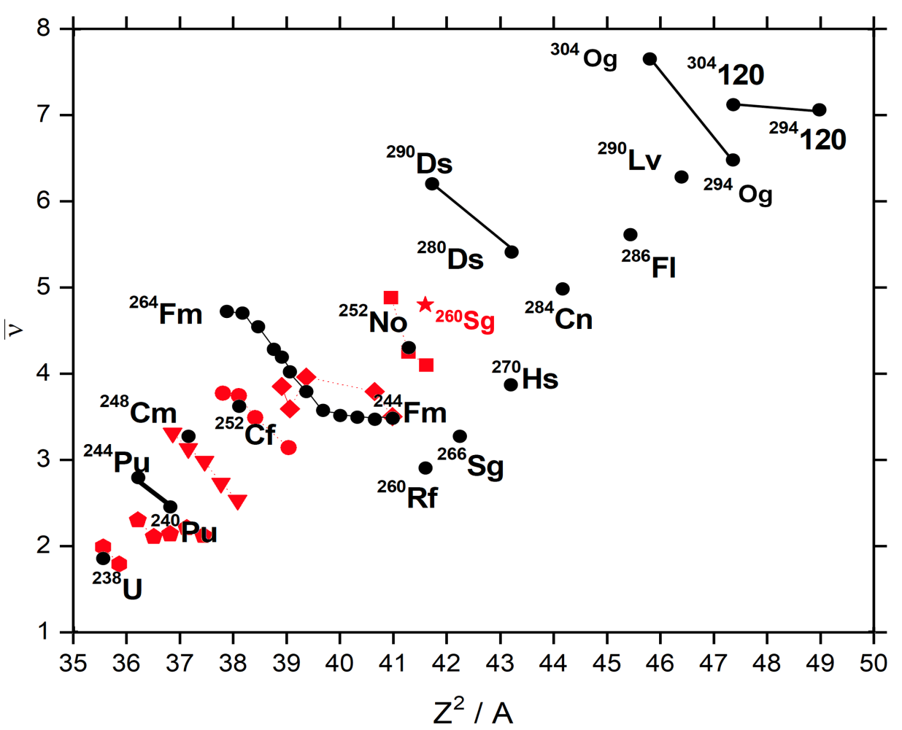
Rubchenya, V.A. Prompt neutron characteristics
in the spontaneous fission of heavy and superheavy nuclei.
LXV International Conference "Nucleus 2015" June 29-July 3, 2015, St. Petersburg

Slide 8
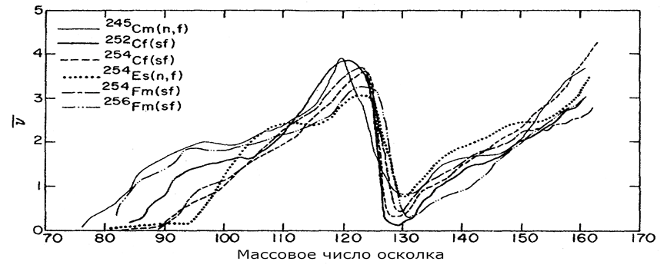
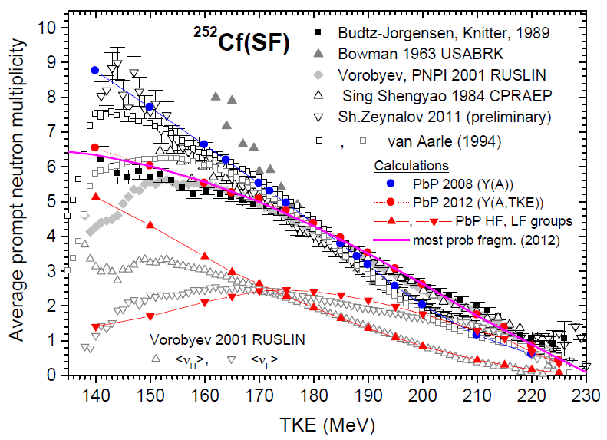
Dependence of neutron yield on fragment mass for several low-energy fissioning systems (“saw-tooth shape”)
Gindler J. PRC. (1979) – Vol. 19, issue 5.
Prompt neutrons vs TKE - ²⁵²Cf data (different black and gray symbols).
I.Visan et al. (2014) Rom. Journ. Phys., Vol. 59, No. 3–4

Slide 9
The estimation of half life > 5 decays
The average number of SF neutrons > 20 fissions
(ε_{n} > 45%)
The determination of neutron
multiplicity distribution > 100 fissions
(ε_{n} > 45%)
The evaluation of TKE (2 FF!) > 100 fissions
The determination of energy or
mass distribution of single fission fragments > 10⁵ fissions

Slide 10
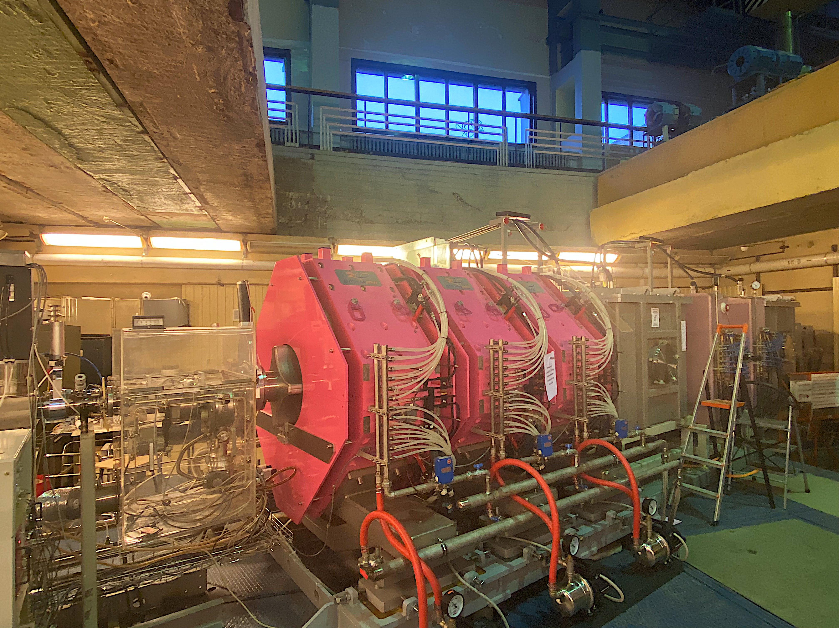
Separator for Heavy ELement Spectroscopy – SHELS
(U400 cyclotron FLNR)
Popeko A. G., et al.
NIM B. (2016).Vol. 376

Slide 11
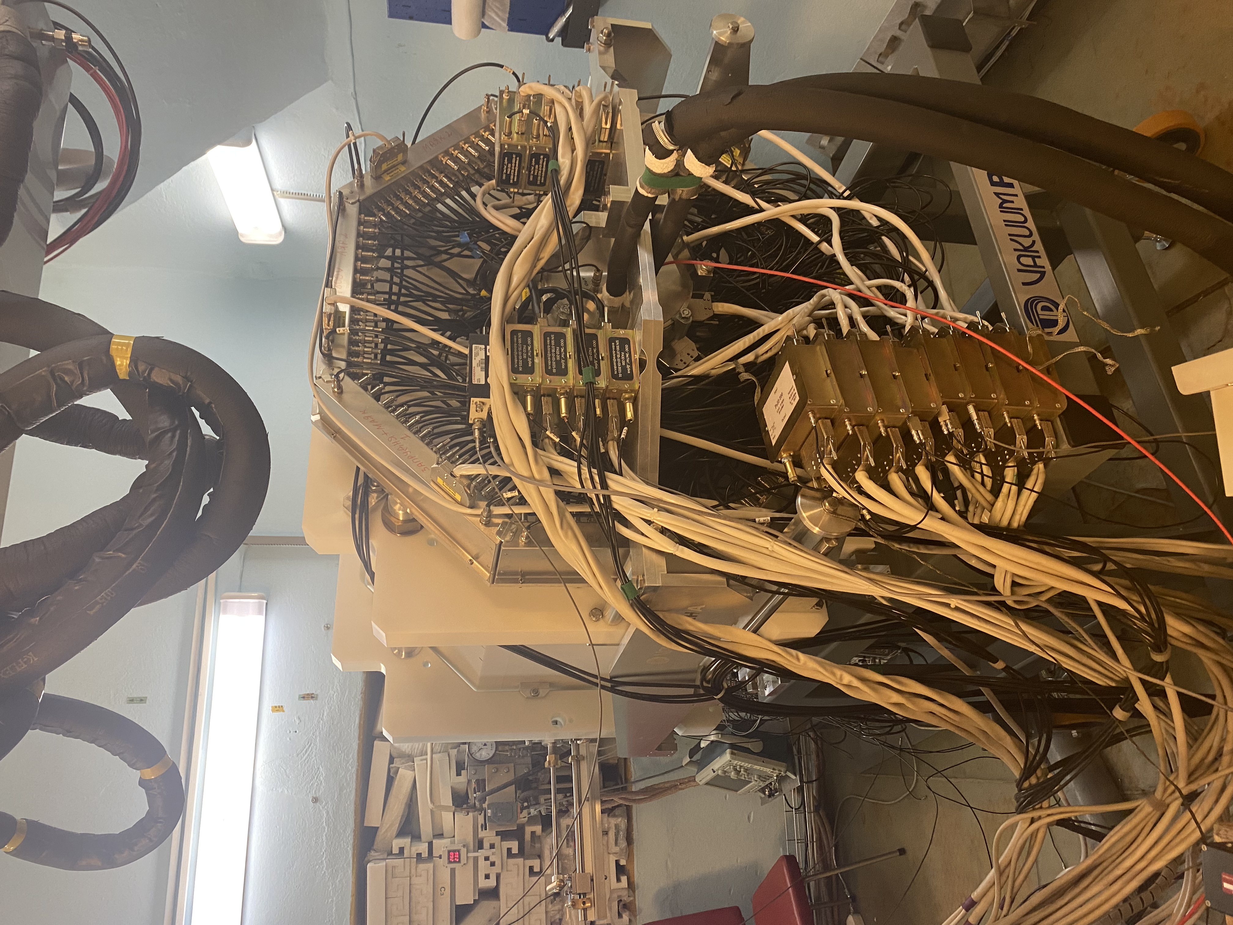
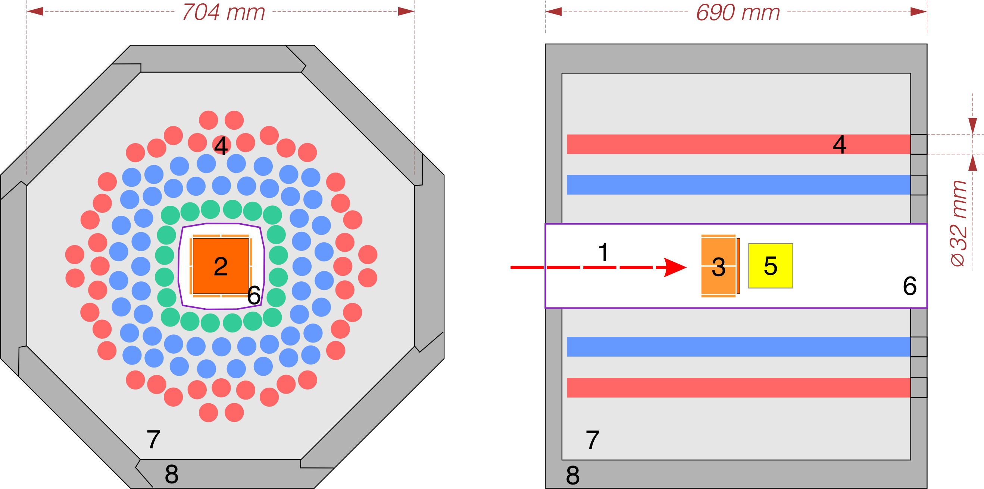
SFiNx – Spontaneous Fission, Neutrons and x-rays
1 – ER “beam”
2,3 – DSSSD box
4 - ³He-based N counters
5 – BGO-scint.
6 – vacuum chamber
7 – neutron moderator
8 – neuron shield
ε_{n} = 55%
Isaev, A. V. et al.
The SFiNx detector system
PEPAN Letters 19, 37–45 (2022)
Isaev, A. V. et al.
Study of spontaneous fission using
the SFiNx system
APP B Proc. Suppl. 14, 835–839 (2021)
DSSD 100×100 мм
128×128 strips

Slide 12
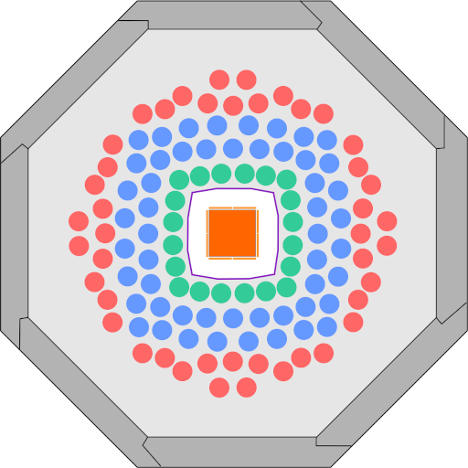
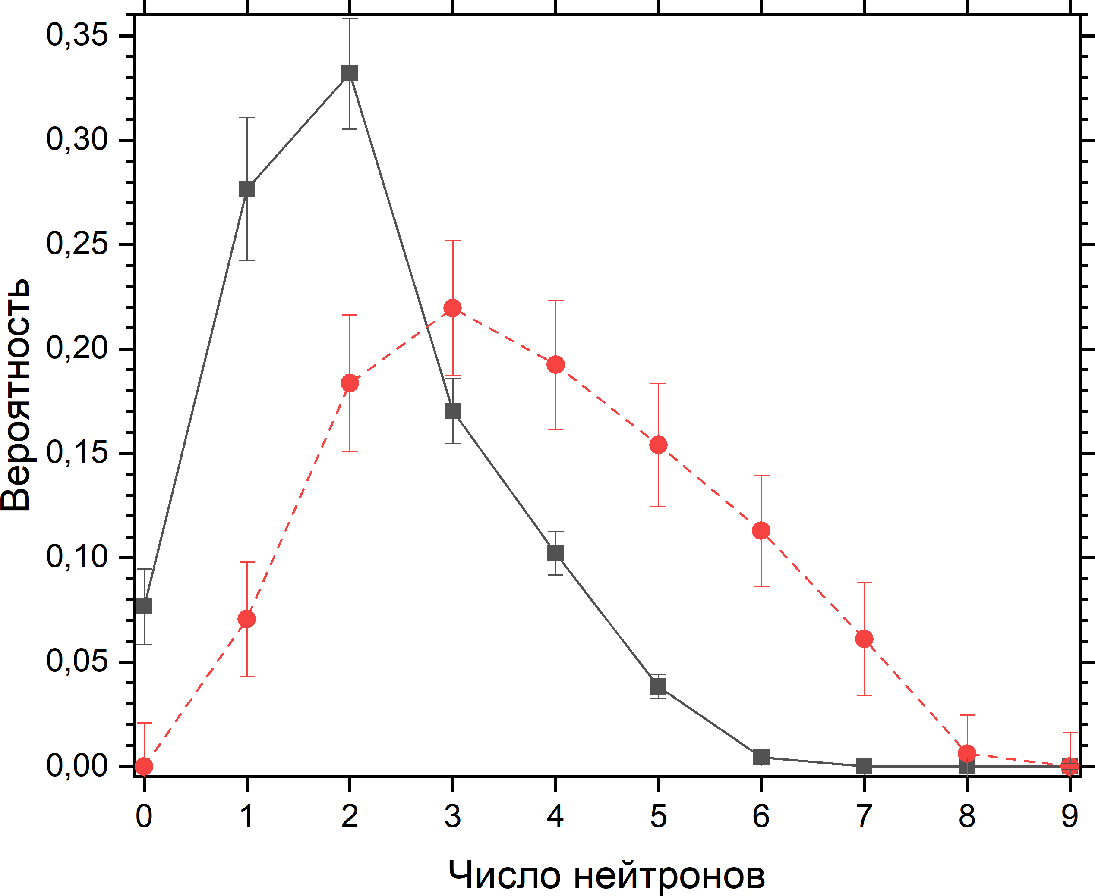
²⁴⁶Fm
b_{SF} ≈ 0,06
⁴⁰Ar + ²⁰⁸Pb = 2n + ²⁴⁶Fm
target ²⁰⁸PbS | 450 μg/sm² ²⁰⁸Pb > 99%
E_{1/2}, MeV | 183±3
σ_{max}, nb | ~5
ε_{n}, % | 54,8±0,1
𝛥t | 30 ms – 15,4 s
∑_{SF} | 235
∑_{n} | 488
$$\overline{\text{ν}}$$ | 3,79±0,30 [1]
$${\text{σ}}_{\text{ν}}^{2}$$ | 2,1
P_{n} | +
T_{1/2} | ${\text{1,50}}_{−0,07}^{+0,08}$ s
b_{SF} | 0,061±0,005
The multiplicity distribution ◼ measured ● reconstructed [2]
P
Mult. neutron events, M
[1] Isaev, A. V. et al. Prompt neutron emission in the spontaneous fission of ²⁴⁶Fm. EPJ A 58.6 (2022)
[2] Mukhin, R. S. et al. Reconstruction of spontaneous fission neutron multiplicity distribution spectra by the statistical regularization method. PEPAN Letters 18, 439–444 (2021)

Slide 13
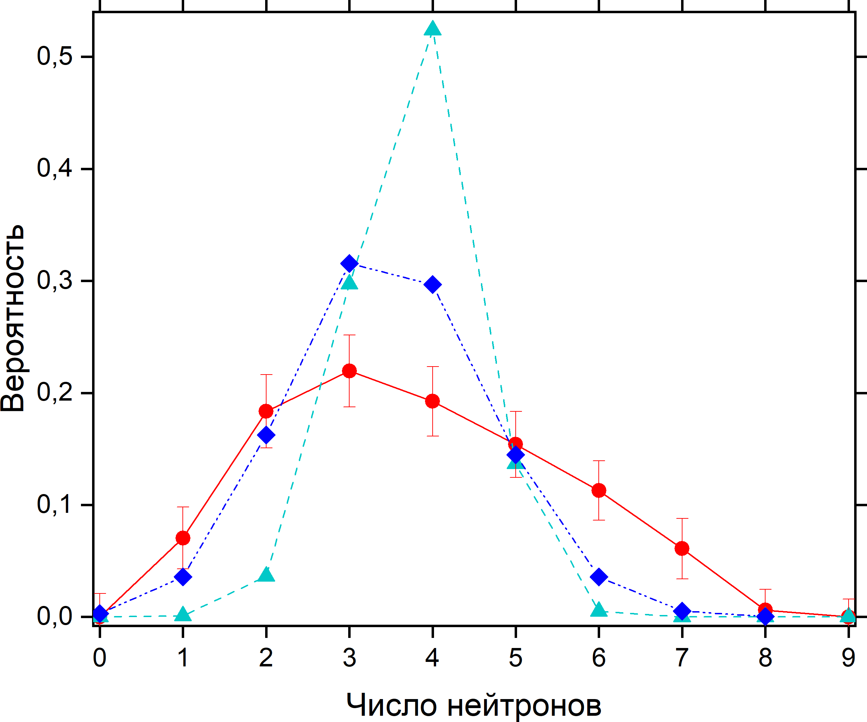
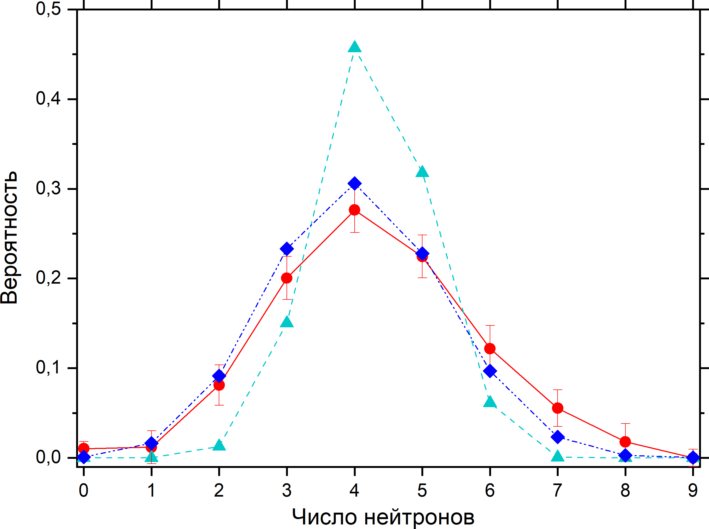
²⁴⁶Fm
²⁵²No
Mult. neutron events, M
Mult. neutron events, M
● Isaev et. Al. 2022 (3,79±0,20) Svirikhin, et al. 2010 (3,55±0,50) | ● Isaev et. Al. 2021 (4,27±0,15) Lazarev, et al. 1974 (4,15±0,30)
▲ The improved scission-point model (3,77) ◆ GEF (3,47±0,02) | ▲ The improved scission-point model (4,27) ◆ GEF (4,04±0,01)

Slide 14
VASSILISSA (SHELS) results
Systematics of prompt neutron multiplicity distribution shapes of SF nuclei with Z > 100
(to be published in EPJ)

Slide 15
SHELS Results – TKE, ν
Isotope | Cross Section (nb) | Calculated average number of neutrons [1] | Measured average number of neutrons, | Calculated average TKE (MeV) [1] | Measured average TKE (MeV)
²⁶⁰Sg* | 0.5 | In progress | 5.0±0.6 | In progress | In progress
²⁵⁴Rf | 2.4 | 4.70 | 3.87±0.34 | 209 | -
²⁵⁶Rf | 15 | 4.24 | 4,30±0,09 | 208 | 198.7±2.8 [2]
²⁵⁰No | 10 | 4.30 | 4.38±0.13 | 202 | 192±2
²⁵⁴No | 2000 | 4.03 | 4,88±0,53 | In progress | 189.2 [3]
²⁵²No | 800 | 4.27 | 4,25±0,09 | 201 | 194.3 [3]
²⁴⁴Fm* | 3 | 3.50 | 3,50±0.20 | 196 | 198±5
²⁴⁶Fm* | 5 | 3.77 | 3,79±0,30 | 196 | 199±4
[1] A.V. Andreev, Eur. Phys. J. A 30, (2006) (The improved scission-point model).
[2] P. Mosat, Phys.Rev. C 101, (2020)
[3] J.F. Wild, J. Alloys Compd.. V. 213–214 (1994)
* 2021-2023 data (SHELS separator)

Slide 16
VASSILISSA (SHELS) results
Rubchenya, V.A. Prompt neutron characteristics
in the spontaneous fission of heavy and superheavy nuclei.
LXV International Conference "Nucleus 2015" June 29-July 3, 2015, St. Petersburg

Slide 17
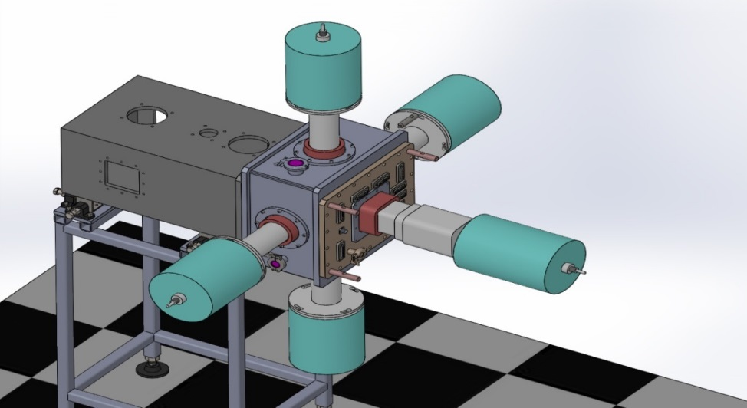
February 2019 SHELS + GABRIELA
⁴⁸Ca + ^{204,206,208}Pb = 2n + ^{250,252,254}No
________________________________________________________
²⁵⁰No
Beam time: 2 weeks (0.5 pμA of ⁴⁸Ca)
Target: 470µg/sm² PbS (99.94% of ²⁰⁴Pb)
15000 Re-FF correlations (0-500 µs)
no Re-alpha correlations
under analysis: ff-TKE, b_{SF}, cross-section, isomeric states
________________________________________________________
²⁵²No
Beam time: 4 days (0.5 pμA of 48Ca)
Target: 400µg/sm² PbS (99.51% of ²⁰⁶Pb)
15000 Re-FF correlations
under analysis: ff-TKE (using for calibration), cross-section
1 - 100x100 mm clover Ge-detector
4 - single crystal Ge-detectors
All with BGO-shield

Slide 18
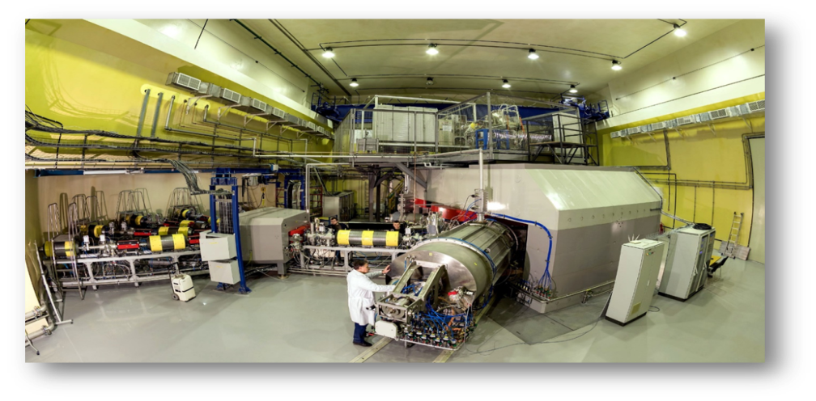
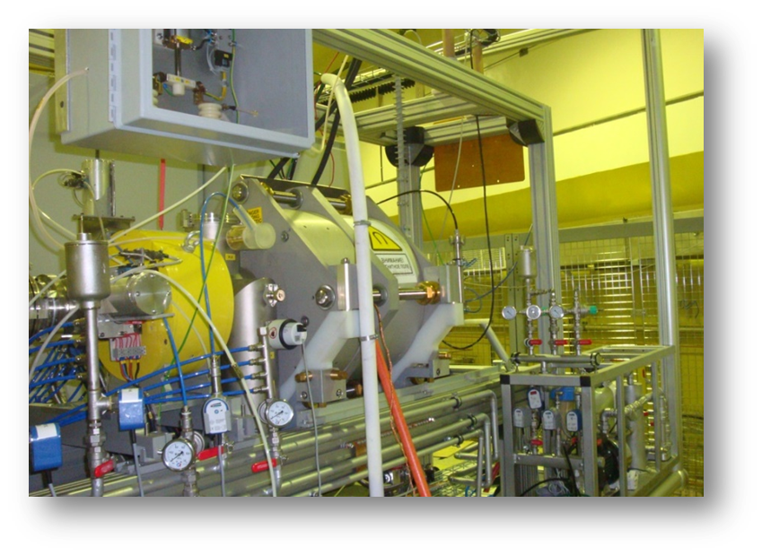
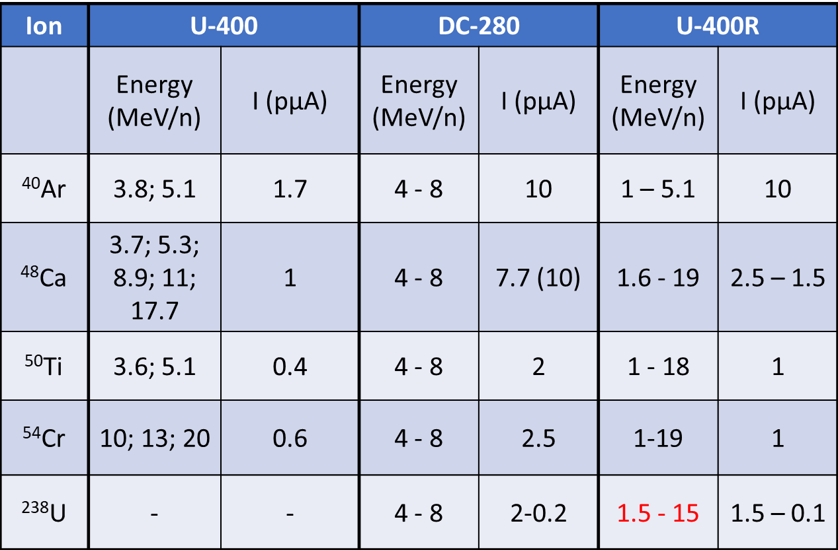
SHE Factory
DECRIS-PM
DC-280

Slide 19
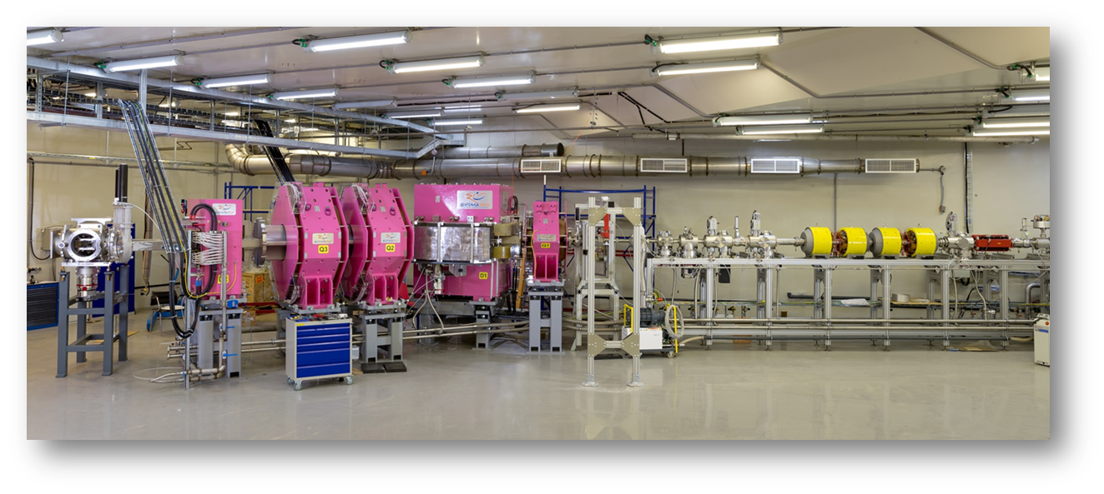
October 2022 DC-280 + GRAND + 128x128 DSSSD

Slide 20
October 2022 DC-280 + GRAND + 128x128 DSSSD
⁴⁸Ca + ²⁰⁸Pb = 2n + ²⁵⁴No
Target: 500 µg/sm² PbS (240 mm in diam. wheel)
Beam: 1 pμA of ⁴⁸Ca
Result: 1.5 alpha/s from ²⁵⁴No implanted to the GRAND focal DSSSD.
SHELS results: 0.5 alpha/s from ²⁵⁴No

Slide 21
To create the correct mass or energy distribution of fission fragments we need to register 10⁵ fissions !!!
 | ²⁵⁴No | ²⁵²No
Cross section of ER formation | 2000 nb | 800 nb
Branching ratio | b_{α}= 90% | b_{SF} = 33%
Efficiency of detection | ε_{α} = 50% | ε_{SF} = 100%
I beam = 1 pμA of ⁴⁸Ca | 120 000 alphas from ²⁵⁴No per 24 | 25 000 fissions of ²⁵²No per 24h
I beam = 3 pμA of ⁴⁸Ca | 360 000 alphas from ²⁵⁴No per 24 | 75 000 fissions of ²⁵²No per 24h

Slide 22
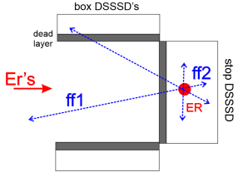
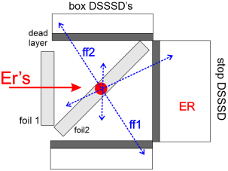
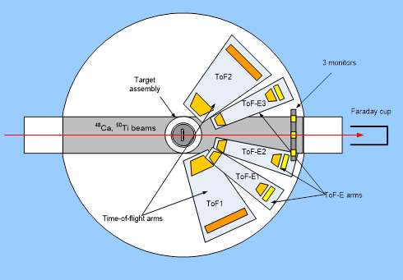
The implantation “box” detector | ε_{det} = 100 % 75 000 SF events per 24h | 2E method (+ neutrons) ΔM > 10 amu
The “box” + inclined film | ε_{det} = 5-10 % (need to be measured!) 3 500 – 7 500 SF events per 24h | 2E method (+ neutrons) 5 < ΔM < 10 amu
GFS + CORSET | ε_{det} = 0.02 % 10 – 20 SF events per 24h | 2V, TOF-E methods 2 < ΔM < 4 amu

Slide 23
- Detailed data on the main characteristics of spontaneous fission were obtained in FLNR: partial SF half-lives, branching ratios, neutron multiplicity data for short-lived nuclei in the vicinity of the shell N=152 (typical cross-sections of complete fusion reactions - 0.5 - 1000 nb).
- With the commissioning of the GRAND separator it is possible to study the nuclei lying in the vicinity of the deformed shell N = 162, and further. The capabilities of the SHE Factory and GRAND make it possible to study the nuclei, with a cross section of 5 picobarn (Fl, Mc).
- In addition, for the first time it is possible to detailed study of the spontaneous fission dynamic for short-lived isotopes heavier than fermium (No, Rf). But it is necessary to expand the capabilities of detecting the products of spontaneous fission of nuclei obtained on the beams of the SHE Factory.
Notes:
На базе ЛЯР получены подробные данные по основным характеристикам спонтанного деления: парциальные периоды полураспада, «вилки», данные о множественности нейтронов для короткоживущих ядер в окрестностях оболочки N=152 (типичные сечения образования 0.5 – 1000 nb).
С введением в строй сепаратора ГРАНД (на Фабрике СТЭ) появляется возможность изучения ядер лежащих в окрестностях дефрмированной оболочки N = 162, и далее. Возможности Фабрики и сепаратора делают доступными для изучения ядра, с сечением образования от 5 пикобарн (Fl, Mc).
Кроме того, впервые появляется возможность детально изучить динамические характеристики спонтанного деления для короткоживущих ядер тяжелее фермия (No, Rf). Но необходимо расширение возможностей детектирования продуктов спонтанного деления ядер, получаемых на пучках Фабрики СТЭ..

Slide 24
Thank you for your attention!
Спасибо за внимание!
Շնորհակալություն ուշադրության համար!

