Slide 1
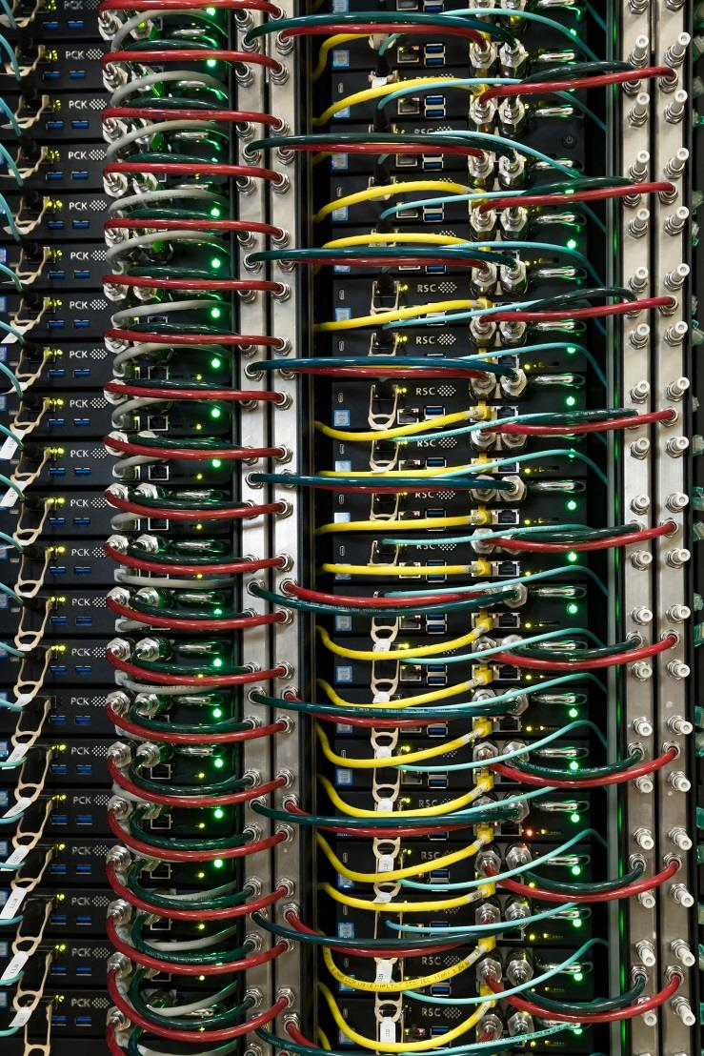
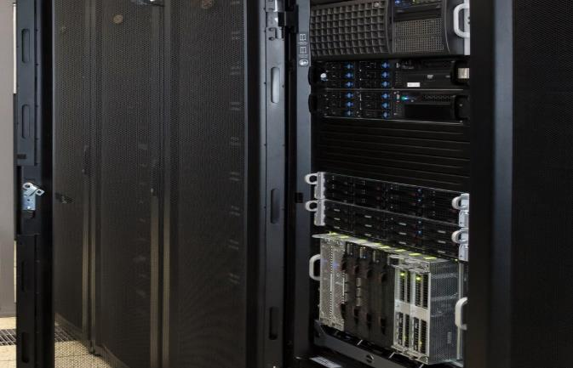
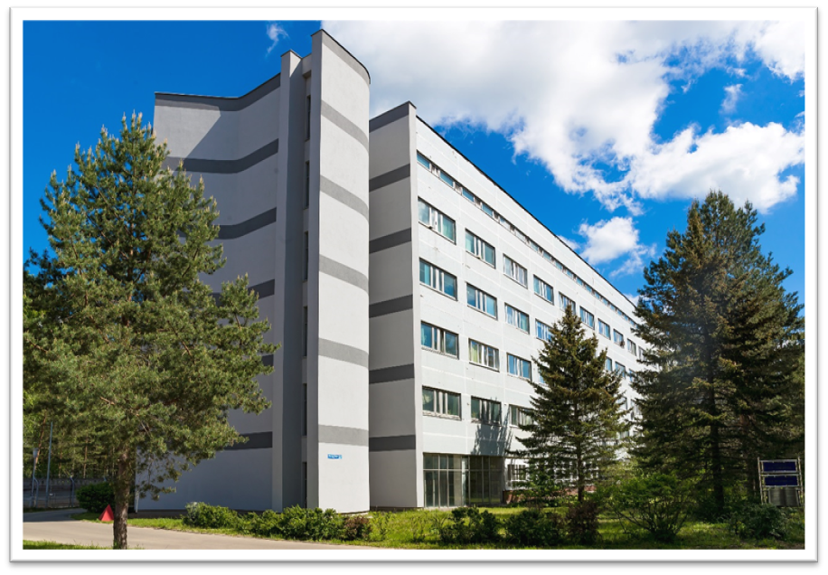
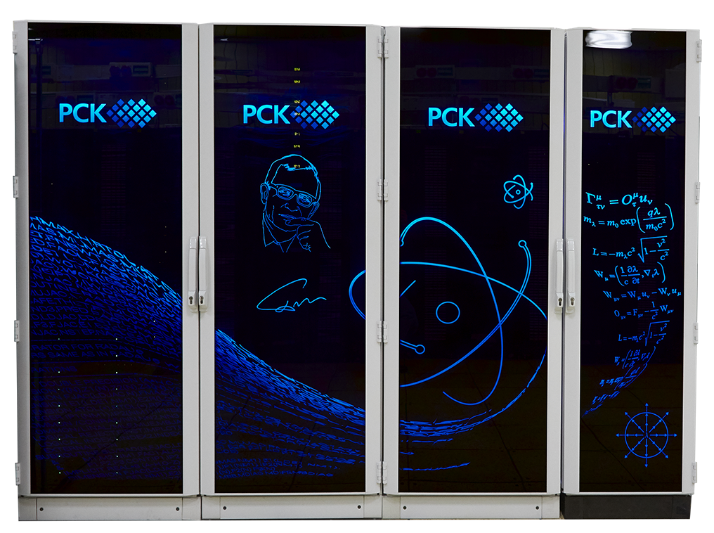

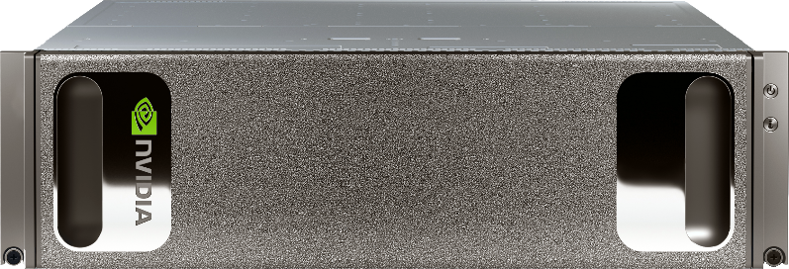
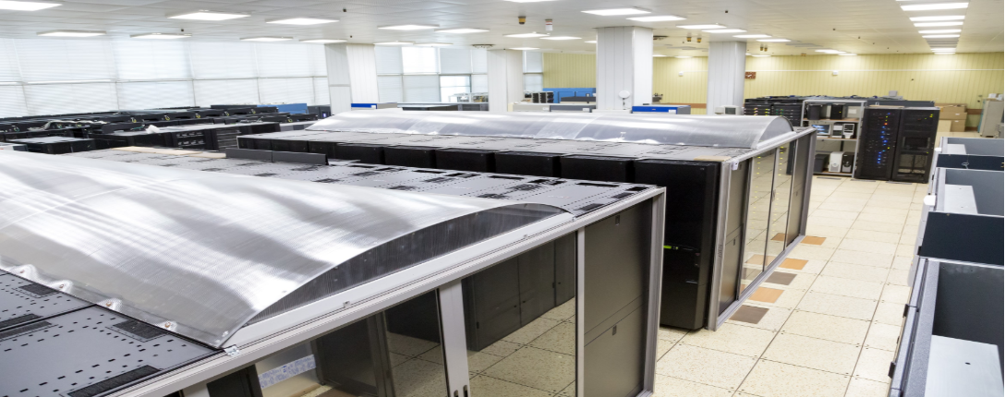
Supercomputer GOVORUN
Vladimir Korenkov (MLIT, JINR)
IUPAP Conference "Heaviest nuclei and atoms“
Yerevan, 29.04.2023
Notes:
На базе платформы HybriLIT продолжается активная разработка программного обеспечения и сервисов для совместного проекта ЛИТ и ЛРБ по созданию информационной системы (ИС) для анализа поведенческих и патоморфологических изменений в центральной нервной системе (ЦНС) при исследовании воздействия ионизирующего излучения и других факторов на биологические объекты.
Разрабатываемая ИС позволит объединить и структурировать данные различных типов от различных экспериментов и различных экспериментальных групп в единое информационное пространство, способное предоставить как удобство хранения и доступа к данным, так и набор передовых (актуальных) алгоритмических процедур автоматизации анализа данных для решения вопросов, связанных с диагностикой различных заболеваний ЦНС, которые остаются глобально открытыми и недостаточно исследованными, в том числе и на текущем этапе развития медицины.
Разрабатываемая ИС на базе методов машинного и глубокого обучения и нейросетевых подходов позволит обеспечить хранение и доступ к экспериментальным данным в удобной для комплексного статистического анализа форме. Использование в рамках создаваемой ИС нейронных сетей и алгоритмов машинного обучения позволит решить сложные задачи медицинской диагностики и нетривиальные задачи патоморфологов при исследовании гистологических препаратов, снижая временные и энергозатраты и исключая человеческий фактор.
Следствием внедрения этой системы станут систематизация накопленных результатов, выявление скрытых закономерностей, проявляющихся в отклике биологических систем на воздействие поражающих факторов и, как следствие, значительное упрощение и ускорение в постановке диагнозов, особенно на ранних стадиях заболеваний, выработке эффективных методик профилактики и противодействия отрицательным факторам воздействия ионизирующего излучения.

Slide 2

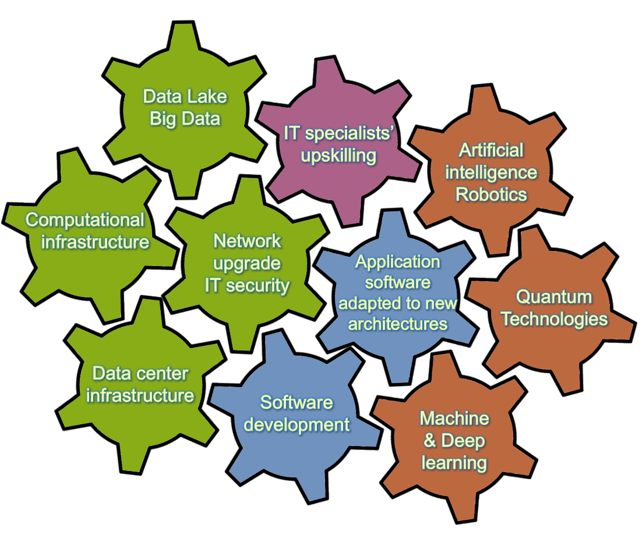
Strategy for Information Technology and
Scientific Computing at JINR
Scientific IT ecosystem:
It will be a steady implementation/upgrades of
Networking (Tb/s range),
Computing infrastructure within the Multifunctional Information & Computing Complex (MICC) and
“Govorun” Supercomputer,
Data center infrastructure,
Data Lake & long-term storage
for all experiments.
The development of new data processing and analysis algorithms based on
ML/DL,
Artificial intelligence,
Big Data
Quantum technologies.
A variety of means will be used for IT specialists’ upskilling.
Coordinated development of interconnected IT technologies and computational methods
Notes:
The concept of the development of information technology, scientific computing and Data Science in the JINR Seven-Year Plan provides for the creation of a scientific IT ecosystem that combines many different technological solutions, trends and methods. The IT ecosystem implies the coordinated development of interconnected IT technologies and computational methods aimed at maximizing the number of JINR strategic tasks to be solved that require intensive data calculations. Particular attention will be paid not only to increasing the performance of the computing systems and resources of the MICC storage systems, including the “Govorun” supercomputer, but also to the further development of the JINR network infrastructure. The most important tasks are the development of new data processing and analysis algorithms based on deep and machine learning, including artificial intelligence, and the development of modern Big Data methods and algorithms for solving applied problems. Research in the field of quantum computing will be aimed at developing algorithms for the intelligent control of JINR physical experimental facilities and at optimizing the solution of resource-intensive problems. The development of the digital platform “JINR Digital Ecosystem”, which integrates existing and future services to support scientific, administrative and social activities, as well as the maintenance of the engineering and IT infrastructures of the Institute, will provide reliable and secure access to various types of data and will enable a comprehensive analysis of information using modern Big Data technologies and artificial intelligence.

Slide 3
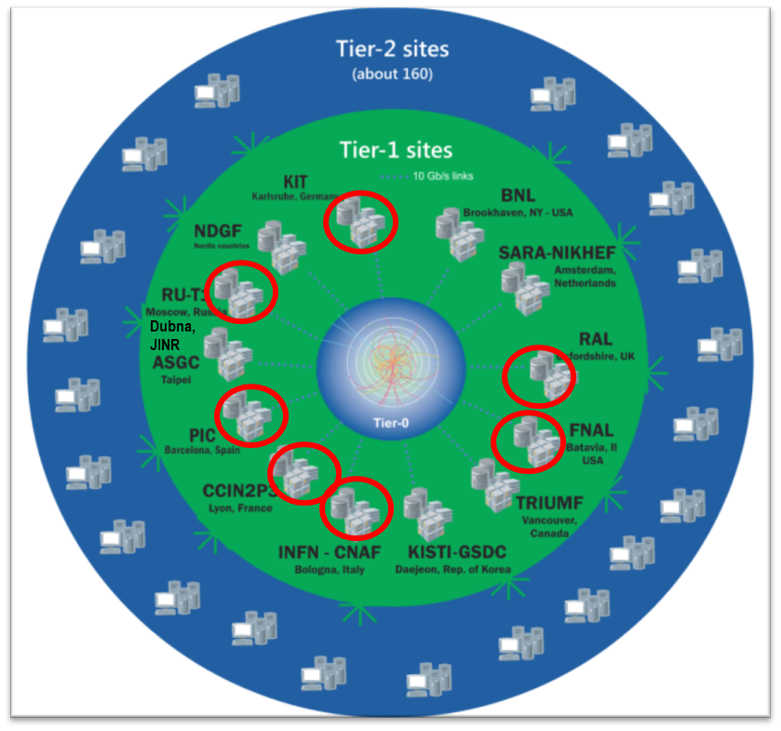
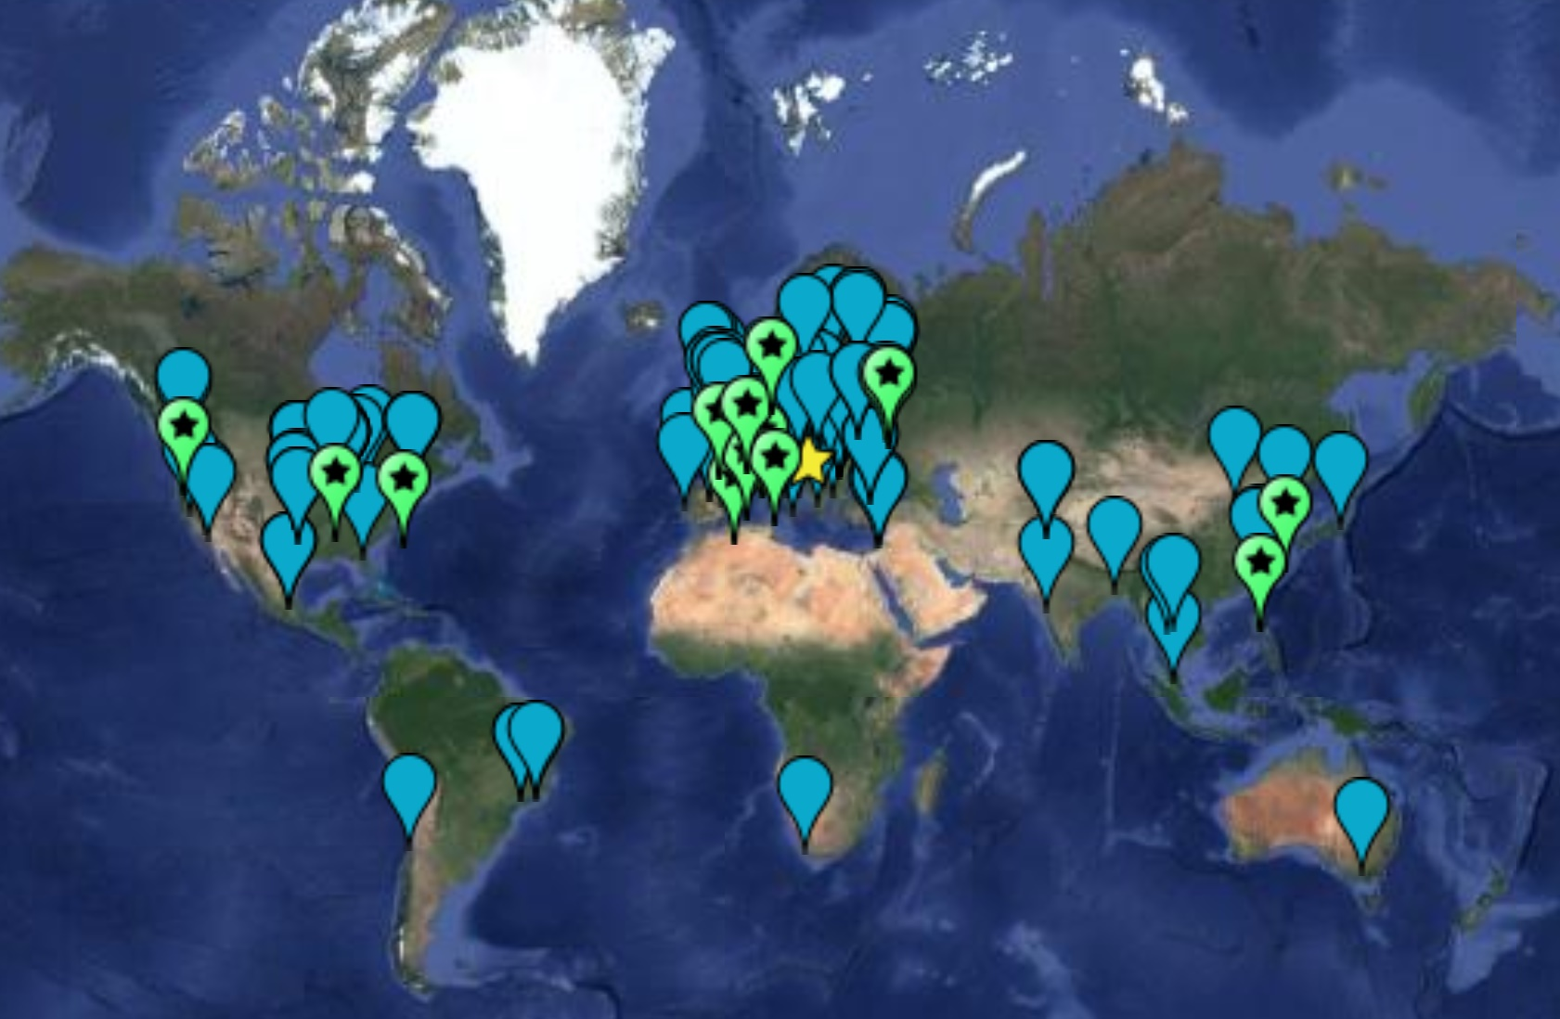
The Worldwide LHC Computing Grid
WLCG: an International collaboration to distribute and analyse LHC data. Integrates computer centres worldwide that provide computing and storage resource into a single infrastructure accessible by all LHC physicists
The mission of the WLCG project is to provide global computing resources to store, distribute and analyze the ~50-70 Petabytes of data expected every year of operations from the Large Hadron Collider.
WLCG computing enabled physicists to announce the discovery of the Higgs Boson.
170 sites
42 countries
> 12k physicists
~1.4 M CPU cores
1.5 EB of storage
> 2 million jobs/day
100-250 Gb/s links
Tier0 (CERN): data recording, reconstruction and distribution | Tier1: permanent storage, re-processing, analysis | Tier2: Simulation, end-user analysis
Worldwide LHC Computing Grid - 2019

Slide 4
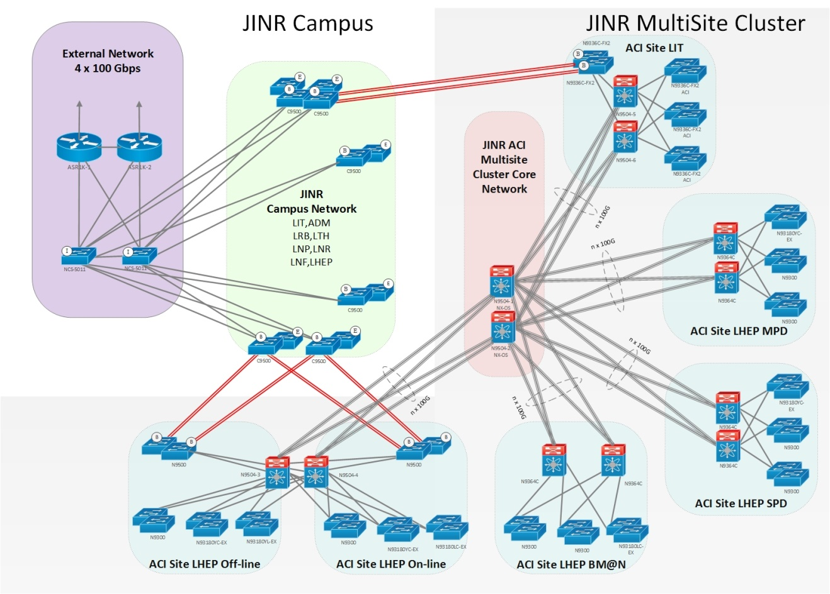
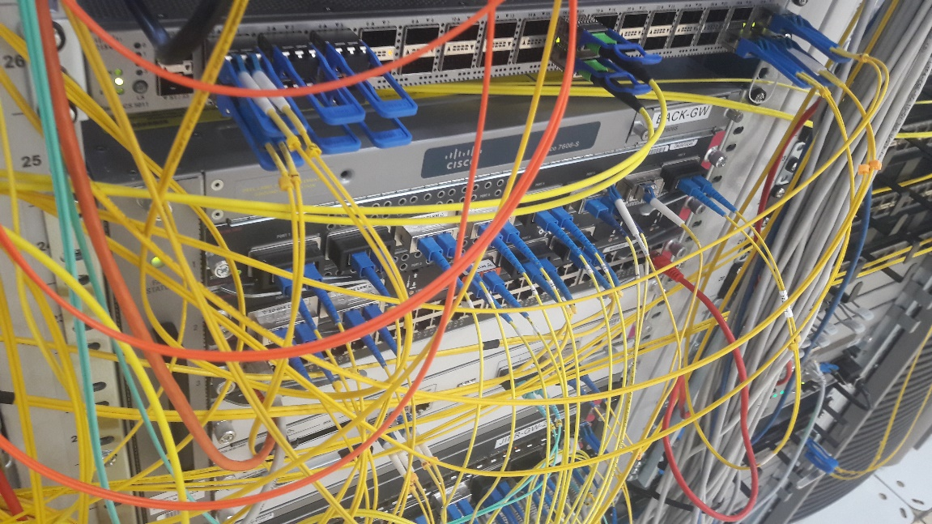
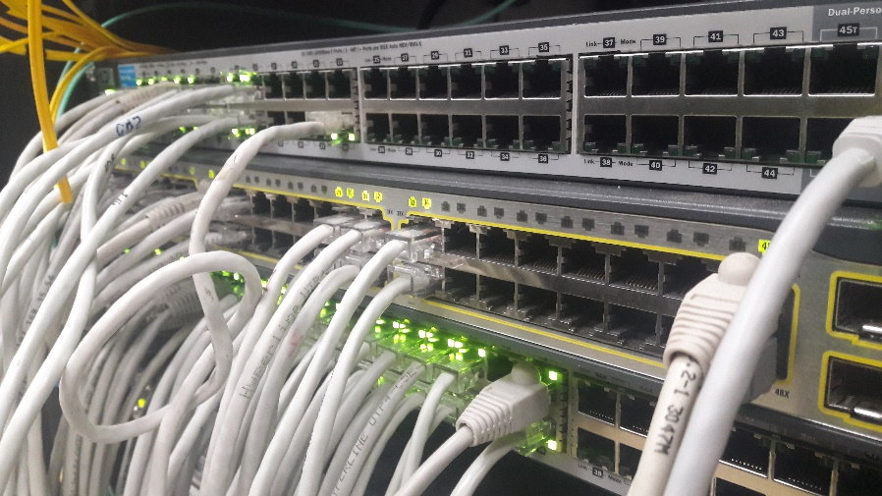
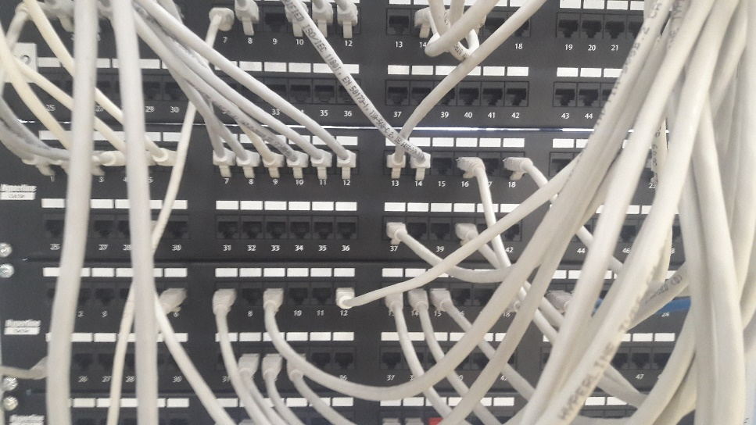
Networking
JINR-Moscow 3x100 Gbit/s
JINR-CERN - 100 Gbit/s and JINR-Amsterdam 100 Gbit/s for LHCOPN, LHCONE, GEANT networks
Direct channels up to 100 Gbit/s for communication using RU-VRF technology with the collaboration of RUHEP research centers and with Runnet, ReTN networks
The multi-site cluster network with a bandwidth 4x100 Gbit/s between VBLHEP and MLIT
The JINR LAN comprises:
9291 network elements
18044 IP-addresses
6355 users registered within the network
4477 *.jinr.ru service users
1455 digital library users
837 remote VPN
111 EDUROAM users
network traffic in 2022
29.56 PB - input
34.19 PB - output
Notes:
One of the most important components of JINR and MICC providing access to resources and the possibility to work with the big data is a network infrastructure.
Обеспечена надежная работа высокоскоростного канала связи Дубна-Москва. Внешний канал ОИЯИ построен по технологии DWDM и использует один канал 3x100 Гбит / с.
Таким образом, внешняя распределенная сеть ОИЯИ будет представлена прямым каналом ОИЯИ-CERN и резервным каналом, проходящим через MMTS-9 в Москве и Амстердаме, обеспечивающим работу LHCOPN (JINR-CERN) для соединения между Tier0 (CERN) и Tier1 (ОИЯИ) и внешней наложенной сети LHCONE, предназначенной для центра Tier2 ОИЯИ, прямых каналов для подключения с использованием технологии RU-VRF при сотрудничестве исследовательских центров RUHEP и сетей Runnet, RASnet.
Reliable operation of the high-speed communication channel Dubna-Moscow is ensured. JINR's external distributed network will be represented by a direct JINR-CERN channel and a backup channel passing through MMTS-9 in Moscow and Amsterdam

Slide 5
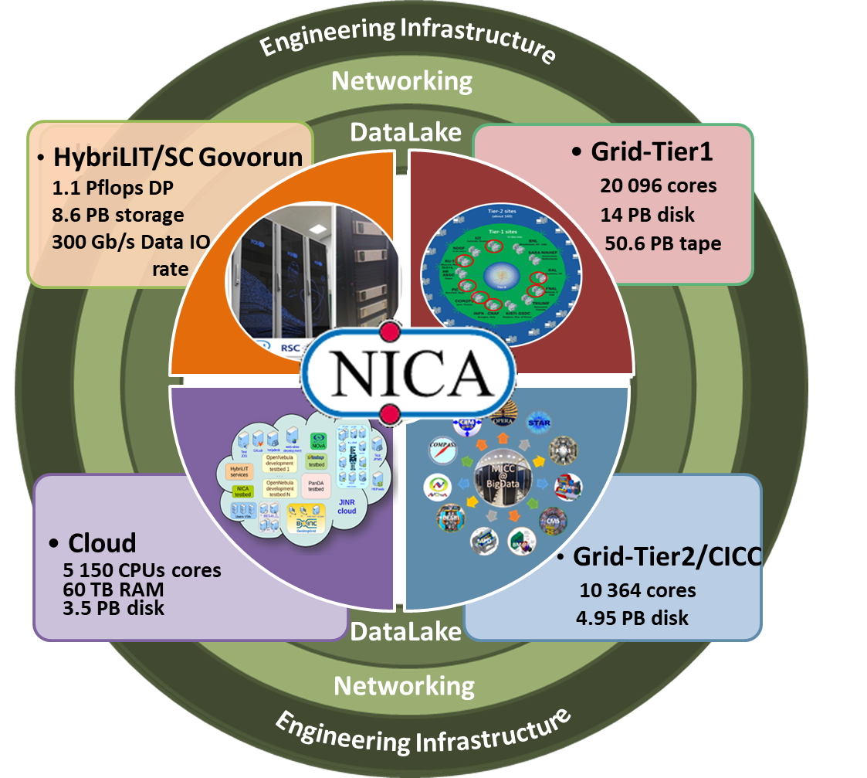
Multifunctional Information and Computing Complex at JINR
The MICC meets the requirements for a modern highly performant scientific computing complex:
multi-functionality,
high performance,
task-adapted data storage system,
high reliability and availability,
information security,
scalability,
customized software environment for different user groups,
high-performance telecommunications and modern local network.
The MICC should be considered as a basic scientific infrastructure project.
Notes:
The Multifunctional Information and Computing Complex (MICC) of MLIT JINR is a key component of the JINR network and information and computing infrastructure. The MICC is regarded as JINR’s unique basic facility and plays a defining role in scientific research, which entails modern computing power and storage systems. The MICC uniqueness is ensured by the consolidation of all state-of-the-art information technologies, including the network infrastructure and the distributed data processing and storage system based on grid technologies and cloud computing, the hyper-converged computing infrastructure with liquid cooling for supercomputer applications. Multifunctionality, high reliability and availability in a 24х7x365 mode, scalability and high performance, a reliable data storage system, information security and an advanced software environment are the main requirements that the MICC meets.

Slide 6
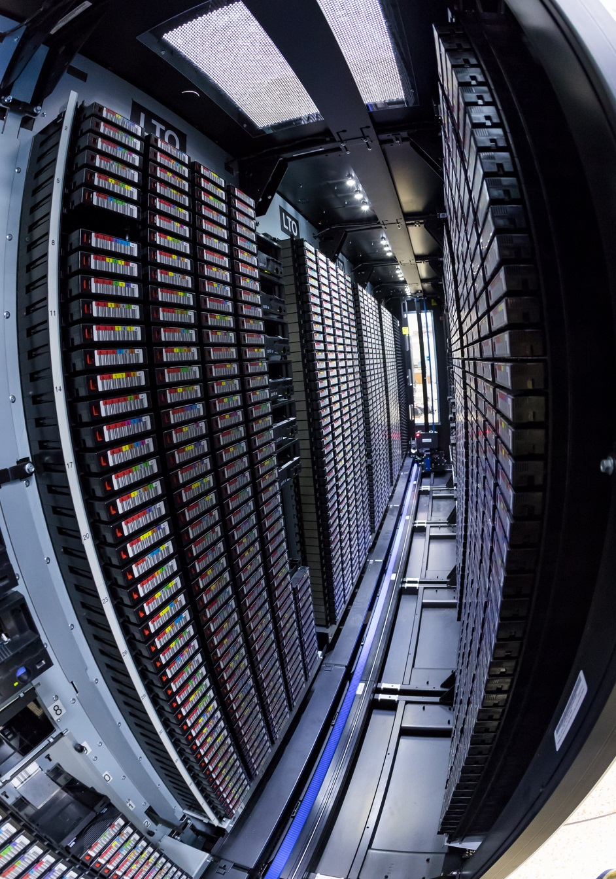
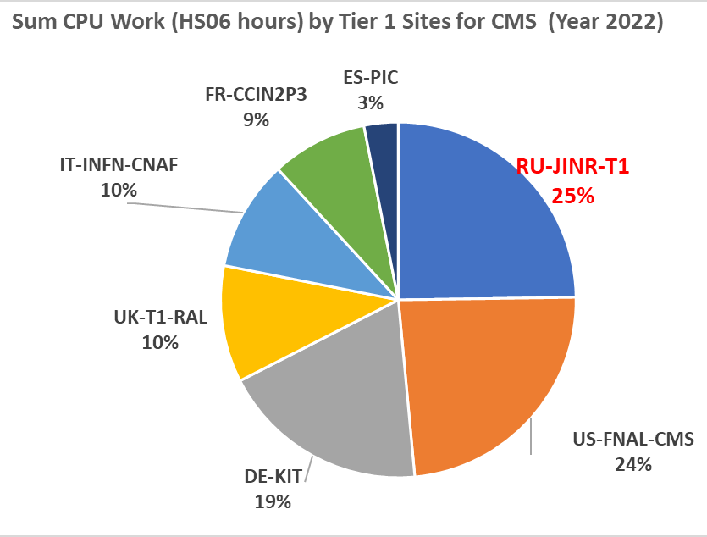
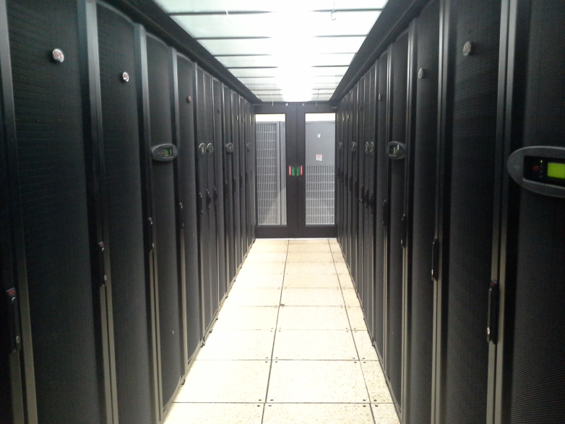
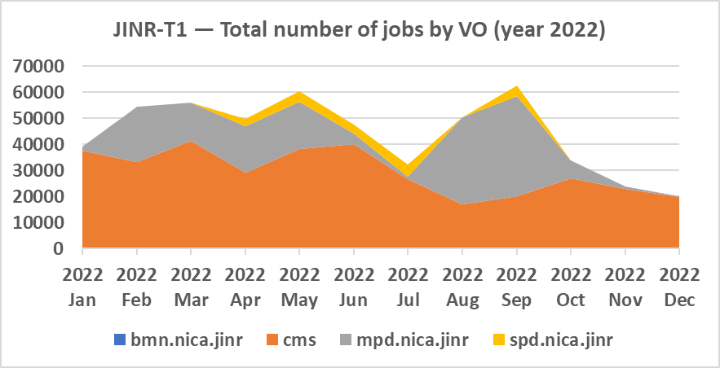
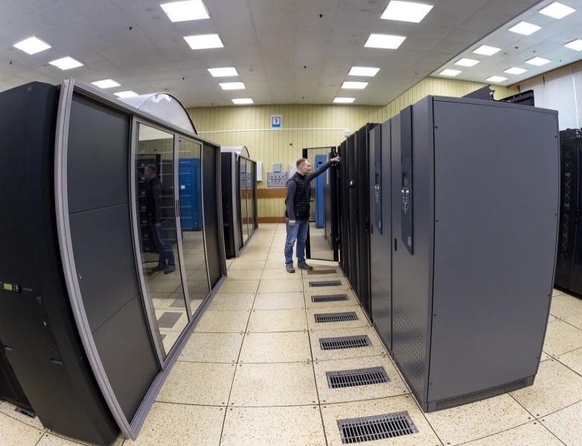
Tier1 at JINR
The JINR Tier1 center has demonstrated stable work not only for CMS (LHC), but also for MPD (NICA).
The Tier1 site for CMS is ranked first among world centers for CMS.
30% of all jobs executed at Tier1 JINR are NICA jobs
  20096 cores
  360 kHS06
  14 PB disks
  50.6 PB tapes
  100% reliability and availability

Slide 7
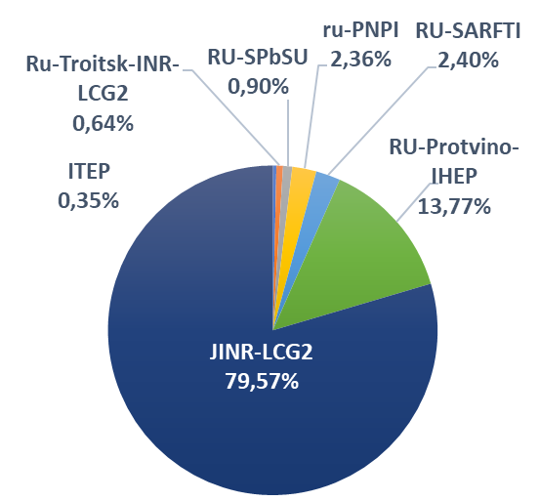
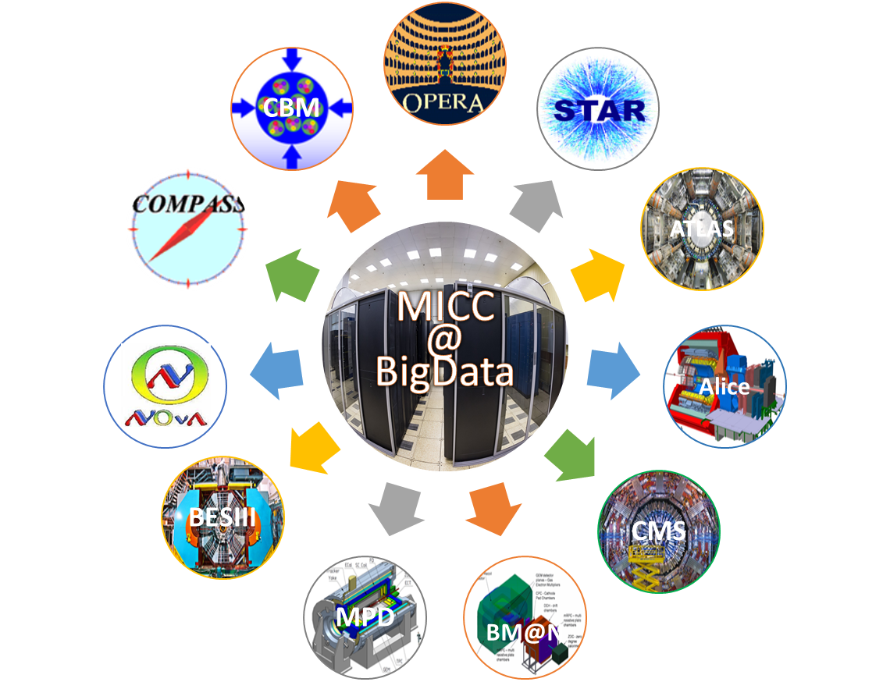
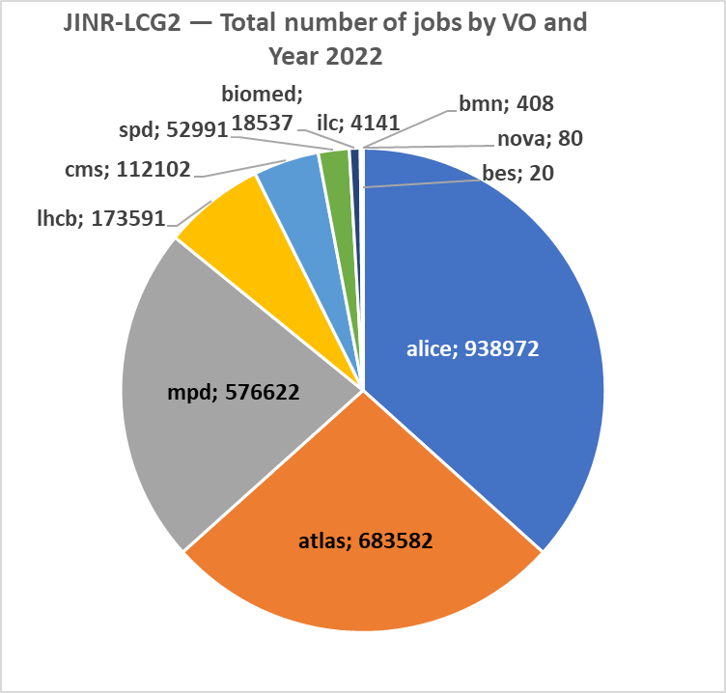
Tier2 at JINR
Tier2 at JINR provides computing power and data storage and access systems for the majority of JINR users and user groups, as well as for users of virtual organizations (VOs) of the grid environment (LHC, NICA, FAIR, etc.).
JINR Tier2 is the most productive in the Russian Data Intensive Grid (RDIG) Federation.
RDIG: distribution by the number of jobs by websites of organizations
(year 2022)
JINR Tier2: Sum CPU work (HS06 hours) by VO (year 2022)

Slide 8
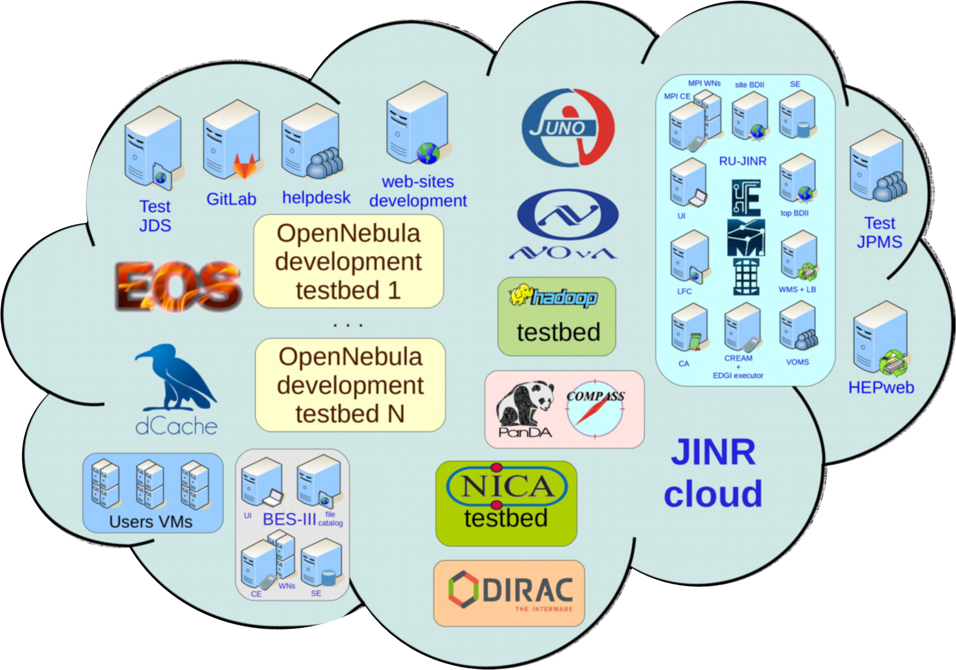
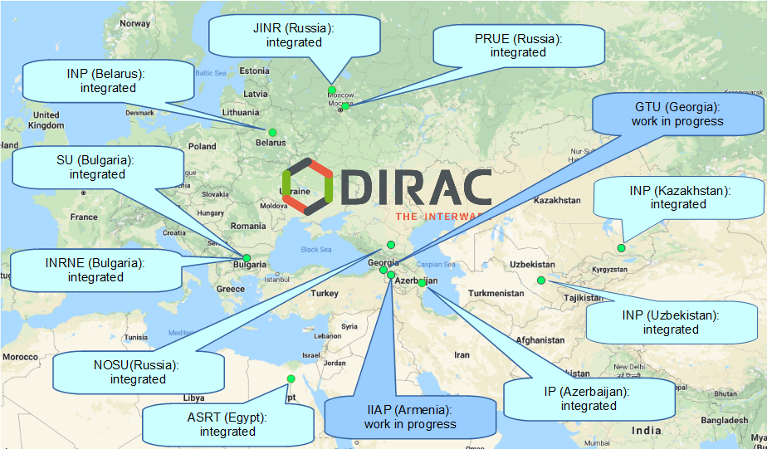
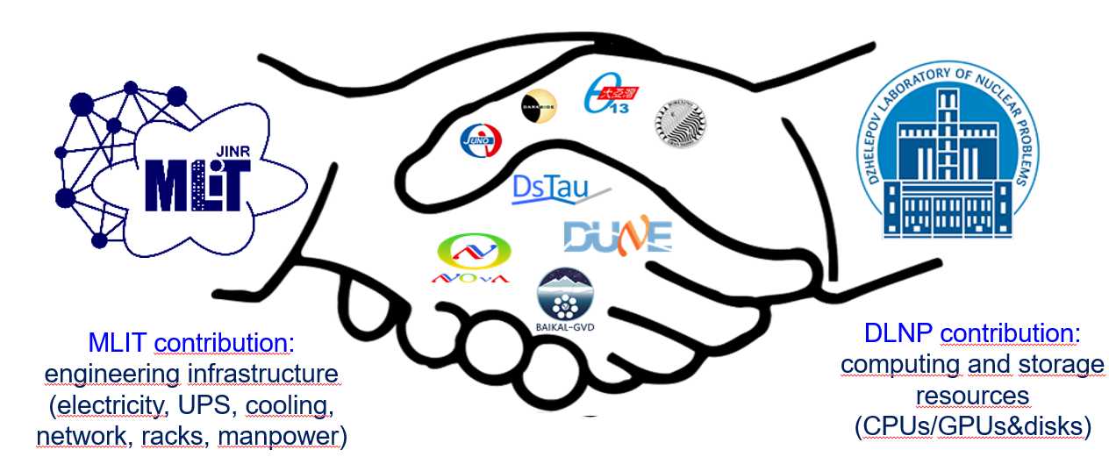
Cloud Infrastructure
Cloud Platform - OpenNebula
Virtualization - KVM
Storage (Local disks, Ceph)
Total Resources
~ 5,000 CPU cores; 60 TB RAM;
3.5 PB of raw ceph-based storage
VMs for JINR users
Computational resources for neutrino experiments
  Testbeds for research and development in IT
  COMPASS production system services
  Data management system of the UNECE ICP Vegetation
  Scientific and engineering computing
  Service for data visualization
  Gitlab and some others
DIRAC-based distributed information and computing environment (DICE) that integrates the JINR Member State organizations’ clouds
Notes:
A universal computing resource that supports individual scientists and provides a variety of common services, ranging from simple websites to complex multi-user computational systems. The main tasks are provision of Computational resources and support of users for the neutrino experiments and creation of distributed information and computing environment that integrates the JINR Member State organizations’ clouds.

Slide 9
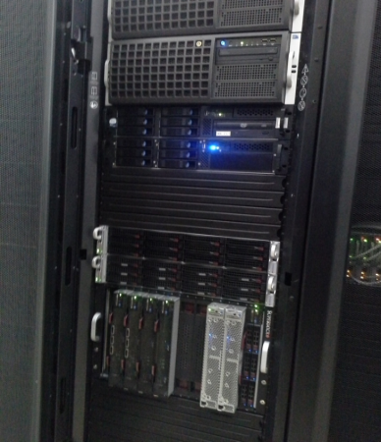
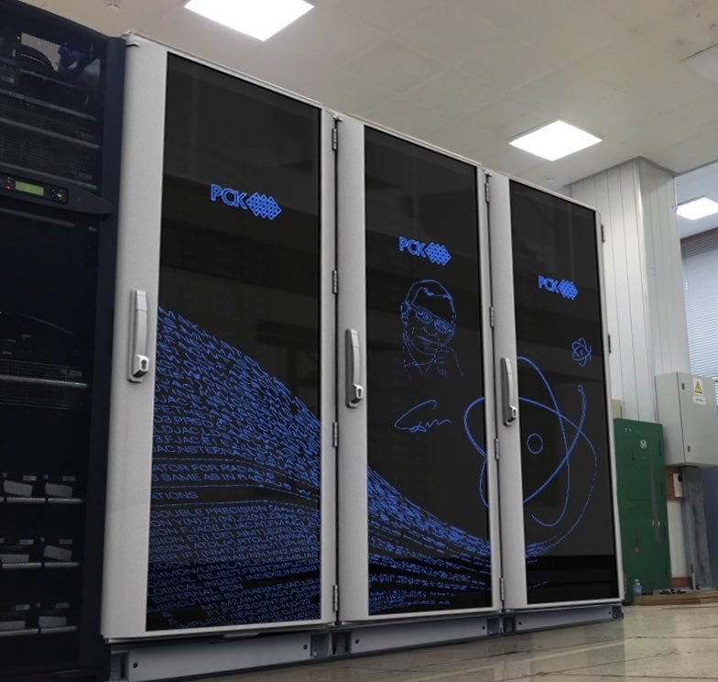
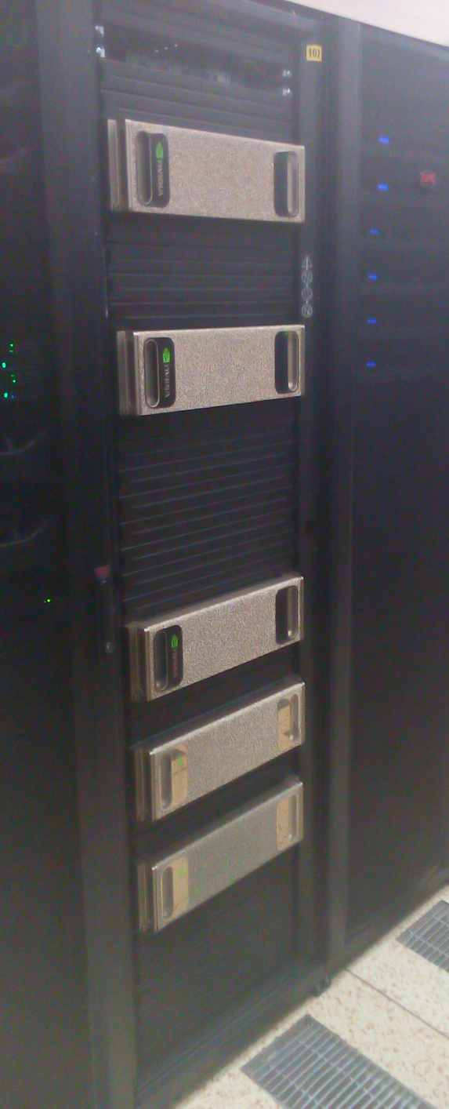
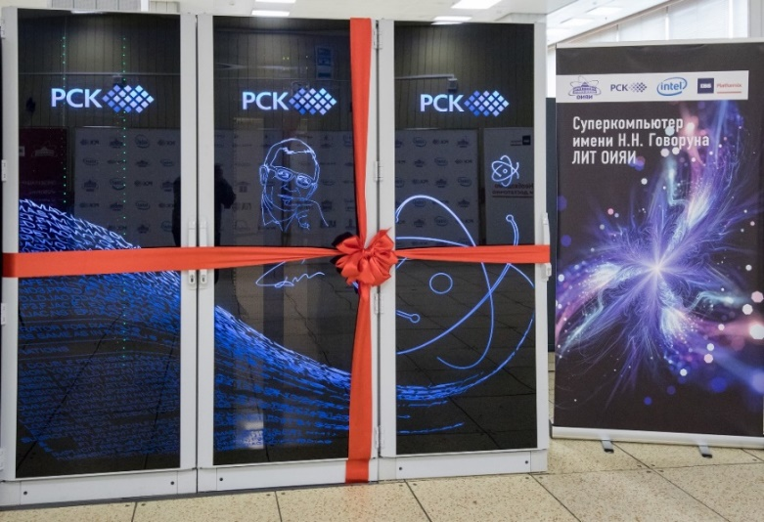
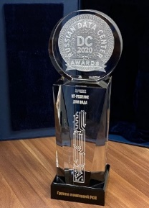
Development of the heterogeneous HybriLIT platform
“Govorun” supercomputer
Second stage 2019:
Full peak performance :
860 TFlops for double precision
288 TB ССХД with I/O speed >300 Gb/s
17th in the current edition of the IO500 list (July 2020)
#10 в Top50
#18 в Top50
“Govorun” supercomputer
First stage 2018:
Full peak performance :
500 TFlops for double precision
9th in the current edition of the IO500 list (July 2018)
Cluster HybriLIT 2014:
Full peak performance:
50 TFlops for double precision
Russian DC Awards 2020 in “The Best IT Solution for Data Centers”

Slide 10
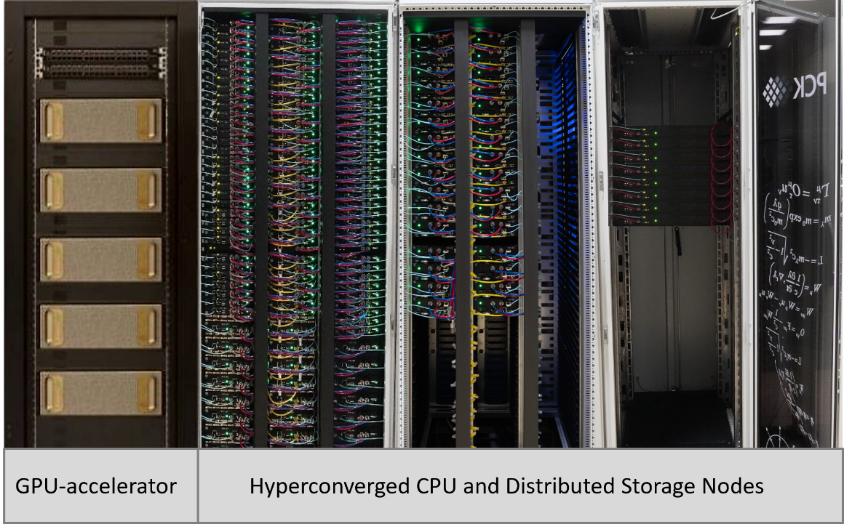
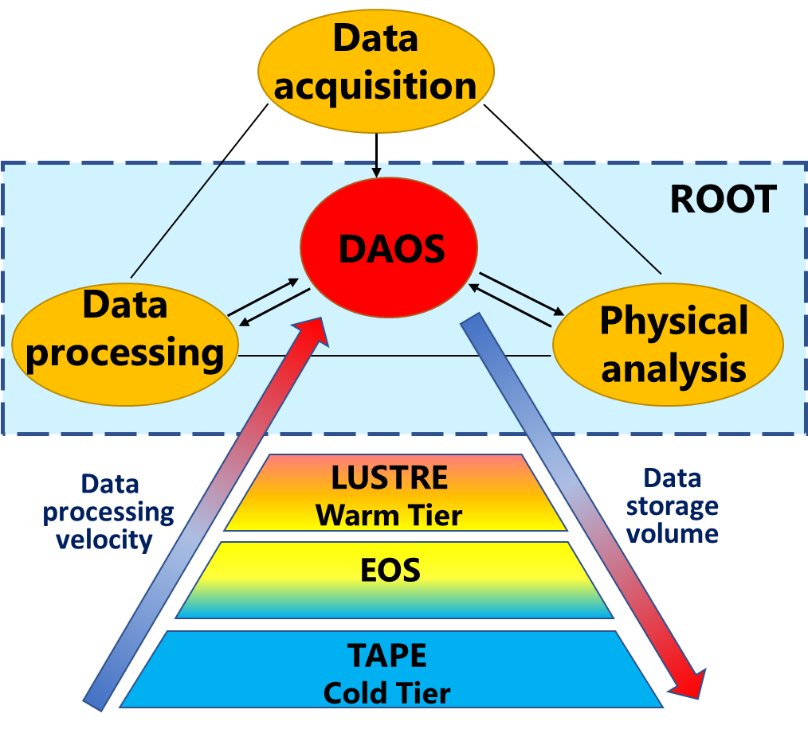
“Govorun” Supercomputer
Hyper-converged software-defined system
Hierarchical data processing and storage system
Scalable solution Storage-on-demand
Total peak performance: 1.1 PFlops DP
GPU component based on NVIDIA
CPU component based on liquid cooling solutions
The most energy-efficient center (PUE = 1.06)
Storage performance >300 GB/s
The expansion of the “Govorun” supercomputer by 32 hyperconverged compute nodes and 8 distributed storage nodes made it possible to:
enhance its performance by 239 Tflops (Total peak performance: 1.1 PFlops DP);
increase the DAOS data processing and storage subsystem to 1.6 PB;
enlarge the volume of the "warm data" storage subsystem by 8 PB with support for the creation of dynamic storage systems such as Luster, DAOS, EOS, dCache, NFS.
Key projects that use the resources of the
SC “Govorun”:
NICA megaproject,
calculations of lattice quantum chromodynamics,
computations of the properties of atoms of superheavy elements,
studies in the field of radiation biology,
calculations of the radiation safety of JINR’s facilities.
Notes:
The JINR MICC heterogeneous infrastructure is represented by the HybriLIT platform, which involves the training and testing polygon and the “Govorun” supercomputer, driven by a common software and information environment. The “Govorun” supercomputer is a scalable liquid-cooled system with a hyperconverged and software-defined architecture and has unique properties for the flexibility of customizing the user’s task, ensuring the most efficient use of the computing resources of the supercomputer. The current configuration of the “Govorun” supercomputer involves computing modules containing GPU and CPU components, as well as a hierarchical data processing and storage system. The total peak performance of the “Govorun” supercomputer is 1.1 PFlops for double-precision calculations (2.2 PFlops for single-precision calculations) with a read/write speed of 300 GB/sec for the hierarchical data processing and storage system. The resources of the "Govorun" supercomputer are used by scientific groups from all JINR Laboratories to solve a wide range of problems both in the field of theoretical physics and for modeling and processing experimental data. Key projects that use the resources of the “Govorun” supercomputer: NICA megaproject, calculations of lattice quantum chromodynamics, computations of the properties of atoms of superheavy elements, studies in the field of radiation biology, calculations of the radiation safety of JINR’s facilities.

Slide 11

Orchestration and hyperconvergence on the “Govorun” supercomputer
Computational field
Requirements for jobs
Resource management software
CPU
CPU
CPU
CPU
CPU
The “Govorun” supercomputer has unique properties for the flexibility of customizing the user’s job.
For his job the user can allocate the required number and type of computing nodes and the required volume and type of data storage systems.
This property enables the effective solution of different tasks, which makes the “Govorun” supercomputer a unique tool for research underway at JINR.
User-I
jobs
CPU
CPU
CPU
CPU
CPU
CPU
CPU
CPU
SSD
SSD
SSD
GPU
GPU
GPU
GPU
GPU
Multi-layered data storage system
CPU
CPU
GPU
User-I1
jobs
SSD
SSD
SSD
SSD
SSD
SSD
SSD
SSD
SSD
SSD
HDD
HDD
HDD
HDD
HDD
Notes:
Исходя из стремительного развития IT-технологий и запросов пользователей, 14 ноября 2019 года в Лаборатории информационных технологий ОИЯИ состоялись презентация и демонстрация модернизированного суперкомпьютера «Говорун». В результате модернизации производительность CPU компоненты увеличилась в 3 раза, объем сверхбыстрой системы хранения данных увеличился более чем в 2 раза, а скорость ввода/вывода возросла более чем в 5 раз. Cовокупная пиковая производительность суперкомпьютера достигла 860 Tflops для операций с двойной точностью и 1,7 Pflops для операций с одинарной точностью, что в свою очередь, позволило ему занять 10-е место в списке Top50 самых мощных суперкомпьютеров России и стран СНГ.
Based on the rapid development of IT technologies and user requests, on 14 November 2019, a presentation and a demonstration of the modernized “Govorun” supercomputer took place in the Laboratory of Information Technologies of JINR. As a result of the modernization, the performance of the CPU component increased three times, the total capacity of the ultrafast data storage system (UDSS) increased more than two times, the data input/output rate grew more than five times. The total peak performance of the supercomputer reached 860 Tflops for double-precision operations and 1.7 Pflops for single-precision operations, which in turn allowed the CPU component of the “Govorun” supercomputer to take the 10th place in the TOP50 list of the most powerful supercomputers in Russia and the CIS.

Slide 12

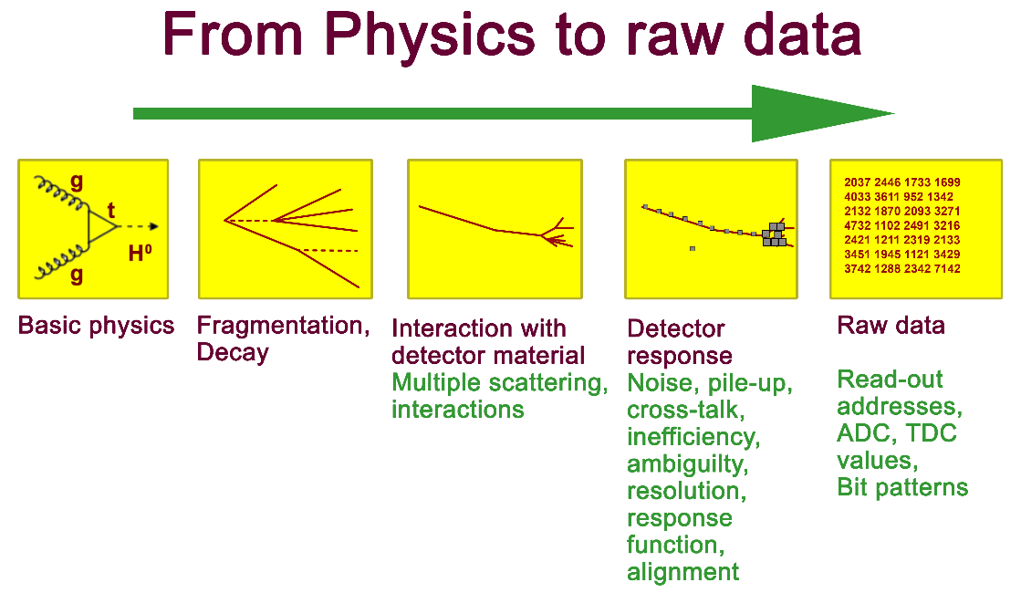
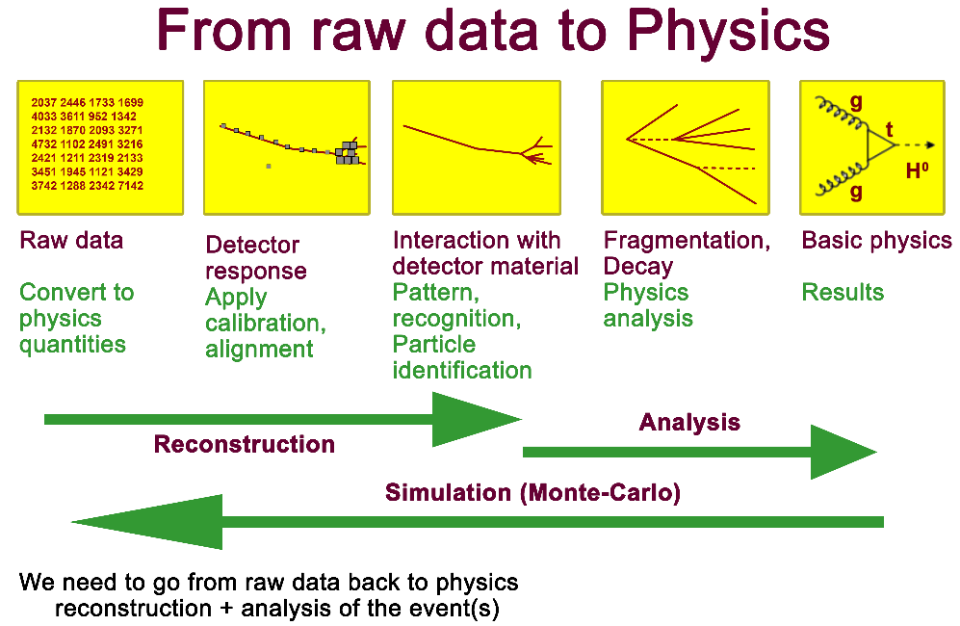
HEP experiments data flow
Data
acquisition
ROOT
DAOS
Data
processing
Physical
analysis
LUSTRE
Warm Tier
Velocity of data
processing
Volume of
data storage
EOS
TAPE
Cold Tier
Notes:
Суперкомпьютер «Говорун» является гиперконвергентной программно-определяемой системой и обладает уникальными свойствами по гибкости настройки под задачу пользователя, обеспечивая максимально эффективное использование вычислительных ресурсов суперкомпьютера. Для ускорения генерации и реконструкции событий для эксперимента MPD на суперкомпьютере «Говорун» была реализована иерархическая структура работы с данными. События эксперимента MPD генерируются и реконструируются на сверхбыстрой системе хранения данных под управлением файловой системы Lustre, затем передаются на теплые хранилища данных (FS ZFS, EOS) и на долгосрочное хранение на ленточную библиотеку. Используя иерархическую структуру работы с данными, для эксперимента MPD было сгенерировано около 2 миллионов событий. Ускорение расчетов на обновленном суперкомпьютере по отношению к предыдущей конфигурации составило 1.45 раза.
The “Govorun” supercomputer is a hyperconverged software-defined system that has unique properties for flexibility of customizing the user’s job, ensuring the most efficient use of computing resources of the supercomputer. To speed up the simulation and reconstruction of events for the MPD experiment, a hierarchical structure of working with data was implemented on the “Govorun” supercomputer. Events of the MPD experiment are simulated and reconstructed on the ultrafast data storage system under the Lustre file system management with a subsequent transfer to semi-cold storages (FS ZFS, EOS) and to the tape library for long-term storage. About 2 million events were generated for the MPD experiment using the hierarchical structure of working with data. The acceleration of calculations on the upgraded supercomputer in comparison with the previous configuration was 1.45 times.

Slide 13

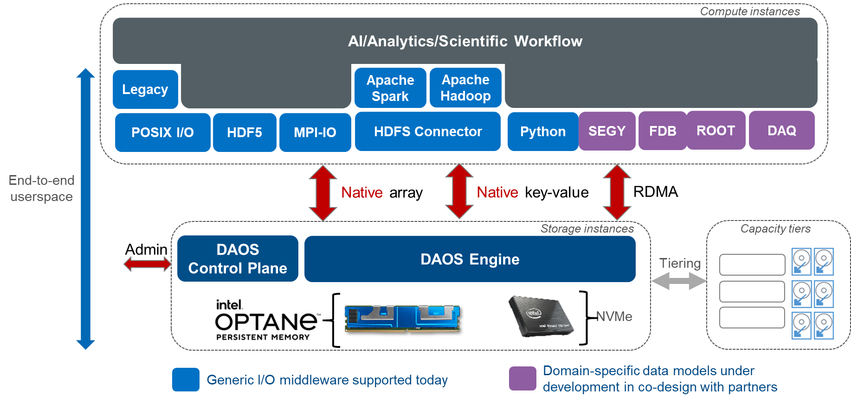
DAOS: Promising technology for HPC, Big Data, AI
DAOS (Distributed Asynchronous Object Storage) Software Ecosystem
Complex approach to build a hierarchical storage system
DAOS is significant part of data acquisition and processing
Different types of containers are used for different data processing stages
No need of POSIX file system for most data operations
Great system performance even for a few DAOS clients
RSC Storage on-Demand software offers unique flexibility, speed, and convenience for DAOS users
The DAOS polygon on the supercomputer “Govorun” take the 1st place among Russian supercomputers in the current IO500 list

Slide 14

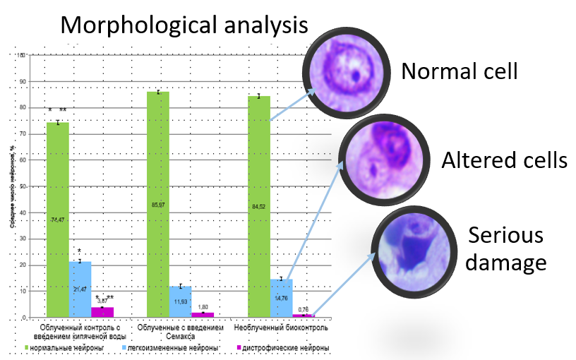
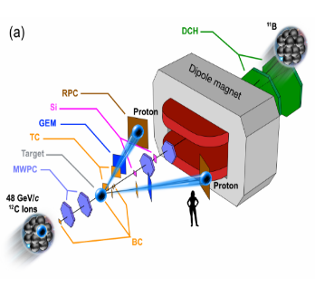
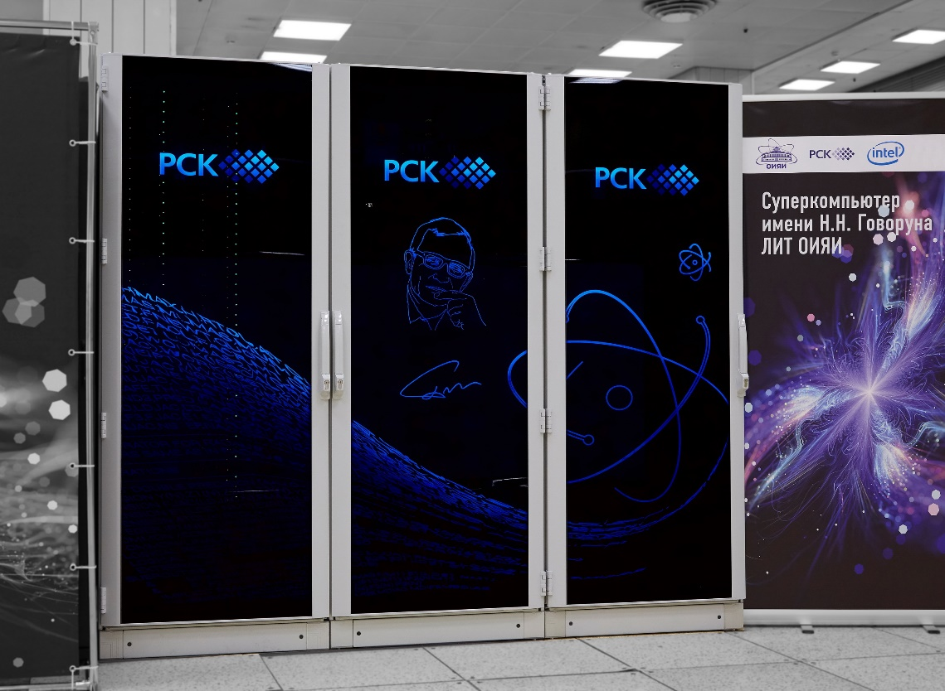
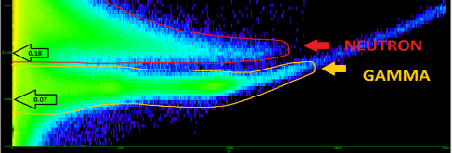
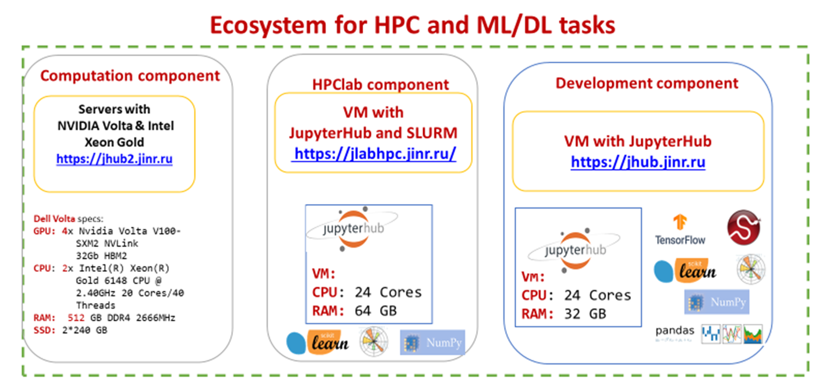

Development of tools and services for users
of the “Govorun” supercomputer
Ecosystem for
Supercomputer Modeling
RESEARCH ENVIRONMENT FOR SOLVING RESOURCE-INTENSIVE TASKS OF JINR:
Ecosystem for
Machine/Deep Learning
Parallel computing
ML/DL/AI tasks
Quantum computing
Tools for data analysis and visualization
Calculations on application packages
Web services for application programs
Training courses
Ecosystem for
Applied Computations

Slide 15
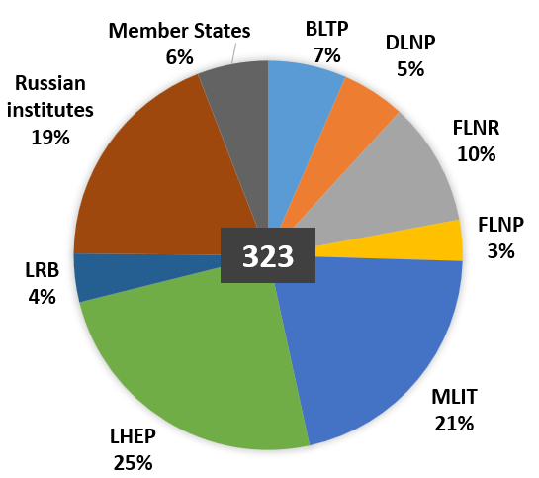
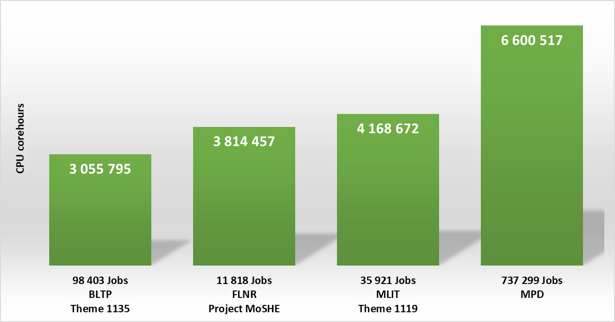
Using of the “Govorun” Supercomputer in 2022
The resources of the “Govorun” SC are used by scientific groups from all the Laboratories of the Institute within 25 themes of the JINR Topical Plan.
The projects that mostly intensive use the CPU resources of the “Govorun” SC:
NICA megaproject,
simulation of complex physical systems,
computations of the properties of atoms of superheavy elements,
calculations of lattice quantum chromodynamics.
Selected statistics of the most
resource intensive projects
During 2022, 890,911 jobs were performed on the CPU component of the “Govorun” SC, which corresponds to 18,543,076 core hours.
Notes:
15

Slide 16
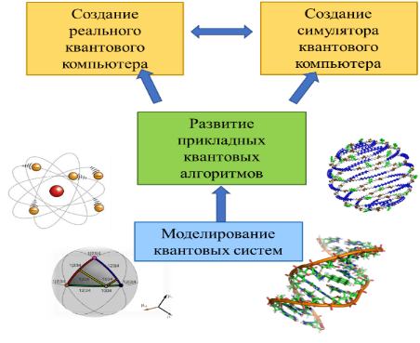
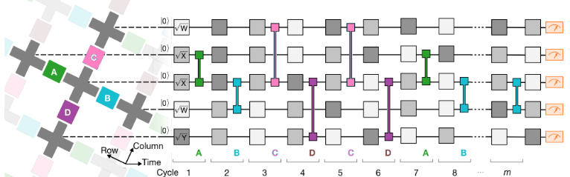
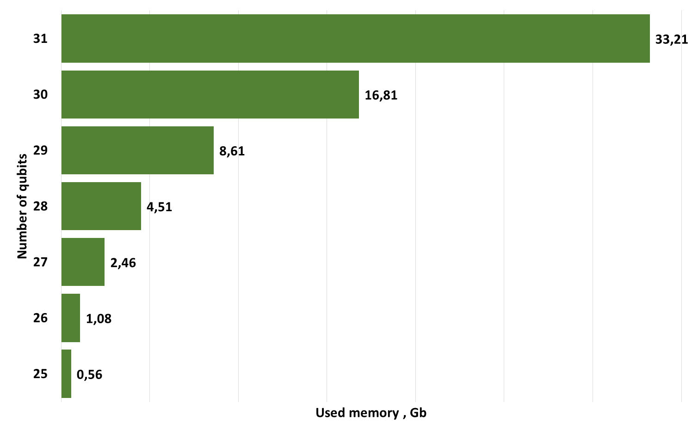
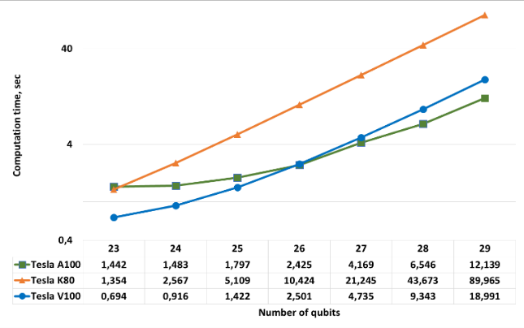

Development of tools and services for modeling the properties of superheavy elements on the Govorun supercomputer
AMS, DIRAC, QuEST, Qiskit, KANTBP, Cirq
For the tasks solved within the framework of the Project, an on-demand computing system was created containing 380 physical cores (760 logical cores) and a file storage with a capacity of 80 TB managed by the NFS file system. Intensive calculations were carried out on this system using the software AMS, DIRAC, QuEST, KANTBP, etc. to calculate the electronic properties of superheavy elements.
Over the course of the project, over 11,800 tasks were solved, on which more than 3,800,000 core-hours were spent.

Slide 17
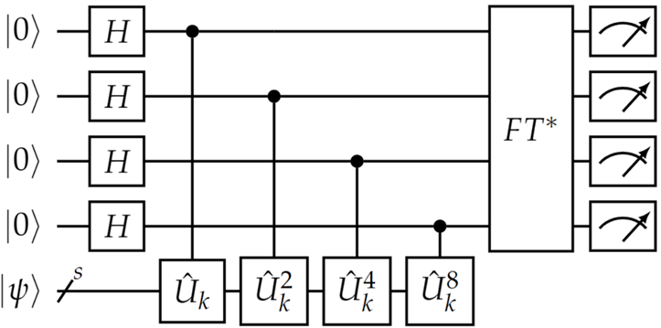

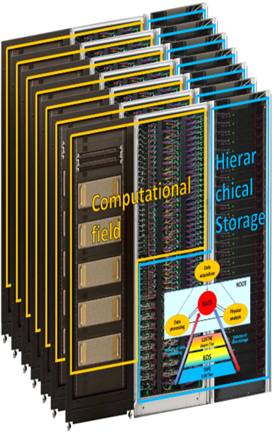
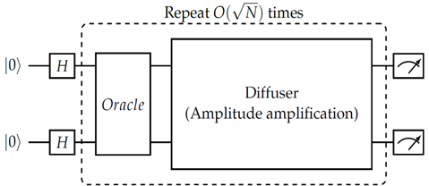
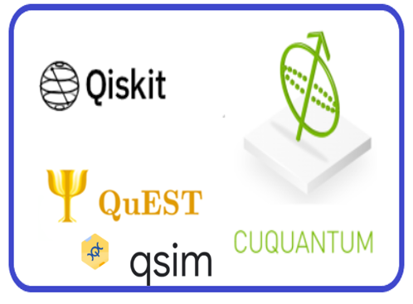


Quantum computing and quantum algorithms in JINR projects
Objective: development of quantum algorithms (QA) for calculations of complex atomic and molecular systems taking into account the limitations of available computing resources
Supercomputer «Govorun»
Formation of a list of QA necessary for solving problems within the framework of the studied physical models.
Choosing the type of quantum simulator for simulation on computers of classical architecture.
Determination of the maximum capabilities of available computing resources for selected quantum simulators (number of qubits and calculation time).
TASKS
Selection and modification of QA taking into account the specifics of computational tasks in the study of electronic and magnetic structures of molecular complexes and crystal fragments of new functional materials with strong electronic correlations.
Investigation of the effectiveness of QA for calculations of complex atomic-molecular systems, taking into account the limiting capabilities of available computing resources in solving problems of quantum chemistry and physics of new functional materials (in the future – the study of chemical properties of heavy elements).
CPU
GPU
38 qubits
34 qubits
Zrelov P.V., Ivancova O.V., Korenkov V.V., Ryabov N.V., Ulyanov S.V. Evaluation of the capabilities of classical computers in the implementation of simulators of quantum algorithms // Software products and systems. 2022. Vol. 35. No. 4. pp. 618-630. DOI: 10.15827/0236-235X.140.618- 630
Notes:
Quantum computing is one of the most rapidly developing areas of quantum end-to-end technologies.
Quantum modeling promises to find application in solving a number of problems of condensed matter physics, high energy physics, atomic physics, quantum chemistry, cosmology, machine learning, artificial intelligence.
The quantum computers currently available are called "noisy" intermediate-scale quantum computers. They implement, as a rule, from 50 to a little more than 100 qubits,
errors occur due to the presence of noise during calculations, and there is no possibility of their correction.
(In November 2022, IBM released the currently most powerful Osprey computer in 433 qubits)
Due to these limitations, according to experts, the use of universal quantum computers for solving practically significant tasks is likely to become effective no earlier than in 10 or even 20 years.
Therefore, the direction associated with software quantum simulators for computing on computers of classical architecture using CPU and GPU is of particular interest at this stage of the development of quantum computing.
The following quantum simulators were selected and implemented in the information computing environment:
QuEST is one of the first simulators using multithreading, distributed computing and GPU accelerators.
Qiskit is the most popular quantum simulator at the moment. It allows you to run simulations on the CPU and GPU, and recently it became possible to use OpenMP and CUDAcuQuantum from NVIDIA (this is an SDK of optimized libraries and tools for accelerating quantum computing workflows, suitable for performing calculations on multiple GPUs), integrated into Qsim to implement multi GPU.
Key quantum algorithms such as the quantum Fourier transform, quantum phase estimation, Grover's algorithm and others can be efficiently modeled using simulators of classical architecture.
Quantum algorithms were implemented:
quantum Fourier transform,
quantum phase estimation,
Grover's algorithm,
a test algorithm (a simplified version of Google's algorithm, on which they demonstrated quantum superiority),
a study of hybrid algorithms has begun, in particular the Variational quantum eigensolver (VQE) – a variational quantum proprietary solver.
The conducted experiments demonstrated:
When modeling on the GPU, you can achieve greater acceleration compared to calculations on the CPU Qiskit is noticeably faster than QuEST on the CPU with all possible parallelization.
The execution time on 4 GPUs (V100) compared to one GPU (V100) is 1.5 times faster (at 25 qubits) and 3.75 times faster at 31 qubits.
The execution time on a single GPU V100 compared to T4 is approximately 3 times faster (at 25-27 qubits) and 7.5 times faster at 28-29 qubits.
The execution time on 1 GPU on CuQuantum and on Qiskit is practically the same, on QuEST the time needs up to 2.5 times more (on 29 qubits).
The dimension of the state vector grows exponentially with the increase in the number of qubits, therefore, due to memory limitations, the quantum circuit is limited to 38 qubits on the CPU and 31 qubits on 1 GPU and 34 qubits on 8 GPU.
However, despite the CPU's ability to simulate a larger number of qubits on the existing infrastructure, the simulation speed on the GPU on all simulators is several times higher than the simulation speed on the CPU.
The tasks were run on a supercomputer using one, two and four Tesla V100 GPUs and one T4.
Activity under topic 1119, approved in April 2023 Intelligent control of technological processes and physical installations in JINR and quantum computing in quantum chemistry and physics.
As part of this activity, the effectiveness of quantum algorithms in solving problems of quantum chemistry and physics of new functional materials will be investigated.
The application of well-known quantum algorithms and their development will be carried out on simulators with classical computing architecture.
The main tasks within the activity related to quantum computing in quantum chemistry and physics:
Selection and modification of quantum algorithms taking into account the specifics of computational tasks in the study of electronic and magnetic structures of molecular complexes and crystal fragments of new functional materials with strong electronic correlations.
Performing calculations for physico-chemical systems using quantum simulators.
Expected result for 2024
Verification of the effectiveness of variational-type quantum algorithms implemented on quantum simulators of classical architecture by applying them to the quantitative description of the dissociation of simple molecules, as well as the electron and spin structure of the ground state of typical lattice models of quantum theory.

Slide 18












“Govorun” Supercomputer for JINR Tasks
The resources of the “Govorun” supercomputer are used by scientific groups from all the Laboratories of the Institute within 25 themes of the JINR Topical Plan for solving a wide range of tasks in the field of theoretical physics, as well as for the modeling and processing of experimental data.
Research results obtained using the supercomputer resources are presented in 260 publications.
Using the results obtained at the Govorun SC, 2 publications were prepared in Nature Physics:
M. Kircher … , O. Chuluunbaatar et al. Kinematically complete experimental study of Compton scattering at helium atoms near the threshold. Vol. 16. № 4. Pp. 756-760
BM@N Collaboration. Unperturbed inverse kinematics nucleon knockout measurements with a 48 GeV/c carbon beam. Vol. 17. Pp. 693-699
Notes:
Ресурсы СК «Говорун» используются научными группами из всех лабораторий Института в рамках 25 тем Проблемно-тематического плана ОИЯИ для решения широкого круга задач как в области теоретической физики, так и для моделирования и обработки экспериментальных данных. Результаты исследований, полученные с использованием ресурсов суперкомпьютера в 2020 году, представлены в 65 публикациях, из них 6 в Q1, 7 в Q2.
The resources of the “Govorun” supercomputer are used by scientific groups from all the Laboratories of the Institute within 25 themes of the JINR Topical Plan for solving a wide range of tasks in the field of theoretical physics, as well as for the modeling and processing of experimental data. Research results obtained using the supercomputer resources in 2020 are presented in 65 publications, 6 of them in Q1, 7 in Q2.

Slide 19



Unified Scalable Supercomputer Research Infrastructure
Based on the integration of the supercomputers of JINR, of the Interdepartmental Supercomputer Center of the Russian Academy of Sciences and of Peter the Great St. Petersburg Polytechnic University, a unified scalable supercomputer research infrastructure based on the National Research Computer Network of Russia (NIKS) was created. Such an infrastructure is in demand for the tasks of the NICA megaproject.
Notes:
Another area of research, in which the resources of the “Govorun” supercomputer are involved, is the creation of a unified scalable research supercomputer infrastructure based on the National Research Computer Network of Russia (NIKS). At present, in addition to the “Govorun” supercomputer, this infrastructure combines the supercomputers of the Interdepartmental Supercomputer Center of the Russian Academy of Sciences and Peter the Great St. Petersburg Polytechnic University. Such an infrastructure is in demand for the tasks of the NICA megaproject.
On the slide you can see the first successful joint experiment on the use of the unified supercomputer infrastructure for the tasks of the NICA megascience project in 2022.

Slide 20




DIRAC-based distributed heterogeneous
environment for MPD tasks
Heterogeneous distributed computing environment
Share of the use of different MICC components for MPD tasks in 2022: the SC “Govorun” resources are the most efficient for MPD tasks.
Increase in the share of the MICC computing resources on the DIRAC platform in normalized CPU HEP-SPEC06 days
The computing cluster of the Institute of Mathematics and Digital Technologies of the Mongolian Academy of Sciences (IMDT MAS) and NIKS (National Research Computer Network, the Russia's largest research and education network) were integrated into the heterogeneous distributed environment based on the DIRAC platform.
Summary statistics of using the DIRAC platform for MPD tasks in 2019-2022
Notes:
20

Slide 21











MICC Monitoring
For a robust performance of the complex it is necessary to monitor the state of all nodes and services - from the supply system to the robotized tape library.
Global real time 24x7 survey of the state of the whole computing complex
In case of emergency, alerts are sent to users via e-mail, SMS, etc.
~ 900 elements are under observation
MICC Operational Center
Notes:
Для стабильной работы комплекса необходимо отслеживать состояние всех узлов и сервисов - от системы питания до роботизированной ленточной библиотеки.

Slide 22










Methods, Algorithms and Software
Notes:
up to this point, we have only talked about one area of lit.

Slide 23



Methods of Mathematical Modeling, Computational Physics, and
High-Performance Computing for Complex System Studies at JINR
Simulating interactions of various types in nuclear-physical systems, including calculations of cross sections for sub-barrier fusion/fission reactions of heavy nuclei within the channel coupling method.
Studying multifactorial processes in models of complex systems with external influences, including the modeling of structural changes in materials under irradiation with charged particles and the superconducting processes study in Josephson structures.
Solving problems arising in the design and optimization of the operation of large experimental facilities, including problems related to the simulation of magnetic fields.
Modeling physical phenomena based on the state equation of dense nuclear matter, including complex astrophysical systems and heavy ion collision processes in the NICA energy range.
Scheme of ionization by Compton scattering at hν= 2.1 keV
Sub-barrier fusion and fission reactions of heavy nuclei
In 2020-2022, more than 150 publications in peer-reviewed scientific publications have been prepared in cooperation with colleagues from the other Laboratories and the JINR Member States; 4 problem-oriented software packages in the JINRLIB electronic program library; 2 computer programs are designed for the international library of computer programs CPC.
Notes:
Aims:
Development and use of mathematical and computational methods for modeling complex physical systems studied within the JINR Topical Plan. Development of approaches to effectively account for the features of physical processes and their mathematical models, described, as a rule, by systems of nonlinear, spatially multidimensional partial differential equations with a large number of parameters, the presence of critical modes and phase transitions.
Development of parallel algorithms and their implementation in software packages for high-performance simulation on modern computing architectures, including the MICC resources.
Carrying out, using the developed methods and software packages, computer simulation to obtain new fundamental information about the objects under study, necessary for the further development of theoretical approaches and planning of experimental projects.

Slide 24





Implementation of ML/DL Methods in Data Processing and Analysis at the NICA Experiments: BM@N, MPD and SPD
Scientific and practical significance: expanding the scope of machine learning methods, in particular, in high energy physics; software for experimental data processing and analysis at the NICA accelerator complex; corresponding development of root-frameworks.
Possible areas for ML/DL application: hit finding, tracking, particle identification, decay reconstruction, global tracking.
The main ML/DL methods: Recurrent Neural Networks, Graph Neural Networks, Convolutional Neural Networks, Decision Trees, Gradient Boosting, etc.
Gradient-boosted decision trees for PID in MPD
Deep GNNs for solving tracking problems in BM@N, BESIII, SPD
Graph Neural Networks for Tracking
The participants are presented by members of all targeted international collaborations: BM@N, MPD, SPD.

Slide 25


Information System for Radiation Biology Tasks
The joint project of MLIT and LRB is focused on creating an Information System (IS) as a set of IT solutions.
The information system allows one to store, quickly access and process data from experiments at LRB using a stack of neural network and classical algorithms of computer vision, providing a wide range of possibilities for automating routine tasks. It gives an increase in productivity, quality and speed of obtaining results
Conceptual scheme of the service

Slide 26


Intelligent Environmental Monitoring Platform
Within the framework of cooperation between MLIT and FLNP, the work on the prediction of air pollution by heavy metals using biomonitoring data, satellite imagery and different technologies of machine and deep learning is in progress. On the MLIT cloud platform, the Data Management System (DMS) of the UNECE ICP Vegetation was created to provide its participants with a modern unified system of collecting, analyzing and processing biological monitoring data.
The studies are carried out using the HybriLIT platform.

Slide 27





JINR Digital EcoSystem
The digital platform “JINR Digital EcoSystem ” integrates existing and future services
to support
  scientific,
  administrative and social activities,
  maintenance of the engineering and IT infrastructures
to provide
  reliable and secure access to various types of data
to enable
  a comprehensive analysis of information
using
  modern Big Data technologies and artificial intelligence.
Single access point to all services
Notes:
One of the major tasks is the creation of a corporate platform “JINR Digital Ecosystem”, which integrates existing and prospective services maintaining scientific, administrative and social activities, as well as the engineering and IT support infrastructures of the Institute. The platform should provide reliable and secure access to various types of data produced by the Institute, from public to confidential. It should allow for a comprehensive analysis of information using modern technologies of Big Data and artificial intelligence.

Slide 28





O.Yu. Derenovskaya
O.Yu. Derenovskaya
O.Yu. Derenovskaya
Personal account of a JINR employee
Notifications in a personal account
Responsive interface, customizable by the user
Easy access, convenient navigation and search for information on a large-scale network of a wide variety of JINR services
O.Yu. Derenovskaya

Slide 29





















Development of the system for training and
retraining IT specialists
Training courses, master classes and lectures
MLIT staff and
leading scientists from JINR and its Member States
Leading manufacturers of modern computing architectures and software
Parallel programming technologies
Tools for debugging and
profiling parallel
applications
Frameworks and tools for ML/DL tasks
Quantum algorithms,
quantum programming and quantum control
Work with applied software packages

Slide 30









The International Symposium Nuclear Electronics and Computing
Distributed computing systems
Computing for MegaScience Projects
Distributed computing applications
Data Management, Organisation and Access
HPC
Virtualization
Big data Analytics and Machine learning
Research infrastructure
The International Conference "Distributed Computing and Grid Technologies in Science and Education"
Detector & Nuclear Electronics
Triggering, Data Acquisition, Control Systems
Distributed Computing, GRID and Cloud Computing
Machine Learning Algorithms and Big Data Analytics new!
Research Data Infrastructures
Computations with Hybrid Systems (CPU, GPU, coprocessors)
Computing for Large Scale Facilities (LHC, FAIR, NICA,
SKA, PIC, XFEL, ELI, etc.)
Innovative IT Education
methods, software and program packages for data processing and analysis;
mathematical methods and tools for modeling complex physical and technical systems, computational biochemistry and bioinformatics;
methods of computer algebra, quantum computing and quantum information processing;
machine learning and big data analytics;
algorithms for parallel and hybrid calculations.
MLIT Schools
Notes:
student schools are traditionally held on the basis of conferences

