Slide 1
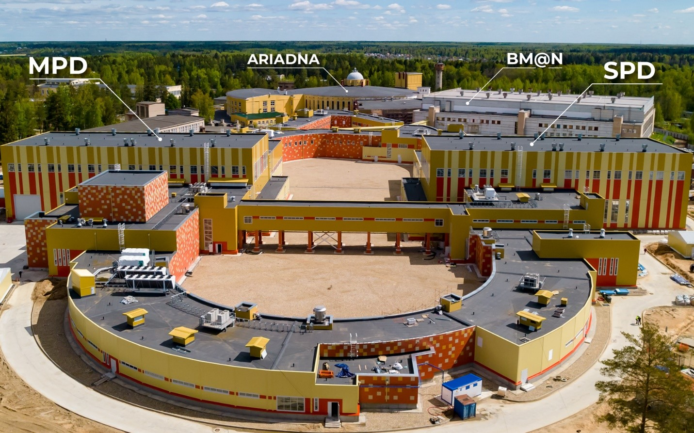
Dedicated to the 90th anniversary of Academician Yuri Oganessian
Applied research at NICA facility
Oleg Belov
(on behalf of the ARIADNA team)
Veksler and Baldin Laboratory of High Energy Physics
Joint Institute for Nuclear Research
IUPAP Conference "Heaviest nuclei and atoms”, 25-30 April 2023, Yerevan, Armenia

Slide 2


Applied Research @ NICA
The Applied Research Infrastructure for Advanced Developments at NICA fAcility (ARIADNA) will include:
(1) Beamlines with magnetic optics, power supplies, beam diagnostics systems, cooling systems, etc.
(2) Experimental zones equipped with target stations for users (detectors, sample holders, irradiation control and monitoring system, etc.)
(3) Supporting user infrastructure (areas for deployment of user’s equipment, for sample preparation and post-irradiation express analyses, etc.)
Low-energy ion beams available at HILAC 3.2 MeV/nucleon | Intermediate-energy ion beams available at Nuclotron 150-1000 MeV/nucleon | High-energy ion beams available at Nuclotron up to 4.5 GeV/nucleon
Life sciences, Radiation damage to microelectronics, Materials science, Novel relativistic nuclear power technology | Life sciences; Materials science; Radiation damage to microelectronics | Materials sciences; Novel relativistic nuclear power technology
Protons and ions with Z = 2 to 92
Ions: ¹²C⁶⁺, ⁴⁰Ar¹⁸⁺, ⁵⁶Fe²⁶⁺, ⁸⁴Kr³⁶⁺, ¹³¹Xe⁵⁴⁺, ¹⁹⁷Au⁷⁹
Ions: ¹H¹⁺, ²D¹⁺, ¹²C⁶⁺, ⁴⁰Ar¹⁸⁺ , ⁷Li³⁺
Irradiation of decapsulated microcircuits and solid materials with 3.2 MeV/nucleon ions.
Irradiation of capsulated microcircuits with
150-350 MeV/nucleon ions. Ions like ¹⁹⁷Au⁷⁹ ⁺ are
decelerated in the capsule to 5-10 MeV/nucleon.
Target station will be equipped with targets from C to Pb and with the systems of beam and target diagnostics, positioning, thermometry, synchronization, radiation control,
and data acquisition.
500-1000 MeV/nucleon ions be available at the target station for biological sample irradiation.

Slide 3

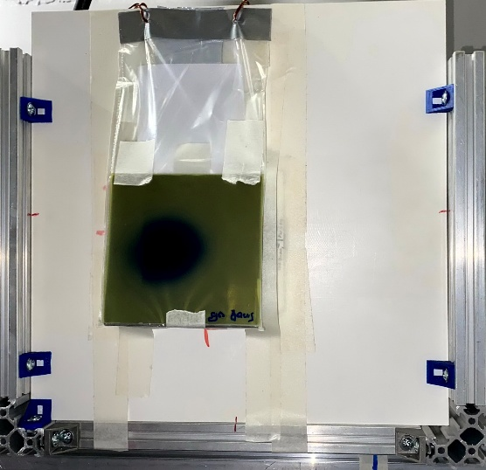
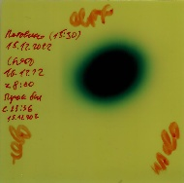
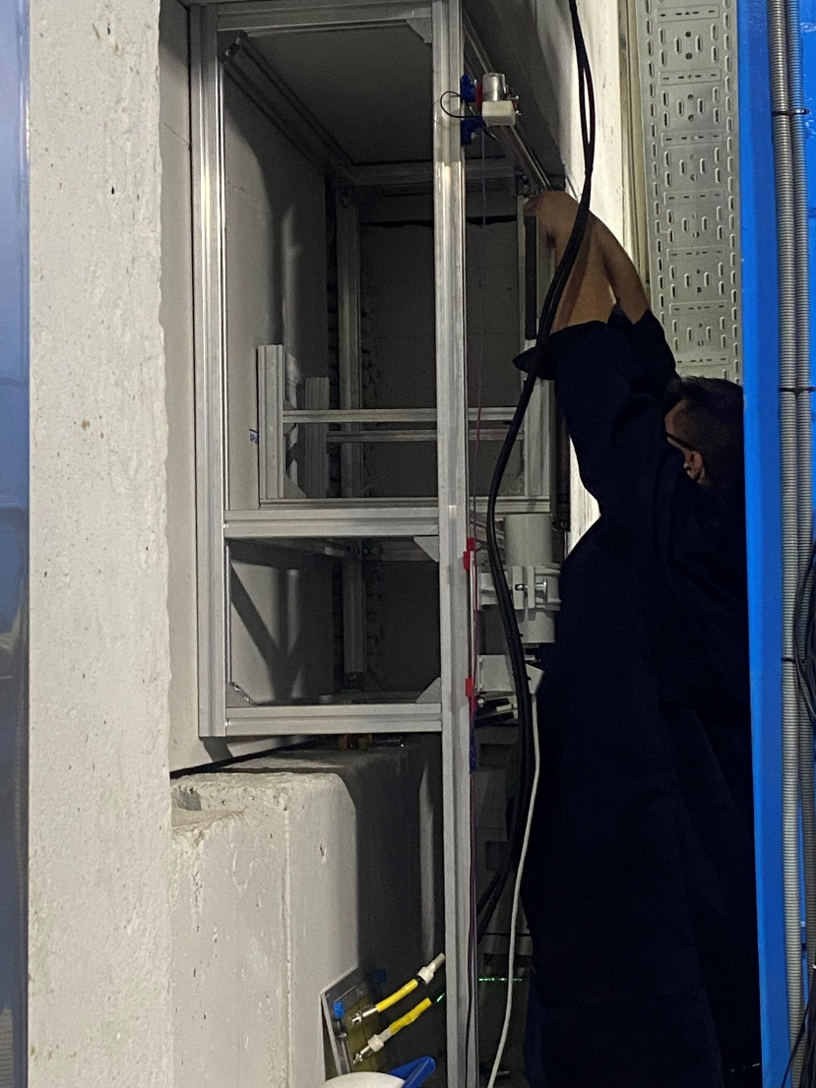
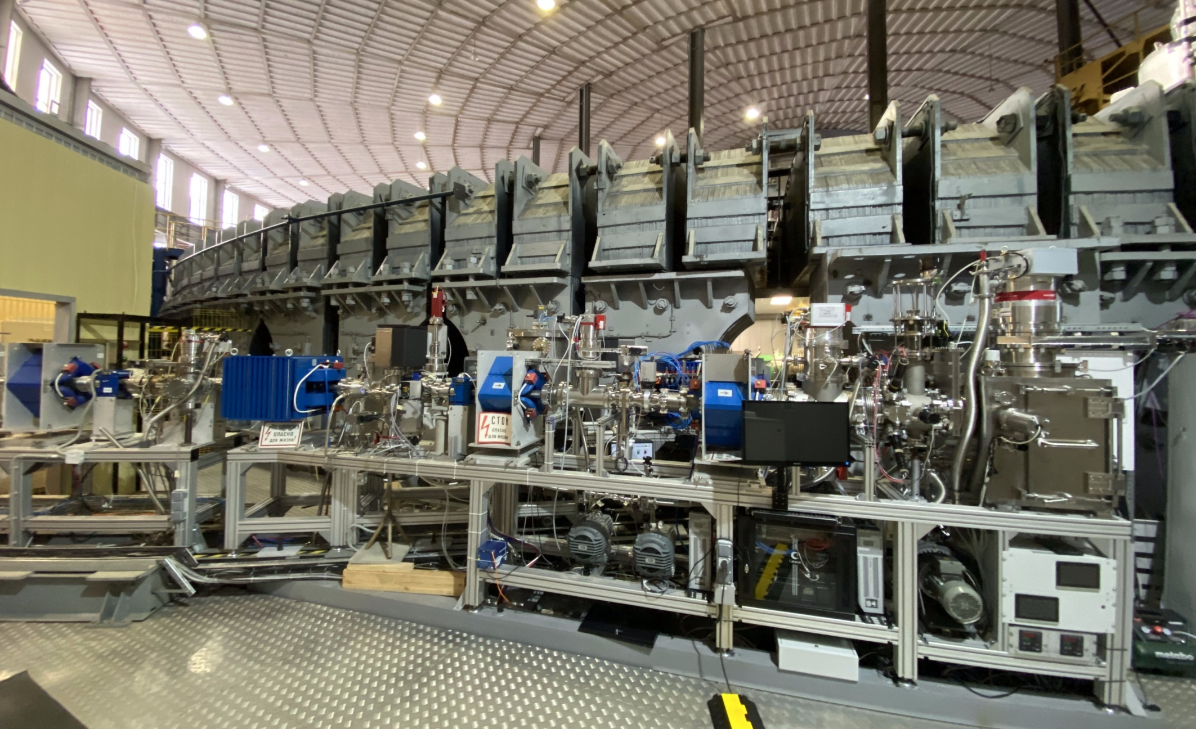
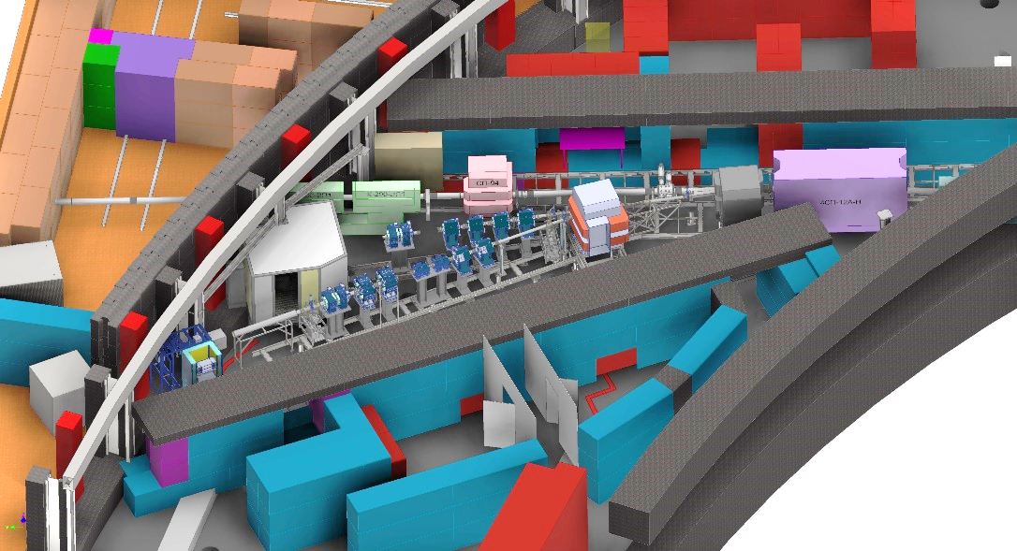
ARIADNA research infrastructure:
Current state and recent developments
Station for LT exposure
The progress was recently made in development of the NICA target stations for applied research.
In December 2021, the beamline and Station Of CHip Irradiation (SOCHI) was completed.
In December 2022, the prototype of the Target station for long-term exposure with higher energies was assembled at the outgoing beam available behind the BM@N facility. This target station has an advantage to use the beam for applied research purposes in parallel with operation of the BM@N setup.
Other ARIADNA beamlines for applied research are in progress
Beam direction
FHCal setup
Target station for long-term exposure
Station Of CHip Irradiation (SOCHI)
SIMBO and ISCRA target stations

Slide 4

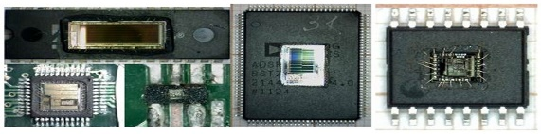
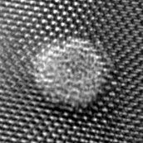
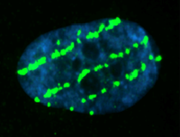
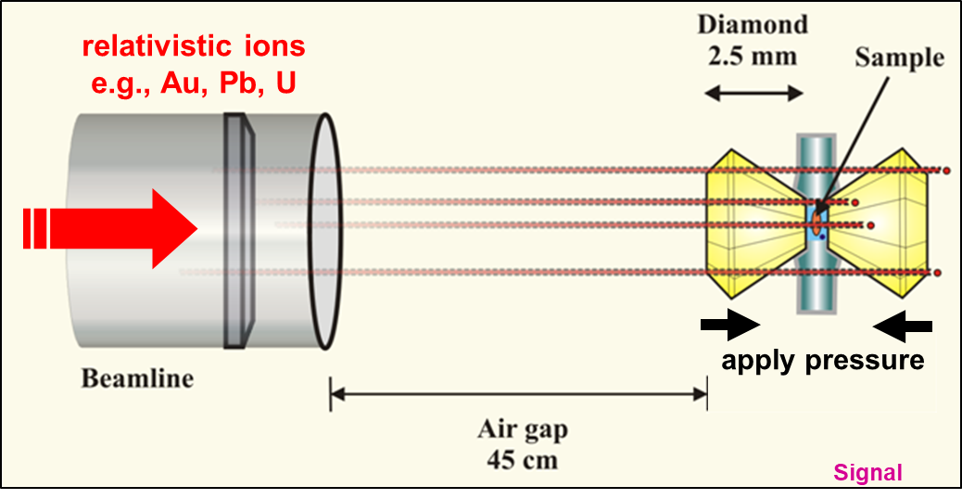
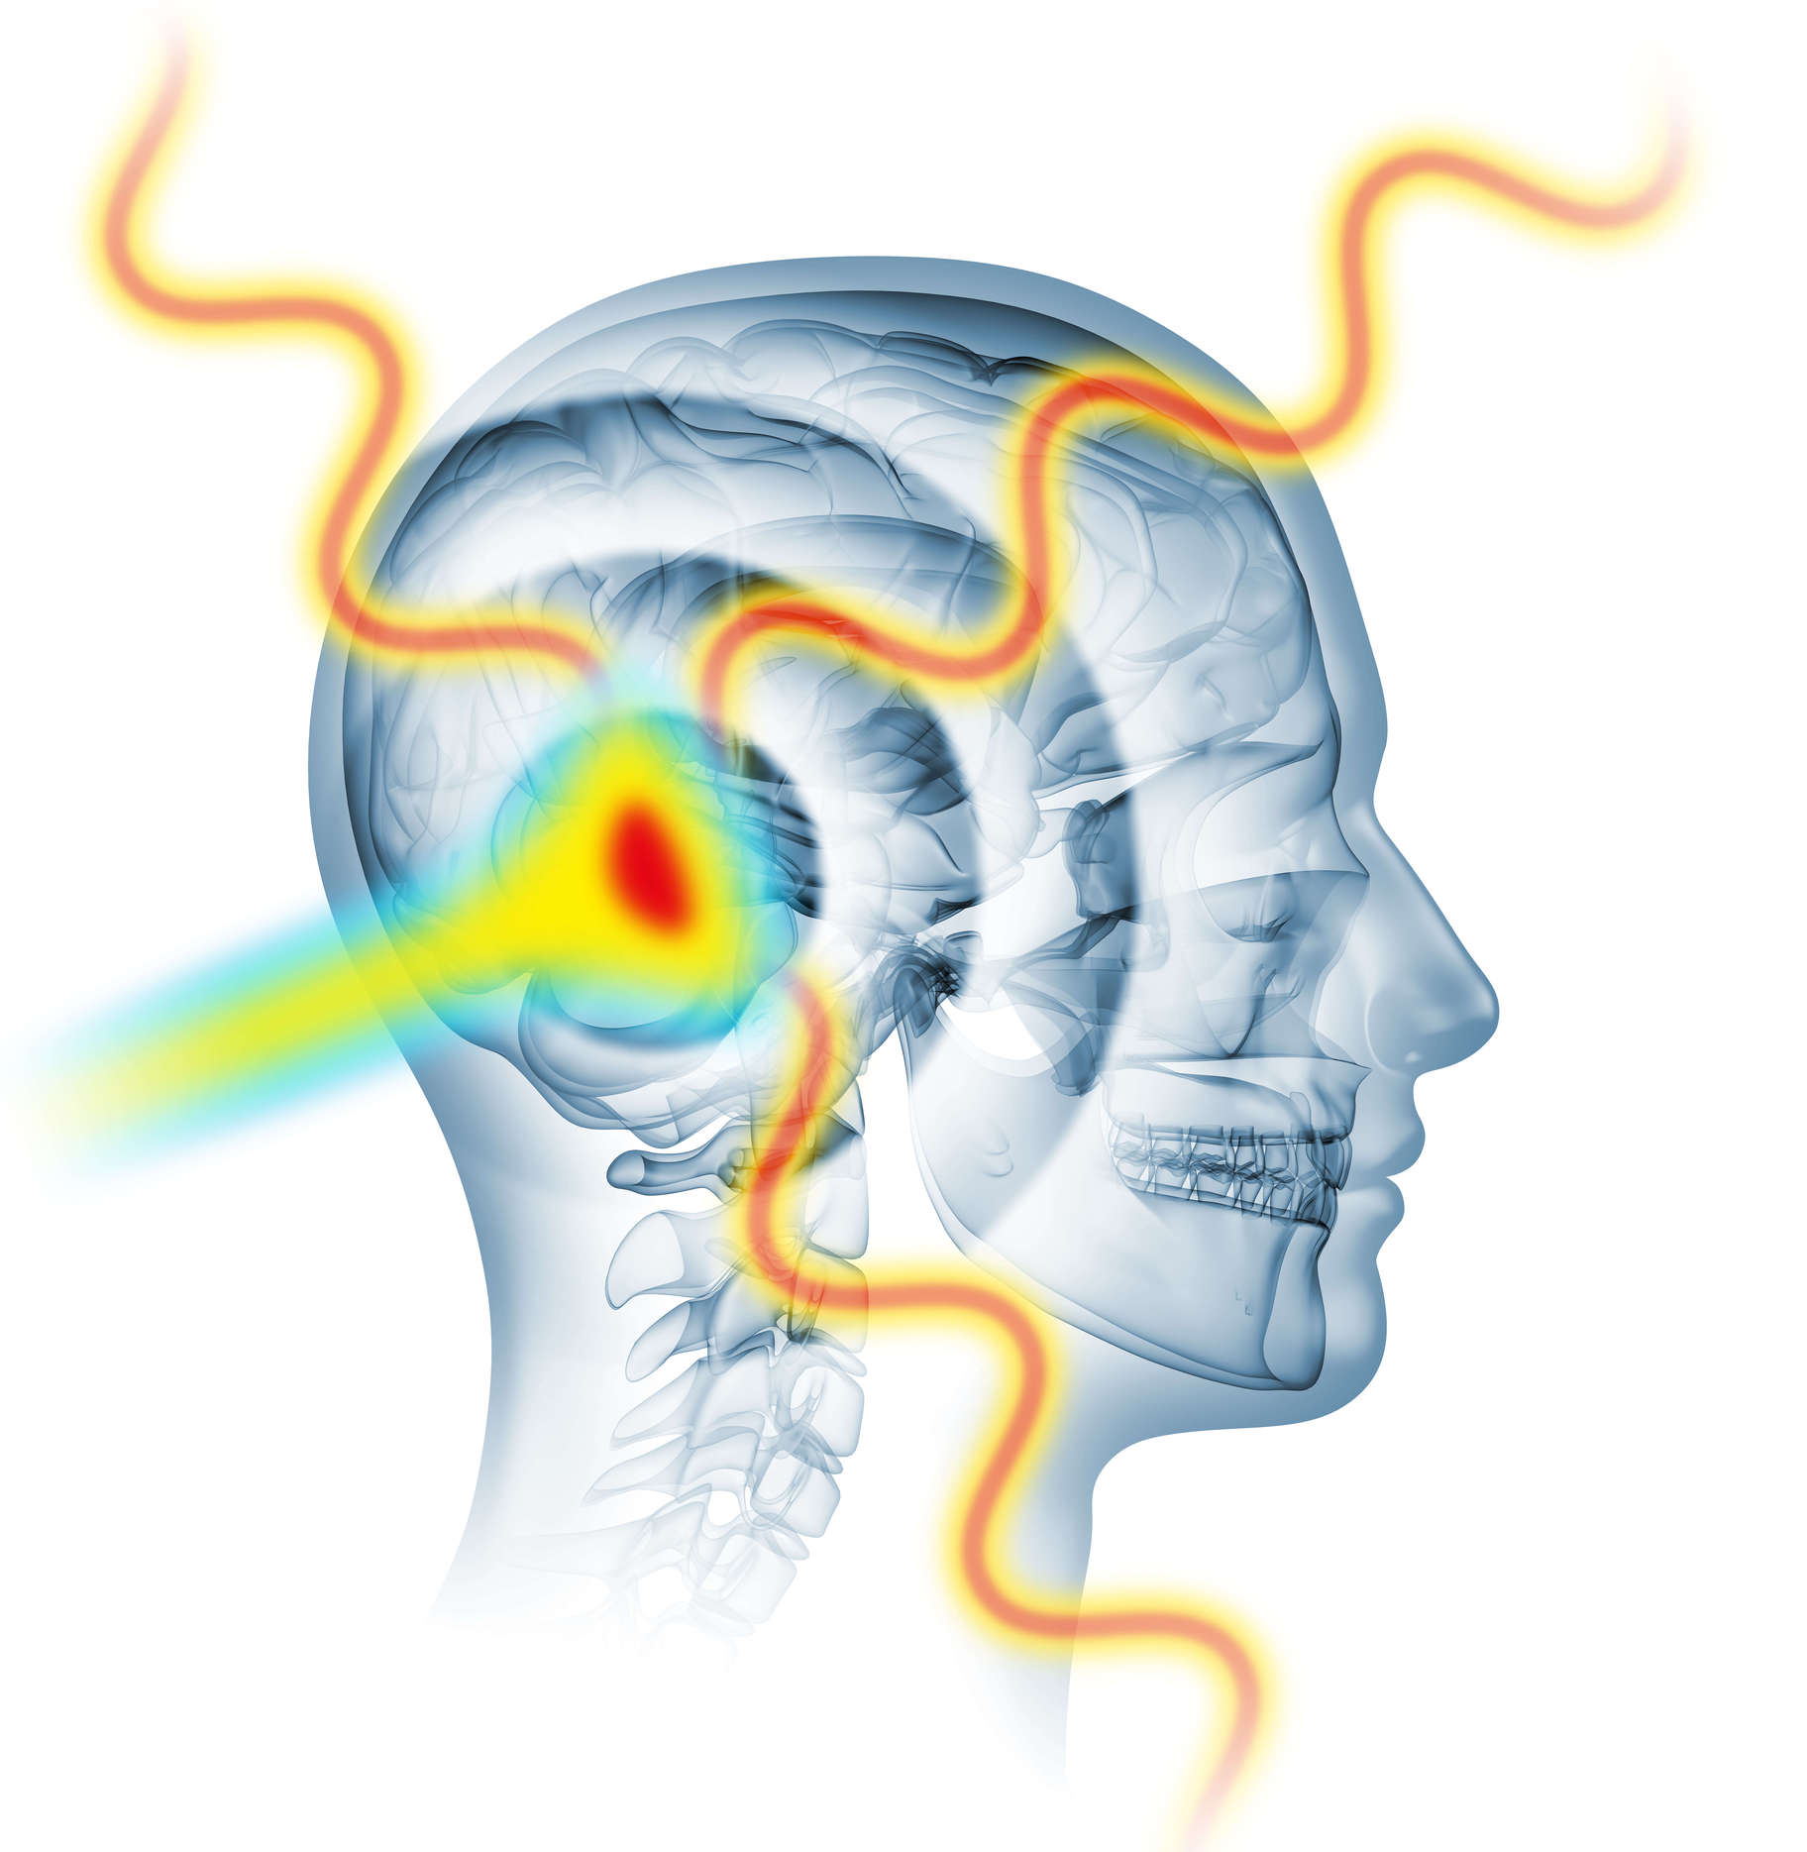
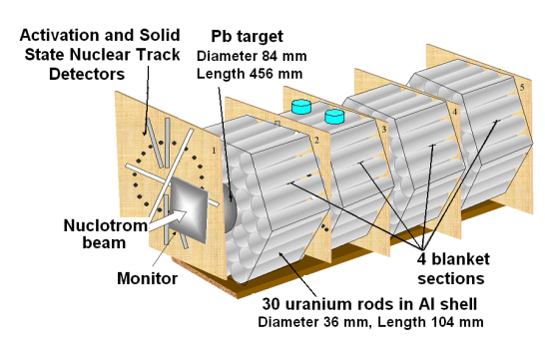
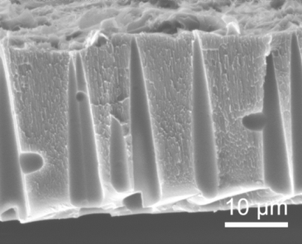
Pillars of applied research at NICA
Radiation effects in microelectronics
Radiation protection
in space
Materials research with ion beams
Radiation biophysics and radiobiology
Materials in extreme radiation dose conditions
Radiation
therapy-related research
Novel technology for radiation waste processing
The entire scope of research is not limited to these directions and open for user proposals

Slide 5
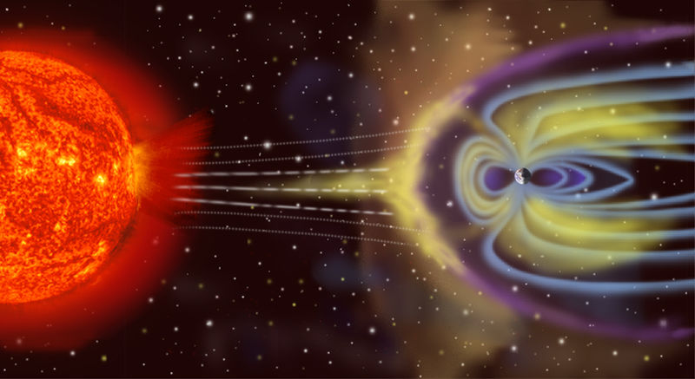
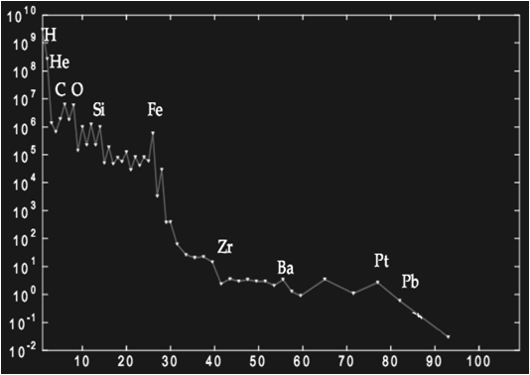
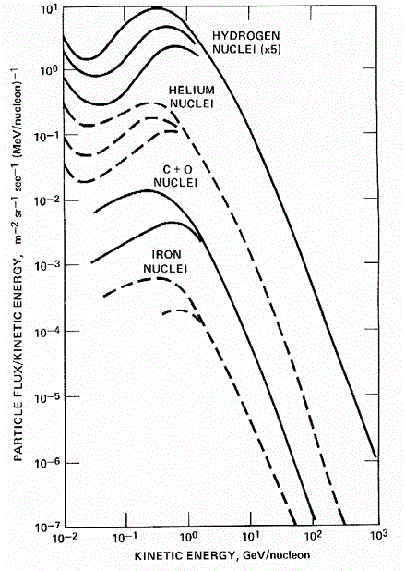
Simulation of space radiation components: Galactic Cosmic Rays
Space radiation environment has 2 sources/types
  Galactic Cosmic Rays (GCR) have Atomic # 1≤ Z ≤ 92 and energies ~100s of MeV/nucleon and higher (shielding ineffective)
  Solar Particle Events (SPE) have 1≤ Z ≤ ~26 and energies up to ~10s of MeV/nucleon
  (shielding can be effective)
Charge
Energy
Protons (Z = 1) ~ 92%
He ions (Z = 2 ) ~ 7%
Ions with с Z = 3÷5 ~ 0.1÷0.15%
Ions of Z = 6÷9 ~ 0,5%
Ions of Z = 10÷15
Ions of Z = 16÷26 ~ 0.065%
Fe ions (Z = 26) ~ 0.025%
GCR spectrum
Relative fraction
Wide range of energies up to 10²⁰ eV
/Dorman, 1975;
Kalmykov et al., 2007/
Z

Slide 6

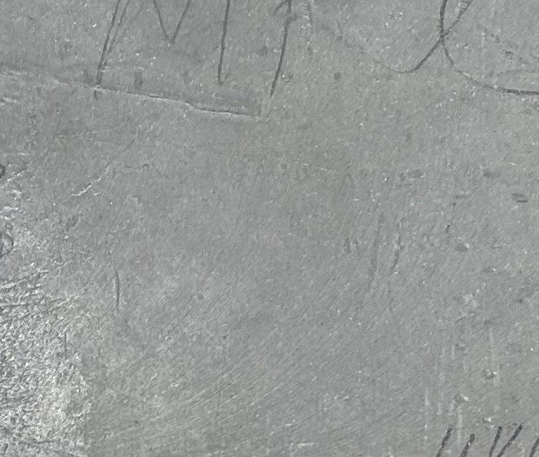
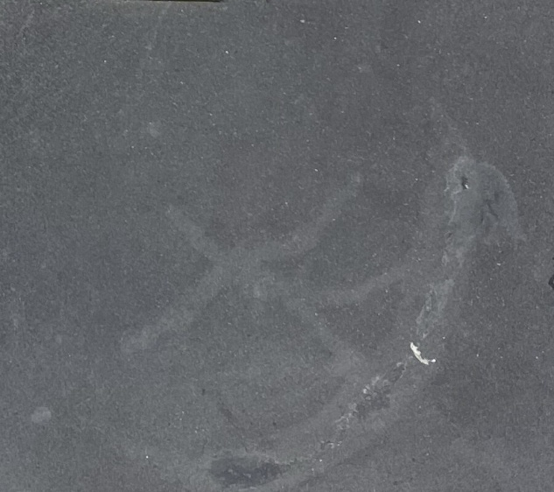


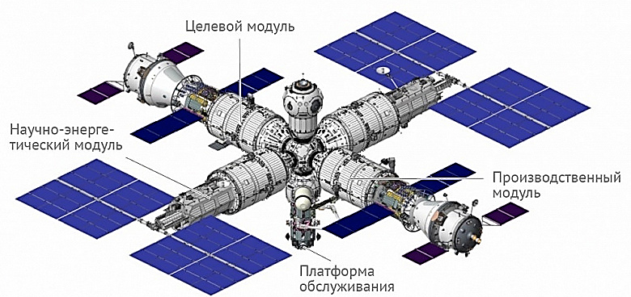
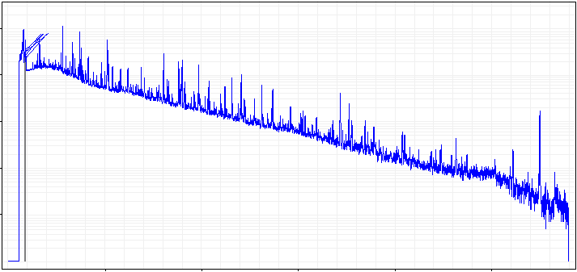
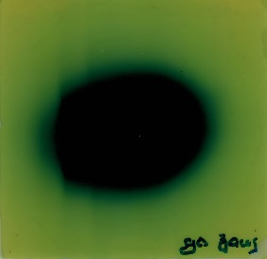
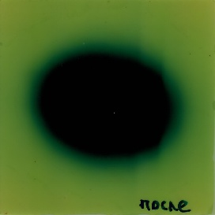
Space Research work package: New composite materials for space industry (protective properties, radiation resistance, radiation-induced modification)
Improving the regular means of radiation protection in spacecrafts for orbital flights and missions beyond the Earth magnetosphere.
Study of shielding properties of existing and new composite materials.
Investigation of radiation modification of composite materials by high-energy accelerated ion beams during long-term irradiation.
ISS
ROSS
Special-purpose module
Shielding material from the International Space Station (ISS)
New shielding material for the future Russian Orbital Service Station (ROSS)
10⁵
Gamma spectrum of ISS sample after heavy ion exposure (¹²⁴Xe⁵⁴⁺, 3.8 GeV/nucleon)
Research and energy module
10⁴
10³
H₁
H₂
Number of counts
10²
10¹
Production module
500
1000
1500
2000
2500
L₁
L₂
Energy, keV
Structural, chemico-physical methods of research and testing.
Comparative studies under the influence of other types of ionizing radiation.
Service platform
Project of the new Russian Orbital Service Station (ROSS)

Slide 7
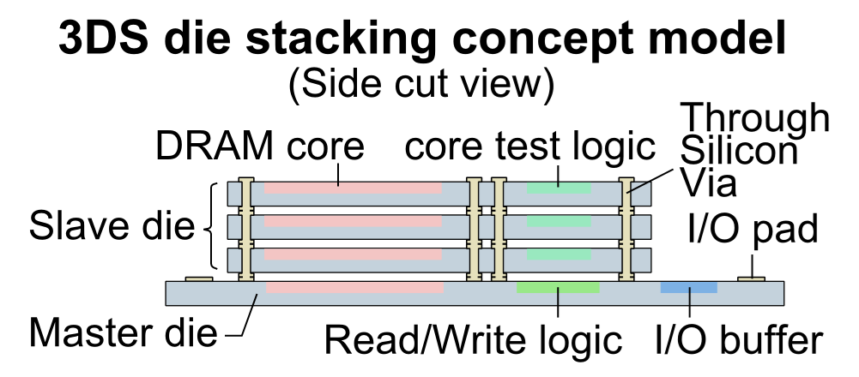
Radiation testing of electronics with ions of relatively high energy
Two types of radiation effects
  Cumulative (dose) effects result from long-term exposure to radiation environment
  Single-Event Effects (SEE) occur promptly due to a single particle strike
Recent studies: 25-50% of spacecraft anomalies due to SEE (depends on spacecraft orbits)
Increasing integration poses problems for SEE testing with
low-energy beams
Multiple die stacked together in packages.
Behavior may differs if dis-assembled, tested separately.
Packages now intrinsic to part performance.
Dis-assembly may compromise timing, thermal and structural characteristics—especially if thinning required.
/R.C. Baumann, 2013 NSREC Short Course/
Ideally, prefer test with ions’ characteristic relevant to space
GCR ions fairly flat out to >2 GeV/nucleon (min. ionizing)
Difficult and expensive to achieve at accelerators
SEE Frontiers:
Technology Frontier
Low-Energy Frontier
High-Energy Frontier – relevant to facilities like NICA
/By R.L. Ladbury at the Meeting of the American Physical Society, Columbus, OH, April 14-17, 2018/

Slide 8

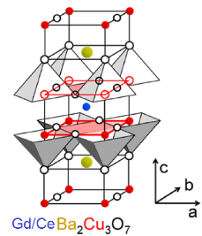
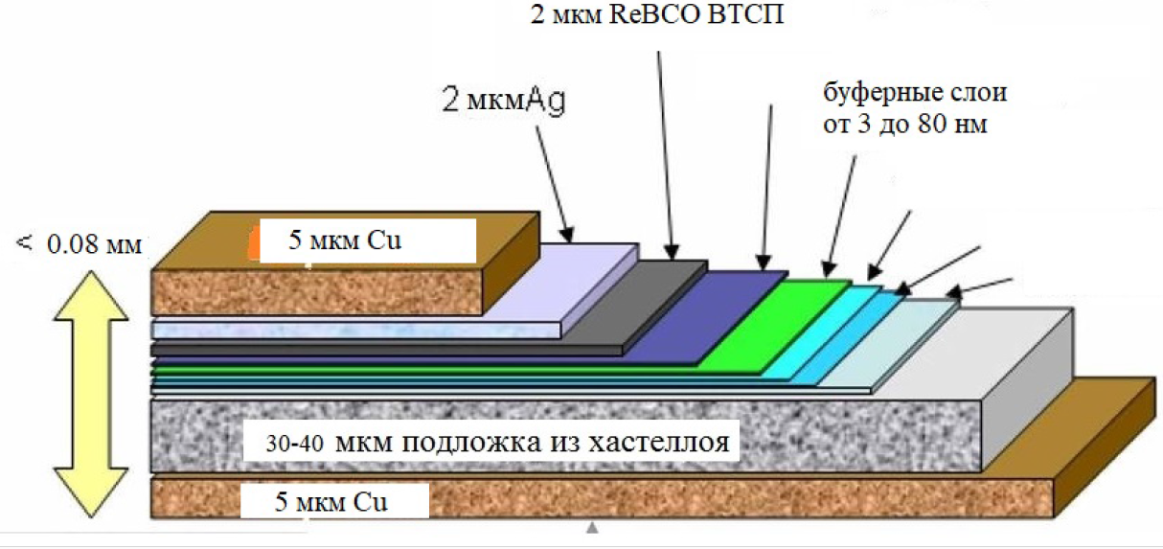




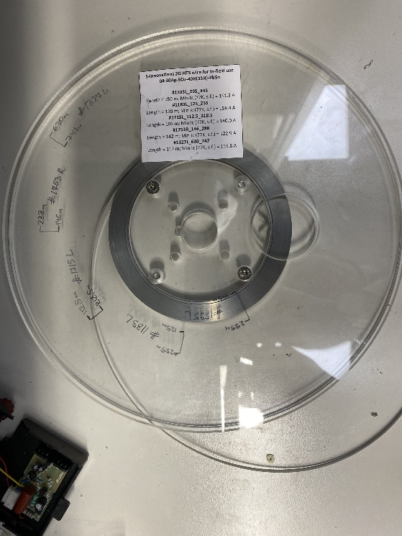
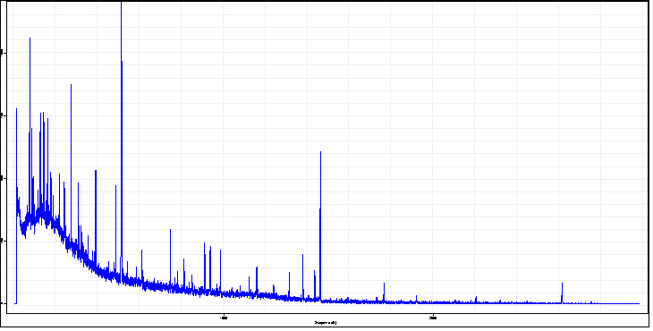
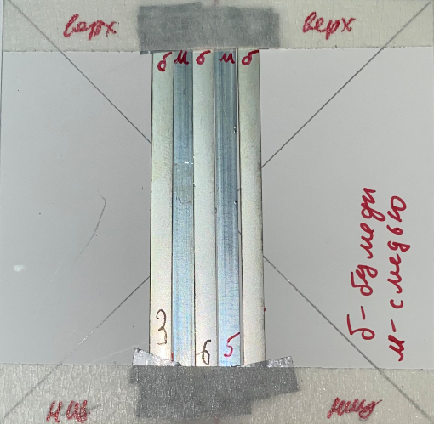
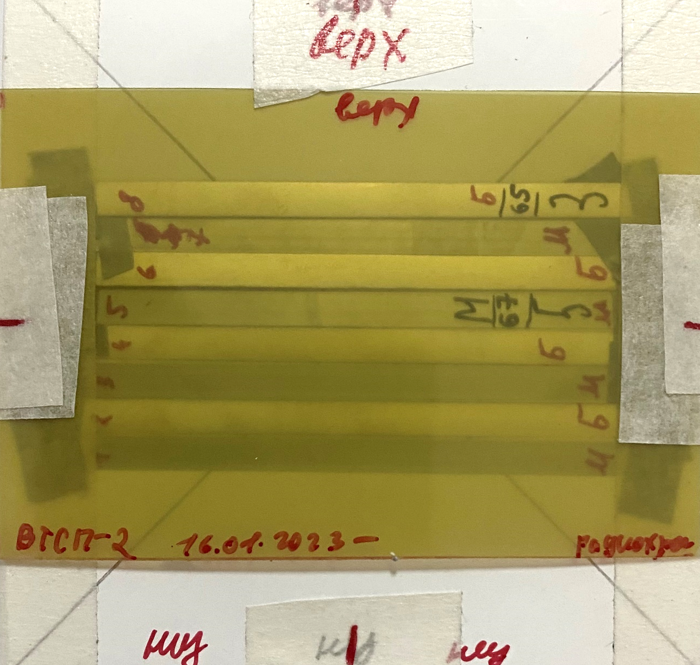
Materials Science working package: Irradiation
of high-temperature superconducting tapes
Development of methods for increasing the critical current of high-temperature superconductors (HTSC) by means of radiation modification (induction of pinning centers in the bulk of the superconductor).
Comparative analysis of the critical current values upon irradiation of HTSC tapes with ¹²⁴Xe⁵⁴⁺ ions of 3.8 GeV/nucleon and protons of 660 MeV.
Estimation of the stability of the effect of increasing the critical current in an irradiated superconductor.
Development of equipment prototypes based on radiation-modified HTSC tapes and their testing.
HTSC tape structure
Orthorhombic
2 μm, ReBCO HTSC
2 μm, Ag
Buffer layers,
3 to 80 nm
< 0.08 μm
5 μm, Cu
30-40 μm, Hastelloy layer
5 μm, Cu
Methods for measuring current-voltage characteristics, Hall coefficient, magnetoresistance, thermo-EMF coefficient, thermal conductivity coefficient, magnetic moment in the temperature range of 1.7–300 K and magnetic fields up to 8 T.
0.1-0.2 mm
Irradiation of vertically and horizontally arranged HTSC tapes with and without copper content
Гамма-спектр облученных образцов ВТСП-лент
10⁶
511 keV
10⁴
⁴⁰K
Number of counts
Beam position
10³
1460 keV
²³²Th
10²
2615 keV
TSC tapes manufactured by
”SuperOx” LLC
10¹
1000
Energy, keV
2000

Slide 9



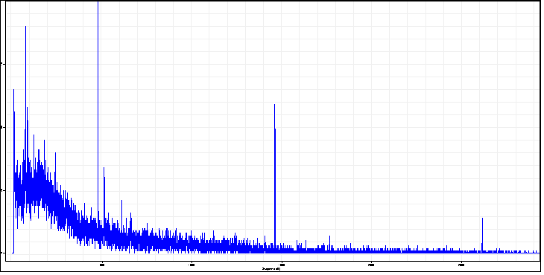

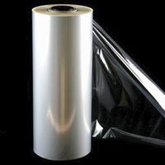
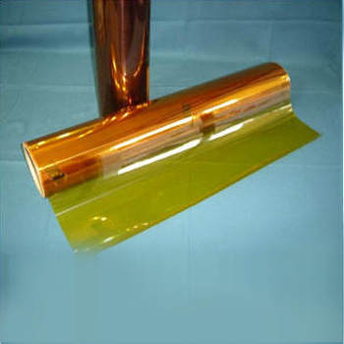
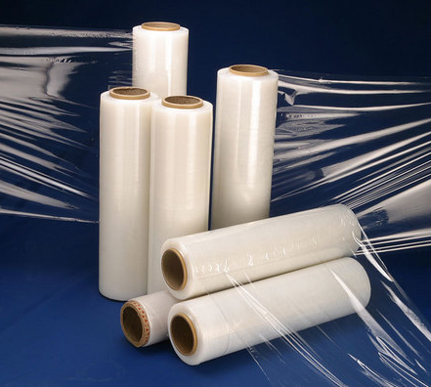
Radiation modification of polytetrafluoroethylene (PTFE), polyethylene terephthalate (PET), polyethylene (PE)
and polyimide (PI) films
Study of the processes of amorphization and recrystallization of polymers and nanocomposite materials.
Investigation of regularities of radiation-chemical damages in PTFE, PET, PE and PI films.
Establishment of regularities in radiolysis of condensed matter under the exposure to ion beams with energies of several GeV/nucleon.
Development of ion-track technologies with "thick" targets and multilayer materials.
Multilayer film packs for exposure
⁷Be
Gamma spectrum of PTFE sample exposed to ions of ¹²⁴Xe⁵⁴⁺, 3.8 GeV/nucleon
Beam direction
477,6 keV
10³
⁴⁰K
Number of counts
10²
511 кэВ
1460 keV
10¹
²³²Th
2615 keV
10⁰
500
1000
1500
2000
2500
Energy, keV
Research methods: scanning and transmission electron microscopy, X-ray phase analysis, X-ray photoelectron spectroscopy and X-ray energy-dispersive elemental analysis, atomic force microscopy and low-temperature nitrogen sorption, wettability with respect to water and heptane, optical and infrared spectroscopy, infrared spectroscopy of frustrated total internal reflection, diffuse spectroscopy and specular reflection, laser Doppler strainmetry.
PTFE, PET, PE and PI films of 12, 20, 40, 50, 80 µm thick

Slide 10
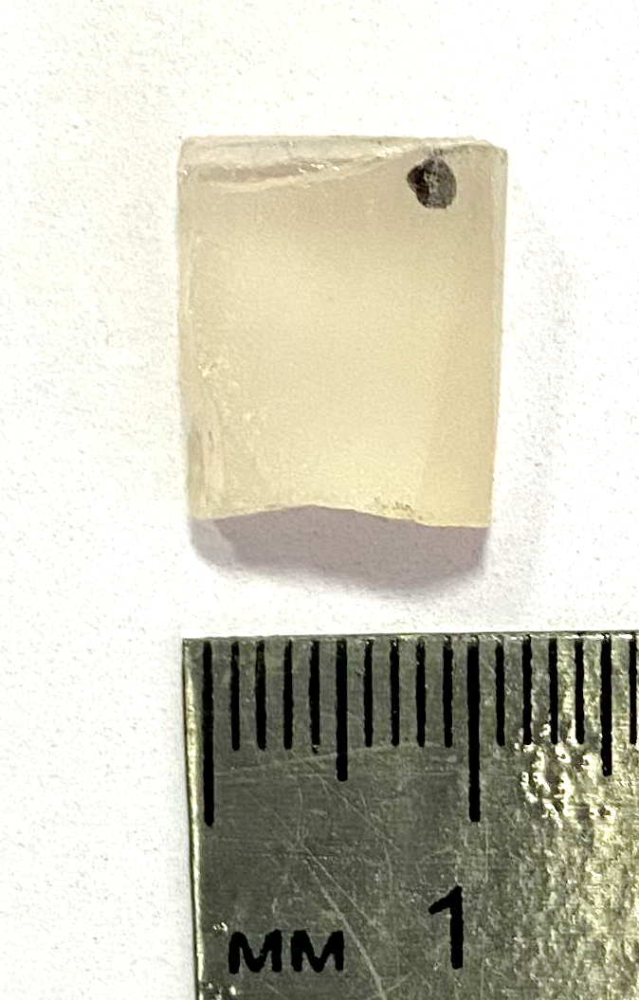
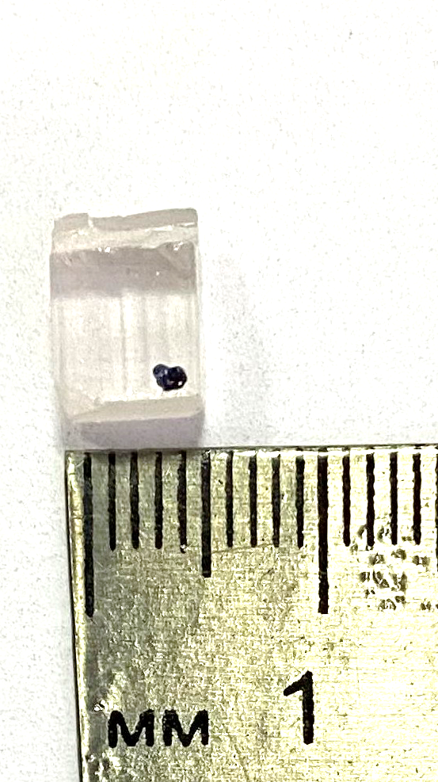
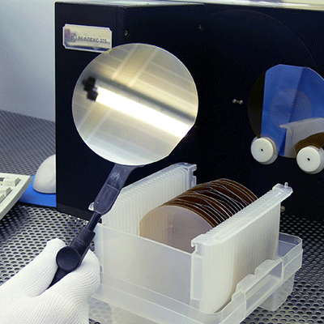
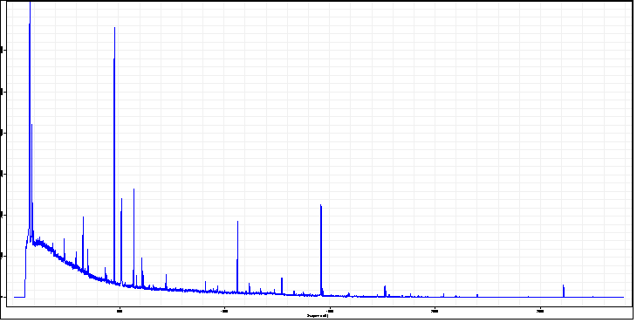
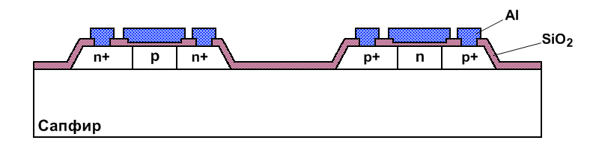
Study of radiation modifications in sapphires (Al₂O₃)
as a result of the long-term heavy ion exposure
Samples of sapphires*
Study of structural modifications and the state of matter as a result of the accelerated ion beam exposure of on sapphires (Al₂O₃).
Improvement of the "silicon on sapphire" technology in topics assuming the impact of relatively high-energy ions (deep space, radiation-resistant electronics for charged particle accelerators, etc.).
Research methods used:
atomic force microscopy; scanning electron microscopy; electron spectroscopy for chemical analysis; X-ray fluorescence analysis; mass spectrometry; thermal analysis.
*Transparent wedge-shaped samples of crystalline alumina (sapphire) produced by the Vernel method.
⁷Be
Gamma spectrum of sapphire sample exposed to ions of ¹²⁴Xe⁵⁴⁺, 3.8 GeV/nucleon
10⁷
”Silicon on sapphire" (SOS) technology
10⁶
477,6 keV
10⁵
Number of counts
10⁴
⁴⁰K
²³²Th
10³
1460 keV
Sapphire
10²
2615 keV
10¹
500
1000
1500
2000
2500
Energy, keV

Slide 11
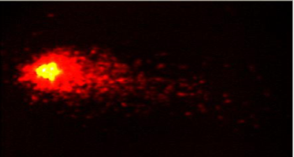
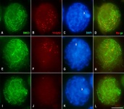
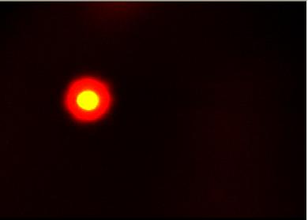
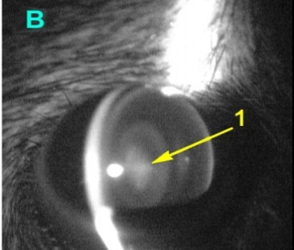
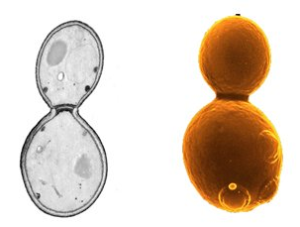
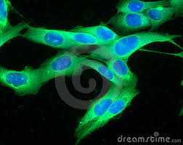
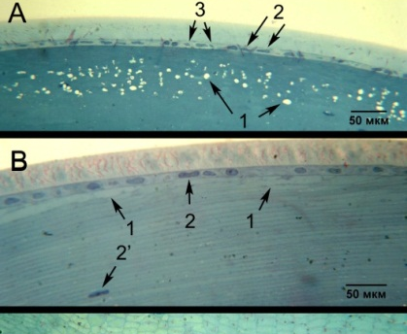
Sample activities of the Life Sciences working package
Molecular biology research (DNA damage and repair)
Aspects of the cell death (apoptosis, necrosis)
Formation of chromosomal aberrations
Mutagenic effect of radiation (gene and structural mutations)
Different aspects of cancerogenesis
Central nervous system disorders
Development of radiation protection measures
Studies for treatment of radiation diseases
Improvement of beam delivery and dosimetry methods for radiotherapy
...

Slide 12
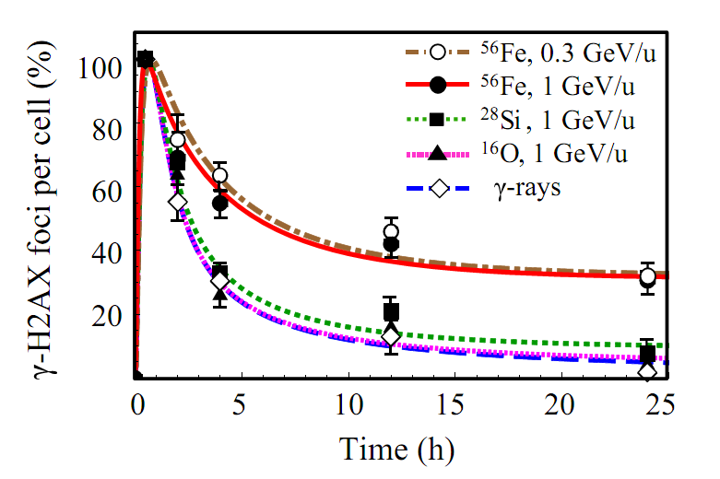

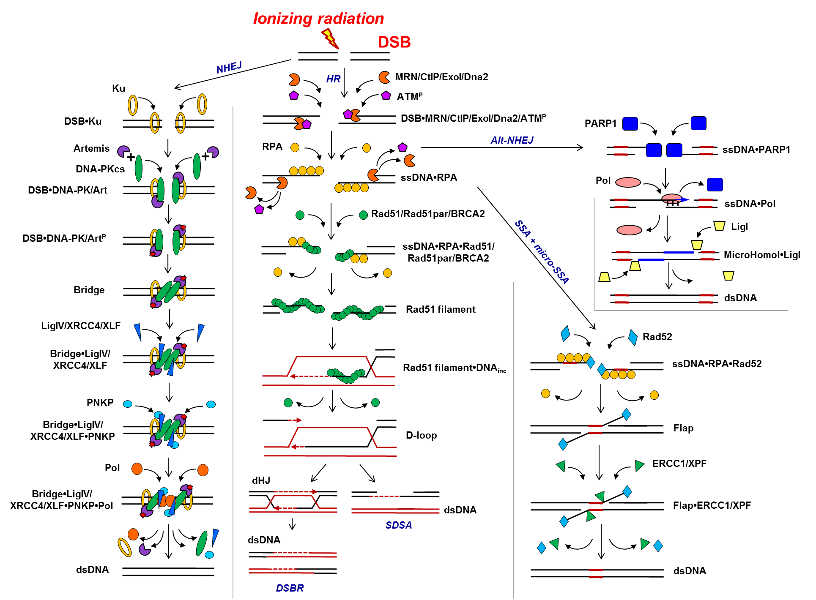

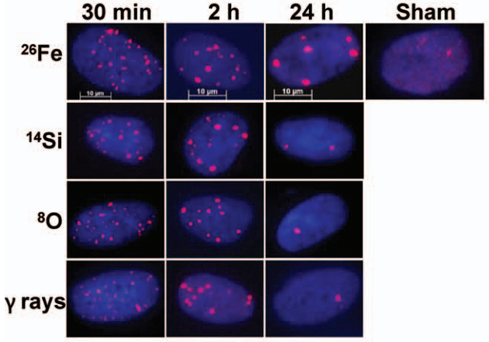
Sample activities within the Life Sciences working package
DNA damage and repair
/Belov et al., 2015-2023/
Time-courses of γ-H2AX remaining after exposure to 1 Gy of iron, silicon, oxygen particles and γ-rays. The curves are the calculated results (Belov et al., 2015); symbols are the experimental data referred to irradiation of human skin ﬁbroblasts (HSF42) (Asaithamby et al., 2008). The error bars represent SEM.
Alt-NHEJ
Development of the global concept of the DNA repair process following the exposure to heavy ions of relatively high energies
– How the clustered DNA damage are formed under the exposure to particle beams of relatively high energies?
­– What are the regularities in molecular mechanisms of this process in comparison with lower energy region?
– What are the particular differences between radiation responses of normal and tumor cells (DNA repair, cell cycle control, cell death) to the exposure with HZE particles of different energies and Z?
– Study of the mechanisms of functioning of mitochondria and their genetic apparatus in normal and tumor cells of mammals under the influence of beams of heavy charged particles with different energies and Z.
Practical implication: Improvement of technologies for ion therapy treatment of malignant neoplasms, including competitive chemoradiotherapy (CRT).
NHEJ
HR
SSA
+
micro SSA
30 min 2 h 24 h Control
Fe
Si
O
γ-rays
Experimental data
/Asaithamby et al., 2008/

Slide 13
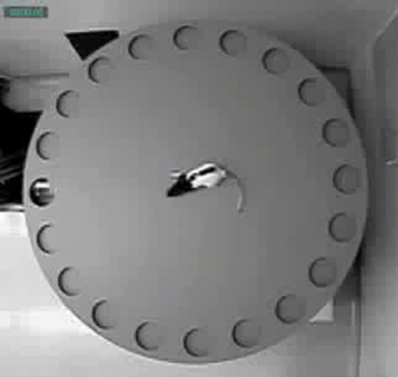
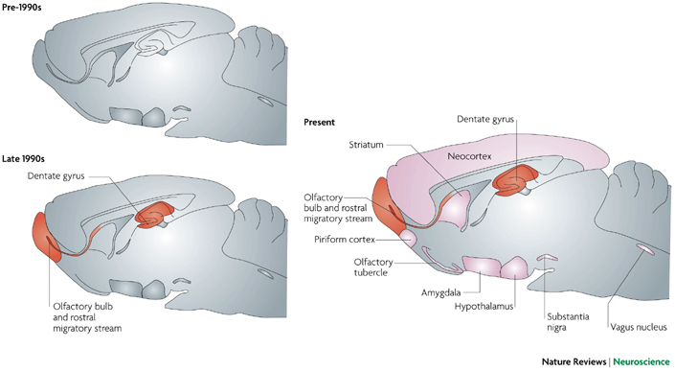






Sample activities within the Life Sciences working package
Ground-based simulation of combined effect of HZE particle exposure and non-radiation factors of long-term space flights beyond the Earth magnetosphere.
– What are the regularities in radiation physiology effects following the HZE exposure?
– How the molecular, neurochemistry and neurophysiology effects are linked between each other?
– What will be the combined effect of HZE particles and simulated microgravity?
Practical implication: Contributing to the risk estimation concept for astronauts and formulating the mission operational recommendations on radiation protection in space.
Ions
(¹²С, 500 MeV/n, 1 Gy)
γ-rays
(⁶⁰Co, 1 Gy)
Prefrontal cortex
Prefrontal cortex
Hippocampus
Nucleus accumbens
Rat brain
Rat brain
Hypothalamus
Hypothalamus
Exposure to ¹²С ions
Exposure to γ-rays
30 days (3 months)
90 days (5 months)
30 days (3 months)
90 days (5 months)
Concentration, %
Concentration, %
NE DOPAC DA HVA 3-MT
НА ДОФУК ДА ГВК 3-МТ 5-ОТ ДОФУК
ДА
НА ДОФУК ДА ГВК 3-МТ
NE DOPAC DA HVA 3-MT 5-HT DOPAC
DA
Ion exposure at
NICA/Nuclotron
Seeking for most radiosensitive brain structures
Belov et al., 2015-2022
Laboratory of High Energy Physics, JINR

Slide 14



Sample activities of the Life Sciences working package
Study of radiolytic damage to neural cell structures
Experimental verification is needed!
30 MeV
⁺p particle track
Distribution of free radicals in a single pyramidal neuron after irradiation
1000 MeV/u ⁵⁶Fe particle
track
Track structure of a 30 MeV proton and 1000 MeV/u ⁵⁶Fe ion in dendritic branches
of pyramidal neuron, as viewed at picosecond, nanosecond, and microsecond after exposure
Belov et al., 2019-2021

Slide 15
ARIADNA collaborations for applied research at NICA
ARIADNA-LS Collaboration | ARIADNA-MSTE Collaboration | ARIADNA-NPT Collaboration
The Collaboration is being established in order to perform experiments in the field of life sciences at the NICA Complex with the ARIADNA beamlines | The Collaboration is being established in order to perform activities and experiments in radiation materials science and radiation testing of electronics at the NICA Complex with the ARIADNA beamlines | The Collaboration is being established in order to facilitate novel developments for nuclear power technology at the NICA Complex with the ARIADNA beamlines
Collaborating organizations
Joint Institute for Nuclear Research (Dubna, Int.)
Institute of Biomedical Problems, RAS (Moscow, Russia)
Burnasyan Federal Medical Biophysical Center of Federal Medical Biological Agency (Moscow, Russia)
Skobeltsyn Research Institute of Nuclear Physics, Moscow State University (Dubna, Russia)
Saint Petersburg State University (Saint Petersburg, Russia)
Tsyb Medical Radiological Research Centre (Obninsk, Russia)
Semenov Research Center of Chemical Physics, RAS (Moscow, Russia)
Institute of Theoretical and Experimental Biophysics, RAS (Moscow, Russia)
Moscow Institute of Physics and Technology (Dolgoprudny, Russia)
Kurnakov Institute of General and Inorganic Chemistry, RAS (Moscow, Russia)
National Research Nuclear University MEPhI (Moscow, Russia)
Joint Institute of High Temperatures, RAS (Moscow, Russia)
North Ossetian State University (Vladikavkaz, Russia)
Institute of Nuclear Problems of the Belarusian State University (Minsk, Belarus)
Institute of Nuclear Physics, AS RUz (Tashkent, Uzbekistan)
LLC Research and production company “Kvant-R” (Moscow, Russia)
LLC “S-Innovations” (Moscow, Russia)
LLC “SOL-Instruments” (Minsk, Belarus)
152 participants
Expected: Orbeli Institute of Physiology, NAS, Yerevan, Armenia

Slide 16
ARIADNA access
Both academic and industrial groups are eligible to access the ARIADNA infrastructure.
A correspondingng user policy at NICA is under development, which includes regulations on equipment use, bioethics, access to beamlines and to supportive user infrastructure, etc.
Funding opportunities can also be provided on the basis of special-purpose grant programs launched for NICA by external funding agencies.
Main counterpart from ARIADNA users: results need to be published!

Slide 17
Ways of getting involved
in ARIADNA
As a member of ARIADNA collaboration: get in touch with us and we will provided instructions on signing an MoU to become a member of the collaboration.
As a user: just prepare and submit you proposal for consideration.
As an ARIADNA partner: let us know how you think you/your research team or company can contribute to ARIADNA and we can prepare a relevant application to be discussed with NICA management.

Slide 18

With best wishes
to Yuri Oganessian
Thank you for your attention

Slide 19





“Plants and Vegetation in Space”
Ground-based and flight experiments on the study of seed germination and plant development under space flight conditions (the effect of long-term exposure of seeds to heavy ions)
Beam
direction
4 seed containers per run
Long-term exposure of seeds to ¹²⁴Xe⁵⁴⁺ ions of
3.8 GeV/nucleon
In total, 16 containers (~ 2x2 cm each) with seeds of mustard, lettuce, dill, indau.
Research methods: assessment of germination, genetic analysis, mutations, developmental features of plants obtained from irradiated seeds.
10³
⁴⁰K
Gamma spectrum of a sample with mustard seeds
1460 keV
10²
511 keV
Number of counts
10¹
²¹⁴Bi
²³²Th
1764 keV
2615 keV
10⁰
1000
2000
Energy, keV
Cosmonaut Sergey Volkov in a flight experiment with plants at ISS
https://www.thetechoutlook.com/

Slide 20





Activation analysis of materials upon irradiation with
¹²⁴Xe⁵⁴⁺ ions of 3.8 GeV/nucleon
10⁷
²⁴Na
Gamma spectrum of an irradiated aluminum sample
Annihilation
1368 keV
511 keV
10⁵
Number of counts
⁷Be
477,6 keV
10³
²²Na
Aluminum target
АМЦ 27817 (1.5 x Ø70 mm)
1272 keV
10¹
Composition (GOST), %
500
1000
1500
2000
2500
Al | 96.35 — 99
Mn | 1 — 1.5
Cu | 0.05 — 0.2
Fe | Up to 0.7
Si | Up to 0.6
Zn | Up to 0.1
Energy, keV
Beam
direction
Spectrometer of gamma radiation SEG-1KP-IFTP (detection unit BDEG-OGK-3K)
Al, 1.5 x 3 = 4.5 mm

Slide 21

Pore formation in MoS₂ monolayer under irradiation by swift heavy ions: A molecular dynamics study
A. Kolesnikova, V. Osipov. Journal of Applied Physics. 2022; 132 (12): 124301.
Average radius of the core region of the ion track (nm) for different types of ions at selected incident energies
Ion energy | Bi | W | Xe | Kr | Ar
26 MeV | 0.8 | 0.85 | 1.02 | 1.41 | 1.84
157 MeV | 1.72 | 1.76 | 2.5 | 3.13 | 4.53
710 MeV | 4.2 | 4.49 | 5.31 | 6.65 | 8.76
4.5 GeV | 10.6 | 11.3 | 13.4 | 16.7 | 23.1
Top view of final atomic configurations resulted from the incidence of Bi, W, Xe, Kr, and Ar ions with energies:
(a) 26 MeV, (b) 157 MeV, (c) 710 MeV, and (d) 4.5 GeV.
Notes:
Fabrication of nanopores in various 2D materials and, in particular, in a monolayer of molybdenum disulfide (ML-MoS2MoS2⁠) is of great importance due to promising practical applications in membrane separation technology,^{1,2} such as water desalination,^{3–5} DNA sequencing,^{6–8} nanopower generators,⁹protein translocation,¹⁰ and gas separation.^{11,12} Interest in this material is also due to the fact that in some parameters, it surpasses the well-known nanoporous graphene. For example, DNA does not adhere to MoS2MoS2⁠, unlike to graphene. Moreover, MoS2MoS2 is thicker than graphene and should capture the ionic current better because the ions are actually larger than the thickness of graphene membranes.⁷

