Slide 1
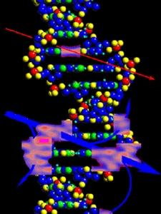
Radiobiological effects of accelerated ultrashort electron beam
Rouben Aroutiounian, Yerevan State University; National Academy of sciences, RA
Bagrat Grigoryan, CANDLE Synchrotron Research Institute, RA
Gohar Tsakanova, CANDLE Synchrotron Research Institute; Institute of Mol.Biology NAS RA
Samvel Harutyunyan- Yerevan State University; JINR
Tigran Harutyunyan - Yerevan State University
Nelly Babayan- Yerevan State University, ; Institute of Mol.Biology NAS RA
Natalya Vorobieva, Andreyan Osipov; N.N. Semenov Federal Research Center for Chemical Physics RAS; Flerov Laboratory of Nuclear Reactions JINR, Dubna, RF
Electron beam
Heavy-ion beam

Slide 2
The research of biological effects of radiation begins from the collaboration of biologists and phisicists in the 30–ies of XX century .
One of the founders of radiobiology was great Russian biologist Timofeev-Resovsky. His scientific circle in Berlin included the physicists Max Delbruck, William Astbury, Niels Bohr, Paul Dirac, Pascual Jordan and Erwin Schrödinger.
Timofeeff, along with his German co-workers Karl G.Zimmer and Max Delbruck, set out the target-or hit-theory. The classic "three-man paper" “On the Nature of Gene Mutation and Gene Structure” (1935) inspired Erwin Schrodinger to deliver his 1943 course of lectures, later published as the book - What Is Life?, which helped draw many physicists to molecular biology.
Timofeeff's principal discovery was his observation of a linear relation between the total radiation dose and the number of mutations. Whether the dose was administered in a single shot, in several fractions or continuously at a low level over an extended period appeared irrelevant.The intensity of the dose did not affect the number of mutations produced.
He suggested that X rays produce mutations much like bombs hitting targets. In the target model, an X-ray photon expels electrons from atoms. These unbound electrons hit other atoms, dislocating more electrons, and so on. The free electrons eventually settle in the electron shells of other atoms. In this way, an X ray creates positively charged ions (atoms missing electrons) and negatively charged ones (atoms having a surplus of electrons).
Timofeeff and his collaborators set out to estimate the size of a single gene by calculating the number of ionizations produced in a certain volume of tissue and by recording the increased number of mutations of a particular gene in that tissue. They found the gene to be a sphere: one to 10 microns! The term Molecular Biology was formed on the base of the meetings of their scientific circle in 1939.

Slide 3
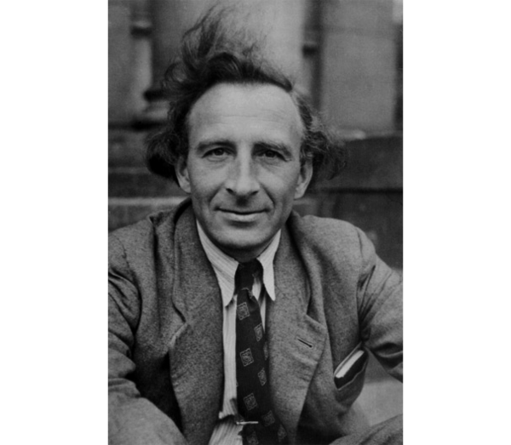
Nikolay Timofeev-Ressovsky
(1900-1981)

Slide 4
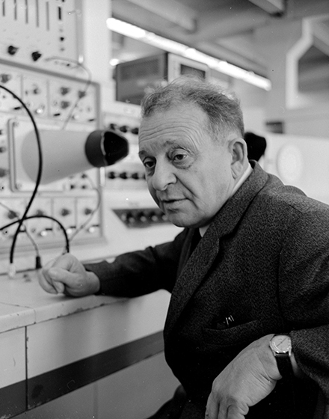

TR role is not only important for development of international, but also for Armenian radiobilogy.
The founder of experimental physics in Armenia was Artem Alikhanyan (1908 – 1978).
Artem Alikhanian 1908-1978

Slide 5
To understand the molecular nature of radiobiological effects previous in vitro studies have been performed at conventional accelerators. They brought to large progress in the understanding of extremely conditions for cells and their genetic apparatus. But in many cases for the research of tiny molecular biological processes you need sometimes to canalize or inhibit the heavy music of high-powered radiation effects.
And now we have to pass to the new dimension of radiobiological research, that was developed in recent years. A new generation of accelerators is being developed, with the operating principle based on the acceleration of charged particles by means of pulsed lasers. In addition to the significantly smaller size and cost, laser accelerators’ advantage is the ability to create directed ultrashort (femtosecond and picosecond) pulses. The advantage of laser generation of photoelectrons is that, by controlling the laser parameters, it is possible to control the parameters of the electron beam.

Slide 6
What is the advantage of laser-generated ultrafast electron beams for biological and clinical application?
-They have very high instantaneous dose delivery within a time interval shorter (sub-pc vs. pc), than many chemical reactions.
Irradiation with ultrashort electron pulses/beams makes it possible to deliver a certain radiation dose (0.1-10 Gy) in a short time. The duration of irradiation with ultrashort electron pulses is much shorter than the duration of biological processes in irradiated cells. The irradiation time is so short that thermal effects caused by energy transfer are also excluded, which makes it possible to study the purely radiative effects of irradiation.
They are really a gift for molecular biologists!
-Typically feature a monoenergetic spectral profile and are better directed (less lateral spread) than other laser-driven ions.
-This allows the precise dose-control induction of local effects on cells and solid tumors with minimal exposure of normal tissues.
-It was shown that very-high-energy electron beams allow higher radiation doses to be delivered, thereby improving the tumor-to-healthy-tissue ratio by delivering a higher radiation dose to the tumor versus normal tissues
-Research on the features of these effects formation is developed over the last dozen years; in fact we are talking about a new direction in radiation biology and medicine.

Slide 7
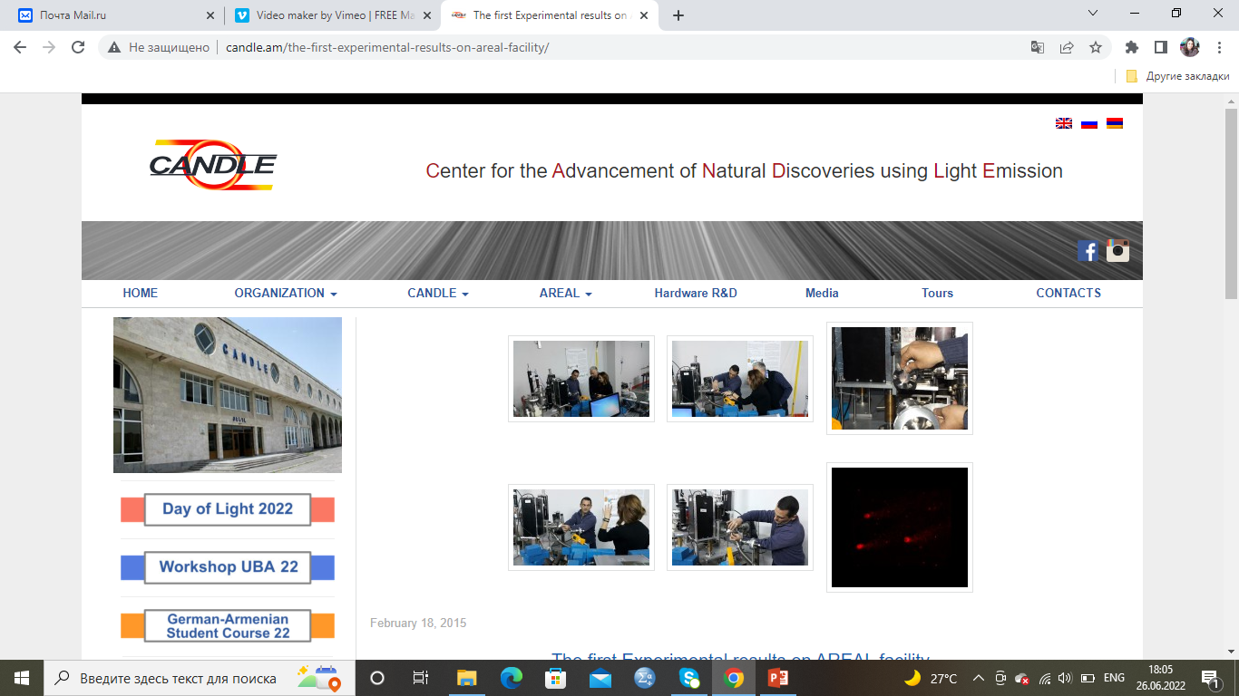

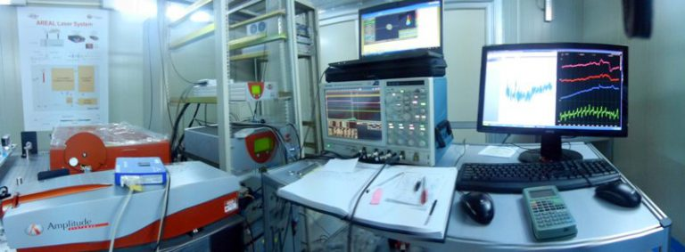
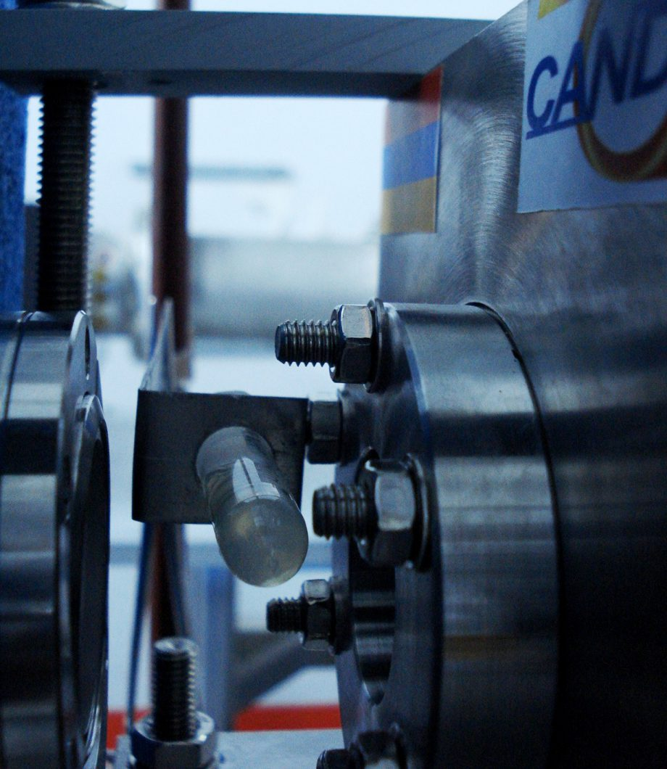
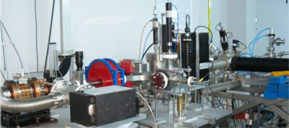
AREAL (Advanced Research Electron Accelerator Laboratory)

Slide 8
In the AREAL accelerator, a copper photocathode is irradiated with an ultraviolet laser with a frequency of up to 50 MHz and an average power of 2 watts (it can reach kilowatts and a peak of 10 MW) at a wavelength of 258 nm (it knocks out the maximum electrons from the copper cathode - quantum yield), pulse duration 0.5 picoseconds and with a pulse energy of 200 μJ. These are focused, ultrashort, high-energy laser pulses. They also knock out electrons from the cathode with a pulse duration of 0.5 picoseconds Ultrashort (sub-picosecond) focused electron bunches are generated.
At the same time, a standing electromagnetic wave with a frequency of 3 GHz and a voltage of more than 100 MV / m (megavolt / meter) is excited in the high-frequency RF resonator with a deep vacuum, where the cathode is located, to instantly capture photoelectrons in the acceleration mode and bring the electron energy to relativistic.RF oscillations have a pulse duration of 10-250 picoseconds.
The electrons sit on top of the individual peaks of the RF oscillations and are amplified and go further in the beam.
The frequency of the electron beam is 1-50 Hz, i.e. between their peaks 1-0.02 seconds (repeat frequency).
Electron pulse duration is 0.4 picoseconds, length 100 micrometers
The nominal electron beam parameters range is:
energy 2-5 MeV, bunch charge 10-250 pC,
The diagnostic tools include the magnetic spectrometer, Faraday cups, YAG screens and pepper port for the beam energy, energy spread, charge, beam profile, emittance measurements and control.
The institution has two experimental stations for practical work in the field of natural sciences.
H1 station is equipped with a focusable electron beam.
H2 station designed for experiments related to electron energies.
AREAL - laser driven, photocathode RF gun based linear accelerators providing ultrashort electron pulses (sub-pico or femtosecond) with the electron energy in MeV domain
Up to now the in vitro and in vivo experiments were performed on:
JETI (Jena Titanium)
- UHPDR - 2.4x10⁹ Gy/sec
- pulse duration - 1x10⁻¹² s
ELBE (Helmholtz-Zentrum,Dresden)
- UHPDR - 1.6x10⁸ Gy/sec
- pulse duration - 5x10⁻¹² s
- pulse duration - 0.04 x10⁻¹² s
Ultrahigh peak dose-rate (UHPDR) 1.6x10¹⁰ Gy/sec
.

Slide 9
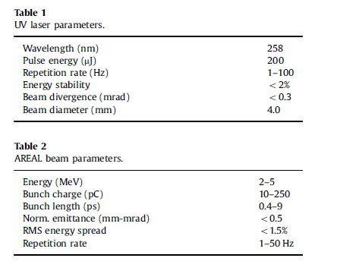
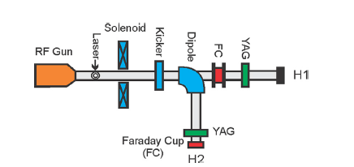
Advanced Research Electron Accelerator Laboratory
AREAL – Армения
Характеристика
Экспериментальная станция
Tsakanov V.M., et al., 2016
Nuclear Instruments & Methods in Physics Research A ,
http://dx.doi.org/10.1016/j. nima.2016.02.028i
Notes:
Основная цель ускорителя Areal генерация и ускорение ультракоротких электронных пучков с малым поперечным эмиттансом???
Ускоритель Areal характеризуется широким диапазоном вариаций параметров пучков и стабильной работой в данном диапазоне
Использование меди в роли фотокатода дает высокий порог повреждения (100 mJ/cm), короткое время ответа (менше чем 0.02 пикосекунды) и долгий срок эксплуатации (1 год)
В заведении есть две экспериментальние станции для проведения практических работ в области естественных наук
H1 станция оборудована фокусируемым электронным пучком
H2 станция предназначена для экспериментов связанных с энергиями электронов
Ультракороткие электронные сгустки AREAL с энергией 2–5 MeV очень удобны для точного и контролируемого исследования в области
радиационной биологии и медицинской физики
В ускорителе АРЕАЛ медный фотокатод облучается ультрафиолетовым лазером
частотой 50 MHц и средней мощностью 2 вт.( может доходить до киловатт и выше)
на длине волны 258 нм (только она влияет на энергию электронов)
длительностью импульса 0,5 пикосекунды
и с энергией в импульсе в 325 мкДж.
Это сфокусированные ультракороткие лазерные импульсы высокой энергии.
Из катода он выбивает электроны тоже длительностью импульса 0,5 пикосекунды
Одновременно в высокочастотном резонаторе RF с глубоким вакуумом, где размещен катод, возбуждается стоячая электромагнитная волна с частотой 3 ГГц и напряжением более 100 МВ/м для мгновенного захвата фотоэлектронов в режим ускорения и доведения энергии электронов до релятивистских.
У колебаний RF длительность импульса 150 пикосекунд
Электроны садятся на верхушку отдельных пиков колебаний RF усиливаются и идут дальше пучком.
Частота электронного пучка 2гц, т.е. между их пиками 0.5 секунд (частота повтора).
Длина импульса электронов 400 fs.

Slide 10
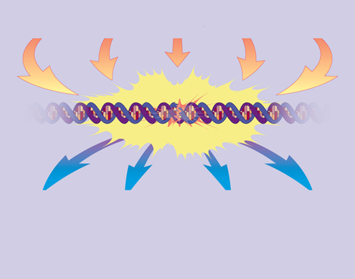
For geneticists, the most important direction in radiobiology is the DNA damage, induced by different types of radiation, including ultrafast electron beams.
The damaged DNA can be repaired, and if repair is not successful, then:
-cells can die by apoptosis.
-arrest in cell cycle can be induced.
-DNA damage can lead to cancer.
Radiation
DNA
damage
Apoptosis
Cell cycle
arrest
DNA repair
Cancer

Slide 11
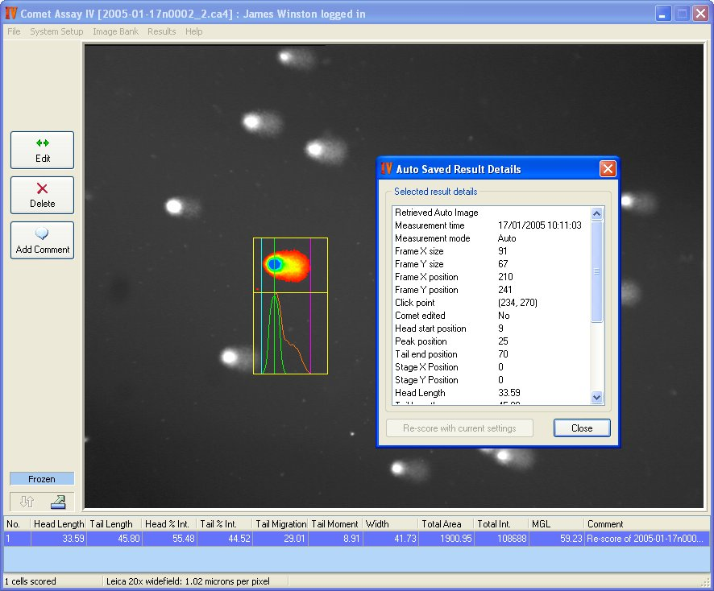
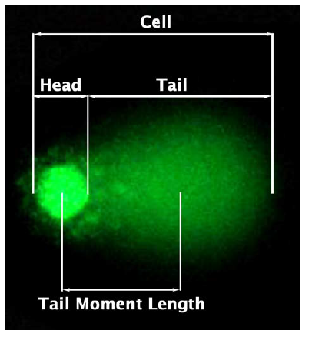
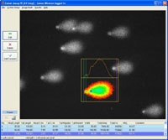
Comet assay – computer analysis

Slide 12
T
Irradiation, dose 4 Gy,
Non-irradiated control
Irradiation, dose 2 Gy,
Comet assay images of K-562 (human chronic myelogenic leukaemia) cells after irradiation by AREAL
Irradiation, dose 8 Gy,
Irradiation, dose 16 Gy,
Irradiation, dose 24 Gy,

Slide 13
DNA damage (Olive Tail Moment) in K-562 cells 0 and 24 hours after irradiation (pulse frequency 2 Hz and 20 Hz)
(K-562 - lymphoblast cells isolated from the bone marrow of CML patient)
The exposure of K562 to AREAL irradiation at different doses revealed the dose-dependent increase of the primary DNA damage. At the high doses the DNA damage decreases. The reason - the level of dead cells can be increased. Electrons, as a source of low LET radiation, lead to DNA lesions, including single-strand and double-strand breaks of DNA, which were generally repaired efficiently., except 24 Gy.
*
*
*
*
*
*
Low dose-rate – 3,6 Gy/min (pulse frequency 2 Hz), High dose-rate – 36 Gy/min (pulse frequency 20 Hz)
The radiation-induced levels of DNA damage depend on dose and dose-rate

Slide 14
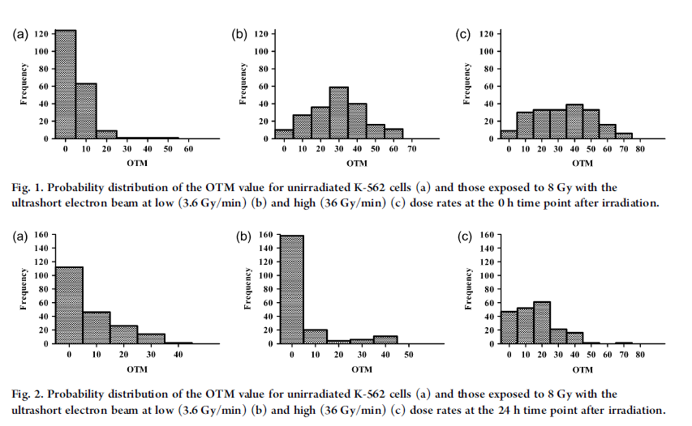
Distribution of cells on the base of DNA damage in K-562 cells after irradiation by low and high dose rate, by Olive Tail Moment
NT
3,6 Gy/min
36 Gy/min
An analysis of the distribution of initial DNA damage after high power irradiation
by increasing the dose-rate of ultrafast electrons revealed
a shift towards an increase in the proportion of damage and expansion of the distribution.
with a subsequent decrease in reparability due to more complex DNA damage.
DNA damage
DNA repair

Slide 15
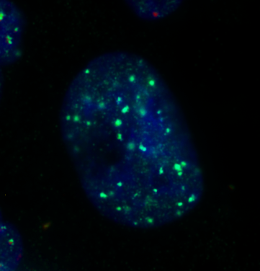
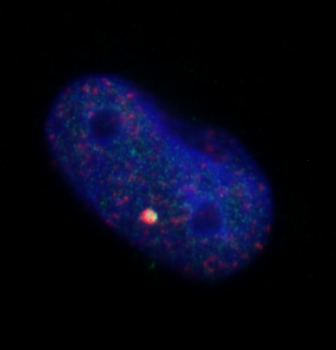
New approach to detection of DNA double strand breaks and DNA repair is analysis of FOCI, that are distinct spots after DNA damage consisting of repair proteins of double-strand DNA ruptures.
FOCI contain hundreds to thousands of copies of various proteins involved in DNA DSB repair
One of the earliest (several minutes) DNA repair events is the phosphorylation of a protein called histone H2AX, that involves many other proteins in the repair process. which are sensors of double-strand breaks of DNA .
For low-LET we measured DNA-PK. DNA-PK - DNA-dependent serine/threonine protein kinase . Autophosphorylation of DNA-PKcs appears to play a key role in NHEJ and is thought to induce a conformational change that allows end processing enzymes to access the ends of the double-strand break.
The quantitative analysis of the foci of repair proteins allows to determine also the mechanisms of their repair.
ɣH2AX foci
Co-localization of ɣH2AX foci and p-DNA-PK
Fluorophores
ɣH2AX foci – Fluorescein (FITC) – green
p-DNA-PK - Texas Red - red
Visualization of phosphorylated ɣH2AX foci in irradiated cell
Сo-localization of phosphorylated ɣH2AX and DNA-PK protein can be visualized

Slide 16
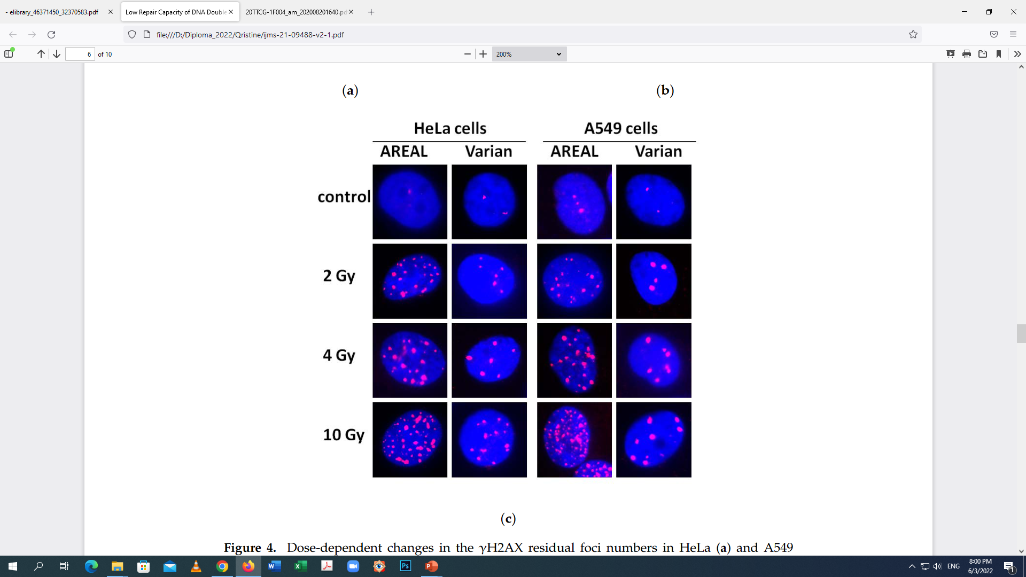
AREAL vs Varian Trilogy linear electron accelerator
Dose-dependent changes in the γH2AX residual foci numbers in HeLa cervical cancer and A549 lung carcinoma cells at 24 h post-irradiation
For AREAL irradiation is demonstrated slower DSB repair rate induced by ultrashort pulsed irradiation for both cell types , compared to Varian.
Pulse duration increases the possibility of DSB-complex with more difficulty repairable DSBs formation.
Notes:
Experiments for the dose-dependence studies of the number of residual γH2AX foci in HeLa and A549 cells at 24 h after AREAL and Varian irradiations have been performed to confirm the phenomenon of the delayed elimination of DNA
DSB repair proteins foci.
In the case of HeLa cells, the number of residual foci was changed insignificantly at the dose range of 1–10 Gy and the “saturation” effect was observed
It was shown that over the entire studied dose range, the residual γH2AX foci after exposure to the pulse irradiation was 1.7–2.9 times higher than that after quasi-continuous irradiation exposure
Overall, the obtained results confirm the conclusion about the delayed nature of the elimination of pulse radiation-induced DSBs repair proteins foci in cancer cells compared to that after quasi-continuous irradiation.

Slide 17
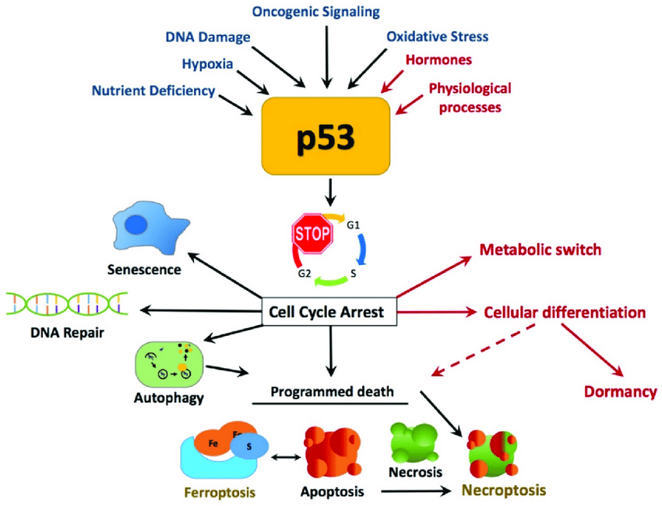
Tumor protein P53, is cellular tumor antigen the “Guardian of the Genome”
The biological role of p53 –
that arrests cell cycle until repairing DSBs

Slide 18
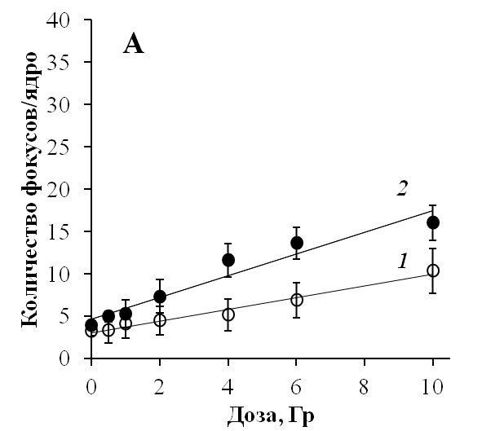
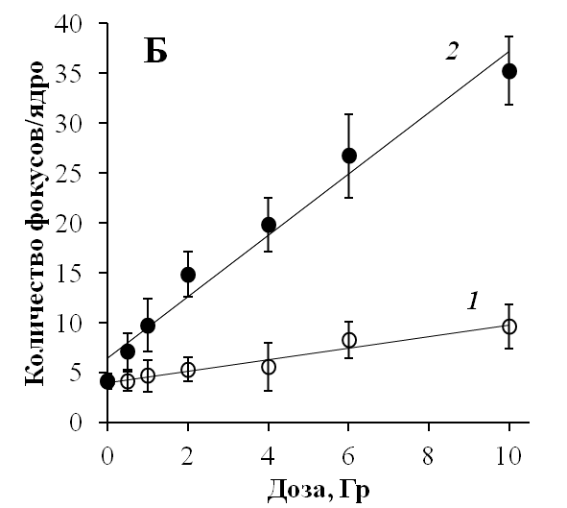
AREAL vs Varian
Residual γH2AX Foci in in wild-type A549 human lung carcinoma cells and H1299
(p53-deficient human lung carcinoma cells) exposed to Subpicosecond Beams of Accelerated Electrons
Dose-dependent differences in the number of residual γH2AX foci in wild-type A549 (a) and p53-defcient H1299 (b) both human lung carcinoma cells in 24 h after exposure to quasi-continuous (1) or subpicosecond (2) pulsed beams of accelerated electrons.
Comparison of the slope coefficients showed that
yield of γH2AX foci for AREAL exposure was 1.8 times higher, than for Varian in A 549 p53 wild type cells,
but ~5.3-fold higher in H1299 p53 deficient cells.
Conclusion: AREAL>VARIAN due to complex damages, Pulsed irradiation induces more difficultly repairable complex DSBs,
the yield of FOCI in human cells is p53-dependent for AREAL irradiation, but not for Varian!
Our results suggested that the yield of γH2AX foci is p53-dependent in case of picosecond electron beam irradiation, but not in case of quasi-continuous electron irradiation. Thus, it can be more effective in cancer cells.
A549
H1299
Foci number/nucleus
Foci number/nucleus
у=3.06x+6.52 (R2 =0.94)
у=1.27x+4.70 (R2 =0.94)
Dose,Gy
Dose,Gy
у=0.69х+3.08 (R2 =0.98)
Notes:
The aim was a comparative analysis of the quantitative yield of the residual phosphorylated histone γH2AX foci as a marker of DNA double-strand breaks in human lung carcinoma cells differing by the p53 status in response to subpicosecond beams of accelerated electrons and quasi-continuous irradiation. A549 human lung carcinoma cells with wild-type p53 expression and p53-defcient H1299 cells were used as the experimental model.
Results:
In A549 lung carcinoma cells with wild-type p53, dose-dependent changes in the number γH2AX residual foci in 24 h after irradiation with quasi-continuous and subpicosecond pulsed beams accelerated electrons were observed (Fig. 1, a). The number of γH2AX residual foci was higher after exposure to subpicosecond pulsed beams than after quasi-continuous irradiation.
In these dose-dependent relationships described by linear equations, the slope coefficient “а” reflects the increment of the effect per dose unit. Comparison of the slope coefficients showed that quantitative yield of γH2AX residual foci exposure to pulsed irradiation was higher by ~1.8 times than after quasi-continuous irradiation in case of A549 cells and ~5.3-fold higher in case of H1299 cells
Conclusion: our results suggested that the yield of residual γH2AX foci in human lung carcinoma cells is p53-dependent in case of subpicosecond electron beam irradiation, but not in case of quasi-continuous electron irradiation

Slide 19
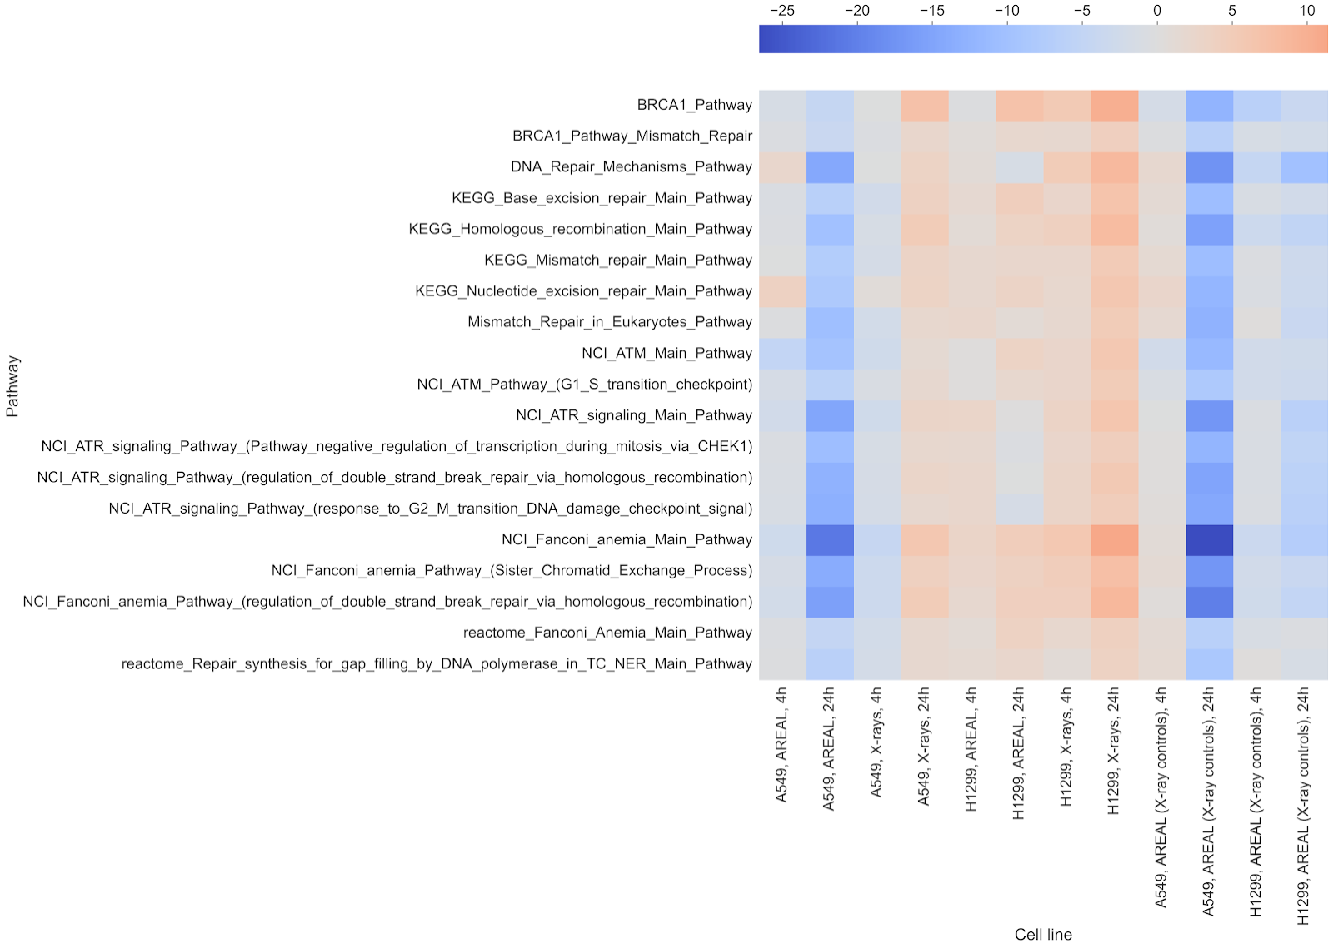
AREAL vs X-rays
Genome-wide transcriptome analysis of wild-type A549 and p53-deficient H1299
human lung carcinoma cells
The gene expression analysis of DNA repair pathways revealed strong p53-dependent action of picosecond electron beam irradiation. Weeker repair …

Slide 20
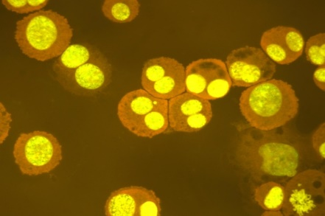
The induction of chromosomal aberrations, such as chromosomal fragments resulting from DNA breaks, or entire chromosome loss was evaluated in MRC5 cell line (human fetal lung fibroblast cells) after 0.1 Gy, 0.5 Gy and 1 Gy doses of electrons compared to X-ray irradiation.
For AREAL - slight, but statistically significant increase was observed
only at the 1 Gy of electrons irradiation
X-ray irradiation - dose-dependent increase of MN frequency was observed, reaching the level of 24±2.1 of BN cells with MN at the irradiation dose of 1 Gy
CBMN assay
To compare the mutagenic capacity of the UPEB with X-ray irradiation, the RBE (relative biological effectiveness) value was calculated as the ratio of the slopes for the two radiation types = about 0.06
The dose-response functions were
AREAL y = 1.1979x+1.4864 (R²=0.83)
X-ray y=20x+2.5 (R² = 0.92)
Cytokinesis-Block Micronucleus CBMN assay - cytochalasin B
The deduced RBE value of AREAL iradiation to X-rays to induce micronuclei in MRC5 cells was about 0.06, suggesting lower level of mutagenic capacity in case of electrons iradiation due to death of cells, not their transmission in generations!

Slide 21
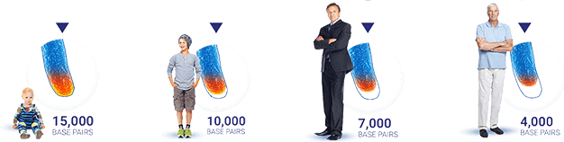
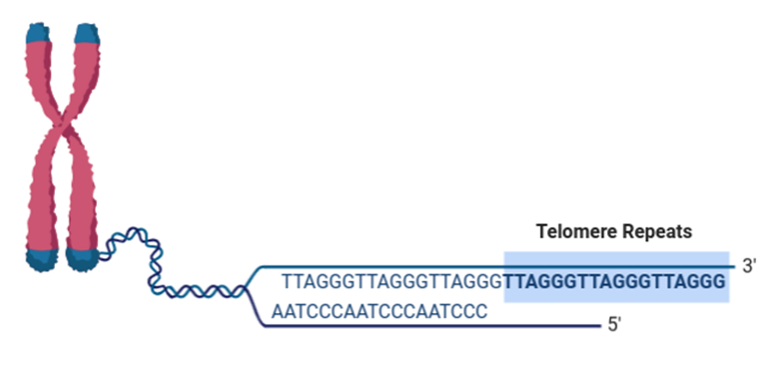
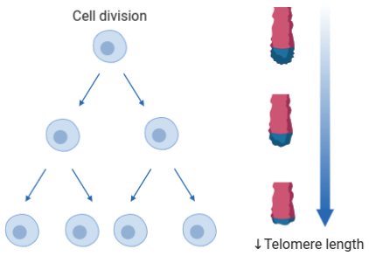
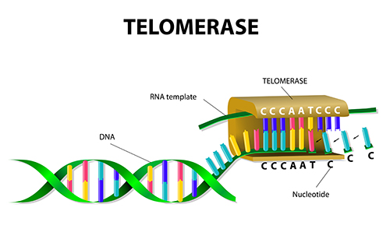
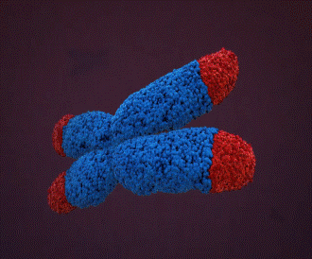
Telomeres
-Telomeres are nucleoprotein structures with repeated sequences of DNA (TTAGGG)n that cap the end of each chromosome arm and function to maintain genome stability.
-With each cell division the length of telomeres gets shorter which limits cell divisions. Also, telomere attrition is correlated with the process of aging.
-However, telomere length can be restored by the enzyme telomerase which is constantly active in cancer cells.
Therefore, a detailed understanding of the mechanisms of telomere loss and preservation is important for human health. 2009 - Nobel prize for their studies of telomeres and telomerase (Blackburn, Greider and Jack Szostak) .
Telomerase restores
telomere length
Notes:
https://www.sciencedirect.com/science/article/pii/S0891584918315521#f0035
https://www.sciencedirect.com/science/article/pii/B9780128161937000221

Slide 22
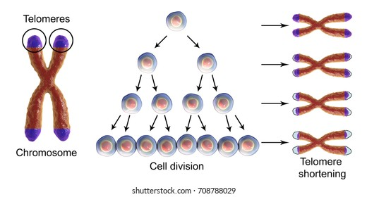
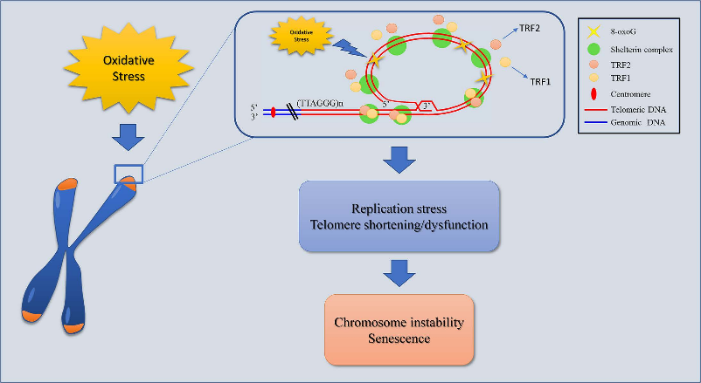
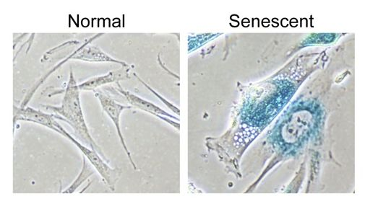
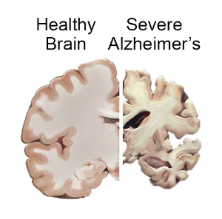
Telomere attrition can be induced by environmental factors
-Alterations of telomere length are associated with various pathological conditions including cancer, cellular senescence, cardiovascular, autoimmune and neurodegenerative or aging-related diseases
-Moreover, environmental factors such as radiation and chemical compounds can increase telomere damage mainly via induction of DNA oxidative damage due to high concentration of G-rich parts in telomeres.
-Telomere shortening suppresses cell division by triggering senescence in normal cells but can promote cancer by triggering genomic instability in pre-cancerous or malignant cells.
-In recent years telomere length alterations have been used as molecular markers for the evaluation of biological effects of radiation.
Environmental factors
(smoking, air pollution,
chemical mutagens)
Radiation
(UV, ionizing)
Cancer
Cellular senescence
Cardiovascular diseases
Neurodegenerative and
age-related diseases
Coluzzi et al. Cells. 2019 Jan 3;8(1):19.
Notes:
Coluzzi E, Leone S, Sgura A. Oxidative Stress Induces Telomere Dysfunction and Senescence by Replication Fork Arrest. Cells. 2019 Jan 3;8(1):19.
Cai Z, Yan LJ, Ratka A. Telomere shortening and Alzheimer's disease. Neuromolecular Med. 2013 Mar;15(1):25-48. doi: 10.1007/s12017-012-8207-9. Epub 2012 Nov 16. PMID: 23161153.

Slide 23
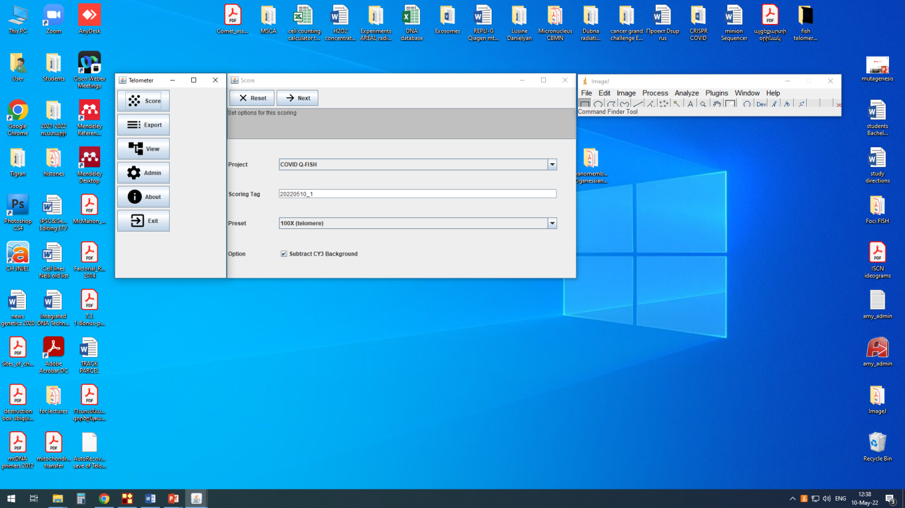
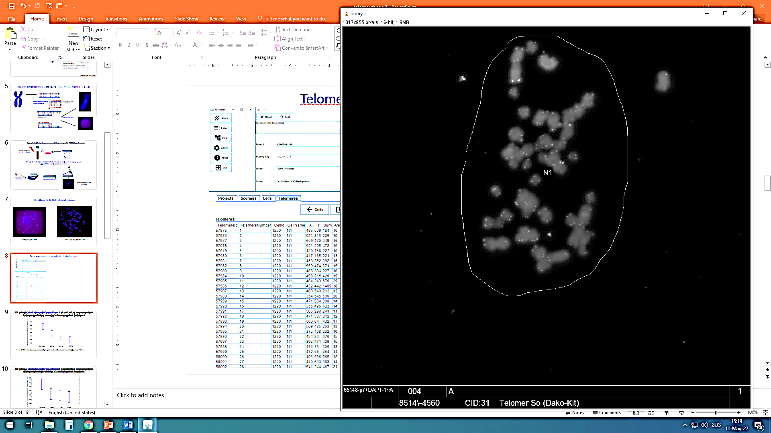
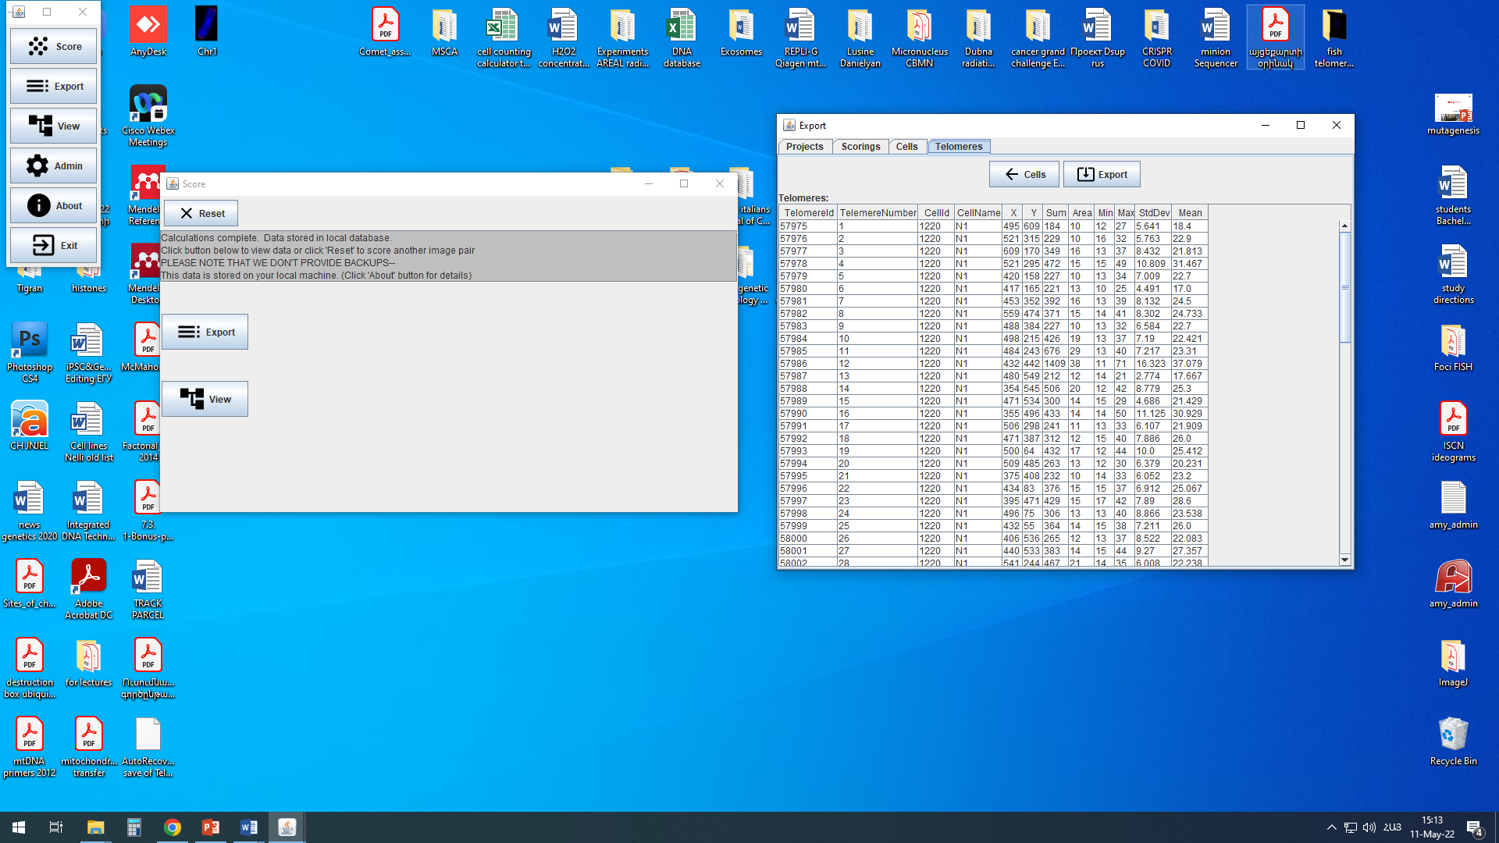
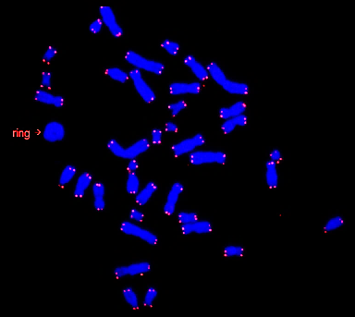
Q-FISH was performed using Telometer plugin for ImageJ program
https://demarzolab.pathology.jhmi.edu/telometer/
--The relative telomere lengths were quantified on a per-cell basis using the open-source plugin Telometer program after converting images to grayscale.
-A region of interest (ROI) with telomeric signals was selected in pictures of DAPI-stained cells. ---Telomeric signals within each ROI were then measured with the ImageJ program and the data of fluorescence intensity and area for each telomeric signal were obtained.
-Relative telomere length of each cell was calculated by multiplying the fluorescence intensity value of each telomeric signal with their corresponding areas and shown as arbitrary units (a.u.).

Slide 24
Relative telomere lengths of human interphase chromosomes in control and after irradiation with AREAL accelerator
Interphase chromosomes
Metaphase chromosomes
*
*
*
*
*
*
-The relative telomere lengths were quantified on a per-cell basis using the open-source plugin Telometer program after converting images to grayscale.
-It is revealed significant shortening of telomeres in all irradiation variants compared to control. Interphase chromosomes are more suitable for the analysis of the dose-effect on telomere length and can be used as markers of genotoxicity of radiation exposure.
-Nevertheless, the resolution of the relative telomere length is higher in metaphase chromosomes which can be informative in combination with molecular-genetic methods for the mechanistic analysis of telomere length dynamics.
Notes:
Relative telomere length, a.u. = sqrt(342891 - 84270.8*sqrt(Dose, Gy))

Slide 25
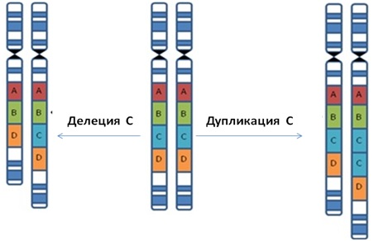
Copy number variation - CNV
CNVs are sequences of DNA of 50 bp or larger compared with its reference genome, 9.5% of the genome contributes to spontaneous CNVs.
Copy number variation is now recognized as one of the major sources of genetic variation.
Despite their importance little is known about environmental risk factors affecting CNVs.
De novo CNVs can arise after influence of replication inhibitors (aphidicolin, hydroxyurea, ionizing radiation), these findings have been confirmed by our group. We studied induced CNVs with application of chemical and physical mutagens.
Deletion
Duplication

Slide 26
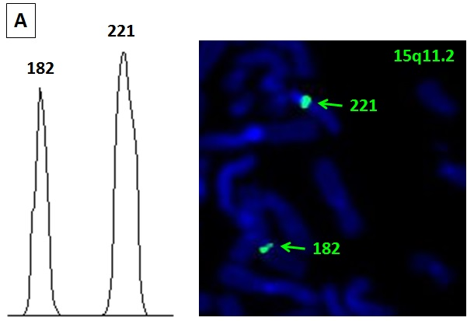
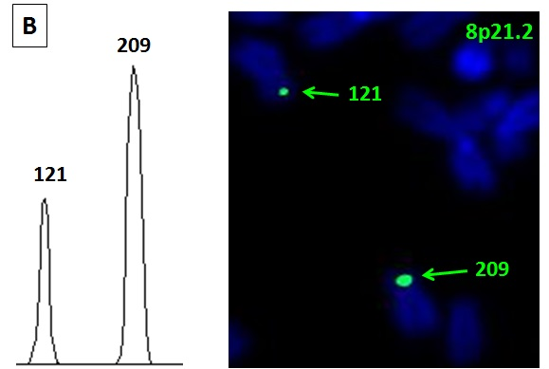
Analysis of fluorescence intensities using Scion Image - different sizes of probes signals
Fluorescence intensities of CNVs on homologous chromosomes 8p21.2
Fluorescence intensities of CNVs on homologous chromosomes 15q11.2

Slide 27
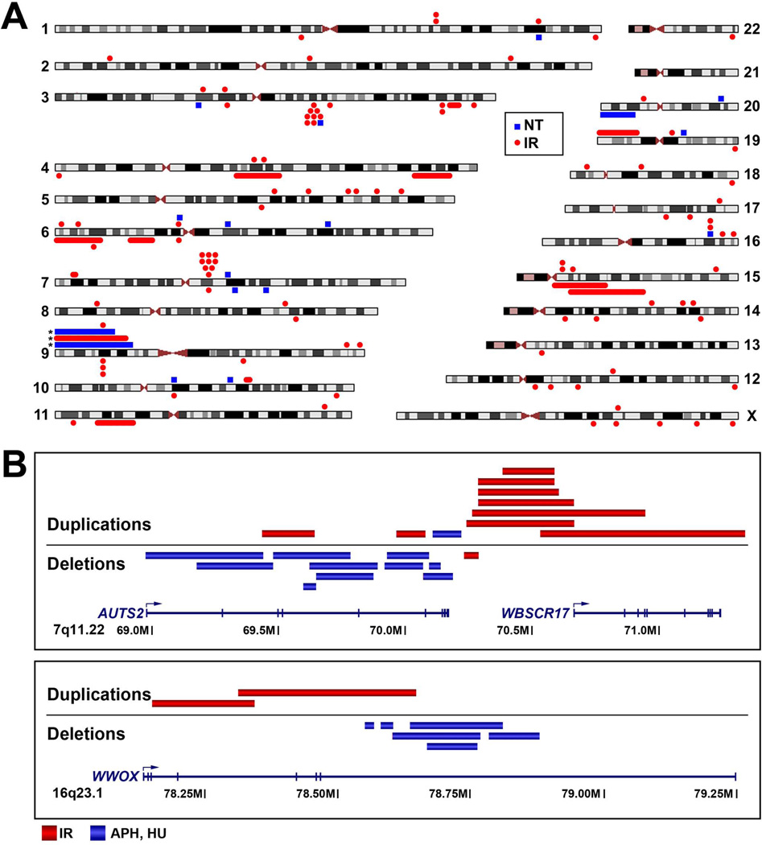
Ionizing radiation (1.5-3 Gy) induces copy number variations (CNVs) of DNA sites.
Arlt et al. Copy number variants are produced in response to low-dose ionizing radiation in cultured cells.
Environ Mol Mutagen. 2014; 55(2):103-13. Irradiation by Philips RT250 (Kimtron Medical)

Slide 28
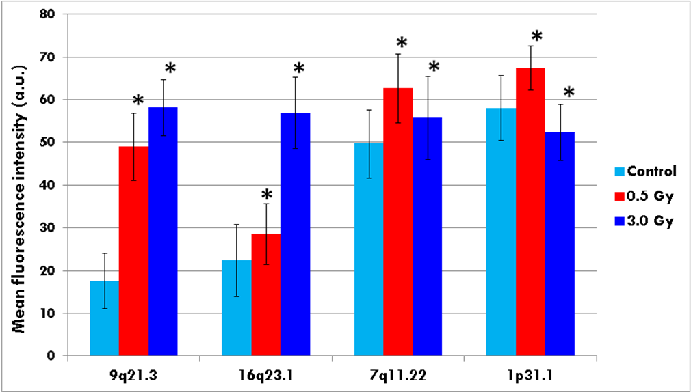
Mean fluorescence intensities of BAC signals at CNV loci measured by ImageJ program.
Irradiation with 3 MeV, 2 Gy/min, 2 Hz
Ultrashort electron pulses at a dose of 0.5 Gy induced duplications at 9q21.3, 16q23.1, 7q11.22 and 1p31.1.
At the dose of 3 Gy irradiation induced duplications at 9q21.3, 16q23.1 and 7q11.22, and deletion at 1p31.1.
*-p<0.05 compared to control.

Slide 29
Conclusions according to in vitro studies
1.AREAL (Ultrashort Pulsed Electron Beam) irradiation-induced DNA damages are characterized by slow DSB repair rate
The pulse duration of ultrashort irradiation is only 0.4 × 10⁻¹² s. So a huge peak dose-rate of 1.6 × 10¹⁰ Gy/s per pulse is achieved during the pulse. Apparently, it increases the possibility of complex difficulty repairable DSBs formation.
2. The radiosensitivity of cells towards AREAL irradiation is p53-dependent. P53-deficient (most frequent cancer cells) are more sensitive to AREAL irradiation
p53 is the tumor suppression protein whose function is. So, this advantage of AREAl radiation can be used in the future to provide cancer cell specificity during irradiation, which will lower side effects associated with the damages occurred in normal cells.
3. AREAL irradiation has low genotoxic capacity
Radiation-induced cytogenetic abnormalities, such as micronucleus formation, represent an early marker of possible delayed effects. These delayed effects during irradiation of the organism may lead to secondary cancers. A much lower level of micronuclei frequency in case of UPEB irradiation was shown in our study, compared to X-ray radiation. So, it can be assumed, that AREAL UPEB radiation has low potential to induce secondary cancers during irradiation of the whole organism.
4. AREAL irradiation induces death by apoptosis. Apoptosis is a regulated cell death mediated by several signaling pathways triggered by multiple factors, such as cellular stress, DNA damage etc. Unlike necrosis, apoptosis is less immunogenic or inflammatory process. For over three decades targeting the apoptosis was a mainstay and goal of clinical oncology.
5. AREAL irradiation is more effective in vitro compared to X-ray and quasi-continuous electron beam (Varian) irradiations used in clinical practice

Slide 30
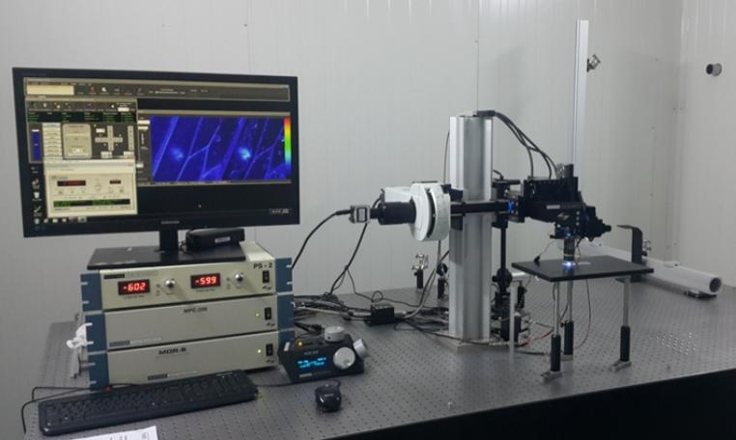
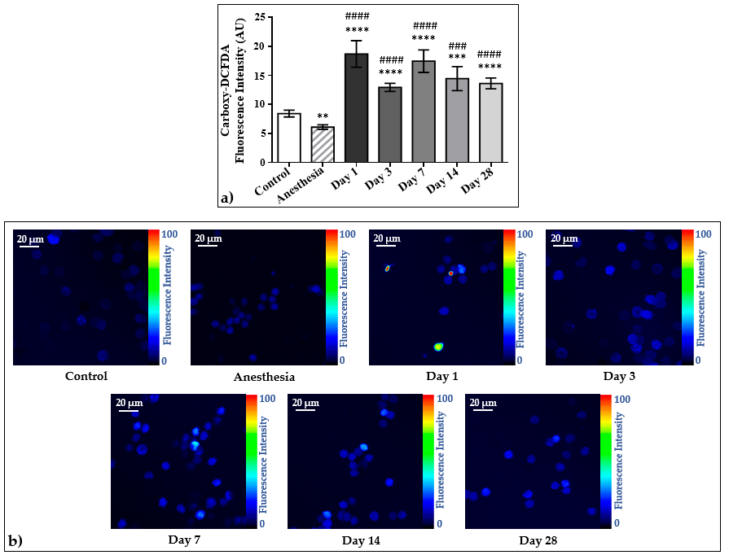
ANIMAL EXPERIMENTS
Two Photon Microscopy Station
Two Photon Imaging of Oxidative Stress in rat red blood cells
The oxidative stress in RBCs increases already on the first day after irradiation, however, it does not rich the control levels even on 28 day. This phenomenon can be explained via the antioxidant status. The activities of superoxide dismutase (a) and catalase (b), as well as the ferroxidase activity of ceruloplasmin (c), in the plasma samples of control and irradiated animals after irradiation with UPEB is impaired.
The antioxidant system of the organism is not able to calm down intense oxidative processes generated by UPEBin the organism. Tsakanova et al., IJMS, 2022

Slide 31
Conclusions according to in vivo studies
In case of ultrashort pulsed electron beam (UPEB) irradiation, the LD50 is observed at the dose 2 Gy and 2 Hz, while it is known from the literature that the LD50 for whole body irradiation with X-rays is 4-6 Gy.
In case of UPEB irradiation, we see alterations in different systems starting already from the first հօur, in some case from the third day, in contrast to X-ray irradiation, for which the alterations start mainly from the 7 day after irradiation.
Delivering less doses we get higher effect of UPEB compared with X-rays, that causes relatively mild anemia in rats and demonstrate more effective and faster recovery than in case of X-rays.

Slide 32
We are planning to get in near future following results:
-The detailed analysis of kinetics, the main ways of repair (non-homologous end joining and homologous recombination) and efficiency (residual damage) of double-strand DNA breaks repair in tumor and normal human cells irradiated with ultrafast pulsed electron beam will be realized.
-The tumor specific epigenetic alterations, based on methylation status and/or kinetics of core protein genes during the activation of specific DNA repair pathways will be investigated.
-Will be estimated the optimal mode of pulsed ultrafast electron beams, which causes the pronounced radiobiological effect.

Slide 33
Tsakanov V.M. , et al. AREAL low energy electron beam applications in life and materials sciences. Nuclear Instruments and Methods in Physics. Research Section A (2016)
Babayan N., Hovhannisyan G., Grigoryan B., Grigoryan R., Sarkisyan N., Tsakanova G., Haroutiunian S., Aroutiounian R..
Dose-rate effect of ultrashort electron beam radiation on DNA damage and repair in vitro. Journal of Radiation Research, 2017.
Babayan N, Grigoryan B, Hovhannisyan G, Tadevosyan G,
Khondkaryan L, Grigoryan R, Sarkisyan N, Aroutiounian R.
Gender differences in DNA damage/repair after laser-generated ultrafast electron beam irradiation. Int J Radiol Radiat Ther. 2018;5(2):85–86.
Harutyunyan T., Hovhannisyan G., Sargsyan A.,
Grigoryan B., Al-Rikabi A.H., Weise A., Liehr T., Aroutiounian R.
Analysis of copy number variations induced by ultrashort electron beam radiation in human leukocytes in vitro.
Molecular Cytogenetics. 2019. 12:18

Slide 34
Harutyunyan, T., Hovhannisyan, G., Sargsyan, A. et al. Analysis of copy number variations induced by ultrashort electron beam radiation in human leukocytes in vitro. Mol Cytogenet 12, 18 (2019).
Babayan, N.; Vorobyeva, N.; Grigoryan, B.; Grekhova, A.; Pustovalova, M.; Rodneva, S.; Fedotov, Y.; Tsakanova, G.; Aroutiounian, R.; Osipov, A. Low Repair Capacity of DNA Double-Strand Breaks Induced by Laser-Driven Ultrashort Electron Beams in Cancer Cells. International Journal of Molecular Sciences, 2020, 21, N 24 (9488), 1-10.
Babayan NS, Guryev DV, Vorobyeva NY, Grigoryan BA, Tadevosyan GL, Apresyan LS, Chigasova AK, Yashkina EI, Rodneva SM, Tsishnatti AA, Fedotov YA, Sarkisyan NK, Manukyan AT, Aroutiounian RM, Osipov AN. Colony-Forming Ability and Residual Foci of DNA Repair Proteins in Human Lung Fibroblasts Irradiated with Subpicosecond Beams of Accelerated Electrons. Bull Exp Biol Med. 172, 2021, pp. 22–25.

Slide 35

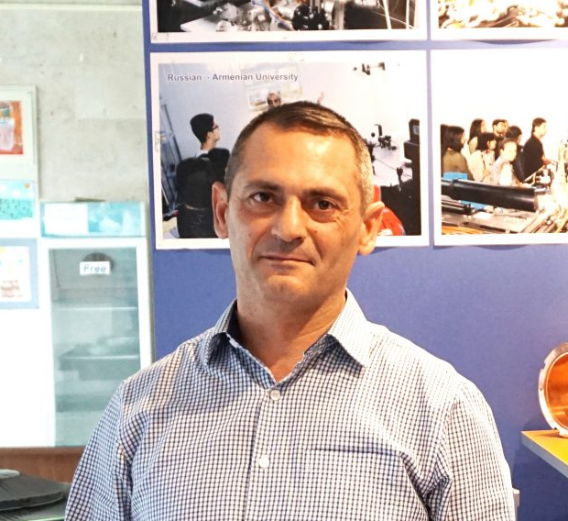
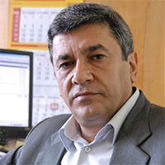
Acknowledgements
Prof. Vasili Tsakanov
1960 - 2021
Dr. Bagrat Grigoryan
Prof. Samvel Harutyunyan

Slide 36
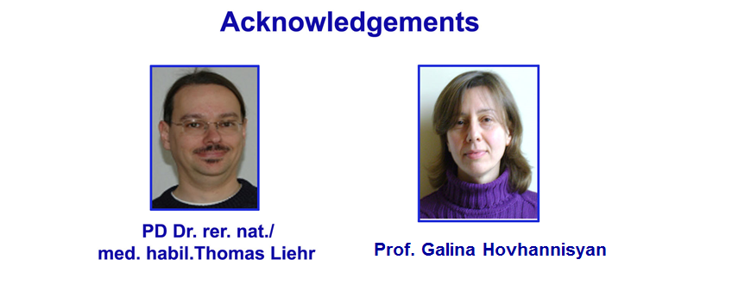


PhD student Anzhela Sargsyan
PhD student Alisa Manukyan

Slide 37
Acknowledgements
The work was supported through grants from the MES-BMBF, RSF (N 19-14-00151) and Science Committee of the RA (#21AG-1F068).
We express our gratitude to our colleagues from AREAL, who created the opportunity to realize our work

Slide 38
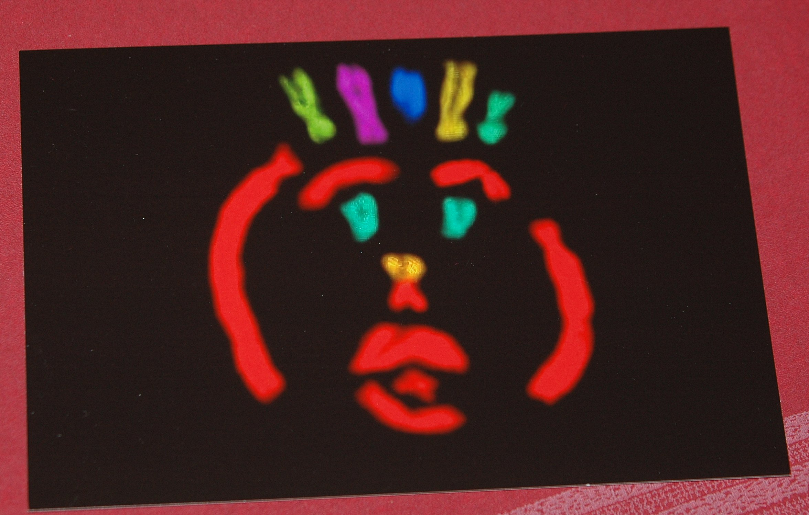
Best Wishes!

Slide 39
.
Баграт
У нас
Лазер с помощью фотоэмиссии генерирует электрический пучок.
RF ускоряет электроны.
В не лазерных ускорителях этого добиваются с помощью длинной многометровой вольфрамовой нити.
250 рС каждый пик
Длительность одного пучка-пика 0.45 пикосекунд
Beem pulse-частота повторения 20 Гц –раз в секунду
за очень короткое время до 1000 Гр
Продуктивность пика у Элбе 7 Рс, а у нас 250 Рс.
Elbe Average energy 31 MeV, dose rate 10 ¹⁰ Гр мин ^{_ 1} Beem pulse 13 млн Гц - 13 млн пучков в секунду, а у нас 20. Низкая мощность дозы – 3,6 Гр/мин (частота импульса - 2 ГЦ), Высокая мощность дозы – 36 Гр/мин (частота импульса 20 ГЦ)
. Было выявлено, что радиочувствительность клеток по обоим параметрам не зависит от структуры электронного импульса.
Таким образом, результаты исследования показали, что сверхвысокие частоты импульсов электронов и низкие частоты импульсов не различаются по радиобиологическим эффектам при мегаэлектроновольтных мощностях.
Сколько в мире ускорителей типа нашего:
Лазерный ускоритель ARES в DESI
У Линаков большой заряд и энергия MW, длительность пульса большая.
Они на терапию, концептуально другие. 30-50 MeV электроны, они же могут 8-10 MeV рентген.
ЛУЭ-75 до 1011 Гр. Ранее был в качестве инжектора. До 75 Мэв, I = 0.5 мкА со средней интенсивностью до 10 мкА (частота следования импульсов 50 Гц)
The С18 cyclotron (produced by IBA, Belgium, При энергии протонов Ер=18 МэВ эта мощность соответствует току пучка Ip ≈ 27 мкА, тогда как циклотрон С18 может обеспечить ток до 100 мкА.
Производит- медицинский изотоп 18F (Фтор-18), который используется в диагностике
Целью данного исследования является дальнейшая разработка технологии получения медицинского радиоизотопа Ga67 путем облучения цинковой мишени в реакции. В настоящее время впервые в Армении начат цикл исследований по развитию технологии получения медицинских изотопов циклотронным методом – таких как Tc99m, Ga67, Cu64, Ga68 и так далее

Slide 40

В линейном ускорителе электроны, т.е. отрицательно заряженные частицы, ускоряются с помощью высокочастотного излучения и могут непосредственно использоваться для облучения опухолей. Поскольку электроны не способны глубоко проникать в ткани, их применяют, например, для лечения кожных опухолевых заболеваний.
Для облучения злокачественных новообразований, расположенных в более глубоких слоях тканей, необходимо использовать фотонное излучение. Когда ускоренные электроны сталкиваются с препятствием (мишенью), изготовленным из тяжелого металла, чаще всего вольфрама, это сопровождается выработкой высокоэнергетического рентгеновского излучения. Чем мощнее фотонное излучение, тем больше глубина его проникновения в ткани.
Как определить ФСД
Фактор снижения дозы при разных режимах (у нас это 2Гц и 20 Гц), вычисляли при сравнении доз, приводящих к определенному эффекту, как например произведение доз, которые приводят к 50% гибели клеток (EC50) после облучения.
Расчет поглощенной дозы
1 Гр — доза, при которой массе 1 кг передается энергия иониз. излучения в 1 джоуль
Таким образом Грей- это поглощенная доза :
Dose-rate in Gy/s depends from the frequency in Hz: D (kGy) = P (kW) x T (s)/M (kg)
М-Масса определяется как произведение объема культуры на плотность
P (kW) = E (meV) x I (mA) где
P (kW) – Power
T (s) – lenth of impulse
E (meV) – energy
I (mA) – charge- кулон/секунду зависит от ГЦ, например, при 2 Гц перемножаем 180 кулон/секунду на 2

Slide 41



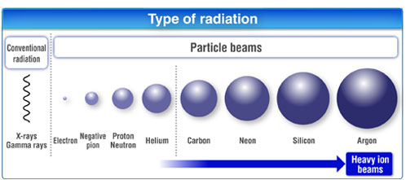
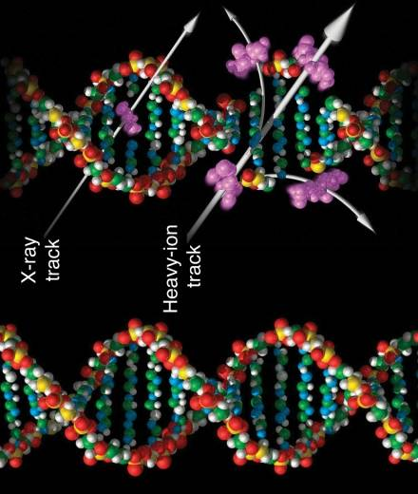
Research Overview
Ionizing radiation: DDR in cancer and normal cells
Main target: DNA
© http://www.hirt-japan.info/en/info/

Slide 42
Linear energy transfer (LET) is the average (radiation) density - energy deposited per unit path length along the track of an ionizing particle. Its units are keV/μm.
Linear energy transfer describes the energy deposition density of a particular type of radiation, which largely determines the biological consequence of radiation exposure.
The LET of a charged particle ² is ∞ Q^{​2}/E_{k}
linear energy transfer is proportional to the square of the charge of the particle - Q^{​2}
linear energy transfer is inversely proportional to the particle's kinetic energy (Ek)
High linear energy transfer radiations: linear energy transfer 3-200 keV/μm
commonly mediated by:
  α-particles
  protons
  Neutrons
  Heavy ions –heavier than Lithium (7)
greater density of interactions at cellular level
more likely, than low linear energy transfer, to produce biological damage in a given volume of tissue
Low linear energy transfer radiations: linear energy transfer 0.2-3 keV/μm
commonly mediated by:
  electrons
  positrons
  gamma rays
  x-rays
less likely than high linear energy transfer to produce tissue damage in the same volume of tissue
Плотноионизирующие частицы (с высокой линейной передачей энергии (ЛПЭ) > 10 кэВ/ мкм) должны значительно эффективнее поражать ДНК и связанные с ней клеточные функции, чем редкоионизирующее (ЛПЭ < 10 кэВ/мкм) излучение. Так как с ростом линейной плотности ионизации (ЛПИ) возрастает вероятность «двунитевого» разрыва ДНК.

Slide 43
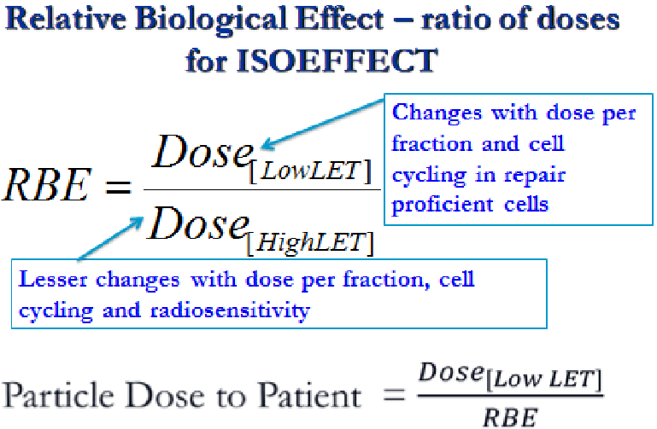
RBE is deﬁned as the ratio of absorbed dose of a low-linear-energy-transfer reference radiation to absorbed dose of the radiation considered that gives an identical biological eﬀect. RBE values vary with absorbed dose, dose rate and biological endpoint considered.

Slide 44
The use of carbon ions for the treatment of certain tumour types, especially radioresistant tumours, is becoming more frequent due to the carbon ion dose localization and high relative biological effectiveness (RBE) in the Bragg peak region. Human beings can also be exposed to heavy ions in space, since galactic cosmic rays are a mixed field consisting of not only high-energy protons and He ions, but also heavier ions including iron. Due to their high linear energy transfer (LET), heavy ions have peculiar track structures, characterized by a high level of energy deposition clustering. Furthermore, high-energy ions produce energetic secondary electrons (‘delta rays’) which can give rise to energy depositions several micrometres away from the core of the primary particle track.
Also in view of hadron therapy and space radiation applications, it is therefore important to characterize heavy-ion tracks from a physical and biophysical point of view. In this framework, herein we will discuss the main physical features of heavy-ion track structure, as well as heavy-ion-induced DNA double-strand breaks, which are regarded as one of the most important initial radiobiological lesions and chromosome aberrations, which are correlated both with cell death and with cell conversion to malignancy.

Slide 45
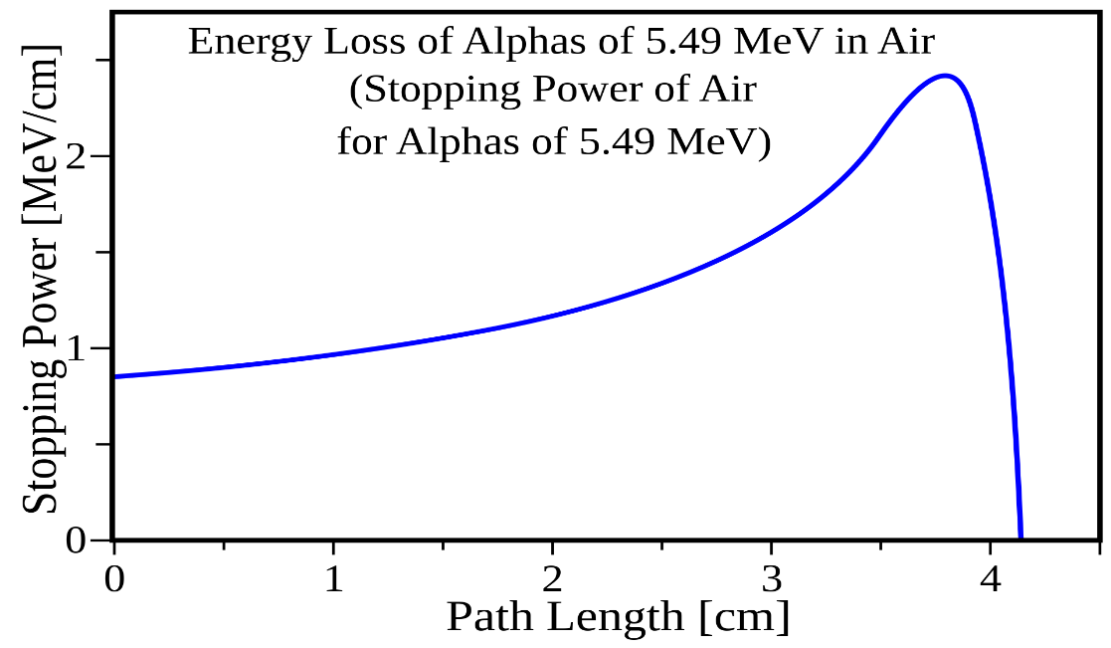
This region (Bragg peak) is defined for each proton energy and can be modulated to coincide with the depth of the target volume. The specific depth–dose distribution offers the theoretical benefit of more localized delivery of radiation than can be achieved with photons produced by a linear accelerator.
The Bragg peak is a pronounced peak on the Bragg curve which plots the energy loss of ionizing radiation during its travel through matter. For protons, α-rays, and other ion rays, the peak occurs immediately before the particles come to rest. It is named after William Henry Bragg, who discovered it in 1903.

Slide 46
Advantages and disadvantages of laser-based accelerators –Comparison!
Ultrahigh peak dose-rate (UHPDR)
The possibility of creating directed ultra-short pulses of enormous dose rate may allow the precise dose-control induction of local effects on solid tumors with minimal exposure of normal tissues
Up to now the in vitro and in vivo experiments were performed on
JETI (Jena Titanium:Sapphire laser system ) Techinsche Instrumente GmbH
Jena, Germany
- Dose-rate - 2.4x10⁹ Gy/sec
- pulse duration - 1x10⁻¹² s
ELBE (Helmholtz-Zentrum Dresden – Rossendorf)
- Dose-rate - 1.6x10⁸ Gy/sec; pulse duration - 5x10⁻¹² s
Power 31 MW, Beem pulse 13 млн Гц
REGAE: The Relativistic Electron Gun for Atomic Exploration
- pulse duration 10⁻¹⁴ s
Average energy 5.6 MeV
Bunch charge 100fC
5J in 25fs; 5Hz
Notes:
Jena Titanium:Sapphire laser system (JETI)
- ELBE at the Helmholtz-Zentrum Dresden – Rossendorf

Slide 47
The radiation source ELBE
(Electron Linac for beams with high Brilliance and low Emittance) was used to mimic the quasi-continuous electron beam of a clinical linear accelerator (LINAC) for comparison with electron pulses at the
ultra-high pulse dose rate of 10 ¹⁰ Gy min ^{_ 1}
-either at the low frequency of a laser accelerator
-or at 13 MHz avoiding effects of prolonged dose delivery.
The impact of pulse structure was analyzed by clonogenic survival assay and
by the number of residual DNA double-strand breaks remaining 24 h after irradiation of two human squamous cell carcinoma.
Response of both cell lines was independent from electron pulse structure for the two endpoints.

Slide 48


Slide 49

Comparative studies of radiobiological effects for AREAL and Varian Accelerators
Varian Trilogy linear electron accelerator (Varian Medical Systems, USA)
For quasi-continuous irradiation, a Varian Trilogy linear electron accelerator (Varian Medical Systems, USA) was used.
Characteristics: electron energy - 4 MeV, dose-rate 5.6 Gy/min, electron beam spot 250×250 mm.
Dosimetry was carried out by the ionization chamber method of absorbed dose measurement in the water phantom according to the international protocol IAEA TRS-398.

Slide 50

Непрерывные лазеры:
Непрерывно выдают стабильную форму волны энергии в течение рабочего времени, с высокой мощностью, и могут обрабатывать материалы с большим объемом и высокой температурой плавления, такие как металлические пластины;
Импульсный лазер:
По ширине импульса импульсные лазеры могут быть далее разделены на миллисекундные лазеры, микросекундные лазеры, наносекундные механизмы, пикосекундные лазеры, фемтосекундные лазеры и аттосекундные лазеры;
Фемтосекундные и аттосекундные лазеры называются сверхбыстрыми лазерами.
Мощность импульсного лазера намного ниже, чем у непрерывного лазера,
Квази-КВ лазер:
Помимо непрерывного лазера и импульсного лазера, высокоэнергетический лазер может быть выведен многократно в течение определенного периода.

Slide 51
REGAE - FEL
Relativistic Electron Gun for Atomic Exploration
The novel source of relativistic electron beams REGAE is a joint project of the CFEL partners Max Planck Society, University of Hamburg and DESY.
The nearly ten-metres-long facility generates ultra short electron pulses of extremely high quality for time-resolved diffraction experiments
The current design is capable of 7 femto-second electron pulses with up to 10⁷ electrons per pulse
Accelerates the electrons to energies of up to 5 MeV
Notes:
The most important impact will likely be made in the fields of chemistry and biology where the central unifying concept of the transition state will come under direct observation.

Slide 52
REGAE the Relativistic Electron Gun for Atomic Exploration is a small electron accelerator build and operated within the framework of the Center for Free-Electron Laser Science CFEL, i.e. in a collaboration of the Max Planck Society, the University of Hamburg and DESY.
REGAE provides high quality electron bunches for time resolved diffraction experiments and serves as test bed for accelerator R&D.
REGAE employs a photo cathode RF gun operated at 3 GHz (S-Band) for the production of electrons. The 1½ cell gun cavity, a scaled version of the cavity in operation at the FLASH FEL, accelerates the electrons to energies of up to 5 MeV.
Extraordinary emittance requirements in the nm range (normalized) and pulse lengths down to a level of ~10 fs require operation at low bunch charges on the sub-pC scale.
The current design is capable of 7 femtosecond (rms) electron pulses with up to 10⁷ electrons per pulse with spatial coherence of over 30 nm.
Femtosecond Electron Diffraction (FED) has the potential to directly observe the most venerable concepts in chemistry and biology most notably enabling a direct atomic level view of transition states. The relevant motions for this barrier-crossing event occur on the sub-hundred femtosecond time-scale which is addressed by pump-probe type experiments. The advantage of relativistic electron diffraction as compared to the more common diffraction with electron energies in the 100 keV range are reduced space charge effects and the higher penetration depth of the electrons.

Slide 53
The Versatile Electron Linear Accelerator (VELA)
A world leading, ultra-high performance electron beam injector system
Ultra short electron pulses, down to below 100 femtoseconds
Ultra high beam position and timing stability
The unique ability to precisely tailor the electron beam, experimental configuration and shielding to match your requirements
Opening Q2 2013
Accelerator Science and Technology Centre
Sci-Tech Daresbury
4 – 5.5 MeV
Bunch Charge
10 – 250 pC
Bunch length (s t,rms)
80 – 3 ps
Normalised emittance
0.1 – 2.0 mm
Beam size (s x,y,rms)
0.1 – 3.5 mm
Energy spread (s e,rms)
0.1 – 5 %
Bunch repetition rate
1 – 10 Hz

Slide 54
ARES is a linear accelerator with a target energy of 50-160 MeV which is currently in the construction and commissioning phase. The facility will provide a low charge, remarkably short electron probe beam with excellent arrival-time stability. The design parameters of the electron beam are summarised in Tab. 1. ARES consists of a normal conducting 2.998 GHz RF photoinjector sending the electron bunches to two S-band RF cavities surrounded by four solenoids each. The travelling wave structures (TWS) are powered by two independent RFstations. The ARES linac can accelerate the electron beam to a maximum beam energy of 155 MeV in the on-crest mode. A reduced final energy of 100 MeV is assumed since the linac not only accelerates the beam but also serves to chirp the bunch for bunch compression via velocity bunching and using a magnetic chicane [4]. For dedicated experiments the electron energy can be adjusted to 50 MeV.
Target Electron Beam Parameters: Unit Value Beam energy MeV 50 – 160; Bunch Charge pC 0.5 – 30; Number of bunches – 1; Repetition Rate Hz 1 – 50; Norm. emittance (rms) µrad 0.1 – 1; Bunch length (rms) fs 0.2-10; Arrival time jitter - fs below 10

Slide 55
LINAC
The advantage of linear accelerator radiation therapy is that it can target the tumor without affecting the surrounding tissue. This process makes the linear accelerator radiation therapy better on the patient and more effective in treating the specific cancer without the side effects of damaging the healthy tissue.
Medical grade LINACS accelerate electrons using a tuned-cavity waveguide, in which the RF power creates a standing wave. Some linacs have short, vertically mounted waveguides, while higher energy machines tend to have a horizontal, longer waveguide and a bending magnet to turn the beam vertically towards the patient. Medical linacs use monoenergetic electron beams between 4 and 25 MeV, giving an X-ray output with a spectrum of energies up to and including the electron energy when the electrons are directed at a high-density target. The electrons or X-rays can be used to treat both benign and malignant disease. The reliability, flexibility and accuracy of the radiation beam produced has largely supplanted cobalt therapy.

Slide 56
Electron Radiation
Electrons are a different form of radiation than photons and have different physical properties, but work biologically the same as photons. Linear accelerators, in addition to producing photons, can also produce electrons; consequently electrons are available at most treatment centers.
Electrons tend to release their energy close to the skin's surface and are commonly used to treat superficial tumors, such as skin cancers and superficial lymph nodes, which may be involved with tumor, such as in breast cancer, hence the radiation does not penetrate much past the skin to deeper normal tissues. This treatment has generally replaced orthovoltage because it can be combined in the same machine as a linear accelerator.

Slide 57
Irradiation
Conventional X-ray irradiation was performed using a 200 kV X-ray RUB RUST-M1 X-irradiator facility (JSC “Ruselectronics”, Moscow, Russia). The exposure at a dose rate of 0.85 Gy/min (2.5 mA, 1.5 mm Al ﬁlter) at room temperature was applied to cells in logarithmic growth state.
Ultrashort beam irradiation was carried out using an electron beam generated by a laser-driven radiofrequency gun-based linear AREAL accelerator (doi: 10.1016/j.nima.2016.02.028). The parameters of the AREAL laser-generated electron beam are presented in Table
The dosimetric measurements were performed with a Faraday cup (commercially available), estimating the integral dose over the pulse. Cells were irradiated at doses of 0.25–10 Gy (~140 electron pulses per 1 Gy) with a repetition rate of 20 Hz. A peak dose rate of 1.6 × 10¹⁰ Gy/s was estimated from the electron pulse duration of 4.5 × 10^{–13} s, based on the laser pulse length, acceleration process, and electron beam transport. The mean absorbed dose-rate of 11.70 ± 0.98 Gy/min (repetition rate 20 Hz sample mass of 4.2 g) was calculated over the period of irradiation and 1% charge fluctuation and 1% beam energy fluctuation was taken into account.
Faraday cup это металлическая (проводящая) чашка, предназначенная для улавливания заряженных частиц в вакууме. Результирующий ток можно измерить и использовать для определения количества ионов или электронов, попадающих в чашку.
Чаша Фарадея может действовать как коллектор для электронов в вакууме (например, от электронного луча ). В этом случае электроны просто ударяются о металлическую пластину / чашку, и возникает ток. Чашечки Фарадея не так чувствительны, как детекторы электронного умножителя , но высоко ценятся за точность из-за прямой зависимости между измеряемым током и количеством ионов.
AREAL Beam Parameters |  | UV Laser Parameters
Beam charge (pC) | 30 | Wavelength (nm) | 258
Electron energy (MeV) | 3.6 | Pulse energy (µJ) | 200
Pulse duration (fs) | 450 | Repetition rate (Hz) | 1–50
Pulse repetition rate (Hz) | 1–50 | Energy stability | <1%
Beam spot size (mm) | 15 | Beam divergence (mrad) | <0.3
Norm. emittance (mm-mrad) | <0.5 | Beam diameter (mm) | 2.0
RMS energy spread | <1.15% | - | -
Online dose information | Faraday cup | - | -

Slide 58
Radiobiological experiments
Radiobiological Endpoints
Cell viability
Methods
DNA damage and repair
Telomere length
Copy Number Variation
Reproductive cell death
Clonogenic Assay
Apoptotic/Necrotic cell death
Annexin V/PI Flowcytometry
Immunocytochemsitry
Comet Assay
Micronucleus assay
Q-FISH
POD-FISH

Slide 59
Comet assay, was used during our experiments for evaluation of DNA damage

Slide 60

Comet analysis
Tail DNA% = 100 x Tail DNA Intensity/Cell DNA Intensity
Tail Moment can be measured using one of the following methods:
Tail Moment = Tail DNA% x Length of Tail (see diagram on left)
Olive Tail Moment = Tail DNA% x Tail Moment Length*
A number of Comet analysis software programs are commercially available, such as LACAAS from Loats Associates, Inc.) and Comet Assay IV from Perceptive Instruments.
*Tail Moment Length is measured from the center of the head to the center of the tail (see diagram)

Slide 61


Slide 62
FOCI. При воздействии редкоионизирующего излучения в дозе 2 Гр, вызывающем гибель от 10 до 90% клеток разных тканей человека, в ДНК одной клетки образуется около 2000 однонитевых и 80 двунитевых разрывов, повреждается 1000 оснований и формируется 300 сшивок с белком. Именно эти поражения и лежат в основе радиационной гибели клетки, длительного нарушения эффективности деления ее потомков и злокачественного перерождения, а в случае воздействия на половые клетки - и генетических последствий облучения родителей для потомства.
Предполагают, что реализация повреждающего действия происходит тогда, когда лучевой ионизации и связанным с ней химическим изменениям подвергается 0,1-1 миллиард молекул.

Slide 63
Detection of DNA DSBs (damage and repair)
DNA DSBs
It is believed that DNA DSBs are the main triggers of cellular processes, which are responsible for the impact of ionizing radiation.
DNA DSB repair
DNA DSB repair is quite slow and if left unrepaired, it will lead to serious cytogenetic abnormalities, cell death, inactivation of gene suppressors or the activation of oncogenes.
Target for Radio
therapy
DNA DSB present key mechanism through which radiotherapy and some chemotherapeutic agents kill cancer cells.
Radiobiological Endpoints
DNA damage and repair
Comparison of DNA damage response (DDR) in cancer and normal cells
An immunocytochemical analysis of proteins participating in the processes of DNA DSBs (FOCI assay) was used

Slide 64
-
FOCI
Существует пять различных типов гистонов, названных H1/Н5, H2A, H2B, H3, H4.
To detect γH2AX and DNA-PK proteins in cells the immunostaining were applied, based on the process of selectively identifying antigens (proteins) in cells by exploiting the principle of antibodies binding specifically to antigens
For immuno-histochemical detection strategies, antibodies are classified as primary or secondary.
Primary antibodies are raised against an antigen of interest (in our case γH2AX and DNA-PK proteins) and are typically unlabeled (we’ve used primary mouse antibodies against γH2AX and rabbit antibodies against DNA-PK)
- Secondary antibodies are fluorescein-conjugated and raised against immunoglobulins of the primary antibody species (in our case FITC conjugated goat anti-mouse and Texas Red conjugated goat anti-rabbit secondary antibodies (IgG) were used).
·

Slide 65
Comet assay in Dubna
The regularities of the induction of DNA double strand breaks and DNA repair in human lymphocytes after irradiation by accelerated heavy ions with different energy
Radiatsionnaia biologiia, radioecologiia 49(1):72-76 January 2009
Vladimir Chausov et al.
The regularities of the induction of DNA double strand breaks (DSB) in human lymphocytes after irradiation by different doses of
accelerated HIGH LET: lithium 7 and carbon ions 12
(33 and 480 MeV/nucleon, LET = 20 and 10.6 keV/micron, respectively)
and LOW LET: gamma-rays by 60Co by using of comet assay were investigated. It was shown that the DSB formation increases linearly with growing of the dose of lithium and carbon ions and gamma-rays.
The biological effectiveness of carbon ions with high energy was similar with gamma-rays,
lithium ions possess greater biological effectiveness in comparison with gamma-rays and value of RBE of lithium ions amount 1.6 +/- 0.1.
It is revealed that the repair proceeds effectively with heavy ion and gamma-ray irradiation by exponential kinetics.
Heavy ions –heavier than Lithium (7)

Slide 66
FOCI in Dubna
Nanoscale. 2018 Jan 18;10(3):1162-1179. doi: 10.1039/c7nr06829h.
Particles with similar LET values generate DNA breaks of different complexity and reparability: a high-resolution microscopy analysis of γH2AX/53BP1 foci.
Jezkova L ¹, Zadneprianetc M , Kulikova E , Smirnova E , Bulanova T , Depes D , Falkova I , Boreyko A , Krasavin E , Davidkova M , Kozubek S , Valentova O , Falk M .
Author information
Abstract
Biological effects of high-LET (linear energy transfer) radiation have received increasing attention, particularly in the context of more efficient radiotherapy and space exploration. Efficient cell killing by high-LET radiation depends on the physical ability of accelerated particles to generate complex DNA damage, which is largely mediated by LET. However, the characteristics of DNA damage and repair upon exposure to different particles with similar LET parameters remain unexplored. We employed high-resolution confocal microscopy to examine phosphorylated histone H2AX (γH2AX)/p53-binding protein 1 (53BP1) focus streaks at the microscale level, focusing on the complexity, spatiotemporal behaviour and repair of DNA double-strand breaks generated by boron (10) and neon (20) ions accelerated at similar LET values (∼135 keV μm⁻¹) and low energies (γ-rays) (8 and 47 MeV per n, respectively)
Both high-LET radiation types generated highly complex γH2AX/53BP1 focus clusters with a larger size, increased irregularity and slower elimination than low-LET γ-rays. Surprisingly, neon ions produced even more complex γH2AX/53BP1 focus clusters than boron ions, consistent with DSB repair kinetics. Although the exposure of cells to γ-rays and boron ions eliminated a vast majority of foci (94% and 74%, respectively) within 24 h, 45% of the foci persisted in cells irradiated with neon. Our calculations suggest that the complexity of DSB damage critically depends on (increases with) the particle track core diameter. Thus, different particles with similar LET and energy may generate different types of DNA damage, should be considered in future research.

Slide 67
Foci in Dubna
The complexity of clustered DNA DSBs in human fibroblasts under the action of low and high-LET radiation
AIP Conference Proceedings 2377, 050005 (2021);
Daria D. Shamina^{1,2,a)}, Alla V. Boreyko^{1,2}, Mariia G. Zadneprianetc¹, Tatiana S. Hramco^{1,2}, Marina E. Krupnova^{1,2}, Elena A. Kulikova¹, Anna S. Pavlova^{1,2}, Elena V. Smirnova¹, and Anfisa S. Filatova^{1,2}
To research the induction and repair of clustered DNA DSBs, human fibroblasts were irradiated
HIGH LET ¹⁵N ions (LET = 181.4 keV/μm, E = 13 MeV/n) and protons with the expanded Bragg peak
(LET = 2 – 100 keV/μm, E = 0.01 – 44 MeV/n) n- Что это?
with LOW LET ⁶⁰Co γ-rays (LET ≈ 0.3 keV/μm),
The dose for all types of irradiation was 1.25 Gy.
The key proteins involved in the repair of base damage (OGG1) and DNA DSBs (53BP1) were visualized by immunocytochemical staining and fluorescence microscopy. To characterize the structure of clustered DNA lesions the detailed quantitative analysis of OGG1 and 53BP1 foci clusters was completed.
The obtained results showed the
Formation of clustered DNA DSBs with higher complexity structure and low repair under the action of HIGH LET 15N ions and protons compared to γ-rays.

Slide 68






Quantitative Fluorescence in situ hybridization or Q-FISH
Telomeric DNA
Telomeres
PNA probe
DNA denaturation and
hybridization with the probe
Metaphase chromosome
Q-FISH analysis
Telomeres
Interphase nucleus

Slide 69






However, the impact of accelerated electrons on telomere length was not studied yet.
Irradiation of human blood with AREAL electron accelerator and Q-FISH analysis
Blood cultivation
Slide with chromosomes
Irradiation
0.5, 1.5 and 3․0 Gy
24 ժամ
In the Institute of Human Genetics Jena (Germany)…
Overnight hybridization (37˚C) and analysis
DNA denaturation (85-87˚C)
Hybridization with telomeric FISH probe
Telomeric Q-FISH
image acquisition

Slide 70
Различия в первичных повреждениях ДНК и репарации между нормальными и опухолевыми клетками
Результаты: повреждение ДНК и кинетика репарации в нормальных и опухолевых клетках человека
Метод: Comet assay
*
*
*
PBMCs
*
*
*
*
KCL22
The level of DNA-damage in PBMC (blood normal cells, female) and KCL22 cell line (blood cancer cells, female) after 3 hours of irradiation
При сверх-высоких дозах облучения (>10Гр) различия в репарации между нормальными и опухолевыми клетками не наблюдается( через 3 часа)
Но при меньших дозах и сроках после облучения-слева: в нормальных клетках, при любых повреждениях активируются все возможные процессы репарации, чтобы избежать геномных повреждений и смерти клеток. В опухолевых же клетках только при летальных дозах репарационная система начинает работать на всю мощность, чтобы обеспечить выживаемость клеток
Notes:
Далее исследовали различие в повреждении и репарации ДНК в нормальных и опухолевых клетках. Справа кривые уровня повреждений ДНК через 3 ч после облучения, когда большая часть поврежденной ДНК должна быть уже репарированной. Показано, что при сверх-высоких дозах облучения (>10Гр) различия в репарации между нормальными и опухолевыми клетками не наблюдается. Однако при дозах <8 Гр можно увидеть значительное отличие - виден более высокий уровень репаративной активности в нормальных клетках (OTM ниже) по сравнению с опухолевыми. Мы предположили, что это может быть связано с нарушениями в репарационных системах, наблюдаемых во многих опухолевых клетках. (PMBC-нормальные фибробласты, KCL22-клетки ХМЛ)
Далее более детально исследовали кинетику репарации в течение 30 мин, 1ч, 4ч и 24 ч после облучения. На графике можно увидеть, что (верхний график) в нормальный клетках профиль репарации одинаков при всех исследованных доза облучения, т.е. доза-зависимое увеличение уровня повреждений сопровождается сопоставимым уровнем репарации ДНК. Однако в опухолевых клетках (нижний график) кинетика репарации хаотичная при низких дозах (0.5-2 Гр) облучения, нет закономерности, а при более высоких дозах (4-8 Гр) кинетика репарации начинает походить на профиль, наблюдаемый в нормальных клетках.
Можно предположить, что опухолевые клетки не активируют весь пул репарационных систем при дозах не приводящих к тотальной смерти клеток (таким образом повышая уровень геномной нестабильности клеток, свойственной опухолевым клеткам), однако при летальных дозах репарационная система начинает работать на всю мощность, чтобы обеспечить выживаемость клеток.
В нормальных же клетках, при любых повреждениях активируются все возможные процессы репарации, чтобы избежать геномных повреждений и смерти клеток в любом случае.

Slide 71
Onco
By Borcia et al.,2014 “The slopes of dose-effect dependences for Olive Tail moment ,calculated by linear interpolation, are 0.31 Gy⁻¹ for normal cells and 2.59 Gy⁻¹ for neoplastic HeLa cells. These values suggest that normal cells are less damaged by radiation than neoplastic ones, which is a good aspect in case of cancer treatment using electron beams.”

Slide 72
Curves for gamma and electrons
In the publication of Praveen (2014) on variation of Olive tail moment with dose for human peripheral blood cells after electron and gamma irradiation. coefficients, the values of the coefficients a and b were found to be 4.14 Gy⁻¹and 1.16 Gy⁻², respectively, for electron radiation; the corresponding values for gamma radiation were 4.57 ± 0.65 Gy‑⁻¹; 0.43 ± 0.19 Gy⁻²
(R2 = 0.99, Chi² = 0.74).
The gamma dose response on DNA damage induction is almost linear with a smaller quadratic component (a/b =10.6), but for electron irradiation, the response is linear quadratic with a larger quadratic component.
This can be attributed to the high dose rate irradiation
(100 Gy min⁻¹) using electron, whereas the dose rate for gamma irradiation was 2 Gy min⁻¹.

Slide 73

Data distribution of comet assay is usually
asymmetric and therefore the use of the t-test is not adequate, and the use of Mann-Whitney test is preferable, but provides insufficient information.
We can assume the distribution of comet assay data is a mixture of two distributions - normal, and exponential. However, that mixture is difficult to characterize.
The two-parameter Weibull model implies, that the probability density function has the following dependence:where, α is the scale parameter or characteristic value of the variable x, here the OTM, and β is the shape parameter.
The integral of the probability density function f(x) is the probability distribution P(x). The probability distribution is normalized so that the total area under the curve equals one.

Slide 74
The comparison between male and female PBMCs response to the irradiation was demonstrated, that female PBMCs are more sensitive, as the DNA-damage level in female PBMCs increased more than 5 times (8Gy) in comparison with negative control, which leads to the formation of unrepairable DSBs and SSBs.
In male’s cells even at the highest dose of irradiation (24Gy) the level of DNA-damage increased less than 2 times in comparison with negative control, and those damages was totally repairable.

Slide 75
Apoptosis and Necrosis
Apoptosis the cell death without inflamation has been considered a major mechanism of radiotherapy-induced cell death, and the regulation of apoptosis is very important point of therapy.
Necrosis is a form of cell death that is uncontrolled and pathological. The fundamental features of necrosis include cellular energy depletion, damage to membrane lipids, and loss of function of homeostatic ion pumps/channels. Symptoms during necrosis: inflammation, decreasing blood flow at affected site, and even tissue death.
So, apoptosis, which can also occur as a defense mechanism during healing processes, is almost beneficial to organism, while necrosis is always abnormal and harmful.

Slide 76

Оценка выживаемости клеток, апоптоза и некроза при действии ускоренного пучка электронов с применением Annexin V/propidium iodide assay
Выживаемость клеток
Annexin V/PI assay
Живые
клетки
Некротические
клетки
Апоптотические клетки
Phosphatidylserine
PI
Annexin V

Slide 77
Методика Flow cytometry
Определение количества клеток, экспрессирующих yH2AX с помощью проточной цитометрии. Проточная цитометрия распознает и выделяет популяции клеток с более или менее интенсивной флюоресценцией yH2AX.
После облучения добавляем антитела к yH2AX (FITC- yH2AX) (только первичные, т.к. yH2AX уже имеет на себе флюорофор FITC).
Справа представлен гейт (выбранная популяция клеток) проанализированных клеток. Популяция клеток выбирается на основе параметров FSC (размер клеток) и SSC (гранулярность клеток).
Определенная популяция гейтируется, чтобы исключить из анализа агрегаты клеток и debris (мусор).

Slide 78
Белок р53 локализуется в ядре и является продуктом гена ТР53, который находится на 17 хромосоме и представляет собой антионкоген, то есть препятствует возникновению злокачественных новообразований. Он является центральным компонентом внутриклеточной охранной системы, основная функция которой заключается в предотвращении размножения в организме клеток с поврежденной структурой ДНК. За это данный ген получил название «страж генома».
Мутации ТР53 — одно из самых частых событий в клетках злокачественных новообразований. По различным данным, от 50 до 80% солидных опухолей имеют различные повреждения ДНК в данном гене, около 90% из которых — миссенс мутации, то есть ведут к изменению структуры белка.
Апоптоз и злокачественные опухоли
Образование любой злокачественной опухоли сопряжено с нарушением механизмов апоптоза (программируемой клеточной гибели), которые контролируются белком р53. Его нормальное функционирование препятствует бесконтрольному делению неполноценных клеток. Если в результате какого-либо воздействия (облучения, химических веществ), в клетке возникают повреждения молекулы ДНК, белок р53 остановит ее деление до устранения повреждения, либо активирует ее программируемую гибель до того, как она успеет поделиться.
Данный механизм работает до тех пор, пока ген ТР53 имеет нормальную структуру. Когда в нем возникают мутации, в клетке накапливается мутантный белок, который не может выполнять свою основную функцию. Это нарушает механизмы включения апоптоза, что проявляется развитием новообразований, а при их существовании — способствует возникновению резистентности опухолевых клеток к проводимой химиотерапии.

Slide 79

*
Результаты: Выживаемость клеток
Метод: Проточная цитометрия Annexin V-FITC/7AAD окрашенных клеток
Контроль
1 Гр
40% апоптотических клеток MRC5,
24 ч после облучения
дозой 1 Гр
Образованные и нерепарабельные γ-H2AX приводят к апоптотической смерти клеток
Notes:
Определение количества клеток, экспрессирующих yH2AX ( но это не фоци) с помощью проточной цитометрии. Проточная цитометрия распознает и выделяет популяции клеток с более или менее интенсивной флюоресценцией yH2AX. (MRC 5 – культура фибробластов)
После облучения добавляем антитела к yH2AX (FITC- yH2AX) (только первичные, т.к. yH2AX уже имеет на себе флюорофор FITC).
Справа представлен гейт (выбранная популяция клеток) проанализированных клеток. Популяция клеток выбирается на основе параметров FSC (размер клеток) и SSC (гранулярность клеток).
Определенная популяция гейтируется, чтобы исключить из анализа агрегаты клеток и debris (мусор).

Slide 80

Е.А.Красавин
Индукция структурных (делеционных tonB trp⁻) мутаций ускоренными тяжелыми ионами
○ - γ-лучи;
● - ⁴He (20 keV/μm);
▼ - ⁴He (50 keV/μm);
■ - ⁴He (78 keV/μm);
♦ - ¹²C (200 keV/μm)

Slide 81
Зависимость ОБЭ от ЛПЭ
1 – генные мутации
2 – делеции
3 – летальный эффект

Slide 82


Образование нестабильных хромосомных аберраций в клетках человека при действии тяжелых ионов
Нестабильные хромосомные аберрации
Блок клеточного деления

Slide 83



Образование стабильных хромосомных аберраций в клетках человека при действии тяжелых ионов
Стабильные аберрации хромосом
γ-лучи
Успешное деление клетки

Slide 84
Зависимость ОБЭ от ЛПЭ частиц по критерию летального действия, индукции мутаций (HPRT) и хромосомных аберраций

Slide 85
Uncertainty principle of Heisenberg-
What Werner Heisenberg formulated for quantum physics (non commuting operators: coordinate and impulse, electric and magnetic fields) to a certain extent has its analogy in biology: In the living state one can observe the collective movement of molecules in cells, which makes it however difficult to determine their exact positions
Formal description of a cell's genetic information should provide the number of DNA molecules in that cell and their complete nucleotide sequences. The genome sequence of any actual living cell cannot physically be known with absolute certainty, independently of the method used. There is an associated uncertainty, in terms of base pairs, equal to or greater than μs (where μ is the mutation rate of the cell type and s is the cell's genome size). The genetic information that makes living cells work is thus better represented by a probabilistic model rather than as a completely defined object.
.

Slide 86

Repair
DNA DS repair
Colorimetric cell-based ELISA
Colorimetric cell-based ELISA
DDR
HRR
MRE11
P-DNA-PK
NHEJ
Notes:
Colorimetric cell-based ELISA մեթոդով

Slide 87
Определение механизма репарации с помощью ELISA
После облучения клетки фиксируются и пермеабилизируются, так как необходимо определить уровень определенных внутриклеточных белков.
После пермеабилизации добавляем первичные антитела к MRE11 или DNA-PK и вторичные антитела с энзимом HRP (enzyme horseradish peroxidase). После добавления определенного субстрата (TMP) данный энзим (HRP) конвертирует субстрат и субстрат приобретает синий цвет. Оптическая плотность окрашенных лунок измеряется plate reader- ом, чем темнее цвет (выше оптическая плотность-optical density: OD), тем больше внутриклеточного белка.

Slide 88
NHEJ (non-homologous end-joining) and HRR (homologous recombination repair)
In normal cells the significant increase of DNA-PK protein was observed, indicating that the NHEJ pathway is predominant in normal cells.
In cancer cells the activation of HRR and NHEJ pathway was observed, however HRR pathway was predominant.
New approach: based on differences in DDR it is possible to increase the radiosensitivity of cancer cells via inhibition (iRNA or CRISPR) of HRR pathway.

Slide 89





ES-BMBF Call For the Establishment of the Armenian-German
Joint Research Laboratory
DNA DSBs repair main pathways
Overview
Notes:
Гомологи́чная рекомбина́ция, или о́бщая рекомбина́ция^{[1]} — тип генетической рекомбинации, во время которой происходит обмен нуклеотиднымипоследовательностями между двумя похожими или идентичными хромосомами.

Slide 90
DNA-PK - DNA-dependent serine/threonine protein kinase . Autophosphorylation of DNA-PKcs appears to play a key role in NHEJ and is thought to induce a conformational change that allows end processing enzymes to access the ends of the double-strand break.
DNA-PK also cooperates with ATM to phosphorylate proteins involved in the DNA damage checkpoint.
Reductions in expression of DNA repair genes (usually caused by epigenetic alterations) are very common in cancers, and are ordinarily even more frequent than mutational defects in DNA repair genes in cancers
ATM serine/threonine kinase ATM (ataxia telangiectasia mutated kinase), is a serine/threonine protein kinase that is recruited and activated by DNA double-strand breaks. It phosphorylates several key proteins that initiate activation of the DNA damage checkpoint, leading to cell cycle arrest, DNA repair or apoptosis. ATM activity in response to single-stranded DNA and single-strand break does not change significantly, and spontaneous phosphorylation of ATM is rarely observed. In this regard, phospho-ATM is a more specific biological marker for the quantitative assessment of radiation-induced DNA DSB than γH2AX.
One of its mediators is nuclear protein MRE11A involved in homologous recombination, telomere length maintenance, and DNA double-strand break repair.

Slide 91
Determination of Oxidative Stress in Living Erythrocytes. The oxidative stress inside living RBCs was determined via the two-photon laser scanning microscopy imaging. RBCs were isolated from the fresh blood samples using isotonic phosphate-buffered saline solution and used for two-photon microscopy imaging immediately to avoid any alterations in the erythrocyte morphology. All the samples were treated with a membrane-permeable carboxy-DCFDA, Sigma-Aldrich fluorescent dye . Two-photon imaging was performed using the laser source available at the AREAL facility, which provides an excitation at the wavelength of 1030 nm and is attached to a two-photon laser-scanning upright microscope (Movable Objective Microscope (MOM), Sutter Instruments, USA).
Data Processing and Statistical Analysis, The images were processed using Fiji/ImageJ software. Statistical analysis was performed using GraphPad Prism 5.01. Depending on whether the data were parametric or non-parametric, one-way ANOVA or the Kruskal–Wallis tests were used, and the differences between groups were determined with Bonferroni or Dunn’s post hoc tests, respectively. Values are expressed as means ± standard error of the mean and p < 0.05 was considered as the statistically significant value.
Our Two-Photon Fluorescence Laser Scanning Microscopy System (MOM Sutter instruments).
For sample excitation Amplitude System infrared pulse laser used. Wavelength: 1030 nm, Energy: up to 25 nJ, Pulse length: 280 fs

Slide 92

ANIMAL EXPERIMENTS
The effect of electron beam exposure on Antioxidant system of rats
The activities of superoxide dismutase (a) and catalase (b), as well as the ferroxidase activity of ceruloplasmin (c), in the plasma samples of control and irradiated animals after irradiation with UPEB is impaired.
The antioxidant system of the organism is not able to calm down intense oxidative processes generated by UPEBin the organism.
Tsakanova et al., IJMS, 2022

Slide 93
Uranyl acetate induces hprt mutations and uranium–DNA adducts in Chinese hamster ovary EM9 cells
Diane M. Stearns, Monica Yazzie, Andrew S. Bradley, Virginia H. Coryell, Jake T. Shelley, Adam Ashby, Craig S. Asplund, R.Clark Lantz
Mutagenesis, Volume 20, Issue 6, November 2005, Pages 417–423,
Questions about possible adverse health effects from exposures to uranium have arisen as a result of uranium mining, residual mine tailings and use of depleted uranium in the military. The purpose of the current study was to measure the toxicity of depleted uranium as uranyl acetate (UA) in mammalian cells. The activity of UA in the parental CHO AA8 line was compared with that in the XRCC1-deficient CHO EM9 line. Cytotoxicity was measured by clonogenic survival. A dose of 200 µM UA over 24 h produced 3.1-fold greater cell death in the CHO EM9 than the CHO AA8 line, and a dose of 300 µM was 1.7-fold more cytotoxic. Mutagenicity at the hypoxanthine (guanine) phosphoribosyltransferase (hprt) locus was measured by selection with 6-thioguanine. A dose of 200 µM UA produced ∼5-fold higher averaged induced mutant frequency in the CHO EM9 line relative to the CHO AA8 line. The generation of DNA strand breaks was measured by the alkaline comet assay at 40 min and 24 h exposures. DNA strand breaks were detected in both lines; however a dose response may have been masked by U–DNA adducts or crosslinks. Uranium–DNA adducts were measured by inductively coupled plasma optical emission spectroscopy (ICP-OES) at 24 and 48 h exposures. A maximum adduct level of 8 U atoms/10³ DNA-P for the 300 µM dose was found in the EM9 line after 48 h. This is the first report of the formation of uranium–DNA adducts and mutations in mammalian cells after direct exposure to a depleted uranium compound. Data suggest that uranium could be chemically genotoxic and mutagenic through the formation of strand breaks and covalent U–DNA adducts. Thus the health risks for uranium exposure could go beyond those for radiation exposure.
adducts are formed when an activated chemical species (electrophilic, positively charged metabolite) binds covalently to negatively charged moieties in DNA.

Slide 94
Max Delbrück joined the work of Timofeev-Ressovsky and Zimmer because he was fascinated by the autonomous nature of genetics. Genetics has a quantitative character, without the use of a physical system of measures; for chemistry such independence from physics is impossible. The difference with genetics is that it finds a natural unit for quantitative, numerical analysis in a separate living organism.
Gunter Zimmer wished to resolve two puzzling observations in radiobiological observations.
There were two puzzles: One puzzle: how is it that a very small amount of energy can cause biological effects, if this energy is given to biological material in the form of ionizing radiation? (In other words: the amount of energy absorbed with a cup of tea drunk can be fatal to a person if the energy is given in the form of X-rays, and not heat.)
And another: why the curved dose-effect in X-ray mutagenesis gives a threshold below which no effect is observed? The description of the shape of the dose-effect curve for which there was no convincing explanation (such as the inevitable biological variability for curves with chemical agents) It led to an entirely new line of thought. The association of specialties initiated in this way turned out to be extremely fruitful, Zimmer recalled this work 30 years later.

Slide 95
AREAL vs X-rays
DNA Repair Pathway Activation Levels of wild-type A549 and p53-deficient H1299
human lung carcinoma cells
Both AREAL and X-rays-exposed H1299 cells showed slight increase in DNA repair PALs compared to unirradiated control with more pronounced increase in DNA repair activity by 24 hours after X-rays exposure․ The gene expression analysis of 19 DNA repair pathway revealed strong p53-dependent action of picosecond electron beam irradiation: normalization to X-rays PALs suggest down-regulation of DNA repair in AREAL exposed H1299 cells (columns 11 and 12) 24 hours after irradiation.

Slide 96
Laser-driven particle accelerators has emerged from FLASH radiotherapy approach as a promising strategy for cancer treatment after publication of Favaudon V. et al., where high dose-rates (>40 Gy s−1) of electron beams produced less pulmonary lesions in C57 black mice than conventional dose-rate exposure (doi: https://doi.org/10.1126/scitranslmed.3008973)
Recent outcomes of animal experiments show that FLASH radiotherapy (FLASH-RT) can reduce radiation-induced damage in healthy tissue without decreasing antitumor effectiveness. The very short radiotherapy time compared to that of conventional dose-rate radiotherapy is another advantage of FLASH-RT. The delivery time of FLASH-RT is too short for reoxygenation, repopulation, and redistribution to occur, or reoxygenation, repopulation, and redistribution may occur but cannot influence the effect of radiotherapy because FLASH-RT is performed only once. Therefore, FLASH-RT may be related to two Rs: DNA repair and intrinsic radiosensitivity.
Conventional X-ray irradiation was performed using a 200 kV X-ray RUB RUST-M1 X-irradiator facility (JSC “Ruselectronics”, Moscow, Russia). The exposure at a dose rate of 0.85 Gy/min (2.5 mA, 1.5 mm Al ﬁlter) at room temperature was applied to cells in logarithmic growth state.
Exponentially growing A549 and H1299 cells were exposed to 2 Gy either of AREAL or X-rays. RNA libraries were created, sequenced, and initially analyzed according to the protocols previously used to create the Atlas of RNA Sequencing Profiles of Normal Human Tissues). Library concentrations and length distribution of amplified cDNA were measured using the Qubit dsDNA HS As-say kit (Life Technologies, USA) and Agilent TapeStation Samples were sequenced using an Illumina NextSeq 550 instrument using a protocol for single-ended reads with an average length of 75 bp. with a reading depth of about 30 million per sample. Primary quality control of data from sequenced libraries was performed using the Illumina SAV software.
FASTQ read files were analyzed using the STAR software [ doi:10.1093/bioinformatics/bts635] in “GeneCounts” mode using transcriptome annotation from Ensembl (GRCh38 genome assembly and GRCh38.89 transcriptome annotation). In total, expression levels of 36596 genes were measured. The data was normalized using DESeq2 [ doi:10.1186/s13059-014-0550-8].
Changes in the activation of intracellular molecular pathways of irradiated cells compared to control cells were quantified using the Oncobox bioinformatics platform

