Slide 1
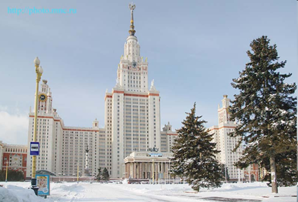

Development of electron accelerators for fundamental research and applied purposes at SINP MSU
V.I. Shvedunov
Skobeltsyn Institute of Nuclear Physics, Lomonosov Moscow State University
IUPAP Conference "Heaviest nuclei and atoms“
Yerevan, 29 April 2023

Slide 2
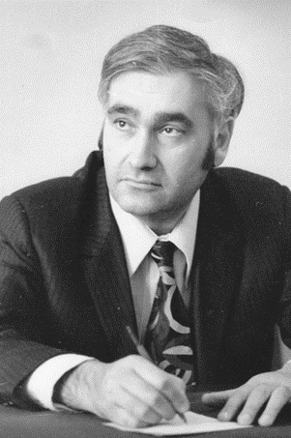
History of electron accelerators development at SINP MSU
From 1959 to 1985, at the Institute of Nuclear Physics of Moscow State University, studies of photonuclear reactions in the region of giant dipole resonance were carried out using 35 MeV betatron as a bremsstrahlung radiation source.
Since 1982, at the initiative of the head of the Department of Electromagnetic Processes and Interaction of Atomic Nuclei, Professor Boris Sarkisovich Ishkhanov, the development of a new unique accelerator began – continuous wave race-track microtron for energy of 175 MeV.
After preliminary study accelerator design and construction started in 1985 in collaboration with scientifical institute and universities of Soviet Union.
This marked the beginning of the history of electron accelerators development at SINP MSU.
B.S. Ishkhanov
1938 - 2020

Slide 3
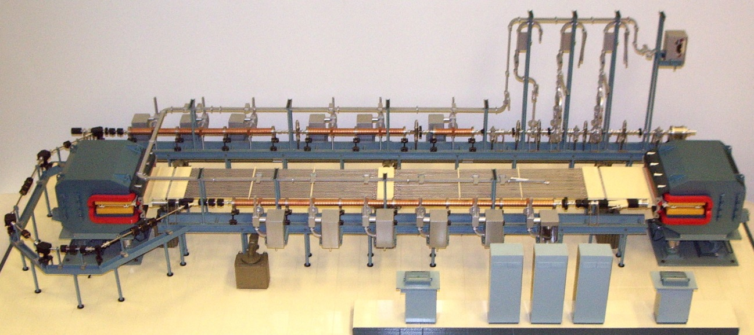
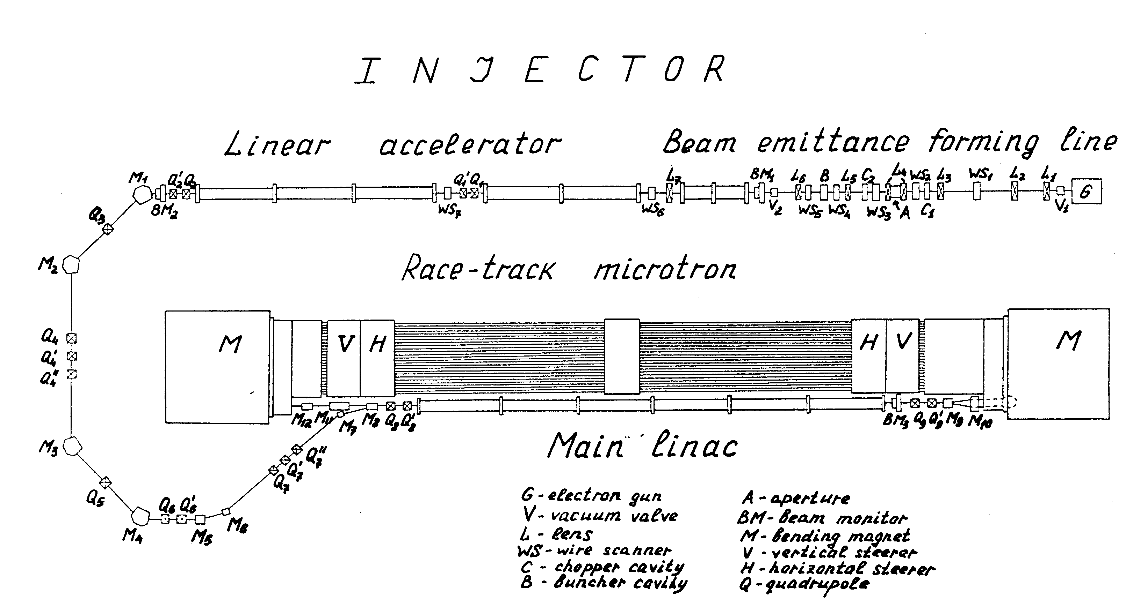
Continuous wave 175 MeV race-track microtron (RTM)
(1983-1992)
Injection energy 6 MeV
Energy gain 6 MeV
Maximum energy 175 MeV
Average current 100 μA
Operating frequency 2450 MHz
Magnet field 1.027 T
Klystron power 22 kW
Number of klystrons 12+1
http://accelconf.web.cern.ch/AccelConf/p93/PDF/PAC1993_2059.PDF

Slide 4
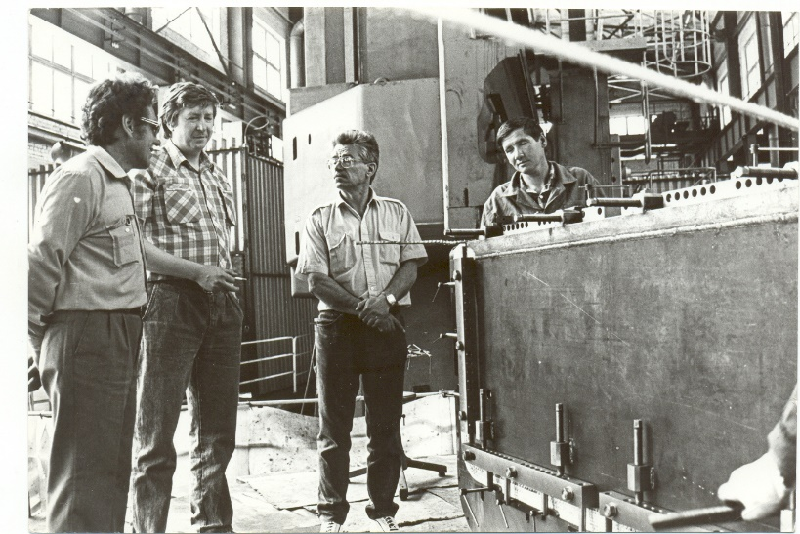
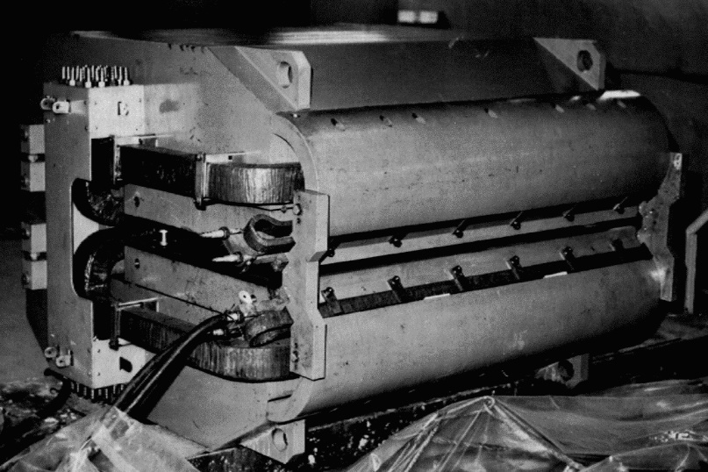
Unique bending magnets with a field level of 1 T and a uniformity of about 10⁻⁴ with mass 18 tons were designed by the Yerevan Physics Institute and were manufactured in the workshops of the Joint Institute for Nuclear Research
In 1991, a 6.2 MeV continuous wave electron linear accelerator was put into operation, and for a number of years was used to study nuclear resonance fluorescence. In 1995, an attempt was made to complete the project together with the Laboratory of Photonuclear Reactions of the Institute for Nuclear Research, Russian Academy of Sciences, headed by Rudolf Amayakovich Eramzhyan, but with his death in 1998, the project was stopped.
Before that since 1994 development of compact accelerators for fundamental research and applied purposes began at SINP MSU in collaboration with scientific institutes, universities and different companies from Russia and US.

Slide 5
70 MeV pulsed RTM
Explosive detection, isotopes production, elemental analysis, nuclear physics
Injection energy | 48 keV
Energy gain | 4.8 MeV / orbit
Orbits | 14
Output energy | 14.8 - 68.3 MeV
Output current at 68.3 MeV | 10 mA
Orbit circumference increase | 1λ/orbit
Operating frequency | 2,856 MHz
Klystron power pulsed | 6 MW
End magnet field induction | 0.963 T
RTM dimensions | 2.2x1.8x0.9 m³
The main features of the project:
- all magnetic elements except steering coils, including large dipoles built with rare-earth permanent magnet material.
- narrow accelerating structure with quadrupole focusing.
Nuclear Instruments and Methods in Physics Research A 550 (2005) 39–53

Slide 6
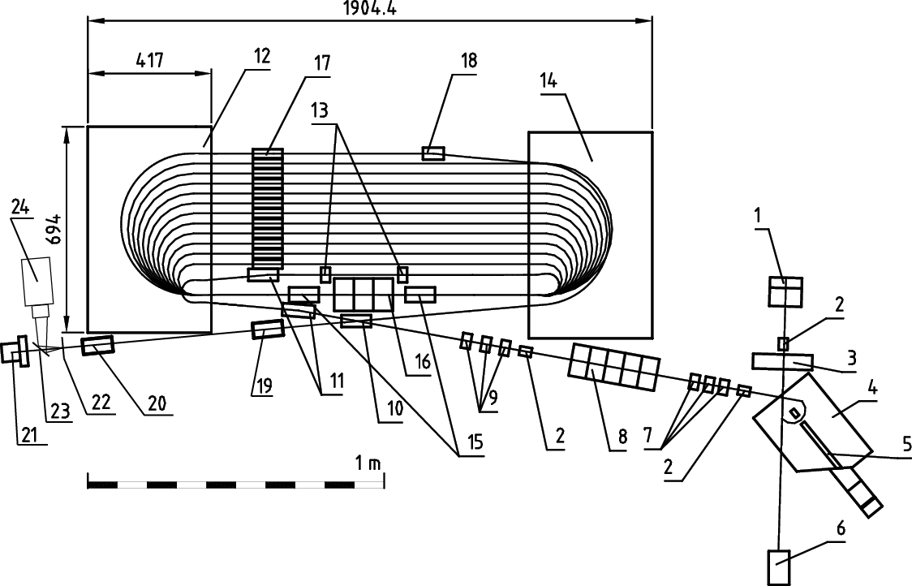
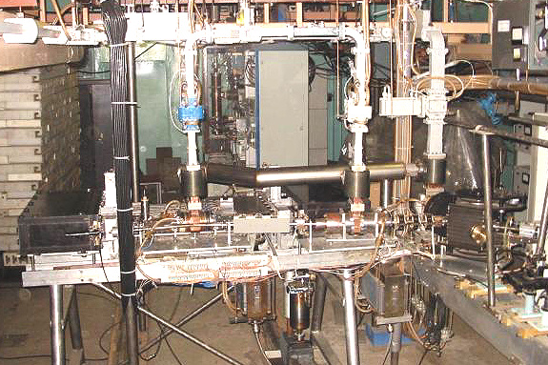
35 MeV high brightness beam pulsed RTM
Generation of coherent radiation of different types by short high charge bunches
Injected beam | 4.85 MeV
Energy gain per turn | 2.43MeV
Output beam | 4.85-34.2 MeV
Normalized emittance | 10 mm mrad
Longitudinal emittance | 200 keV deg
Micro pulse | 5 ps
Pulse repetition | 1-150 Hz
Micro charge | 150 pC
RF frequency | 2,856 MHz
Pulsed RF power | <3 MW
End magnet field | 0.486 T
The main features of the project:
- Injection from RF gun with photocathode and buster linac
- large dipoles built with rare-earth permanent magnet material
Nuclear Instruments and Methods in Physics Research A 531 (2004) 346–366

Slide 7
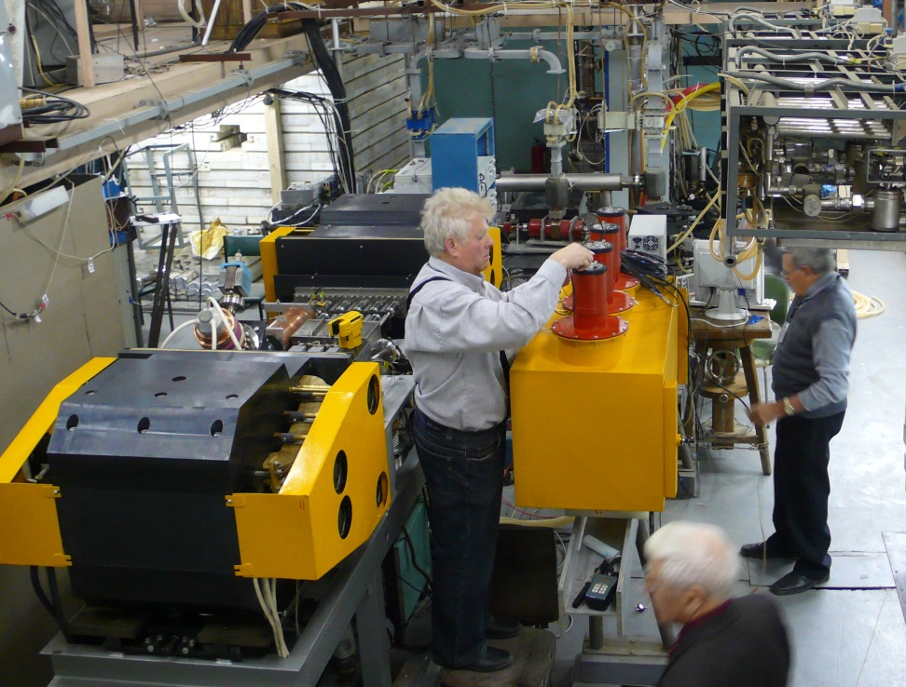
55 MeV pulsed race-track microtron
Explosive detection, isotopes production,
elemental analysis
Photonuclear reactions: activation technique with high resolution germanium detector.
One aspect – study of neutron deficient nuclei.
Output energy 55 MeV
Output pulse current Up to 10 mA
Repetition rate 6.25 – 50 Hz
Number of linac passages 11
Energy gain / turn 5 MeV
Current pulse length 6 µs
Operating frequency 2856 MHz
End magnet field 1.0 T
Maximum RF power 6 MW
Orbit circumference increase / turn 1 λ
Instruments and Experimental Techniques, v. 61, № 2, 2018, pp. 173-191

Slide 8
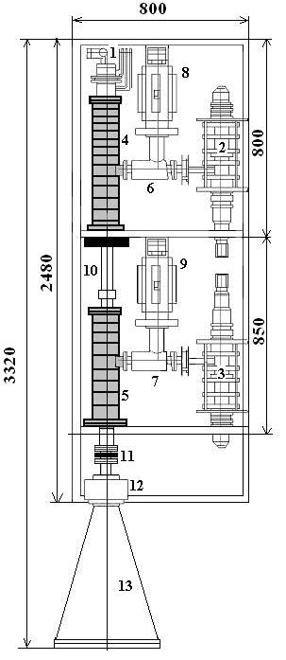
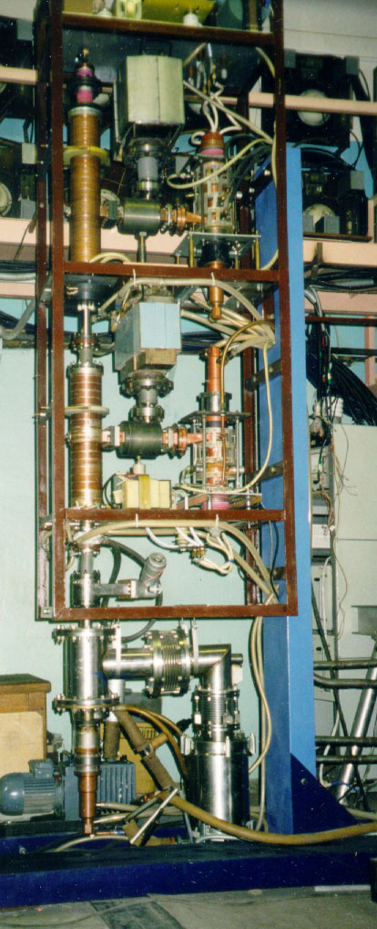
SINP MSU 60 KW, 1.2 MEV COMPACT CW LINAC
FOR RADIATION TECHNOLOGIES (PROTOTYPE)
 | One-Section | Two-Sections
Beam energy | 0.6 MeV | 1.2 MeV
Beam current | 0 to 50 mA | 0 to 50 mA
Maximum beam power | 30 kW | 60 kW
Length | 0.8 m | 1.3 m
Gun/klystron high voltage | 15 kV | 15 kV
Plug power consumption | ~75 kW | ~150 kW
Electrical efficiency | ~40% | ~40%
Instruments and Experimental Techniques, v. 45, № 5, 2002, pp. 691-697

Slide 9
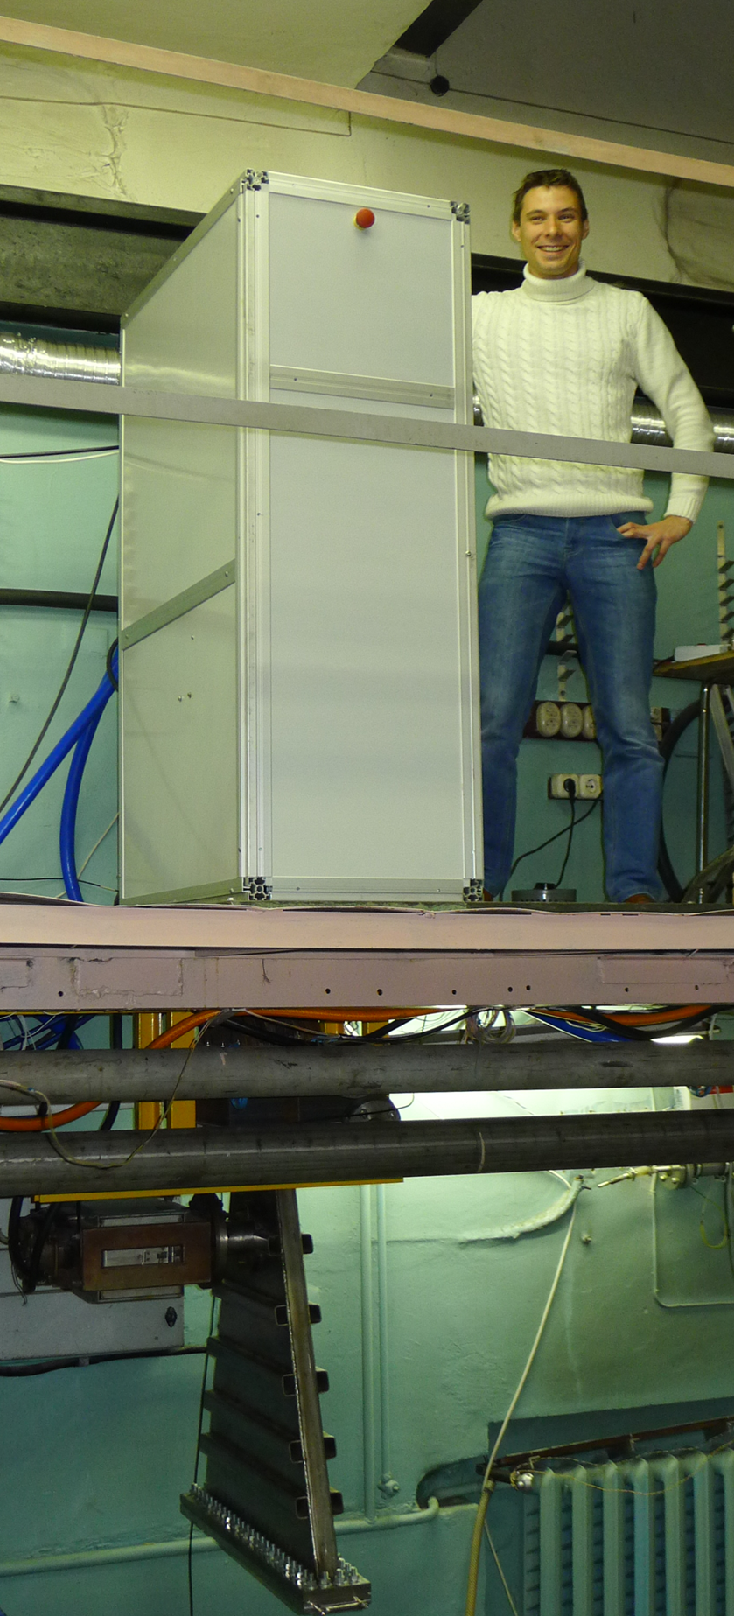
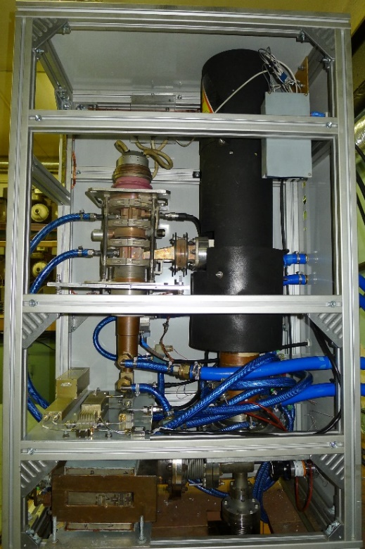
1 MeV CW linac
Comparison with DC accelerator
Beam energy 1 MeV
Average beam current, max 25 mA
Average beam power, max 25 kW
Operating frequency 2450 MHz
Klystron average power 50 kW
Wall plug efficiency 30%
Beam scanning width 80 cm
Accelerator dimensions 470 x 784 x 1375 mm¹⁾
1)Without output horn and power supply
PHYSICAL REVIEW ACCELERATORS AND BEAMS 20, 044702 (2017)

Slide 10
Perspectives for CW linac
Relations between accelerating structure length and energy gain for different values of the klystron power and RF
power losses in the walls per unit of length. (a) Electronic efficiency 80%, (b) 50%.
PHYSICAL REVIEW ACCELERATORS AND BEAMS 20, 044702 (2017)

Slide 11
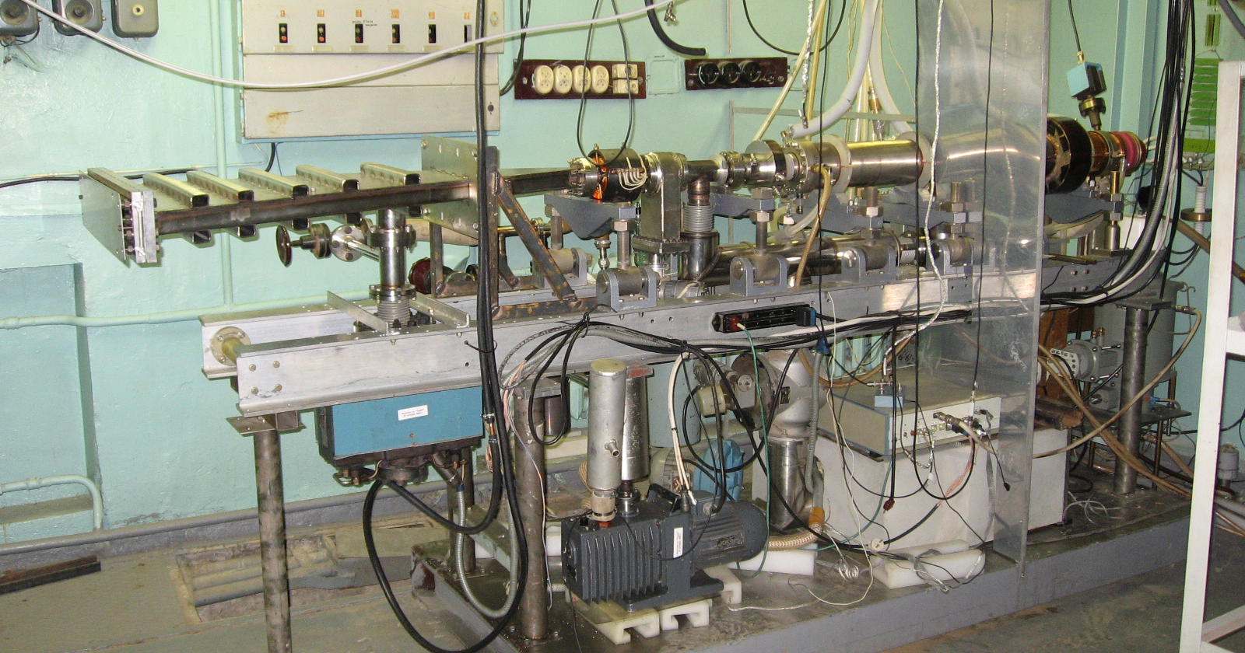
SINP MSU 10 MeV TECHNOLOGICAL LINAC (PROTOTYPE )
Beam energy 10 MeV
Pulsed beam current 430 mA
Average beam power 15 kW
Operating frequency 2856 MHz
Klystron pulsed power 6 MW
Klystron average power 25 kW
Wall plug efficiency 20%
Beam scanning width 80 cm
http://accelconf.web.cern.ch/AccelConf/r08/papers/WEBPH11.pdf

Slide 12





+
“Scantronic Systems”
Business &
Applications,
MSU
Science &
Engineering
In June 2013 on the basis of the SINP MSU
"Laboratory of Electron Accelerators MSU" Ltd.
was created
- goal: practical application of results of fundamental research
35%
65%
Total staff about 30 persons
Conceptual design, calculations, engineering design, purchase and manufacture of equipment, assembling, commissioning, allocation at customer site, support of operation.
Laboratory of Electron Accelerators MSU, Ltd., 2013

Slide 13
To date, LEA MSU has designed, produced and delivered to customers electron accelerators for:
Radiography 10
Stationary X-ray inspection 13
Mobile X-ray inspection 16
Portal X-ray inspection 2
Train X-ray inspection 6
Radiation therapy 1
Sterilization 2
________________________________________
Total since 2013 : 50
In 2023 LEA MSU must deliver 11 different accelerators according to signed contracts, about the same number of accelerators are under discussion.

Slide 14
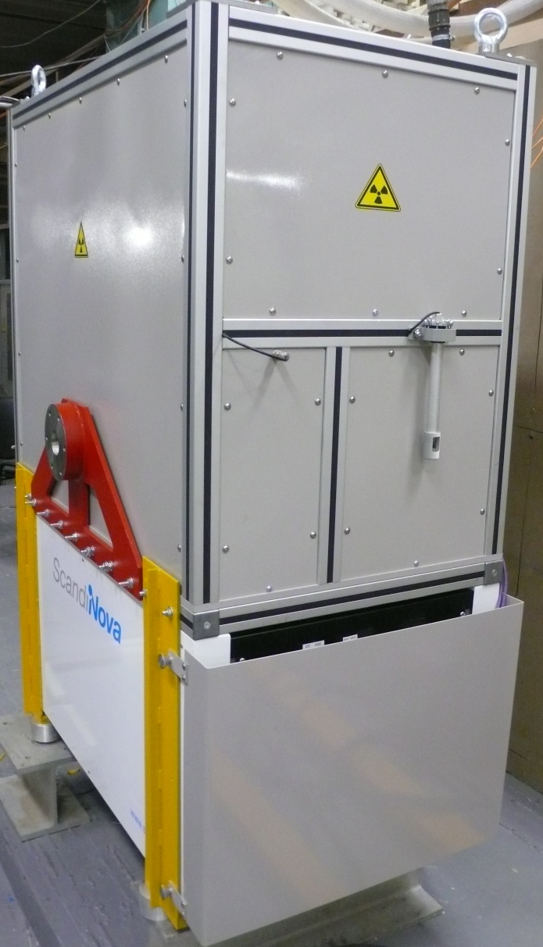
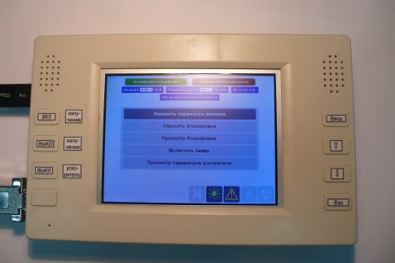
Accelerator for radiography
Maximum energy 6, 8, 10 MeV
Range of energy regulation 3-10 MeV
Max dose rate at 1 m at 6/8/10 MeV 8/10/40 Gy/min
Beam spot dimension <1 мм
Control panel

Slide 15
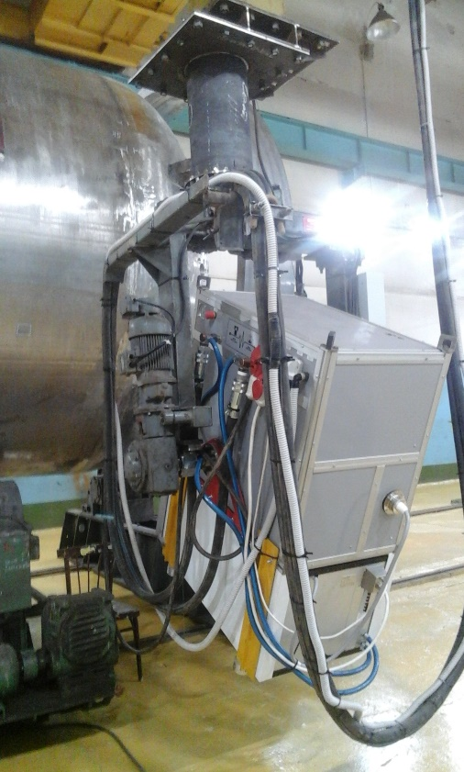
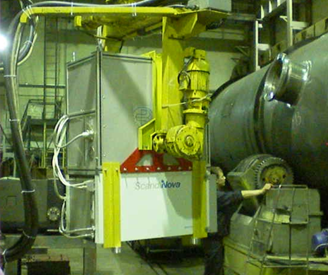
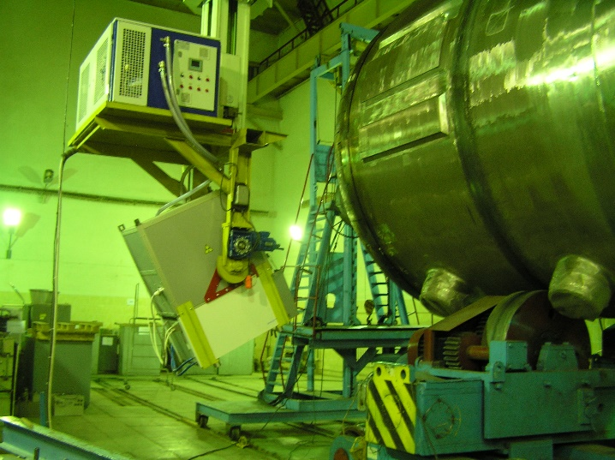
Our accelerator for radiography in operation at different factories in atomic power reactors industry

Slide 16
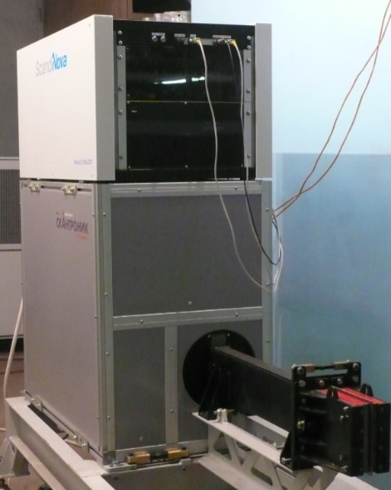
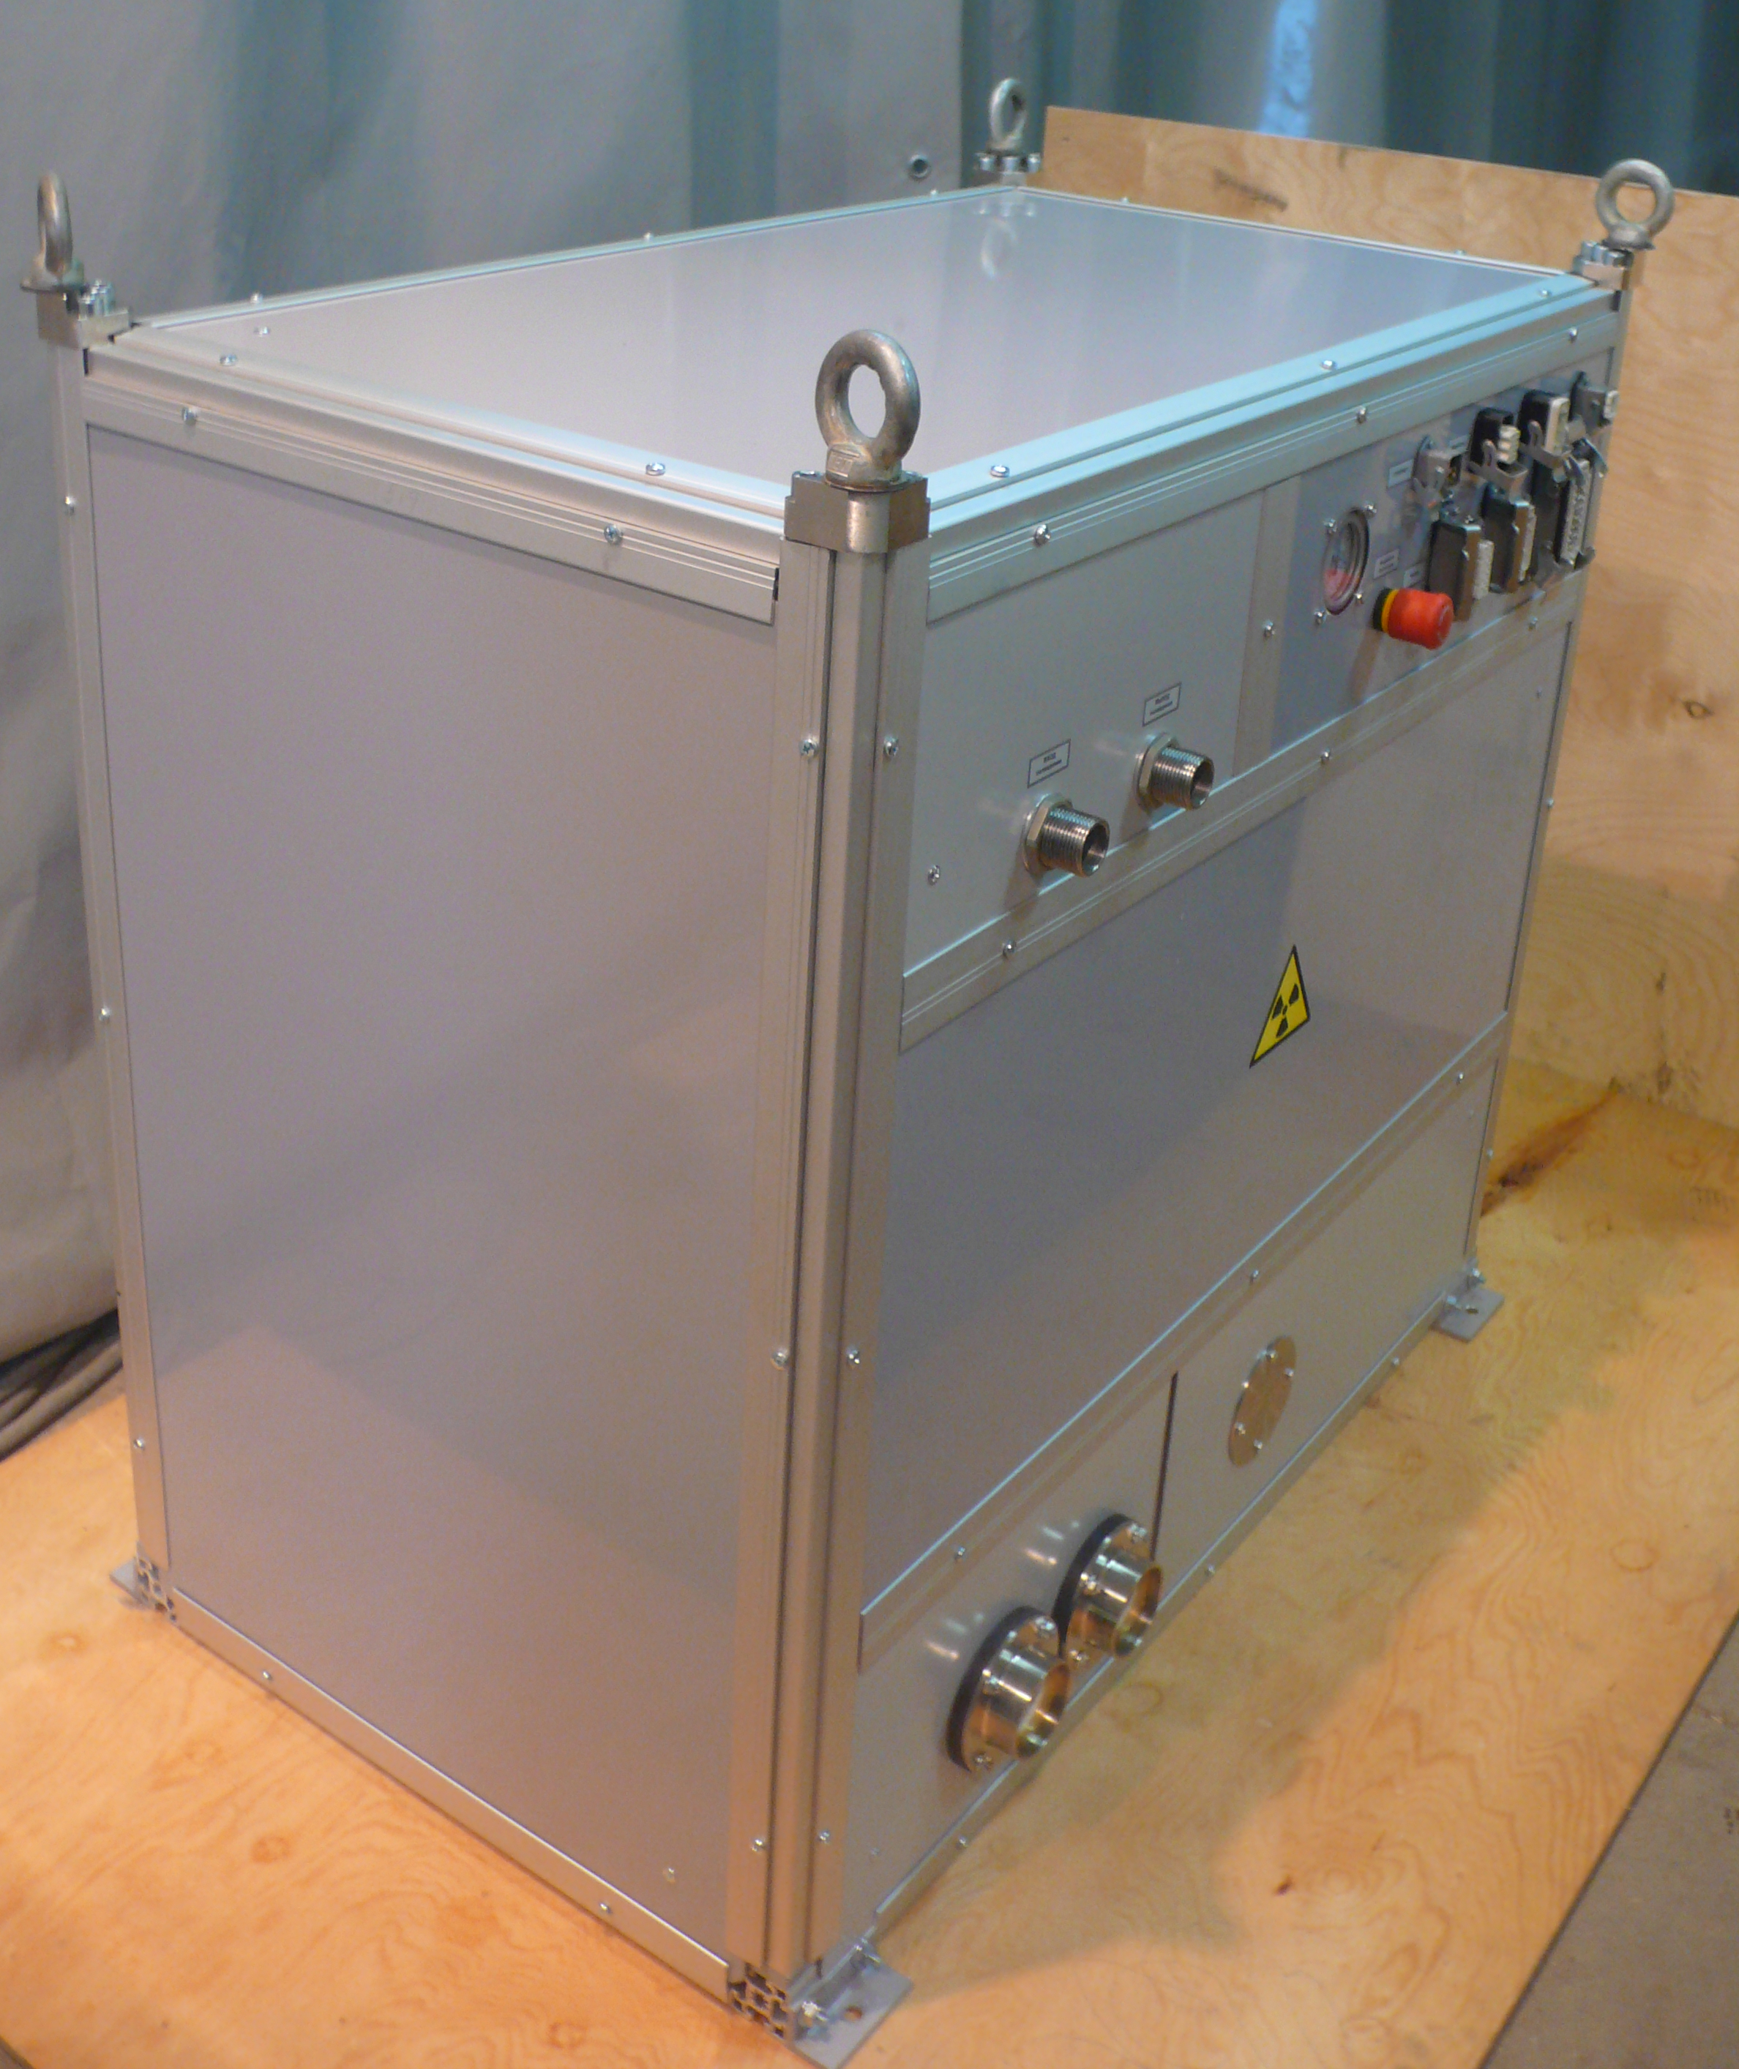
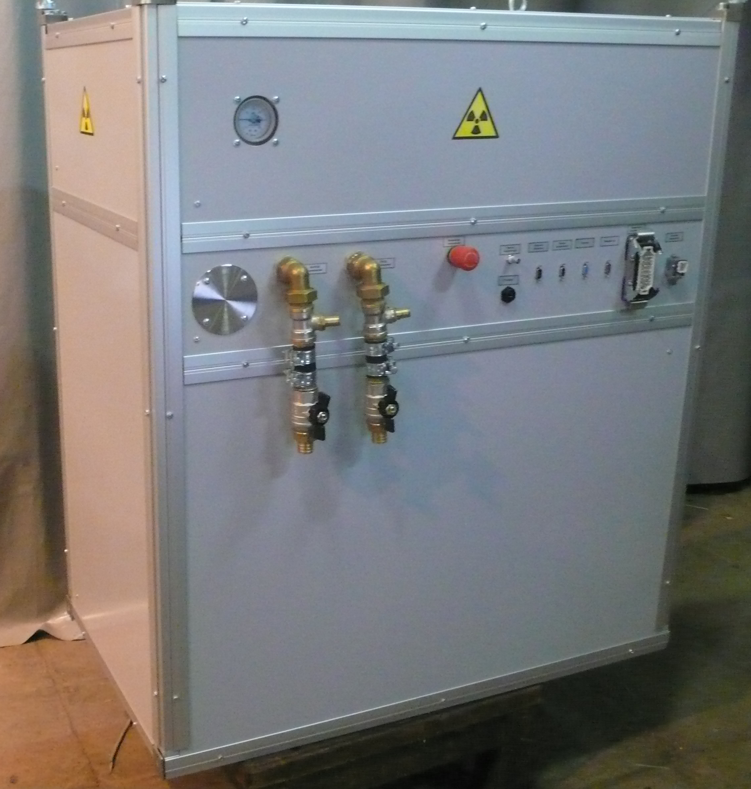
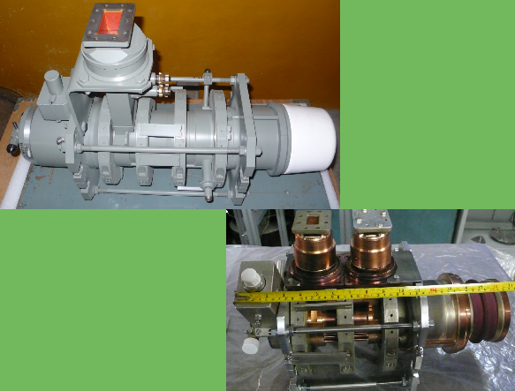
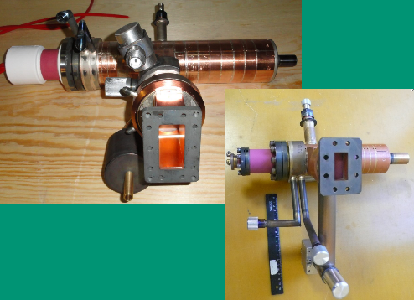
Electron accelerators with pulse-to-pulse energy switching for cargo inspection complexes with capability of materials recognition
For stationary mobile train
Energy 3.5/6 MeV 6/9 MeV
Energy stability 0.3%
Dose rate up to 10 Gy/min
Pulse repetition rate up to 2×1000 Hz
Radiation leakage 2×10⁻⁵ – 10⁻⁶
KIU-168
KIU-273
Klystrons and accelerating systems for S- and C- bands (2856 MHz and 5712 MHz)

Slide 17
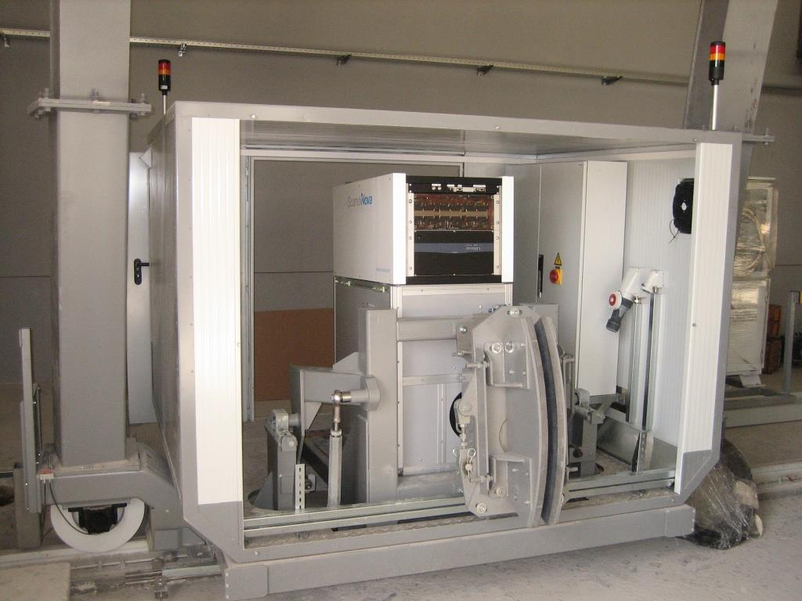
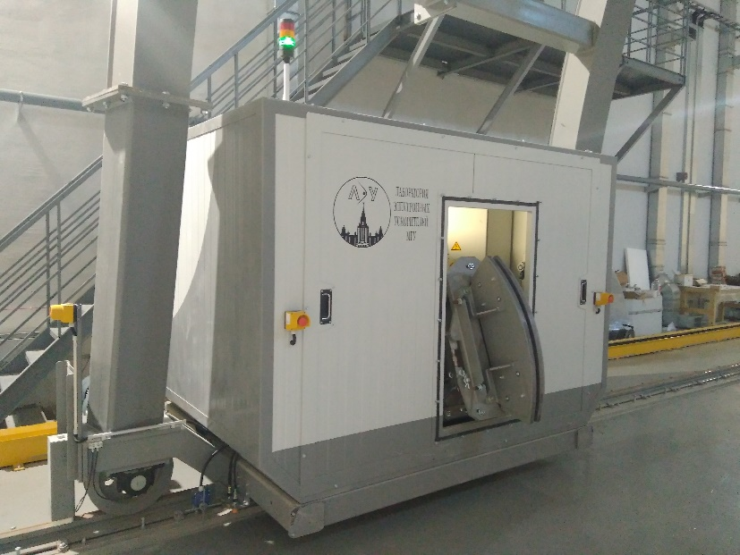
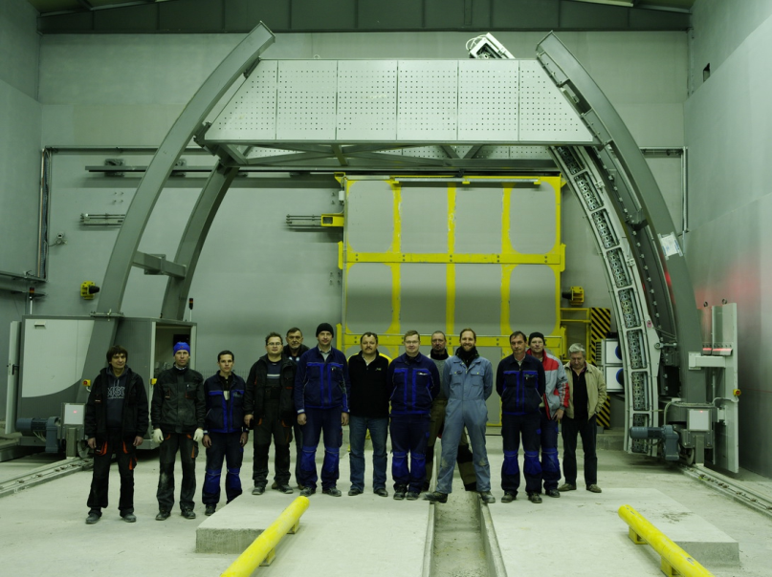
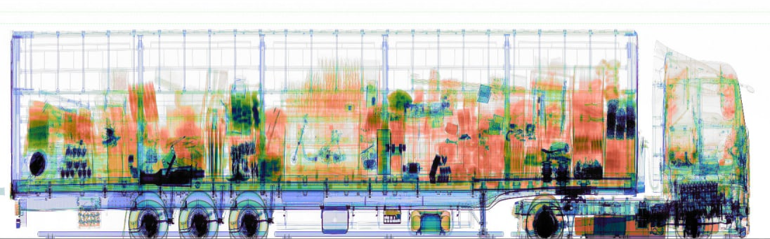
Stationary X-ray inspection system
ST-6035 (Scantronic System LLC)
http://www.scantronicsystems.com/en/

Slide 18
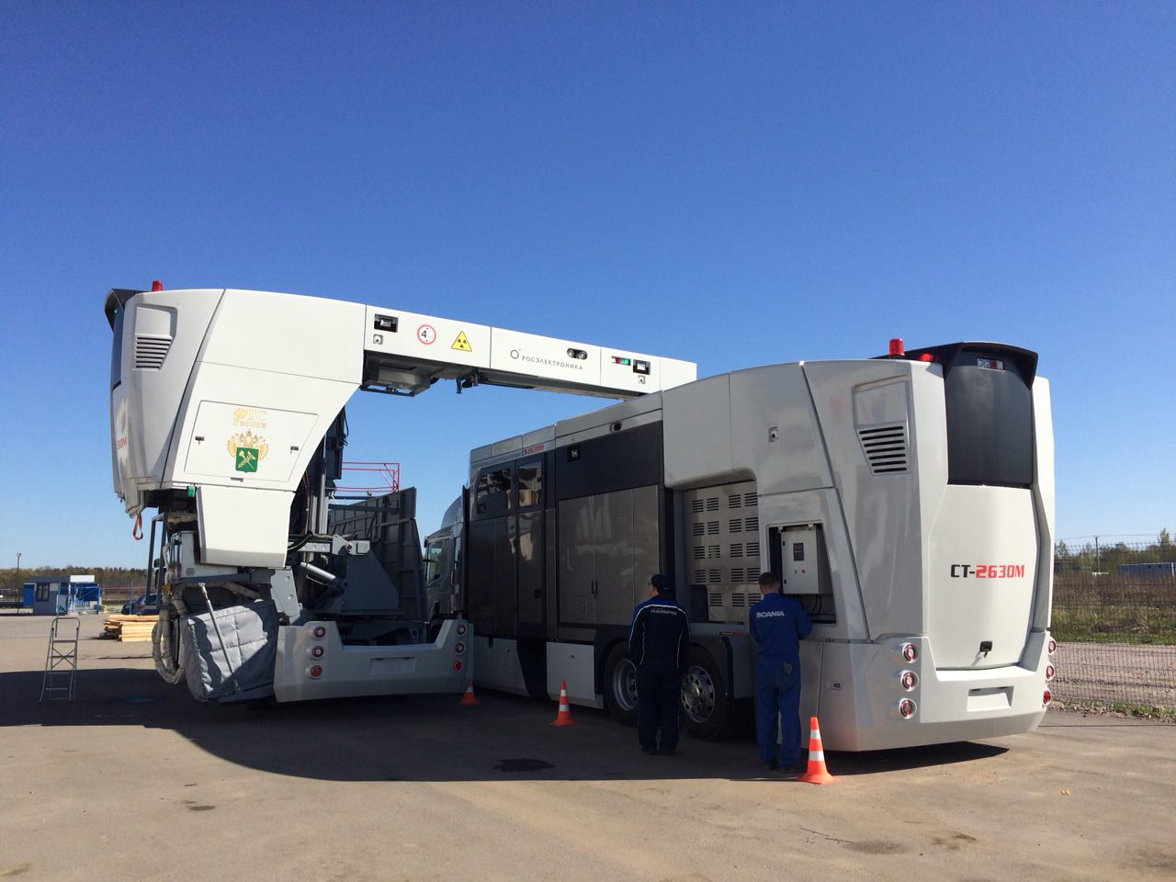
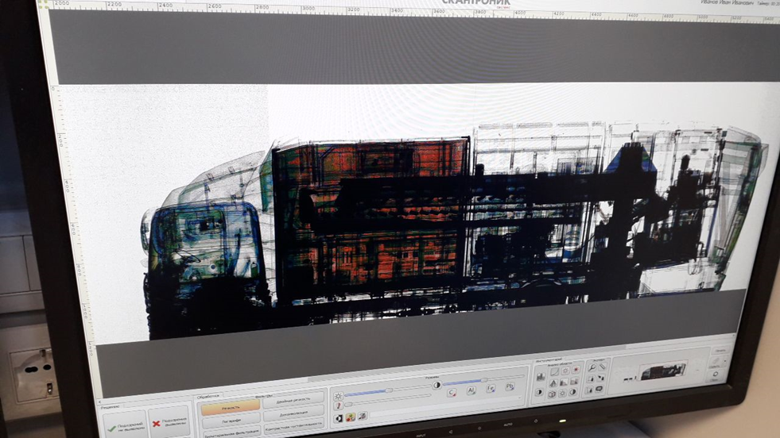
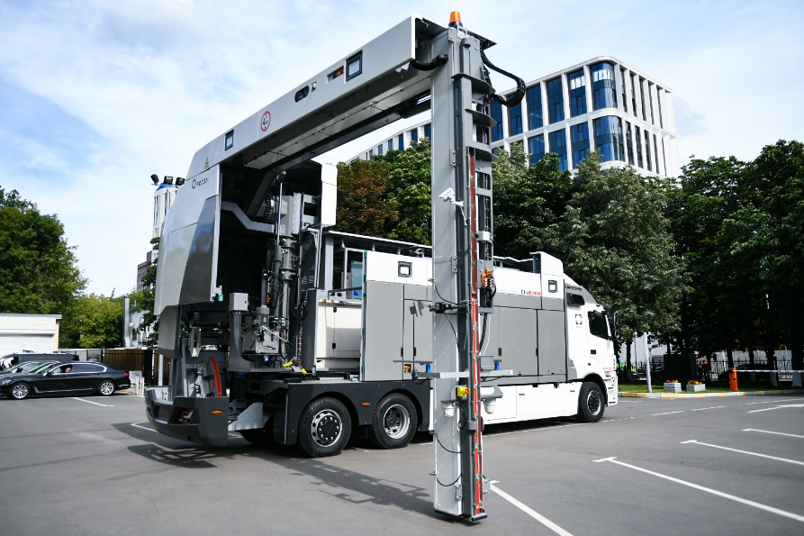
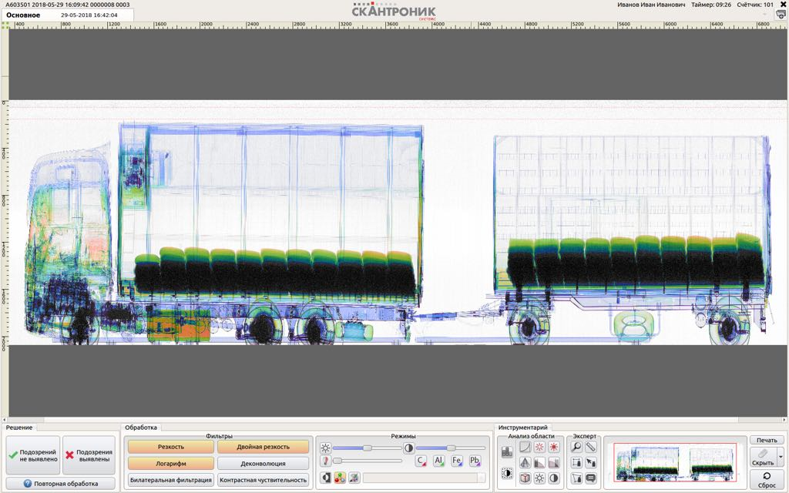
Mobile X-ray inspection system
ST-2630M (Scantronic System LLC)
1-st version
2-d version
http://www.scantronicsystems.com/en/

Slide 19
Train X-ray inspection system
ST-2630T (Scantronic System LLC)
Two ways system
Picture of the contents of railway carriage
Accelerator
http://www.scantronicsystems.com/st2630t_ru/

Slide 20
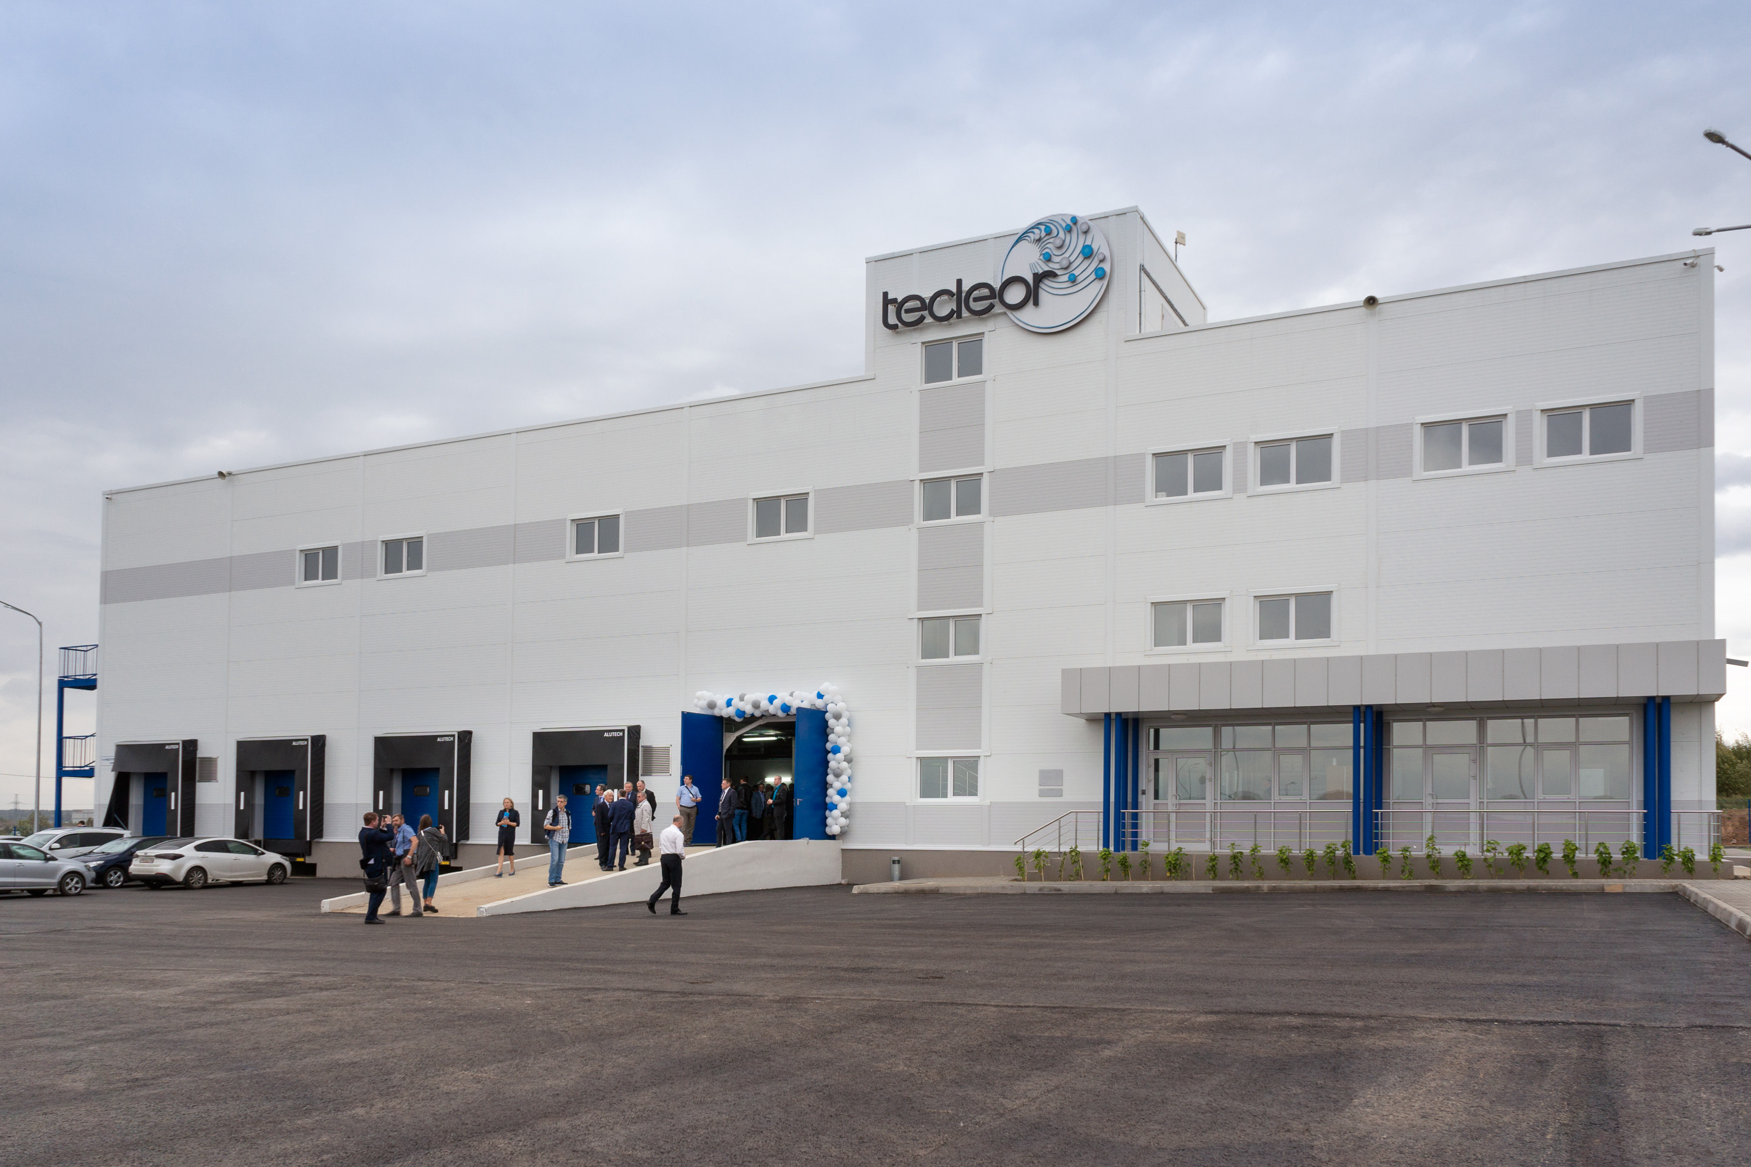
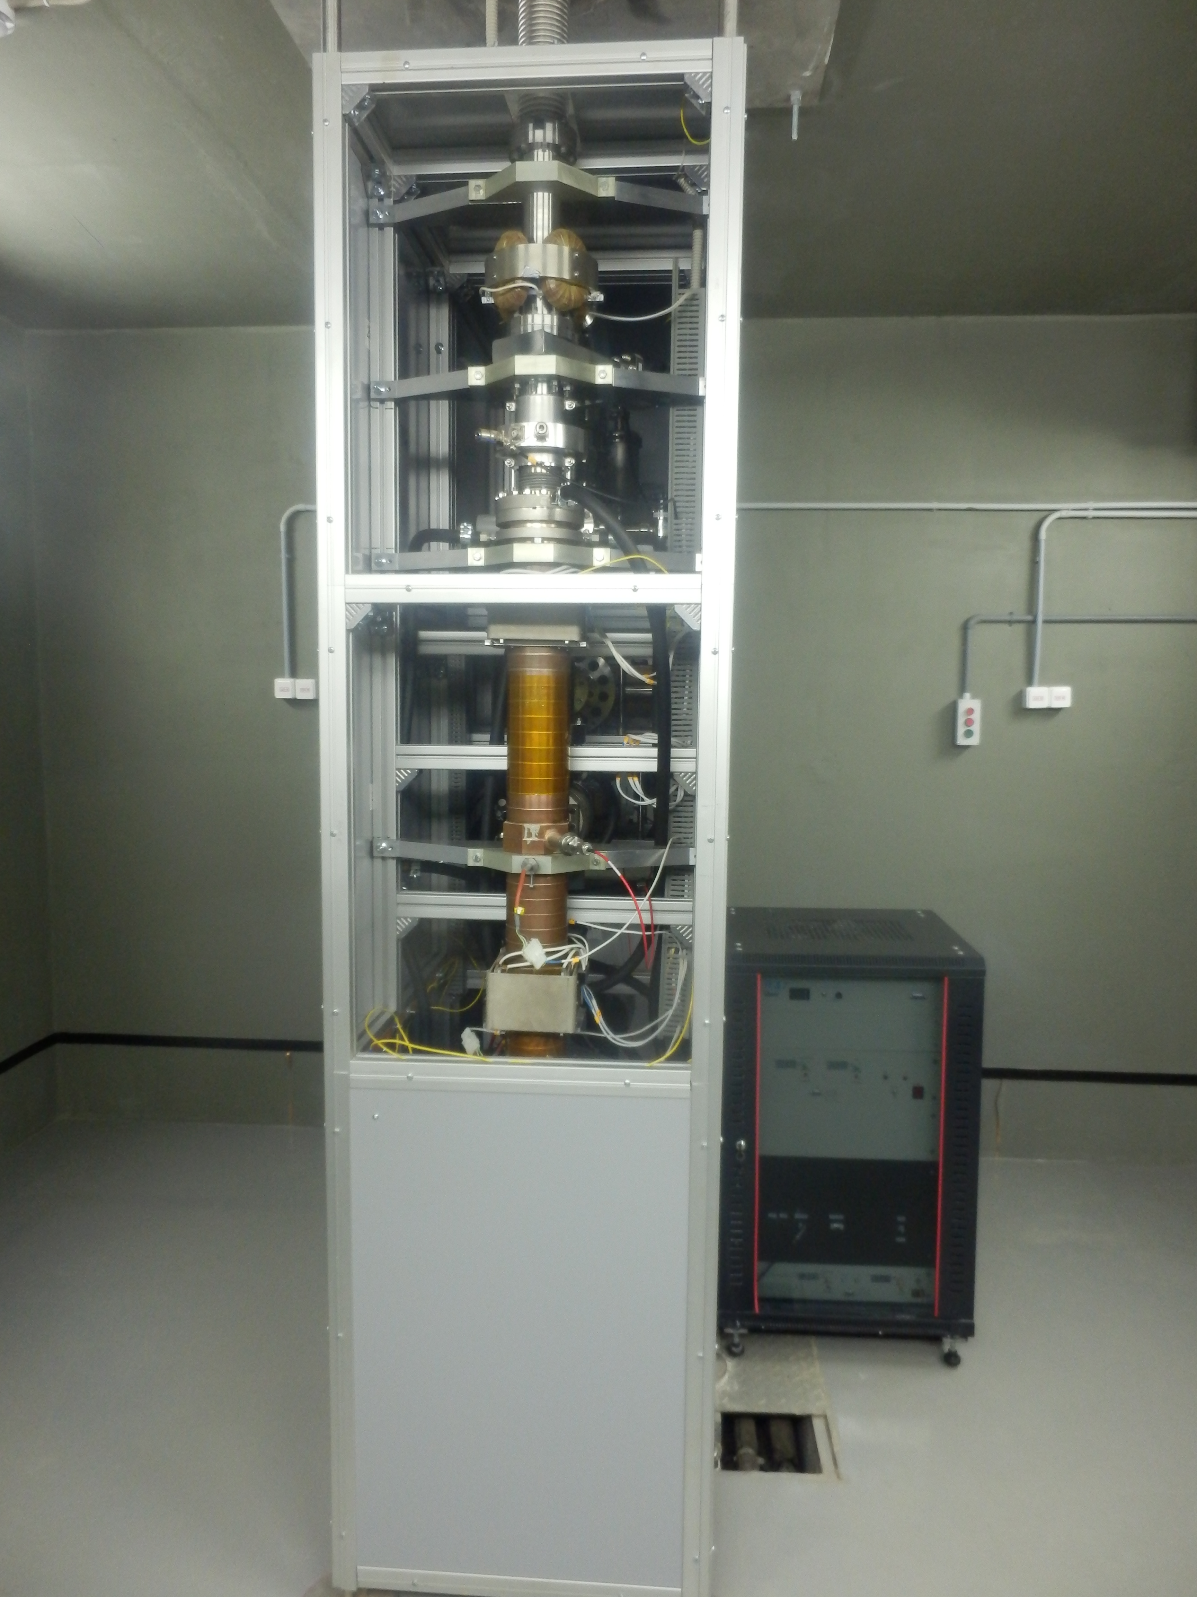
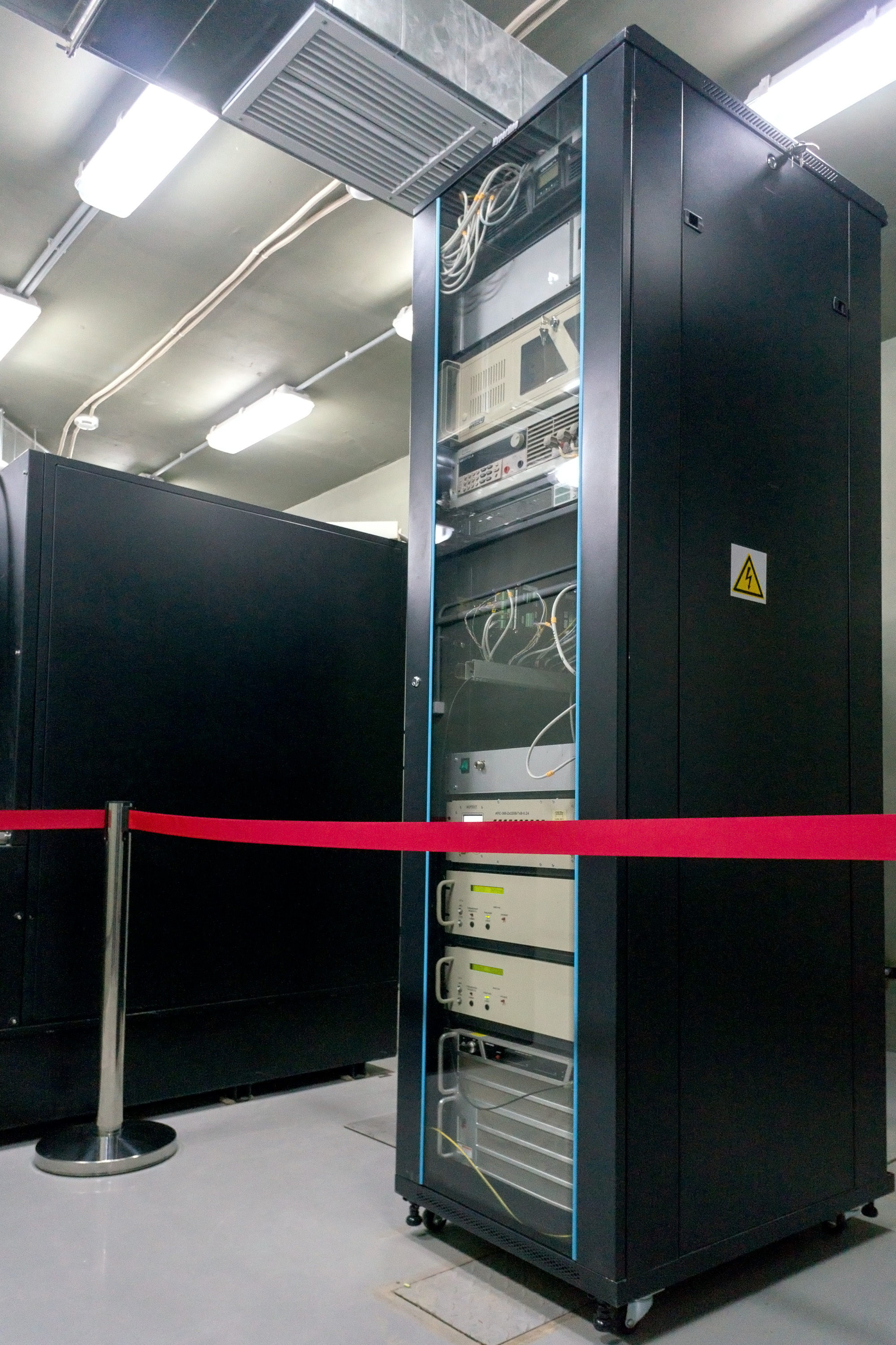
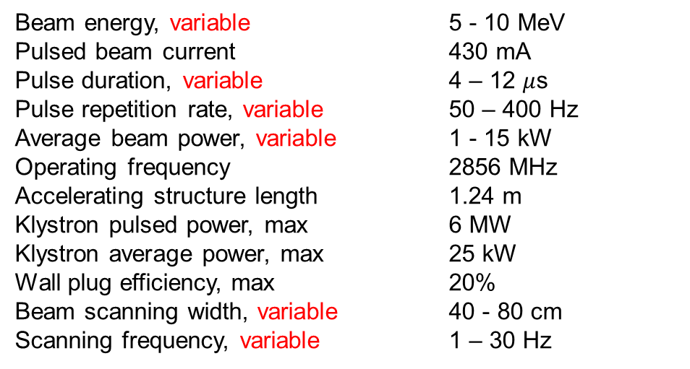
Antimicrobial product processing complex
in the Kaluga region (“Tecleor”)
https://www.tecleor.com/en/
Beam energy, variable 5 - 10 MeV
Pulsed beam current 430 mA
Pulse duration, variable 4 – 12 $μ$s
Pulse repetition rate, variable 50 – 400 Hz
Average beam power, variable 1 - 15 kW
Operating frequency 2856 MHz
Accelerating structure length 1.24 m
Klystron pulsed power, max 6 MW
Klystron average power, max 25 kW
Wall plug efficiency, max 20%
Beam scanning width, variable 40 - 80 cm
Scanning frequency, variable 1 – 30 Hz
LEA MSU accelerator equipment

Slide 21
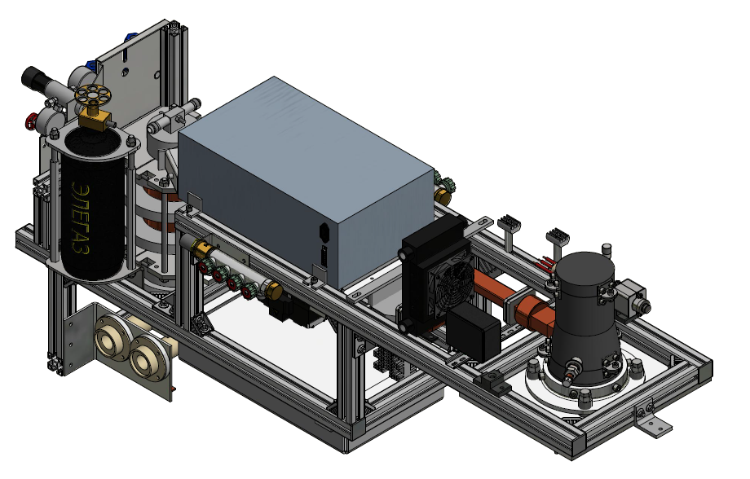
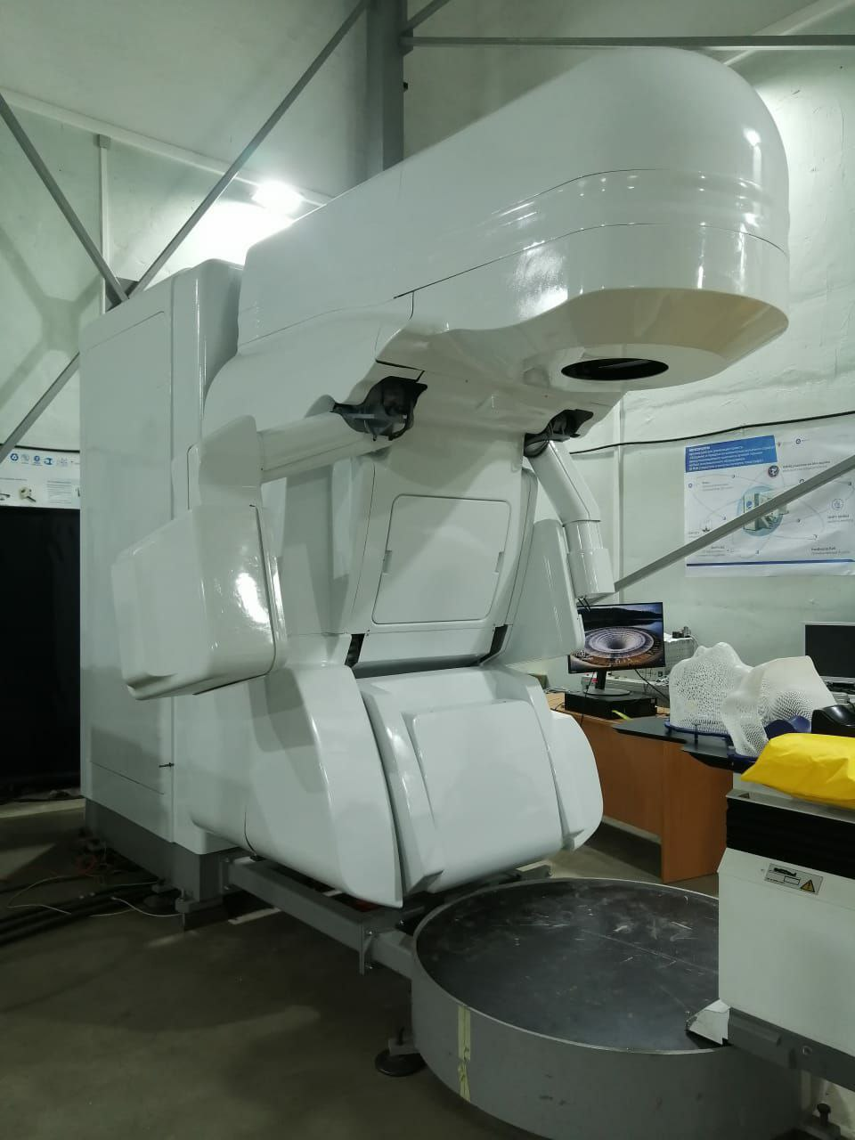
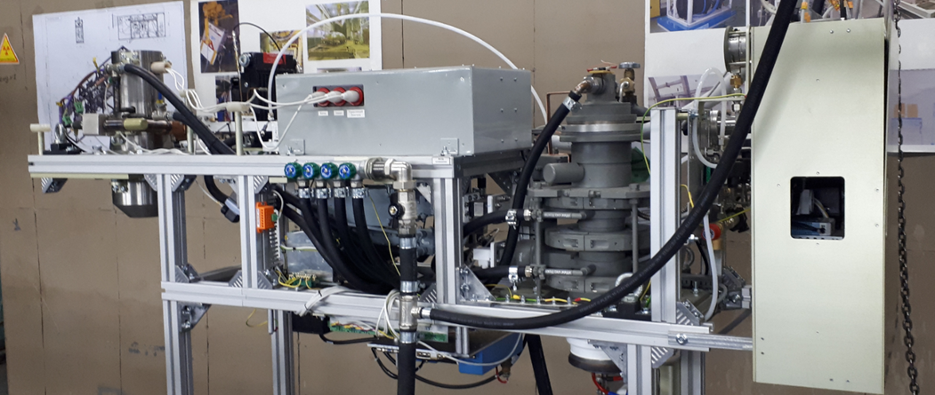
Complex of radiotherapy KLT-6 (Rosatom)
Accelerator parameters:
Beam energy 2.5/6 MeV
Dose rate 10 Gy/min
Accelerator design
Test stand
Gantry

Slide 22
New SINP MSU projects

Slide 23
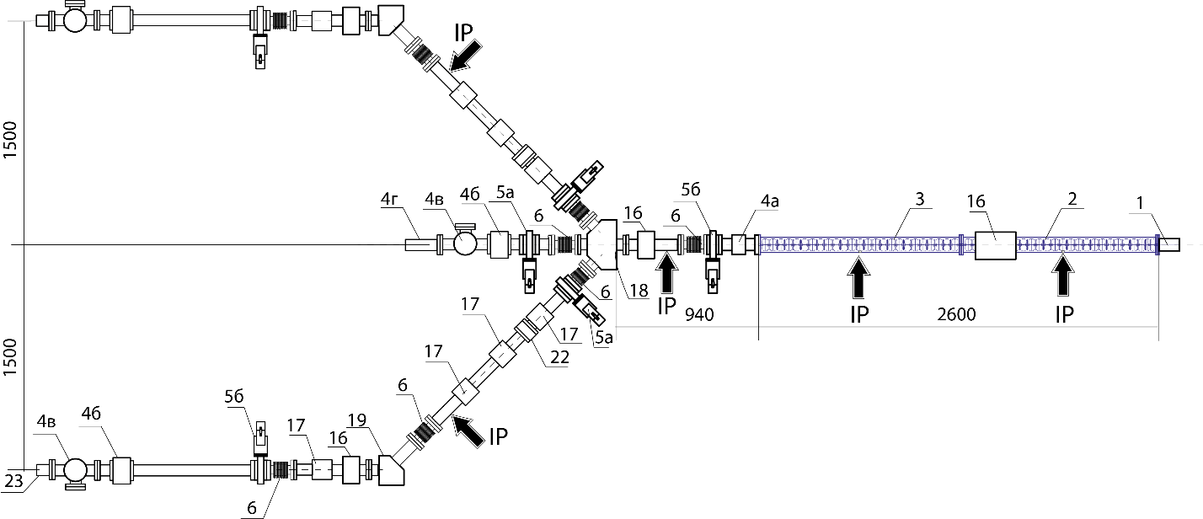
Project of 35 MeV pulsed electron linear accelerator for photonuclear reactions study and experiments for medical isotopes production
Parameter | Value
Maximum beam energy | 40 MeV
Average beam current | 100 μA
Number of accelerating structure sections/klystrons | 2
Operating frequency | 2856 MHz
Klystron pulsed RF power | 8 MW
1-electron gun, 2, 3 -sections of the accelerating structure, 4a-pulsed current beam monitor, 4b-average beam current and beam position monitors, 4c-screen for beam observation, 4d-Faraday cup, 5a- pneumatically controlled vacuum gate, 5b manual vacuum gate, 6 - bellows, 16 - beam steering coils, 17 - quadrupole lens, 18-distributing magnet, 19-bending magnet, 22 -collimator, 23-target, IP – ion pump.

Slide 24

Projects of Laser-Electron Compton X-ray and gamma-ray generators
Electrons
Light
X-rays
Electron Scattering by an Intense Polarized Photon Field
Richard H. Milburn
Phys. Rev. Lett. 10, 75 – Published 1 February 1963
The Compton effect on relativistic electrons and the possibilty of obtaining high energy beams
F.R. Arutyunian, V.A. Tumanian
Physics Letters Volume 4, Issue 3, 1 April 1963, Pages 176-178

Slide 25
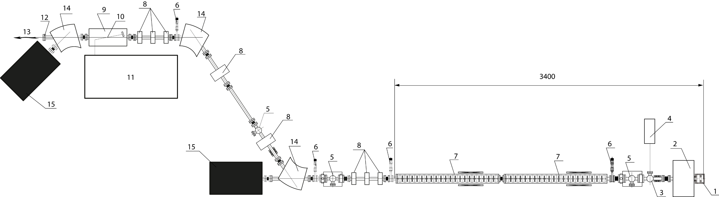
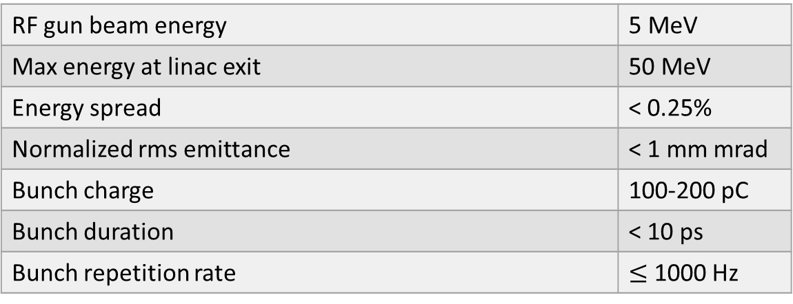
Electron beam parameters
RF gun beam energy | 5 MeV
Max energy at linac exit | 50 MeV
Energy spread | < 0.25%
Normalized rms emittance | < 1 mm mrad
Bunch charge | 100-200 pC
Bunch duration | < 10 ps
Bunch repetition rate | $≤$ 1000 Hz
Project of Compton X-ray source
1 – RF gun with a photocathode, 2 – solenoid, 3 – laser radiation input window, 4 – photocathode laser, 5 – beam diagnostics station, 6 – vacuum gate, 7 – accelerating structures, 8 – quadrupole lenses, 9 – interaction chamber, 10 – interaction point, 11 – main laser, 12 – X-ray output window, 13 – X-rays, 14 – bending magnets, 15 – beam absorbers.

Slide 26
Parameters and applications of the Compton X-ray source
monochromatic narrow-directed radiation for X-ray diffraction analysis and microanalysis, incl. biological crystallography;
monochromatic radiation for studying objects using coherent X-ray optics (phase-contrast tomography, ptychography, coherent diffraction imaging, etc.);
monochromatic (short-pulse) radiation for research in radiation biophysics;
monochromatic (short-pulse) radiation for studying the radiation resistance of elements of electronic devices;
monochromatic picosecond pulsed radiation for studying fast processes, incl. phase transitions;
focused x-rays with a spectrum width of up to 2% for research by EXAFS and XANES spectroscopy.
Parameter | Value
Source diameter | 30 ± 10 mm
Pulse duration | 10 ± 5 ps
Max repetition rate | 1000 Hz
Interaction angle | 3⁰±2⁰
Divergency at max. energy | 0.8 mrad
 | 1-st laser harmonic | 4-th laser harmonic
Max. photon energy | 46 keV | 184 keV
FWHM at zero angle | 400 eV | 1.6 eV
Spectral brightness | 2⋅10¹⁰ ph/(mm²⋅mrad²⋅s⋅0.1%) | 5⋅10⁹ ph/(mm²⋅mrad²⋅s⋅0.1%)
Average total flux | 10¹⁰ ph/s | 2⋅10⁹ ph/s

Slide 27
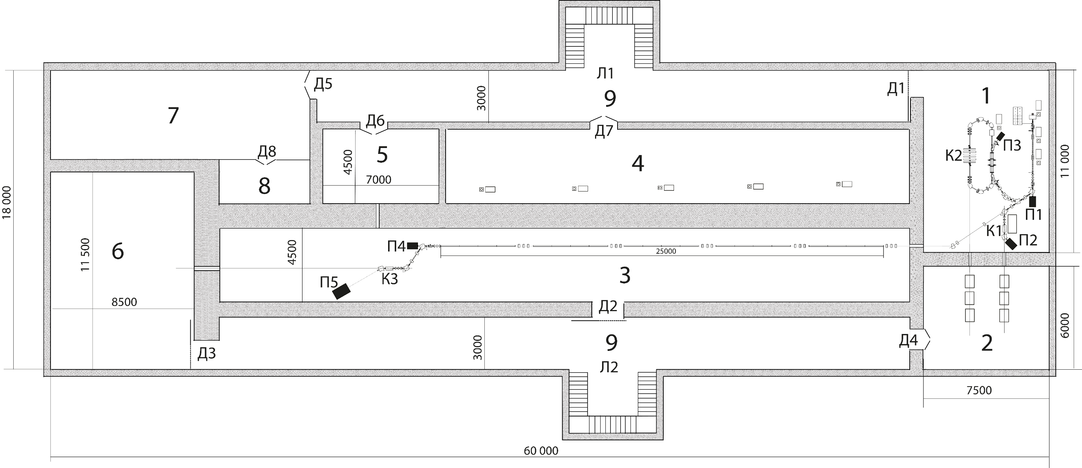
Possible extension for Compton source of gamma-ray radiation with energy up to 30-40 MeV
500 .... 750 MeV

Slide 28
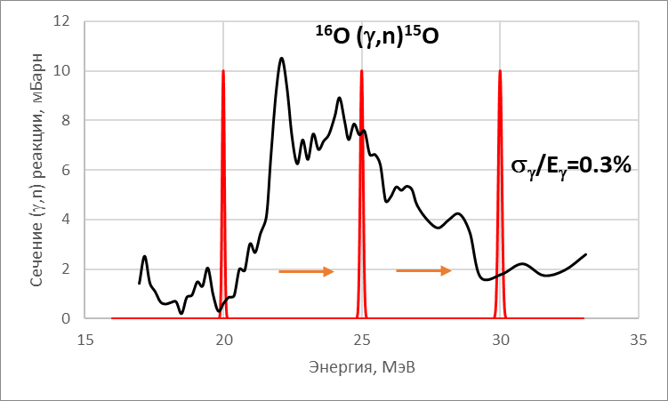
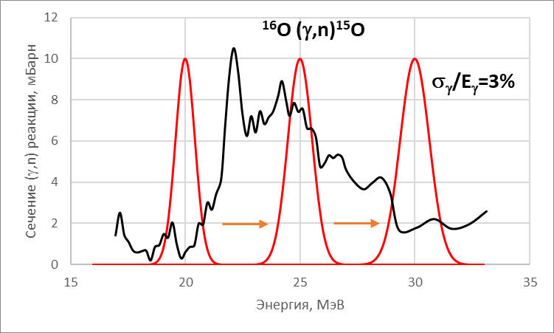
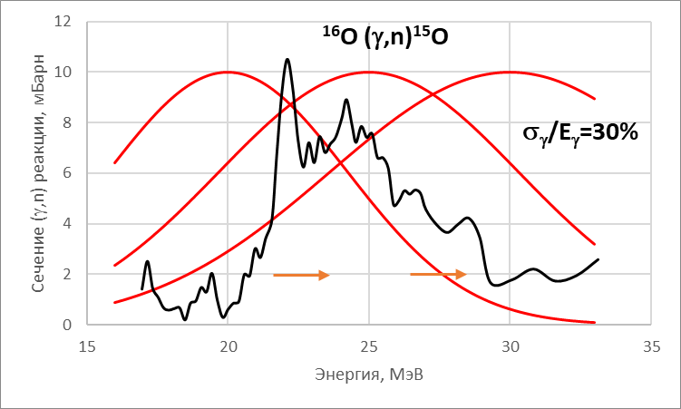
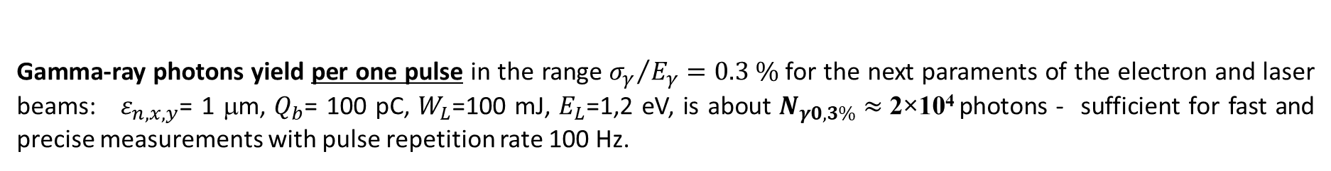
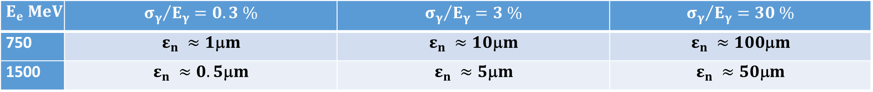
Precise measurements of photonuclear reactions cross sections
What is necessary
Existing Compton sources
Requirements for the normalized emittance for various degrees of monochromaticity ($β$ =1 m – beta function)
$$E_{e} MeV$$ | $${σ_{γ}}/{E_{γ}}=0.3 \%$$ | $${σ_{γ}}/{E_{γ}}=3 \%$$ | $${σ_{γ}}/{E_{γ}}=30 \%$$
750 | $$ε_{n} ≈1\text{m}m$$ | $$ε_{n} ≈10\text{m}m$$ | $$ε_{n} ≈100\text{m}m$$
1500 | $$ε_{n} ≈0.5\text{m}m$$ | $$ε_{n} ≈5\text{m}m$$ | $$ε_{n} ≈50\text{m}m$$
Gamma-ray photons yield per one pulse in the range ${σ_{γ}}/{E_{γ}}=0.3 \%$ for the next paraments of the electron and laser beams: $ε_{n,x,y}$= 1 μm, $Q_{b}$= 100 pC, $W_{L}$=100 mJ, $E_{L}$=1,2 eV, is about $N_{γ0,3\%}≈$2×10⁴ photons - sufficient for fast and precise measurements with pulse repetition rate 100 Hz.

Slide 29
Thank you!

