Slide 1


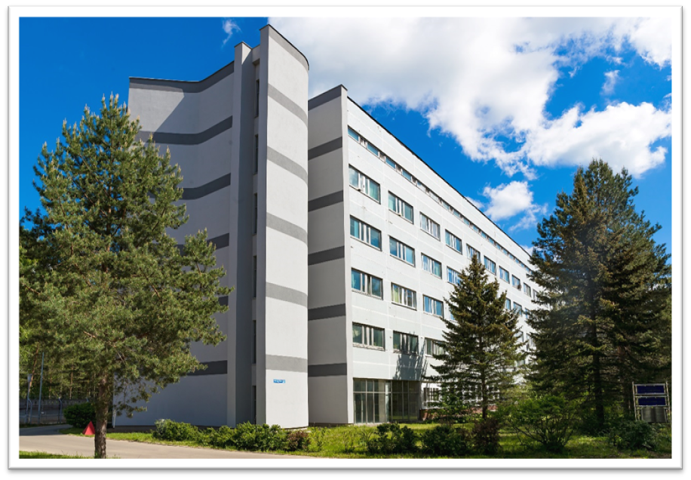

Многофункциональный информационно-
вычислительный комплекс ЛИТ ОИЯИ
Кореньков Владимир Васильевич
Семинар ЛФВЭ, 13 апреля 2023 года

Slide 2
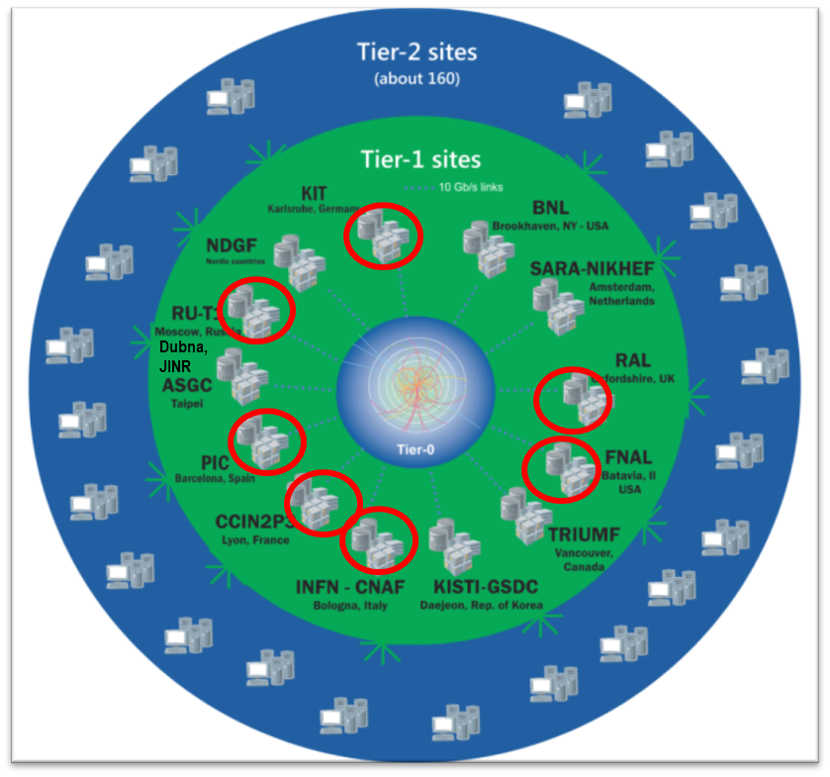
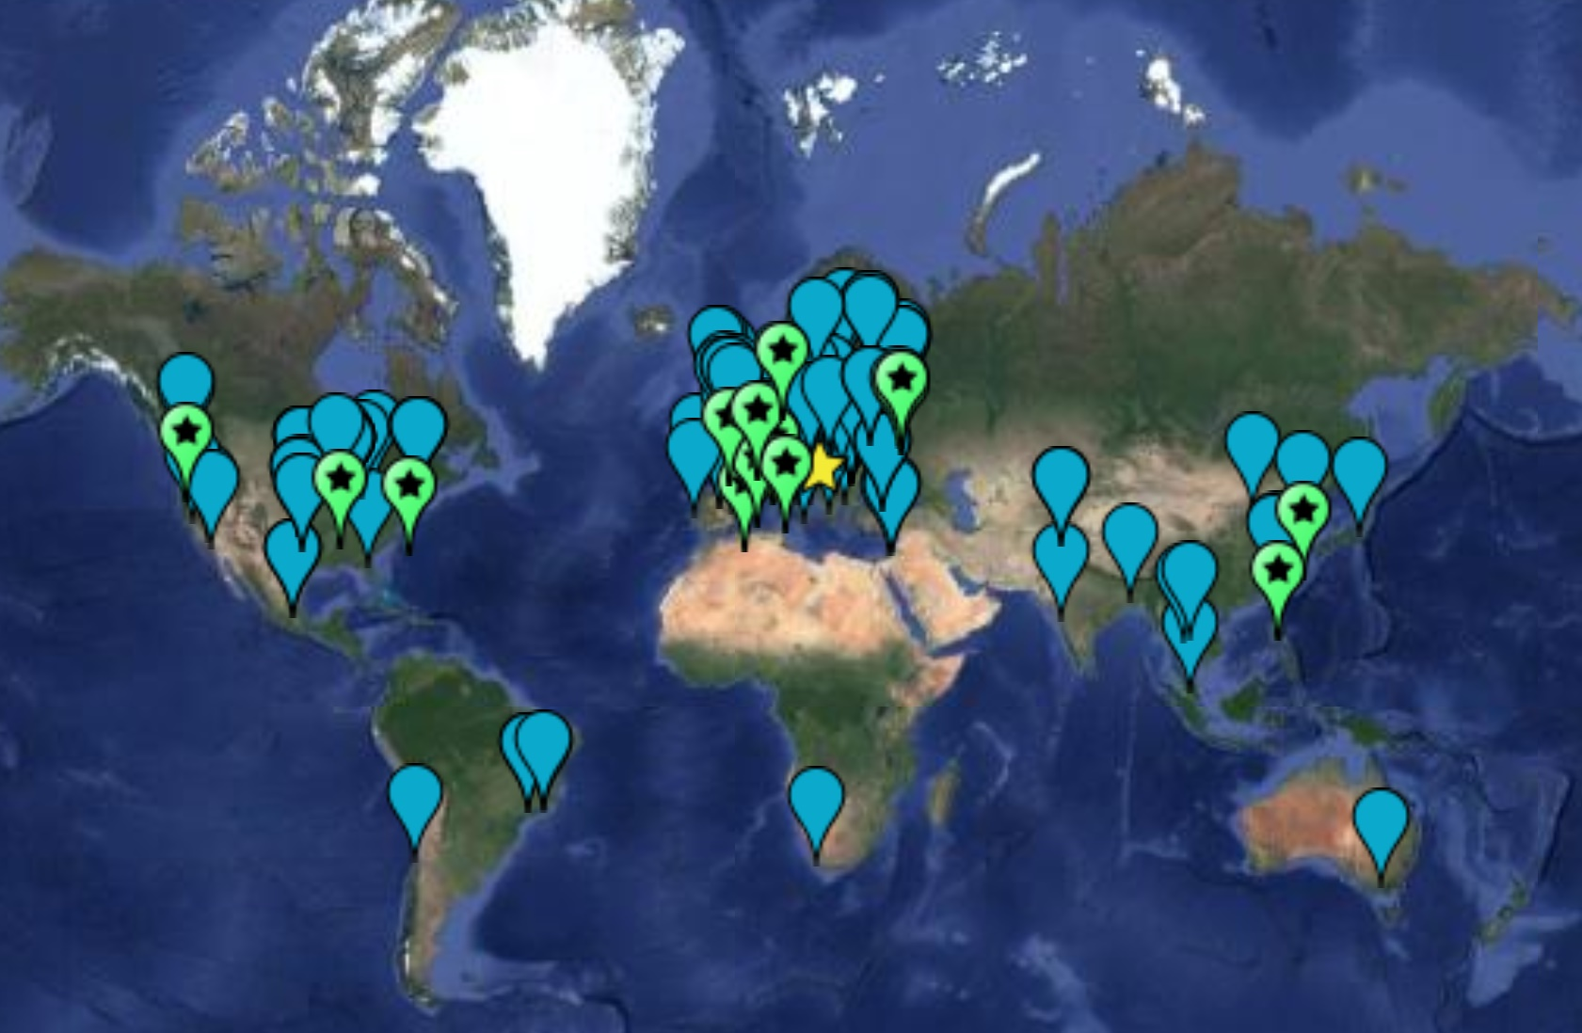
The Worldwide LHC Computing Grid
WLCG: an International collaboration to distribute and analyse LHC data. Integrates computer centres worldwide that provide computing and storage resource into a single infrastructure accessible by all LHC physicists
The mission of the WLCG project is to provide global computing resources to store, distribute and analyze the ~50-70 Petabytes of data expected every year of operations from the Large Hadron Collider.
WLCG computing enabled physicists to announce the discovery of the Higgs Boson.
161 sites
42 countries
~1M CPU cores
1 EB of storage
> 3 million jobs/day
10-100 Gb links
Tier0 (CERN): data recording, reconstruction and distribution | Tier1: permanent storage, re-processing, analysis | Tier2: Simulation, end-user analysis
Worldwide LHC Computing Grid - 2019

Slide 3

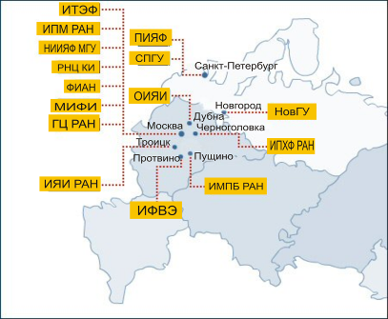
Russian Data Intensive Grid infrastructure (RDIG)
The Russian consortium RDIG (Russian Data Intensive Grid), was set up in September 2003 as a national federation in the EGEE project. A protocol between CERN, Russia and JINR on participation in the LCG project was signed in 2003.
MoU on participation in the WLCG project was signed in 2007.
RDIG Resource Centres:
– ITEP
– JINR-LCG2 (Dubna)
– RRC-KI
– RU-Moscow-KIAM
– RU-Phys-SPbSU
– RU-Protvino-IHEP
– RU-SPbSU
– Ru-Troitsk-INR
– ru-IMPB-LCG2
– ru-Moscow-FIAN
– ru-Moscow-MEPHI
– ru-PNPI-LCG2 (Gatchina)
– ru-Moscow-SINP
-

Slide 4
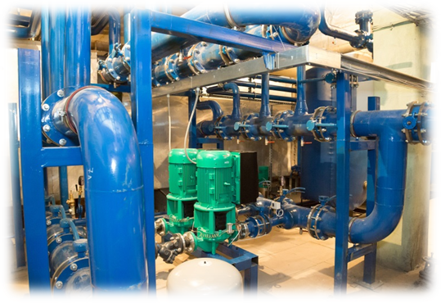
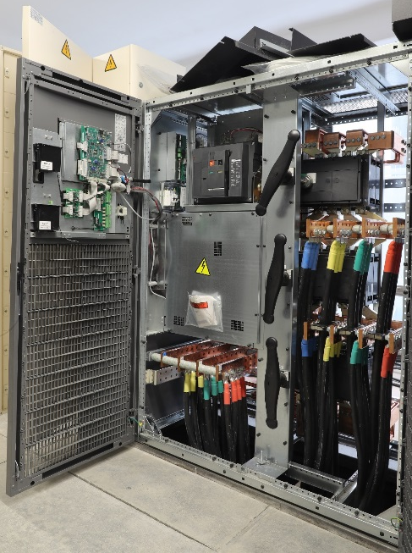
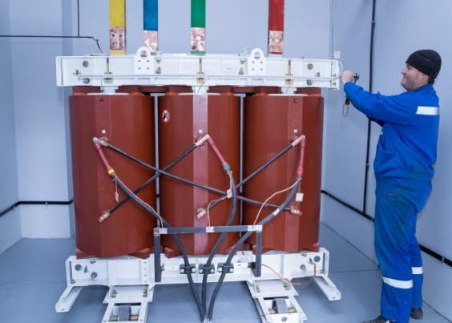
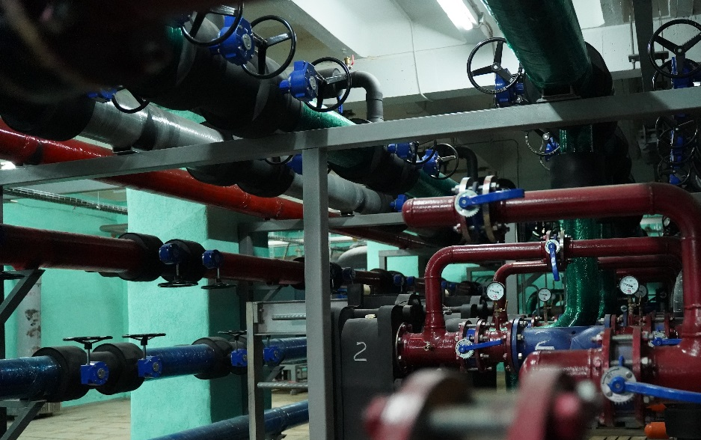
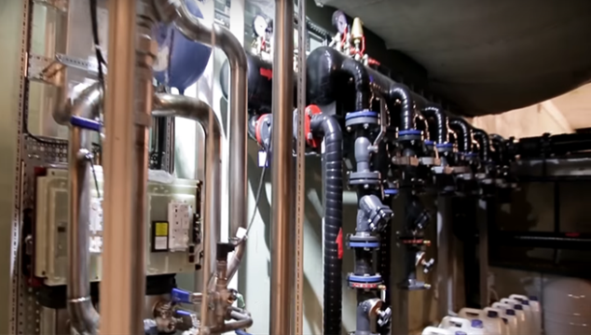
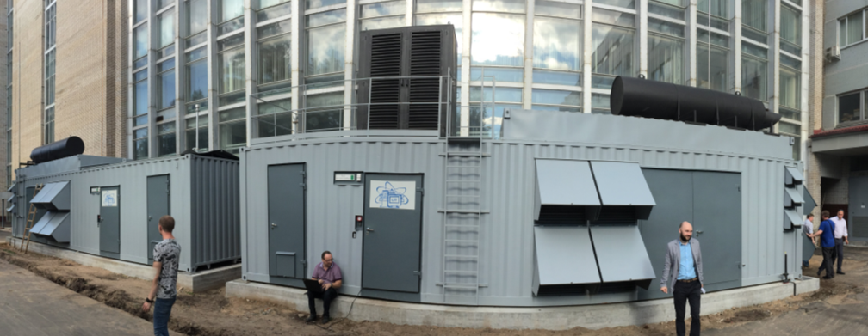
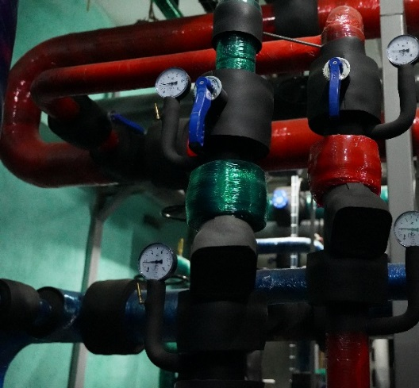
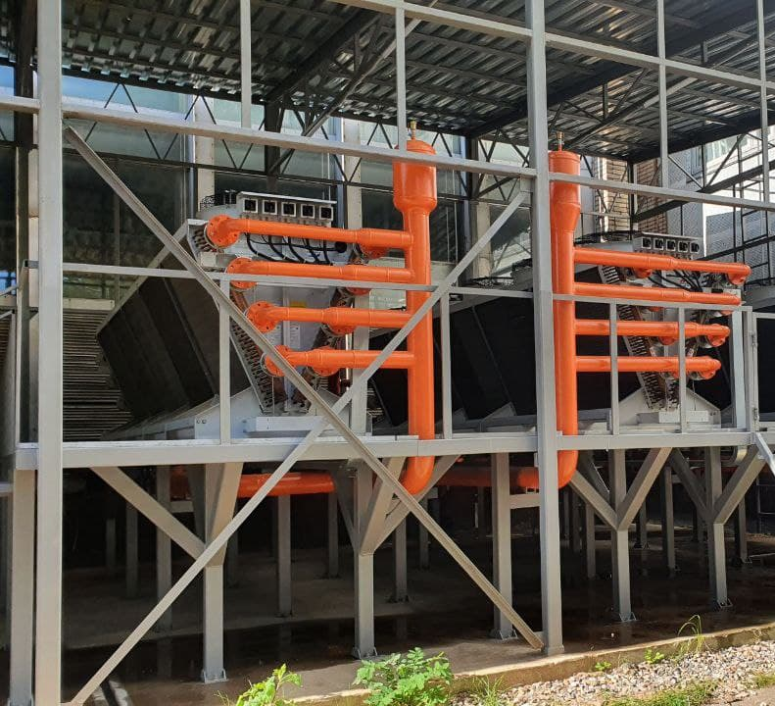
Engineering Infrastructure
Power supply expansion
New cooling system for the MICC machine hall
100% “hot water” cooling system of the “Govorun”
supercomputer
Guaranteed power supply using diesel generators and
uninterruptible power supplies
Notes:
The MICC engineering infrastructure is designed to provide reliable, uninterrupted and fault-tolerant operation of the computing subsystem and network infrastructure, protecting the complex as much as possible from the effects of negative factors during equipment operation.

Slide 5
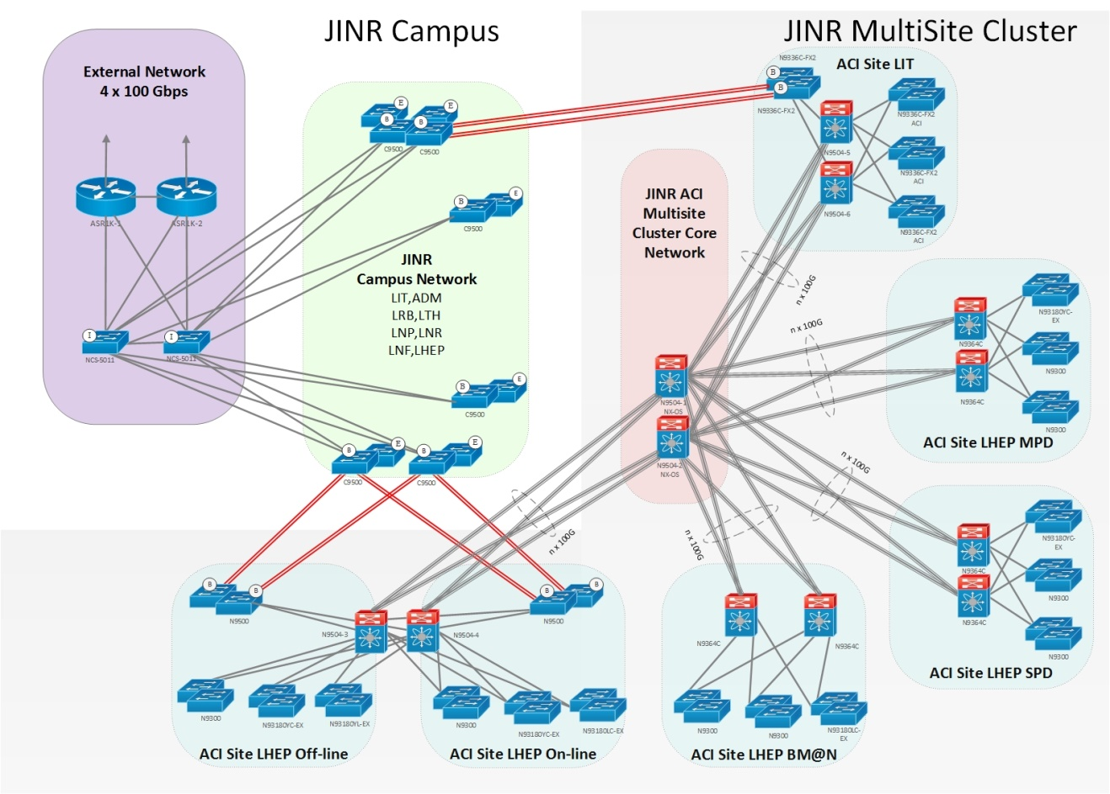
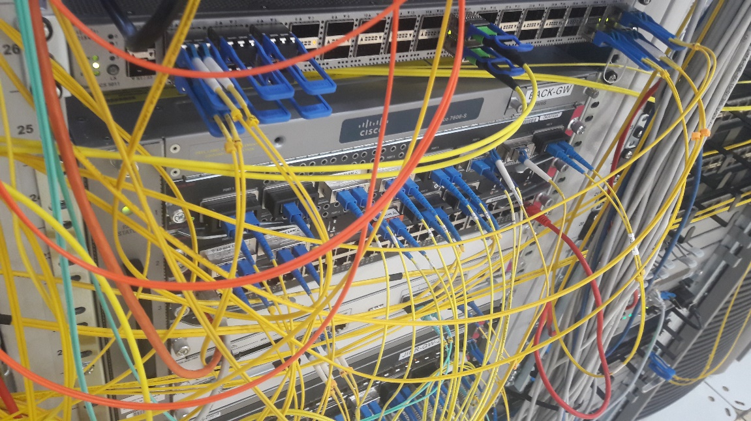
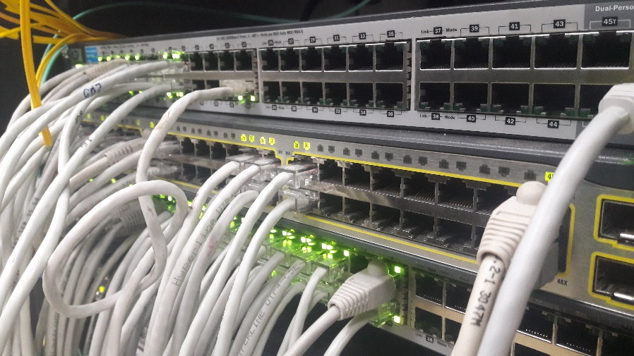
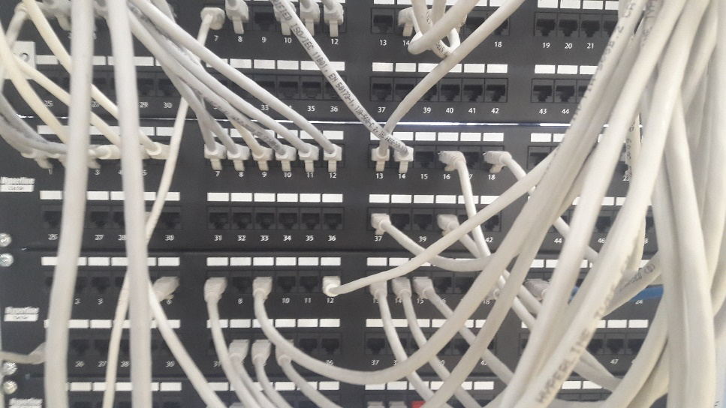
Networking
JINR-Moscow 3x100 Gbit/s
JINR-CERN - 100 Gbit/s and JINR-Amsterdam 100 Gbit/s for LHCOPN, LHCONE, GEANT networks
Direct channels up to 100 Gbit/s for communication using RU-VRF technology with the collaboration of RUHEP research centers and with Runnet, ReTN networks
The multi-site cluster network with a bandwidth 4x100 Gbit/s between VBLHEP and MLIT
The JINR LAN comprises:
8768 network elements
17602 IP-addresses
6377 users registered within the network
4203 *.jinr.ru service users
1419 digital library users
504 remote VPN and EDUROAM users
network traffic in 2021
33.23 PB - input
35.86 PB - output
Notes:
One of the most important components of JINR and MICC providing access to resources and the possibility to work with the big data is a network infrastructure.
Обеспечена надежная работа высокоскоростного канала связи Дубна-Москва. Внешний канал ОИЯИ построен по технологии DWDM и использует один канал 3x100 Гбит / с.
Таким образом, внешняя распределенная сеть ОИЯИ будет представлена прямым каналом ОИЯИ-CERN и резервным каналом, проходящим через MMTS-9 в Москве и Амстердаме, обеспечивающим работу LHCOPN (JINR-CERN) для соединения между Tier0 (CERN) и Tier1 (ОИЯИ) и внешней наложенной сети LHCONE, предназначенной для центра Tier2 ОИЯИ, прямых каналов для подключения с использованием технологии RU-VRF при сотрудничестве исследовательских центров RUHEP и сетей Runnet, RASnet.
Reliable operation of the high-speed communication channel Dubna-Moscow is ensured. JINR's external distributed network will be represented by a direct JINR-CERN channel and a backup channel passing through MMTS-9 in Moscow and Amsterdam

Slide 6
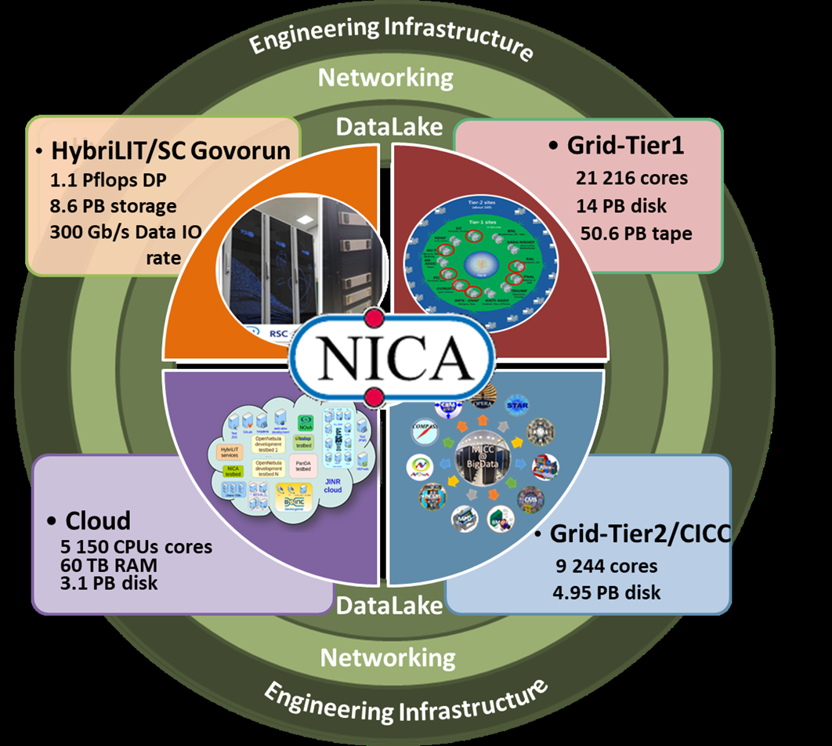
Multifunctional Information and Computing Complex at JINR
The MICC meets the requirements for a modern highly performant scientific computing complex:
multi-functionality,
high performance,
task-adapted data storage system,
high reliability and availability,
information security,
scalability,
customized software environment for different user groups,
high-performance telecommunications and modern local network.
The MICC should be considered as a basic scientific infrastructure project.
Notes:
The Multifunctional Information and Computing Complex (MICC) of MLIT JINR is a key component of the JINR network and information and computing infrastructure. The MICC is regarded as JINR’s unique basic facility and plays a defining role in scientific research, which entails modern computing power and storage systems. The MICC uniqueness is ensured by the consolidation of all state-of-the-art information technologies, including the network infrastructure and the distributed data processing and storage system based on grid technologies and cloud computing, the hyper-converged computing infrastructure with liquid cooling for supercomputer applications. Multifunctionality, high reliability and availability in a 24х7x365 mode, scalability and high performance, a reliable data storage system, information security and an advanced software environment are the main requirements that the MICC meets.

Slide 7
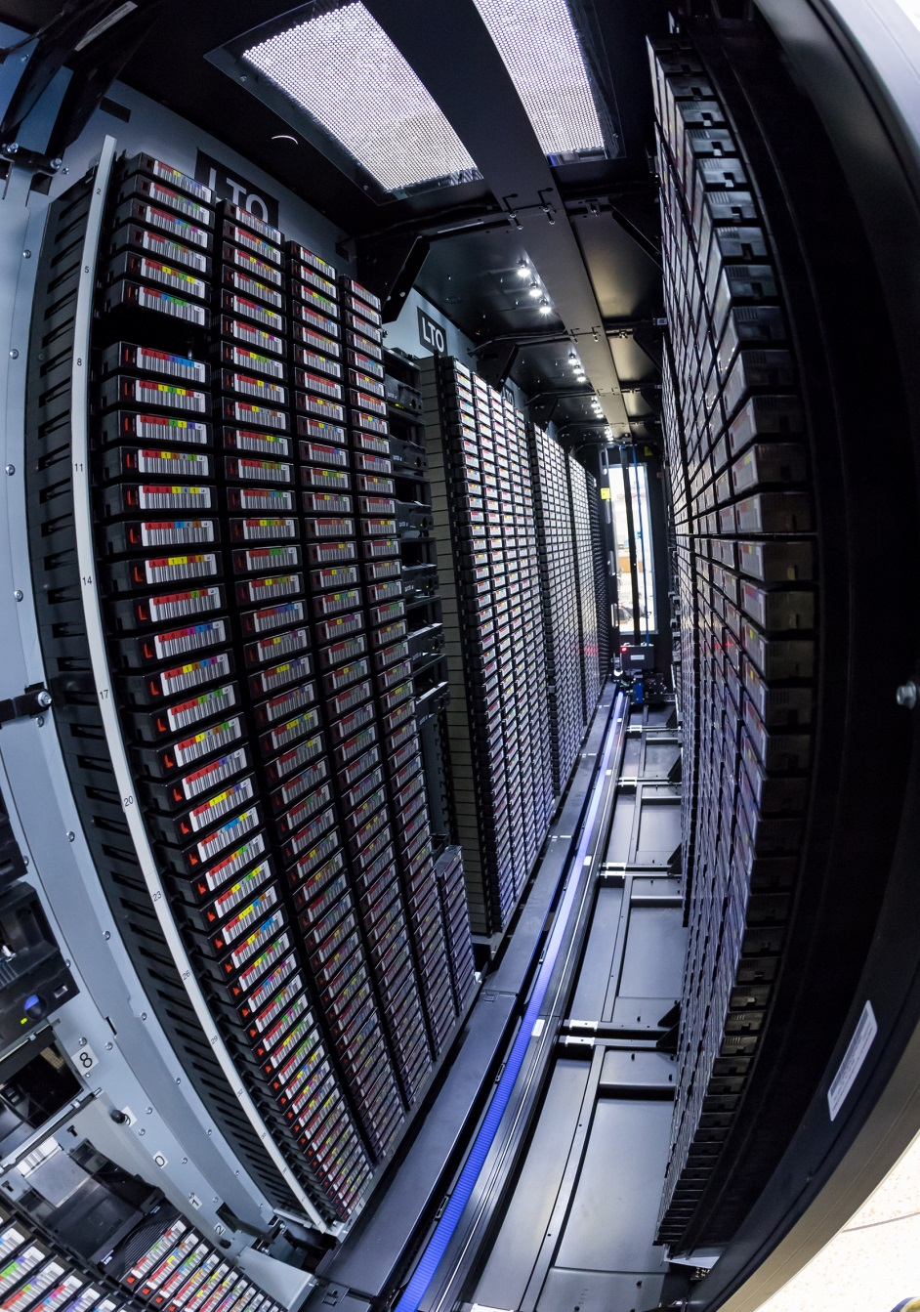
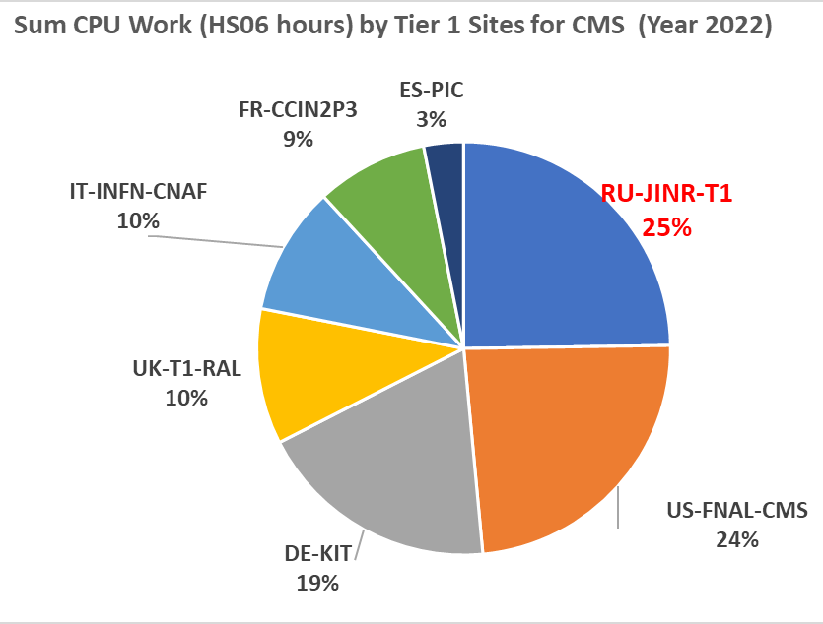
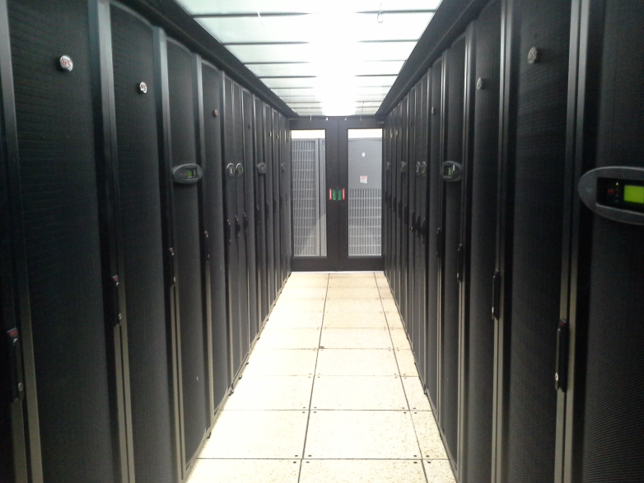
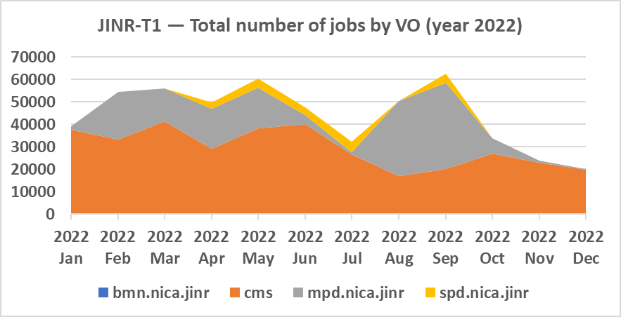
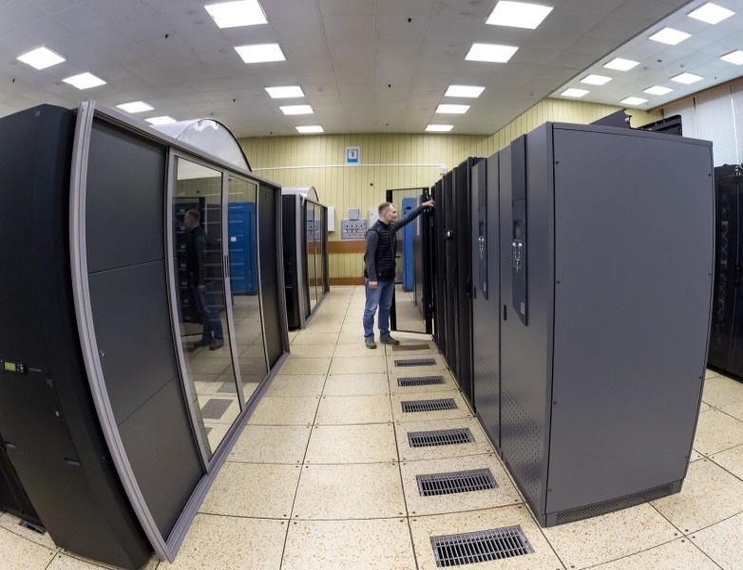
Tier1 at JINR
The JINR Tier1 center has demonstrated stable work not only for CMS (LHC), but also for MPD (NICA).
The Tier1 site for CMS is ranked first among world centers for CMS.
30% of all jobs executed at Tier1 JINR are NICA jobs
  216216 cores
  360 kHS06
  16 PB disks
  52.6 PB tapes
  100% reliability and availability

Slide 8
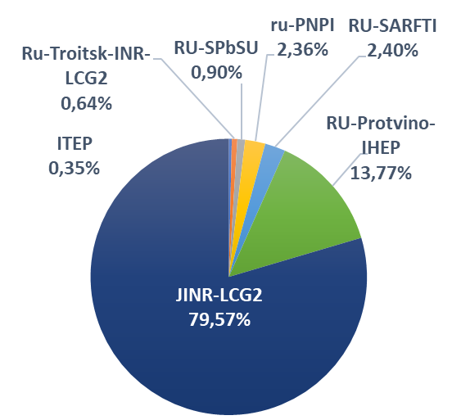
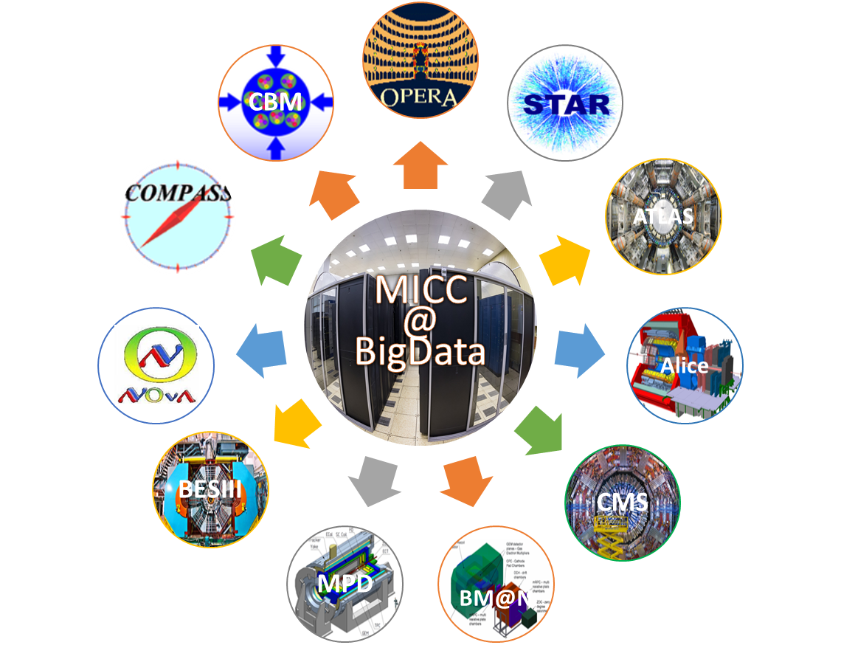
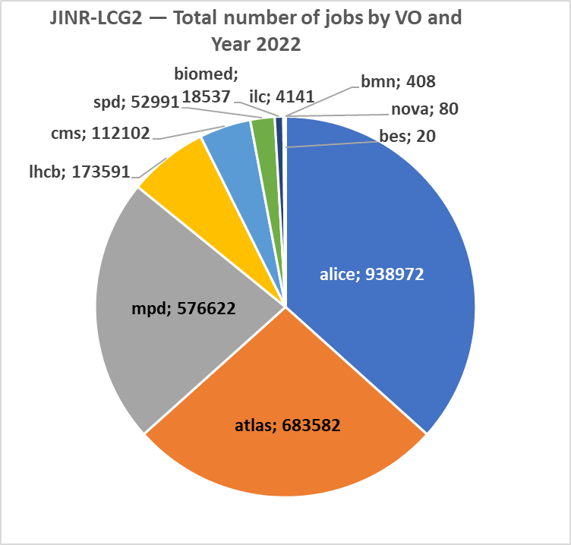
Tier2 at JINR
Tier2 at JINR provides computing power and data storage and access systems for the majority of JINR users and user groups, as well as for users of virtual organizations (VOs) of the grid environment (LHC, NICA, FAIR, etc.).
JINR Tier2 is the most productive in the Russian Data Intensive Grid (RDIG) Federation.
RDIG: distribution by the number of jobs by websites of organizations
(year 2022)
JINR Tier2: Sum CPU work (HS06 hours) by VO (year 2022)

Slide 9
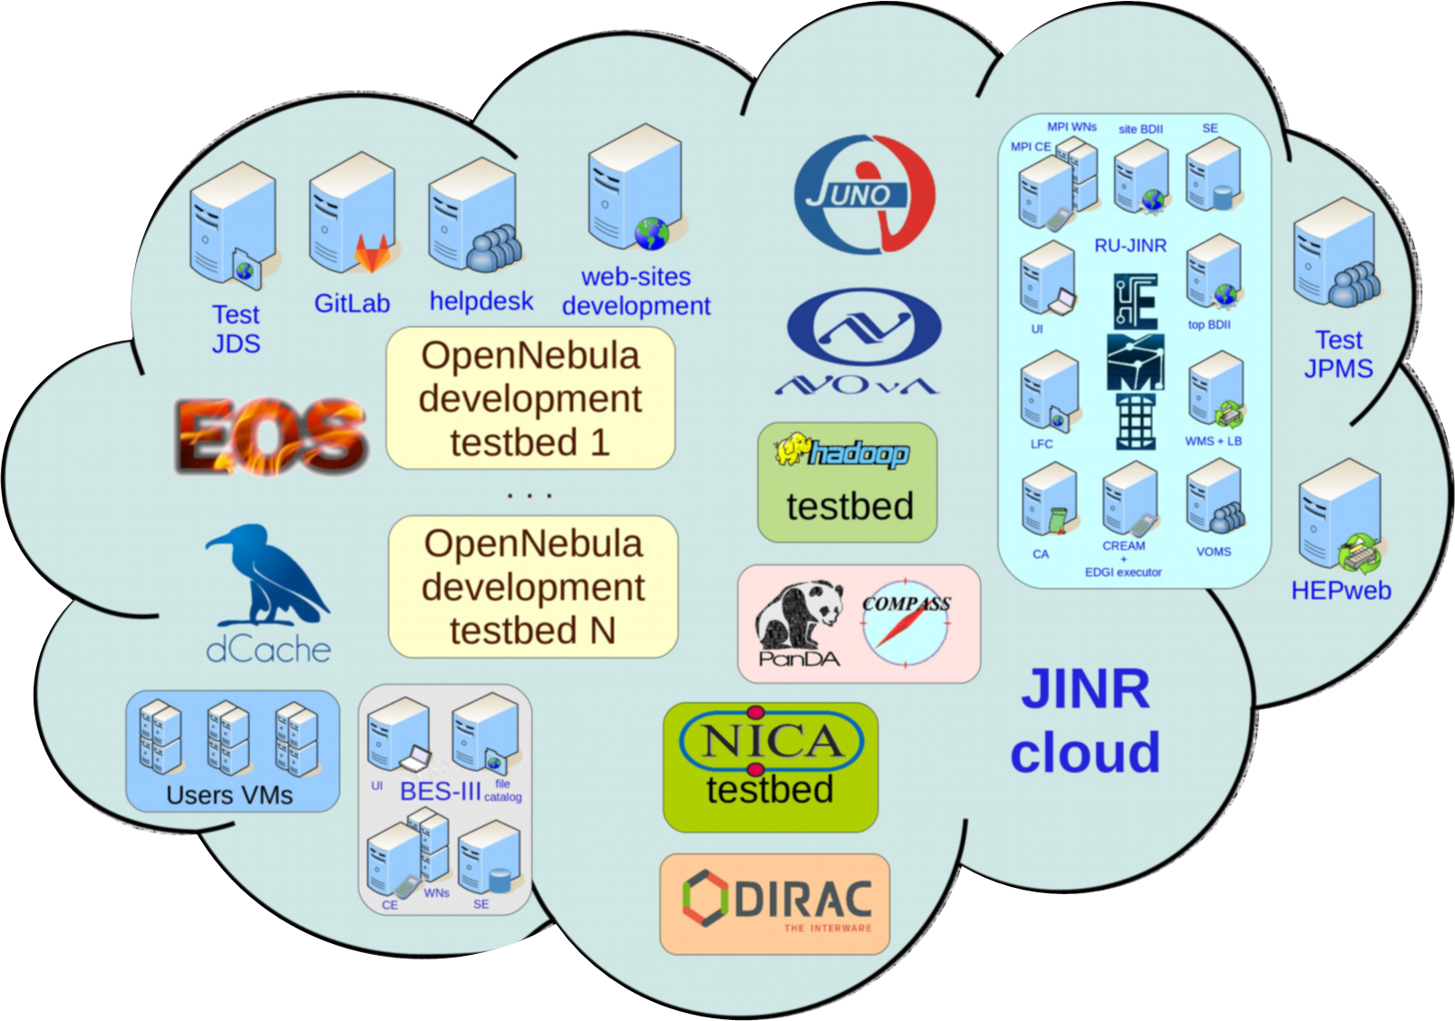
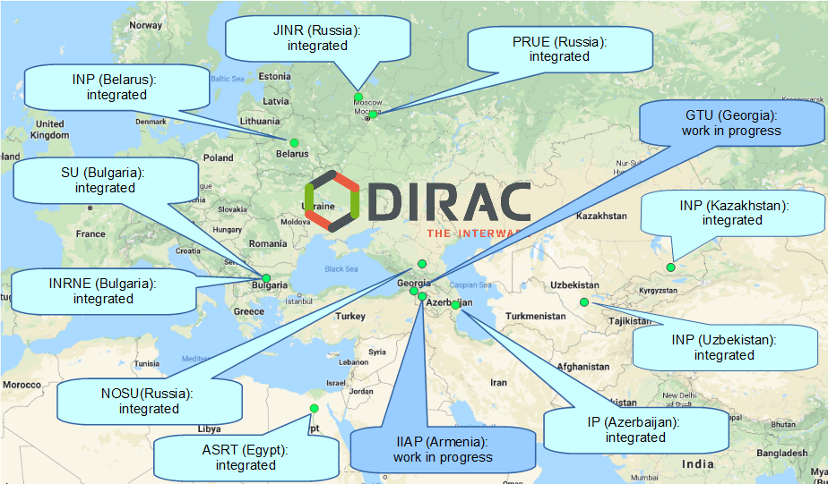
Cloud Infrastructure
Cloud Platform - OpenNebula
Virtualization - KVM
Storage (Local disks, Ceph)
Total Resources
~ 5,000 CPU cores; 60 TB RAM; 4.1 PB of raw ceph-based storage
- VMs for JINR users
  Computational resources for neutrino experiments
  Testbeds for research and development in IT
  COMPASS production system services
  Data management system of the UNECE ICP Vegetation
  Scientific and engineering computing
  Service for data visualization
  Gitlab and some others
DIRAC-based distributed information and computing environment that integrates the JINR Member State organizations’ clouds
Notes:
A universal computing resource that supports individual scientists and provides a variety of common services, ranging from simple websites to complex multi-user computational systems.

Slide 10
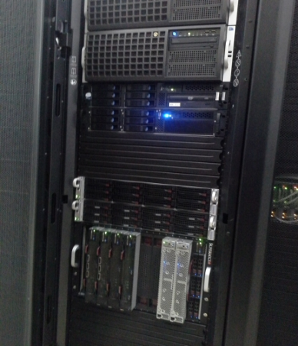
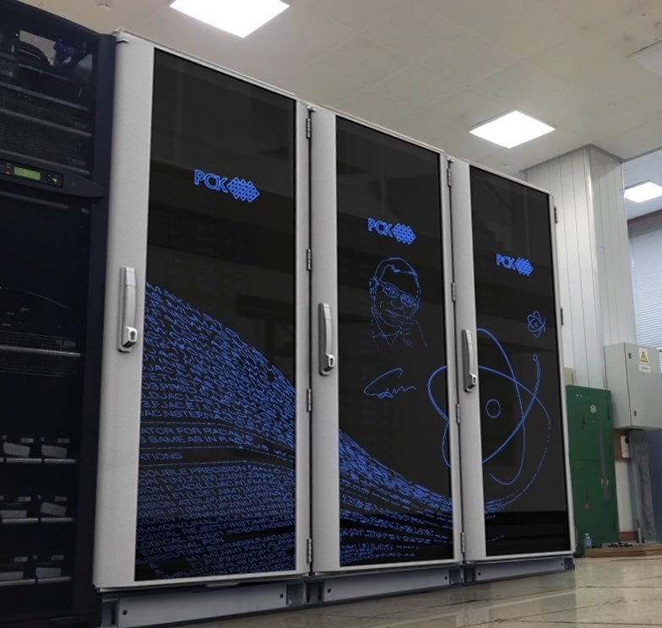
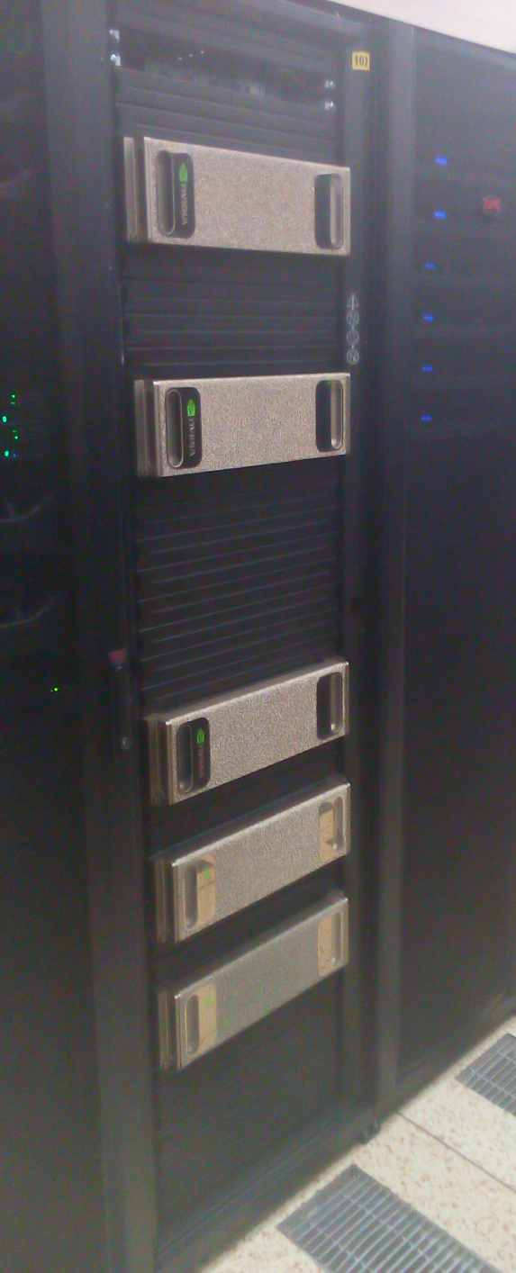
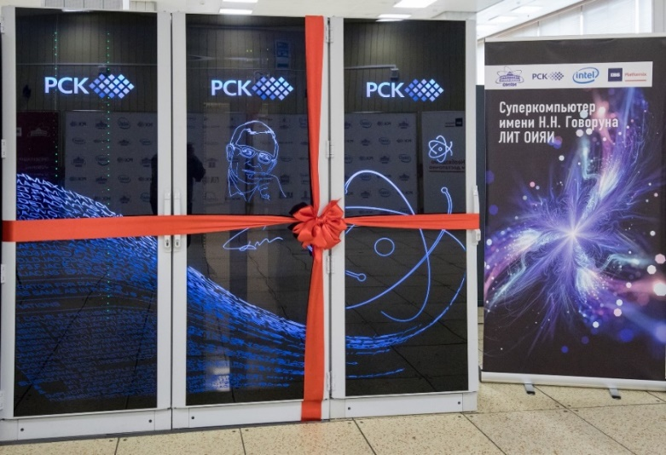
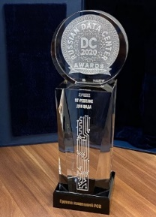
Development of the heterogeneous HybriLIT platform
“Govorun” supercomputer
Second stage 2019:
Full peak performance :
860 TFlops for double precision
288 TB ССХД with I/O speed >300 Gb/s
17th in the current edition of the IO500 list (July 2020)
#10 в Top50
#18 в Top50
“Govorun” supercomputer
First stage 2018:
Full peak performance :
500 TFlops for double precision
9th in the current edition of the IO500 list (July 2018)
Cluster HybriLIT 2014:
Full peak performance:
50 TFlops for double precision
Russian DC Awards 2020 in “The Best IT Solution for Data Centers”

Slide 11
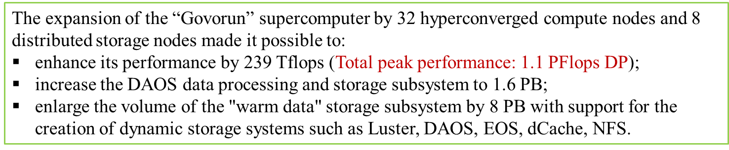
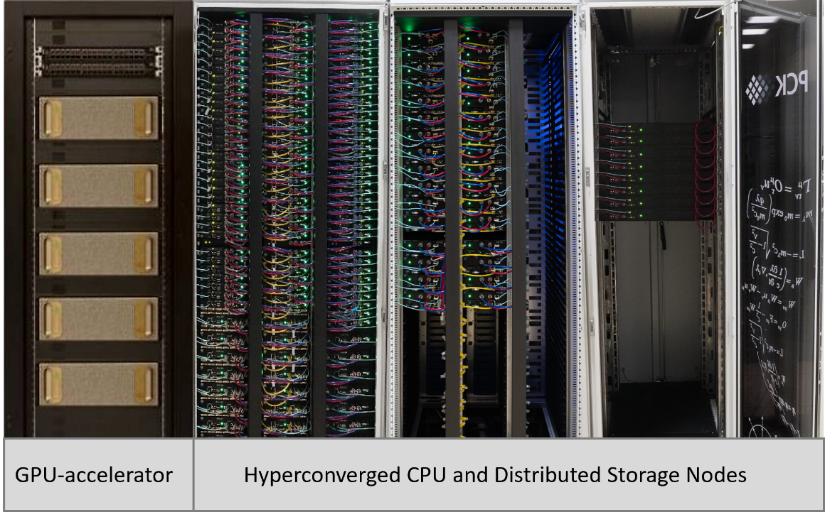
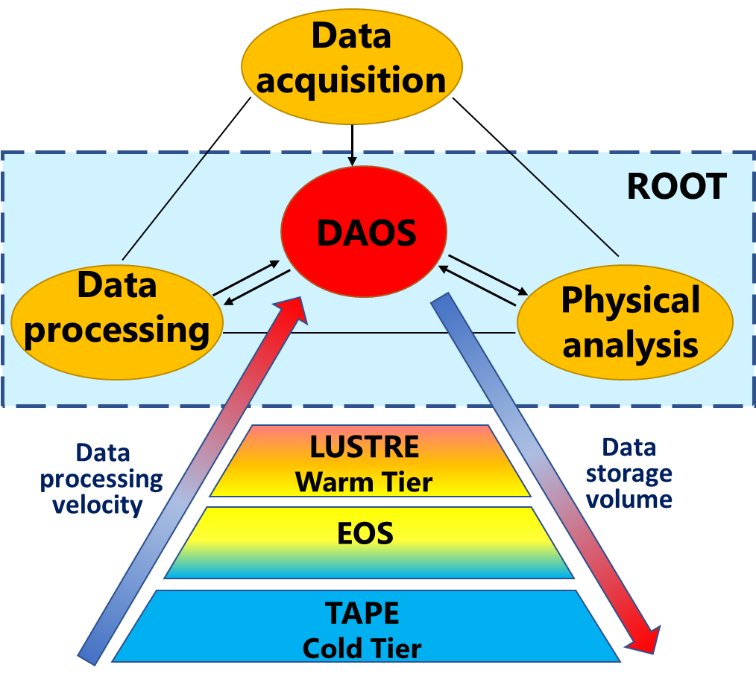
“Govorun” Supercomputer
Hyper-converged software-defined system
Hierarchical data processing and storage system
Scalable solution Storage-on-demand
Total peak performance: 1.1 PFlops DP
GPU component based on NVIDIA
CPU component based on liquid cooling solutions
The most energy-efficient center (PUE = 1.06)
Storage performance >300 GB/s
Key projects that use the resources of the SC “Govorun”:
NICA megaproject,
calculations of lattice quantum chromodynamics,
computations of the properties of atoms of superheavy elements,
studies in the field of radiation biology,
calculations of the radiation safety of JINR’s facilities.
Notes:
The JINR MICC heterogeneous infrastructure is represented by the HybriLIT platform, which involves the training and testing polygon and the “Govorun” supercomputer, driven by a common software and information environment. The “Govorun” supercomputer is a scalable liquid-cooled system with a hyperconverged and software-defined architecture and has unique properties for the flexibility of customizing the user’s task, ensuring the most efficient use of the computing resources of the supercomputer. The current configuration of the “Govorun” supercomputer involves computing modules containing GPU and CPU components, as well as a hierarchical data processing and storage system. The total peak performance of the “Govorun” supercomputer is 1.1 PFlops for double-precision calculations (2.2 PFlops for single-precision calculations) with a read/write speed of 300 GB/sec for the hierarchical data processing and storage system. The resources of the "Govorun" supercomputer are used by scientific groups from all JINR Laboratories to solve a wide range of problems both in the field of theoretical physics and for modeling and processing experimental data. Key projects that use the resources of the “Govorun” supercomputer: NICA megaproject, calculations of lattice quantum chromodynamics, computations of the properties of atoms of superheavy elements, studies in the field of radiation biology, calculations of the radiation safety of JINR’s facilities.

Slide 12
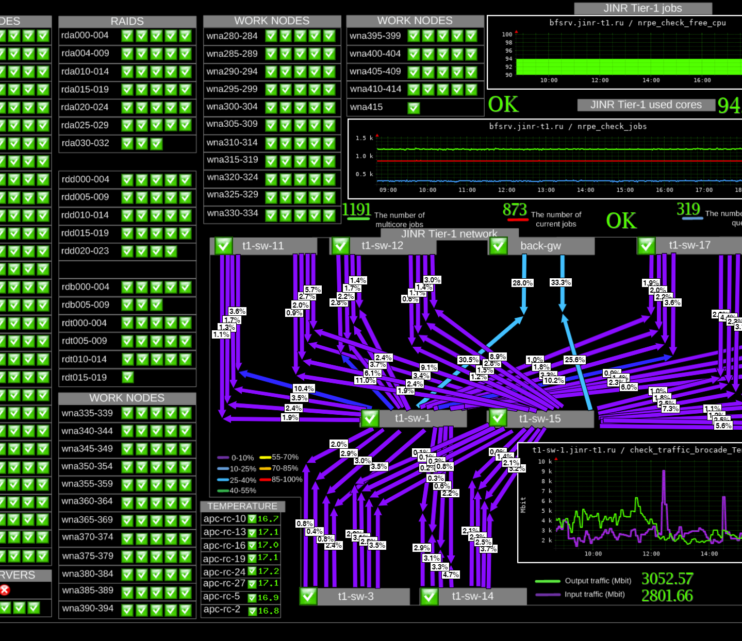
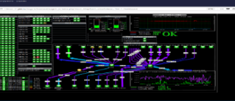

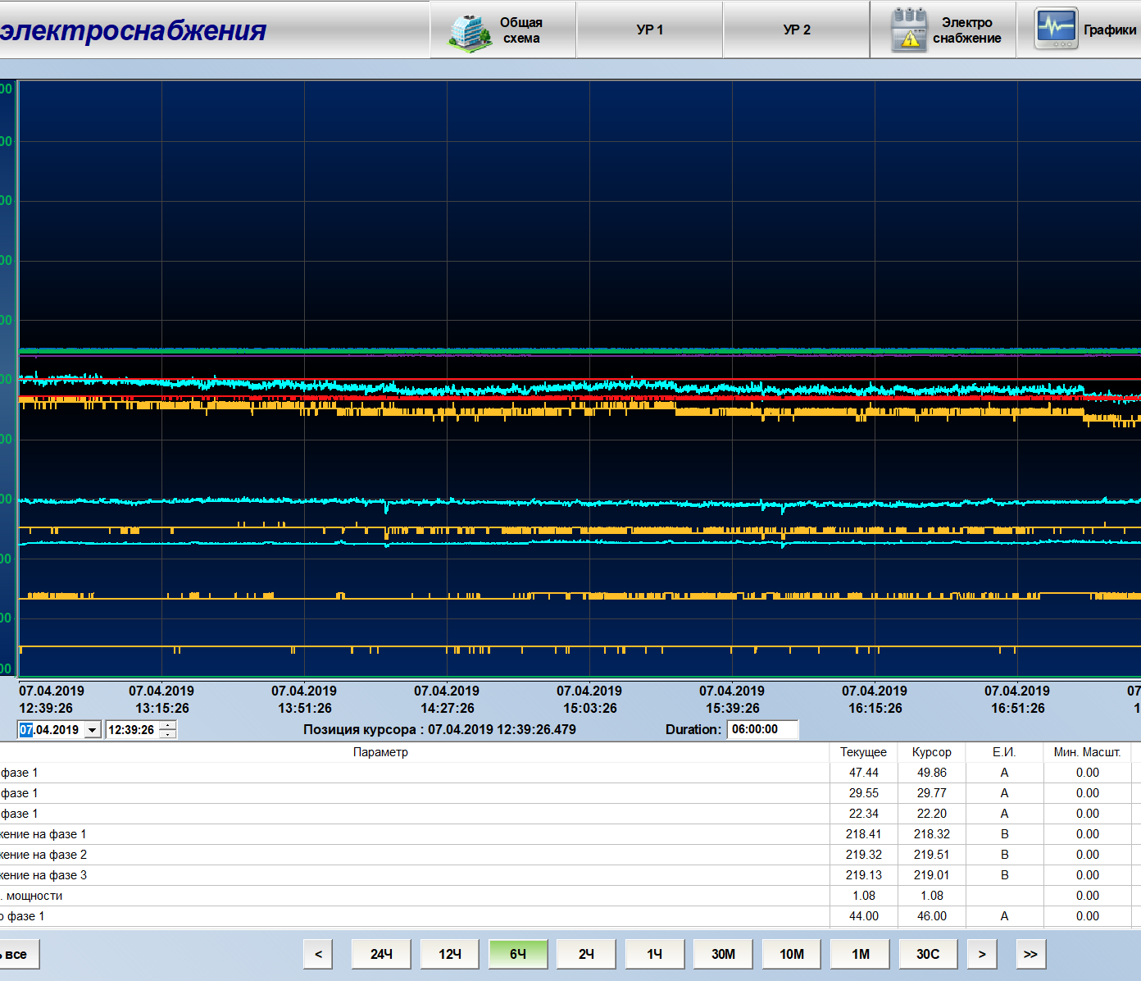
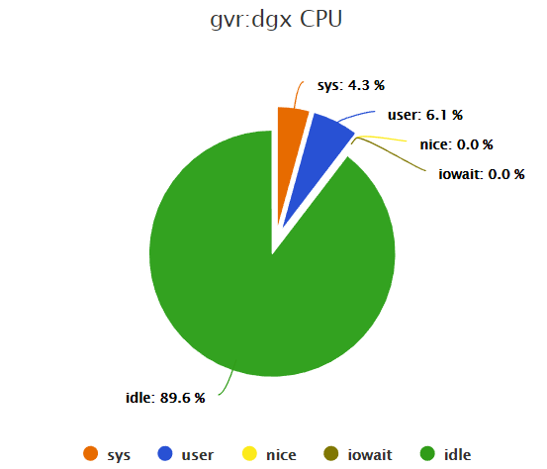
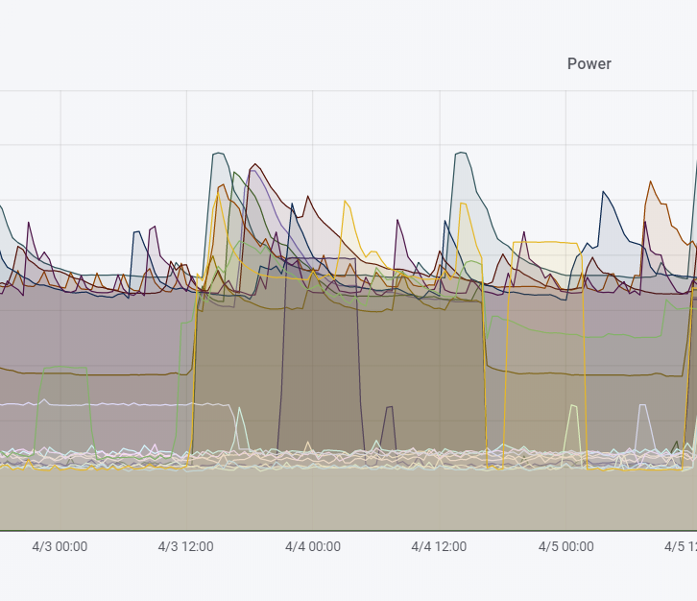
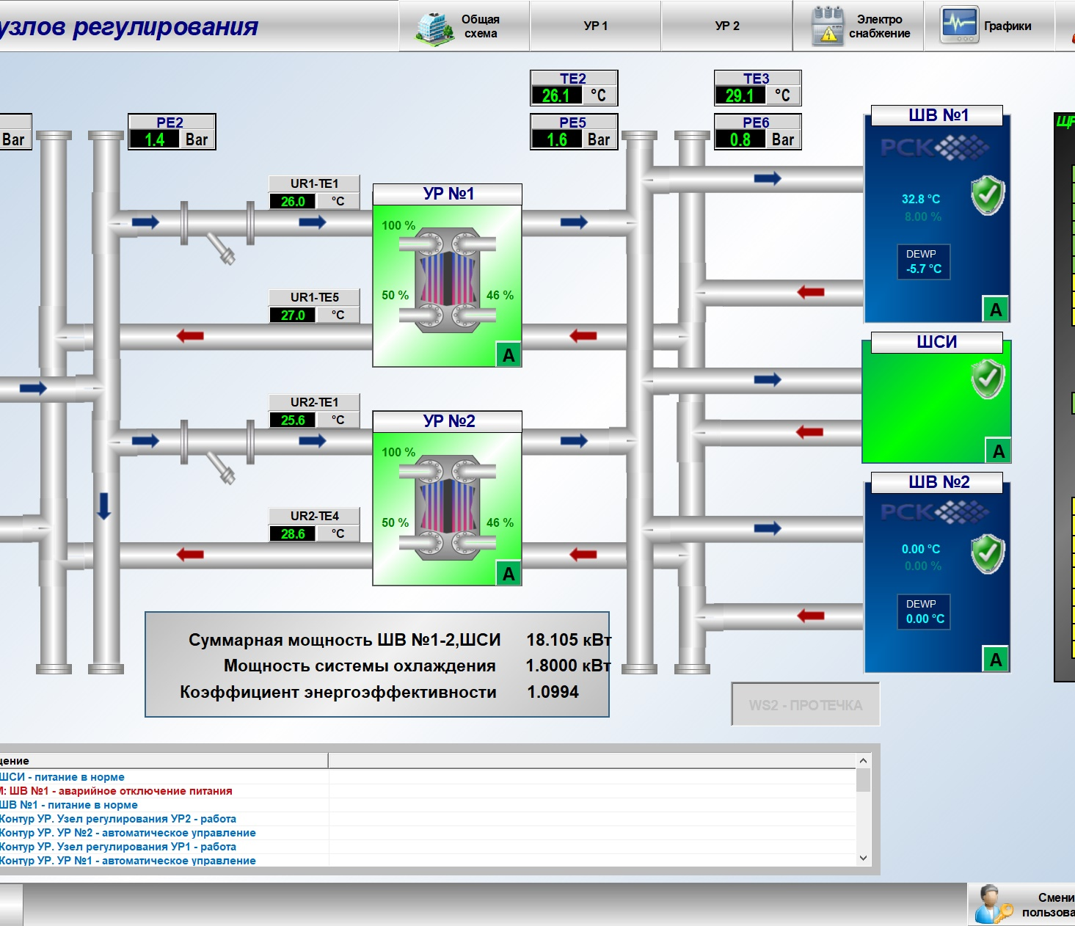
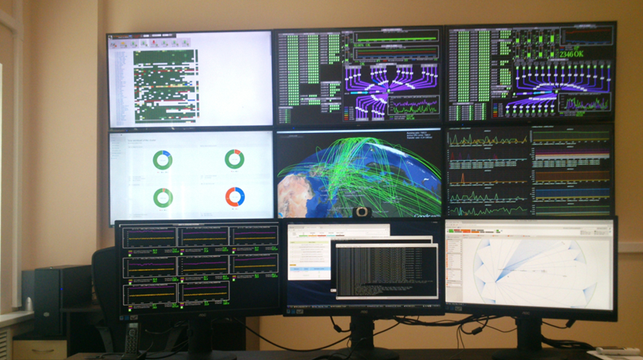
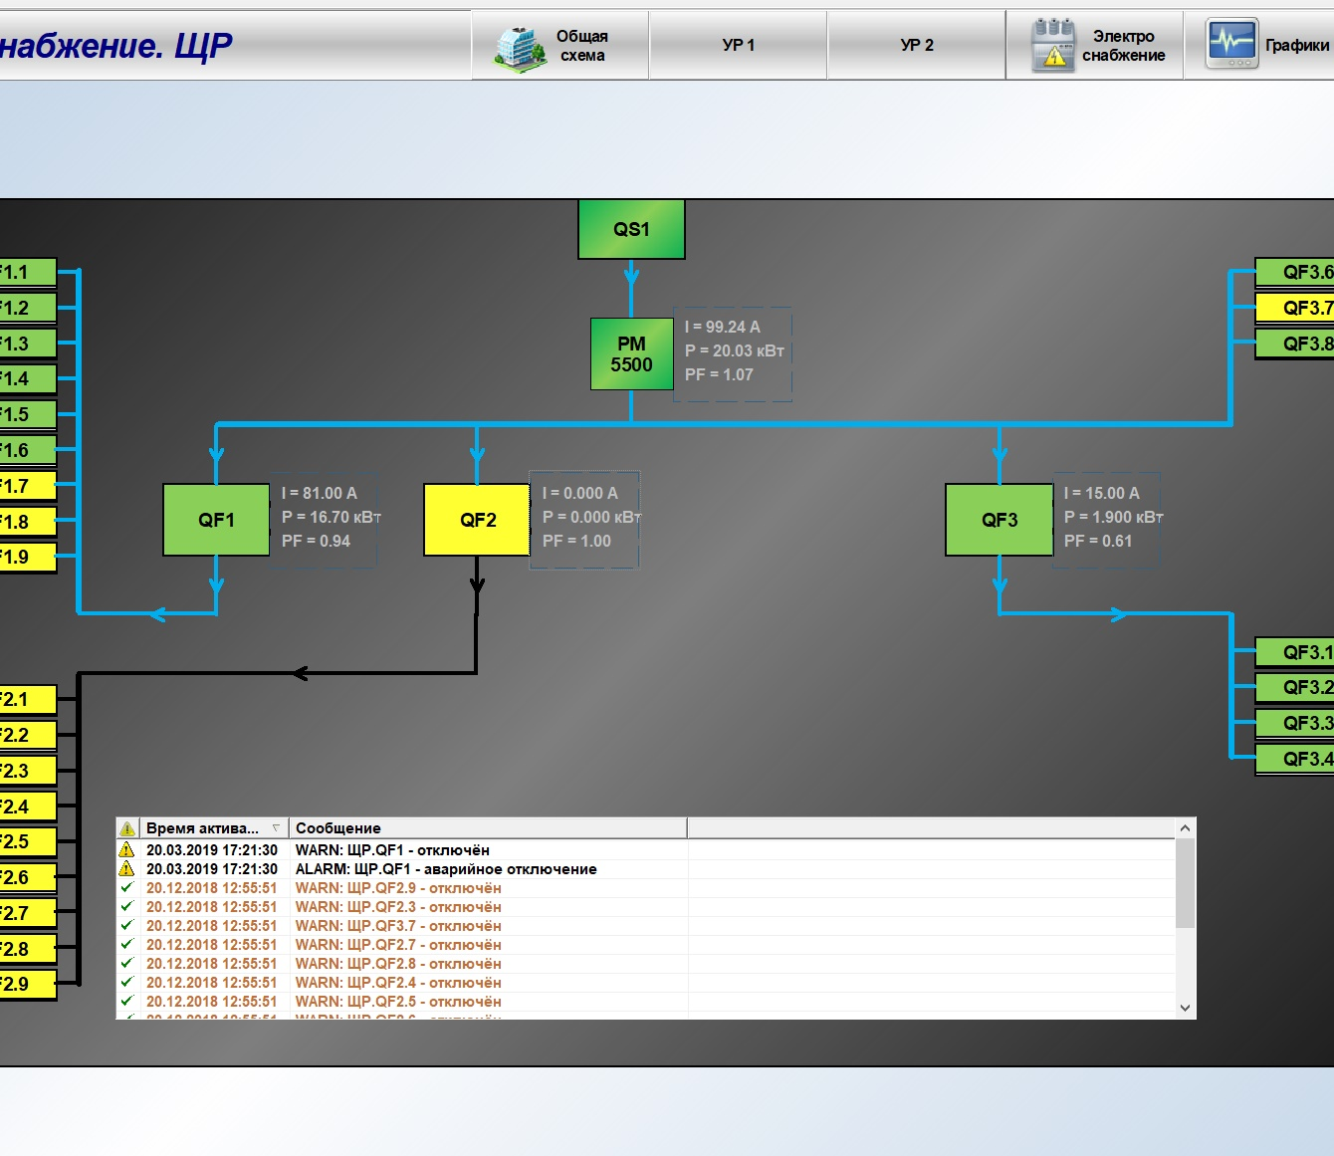
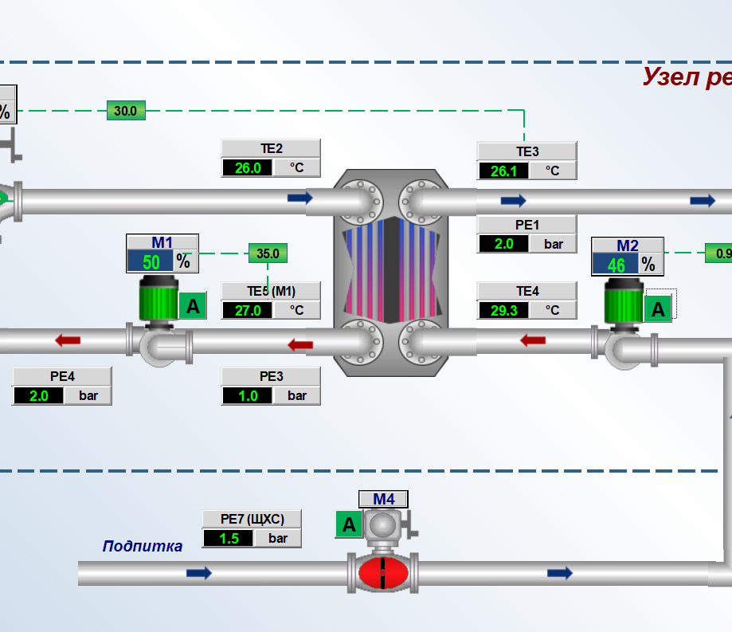
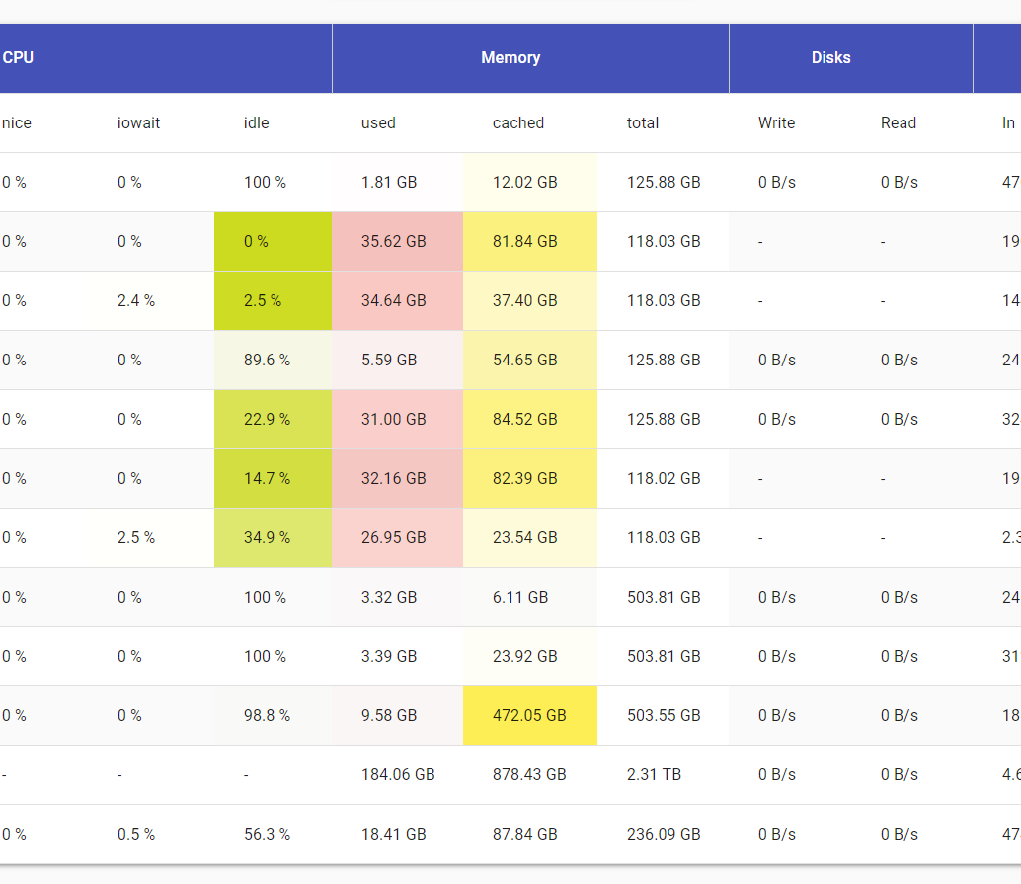
MICC Monitoring
For a robust performance of the complex it is necessary to monitor the state of all nodes and services - from the supply system to the robotized tape library.
Global real time 24x7 survey of the state of the whole computing complex
In case of emergency, alerts are sent to users via e-mail, SMS, etc.
~ 850 elements are under observation
MICC Operational Center
Notes:
Для стабильной работы комплекса необходимо отслеживать состояние всех узлов и сервисов - от системы питания до роботизированной ленточной библиотеки.

Slide 13

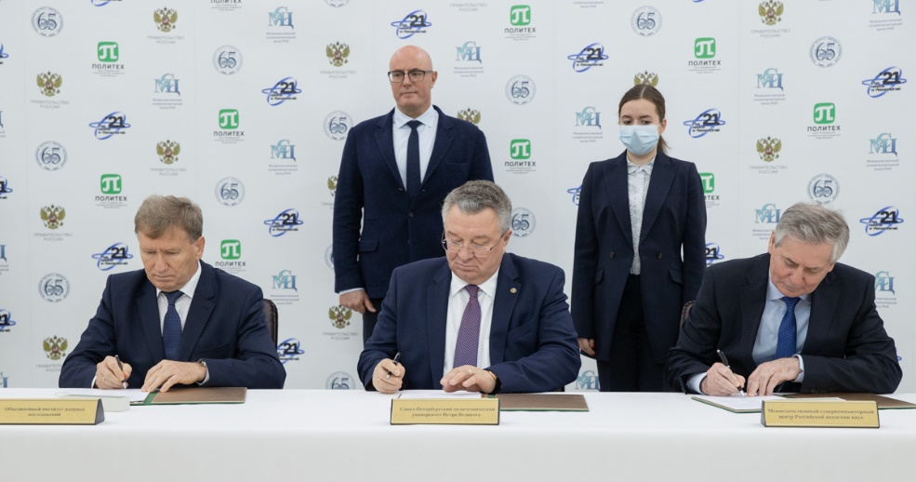










Объединенная географически распределенная
суперкомпьютерная инфраструктура
В январе 2022 года успешно завершен первый совместный эксперимент по использованию объединенной суперкомпьютерной инфраструктуры для задач проекта NICA.
Всего было запущено 3000 задач генерации данных методом Монте-Карло и реконструкции событий для эксперимента MPD. Сгенерировано и реконструировано порядка 3 миллионов событий. Полученные данные перемещены в Дубну для дальнейшей обработки и физического анализа

Slide 14
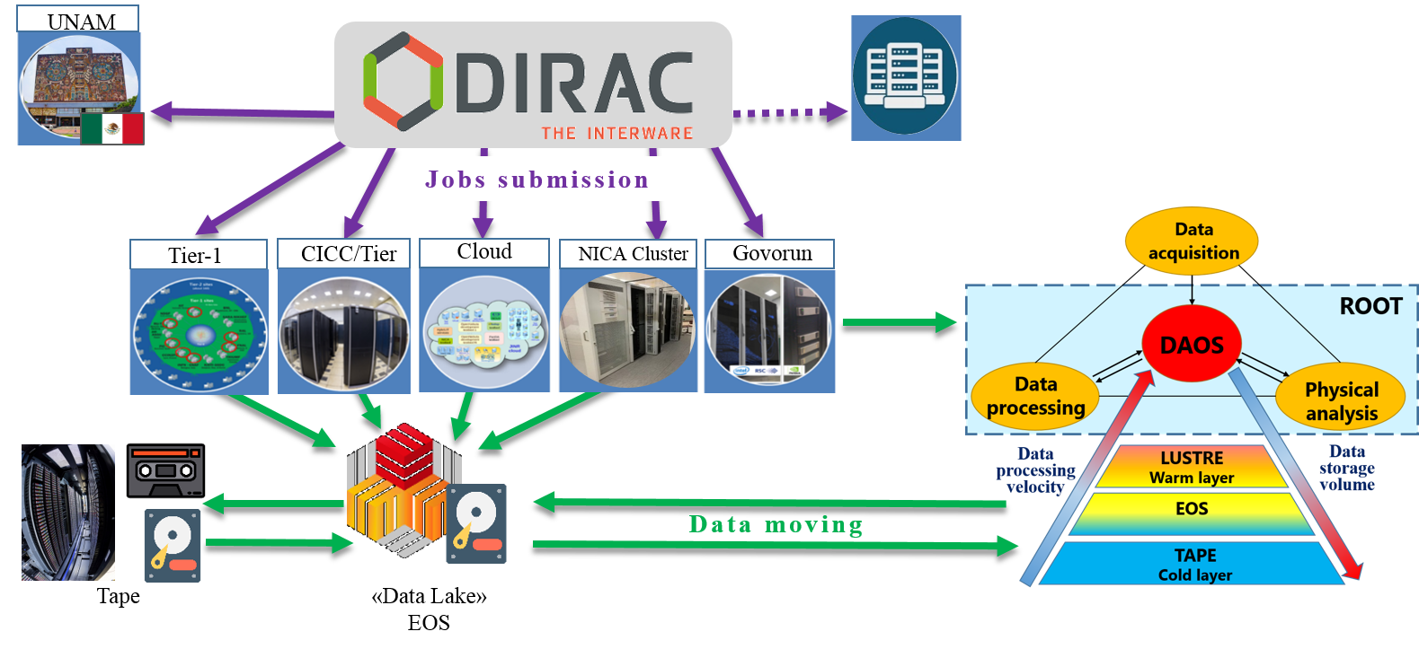


Heterogeneous Distributed Computing Environment
A heterogeneous computing environment, based on the DIRAC platform, was created for processing and storing data of experiments conducted at JINR. Tier1, Tier2, the “Govorun” supercomputer, the clouds of the JINR Member States, the NICA cluster, as well as the resources of the National Research Computer Network of Russia, the cluster of the National Autonomous University of Mexico (UNAM, within cooperation on the MPD project) and the cluster of Institute of Mathematics and Digital Technology (Mongolian Academy of Science), were integrated into
DIRAC. The distributed infrastructure is used by the MPD, Baikal-GVD, BM@N, SPD.
IMDT MAS
Notes:
A heterogeneous computing environment, based on the DIRAC platform, was created for processing and storing data of experiments conducted at JINR. By the end of 2021, all the MICC components, the clouds of the JINR Member States, the NICA cluster, as well as the cluster of the National Autonomous University of Mexico (NAUM, within cooperation on the MPD project), were integrated into DIRAC. The first physics jobs of the BM@N and SPD experiments were launched. For the time being, the distributed infrastructure is used by the following experiments: MPD, Baikal-GVD, BM@N, SPD.
This infrastructure is most actively utilized by the MPD collaboration; it is used for mass Monte Carlo data generation for all physical working groups.

Slide 15
Tier1 – Tier2 in Russia (last 6 Month,
Sum CPU work in HS06 hours)
JINR-T1 1,134,184,442 56.02%
RRC-KI-T1 442,737,446 21,87%
JINR-LCG2 378,846,026 18.71%
RU-Protvino-IHEP 53,421,896 2.64%
ru-PNPI 11,705,844 0.58%
Ru-Troitsk-INR-LCG2 3,036,872 0.15%
RU-SARFTI 546,230 0.03%

Slide 16

From RDIG to RDIG-M
The Russian consortium RDIG (Russian Data Intensive GRID) was set up in September 2003 as a national federation in the EGEE project.
A protocol between CERN, Russia and JINR on participation in the LCG project was signed in 2003. MoU on participation in the WLCG project was signed in 2007.
Consortium RDIG-M − Russian Data Intensive GRID for Megascience projects
WLCG
JINR
PNPI
ITEP
IHEP
SpbSU
INR
RRC-KI
Mega-science
projects
JINR
PNPI
ITEP
IHEP
SpbSU
INR
RRC-KI
S
.
.
S
S
.
.
S
.
.
S
S
.
.

Slide 17
Ожидаемые результаты проекта МИВК:
1. Модернизация инженерной инфраструктуры МИВК ОИЯИ (реконструкция в соответствии с современными требованиями машинного зала 4-ого этажа ЛИТ).
2. Модернизация и развитие распределенной вычислительной платформы для проекта NICA с привлечением вычислительных центров коллаборации NICA.
3. Создание грид-кластера Tier0 для экспериментов мегапроекта NICA для хранения экспериментальных и смоделированных данных. Расширение производительности и емкости систем хранения грид-кластеров Tier1 и Tier2 в качестве центров обработки данных для экспериментов мегапроекта NICA, нейтринной программы ОИЯИ и экспериментов на LHC.
4. Расширение облачной инфраструктуры ОИЯИ с целью увеличения предоставляемого пользователям спектра сервисов на основе технологий контейнеризации. Автоматизация развертывания облачных технологий в организациях стран-участниц ОИЯИ.
5. Расширение платформы HybriLIT, включая суперкомпьютер «Говорун», как гиперконвергентной программно-определяемой среды с иерархической системой хранения и обработки данных.
6. Проектирование и разработка распределенной программно-конфигурируемой высокопроизводительной вычислительной платформы, объединяющей суперкомпьютерные, грид- и облачные технологии для эффективного использования новых вычислительных архитектур.
7. Разработка системы защиты компьютерной инфраструктуры на основе принципиально новых парадигм, включая квантовую криптографию, нейрокогнитивные принципы организации данных и взаимодействия объектов данных, глобальную интеграцию информационных систем, универсальный доступ к приложениям, новые интернет-протоколы, виртуализацию, социальные сети, данные мобильных устройств и геолокации.

