Slide 2
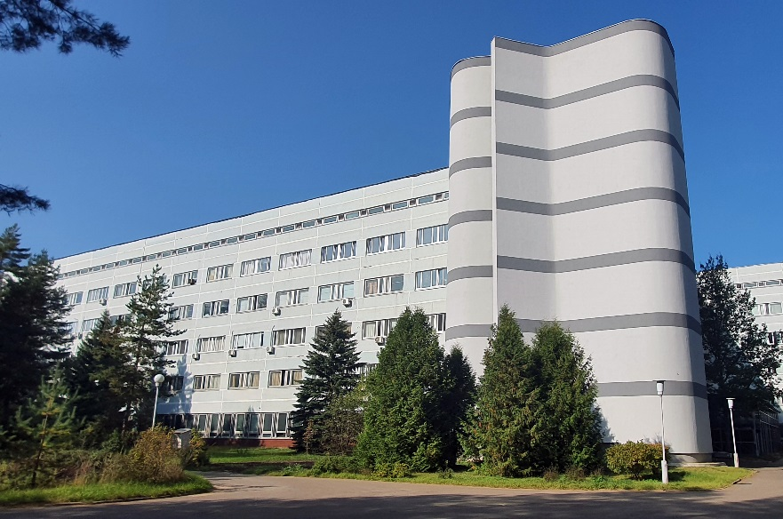
Интеграция вычислительных ресурсов
Научный сотрудник Игорь Пелеванюк
Лаборатория информационных технологий им. М.Г. Мещерякова

Slide 3
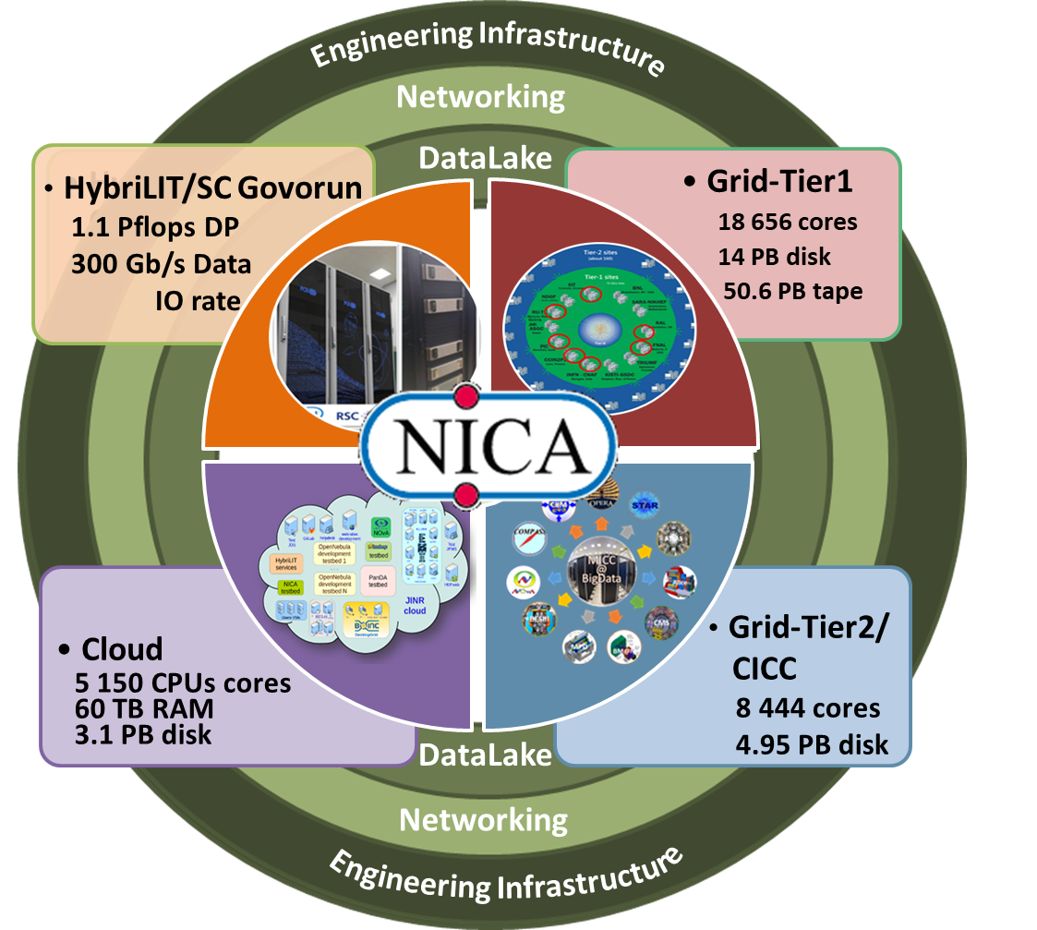
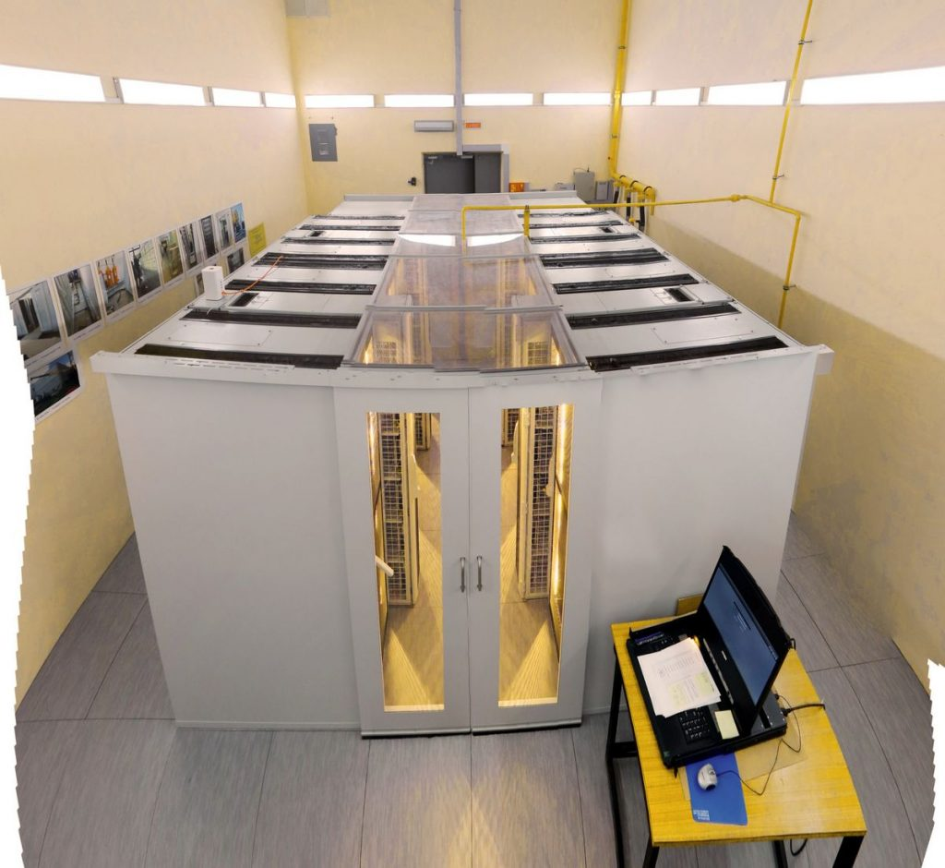
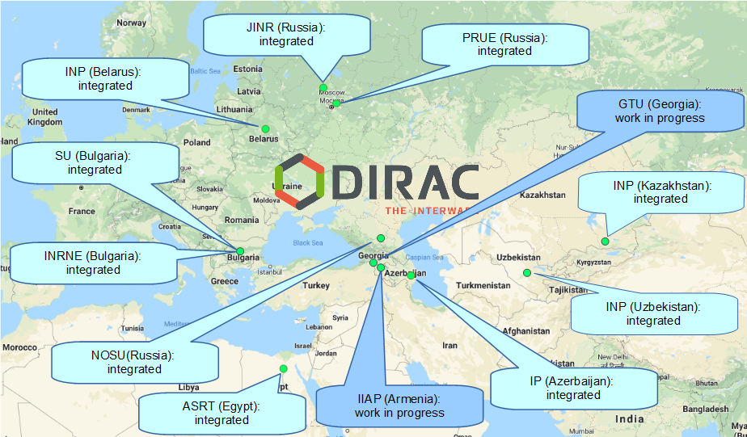
Вычислительные ресурсы
MICC
NICA cluster
JINR Member States
Others...

Slide 4
Зачем интегрировать ресурсы
Большое количество однотипных вычислительных задач - сотни тысяч задач, сотни CPU-лет в год.
Запуск таких объёмов на любом из доступных ресурсов приведёт к одному из двух исходов:
Задачи будут считаться слишком долго
Вычислительный ресурс будет недоступен для других пользователей
Ручной запуск на разных ресурсах превратится в большую проблему для ответственного:
Придётся эмпирически делить нагрузку между ресурсами
Входные данные придётся вручную распределять по разным ресурсам. Сбор результатов так же потребует дополнительных усилий.
Вопросы использования новых появившихся ресурсов – это на 100% проблема конечного пользователя. Ему придётся быть в курсе изменений на всех используемых ресурсах.
В случае появления проблем на ресурсах или обнаружения ошибок в запускаемых задачах пользователю потребуется перезапускать или перенаправлять нагрузку в «ручном режиме»

Slide 5
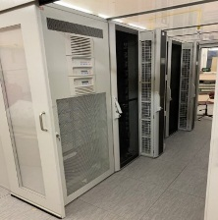
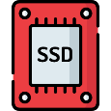
Что было сделано
UNAM
MICC basic facility
NICA cluster
MLIT EOS
Clouds
Tier-1
Tier-2
Govorun
Lustre
Ultra-fast storage
NRCN (National Research Computer Network) is the Russia's largest research and education (R&E) network. May allow execution of jobs submitted to Govorun on a resources of the network. Massive tests with MPD jobs were performed successfully in the beginning of 2022
Polytech
MSC

Slide 6
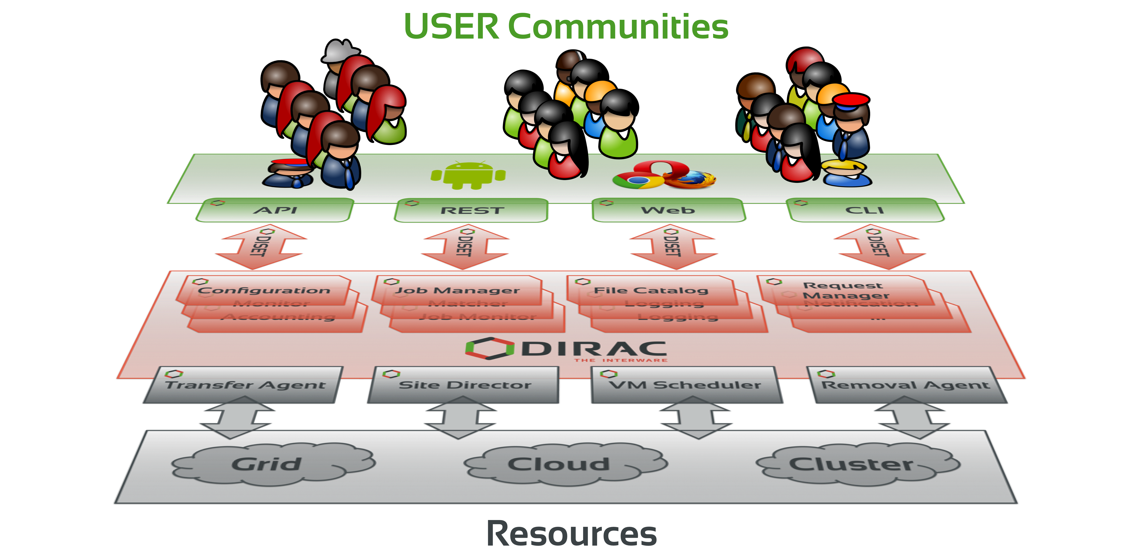
What is DIRAC?
DIRAC provides all the necessary components to build ad-hoc grid infrastructures interconnecting computing resources of different types, allowing interoperability and simplifying interfaces. This allows to speak about the DIRAC interware.
Web
CLI
API
REST

Slide 7
Birth of DIRAC
LHC experiments, all developed their own middleware
PanDA, AliEn, glideIn WMS, PhEDEx, …
DIRAC is developed originally for the LHCb experiment
The experience collected with a production grid system of a large HEP experiment is very valuable
Several new experiments expressed interest in using this software relying on its proven in practice utility
In 2009 the core DIRAC development team decided to generalize the software to make it suitable for any user community.
The results of this work allow to offer DIRAC as a general purpose distributed computing framework
7

Slide 8
Why DIRAC?
1. Single system for all aspects of computing
User Interface
API
Central configuration
Workload management
Data management
Integration tools
File Catalog
Workflow management
Metadata management
Accounting
Management

Slide 9
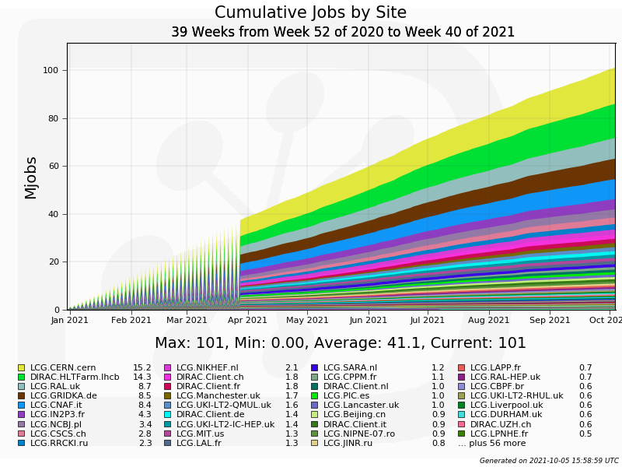
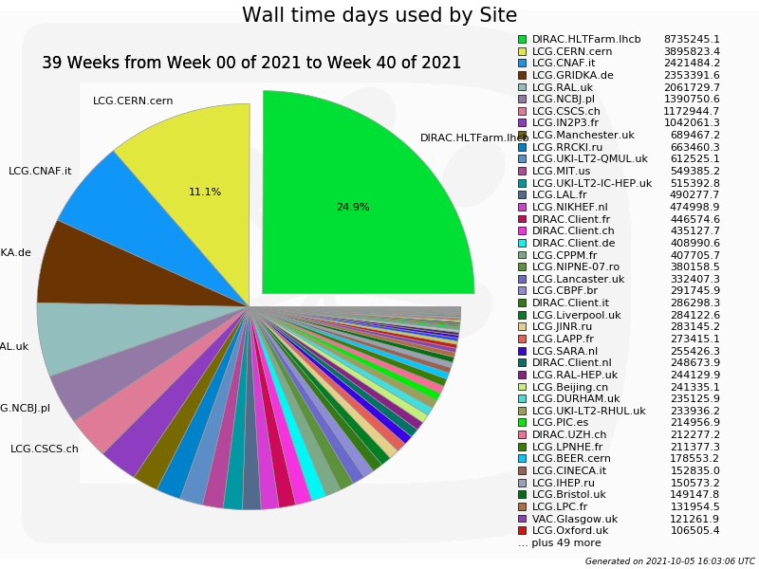
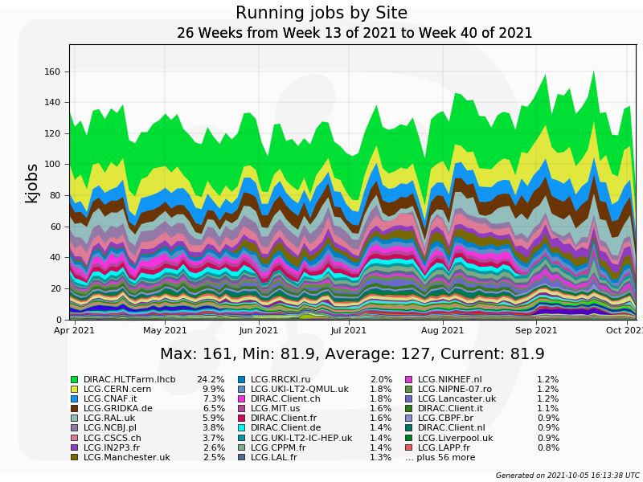
Why DIRAC?
2. Good performance

Slide 10
Why DIRAC?
3. Active users and developers community

Slide 11
DIRAC standard job workflow
1. Initial configuration
2. Input data download
3. Processing
4. Output data upload
5.Finalization

Slide 12
Job example
dirac-configure config.cfg
dirac-dms-get-file /bmn/raw/AuAu/data1002.raw
root –l –q –b reco.MC(“./data1002.raw”)
dirac-dms-put-file /bmn/reco/AuAu/data1002.root \\ data1002.root \\
JINR-EOS-BMN
rm –f data1002.raw data1002.root

Slide 13
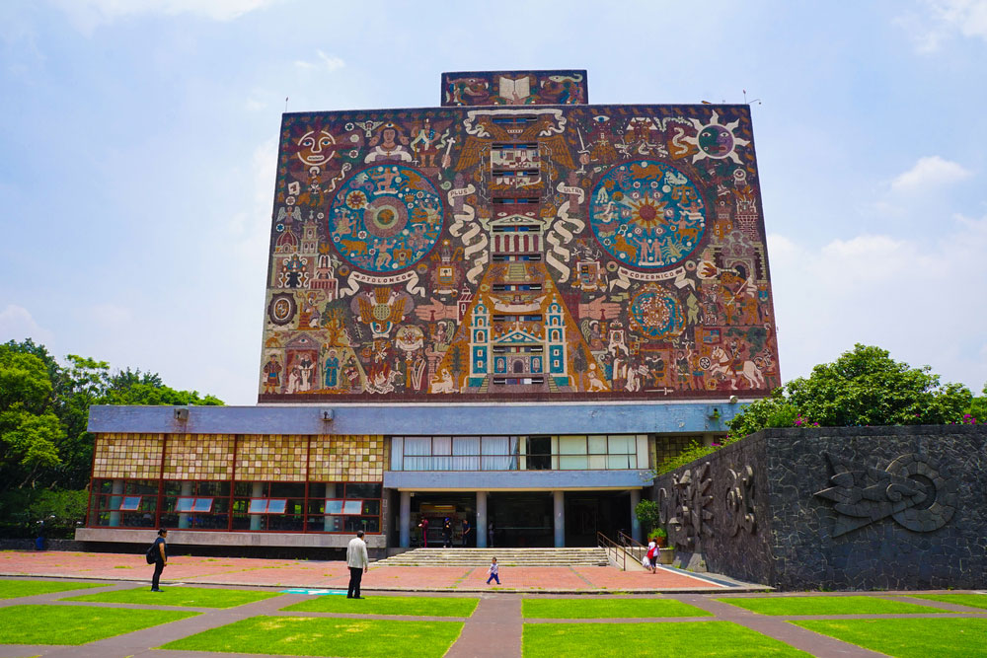
Workload management
Submit thousand of jobs to DIRAC Job Queue
Tier-1
CICC/Tier-2
Clouds
Govorun
NICA Cluster
UNAM

Slide 14
Workload management
Submit thousand of jobs to DIRAC Job Queue
User Job
User Job
User Job
User Job
User Job
User Job
User Job
User Job
User Job
Tier-1
CICC/Tier-2
Clouds
Govorun
NICA Cluster
UNAM

Slide 15
Workload management
Submit thousand of jobs to DIRAC Job Queue
User Job
User Job
User Job
User Job
User Job
User Job
User Job
User Job
User Job
Pilot job
Pilot job
Pilot job
Pilot job
Pilot job
Pilot job
Tier-1
CICC/Tier-2
Clouds
Govorun
NICA Cluster
UNAM

Slide 16
Workload management
Submit thousand of jobs to DIRAC Job Queue
User Job
User Job
User Job
User Job
User Job
User Job
Pilot job
Pilot job
Pilot job
Pilot job
Pilot job
Pilot job
User Job
User Job
User Job
User Job
User Job
User Job
Tier-1
CICC/Tier-2
Clouds
Govorun
NICA Cluster
UNAM

Slide 17
History of DIRAC at JINR
2013 – Development of monitoring system for BES-III installation. First tries to setup and configure DIRAC infrastructure.
2017 – DIRAC Interware installed; basic configuration done. Used for educational purposes. dCache storage integrated, Tier2 integrated.
2018 – HybriLIT integrated. JINR cloud integrated using OCCI protocol. Tests of full cycle of Monte-Carlo for BM@N were performed.
2019 – Clouds of JINR Member-States integrated by module developed in JINR. MPD starts using DIRAC for massive Monte-Carlo production. Tier1, Govorun and EOS integrated in DIRAC.
2020 – Folding@Home jobs submitted to clouds via DIRAC. Baikal-GVD jobs submitted to JINR and PRUE clouds.
2021 – First tests for SPD Monte-Carlo successfully done. First million jobs done!
2022– Total walltime exceeds 1000 years. DIRAC in JINR updated to use Python 3.

Slide 18
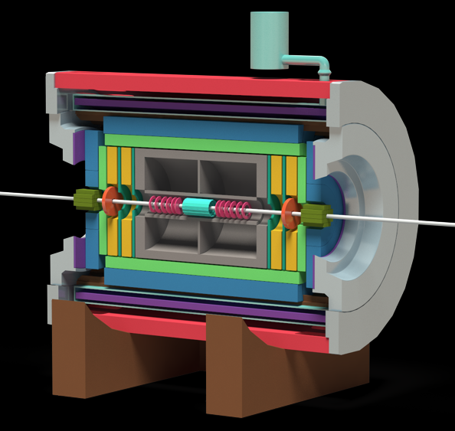
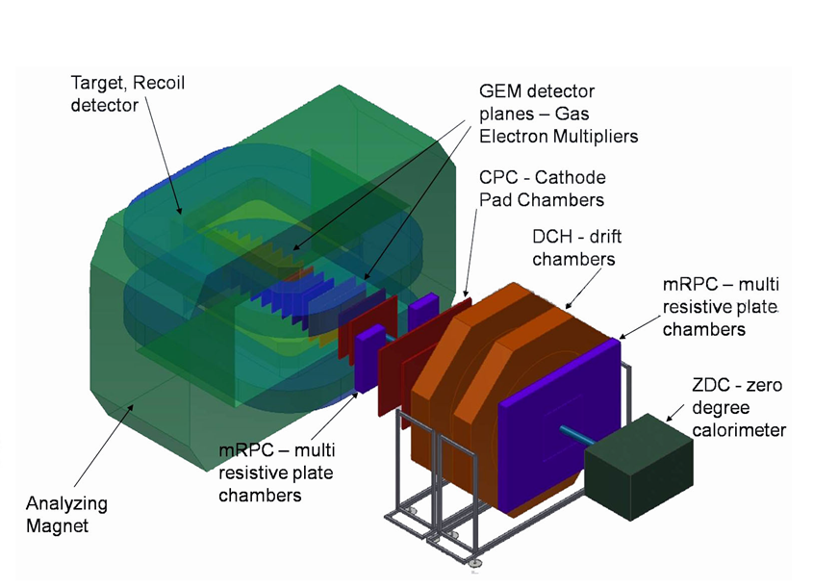
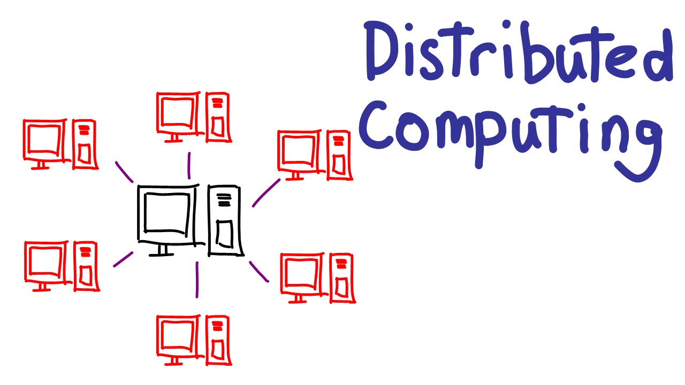
What do we use DIRAC for?
MPD@NICA
Baikal-GVD
BM@N
Monte-Carlo – Real
Analysis – Maybe
Monte-Carlo – Real
Monte-Carlo – Real
Reconstruction – Real
SPD@NICA
Monte-Carlo – Real
Folding@HOME
Teaching

Slide 19
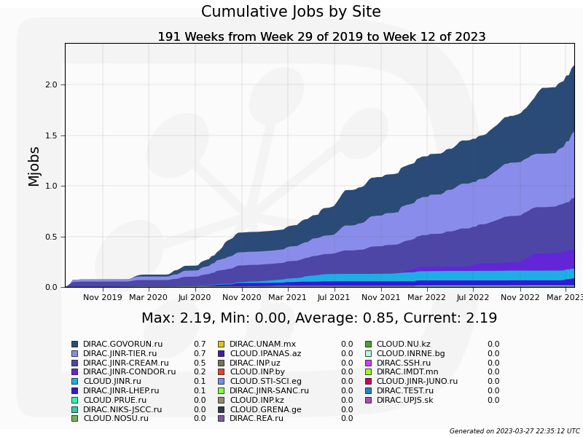
Statistics: jobs done
2 Million jobs

Slide 20
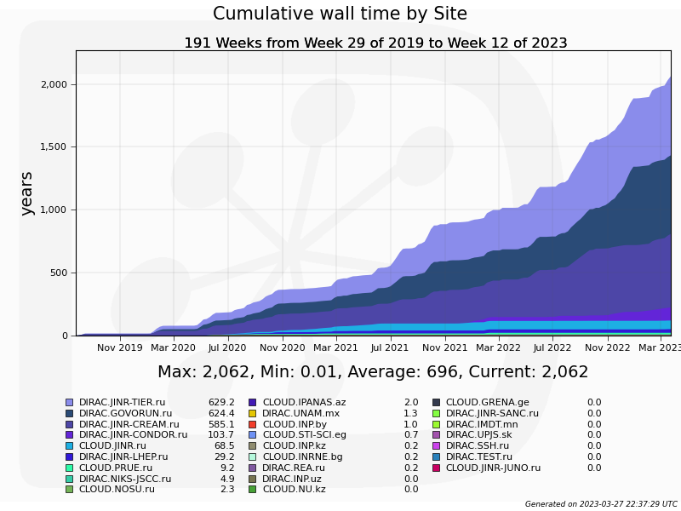
Statistics: walltime
2000 years
of computation on one core

Slide 21
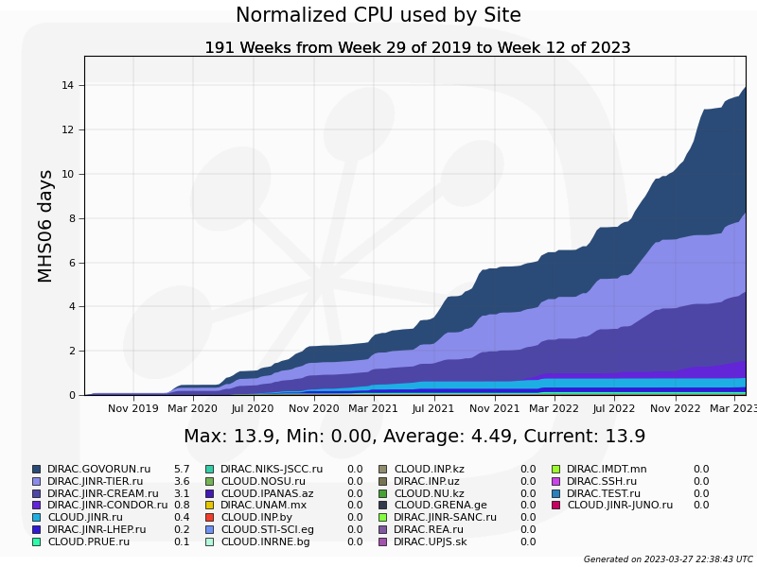
Statistics: normalized time

Slide 22
Ratio: between experiments

Slide 23
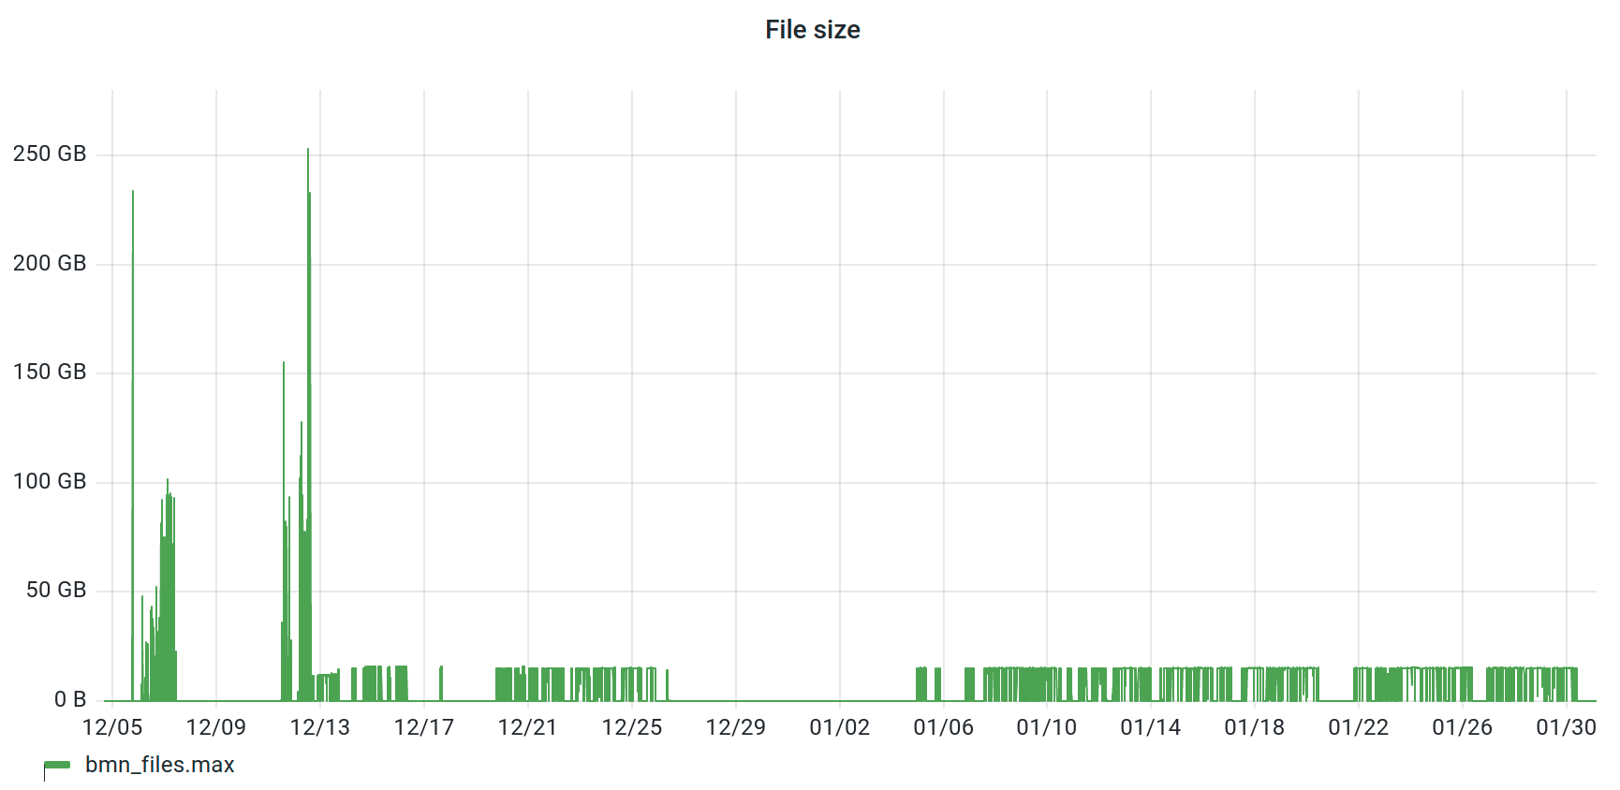
Example:
BM@N run8 raw data processing (with Konstantin Gertsenberger)
Total files ~ 30000
Total raw size ~ 400TB

Slide 24
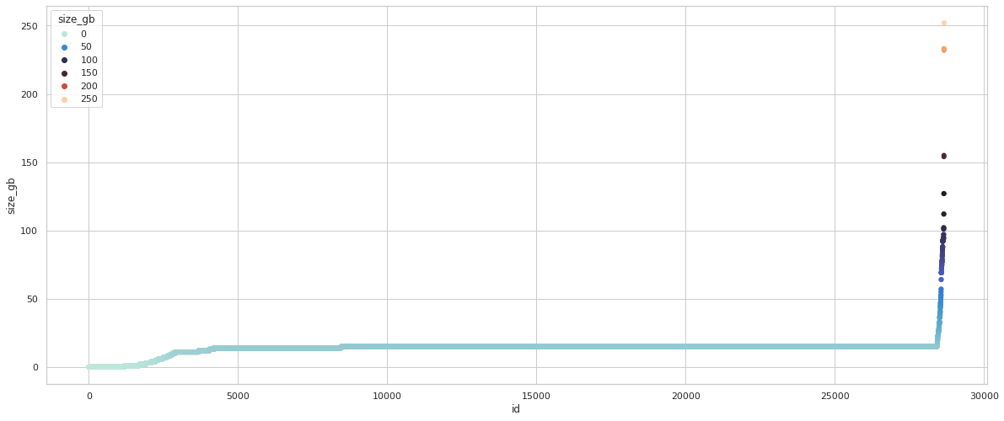
BM@N run8 raw data size
1%
> 16 GB
(Govorun only)
15% < 14 GB
84% 14-16 GB
15

Slide 25
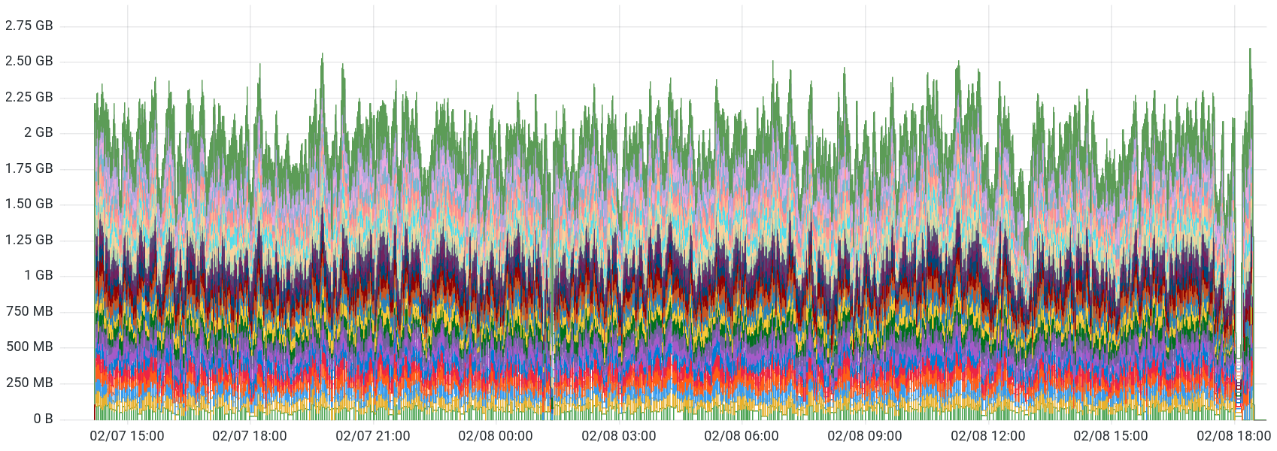
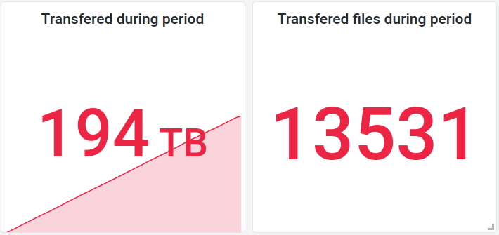
EOS LHEP -> EOS LIT
Average transfer speed on 20 streams 1.92 GB/s

Slide 26
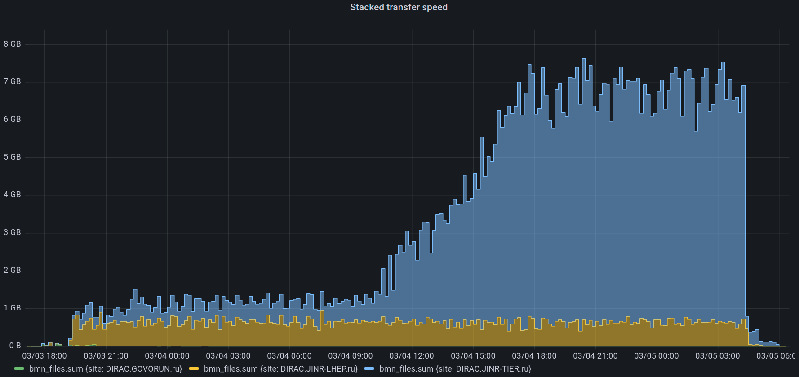
BM@N Digi->Dst
300 jobs running
4 MB/s per job
1580 jobs running
4.1 MB/s per job
NICA Cluster
Tier1

Slide 27
DIRAC: Igor Pelevanyk, Andrey Tsaregorodtzev Baikal-GVD: Dmitry Zaborov BM@N: Konstantin Gertsenberger MPD: Oleg Rogachevskiy, Andrey Moshkin SPD: Alexey Zhemchugov, Katherin Shtejer Responsible for resources: Govorun: Dmitry Podgainy, Dmitry Belyakov, Aleksandr Kokorev, Maxim Zuev, NICA cluster: Boris Schinov, Ivan Slepov Tier-1,Tier-2, EOS: Valery Mitsyn Cloud: Nikolay Kutovskiy, Nikita Balashov dCache: Vladimir Trofimov
List of participants

Slide 28
Detailed articles
1. Gergel, V., V. Korenkov, I. Pelevanyuk, M. Sapunov, A. Tsaregorodtsev, and P. Zrelov. 2017. Hybrid Distributed Computing Service Based on the DIRAC Interware.
2. Korenkov, V., Pelevanyuk, I. & Tsaregorodtsev, A. 2019, "Dirac system as a mediator between hybrid resources and data intensive domains", CEUR Workshop Proceedings, pp. 73.
3. Balashov, N.A., Kuchumov, R.I., Kutovskiy, N.A., Pelevanyuk, I.S., Petrunin, V.N. & Tsaregorodtsev, A.Y. 2019, "Cloud integration within the DIRAC Interware", CEUR Workshop Proceedings, pp. 256.
4. Korenkov, V., Pelevanyuk, I. & Tsaregorodtsev, A. 2020, Integration of the JINR hybrid computing resources with the DIRAC interware for data intensive applications.
5. Kutovskiy, N., Mitsyn, V., Moshkin, A., Pelevanyuk, I., Podgayny, D., Rogachevsky, O., Shchinov, B., Trofimov, V. & Tsaregorodtsev, A. 2021, "Integration of Distributed Heterogeneous Computing Resources for the MPD Experiment with DIRAC Interware", Physics of Particles and Nuclei, vol. 52, no. 4, pp. 835-841.
6. Pelevanyuk, I., "Performance evaluation of computing resources with DIRAC interware", AIP Conference Proceedings 2377, 040006 (2021)

Slide 30
Computing Resources
MPD collaboration
JINR
Tier-1
920 slots
CICC/Tier-2
1000 slots
Cloud
80 slots
Govorun
184-3000 slots
NICA Cluster
250 slots
UNAM
100 slots
Clouds
IPANAS
16 slots
INP
132 slots
SU
48 slots
INRNE
20 slots
INP
50 slots
REA Plehanova
132 slots
NOSU
84 slots
STI-SCI
98 slots
Total amount of cores exceeds 5000

Slide 31
Individual CPU core performance study
Centralized job management gives possibility for centralized and unified performance study of different computing resources.
Before running user jobs DIRAC Pilots execute benchmark for CPU core they are running on.
Benchmark is DiracBenchmark2012 or DB12. It evaluate just CPU core performance. Disk I/O, RAM speed, Network, CPU caches and other highly important aspects of performance are neglected by DB12.

Slide 32
DB12 benchmark study
Piece of road from point A to B
A Monte-Carlo task
Speed of the car
Performance of the computer
Time to complete
Time to complete
$$Time= \frac{Amount of work}{Speed of computer}$$
DB12 gives results like: 10(old slow core), 17 (standard server core), 27 (high performance core)
What if we build a plot, where X is DB12 result, Y is time in seconds. Then, every point on the plot represent one job.
It would be mostly useless if all jobs were unique and different. But, in the real life there are usually many similar jobs.

Slide 33
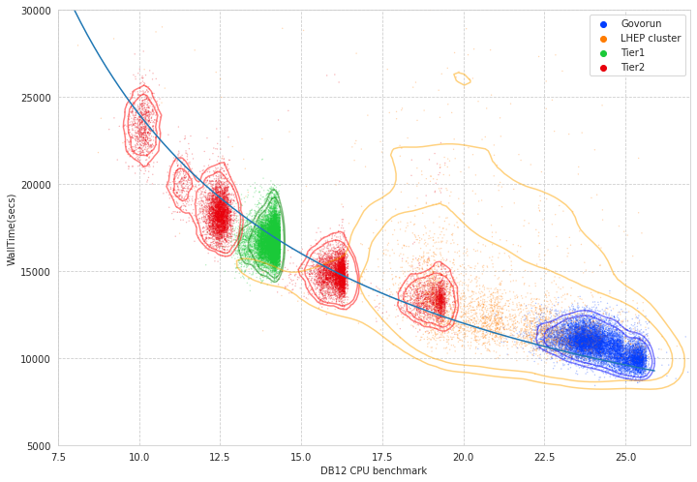
Performance analysis

Slide 34
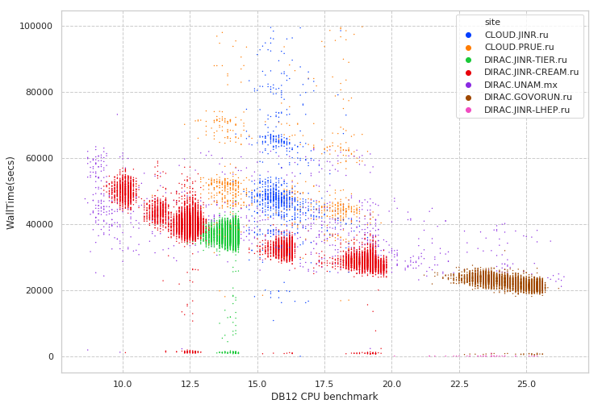
Performance analysis
Folding@Home
MPD MC
Immediate errors or short jobs
Errors during execution

Slide 35
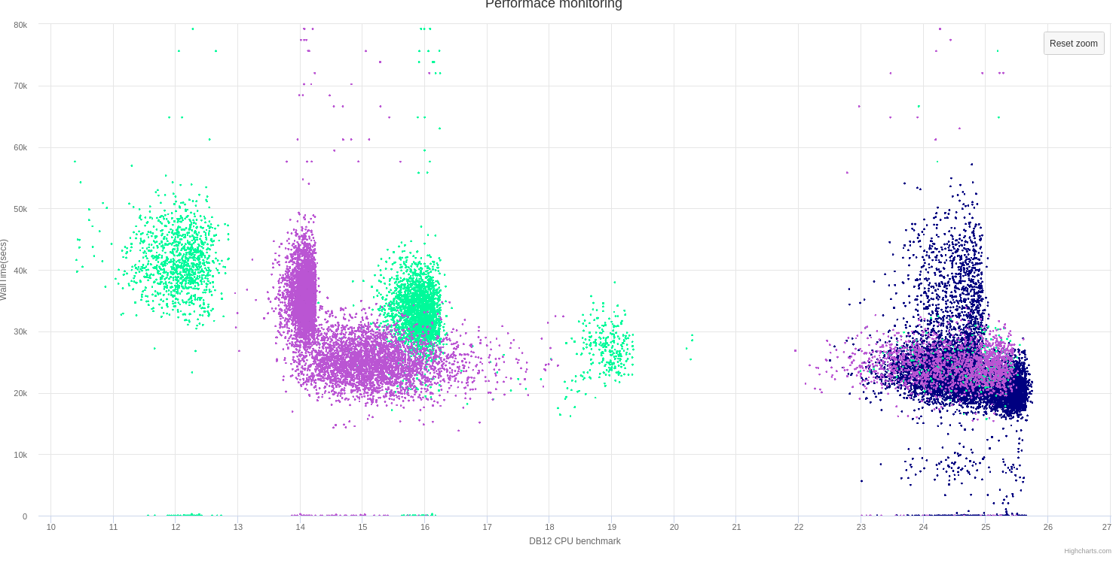
Discoveries
Wrong AMD processors estimation
Occasional speed loss on high ram Govorun nodes
Walltime
DB12 benchmark

Slide 36
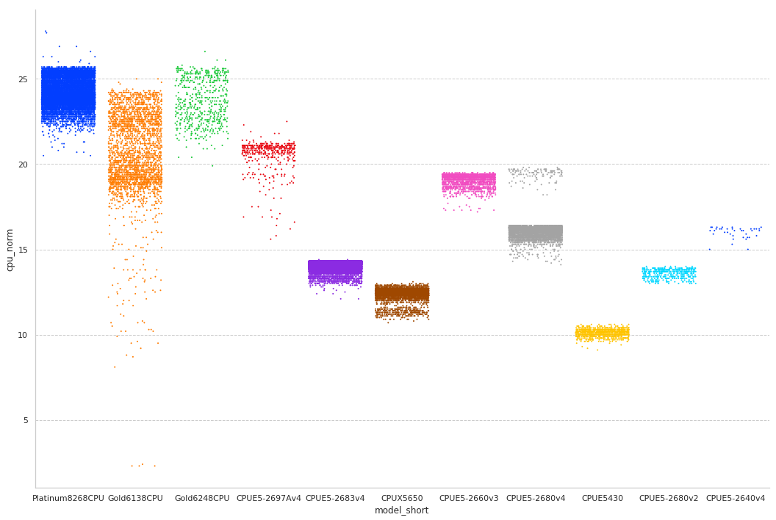
CPU core performance

Slide 37
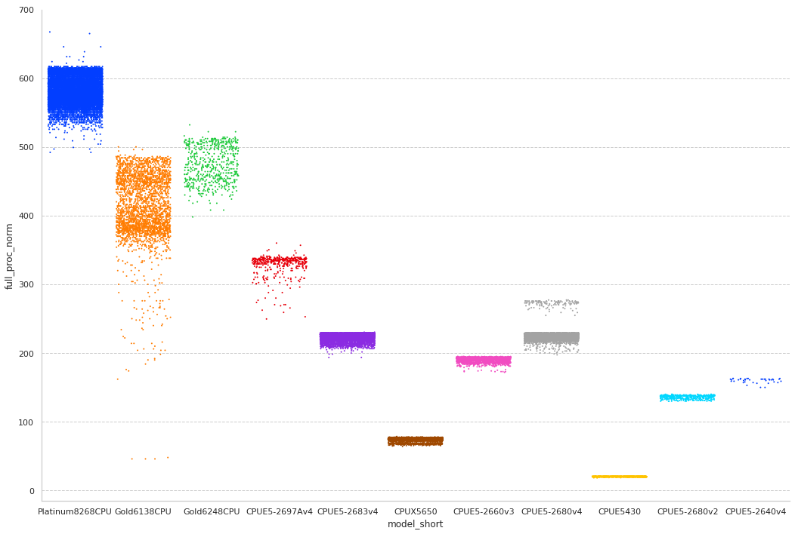
Total CPU performance

Slide 38
User job monitoring
$ root macro.c(input)
$ job_monitoring root macro.c(input)
User job (root)
job_monitoring
User job (root)
Monitoring DB (InfluxDB)

Slide 39
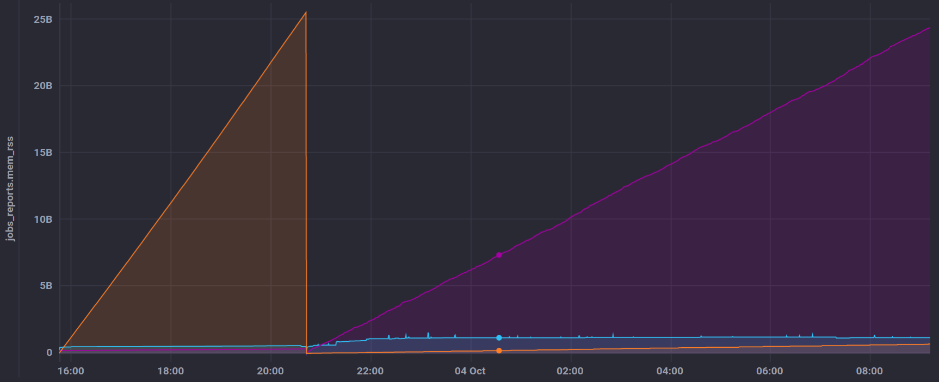
User job monitoring
GenToDst job on Govorun
Disk out
Disk in
RAM usage

