Slide 1
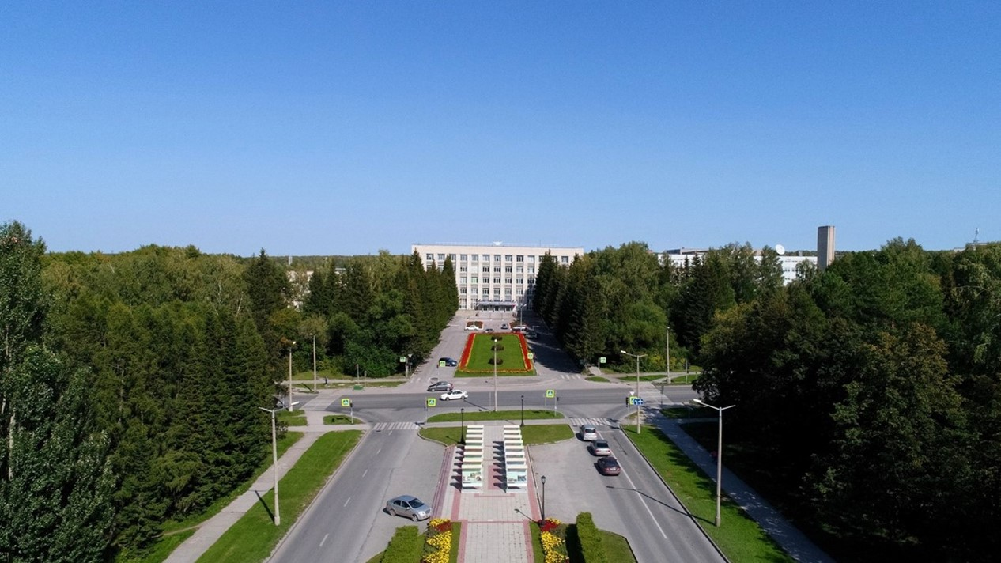
The Budker Institute of Nuclear Physics

Slide 2
SPD Magnet

Slide 3
SPD Magnet (geometry)
Cryostat: Outer diameter -4008 mm;
Inner diameter - 3468 mm;
Length 4080 mm;
Thickness - 270 mm;
Cold mass: Outer diameter -3756 mm;
Inner diameter - 3662 mm;
Length 3330 mm;
Coils: (2 pieces): Number of layers - 2; Number of turns 2x150=300.
(1 piece): Number of layers - 2; Number of turns 2x75=150
Total number of turns - 750
Weight: - cryostat - 16200 kg
- shield - 1020 kg
- cold mass - 5240 kg
Total: ~22.5 t

Slide 4
Inner diameter is 4008 mm, Outer diameter is 3468 mm, length is 4080 mm Outer diameter of coils is 3708 mm, length: two coils - 1260 mm, one – 630 mm. Gap between coils 70 mm
SPD Magnet (dimensions)
The main characteristics of the magnet:
Magnetic field along the axis - 1.0T with uniformity ± 2%;
The superconductive solenoid consists of three coils, the current is 5200 A.
Conductor type: Rutherford type cable consists of 8 strands with a diameter of 1.4mm and a Cu / NbTi ratio of one, extruded into a matrix of high purity aluminum A996, the conductor cross-section at a temperature of 4.5K is 7.90mm in width and 10.90mm in height;
Switching box
Guides for placing the calorimeter

Slide 5
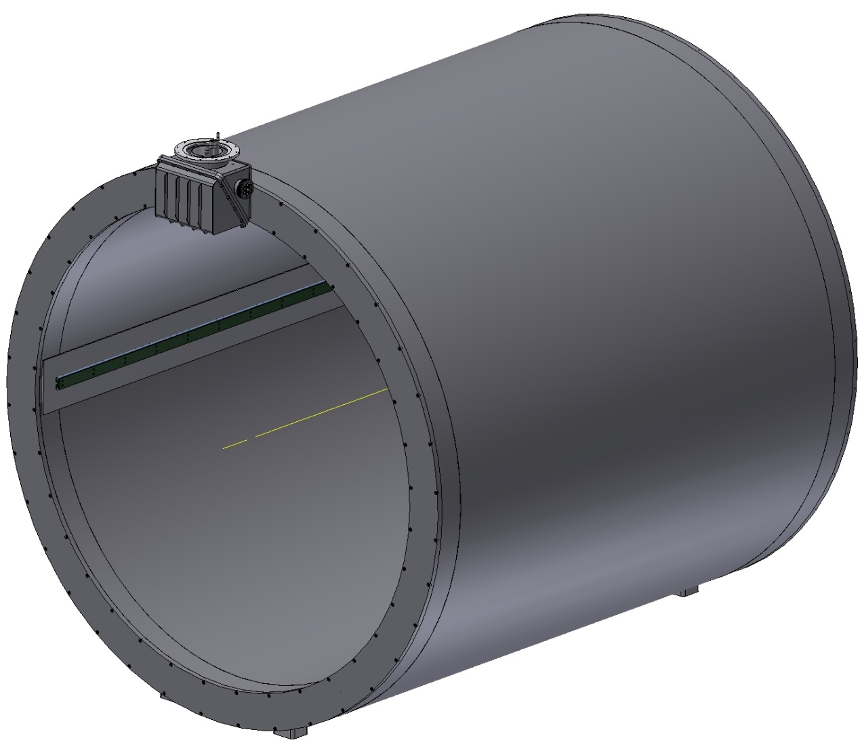
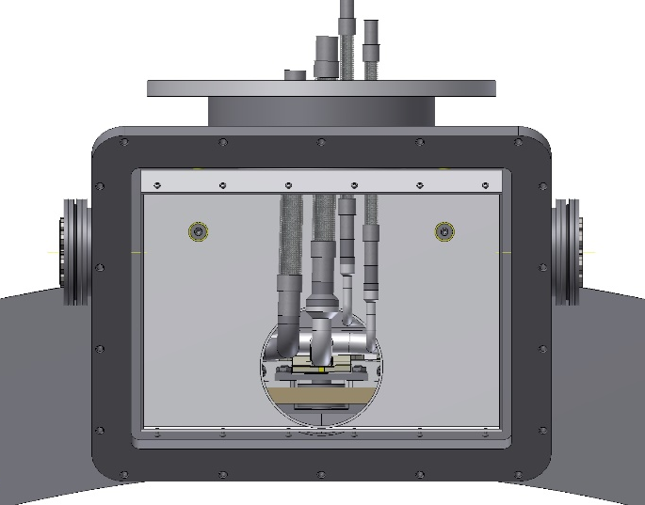
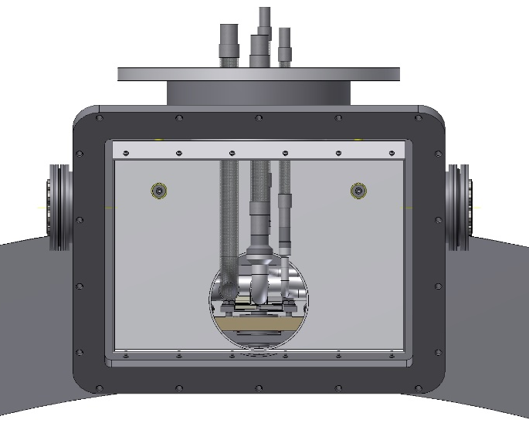
The connection of the bus bars of the magnet with the current leads takes place in a special box. The cryostat has guides for positioning the calorimeter (~60t). The weight of magnet is ~22.5 t
SPD Magnet
Guides for placing the calorimeter
Switching box
Pipes position 300K
Pipes position 4.5K

Slide 6
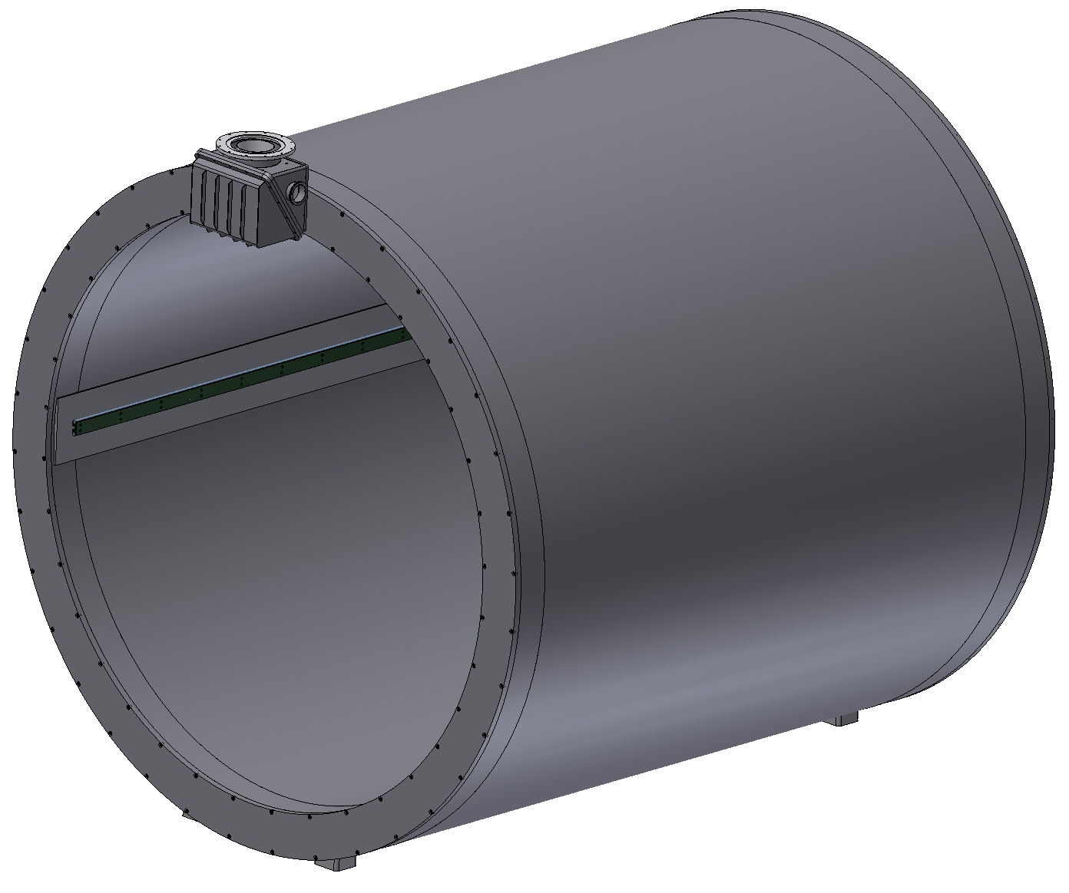
Inner diameter is 4008 mm, Outer diameter is 3468 mm, length is 4080 mm. The thickness of the outer shell is 12 mm, the inner shell is 20 mm, the thickness of the flanges is 45 mm. The thickness at the ends of the shells is 40 mm. Material: St. Steel. The weight of Cryostat is ~16.2 t
Cryostat

Slide 7
The maximum equivalent stress is 65 MPa. The maximum deformation is 1 mm.
Cryostat (calculation)
Operation condition (p=0.05 MPa) + weight.

Slide 8
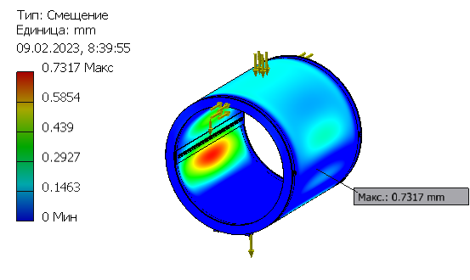
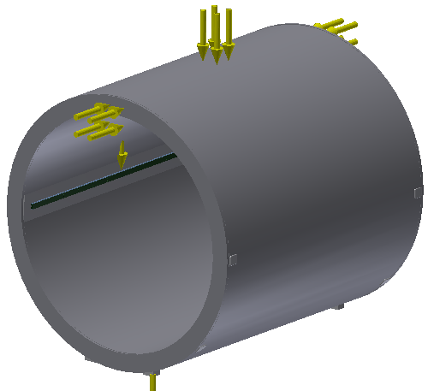
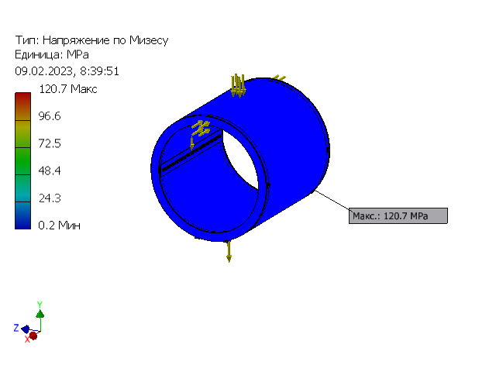
The maximum equivalent stress is 120 MPa. The maximum deformation is 0,7 mm.
Cryostat (calculation)
Operation condition (p=0.1 MPa), weight + weight of calorimeter (60t )

Slide 9
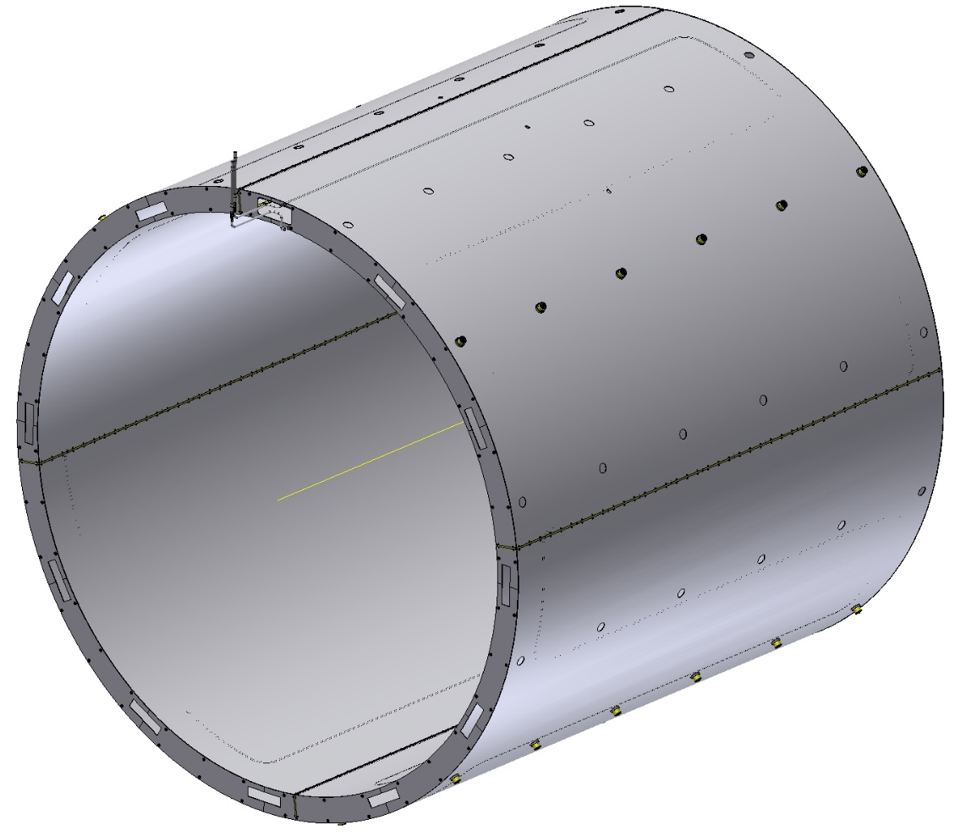
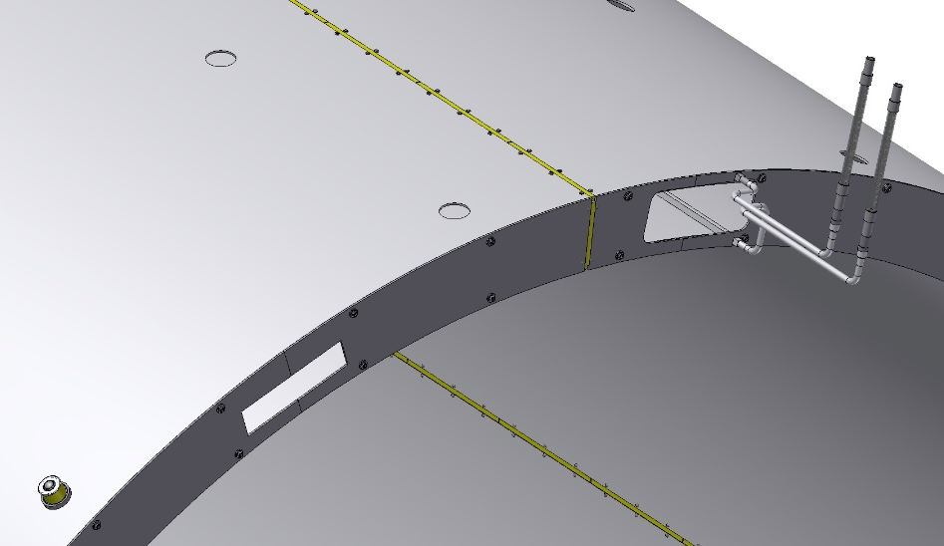
Outer diameter - 3898 mm, inner diameter - 3568 mm, length - 3600 mm. Wall thickness - 4 mm, Material - aluminum alloy AMg-5. Screen weight ~1 t
Thermal shield 80K
Gap
Insulator G10
Collector
For the collector, a 12x12 with 8 mm hole Al profile welded to the shell of the shields is used. The shield is divided around the perimeter into 4 parts using G10 insulators. Outside the shield is covered with 30 layers of MLI and inside surface of the shield is covered with 10 layers of MLI .

Slide 10
Shield
Ring (G10)
Support
Balls transfer units
Bush(G10)
The shield is positioned in the cryostat using ball bearings with an insulating ring (4 rows at the bottom and 2 rows at the top).
In the axial direction, the screen is fixed in the central part with help of bolts through the insulating bush - 4 point at the top and 4 point at the bottom.

Slide 11
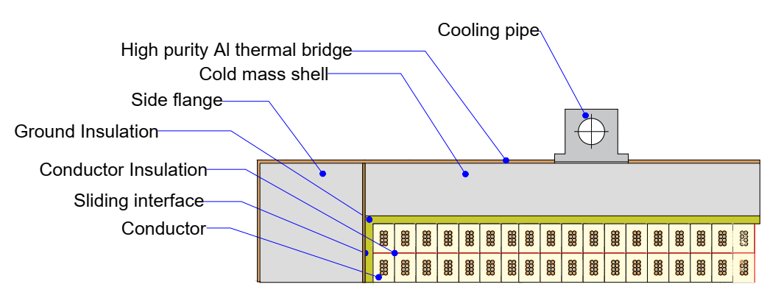
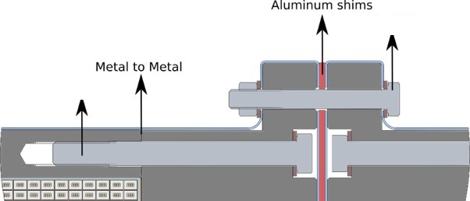
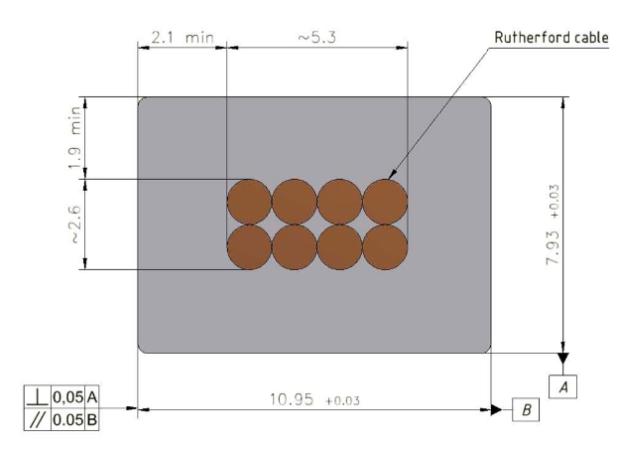
Cold Mass (design)
2x 2 layers - 300 turns
1x 2 layers - 150 turns
Magnetic field - 1 T
Current - 5.2 kA
Conductor mechanical and electrical parameters.
Thickness (after cold work) at 300 K | mm | 7.93 | ± 0.03
Width (after cold work) at 300 K | mm | 10.95 | ± 0.03
Critical current (at 4.2 K, 5 T) | A | > 14690
Critical current (at 4.5 K, 3 T) | A | > 16750
Overall Al/Cu/sc ratio |  | 10.5/1.0/1.0
Aluminum RRR (at 4.2 K, 0 T) |  | > 600
Al 0.2% yield strength at 300 K | MPa | > 30
36 x M12
Rutherford cable, 8 strands, extruded in Al matrix
64 x M12
10.95 мм x 7.93 мм,
NbTi / Cu d=1.4 мм
Rutherford cable is used to wind the coils. If necessary, we will use special shims between the sections of the coils.

Slide 12
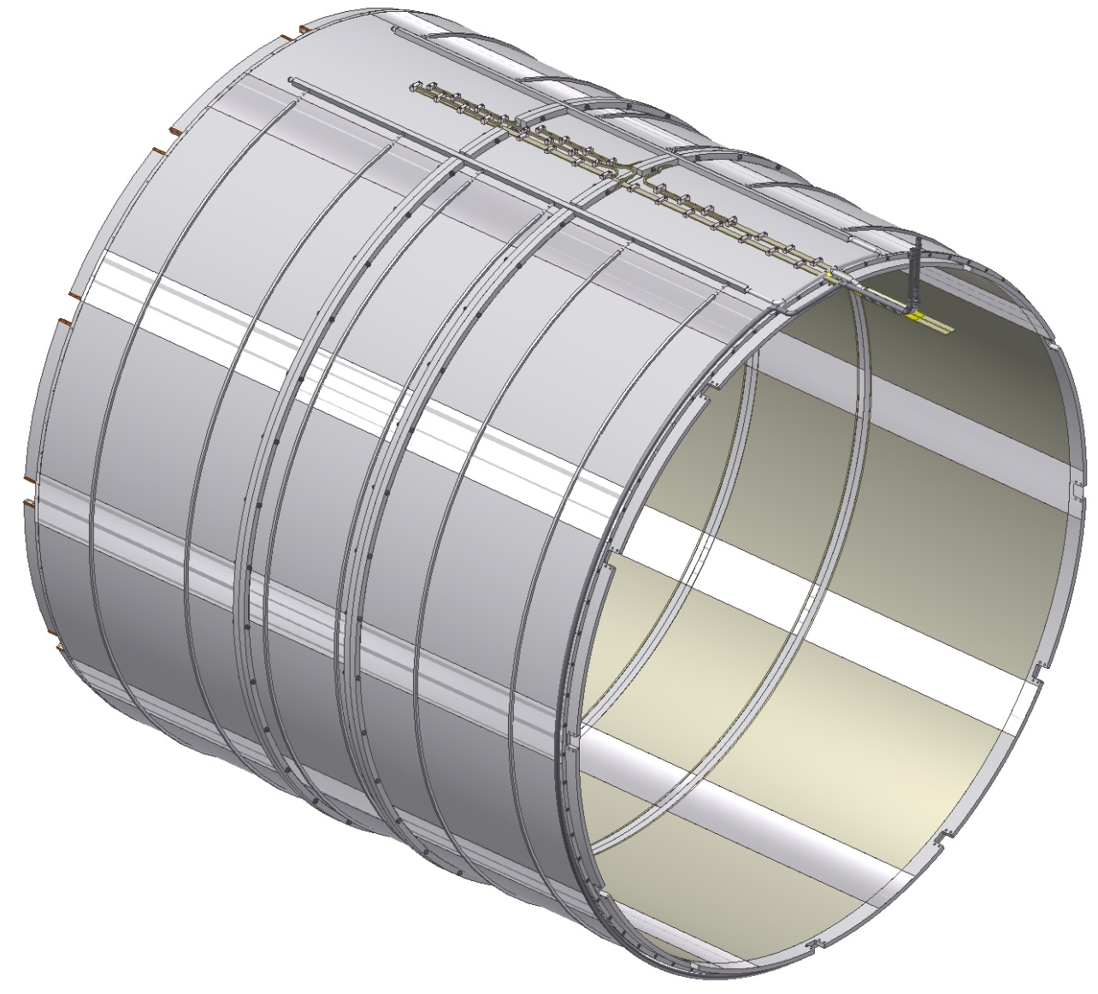
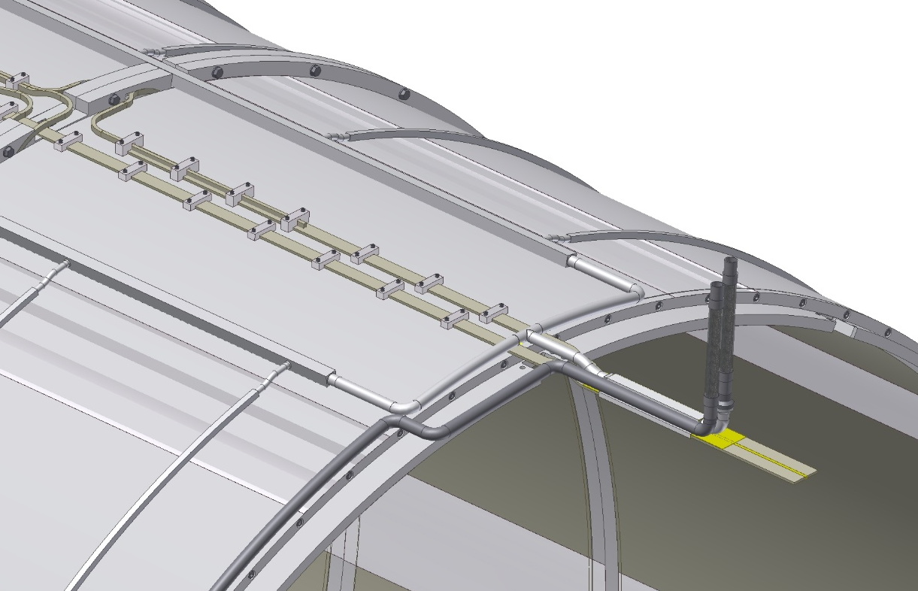
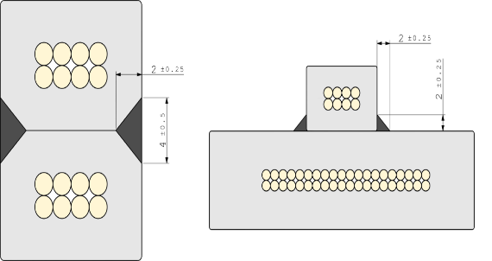
Inner diameter is 3662 mm, Outer diameter is 3756 mm, The length is 3330 mm, The weight of cold mass is ~5,2 t. Thermal bridges made of high purity aluminum are used for temperature equalization
Cold Mass
Support brackets
Bus-bars
Manifold
layer-to-layer and coil-to-coil joints
Thermobriges

Slide 13
The magnet consists of 3 coils: front and back have 2 layers of 300 turns, cable length ~ 3300 meters; the central coil has 2 layers of 150 turns, the cable length is ~1650 meters. It is planned to use the thermosyphon method of cooling using tubes 14 мм x14 мм with a hole of 10 mm, welded to the shell of the cold mass.
Cold Mass
Collector
Out
Bimetal Al-St.Steel.
In

Slide 14
Fixed support
SPD Magnet (Suspension system)
Sliding support
Spherical bearing
Fixation of the cold mass is made with help of triangular suspensions made of STEF-1, 12 pieces on each side. On one side the supports are fixed, on the other side its are sliding to compensate for temperature changes in the length of the coil. The Suspensions have spherical bearings to avoid bending during thermal changes in the dimensions of the cold mass.

Slide 15
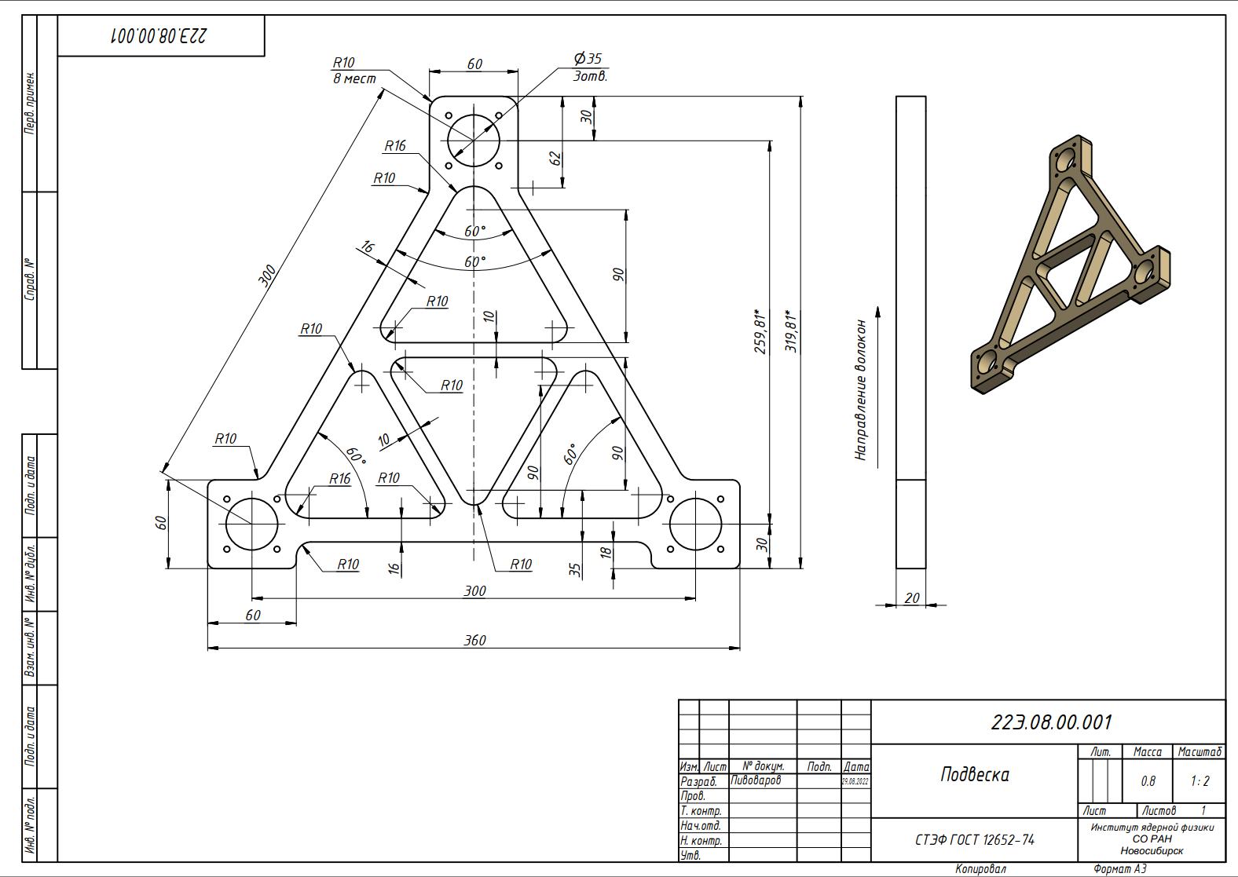
The maximum equivalent stress is 96 MPa (Permissible stress is 132 Мпа). The maximum deformation is 0,9 mm.
Suspension (calculation)
Calculation for cross force P = 1 t. (material – СТЭФ-1)

Slide 16
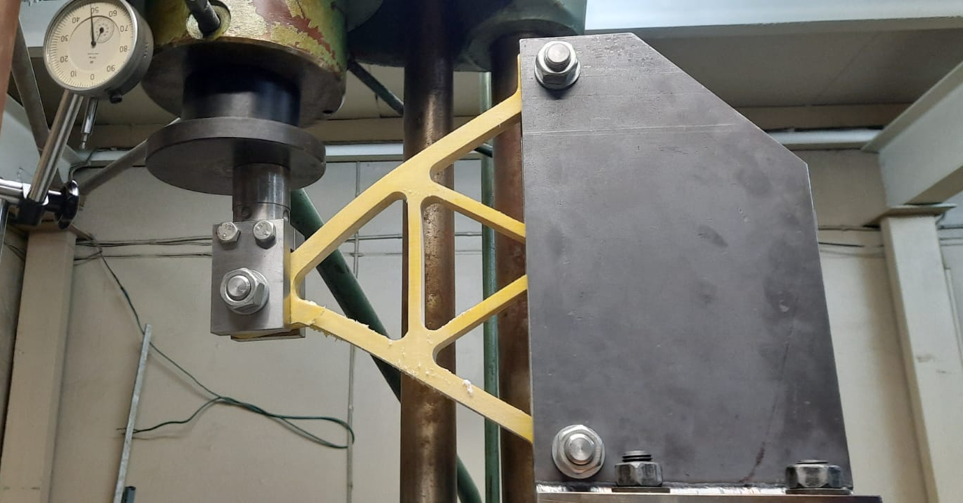
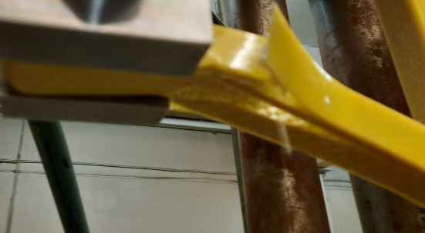
Destruction of the suspension 300К - 3920 kg
Destruction of the suspension 100К - 4250 kg
We have made and tested the suspension at 300K and 100K

Slide 17
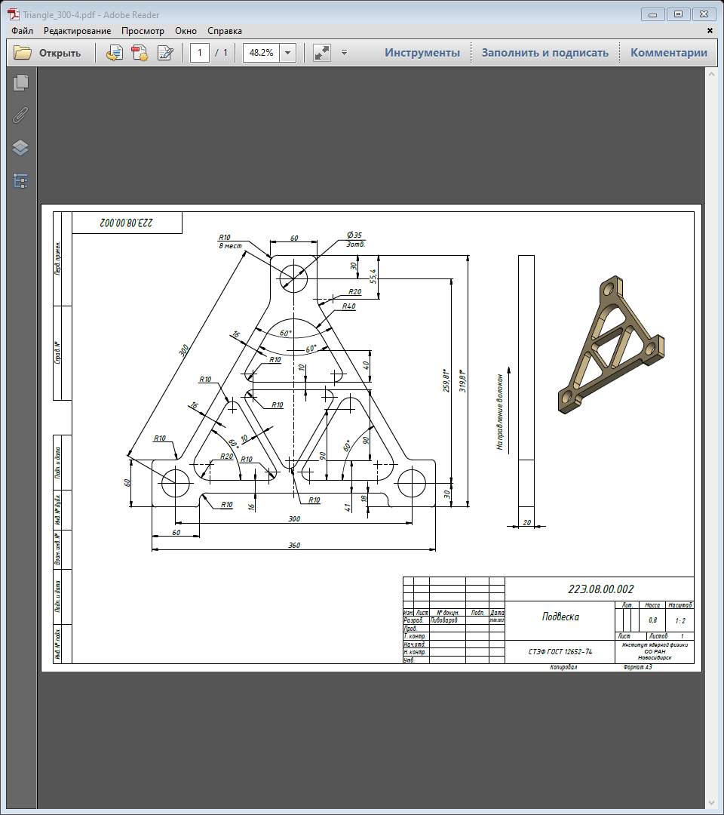
Calculation: The maximum equivalent stress is 101 Mpa The maximum deformation is 1,4 mm.
Suspension (modified)
Calculation for cross force P = 1,5 t. (material – СТЭФ-1)
I modified the suspension. We plan to manufacture and test the modified suspension.

Slide 18
The maximum equivalent stress is 46.2 MPa. The maximum deformation is 0,43 mm.
Suspension (calculation)
P = 9 t. (magnetic forces from displacement Coils along the axis by 5 mm) + 10 tons (2g).

Slide 19
SPD Магнит with Control Dewar
Connection of current leads with Bas-bars coils.

Slide 20
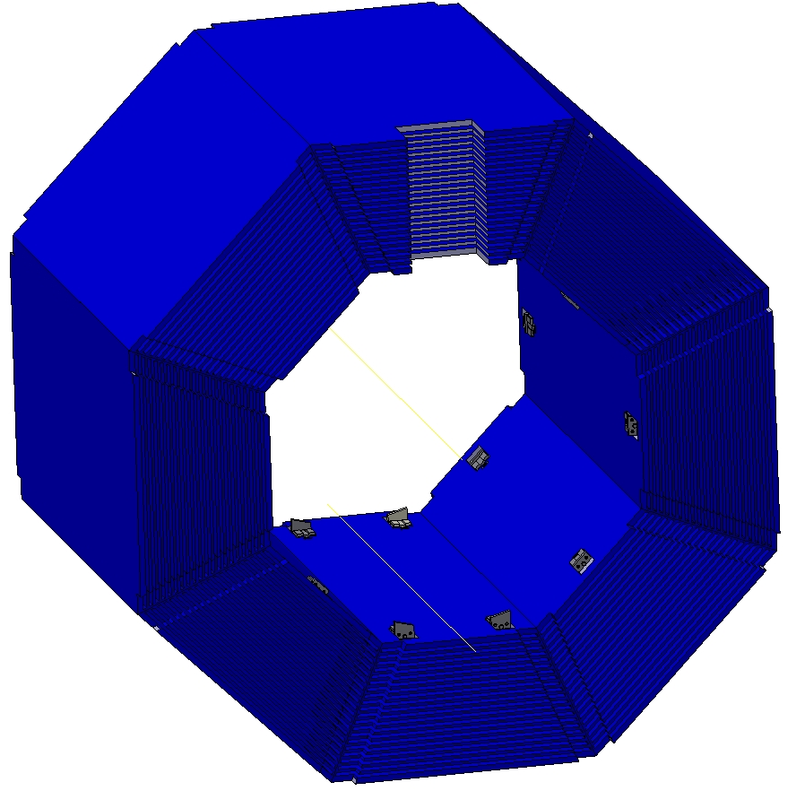
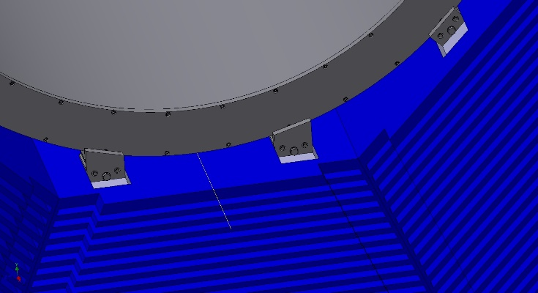
SPD Magnet (fixation)
The cryostat is fixed in an iron yoke by means of special adjustable supports fixed on octants.

Slide 21
SPD Magnet (fixation)
Adjustable support
The wedge surface of the support allows you to move the cryostat relative to the yoke in any direction.

Slide 22
Нижний октант ярма (Нагрузка –80 t)
The maximum equivalent stress is 95MPa. The maximum deformation is 1,6 mm

Slide 23
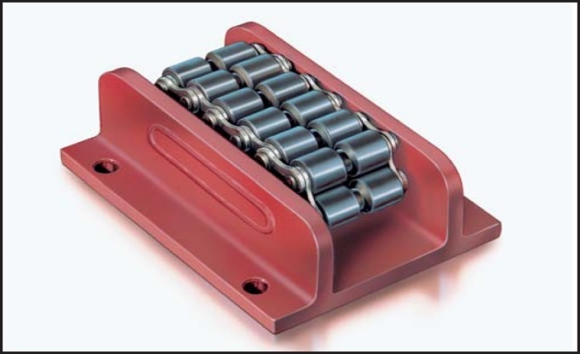
Magnet Assembly Procedure
Cryostat flange support
Roller skate Boerkey
Cryostat Inner Shell Support
Inner Shield support
Cold mass support
Outer Shield support
Assembly stand
To assemble the magnet, a special stand with an I-beam - 700 GOST 26020-83, 9 meters long, with a guide rail and a roller system (Roller skate Boerkey model AM-H) for rolling up the magnet elements, is used. Such a scenario was used to assemble the PANDA magnet, which was successfully assembled at the Votkinsk plant.

Slide 24
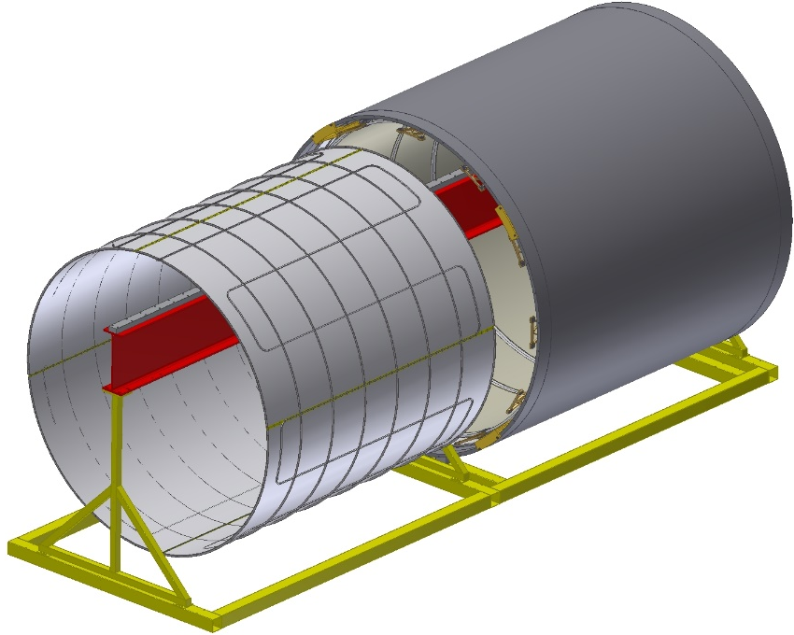
Magnet Assembly Procedure
Installing the outer shell
Installing the outer shield
Position the outer shield
Сегмент
Installing the Cold Mass
Position the Cold Mass. Fixing on temporary segments
Installing the inner shield

Slide 25
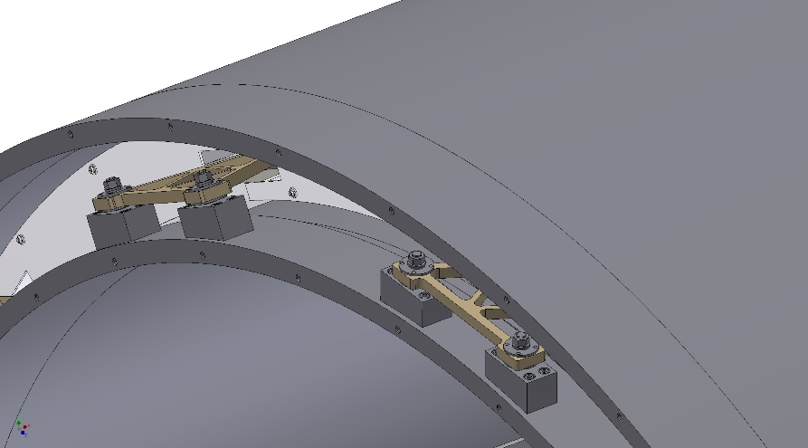
Magnet Assembly Procedure
Shield flange segments
The Inner shield position. Partial installation of the shield flange segments
Installing the inner shell
The Inner shell position.
Fixing of the cold mass on the inner shell. Removal of the temporary segments after fixing the cold mass. Installation all shield flange segments.
Installation of cryostat flanges

Slide 26
Installation of the SPD Magnet in the iron yoke.
To install the magnet in an iron yoke, a special stand with an I-beam - 700 GOST 26020-83 12 meters long with a guide rail and a roller system (Roller skate Boerkey model AM-H) is used.

Slide 27
Thank you for your attention!

