Slide 1
Alignment Components and Supports for Control Dewar Vessel and Current Leads
The Budker Institute
of Nuclear Physics
Novosibirsk
Joint Institute for
Nuclear Research
Dubna
T.Bedareva, E.Pyata, S.Pivovarov, M.Kholopov, A.Erokhin

Slide 2
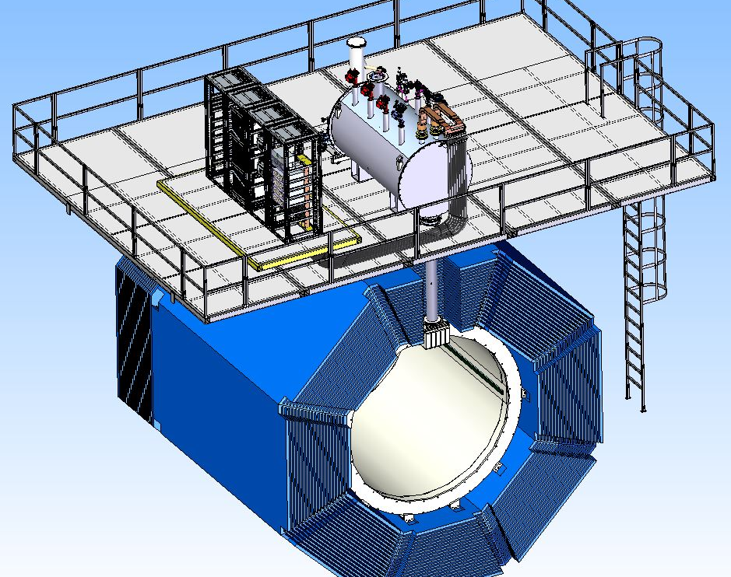
General guidelines for using the platform
The Budker Institute
of Nuclear Physics
Novosibirsk
Joint Institute for
Nuclear Research
Dubna
Current Source and Energy Extraction System
Control Dewar
Vessel
For preparation, installation and, subsequently, for repair works it is necessary to have free space on the platform for access to commutation elements, placement of working equipment and for quality check of connections and of cables fixation.
The platform must have good access for transportation of equipment and personnel to the place of work.
The length of the transfer line depends on the dimensions and configuration of the frame for sliding endcap halves and also on the type of platform
Platform
Transfer Line
Cryostat
Yoke

Slide 3
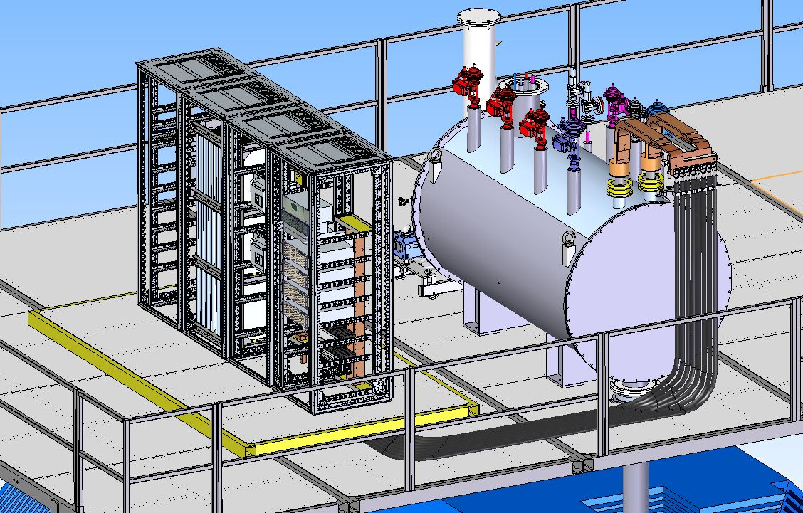
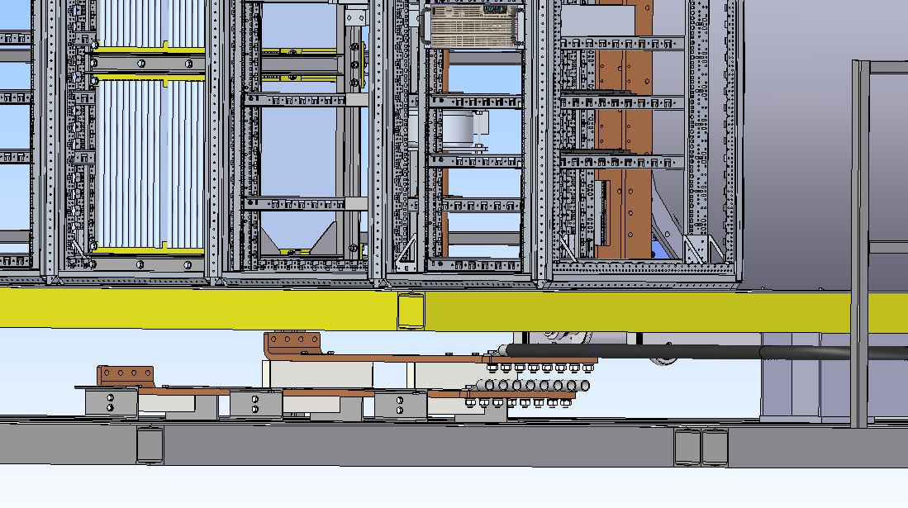
The Budker Institute
of Nuclear Physics
Novosibirsk
Joint Institute for
Nuclear Research
Dubna
Commutation busbars
False floor
A false floor is required to keep the conditions of electrical safety.
The false floor dimensions are determined in accordance with the requirements for the necessary work.
False floor
Cable

Slide 4
The Budker Institute
of Nuclear Physics
Novosibirsk
Joint Institute for
Nuclear Research
Dubna
Conclusion
Further design of the SPD solenoid requires:
The dimensions and 3D model of the frame for sliding endcap halves;
The type, dimensions and 3D model of the working platform.

Slide 5
The Budker Institute
of Nuclear Physics
Novosibirsk
Joint Institute for
Nuclear Research
Dubna
Thank you for your attention!

