Slide 1


Ion-track technology @ Application of accelerated heavy ions at the Centre of Applied Nuclear Physics of the Flerov Laboratory of Nuclear Reactions, JINR
Nechaev A.N., Skuratov V.A., Apel P.Yu.

Slide 2
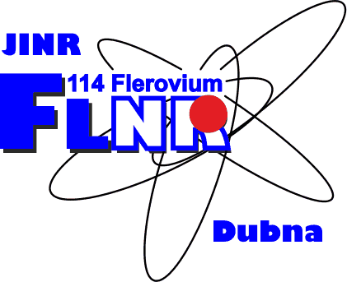
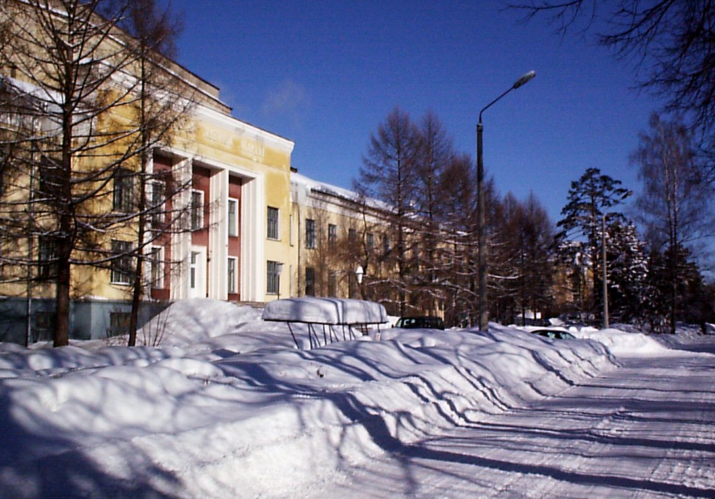
Mission and Accelerator facilities of the
FLEROV Laboratory of Nuclear Reaction
Founded May 1957
The scientific program of FLNR includes experiments on the synthesis and investigation of nuclear-physical and chemical properties of new superheavy elements, the investigation of fusion-fission reactions and multinucleon transmission in the collision of heavy ions; the study of the properties of nuclei at the nucleon stability boundary and the mechanisms of nuclear reactions with accelerated radioactive nuclei; the interaction of heavy ions with various materials (polymers, semiconductors, electronic components of space technology, etc.).
U400M, 4m heavy ion cyclotron, E = 6 - 100 MeV/n
U400, 4m heavy ion cyclotron, E = 0.5 - 20 MeV/n
U200, 2m heavy ion cyclotron, E = 3 - 15 MeV/n
IC100, 1m heavy ion cyclotron, E = 1.2; 0.5 MeV/n
Microtron MT25, electron accelerator, E = 25 MeV
Notes:
In May 1957 the 2nd session of the JINR Scientific Council reached a decision to found the Laboratory of Nuclear Reactions (LNR) with a special-purpose cyclotron for heavy ion research as a basic facility. Corresponding Member of the USSR Academy of Science G.N. Flerov was appointed Director of the Laboratory.

Slide 3
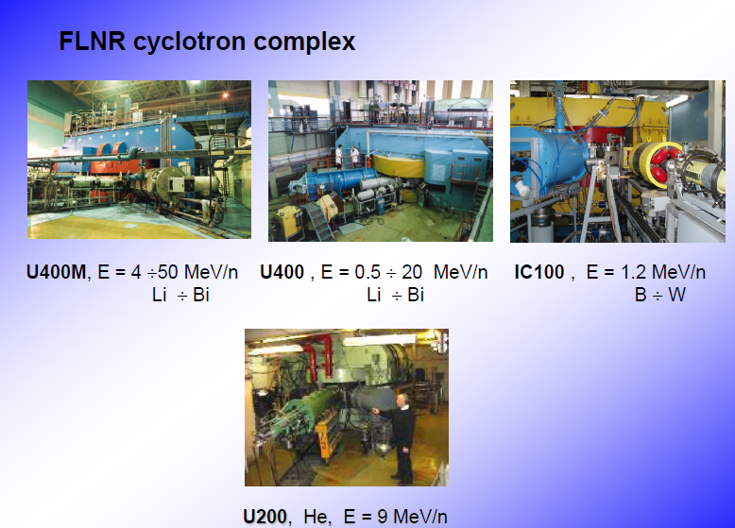
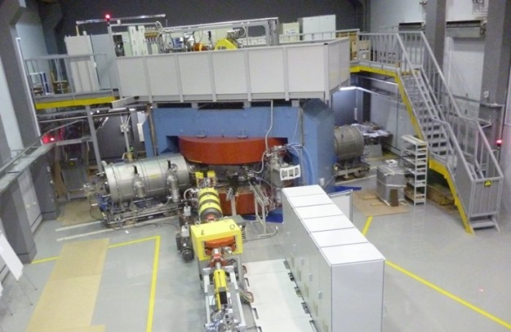
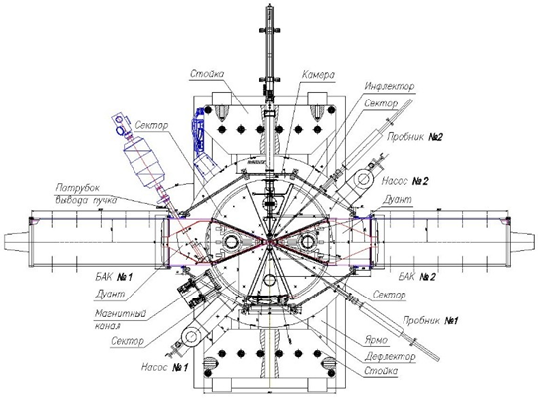
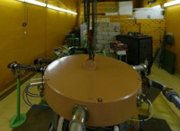
DС140
DC-280
Microtron MT25
Major Goal: to find commercial applications for accelerator facilities as key factor of ion track technology for novel materials !
Notes:
FLNR ACCELERATOR COMPLEXES
U400 - Accelerator complex based on U400 isochronous cyclotron was put into operation in 1979. U400 accelerator is Laboratory's basic setup for synthesis of new elements.
U400M - Accelerator complex based on U400M isochronous cyclotron was put into operation in 1993. In 2002 this cyclotron was included in DRIBs accelerator complex designed for production of radioactive ion beams.
DC280 - Creation of SHE factory based on the high-intensity universal DC-280 cyclotron (A ≤ 238, E ≤ 10 MeV·A, I ≤ 20 pµA) in a new separate experimental building is a part of the DRIBs-III project according to the Seven-Year Plan for the Development of JINR 2010-2016 approved by the Committee of Plenipotentiaries of the Governments of the JINR Member States (CPP) in November 2009.
DRIBs - DRIBs-I accelerator complex (130m long) is designed for production of radioactive ion beams and combines constructively U400 and U400M cyclotrons. Was put into operation in 2002.
U200 - Accelerator complex based on U200 isochronous cyclotron was put into operation in 1968. At present U200 cyclotron is used for production of ultraclean radioisotopes for ecology and nuclear medicine.
MT-25 - Microtron electron accelerator was put into operation in 1973 (MT-17). It was totally upgraded in 1980 (MT-22) and in 1986 (MT-25). This microtron is used for study and production of ultraclean radioisotopes.
DC-40 (IC-100) - Cyclotron complex is the full-scale upgrade of IC-100 cycle implanter. Designed for high technology and applied research.

Slide 4
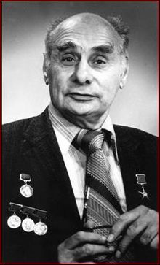
Center of Applied Nuclear Physics,
Flerov Laboratory of Nuclear Reactions
FOUNDED – 1974
Profile
Head: Prof Sergey Dmitriev
Sector No 8 (Ion-implantation nanotechnology and radiation
materials science)
8 staff, 2 x Dr Sci, 3 x PhD
18 researchers, including 2 x Dr Sci, 12 x PhD
ION TRACK TECHNOLOGY AT THE CENTER
Activity 1
Swift heavy ions in radiation material science
Activity 2
Track membrane production as a successful example of ion-track technology application
Activity 3
Gamma-activation and XRF analyses for geology, material and environmental study: study of uranium, thorium and their decay products

Slide 5
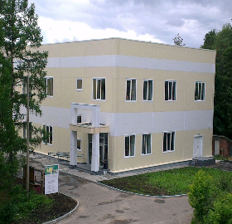
Development of the “Nanotechnology Centre”
In 2017-2021 the park of equipment was augmented with:
Transmission electron microscope Talos F200i (Thermo Fisher Scientific)
Tabletop scanning electron microscope TM4000 Plus (Hitachi)
Universal testing machine AG-S 50Н (Shimadzu)
Raman spectrometer R-532 (EnSpectr)
Thermogravimetry instrument: TG 209 F1 Libra (Netzsch)
Differential scanning calorimetry instrument: DSC 3 (Mettler Toledo)
Particle analyzer: Zetasizer Nano ZSP (Malvern)
Nanofiber electrospinning machine: Nanon-01A (MECC)
Struers TenuPol-5 Jet polishing system (for automatic electrolytic thinning of specimens for examination in a transmission electron microscope)
Struers LectroPol-5. The system for automatic, micro- processor controlled electrolytic polishing and etching of metallographic specimens
Incubators: GI2-2 (Sheldon Laboratory); Friocell (BMT Medical Technology)
Cryogenic Probe Station for Electrical measurements (model TTPX Lakeshore)
High vacuum bench top evaporator Vacu Prep II (EDEN Instrum. )
Research equipment in 2016:
Two scanning electron microscopes (Hitachi SU8020 and S3400N) with a number of options (X-ray microanalysis, cathodoluminescence, etc)
Specialized equipment for sample preparation for SEM
Atomic force microscope with Raman spectrometer NTEGRA Spectra
X Ray photoelectron spectroscopy (K-Alpha instrument)
Fourier-transform IR spectrophotometer Nicolet 6700 UV-Vis spectrophotometer Evolution 600
Specialized electronics for measurements on single nanopores: Axopatch 200B
Capillary flow porometer Porolux 1000 and other equipment for membrane testing
Versatile equipment for chemical lab, etc.

Slide 6
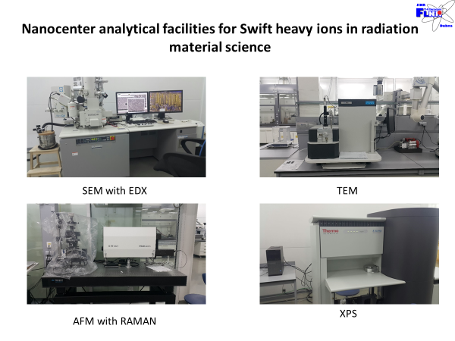

Slide 7
ION-TRACK TECHNOLOGY
Ion tracks are damage-trails created by swift heavy ions penetrating through solids, which may be sufficiently-contiguous for chemical etching in a variety of crystalline, glassy, and/or polymeric solids. They are associated with cylindrical damage-regions several nanometers in diameter and can be studied by Rutherford backscattering spectrometry (RBS), transmission electron microscopy (TEM), small-angle neutron scattering (SANS), small-angle X-ray scattering (SAXS) or gas permeation.

Slide 8
Ion track technology deals with the production and application of ion tracks in microtechnology and nanotechnology.Ion tracks can be selectively etched in many insulating solids, leading to cones or cylinders, down to 8 nanometers in diameter. Etched track cylinders can be used as filters,Coulter counter microchannels,] be modified with monolayers, or be filled by electroplating.
Ion track technology has been developed to fill certain niche areas where conventional nanolithography fails, including:
Direct shaping of radiation-resistant minerals, glasses and polymers
Generation of elongated structures with a resolution limit down to 8 nanometers
Direct generation of holes in thin films without any development process
Defining structural depth by ion range rather than by target thickness
Generating structures with aspect ratio (depth divided by width) up to 10⁴.
Shaping rigid and flexible materials at a defined cutting angle
Exploring the realm of aligned textures with defined inclination angles
Generation of random patterns consisting of partially overlapping single tracks
Generation of large numbers of individual single track structures
Generation of aimed patterns consisting of individual single tracks

Slide 9
Irradiation apparatus and methods
Several types of swift heavy ion generators and irradiation schemes are currently used:
Alpha and fission sources provide low intensity beams with broad angular-, mass-, and energy distribution. The range of the emitted fission fragments is limited to about 15 micrometers in polymers. Weak californium-252 or americium-241 sources are used for scientific and technological explorations. They are compact, inexpensive, and can be handled safely.
Nuclear reactors provide fission fragments with broad angular-, mass-, and energy distributions. Similar to alpha and fission sources, the penetration range of the emitted fission fragments is limited to about 15 micrometers in polymers. Nuclear reactors are used for filter production.
Heavy ion particle accelerators provide parallel-beam irradiations at high luminosity with ions of defined mass, energy, and tilt angle. Intensities are available in wide ranges, even up to billions of ions per second. Depending on the available energy, track lengths between a few and several hundred micrometers can be produced. Accelerators are used in micro- and nanotechnology. Radioactive contamination is absent at ion energies below the Coulomb barrier.
- Ion microbeams offer the highest level of control of the irradiation process. These restrict the output of a heavy ion accelerator to a small filament which can be scanned over the sample surface. Scribing with individual swift heavy ions is possible with an aiming precision of about one micrometer.[

Slide 10
Ion-track technology @ Application of accelerated heavy ions at FLNR

Slide 11
Activity 1
Swift heavy ions in radiation material science:
Testing of microelectronics by swift ions simulation of galactic cosmic ray;
Fission fragments simulation for Development, Characterization and Testing of novel materials for the nuclear industry.

Slide 12
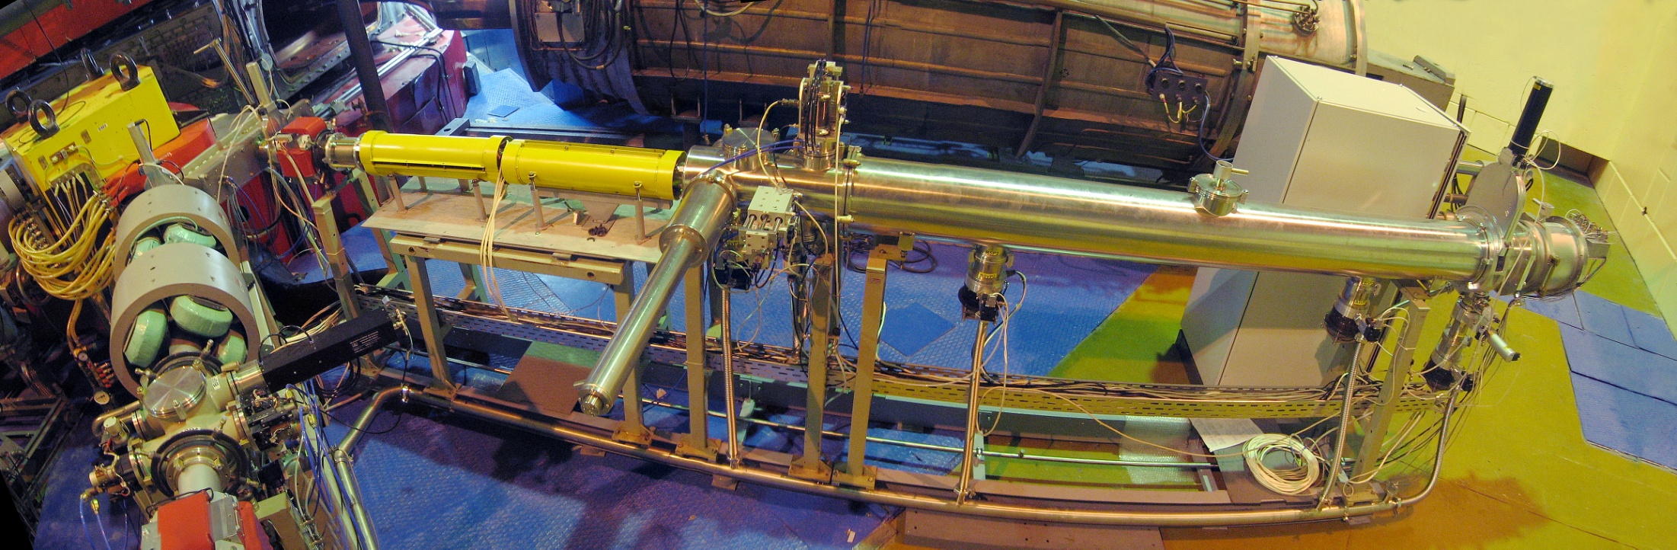
Multiple Low and High energy ion beam lines
Bending magnet
TOF measurement
X-Y correction magnets
Faraday cup
Vacuum gate valve
Luminophore drive
Test chamber
X-Y scanning system (50 Hz)
Turbo molecular pumps
Ta foils (5-27 μm) drive

Slide 13
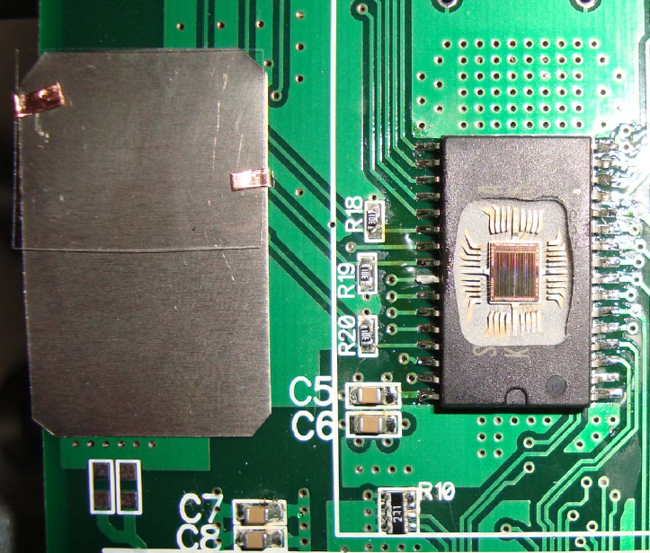
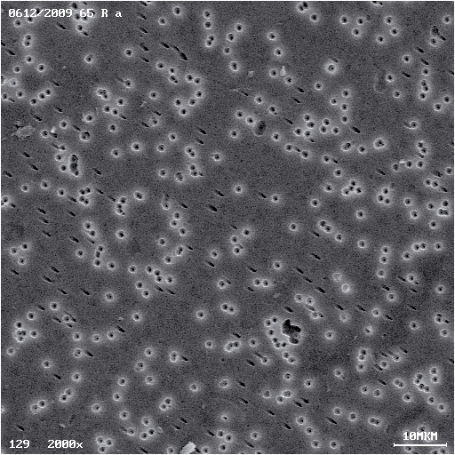
Ion beam diagnostic for space programs
The composition of galactic cosmic rays :
83% protons
13% alpha particles
3% electrons
1% heavy ions (Z>4)
Polymer track detector and the DUT
Etching threshold for ion tracks in
polycarbonate – 2.5 MeV/(mg/cm²) (O, Ne)
polyethylene terephthalate – 8 MeV/(mg/cm²) (Ar÷Bi)
SEM micrograph of polymer track detector

Slide 14
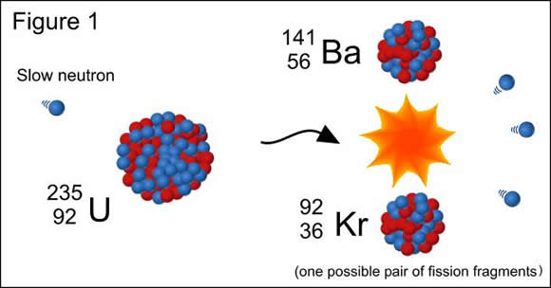
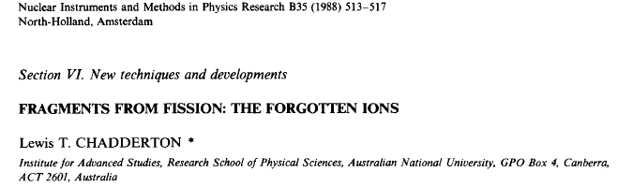
Fission fragments simulation - Development, Characterization and Testing of novel materials for the nuclear industry

Slide 15
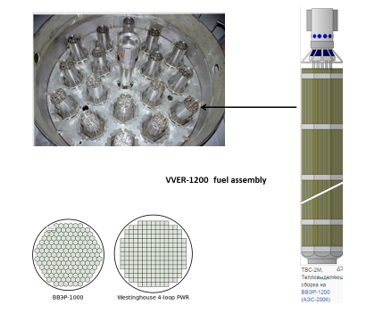
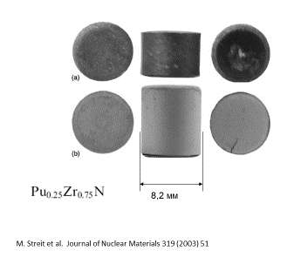
Examination of the dense ionization effect in ceramics and oxides with heavy ions of fission fragments energy
Inert matrices - ceramics with a high melting point and with low neutron absorption cross sections to be used as hosts for transmutation of actinides via nuclear reactions
Examples of fuel compositions for LWR:
(Pu)O₂ - MgO-ZrO₂
(Pu,Np,Am)O₂, MgO-ZrO₂
(Am,Np,Pu,Zr)N

Slide 16
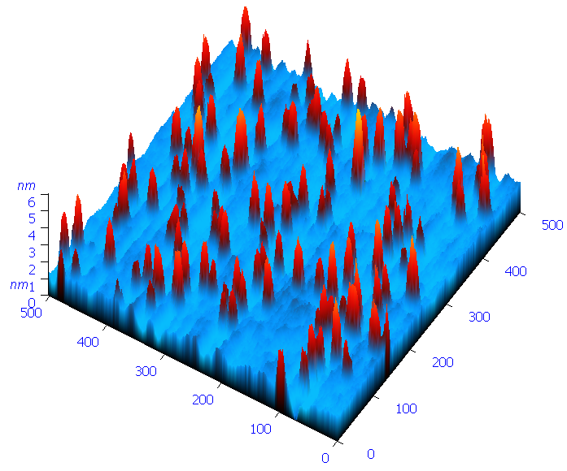
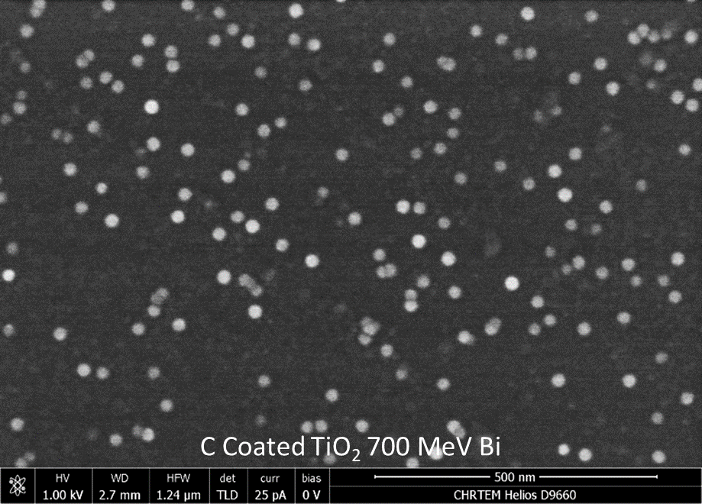
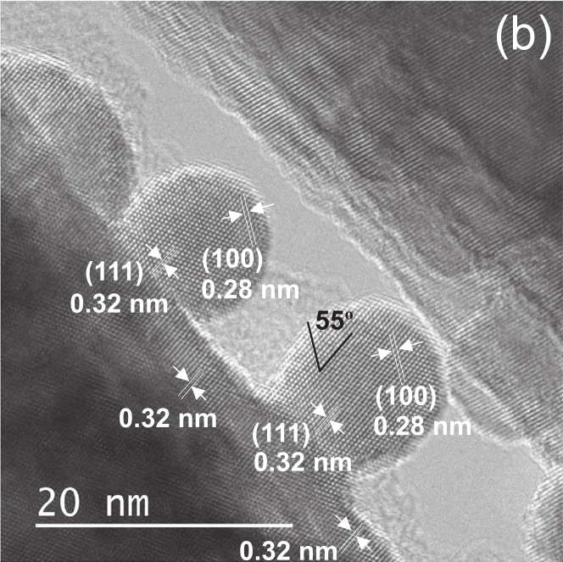
Examination of the dense ionization effect in ceramics and oxides with heavy ions of fission fragments energy. Surface effects of dense ionization in ceramics and oxides
SEM & 3D AFM image of MgAl₂O₄ surface irradiated with 710 MeV Bi ions (Ion fluence 5x10¹⁰ cm⁻²).

Slide 17
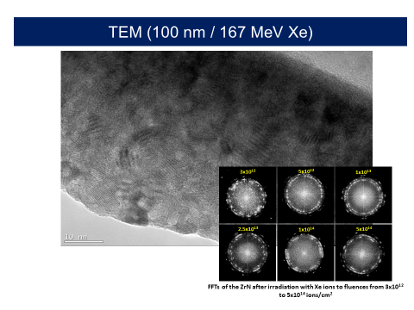
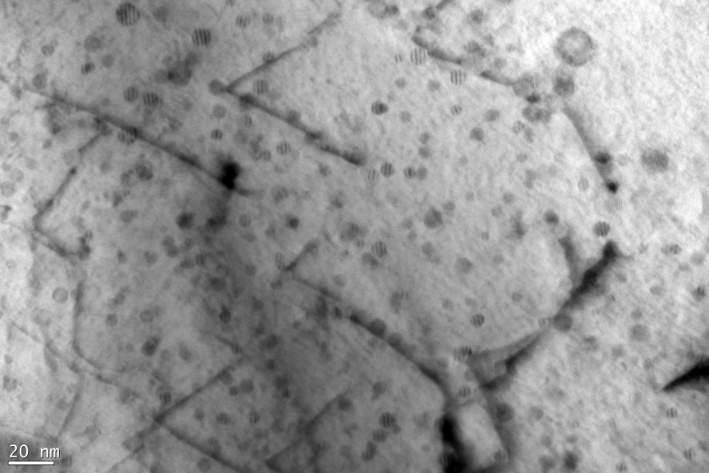
Examination of dense ionization effect in nanostructured materials
Radiation tolerance of nanostructured ZrN coating on cladding materials simulating fission fragments impact
Radiation stability of ODS alloys against fission fragment impact
Nanostructuring may enhance localization of energy deposition in the ion trajectory region and affect the latent track formation processes
ODS = Oxide dispersion strengthened alloys:
Ferritic matrix + 5÷50 nm size thermally stable oxides dispersed within it
Strengthening principle in ODS alloys:
NPs are obstacles to dislocation glide.
ODS steels are promising candidates for fuel cladding

Slide 18
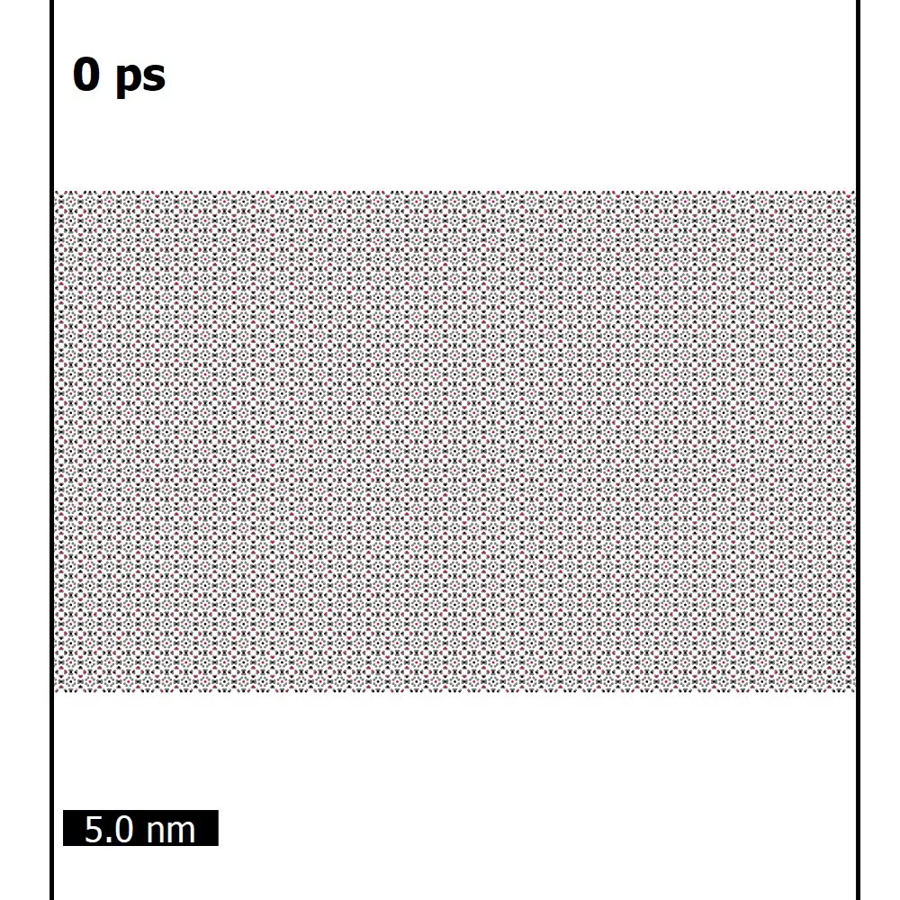
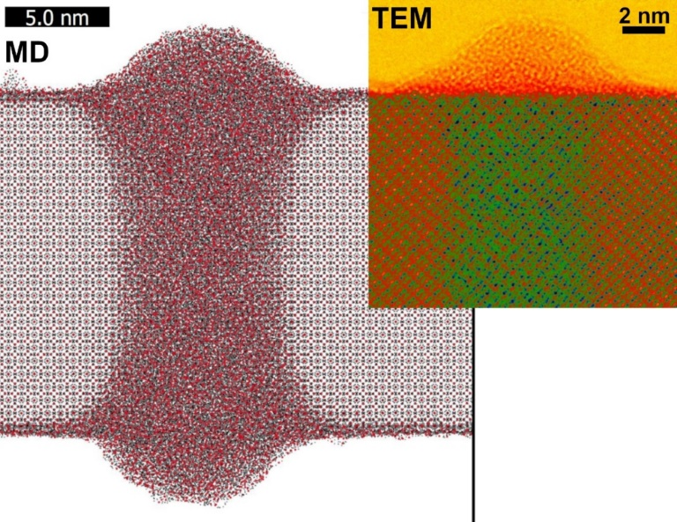
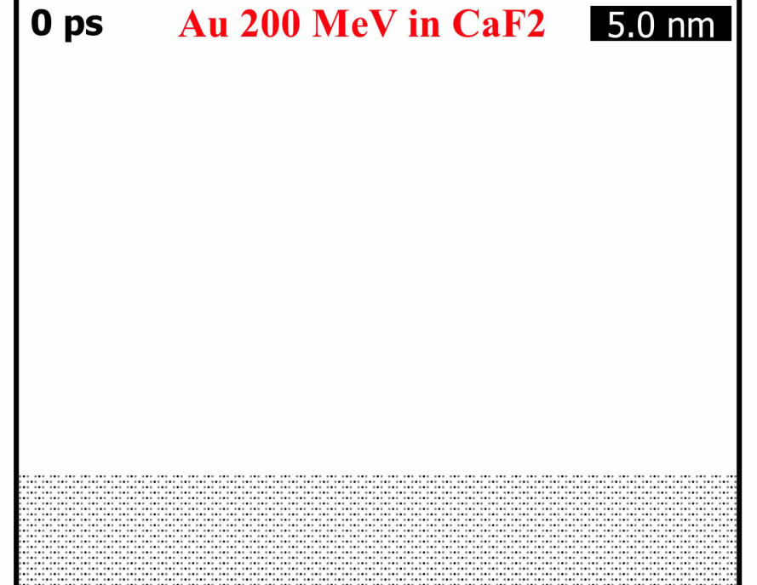
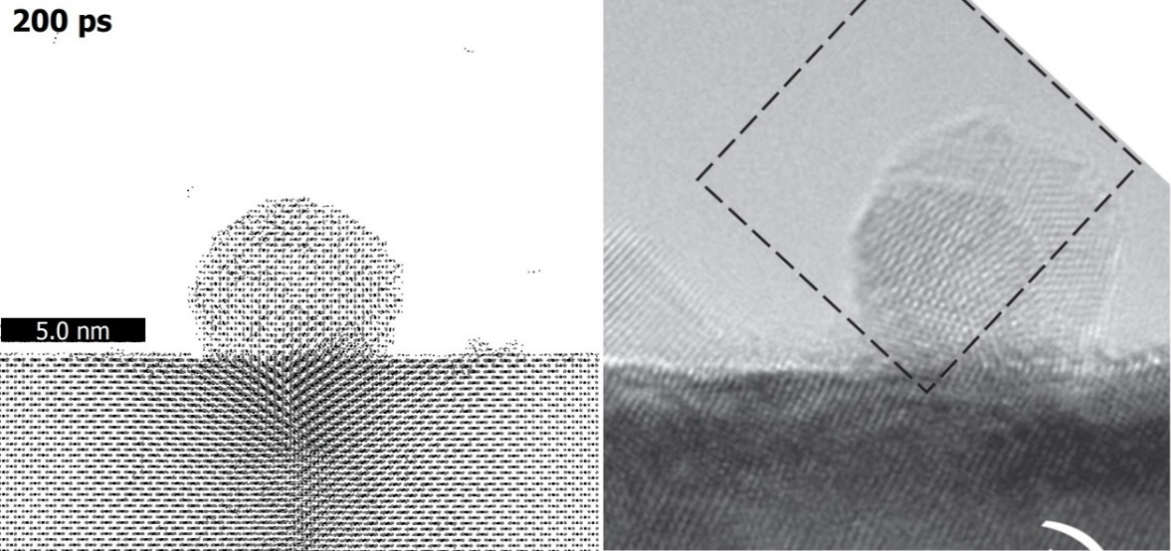
Modeling of swift heavy ion effects in dielectrics
Monte-Carlo + molecular dynamics methods
Y₃Al₅O₁₂
  TiO₂
TEM
MD
N. Ishikawa et al. Nanotechnology. 28(2017)445708
R.A. Rymzhanov et al., J. Appl. Phys. 127, 015901 (2020)

Slide 19
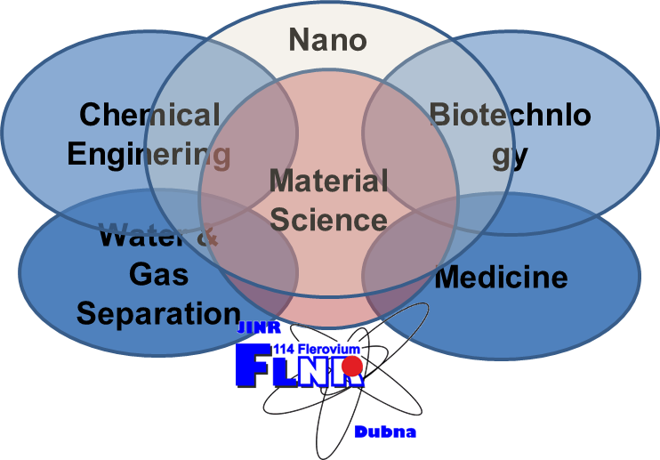
Activity 2
Track membrane production as a successful example of ion-track technology application

Slide 20
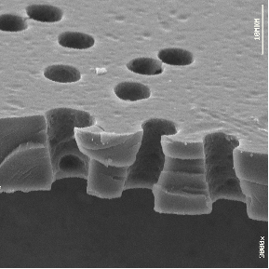
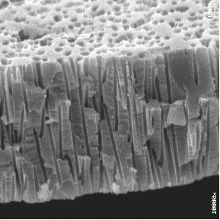
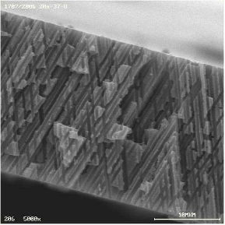
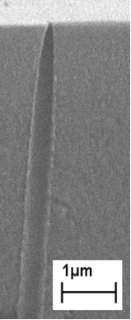
Track etched membranes are the first commercial “Man-Made” membrane created using physical methods

Slide 21
Main principles of TM technology
Two types of TM based on irradiation techniques: reactor TM and accelerator TM
Fundamental principle
E.Silk, R. Barns – 1959 and V. Perelygin, R. Flisher , P,Price - 1963
Fission particles or heavy ions (E ≈ MeV/nuc)
10 - 100 μm
Fluence
1 – 10¹⁰ cm²

Slide 22
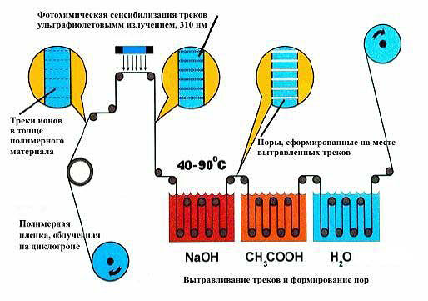
Accelerator TM production technology at FLNR-JINR (start to operate in 1970)

Slide 23
TM by accelerator ion tracking
Advantages of Flerov’s idea
No radioactive contamination of the material when the ion energy is below the Coulomb barrier;
Identity of bombarding particles = all tracks show the same etching properties;
Higher energy of particles = larger range = thicker foils can be perforated;
Better conditions for producing high-density (>10⁹ cm²) track arrays;
Particles heavier than fission fragments can be used (U²³⁸, for instance);
It is easier to control the impact angle and produce arrays of parallel tracks or create some particular angular distributions for getting rid of merging pores
Disadvantages
The stability of the particle flux from an accelerator is usually lower;
A higher cost of irradiation.

Slide 24
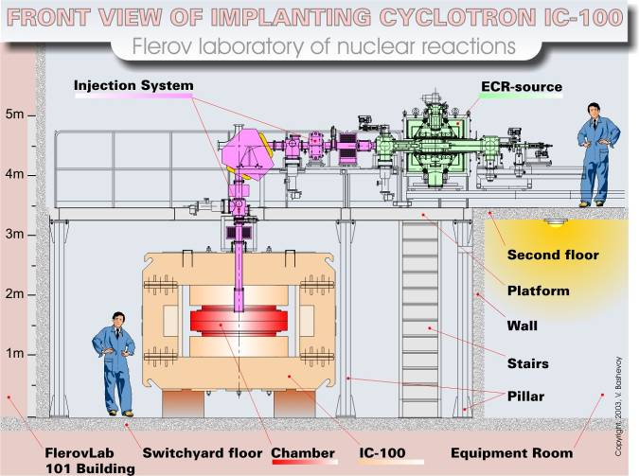
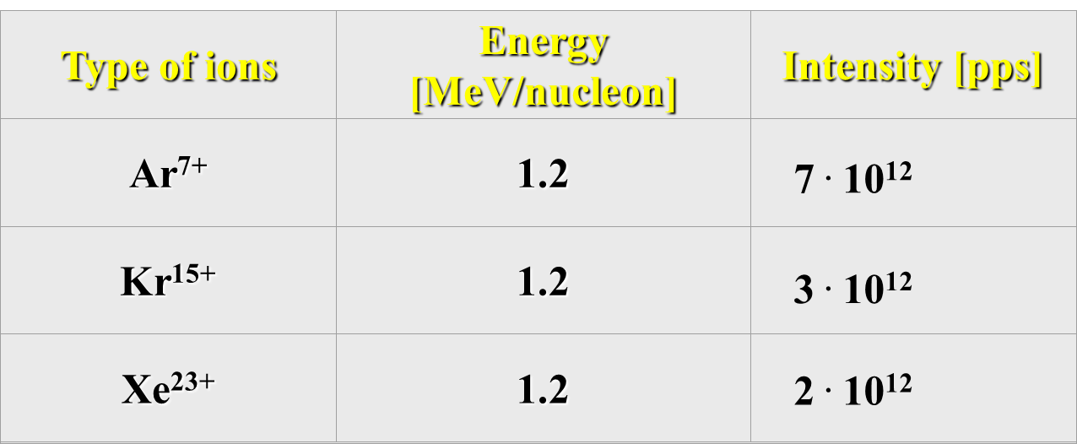
Cyclotron IC-100 for applied research
ECR - Electron Cyclotron Resonance Source

Slide 25
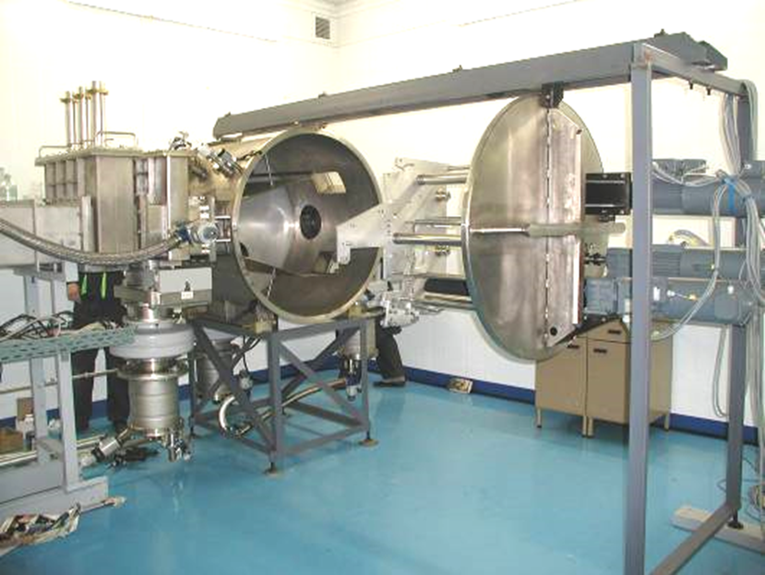
Track etched membrane
TECHNOLOGY
1 step : Polymeric Film irradiation

Slide 26
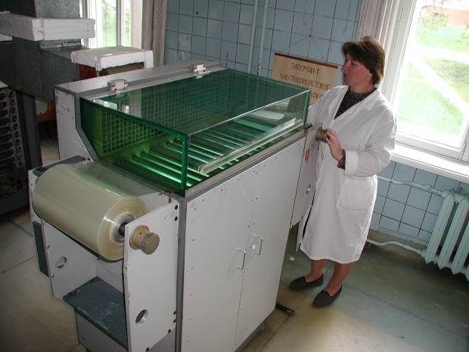
Track etched membranes
TECHNOLOGY
2 step:
UV light sensibilization

Slide 27
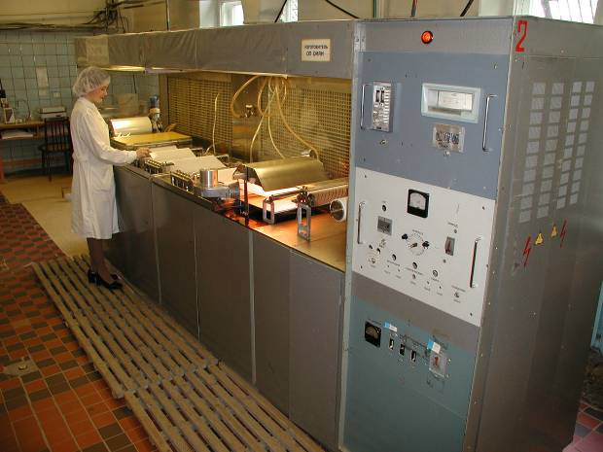
Track etched membranes
TECHNOLOGY
3 step:
etching

Slide 28
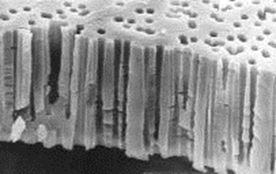
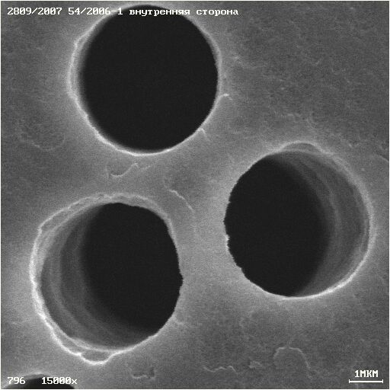
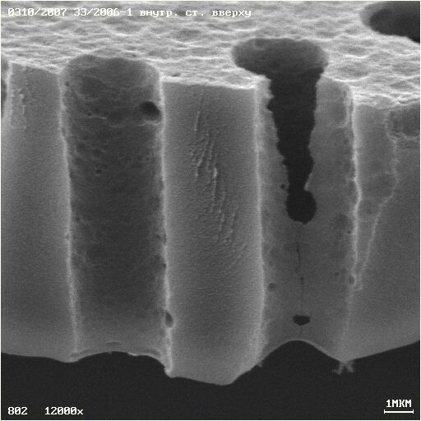
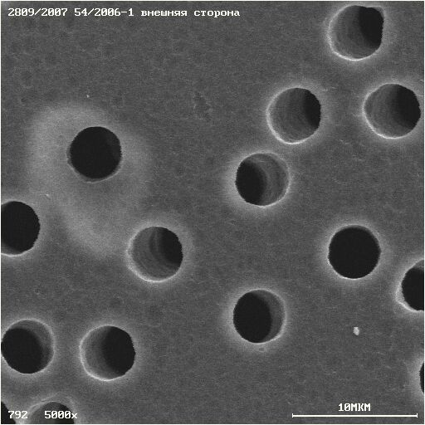
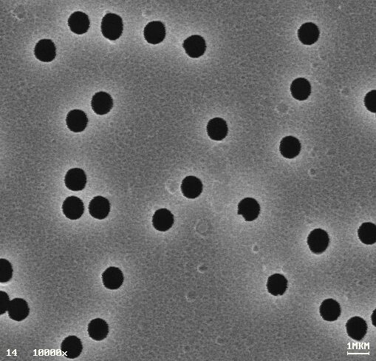
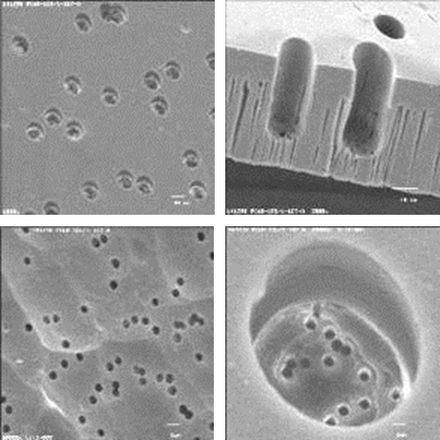
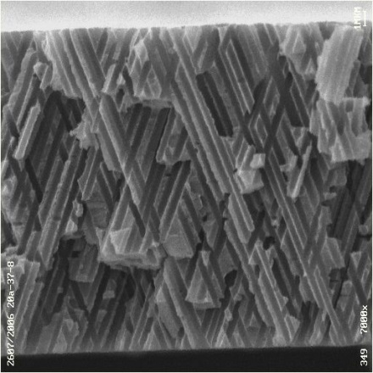
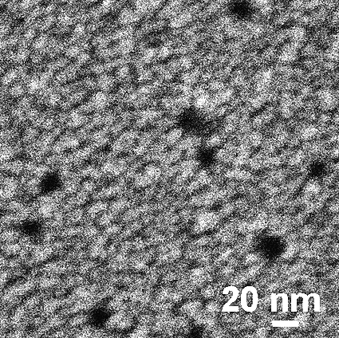
FLNR - Track Etched Membranes
МIRROMETER
NANOMETERS

Slide 29
Track etching of common polymer
Material | pH | Wet etchant | Sensitizer¹⁾ | Desensitizer²⁾ | T/C³⁾ | Speed⁴⁾ | Selectivity⁵⁾
PC | basic | NaOH | UV | Alcohols | 50-80 | Fast | 100-10000
PET | basic | NaOH | UV, DMF | Alcohols | 50-90 | Fast | 10-1000
 | basic | K₂CO₃ |  |  | 80 | Slow | 1000
PI | basic | NaOCl |  | NaOH | 50-80 | Fast | 100-1000
CR39 | basic | NaOH | UV |  | 50-80 | Fast | 10-1000
PVDF⁶⁾ | basic | KMnO₄ + NaOH |  |  | 80 | Medium | 10-100
PMMA⁶⁾ | acidic | KMnO₄ + H₂SO₄ |  |  | 50-80 | Medium | 10
PP⁶⁾ | acidic | CrO₃ + H₂SO₄ |  |  | 80 | Fast | 10-100

Slide 30
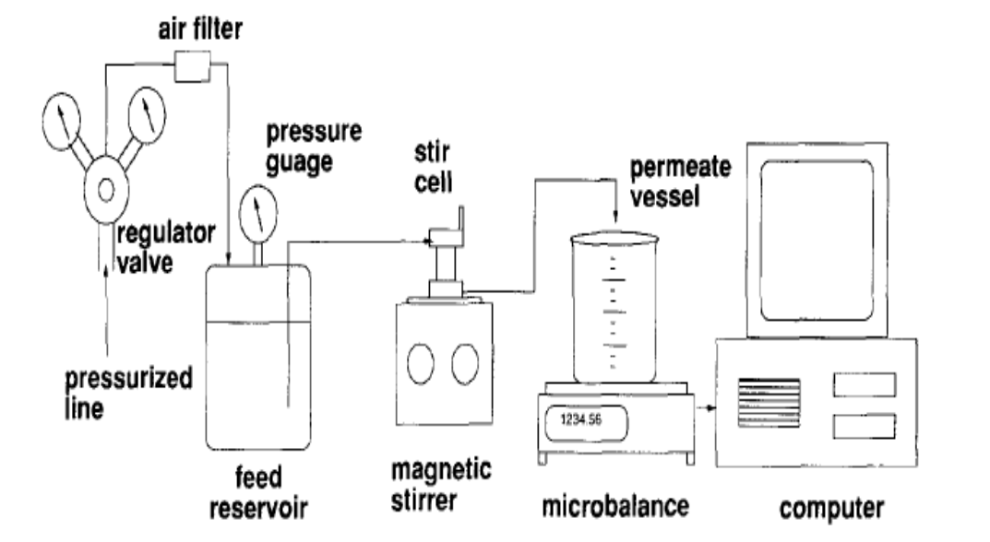
Physico-chemical Properties of TM
Characterization Technologies & Certification
Structure –related parameters: Determination of pore size, pore size distribution, top layer thickness and surface porosity
Permeation related parameters: Determination of the actual separation parameters using solutes that are more or less retained by the membrane
GENERAL METHODS IN MEMBRANE CHARACTERIZATION:
Electronic microscopy
Atomic force microscopy
Bubble-point method
Bubble-point with gas permeation
Mercury intrusion method
Permeability method
Gas-adsorption-desorption
Thermo-porometry
Permporosimetry
Liquid displacement
Solute rejection measurements

Slide 31
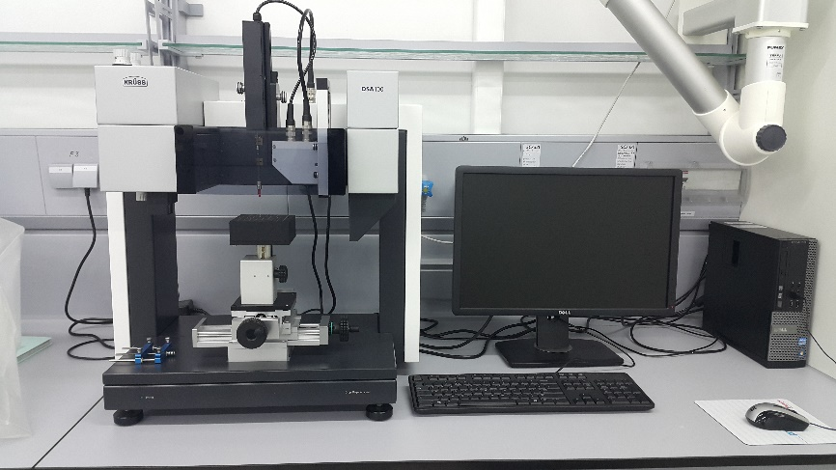
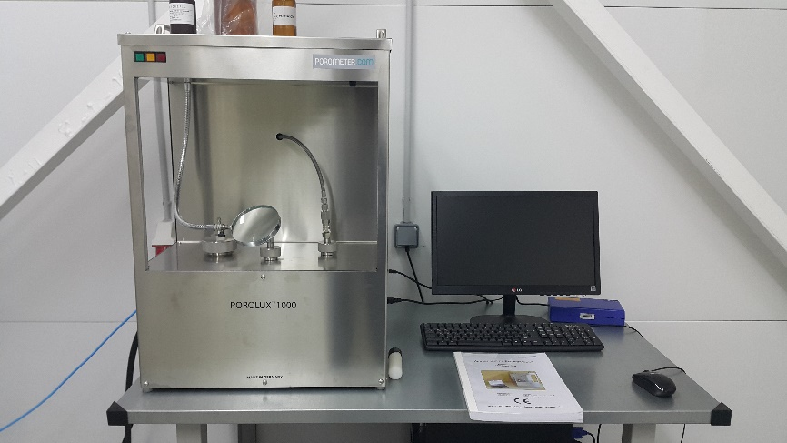
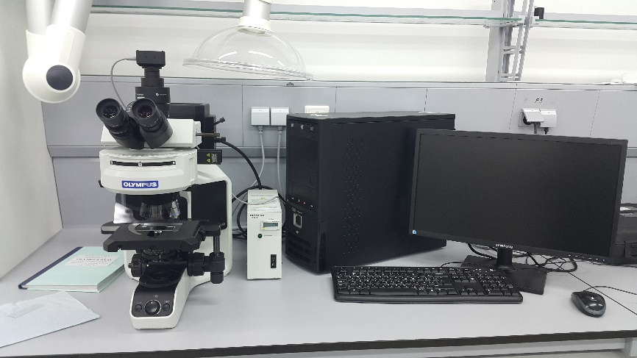
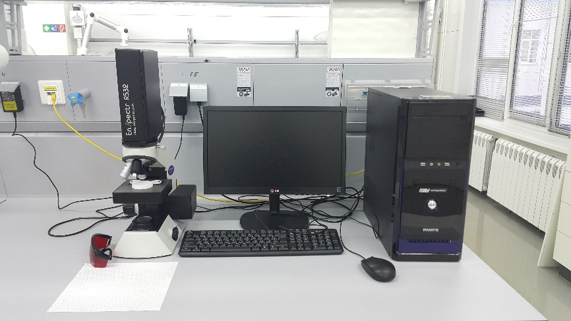
Nanocenter analytical facilities for TM
Characterization Technologies & Certification
Contact angle apparatus
Bubble point test apparatus
Optical Microscopy
Micro RAMAN

Slide 32
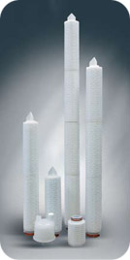


Successful commercial application of TM
Microfiltration
Sanity-microbiological and environmental control
Polishing and sterilization filters for wide range of water treatment processes and food industry
Pharmaceutical industry - vaccine and liposome productions
Gas separation and air filtration
Clean room filter system with O₂/CO₂ separation
Medicine
Therapeutic treatment of blood – Plasmaphereses
Cervical cancer screening
Glaucoma TM implant
Individual Insert Handling for cell cultivation based on TM

Slide 33



Vaccines production: enrichment and diafiltration using cross-flow filtration
Vaccines against influenza, tick-borne encephalitis, rabies, foot and mouth disease produced by “MICROGEN”, Russia

Slide 34




CROSS-FLOW FILTRATION USING TRACK ETCHED MEMBRANES

Slide 35



MEMBRANE PLASMOFILTER PFM – 800 based on extraordinary behavior TM in blood filtration and advanced operating design
2014 sales in Russia and in former USSR republics 250 000 units
Membrane plasmapheresis – modern convenient way for problem solving
in detoxication, immuno & gemocorrection of patient by harmful substance plasmaectomy
TECHNICAL CHARACTERISTICS OF PFM-800
Overall dimension - 50 Х 100 Х 8 mm Plasma outlet - 30- 35%
Blood flow velocity - 100 ml/min Blood volume in system - 20 ml
Sterilization- irradiation Price $25 (hollow fiber membrane system $200)

Slide 36


Slide 37


Infusion & Transfusion filters
Beijing Fert Technology Co. Ltd
Nuclear track membrane as a key component of filtration devices can be used
to remove solid particles in liquid medicine, such as injections and transfusions.
The removal efficiency for solid particles of diameter of 5 μm is higher than 90%.
The flow rate of liquid medicine through the filtration device is higher than 500 ml/10 min under the pressure of 1 m high water.
The stability or reproducibility as well as the above parameters are good
enough to satisfy the requirements of medical services.

Slide 38

Skin protection Foliderm

Slide 39



WATER TREATMENT
Spiral filtration modules
TM with pore diameters from 0.2 to 1.5 µm
Up to 50 square meters of membrane in one module
A great resource due to the periodic regeneration
Can withstand 700-800 cycles of regeneration –
in contrast to the membranes of other types .
“Water polishing" for microelectronics and pharmaceutical
companies working according to GMP standards
household water filters
NEROX and SIMPEX

Slide 40



Air and water pollution control using TM

Slide 41


Individual Insert Handling for cell cultivation based on TM
Applications (Clear and BD FluoroBlok™ Membranes)
Angiogenesis Endothelial Cell Migration/Invasion
Tumor Cell Biology Tumor Cell Migration/Invasion
Inflammation Monocyte, Leukocyte Chemotaxis Transendothelial Cell Migration
ADME/Tox Transport and Permeability
Toxicity Assays
Cell Differentiation Blood Brain Barrier Models Co-culture studies (primary cells, stem cells)
Drug Discovery (single parameter or multiplexing)
Cell Imaging

Slide 42



Liposome and controlled micro and nano emulsions production
Many of the most significant properties of emulsion-based products, such as shelf life, appearance, texture, flavour, encapsulation degree, and release rate are determined by the size of the droplets they contain. The size and the size distribution of droplets is the key to the stability of an emulsion, as it determines the rate of coalescence and its fitness for intended use.

Slide 43

Template synthesis technique using TM – simple way to produce consolidated micro & nano materials
Materials: Metal, metal alloys and composites, semiconductors, carbon…..
Forms of material – replica from porous template
Geometry: whiskers, tubes, needles …….
Size: minimum - 10 nanometers and
maximum – hundreds of microns
The template syntheses of Metal-Semiconductor-Carbon Micro & Nano-wire arrays and High Aspect Ratio Nanoparticles opens up New Avenues in Nano-Device Fabrication

Slide 44


Applications of High Aspect Ratio Nanoparticles and Nanoarrays
Several applications of high aspect ratio nanoparticles have been shown, and many others continue to be unfolded
  Biology
  Gene therapy
  Bio-separations
  Separations
  Catalysis
  Sensing
  Electronics
  Optical applications
  Etc.

Slide 45

Track etched membranes – world market
The report "Track etched Membrane Market by Product (Membrane Filter, Capsule & Cartridge Filter, Cell Culture Insert), Material (Polycarbonate, Polyimide), Application (Cell Biology, Microbiology, Analytical testing, Automotive), End User - Global Forecast to 2023", The track etched membrane market is expected to reach USD 813.1 million by 2023 from USD 476.0 million in 2018, at a CAGR of 11.3% from 2018 to 2023. The growth of the pharmaceutical R&D expenditure is expected to be one of the major factors driving the growth of this market during the forecast period. Moreover, the collaborative application of nanotechnology and track etching is expected to increase the adoption of track etched membranes in various applications, such as healthcare, fuel cells, telecommunications, and transportation.
https://www.marketsandmarkets.com/
PressReleases/track-etched-membrane.asp

Slide 46
Current status of joint R&D in FLNR-IINC in development novel approaches in TM and micro & nanoporous templates
Multifunctional asymmetric nanostructures in Heavy Ion Irradiated Polyester Films for biosensors
Multifunctional TM modified using Photocatalytic layers and nanofibers for water treatment and
Silver & Gold nanoparticle arrays on TM for Surface Enhanced Raman Spectroscopy as a Tool for Pathogen Cell, viruses , RNA-DNA Express – Testing
TM for biotechnological applications using gel- and buffer-electrophoreses for “blotting” system
Exosome cultivation and separation technology

Slide 47


Slide 48

International co-operation
Co-authors from member countries (11):
Republic of Belarus
Republic of Bulgaria
Czech Republic
Democratic People’s Republic of Korea
Republic of Moldova
Republic of Poland
Romania
Russian Federation
Slovak Republic
Ukraine
Socialist Republic of Vietnam
… from associated member states:
Germany
Republic of South Africa
Serbia
Active co-operation with non-member states:
China
USA
Spain
Australia

Slide 49
We are waiting for new ideas in heavy ion
irradiated materials application!
Thank you

