Slide 1

Аспекты практического использования электронных пучков низких энергий (до 10 МэВ)
R&D Laboratory for Pulse-Beam, Electric Discharge and Plasma Technologies
School of Advanced Manufacturing Technologies
Tomsk Polytechnic University
Иван Сергеевич Егоров
к.т.н., с.н.с., доцент ТПУ
EgorovIS@tpu.ru
+7 923 417 48 92
Дубна, июль 2024

Slide 2

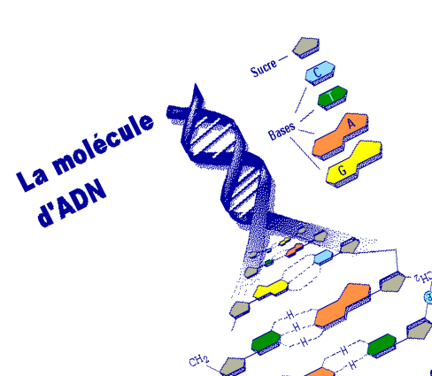
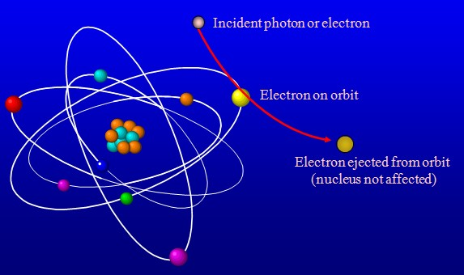
1. What is electron beam irradiation? Why we study it?
What is irradiation?
Ionisations
Radicals
Chemical effects
Cross-linking
Physical process:
exposure to ionizing radiation
Chain scission
Less than 10MeV
BROKEN STRAND
Biological effects
Living organisms
no longer reproduce / die.
WEAK BOND REPLACED
BY STRONG BOND
No chemical additives
No biological adaptation
Transfer of energy only
Products can be treated within closed packages
Absorbed dose is the main parameter.
1 Gray = 1 Joule / kg
Irradiated products do not
become radioactive [1]
[1] СанПиН 2.6.1.2573 –10 «Гигиенические требования к размещению и эксплуатации ускорителей электронов с энергией до 100 МэВ», до 10 МэВ - I группа ускорителей

Slide 3
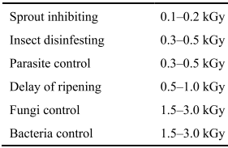
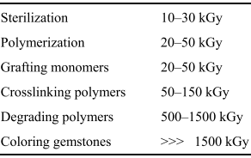
2. EB application doses
Absorbed dose requirements for some industrial processes [2]
Dose: 10 kGy = 1MRad = 10kJ/1kg = 2.4º for water heat
Dose 10 kGy is acceptable for irradiation in food industry [3, 4]
[2] R. Mehnert, Review of industrial applications of electron accelerators,(1996).doi:10.5170/CERN-2006-12.383.
[3] High Dose Irradiation: Wholesomeness of Food Irradiated with Doses above 10kGy, Report of a Joint FAO/IAEA/WHO Study Group, Technical Report Series 890 WHO. Geneva, 1999
[4] CAC/RCP19-1979,rev.1-2003 Recommended International Code of Practice for Radiation Processing of Foods

Slide 4

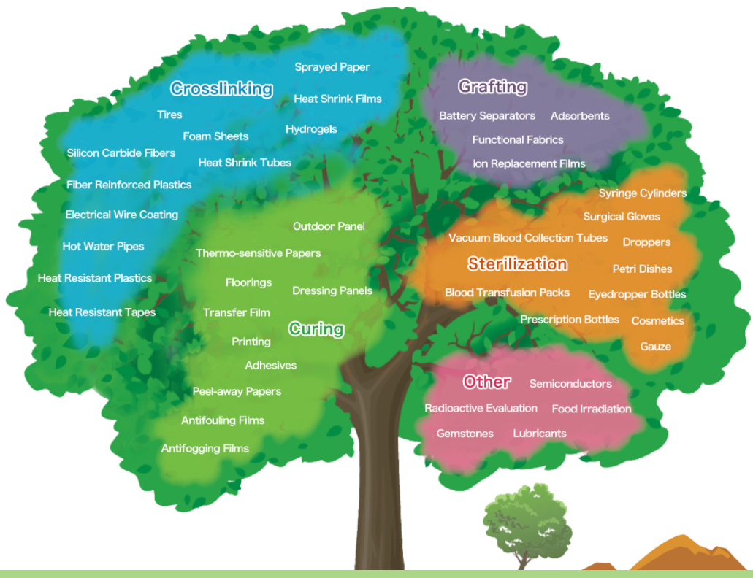
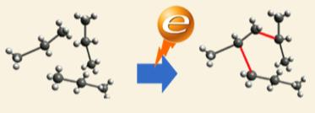
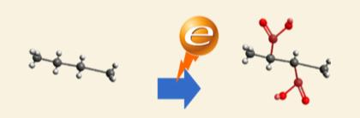
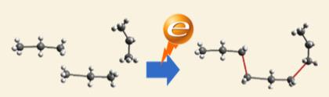
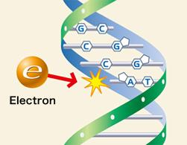
3. Electron beam application trends
Crosslinking
Grafting
Curing
Sterilization
[5] https://www.nhv.jp/en/eb/effect.html

Slide 5

4. Mechanisms of the impact of ionizing radiation on biological objects
e-beam
How it works?
Radiolysis of water [6]
Water is Life!
H
H
O
Active chemical compounds produced by radiolysis of water
e_{aq}
OH*
H*
H₂O₂
O₃
[6] Calado T., Venâncio A., Abrunhosa L. Irradiation for Mold and Mycotoxin Control: A Review // Comprehensive Reviews in Food Science and Food Safety. – 2014. – DOI: 10.1111/1541-4337.12095

Slide 6
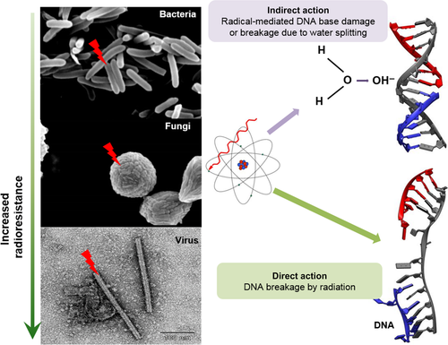
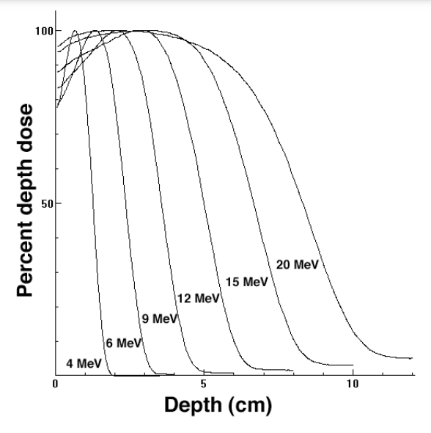
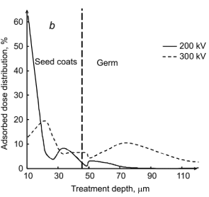
5. Some practical use features of electron beams for disinfection
Hull; Fiber
Grain structure
Aleurone Layer (Bran);
Protein and Fiber
Endosperm; Starch
Germ (Embryo);
Protein and Lipid
2 mm
in water
[7]
[8]
[9]
[7] Jeong M.A., Jeong R.D. Applications of ionizing radiation for the control of postharvest diseases in fresh produce: recent advances // Plant Pathology. – 2018. – DOI: 10.1111/ppa.12739.
[8] D. Dance, S. Christofides, M. Maidment I.M. Diagnostic Radiology Physics: A handbook for teachers and students // IAEA. 2014. 710 p.
[9] I.S. Egorov, A.A. et. al, Influence of the Kinetic Energy Spectrum of Pulsed Beam Electrons on the Effective Absorbed Dose Distribution Over the Target Depth, Russian Physics Journal. 63 (2020) 36–40. doi:10.1007/s11182-020-02166-5.

Slide 7
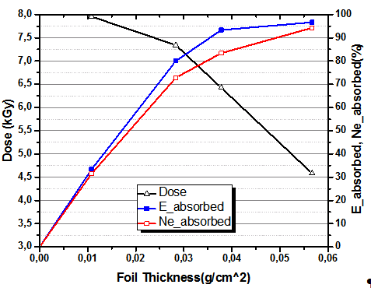
6. Depth dose distribution for electron beam of monoenergetic and composite spectra
А
Physics matter!!!
Absorbed Dose, beam energy and electron numbers distribution over the of depth aluminium target for pulsed ASTRA-M electron accelerator
[10]
Typical (idealized) depth dose distribution for a monoenergetic electron beam in a homogeneous material with a low atomic number.
[11]
[10] ISO/ASTM 51431:2005 Standard Practice for Dosimetry in Electron Beam and X-Ray (Bremsstrahlung) Irradiation Facilities for Food Processing
[11] A. Poloskov, M. Serebrennikov, A. Isemberlinova, I. Egorov, Energy depth distribution of pulsed electron beam with wide electron kinetic energy spectrum for an aluminum target, Journal of Physics: Conference Series. 1393 (2019) 012115. doi:10.1088/1742-6596/1393/1/012115.

Slide 8
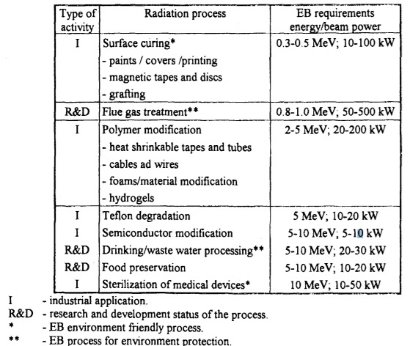
7. What kind of accelerators in use?
А
Radiation processing technologies applied in industry.
Highlights:
Industry needs average power;
KeV follows application;
[12] Zbigniew Zimek, Electron accelerators for environmental protection, RAPORTY IChTJ. SERIA B nr 8/98, (1998). BOOK!

Slide 9
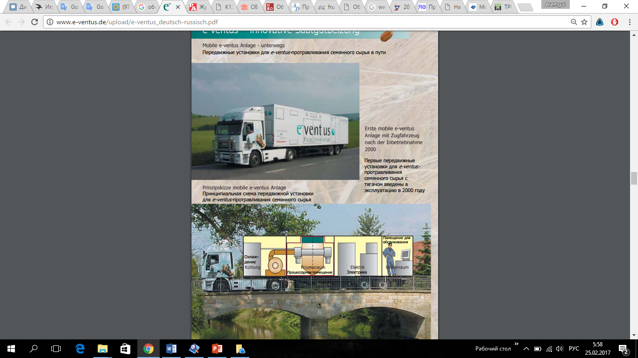
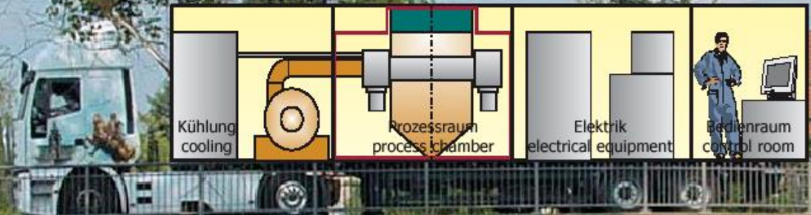
8. Examples. Food processing. Seed treatment
9
Mobile treatment plant WESENITZ II
• Governmental funded development project
• 2 line emitting sources, 145 kV
• Continuous treatment on air
• Throughput: 30 t/h
• 1997 -1999
[13] Electron treatment of seed. Presentation of Fraunhofer Institute for Organic Electronics, Electron Beam and Plasma Technology FEP Dresden, Germany. https://indico.cern.ch/event/364085/contributions/1779838/attachments/724493/994340/2015_04_-_EuCARD_II_Seed.pdf

Slide 10
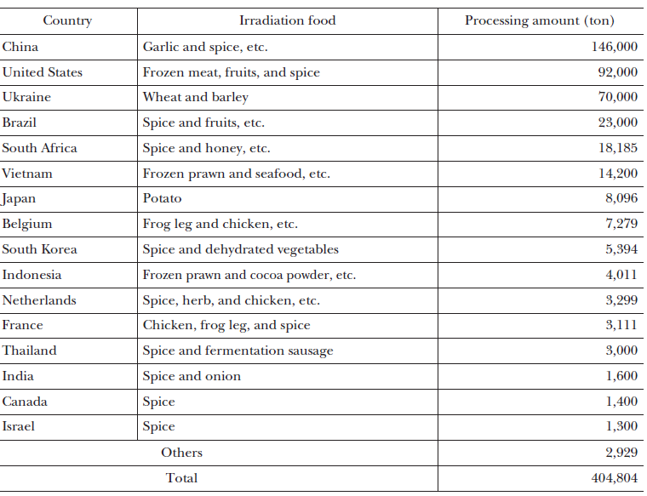

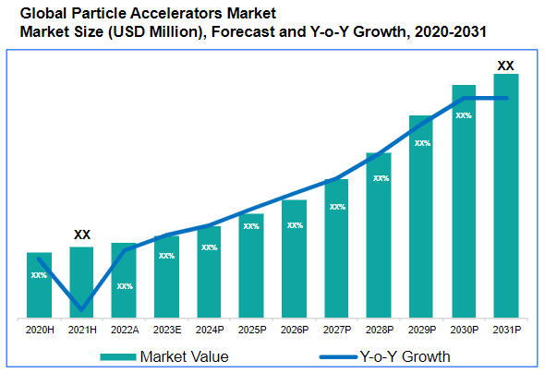
8 Examples. Food processing
10
Processing amount of food irradiation in the world (2005) [14]
Data Bridge Market Research
China Garlic and spice, etc. 146,000 ton
DATAINTELO
[14] Kashiwagi M., Hoshi Y. Electron beam processing system and its application // SEI Technical Review. – 2012. – № 75. – P. 47–54.

Slide 11
9. Worldwide standards
ISO Standards related to Electron Beam processing:
ISO 14470:2011 Food irradiation — requirements for the development, validation and routine control of the process of irradiation using ionizing radiation for the treatment of food;
ISO/ASTM 51900:2009 Guide for dosimetry in radiation research on food and agricultural products;
ISO 11137-1:2006 Sterilization of health care— Radiation;
ISO 16645:2016 Radiological protection — medical electron accelerators;
ISO/ASTM 52303:2015 Guide for absorbed-dose mapping in radiation processing facilities;
ISO/ASTM 51631:2013 Practice for use of calorimetric dosimetry systems for electron beam dose measurements and dosimetery system calibrations;
ISO 15573:1998 Practice for dosimetry in an electron-beam facility for radiation processing at energies between 80 KeV and 300 KeV;
ISO 15569:1998 Practice for dosimetry in an electron-beam facility for radiation processing at energies between 300 KeV and 25 MeV;
ISO/CD 15614-11 Specification and qualification of welding procedures for metallic materials;
ISO/ASTM 52904:2019 Additive manufacturing — process characteristics and performance — practice for metal powder bed fusion process to meet critical applications;
А
ISO/ASTM 51431:2005
Standard Practice for Dosimetry in Electron Beam and X-Ray (Bremsstrahlung) Irradiation Facilities for Food Processing
ГОСТ Р ИСО/АСТМ 51431-2012
Руководство по дозиметрии при обработке пищевых продуктов электронными пучками и рентгеновским (тормозным) излучение

Slide 12
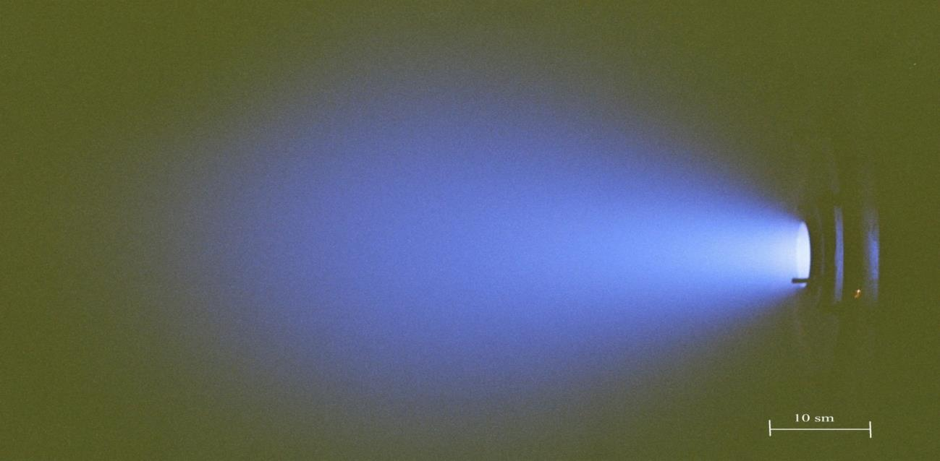
5. Conclusion
1. Ускорители заряженных частиц используются для решения практических задач
2. До 10 МэВ облучение не приводит к значимой активации объекта
3. Поглощенная доза 10 кГр приемлема для обработки продуктов питания
4. Радиационные технологии – область хозяйственной деятельности государства
E-beam 0.5 MeV ejected to atmosphere
5. Для ряда применений нужны компактные ускорители с энергией частиц <1 МэВ малой (единицы кВт) и средней (кВт) мощности

Slide 13
Аспекты практического использования электронных пучков низких энергий (до 10 МэВ)
R&D Laboratory for Pulse-Beam, Electric Discharge and Plasma Technologies
School of Advanced Manufacturing Technologies
Tomsk Polytechnic University
Иван Сергеевич Егоров
к.т.н., с.н.с., доцент ТПУ
EgorovIS@tpu.ru
+7 923 417 48 92
Дубна, июль 2024

