Slide 1
Feasibility of model-independent reconstruction of the amplitudes of the pp elastic scattering matrix at the SPASCHARM facility at U70
A.A. Bogdanov^{1,4}, V.P. Ladygin³, V.V. Mochalov^{1,2}, V.V. Moiseev², M.B. Nurusheva¹, V.L.Rykov¹, P.A. Semenov^{1,2}
¹National Research Nuclear University (Moscow Engineering Physics Institute), Moscow, 115409, Russia
²NRC «Kurchatov Institute» - IHEP, Protvino, Moscow region, 142281, Russia
³ Joint Institute for Nuclear Research, Dubna, Moscow region, 141980,Russia
XIX Workshop on High Energy Spin Physics, DSPIN-23 (Efremov-90)
4 – 8 September 2023. Dubna, JINR

Slide 2
The concept design of the SPASCHARM experiment setup allows us to measure non-vanishing observables for direct reconstruction of the pp elastic scattering amplitudes at the energy of 16 GeV. We discuss experimental measurements required to extract all amplitudes for two types of polarized target and polarized proton beam.
1
XIX Workshop on High Energy Spin Physics, DSPIN-23 (Efremov-90)
4 – 8 September 2023. Dubna, JINR
2

Slide 3
Polarized beams
In channel 24A, the formation of polarized beams is assumed protons and antiprotons with three directions of polarization. This requires the creation systems of superconducting magnets "Siberian snakes" that provide rotation of the beam polarization on the target. Such system was proposed by the group of the Institute of Nuclear Physics (INP) SB RAS under the leadership of Yu. M. Shatunov [1]
General system properties:
helicoidal magnet - Bmax = 47 kG, length λ = 2.5 m;
corrective dipole - B = 23 kG, length l = 30 cm;
the total length of the system is 6.5 m,;
the spin transparency is 97%.
The final development of the optical system can be carried out at the Institute of Nuclear Physics SB RAS (Novosibirsk), manufacturing - at the IHEP (Protvino) or JINR (Dubna).
Polarized proton acceleration in U-70 is possible with three partial snakes
[1] Koop I. A., Otboyev A. V., Shatunov P. Yu., Shatunov Yu. M. Two Examples
of In-Flight Spin Flippers // Phys. Part. Nucl. 2014. V. 45. P. 279–282
XIX Workshop on High Energy Spin Physics, DSPIN-23 (Efremov-90)
4 – 8 September 2023. Dubna, JINR
3

Slide 4
Polarized targets
To measure single-spin transverse asymmetries on channel 14 and two-spin transverse asymmetries ANN on channel 24, it is planned to use a “frozen” type transversely polarized target. The currently used target underwent a deep modernization for operation in a magnetic field of 2.4 T (with polarization pumping) and successfully worked in the test run of 2018. As a result, in a short time, it was possible to obtain a polarization above 70% with a theoretical maximum of about 75%, and polarization during data acquisition was 65%.
To measure the two-spin longitudinal asymmetries of ALL, a longitudinally polarized target is used in the setup. The cryostat for this target [2] was manufactured in 1990 within the experiment E704 at FNAL (USA) and is now at JINR.
It is planned to use a new transverse and longitudinal polarized target in the SPASCHARM experimental setup. To date, specialists from the universities of Bonn and Mainz have extensive experience in this area [3,4]. A feature of such a target is the possibility of creating both longitudinal and two transverse (vertical and horizontal) polarizations.
[2] Grosnick D. P. et al. // Phys. Rev. D. 1997. V. 55. P. 1159–1187
[3] Runkel S. The Polarized Target at the CBELSA/TAPS // PoS (SPIN 2018).2018. No. 108.
[4] Dutz H. The Bonn Frozen Spin Target // EU Workshop, EP7, SPINMAP, Linz, 2011.
XIX Workshop on High Energy Spin Physics, DSPIN-23 (Efremov-90)
4 – 8 September 2023. Dubna, JINR
4

Slide 5
Notation
According the Nucleon-Nucleon (NN) formalism and the four-index notation for observables given in [5], we use the scattering matrix in the form:
where ɑ, b, c, d and e are the scattering complex amplitudes, σ₁ and σ₂ are the Pauli 2 x 2 matrices, k and k’ are the unit vectors in the directions of the incident and scattered particles, respectively
[5] J. Bystricky, F. Lehar, P. Winternitz. Journal de Physique,
1978, 39 (1), pp.1-32.
XIX Workshop on High Energy Spin Physics, DSPIN-23 (Efremov-90)
4 – 8 September 2023. Dubna, JINR
5

Slide 6
Notation
The subscripts of the observables, Xsrbt, refer to the polarization states of the scattered, recoil, beam, and target particles, respectively:
Xsrbt
The polarizations of the beam and target particles are oriented along unit vectors n, s, and k for the beam and target laboratory frame:
k, n = [ k x k’], s = [ n x k]
and n, s”, and k” for the recoil particle frame:
k”, n, s” = [ n x k”]
XIX Workshop on High Energy Spin Physics, DSPIN-23 (Efremov-90)
4 – 8 September 2023. Dubna, JINR
6

Slide 7
The set of 15 observables
Earlier [6], we discussed the SPASCHARM configuration a longitudinally and transversely polarized target is used in the setup providing the opportunity to measure 15 observables:
A_{oono} , A_{ooon} - beam and target analyzing power, respectively;
A_{oonn} , A_{ookk} , A_{oosk} - three double-spin asymmetries ;
K_{onno} , K_{os’’so} , K_{os’’ko} - three polarization transfer coefficients from the beam to the recoil particle;
D_{onon} , D_{os’’ok} - depolarization coefficients for the target;
N_{onkk} , N_{onsk} , N_{os’’nk} , N_{os’’kn} , N_{os’’sn} , - polarizations of the recoil
particle.
P_{onoo} = A_{ooon} = A_{oono} = P - the polarization of the recoil proton is the same as analyzing power
[6] Bogdanov A A et al 2020 J.Phys.Conf.Ser. 1435 (2020) 012044
XIX Workshop on High Energy Spin Physics, DSPIN-23 (Efremov-90)
4 – 8 September 2023. Dubna, JINR
7

Slide 8
The set of 19 observables
The SPASCHARM configuration with the new polarized active target [7] all three polarizations will be available: longitudinal, vertical and horizontal, providing the opportunity to measure 19 observables and then reconstruct all amplitudes in laboratory frame in simple way [8]. In addition to the experiment with a target, polarized vertically and longitudinally only, here we can measure an additional four observables: A_{ooss} , D_{os’’os} , N_{os’’ns} , N_{onks}
[7] Biroth M et al 2015 “Design of the Mainz Active Polarized Proton Target”, PoS (PSTP2015) 005
[8] Bogdanov A A et al 2020 J.Phys.Conf.Ser. 1690 (2020) 012084
XIX Workshop on High Energy Spin Physics, DSPIN-23 (Efremov-90)
4 – 8 September 2023. Dubna, JINR
8

Slide 9
The complete set of observables
The reconstruction of amplitudes was carried out in the center of mass system [6] and in laboratory frame [8]
Note that in our experiment the beam will be polarized along n, s or k while the target will be polarized along n or k and the components n and s" of the recoil particles will be analyzed
The minimal set of observables for direct reconstruction of the scattering amplitudes consists of cross section σ and 9 spin observables (in the center of mass system): A_{oono}, A_{ooml}, K_{omlo}, K_{ommo}, D_{omol}, N_{omln}, N_{onml}, N_{ommn}, N_{onll} .
Simple direct reconstruction from 11 observables (in laboratory frame): P, A_{oonn}, A_{ookk}, A_{oosk ,}K_{onno} K_{os’’ko}, K_{os’’so}, D_{onon}, N_{onsk}, N_{onkk},.
Both SPASCHARM beam and the target will be polarized along n, s or k directions, and the components n and s" of the recoil particles will be analyzed, the minimum set consists of 13 observables: P, A_{oonn}, A_{ookk} , A_{oosk} , A_{ooss ,}K_{onno} , K_{os’’ko}, D_{os’’ok}, D_{onon}, N_{onsk}, N_{onkk}, N_{onks}
XIX Workshop on High Energy Spin Physics, DSPIN-23 (Efremov-90)
4 – 8 September 2023. Dubna, JINR
9

Slide 10
The criteria to select elastic processes
To estimate the S / (S + B) ratio, 10⁶ events were simulated using the PYTHIA 8 generator. The signal is elastic pp scattering. Background - diffraction processes as A + B → X + B, A + B → A + X in which only two charged particles enter the detector. The geometry and resolution of the detector were taken into account In the simulation. Separation was carried out using the two-dimensional distribution tg1 * tg2 of the difference in angles (phi1-phi2) [6].
XIX Workshop on High Energy Spin Physics, DSPIN-23 (Efremov-90)
4 – 8 September 2023. Dubna, JINR
10

Slide 11
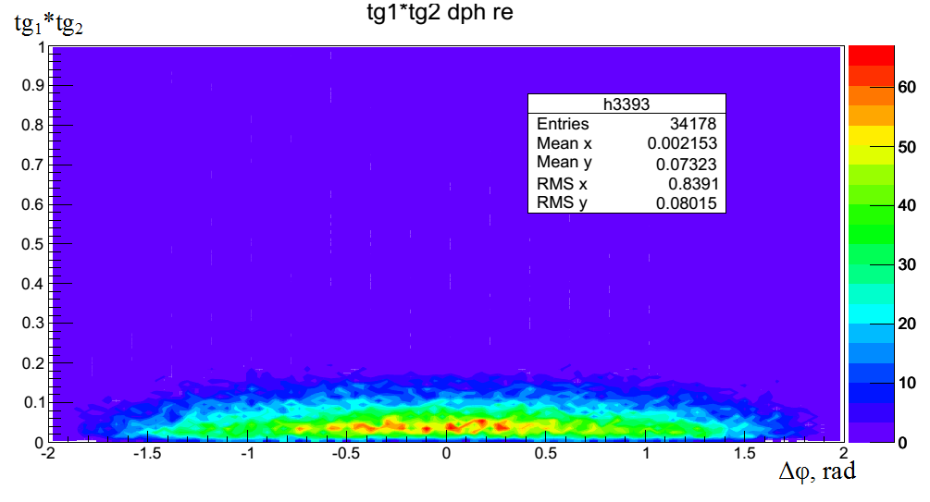
Two-dimensional histogram. Multiplying of tangents of polar angles and the difference of azimuthal angles. Only for elastic processes 164612
Separation was carried out using the two-dimensional distribution tg1 * tg2 of the difference in angles
Two-dimensional histogram. Multiplying of tangents of polar angles and the difference of azimuthal angles. Only for diffractive processes 34178
XIX Workshop on High Energy Spin Physics,
DSPIN-23 (Efremov-90) 4 – 8 September 2023. Dubna, JINR
11

Slide 12
Possibility of separating elastic pp scattering
Fig. 2 Distribution of scattered protons depending on the polar angle. Blue distribution correspond to elastic processes. Red distribution correspond to diffraction processes.
Fig. 1 Distribution of recoil protons depending on the polar angle. Blue distribution correspond to elastic processes. Red distribution correspond to diffraction processes
Elastiс p+p→p+p event is signal to analyze. Main background is single p + p→p + X, p + p →X + p and double diffraction processes Signal S / (S + B) = 0.995 Background. 10⁵ events were simulated using the PYTHIA 8 generator.
XIX Workshop on High Energy Spin Physics, DSPIN-23 (Efremov-90)
4 – 8 September 2023. Dubna, JINR
12

Slide 13
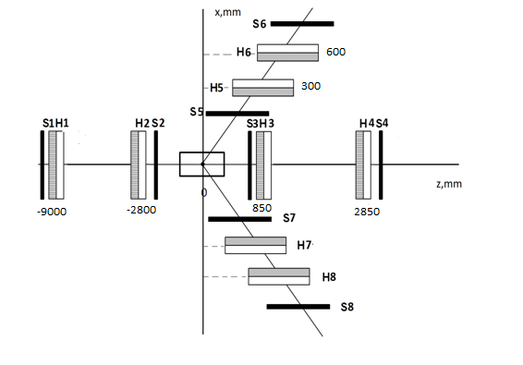
The detector scheme
XIX Workshop on High Energy Spin Physics, DSPIN-23 (Efremov-90)
4 – 8 September 2023. Dubna, JINR
13

Slide 14
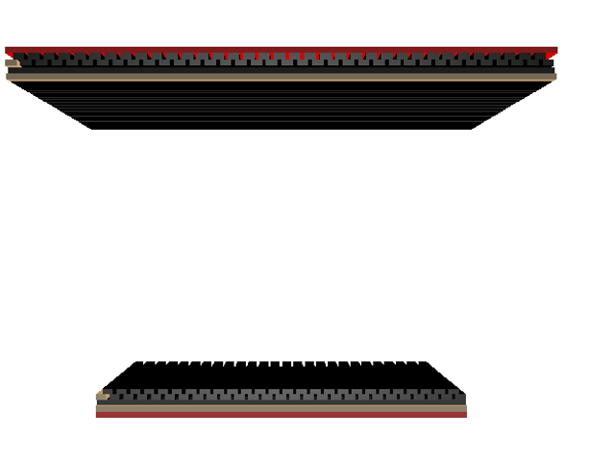
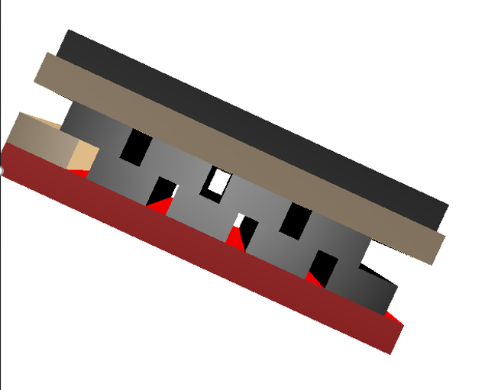
Scintillator “Comb” hodoscope
The calculations were carried out
for hodoscopes with a scintillation element size of 6 mm
(that is, a step of 2 mm)
Elements S5H5 , S6H6
Element S3H3
XIX Workshop on High Energy Spin Physics, DSPIN-23 (Efremov-90)
4 – 8 September 2023. Dubna, JINR
14

Slide 15
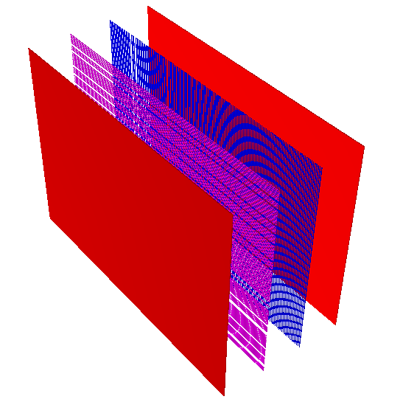
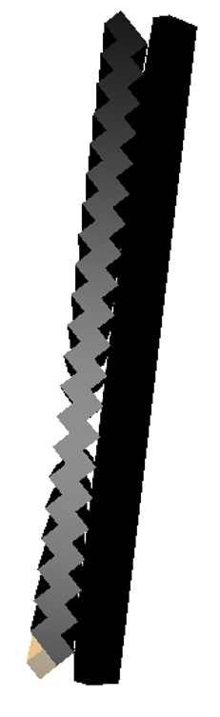
Proportional chambers and scintilliator
The distance between the planes is 9.7 cm . The distance between the wires is 2 mm. The width and length correspond to the dimensions of the detectors H5-H8, which in turn depends on the distance from the target
However, the amount of matter on the beam path in the "comb" hodoscope is larger by 67% with the same thickness of the scintillator rods as in the single-layer hodoscope.
Element S4H4
Elements S5H5.
XIX Workshop on High Energy Spin Physics, DSPIN-23 (Efremov-90)
4 – 8 September 2023. Dubna, JINR
15

Slide 16
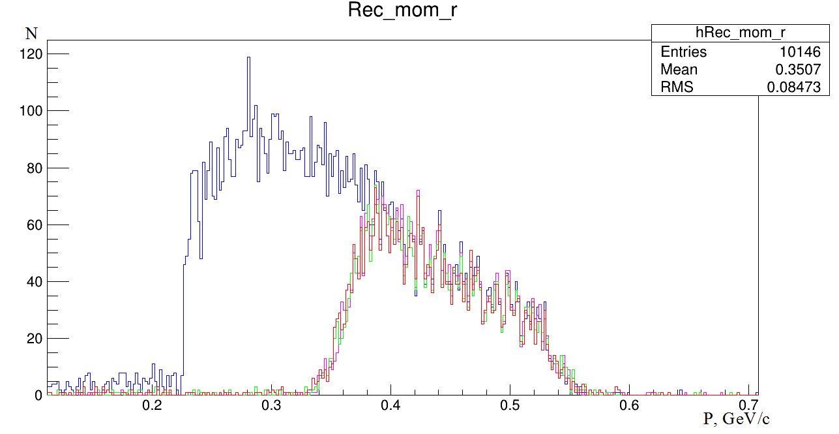
Number of events of two different detector setup
Polarized target without magnetic field for Scintillator detector setup 3971
Liquid hydrogen target without magnetic field for Scintillator detector setup 4080
Polarized target with magnetic field for Scintillator detector setup 3956
Liquid hydrogen target without magnetic field for Proportional chamber detector 10146
Momentum distribution
of the recoil proton
If the recoil arm is made from scintillators, then the efficiency is about 2.5 times less than if the recoil detectors are made from proportional chambers.
XIX Workshop on High Energy Spin Physics, DSPIN-23 (Efremov-90)
4 – 8 September 2023. Dubna, JINR
16

Slide 17
Discussion and conclusion
Channel 24A involves the formation of polarized beams of protons and antiprotons with three directions of polarization using systems of superconducting magnets "Siberian snakes".
Two types of polarized targets with two and three polarization components will make it possible to measure 15 and 19 observables, respectively
The complete sets of observables for direct reconstruction of the scattering amplitudes is 10 (c.m.s.) and 11 (laboratory frame) - from 15 observables and 13 (laboratory frame) - from 19 observables
Full Monte Carlo was prepared to study feasibility to measure elastic pp and p(bar)p scattering in the SPASCHARM experiment at 16 GeV.
MC study demonstrated possibility to study spin effects in elastic scattering in non-investigated region:
Fast MC study demonstrated the possibility to suppress background and select elastic process.
Real MC shows, that registration efficiency (region) become significantly (3 times) better if proportional chambers replace traditional scintillator hodoscopes (these chambers are already designed and can be manufactured in few months).
XIX Workshop on High Energy Spin Physics, DSPIN-23 (Efremov-90)
4 – 8 September 2023. Dubna, JINR
17

Slide 18
Acknowledgments
.
This work has been supported by RSF grant 22-1200164
The work was funded by the Ministry of Science and Higher Education of the Russian Federation, Project "New Phenomena in Particle Physics and the Early Universe" FSWU-2023-0073
XIX Workshop on High Energy Spin Physics, DSPIN-23 (Efremov-90)
4 – 8 September 2023. Dubna, JINR

Slide 19
Thanks for your attention
XIX Workshop on High Energy Spin Physics, DSPIN-23 (Efremov-90)
4 – 8 September 2023. Dubna, JINR

Slide 20
Back up

Slide 21
Motivation
The scattering matrix is a canonical concept for describing the scattering processes. However, its elements cannot be directly measured. Therefore, an appropriate full set of observables needs to be defined for the subsequent unambiguous direct reconstruction of the scattering amplitudes (DRSA) from this set.
DRSA is a fully model-independent analysis using only the fundamental conservation laws.
For the last 30 years, the statistical and direct reconstructions of the pp scattering matrix have been undertaken a number of times at various energies [5]. But, direct reconstruction of amplitudes for pp-elastic scattering has been done only for energies below 6 GeV/c. So far, no any data are available for p(bar)p - elastic scattering.
A complete list of available DRSA analyzes for the observed elastic pp scattering is provided in [5] F. Legar, E.A. Strokovsky “Phenomenology and Analysis of Nucleon Scattering Data” (2010)

