Slide 1

The aim of this study is to evaluate the azimuthal asymmetries in hadron production from the longitudinally polarized target as a manifestation of the quark-spin and transverse-momentum dependent PDF and PFF
O.Kouznetsov JINR
(member of the COMPASS Collaboration)

Slide 2



Studies of the nucleons structure using the SIDIS azimuthal angle asymmetries calculated with modified double ratios of numbers of the hadrons
A.V. Efremov
I.A. Savin
Yu.I. Ivanshin

Slide 3

This paper was supposed to be published in PEPAN (ЭЧАЯ)
hadrons h and unobserved particles X in the final state are sensitive to the spin-dependent Parton Distribution Functions (PDFs) of nucleons. The SIDIS cross section depends, in particular, on the azimuthal angle of each produced hadron, which leads to azimuthal asymmetries related to convolutions of the nucleon Transverse-Momentum-Dependent (TMD) PDFs and parton-to-hadron Fragmentation Functions (FFs).
The COMPASS collaboration collected data on the related SIDIS off the ⁶LiD (referred to as “deuteron”) polarized target in 2002, 2003, 2004, 2006 and off the NH₃ (referred to as “proton”) polarized target in 2007, 2010, 2011. These data provide an opportunity to measure all predicted TMD QPDFs.
M.G. Alekseev et al. [COMPASS Collaboration] // Eur. Phys. J. C 70 (2010) 39 [arXiv: 1007.1562]. 2002-2004 data analisys (11 pages)
C. Adolf et al. [COMPASS Collaboration] // Eur. Phys. J. C 78 (2018) 952 [arXiv: 1609.06062 ]. 2006 data analysis (13 pages)

Slide 4
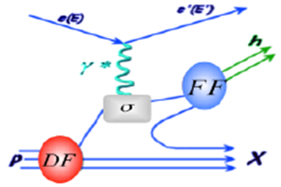
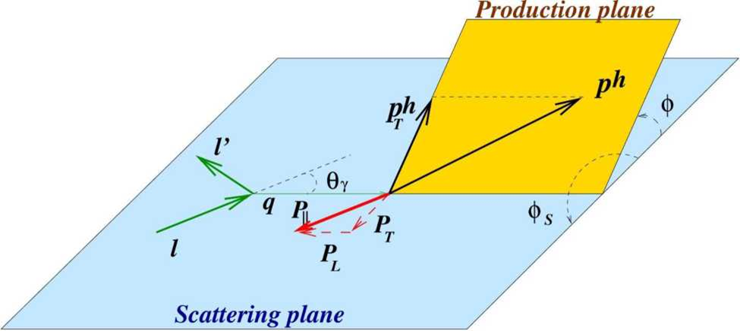
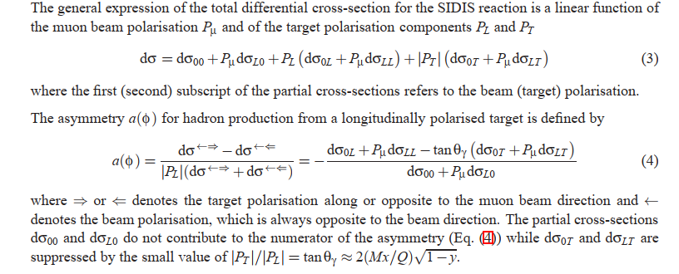
Total differential SIDIS cross-section

Slide 5
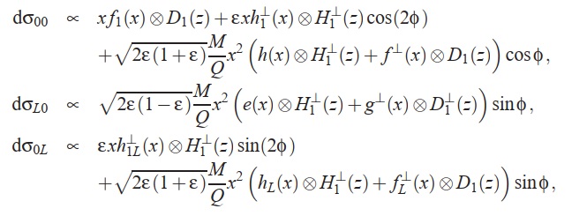
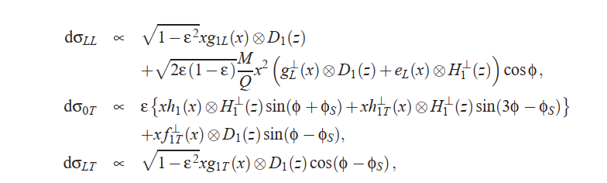
SIDIS cross section

Slide 6
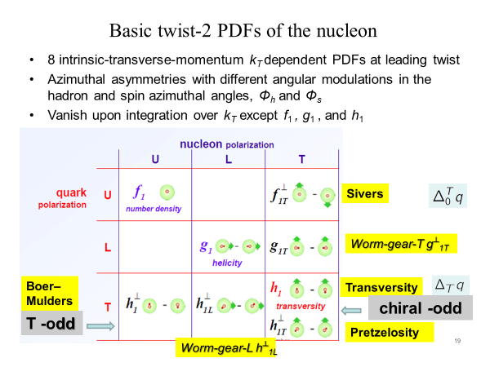
бубликообразность

Slide 7
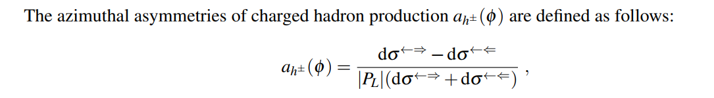
Azimuthal asymmetry of charged hadrons
The azimuthal asymmetries are related to transverse-momentum-dependent Parton Distribution Functions (PDF) and polarized and nonpolarized Parton Fragmentation Functions (PFF). They can depend on the transverse or longitudinal component of the quark spin.

Slide 8
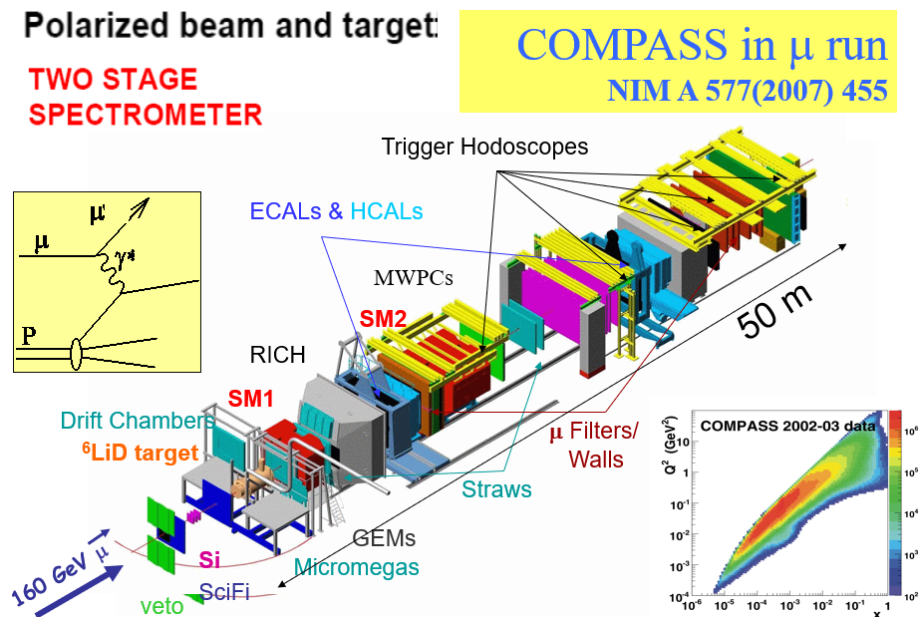
Experimental set-up: spectrometer
The COMPASS set-up is a two-stage forward spectrometer with the world’s largest polarized target and various types of tracking and particle identification detectors (PID) in front and behind of two large aperture magnets SM1 and SM2. The spectrometer was operated in the high energy (160 GeV) muon beam at CERN.

Slide 9
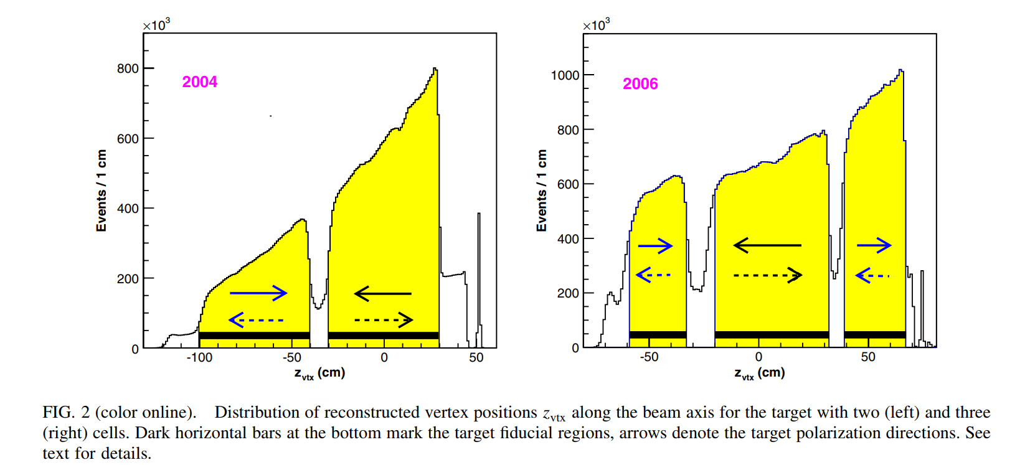
Experimental set-up: target
The major modifications in 2006 were as follows: (i) the replacement of the two 60 cm long target cells by three cell of lengths 30 cm, 60 cm and 30 cm, (ii) the replacement of the target solenoid magnet by the new one with a wider aperture and (iii) the installation of the electro-magnetic calorimeter ECAL1 in front of the hadron calorimeter HCAL1. These modifications aimed to further minimizing systematic uncertainties, to increasing an acceptance of the spectrometer and improving its e/γ identification capabilities. From another side that has required reconsidering methods of data stability tests and asymmetry calculations.

Slide 10
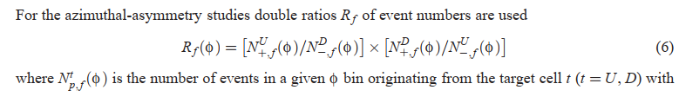
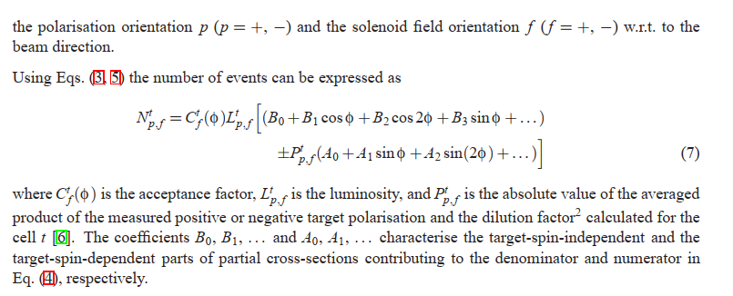
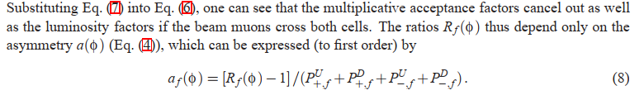
Double ratios (DR)

Slide 11
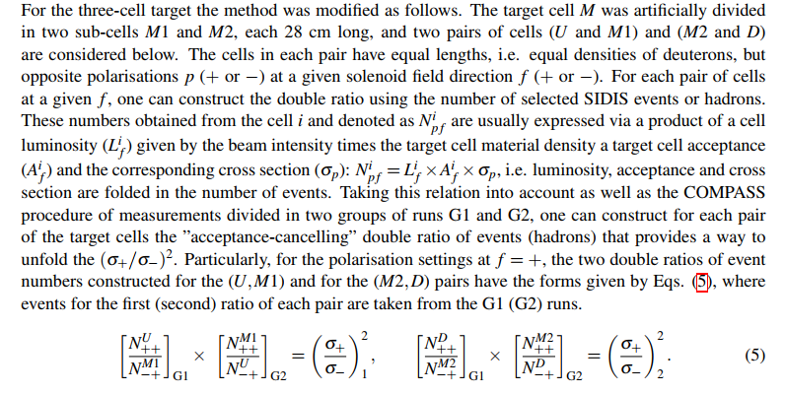

Modified double ratios (MDR)

Slide 12
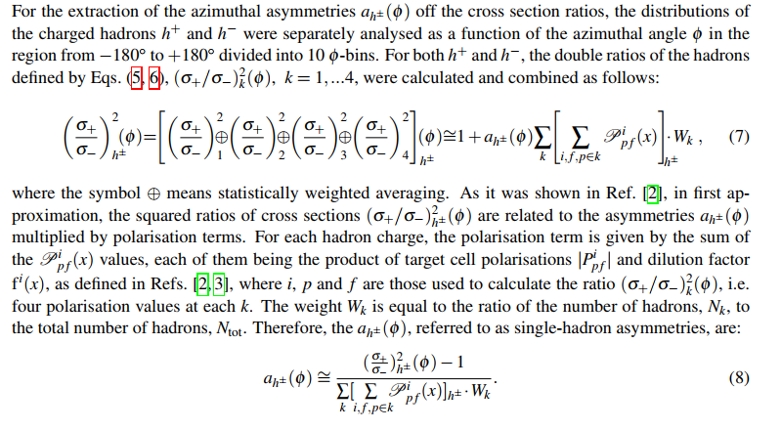
MDR and the

Slide 13
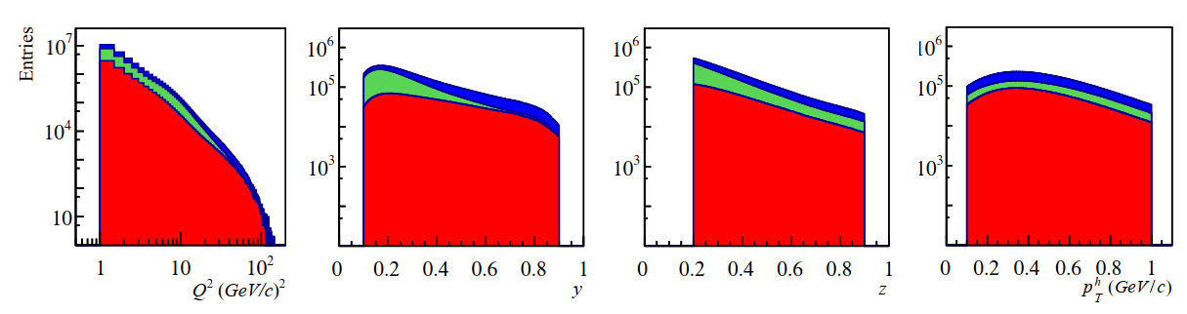
The combined data of 2002, 2003, 2004 and 2006 years
Events detected by the COMPASS spectrometer were conserved for the analysis under condition Q² > 1 (GeV/c)².
The statistics of 2002-2004 was about 96·10⁶ events.
The statistics of 2006 was about 64·10⁶ events.

Slide 14
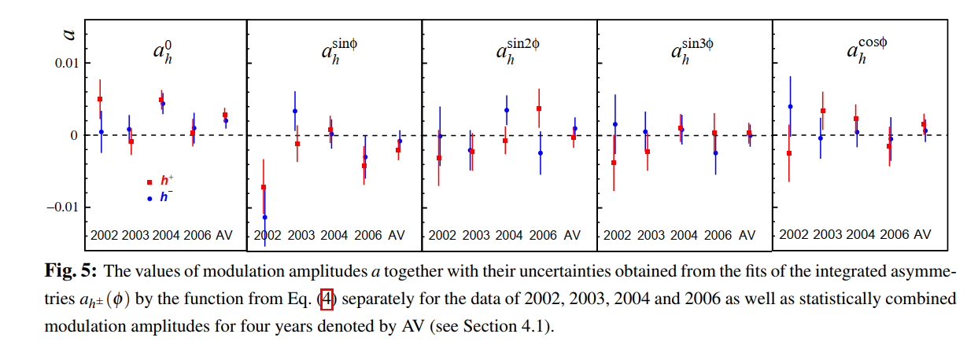
Integrated asymmetries
The asymmetries were fitted by the function from Eq. (4) using the standard least-square-method and extracting all asymmetry modulation amplitudes simultaneously

Slide 15
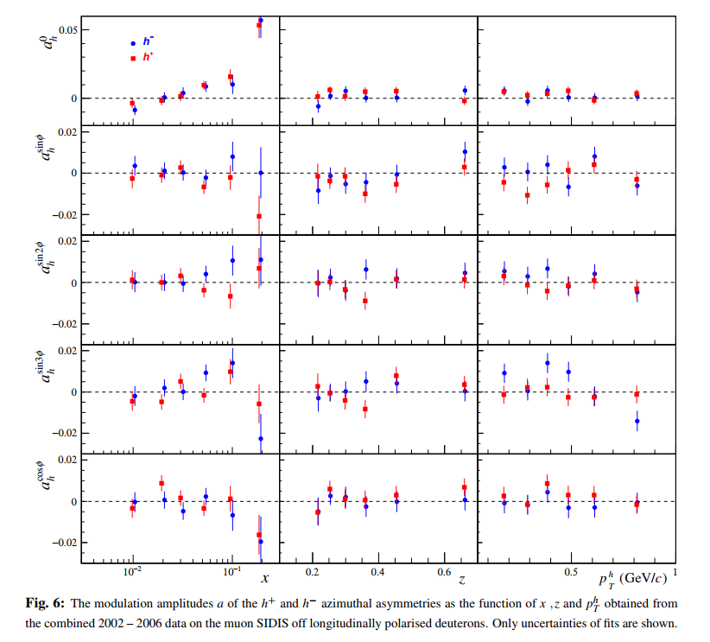
Asymmetries as functions of kinematic variables

Slide 16
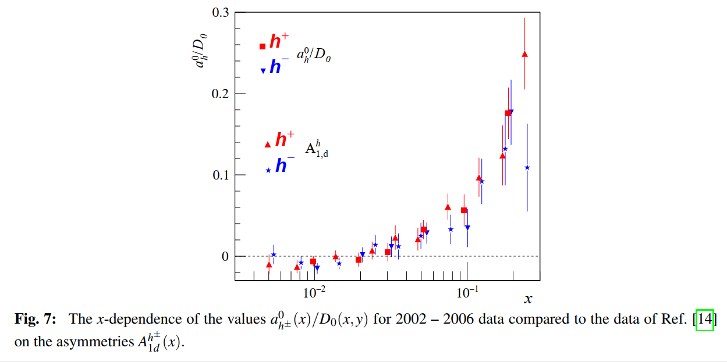
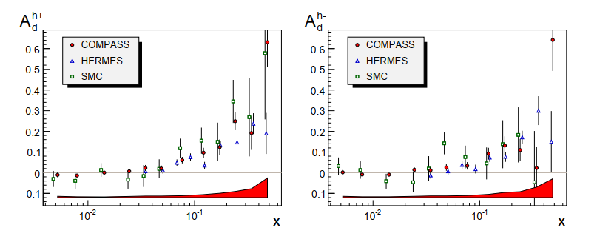
Comparison of the hadrons symmetries as functions X

Slide 17
Conclusion (results)
Altogether, contributions of TMD PDFs convoluted with PFFs to the azimuthal asymmetries in the SIDIS cross sections of hadron production by muons off longitudinally polarized deuterons are small.
This could happened either due to possible cancellations of the opposite contributions to the cross section from the deuteron up and down quarks, or/and due to the smallness of the transverse component of the longitudinal target polarization and of the M/Q suppression factor.
The first assumption can be checked by analyzing the azimuthal asymmetries in the cross sections of hadron production off longitudinally polarized protons.

Slide 18
Conclusion (MDR)
In conclusions, the SIDIS azimuthal angle asymmetries in the hadron productions off the longitudinally polarized deuterons which are free of possible false contributions were measured using the Modified Double Ratios of numbers of the
hadrons. Sources of possible false contributions to these asymmetries and their absence while using the MDRs were studied and described in this Paper. Advantages of such measurements are as following.
(1). For obtaining results on the muon SIDIS azimuthal angle asymmetries off polarized targets using the MDRs it does not required the knowledge of the set-up luminosity and acceptance, the value of the first of which is usually measured separately and the second one is calculated by MC simulations.
(2). The results on the SIDIS azimuthal angle asymmetries obtained with the MDRs have smaller statistical and systematic errors due to the absence of contributions to them from additional measurements and from the events generated by the MC simulations.
(3). For the analysis of the SIDIS azimuthal angle asymmetries from the longitudinally polarized deuterons, the MDRs of numbers of the hadrons provide measures to estimate false contributions to the SIDIS angle asymmetries related with the non perfect account of the set-up in the events reconstruction algorithm.

Slide 19
Acknowledgements
We gratefully acknowledge the support of our colleagues during the development of the Modified Double Ratios methods. The JINR colleagues are thankful to V.V. Kukhtin for critical reading of the manuscript and to S.V.Chubakova for professional English corrections.

