Slide 1
XIXth Workshop on High Energy Spin Physics
dedicated to 90th anniversary of A.V. Efremov birth
Transition energy crossing of
polarized proton beam at NICA.
Speaker: Kolokolchikov S. ^{1,2} (sergey.bell13@gmail.com)
Co-authors: Senichev Yu. ^{1,2}, Aksentev А. ^{1,2,3}, Melnikov A. ^{1,2,4}
¹Institute for Nuclear Research RAS, Moscow, Russia,
²Moscow Institute of Physics and Technology, Dolgoprudny, Russia,
³Moscow Engineering Physics Institute (MEPI), Moscow
⁴Landau Institute for Theoretical Physics, Chernogolovka,
Dubna, 04 September 2023.
04/07/2023
1
Dubna, 2023.

Slide 2
Abstract
At an experiment on acceleration of a polarized proton beam up to an energy at 13 GeV, the possibility of crossing the transition energy at 5.7 GeV by a jump is considered.
The scheme of crossing by a rapid change of transition energy, assumes the longitudinal movement of the beam near the zero value of the slip coefficient.
The jump itself is carried out in the absence of an RF field. The paper presents the influence of the above features on the dynamics of a polarized beam.
XIXth Workshop on High Energy Spin Physics
Dubna, 2023.
04/07/2023
2

Slide 3
TABLE OF CONTENTS
Transition Energy
Orbital Tracking
Spin Tracking
XIXth Workshop on High Energy Spin Physics
Dubna, 2023.
04/07/2023
3

Slide 4
Transition Energy
XIXth Workshop on High Energy Spin Physics
Dubna, 2023.
04/07/2023
4

Slide 5
Momentum compaction factor at Transition
Energy change $→$ 1) momentum change; 2) trajectory change.
MCF
Slip-factor
$$α=\frac{dC/C}{dp/p}$$
$$η=−\frac{ Δf/f}{Δp/p }$$
$$η=α−\frac{1}{γ^{2}}$$
1st Ord
$$\frac{ΔC}{C_{0}}=α_{0}δ+α_{1}δ^{2}+⋯$$
$$\frac{Δf}{f_{0}}=η_{0}δ+η_{1}δ^{2}+⋯$$
$$η_{0}=α_{0}−\frac{1}{γ^{2}}$$
$$η_{1}=α_{1}−\frac{η_{0}}{γ^{2}}+\frac{3β^{2}}{2γ^{2}}$$
2nd Ord
At $η=0$ get for Lorentz-factor $γ_{кр}=\frac{1}{\sqrt{α}}$, thus, transition energy can be determine.
XIXth Workshop on High Energy Spin Physics
Dubna, 2023.
04/07/2023
5

Slide 6
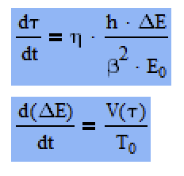
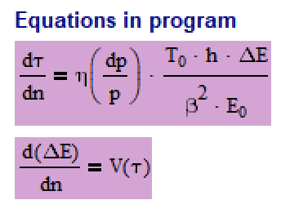
Equations of Longitudinal Motion
Classical form
– Energy Kick
– arrival Time drift
Slippage factor
Synchronious Particle
BLonD: https://blond.web.cern.ch/
XIXth Workshop on High Energy Spin Physics
Dubna, 2023.
04/07/2023
6

Slide 7
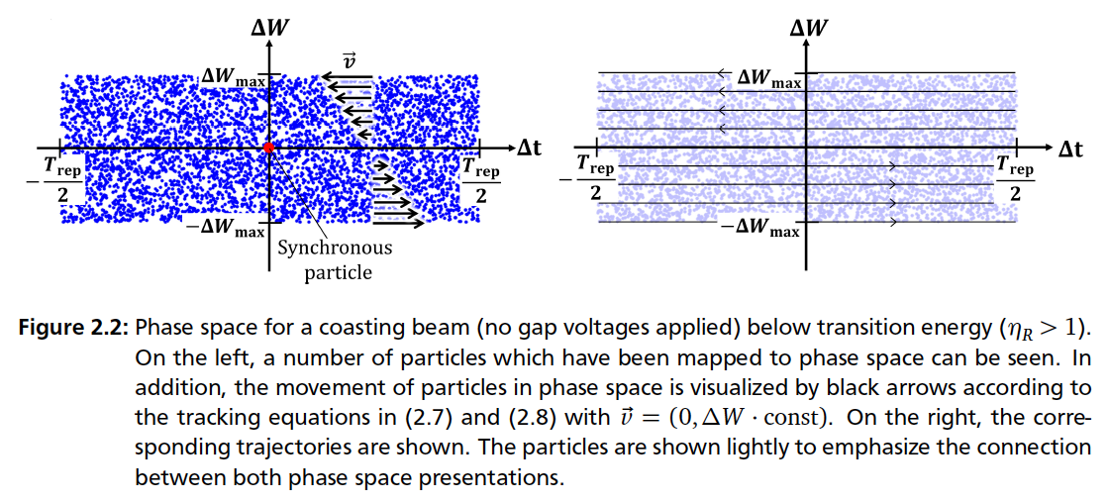
Coasting Beam
Jens Schweickhardt, Modeling and Optimization of Barrier-Bucket RF Systems, 2021
XIXth Workshop on High Energy Spin Physics
Dubna, 2023.
04/07/2023
7

Slide 8
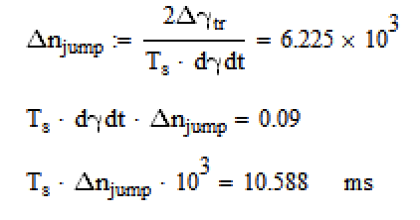
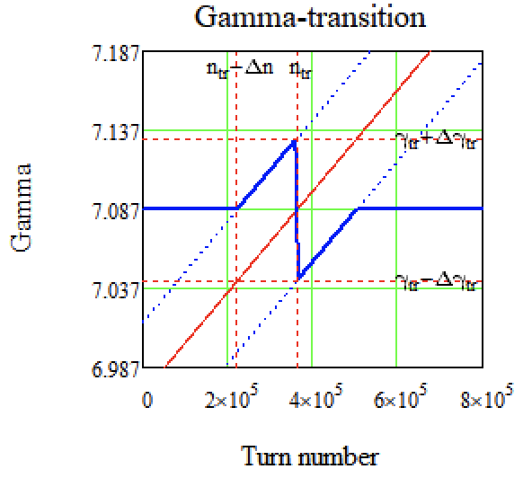
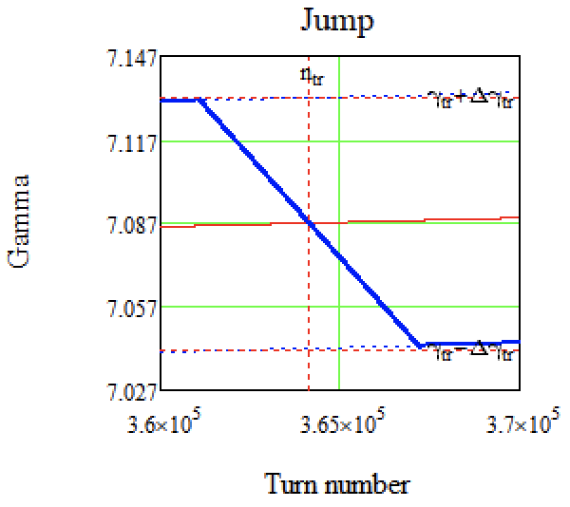
Jump-scheme at NICA
– turns before jump
– turns at jump
– $∆γ_{jump}$
Here is a 5 different states of longitudinal
optics based on transition energy:
1) acceleration from injection energy with initial value;
2) smooth increase to peak;
3) jump;
4) smooth recovery till initial transition;
5) initial value till the experiment energy;
First defines 3) state based on the maximum available speed of transition shift and available transition size
Secondly, we can understand states 3 and 4, as they changed parallel to beam energy
Finally, states 3 and 5 also can be understand
– jump time
2
2
1
3
5
3
4
4
XIXth Workshop on High Energy Spin Physics
Dubna, 2023.
04/07/2023
8

Slide 9
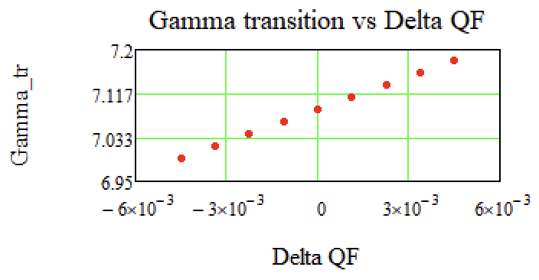
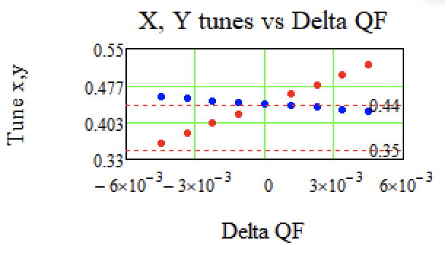
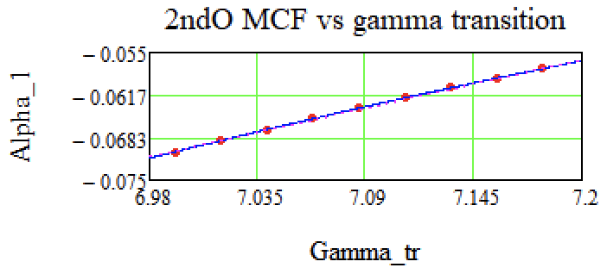
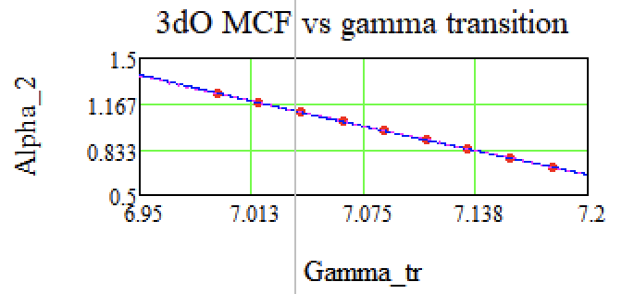
Momentum compaction factor at Transition
XIXth Workshop on High Energy Spin Physics
Dubna, 2023.
04/07/2023
9

Slide 10
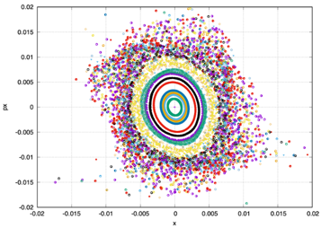
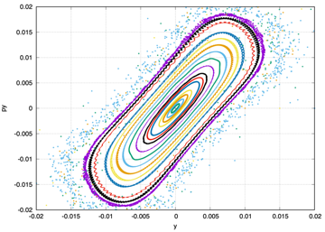
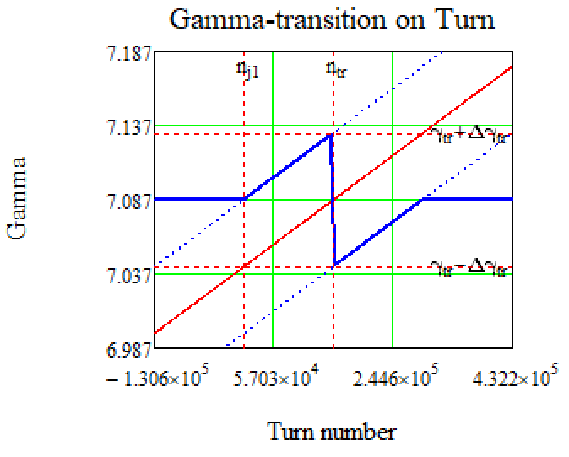
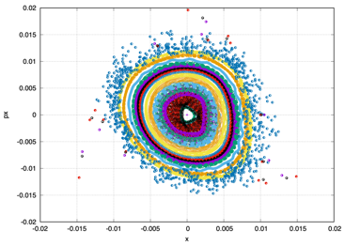
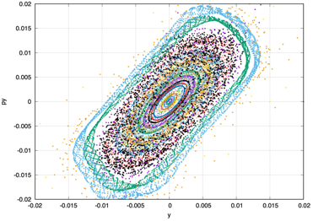
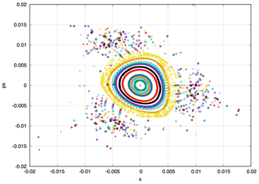
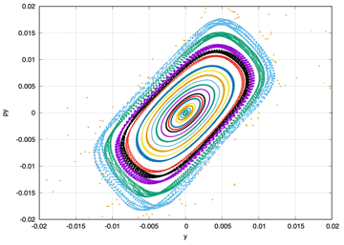
Dynamics aperture
XIXth Workshop on High Energy Spin Physics
Dubna, 2023.
04/07/2023
10

Slide 11
Impedance
XIXth Workshop on High Energy Spin Physics
Dubna, 2023.
04/07/2023
11

Slide 12
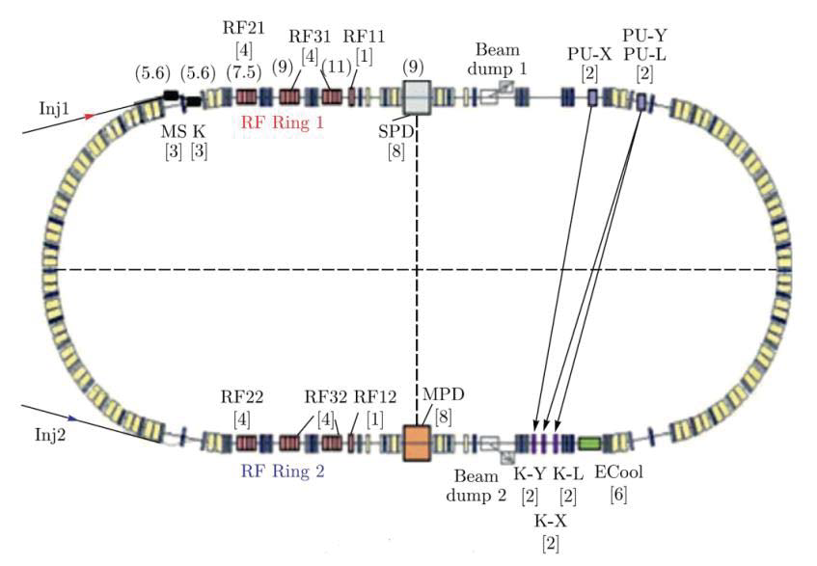
NICA Elements
XIXth Workshop on High Energy Spin Physics
Dubna, 2023.
04/07/2023
12

Slide 13
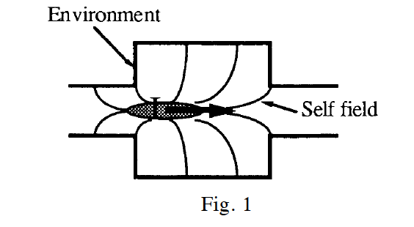
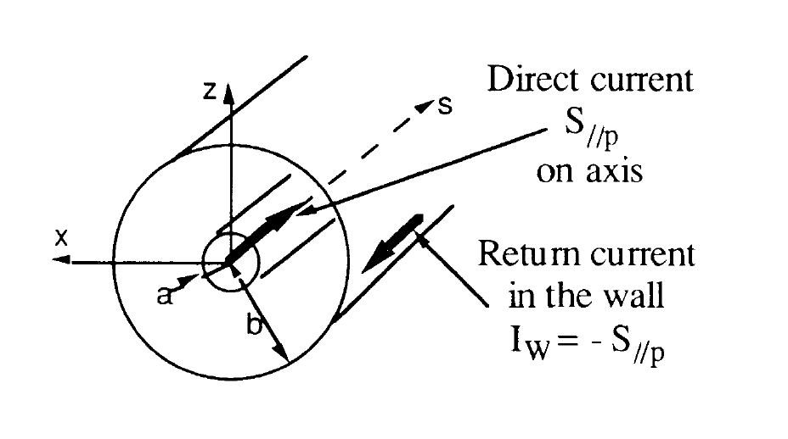
Impedances
Definition of Impedance:
Laclare, J L (ESRF, Grenoble), Coasting beam longitudinal coherent instabilities, CAS - CERN Accelerator School : 5th General Accelerator Physics Course, pp.349-384, DOI: 10.5170/CERN-1994-001.349
XIXth Workshop on High Energy Spin Physics
Dubna, 2023.
04/07/2023
13

Slide 14
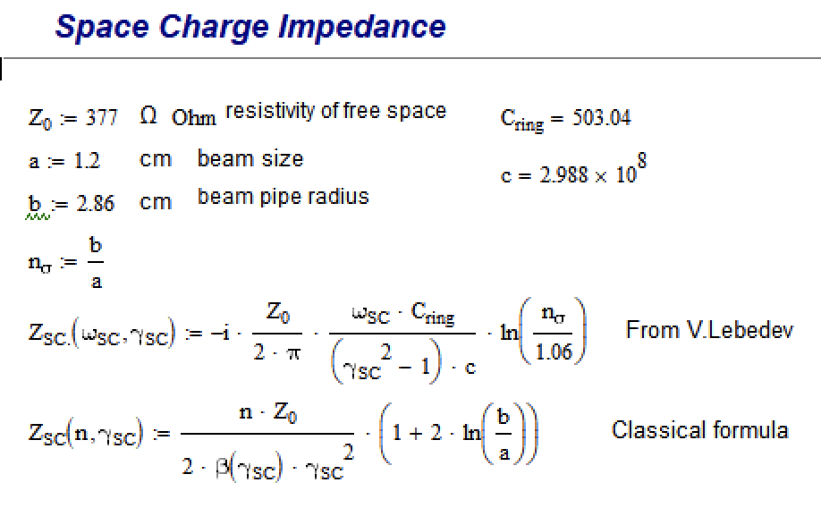
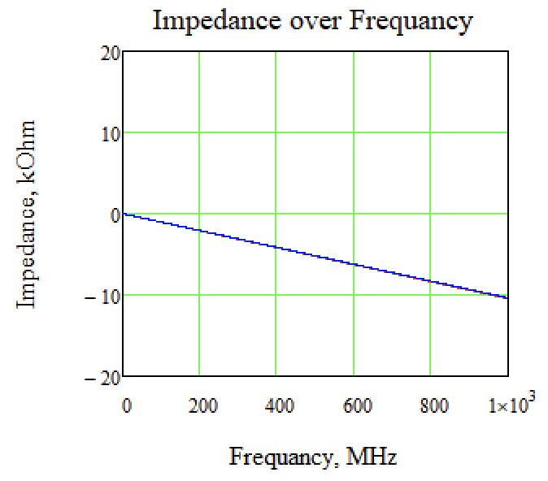
Space Charge Impedance
XIXth Workshop on High Energy Spin Physics
Dubna, 2023.
04/07/2023
14

Slide 15
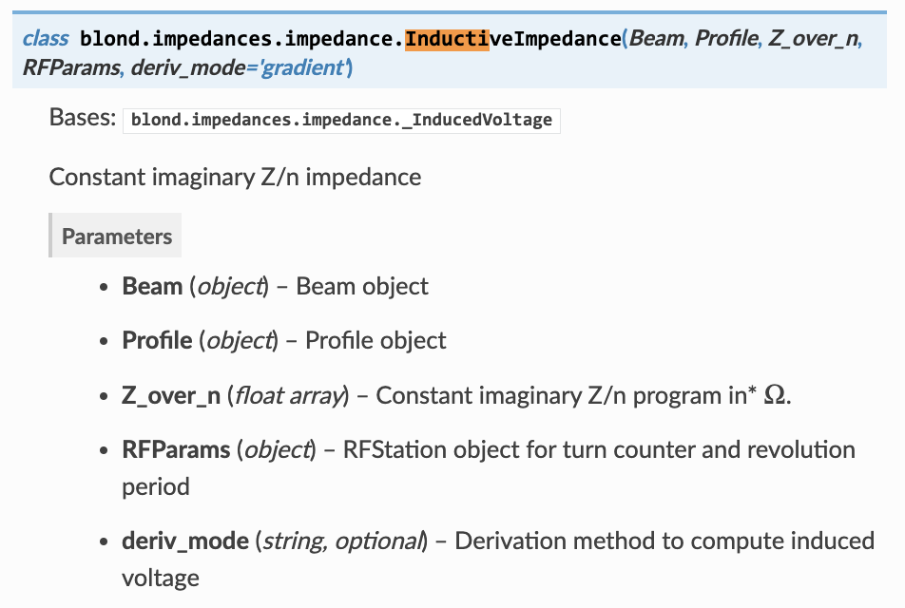
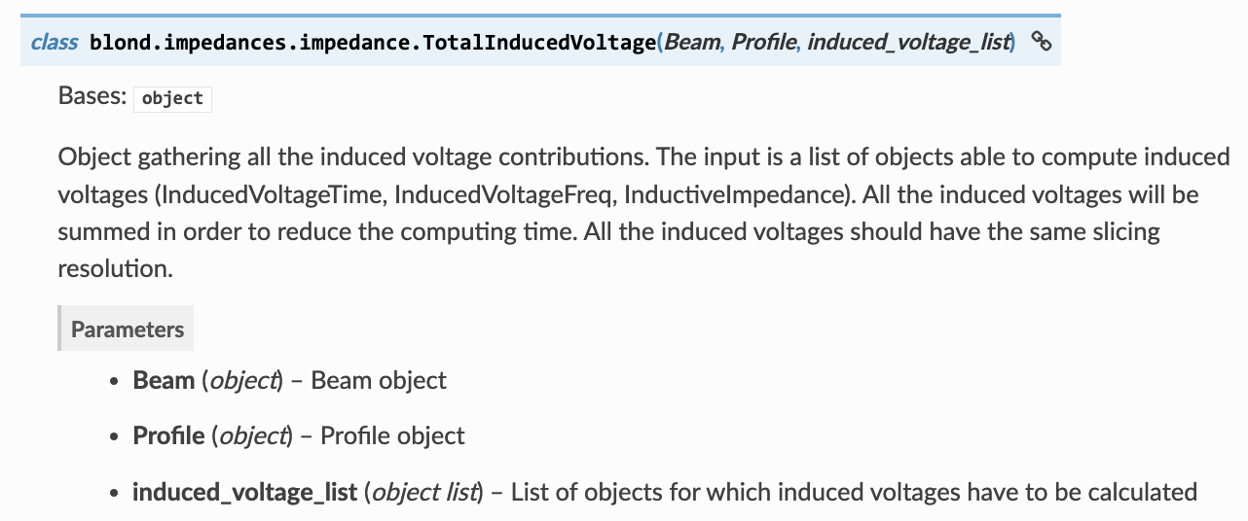
BLonD. Inductive Impedance (SC) – Induced Voltage
BLonD: https://blond.web.cern.ch/
P. F. Derwent, Implementation of BLonD for Booster Simulations, Beams-doc # 8690, 2020
XIXth Workshop on High Energy Spin Physics
Dubna, 2023.
04/07/2023
15

Slide 16
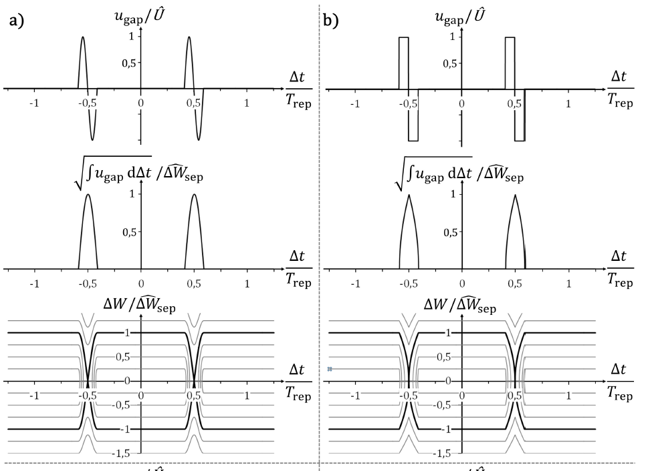
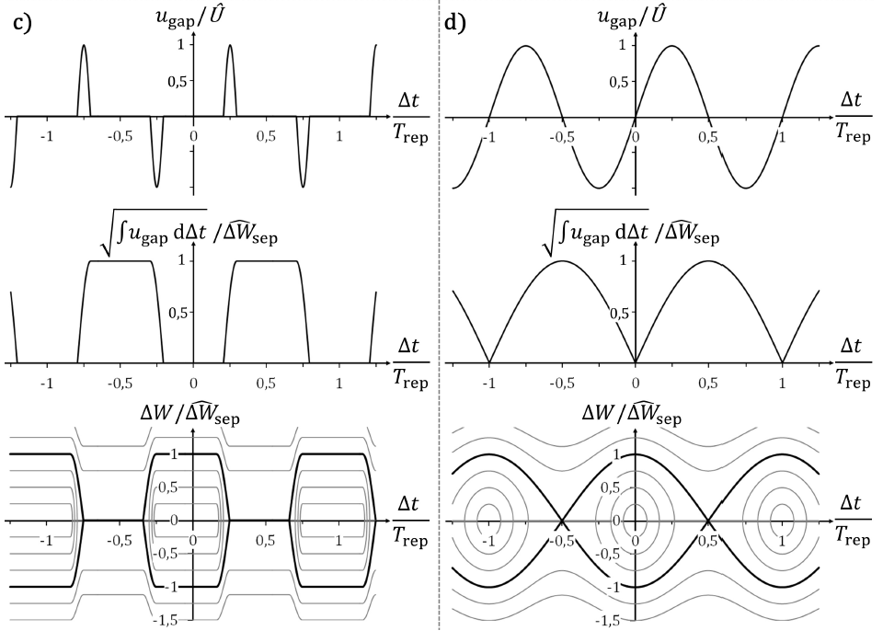
Phase portraits of different BB
Jens Schweickhardt, Modeling and Optimization of Barrier-Bucket RF Systems, 2021
XIXth Workshop on High Energy Spin Physics
Dubna, 2023.
04/07/2023
16

Slide 17
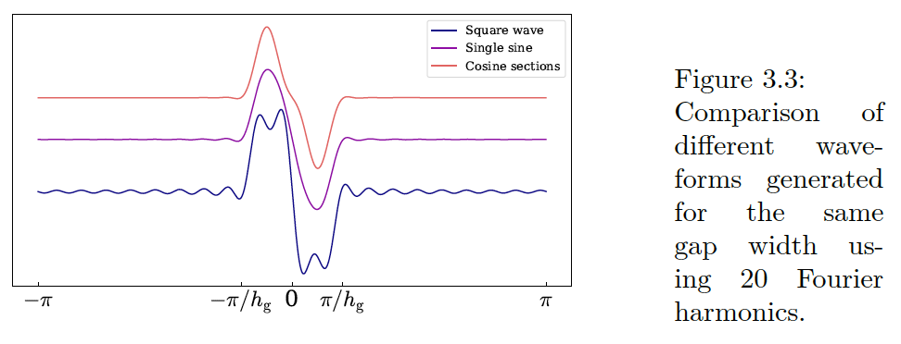
Fourier Expansion
Square signal
Fourier Expansion
Sigma modulation
RF Kick
Mihaly Vadai, Beam Loss Reduction by Barrier Buckets
in the CERN Accelerator Complex, CERN, Geneva, 2021
XIXth Workshop on High Energy Spin Physics
Dubna, 2023.
04/07/2023
17

Slide 18
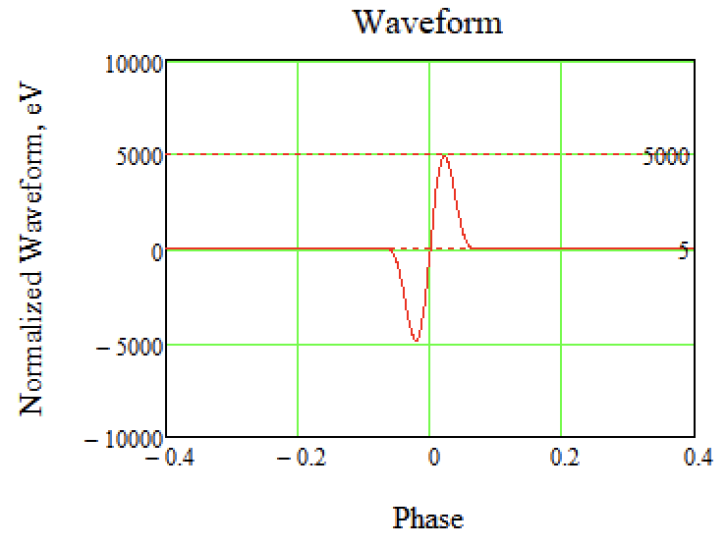
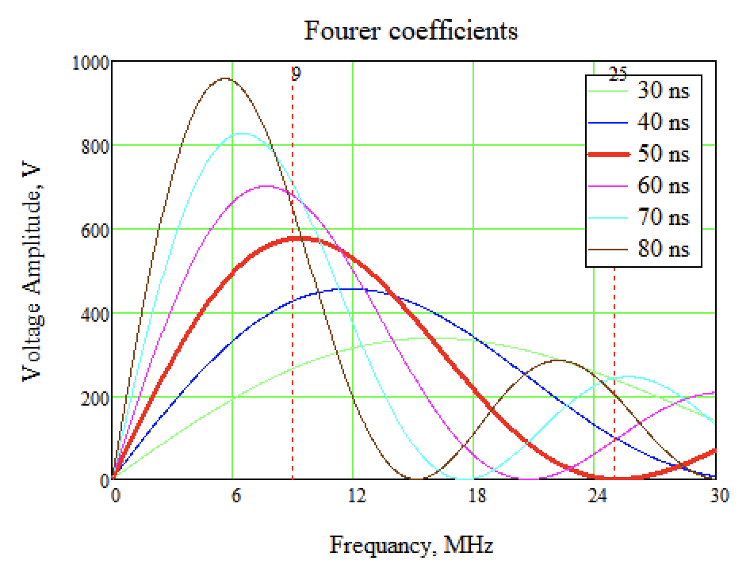
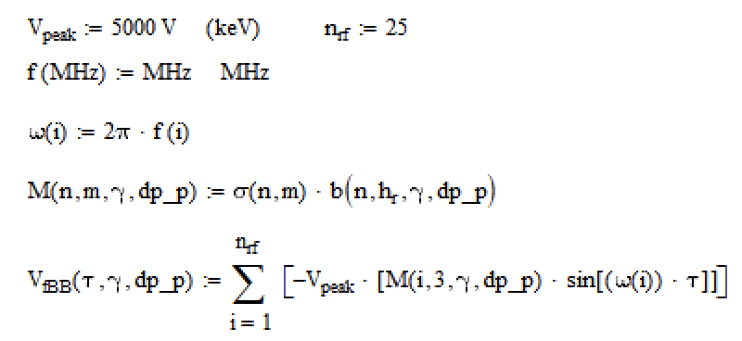
XIXth Workshop on High Energy Spin Physics
Dubna, 2023.
04/07/2023
18

Slide 19
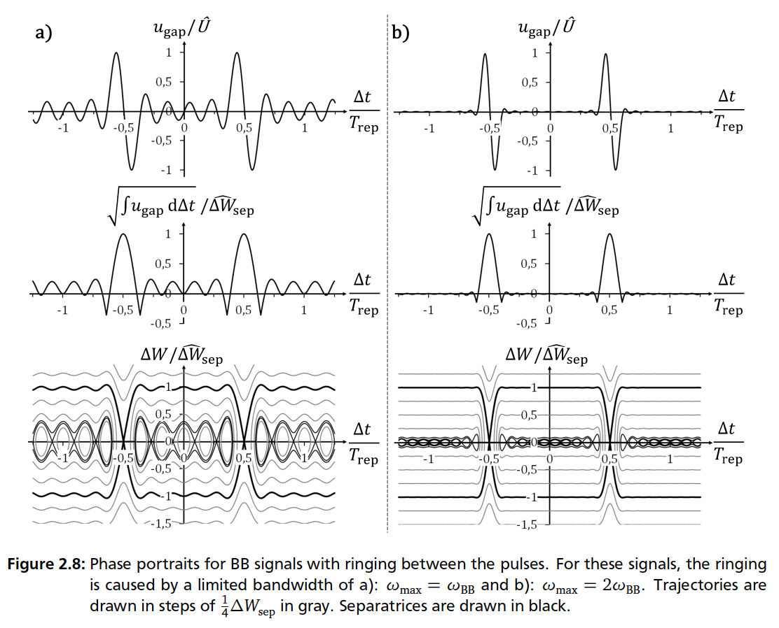
Separatrix of BB
Jens Schweickhardt, Modeling and Optimization of Barrier-Bucket RF Systems, 2021
XIXth Workshop on High Energy Spin Physics
Dubna, 2023.
04/07/2023
19

Slide 20
Orbital Tracking
XIXth Workshop on High Energy Spin Physics
Dubna, 2023.
04/07/2023
20

Slide 21
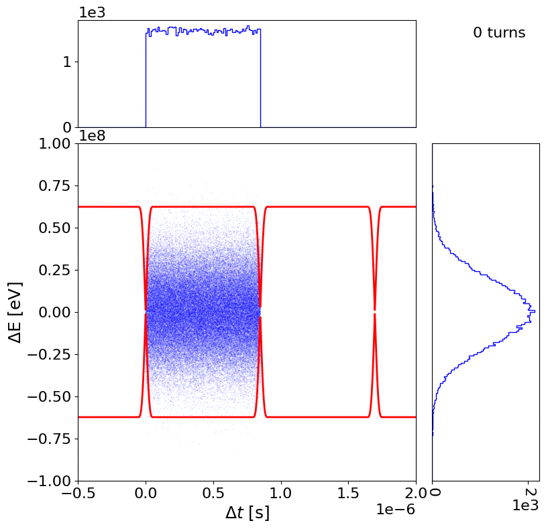
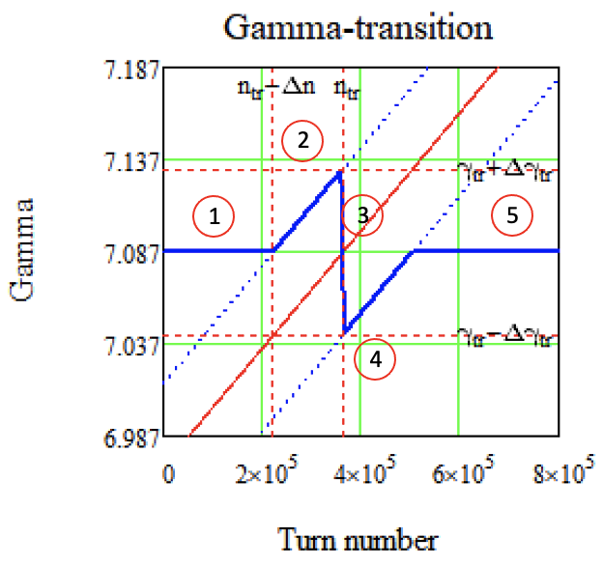
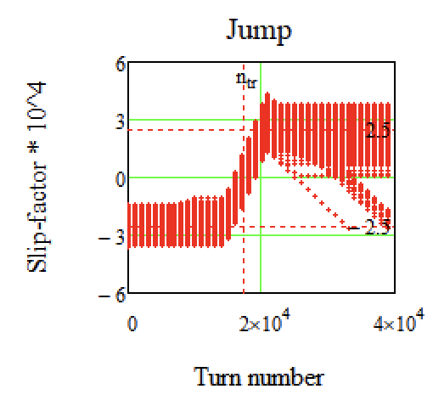
Effect of High Order MCF
$γ_{tr}$ – smooth increase (2nd stage)
NO SC
BB RF
$α_{0,1,2}$ stationary
At 2nd stage
$$γ_{tr}∥γ_{beam}⇒ η_{s}∥η_{tr}$$
$$η_{s}=const$$
Taking into account $δ={dp}/p,$
get a range of $η$ for different particles
2
XIXth Workshop on High Energy Spin Physics
Dubna, 2023.
04/07/2023
21

Slide 22
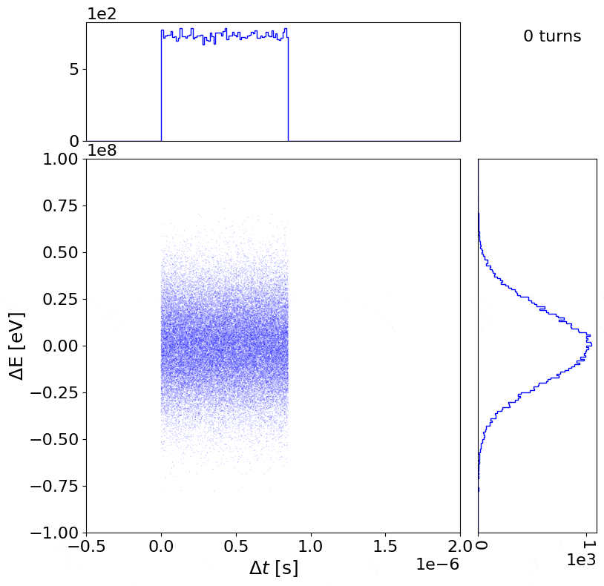
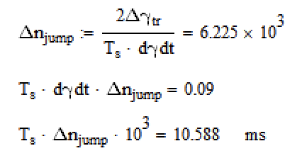
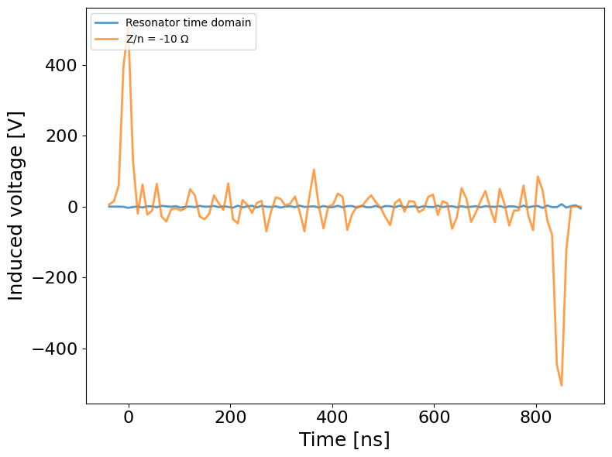
Space Charge Impedance Effect at Transition Jump
Jump – (3^{d} stage)
Only SC
No RF
$α_{0,1,2}$ change at a turn
XIXth Workshop on High Energy Spin Physics
Dubna, 2023.
04/07/2023
22

Slide 23
Spin Tracking
XIXth Workshop on High Energy Spin Physics
Dubna, 2023.
04/07/2023
23

Slide 24
Particle Spin Tracking (Acceleration near Transition)
T-BMT Equations
$$\frac{d\vec{S}}{dt}=\vec{S}×{\vec{Ω}}_{MDM},$$
$${\vec{Ω}}_{MDM}=\frac{q}{mγ}\left\{\left(γG+1\right){\vec{B}}_{⊥}+\left(G+1\right){\vec{B}}_{∥}\left.−\left(γG+\frac{γ}{γ+1}\right)\frac{\vec{β}×\vec{E}}{c}\right\}\right.$$
$${\vec{Ω}}_{MDM}=\frac{q}{mγ}\left(γG+1\right){\vec{B}}_{⊥}$$
For pure magnetic ring
XIXth Workshop on High Energy Spin Physics
Dubna, 2023.
04/07/2023
24

Slide 25
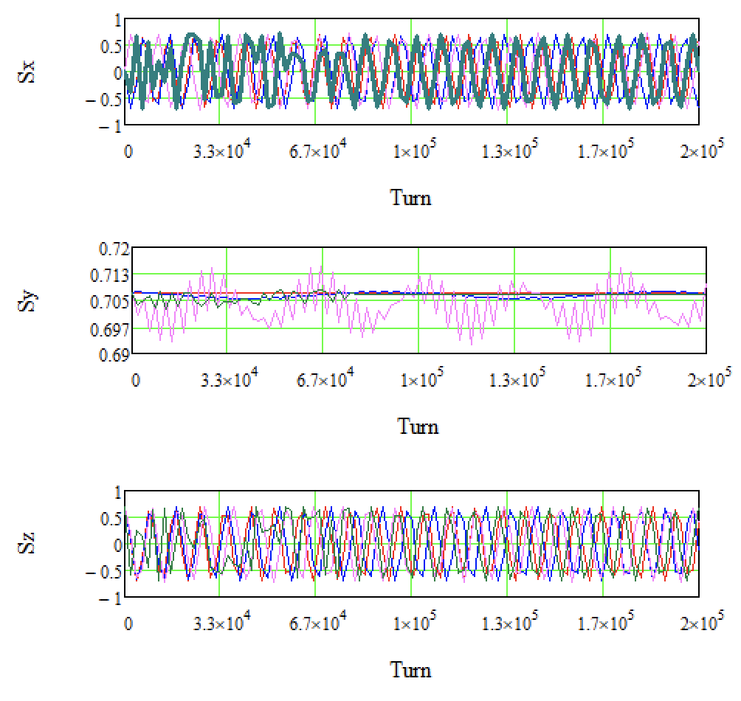
Particle Spin Tracking (Acceleration near Transition)
Parameters
Lattice:
$$γ_{p}=7.042$$
$$γ_{tr}=7.087$$
$$η_{0}=−1{×10}^{−4}$$
$turns=2$ ${×10}^{5}$
Spin:
$$α_{YZ}=45°$$
RF is turn on
COSY Infinity: https://www.bmtdynamics.org/cosy/
XIXth Workshop on High Energy Spin Physics
Dubna, 2023.
04/07/2023
25

Slide 26
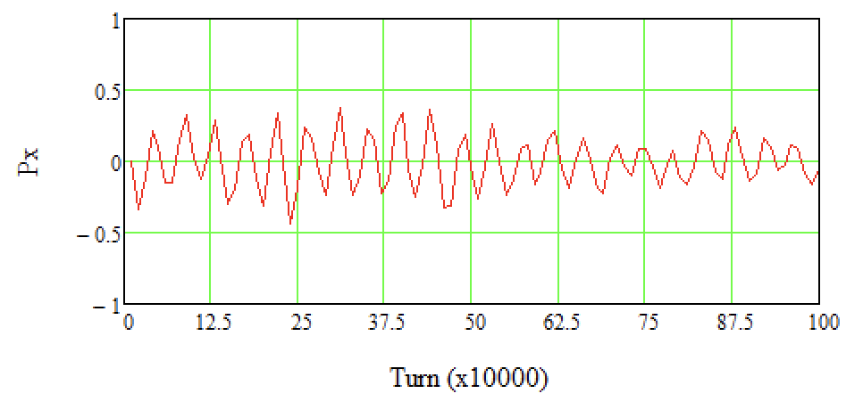
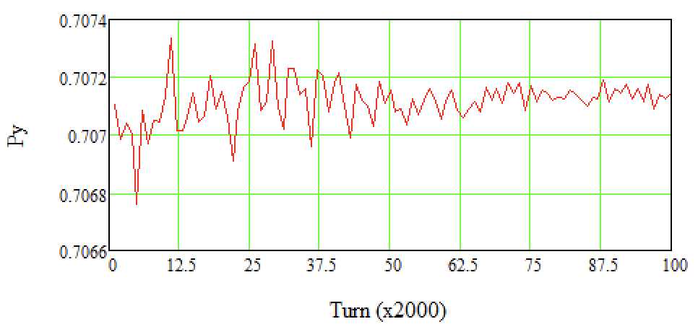
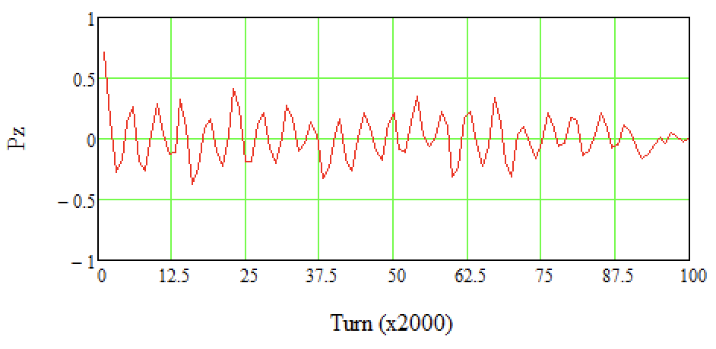
Polarization (Acceleration near Transition)
Parameters
Lattice:
$$γ_{p}=7.042$$
$$γ_{tr}=7.087$$
$$η_{0}=−2{×10}^{−4}$$
$turns=2$ ${×10}^{5}$
Spin:
$$α_{YZ}=45°$$
RF is turn on
XIXth Workshop on High Energy Spin Physics
Dubna, 2023.
04/07/2023
26

Slide 27
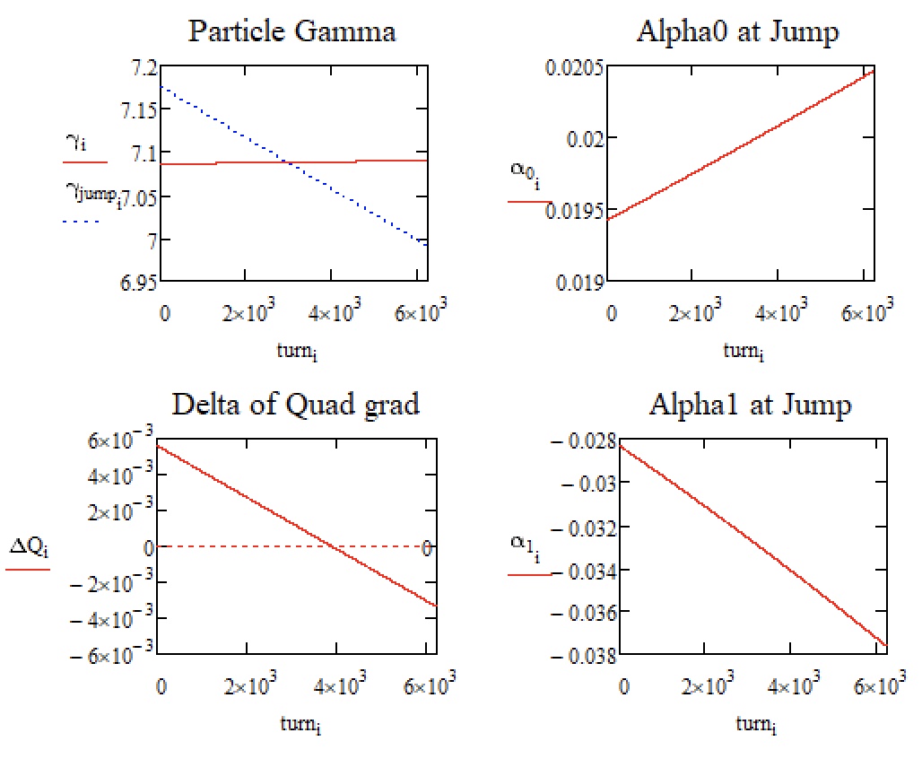
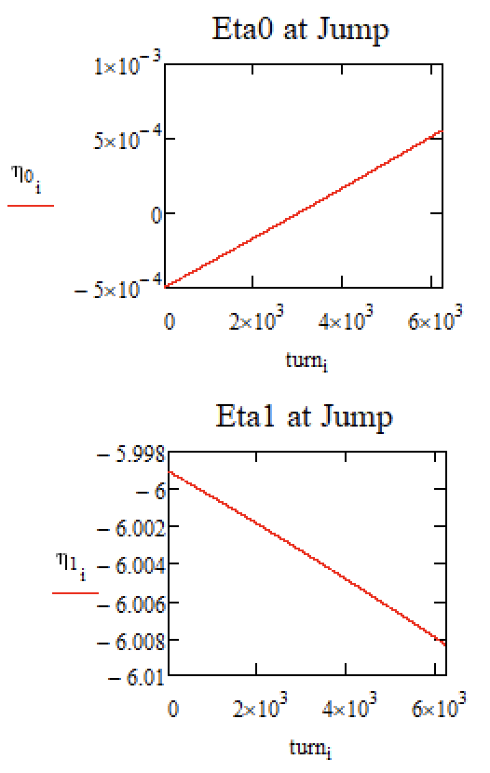
Lattice Parameters (during Jump)
XIXth Workshop on High Energy Spin Physics
Dubna, 2023.
04/07/2023
27

Slide 28
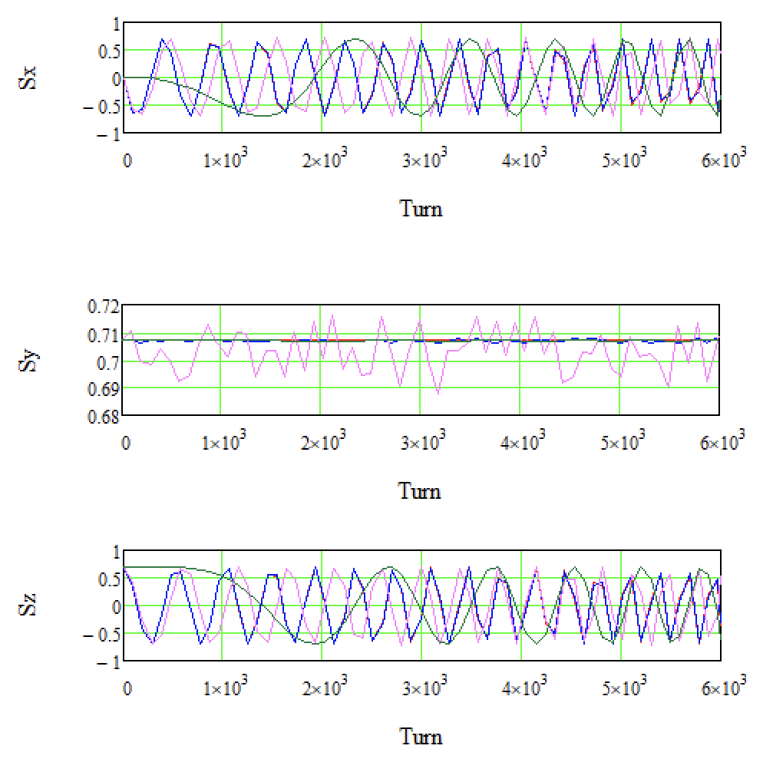
Particle Spin Tracking (during Jump)
Parameters
Lattice:
$$γ_{p}=\text{from} \text{7}\text{.}\text{0856} \text{to} \text{7}\text{.}\text{0896}$$
$γ_{tr}=$ from $7.1754$ to $6.9903$
$$\text{Max}(\left|η_{0}\right|)=5{×10}^{−4}$$
$$turns=6225$$
Spin:
$$α_{YZ}=45°$$
RF is turn off
Shown 4 particles with different initial parameters in$x, y, {dp}/p$
XIXth Workshop on High Energy Spin Physics
Dubna, 2023.
04/07/2023
28

Slide 29
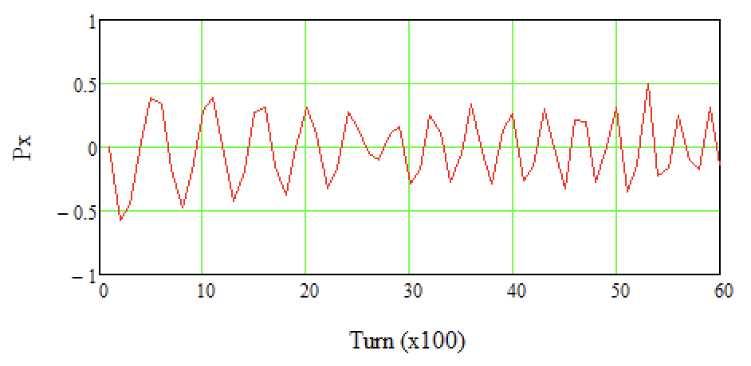
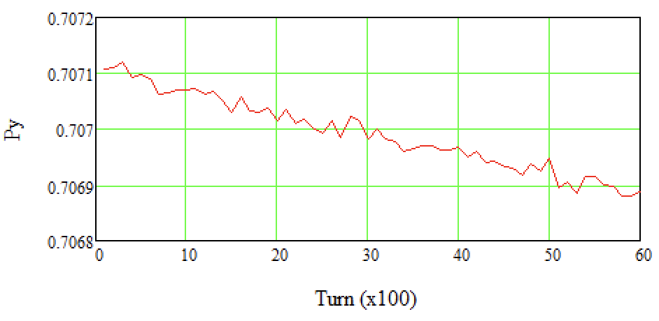
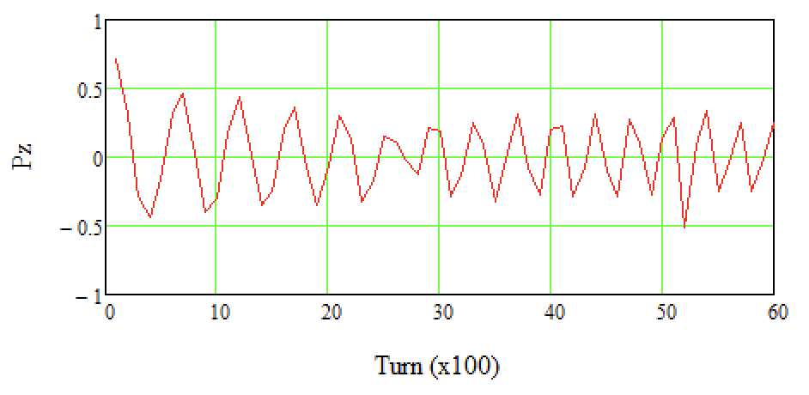
Polarization (during Jump)
Parameters
Lattice:
$$γ_{p}=\text{from} \text{7}\text{.}\text{0856} \text{to} \text{7}\text{.}\text{0896}$$
$γ_{tr}=$ from $7.1754$ to $6.9903$
$$\text{Max}(\left|η_{0}\right|)=5{×10}^{−4}$$
$$turns=6225$$
Spin:
$$α_{YZ}=45°$$
RF is turn off
XIXth Workshop on High Energy Spin Physics
Dubna, 2023.
04/07/2023
29

Slide 30
Сonclusion
Considered:
Longitudinal Dynamic Modeling near Transition Energy taking into account high orders of MCF and Impedances;
Spin Tracking to consider polarization.
Outcomes:
During the jump procedure the beam hold in separatrix;
And the polarization is not destroyed;
Transition Energy Jump is an available option cross transition energy.
XIXth Workshop on High Energy Spin Physics
Dubna, 2023.
04/07/2023
30

Slide 31
References
Laclare, J L (ESRF, Grenoble), Coasting beam longitudinal coherent instabilities, CAS - CERN Accelerator School : 5th General Accelerator Physics Course, pp.349-384, DOI: 10.5170/CERN-1994-001.349
Jens Schweickhardt, Modeling and Optimization of Barrier-Bucket RF Systems, 2021
Mihaly Vadai, Beam Loss Reduction by Barrier Buckets in the CERN Accelerator Complex, CERN, Geneva, 2021
П.Р. Зенкевич, А.А. Коломиец, Электромагнитное моделирование элементов структуры коллайдера NICA, Письма в ЭЧАЯ. 2020. Т. 17, № 4(229). С. 445–452
A. Tribendis and others, Constraction and first test results of the barrier and harmonic RF systems for the NICA collider, IPAC2021, Campinas, SP, Brazil, doi:10.18429/JACoW-IPAC2021-MOPAB365
A.M. Malyshev and others, Barrier station RF1 of the NICA collider. Design features and influence on beam dynamics, RuPAC2021, Alushta, Russia, doi:10.18429/JACoW-RuPAC2021-WEPSC15
P. F. Derwent, Implementation of BLonD for Booster Simulations, Beams-doc # 8690, 2020
BLonD: https://blond.web.cern.ch/
COSY Infinity: https://www.bmtdynamics.org/cosy/
XIXth Workshop on High Energy Spin Physics
Dubna, 2023.
04/07/2023
31

Slide 32
Backups
XIXth Workshop on High Energy Spin Physics
Dubna, 2023.
04/07/2023
32

Slide 33
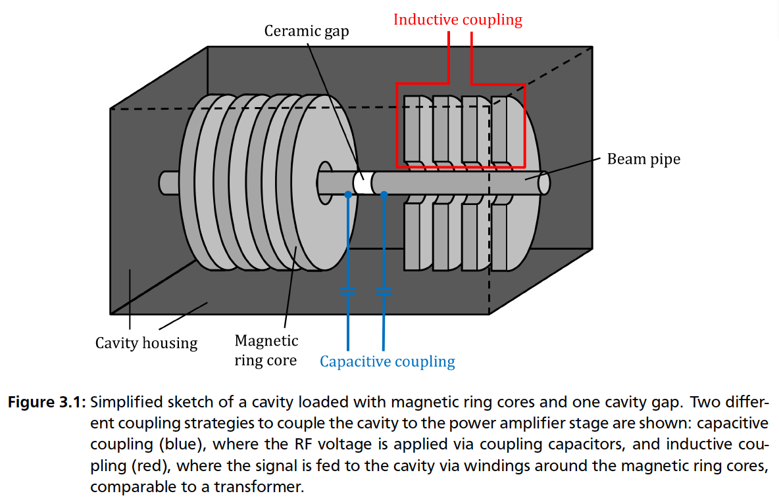
Barrier Bucket
Jens Schweickhardt, Modeling and Optimization of Barrier-Bucket RF Systems, 2021
XIXth Workshop on High Energy Spin Physics
Dubna, 2023.
04/07/2023
33

Slide 34
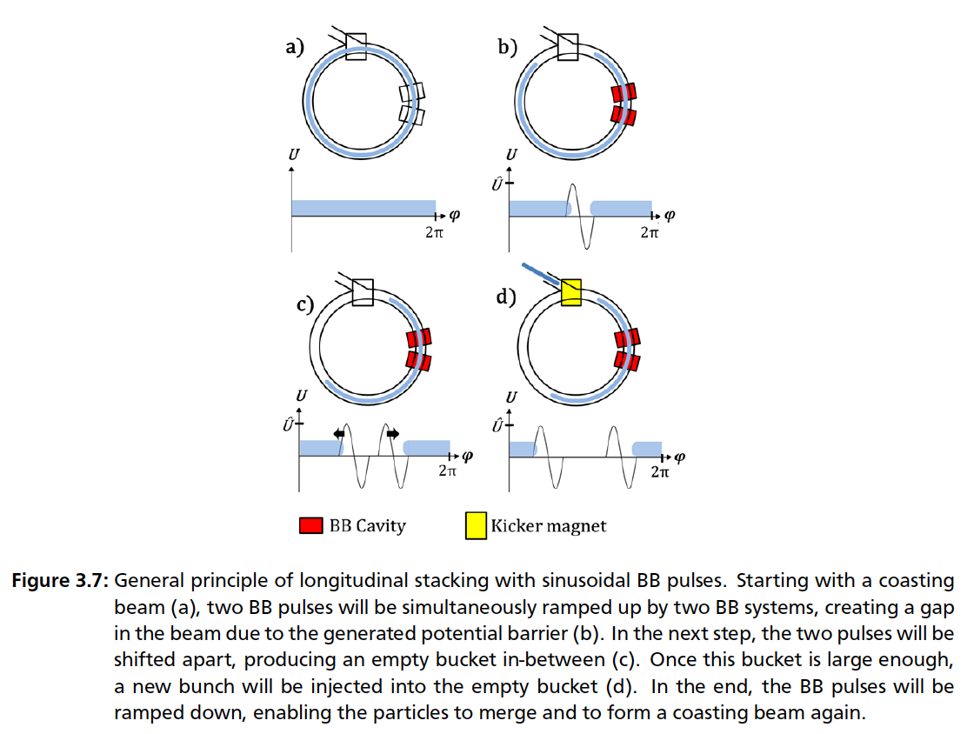
Principle of stacking with BB
Jens Schweickhardt, Modeling and Optimization of Barrier-Bucket RF Systems, 2021
XIXth Workshop on High Energy Spin Physics
Dubna, 2023.
04/07/2023
34

Slide 35
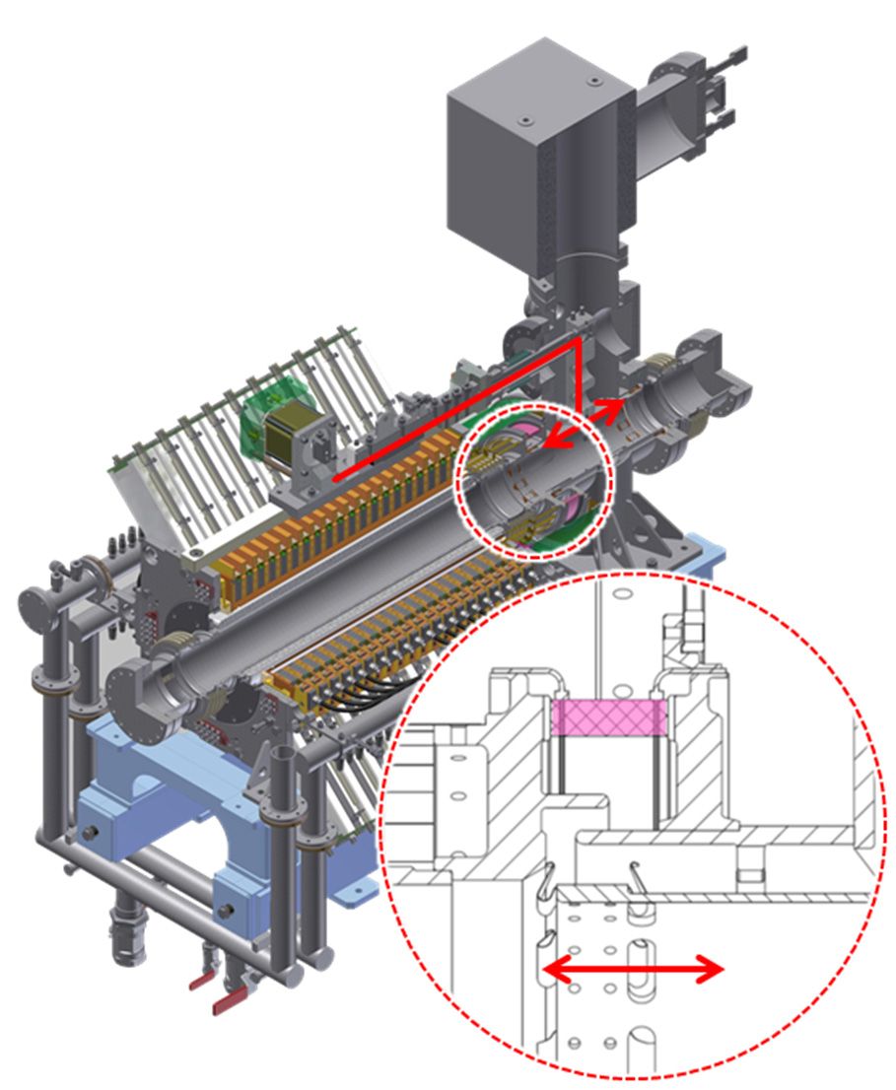
Barrier Bucket at NICA
A. Tribendis and others, Constraction and first test results of the barrier and harmonic RF systems for the NICA collider, IPAC2021, Campinas, SP, Brazil, doi:10.18429/JACoW-IPAC2021-MOPAB365
XIXth Workshop on High Energy Spin Physics
Dubna, 2023.
04/07/2023
35

Slide 36
Barrier Bucket at NICA
A.M. Malyshev and others, Barrier station RF1 of the NICA collider. Design features and influence on beam dynamics, RuPAC2021, Alushta, Russia, doi:10.18429/JACoW-RuPAC2021-WEPSC15
XIXth Workshop on High Energy Spin Physics
Dubna, 2023.
04/07/2023
36

Slide 37
BB RF1 Impedances
Equivalent circuit of one ring (from the 1st to the 19th).
Last ring and accelerating gap.
A.M. Malyshev and others, Barrier station RF1 of the NICA collider. Design features and influence on beam dynamics, RuPAC2021, Alushta, Russia, doi:10.18429/JACoW-RuPAC2021-WEPSC15
System impedance calculated by equivalent circuit impedance
XIXth Workshop on High Energy Spin Physics
Dubna, 2023.
04/07/2023
37

Slide 38
BB RF1 Impedances
A.M. Malyshev and others, Barrier station RF1 of the NICA collider. Design features and influence on beam dynamics, RuPAC2021, Alushta, Russia, doi:10.18429/JACoW-RuPAC2021-WEPSC15
System impedance calculated by equivalent circuit impedance
XIXth Workshop on High Energy Spin Physics
Dubna, 2023.
04/07/2023
38

Slide 39
Dispersion Relation
Laclare, J L (ESRF, Grenoble), Coasting beam longitudinal coherent instabilities, CAS - CERN Accelerator School : 5th General Accelerator Physics Course, pp.349-384, DOI: 10.5170/CERN-1994-001.349
XIXth Workshop on High Energy Spin Physics
Dubna, 2023.
04/07/2023
39

Slide 40
Vlasov’s Equation and Dispersion Relation
Laclare, J L (ESRF, Grenoble), Coasting beam longitudinal coherent instabilities, CAS - CERN Accelerator School : 5th General Accelerator Physics Course, pp.349-384, DOI: 10.5170/CERN-1994-001.349
XIXth Workshop on High Energy Spin Physics
Dubna, 2023.
04/07/2023
40

